Slide 1



Engaging Black Consumers

Slide 2



As we celebrate Black History Month, it’s essential
for all brands to recognize the importance of inclusivity marketing in today’s modern society and how marketers can integrate this within their media plans.
Learn about the buying power of Black consumers and how you can successfully engage these audiences and enable action through culturally-relevant content and communications.
This information is exclusively provided to VAB members and qualified marketers. Further distribution is prohibited.
PAGE 2

Slide 3

Black consumers have collectively
increased their spending power by 60%
over the last decade which far outpaces their population growth during the same time period
U.S. Aggregate Expenditures of Black / African-Americans
in Billions
+60%
vs. 2009
U.S. Population of Black / African-Americans
(000)
+17%
vs. 2009
40,216
41,577
45,326
46,919
Source: VAB Analysis of Bureau of Labor Statistics data, Race of reference person: Shares of annual aggregate expenditures and sources of income, Consumer Expenditure Survey, 2009, 2011, 2016 & 2019. VAB Analysis of U.S. Census Bureau data The Black Alone or in Combination Population in the United States: Table 1. Population by Sex and Age, for Black Alone or in Combination : 2009; Table 1. Population by Sex and Age, for Black Alone or in Combination: 2011; Table 15. Population by Sex and Age, for Black Alone or in Combination: 2016; Table 15. Population by Sex and Age, for Black Alone or in Combination: 2019.
This information is exclusively provided to VAB members and qualified marketers. Further distribution is prohibited.
PAGE 3

Slide 4
Black audiences watch almost 13 more hours of video per week than the average adult 18+, led by linear and connected TV
Black 18+ total video consumption is 30% higher than the average adult; 36% higher for linear TV
% Share Of Weekly ‘Time Spent’ By Video Device – Q2 ‘20
(Hrs:Mins Among U.S. Population)
+48%
YoY increase in ‘time spent’ with TV-connected devices among Black Americans
Source: Nielsen Total Audience Report, November 2020, hours:minutes among users, P18+. TV-Connected Device = DVD, game console, internet connected device; Internet Connected Device = devices connected to the TV that are used to stream content such as Apple TV, Roku, Google Chromecast, Amazon Fire TV, Smartphone, Computer/Laptops, etc. (inclusive of smart TV app usage).
This information is exclusively provided to VAB members and qualified marketers. Further distribution is prohibited.
PAGE 4
This information is exclusively provided to VAB members and qualified marketers. Further distribution is prohibited.

Slide 5
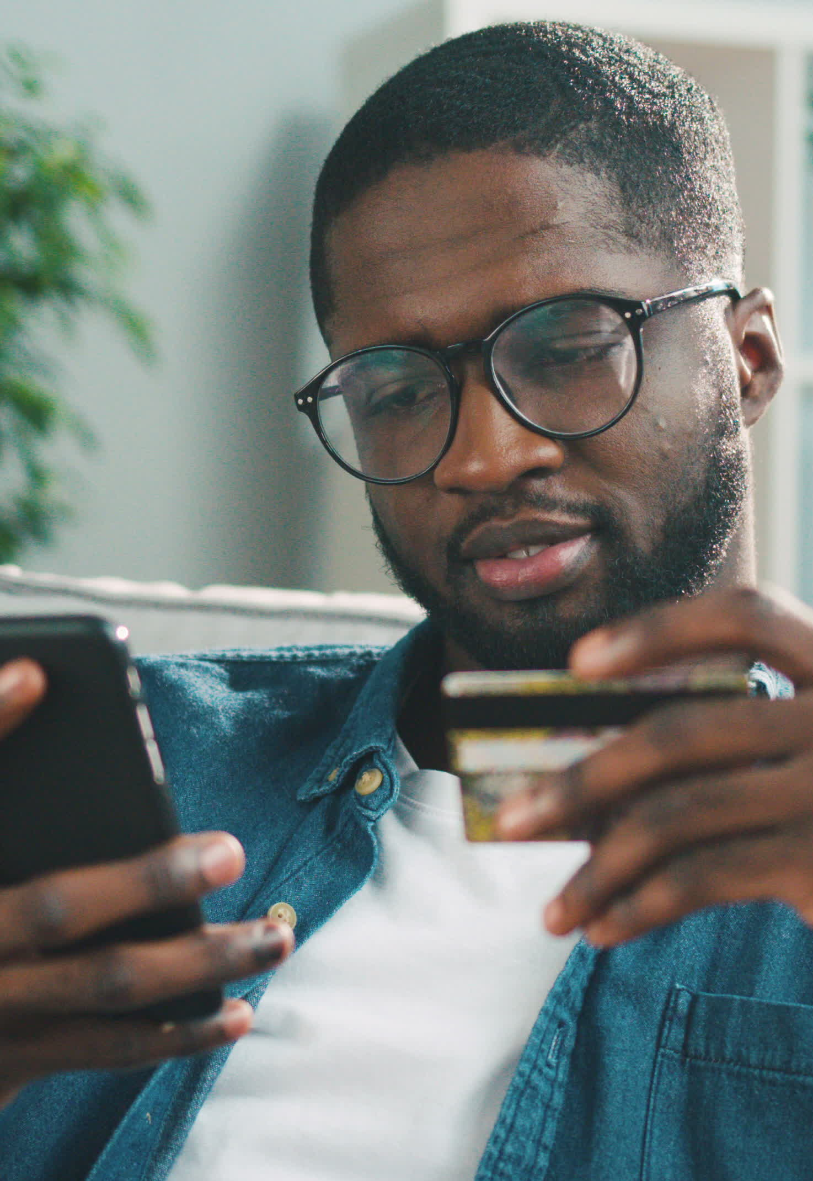
Black audiences are more likely to watch
a TV program if they find it relevant to
their identity which increases the purchase propensity of the products advertised
% of Black Respondents vs. Non-Hispanic White
P18+
‘I’m more likely to watch a TV show if it is relevant to my own cultural identity’
‘I have purchased a product I saw while watching a TV program or endorsed by
a favorite TV personality / actor’
+68%
+65%
31%
68%
XX%
= % of Respondents
Source: VAB’s ‘Discover the Difference: How Culturally Relevant Video Content Drives Action By Multicultural Audiences’. VAB / Dynata ‘Multicultural Video Engagement Survey,’ August 2019. Q7: What qualities make you more likely to watch a TV program? Select any or all that apply. Q10: Please indicate how often you do the following. Respondents Answer = Always, Frequently or Occasionally. African American/Black/Caribbean American = 302 Respondents, Non-Hispanic White = 300 Respondents.
This information is exclusively provided to VAB members and qualified marketers. Further distribution is prohibited.
PAGE 5

Slide 6
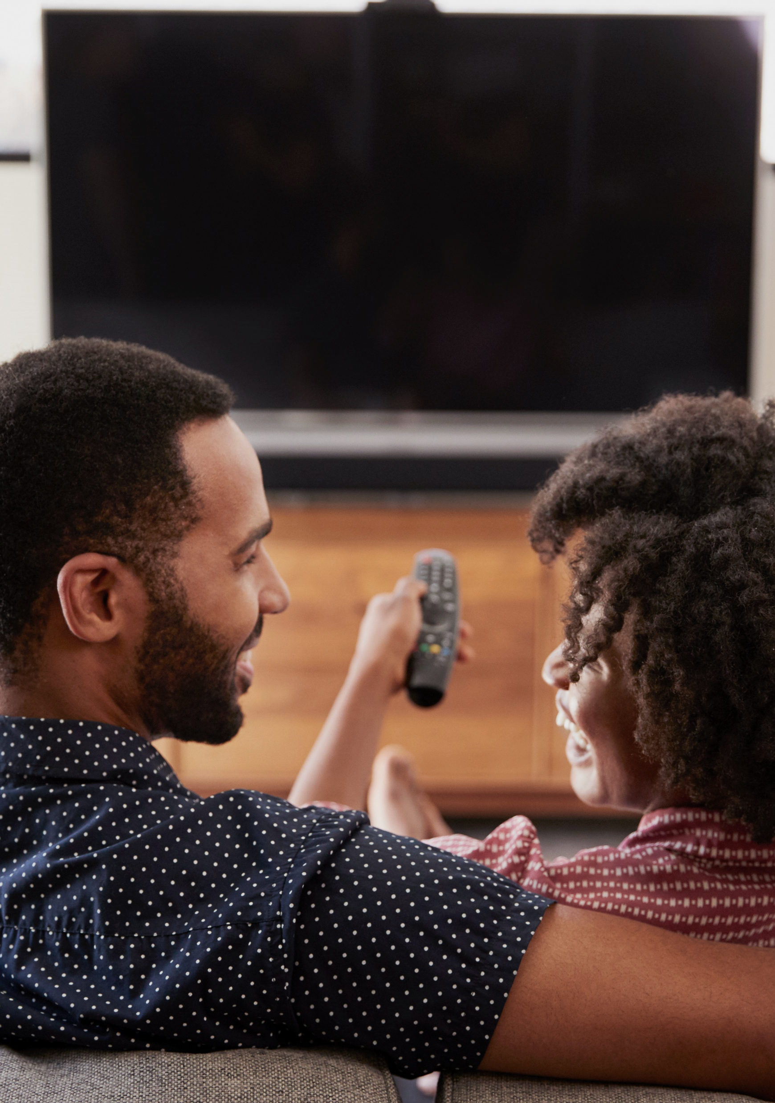
Black sports fans are also much more engaged, habitual viewers of live sports which drives greater consumer action through the purchase funnel
60%
of Black sports fans are habitual viewers, watching live sports on any device
at least every other day
(vs. 44% of NH Whites)
% Of Sports Fans Who Have Done The Following…
Awareness & Consideration
All
Black
Index*
I have talked with friends and/or family about an advertisement I saw while watching sports on TV
30%
40%
136
Consideration & Intent
I have visited a website for a product that
I saw advertised while watching sports on TV
22%
28%
129
Sales
I have purchased a product or service
I saw advertised while watching sports on TV
23%
25%
110
*index vs. all P18+ sports fan
Source: VAB / Dynata ‘Sports Viewing Experience Survey,’ September 2019. Survey base = self-identified sports fans, P18+. Q18. Which of the following statements do you believe are true for you? Avid Fans Respondents (habitually watch sports on TV, intensely follow teams / players, etc). All Sports Fans based on P18+. NH White = Non-Hispanic White.
This information is exclusively provided to VAB members and qualified marketers. Further distribution is prohibited.
PAGE 6

Slide 7
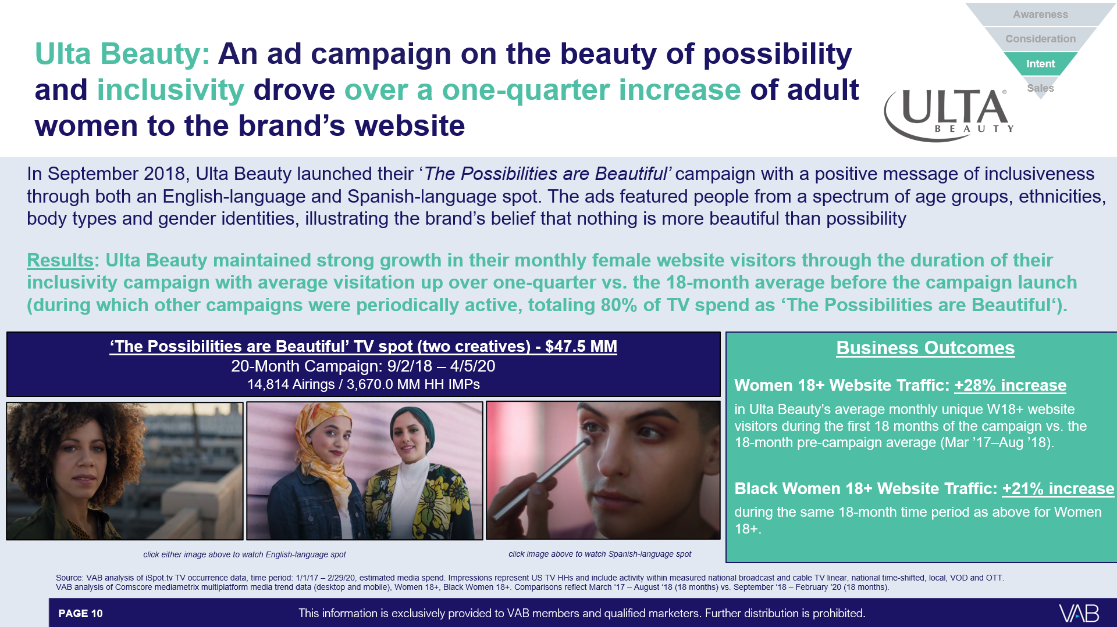
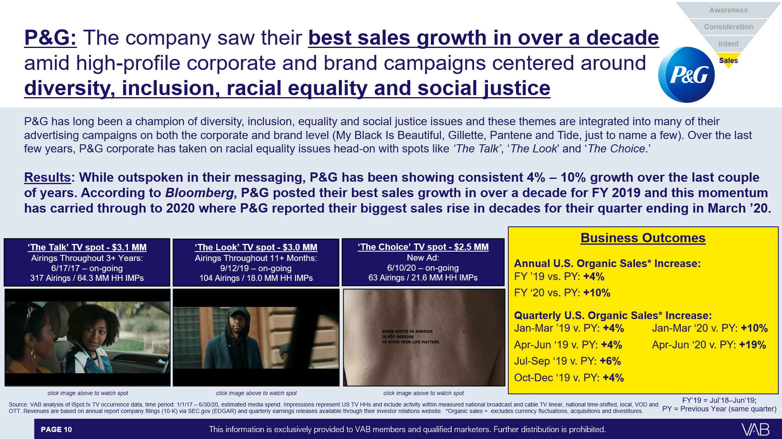
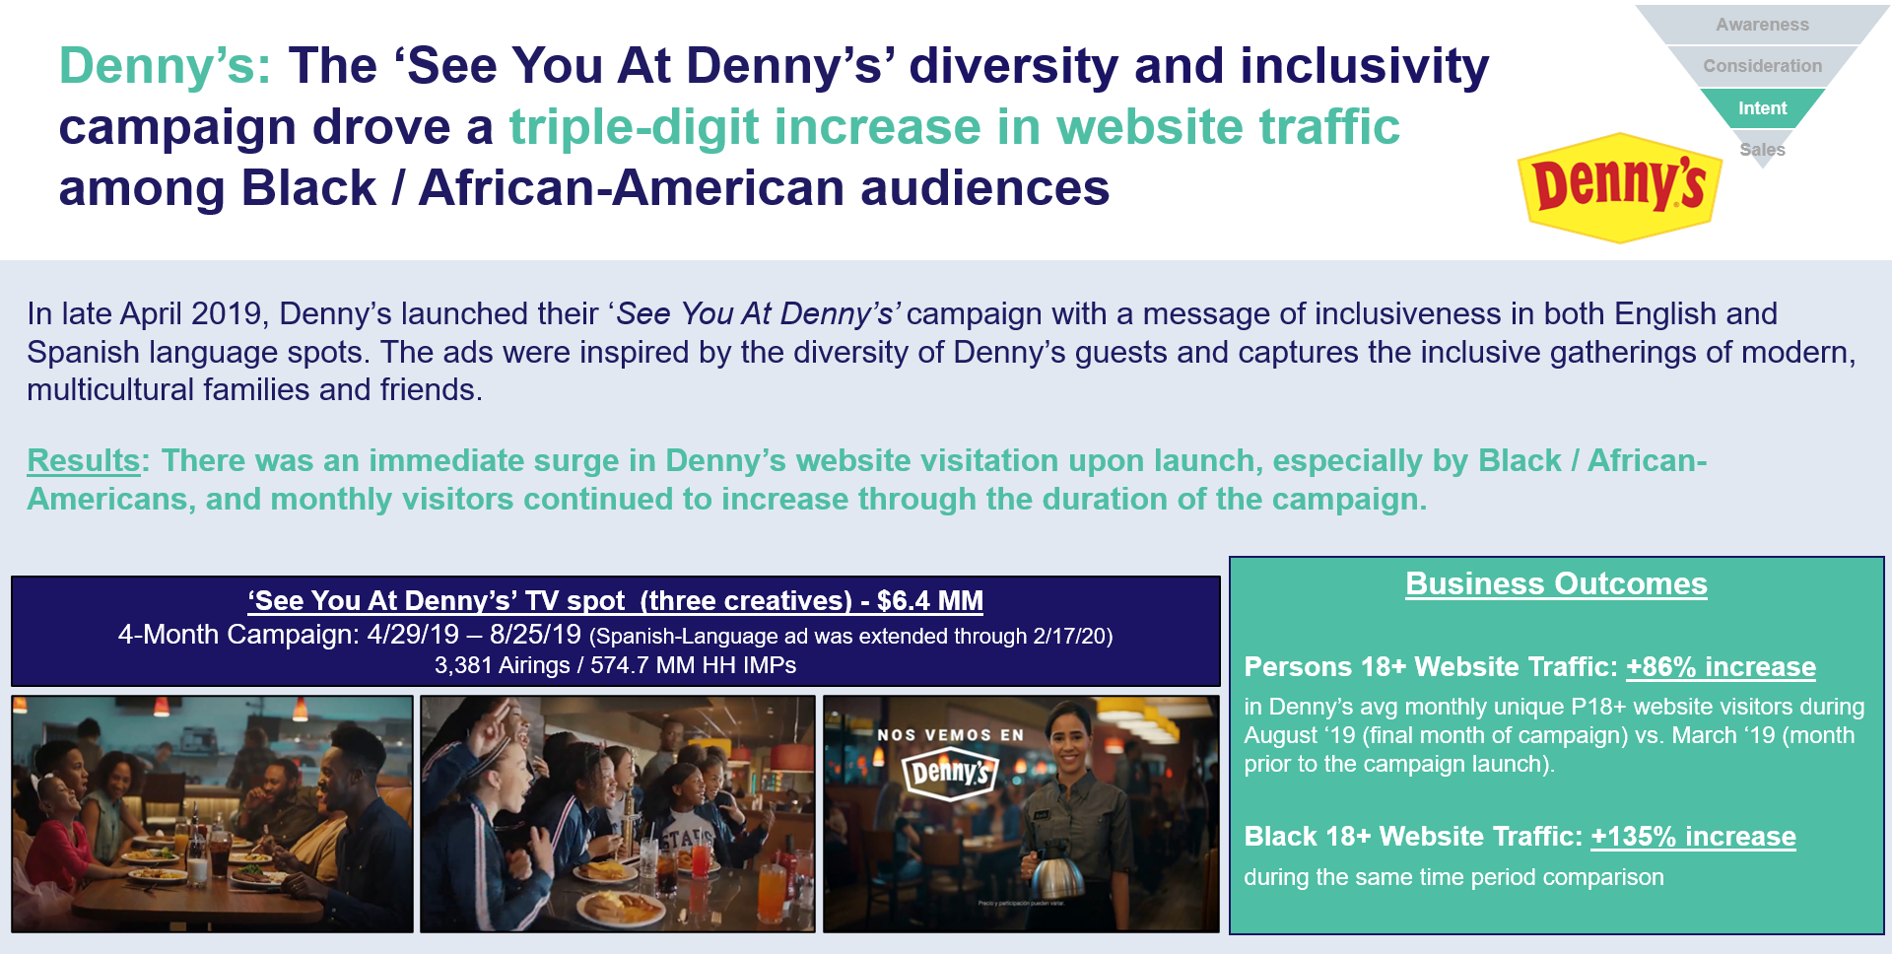
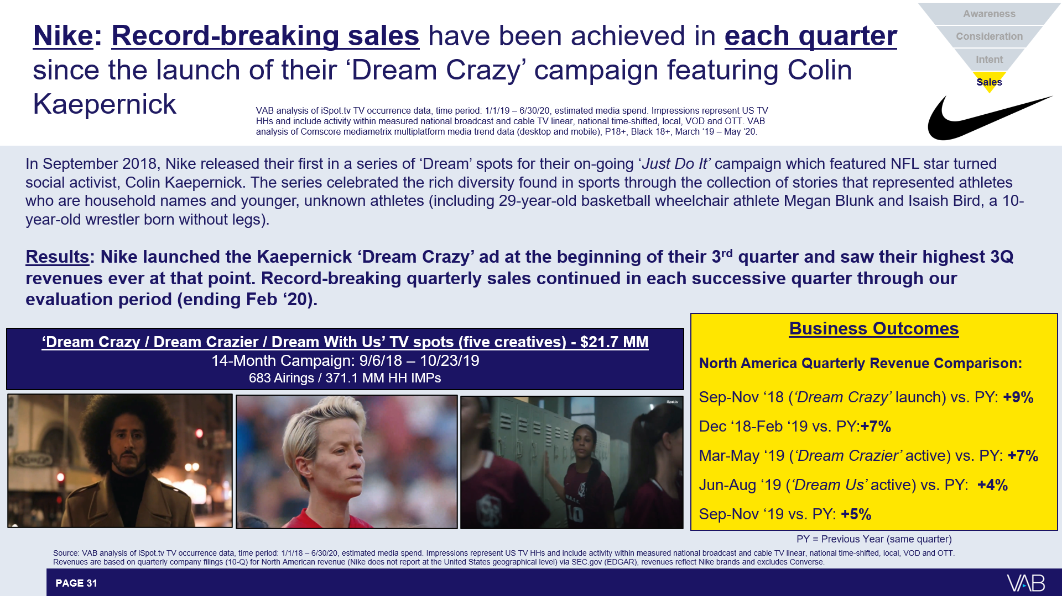
Beyond relevant programming, ad campaigns with a core message
of diversity and inclusion resonate with black audiences and have
the power to drive lower-funnel metrics like website traffic and sales
This information is exclusively provided to VAB members and qualified marketers. Further distribution is prohibited.
PAGE 7

Slide 8
Marketers can directly tap into the growing spending power of the Black population through a holistic video plan featuring linear TV, connected TV and mobile
By aligning with culturally relevant content, marketers can create an intimate bond with Black audiences through their favorite programming and personalities which drives purchase decisions
Ad campaigns that showcase authentic voices and promote diversity, equity and inclusivity resonate with Black audiences and drive successful business outcomes, particularly lower funnel metrics
Key Marketer Takeaways
This information is exclusively provided to VAB members and qualified marketers. Further distribution is prohibited.
PAGE 8

Slide 9
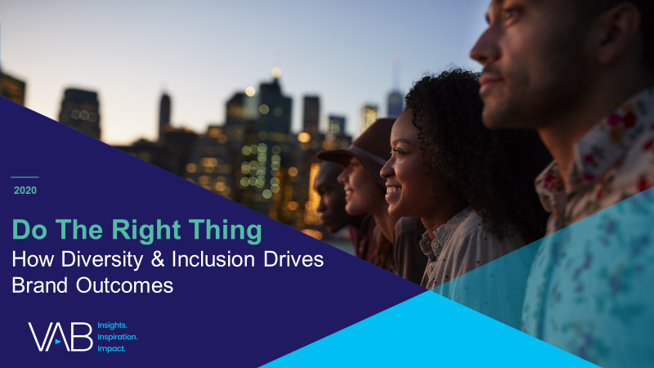
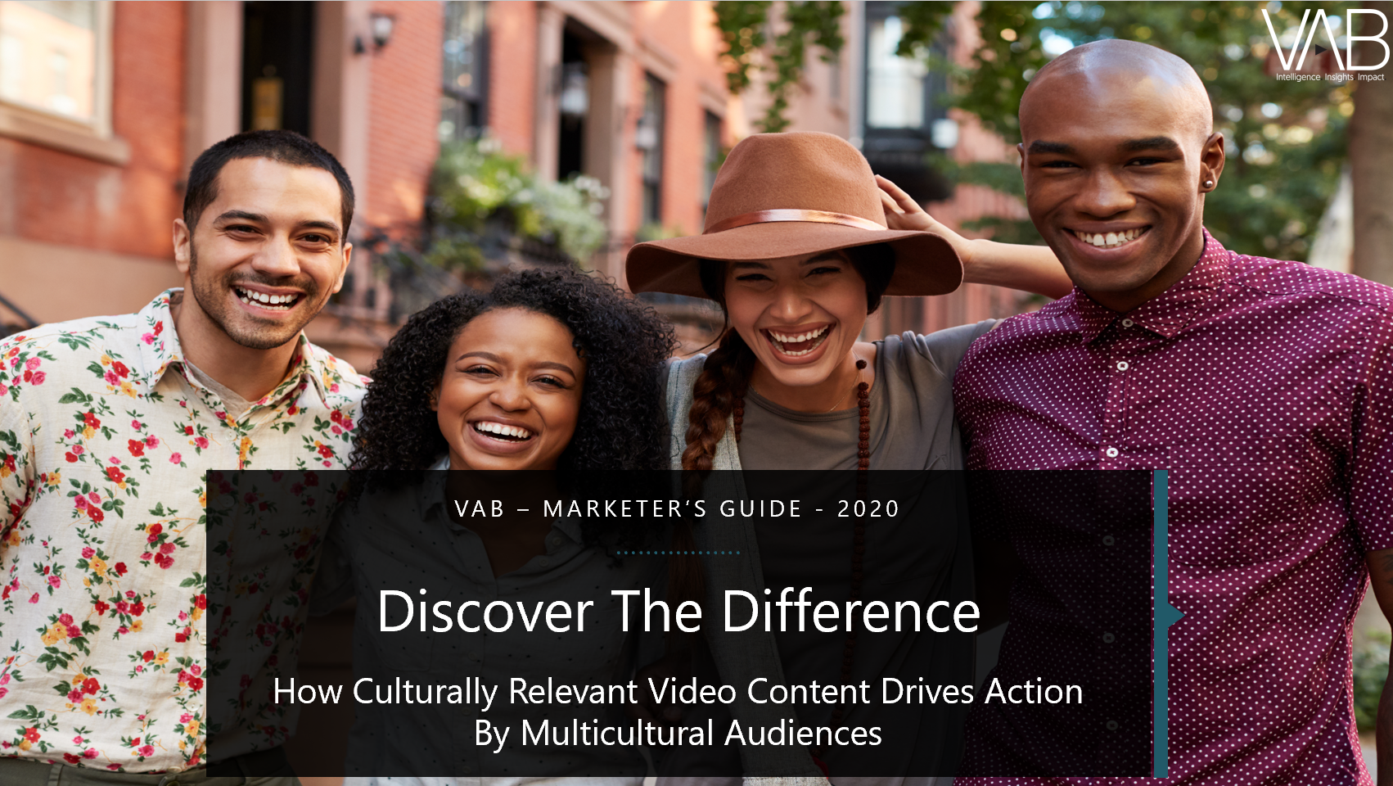
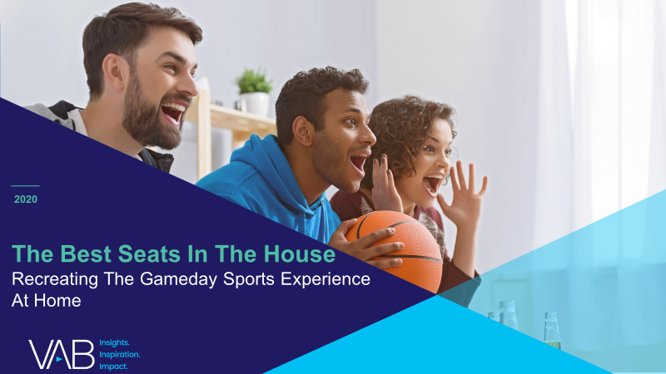
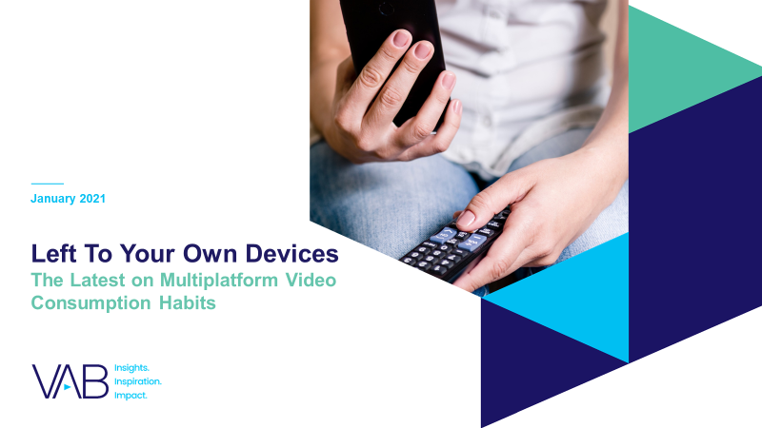
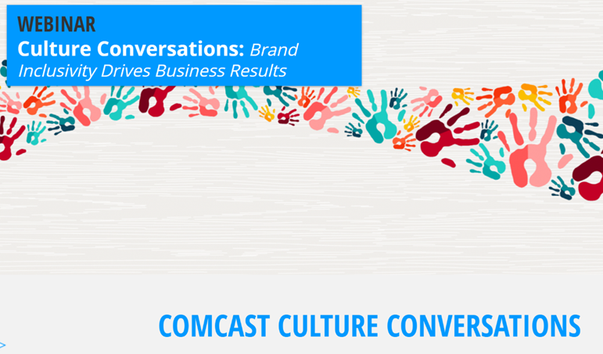
Creators
Reed Kiely
Karolina Guillen
Insights Manager
reedk@thevab.com
Senior Insights Analyst
karolinag@thevab.com
Discover more
Looking for more data, insights and takeaways? Check out this related VAB content
Do The Right Thing
How Diversity & Inclusion Drives Brand Outcomes
Discover The Difference
How Culturally Relevant Video Content Drives Action By Multicultural Audiences
The Best Seats
In The House
Recreating The Gameday Sports Experience At Home
We are committed to providing marketers with the data and insights they need to develop thoughtful, inclusive campaigns & strategies. To find out more on the unique media consumption behaviors and cultural trends of multicultural consumers, visit our Multicultural Marketing Resource Center.
Left To Your Own Devices
The Latest On Multiplatform Video Consumption Habits
Comcast Culture Conversations (Webinar)
Brand Inclusivity Drives
Business Outcomes
VAB Members, brand marketers and agencies get free and immediate access to VAB’s content library. Get access at theVAB.com
This information is exclusively provided to VAB members and qualified marketers. Further distribution is prohibited.
PAGE 9

Slide 10

About VAB
VAB is an insights-driven organization that inspires marketers to reimagine their media strategies resulting in fully informed decisions.
Drawing on our marketing expertise, we simplify the complexities in our industry and discover new insights that transform the way marketers look at their media strategy.
Discover
We keep you one step ahead with the latest thinking so you can create innovative, forward-looking strategies.
Simplify
We save you time by bringing you the latest data & actionable takeaways you can use to inform your marketing plans.
Transform
We help you build your brand by focusing on core marketing principles that will help drive tangible business outcomes.
We are committed to your business growth and proud to offer VAB members, brand marketers and agencies complimentary access to our continuously-growing Insights library. Get immediate access at theVAB.com.
This information is exclusively provided to VAB members and qualified marketers. Further distribution is prohibited.
PAGE 10

