Slide 1


June 14, 2024
Question of the Week:
“During this election year, how can I get the most impact from my local ad campaign?”

Slide 2
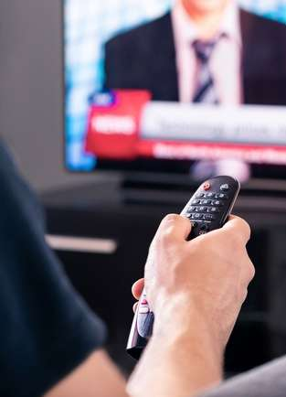

Answer: Invest ad dollars in local TV news platforms
As election day draws closer, more Americans will once again increase their news consumption across media platforms.
However, people are increasingly worried about the spread of false information online and the lack of transparency in digital ad-tech can lead brands to jeopardize consumer trust by unintentionally placing ads in news misinformation and disinformation content.
Local TV news provides a strong and safe solution for brands looking to align with the surge in audiences around election coverage.
Investing in local TV news platforms delivers audience scale in a trusted, transparent, brand-safe environment while supporting high-quality journalism which ensures advertising dollars are contributing to the integrity of trusted news reporting.
Ultimately, consumers hold brands accountable – they are more likely to buy from brands that advertise in trusted, brand safe environments and they will stop buying from brands that advertise
with untrustworthy publishers and platforms.
This information is exclusively provided to VAB members and qualified marketers.
PAGE 2

Slide 3

Nearly 60% of adults were already closely following the 2024 election at the beginning of the year which highlights the significant interest involved
How Closely Have You Been Following the 2024 Presidential Election?
Source: The Ipsos Consumer Tracker, fielded January 23-24, 2024 among 1,119 U.S. adults.
This information is exclusively provided to VAB members and qualified marketers.
PAGE 3

Slide 4
While the election is still months away, many media users are beginning to spend more time with related content & coverage across channels
Media users who have changed consumption in the past 30 days due to the election
Net change in behavior Increase – decrease in election content
9%
5%
6%
6%
2%
7%
-3%
Source: Dentsu, Consumer Navigator – American Mindset, Wave 51, April 2024.
This information is exclusively provided to VAB members and qualified marketers.
PAGE 4

Slide 5

However, as Americans seek to keep up with election coverage, they have real concerns around misinformation on digital media channels
80%
of consumers believe misinformation is a serious issue in digital media
Source: Integral Ad Science, Advertising in the Age of Misinformation, 2022. Based on survey of 1,189 U.S. adults in July 2022. Download VAB’s ‘Credibility Crisis’ to learn more.
This information is exclusively provided to VAB members and qualified marketers.
PAGE 5

Slide 6
In fact, many consumers will not buy a brand, or will stop buying a brand, if they see its ads next to objectionable content
nearly
90%
82%
67%
of consumers feel that
brands bear responsibility
for ensuring their ads run
beside content that is safe
of consumers say it is important that a brand’s
ads appear on content
that is safe, accurate
and trustworthy
of consumers would be likely to stop using the brand
if they viewed the brand’s digital advertising beside false, objectionable or inflammatory content
Source: DoubleVerify & Harris Poll, Consumers Reject Brands That Advertise on ‘Fake News’ and Objectionable Content Online, June 2019. *WARC Journal of Advertising Research, Is your brand protected? Assessing brand safety risks in digital campaigns, November 2023. Based on an online survey of advertising and brand management professionals with decision-making authority over the purchasing or spending for brands with at least $10 million in annual advertising spend. Download VAB’s ‘Exposed: 5 Inconvenient Truths’ or ‘What is Brand Safety’ to learn more.
This information is exclusively provided to VAB members and qualified marketers.
PAGE 6

Slide 7
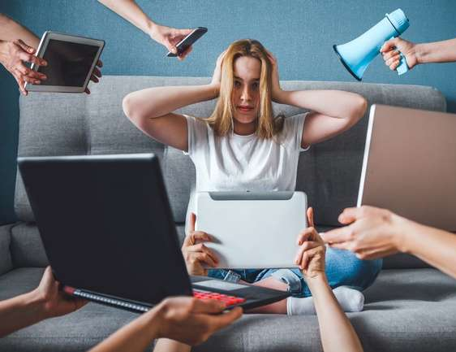
And yet, nearly half of the ad dollars spent on digital news websites go towards platforms that openly publish news-related misinformation
For every $2.16 spent on news websites in the U.S.,
$1 is spent on misinformation
Source: NewsGuard and Comscore, Special Report: Top brands are sending $2.6 billion to misinformation websites each year, August 2021. Download VAB’s ‘Credibility Crisis’ to learn more.
This information is exclusively provided to VAB members and qualified marketers.
PAGE 7

Slide 8


When it comes to trust, TV is the top source for news updates and, because of this, serves as most adults’ ‘go-to’ for the latest information
TV is the #1 trusted source
for news among adults
(63% agree)
TV is the #1 source for adults
to stay informed / up-to-date
(56% agree)
Source: VAB analysis of MRI-Simmons Q2 2023 Trending Topics Study, A18+. Reflects respondents who said they trust TV / streaming news as a source for financial news, science news, political news or local news. VAB analysis of MRI-Simmons 2023 Spring USA Study, A18+. Download VAB’s ‘Credibility Crisis’ to learn more.
This information is exclusively provided to VAB members and qualified marketers.
PAGE 8

Slide 9


Most adults who actively stay informed on today’s issues get their news from TV platforms
70%
65%
of A18+ agree it is important to keep up-to-date with news and current affairs
of U.S. adults get their news from TV
Source: VAB analysis of MRI-Simmons 2023 Spring USA Study, A18+. Pew Research Center, survey of U.S. adults conducted July 18 – August 21, 2022. Reflects respondents who answered ‘sometimes’ or ‘often’. Download VAB’s ‘Credibility Crisis’ to learn more.
This information is exclusively provided to VAB members and qualified marketers.
PAGE 9

Slide 10

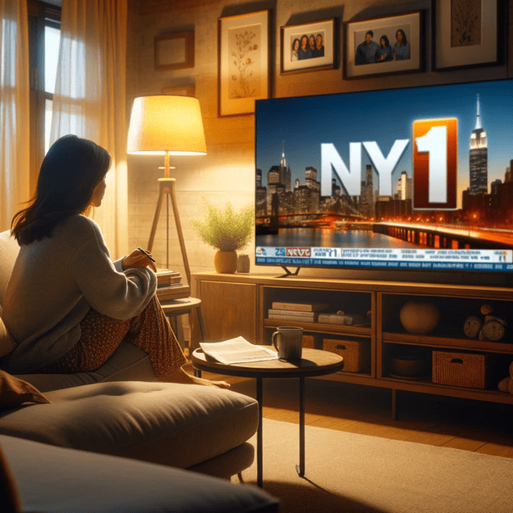
More specifically, Local TV news reaches engaged audiences at scale, delivering a majority of adults across markets daily
62%
of U.S. adults watch local news daily on their TV
Source: Spectrum News / Morning Consult study via Charter Communications press release, Spectrum News/Morning Consult Poll Finds 83% of Americans Trust Local News, 8/25/2022. Download VAB’s ‘Credibility Crisis’ to learn more.
This information is exclusively provided to VAB members and qualified marketers.
PAGE 10

Slide 11



Local news is valued by many Americans because it is trustworthy, provides useful information and can positively impact their community
83%
77%
72%
Find local news coverage on TV to be
most trustworthy
Feel local news provides people with important info about their community & critical national news
Agree local news helps enact positive change in their local community
Source: Spectrum News / Morning Consult study via Charter Communications press release, Spectrum News/Morning Consult Poll Finds 83% of Americans Trust Local News, 8/25/2022. Download VAB’s ‘Credibility Crisis’ to learn more.
This information is exclusively provided to VAB members and qualified marketers.
PAGE 11

Slide 12

Furthermore, ads in trusted, brand safe environments – such as local TV news - have proven to drive quantifiable results for businesses
+233%
lift in conversions for
brand safe impressions vs.
non brand safe impressions
Source: Integral Ad Science, Does Media Quality Drive Attention and Outcomes?, March 2022. Download VAB’s ‘What is Brand Safety’ to learn more.
This information is exclusively provided to VAB members and qualified marketers.
PAGE 12

Slide 13


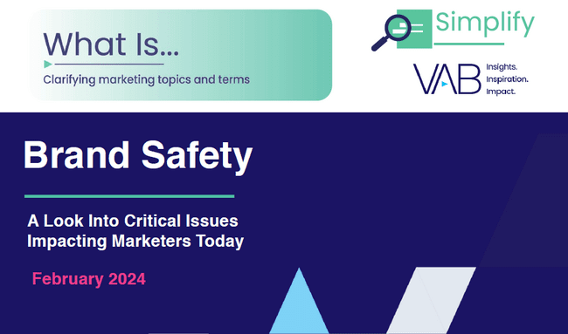
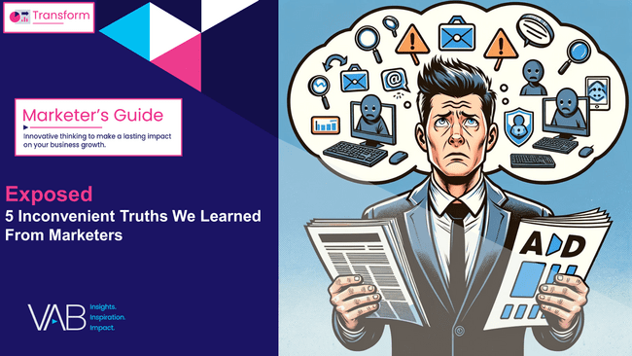


Download these other VAB resources to learn more about the impact of trust, transparency and brand safety
This information is exclusively provided to VAB members and qualified marketers.
PAGE 13

Slide 14


About VAB
VAB plays a dual role in the video advertising industry. We are leading the change to bring about a more innovative and transparent marketplace. We also provide the insights and thought leadership that enables marketers to develop business-driving marketing strategies.
Drawing on our marketing expertise, we simplify the complexities in our industry and discover new insights that transform the way marketers look at their media strategy.
We are committed to your business growth and proud to offer VAB members, brand marketers and agencies complimentary access to our continuously-growing Insights library. Get immediate access at theVAB.com.
This information is exclusively provided to VAB members and qualified marketers.
PAGE 14

