Slide 1


VIDEO ADVERTISING BUREAU - REPORT 2019
.................
Doubling Down
Exploring Tech Giants’ Investment In TV

Slide 2

FAANG Collectively Spent Over $2 Billion On TV In 2018,
More Than Double Their Annual Investment vs. Three Years Ago
FAANG U.S. TV Spend
($$$ in Millions)
+38%
$2,180.1
+7%
+46%
$1,581.8
$1,478.8
$1,014.1
Source: VAB analysis of Nielsen AdIntel, calendar year 2015-2018, TV spend includes cable TV, broadcast TV, Spanish language cable TV, Spanish language broadcast TV, spot TV, and syndicated TV. U.S. TV spend only.
FAANG includes: Facebook, Apple, Amazon, Netflix and Google.
2

Slide 3








Collectively, FAANG Would Now Rank As The #2 TV Spender In The U.S.
TV Spenders Ranked By Parent Companies
2015
2016
2017
2018
#1
#1
#1
#1
#2
#2
#2
#2
#3
#3
#3
#3
#4
#4
#4
#4
#5
#5
#5
#5
#6
#6
#6
#6
#7
#7
#7
#7
#8
#8
#8
#8
Source: VAB analysis of Nielsen AdIntel, calendar year 2015-2018, TV spend includes cable TV, broadcast TV, Spanish language cable TV, Spanish language broadcast TV, spot TV, and syndicated TV. U.S. TV spend only.
FAANG includes: Facebook, Apple, Amazon, Netflix and Google.
3

Slide 4



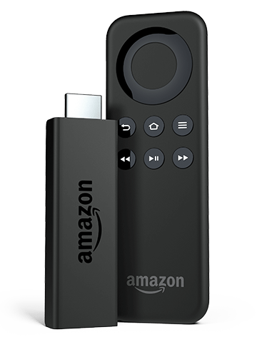


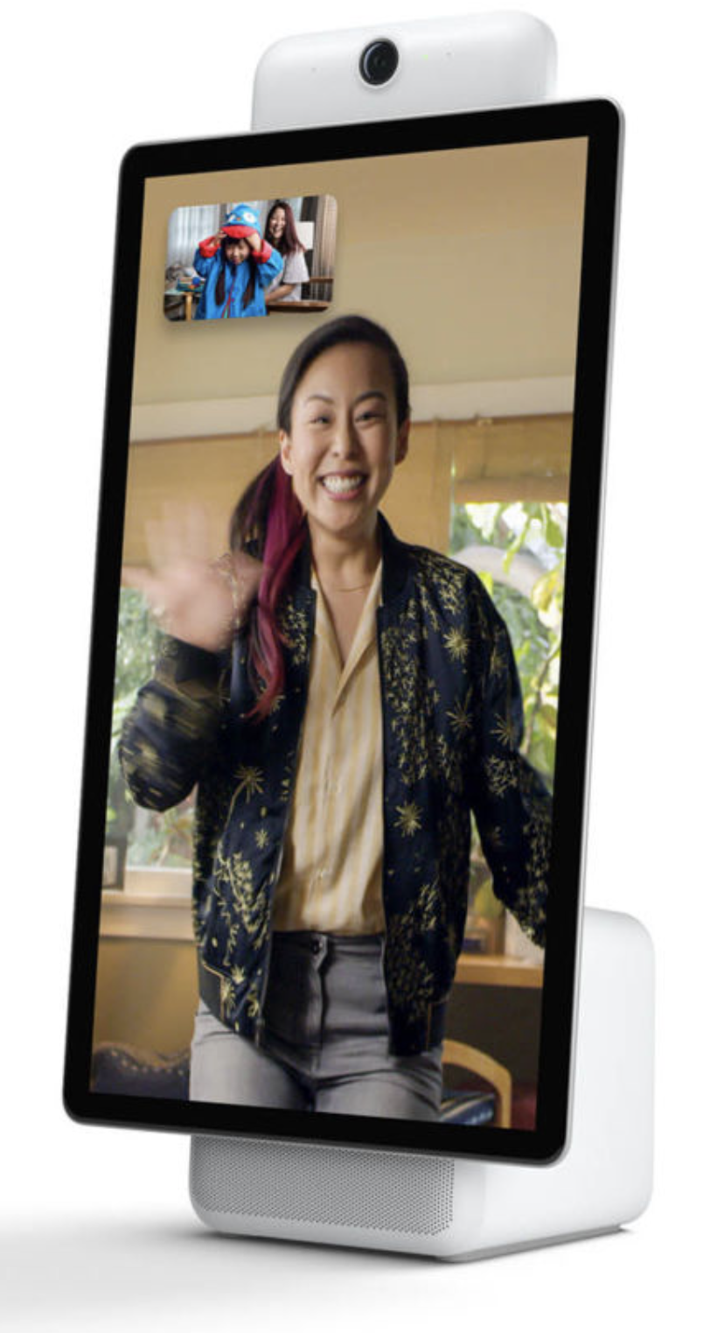





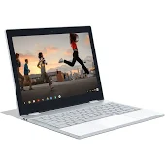
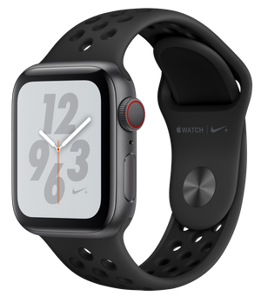

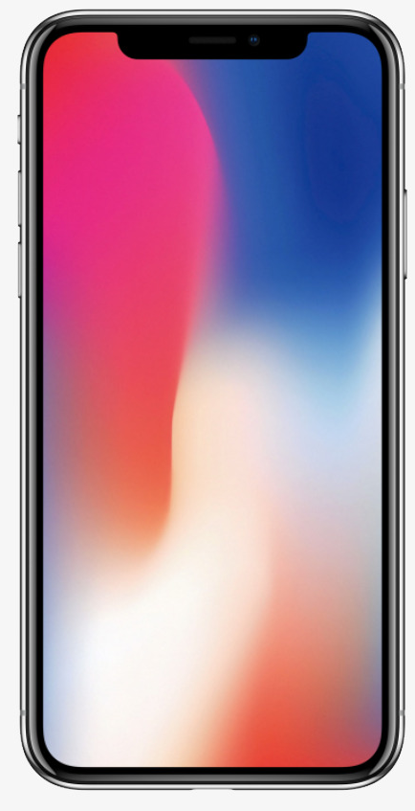

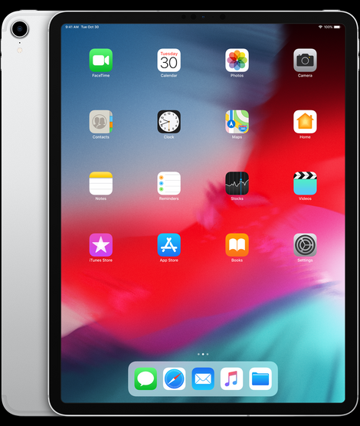

FAANG Advertises Their Newest Products Through Television To Reach Desirable, Tech-Enthusiast Audiences At Scale
Sampling of Top Brands Advertised on TV by FAANG
Google Home
Oculus Go
Fire TV
Portal
Echo
Pixel 3
Pixelbook
Apple Watch 4
iPhone X
iPad
Source: VAB analysis of Nielsen AdIntel, calendar year 2015-2018, TV spend includes cable TV, broadcast TV, Spanish language cable TV, Spanish language broadcast TV, spot TV, and syndicated TV. U.S. TV spend only.
FAANG includes: Facebook, Apple, Amazon, Netflix and Google.
4

Slide 5




For More Information Visit Us Online
TheVAB.com
Join Our Email List
Follow Us:
@VideoAdBureau
Follow Us:
VAB (Video Advertising Bureau)

