Slide 1

Don’t Sleep On TV:
How Television Drives Outcomes For The Mattress & Bedding Categories

Slide 2
Contents
Summary 3
Category Overview
  Historical TV Spending Trend 4-5
  Brands Included Within Analysis 6
Analysis Correlations
  TV Spend vs. Website Traffic 7-9
  TV Spend vs. Online Interactions 10-11
  TV Spend vs. U.S. Revenues 12
Contact Information 13
VAB REPORT: DON’T SLEEP ON TV

Slide 3
How Television Drives Outcomes For Mattress & Bedding Brands
In recent years, the mattress & bedding categories have experienced a transformation as several new brands – many of which are digital-native, “direct-disruptors” that sell their products directly to consumers - have entered the marketplace.
With this heightened competition has come greater advertising spend, particularly within Television, as brands seek out the scale and engagement that the medium provides in order to establish brand recognition and differentiate themselves from their competitors in an effort to impact sales.
In this report, Don’t Sleep On TV, we examine the TV spend of 16 mattress / bedding-related brands in relation to available brand metrics such as website traffic, online interactions and revenue to determine what, if any, correlations exist.
Utilizing recognized and trusted third-party data measurement providers such as Nielsen (TV spend), comScore (website traffic) and iSpot.tv (online interactions), we uncovered the following facts from our analysis:
  As mattress brands battle for competitive market share, TV spend increased 74% in 2017 vs. year ago
  For those TV spenders, all brands whose website traffic is measured in comScore (15 out of 15) saw a definitive correlation
    Website traffic skyrocketed for those brands that launched new TV campaigns, helping increase monthly website traffic by hundreds of thousands of potential new customers
    Web traffic increased for those who increased their TV investment or, conversely, traffic decreased for those whose TV spending declined
  TV ignites brand interest and pushes consumers to learn more through higher search queries and additional online viewing of the TV ads
  Most importantly, brands often see double-digit revenue growth when they increase their TV investment
VAB REPORT: DON’T SLEEP ON TV

Slide 4
The Mattress & Bedding Retail Store Categories Combined Collectively Spent Over $650 Million On TV in 2017
The 2017 spend represents a 17% increase in TV investments YOY which came from a mix of new brand entrants as well as organic growth from brands increasing their existing investments
# of Brands
($100K+
TV investment)
105
101
108
108
116
119
VAB REPORT: DON’T SLEEP ON TV
Source: VAB analysis of Nielsen Ad Intel data, calendar year 2012-2017. TV spend includes national cable TV, broadcast TV, Spanish language cable TV, Spanish language broadcast TV, spot TV, syndication TV. Reflects the cume TV spend of the “mattresses” and “bedding store” categories.

Slide 5
Within The Mattress Category Specifically, TV Spend Collectively Skyrocketed In 2017
2017 TV spend within the mattress category increased 74% YOY which came from a mix of new brand entrants as well as organic growth from brands increasing their existing investments
# of Brands
($100K+
TV investment)
15
19
20
VAB REPORT: DON’T SLEEP ON TV
Source: VAB analysis of Nielsen Ad Intel data, calendar year 2012-2017. TV spend includes national cable TV, broadcast TV, Spanish language cable TV, Spanish language broadcast TV, spot TV, syndication TV. Reflects the cume TV spend of the “mattresses” category.

Slide 6









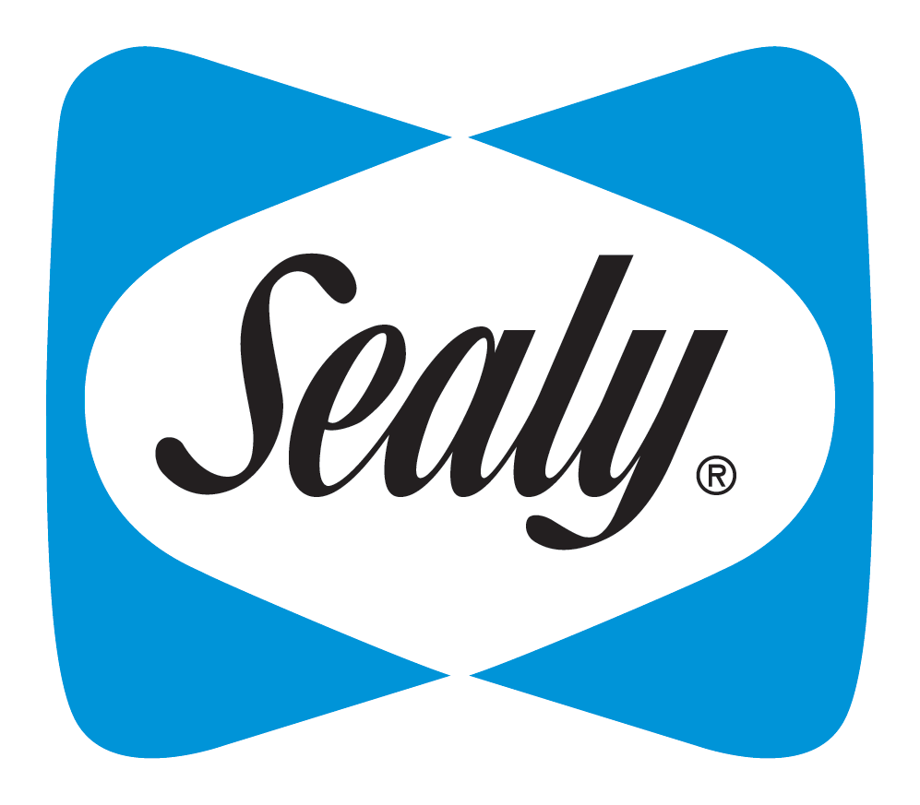






16 Mattress & Bedding Retail Store-Related Brands Analyzed
We analyzed the TV spend and individual key metrics (where available) like website traffic, online interactions and revenue of these 16 brands across the mattress & bedding retail store categories
“Mattress” Brands
“Bedding Retail Store” Brands
VAB REPORT: DON’T SLEEP ON TV
The above list represents a mix of brands across the mattress & bedding retail store categories who invested $300K+ in measured TV spend between CY 2017 – 1Q 2018 (Nielsen AdIntel) and have available data within at least one of the following business metrics: website traffic unique visitors via comScore, online interactions (search queries or online views) via iSpot.tv, or revenue estimates through reliable & verified sources such as SEC.gov or Pivotal Research.

Slide 7
Website Traffic Skyrocketed For Many “Newer” Mattress-Related Brands As Soon As They Launched A TV Campaign
Average Monthly Website Unique Visitors (000) Comparison
Based Over A Three-Year Time Period (May ‘15 – Apr ‘18)
Monthly Average:
Prior To TV Launch
Monthly Average:
TV Launch – Apr ‘18
Company
% Difference
N/A
105
N/A
136
207
608
+194%
N/A
153
109
1,446
+1,227%
213
363
+70%
N/A
163
Source: VAB analysis of comScore mediametrix multiplatform media trend data; total audience (Desktop P2+. Mobile 18+), May ‘15 – April ’18 (calendar months). VAB analysis of Nielsen Ad Intel data, TV spend (national cable TV, national broadcast TV, Spanish language broadcast TV, Spanish language cable TV, spot TV, syndication TV), May ‘15– Apr ’18 (calendar months). N/A = not enough traffic for comScore to measure. Averages are based on months with measured and reported unique visitor (000) data.

Slide 8
TV Also Drives Web Traffic For The More “Established” Mattress-Related Brands That Have A Continual Advertising Presence
The below chart reflects the shifts in spend and online traffic for brands who were active on TV every month, or nearly every month, for the last three years
TV Spend Up, Website Traffic Up
(18-Month vs. 18-Month Comparison: May ’15 – Oct ’16 vs. Nov ‘16 – Apr ‘18)
Avg Monthly TV Spend (000):
May ‘15 - Oct ’16:
$7,880
$9,968
$448
Nov ‘16 – Apr ‘18:
$13,017
$12,230
$825
% Difference:
+65%
+23%
+84%
Avg Monthly Unique Visitors (000):
May ‘15 - Oct ’16:
647
1,317
230
Nov ‘16 – Apr ‘18:
1,108
1,469
271
% Difference:
+71%
+12%
+18%
VAB REPORT: DON’T SLEEP ON TV
Source: VAB analysis of comScore mediametrix multiplatform media trend data; total audience (Desktop P2+, Mobile 18+), May ‘15 – April ’18 (calendar months). VAB analysis of Nielsen Ad Intel data, TV spend (national cable TV, national broadcast TV, Spanish language broadcast TV, Spanish language cable TV, spot TV, syndication TV), May ’15 – Apr ’18 (calendar months).

Slide 9
Conversely, “Established” Brands That Decrease Their TV Spending Tend To See Their Website Traffic Decline Also
The below chart reflects the shifts in spend and online traffic for brands who have been active on TV but decreased their average spending over the last three years
TV Spend Down, Website Traffic Down
(18-Month vs. 18-Month Comparison: May ’15 – Oct ’16 vs. Nov ‘16 – Apr ‘18)
Avg Monthly TV Spend (000):
May ‘15 - Oct ’16:
$1,509
$4,251
$3,998
$400
Nov ‘16 – Apr ‘18:
$766
$296
$3,885
$240
% Difference:
-49%
-93%
-3%
-40%
Avg Monthly Unique Visitors (000):
May ‘15 - Oct ’16:
128
258
217
73
Nov ‘16 – Apr ‘18:
53
100
169
40
% Difference:
-59%
-61%
-22%
-45%
VAB REPORT: DON’T SLEEP ON TV
Source: VAB analysis of comScore mediametrix multiplatform media trend data; total audience (Desktop P2+, Mobile 18+), May ‘15 – April ’18 (calendar months). VAB analysis of Nielsen Ad Intel data, TV spend (national cable TV, national broadcast TV, Spanish language broadcast TV, Spanish language cable TV, spot TV, syndication TV), May ’15 – Apr ’18 (calendar months).

Slide 10



Increased TV Investments Have A Propensity To Drive An
Even Greater Amount Of Search Queries
Sampling of Brands: TV Spend vs. “Search Queries” YOY % Increase
2016 vs. 2017
Brand
TV Spend
Search
Queries
+365%
+527%
+87%
+747%
+216%
+417%
+173%
+2,590%
VAB REPORT: DON’T SLEEP ON TV
Source: TV spending based on VAB analysis of Nielsen Ad Intel data, TV spend (national cable TV, national broadcast TV, Spanish language broadcast TV, Spanish language cable TV, spot TV, syndication TV), CY 2016 & 2017. Search queries based on VAB analysis of iSpot.tv data and reflects TV commercial-related searches (Google, Bing, Yahoo!). Search queries are correlated to TV ad airing data.

Slide 11

Increased TV Activity Also Drives Consumers Online To Engage Further With Brands Through Additional Viewings Of Their TV Ad
Sampling of Brands: TV Spend vs. “Online Video Views” YOY % Increase
2016 vs. 2017
Brand
TV Spend
Online
Video Views
+78%
+417%
+ 365%
+24,122%
+87%
+152%
+216%
+6,145%
+73%
+98%
+12%
+572%
+173%
+1,388%
VAB REPORT: DON’T SLEEP ON TV
Source: TV spending based on VAB analysis of Nielsen Ad Intel data, TV spend (national cable TV, national broadcast TV, Spanish language broadcast TV, Spanish language cable TV, spot TV, syndication TV), CY 2016 & 2017. Online Video Views are based on VAB analysis of iSpot.tv data and reflects and earned, not promoted, online video views of TV ads (YouTube, iSpot.tv). Online Video Views are correlated to TV ad airing data.

Slide 12

Most Importantly, Brands Often See Double-Digit Revenue Growth When They Increase Their TV Investment
Company
2016
2017
YoY Diff
TV Spend (000):
$13,560
$63,480
+$49,920
Founded in 2014
Revenue (000):
$80,000
$150,000
+$70,000
+88%
TV Spend (000):
$10,555
$18,777
+$8,222
Revenue (000):
$200,000
$400,000
+$200,000
+100%
Founded in 2013
TV Spend (000):
$448
$1,417
+$969
Revenue (000):
$180,000
$200,000
+$20,000
+11%
Founded in 2010
TV Spend (000):
$127,548
$142,897
+$15,353
Founded in 1987
Revenue (000):
$1,311,291
$1,444,497
+$130,000
+10%
VAB REPORT: DON’T SLEEP ON TV
%
=revenue increase between 2016 & 2017
Source: Revenues reflect estimated U.S. revenue data from Pivotal Research, with the exception of Sleep Number which is based on SEC financial filings via SEC.gov (Select Comfort / Sleep Number). TV spend based on VAB analysis of Nielsen Ad Intel data, TV spend (national cable TV, national broadcast TV, Spanish language broadcast TV, Spanish language cable TV, spot TV, syndication TV), CY 2016 & 2017.

Slide 13


For More Information Visit Us Online
TheVAB.com
Follow us:
@VideoAdBureau
Like us:
facebook.com/VideoAdvertisingBureau

