Slide 1
Do We Have Consensus?
How the Ad Community’s Media Behaviors Became America’s “Norms”

Slide 2
The Brief
Overview 3
Concept & Methodology 4
Advertising Community Respondent Profile 5
Lifestyle Comparisons 10
Media Usage 16
Preferences & Perceptions 25
TV Consumption 42
Contact Information 47

Slide 3
Raise Your Hand If…
You’ve been to an industry conference recently where a seemingly all-knowing marketing guru, media futurist or digital “expert” asked you to put your hand up in response to his “provocative,” but leading, question such as…
…Except sports & big specials, how many of you here still watch live TV?
…For the TV you do watch, how many here are time-shifting all the commercials?
…How many people here couldn’t live without your smartphone?
…How many people here watch most of their video content on a mobile device?
…How many people here watch more content on streaming apps than TV?
You then looked around the ballroom, saw nearly everyone else’s hand up and immediately assumed this behavior naturally projects out across the American population.
But just because you, an advertising professional, possess these behaviors does that mean everyone else in this country does too?
This report set out to address this very question with a survey conducted among the advertising community across the spectrum of decision-making disciplines. Results in regards to our lifestyle, device ownership and media consumption were compared to syndicated research for the average population to show the true contrast between “the advertising industry bubble” and the “average everyday American.”
The goal of this report is to determine if we let our own unique lifestyle and media consumption habits inadvertently affect our views…

Slide 4

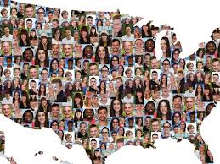
Concept & Methodology
Our goal was to investigate how the advertising community compares to the general public and explore their perceptions about ‘typical’ American media behavior
Advertising Community
“Average American”
Commissioned a custom online study by Research Now
250 respondents who must be currently employed full time at a media, full service or digital / social agency or as a marketer / advertiser at a brand
In-field February 6th – 16th, 2017
Third-party syndicated research (e.g. Nielsen, comScore, GfK MRI, etc)
Replicated exact wording of syndicated questions in custom study
Utilized most current data available for Adults 18+

Slide 5
Who Are Our Advertising Community Respondents?

Slide 6
74% Of Respondents Have An Integrated Media Strategy Or Media Investment / Buying Background
How do you best describe your primary function at work?
Position titles represent a cross section of the industry – from junior level to senior executive
71% currently work at an ad agency (full service, digital / social or media)
29% currently work at an advertiser / marketer
Source: VAB / Research Now “Advertising Community” Survey, February 2017. Q11: Which one of these bests describes your primary function at work? (select one). Respondents = 254

Slide 7
Even Though Our Respondents Were Spread Across The Country, They Reside Primarily In Urban Areas
Which Region & Area Best Describes Where You Live In?
Source: VAB / Research Now “Advertising Community” Survey, February 2017. Q3: Please select which region/state you live in (select one). Q4: Which are best describes where you live? Respondents = 254.

Slide 8
Our Respondents Skew Male & Younger Than The Population
Advertising Community
Source: VAB / Research Now “Advertising Community” Survey, February 2017. Q1: What is your gender? Respondents = 254. Comparison made to “average A18+ population” is based on Nielsen 2016-2017 National Universe Estimates.

Slide 9
…And Are More Affluent Than The Average Population
What Is Your Annual Income?
65% = $75K+ IEI
23% = $75K+ IEI
Source: VAB / Research Now “Advertising Community” Survey, February 2017. Q5: What is your annual income? Respondents = 254. “Average A18+ population” data based on VAB analysis of GfK MRI 2016 Doublebase (“Individual Employment Income” – IEI) and reflects only those who are currently employed full-time.

Slide 10
How Does the Lifestyle of Advertising Professionals Compare with the Average American?

Slide 11
We Are Career-Driven Workaholics And, Yes, More Stressed Than The Average Population
% That Agree With The Following “Work/Life Balance” Statements
Source: VAB / Research Now “Advertising Community” Survey, February 2017. Q12: Please indicate below how much you agree or disagree with the following statements (Top 2 Box agree); Respondents = 254. “Average A18+ population” data based on GfK MRI 2016 Doublebase.

Slide 12
Media Planners / Buyers Tend to Be More Stressed (And Work More Weekends) Than Brand Marketers
% That Agree With The Following “Work/Life Balance” Statements
Source: VAB / Research Now “Advertising Community” Survey, February 2017. Q12: Please indicate below how much you agree or disagree with the following statements (Top 2 Box agree). Brand Marketer / Advertiser =74; Media Planner/Buyer Respondents=188. “Average A18+ population” data based on GfK MRI 2016 Doublebase.

Slide 13
Amidst All This Work, We Find A Way To Have Fun…
We Are More Active & “On The Go” Than Most Americans
Which Activities Do You Participate In At Least Once A Month?
Source: VAB / Research Now “Advertising Community” Custom Survey, February 2017. Q32: Please indicate how often you engage in the following activities? Respondents = 254. “Average A18+ Population” based on GfK MRI 2016 Doublebase (“any sports” is based on last 12 months for MRI).

Slide 14
We Also See More Movies in the Theater Than Most Americans
How Often Have You Been To A Movie Theater?
(Last 90 Days)
18% go to the movies at least once a month
65% go to the movies at least once a month
Source: VAB / Research Now “Advertising Community” Custom Survey, February 2017. Q28: How often have you been to a movie theater in the last 90 days? Respondents = 254. “Average A18+ Population” data based on GfK MRI 2016 Doublebase.

Slide 15
Of Course, In The Interest Of Staying On Top Of Pop Culture, We Need To Be The First To See A Movie
When Do You Prefer To See A New Movie In The Theater?
Advertising Pros are 2x more likely to see a movie opening weekend
Source: VAB / Research Now “Advertising Community” Custom Survey, February 2017. Q29: When do you prefer to see a new movie in the theater? Respondents = 254. “Average A18+ Population” data based on the universe of people who have seen a movie in GfK MRI 2016 Doublebase.

Slide 16
Advertising Pros Have A Different Lifestyle Than Average Americans -
Does This Effect Media Usage?

Slide 17
We Rely On TV & The Internet, Fairly & Equally, For Entertainment & Escape
For The Following Statements, Which Media Do You Think It Describes?
Source: VAB / Research Now “Advertising Community” Survey, February 2017. Q25: For each of the following statements, please check off which media you think it describes; Respondents = 254.

Slide 18
In Contrast, The Average Adult Overwhelmingly Relies On TV
For The Following Statements, Which Media Do You Think It Describes?
America’s sentiment and passion for TV is much stronger than Advertising Professionals
Source: VAB / Research Now “Advertising Community” Survey, February 2017. Q25: For each of the following statements, please check off which media you think it describes; Respondents = 254. “Average A18+ population” data based on GfK MRI 2016 Doublebase.

Slide 19
We Like (?) To Always Be Connected And Are More Likely To Be Early Adopter Gadget Gurus
% That Agree With The Following “Early Adopter / Technology” Statements
Source: VAB / Research Now “Advertising Community” Survey, February 2017. Q18: Please indicate below how much you agree or disagree with the following statements (Top 2 Box agree); Respondents = 254. “Average A18+ population” data based on GfK MRI 2016 Doublebase.

Slide 20
Therefore, We Are More Likely To Own Almost
Every Major Device
% That Have At Least One Device In Their Household
Source: VAB / Research Now “Advertising Community” Survey, February 2017. Q13: How many of each of the following devices are there in your household? Total Respondents = 254, Media Planner / Buyer Respondents = 188. “Average A18+ population” data based on Nielsen UE information, January 2017, P18+.

Slide 21
Except TV’s…We Are Much Less Likely To Have Multiple
In Our Household
% That Have 2 or More TVs In Their Households
Of all the Advertising functions we surveyed Urban, Integrated Media Professionals own the fewest TV’s
3+ = 21% 15% 63%
4+ = 8% 4% 38%
Source: VAB / Research Now “Advertising Community” Survey, February 2017. Q13: How many of each of the following devices are there in your household? Total Respondents = 254, Media Planner / Buyer Respondents = 188. “Average A18+ population” data based on Nielsen UE information, January 2017, P18+.

Slide 22
However, We Invest In Smart TV’s And OTT Devices That Allow Easy Access to Streaming Content
Device Ownership in Household
Advertising Professionals are more than 2x as likely to own an internet connected TV
Source: VAB / Research Now “Advertising Community” Survey, February 2017. Q14: Which of the following devices do you or anyone else in your household own? Respondents = 254. “Average A18+ population” data based on Nielsen NPower, January 2017 household data; HDTV (not Internet connected) based on GfK 2016 Doublebase.

Slide 23
We Are Content Thirsty & Platform Agnostic –
SVOD Services, TV Everywhere Apps, VOD
Which Service Have You Used In The Past Month?
Always on the lookout for hot, new content, Advertising Professionals are more likely to utilize a wide variety of services – except Network TV apps
Source: VAB / Research Now “Advertising Community” Survey, February 2017. Q17: Which of the following services have you used in the past month? Respondents = 254. “Average P13+ population” data based on GfK Comparing Streaming Services 2016 study, U.S., P13-64; “network TV website or app” based on comScore MediaMetrix Multiplatform data, January 2017. Facebook Live is based on VAB analysis of eMarketer November 2016 data and projected to the U.S. population.

Slide 24
Even Though We Have Access To Multiple Platforms, We Are No More “Cord Cutters” Than The Average Adult
Which Service Does Your Household Subscribe To?
Source: VAB / Research Now “Advertising Community” Survey, February 2017. Q15: Which of the following do you or someone in your household subscribe to? Total Respondents=254; Media Planner/Buyer Respondents=188. “Average A18+ population” data based on Nielsen NPower, February 2017 household data; Sling TV is estimated based on mid-September 2016 Nielsen subscriber estimates.

Slide 25
Does Our Unique Media Preferences Skew Our Perceptions of General Media Usage?

Slide 26

Perception vs. Reality
In our Advertising Community survey, we asked respondents to provide two separate responses to our media consumption questions:
Self-reported
Estimated
“What do you do…”
“What do you think an average American does…”
Then we compared the advertiser responses to the general population’s “real” media consumption based on third-party syndicated research

Slide 27
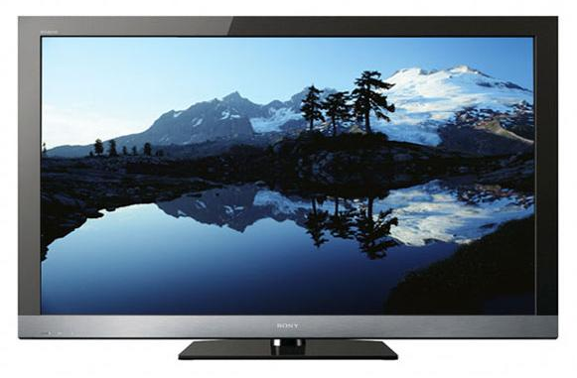



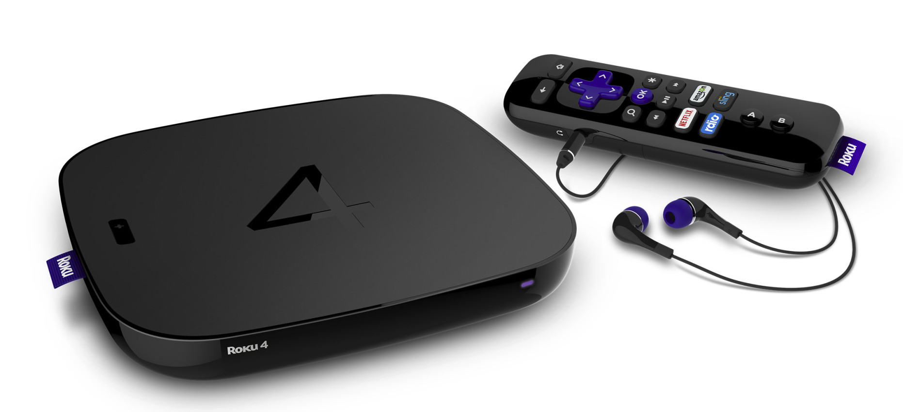
32% of the Advertising Community’s Video Consumption
Is Done On TV
Total Video Consumption (P18+): % By Device
(Live or Recorded on a TV set)
(Via a TV connected device)
(On a PC/desktop/laptop computer)
(On a Tablet)
(On a Smartphone)
Advertising Community: (Reported Share)
32%
20%
22%
13%
13%
Source: VAB / Research Now “Advertising Community” Survey, February 2017. Q23: Of all the video that you watch, what % of time do you watch video (UGC, broadcast, streaming, cable TV programs, online video, etc.) on the following devices? (mean average summary which factors in 0% responses); Respondents = 254.

Slide 28
We Believe The Average Adult’s Share Of Video Viewing On
TV Is Even Lower
Total Video Consumption (P18+): % By Device
(Live or Recorded on a TV set)
(Via a TV connected device)
(On a PC/desktop/laptop computer)
(On a Tablet)
(On a Smartphone)
Advertising Community: (Reported Share)
32%
20%
22%
13%
13%
Estimated by Advertising Community: (Avg Adult 18+ Share)
25%
19%
21%
17%
18%
Adverting Pros believe average Americans consume more video on mobile devices than themselves
Source: VAB / Research Now “Advertising Community” Survey, February 2017. Q23: Of all the video that you watch, what % of time do you watch video (UGC, broadcast, streaming, cable TV programs, online video, etc.) on the following devices? (mean average summary which factors in 0% responses); Q24: Of all the video that an average American (P18+) watches, what % of the time do you believe they watch video (UGC, broadcast, streaming, cable TV programs, online video, etc.) on the following devices? (mean average summary which factors in 0% responses). Respondents = 254.

Slide 29
In Reality, 82% Of Adult 18+ Video Viewing Is On TV
Total Video Consumption (P18+): % By Device
(Live or Recorded on a TV set)
(Via a TV connected device)
(On a PC/desktop/laptop computer)
(On a Tablet)
(On a Smartphone)
Advertising Community: (Reported Share)
32%
20%
22%
13%
13%
Estimated by Advertising Community: (Avg Adult 18+ Share)
25%
19%
21%
17%
18%
ACTUAL Adult 18+ Share: (based on Nielsen)
82%
11%
5%
1%
2%
Source: VAB / Research Now “Advertising Community” Survey, February 2017. Q23: Of all the video that you watch, what % of time do you watch video (UGC, broadcast, streaming, cable TV programs, online video, etc.) on the following devices? (mean average summary which factors in 0% responses); Q24: Of all the video that an average American (P18+) watches, what % of the time do you believe they watch video (UGC, broadcast, streaming, cable TV programs, online video, etc.) on the following devices? (mean average summary which factors in 0% responses). Respondents = 254. “Average P18+ population” data based on Nielsen’s Comparable Metrics Report, Q3’16, P18+, and reflects an average week between June 27th, 2016 – September 25, 2016.

Slide 30
Time Spent: 67% Of Us Say That We Watch Two Or Less Hours Of TV Per Day
In an average day, approximately how much time do you spend
watching TV on a TV set?
2 Hours or Less
Source: VAB / Research Now “Advertising Community” Custom Survey, February 2017. Q19: In an average day, approximately how much time do you spend watching TV on a TV set (live, recorded / from a DVR or VOD)? Total Respondents = 254. Data doesn’t include those respondents who answered “don’t know.”

Slide 31
We Believe The Average Adult’s TV Viewing Habits
Align With Our Own
In an average day, how much time do you think the average adult spends watching TV on a TV set?
2 Hours or Less
2 Hours or Less
2 Hours or Less
Source: VAB / Research Now “Advertising Community” Custom Survey, February 2017. Q19: In an average day, approximately how much time do you spend watching TV on a TV set (live, recorded / from a DVR or VOD)? & Q20: In an average day, how much time do you think the American public (P18+) spends watching TV on A TV set. Total Respondents = 254; Media Planner/Buyer Respondents = 188. Data doesn’t include those respondents who answered “don’t know.”

Slide 32
However, We Vastly Underestimate How Much Time Is Actually Spent By The Average Adult Watching TV
In an average day, approximately how much time do you spend, and how much time do you think the average adult spends, watching TV on a TV set?
The average adult spends double the time watching TV than estimated by most media professionals
Avg Daily Time Spent
(hrs:mins)
Avg Daily Time Spent: 2 Hours Or Less
Actual
Source: VAB / Research Now “Advertising Community” Custom Survey, February 2017. Q19: In an average day, approximately how much time do you spend watching TV on a TV set (live, recorded / from a DVR or VOD)? & Q20: In an average day, how much time do you think the American public (P18+) spends watching TV on A TV set. Total Respondents = 254; Media Planner/Buyer Respondents = 188. Data doesn’t include those respondents who answered “don’t know.” “Average A18+ Population” data based on VAB analysis of on Nielsen Comparable Metrics Report, Q3’16, and reflects an average week between June 27th, 2016 – September 25, 2016 for total population.

Slide 33
Over 60% Of Us Say We Spend Over 30 Minutes Per Day Watching Video On Our Computer
In an average day, approximately how much time do you spend watching video on a computer?
30 Mins or More
Source: VAB / Research Now “Advertising Community” Custom Survey, February 2017. Q19: In an average day, approximately how much time do you spend watching video on a computer (desktop/laptop/PC)? Total Respondents = 254. Data doesn’t include those respondents who answered “don’t know.”

Slide 34
We Believe That The Average Adult Spends Even More Time Than Us Watching Video On A Computer
In an average day, approximately how much time do you think the average adult spends watching video on a computer?
30 Mins or More
30 Mins or More
30 Mins or More
Source: VAB / Research Now “Advertising Community” Custom Survey, February 2017. Q19: In an average day, approximately how much time do you spend watching video on a computer (desktop/laptop/PC)? & Q20: In an average day, how much time do you think the American public (P18+) spends watching video on a computer (desktop/laptop/PC)? Total Respondents = 254; Media Planner/Buyer Respondents = 188. Data doesn’t include those respondents who answered “don’t know.”

Slide 35
Unlike TV Though, We Vastly Overestimate How Much Time Is Actually Spent Watching Video On A Computer
In an average day, approximately how much time do you spend, and how much time do you think the average adult spends, watching video on a computer?
The average adult spends less than half the time estimated by most media pros watching video on a computer
Actual
Avg Daily Time Spent: 30 Minutes or More
Avg Daily Time Spent
(hrs:mins)
Actual
Source: VAB / Research Now “Advertising Community” Custom Survey, February 2017. Q19: In an average day, approximately how much time do you spend watching video on a computer (desktop/laptop/PC)? & Q20: In an average day, how much time do you think the American public (P18+) spends watching video on a computer (desktop/laptop/PC)? Total Respondents = 254; Media Planner/Buyer Respondents = 188. Data doesn’t include those respondents who answered “don’t know.” “Average A18+ Population” data based on VAB analysis of on Nielsen Comparable Metrics Report, Q3’16, and reflects an average week between June 27th, 2016 – September 25, 2016 for total population.

Slide 36
54% Of Us Say We Spend Over 30 Minutes Per Day Watching Video On Our Mobile Devices
In an average day, approximately how much time do you spend watching video on a mobile device?
30 Mins or More
Source: VAB / Research Now “Advertising Community” Custom Survey, February 2017. Q19: In an average day, approximately how much time do you spend watching video on a mobile device (smartphone or tablet)? Total Respondents = 254. Data doesn’t include those respondents who answered “don’t know.”

Slide 37
We Believe That The Average Adult Spends Even More Time Than Us Watching Video On Mobile Devices
In an average day, approximately how time do you think the average adult spends watching video
on a mobile device?
30 Mins or More
30 Mins or More
30 Mins or More
Source: VAB / Research Now “Advertising Community” Custom Survey, February 2017. Q19: In an average day, approximately how much time do you spend watching video on a mobile device (smartphone or tablet)? & Q20: In an average day, how much time do you think the American public (P18+) spends watching video on a mobile device (smartphone or tablet)? Total Respondents = 254; Media Planner/Buyer Respondents = 188. Data doesn’t include those respondents who answered “don’t know.”

Slide 38
However, We Vastly Overestimate How Much Time Is Actually Spent By The Average Adult Watching Video On Mobile Devices
In an average day, approximately how much time do you spend, and how much time do you think the average adult spends, watching video on a mobile device?
Avg Daily Time Spent: 30 Minutes or More
Avg Daily Time Spent
(hrs:mins)
Actual
Actual
Source: VAB / Research Now “Advertising Community” Custom Survey, February 2017. Q19: In an average day, approximately how much time do you spend watching video on a mobile device (smartphone or tablet)? & Q20: In an average day, how much time do you think the American public (P18+) spends watching video on a mobile device (smartphone or tablet)? Total Respondents = 254; Media Planner/Buyer Respondents = 188. Data doesn’t include those respondents who answered “don’t know.” “Average A18+ Population” data based on VAB analysis of on Nielsen Comparable Metrics Report, Q3’16, and reflects an average week between June 27th, 2016 – September 25, 2016 for total population.

Slide 39

We Also Vastly Overestimate The Actual Time The Average Population Spends Per Day Watching Videos On YouTube
In an average day, approximately how much time do you spend, and how much time do you think the average person spends, watching videos on YouTube?
(YouTube Videos)
Avg Daily Time Spent: 30 Minutes or More
Avg Daily Time Spent
(hrs:mins)
Actual
Source: VAB / Research Now “Advertising Community” Custom Survey, February 2017. Q19: In an average day, approximately how much time do you spend doing the following activities? (activities done at the same time are counted separately), Q20: In an average day, approximately how much time does an average American (age 18+) spend doing the following activities? (activities done at the same time are counted separately), Total Respondents = 254, Media Planner / Buyer Respondents = 188. Data doesn’t include those respondents who answered “don’t know.” “Average P18+ Population” data based on comScore mediametrix multiplatform, January 2017, P18+.

Slide 40


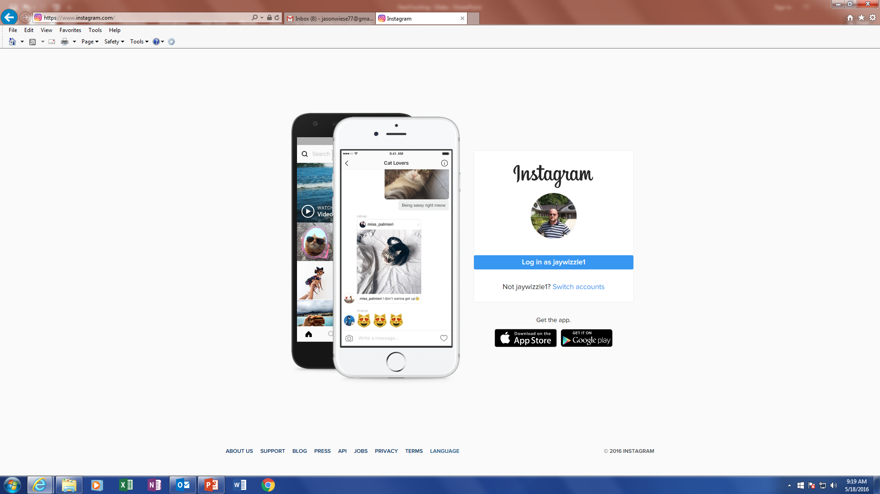
The Same Trend Holds For Facebook & Instagram
In an average day, approximately how much time do you spend, and how much time do you think the average person spends, on Facebook Or Instagram?
(Facebook & Instagram)
Avg Daily Time Spent: 1 Hour or More
Avg Daily Time Spent
(hrs:mins)
Actual
Source: VAB / Research Now “Advertising Community” Custom Survey, February 2017. Q19: In an average day, approximately how much time do you spend doing the following activities? (activities done at the same time are counted separately), Q20: In an average day, approximately how much time does an average American (age 18+) spend doing the following activities? (activities done at the same time are counted separately), Total Respondents = 254, Media Planner / Buyer Respondents = 188. Data doesn’t include those respondents who answered “don’t know.” “Average P18+ Population” data based on comScore mediametrix multiplatform, January 2017, P18+.

Slide 41

…and Twitter and Virtually Every Digital Platform We Asked About
In an average day, approximately how much time do you spend, and how much time do you think the average person spends, on Twitter?
(Twitter)
Avg Daily Time Spent: 30 Minutes or More
Avg Daily Time Spent
(hrs:mins)
Actual
Source: VAB / Research Now “Advertising Community” Custom Survey, February 2017. Q19: In an average day, approximately how much time do you spend doing the following activities? (activities done at the same time are counted separately), Q20: In an average day, approximately how much time does an average American (age 18+) spend doing the following activities? (activities done at the same time are counted separately), Total Respondents = 254, Media Planner / Buyer Respondents = 188. Data doesn’t include those respondents who answered “don’t know.” “Average P18+ Population” data based on comScore mediametrix multiplatform, January 2017, P18+.

Slide 42
How Do We Consume TV?

Slide 43
We Say That We Time-Shift Almost Half Of Our Total
TV Viewing
How Do You Consume TV Programming On Your TV Set?
% of Total TV Viewing Time
Source: VAB / Research Now “Advertising Community” Survey, February 2017. Q21: In a typical week, what % of your total TV viewing is spent on the following? (mean average summary which factors in 0% responses) Respondents = 254.

Slide 44
We Believe That People Time Shift Their TV Viewing As Much As We Do
How Do You Think The Average Person 12+ Consumes TV On Their TV Set?
% of Total TV Viewing Time
Source: VAB / Research Now “Advertising Community” Survey, February 2017. Q21: In a typical week, what % of your total TV viewing is spent on the following? (mean average summary which factors in 0% responses), Q22: In a typical week, what % of an average American’s (P12+) total TV viewing do you think is spent on the following? (mean average summary which factors in 0% responses); Respondents = 254, Media Planner/Buyer Respondents = 188.

Slide 45
We Vastly Overestimate Time-Shifting Because, In Reality, 89%
Of Viewing Is Live
Live Vs. Time-Shifted Television Consumption (P12+)
% of Total TV Viewing Time
Source: VAB / Research Now “Advertising Community” Survey, February 2017. Q21: In a typical week, what % of your total TV viewing is spent on the following? (mean average summary which factors in 0% responses), Q22: In a typical week, what % of an average American’s (P12+) total TV viewing do you think is spent on the following? (mean average summary which factors in 0% responses); Respondents = 254, Media Planner/Buyer Respondents = 188. “Average P12+” population” data based on VAB analysis of Nielsen Total Audience Report, 3Q’16, Total Day.

Slide 46













































We Watch Different Programs, On Different Platforms
Than The Average Adult
We Skew Towards Edgy Programming on Pay-TV & SVOD Services; Only 5 Programs Overlapped in the Top 25
Advertising Community’s “Favorite Programs” vs. Adult 18+ “Program Ratings” Ranker Comparison
#1
(HBO)
#14t
(Netflix)
#1
(CBS)
#13
(FOX)
#2
#14t
(CW)
#2
(CBS)
#14
(NBC)
(HBO)
#14t
(AMC)
#3
(NBC)
#15
(CBS)
#3t
(CBS)
#14t
(FX)
#4
(CBS)
#16
(CBS)
#3t
(NBC)
#5
#18t
(Comedy Central)
#5
(CBS)
#17
(NBC)
(AMC)
#6t
(CBS)
#18t
#6
(CBS)
#18
(NBC)
#6t
(HBO)
(CW)
#7
(CBS)
#19
(CBS)
#8t
(USA)
#18t
(ABC)
#20
(ABC)
#8
(CBS)
#8t
(CW)
#21
(NBC)
#18t
(NBC)
#9
(CBS)
#8t
(FX)
#18t
(ABC)
#22
(CBS)
#10
(ABC)
#11t
(ABC)
#18t
(NBC)
#23
(ABC)
#18t
(USA)
#11
(CBS)
#11t
(Netflix)
#24
(NBC)
#11t
(CBS)
#18t
(AMC)
#12
(CBS)
#25
(CBS)
Source: VAB / Research Now “Advertising Community” Custom Survey, February 2017. Q27: What is your favorite program on TV at the moment (could include broadcast, cable, pay-TV or subscription streaming)? Respondents = 189 (the balance of the 254 total respondent did not provide a specific answer). “Average 18+ population” data based on Nielsen NPower, February 2017, P18+, Live+7 for cable + broadcast, excludes specials and sports.

Slide 47


For More Information Visit Us Online
TheVAB.com
Follow us:
@VideoAdBureau
Like us:
facebook.com/VideoAdvertisingBureau

Slide 48
Member Bonus Slides

Slide 49
Media Professionals Really Enjoy Their “Off” Time
Which Activities Do You Participate In At Least Once A Month?
Source: VAB / Research Now “Advertising Community” Custom Survey, February 2017. Q32: Please indicate how often you engage in the following activities?; Total Respondents=254; Media Planner/Buyer Respondents=188. “Average A18+ Population” based on GfK MRI 2016 Doublebase (“any sports” is based on last 12 months for MRI).

Slide 50
We Also Vastly Underestimate TV’s Actual Share Of Total Video Consumption Among Millennials As Well
Total Video Consumption (Millennials): % By Device
(Live or Recorded on a TV set)
(Via a TV connected device)
(On a PC/desktop/laptop computer)
(On a Tablet)
(On a Smartphone)
Estimated by Advertising Community: (Avg Adult 18-34 Share)
26%
21%
20%
17%
16%
Estimated by Media Planner / Buyer: (Avg Adult 18-34 Share)
26%
20%
22%
17%
15%
ACTUAL Adult 18-34 Share: (based on Nielsen)
63%
25%
8%
1%
4%
Source: VAB / Research Now “Advertising Community” Survey, February 2017. Q24: Of all the video that an average Millennial (P18-34) watches, what % of time do you believe they watch video (UGC, broadcast, streaming, cable TV programs, online video, etc.) on the following devices? (mean average summary which factors in 0% responses); Respondents = 254, Media Planner/Buyer Respondents = 188. “Average Millennial population” data based on Nielsen’s Comparable Metrics Report, Q3’16, P18-34, and reflects an average week between June 27th, 2016 – September 25, 2016.

Slide 51
We Vastly Underestimate Live TV’s Share Of Overall TV Viewing For Millennials As Well
Live Vs. Time-Shifted Television Consumption (Millennials)
% of Total TV Viewing Time
Source: VAB / Research Now “Advertising Community” Survey, February 2017. Q22: In a typical week, what % of an average Millennials' (P18-34) total TV viewing do you think is spent on the following? (mean average summary which factors in 0% responses); Total Respondents = 254, Media Planner/Buyer Respondents = 188. “Average P18-34” population” data based on VAB analysis of Nielsen Total Audience Report, 3Q’16, Total Day.

Slide 52
70% Of Advertising Respondents Named An Ad-Supported TV Show As Their Favorite Program
What Is Your Favorite TV Program?
(individual programs attributed to a Television Type)
Interestingly, not everyone’s “favorite show at the moment” is a current program in first-run:
Breaking Bad
Friends
Mad Men
Source: VAB / Research Now “Advertising Community” Custom Survey, February 2017. Q27: What is your favorite program on TV at the moment (could include broadcast, cable, pay-TV or subscription streaming)? Respondents = 189 (the balance of the 254 total respondent did not provide a specific answer).

Slide 53
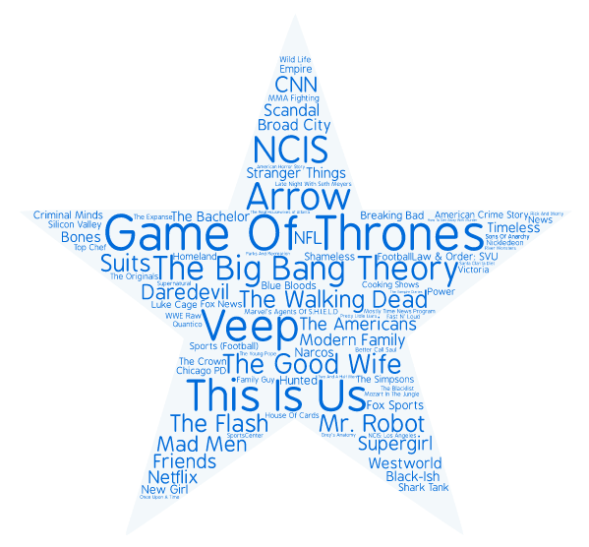
87 Different Shows Were Named By Advertising Respondents When They Were Asked Their Favorite Current TV Program
What Is Your Favorite TV Program?
Source: VAB / Research Now “Advertising Community” Custom Survey, February 2017. Q27: What is your favorite program on TV at the moment (could include broadcast, cable, pay-TV or subscription streaming)? Respondents = 189 (the balance of the 254 total respondent did not provide a specific answer).

Slide 54

We Also Vastly Overestimate The Actual Time The Average Population Spends Per Day on Snapchat
In an average day, approximately how much time do you spend, and how much time do you think the average person spends, on Snapchat?
(Snapchat)
Avg Daily Time Spent: 30 Minutes or More
Avg Daily Time Spent
(hrs:mins)
Actual
Source: VAB / Research Now “Advertising Community” Custom Survey, February 2017. Q19: In an average day, approximately how much time do you spend doing the following activities? (activities done at the same time are counted separately), Q20: In an average day, approximately how much time does an average American (age 18+) spend doing the following activities? (activities done at the same time are counted separately), Total Respondents = 254, Media Planner / Buyer Respondents = 188. Data doesn’t include those respondents who answered “don’t know.” “Average P18+ Population” data based on comScore mediametrix multiplatform, January 2017, P18+.

Slide 55

We Overestimate The Actual Time The Average Population Spends Per Day Listening To Streaming Music
In an average day, approximately how much time do you spend, and how much time do you think the average person spends, listening to streaming music?
(Streaming Music)
Avg Daily Time Spent: 30 Minutes or More
Avg Daily Time Spent
(hrs:mins)
Actual
Source: VAB / Research Now “Advertising Community” Custom Survey, February 2017. Q19: In an average day, approximately how much time do you spend doing the following activities? (activities done at the same time are counted separately), Q20: In an average day, approximately how much time does an average American (age 18+) spend doing the following activities? (activities done at the same time are counted separately), Total Respondents = 254, Media Planner / Buyer Respondents = 188. Data doesn’t include those respondents who answered “don’t know.” “Average P18+ Population” data based on comScore mediametrix multiplatform, January 2017, P18+.

Slide 56







Advertising Respondents Have Moved Beyond Mainstream & Prefer More Niche & “City Focused” Websites & Apps
Which Of The Following Websites Or Apps Have You Visited/Used In The Last Month?
Advertising Community
Media Planner/Buyer
Average P18+ Population
67%
64%
80%
43%
44%
76%
54%
54%
45%
39%
43%
34%
48%
49%
42%
15%
18%
11%
28%
28%
14%
16%
19%
3%
Source: VAB / Research Now “Advertising Community” Survey, February 2017. Q16: Which of the following websites or apps have you visited/used in the last month? Total Respondents = 254; Media Planner/Buyer Respondents = 188. “Average A18+ Population” based on comScore Media Metrix multi-platform, January 2017.

