Slide 1
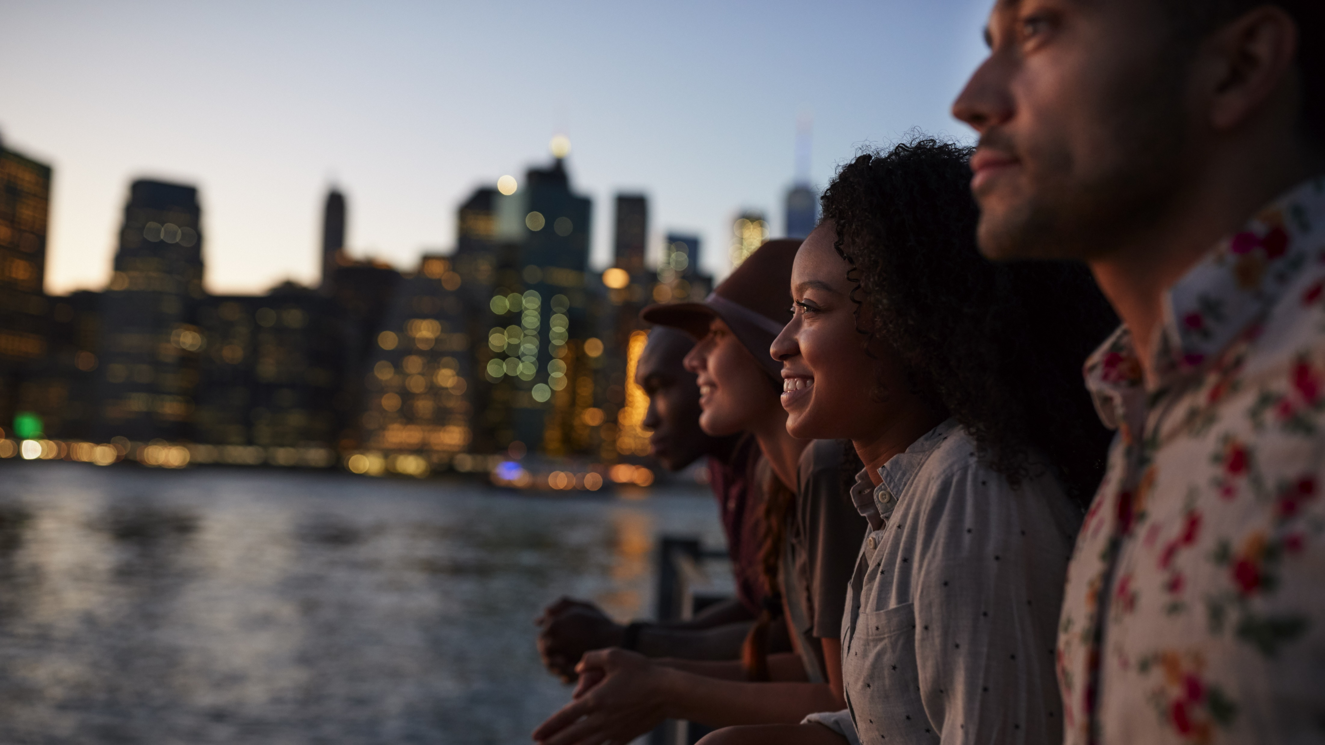


2020
Do The Right Thing
How Diversity & Inclusion Drives Brand Outcomes

Slide 2

About VAB
VAB is an insights-driven organization that inspires marketers to reimagine their media strategies resulting in fully informed decisions.
Drawing on our marketing expertise, we simplify the complexities in our industry and discover new insights that transform the way marketers look at their media strategy.
Simplify
We save you time by bringing you the latest data & actionable takeaways you can use to inform your marketing plans.
Discover
We keep you one step ahead with the latest thinking so you can create innovative, forward-looking strategies.
Transform
We help you build your brand by focusing on core marketing principles that will help drive tangible business outcomes.
This information is exclusively provided to VAB members and qualified marketers. Further distribution is prohibited.
PAGE 2

Slide 3
Contents
1
How Diversity & Inclusion Drives Brand Outcomes Across The Purchasing Funnel
4
Driving More Consumer Intent Through Increased Website Engagement
2
Increasing Awareness By Garnering
Higher Attention
5
Converting Consumer Action Into Sales
3
Fostering Greater Brand Consideration Through Increased Digital Interactions
6
Key Takeaways For Marketers

Slide 4
What You’ll Learn…
How ad campaigns with a core message of diversity and inclusion deliver stronger brand results throughout the purchasing funnel, from awareness to sales.
How you can better engage multicultural audiences by understanding the campaign themes and strategies that have proven successful.
This information is exclusively provided to VAB members and qualified marketers. Further distribution is prohibited.
PAGE 4

Slide 5
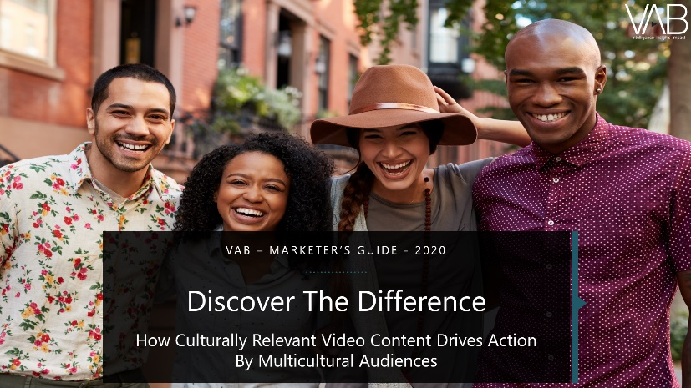
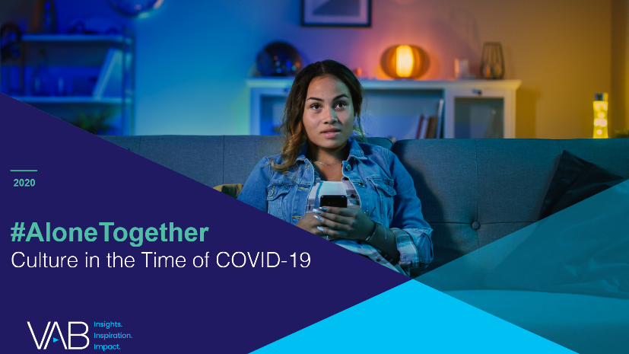
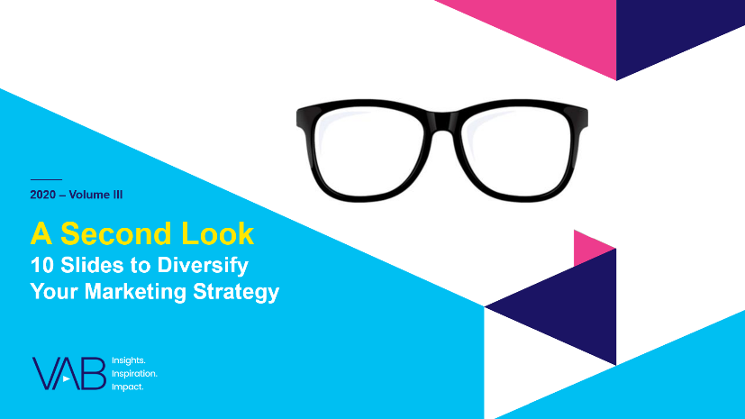
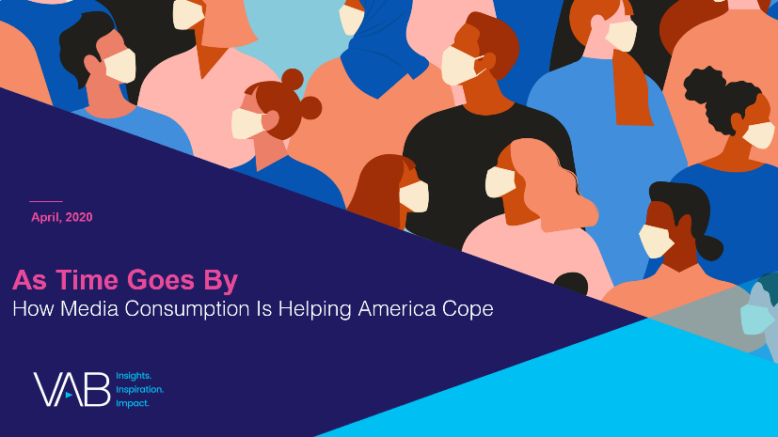
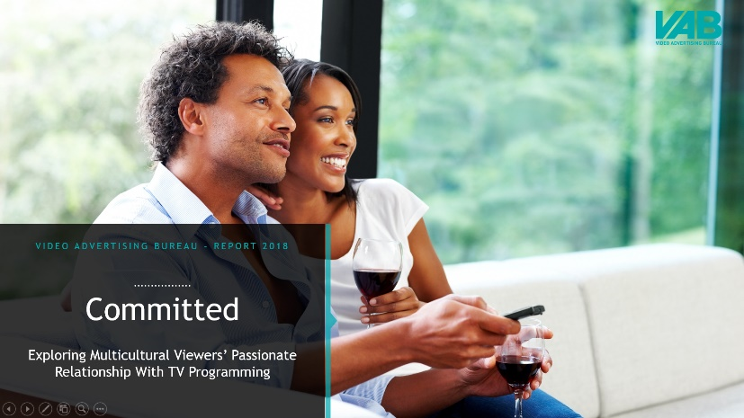
VAB is wholly committed to providing marketers with the data and insights they need to develop thoughtful, inclusive campaigns & strategies.
The guides, reports, videos and infographics featured within our
Multicultural Marketing Resource Center offer education on the unique media consumption behaviors and cultural trends of Black, Hispanic and Asian consumers and provide marketers with tangible, actionable insights.
It is in this spirit of helping marketers develop inclusive strategies
that we have developed this guide…
click cover imagery above to download report
This information is exclusively provided to VAB members and qualified marketers. Further distribution is prohibited.
PAGE 5
PAGE 1

Slide 6
In the current business environment and economic climate where every dollar counts and brand results are more scrutinized than ever, we wanted to take our multicultural analyses a step further by tying diversity and inclusion campaigns to business outcomes.
Therefore, we analyzed hundreds of campaigns and more than 3,300
TV spots from over 50 brands across a mix of categories spanning the last five years. Not only is a multicultural approach essential in a modern society, but the resulting 20+ cases studies clearly illustrate the bottom-line benefits of inclusivity. No matter what goals or KPIs you need to deliver, from awareness through to sales, there is a clear correlation between “doing the right thing” and business success.
This information is exclusively provided to VAB members and qualified marketers. Further distribution is prohibited.
PAGE 6
PAGE 1

Slide 7
Eight strategies for diversity and inclusion campaigns that resonate the most with consumers and drive greater business outcomes for brands
Showcasing Real, Authentic, Inspirational Voices
Embracing People’s Strengths & Vulnerabilities
Promoting Empowerment
Celebrating Modern Society
Supporting Their Community
Speaking Their Language… Authentically
Creating Products For Underrepresented People & Underserved Markets
Taking A Stand For Social Justice
This information is exclusively provided to VAB members and qualified marketers. Further distribution is prohibited.
PAGE 7

Slide 8

To quantify the relative success of a marketing campaign, we analyzed TV creative as a surrogate for overall business results for most of our case studies
Analyzing TV creative enabled us to:
Develop comparable metrics across categories, brands, ad executions, etc.
Compare diversity/inclusivity campaigns and non-diversity/inclusivity campaigns with the same success metrics
Establish benchmarks through the purchase funnel
Understand investment levels and campaign dates to align marketing activity with brand metrics
Note: TV creative review was based on VAB analysis of iSpot.tv TV occurrence data.
This information is exclusively provided to VAB members and qualified marketers. Further distribution is prohibited.
PAGE 8
PAGE 1

Slide 9
The brand metrics we analyzed for diversity and inclusion campaigns provide an in-depth understanding on how media activity compares to business outcomes at each stage of the purchase funnel
Brand Metrics By Funnel Stage
Awareness
  Ad Attention Score
  Brand / Industry Attention Index
  Brand Attention Ranking
Consideration
  Positive Sentiment
  Digital Engagement Impact (TV spend vs. digital interactions)
Intent
  Monthly Unique Website / App Traffic
Sales
  Total or Organic Revenues / Sales
  Unit Sales
Awareness
Consideration
Sales
Intent
Note: ‘Awareness’ and’ Consideration’ metrics data is derived from iSpot.tv TV occurrence, attention and engagement analytics; ‘Intent’ metric data is based on Comscore mediametrix multiplatform media trend analytics and ‘Sales’ metrics data is based on company filings (10-Q, 10-K) via SEC.gov (EDGAR) or company reports.
This information is exclusively provided to VAB members and qualified marketers. Further distribution is prohibited.
PAGE 9
PAGE 1

Slide 10
Below are definitions of the metrics utilized throughout this guide with
an explanation of how these metrics affect an overall marketing campaign
Several TV creative metrics, such as ad attention score, can be used as a proxy for overall consumer response to marketing campaigns
Metric | Definition | Why Is It Important To Marketers?
Ad Attention Score (iSpot.tv) | On average, how long is a TV ad viewed as a % of its duration before being interrupted? | The higher the score, the more likely a consumer is paying attention to an entire brand message which can drive greater awareness.
Brand / Industry Attention Index (iSpot.tv) | How does the attention score compare to other brand TV ads, or TV ads in the industry, during the measured time period? | Shows how much more impactful that ad is (as measured by attention paid to it) vs. other ads.
Brand Attention Ranking (iSpot.tv) | Where does a TV ad rank on attention score compared to the other brand TV ads during the measured time period. | Provides a comparison of how attentive people are towards a campaign / message vs. other campaigns for the brand.
Positive Sentiment (iSpot.tv) | % of people who react positively to an ad based on votes registered through iSpot.tv’s public commercial site and YouTube. | People that like an ad and, more importantly, like the messaging of an ad are more likely to consider a brand for purchase.
Digital Engagement Impact (iSpot.tv) | Comparison of an ad’s TV spend share of voice for a brand vs. the share of total brand digital interactions the ad garners (search, social, earned online video views) during a measured time period. | Demonstrates that ad’s ability to deliver outsized impact and engagement relative to the spend.
Monthly Unique Website / App Visitors (Comscore) | The number of individuals visiting a brands’ website and/or app in a specific month or averaged over multiple months, also can be expressed as a % increase when analyzing two time periods. | Indicates how many consumers are ‘coming to the brand’s front door’ – learning more, looking at products, making purchases.
Revenues / Unit Sales (SEC filings / company reports) | Our analysis to quantify sales is dependent on publicly available company data including units sold, total sales and organic sales which excludes currency fluctuations, acquisitions and divestitures. | The bottom of the funnel and the ultimate customer action taken.
This information is exclusively provided to VAB members and qualified marketers. Further distribution is prohibited.
PAGE 10

Slide 11

Increasing Awareness By Garnering Higher Attention

Slide 12

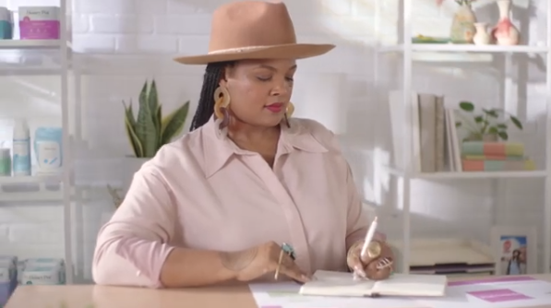
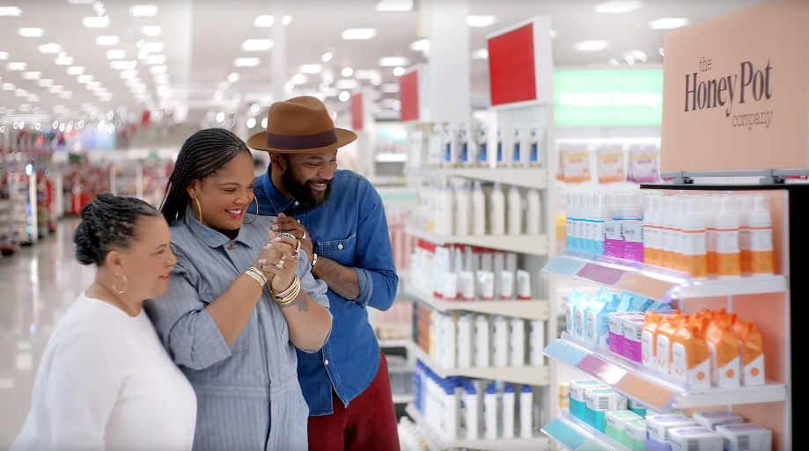
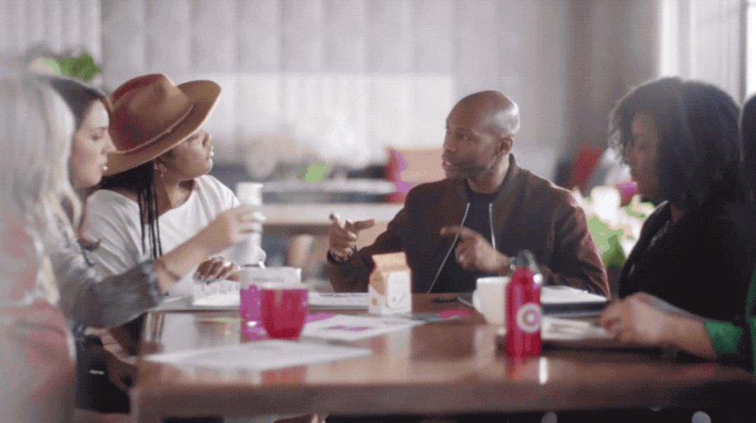
Target: ‘Entrepreneur’ campaign featuring positive messaging and support of minority female-owned businesses ranked #8 in attentiveness out of 296 ads
For Black History Month in 2020, Target released an ad entitled ‘Entrepreneur: The Honey Pot’ as part of their ‘Founders We Believe In’ series. The spot featured Beatrice Dixon, owner of The Honey Pot, who talked about how difficult it was for her to start her own company, while expressing gratitude to Target for helping her overcome obstacles and paving the way for her to get shelf space in other retailers.
Results: One of the highest attention scores of all Target ads, Honey Pot sales increased 20-30% across its retailers a month after the campaign launched.
Business Outcomes
Ad Attention Score: 96.8
On average, the ad was viewed for 97% of its duration before interruption.
Brand Attention Index: 170
70% fewer interruptions than the average Target ad during the measured time period.
Brand Attention Ranking: #8
Ad ranked #8 in viewer attention among 296 Target ads that aired between 1/1/16 – 6/30/20.
‘Entrepreneur: The Honey Pot’ TV spot - $15.3 MM
6-Week Flight: 2/1/20 – 3/16/20
4,473 Airings / 1,244.8 MM HH IMPs
click banner above images to watch spot
Source: VAB analysis of iSpot.tv TV occurrence data and attention analytics, time period: 1/1/16 – 6/30/20, estimated media spend. Impressions represent US TV HHs and include activity within measured national broadcast and cable TV linear, national time-shifted, local, VOD and OTT. Attention scoring is based on national aired impressions viewed live/same day and played from the beginning. Interruptions = changing the channel, skipping the ad (via DVR), turning off the TV device or pulling up the programming guide.
This information is exclusively provided to VAB members and qualified marketers. Further distribution is prohibited.
PAGE 12

Slide 13

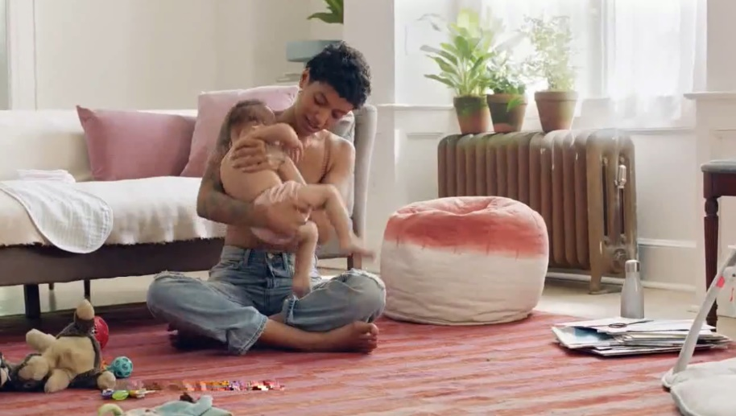

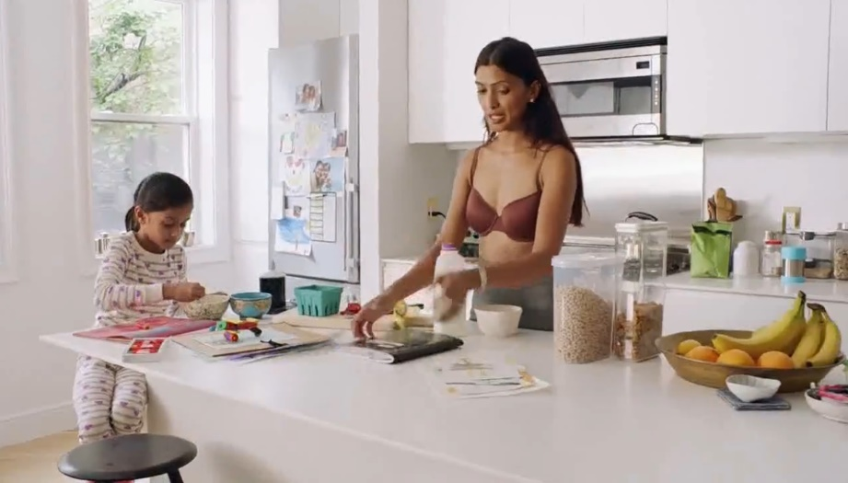
ThirdLove: Their national ad campaign launch which embraced modern femininity and inclusion was one
of the most attentive ads within the industry
In September 2018, ThirdLove launched their first national brand campaign entitled ‘To Each, Her Own.’ Directed and shot by women, the campaign embodied ThirdLove’s greater mission to embrace modern femininity with women of all ages, ethnicities, and sizes, in various walks of life, through different moments of time that are universally understood, yet vastly underrepresented.
Results: The campaign highly over indexed the average ad attention from other brands within the category and has garnered
the second highest attention score of all ThirdLove ads.
Business Outcomes
Ad Attention Score: 96.2
On average, the ad was viewed for 96% of its duration before interruption.
Industry Attention Index: 142
42% fewer interruptions than the average ad within the category during the measured time period.
(Brand Attention Index =115).
Brand Attention Ranking: #2
Ad ranked #2 in viewer attention among 12 ThirdLove ads that aired between 1/1/17 – 6/30/20.
‘To Each, Her Own’ TV spot - $9.4 MM
Airings Throughout 18 Months: 9/10/18 – 3/16/20
17,914 Airings / 1,106.9 MM HH IMPs
click banner above images to watch spot
Source: VAB analysis of iSpot.tv TV occurrence data and attention analytics, time period: 1/1/17 – 6/30/20, estimated media spend. Impressions represent US TV HHs and include activity within measured national broadcast and cable TV linear, national time-shifted, local, VOD and OTT. Attention scoring is based on national aired impressions viewed live/same day and played from the beginning. Interruptions = changing the channel, skipping the ad (via DVR), turning off the TV device or pulling up the programming guide.
This information is exclusively provided to VAB members and qualified marketers. Further distribution is prohibited.
PAGE 13

Slide 14

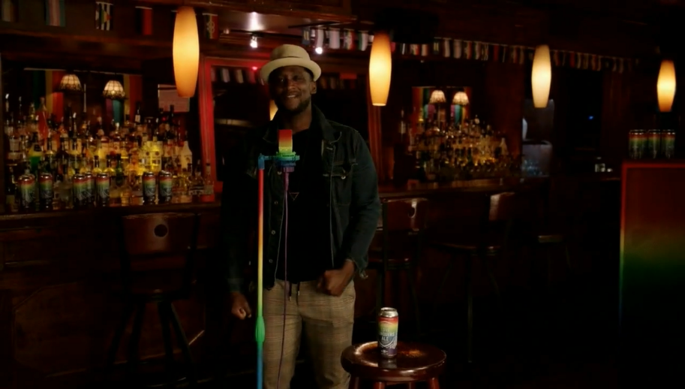
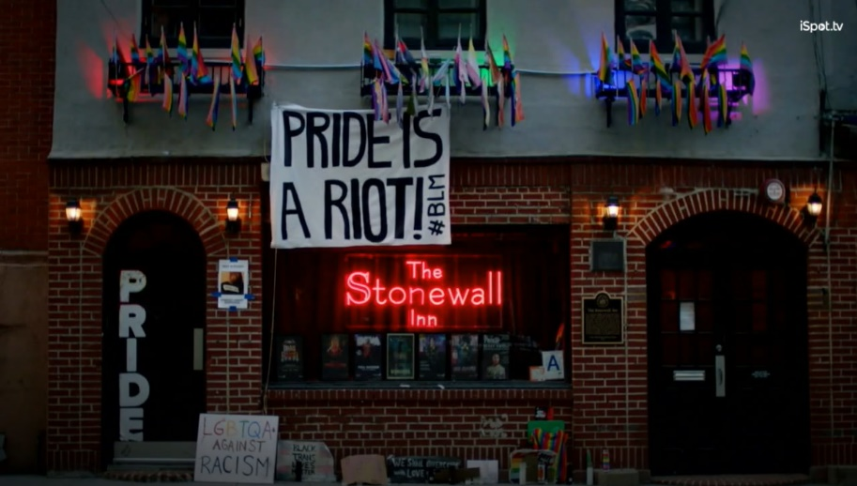
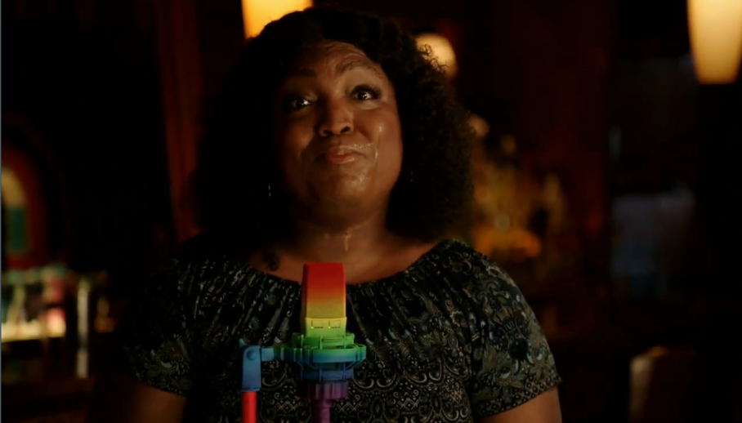
Samuel Adams: Celebrating Pride month with authentic voices from the LGBTQ+ community, the ‘Love Conquers All’ campaign ranked #2 in attentiveness among 35 ads
In June 2020, Sam Adams released the ‘Let There Be Pride’ ad as part of their ‘Love Conquers All’ campaign in partnership with GLAAD. Aligning with their mission to raise up the voices of the LGBTQ+ community, ‘Let There Be Pride’ was written by poet and advocate Richard Blanco and performed at Stonewall Inn, the birthplace of the modern gay rights movement.
Results: ‘Let There Be Pride’ garnered one of the highest attention scores of all Samuel Adams ads during our measurement time period and had the highest attention score among other Samuel Adams ads with similarly short flights and impressions delivery.
Business Outcomes
Ad Attention Score: 97.0
On average, the ad was viewed for 97% of its duration before interruption.
Brand Attention Index: 157
57% fewer interruptions than the average Sam Adams ad during the measured time period.
Brand Attention Ranking: #2
Ad ranked #2 in viewer attention among 35 Samuel Adams ads that aired between 1/1/16 – 6/30/20.
‘Let There Be Pride’ TV spot - $706K
2-Week Flight: 6/16/20 – 6/29/20
258 Airings / 40.7 MM HH IMPs
click banner above images to watch spot
Source: VAB analysis of iSpot.tv TV occurrence data and attention analytics, time period: 1/1/16 – 6/30/20, estimated media spend. Impressions represent US TV HHs and include activity within measured national broadcast and cable TV linear, national time-shifted, local, VOD and OTT. Attention scoring is based on national aired impressions viewed live/same day and played from the beginning. Interruptions = changing the channel, skipping the ad (via DVR), turning off the TV device or pulling up the programming guide. ‘Similar’ Samuel Adams ads reflect those that were active for less than one month and had less than $1MM spend.
This information is exclusively provided to VAB members and qualified marketers. Further distribution is prohibited.
PAGE 14

Slide 15

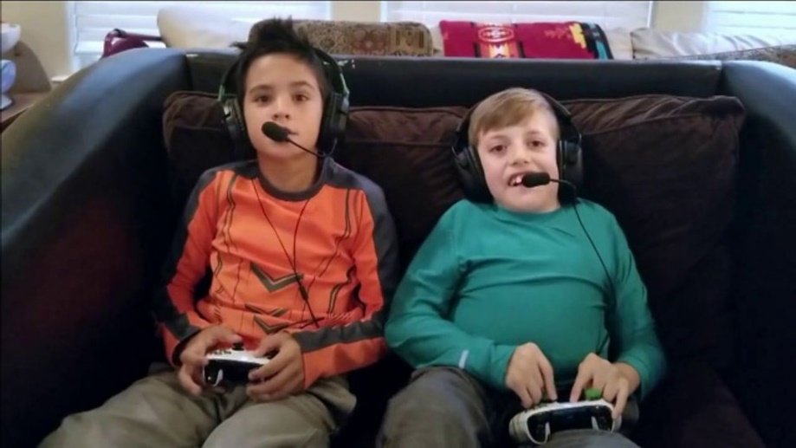
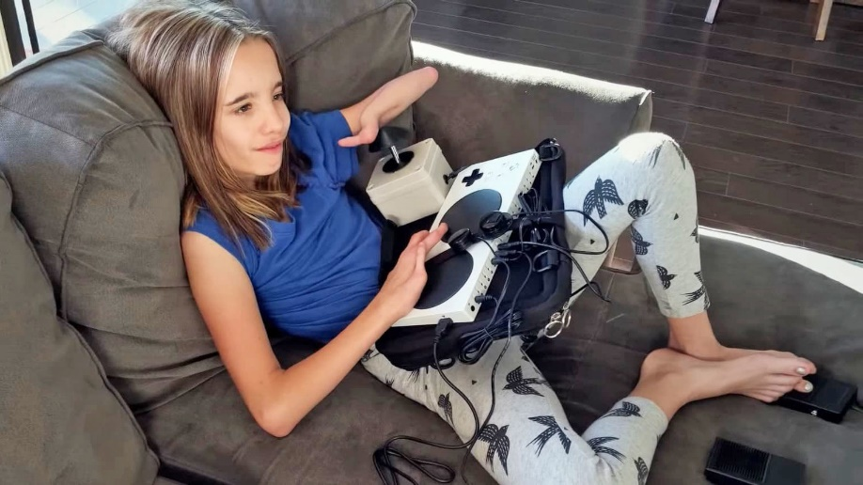
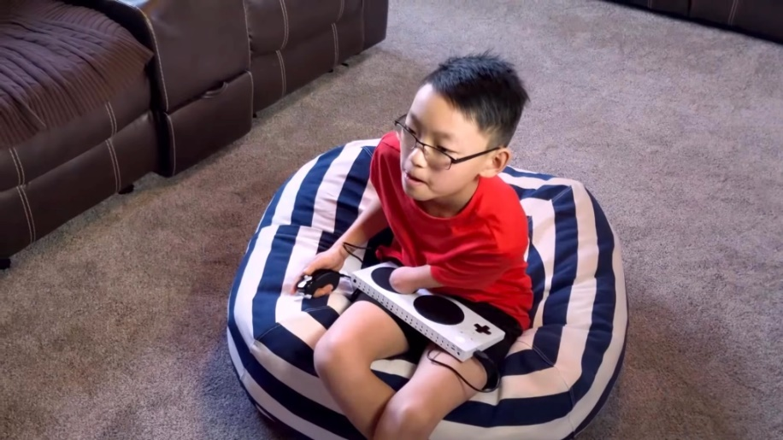
Xbox: The Super Bowl provided a platform for the brand’s most attentive ad ever which focused on making gaming an inclusive experience for kids with disabilities
In February 2019, Microsoft aired a one-minute ad during the Super Bowl showcasing their latest Xbox Adaptive Controller. Entitled ‘We Will Win,’ the spot featured a handful of children with physical disabilities who talked about their love of video games and how these games allow them to bond with their friends. The message was one of inclusion and empowerment for young people with disabilities and the ad ended with the inspirational line, ‘when everybody plays, we all win.’
Results: Microsoft invested over $10 million to air this one-minute spot once during the Super Bowl and with such a captive, and large, audience its no surprise this garnered the highest viewer attention for an Xbox ad during our measurement period.
Business Outcomes
Ad Attention Score: 98.8
On average, the ad was viewed for 99% of its duration before interruption.
Brand Attention Index: 188
88% fewer interruptions than the average Xbox ad during the measured time period.
Attention Ranking: #1
Ad ranked #1 in viewer attention among 116 Xbox ads that aired between 1/1/16 – 6/30/20.
‘We All Win’ TV spot - $10.4 MM
1 Airing (Super Bowl LIII): 2/3/19
95.5 MM HH IMPs
click banner above images to watch spot
Source: VAB analysis of iSpot.tv TV occurrence data and attention analytics, time period: 1/1/16 – 6/30/20, estimated media spend. Impressions represent US TV HHs and include activity within measured national broadcast and cable TV linear, national time-shifted, local, VOD and OTT. Attention scoring is based on national aired impressions viewed live/same day and played from the beginning. Interruptions = changing the channel, skipping the ad (via DVR), turning off the TV device or pulling up the programming guide.
This information is exclusively provided to VAB members and qualified marketers. Further distribution is prohibited.
PAGE 15

Slide 16





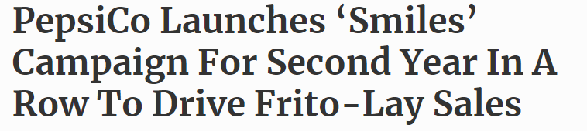
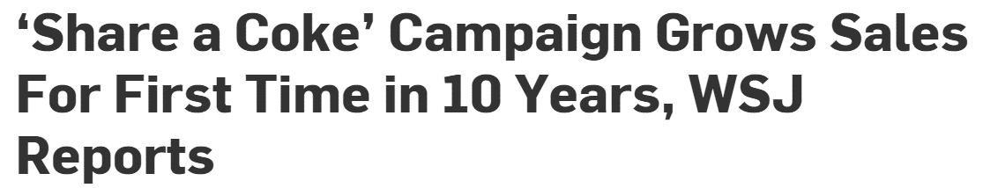
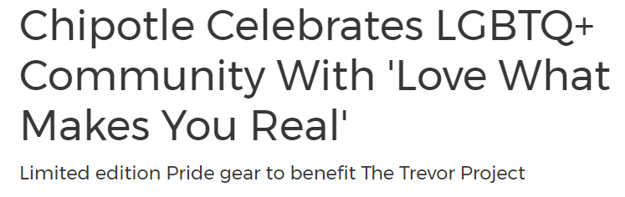
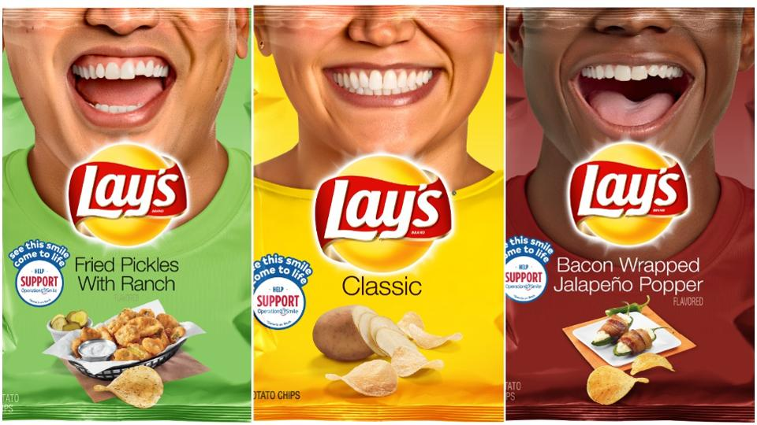
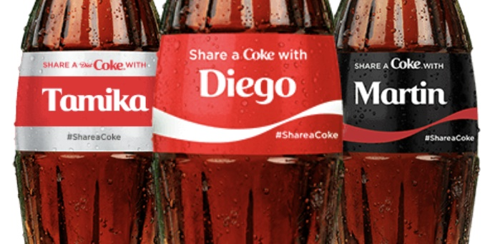
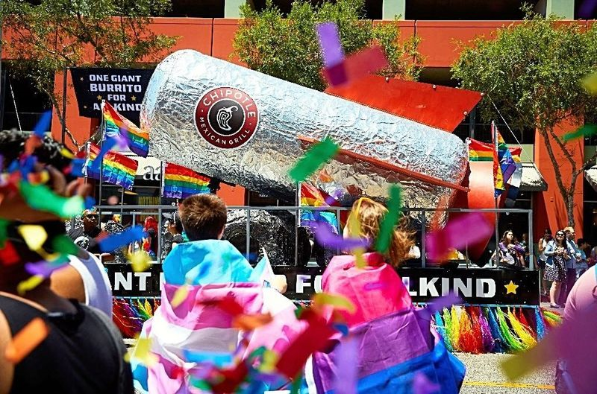
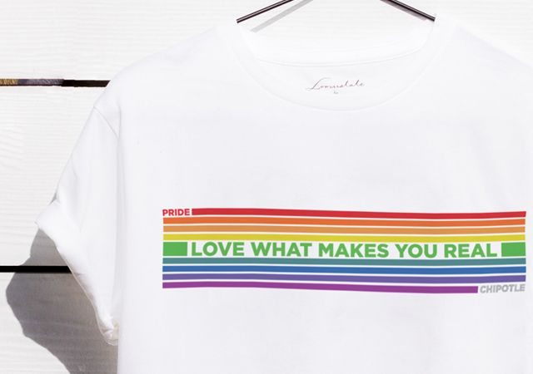
Lay’s, Coca-Cola, Chipotle: Increased attention through innovative product packaging and merchandising that promote diversity and inclusion
+107%*
Lay’s featured 31 ‘everyday smilers’ and their inspiring stories on the packaging of 60+ varieties of potato chips to benefit international medical charity, Operation Smile (plus a $1 million donation)
Coca-Cola launched the ‘Share a Coke’ campaign in 2013 where labels on plastic bottles of Coke say ‘Share a Coke with…’ and includes diverse names from around the world. Highly ‘shareable,’ people would post bottle images on social media when they saw their own names on one.
In 2019, Chipotle celebrated the LGBTQ+ community with limited edition pride gear benefiting The Trevor Project, a suicide prevention and crisis intervention organization. Additionally, the brand participated in parades and hosted fundraisers supporting nonprofits.
*107% increase in average monthly Lays.com website visitors between Jul’19 – Aug’19 vs. June ’19;
VAB analysis of Comscore mediametrix multiplatform media trend data, total audience (desktop P2+; mobile P18+).
This information is exclusively provided to VAB members and qualified marketers. Further distribution is prohibited.
PAGE 16

Slide 17

Major Takeaways: Increasing Awareness By Garnering Higher Attention
Inclusive campaigns break through the advertising clutter, which in turn drives stronger awareness and exposure for brands
Diversity & inclusion campaigns drive outsized attention relative to their investment and they have the ability to generate awareness regardless of spend level or duration
  Quantifiable impacts can be made with campaigns below $1MM and flights that are tied into specific events and societal moments
  Additionally, savvy marketers invest heavily in these initiatives, with some campaigns spanning multiple years
This information is exclusively provided to VAB members and qualified marketers. Further distribution is prohibited.
PAGE 17

Slide 18
Fostering Greater Brand Consideration Through Increased Digital Interactions

Slide 19
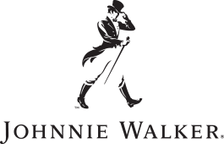


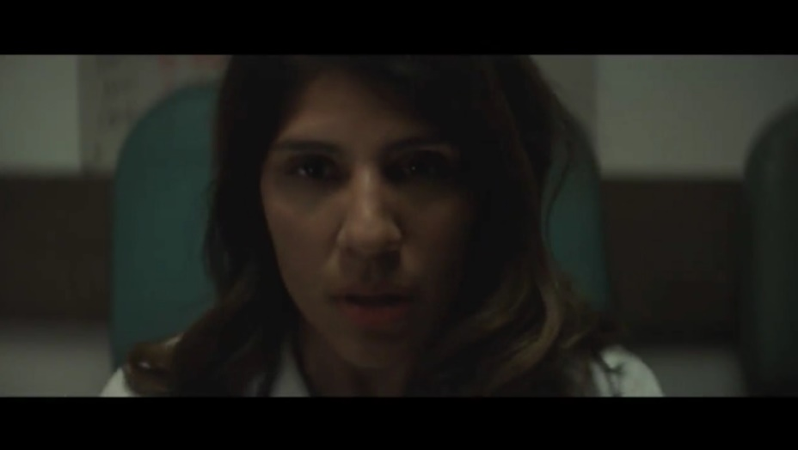
Johnnie Walker: The ‘Keep America Walking’ campaign focused on inclusion drove two-thirds of the brand’s total digital interactions over the last five years
On election day in 2016, Johnnie Walker released an ad entitled ‘This Land’ as part of their ‘Keep America Walking’ campaign. The spot quotes Woody Guthrie’s song ‘This Land is Your Land,’ in both English and Spanish, to spread a message of unity and inclusion. The ad offers distinct visualizations and provides an authentic representation of America’s rich cultural diversity.
Results: Viewer sentiment was overwhelmingly positive for the ad, especially considering the divisiveness of the times during the 2016 Presidential election, which helped spur high digital interactions (mainly social mentions and online video views) relative to brand spend.
Business Outcomes
Positive Sentiment: 90%
Average positive sentiment for all other Johnnie Walker ads: 80%
Digital Engagement Impact:
Although only 16% of TV spend, it resulted in 65% of total earned online activity
‘This Land’ TV spot - $5.7 MM
Airings Throughout 18 Weeks: 11/8/16 – 3/14/17
446 Airings / 222.0 MM HH IMPs
click banner above images to watch spot
Source: VAB analysis of iSpot.tv TV occurrence data and engagement analytics, time period: 1/1/16 – 6/30/20, estimated media spend. Impressions represent US TV HHs and include activity within measured national broadcast and cable TV linear, national time-shifted, local, VOD and OTT. ‘Digital Engagement Impact’ figures are based on all measured TV activity between 1/1/16 – 6/30/20. ‘Total Earned Online Activity’ = TV-driven searches, TV-driven social actions, TV-driven earned online video views.
This information is exclusively provided to VAB members and qualified marketers. Further distribution is prohibited.
PAGE 19

Slide 20

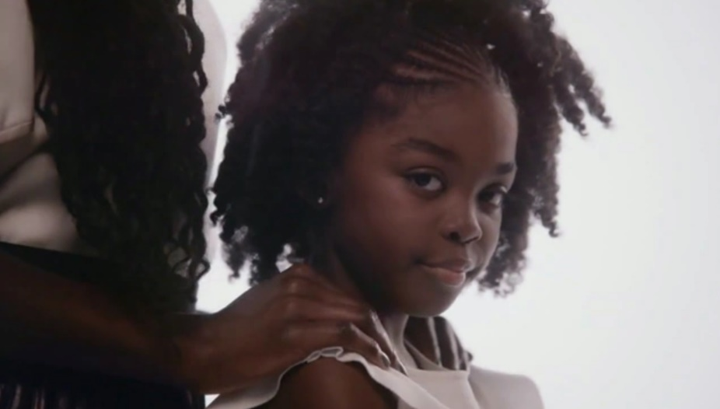
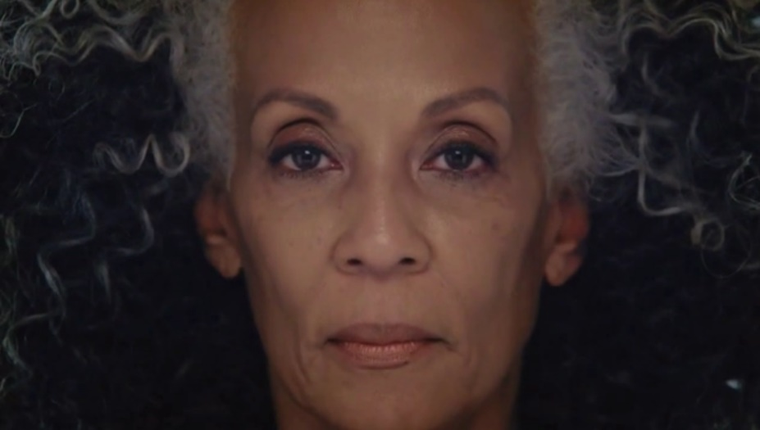
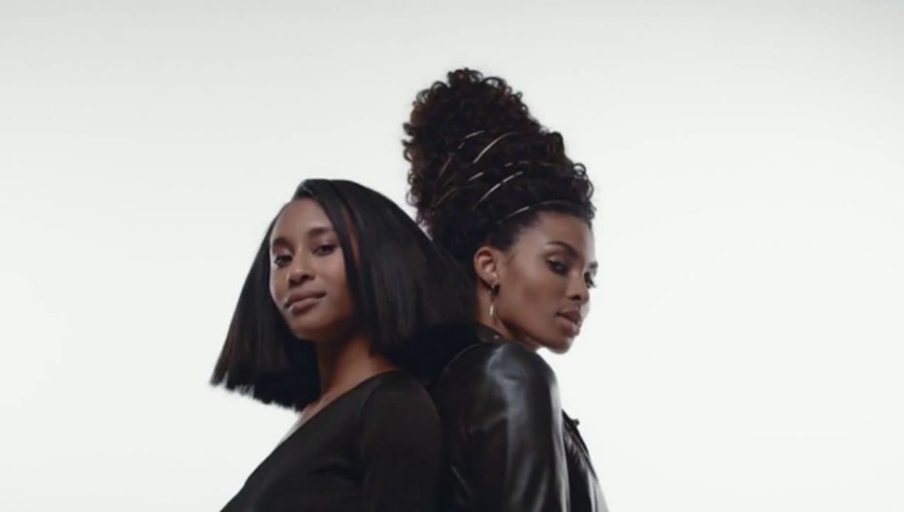
Pantene: Although much smaller in spend, their ad
celebrating strong, black women was very positively
received and drove over one-quarter of their digital interactions
In March 2017, Pantene released the ‘Celebrating Strong, Beautiful African American Hair’ ad as part of their ‘Strong is Beautiful’ campaign in order to celebrate the beauty and diversity of different hair textures and styles from Black women. The spot introduced their Gold Series, a collection of hair products formulated to address the specific needs of Black women.
Results: The campaign drove more digital interactions than any of the other 29 ads aired during the measurement period, including ones that had between 3x - 10x more TV investment support.
Business Outcomes
Positive Sentiment: 97%
Average positive sentiment for all other Pantene ads: 87%
Digital Engagement Impact:
Although only 3% of TV spend, it resulted in 26% of total earned online activity
‘Celebrating Strong, Beautiful African American Hair’ TV spot - $3.8 MM
Airings Throughout 21 Months: 3/22/17 – 12/30/18
1,240 Airings / 165.1 MM HH IMPs
click banner above images to watch spot
Source: VAB analysis of iSpot.tv TV occurrence data and engagement analytics, time period: 1/1/17 – 6/30/20, estimated media spend. Impressions represent US TV HHs and include activity within measured national broadcast and cable TV linear, national time-shifted, local, VOD and OTT. ‘Digital Engagement Impact’ figures are based on all measured TV activity between 1/1/17 – 6/30/20. ‘Total Earned Online Activity’ = TV-driven searches, TV-driven social actions, TV-driven earned online video views.
This information is exclusively provided to VAB members and qualified marketers. Further distribution is prohibited.
PAGE 20

Slide 21

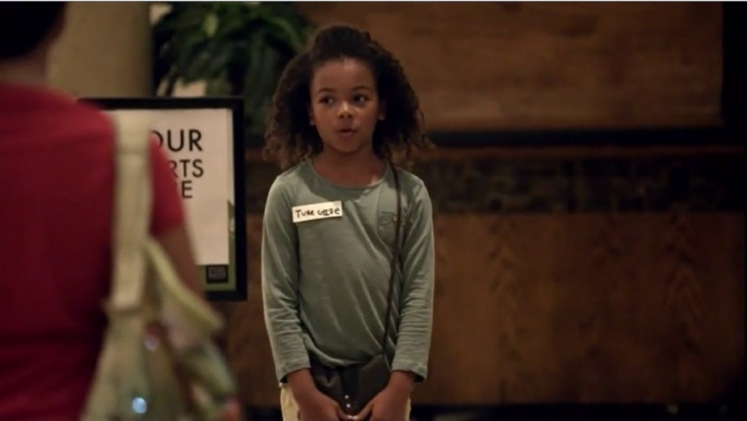

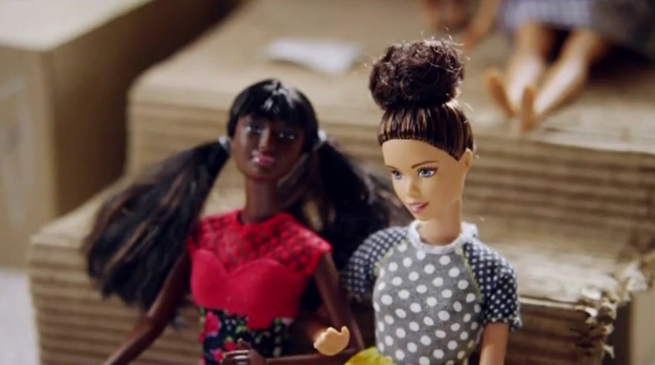
Barbie: ‘Imagine the Possibilities’ female empowerment and inclusion ad drove more than three-quarters of the brand’s total digital interactions since 2015
In fourth quarter 2015, Barbie released the ‘Imagine The Possibilities’ ad as part of their ‘You Can Be Anything’ campaign to promote female empowerment. The spot showed five diverse girls playing out what they want to be when they grow up – choosing a vet, a museum guide, a businesswoman, a college professor and a soccer coach – and was filmed unscripted in front of unsuspecting adults.
Results: The ad garnered almost universal positivity and spurred tremendous digital interactions (social, search and video views) for the brand, much more so than any of the other 71 ads they aired during the measurement period.
Business Outcomes
Positive Sentiment: 97%
Average positive sentiment for all other Barbie ads: 89%
Digital Engagement Impact:
Although only 8% of TV spend, it resulted in 78% of total earned online activity
‘Imagine The Possibilities’ TV spot - $12.0 MM
Airings Throughout 4 Years: 11/26/15 – 12/17/19
155 Airings / 396.6 MM HH IMPs
click banner above images to watch spot
Source: VAB analysis of iSpot.tv TV occurrence data and engagement analytics, time period: 7/1/15 – 6/30/20, estimated media spend. Impressions represent US TV HHs and include activity within measured national broadcast and cable TV linear, national time-shifted, local, VOD and OTT. ‘Digital Engagement Impact’ figures are based on all measured TV activity between 7/1/15 – 6/30/20. ‘Total Earned Online Activity’ = TV-driven searches, TV-driven social actions, TV-driven earned online video views.
This information is exclusively provided to VAB members and qualified marketers. Further distribution is prohibited.
PAGE 21

Slide 22

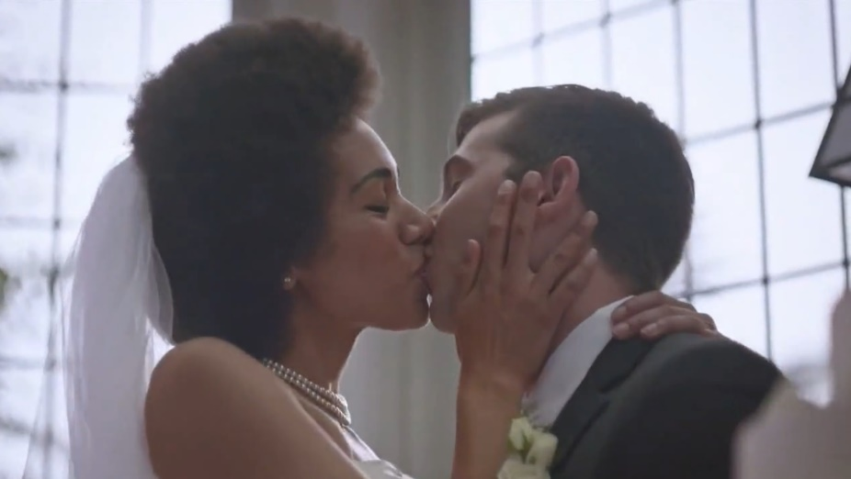

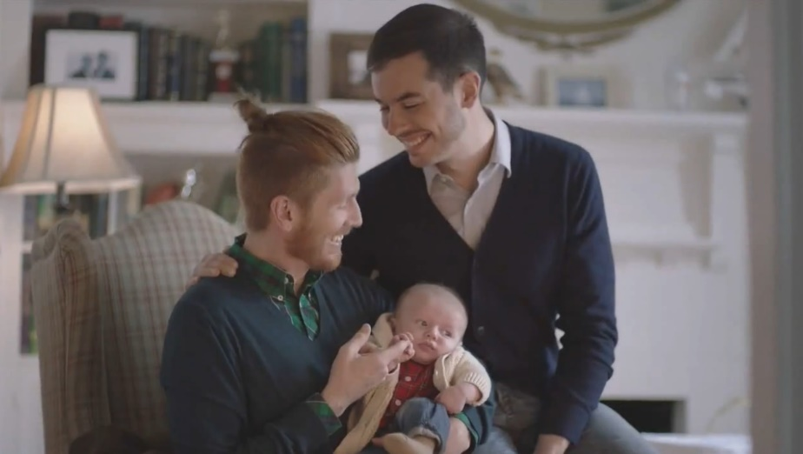
Tylenol: In 2015, the brand launched their ‘#HowWeFamily’ campaign featuring same-sex and interracial couples which has driven more than half of their total digital interactions since
Tylenol launched the first ad of their ‘#HowWeFamily’ campaign eleven days before the U.S. Supreme Court legalized same-sex marriage in all fifty states. The ad celebrates diverse family units by featuring same-sex and interracial couples and was part of a broader effort by the brand to challenge conventional definitions of family.
Results: The ad prompted very high digital interactions (mainly social and online video views) in relation to any of their other ads and, although positive sentiment was on par with their average ad, the percentage would surely be higher if aired today vs. 2015
Business Outcomes
Positive Sentiment: 74%
Average positive sentiment for all other Tylenol ads: 76%
Digital Engagement Impact:
Although only 2% of TV spend, it resulted in 61% of total earned online activity
‘How We Family’ TV spot - $3.1 MM
6-Week Flight: 6/15/15 – 7/27/15
601 Airings / 358.8 MM HH IMPs
click banner above images to watch spot
Source: VAB analysis of iSpot.tv TV occurrence data and engagement analytics, time period: 5/1/15 – 6/30/20, estimated media spend. Impressions represent US TV HHs and include activity within measured national broadcast and cable TV linear, national time-shifted, local, VOD and OTT. ‘Digital Engagement Impact’ figures are based on all measured TV activity between 5/1/15 – 6/30/20. ‘Total Earned Online Activity’ = TV-driven searches, TV-driven social actions, TV-driven earned online video views.
This information is exclusively provided to VAB members and qualified marketers. Further distribution is prohibited.
PAGE 22

Slide 23
Major Takeaways: Fostering Greater Brand Consideration Through Increased Digital Interactions
When marketers embrace topics that sharply resonate with consumers it yields significant dividends in terms of engagement like stirring social conversation, increasing online video views and improving search queries
Over time we’ve seen positive sentiment rates increase, indicating that beyond just being accepted, campaigns that celebrate inclusivity have come to be expected by consumers
This information is exclusively provided to VAB members and qualified marketers. Further distribution is prohibited.
PAGE 23

Slide 24
Driving More Consumer Intent Through Increased Website Engagement

Slide 25

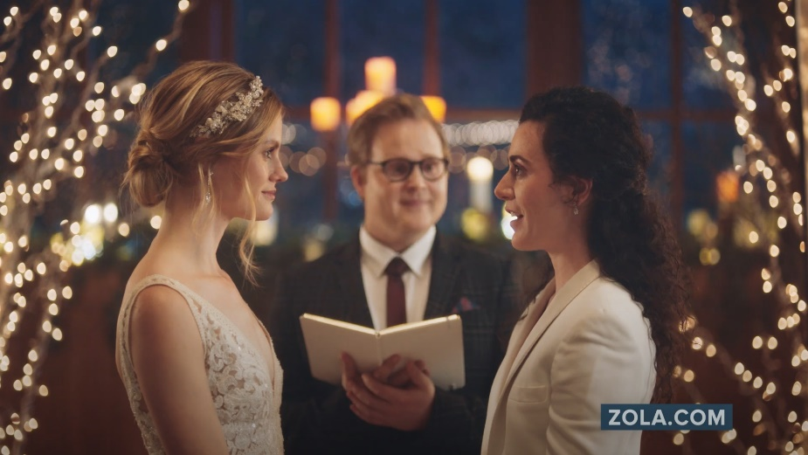
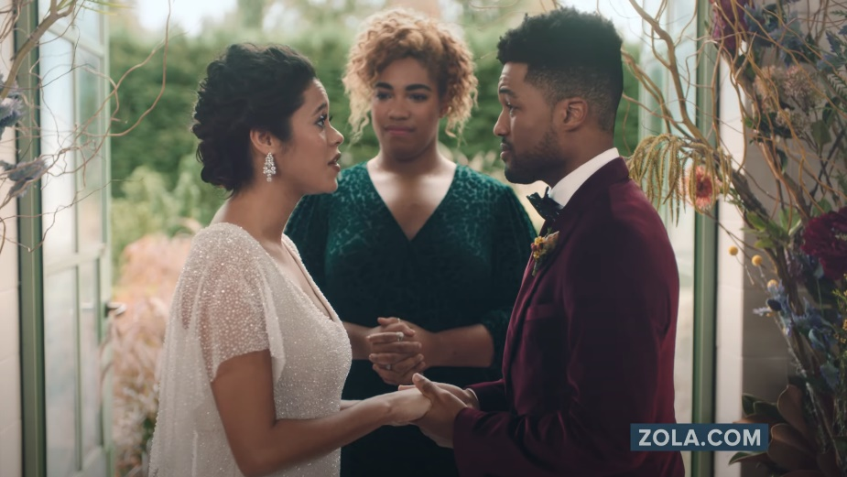
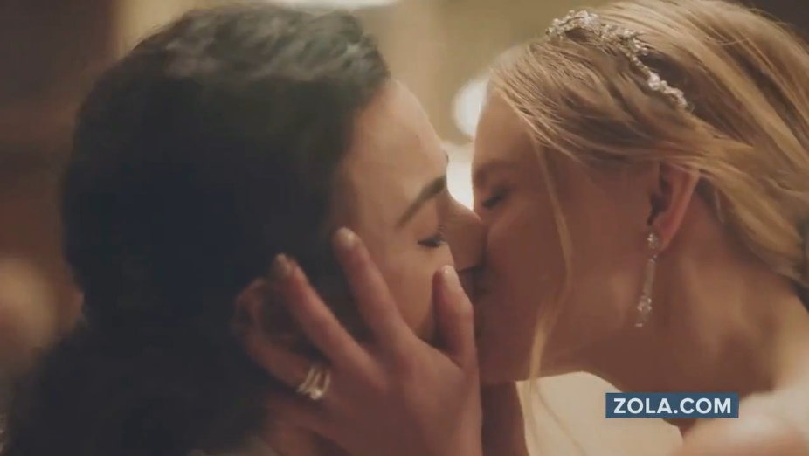
Zola: The launch of their diversity and LGBTQ+ inclusion campaign led to the brand’s most trafficked month ever
on their website
In December 2019, Zola debuted their ‘No Regrets’ campaign which included six different spots focused specifically on diversity and LGBTQ+ inclusion. The ads show three couples who all appear to be reciting their vows but instead are stating regrets from their wedding planning, which highlights just how much people have lost touch with what matters – the couple.
Results: Zola saw their highest total monthly unique website traffic ever in January 2020, two months into the campaign launch, with 345K more digital visitors than their second highest trafficked month (January 2019). Zola was continuing their upward momentum through first quarter 2020 until COVID-19 hit.
Business Outcomes
Persons 18+ Website Traffic: +15% increase
in Zola’s two-month average unique P18+ website visitors towards the end of the campaign between Feb-Mar ‘20 (YoY comparison).
Black 18+ Website Traffic: +70% increase
in Zola’s two-month average unique Black 18+ website visitors during the same time frame period comparison
as above for P18+.
‘No Regrets’ TV spot (six creatives) - $2.7 MM
16-Week Campaign: 12/2/19 – 3/24/20
3,852 Airings / 698.1 MM HH IMPs
click image above to watch spot
click image above to watch spot
click image above to watch spot
Source: VAB analysis of iSpot.tv TV occurrence data, time period: 1/1/19 – 6/30/20, estimated media spend. Impressions represent US TV HHs and include activity within measured national broadcast and cable TV linear, national time-shifted, local, VOD and OTT. VAB analysis of Comscore mediametrix multiplatform media trend data (desktop and mobile), P18+, Black 18+, January ‘19 – March ‘20. Comparisons reflect January ‘20 vs. January ‘19 and February-March ‘20 vs. February-March ‘19.
This information is exclusively provided to VAB members and qualified marketers. Further distribution is prohibited.
PAGE 25

Slide 26

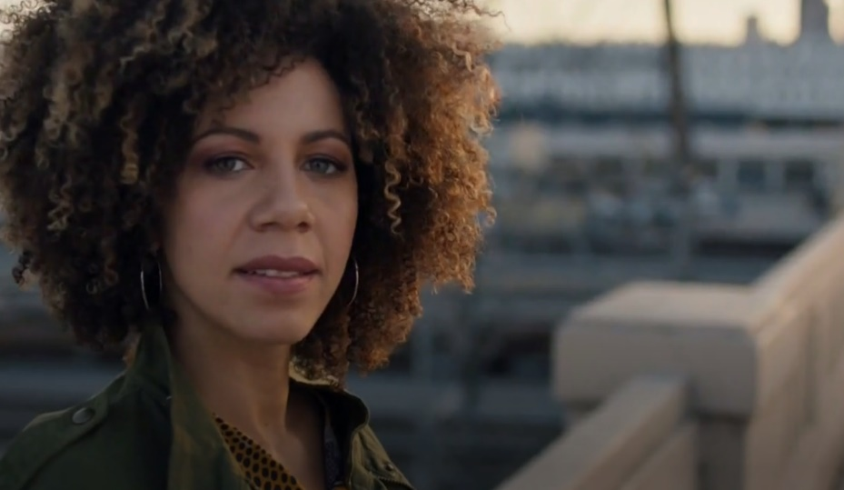
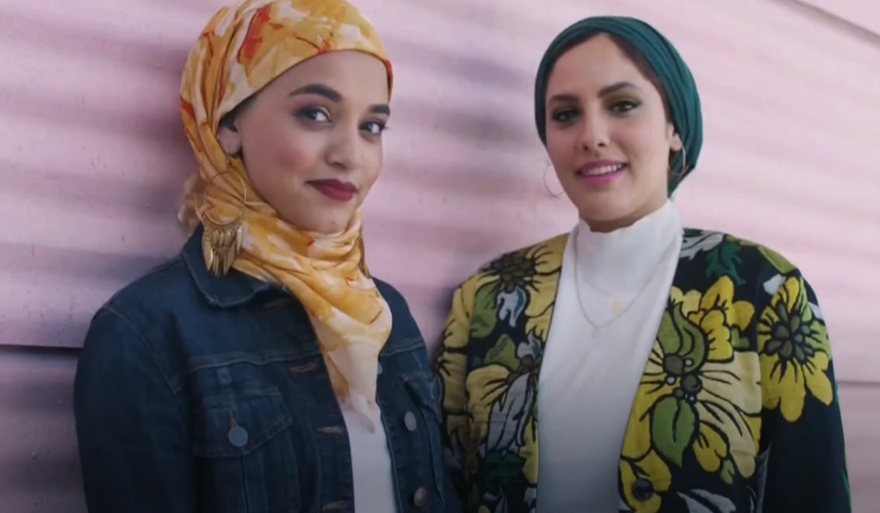
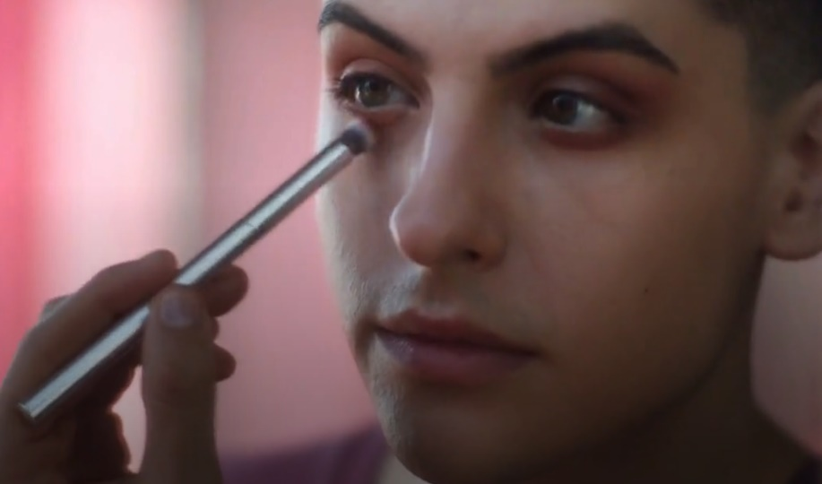
Ulta Beauty: An ad campaign on the beauty of possibility and inclusivity drove over a one-quarter increase of adult women to the brand’s website
In September 2018, Ulta Beauty launched their ‘The Possibilities are Beautiful’ campaign with a positive message of inclusiveness through both an English-language and Spanish-language spot. The ads featured people from a spectrum of age groups, ethnicities, body types and gender identities, illustrating the brand’s belief that nothing is more beautiful than possibility
Results: Ulta Beauty maintained strong, steady growth in their monthly female website visitors through the duration of their inclusivity campaign with average visitation up over one-quarter vs. the 18-month average before the campaign launch (during which time other campaigns were periodically active, totaling 80% of TV spend as ‘The Possibilities are Beautiful‘).
‘The Possibilities are Beautiful’ TV spot (two creatives) - $47.5 MM
20-Month Campaign: 9/2/18 – 4/5/20
14,814 Airings / 3,670.0 MM HH IMPs
Business Outcomes
Women 18+ Website Traffic: +28% increase
in Ulta Beauty’s average monthly unique W18+ website visitors during the first 18 months of the campaign vs. the
18-month pre-campaign average (Mar ’17–Aug ’18).
Black Women 18+ Website Traffic: +21% increase
during the same 18-month time period as above for Women 18+.
click either image above to watch English-language spot
click image above to watch Spanish-language spot
Source: VAB analysis of iSpot.tv TV occurrence data, time period: 1/1/17 – 2/29/20, estimated media spend. Impressions represent US TV HHs and include activity within measured national broadcast and cable TV linear, national time-shifted, local, VOD and OTT. VAB analysis of Comscore mediametrix multiplatform media trend data (desktop and mobile), Women 18+, Black Women 18+. Comparisons reflect March ‘17 – August ‘18 (18 months) vs. September ‘18 – February ’20 (18 months).
This information is exclusively provided to VAB members and qualified marketers. Further distribution is prohibited.
PAGE 26

Slide 27

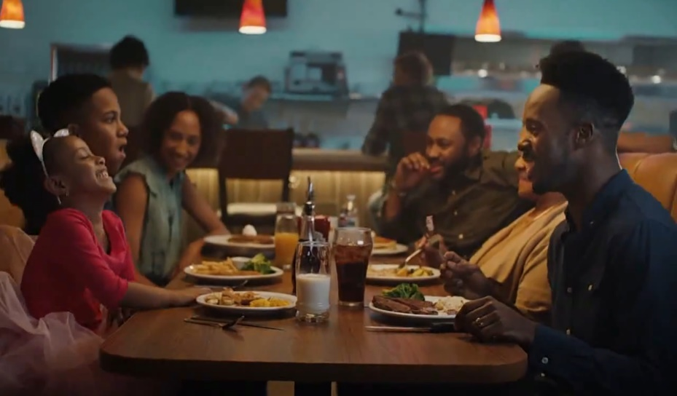
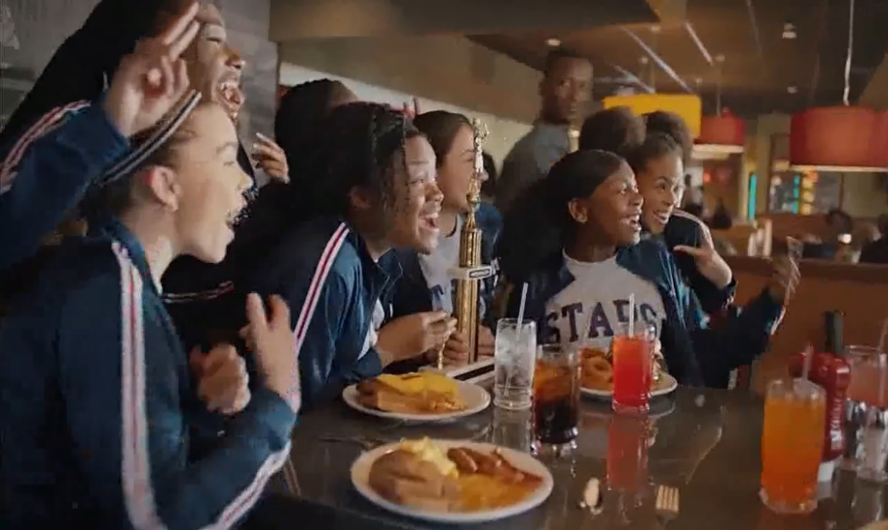
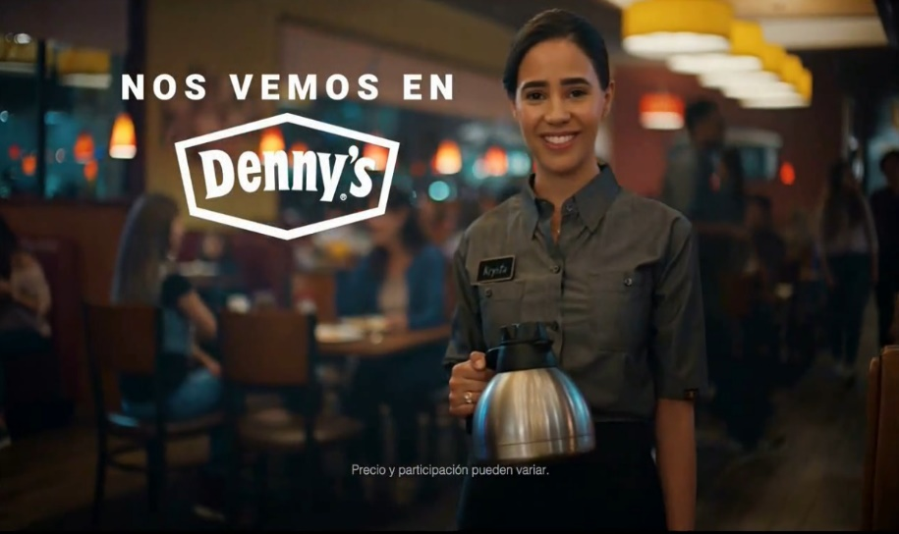
Denny’s: The ‘See You At Denny’s’ diversity and inclusivity campaign drove a triple-digit increase in website traffic among Black / African-American audiences
In late April 2019, Denny’s launched their ‘See You At Denny’s’ campaign with a message of inclusiveness in both English and Spanish language spots. The ads, which were produced in collaboration with Fluent360, Conill and EP+Co agencies, were inspired by the diversity of Denny’s guests and captures the inclusive gatherings of modern, multicultural families and friends.
Results: There was an immediate surge in Denny’s website visitation upon launch, especially by Black / African-Americans, which continued through the duration of the campaign. Average monthly unique Black 18+ visitors post-campaign (Sep ’19 - May ’20) continues to be +50% higher than the three-month average pre-campaign (+65% higher for total P18+).
Business Outcomes
Persons 18+ Website Traffic: +86% increase
in Denny’s average monthly unique P18+ website visitors during August ‘19 (final month of campaign) vs. March ‘19 (pre-campaign), with unique visitors building through the flight.
Black 18+ Website Traffic: +135% increase
in Denny’s average monthly unique Black 18+ website visitors during the same time frame comparison as above, with unique visitors increasing steadily through the flight.
‘See You At Denny’s’ TV spot (three creatives) - $6.4 MM
4-Month Campaign: 4/29/19 – 8/25/19 (Spanish-Language ad was extended through 2/17/20)
3,381 Airings / 574.7 MM HH IMPs
click image above to watch English-language spot
click image above to watch English-language spot
click image above to watch Spanish-language spot
Source: VAB analysis of iSpot.tv TV occurrence data, time period: 1/1/19 – 6/30/20, estimated media spend. Impressions represent US TV HHs and include activity within measured national broadcast and cable TV linear, national time-shifted, local, VOD and OTT. VAB analysis of Comscore mediametrix multiplatform media trend data (desktop and mobile), P18+, Black 18+, March ‘19 – May ‘20.
This information is exclusively provided to VAB members and qualified marketers. Further distribution is prohibited.
PAGE 27

Slide 28
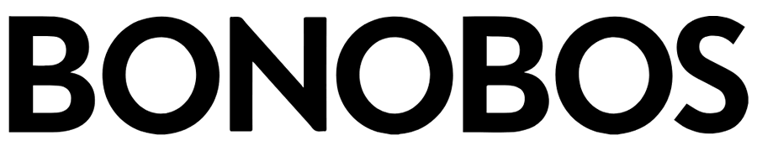
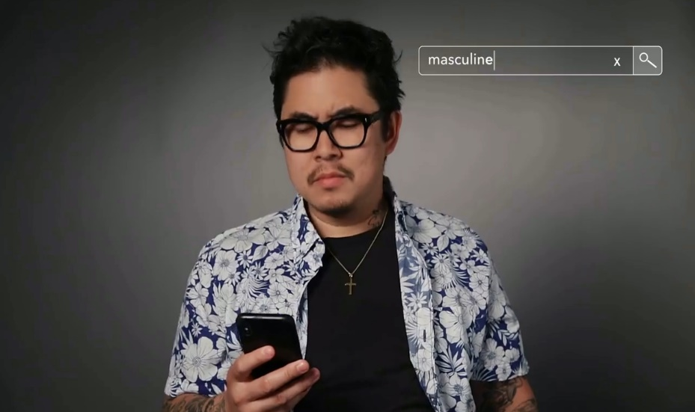
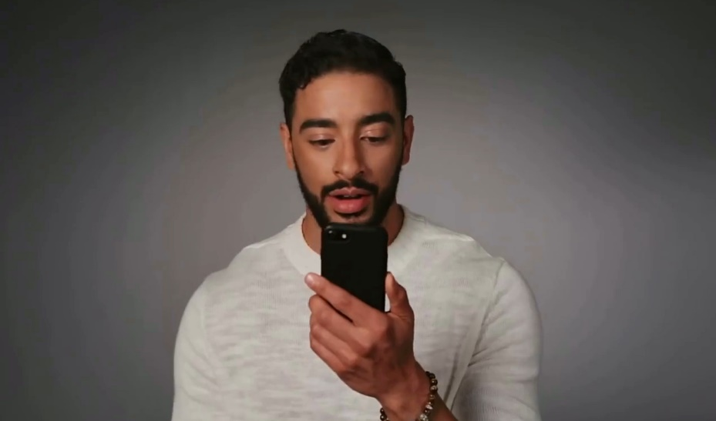
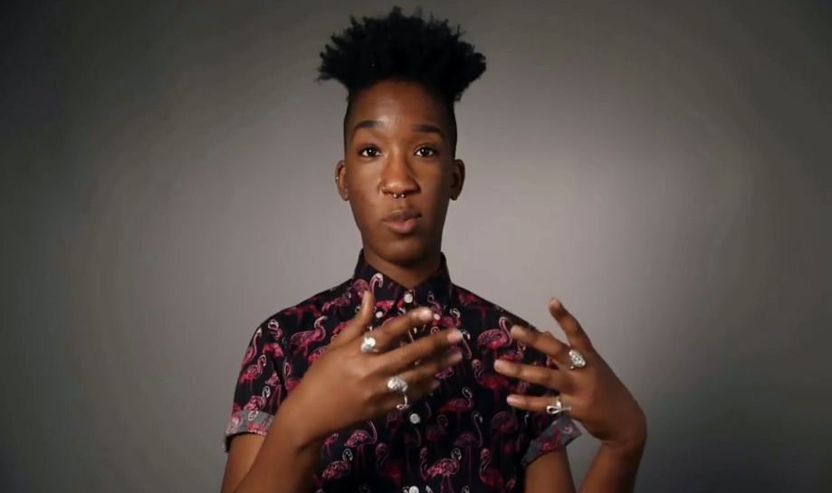
Bonobos: Modern masculinity messaging within a diversity-focused ad campaign sparked a triple-digit surge in website traffic
In July 2018, Bonobos released their first national campaign ad, ‘Evolve The Definition,’ as part of their ‘Project 172’ campaign. Project172 is a portrait of modern masculinity that showcases 172 diverse, ‘real’ individuals across a spectrum of body shape, race, age, sexual orientation and identity who were interviewed so they could discuss how they define masculinity.
Results: There was an immediate surge in Bonobos website visitation upon campaign launch with adult 18+ traffic more than doubling over the two months of the campaign and Black / African-American adult traffic more than tripling during the time period.
Business Outcomes
Persons 18+ Website Traffic: +152% increase
in Bonobos’ two-month average unique P18+ website visitors between July-August ‘18 (campaign months) vs. June ’18 (pre-campaign).
(+165% increase in July ’18 only vs. June ‘18)
Black 18+ Website Traffic: +279% increase
in Bonobos’ average monthly unique Black 18+ website visitors during the same time frame comparison as above.
(+207% increase in July ‘18 only vs. June ’18)
‘Evolve The Definition’ TV spot - $2.0 MM
6-Week Flight: 7/18/18 – 9/3/18
390 Airings / 69.6 MM HH IMPs
click banner above images to watch spot
Source: VAB analysis of iSpot.tv TV occurrence data, time period: 1/1/18 – 6/30/20, estimated media spend. Impressions represent US TV HHs and include activity within measured national broadcast and cable TV linear, national time-shifted, local, VOD and OTT. VAB analysis of Comscore mediametrix multiplatform media trend data (desktop and mobile), P18+, Black 18+, June ‘18 – August ‘18.
This information is exclusively provided to VAB members and qualified marketers. Further distribution is prohibited.
PAGE 28

Slide 29
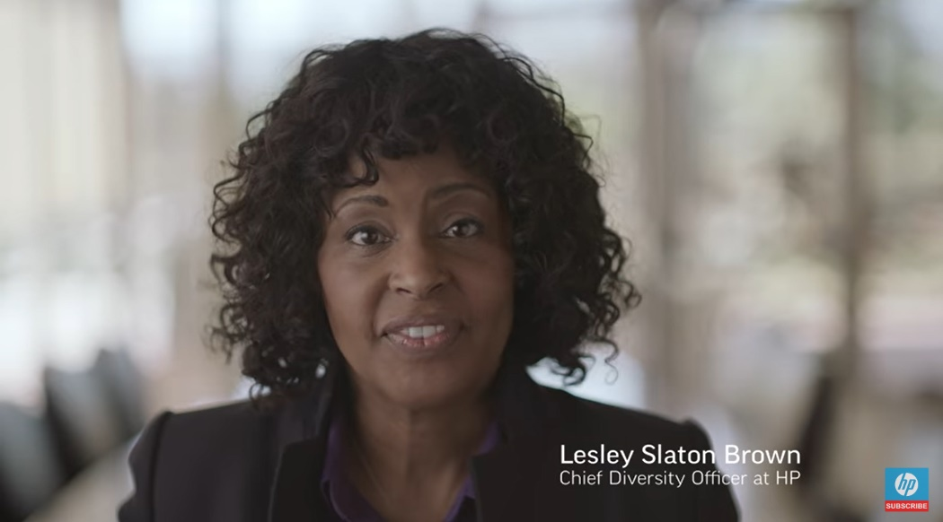
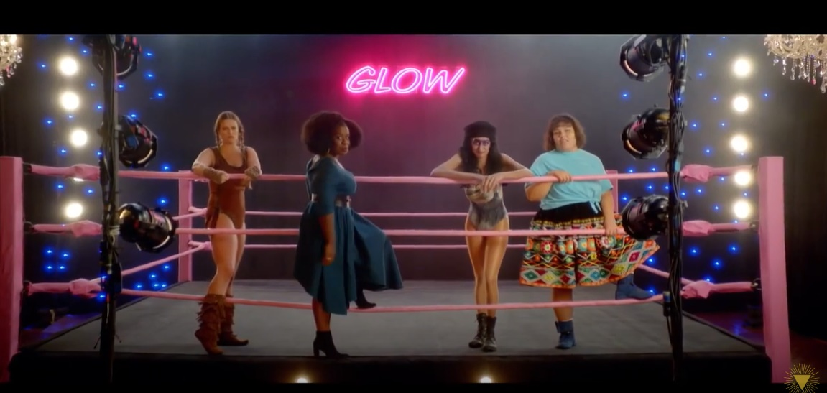

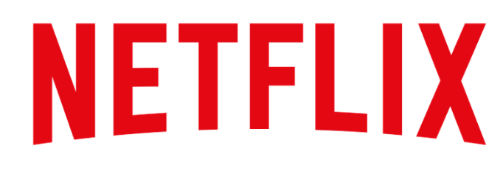
Hewlett-Packard and Netflix: Online video-driven diversity and inclusion campaigns, for both the workplace and in entertainment, drove significant engagement to brands’ digital platforms
Hewlett-Packard –
‘Reinvent Mindsets: Let’s Get In Touch’
Netflix – ‘Make Room’
+28% increase
in Hewlett-Packard’s P18-49 website visitors during May ‘17 vs. April ‘17
+28% increase
in Black / African-American monthly unique visitors to Netflix digital platforms six months after the campaign launched (Aug ‘19 vs. Feb’19)
vs.
+8% increase of total audience during
the same time period
On April 26th 2017, Hewlett-Packard launched the ‘Let’s Get In Touch’ video online as part of their ‘Reinvent Mindsets’ campaign that also includes spots targeted towards women, LGBTQ and Latinos. This video was targeted to
the Black community and based on the statistic that when qualified for a job, Black Americans are three times more likely to experience a denial.
In fact, black audiences accounted for 38% of Netflix’s audience growth during this time
On February 28th 2019, Netflix launched a 60-second film featuring Orange Is the New Black star Uzo Aduba, comedian Hannah Gadsy and indigenous Mexican actor Yalitza Aparicio to celebrate Netflix’s commitment to diversity and inclusion. The video was also a call out to the entertainment industry – ‘let’s make room for the voices yet to be heard. For the stories yet to be told.’
Source: VAB analysis of Comscore mediametrix multiplatform media trend data (desktop and mobile), Hewlett-Packard: P18-49, Netflix: total Black/African-American audience and total audience (desktop P2+; mobile P18+).
This information is exclusively provided to VAB members and qualified marketers. Further distribution is prohibited.
PAGE 29

Slide 30
Major Takeaways: Driving More Consumer Intent Through Increased Website Engagement
Regardless of your brand’s target consumer, category or business model (retails, QSR or direct-to-consumer), embracing diversity can inspire deeper engagement, consideration and interaction while bringing many more potential customers onto your digital platforms
Embracing an inclusivity mindset creates an important point of differentiation for a brand in its category. Consumers most often don’t just buy a product, they buy a brand story. A meaningful, authentic brand message gives consumers a reason to prefer one brand over another
This information is exclusively provided to VAB members and qualified marketers. Further distribution is prohibited.
PAGE 30

Slide 31
Converting Consumer Action Into Sales

Slide 32
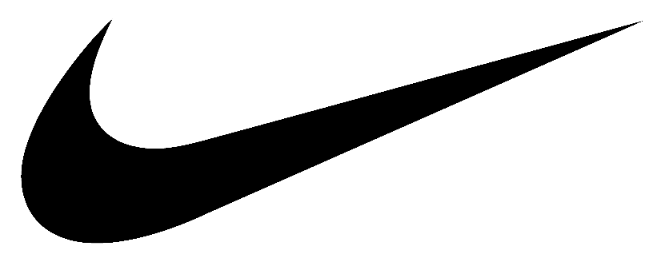



Nike: Record-breaking sales have been achieved in each quarter since the launch of their ‘Dream Crazy’ campaign featuring Colin Kaepernick
In September 2018, Nike released their first in a series of ‘Dream’ spots for their on-going ‘Just Do It’ campaign. The first ad (‘Dream Crazy’) featured controversial NFL star turned social activist, Colin Kaepernick, who remarked ‘believe in something, even if it means sacrificing everything.’ The ads celebrate the rich diversity found in sports through the collection of stories that represent athletes who are household names and those that should be (including 29-year old basketball wheelchair athlete Megan Blunk and Isaish Bird, a 10-year old wrestler born without legs).
Results: Nike launched the ‘Dream Crazy’ ad at the beginning of their 3rd quarter and proceeded to see their highest 3Q revenues ever at that point and their highest year-over-year growth in any quarter in over two and a half years. Record-breaking quarterly sales have continued in each successive quarter through our evaluation period (ending Feb ‘20).
Business Outcomes
North America Quarterly Revenue Comparison:
Sep-Nov ‘18 (‘Dream Crazy’ launch) vs. PY: +9%
Dec ‘18-Feb ‘19 vs. PY:+7%
Mar-May ‘19 (‘Dream Crazier’ active) vs. PY: +7%
Jun-Aug ‘19 (‘Dream Us’ active) vs. PY: +4%
Sep-Nov ‘19 vs. PY: +5%
‘Dream Crazy / Dream Crazier / Dream With Us’ TV spots (five creatives) - $21.7 MM
14-Month Campaign: 9/6/18 – 10/23/19
683 Airings / 371.1 MM HH IMPs
click image above to watch spot
click image above to watch spot
click image above to watch spot
PY = Previous Year (same quarter)
Source: VAB analysis of iSpot.tv TV occurrence data, time period: 1/1/18 – 6/30/20, estimated media spend. Impressions represent US TV HHs and include activity within measured national broadcast and cable TV linear, national time-shifted, local, VOD and OTT. Revenues are based on quarterly company filings (10-Q) for North American revenue (Nike does not report at the United States geographical level) via SEC.gov (EDGAR), revenues reflect Nike brands and excludes Converse.
This information is exclusively provided to VAB members and qualified marketers. Further distribution is prohibited.
PAGE 32

Slide 33




P&G: The company saw their best sales growth in over a decade amid high-profile corporate and brand campaigns centered around diversity, inclusion, racial equality and social justice
P&G has long been a champion of diversity, inclusion, equality and social justice issues and these themes are integrated into many of their advertising campaigns on both the corporate and brand level (My Black Is Beautiful, Gillette, Pantene and Tide, just to name a few). Over the last few years, P&G corporate has taken on racial equality issues head-on with spots like ‘The Talk’ which addressed the conversations Black parents have to have with their children about racism, ‘The Look’ which takes on racial prejudice and a third spot, released this year entitled ‘The Choice,’ that calls on all people to be anti-racist.
Results: While outspoken in their messaging, P&G has been showing consistent 4% – 10% growth over the last couple of years. According to Bloomberg, P&G posted their best sales growth in over a decade for FY 2019 and this momentum has carried through to 2020 where P&G reported their biggest sales rise in decades for their quarter ending in March ’20 (Q3).
Business Outcomes
Annual U.S. Organic Sales* Increase:
FY ’19 vs. PY: +4%
FY ‘20 vs. PY: +10%
Quarterly U.S. Organic Sales* Increase:
Jan-Mar ’19 v. PY: +4% Jan-Mar ‘20 v. PY: +10%
Apr-Jun ‘19 v. PY: +4% Apr-Jun ‘20 v. PY: +19%
Jul-Sep ‘19 v. PY: +6%
Oct-Dec ‘19 v. PY: +4%
‘The Talk’ TV spot - $3.1 MM
Airings Throughout 3+ Years:
6/17/17 – on-going
317 Airings / 64.3 MM HH IMPs
‘The Look’ TV spot - $3.0 MM
Airings Throughout 11+ Months:
9/12/19 – on-going
104 Airings / 18.0 MM HH IMPs
‘The Choice’ TV spot - $2.5 MM
New Ad:
6/10/20 – on-going
63 Airings / 21.6 MM HH IMPs
click image above to watch spot
click image above to watch spot
click image above to watch spot
FY’19 = Jul’18–Jun’19;
PY = Previous Year (same quarter)
Source: VAB analysis of iSpot.tv TV occurrence data, time period: 1/1/17 – 6/30/20, estimated media spend. Impressions represent US TV HHs and include activity within measured national broadcast and cable TV linear, national time-shifted, local, VOD and OTT. Revenues are based on annual report company filings (10-K) via SEC.gov (EDGAR) and quarterly earnings releases available through their investor relations website. *Organic sales = excludes currency fluctuations, acquisitions and divestitures.
This information is exclusively provided to VAB members and qualified marketers. Further distribution is prohibited.
PAGE 33

Slide 34




Coca-Cola: An immediate and prolonged sales lift in the mid-to-high single digits was seen upon the reintroduction of the brand’s inclusivity-focused ‘Share a Coke’ program
Leading into the summer of 2017, Coca-Cola reintroduced its successful ‘Share a Coke’ program, rebranded ‘Share an ICE COLD Coke,’ by featuring a diverse mix of last names (including Garcia, Rodriguez, Lopez) in addition to bringing back even more first names on 20-ounce bottles across their portfolio. The supporting ad campaign, in both English and Spanish, was targeted towards millennials and featured younger, more multicultural, people across all ethnicities with a message focus of inclusivity (i.e., sharing a coke).
Results: Coca-Cola saw an immediate +7% lift in quarterly sales once the new campaign launched during 2Q ’17 and average quarterly sales growth (based on percentage) almost doubled in Year Two of the campaign, even with a higher sales base from the previous year.
Business Outcomes
North America Net Revenues:
1Q ‘17 vs PY: +2%
2Q ‘17 (‘Share an ICE COLD Coke’ launches ) vs. PY: +7%
3Q ‘17 vs. PY: +4%
4Q ‘17 vs. PY: +5%
1Q ‘18 vs. PY: +10%
2Q ‘18 vs. PY: +6%
3Q ‘18 vs. PY: +11%
4Q ‘18 vs. PY: +8%
‘Share A Coke’ TV spots (ten creatives including two Spanish-language) - $65.6 MM
Airings Throughout 15 Months: 4/27/17 – 7/30/18
14,348 Airings / 3,360.5 MM HH IMPs
click image above to watch spot
click image above to watch spot
click image above to watch spot
Source: VAB analysis of iSpot.tv TV occurrence data, time period: 1/1/16 – 6/30/20, estimated media spend. Impressions represent US TV HHs and include activity within measured national broadcast and cable TV linear, national time-shifted, local, VOD and OTT. Revenues are based on quarterly company filings (10-Q) for North American revenue (Coca-Cola does not report at the United States geographical level) via SEC.gov (EDGAR). Click each image to watch spot.
PY = Previous Year (same quarter)
This information is exclusively provided to VAB members and qualified marketers. Further distribution is prohibited.
PAGE 34

Slide 35




Toyota RAV4: The nameplate has become the best-selling SUV in America behind recent, strong diversity and female empowerment campaigns
RAV4 is now not only Toyota’s highest selling nameplate in the U.S. but it’s the best-selling SUV in America and, during their ascendancy, diversity and inclusion has been featured prominently in their advertising campaigns. The brand casts people of all ethnicities within their spots and have created a host of Spanish-language ads. Their agency, Burrell Communications, also produced a Super Bowl ad with an empowering message about shattering perceptions featuring Toni Harris, the first female athlete to receive a full college football scholarship in a skill position.
Results: 2019 was Toyota RAV4’s highest annual unit sales ever and marked their eighth straight year of successive unit growth. In fact, RAV4 sold 130K+ units more than they did five years ago in 2015. Their Hybrid model is doing particularly well, posting a 92% increase YoY.
‘Bring The Heat’ TV spot - $42.0 MM
12-Month Campaign:
2/4/19 – 2/2/20
4,865 Airings / 1,874.8 MM HH IMPs
‘Toni’ TV spot - $21.6 MM
10-Month Campaign:
1/29/19 – 11/24/19
284 Airings / 330.5 MM HH IMPs
13 Spanish-Language TV spots - $22.6 MM
Various Flights: 1/12/16 – 3/29/20
7,018 Airings / 933.8 MM HH IMPs
Business Outcomes
Annual U.S. Unit Sales: +42% increase
in RAV4 vehicles sold annually in the U.S. over the last five years between 2015 and 2019 (315,142 vs. 448,071).
click image above to watch spot
click image above to watch spot
click image above to watch spot
Source: VAB analysis of iSpot.tv TV occurrence data, time period: 1/1/16 – 6/30/20, estimated media spend. Impressions represent US TV HHs and include activity within measured national broadcast and cable TV linear, national time-shifted, local, VOD and OTT. Revenues are based on Toyota Motor North America’s U.S. Sales Annual Summaries available through their online news pressroom portal.
This information is exclusively provided to VAB members and qualified marketers. Further distribution is prohibited.
PAGE 35

Slide 36




Bumble, McDonald’s: Diversity and inclusion-driven social media campaigns overlaid with relevant localized out-of-home messaging drive younger consumers to take action through website sign-ups and in-app purchases
‘Find Them On Bumble’
McDonald’s – ‘Share the Love’
+19% increase
in Bumble average monthly digital P18-34 visitors during
1Q ‘19 vs. Sep ’18
(+7% increase: 4Q ‘18 vs. Sep’ 18)
+5% increase
McDonald’s app P18-34 users in July ‘19 vs. Jun ‘19
In 4Q ’18, Bumble plastered the real-life stories of 112 of its ‘inspirational and relatable’ users with a diverse array of backgrounds, love lives, friendships and careers all over NYC for it’s largest advertising campaign to date utilizing billboards, storefronts, subway takeovers and double-decker illuminated buses.
In 2019, to align with National French Fry Day on July 13th, McDonald’s created a diversity-focused campaign encouraging consumers to ‘share the love.’ The campaign, which was a play on the brand’s iconic golden arches, included social media, out-of-home and in-restaurant point-of-sale.
Source: VAB analysis of Comscore mediametrix multiplatform media trend data (desktop and mobile), P18-34.
This information is exclusively provided to VAB members and qualified marketers. Further distribution is prohibited.
PAGE 36

Slide 37
Major Takeaways: Converting Consumer Actions Into Sales
Doing the right thing by developing and investing in diverse, inclusive campaigns grows the bottom line
In addition to their ad campaigns, marketers should consider what other ways they can go to market with a message of inclusivity (e.g. partnerships, packaging, product lines)
When relevant to the brand, marketers should consider creating in-language executions to more strongly relate to their consumers
This information is exclusively provided to VAB members and qualified marketers. Further distribution is prohibited.
PAGE 37

Slide 38




Key Takeaways For Marketers
Embrace diversity & inclusion as a core part
of your brand’s DNA
Diversity & inclusion campaigns will yield better results for your business
Campaigns need to be ‘Real’ to be effective
Video is a strong platform for inclusivity messaging
Brands that are embracing inclusion and making it a core part of their messaging are seeing greater business outcomes as a result.
Brands are seeing greater results across the purchasing funnel, including double-
and triple-digit increases in their website traffic along
with sustained sales growth during and after a campaign launch.
The campaigns that resonate the most are those that showcase authentic voices, embrace real people, promote empowerment, celebrate modern society, support the community, speak their language, create relevant products and take a stand
for social justice.
The sight, sound and emotion of video is a powerful platform to drive mass attention and positive sentiment as well as second-screen behaviors like digital interactions and website traffic and also, ultimately, sales.
This information is exclusively provided to VAB members and qualified marketers. Further distribution is prohibited.
PAGE 38

Slide 39






Thank You
Creators
Jason Wiese
Reed Kiely
Karolina Guillen
SVP, Director of Strategic Insights
jasonw@thevab.com
Insights Manager
reedk@thevab.com
Senior Insights Analyst
karolinag@thevab.com
Interested in learning more? Check out this related content:
A Matter of Principle
Reassessing Your Strategy
in Today’s Environment
A Second Look:
10 Slides to Diversify
Your Marketing Strategy
Discover The Difference:
How Culturally Relevant Video Content Drives Action By Multicultural Audiences
This information is exclusively provided to VAB members and qualified marketers. Further distribution is prohibited.
PAGE 39

Slide 40

Get immediate access to the VAB Insights library
We’ve answered hundreds of marketers’ questions.
Our guides, reports, webinars and videos provide actionable insights to help marketers navigate today’s video landscape and think differently about their strategy.
We are committed to your business growth and proud to offer brand marketers and agencies complimentary access to our continuously-growing Insights library.
Get Access at theVAB.com or visit us here
This information is exclusively provided to VAB members and qualified marketers. Further distribution is prohibited.
PAGE 40

