Slide 1
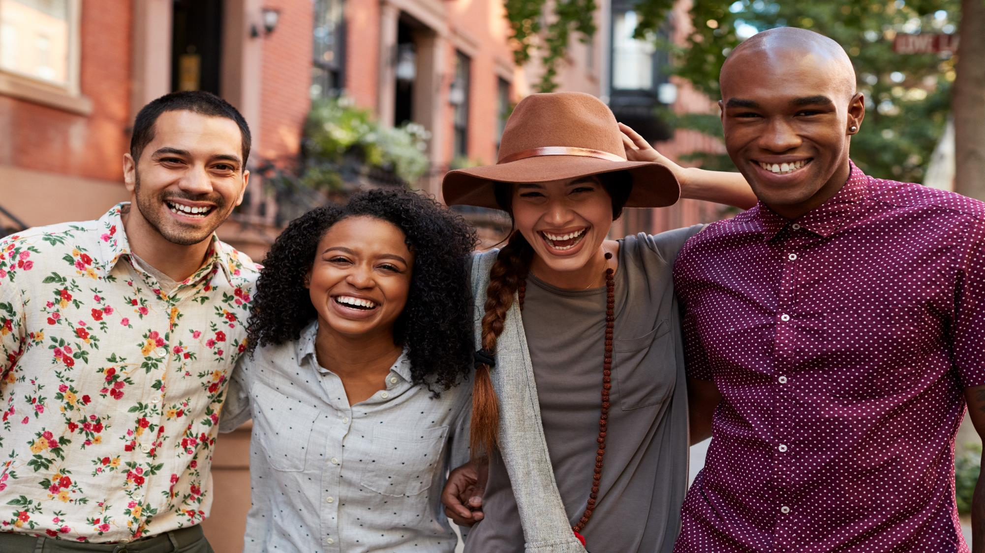

VAB – MARKETER’S GUIDE - 2020
.................
Discover The Difference
How Culturally Relevant Video Content Drives Action
By Multicultural Audiences

Slide 2

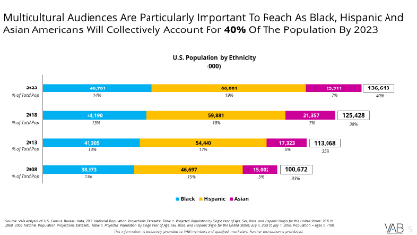
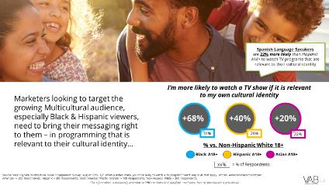
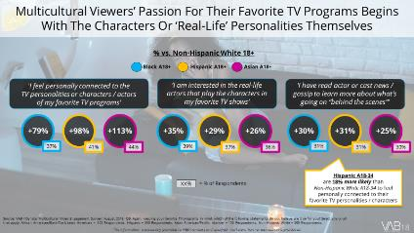
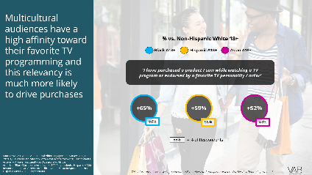
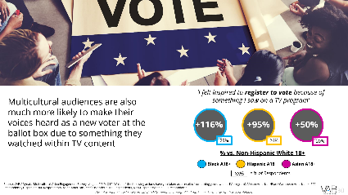
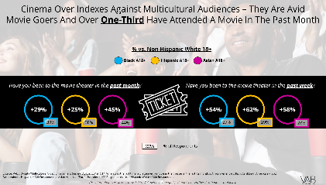

Contents
1
2
1
Understanding The Opportunity
The Economic Growth Of Multicultural Audiences
2
Building Commitment
The Importance Of Cultural Relevancy in TV
3
4
3
Generating Engagement
Online And ‘In Real Life’ TV Communities
4
Inspiring Buying Decisions
Delivering Outcomes For Brands
5
5
Igniting Involvement
TV As A ‘Force For Good’
6
6
Exploring The Cinematic Experience
How Representation Leads To Success
2

Slide 3


Discover The Difference
Multicultural audiences are a major force in today’s economy. In fact, Black, Hispanic and Asian demographics will collectively account for 40% of the population by 2023. Although they skew much younger than the average population, their aggregated annual spending has increased by 57% over the last 10 years to $2.2 trillion.
With media fragmentation intensifying, the delivery of relevant content is vital for grabbing consumer’s attention and can help generate rich emotional connections among viewers. This is why not only reaching, but increasing relevancy among, valuable multicultural segments to spur consumer actions and business outcomes for brands has never been more important.
To help marketer’s understand multicultural audiences’ engagement with premium video content, we conducted the ‘Multicultural Video Engagement’ custom study in partnership with Dynata. Within this survey, we sought to identify how Black, Hispanic and Asian audiences interact with culturally relevant content, how they further engage with this content both online and offline, and how their connection with relevant content drives involvement and consumer action.
As marketers compete for consumers’ attention, it’s crucial to recognize the unique connections that multicultural audiences have with premium video and how engaging through culturally relevant programming can foster brand recognition and trust that inspires purchases and ignites involvement.
In recognition of these unique connections, we invite you to discover the difference as we compare our findings against a Non-Hispanic White demographic and across the three multicultural segments that are the focal point of this study.
3
This information is exclusively provided to VAB members and qualified marketers. Further distribution is prohibited.

Slide 4



Understanding
The Opportunity
Multicultural audiences are a major force within the U.S. economy and they only continue to grow, so reaching and increasing relevancy among these valuable consumers to spur action has never been more important

Slide 5
Multicultural Audiences Are Particularly Important To Reach As Black, Hispanic And Asian Americans Will Collectively Account For 40% Of The Population By 2023
136,613
% of Total Pop
14%
19%
7%
40%
125,428
% of Total Pop
13%
18%
7%
38%
113,068
% of Total Pop
13%
17%
5%
35%
100,672
% of Total Pop
13%
15%
5%
33%
Source: VAB Analysis of U.S. Census Bureau data, 2017 National Population Projections Datasets: Table 1. Projected Population by Single Year of Age, Sex, Race, and Hispanic Origin for the United States: 2016 to 2060. 2008 National Population Projections Datasets, Table 1. Projected Population by Single Year of Age, Sex, Race, and Hispanic Origin for the United States: July 1, 2000 to July 1, 2050. Population = age 0 – 100.
This information is exclusively provided to VAB members and qualified marketers. Further distribution is prohibited.
5

Slide 6
Multicultural Audiences Also Skew Much Younger Than Non-Hispanic White Demographic – With Approximately One-Half Under The Age Of 34
2018 U.S. Population by Age & Ethnicity
(000)
Source: VAB Analysis of U.S. Census Bureau data, 2017 National Population Projections Datasets: Table 1. Projected Population by Single Year of Age, Sex, Race, and Hispanic Origin for the United States: 2016 to 2060.
This information is exclusively provided to VAB members and qualified marketers. Further distribution is prohibited.
6

Slide 7
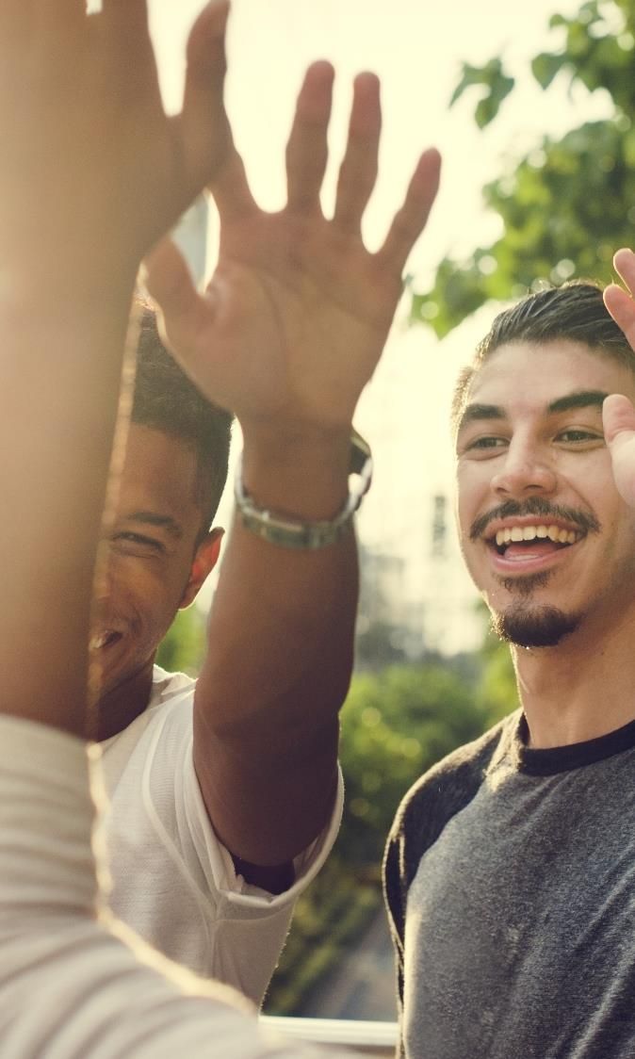
Although Younger, Multicultural Audiences Have Collectively Increased Their Spending Over The Last 10 Years By 57%, Or Almost $2.2 Trillion
$2,187.8
$1,592.4
$1,389.6
Source: VAB Analysis of Bureau of Labor Statistics data, Race of reference person: Shares of annual aggregate expenditures and sources of income, Consumer Expenditure Survey, 2008, 2013 & 2018; Hispanic or Latino origin of reference person: Shares of annual aggregate expenditures and sources of income, Consumer Expenditure Survey, 2008, 2013 & 2018.
7
This information is exclusively provided to VAB members and qualified marketers. Further distribution is prohibited.

Slide 8
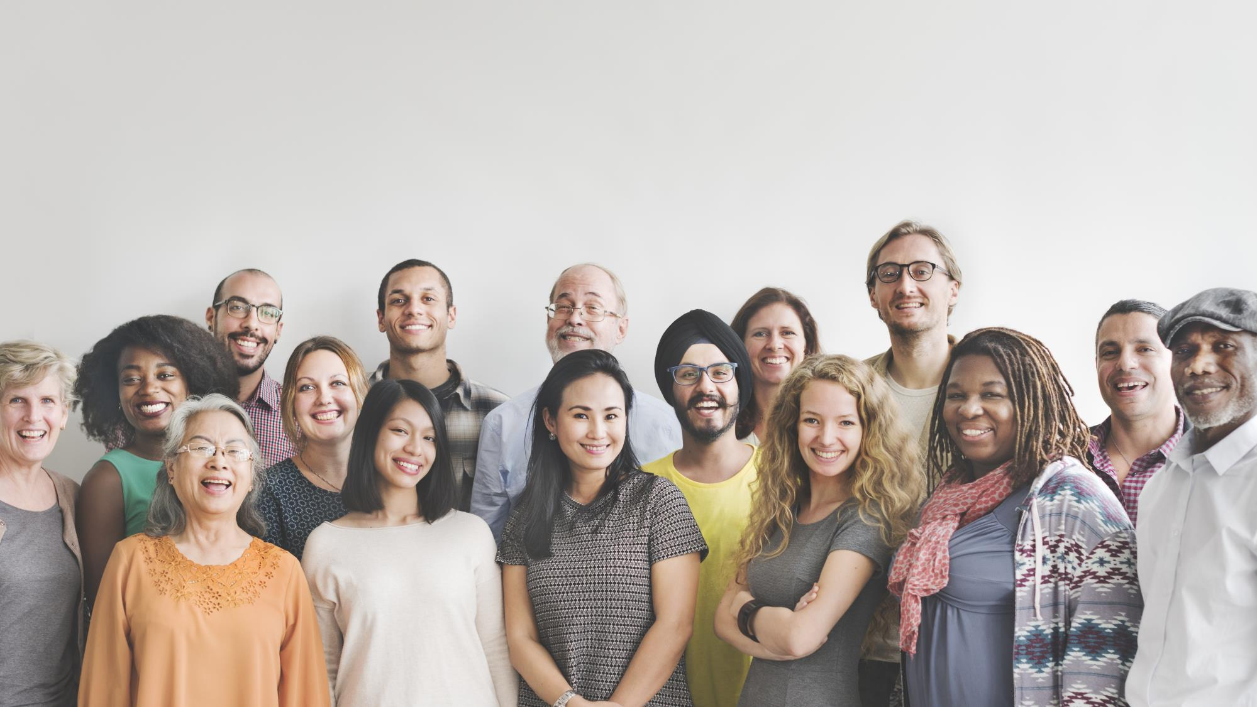
Marketers’ Ability To Enhance Relevancy Among Targeted Audiences
Is Critical, Especially Against Valuable Multicultural Audiences,
As Media Fragmentation Increases Competition For Consumer Attention
This information is exclusively provided to VAB members and qualified marketers. Further distribution is prohibited.
8

Slide 9
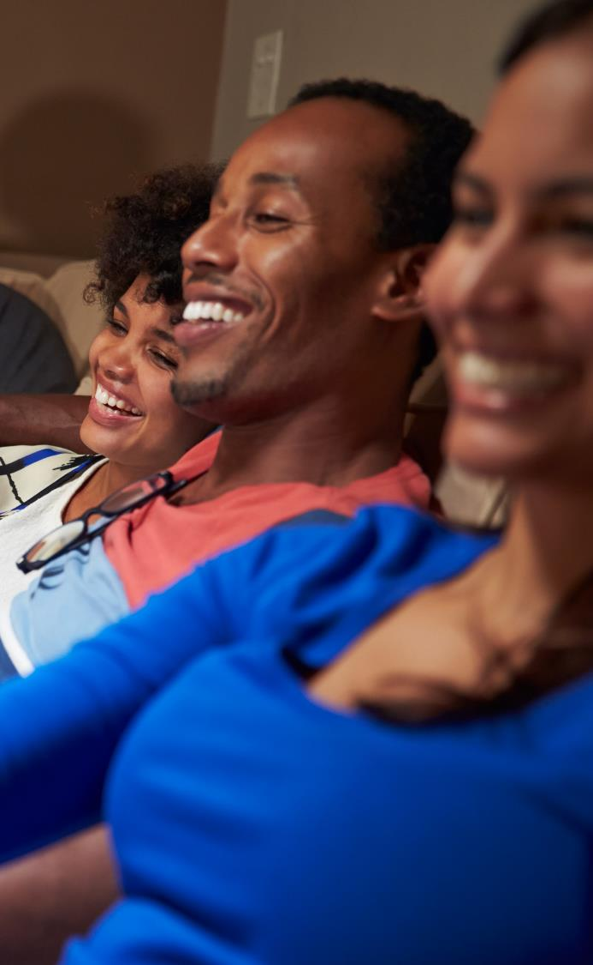



Relevant Content Is Vital For Grabbing Consumers’ Attention And Can Help Generate Rich Emotional Connections Among Viewers
+
+
Meet A
Consumer Need
Meet A
Moment In Time
Evoke An Emotion
Consumers are thankful when advertising reminds them about something they need
They like when an ad fits with what they are watching/listening to/reading
They like ads that make them feel something
Source: Xandr, It’s About Time: Relevance Report 2019.
9
This information is exclusively provided to VAB members and qualified marketers. Further distribution is prohibited.

Slide 10
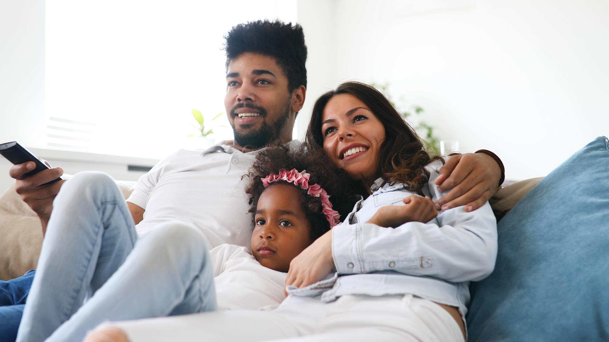
In fact, ads that are relevant to a viewer are deemed more believable and appealing and
ad recall is much higher
Campaigns Defined as ‘Relevant’ vs. Average Campaign
+130%
+169%
+148%
More
Believable
Higher
Ad Appeal
Ad Recall
Source: Xandr, It’s About Time: Relevance Report 2019.
10
This information is exclusively provided to VAB members and qualified marketers. Further distribution is prohibited.

Slide 11
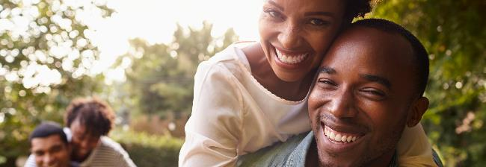



Since Relevancy Is So Important In Today’s Advertising Environment, VAB
Conducted A Custom Study To Understand Multicultural Audiences’ Connection
With Premium Video Content And How Their Engagement Inspires Action
To do this, VAB commissioned Dynata to conduct the ‘Multicultural Video Engagement’ Survey, fielded online in August 2019. In order to get a solid sample size across the major multicultural segments, the results are based on 1,002 adults 18+ who identified themselves as Black (302 respondents), Hispanic (300 respondents), Asian (100 respondents), or Non-Hispanic White (300 respondents).
Within this survey, we sought to understand how multicultural audiences interact with culturally relevant content, how they engage further with this content through online and ‘real life’ interactions and conversations, and how their passion and commitment drives greater involvement and consumer action.
We hope these findings inspire marketers as they discover the differences across multicultural audiences…
This information is exclusively provided to VAB members and qualified marketers. Further distribution is prohibited.
11

Slide 12

Building Commitment
Multicultural audiences have a deep connection with TV programming and respond positively to culturally relevant programming

Slide 13
A Majority Of Multicultural Audiences Commit At Least Two Hours A Day To Watching Broadcast Or Cable TV Programming Across Devices And Platforms
How much time do you spend watching Broadcast or Cable TV content in a given day?
(across all devices and platforms)
Source: VAB / Dynata ‘Multicultural Video Engagement Survey,’ August 2019. S3. On average, how much time do you spend watching Broadcast (i.e. ABC, CW, NBC, Univision, Fox) or Cable (i.e. FX, ESPN Deportes, AMC, BET, TBS, HGTV, etc) TV content in a given day? Please include any viewing that takes place on a TV, mobile device, computer/laptop, through an app/website (i.e. CBS All Access, Hulu, etc), streaming or on-demand service.
African American/Black/Caribbean American = 302 Respondents, Hispanic = 300 Respondents, Asian American/Pacific Islander = 100 Respondents, Non-Hispanic White = 300 Respondents.
This information is exclusively provided to VAB members and qualified marketers. Further distribution is prohibited.
13

Slide 14

Spanish-Language Speakers
are 22% more likely than Hispanic A18+ to watch TV programs that are relevant to their cultural identity
‘I’m more likely to watch a TV show if it is relevant to my own cultural identity’
Marketers looking to target the growing Multicultural audience, especially Black & Hispanic viewers, need to bring their messaging right to them – in programming that is relevant to their cultural identity…
+68%
+40%
+20%
31%
26%
22%
% vs. Non-Hispanic White 18+
Black A18+
Hispanic A18+
Asian A18+
XX%
= % of Respondents
Source: VAB / Dynata ‘Multicultural Video Engagement Survey,’ August 2019. Q7: What qualities make you more likely to watch a TV program? Select any or all that apply . African American/Black/Caribbean American = 302 Respondents, Hispanic = 300 Respondents, Asian American/Pacific Islander = 100 Respondents, Non-Hispanic White = 300 Respondents.
This information is exclusively provided to VAB members and qualified marketers. Further distribution is prohibited.
14

Slide 15

Spanish-Language Speakers
are 33% more likely than Hispanic A18+ to watch TV programs that feature a diverse cast
‘I’m more likely to watch a TV show if it features a diverse cast’
…As well as programs that feature a diverse cast; Black, Hispanic, Asian and Spanish-speaking viewers are more likely to be interested in programming that is representative of people from a mix of ethnicities & cultures including their own.
+76%
+37%
+35%
36%
28%
28%
% vs. Non-Hispanic White 18+
Black A18+
Hispanic A18+
Asian A18+
XX%
= % of Respondents
Source: VAB / Dynata ‘Multicultural Video Engagement Survey,’ August 2019. Q7: What qualities make you more likely to watch a TV program? Select any or all that apply. African American/Black/Caribbean American = 302 Respondents, Hispanic = 300 Respondents, Asian American/Pacific Islander = 100 Respondents, Non-Hispanic White = 300 Respondents.
This information is exclusively provided to VAB members and qualified marketers. Further distribution is prohibited.
15

Slide 16

Black A18-34
are 20% more likely than
Non-Hispanic White A18-34 to watch TV programs with characters / personalities who are relatable
Hispanic A18-34
are 18% more likely than
Non-Hispanic White A18-34 to watch TV programs with characters / personalities who are relatable
‘I’m more likely to watch a show if I find the
main TV personalities or characters relatable’
They are also more likely to be interested in programs that showcase main characters or personalities who are relatable to themselves and their environment – some of these characters are not necessarily likeable either (i.e., ‘love to hate’ personalities)
+17%
+12%
+21%
44%
43%
46%
% vs. Non-Hispanic White 18+
Black A18+
Hispanic A18+
Asian A18+
XX%
= % of Respondents
Source: VAB / Dynata ‘Multicultural Video Engagement Survey,’ August 2019. Q7: What qualities make you more likely to watch a TV program? Select any or all that apply. African American/Black/Caribbean American = 302 Respondents, Hispanic = 300 Respondents, Asian American/Pacific Islander = 100 Respondents, Non-Hispanic White = 300 Respondents.
This information is exclusively provided to VAB members and qualified marketers. Further distribution is prohibited.
16

Slide 17

Generating Engagement
Multicultural viewers’ passion and commitment for premium video content extends both online to like-minded fans and ‘in real life’ across family and friends

Slide 18
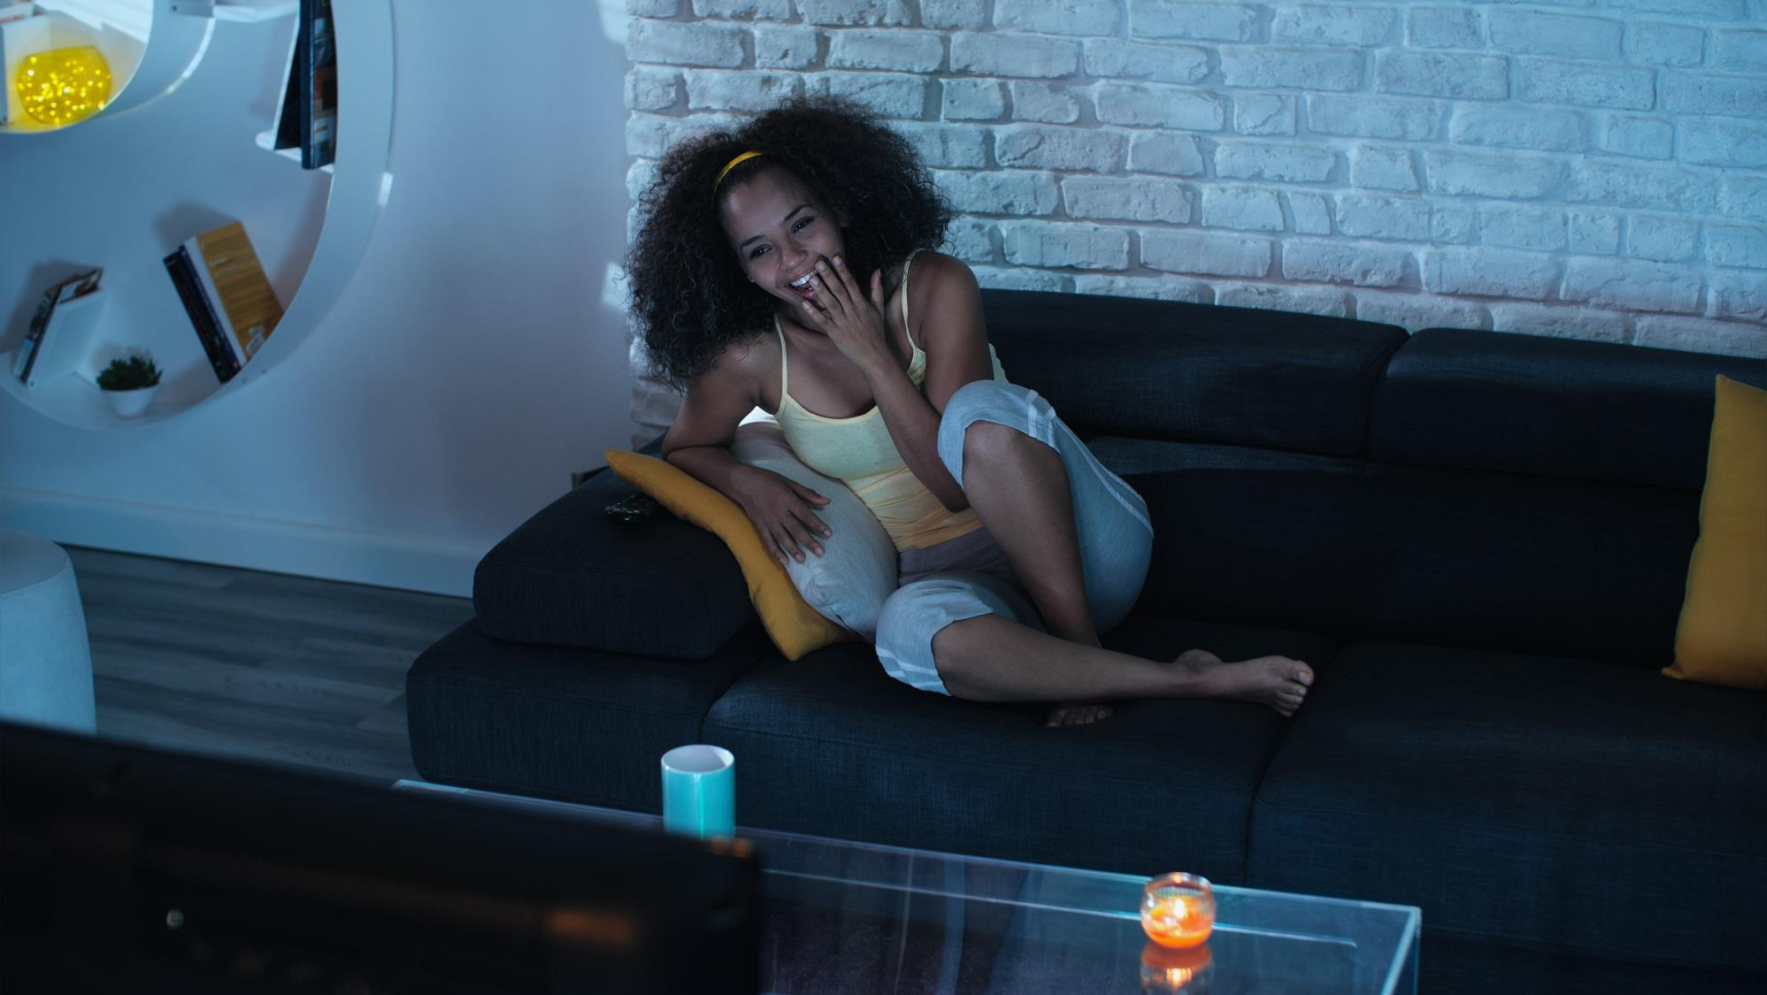
Multicultural Viewers’ Passion For Their Favorite TV Programs Begins
With The Characters Or ‘Real-Life’ Personalities Themselves
% vs. Non-Hispanic White 18+
Black A18+
Hispanic A18+
Asian A18+
'I feel personally connected to the
TV personalities or characters / actors
of my favorite TV programs’
‘I am interested in the real-life actors that play the characters in my favorite TV shows’
‘I have read actor or cast news / gossip to learn more about what’s going on “behind the scenes”’
+79%
+98%
+113%
+35%
+29%
+26%
+30%
+31%
+25%
37%
41%
44%
39%
37%
36%
31%
31%
30%
Hispanic A18-34
are 18% more likely than
Non-Hispanic White A18-34 to feel personally connected to their favorite TV personalities / characters
XX%
= % of Respondents
Source: VAB / Dynata ‘Multicultural Video Engagement Survey,’ August 2019. Q9: Again, keeping your favorite TV programs in mind, which of the following statements do you believe are true for you? Select any or all that apply. African American/Black/Caribbean American = 302 Respondents, Hispanic = 300 Respondents, Asian American/Pacific Islander = 100 Respondents, Non-Hispanic White = 300 Respondents.
This information is exclusively provided to VAB members and qualified marketers. Further distribution is prohibited.
18

Slide 19




And This Passion Extends To Social Media Where They Are Much More Likely To Directly Interact With TV Programs, Actors And Related Hashtags
% vs. Non-Hispanic White 18+
Black A18+
Hispanic A18+
Asian A18+
Follow or ‘like’ TV programs/characters/actors on Facebook or Instagram
Tweet directly at
TV personalities or actors about the TV program
Follow trending hashtags related to a new episode of a TV program before, during or after it airs to stay on top of the social conversation
Share, post or tweet video clips / content / memes about a TV program across social media
+86%
+79%
+54%
+108%
+104%
+83%
+117%
+95%
+78%
+84%
+76%
+47%
76%
73%
63%
57%
56%
50%
71%
64%
58%
69%
66%
55%
Spanish-Language Speakers
are 21% more likely than Hispanic A18+ to Tweet directly at TV personalities or actors about the TV program
Black A18-34
are 13% more likely than Non-Hispanic White A18-34 to follow trending hashtags related to a new episode of a TV program
XX%
= % of Respondents
Source: VAB / Dynata ‘Multicultural Video Engagement Survey,’ August 2019. Q8: Keeping your favorite TV programs in mind, please indicate how often you do the following on social media. Respondents Answer = Always, Frequently or Occasionally. African American/Black/Caribbean American = 302 Respondents, Hispanic = 300 Respondents, Asian American/Pacific Islander = 100 Respondents, Non-Hispanic White = 300 Respondents.
This information is exclusively provided to VAB members and qualified marketers. Further distribution is prohibited.
19

Slide 20
Beyond Social Media, Multicultural Audiences Are Also Feeding Their Passion For TV Programming By Seeking Out More Relevant Content Online
% of Respondents
% vs. Non-Hispanic White 18+
72%
72%
69%
83%
83%
79%
73%
70%
71%
79%
78%
81%
79%
76%
73%
75%
75%
75%
Source: VAB / Dynata ‘Multicultural Video Engagement Survey,’ August 2019. Q10: Please indicate how often you do the following on social media. Respondents Answer = Always, Frequently or Occasionally. African American/Black/Caribbean American = 302 Respondents, Hispanic = 300 Respondents, Asian American/Pacific Islander = 100 Respondents, Non-Hispanic White = 300 Respondents.
This information is exclusively provided to VAB members and qualified marketers. Further distribution is prohibited.
20

Slide 21
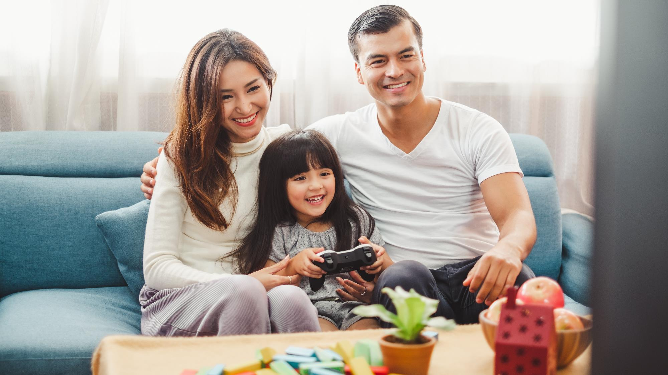
Multicultural Viewers Are Also More Likely To Share Their Interests Around
TV Content With Family And Friends Both Online And ‘In Real Life’
% vs. Non-Hispanic White 18+
Black A18+
Hispanic A18+
Asian A18+
‘I have started a conversation with friends / family / online community about a TV program on social messaging platforms’
Spanish-Language Speakers
are 13% more likely than Hispanic A18+ to have started a conversation with friends / family / online community about a TV program on social messaging platforms
+82%
+69%
+54%
77%
71%
65%
Hispanic A18-34
are 39% more likely than Non-Hispanic White A18-34 to have tried to / have convinced a friend or family member to start watching their favorite TV program
‘I have tried to / have convinced a friend or family member to start watching my favorite TV program’
+21%
+19%
+2%
41%
41%
35%
XX%
= % of Respondents
Source: VAB / Dynata ‘Multicultural Video Engagement Survey,’ August 2019. Q8: Keeping your favorite TV programs in mind, please indicate how often you do the following on social media. Respondents Answer = Always, Frequently or Occasionally. Q13: Which of the following statements are true for you? Select any or all that apply. African American/Black/Caribbean American = 302 Respondents, Hispanic = 300 Respondents, Asian American/Pacific Islander = 100 Respondents, Non-Hispanic White = 300 Respondents.
This information is exclusively provided to VAB members and qualified marketers. Further distribution is prohibited.
21

Slide 22
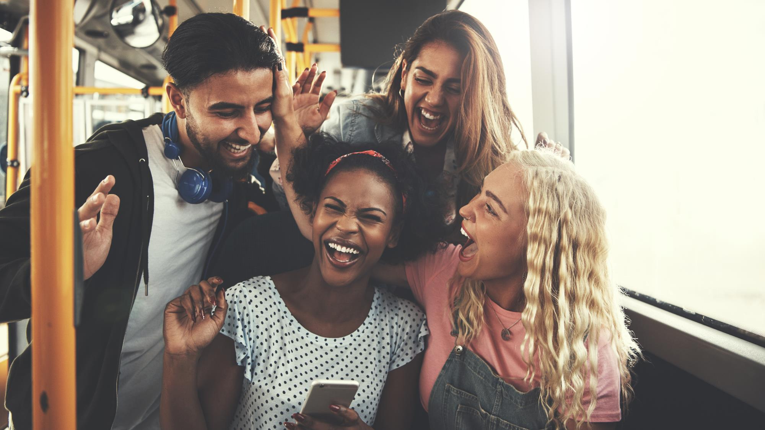
Inspiring Buying Decisions
Culturally relevant TV programming creates passion and commitment among multicultural audiences that drives consumer actions which delivers greater outcomes
for brands

Slide 23
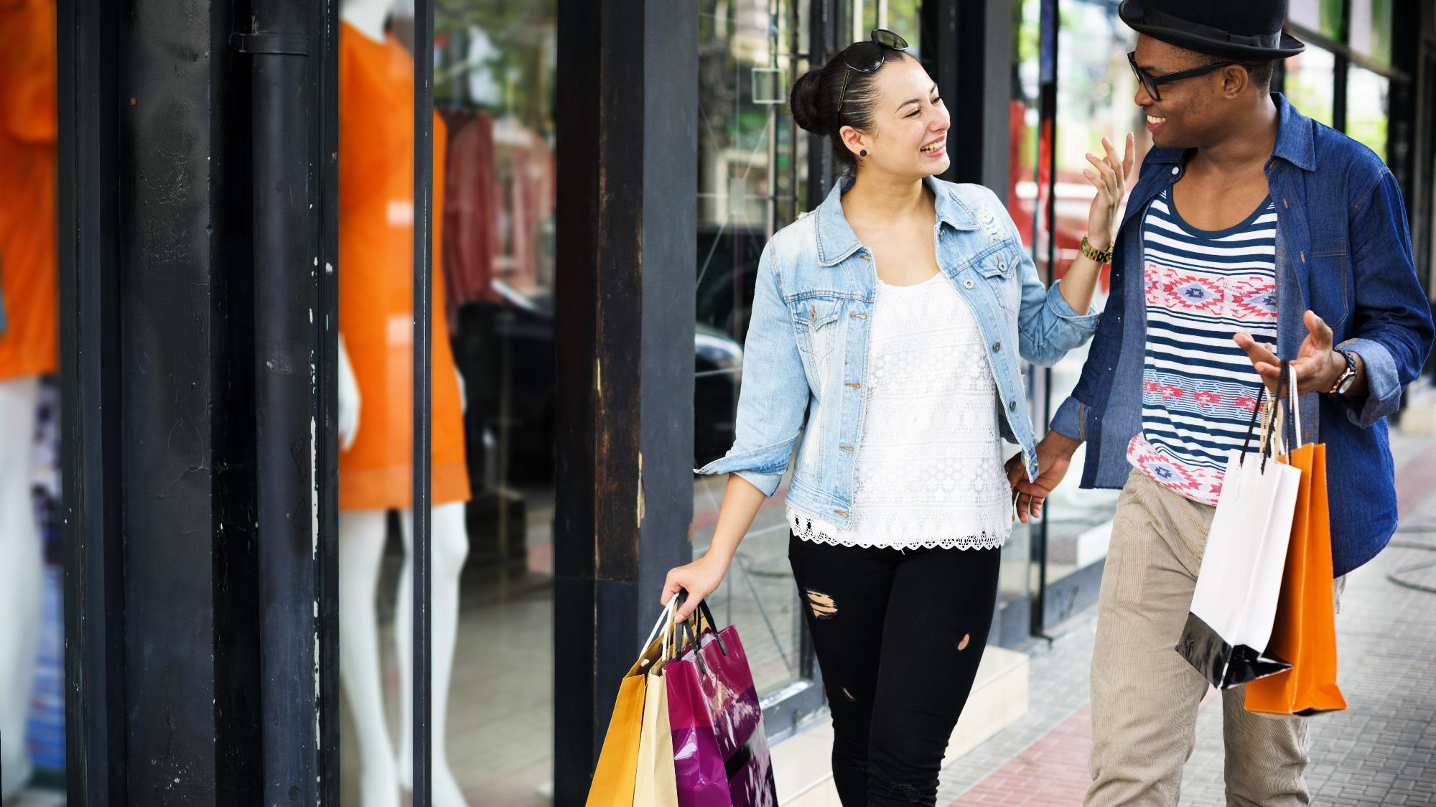
Multicultural audiences have a high affinity toward their favorite TV programming, characters and personalities and
this relevancy is much more likely
to drive product purchases
% vs. Non-Hispanic White 18+
Black A18+
Hispanic A18+
Asian A18+
‘I have purchased a product I saw while watching a TV program or endorsed by a favorite TV personality / actor’
+65%
+59%
+52%
68%
66%
63%
XX%
= % of Respondents
Source: VAB / Dynata ‘Multicultural Video Engagement Survey,’ August 2019. Q10: Please indicate how often you do the following. Respondents Answer = Always, Frequently or Occasionally. African American/Black/Caribbean American = 302 Respondents, Hispanic = 300 Respondents, Asian American/Pacific Islander = 100 Respondents, Non-Hispanic White = 300 Respondents.
23
This information is exclusively provided to VAB members and qualified marketers. Further distribution is prohibited.

Slide 24
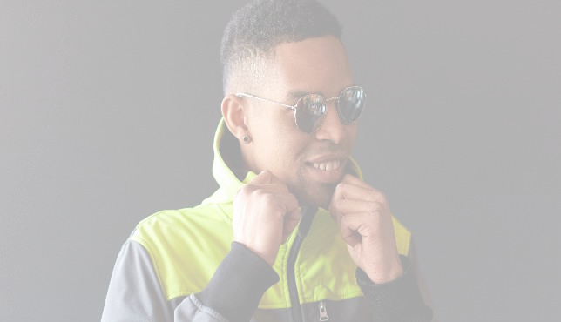

The Emotional Connection Multicultural Viewers Have With Their Favorite
TV Characters / Personalities Can Also Influence Their Personal Style Choices
% vs. Non-Hispanic White 18+
Black A18+
Hispanic A18+
Asian A18+
‘I have modeled my personal style after one of my favorite TV personalities or characters’
‘I have purchased clothing similar to what my favorite TV personality or character wears on the show’
+135%
+167%
+167%
+161%
+126%
+71%
21%
24%
24%
30%
26%
20%
Spanish-Language Speakers
are 16% more likely than Hispanic A18+ to have modeled their personal style after one of their favorite TV personalities / characters
Black A18-34
are 26% more likely than Non-Hispanic White A18-34 to purchase clothing that is similar to what their favorite TV personality / character wears on the show
XX%
= % of Respondents
Source: VAB / Dynata ‘Multicultural Video Engagement Survey,’ August 2019. Q11: Which of the following statements are true for you? Select any or all that apply. African American/Black/Caribbean American = 302 Respondents, Hispanic = 300 Respondents, Asian American/Pacific Islander = 100 Respondents, Non-Hispanic White = 300 Respondents.
This information is exclusively provided to VAB members and qualified marketers. Further distribution is prohibited.
24

Slide 25
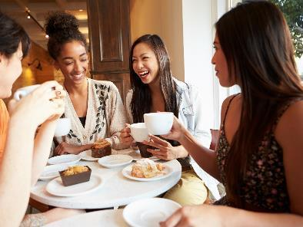

Culturally Relevant TV Programming Is More Likely To Inspire Viewers When It Comes To Food, Both At Home Or At A Restaurant
% vs. Non-Hispanic White 18+
‘I have eaten at a restaurant / purchased a cook book because it, or it’s chef / owner / author, was featured on a TV show’
‘I was inspired to make a food recipe based on a TV show or segment’
+36%
+63%
+34%
+14%
+17%
+12%
30%
36%
30%
31%
32%
31%
XX%
= % of Respondents
Source: VAB / Dynata ‘Multicultural Video Engagement Survey,’ August 2019. Q11: Which of the following statements are true for you? Select any or all that apply. African American/Black/Caribbean American = 302 Respondents, Hispanic = 300 Respondents, Asian American/Pacific Islander = 100 Respondents, Non-Hispanic White = 300 Respondents.
This information is exclusively provided to VAB members and qualified marketers. Further distribution is prohibited.
25

Slide 26

TV programming is also more likely to inspire Multicultural audiences to take on a home improvement project, especially among Hispanic viewers
% vs. Non-Hispanic White 18+
Black A18+
Hispanic A18+
Asian A18+
‘I have done a home improvement project inspired by something I saw on a TV show’
+17%
+58%
+26%
20%
26%
21%
XX%
= % of Respondents
Source: VAB / Dynata ‘Multicultural Video Engagement Survey,’ August 2019. Q11: Which of the following statements are true for you? Select any or all that apply. African American/Black/Caribbean American = 302 Respondents, Hispanic = 300 Respondents, Asian American/Pacific Islander = 100 Respondents, Non-Hispanic White = 300 Respondents.
26
This information is exclusively provided to VAB members and qualified marketers. Further distribution is prohibited.

Slide 27

Igniting Involvement
Beyond inspiring purchase decisions, culturally relevant TV programming is a ‘force for good’ and can motivate multicultural audiences to get involved in social causes that are important within today’s society

Slide 28
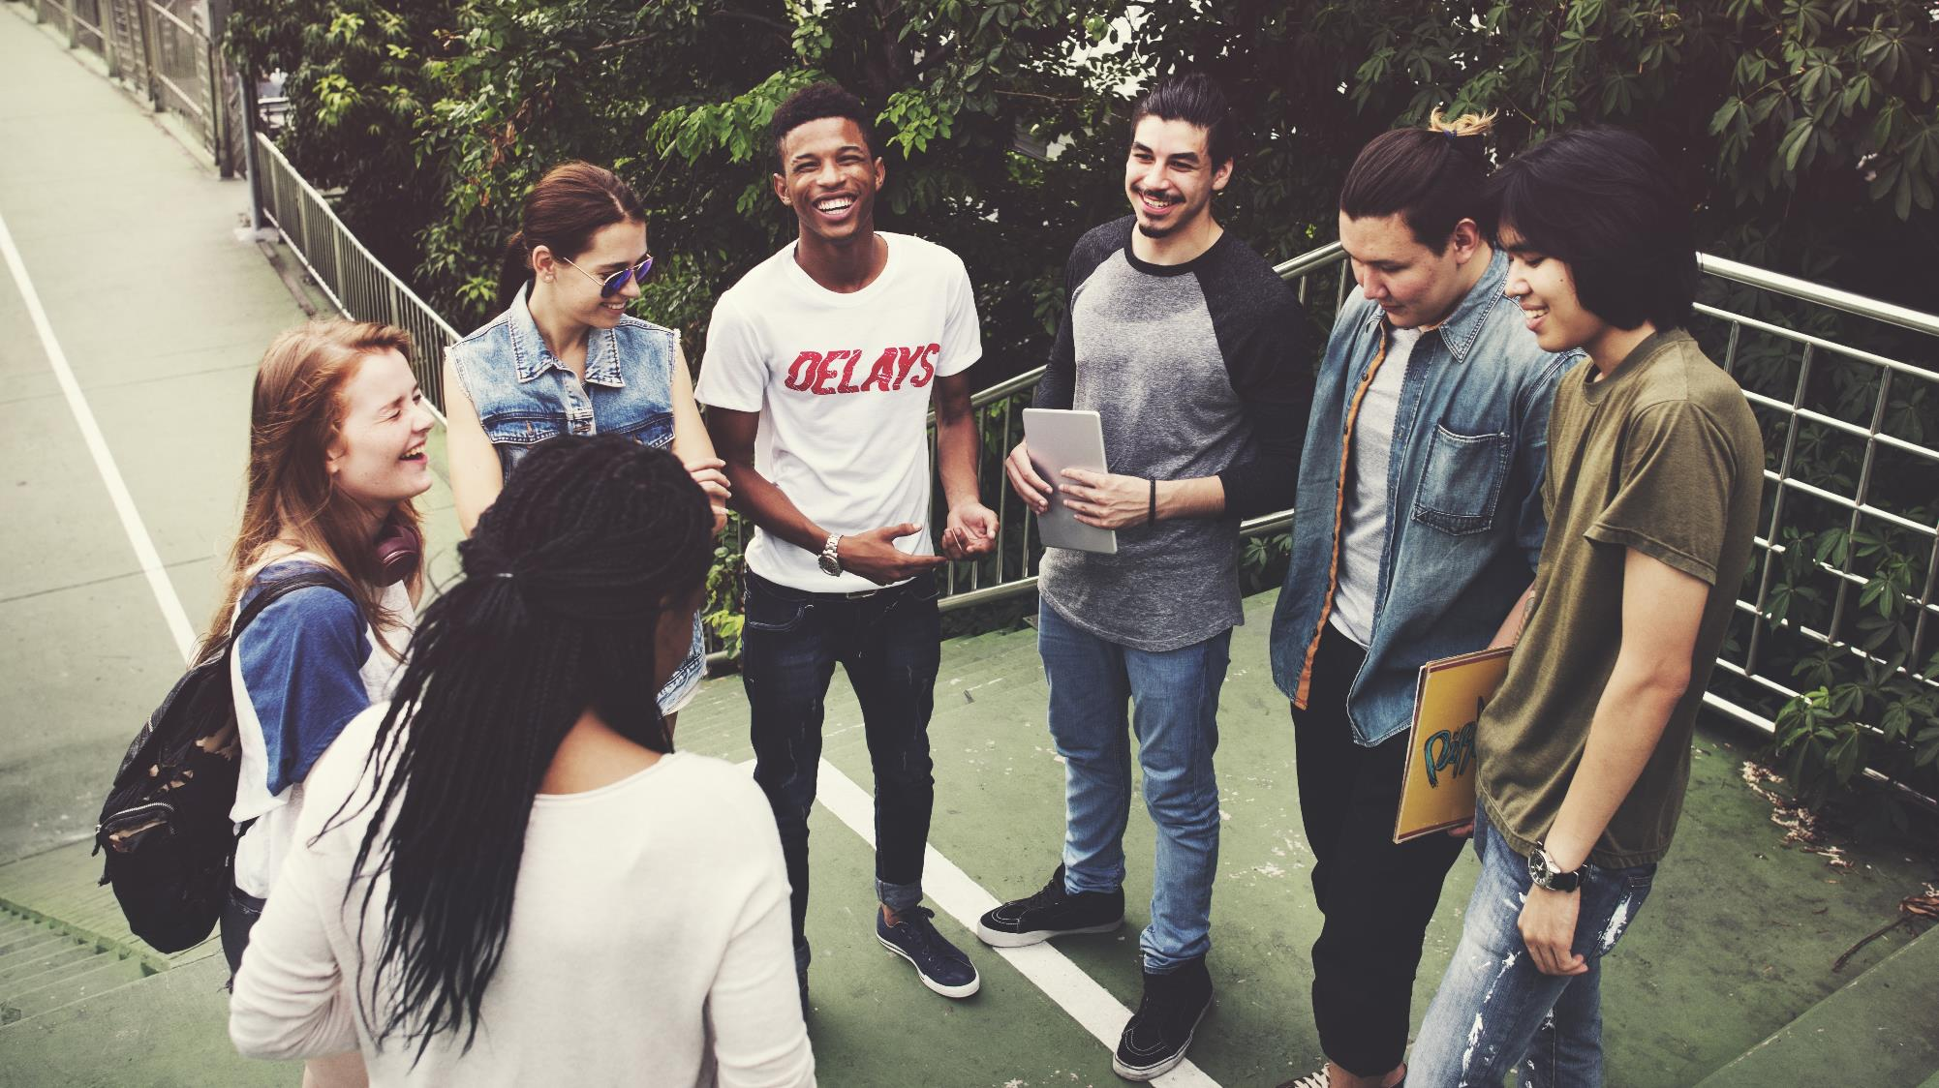
TV programming plays an important role when it comes to inspiring viewers to get involved in social issues that are critical to their community, especially for Black audiences
% vs. Non-Hispanic White 18+
Black A18+
Hispanic A18+
Asian A18+
‘I felt inspired to take a social action / take up a cause because of something I saw on a TV program’
+96%
+88%
+68%
27%
26%
23%
‘I felt inspired to have sought out more info about a social cause
or historical event because of something I saw on a TV program’
Black & Hispanic A18-34
are 23% more likely than Non-Hispanic White A18-34 to have sought out more information about a social cause or a historical event because of something they saw on TV
+63%
+39%
+26%
37%
32%
29%
Source: VAB / Dynata ‘Multicultural Video Engagement Survey,’ August 2019. Q12: Which of the following actions have you taken as a result of something you saw on a TV program? African American/Black/Caribbean American = 302 Respondents, Hispanic = 300 Respondents, Asian American/Pacific Islander = 100 Respondents, Non-Hispanic White = 300 Respondents.
XX%
= % of Respondents
28
This information is exclusively provided to VAB members and qualified marketers. Further distribution is prohibited.

Slide 29
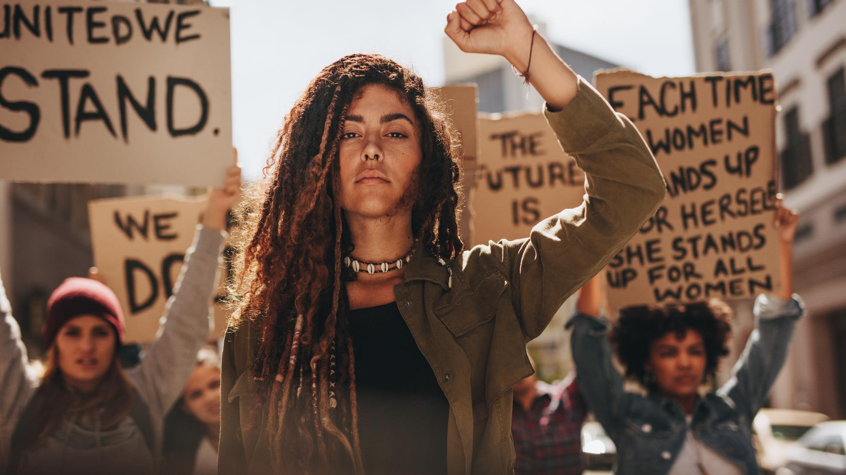
Powerful And Culturally Relevant Storytelling Within TV Content Also Has
The Ability To Energize Multicultural Audiences To Make Their Voices Heard
% vs. Non-Hispanic White 18+
Black A18+
Hispanic A18+
Asian A18+
‘I felt inspired to attend a rally / protest because of something I saw on a TV program’
‘I felt inspired to sign a petition because of something I saw on a TV program’
+165%
+128%
+67%
+59%
+33%
+12%
16%
14%
10%
23%
19%
16%
XX%
= % of Respondents
Source: VAB / Dynata ‘Multicultural Video Engagement Survey,’ August 2019. Q12: Which of the following actions have you taken as a result of something you saw on a TV program? African American/Black/Caribbean American = 302 Respondents, Hispanic = 300 Respondents, Asian American/Pacific Islander = 100 Respondents, Non-Hispanic White = 300 Respondents.
This information is exclusively provided to VAB members and qualified marketers. Further distribution is prohibited.
29

Slide 30

‘I felt inspired to register to vote because of something I saw on a TV program’
Multicultural audiences are also much more likely to make their voices heard as a new voter at the ballot box due to something they watched within TV content
+116%
+95%
+50%
29%
26%
20%
% vs. Non-Hispanic White 18+
Black A18+
Hispanic A18+
Asian A18+
XX%
= % of Respondents
Source: VAB / Dynata ‘Multicultural Video Engagement Survey,’ August 2019. Q12: Which of the following actions have you taken as a result of something you saw on a TV program? African American/Black/Caribbean American = 302 Respondents, Hispanic = 300 Respondents, Asian American/Pacific Islander = 100 Respondents, Non-Hispanic White = 300 Respondents.
This information is exclusively provided to VAB members and qualified marketers. Further distribution is prohibited.
30

Slide 31
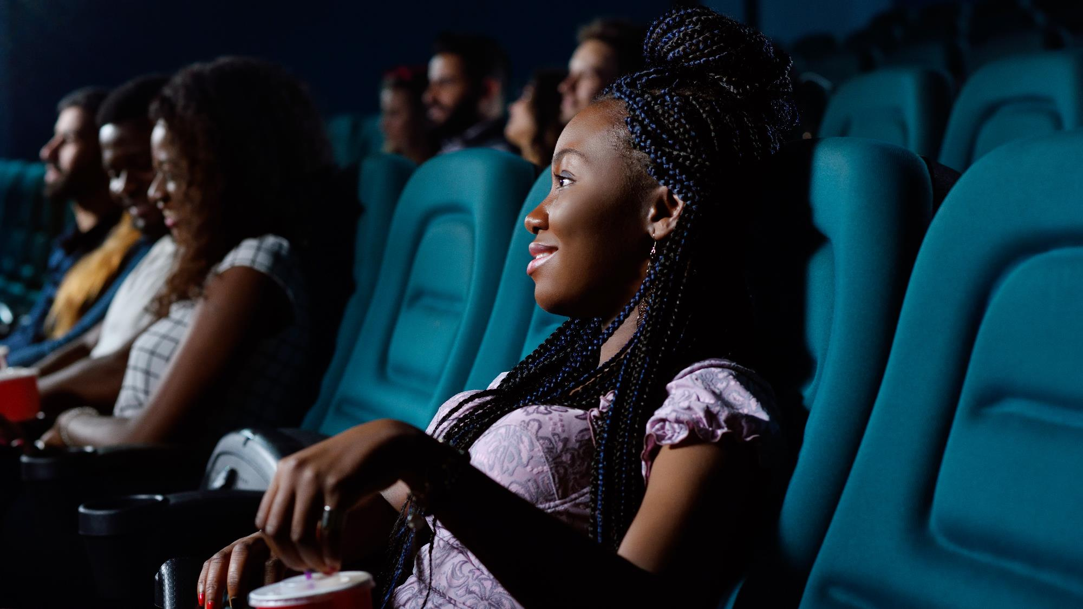
Exploring
The Cinematic Experience
How Multicultural representation
in Cinema leads to box office successes and how advertising drives the avid multicultural moviegoer to take consumer action

Slide 32
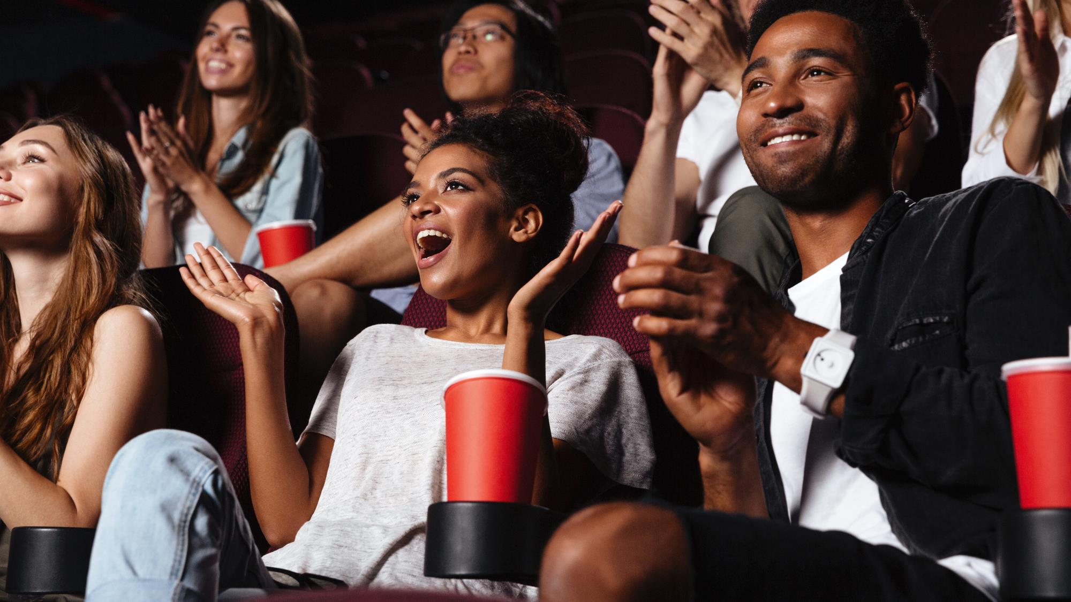

Cinema Over Indexes Against Multicultural Audiences – They Are Avid
Movie Goers And Over One-Third Have Attended A Movie In The Past Month
% vs. Non-Hispanic White 18+
Black A18+
Hispanic A18+
Asian A18+
Have you been to the movie theater in the past month?
Have you been to the movie theater in the past week?
+29%
+25%
+45%
+54%
+62%
+58%
39%
38%
44%
27%
29%
28%
XX%
= % of Respondents
Source: VAB / Dynata ‘Multicultural Video Engagement Survey,’ August 2019. Q14: When was the last time you attended a movie in the theater in the last 12 months? African American/Black/Caribbean American = 302 Respondents, Hispanic = 300 Respondents, Asian American/Pacific Islander = 100 Respondents, Non-Hispanic White = 300 Respondents.
This information is exclusively provided to VAB members and qualified marketers. Further distribution is prohibited.
32

Slide 33



Recent Relevant Films With Predominantly Black, Hispanic / Latino Or Asian Casts Have Been Very Effective At Over Delivering Multicultural Audiences
Average Audience Composition by Ethnicity
35%
49%
38%
African-American / Black
Hispanic/Latino
Asian/Pacific Islander
African-American/Black Moviegoers were 3x more likely to see Black Panther vs. average attendance
Hispanic/Latino Moviegoers were 2.5x more likely to see The Curse of La Llorona vs. average attendance
Asian Moviegoers were 5x more likely to see Crazy Rich Asians vs. average attendance
Source: MPAA, 2018 Theme Report, Comscore/Screen Engine; MarketWatch, Strong Asian-American turnout helped propel ‘Crazy Rich Asians’ to No. 1, Warner Bros. demographic information, 8/21/2018; Deadline, How Hispanic Audiences Drove New Line’s ‘La Llorona’ To $26.5M Easter Weekend B.O. Win, 4/21/2019.
This information is exclusively provided to VAB members and qualified marketers. Further distribution is prohibited.
33

Slide 34

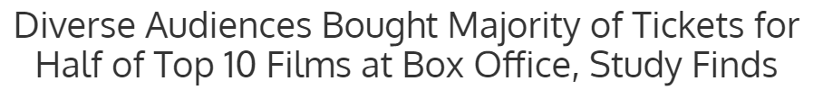





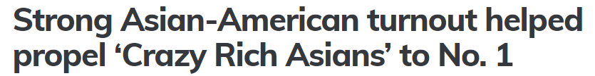
Due to their passion and desire to seek out relevant and entertaining content, Multicultural audiences have driven the major successes of several recent films that featured a diverse cast
34
This information is exclusively provided to VAB members and qualified marketers. Further distribution is prohibited.

Slide 35
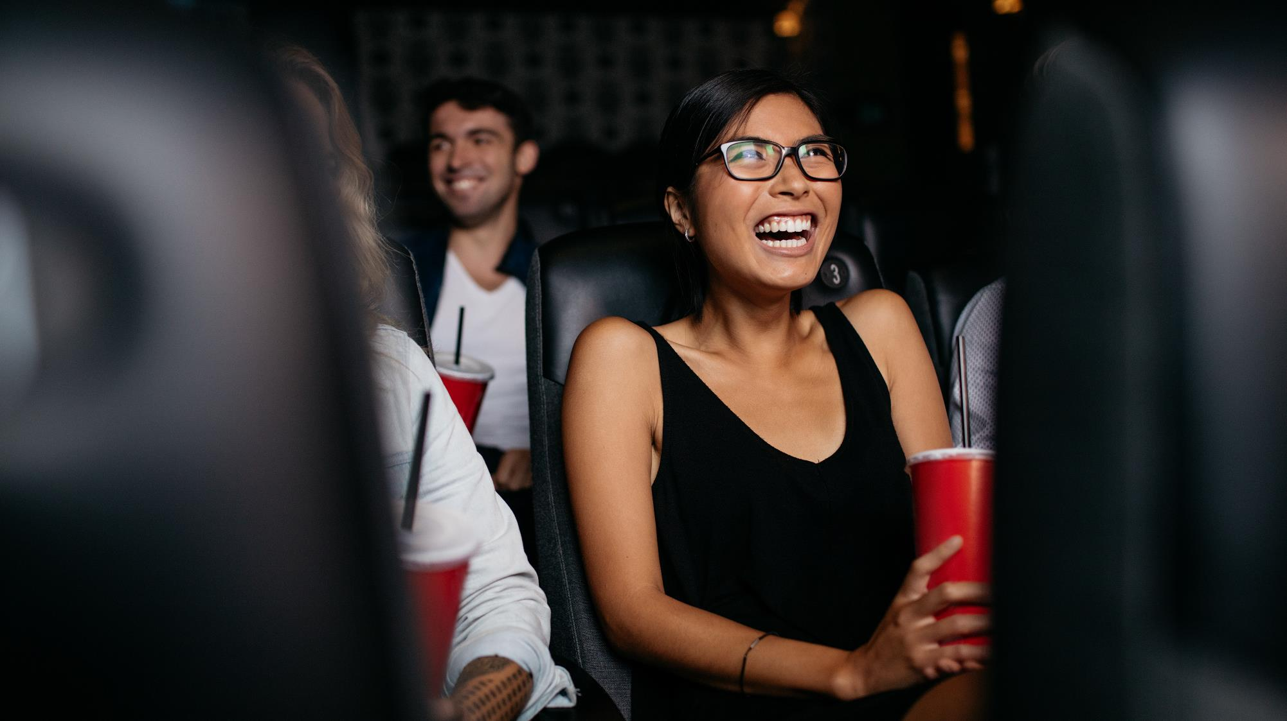



Driving Consideration & Intent: Multicultural Audiences Are More Likely To Engage With Cinema Advertisers Through In-Theater Games, Social Media And Brand Websites
% vs. Non-Hispanic White 18+
Black A18+
Hispanic A18+
Asian A18+
Have You Taken the Following Actions After Seeing an Ad in a Movie theater?
Interact with cinema advertising through interactive polling, games, trivia, etc.
+81%
+72%
+68%
73%
69%
67%
Connect on social media with a brand that I saw advertised
+104%
+94%
+83%
75%
71%
67%
Visit a brand’s website on my mobile phone to get more information about a product I saw advertised
+59%
+61%
+71%
80%
80%
85%
XX%
= % of Respondents
Source: VAB / Dynata ‘Multicultural Video Engagement Survey,’ August 2019. Q16: How often do you interact with cinema advertising through interactive polling, games, trivia, etc.? Q17: How often have you done the following as a result of seeing an advertisement in the movie theater or in the theater lobby? Q15: After seeing an ad in a movie theater, how often do you visit a brand’s website on your mobile phone to get more information about a product you saw advertised? Respondents Answer = Always, Frequently or Occasionally. African American/Black/Caribbean American = 302 Respondents, Hispanic = 300 Respondents, Asian American/Pacific Islander = 100 Respondents, Non-Hispanic White = 300 Respondents.
This information is exclusively provided to VAB members and qualified marketers. Further distribution is prohibited.
35

Slide 36
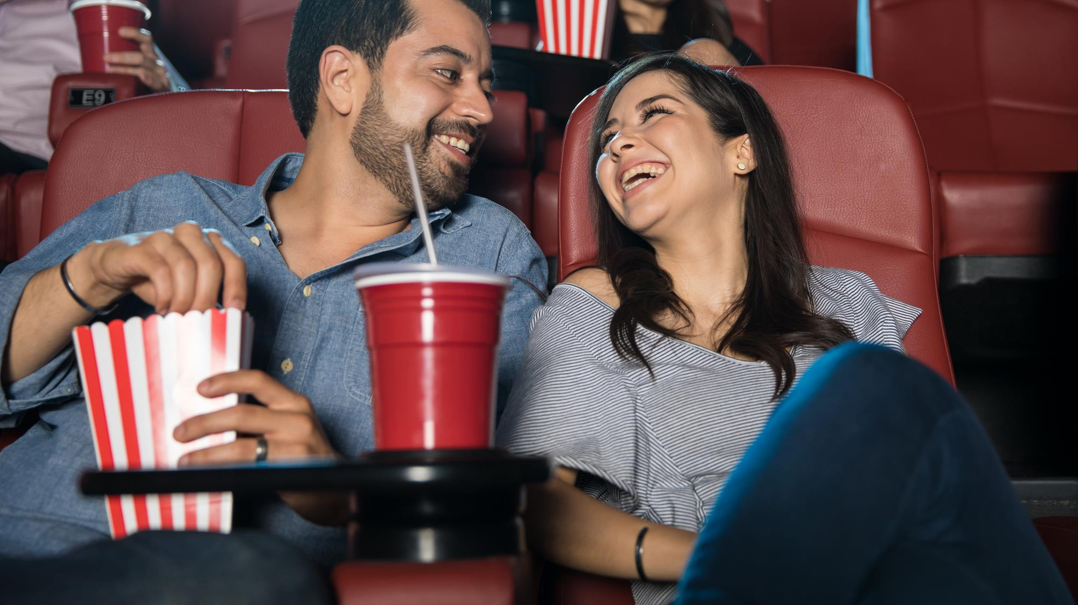
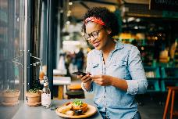

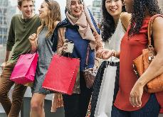

Inspiring Purchases: Beyond Buying Movie Tickets, Multicultural Audiences Are Also More Likely To Actively Spend On Brands They See Advertised Within Cinema
Have You Taken the Following Actions After Seeing an Ad in a Movie Theater?
% vs. Non-Hispanic White 18+
Black A18+
Hispanic A18+
Asian A18+
Go out dining
+51%
+48%
+50%
84%
82%
83%
Go to a live event you saw advertised
+73%
+65%
+62%
69%
66%
64%
Go out shopping
+74%
+64%
+67%
79%
75%
76%
Purchase a product I saw advertised
+55%
+53%
+44%
XX%
= % of Respondents
78%
77%
73%
Source: VAB / Dynata ‘Multicultural Video Engagement Survey,’ August 2019. Q17: How often have you done the following as a result of seeing an advertisement in the movie theater or in the theater lobby? Respondents Answer = Always, Frequently or Occasionally. African American/Black/Caribbean American = 302 Respondents, Hispanic = 300 Respondents, Asian American/Pacific Islander = 100 Respondents, Non-Hispanic White = 300 Respondents.
This information is exclusively provided to VAB members and qualified marketers. Further distribution is prohibited.
36

Slide 37
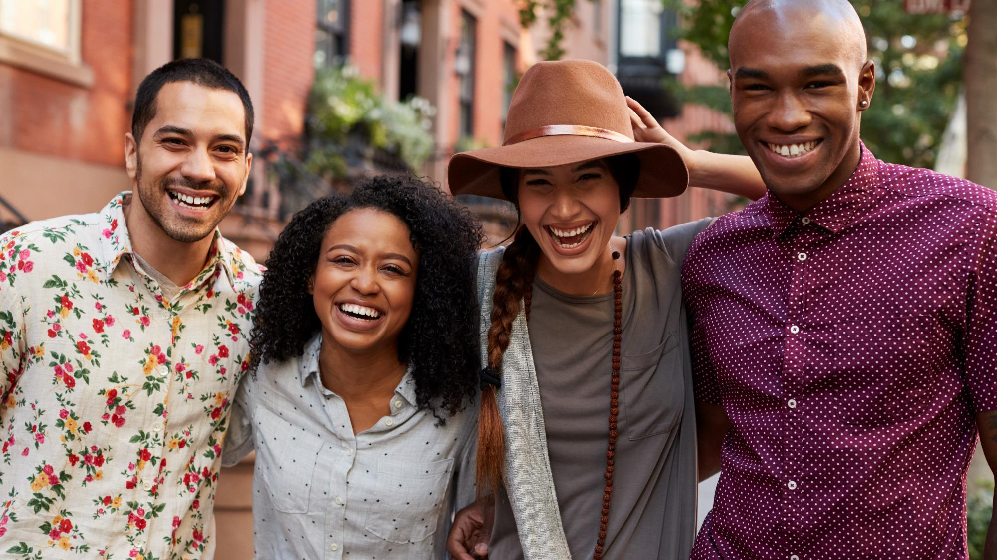






In Summary, Multicultural Audiences Are…
Black, Hispanic & Asian Americans will account for 40% of the U.S. population by 2023 and will only continue to grow. Although younger, they spend nearly $2.2 Trillion annually, a 57% increase over the last 10 years
Deeply Committed to Relevant Programming
Passionate About ‘Sharing’ Their Favorite TV Programs
A Big Opportunity for Marketers
Multicultural viewers are more likely to watch a TV show if it is relevant to their own cultural identity, it has a diverse cast and / or it features relatable TV personalities or characters
They feel personally connected to their favorite TV characters and actors and actively seek more information and content online. Conversations with fellow fans online and ‘in real life’ with family & friends fuels their passion
Inspired by TV Content
To Make Purchases
Motivated by TV Content
To Get Involved
Avid, ‘Action-Oriented’ Moviegoers
Because of their emotional connections, TV programs and personalities are more likely to influence everything from their personal style and the way they dress, to what and where they eat, and how they decorate their home
Whether they are attending a rally, signing a petition or registering to vote, culturally relevant TV programming acts as a ‘force for good’ in motivating multicultural viewers to get involved and let their voice be heard
Multicultural audiences have driven the success of many recent films featuring diverse casts. Their passion extends to consumer action as they are more likely
to spend on brands they see advertised within cinema
This information is exclusively provided to VAB members and qualified marketers. Further distribution is prohibited.
37

Slide 38




For more information visit us online
TheVAB.com
Register for Complimentary Access to
VAB Insights
Follow us:
@VABIntel
Follow us:
VAB

