Slide 1


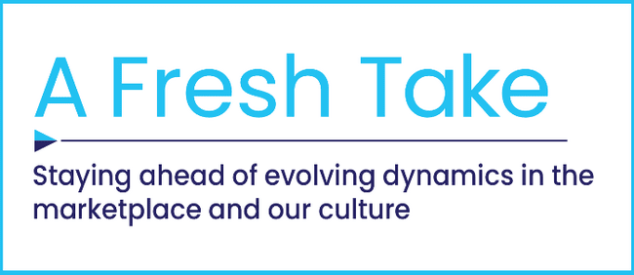


Disconnect to Reconnect
How Real-Life Shared Experiences Are the Antidote for Social Media Isolation Among Gen Z

Slide 2
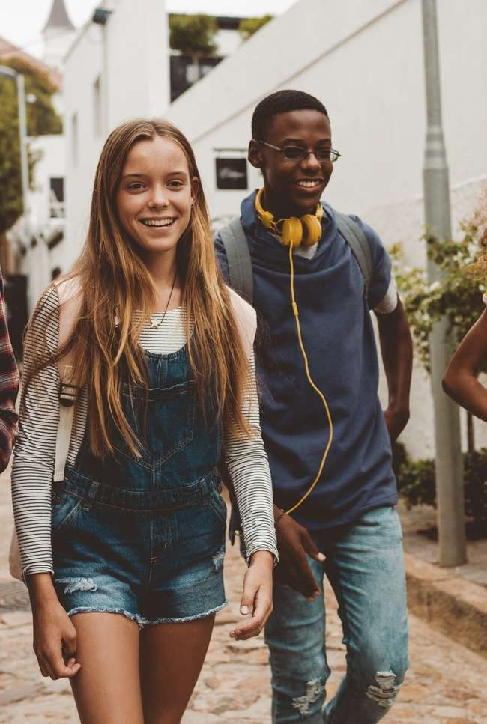

Despite being labeled ‘digital-first’, Gen Z
is increasingly drawn to shared experiences
The negative impacts of social media platforms have become impossible to ignore, including persistent feelings of isolation and unhappiness which has created numerous mental health issues among Gen Z.
As Gen Z steps back from social platforms to improve their mental well-being, they are embracing more positive, real-life shared experiences that instill greater emotional connections and a break from their online lives.
Shared moments - such as watching TV, streaming or theatrical movie releases with friends or family - fosters community and excitement, filling the emotional void created by social media.
By harnessing the deep emotional connections these experiences ignite, brands can develop more impactful campaigns that resonate with Gen Z and drive meaningful consumer engagement.
‘Gen Z’ is typically defined as individuals born between 1997 and 2012 (ages 12-27).
This information is exclusively provided to VAB members and qualified marketers.
PAGE 2

Slide 3

Gen Z’s growing recognition of the real harms caused by social media usage is leading many of them to disconnect

Slide 4


Social media constantly creates negative experiences for Gen Z which makes many feel isolated, sad and unhappy
57%
37%
of Gen Z associate social media with ‘isolation’
of adults 18-24 agree that they often feel sad or unhappy after going on social media*
(vs. 34% in 2021)
Source: Harris Poll via EMARKETER, Gen Z’s love-hate relationship with social media deepens, 9/25/24. *VAB analysis of MRI-Simmons Spring 2024 vs. 2021 USA Study, A18+. Percentages are based on respondents who agreed with the statement, ‘I often feel sad or unhappy after going on social media.’ Any agree.
This information is exclusively provided to VAB members and qualified marketers.
PAGE 4

Slide 5
A significant segment of Gen Z say that social media has hurt them personally and has had an adverse effect on their emotional health
% of A18-27 who believe social media had
a negative impact on their emotional health
29%
of adults ages 18-27 say that social media has
hurt them personally
37%
A18-27
47%
LGBTQ A18-27
44%
Women A18-27
Source: Harris Poll via The New York Times, Gen Z Has Regrets, 09/17/2024. Based on online survey of 1,006 Gen Z adults, aged 18-27 about their beliefs regarding the impact that social media and smartphones have had on them and whether they’d support select reform efforts to address addiction; fielded 8/8/24 – 8/15/24.
This information is exclusively provided to VAB members and qualified marketers.
PAGE 5

Slide 6


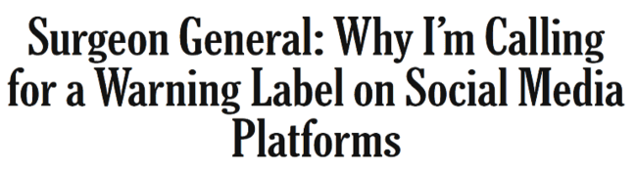





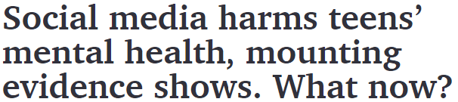


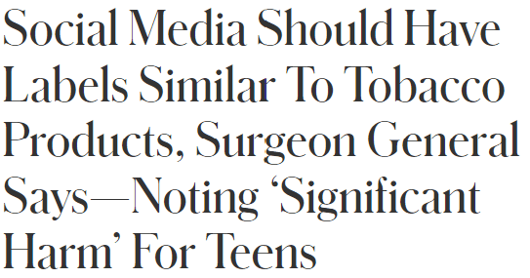

Numerous research studies highlight the mental health risks associated with social media use that impact the overall wellbeing of youths
6/17/2024
9/14/2021
Facebook Knows Instagram Is Toxic for Teen Girls, Company Documents Show
Its own in-depth research shows a significant teen mental-health issue that Facebook plays down in public
‘Social media can cause ‘a range of documented risks that affect heavy users, including sleep deprivation, body image distortion, depression, anxiety, exposure to content promoting suicide and eating disorders, sexual predation and sextortion, and “problematic use,” which is the term psychologists use to describe compulsive overuse that interferes with success in other areas of life.’
- The New York Times, Gen Z Has Regrets (9/17/24)
6/17/2024
10/8/24
TikTok sued by 14 attorneys general over alleged harm to children’s mental health
3/29/2024
2/20/2024
The Social Dilemma: Social Media and Your Mental Health
2/20/2024
Experiment finds limiting social media use can reduce mental health issues in distressed youth
6/17/2024
6/10/2024
I'm always on social media and I'm pretty sure you are, too. Why are we still lonely?
This information is exclusively provided to VAB members and qualified marketers.
PAGE 6

Slide 7
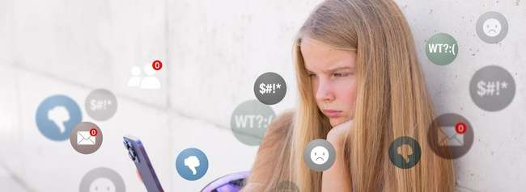
Gen Z views social platforms as unsafe for teenagers and plans to limit their own children's access, with many even supporting bans for minors
% of Gen Z who agree with the following
82%
believes that social media is responsible for the increase in teen depression
45%
Say they “would not or will not allow my child to have a smartphone before reaching high school age”*
(i.e. about 14 years old)
36%
Support social media bans
for those under the age of 18*
Source: YouGov, What Americans think about social media and mental health, 3/11/2023. Based on Gen Z (born 2000 and later) respondents who believe social media is ‘completely’, ‘mostly’ or ‘somewhat’ responsible for the increase in teen depression. *Harris Poll via The New York Times, Gen Z Has Regrets, 09/17/2024.
This information is exclusively provided to VAB members and qualified marketers.
PAGE 7

Slide 8
They also harbor concerns around the harmful and opaque practices of social media platforms
I don't think social media platforms do enough to delete harmful content
I'm sharing less data
with platforms because
it's too hard to track
how it's being used
I'm concerned about the polarization of political opinion on social media
I feel manipulated by the algorithms and rules which control what content I see
Source: Marigold, 2024 U.S. Consumer Trends Index.
This information is exclusively provided to VAB members and qualified marketers.
PAGE 8

Slide 9
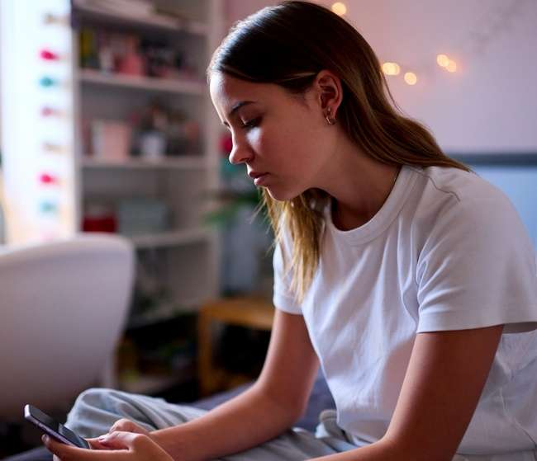
These concerns extend to the advertising experience on social media platforms, which many find to be annoying
% of Gen Z who agree with the following regarding their experience with social media websites or apps*
65%
43%
are concerned about malware, viruses, buffering and other issues
often find themselves feeling annoyed / frustrated with the video ad experience
Source: VAB custom research fielded by Hub Entertainment Research as part of the 2023 Conquering Content report. Data sourced from Hub’s survey of 1,600 TV consumers, ages 16-74 who meet the following criteria: watch at least one hour of TV / week, have broadband access / U.S. Census balanced. Data collected October 2023. QVAB2: How often do you find yourself feeling annoyed / frustrated with the video ad experience on the following platforms? QVAB3: How concerned are you with malware, viruses, buffering etc. when watching video ads on the following apps or websites? Based on respondents aged 16-24.
This information is exclusively provided to VAB members and qualified marketers.
PAGE 9

Slide 10

Most of Gen Z don’t trust the advertising they see on social media platforms either
58%
of Gen Z don't trust
the advertising they see
on social media
Source: Marigold, 2024 U.S. Consumer Trends Index.
This information is exclusively provided to VAB members and qualified marketers.
PAGE 10

Slide 11







Due to all their issues with social media, many of Gen Z have even gone so far as to wish that the major platforms weren’t invented in the first place
Percentage of Gen Z respondents who agree with the statement
“I wish ___ had never been invented”
Smartphones
Internet
Source: Harris Poll via The New York Times, Gen Z Has Regrets, 09/17/2024.
This information is exclusively provided to VAB members and qualified marketers.
PAGE 11

Slide 12



As a result, Gen Z is disconnecting from social media, seeking relief from its negative impact and upsetting content
% of Gen Z respondents who agree with the following
83%
54%
51%
Have taken steps to distance themselves from social media
(e.g., turning off in-app notifications, deleting accounts, or muting and unfollowing certain users)
Have closed or stopped using an account in the last year because they’ve been upset by posts they’ve seen*
Are actively engaging less with social media for the sake of their mental health*
Source: Harris Poll via EMARKETER, Gen Z’s love-hate relationship with social media deepens, 9/25/24. *Marigold, 2024 U.S. Consumer Trends Index.
This information is exclusively provided to VAB members and qualified marketers.
PAGE 12

Slide 13

Gen Z has significantly cut down on the time they spend on social media platforms, signaling a broader shift in their behavior
-25%
A18-24 YoY Total Time Spent
on Social Networking Apps
(Snapchat, Facebook, TikTok, X, Instagram)
May - July ‘23 vs. May - July ’24
Source: VAB analysis of Comscore Media Metrix multiplatform media trend data (includes mobile, desktop). Based on A18-24 total minutes spent during a three-month period YoY (May – July ‘23 vs. May – July ’24) across Snapchat, Facebook, TikTok, X and Instagram.
Among P13-17, YoY time spent was down -18% across Snapchat, Facebook, TikTok, X and Instagram (desktop only, excludes mobile).
This information is exclusively provided to VAB members and qualified marketers.
PAGE 13

Slide 14

"Gen Z is championing a slower, more thoughtful approach to life. They're reminding us all that in our fast-paced, instant-everything world, there's still a place for the slow development of film, the excitement of unexpected outcomes, and the lasting value of holding a piece of history in your hands."
Sharmin Attaran, Marketing Professor at Bryant University
(Business Insider, 5/9/23)
This information is exclusively provided to VAB members and qualified marketers.
PAGE 14

Slide 15
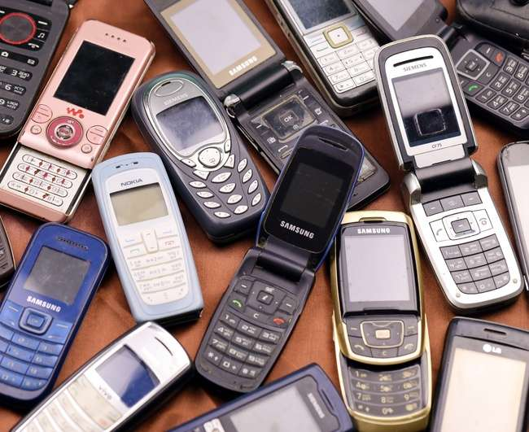


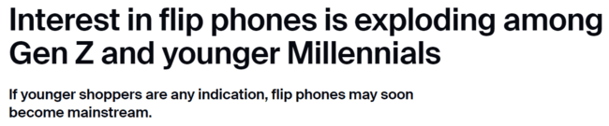
To get away from the toxicity of social media, some Gen Z are adopting flip phones instead, finding they allow them to live in the moment more easily
11/21/23
The hashtag #flipphone is trending and has more than 830 million views on TikTok!*
15x
Increase in online searches for flip phones among Gen Z and Millennials from 2022-2023
"2023 [was] the year that many young people have reflected on their digital lives. Remembering the simpler times of tech in the noughties and the trends of that era are also coming back around.“
- Liam Howley, CMO, Decluttr
Source: ZDNET, Interest in flip phones is exploding among Gen Z and younger Millennials, 11/21/2023. *CNBC, How Gen Z uses technology – flip phones, digital cameras, voice memos, 10/17/23.
This information is exclusively provided to VAB members and qualified marketers.
PAGE 15

Slide 16


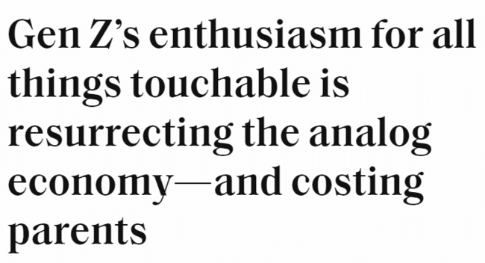



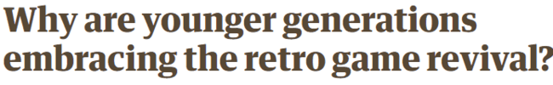
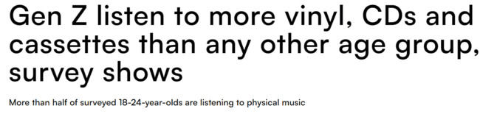
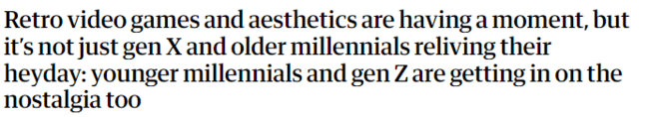
They are even turning to technology and games that directly satisfy their desire for more tangible, authentic experiences
7/5/2024
10/17/2023
4/2/2024
4/19/2024
This information is exclusively provided to VAB members and qualified marketers.
PAGE 16

Slide 17
Gen Z is counteracting the negative effects
of social media by embracing real-life shared experiences with friends and family through TV, streaming and cinema

Slide 18

As they seek out authentic experiences, many Gen Z are returning more to socializing in-person with friends to relieve stress and boost their mood
25%
of Gen Z have socialized with others specifically to relieve stress
+56% vs. 2021 (+16%)
Source: VAB analysis of MRI-Simmons Spring 2024 vs. 2021 USA Study, A18+. Based on A18-24 respondents who said they have socialized to relieve stress in the last 30 days.
This information is exclusively provided to VAB members and qualified marketers.
PAGE 18

Slide 19
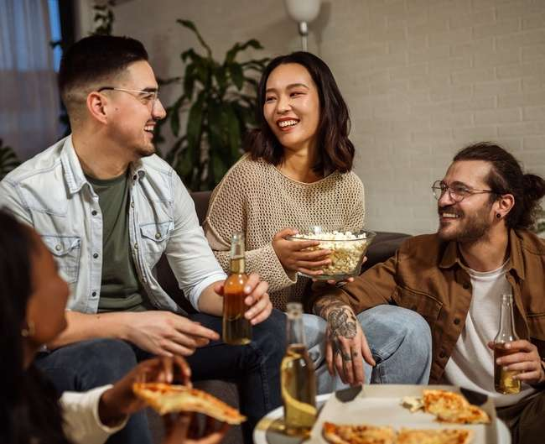

They are also spending more time socializing at home with friends and family to satisfy their craving for shared, tangible experiences
30%
of Gen Z enjoy entertaining friends or relatives at home
+7% vs. 2019 (28%)
Source: VAB analysis of MRI-Simmons Spring 2024 vs. 2019 USA Study, A18+. Percentages are based on A18-24 respondents who have entertained friends or relatives at home in the last 12 months.
This information is exclusively provided to VAB members and qualified marketers.
PAGE 19

Slide 20
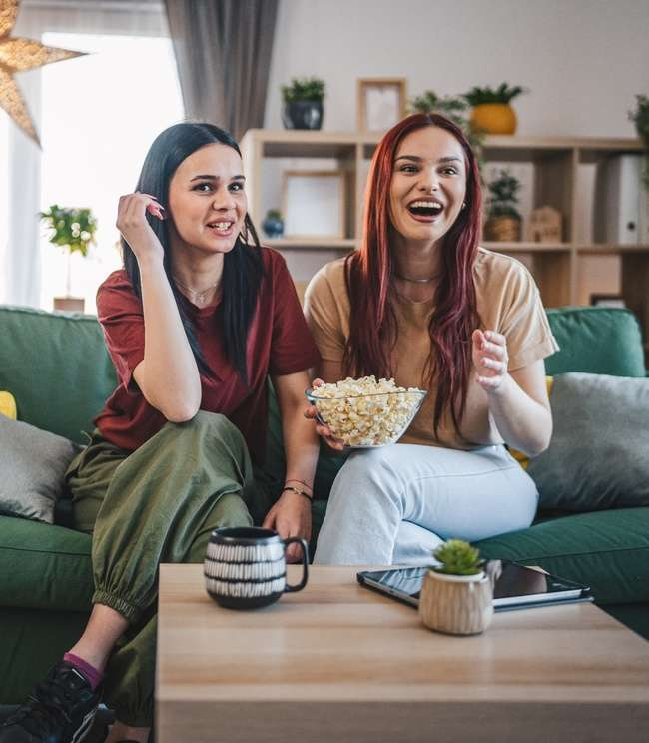

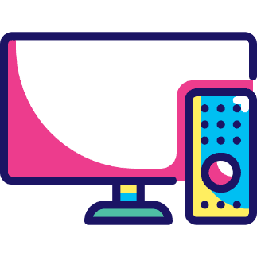
A common bond among most of Gen Z is their passion for long-form, professionally produced content across multiscreen TV
Gen Z’s Passion for Premium Video Across Screens
Streaming
Linear TV
75%
72%
say that they
‘love streaming TV shows’
say that they
‘just love watching TV’
Source: VAB analysis of MRI-Simmons August 2024 Cord Evolution, Study/ Based on A18-24 respondents, ‘any agree.’
This information is exclusively provided to VAB members and qualified marketers.
PAGE 20

Slide 21



TV and streaming has the power to uplift their moods much more effectively than the major social platforms
% of Gen Z who say something they watched on TV or streaming has…
49%
28%
25%
‘Made me laugh out loud’
‘Brought me to tears’
‘Made me feel overjoyed’
142 Index vs. Instagram (35%)
142 Index vs. TikTok (20%)
170 Index vs. Snapchat (15%)
Source: VAB custom research fielded by Hub Entertainment Research as part of the 2023 Video Redefined report. Data sourced from Hub’s survey of 1,900 consumers, ages 13-74. P13-24 respondents = 620 (unweighted). Data collected December 2023. Q1: Which of the following statements apply to you when you watch videos, shows or movies on the following platforms? Learn more by downloading ‘Laugh, Cry, Share, Buy: How TV & Streaming Influences Gen Z More Than Leading Social Platforms’.
This information is exclusively provided to VAB members and qualified marketers.
PAGE 21

Slide 22


Gen Z audiences use TV and streaming as a primary way to foster shared experiences with friends and family
43%
of Gen Z say when watching
TV or streaming
‘they enjoy the quality time they share with friends / family’
Source: VAB custom research fielded by Hub Entertainment Research as part of the 2023 Video Redefined report. Data sourced from Hub’s survey of 1,900 consumers, ages 13-74. P13-24 respondents = 620 (unweighted). Data collected December 2023. Q1: Which of the following statements apply to you when you watch videos, shows or movies on the following platforms? Learn more by downloading ‘Laugh, Cry, Share, Buy: How TV & Streaming Influences Gen Z More Than Leading Social Platforms’.
This information is exclusively provided to VAB members and qualified marketers.
PAGE 22

Slide 23

They are receptive to advertising, which enables marketers to reach and engage them in relaxed, attentive environments
% of Gen Z respondents who agree with the following
58%
prefer streaming free video content with ads / commercials instead of paying for a subscription without ads / commercials
38%
say the ability to access free content in exchange for ads has motivated them to watch or sign up for a free ad-supported streaming service*
Source: VAB analysis of MRI-Simmons 2024 August Cord Evolution Study, A18+. Based on A18-24 respondents. *VAB custom research fielded by Hub Entertainment Research as part of the 2023 Evolution of Video Branding report. Data sourced from Hub’s survey of 2,400 TV consumers, ages 16-74 who meet the following criteria: watch at least one hour of TV / week, have broadband access. U.S. census balanced. Data collected early February 2023. Q: Which of the following are reasons for why you have watched / signed up for a free ad-supported streaming TV service? Based on respondents aged 16-24.
This information is exclusively provided to VAB members and qualified marketers.
PAGE 23

Slide 24
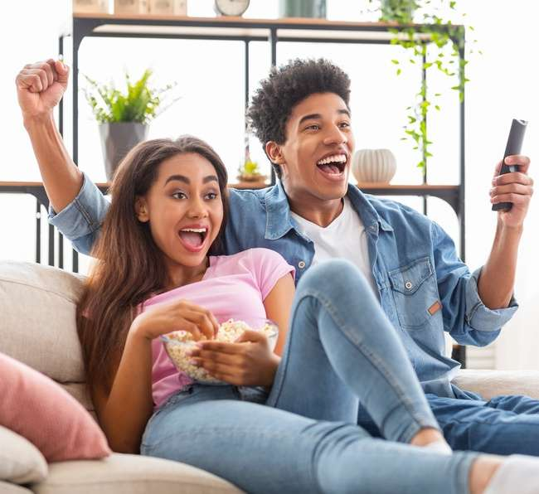
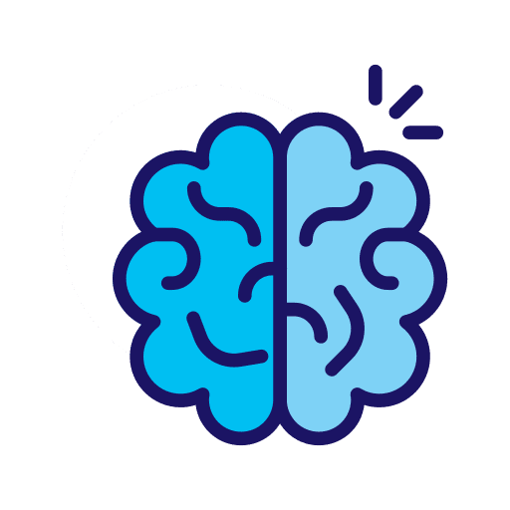
Shared experiences of watching TV in their living room also leads to increases in ad recall
+23%
Increase in ad recall when watching with others in the living room vs. watching alone
Source: Thinkbox UK, Context Effects, Map The Territory & Tapestry Research, 2024. Source: A18. Do you remember seeing any advertising when you watched [occasion]? A10. Who, if anyone, were you watching [occasions] with? Base: 4,005 viewing occasions with ads answered by 2,017 online respondents aged 18-75 who watched any type of video content via any source the previous day. Sample matched to Barb.
This information is exclusively provided to VAB members and qualified marketers.
This information is exclusively provided to VAB members and qualified marketers.
PAGE 24
PAGE 24

Slide 25
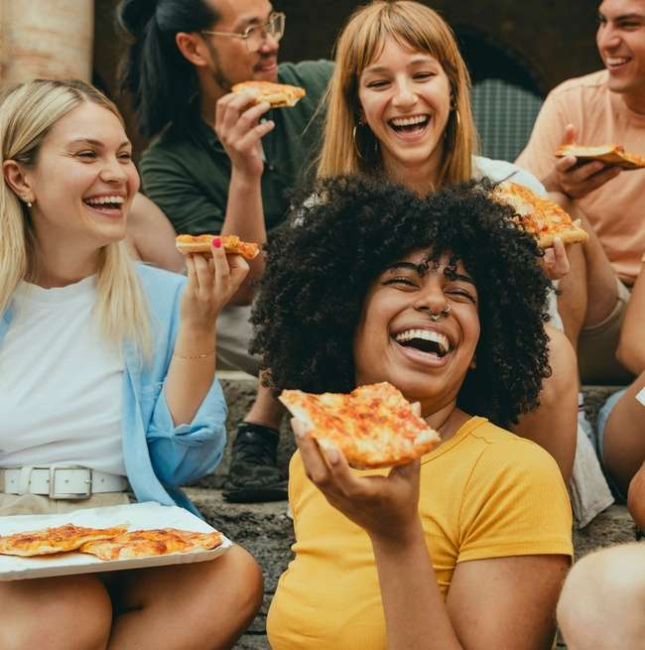

Outside of the home, Gen Z is also increasing their social time with friends and family around their community
% of A18-24 who consider themselves ‘heavy’ socializers
‘Socializing / doing things with friends around town (‘heavy’ # of hrs/wk)
26%
+63% vs. 2022 (16%)
Source: VAB analysis of MRI-Simmons Spring 2024 vs. 2022 USA study, A18+. ‘Socializing / doing things with friends around town’ based on A18-24 respondents who did this activity for a ‘heavy’ number of hours per week as assigned by MRI-Simmons. To learn more, download ‘The Pursuit of Happyness: How Mood Lights Up Ad Engagement at the Cinema’.
This information is exclusively provided to VAB members and qualified marketers.
This information is exclusively provided to VAB members and qualified marketers.
PAGE 25
PAGE 25

Slide 26
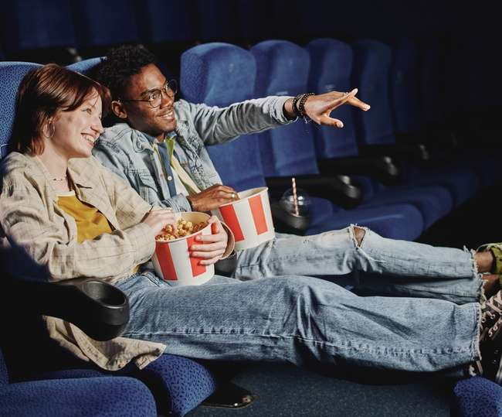

Cinema is a popular destination for Gen Z with nearly two-thirds having gone to see a movie at their local theater in the last six months
% of A18-24 who attended a movie in the last 6 months
63%
+43%
vs. 2021 (44%)
Source: VAB analysis of MRI-Simmons Spring 2024 vs. Spring 2021 USA study, A18-24. To learn more, download ‘The Pursuit of Happyness: How Mood Lights Up Ad Engagement at the Cinema’.
This information is exclusively provided to VAB members and qualified marketers.
PAGE 26

Slide 27



A universally ‘shared’ experience, cinema fosters social connection and bonding between family and friends
% of moviegoers that…
98%
of viewing at the movie theater is ‘co-viewing’ with others in your group
88%
say ‘shared experiences’ provide
a sense of social connection
and bonding that creates
lasting memories they cherish*
80%
say going to the movies
brings family and friends together**
Source: Digital Cinema Media (DCM), Maxmising Cultural Power with Cinema, 2024. Barb / TRP / 2023 / All devices + DCM, 2024 YTD. *NCM, Moviegoing Audience Insights, Behind-The-Screens (BTS) Online Community, November/December 2023, Base: A18+ Moviegoers. **The Cinema Foundation, ‘The Value of A Movie Ticket’, April 2023.
This information is exclusively provided to VAB members and qualified marketers.
PAGE 27

Slide 28
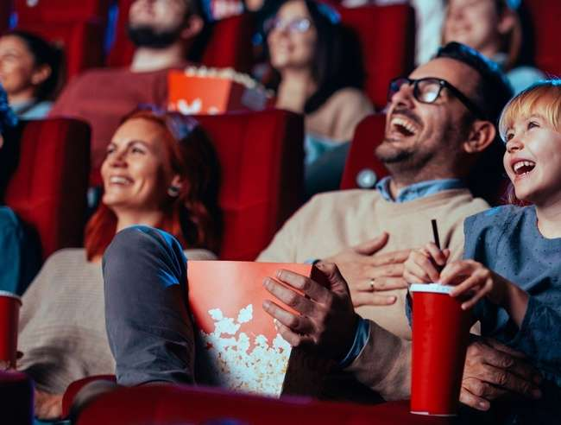
Because of their shared experience, people are much more likely to be in a good mood at the movie theater vs. when they are on social media
% of time spent in a good mood
78%
of people who visit the cinema spend their time there in a good mood
Source: Digital Cinema Media (DCM), Cinema Effectiveness Roadmap, 2023. IPA Touch Points. To learn more, download ‘The Pursuit of Happyness: How Mood Lights Up Ad Engagement at the Cinema’.
This information is exclusively provided to VAB members and qualified marketers.
PAGE 28

Slide 29

TV, streaming and cinema all create positive vibes which makes people more inclined to purchase products they see advertised
Impact of positive mindset on response to advertising
+18%
+35%
Increase in brand favorability
Increase in purchase intent
Source: Hearst, Power of Positivity, 2023. To learn more, download ‘The Pursuit of Happyness: How Mood Lights Up Ad Engagement at the Cinema’.
This information is exclusively provided to VAB members and qualified marketers.
PAGE 29

Slide 30




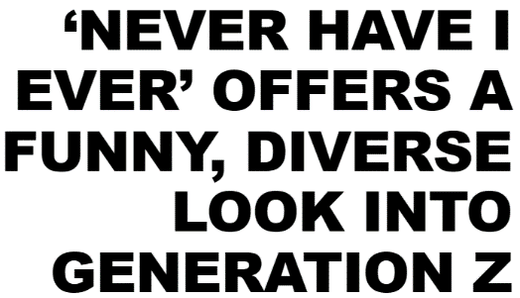


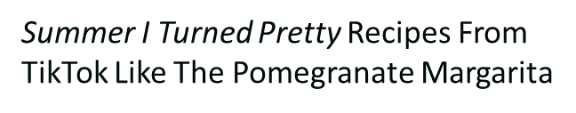


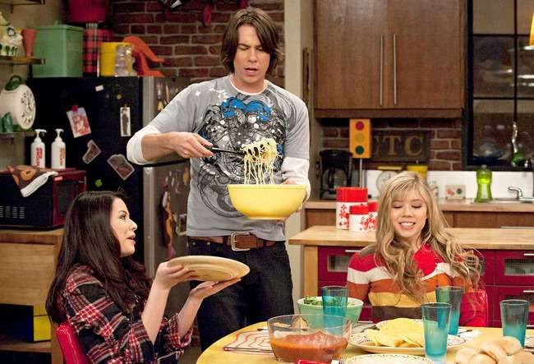

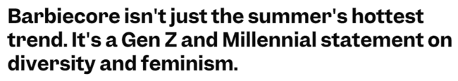
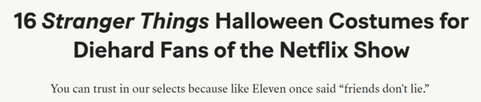


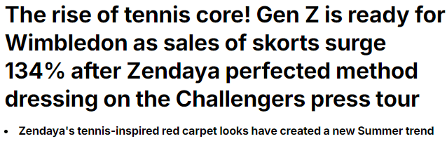


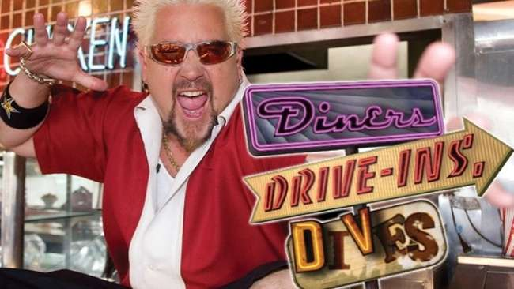
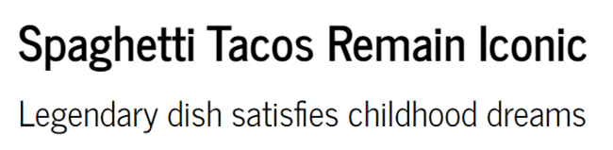

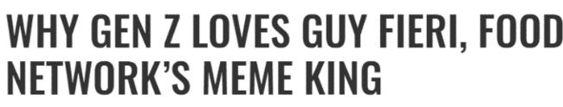
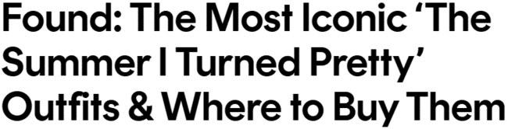

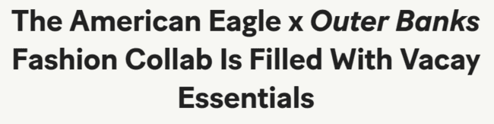

Gen Z eagerly takes inspiration from TV, streaming and movies when planning real-life shared experiences with friends
Sampling of TV & Streaming Shows and Movies Gen Z Pulls Inspiration From
5/7/2020
9/7/2022
10/15/2022
2/20/2024
2/25/2021
5/24/2023
7/24/2022
5/4/2024
2/22/2023
7/24/2023
9/16/2024
This information is exclusively provided to VAB members and qualified marketers.
PAGE 30

Slide 31

Gen Z is pulling back from social media to protect their mental health, choosing more fulfilling, offline activities for connection and a break from negativity
To escape the toxicity of social media, more positive, real-life shared experiences are gaining popularity
as Gen Z seeks tangible and more sociable activities
Shared experiences like watching TV and streaming content and going to the cinema with others provide Gen Z with a sense of community and excitement, standing in contrast to the isolation of social media
High-quality premium video content profoundly influences Gen Z’s mood and behavior, providing brands with a unique opportunity to engage these highly attentive audiences
Key Marketer Takeaways
This information is exclusively provided to VAB members and qualified marketers.
PAGE 31

Slide 32

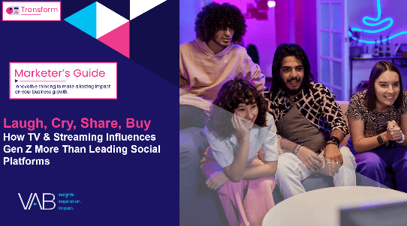
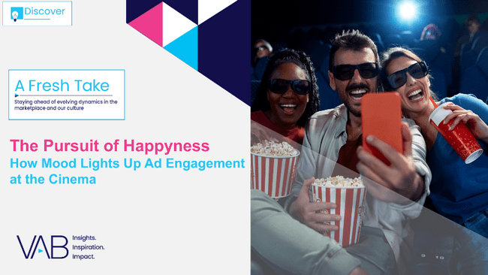
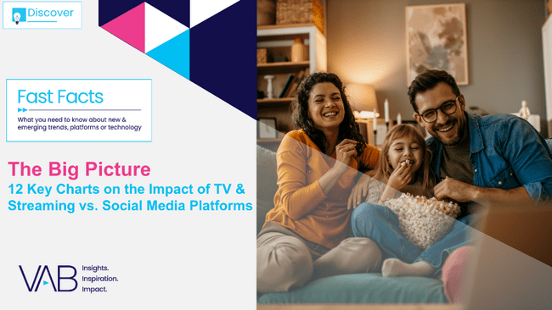
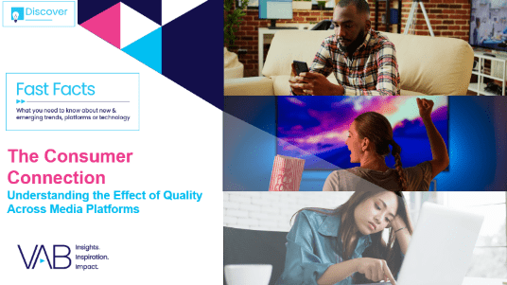

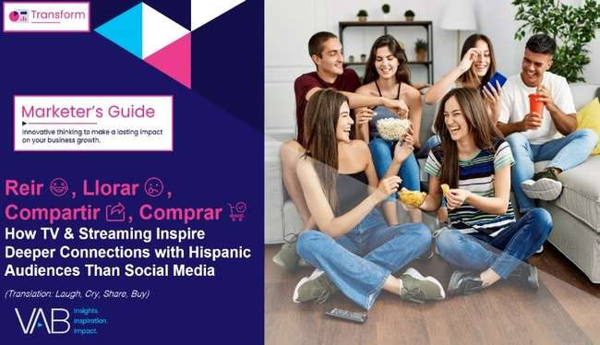
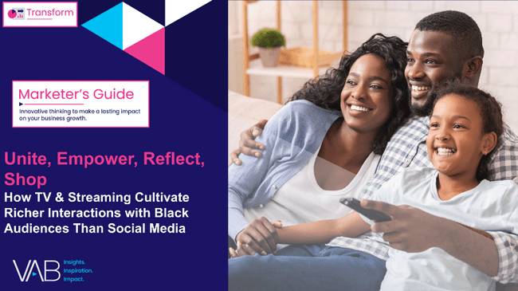

Creators
Jason Wiese
Leah Montner-Dixon
SVP, Director of Strategic Insights
jasonw@thevab.com
Director, Audience & Behavioral Insights
leahm@thevab.com
Kaileen Cain
Laugh, Cry, Share, Buy
How TV & Streaming Influences Gen Z
More Than Leading Social Platforms
The Pursuit of Happyness
How Mood Lights Up Ad Engagement at the Cinema
Senior Insights Analyst
kaileenc@thevab.com
Discover more
Looking for more data, insights and takeaways? Check out this related VAB content
The Big Picture
12 Key Charts on the Impact of TV & Streaming vs. Social Media Platforms
The Consumer Connection
Understanding the Effect of Quality Across Media Platforms
We are committed to providing marketers with the data and insights they need to develop thoughtful, inclusive campaigns & strategies. To find out more on the unique media consumption behaviors and cultural trends of diverse audiences, visit the VAB’s DEIB Marketing Resources.
Reir, Llorar, Compartir, Comprar
How TV & Streaming Inspire Deeper Connections with Hispanic Audiences Than Social Media
Unite, Empower, Reflect, Shop
How TV & Streaming Cultivate Richer Interactions with Black Audiences Than Social Platforms
This information is exclusively provided to VAB members and qualified marketers.
PAGE 32

Slide 33


About VAB
VAB is an insights-driven organization that inspires marketers to reimagine their media strategies resulting in fully informed decisions.
Drawing on our marketing expertise, we simplify the complexities in our industry and discover new insights that transform the way marketers look at their media strategy.
We are committed to your business growth and proud to offer VAB members, brand marketers and agencies complimentary access to our continuously-growing Insights library. Get immediate access at theVAB.com.
This information is exclusively provided to VAB members and qualified marketers.
PAGE 33

