Slide 1


VAB – MARKETER’S GUIDE - 2019
Direct Outcomes
Analyzing The ‘Big Bets’ DTC Brands Are Making On TV

Slide 2
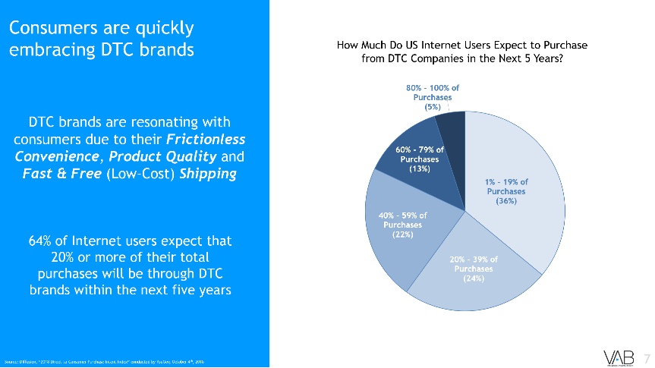
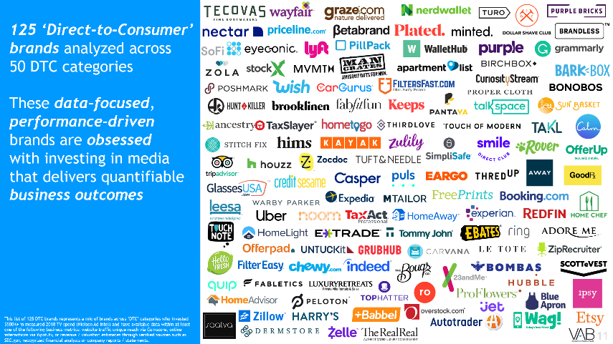
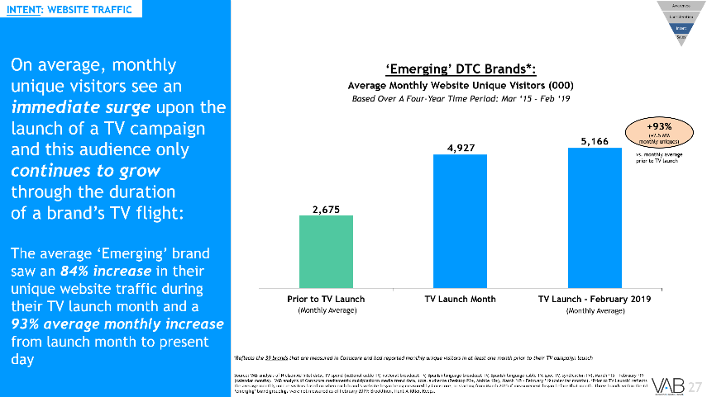
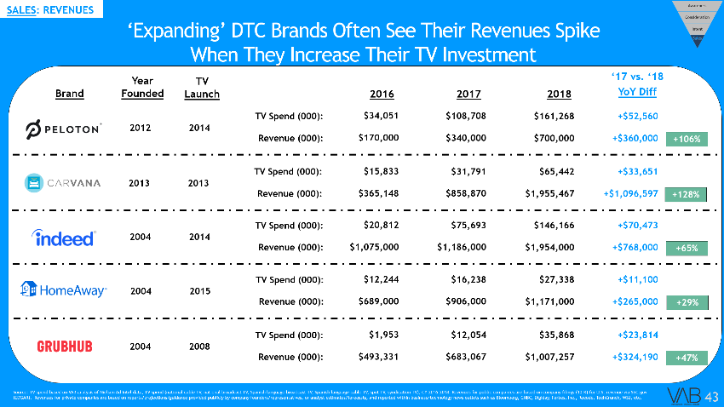
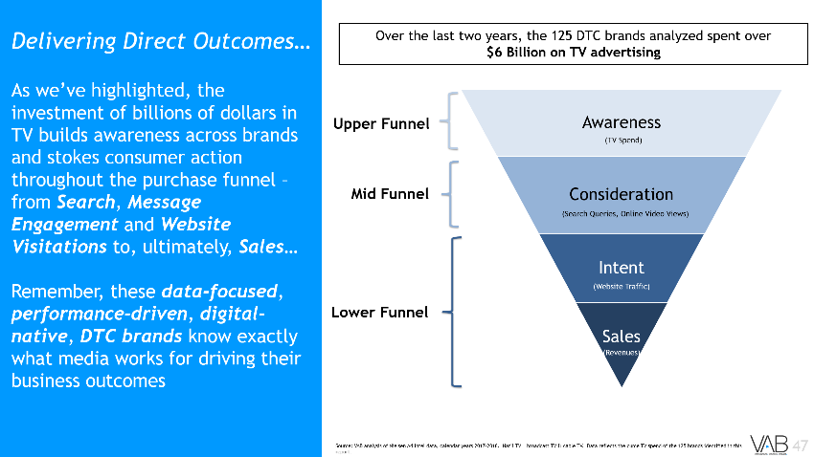
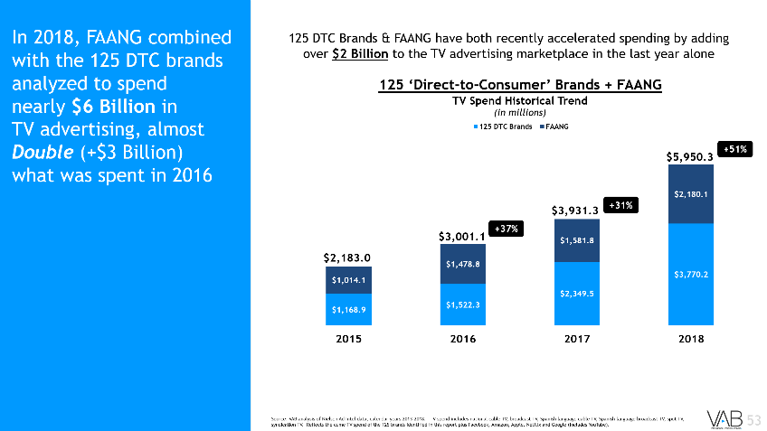

Contents
1
Overview
1
2
2
Direct-to-Consumer Analysis Summary
3
3
‘Emerging’ DTC Brand Segment
4
4
‘Expanding’ DTC Brand Segment
5
5
Unboxing The Outcomes
6
6
Additional Set of Digital-Native, Data-Focused, Outcomes-Obsessed Brands
2

Slide 3


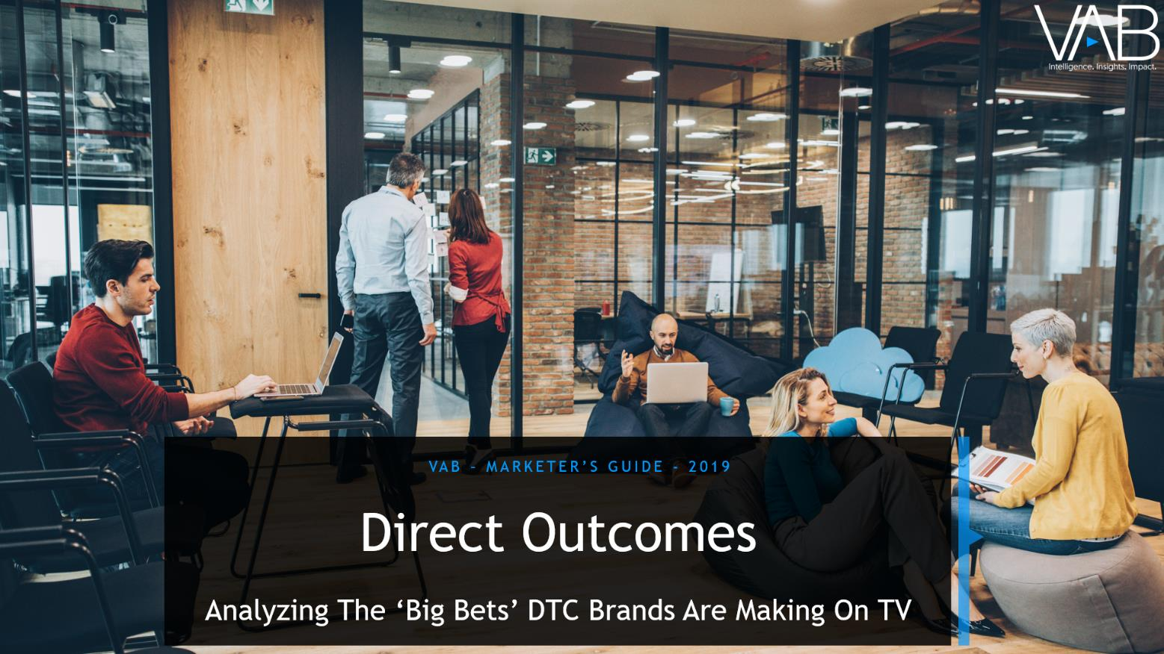
We’re passionate about identifying growth brands within the U.S. economy which is why for the last six years we’ve been tracking TV spending
from data-focused, performance-driven, digital-native DTC brands.
Over the last three years alone, we’ve developed the following reports on brands within growing
DTC categories:
2017
35 Category Disruptor Brands
2018
50 Direct-Disruptor Brands
2019
125 Direct-to-Consumer Brands
Brand list reflects a mix
of 65 ‘first timers’ in our analysis along with updates to 60 brands analyzed in previous reports
3
Click on the cover pages for 2017 and 2018 to be re-directed to the full reports of ‘The Market-Changer’s Playbook’ and ‘Direct Impact’

Slide 4
In regards to this year’s guide, Direct Outcomes, we’re focused on highlighting how TV has been instrumental in driving consumer action across each stage of the purchase funnel for a robust set of Direct-to-Consumer brands
Today, not only are categories of all shapes and sizes being disrupted by Direct-to-Consumer brands, but now the original disruptors are being disrupted by new ‘direct’ brand entrants.
Case in point, in the ‘mattress-in-a-box’ category alone there are over 150 brands competing with the likes of Casper and Leesa for consumers’ attention and, more importantly, their share of wallet.
These hypercompetitive business environments have sparked a need for marketers to focus on both customer retention and acquisition as brands look to reach a wider, new audience to expand their customer base.
While DTC brands typically launch with a social media-dominant strategy, many brands have evolved and are going big into TV as rising digital costs, difficulties in effectively scaling their audience and advertising saturation present challenges to achieving further growth.
These brands have effectively employed TV to drive both short- and long-term success through the purchase funnel – from skyrocketing website traffic that brings in millions of new prospective customers immediately after a TV campaign launches to significant lifts in sales seen during sustained TV campaigns.
The proof of success is highlighted by the DTC brands themselves. With their cutting edge analytic tools and team of data scientists at their disposal, DTC brands know exactly what media works for driving their business which is why this set of 125 companies have bet big on TV, collectively investing $3.8 Billion in TV advertising during 2018, a 60% increase from just the year prior.
You Innovate. TV Elevates.
4

Slide 5

What Are Direct-to-Consumer (DTC) or ‘Direct Brands’?
Direct-to-Consumer (DTC) means the company is selling their product directly to end customers without third-party retailers, wholesalers or other middlemen.
First-party data collection as well as performance measurement and analytics are core competencies of these companies.
An influx of new DTC brands is helping drive growth within ecommerce…
5

Slide 6
Ecommerce Now Accounts For Over $500 Billion In Sales Within The U.S.,
Double What It Was Only Five Years Ago
Ecommerce Sales as a % of Total Retail Sales*
(in billions)
5.3%
5.6%
6.4%
7.2%
7.9%
8.7%
9.5%
10.6%
11.6%
13.0%
14.3%
*Total Retail Sales – Total factors out the sale of items not normally purchased online, such as fuel, automobiles and sales in restaurants.
6
Source: Internet Retailer, U.S. Commerce Dept. https://www.digitalcommerce360.com/article/e-commerce-sales-retail-sales-ten-year-review/

Slide 7
DTC brands are resonating with consumers due to their Frictionless Convenience, Product Quality and Fast & Free (Low-Cost) Shipping
Consumers are quickly embracing DTC brands
How Much Do US Internet Users Expect to Purchase
from DTC Companies in the Next 5 Years?
64% of Internet users expect that 20% or more of their total purchases will be through DTC brands within the next five years
7
Source: Diffusion, “2018 Direct-to-Consumer Purchase Intent Index” conducted by YouGov, October 4th, 2018

Slide 8




DTC Brands Are Obsessed With Utilizing Data & Technology To Improve
The Consumer Experience And Maximize Sales & Profitability
“When you see our data making a direct impact on a customer’s happiness, it really shows that using data isn’t cold or impersonal. It’s the best way to get to know our customers and figure out how we can give them exactly what they want – a perfectly fitting bra.”
“Internally, we are a tech company first and foremost. Outwardly, we focus on the product, the experience and the community, but everything comes together because of serious technology we have behind the scenes.”
-Graham Stanton, Co-Founder & SVP Global Marketing & Sales, Peloton
- Heidi Zak, Co-Founder & CEO, ThirdLove
“We understand online very well, we also understand consumer behavior and we’re a very data driven company. Those are all advantages we have, because that is basically where we came from.”
- Constantin Eis, Co-Founder & Global Managing Director, Casper
8

Slide 9

With cutting edge analytic tools & a team of data scientists at their disposal, media channels are scrutinized and optimized on a real-time basis…
Simply put, DTC companies know
exactly what media works
for driving their business
9
9

Slide 10

Direct-to-Consumer Analysis Summary
125 Brands Across 52 Unique DTC Categories

Slide 11




























































































































125 ‘Direct-to-Consumer’ brands analyzed across
52 DTC categories
These data-focused, performance-driven brands are obsessed
with investing in media that delivers quantifiable business outcomes
This list of 125 DTC brands represents a mix of brands across ‘DTC’ categories who invested $500K+ in measured 2018 TV spend (Nielsen Ad Intel) and have available data within at least one of the following business metrics: website traffic unique reach via Comscore, online interactions via iSpot.tv, or revenue / valuation estimates through verified sources such as SEC.gov, recognized financial analysts or company reports / statements.
11

Slide 12




















































































When challenged to grow big and increase their customer base and build revenues…
From
To
10’s of 1,000’s Users
Millions of Users
Millions in Revenue
Billions in Revenue
Early/Trial Customers
New/Repeat/Loyal Customers
New Brands
Trusted New Brands
12

Slide 13
…they all made the
‘Big Bet’ on TV
In fact, these 125 Direct-to-Consumer brands collectively
spent almost $3.8 Billion on TV in 2018, 2.5x what was invested in 2016
DTC brands have accelerated spending recently - these 125 brands alone added
$1.4 Billion to the TV advertising marketplace over the last year
125 ‘Direct-to-Consumer’ Brands
+60%
+54%
+30%
+37%
+63%
# of Existing Brands
100
109
116
121
125
125
Source: VAB analysis of Nielsen Ad Intel data, calendar years 2013-2018. TV spend includes national cable TV, broadcast TV, Spanish language cable TV, Spanish language broadcast TV, spot TV, syndication TV. Reflects the cume TV spend of the 125 brands identified in this report. Not all companies existed since 2013 as reflected at the bottom of the chart. Existing brands = the number of brands that had launched publicly by that year out of the 125 brand grouping.
13

Slide 14
During this six-year time period, the vast majority of spending is from organic growth by brands that were launched in 2013 or before…
…the balance is due to newer brands entering the marketplace and launching TV campaigns
Brands that launched several years ago and are active on TV continue to increase their investment - adding over $900 Million in TV advertising last year
125 ‘Direct-to-Consumer’ Brands
$3,770.2
$2,349.5
$1,522.3
$1,168.9
+44%
$853.4
+45%
$525.0
+27%
+63%
+34%
14
Source: VAB analysis of Nielsen Ad Intel data, calendar years 2013-2018. TV spend includes national cable TV, broadcast TV, Spanish language cable TV, Spanish language broadcast TV, spot TV, syndication TV. Reflects the cume TV spend of the 125 brands identified in this report.

Slide 15
Several Traditional Categories Have Become Hypercompetitive
With The Recent Influx Of Multiple DTC Brand Entrants
$286.0
$266.2
$192.7
$194.5
$125.4
$92.5
$95.3
$85.8
$85.6
$63.2
$48.2
$28.3
$31.6
$35.8
$17.5
$1.8
Source: VAB analysis of Nielsen Ad Intel data, calendar years 2013-2018. TV spend includes national cable TV, broadcast TV, Spanish language cable TV, Spanish language broadcast TV, spot TV, syndication TV. Zillow excludes Trulia.
15

Slide 16



In Fact, ‘Direct-to-Consumer’ Brands Are Now Some Of The Biggest TV Evangelists
“A lot of people oftentimes don’t understand the economics of TV and how to measure it. TV can be less expensive and more beneficial than digital. It just takes more to get an initial test off the ground, but from a CPM basis, it’s comparable, if not better, in some places, especially now that people are buying for these hyper-targeted custom audiences in digital.”
“If I were advising another company, I would tell them to test TV.
But, as a competitor, I would tell them not to.
“We see the benefits of using it (TV) early. It’s not a small investment in terms of developing the creative and media costs, but it’s a channel that enables you to tell a story.”
Jerry Hum, Co-Founder & CEO, Touch of Modern
(May 2019)
Steven Gutentag, Co-Founder, Keeps
(Digiday, 1/22/19)
David Webb, Director of Growth & Analytics, HelloFresh (Digiday, 6/20/18)
“Television is definitely a growing channel for us. There is something physical about TV…Something physical that someone touches. In some ways, it’s just more real.”
“Increasingly, TV provides you with just as much analytics and ability to attribute where customers are coming from.”
“The Wayfair brand is only a little over six years old and we’ve been able to build it as a household brand very quickly over just the last few years. Without using television, I don’t think we would be where we are today.”
Malcolm Scovil, Head of Marketing, Tophatter
(Digiday, 6/20/18)
Heidi Zak, Co-Founder & CEO, ThirdLove (Digiday, 1/22/19)
Niraj Shah, Co-Founder, Wayfair
(2018)
16

Slide 17








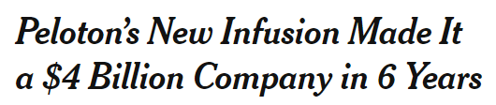






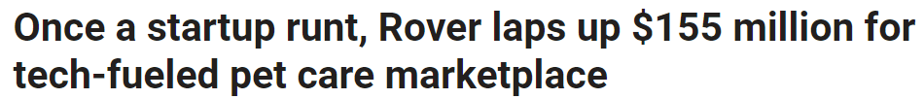


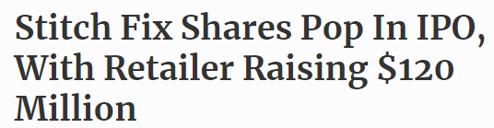






Across the DTC brands analyzed, Television has been instrumental in many business successes including:
-Subscriber Growth
-Sales / Revenue Growth
-Increased Valuations / Achieving ‘Unicorn’ Status
-Additional Funding Raised
-IPO Issuances
-Acquisitions
($9.1 MM cume TV spend since 2018)
($117.7 MM cume TV spend since 2014)
($310.9 MM cume TV spend since 2014)
($27.4 MM cume TV spend since 2017)
($274.7 MM cume TV spend since 2016)
($9.1 MM cume TV spend since 2014)
($43.1 MM cume TV spend since 2013)
($6.2 MM cume TV spend since 2018)
($38.8 MM cume TV spend since 2017)
($18.2 MM cume TV spend since 2018)
($2.8 MM cume TV spend since 2015)
Source: VAB analysis of Nielsen Ad Intel data, calendar years 2013-2018. TV spend includes national cable TV, broadcast TV, Spanish language cable TV, Spanish language broadcast TV, spot TV, syndication TV.
($$$) = cume TV spend between TV launch - 2018; MM = millions; (year) = TV launch year
17

Slide 18


DTC Segment Definitions
‘Direct-to-Consumer’ brands exist across a multitude of categories, serve a myriad of consumer purposes and can be at a different business lifecycle / maturity level relative to other DTC brands
Because of this, developing one overarching ‘like-for-like’ analysis comparison across all 125 brands can be challenging
For the purposes of this guide, we designated each DTC brand analyzed into one of two groups based on similar characteristics:
125 Direct-to-Consumer Brands Analyzed
‘Emerging’ Brands
(63 Brands)
Newer brands with an average age of 8 years old who only began investing in TV within the last three years (last two years on average)
‘Expanding’ Brands
(62 Brands)
Brands with an average age of 13 years old who have been investing in TV for at least the last four years (eight years on average)
18
18
Notes:
https://

Slide 19
As we’ll showcase in this analysis, TV advertising drives consumer action through the purchase
funnel for both the younger ‘Emerging’ brands and
the more mature
‘Expanding’ brands
We analyzed the TV spend and individual key metrics (where available) including digital interactions, website traffic and revenues across brands
Awareness
Intent
Sales
Consideration
Upper Funnel
(TV Spend)
Mid Funnel
(Search Queries, Online Video Views)
(Website Traffic)
Lower Funnel
(Revenues)
19

Slide 20

‘Emerging’ DTC Brands
We analyzed the TV spend and individual key metrics (where available) like
digital interactions, website traffic and revenues of 63 brands across 34 categories

Slide 21









































63 ‘Emerging’ Direct-to-Consumer Brands
These 63 ‘emerging’ DTC brands are an average of eight years old and only began investing in TV within the last three years (last two years on average)
Personal Finance
Mattresses
Marketplace
Transportation
E-Commerce
Pet Products
Craft Supplies / Vintage Items
Real Estate
Automotive
Food Delivery &
Meal Kit Subscription
Eyewear
Wellness & Fitness
Men’s Clothing
Men’s Health / Personal Care
Apparel
Women’s Clothing
Men’s Lifestyle
Skin Care & Beauty
Vacation Rentals
Luggage
Murder Mystery Game
(Subscription)
Bedding
Wedding Registry
Pharmacy
Socks
SVOD
Filters
Dental
Boots
Writing Assistant
Watches
Underwear /
Lingerie
At-Home Services
Contact Lenses
21

Slide 22
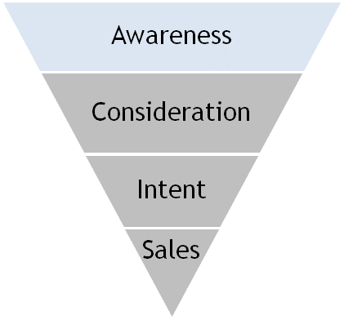
AWARENESS: TV SPEND
New TV advertisers and existing advertisers who increased their spend combined to invest almost $900 million more in TV over the last year
These 63 ‘Emerging’ DTC brands collectively spent over $1.4 Billion on TV in 2018, a 167% Increase over the prior year
63 ‘Emerging’ DTC Brands
+167%
+241%
# of Existing Brands
59
63
63
22
Source: VAB analysis of Nielsen Ad Intel data, calendar years 2013-2018. TV spend includes national cable TV, broadcast TV, Spanish language cable TV, Spanish language broadcast TV, spot TV, syndication TV. Reflects the cume TV spend of the 63 ‘emerging’ brands identified in this report. Existing brands = the number of brands that had launched publicly by that year out of the 63 brand grouping.

Slide 23









AWARENESS: TV SPEND
Many ‘Emerging’ DTC brands across categories have made a Big Investment in TV
over the past year…
In fact, 65% of ‘Emerging’ brands (41 out of 63) were either new TV advertisers in 2018 or they were existing advertisers who more
than doubled their
TV investment YoY
Sampling: 10 ‘Emerging’ DTC Brands That Went Big Into TV
23
Source: VAB analysis of Nielsen Ad Intel data, calendar years 2013-2018. TV spend includes national cable TV, broadcast TV, Spanish language cable TV, Spanish language broadcast TV, spot TV, syndication TV. Chart reflects a sampling of brands across various categories.

Slide 24
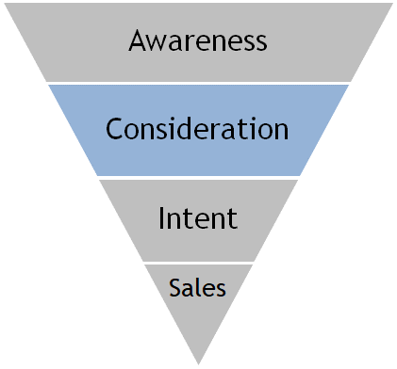
CONSIDERATION: DIGITAL INTERACTIONS
TV is the catalyst that jumpstarts consideration around a brand in the form of more exploration and additional viewing of their advertising online
These digital actions far outpace the collective
increase in TV spend
across the 38 measured
brands
‘Emerging’ DTC Brands*:
TV Spend vs. ‘Digital Actions’ YOY % Increase
2017 vs. 2018
*Reflects the 38 brands that are measured in iSpot.tv and had TV spending in both 2017 & 2018 for comparison purposes.
Source: TV spending based on VAB analysis of Nielsen Ad Intel data, TV spend (national cable TV, national broadcast TV, Spanish language broadcast TV, Spanish language cable TV, spot TV, syndication TV), calendar years 2017 & 2018. Digital actions based on VAB analysis of iSpot.tv data and reflects TV commercial-related searches (Google, Bing, Yahoo!) and earned, not promoted, online video views of TV ads (YouTube, iSpot.tv). Digital actions are correlated to TV ad airing data.
24

Slide 25









CONSIDERATION: SEARCH QUERIES
Sampling of Brands: TV Spend vs. Search Queries
YOY % Increase: 2017 vs. 2018
Increased TV spend prompts a greater number of potential customers to seek out more information about a brand online…
In fact, most ‘Emerging’ brands saw Double- or Triple-Digit Lifts in search queries related
to their ads as they increased their TV investment
Brand
TV Spend
Search Queries
+350%
+585%
+225%
+480%
+38%
+99%
+149%
+119%
+64%
+136%
+682%
+1,125%
+173%
+119%
+1,637%
+1,456%
+8,426%
+6,929%
+184%
+163%
+105%
+197%
+337%
+160%
+3,874%
+3,398%
+38%
+66%
+783%
+762%
25
Source: TV spending based on VAB analysis of Nielsen Ad Intel data, TV spend (national cable TV, national broadcast TV, Spanish language broadcast TV, Spanish language cable TV, spot TV, syndication TV), calendar years 2017 & 2018. Digital actions based on VAB analysis of iSpot.tv data and reflects TV commercial-related searches (Google, Bing, Yahoo!). Digital actions are correlated to TV ad airing data.

Slide 26








CONSIDERATION: ONLINE VIDEO VIEWS
Sampling of Brands: TV Spend vs. Online Video Views
YOY % Increase: 2017 vs. 2018
Unlike most advertising, the storytelling nature
and visceral connection
of TV advertising compels
people to go online to
re-watch ads again…
In fact, most ‘Emerging’ brands saw Double- or Triple-Digit Lifts in
non-paid online video views of their TV ads
as they increased their
TV investment
Brand
TV Spend
Online Video Views
+527%
+285%
+25%
+321%
+149%
+4,478%
+27%
+445%
+706%
+2,663%
+28%
+36%
+682%
+387%
+1,637%
+2,075%
+8,426%
+1,102%
+361%
+283%
+105%
+122%
+74%
+431%
+90%
+264%
+3,874%
+3,172%
+8,635%
+5,096%
26
Source: TV spending based on VAB analysis of Nielsen Ad Intel data, TV spend (national cable TV, national broadcast TV, Spanish language broadcast TV, Spanish language cable TV, spot TV, syndication TV), calendar years 2017 & 2018. Digital actions based on VAB analysis of iSpot.tv data and reflects earned, not promoted, online video views of TV ads (YouTube, iSpot.tv). Digital actions are correlated to TV ad airing data.

Slide 27
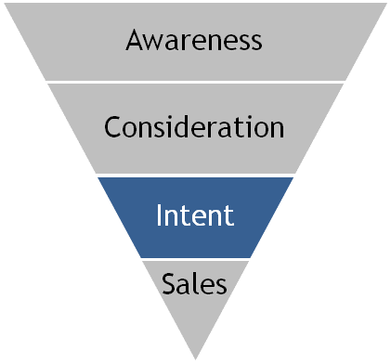
INTENT: WEBSITE TRAFFIC
On average, monthly unique visitors see an immediate surge upon the launch of a TV campaign and this audience only continues to grow through the duration
of a brand’s TV flight:
The average ‘Emerging’ brand saw an 84% increase in their unique website traffic during their TV launch month and a 93% average monthly increase from launch month to present day
‘Emerging’ DTC Brands*:
Average Monthly Website Unique Visitors (000)
Based Over A Four-Year Time Period: Mar ‘15 – Feb ‘19
+93%
(+2.5 MM
monthly uniques)
vs. monthly average prior to TV launch
(Monthly Average)
(Monthly Average)
*Reflects the 39 brands that are measured in Comscore and had reported monthly unique visitors in at least one month prior to their TV campaign launch
Source: VAB analysis of Nielsen Ad Intel data, TV spend (national cable TV, national broadcast TV, Spanish language broadcast TV, Spanish language cable TV, spot TV, syndication TV), March ‘15 – February ‘19 (calendar months). VAB analysis of Comscore mediametrix multiplatform media trend data, total audience (Desktop P2+, Mobile 18+), March ’15 – February ’19 (calendar months). ‘Prior to TV Launch’ reflects the average monthly unique visitors based on when each brand’s website began being measured by Comscore, or starting from March 2015 if measurement began before that month. Three brands within the 63 ‘emerging’ brand groupings were not measured as of February 2019: Brooklinen, Hunt-A-Killer, Keeps.
27

Slide 28











INTENT: WEBSITE TRAFFIC
Sampling of Brands: Monthly Website Unique Visitors (000) Comparison
Based Over A Four-Year Time Period (Mar ‘15 – Feb ‘19)
While most DTC brands start with a social media-dominant strategy (Facebook, Instagram, etc), website traffic skyrocketed for many ‘Emerging’ brands
once they launched
a TV campaign
Monthly Average:
Prior To TV Launch
Monthly Average:
TV Launch – Feb ‘19
#
Diff
%
Diff
Brand
1,190
2,000
+810
+68%
188
377
+189
+101%
33
88
+55
+165%
12,142
20,862
+8,720
+72%
1,791
8,338
+6,547
+366%
35,314
48,192
+12,878
+36%
149
247
+98
+66%
1,835
5,199
+3,365
+183%
98
205
+107
+109%
2,471
10,549
+8,078
+327%
4,430
10,363
+5,932
+134%
1,245
3,006
+1,761
+141%
5,978
13,812
+7,833
+131%
1,309
1,630
+321
+25%
260
606
+346
+133%
1,113
2,254
+1,141
+102%
549
1,013
+464
+85%
18,307
40,463
+22,156
+121%
1,584
3,008
+1,424
+90%
254
1,324
+1,070
+422%
Source: VAB analysis of Nielsen Ad Intel data, TV spend (national cable TV, national broadcast TV, Spanish language broadcast TV, Spanish language cable TV, spot TV, syndication TV), March ‘15 – February ‘19 (calendar months). VAB analysis of Comscore mediametrix multiplatform media trend data, total audience (Desktop P2+, Mobile 18+), March ’15 – February ’19 (calendar months). ‘Prior to TV Launch’ reflects the average monthly unique visitors based on when each brand’s website began being measured by Comscore, or starting from March 2015 if measurement began before that month.
28

Slide 29





INTENT: WEBSITE TRAFFIC
Sampling of Brands: Monthly Website Unique Visitors (000) Comparison
Based Over A Four-Year Time Period (Mar ‘15 – Feb ‘19)
TV also helps build brand recognition while driving new consumers to brand websites…
In fact, there were
21 ‘Emerging’ DTC brands whose website traffic
was not measured until they began airing a
TV campaign
Monthly Average:
Prior To TV Launch
Monthly Average:
TV Launch – Feb ‘19
Brand
N/A
283
N/A
176
N/A
465
N/A
136
N/A
835
N/A
783
N/A
600
N/A
102
N/A
317
N/A
396
N/A
28
N/A
438
N/A
35
N/A
1,306
N/A
150
Source: VAB analysis of Nielsen Ad Intel data, TV spend (national cable TV, national broadcast TV, Spanish language broadcast TV, Spanish language cable TV, spot TV, syndication TV); March ‘15 – February ‘19 (calendar months). VAB analysis of Comscore mediametrix multiplatform media trend data, total audience (Desktop P2+, Mobile 18+), March ’15 – February ’19 (calendar months). ‘Prior to TV Launch’ reflects the average monthly unique visitors based on when each brand’s website began being measured by Comscore, or starting from March 2015 if measurement began before that month. N/A = not enough traffic for Comscore to measure.
29

Slide 30
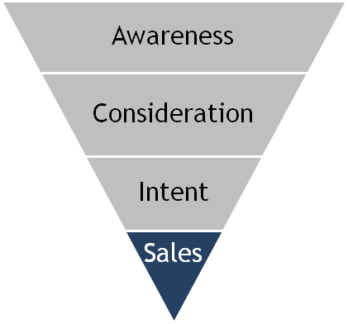

SALES: REVENUES
In Regards To Sales, ‘Emerging’ DTC Brands Often See Their Revenues Take Off When They Launch Their First TV Campaign
Year Founded
TV Launch
‘17 vs. ‘18
YoY Diff
Brand
2016
2017
2018
TV Spend (000):
---
$852
$33,871
+$33,019
2009
2017
Revenue (000):
$118,000
$150,000
$200,000
+$50,000
+33%
TV Spend (000):
---
$15,538
$50,560
+$35,022
2006
2017
Revenue (000):
$171,302
$282,664
$405,780
+$123,116
+44%
TV Spend (000):
$85,433
$99,405
$137,282
+$37,877
2011
2016
Revenue (000):
$880,000
$1,500,000
$2,600,000
+$1,100,000
+73%
TV Spend (000):
---
$3,023
$13,195
+$10,172
2013
2017
Revenue (000):
$20,000
$80,000
$160,000
+$80,000
+100%
TV Spend (000):
---
---
$7,662
+$7,662
2005
2018
Revenue (000):
$276,537
$317,755
$425,841
+$108,086
+34%
30
Source: TV spend based on VAB analysis of Nielsen Ad Intel data, TV spend (national cable TV, national broadcast TV, Spanish language broadcast TV, Spanish language cable TV, spot TV, syndication TV), CY 2016-2018. Revenues for public companies are based on company filings (10-K) for U.S. revenue via SEC.gov (EDGAR). Revenues for private companies are based on reports/projections/guidance provided publicly by company founders/representatives, or analyst estimates/forecasts, and reported within business/technology news outlets such as Bloomberg, CNBC, Digiday, Forbes, Inc., Recode, TechCrunch, WSJ, etc.

Slide 31



SALES: REVENUES
More Specifically, Several New TV Advertisers In 2018 Saw A
Near Immediate & Significant Sales Lift After Their TV Launch
Year Founded
TV Launch
‘17 vs. ‘18
YoY Diff
Brand
2016
2017
2018
TV Spend (000):
---
---
$10,548
+$10,548
2015
2018
Revenue (000):
$12,000
$48,000
$150,000
+$102,000
+213%
TV Spend (000):
---
---
$18,782
+$18,782
2016
2018
Revenue (000):
N/A
$35,000
$315,000
+$280,000
+800%
TV Spend (000):
---
---
$9,093
+$9,093
2012
2018
Revenue (000):
$7,000
$22,000
$100,000
+$78,000
+355%
TV Spend (000):
---
---
$1,906
+$1,906
2014
2018
Revenue (000):
$25,000
$47,900
$60,000
+$12,100
+25%
TV Spend (000):
---
---
$3,815
+$3,815
2014
2018
Revenue (000):
$1,000
$10,000
$30,000
+$20,000
+200%
31
Source: TV spend based on VAB analysis of Nielsen Ad Intel data, TV spend (national cable TV, national broadcast TV, Spanish language broadcast TV, Spanish language cable TV, spot TV, syndication TV), CY 2016-2018. Revenues for public companies are based on company filings (10-K) for U.S. revenue via SEC.gov (EDGAR). Revenues for private companies are based on reports/projections/guidance provided publicly by company founders/representatives, or analyst estimates/forecasts, and reported within business/technology news outlets such as Bloomberg, CNBC, Digiday, Forbes, Inc., Recode, TechCrunch, WSJ, etc. N/A = not publicly available.

Slide 32










SALES: ACQUISITIONS
‘Emerging’ Brands That Recently Launched TV Campaigns Have Also Become Attractive Acquisition Targets By ‘Incumbent’ Companies Looking To Own A Disruptor
Acquired Brand
Year Founded
TV Launch
Cume TV Spend*
Buyer
Acquisition Date
$$$
2011
Jun ‘16
$117.5MM
Apr ‘17
$3.35B
2013
Aug ‘17
$5.5MM
Jun ‘18
~$1.0B
2013
Sep ‘16
$25.0MM
May ‘18
$200MM
2013
Oct ‘17
$10.6MM
Aug ‘18
$100MM
2012
Jan ‘16
$7.9MM
Aug ‘18
N/A**
Sources: VAB analysis of Nielsen Ad Intel data, TV spend (national cable TV, national broadcast TV, Spanish language broadcast TV, Spanish language cable TV, spot TV, syndication TV); March ‘15 – February ‘19 (calendar months). Acquisition price based on publicly-released reports. *Cume TV spend reflects the measured TV spend between a brand’s TV launch date and their acquisition month. **Tuft & Needle agreed to merge with Serta, however terms were not publicized.
32

Slide 33

‘Expanding’ DTC Brands
We analyzed the TV spend and individual key metrics (where available) like
digital interactions, website traffic and revenues of 62 brands across 31 categories

Slide 34











































62 ‘Expanding’ Direct-to-Consumer Brands
These 62 ‘expanding’ DTC brands are an average of 13 years old and have been investing in TV for at least the last four years (eight years on average)
Personal Finance
Mattresses
Marketplace
Transportation
Home Goods
Pet Products
Real Estate
Automotive
Men’s Clothing
Therapy
Food Delivery &
Meal Kit Subscription
Eyewear
Medical Care
Travel Search Engine
Flower Delivery
Women’s Clothing
Beauty-Related Subscription
Shaving & Grooming Products
Tax Filing
Language
Exercise Equipment
Vacation Rentals
Home Security
Dog Walking
Home Improvement
Photography
Job Search
Genealogy
Shopping Rewards
Hearing Aids
Underwear /
Lingerie
34

Slide 35
AWARENESS: TV SPEND
Organic TV advertising growth through existing brands led to an increase spend over $500 million vs. the prior year
Even though these 62 ‘Expanding’ DTC brands are more established
and have higher brand recognition, they continue to steadily
grow their TV investments…
These brands collectively spent almost $2.4 Billion
on TV in 2018
62 ‘Expanding’ DTC Brands
+29%
+33%
+17%
+37%
+63%
# of Existing Brands
59
62
62
62
62
62
Source: VAB analysis of Nielsen Ad Intel data, calendar years 2013-2018. TV spend includes national cable TV, broadcast TV, Spanish language cable TV, Spanish language broadcast TV, spot TV, syndication TV. Reflects the cume TV spend of the 62 ‘expanding’ brands identified in this report. Not all companies existed since 2013 as reflected at the bottom of the chart. Existing brands = the number of brands that had launched publicly by that year out of the 62 brand grouping.
35

Slide 36






AWARENESS: TV SPEND
TV has proven to be so effective in expanding their customer bases that many ‘Expanding’ DTC brands have increased their TV investment by Double- or Triple-Digits over the last year
Sampling: 10 ‘Expanding’ DTC Brands That Went Big Into TV
36
Source: VAB analysis of Nielsen Ad Intel data, calendar years 2013-2018. TV spend includes national cable TV, broadcast TV, Spanish language cable TV, Spanish language broadcast TV, spot TV, syndication TV. Chart reflects a sampling of brands across various categories.

Slide 37
CONSIDERATION: DIGITAL INTERACTIONS
For these more established DTC brands, increased TV activity drives greater consideration around
a brand in the form
of more searches and additional viewing
of the TV ad online
‘Expanding’ DTC Brands:
TV Spend vs. “Digital Actions” YOY % Increase
2017 vs. 2018
*Reflects the 58 brands that are measured in iSpot.tv and had TV spending in both 2017 & 2018 for comparison purposes.
Source: TV spending based on VAB analysis of Nielsen Ad Intel data, TV spend (national cable TV, national broadcast TV, Spanish language broadcast TV, Spanish language cable TV, spot TV, syndication TV), calendar years 2017 & 2018. Digital actions based on VAB analysis of iSpot.tv data and reflects TV commercial-related searches (Google, Bing, Yahoo!) and earned, not promoted, online video views of TV ads (YouTube, iSpot.tv). Digital actions are correlated to TV ad airing data.
37

Slide 38















CONSIDERATION: SEARCH QUERIES
Sampling of Brands: TV Spend vs. Search Queries
YOY % Increase: 2017 vs. 2018
Increased TV spend prompts a greater number of potential customers to seek out more information about a brand online…
In fact, most ‘Expanding’ brands saw Double- or Triple-Digit Lifts in search queries related
to their ads when they increased their TV investment
Brand
TV Spend
Search Queries
+107%
+85%
+726%
+824%
+106%
+126%
+53%
+14%
+345%
+60%
+28%
+44%
+101%
+285%
+673%
+90%
+198%
+256%
+93%
+237%
+74%
+103%
+36%
+157%
+48%
+167%
+49%
+51%
+74%
+85%
+91%
+108%
+58%
+78%
+196%
+710%
+6%
+23%
+68%
+287%
38
Source: TV spending based on VAB analysis of Nielsen Ad Intel data, TV spend (national cable TV, national broadcast TV, Spanish language broadcast TV, Spanish language cable TV, spot TV, syndication TV), calendar years 2017 & 2018. Digital actions based on VAB analysis of iSpot.tv data and reflects TV commercial-related searches (Google, Bing, Yahoo!). Digital actions are correlated to TV ad airing data.

Slide 39










CONSIDERATION: ONLINE VIDEO VIEWS
Sampling of Brands: TV Spend vs. Online Video Views
YOY % Increase: 2017 vs. 2018
Because DTC TV ads
tend to be more unique, creative & engaging, viewers seek them out online to experience them again…
In fact, most ‘Expanding’ brands saw Double- and Triple-Digit Lifts in
non-paid online video views of their TV ads when they increased
their TV investment
Brand
TV Spend
Online Video Views
+107%
+104%
+46%
+381%
+106%
+280%
+53%
+130%
+345%
+257%
+37%
+436%
+101%
+417%
+198%
+1,093%
+93%
+514%
+100%
+91%
+74%
+604%
+49%
+267%
+74%
+186%
+91%
+914%
+319%
+423%
39
Source: TV spending based on VAB analysis of Nielsen Ad Intel data, TV spend (national cable TV, national broadcast TV, Spanish language broadcast TV, Spanish language cable TV, spot TV, syndication TV), calendar years 2017 & 2018. Digital actions based on VAB analysis of iSpot.tv data and reflects earned, not promoted, online video views of TV ads (YouTube, iSpot.tv). Digital actions are correlated to TV ad airing data.

Slide 40


































INTENT: WEBSITE TRAFFIC
Since ‘Expanding’ brands are more established, we are able to compile a TV Spend vs. Website Traffic correlation analysis across four years of available data…
Based on this analysis,
our findings show a Definitive Correlation (80%) between TV spend & website traffic of the ‘Expanding’ brands
47 of the 59 Measured ‘Expanding’ DTC Brands (80%)
Analyzed Exhibited a Direct Correlation Between TV Spend & Brand Website Traffic
Brands With A Definitive Correlation between TV Spend & Monthly Unique Visitors
*analysis excludes TouchNote, FreePrints and Tommy John which weren’t measured in Comscore during the time period
40
Source: VAB analysis of Nielsen Ad Intel data, TV spend (national cable TV, national broadcast TV, Spanish language broadcast TV, Spanish language cable TV, spot TV, syndication TV), March ‘15 – February ‘19 (calendar months); VAB analysis of Comscore mediametrix multiplatform media trend data; total audience (Desktop P2+, Mobile 18+), March ’15 – February ’19 (calendar months).

Slide 41





INTENT: WEBSITE TRAFFIC
TV Drives Website Traffic For ‘Expanding’ DTC Brands That Have
A Continual Advertising Presence
TV Spend Up, Website Traffic Up
(24-Month Vs. 24-Month Comparison: Mar ’15 – Feb ’17 vs. Mar ‘17 – Feb ‘19)
Avg Monthly TV Spend (000):
Mar ‘15 - Feb ’17:
$2,495
$567
$915
$2,957
$5,499
$3,755
Mar ‘17 – Feb ‘19:
$12,094
$1,575
$1,493
$6,474
$7,835
$5,847
% Difference:
+385%
+178%
+63%
+119%
+42%
+56%
Avg Monthly Unique Visitors (000):
Mar ‘15 - Feb ’17:
58
843
397
22,771
4,337
751
Mar ‘17 – Feb ‘19:
500
3,606
777
40,662
6,903
2,756
% Difference:
+766%
+328%
+96%
+79%
+59%
+267%
Avg Monthly Unique Visitors Increase (000):
+442
+2,763
+380
+17,891
+2,526
+2,005
Source: VAB analysis of Nielsen Ad Intel data, TV spend (national cable TV, national broadcast TV, Spanish language broadcast TV, Spanish language cable TV, spot TV, syndication TV), March ‘15 – February ‘19. VAB analysis of Comscore mediametrix multiplatform media trend data; total audience (Desktop P2+, Mobile 18+), March ’15 – February ’19 (calendar months).
41

Slide 42





INTENT: WEBSITE TRAFFIC
In Fact, Tight Correlations Exist Between TV Spend And Website Traffic
For ‘Expanding’ DTC Brands That Have A Continual Advertising Presence
TV Spend Up, Website Traffic Up
(24-Month Vs. 24-Month Comparison: Mar ’15 – Feb ’17 vs. Mar ‘17 – Feb ‘19)
Avg Monthly TV Spend (000):
Mar ‘15 - Feb ’17:
$337
$1,138
$3,202
$3,036
$3,185
$2,995
Mar ‘17 – Feb ‘19:
$1,254
$1,980
$5,935
$4,286
$3,997
$3,899
% Difference:
+272%
+74%
+85%
+41%
+25%
+30%
Avg Monthly Unique Visitors (000):
Mar ‘15 - Feb ’17:
413
10,983
11,572
1,862
1,623
64,325
Mar ‘17 – Feb ‘19:
1,454
19,992
20,766
2,599
2,155
83,496
% Difference:
+252%
+82%
+79%
+40%
+33%
+30%
Avg Monthly Unique Visitors Increase (000):
+1,041
+9,009
+9,194
+737
+532
+19,171
Source: VAB analysis of Nielsen Ad Intel data, TV spend (national cable TV, national broadcast TV, Spanish language broadcast TV, Spanish language cable TV, spot TV, syndication TV), March ‘15 – February ‘19. VAB analysis of Comscore mediametrix multiplatform media trend data; total audience (Desktop P2+, Mobile 18+), March ’15 – February ’19 (calendar months).
42

Slide 43



SALES: REVENUES
‘Expanding’ DTC Brands Often See Their Revenues Spike
When They Increase Their TV Investment
Year Founded
TV Launch
‘17 vs. ‘18
YoY Diff
Brand
2016
2017
2018
TV Spend (000):
$34,051
$108,708
$161,268
+$52,560
2012
2014
Revenue (000):
$170,000
$340,000
$700,000
+$360,000
+106%
TV Spend (000):
$15,833
$31,791
$65,442
+$33,651
2013
2013
Revenue (000):
$365,148
$858,870
$1,955,467
+$1,096,597
+128%
TV Spend (000):
$20,812
$75,693
$146,166
+$70,473
2004
2014
Revenue (000):
$1,075,000
$1,186,000
$1,954,000
+$768,000
+65%
TV Spend (000):
$12,244
$16,238
$27,338
+$11,100
2004
2015
Revenue (000):
$689,000
$906,000
$1,171,000
+$265,000
+29%
TV Spend (000):
$1,953
$12,054
$35,868
+$23,814
2004
2008
Revenue (000):
$493,331
$683,067
$1,007,257
+$324,190
+47%
43
Source: TV spend based on VAB analysis of Nielsen Ad Intel data, TV spend (national cable TV, national broadcast TV, Spanish language broadcast TV, Spanish language cable TV, spot TV, syndication TV), CY 2016-2018. Revenues for public companies are based on company filings (10-K) for U.S. revenue via SEC.gov (EDGAR). Revenues for private companies are based on reports/projections/guidance provided publicly by company founders/representatives, or analyst estimates/forecasts, and reported within business/technology news outlets such as Bloomberg, CNBC, Digiday, Forbes, Inc., Recode, TechCrunch, WSJ, etc.

Slide 44




SALES: REVENUES
‘Expanding’ DTC Brands Often See Their Revenues Spike
When They Increase Their TV Investment
Year Founded
TV Launch
‘17 vs. ‘18
YoY Diff
Brand
2016
2017
2018
TV Spend (000):
$37,749
$44,180
$46,938
+$2,758
2004
2012
Revenue (000):
$846,589
$1,076,794
$1,333,554
+$256,760
+24%
TV Spend (000):
$34,339
$44,522
$57,203
+$12,861
1982
1993
Revenue (000):
$1,941,000
$2,366,000
$2,873,000
+$507,000
+21%
TV Spend (000):
$10,555
$18,777
$19,073
+$296
2014
2015
Revenue (000):
$200,000
$300,000
$400,000
+$100,000
+33%
TV Spend (000):
---
$630
$5,205
+$4,575
2011
2014
Revenue (000):
$100,000
$150,000
$250,000
+$100,000
+67%
TV Spend (000):
$56,268
$67,267
$91,971
+$24,704
1996
2013
Revenue (000):
$2,294,000
$2,452,000
$2,646,000
+$194,000
+8%
44
Source: TV spend based on VAB analysis of Nielsen Ad Intel data, TV spend (national cable TV, national broadcast TV, Spanish language broadcast TV, Spanish language cable TV, spot TV, syndication TV), CY 2016-2018. Revenues for public companies are based on company filings (10-K) for U.S. revenue via SEC.gov (EDGAR). Revenues for private companies are based on reports/projections/guidance provided publicly by company founders/representatives, or analyst estimates/forecasts, and reported within business/technology news outlets such as Bloomberg, CNBC, Digiday, Forbes, Inc., Recode, TechCrunch, WSJ, etc.

Slide 45








SALES: ACQUISITIONS
‘Expanding’ DTC Brands Who Launched TV Campaigns Have Also Become
Attractive Acquisition Targets By ‘Incumbent’ Companies Looking To Own A Disruptor
Acquired Brand
Year Founded
TV Launch
Cume TV Spend*
Buyer
Acquisition Date
$$$
2004
Mar ‘15
$7.7MM
Dec ‘15
$3.9B
2014
Sep ‘15
$58.8MM
Aug ‘16
$3.3B
2012
Feb ‘15
$96.7MM
Feb ‘18
~$1.0B
2011
Jan ‘13
$142.3MM
Jul ‘16
$1.0B
2012
Dec ‘14
$57.8MM
Sep ‘17
$300MM
2007
Nov ‘13
$78.9MM
Feb ‘19
N/A***
Sources: VAB analysis of Nielsen Ad Intel data, TV spend (national cable TV, national broadcast TV, Spanish language broadcast TV, Spanish language cable TV, spot TV, syndication TV); March ‘15 – February ‘19 (calendar months). Acquisition price based on publicly-released reports. *Cume TV spend reflects the measured TV spend between a brand’s TV launch date and their acquisition month. ** Cume TV spend only goes through February 2019. ***Terms of the acquisition were not disclosed as of April 2019.
45

Slide 46

Unboxing The Outcomes

Slide 47
Delivering Direct Outcomes…
As we’ve highlighted, the investment of billions of dollars in TV builds awareness across brands and stokes consumer action throughout the purchase funnel – from Search, Message Engagement and Website Visitations to, ultimately, Sales…
Remember, these data-focused, performance-driven, digital-native, DTC brands know exactly what media works for driving their business outcomes
Over the last two years, the 125 DTC brands analyzed spent over
$6 Billion on TV advertising
Awareness
Intent
Sales
Consideration
Upper Funnel
(TV Spend)
Mid Funnel
(Search Queries, Online Video Views)
(Website Traffic)
Lower Funnel
(Revenues)
47
Source: VAB analysis of Nielsen Ad Intel data, calendar years 2017-2018. Nat’l TV = broadcast TV & cable TV. Data reflects the cume TV spend of the 125 brands identified in this report.

Slide 48
3 Key Takeaways
1
2
3
DTC brands know exactly what media works for driving their business which is why they have collectively increased their
TV spend +60% YoY to $3.8B
A brand’s website traffic continues to grow during their TV flight after seeing an immediate surge (+84% UVs) during the
TV campaign launch month
Brands often see their annual revenues increase double- or triple-digits when they make a ‘Big Bet’ on TV (new campaign launch or heavy-up investment)
48

Slide 49

By the way, there is another set of digital-native, data-focused, outcomes-obsessed brands pouring money into TV

Slide 50


FAANG (Facebook, Amazon, Apple, Netflix & Google) collectively spent over
$2 Billion On TV in 2018,
more than double their annual investment vs. only three years ago
Source: VAB analysis of Nielsen AdIntel, calendar year 2015-2018, TV spend includes cable TV, broadcast TV, Spanish language cable TV, Spanish language broadcast TV, spot TV, and syndicated TV. U.S. TV spend only. FAANG includes: Facebook, Apple, Amazon, Netflix and Google (includes YouTube).
50

Slide 51

FAANG’s TV Spend Has Increased Rapidly As They Roll Out
New, Mass Market Products & Services
FAANG U.S. TV Spend
($$$ in Millions)
+38%
$2,180.1
+7%
+46%
$1,581.8
$1,478.8
$1,014.1
Source: VAB analysis of Nielsen AdIntel, calendar year 2015-2018, TV spend includes cable TV, broadcast TV, Spanish language cable TV, Spanish language broadcast TV, spot TV, and syndicated TV. U.S. TV spend only. FAANG includes: Facebook, Apple, Amazon, Netflix and Google (includes YouTube).
51

Slide 52










FAANG Collectively Now Ranks As The #2 TV Spender In The U.S.,
Surpassing Top Auto Markers And Just Behind P&G
TV Spenders Ranked By Parent Companies
2015
2016
2017
2018
#1
#1
#1
#1
#2
#2
#2
#2
#3
#3
#3
#3
#4
#4
#4
#4
#5
#5
#5
#5
#6
#6
#6
#6
#7
#7
#7
#7
#8
#8
#8
#8
52
Source: VAB analysis of Nielsen AdIntel as of February 2019, calendar year 2015-2018, TV spend includes cable TV, broadcast TV, Spanish language cable TV, Spanish language broadcast TV, spot TV, and syndicated TV. U.S. TV spend only. FAANG includes: Facebook, Apple, Amazon, Netflix and Google (includes YouTube).

Slide 53
In 2018, FAANG combined with the 125 DTC brands analyzed to spend
nearly $6 Billion in
TV advertising, almost Double (+$3 Billion)
what was spent in 2016
125 DTC Brands & FAANG have both recently accelerated spending by adding
over $2 Billion to the TV advertising marketplace in the last year alone
125 ‘Direct-to-Consumer’ Brands + FAANG
$5,950.3
+51%
$3,931.3
+31%
$3,001.1
+37%
$2,183.0
53
Source: VAB analysis of Nielsen Ad Intel data, calendar years 2013-2018. TV spend includes national cable TV, broadcast TV, Spanish language cable TV, Spanish language broadcast TV, spot TV, syndication TV. Reflects the cume TV spend of the 125 brands identified in this report plus Facebook, Amazon, Apple, Netflix and Google (includes YouTube).

Slide 54






















































































You Innovate. TV Elevates.
54

Slide 55




Contact Us
Jason Wiese
SVP, Director of Strategic Insights
jasonw@thevab.com
Join Our Email List
Reed Kiely
Senior Multi-Platform Video Analyst reedk@thevab.com
VAB
@VABintel

