Slide 1
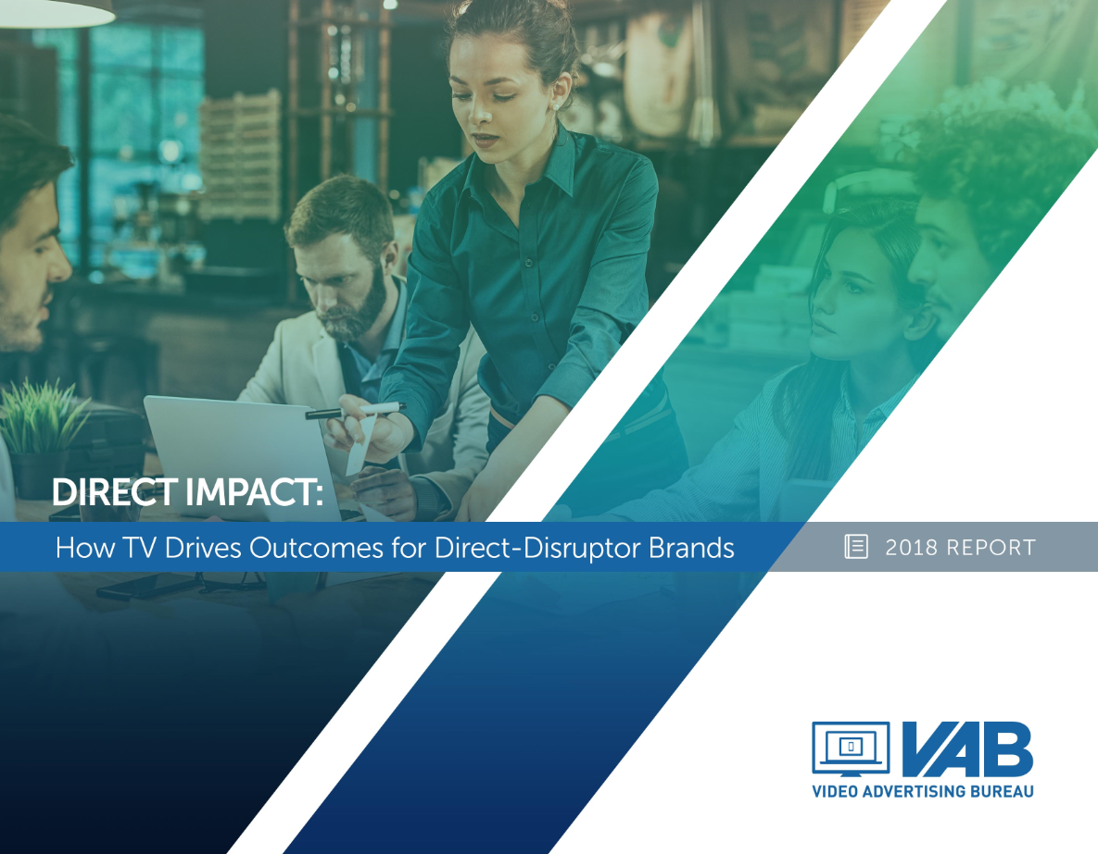
Direct Impact:
How TV Drives Outcomes For Direct-Disruptor Brands

Slide 2
Contents
Overview 3
Direct Impact: How TV Drives Outcomes For Brands 4
Direct-Disruptor Brands Summary 5-9
“Emerging” Direct-Disruptor Brands 10-18
Summary 11
TV Spend 12
Website Traffic 13-14
Online Interactions 15-16
Revenues 17-18
“Expanding” Direct-Disruptor Brands 19-27
Summary 20
TV Spend 21
Website Traffic 22-24
Search Queries 25
Revenues 26-27
Key Takeaways 28
Contact Information 29
VAB: DIRECT IMPACT

Slide 3
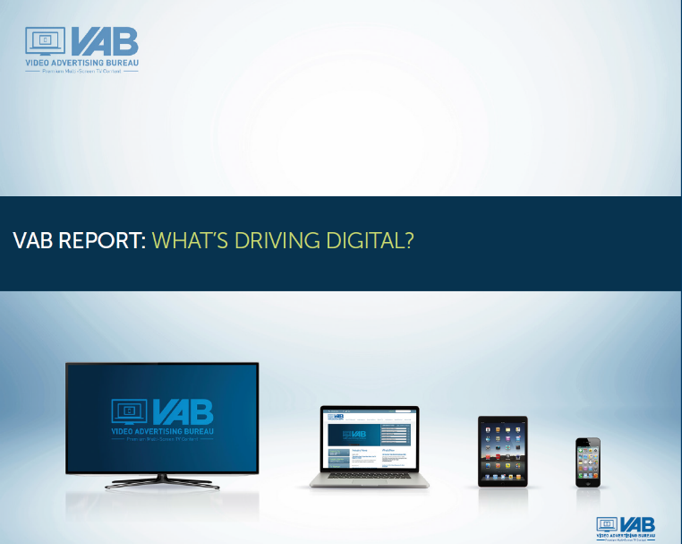


Five Years And Counting Of Tracking TV Spending From
Digital-Native, Data-Driven, Direct-Disruptor Brands
Back in 2014, the VAB began following the effect of TV spend on digital-native brands with "What's Driving Digital," a look at what triggers online traffic and revenues for 75 “pure-play” internet brands such as Priceline, E*Trade & Overstock.
Then in 2016, we released "What's App'ning!!: The TV-Traffic Correlation For Mobile Apps" which served as a category case study illustrating the correlation between TV spend and app traffic for 60 mobile apps across 10 categories.
In 2017 came our analysis exploring the effect of TV spend on key brand metrics such as website traffic, online interactions and revenue / sales for a robust set of 35 category disruptors - like Airbnb, Wayfair & Zillow – called "The Market-Changer's Playbook: Why TV Is Where Disruptors Go To Grow Big"
Each report highlighted how marketers implemented TV campaigns to take their brands to the next level of growth.
Now in our fifth year, join us in our latest release, “Direct Impact: How TV Drives Outcomes For Direct-Disruptor Brands,” as we examine the effect of TV spend on the business outcomes of 50 “direct-disruptor” brands…
VAB: DIRECT IMPACT

Slide 4
Direct Impact: How TV Drives Outcomes For “Direct” Brands
Commerce is experiencing an unprecedented evolution. Technology-driven transformation has permanently altered consumption habits and behaviors which has given rise to a series of new “direct-disruptor” brands across countless product categories.
Whether it’s Peloton for fitness, Gwynnie Bee for personal shopping or Hello Fresh for food delivery, many of these brands are effectively challenging long-time category market share leaders and are considered brands of the future.
But the future is now for these digital-native, data-driven companies who are looking for immediate action at scale from consumers in the short term while also embarking on longer-term brand building strategies to separate themselves from the competition.
In this report, Direct Impact, we examine the TV spend of 50 “direct-disruptor” brands in relation to available brand metrics such as website traffic, online interactions and revenue to determine what, if any, correlations exist.
After crunching the numbers, the figures clearly show that TV investments drive major business outcomes for these digital-native, data-driven, direct-disruptor brands analyzed.
Continue on to learn more about the direct impact of TV spend on key brand metrics…
VAB: DIRECT IMPACT

Slide 5
Direct-Disruptor Brands Summary

Slide 6
“Direct-Disruptor” Definitions
“Direct-disruptors” are digital-native brands who sell, or otherwise provide, goods and services directly to consumers. First-party data collection as well as performance measurement and analytics are the core competencies of these companies.
With cutting edge analytic tools and a team of data scientists at their disposable, media channels are scrutinized and optimized on a real-time basis. As a result, their media investment reflects, with near precision, the most effective and efficient sales drivers for their business.
However, “direct-disruptor” brands exist across a multitude of categories, serve a myriad of consumer purposes and can be at a different business lifecycle / maturity relative to other brands which can make “like-for-like” analysis comparisons challenging.
For the purposes of this report, we separated the 50 direct-disruptor brands we analyzed into one of two groups based on similar characteristics:
“Emerging” Direct-Disruptor Brands – newer brands with an average age of 8 years old who have only been investing in TV since 2015 (two years on average)
“Expanding” Direct-Disruptor Brands – brands with an average age of 15 years old who have been investing in TV for at least the last four years (eight years on average)
VAB: DIRECT IMPACT

Slide 7













































50 “Direct-Disruptor” Brands Analyzed Across Many Categories
We analyzed the TV spend and individual key metrics (where available) like website traffic, online interactions and revenue of these 50 brands across 30 categories
“Emerging” Direct-Disruptor Brands
“Expanding” Direct-Disruptor Brands
Food Delivery
Apparel
Mattresses
Food Delivery
Apparel
Fitness
Personal Shopping
Resale Marketplace
Razors
Interior Design
Pet Care
Travel
Pet Care
Alcohol
Travel
Coupons
Contact Lenses
Job Search
Lodging
Auto
Watches
Home Services
Retail
Beauty Supplies
Auction
Real Estate
Genealogy
Coupons
Therapy
Health
Money Transfer
Personal Finance
Business Services
Personal Finance
Personal Loans
VAB: DIRECT IMPACT
The above list represents a mix of brands across “direct” categories who invested $500K+ in measured 2017 TV spend (Nielsen AdIntel) and have available data within at least one of the following business metrics: website traffic unique reach via comScore, online interactions via iSpot.tv, or revenue / valuation estimates through reliable & verified sources such as SEC.gov, Pivotal Research or company press releases / company representative statements.

Slide 8
These 50 Direct-Disruptor Brands Collectively Spent
Over $1.3 Billion On TV In 2017; A 98% Increase YOY
“Direct-disruptor” brands have accelerated spending recently in this very competitive environment, having invested over $650MM more in TV over the last year
VAB: DIRECT IMPACT
Source: VAB analysis of Nielsen Ad Intel data, calendar year 2015-2017. TV spend includes national cable TV, broadcast TV, Spanish language cable TV, Spanish language broadcast TV, spot TV, syndication TV. Reflects the cume TV spend of the 50 direct brands identified in this report. All 50 companies existed since 2015, except for Hubble, which was founded in 2016.

Slide 9


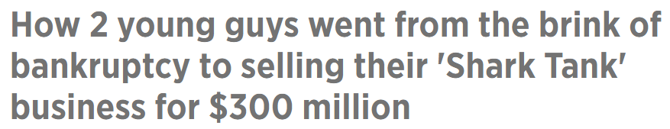



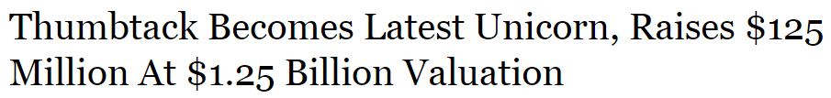
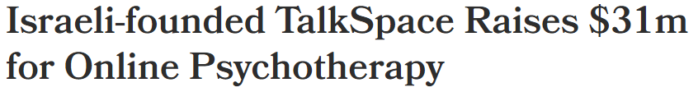


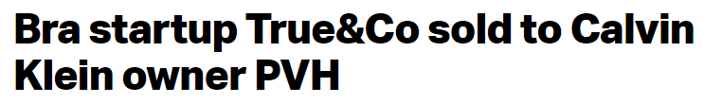






Television Has Driven Many Business Successes Across The
50 “Direct-Disruptor” Brands Analyzed
VAB: DIRECT IMPACT
Click Thru Images for Article

Slide 10
“Emerging”
Direct-Disruptor Brands

Slide 11
“Emerging” Direct-Disruptor Brands
These 34 “emerging” direct-disruptor brands have an average age of 8 years old and have been investing in TV only since 2015 (two years on average)
Most “emerging” direct-disruptor brands saw their online traffic explode as soon as they launched an initial TV campaign
For these newer direct-disruptor brands, TV jumpstarts online conversation, exploration and viewing centered around the brands themselves
Most brands in this group are private companies who have recently begun to utilize TV as a key part of their media mix
“Emerging” Direct-Disruptor Brands
Food Delivery
Apparel
Mattresses
Personal Shopping
Resale Marketplace
Razors
Pet Care
Alcohol
Travel
Coupons
Contact Lenses
Watches
Home Services
Retail
Beauty Supplies
Auction
Therapy
Health
Money Transfer
Personal Finance
Business Services
VAB: DIRECT IMPACT

Slide 12
These 34 “Emerging” Brands Collectively Spent Over
$500 Million On TV In 2017; A 138% Increase YOY
“Emerging” direct-disruptor brands have accelerated spending recently in this very competitive environment, having invested over $300MM more in TV over the last year
VAB: DIRECT IMPACT
Source: VAB analysis of Nielsen Ad Intel data, calendar year 2015-2017. TV spend includes national cable TV, broadcast TV, Spanish language cable TV, Spanish language broadcast TV, spot TV, syndication TV. Reflects the cume TV spend of the 34 direct brands identified in this report. All 34 companies existed since 2015, except for Hubble, which was founded in 2016.

Slide 13
On Average, “Emerging” Brands Saw A 83% Lift In Their
Unique Website Traffic After They Launched A TV Campaign
“Emerging” brands saw a continual lift in their website traffic that spans their initial TV launch to present day
“Emerging” Direct-Disruptor Brands
Average Monthly Website Unique Visitors (000)
Based Over A Three-Year Time Period: Feb’15 – Jan ‘18
+83%
(Monthly Average)
(Monthly Average)
Based on the 29 brands within the “emerging” direct-disruptor brands segment that are measured in comScore
VAB: DIRECT IMPACT
Source: VAB analysis of comScore mediametrix multiplatform media trend data; total audience (Desktop P2+, Mobile 18+), February ‘15 – January ’18 (calendar months). VAB analysis of Nielsen Ad Intel data, TV spend (national cable TV, national broadcast TV, Spanish language broadcast TV, Spanish language cable TV, spot TV, syndication TV), Feb ’15 – Jan ’18 (calendar months).

Slide 14
Website Traffic Skyrocketed For Many “Emerging” Brands As Soon As They Launched A TV Campaign
Monthly Website Unique Visitors (000) Comparison
Based Over A Three-Year Time Period (Feb ‘15 – Jan ‘18)
Monthly Average:
Prior To TV Launch
Monthly Average:
TV Launch – Jan ‘18
Company
% Difference
Blink Health
261
449
+72%
Chewy
1,732
5,570
+222%
Eloquii
165
200
+21%
Flipp
2,133
6,835
+221%
Harry’s
764
1,118
+46%
Hubble
N/A
305
MileIQ
N/A
1,049
MVMT
192
912
+375%
Nerdwallet
4,269
12,005
+181%
OfferUp
N/A
4,791
Poshmark
5,865
10,680
+82%
Remitly
117
269
+130%
Saatva
184
343
+86%
Stitch Fix
1,151
2,241
+95%
Sun Basket
197
479
+143%
ThredUp
2,554
2,991
+17%
Top Hatter
1,891
4,317
+128%
Source: VAB analysis of comScore mediametrix multiplatform media trend data; total audience (Desktop P2+. Mobile 18+), February ‘15 – January ’18 (calendar months). VAB analysis of Nielsen Ad Intel data, TV spend (national cable TV, national broadcast TV, Spanish language broadcast TV, Spanish language cable TV, spot TV, syndication TV), Feb ‘15– Jan ’18 (calendar months). N/A = not enough traffic for comScore to measure.

Slide 15
TV Is The Catalyst That Jumpstarts Greater Conversation, Exploration & Viewing Of Their Advertising Online
TV leads to increased searches, social actions and non-paid online video views of a brand’s TV ad. In fact, these digital actions in total far outpace the collective increase in TV spend across the 22 measured “emerging” direct brands.
22 “Emerging” Direct-Disruptor Brands: TV Spend vs. “Digital Actions” YOY % Increase
2016 vs. 2017
Total Digital Actions (+177% YOY)
22 brands reflect the number measured in iSpot.tv that also had TV spending in both 2016 & 2017 for comparison purposes.
Source: TV spending based on VAB analysis of Nielsen Ad Intel data, TV spend (national cable TV, national broadcast TV, Spanish language broadcast TV, Spanish language cable TV, spot TV, syndication TV), CY 2016 & 2017. Digital actions based on VAB analysis of iSpot.tv data and reflects TV commercial-related searches (Google, Bing, Yahoo!), social actions (posts, likes, shares and comments related to TV ads on Facebook, Twitter, YouTube, iSpot.tv) and earned, not promoted, online video views of TV ads (YouTube, iSpot.tv). Digital actions are correlated to TV ad airing data.

Slide 16
Most Brands Saw Across-The-Board Lifts In Online Metrics Related To Their Ads As They Increased Their TV Investment
Sampling of Brands: TV Spend vs. “Digital Actions” YOY % Increase
2016 vs. 2017
Brand
TV Spend
Search Queries
Social Actions
Total Online Views
+121%
+12,362%
+558%
+1,879%
+150%
+34%
+174%
+616%
+5,815%
+2,282%
+77,000%
+7,512%
+801%
+1,310%
+109%
+199%
+141%
+117%
+232%
+79%
+155%
+322%
+25,120%
+74,575%
+2,246%
+626%
+475%
+2,158%
+216%
+417%
+73%
+6,145%
+845%
+768%
+26,300%
+751%
+69%
+132%
+764%
+6,715%
Source: TV spending based on VAB analysis of Nielsen Ad Intel data, TV spend (national cable TV, national broadcast TV, Spanish language broadcast TV, Spanish language cable TV, spot TV, syndication TV), CY 2016 & 2017. Digital actions based on VAB analysis of iSpot.tv data and reflects TV commercial-related searches (Google, Bing, Yahoo!), social actions (posts, likes, shares and comments related to TV ads on Facebook, Twitter, YouTube, iSpot.tv) and earned, not promoted, online video views of TV ads (YouTube, iSpot.tv). Digital actions are correlated to TV ad airing data.

Slide 17
“Emerging” Brands Often See Their Revenues Take Off When They Launch A TV Campaign Or Increase Their Investment
Company
2016
2017
YoY Diff
(TV launch: 2016)
TV Spend (000):
$13,560
$63,480
$49,920
Revenue (000):
$80,000
$150,000
$70,000
+88%
Founded in 2014
(TV launch: 2016)
TV Spend (000):
$574
$13,467
$12,893
Revenue (000):
$200,000
$300,000
$100,000
+50%
Founded in 2013
(TV launch: 2017)
TV Spend (000):
---
$3,438
$3,438
Founded in 2012
Revenue (000):
$100,000
$150,000
$50,000
+50%
(TV launch: 2017)
TV Spend (000):
---
$2,670
$2,670
Revenue (000):
$60,000
$80,000
$20,000
+33%
Founded in 2013
(TV launch: 2017)
TV Spend (000):
---
$535
$535
Revenue (000):
$50,000
$100,000
$50,000
+100%
Founded in 2011
VAB: DIRECT IMPACT
%
=revenue increase between 2016 & 2017
Source: Revenues reflect estimated revenue data from Pivotal Research. TV spend based on VAB analysis of Nielsen Ad Intel data, TV spend (national cable TV, national broadcast TV, Spanish language broadcast TV, Spanish language cable TV, spot TV, syndication TV), CY 2016 & 2017.

Slide 18
“Emerging” Brands Often See Their Revenues Take Off When They Launch A TV Campaign Or Increase Their Investment
Company
2016
2017
YoY Diff
(TV launch: 2017)
TV Spend (000):
---
$22,846
$22,846
Founded in 2011
Revenue (000):
$872,327
$1,090,163
$217,836
+25%
(TV launch: 2016)
TV Spend (000):
$448
$1,417
$969
Revenue (000):
$180,000
$200,000
$20,000
+11%
Founded in 2010
(TV launch: 2017)
TV Spend (000):
---
$605
$605
Founded in 2014
Revenue (000):
$124,000
$275,000
$151,000
+122%
(TV launch: 2016)
TV Spend (000):
$553
$5,227
$4,674
Revenue (000):
$40,000
$100,000
$60,000
+150%
Founded in 2012
(TV launch: 2017)
TV Spend (000):
---
$852
$852
Founded in 2012
Revenue (000):
$118,800
$150,000
$31,200
+26%
VAB: DIRECT IMPACT
%
=revenue increase between 2016 & 2017
Source: Revenues reflect estimated revenue data from Pivotal Research, with the exception of Top Hatter which is based on analyst estimates per Fortune (5/11/17). TV spend based on VAB analysis of Nielsen Ad Intel data, TV spend (national cable TV, national broadcast TV, Spanish language broadcast TV, Spanish language cable TV, spot TV, syndication TV), CY 2016 & 2017.

Slide 19
“Expanding”
Direct-Disruptor Brands

Slide 20
“Expanding” Direct-Disruptor Brands
These 16 “expanding” direct-disruptor brands have an average age of 15 years old and have been investing in TV for at least the last four years (eight years on average)
There is a strong correlation between TV spend and website traffic within their TV advertising continuity
For these more established brands, TV continues to be a key driver of search queries
Correlations also exist between TV spend increases and increased revenues
“Expanding” Direct-Disruptor Brands
Food Delivery
Apparel
Fitness
Interior Design
Pet Care
Travel
Job Search
Lodging
Auto
Real Estate
Genealogy
Coupons
Personal Finance
Personal Loans
VAB: DIRECT IMPACT

Slide 21
These 16 “Expanding” Brands Collectively Spent Almost $800 Million On TV In 2017; A 78% Increase YOY
“Expanding” direct-disruptor brands have invested over $300MM more in TV over the last year
VAB: DIRECT IMPACT
Source: VAB analysis of Nielsen Ad Intel data, calendar year 2015-2017. TV spend includes national cable TV, broadcast TV, Spanish language cable TV, Spanish language broadcast TV, spot TV, syndication TV. Reflects the cume TV spend of the 16 “expanding” direct brands identified in this report.

Slide 22
There Is A Definitive Correlation Between TV Spend & Website Traffic For These “Expanding” Brands
12 of the 15 Measured “Expanding” Direct-Disruptor Brands (80%) Analyzed Exhibited
a Direct Correlation Between TV Spend & Website Traffic
12 Brands
Correlation between TV Spend &
Monthly Unique Visitors
3 Brands
Lack of correlation between TV Spend &
Monthly Unique Visitors
*analysis excludes “Five Four” brand which wasn’t measured in comScore during the time period
VAB: DIRECT IMPACT
Source: VAB analysis of comScore mediametrix multiplatform media trend data; total audience (Desktop P2+, Mobile 18+), February ‘16 – January ’18 (calendar months). VAB analysis of Nielsen Ad Intel data, TV spend (national cable TV, national broadcast TV, Spanish language broadcast TV, Spanish language cable TV, spot TV, syndication TV), Feb ’16 – Jan ’18 (calendar months).

Slide 23
TV Drives Online Traffic For “Expanding” Brands That Have
A Continual Advertising Presence
The below chart reflects the shifts in spend and online traffic for brands who were active on TV every month, or nearly every month, for the last two years
TV Spend Up, Website Traffic Up
(Year-Over-Year Comparison: Feb ’16 – Jan ’17 vs. Feb ‘17 – Jan ‘18)
Avg Monthly TV Spend (000):
Feb ‘16 - Jan ’17:
$3,784
$2,296
$225
Feb ‘17 – Jan ‘18:
$9,204
$2,898
$1,273
% Difference:
+143%
+26%
+466%
Avg Monthly Unique Visitors (000):
Feb ‘16 - Jan ’17:
96
1,703
973
Feb ‘17 – Jan ‘18:
236
2,096
2,072
% Difference:
+147%
+23%
+113%
VAB: DIRECT IMPACT
Source: VAB analysis of comScore mediametrix multiplatform media trend data; total audience (Desktop P2+, Mobile 18+), February ‘16 – January ’18 (calendar months). VAB analysis of Nielsen Ad Intel data, TV spend (national cable TV, national broadcast TV, Spanish language broadcast TV, Spanish language cable TV, spot TV, syndication TV), Feb ’16 – Jan ’18 (calendar months).

Slide 24
TV Drives Online Traffic For “Expanding” Brands That Have
A Continual Advertising Presence
The below chart reflects the shifts in spend and online traffic for brands who were active on TV every month, or nearly every month, for the last two years
TV Spend Up, Website Traffic Up
(Year-Over-Year Comparison: Feb ’16 – Jan ’17 vs. Feb ‘17 – Jan ‘18)
Avg Monthly TV Spend (000):
Feb ‘16 - Jan ’17:
$5,174
$2,667
$247
Feb ‘17 – Jan ‘18:
$6,358
$6,320
$1,200
% Difference:
+23%
+137%
+386%
Avg Monthly Unique Visitors (000):
Feb ‘16 - Jan ’17:
4,631
12,138
5,458
Feb ‘17 – Jan ‘18:
6,201
16,963
6,680
% Difference:
+34%
+40%
+22%
VAB: DIRECT IMPACT
Source: VAB analysis of comScore mediametrix multiplatform media trend data; total audience (Desktop P2+, Mobile 18+), February ‘16 – January ’18 (calendar months). VAB analysis of Nielsen Ad Intel data, TV spend data (national cable TV, national broadcast TV, Spanish language broadcast TV, Spanish language cable TV, spot TV, syndication TV), Feb ’16 – Jan ’18 (calendar months).

Slide 25
For These More Established Direct-Disruptor Brands,
Increased TV Activity Drives Search Queries
Sampling of Brands: TV Spend vs. Search Queries YOY % Increase
2016 vs. 2017
Brand
TV Spend
Search Queries
+27%
+76%
+124%
+177%
+26%
+117%
+24%
+180%
+23%
+319%
+1,513%
+1,200%
+15%
+275%
+219%
+341%
+391%
+455%
+103%
+188%
VAB: DIRECT IMPACT
Source: TV spending based on VAB analysis of Nielsen Ad Intel data, TV spend (national cable TV, national broadcast TV, Spanish language broadcast TV, Spanish language cable TV, spot TV, syndication TV), CY 2016-2017. Digital actions based on VAB analysis of iSpot.tv data and reflects TV commercial-related searches (Google, Bing, Yahoo!). Digital actions are correlated to TV ad airing data.

Slide 26
“Expanding” Brands Often See Their Revenues Take Off When They Increase Their TV Investment
Company
2016
2017
YoY DIff
(TV launch: 2015)
TV Spend (000):
$26,132
$35,915
$9,782
Revenue (000):
$663,324
$1,008,989
$345,665
+52%
Founded in 2011
(TV launch: 2014)
TV Spend (000):
$34,051
$108,708
$74,657
Founded in 2012
Revenue (000):
$170,000
$340,000
$170,000
+100%
(TV launch: 2015)
TV Spend (000):
$38,927
$73,168
$34,241
Revenue (000):
$80,000
$100,000
$20,000
+25%
Founded in 2011
(TV launch: 2015)
TV Spend (000):
$242
$1,533
$1,290
Revenue (000):
$50,000
$100,000
$50,000
+100%
Founded in 2002
VAB: DIRECT IMPACT
%
=revenue increase between 2016 & 2017
Source: Revenues are based on estimated revenue data from Pivotal Research (Hello Fresh, Peloton, Five Four, Adore Me). TV spend based on VAB analysis of Nielsen Ad Intel data, TV spend (national cable TV, national broadcast TV, Spanish language broadcast TV, Spanish language cable TV, spot TV, syndication TV), CY 2016 & CY 2017.

Slide 27
“Expanding” Brands Often See Their Revenues Take Off When They Increase Their TV Investment
Company
2016
2017
YoY DIff
(TV launch: 1999)
TV Spend (000):
$23,378
$26,932
$3,554
Revenue (000):
$384,402
$617,736
$233,334
+61%
Founded in 1998
(TV launch: 2000)
TV Spend (000):
$95,809
$121,624
$25,815
Revenue (000):
$850,000
$1,000,000
$150,000
+18%
Founded in 1983
(TV launch: 2009)
TV Spend (000):
$12,244
$15,015
$2,771
Revenue (000):
$689,000
$906,000
$217,000
+31%
Founded in 2005
(TV launch: 2013)
TV Spend (000):
$15,833
$31,791
$15,958
Revenue (000):
$365,148
$858,870
$493,722
+135%
Founded in 2013
VAB: DIRECT IMPACT
%
=revenue increase between 2016 & 2017
Source: Revenues are based on the following – company filings (10-K) for U.S. revenue via SEC.gov (LendingTree, HomeAway, Carvana), and analyst estimates per Forbes & NASDAQ global newswire (9/12/17) for Ancestry.com. TV spend based on VAB analysis of Nielsen Ad Intel data, TV spend (national cable TV, national broadcast TV, Spanish language broadcast TV, Spanish language cable TV, spot TV, syndication TV), CY 2016 & CY 2017.

Slide 28
Key Takeaways
Food delivery. Contact lenses. Fitness. Personal Shopping. Pet care. Today, many categories are being transformed by new product entrants who are forgoing traditional supply chains and developing “one-to-one” relationships directly with consumers.
By their nature, these data-driven, direct-disruptor brands have all had an active digital presence since their inception. Whether through owned, earned and, in many cases, paid media, these brands have built and maintained a consumer-facing digital footprint since day 1.
However, when these brands wanted to build market share beyond a core, albeit limited, customer base they added TV as a critical component to their media mix. In short, TV is where these brands went to grow big.
Brands saw immediate positive business outcomes as they entered, and expanded their presence, in TV and the proof is in the numbers. For instance, “emerging” brands saw an 83% average lift in their website traffic once they launched TV while “expanding” brands saw triple-digit increases in their search volume. Of course, brands in both segments saw significant revenue growth as well.
These performance-driven companies know exactly what media works for driving their business and it’s why these 50 direct-disruptors have collectively doubled their TV spending each of the last two years.
Television. Be Known.
VAB: DIRECT IMPACT

Slide 29


For More Information Visit Us Online
TheVAB.com
Follow us:
@VideoAdBureau
Like us:
facebook.com/VideoAdvertisingBureau

