Slide 1



2020
Direct Effect
Driving Intent For Emerging DTC Brands

Slide 2


About VAB
VAB is an insights-driven organization that inspires marketers to reimagine their media strategies resulting in fully informed decisions.
Drawing on our marketing expertise, we simplify the complexities in our industry and discover new insights that transform the way marketers look at their media strategy.
Simplify
We save you time by bringing you the latest data & actionable takeaways you can use to inform your marketing plans.
Discover
We keep you one step ahead with the latest thinking so you can create innovative, forward-looking strategies.
Transform
We help you build your brand by focusing on core marketing principles that will help drive tangible business outcomes.
This information is exclusively provided to VAB members and qualified marketers. Further distribution is prohibited.
PAGE 2

Slide 3
Driving Intent For Emerging Direct-to-Consumer Brands
In our recently released report entitled 'Welcome To TV’, we introduced a diverse group of brands who launched their first-ever national TV campaign during 2019. Two-thirds of those new advertisers were direct-to-consumer brands which further solidified the importance of this segment within the American economy.
Earlier this year, we delved into the DNA of DTC brands and their importance to society in our marketer’s guide, 'Deciphering Direct-to-Consumer’. However, this segment has never been more vital than it is today, in the time of COVID-19 and a world of physical distancing, lockdowns, closures and ‘stay at home’ mandates. DTC brands offer an array of essential goods and services delivered right to your door or seamlessly online.
As an extension of our ‘Welcome To TV’ report series and a continuation of our annual ‘direct-to-consumer’ attribution analyses, this report looks at how TV is instrumental in driving consumer intent and building customer bases by correlating TV investment to website traffic for a set of 50 new DTC TV advertisers.
This information is exclusively provided to VAB members and qualified marketers. Further distribution is prohibited.
PAGE 3

Slide 4


















DTC brands generally establish their customer base through social media, but to grow beyond their initial loyal, niche consumers they must add platforms that provide a broader audience like Multiscreen TV
DTC Advertising Evolution
Social Media
Sampling of brands that are primarily advertising in this channel
Podcasts, Out-of-Home, Satellite Radio
Sampling of brands that have added these channels to their media mix
Multiscreen TV
Sampling of brands that have added TV to their media mix
DTC Brand Maturity
To learn more about the DNA and evolution of DTC brands, download our ‘Deciphering Direct-to-Consumer’ marketer’s guide here.
This information is exclusively provided to VAB members and qualified marketers. Further distribution is prohibited.
PAGE 4

Slide 5















































In this analysis, we look at the
effect TV spending has on website traffic for 50 new TV advertisers within the Direct-to-Consumer segment.
These ‘emerging’ DTC brands
(8 years old on average), spanning 39 categories, launched their first national TV campaign between
4Q ’18 – 4Q ‘19 and have invested over $425 million on TV collectively during this time period.
This list of 50 Direct-to-Consumer brands represents a mix of companies across DTC categories who launched their first national TV campaign between 4Q ‘18 – 4Q ’19 and invested $500K+ in total measured TV spend (Nielsen Ad Intel), including spot TV, over a two-year period between Feb ‘18 –Jan ’20. These brands also had to be measured in Comscore with available monthly unique website visitors data for analysis purposes.
This information is exclusively provided to VAB members and qualified marketers. Further distribution is prohibited.
PAGE 5

Slide 6



These newcomers are not only relevant in today’s economy but are especially vital to consumers and businesses in the time of COVID-19
Many of the DTC brands within our analysis offer essential products and services that allow people to order, or connect with, from the comfort of their own home while limiting physical interactions with others
Essential DTC Brands During the COVID-19 Pandemic
Doordash provides door-to-door food delivery helping customers stay at home and restaurants stay in business.
Postmates provides online deliveries from restaurants, retailers, grocers and more enabling anyone to have anything delivered on-demand..
With ecommerce growing during this time of physical distancing, Honey automatically finds and applies coupons codes to online shopping carts.
From groceries to household essentials, Shipt simplifies life with deliveries from local stores right to your door.
Redbox allows people to stream movies & TV shows on-demand at home or to rent them at kiosks in grocery stores and pharmacies.
Hinge is a mobile-first dating app designed for people who want to get off of dating apps.
Simple Habit is a 5-minute meditation app to help busy people stress less, achieve more and live better.
Pray is an interfaith mobile app that helps religious leaders stay connected with their congregants and provide daily prayers, bible stories, etc.
A modern twist on the neighborhood butcher, ButcherBox is a subscription service that delivers beef, chicken & pork directly to your door.
Classpass is normally focused
on providing access to fitness facilities but has shifted their focus to providing at-home workout sessions during this time.
This information is exclusively provided to VAB members and qualified marketers. Further distribution is prohibited.
PAGE 6

Slide 7

DTC brands are also helping people manage their personal finances, seamlessly conduct business and home school their kids
Essential DTC Brands During the COVID-19 Pandemic
Axos offers online banking, mobile deposits, checking, savings, and loans, giving consumers the ability to manage their finances at home.
Dave provides online banking services including overdraft protection, automated budgeting, no-interest cash advances and un-bounceable checks
Kabbage is an online financial company that provides funding and loans to small businesses and consumers through an automated lending platform.
Robinhood is a financial services mobile app and website that offers the ability to invest in stocks and options, commission-free with no minimum deposit.
ServiceNow is a cloud-based computing platform that delivers digital workflows for companies. They transform the IT experience and automate HR services.
Smartsheet is a ‘software as a service’ work management platform used to assign tasks, track project progress, manage calendars, share documents, etc.
Reading IQ is a digital library that provides thousands of books for kids ages 2-12 that can be accessed at any time.
Scribd is an e-book and audiobook subscription service that includes more than one million adults & children titles that can be read from the comfort of home.
This information is exclusively provided to VAB members and qualified marketers. Further distribution is prohibited.
PAGE 7

Slide 8
Our analysis on driving ‘intent’ (i.e. website traffic) for 50 DTC brands includes companies across a wide spectrum of TV investment levels
TV Spend: $500K - $2MM
TV Spend: $2MM - $10MM
TV Spend: $10MM+
Source: VAB analysis of Nielsen Ad Intel data, total TV spend based on a two-year period: Feb’18 – Jan ‘20. TV spend includes national cable TV, broadcast TV, Spanish language cable TV, Spanish language broadcast TV. Brands reflect those with total TV spend over $500K.
This information is exclusively provided to VAB members and qualified marketers. Further distribution is prohibited.
PAGE 8

Slide 9
Interestingly, brands increased their TV investment by 51% on average across all levels during ‘when on TV’ months after their initial launch
Average Monthly TV Spend (000)
All Brands’ TV Campaign Average
Based Over a Two-Year Time Period: Feb ‘18 – Jan ‘20
$500K - $2MM TV Spend
$2MM - $10MM TV Spend
$10MM+ TV Spend
+50%
+50%
+63%
Source: VAB analysis of Nielsen Ad Intel data, TV spend (national cable TV, national broadcast TV, Spanish language broadcast TV, Spanish language cable TV, spot TV, syndication TV), Feb ‘18 – Jan ‘20 (calendar months). Note: the $2MM-$10MM TV spend bucket excludes Expensify which executed a targeted, heavy one-month TV campaign only.
This information is exclusively provided to VAB members and qualified marketers. Further distribution is prohibited.
PAGE 9

Slide 10

Segmentation Analysis
Due to varying measurement data availability across brands, we segmented the 50 DTC companies into two groups for the purpose of this analysis

Slide 11





















First Segment: There were 36 brands that had reported monthly website traffic measurement before launching their first national TV campaign
Online Banking
E-Commerce
Food Delivery
Online Delivery
Shoes
Apparel & Accessories
Wellness & Fitness
Pharmaceutical
Pet Care
Meal Kits
Professional Services
Boots
Phone Accessories
Feminine Care
Home Goods
Insurance
Vitamins
Financial Services
Men’s Grooming
Coupons
Furniture
Digital Frames
Biometric Security
Online Books Subscription Service
Location-Based Services
Mobile Tickets
Online Dating
Video-on-Demand
Religion
Meditation
Source: VAB analysis of Comscore mediametrix multiplatform media trend data, total audience (Desktop P2+, Mobile 18+), Jan ‘16 – Jan ‘20 (calendar months).
This information is exclusively provided to VAB members and qualified marketers. Further distribution is prohibited.
PAGE 11

Slide 12
On average, monthly unique visitors saw an immediate surge upon
the launch of a TV campaign and this audience only continued to grow through the duration of these brands’ TV flight
36 ‘Emerging’ DTC Brands*
Average Monthly Website Unique Visitors (000)
Based Over a Four-Year Time Period: Jan ‘16 – Jan ‘20
+85%
(+1.6MM monthly uniques)
+56%
(+1.0MM monthly uniques)
vs. monthly average prior to TV launch
vs. monthly average prior to TV launch
(monthly average)
(TV launch – January 2020)
Source: VAB analysis of Nielsen Ad Intel data, TV spend (national cable TV, national broadcast TV, Spanish language broadcast TV, Spanish language cable TV, spot TV, syndication TV), Feb ‘18 – Jan ‘20 (calendar months). VAB analysis of Comscore mediametrix multiplatform media trend data, total audience (Desktop P2+, Mobile 18+), Jan ‘16 – Jan ‘20 (calendar months). ‘Prior to TV Launch’ reflects the average monthly unique visitors based on when each brand’s website began being measured by Comscore, or starting from January 2016 if measurement began before that month. *Reflects the 36 brands that are measured in Comscore and had reported monthly unique visitors in at least one month prior to their campaign launch.
This information is exclusively provided to VAB members and qualified marketers. Further distribution is prohibited.
PAGE 12

Slide 13
While all investment levels saw at least double-digit traffic increases
on average, the biggest TV investors tripled their monthly unique visitors during this short time period
36 ‘Emerging’ DTC Brands*
Average Monthly Website Unique Visitors (000)
Based Over a Four-Year Time Period: Jan ‘16 – Jan ‘20
12 Brands: $500K - $2MM TV Spend
16 Brands: $2MM - $10MM TV Spend
8 Brands: $10MM+ TV Spend
+205%
(+5.3MM)
+126%
(+3.3MM)
+31%
(+338K)
+22%
(+236K)
+18%
(+376K)
+34%
(+693K)
(monthly average)
(TV launch – Jan ‘20)
(monthly average)
(TV launch – Jan ‘20)
(monthly average)
(TV launch – Jan ‘20)
(% & MM) vs. monthly average prior to TV launch
(% & MM) vs. monthly average prior to TV launch
(% & MM) vs. monthly average prior to TV launch
Source: VAB analysis of Nielsen Ad Intel data, TV spend (national cable TV, national broadcast TV, Spanish language broadcast TV, Spanish language cable TV, spot TV, syndication TV), Feb ‘18 – Jan ‘20 (calendar months). VAB analysis of Comscore mediametrix multiplatform media trend data, total audience (Desktop P2+, Mobile 18+), Jan ‘16 – Jan ‘20 (calendar months). ‘Prior to TV Launch’ reflects the average monthly unique visitors based on when each brand’s website began being measured by Comscore, or starting from January 2016 if measurement began before that month. *Reflects the 36 brands that are measured in Comscore and had reported monthly unique visitors in at least one month prior to their campaign launch.
This information is exclusively provided to VAB members and qualified marketers. Further distribution is prohibited.
PAGE 13

Slide 14



Sampling of Brands: Monthly Website Unique Visitors (000) Comparison
Based Over a Four-Year Time Period: Jan ‘16 – Jan ‘20
While most DTC brands start with a social media-dominant strategy (Facebook, Instagram, etc.), monthly unique website visitors quickly skyrocketed for these ‘emerging’ new TV advertisers with many welcoming millions of potential new customers to their digital platforms
Brand | Monthly Average: Prior to TV Launch | Monthly Average: TV Launch – Jan ‘20 | # Diff | % Diff
 | 5,467 | 22,020 | +16,553 | +303%
 | 2,783 | 13,381 | +11,048 | +397%
 | 3,426 | 11,208 | +7,783 | +227%
 | 5,249 | 10,352 | +5,103 | +97%
 | 6,061 | 11,027 | +4,966 | +82%
 | 1,430 | 3,470 | +2,040 | +43%
 | 3,414 | 5,259 | +1,846 | +54%
 | 2,920 | 3,923 | +1,003 | +34%
 | 1,808 | 2,788 | +980 | +54%
 | 2,340 | 3,284 | +944 | +40%
 | 765 | 1,662 | +897 | +117%
 | 1,696 | 2,416 | +720 | +42%
Source: VAB analysis of Nielsen Ad Intel data, TV spend (national cable TV, national broadcast TV, Spanish language broadcast TV, Spanish language cable TV, spot TV, syndication TV), Feb ‘18 – Jan ‘20 (calendar months). VAB analysis of Comscore mediametrix multiplatform media trend data, total audience (Desktop P2+, Mobile 18+), Jan ‘16 – Jan ‘20 (calendar months). ‘Prior to TV Launch’ reflects the average monthly unique visitors based on when each brand’s website began being measured by Comscore, or starting from January 2016 if measurement began before that month.
This information is exclusively provided to VAB members and qualified marketers. Further distribution is prohibited.
PAGE 14

Slide 15




Sampling of Brands: Monthly Website Unique Visitors (000) Comparison
Based Over a Four-Year Time Period: Jan ‘16 – Jan ‘20
Even smaller DTC brands saw near immediate, double-
and triple-digit increases in their monthly unique
website visitors
Brand | Monthly Average: Prior to TV Launch | Monthly Average: TV Launch – Jan ‘20 | # Diff | % Diff
 | 65 | 211 | +146 | +224%
 | 58 | 171 | +113 | +193%
 | 119 | 300 | +181 | +152%
 | 155 | 384 | +229 | +147%
 | 163 | 341 | +178 | +109%
 | 549 | 1,081 | +532 | +97%
 | 134 | 240 | +105 | +79%
 | 336 | 595 | +258 | +77%
 | 286 | 474 | +188 | +66%
 | 142 | 227 | +85 | +60%
 | 153 | 225 | +72 | +47%
 | 731 | 1,077 | +346 | +47%
Source: VAB analysis of Nielsen Ad Intel data, TV spend (national cable TV, national broadcast TV, Spanish language broadcast TV, Spanish language cable TV, spot TV, syndication TV), Feb ‘18 – Jan ‘20 (calendar months). VAB analysis of Comscore mediametrix multiplatform media trend data, total audience (Desktop P2+, Mobile 18+), Jan ‘16 – Jan ‘20 (calendar months). ‘Prior to TV Launch’ reflects the average monthly unique visitors based on when each brand’s website began being measured by Comscore, or starting from January 2016 if measurement began before that month.
This information is exclusively provided to VAB members and qualified marketers. Further distribution is prohibited.
PAGE 15

Slide 16




Second Segment: There were 14 brands whose website traffic was not measured before they launched their first national TV campaign
Online Banking
Mattresses
Personal Style
Apparel & Accessories
Education
Dash Camera
Home Security
Book Summary Service
Automotive
Seasonal Trees
Fruit-Infused Water
Source: VAB analysis of Comscore mediametrix multiplatform media trend data, total audience (Desktop P2+, Mobile 18+), Jan ‘16 – Jan ‘20 (calendar months).
This information is exclusively provided to VAB members and qualified marketers. Further distribution is prohibited.
PAGE 16

Slide 17


Sampling of Brands: Monthly Website Unique Visitors (000) Comparison
Based Over a Four-Year Time Period: Jan ‘16 – Jan ‘20
TV helps build brand recognition while driving hundreds of thousands of potential new customers to a brand’s digital platform
Brand | Monthly Average: Prior to TV Launch | Monthly Average: TV Launch – Jan ‘20
 | N/A | 4,972
 | N/A | 796
 | N/A | 672
 | N/A | 573
 | N/A | 556
 | N/A | 420
 | N/A | 233
 | N/A | 223
Source: VAB analysis of Nielsen Ad Intel data, TV spend (national cable TV, national broadcast TV, Spanish language broadcast TV, Spanish language cable TV, spot TV, syndication TV), Feb ‘18 – Jan ‘20 (calendar months). VAB analysis of Comscore mediametrix multiplatform media trend data, total audience (Desktop P2+, Mobile 18+), Jan ‘16 – Jan ‘20 (calendar months). ‘Prior to TV Launch’ reflects the average monthly unique visitors based on when each brand’s website began being measured by Comscore, in the case of these brands there was no measurement until they launched their TV campaign. N/A = not enough traffic for Comscore to measure.
This information is exclusively provided to VAB members and qualified marketers. Further distribution is prohibited.
PAGE 17

Slide 18
Other brands saw significant lifts in online traffic during targeted TV campaigns and specific time periods
Treetopia saw their average Nov-Dec ’19 seasonal unique website traffic increase 41%,
or +112K monthly visitors,
YoY after doubling their TV investment to $770K during the two month timeframe.
Frontpoint invested $1.5MM total on TV between Nov’19 – Jan ’20 and saw their monthly website traffic build from ‘not measured’ in Oct ‘19 to 164K unique visitors in Jan ’20.
After ReadingIQ invested $1.5MM in TV during calendar year 2019, the brand’s website began being measured in Comscore and saw 73K unique visitors in Jan ‘20.
Mizzen+Main invested $800K total on TV during 4Q between
Oct ’19 – Dec ’19 and saw their monthly website traffic build from ‘not measured’ in Sep ‘19 to 49K unique visitors in
Dec ‘19.
Source: VAB analysis of Nielsen Ad Intel data, TV spend (national cable TV, national broadcast TV, Spanish language broadcast TV, Spanish language cable TV, spot TV, syndication TV), Feb ‘18 – Jan ‘20 (calendar months). VAB analysis of Comscore mediametrix multiplatform media trend data, total audience (Desktop P2+, Mobile 18+), Feb ‘18 – Jan ‘20 (calendar months).
This information is exclusively provided to VAB members and qualified marketers. Further distribution is prohibited.
PAGE 18

Slide 19


With the successes seen in driving ‘intent’ among a broader audience, DTC marketers are championing the growth opportunities available through multiscreen TV
"Our aim was to create something visually delightful in order to elevate the spot beyond the everyday scenarios typical to the category. Ultimately, we hope the campaign drives acquisition but also creates equity for the brand."
“(TV) has been game-changing for the business. We’ve been able to reach more new people on TV than in any other channel. If you think of it from a growth perspective, there’s no other channel where you can just flip a switch overnight like TV. It has massively exposed us to a broader set of people.”
“It’s (TV) connecting with people in a different way because of how they consume content. You can really tap into their mindset. It just opens up the door to new storytelling.”
Adam Ledbury, Associate Creative Director at M/H VCCP
(in partnership with Doordash), Doordash
(1/14/19)
Elie Donahue, VP of Marketing, Rothy’s
(AdWeek, 3/11/19)
Branden Windle, Co-founder & Chief Marketing Officer, Tecovas
Interview with Tatari.tv
“We started a TV pilot in April and every month since it’s been an increasing part of our channel mix….attribution on TV isn’t as perfect as other channels, but at the end of the day, we’d rather have something that’s clearly making an impact even if the attribution isn’t perfect.”
“Our goal is to continue to share our mission with new audiences. We are excited to see the impact this national TV ads campaign can make. Our video ‘Warmth’ encompasses our story and what it feels like to be a part of the Love Your Melon community.”
“In a category where so many focus on the tactical nature of delivery and technology, we decided to tap into the human truth of intense cravings and bring this to life through incredible storytelling.”
Jordan Gladstone, Director of Marketing, Dave
Interview with Tatari.tv
Eric Edge, SVP of Marketing & Communications, Postmates
(Campaign Live, 2/10/20)
Zachary Quinn, President, Love Your Melon
(Business Wire, 10/30/19)
This information is exclusively provided to VAB members and qualified marketers. Further distribution is prohibited.
PAGE 19

Slide 20
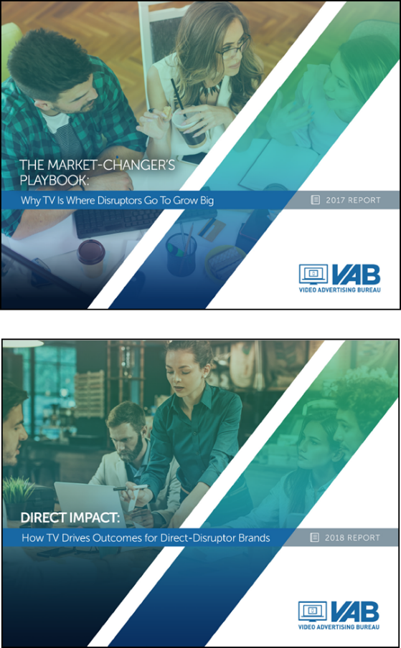
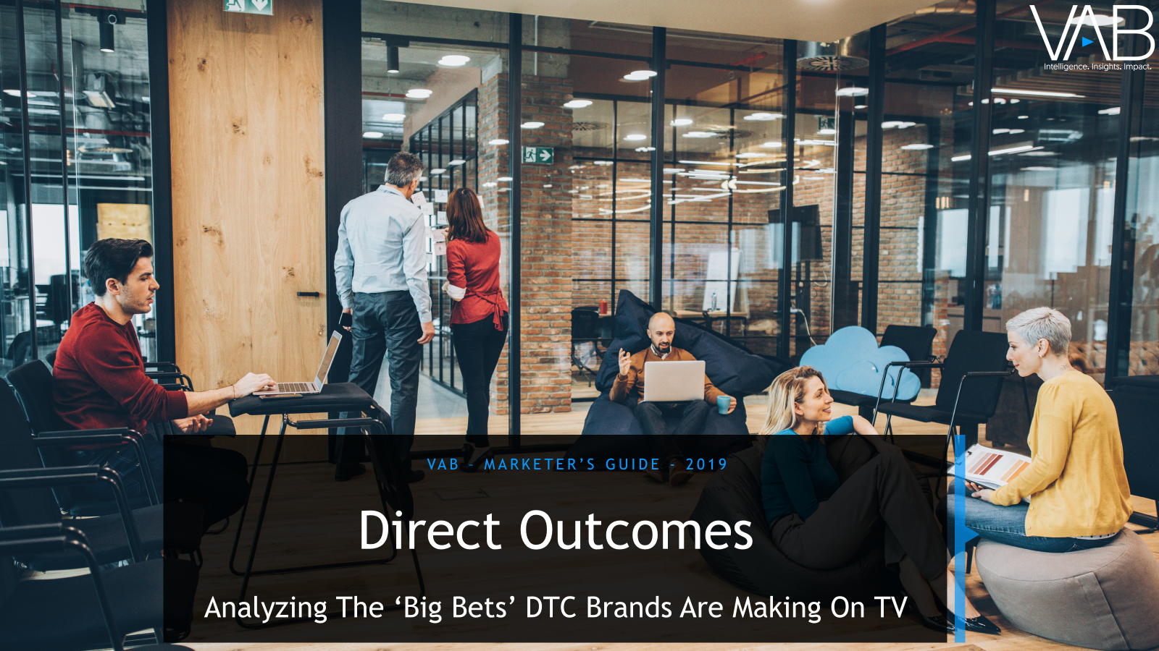

These successes are the latest proof points uncovered over the last several years that show similar results for TV driving business outcomes
2017
‘The Market-Changers Playbook’
2018
‘Direct Impact’
2019
‘Direct Outcomes’
2020
‘Direct Effect’
10 ‘brand building / emerging’ direct disruptors saw an average +139% lift in their website traffic after they launched their first TV campaign. (+2.5MM average monthly unique visitors).
29 ‘emerging’ direct disruptors saw an average +83% lift in their website traffic after they launched their first TV campaign (+1.2MM average monthly unique visitors).
39 ‘emerging’ direct-to-consumer brands saw an average +93% lift in their website traffic after they launched their first TV campaign (+2.5MM average monthly unique visitors).
36 ‘emerging’ direct-to-consumer brands saw an average +85% lift in their website traffic after they launched their first TV campaign (+1.6MM average monthly unique visitors).
Note: click on each image to download the report and to learn more about the analyses methodology. For ‘The Market-Changers Playbook,’ figures for the ‘Brand Building Disruptor’ segment excludes Yelp and three brands that were not Comscore measured before their TV campaign launched.
This information is exclusively provided to VAB members and qualified marketers. Further distribution is prohibited.
PAGE 20

Slide 21



Key takeaways for marketers
Although we looked at data-obsessed, performance-driven, ‘direct-to-consumer’ ecommerce brands,
this analysis is applicable across brands and categories
Brands of all sizes and budget levels are entering the TV marketplace looking to build ‘intent’ among consumers and increase their customer base
Regardless of budget, brands are seeing quantifiable business outcomes from their TV investment as a result
of consumer engagement and direct actions taken
These successful outcomes are driving brands to rapidly re-invest into TV and increase their spend from their initial expenditure
This information is exclusively provided to VAB members and qualified marketers. Further distribution is prohibited.
PAGE 21

Slide 22



Thank You
Creators
Jason Wiese
Leah Montner-Dixon
Karolina Guillen
SVP, Director of Strategic Insights
jasonw@thevab.com
Insights Manager
leahm@thevab.com
Senior Insights Analyst
karolinag@thevab.com
Interested in learning more? Check out this related content:
Direct Impact:
How TV Drives Outcomes
For Direct-Disruptor Brands
Direct Outcomes:
Analyzing The 'Big Bets' DTC Brands
Are Making On TV
Deciphering Direct-to-Consumer:
An Insider’s Guide to America’s Fastest Growing Brands
This information is exclusively provided to VAB members and qualified marketers. Further distribution is prohibited.
PAGE 22

Slide 23

Get immediate access to the VAB Insights library
We’ve answered hundreds of marketers’ questions.
Our guides, reports, webinars and videos provide actionable insights to help marketers navigate today’s video landscape and think differently about their strategy.
We are committed to your business growth and proud to offer brand marketers and agencies complimentary access to our continuously-growing Insights library.
Get Access at theVAB.com or visit us here
This information is exclusively provided to VAB members and qualified marketers. Further distribution is prohibited.
PAGE 23

