Slide 1


April 26, 2024
Question of the Week:
“Despite Google’s recent delay, how do I reduce my dependency on third-party cookies?”

Slide 2







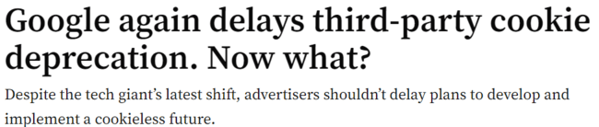



Why This Matters: On April 23rd, 2024, Google announced that they are
yet again delaying the deprecation of third-party cookies
Sampling of headlines on Google’s Impending Cookie Deprecation
4/23/24
2/1/23
7/28/22
6/24/21
1/14/20
This information is exclusively provided to VAB members and qualified marketers.
PAGE 2

Slide 3


Definition: What is a ‘cookie’?
Unique identifiers that can assign an internet browser or device to an individual
  allows a website to recognize a specific user and their online behaviors
  remembers information that the user may have previously entered
Download VAB’s ‘Untangling Terminology Within Video Measurement’ for more definitions on ‘Platforms & Devices’, ‘Audience Measurement’, ‘Ratings & Currency’, ‘Data Management’ and ‘Engagement & Performance’.
This information is exclusively provided to VAB members and qualified marketers.
PAGE 3

Slide 4









Solution: Leverage future-proofing technology like Universal IDs which offer a privacy-focused alternative for targeting
While Universal IDs have been around for several years, the increased adoption and interoperability of Universal IDs will play an important role in enhancing audience targeting and measurement capabilities
Multiple Universal IDs
Universal IDs can help marketers to…
Universal ID (UID) - Unique identifier that allows publishers and advertisers to recognize and authenticate users across publishers, platforms & devices, providing a holistic view of audiences.
There are several Universal IDs in the marketplace that can serve as a futureproof way to target and measure audiences for CTV and programmatic campaigns.
Eliminate dependency on 3rd party cookies
More seamlessly partner with publishers and data providers to match first-party data on PII in a privacy compliant and secure manner
Achieve greater precision in audience targeting
Increases accuracy of cross-channel measurement
Universal ID Examples
UID 2.0
Open ID
Ramp ID
Download VAB’s ‘What’s the Deal with Viewership Data Collection?’ to learn more.
This information is exclusively provided to VAB members and qualified marketers.
PAGE 4

Slide 5

Industry Perspective
“The identity problem is not Google's problem to solve. It's yours. Google did not create our dependency on cookies, we did."
John Halley, President, Paramount Advertising
IAB ALM 2024
This information is exclusively provided to VAB members and qualified marketers.
PAGE 5

Slide 6






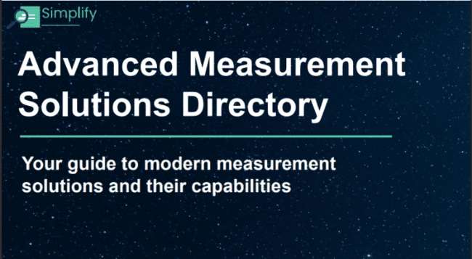




Want more? VAB has a wealth of resources available that can prepare you for a cookieless future
What’s the Deal with Viewership Data Collection?
What’s the Deal with Identity?
What’s the Deal with Engagement?
What’s the Deal with Outcomes?
What’s the Deal with What’s Next in Measurement?
Data-Driven Opportunities in a Cookieless World
Advanced Measurement Solutions Directory
New Year’s Resolutions #3: Embrace Innovation
Reaching the Right Audiences
Unlocking Brand Growth with Audience-Based Buying
Learn how to future-proof your campaigns at www.thevab.com
This information is exclusively provided to VAB members and qualified marketers.
PAGE 6

Slide 7


About VAB
VAB plays a dual role in the video advertising industry. We are leading the change to bring about a more innovative and transparent marketplace. We also provide the insights and thought leadership that enables marketers to develop business-driving marketing strategies.
Drawing on our marketing expertise, we simplify the complexities in our industry and discover new insights that transform the way marketers look at their media strategy.
We are committed to your business growth and proud to offer VAB members, brand marketers and agencies complimentary access to our continuously-growing Insights library. Get immediate access at theVAB.com.
This information is exclusively provided to VAB members and qualified marketers.
PAGE 7

