Slide 1





2021
Delayed Adulthood
How Younger & Older Generations Are Achieving ‘Life Milestones’ at Their Own Pace

Slide 2
What You’ll Learn…
How the ‘traditional’ path to adulthood and the consumer milestones along the way have evolved
Why younger generations are ‘delaying adulthood’ by waiting longer to get married, have children or buy a home, and the impact of COVID-19
The value of older generations’ buying power and how adults over 50 are enjoying more economic freedom later in life
How marketers can reach their best prospects by life stage, buying behaviors and characteristics through an audience-based approach
This information is exclusively provided to VAB members and qualified marketers. Further distribution is prohibited.
PAGE 2

Slide 3

What is ‘Delayed Adulthood’?
While adulthood is traditionally marked by independence from their parents, there has been a decades-long trend, which was exacerbated by the pandemic, of young adults holding off on achieving key milestones - such as becoming financially independent, moving away from home, getting married and having children – until later in life.
Beyond the acceleration of this trend among young adults, older consumers are also living very different lives than adults 50+ of previous generations. In fact, they are delaying their own milestones, such as retiring or downsizing their homes. While some of this is due in part to their adult children still needing support, many older adults are now living more active and social lives after 50, and with more disposable income to spend.
This information is exclusively provided to VAB members and qualified marketers. Further distribution is prohibited.
PAGE 3

Slide 4

How is ‘Delayed Adulthood’ impacting marketers?
Assumptions on what people are in market for based on their age are no longer true.
This has significant implications for brands who are targeting their campaigns on traditional age demographics (e.g. A18-34, A18-49, A25-54) since what consumers buy is not dictated by age.
As purchases are more dictated by lifestage and behaviors (vs. demo), it underscores the importance of considering a more modern, audience-first targeting approach.
This information is exclusively provided to VAB members and qualified marketers. Further distribution is prohibited.
PAGE 4

Slide 5

Delayed Adulthood – The Impact on Today’s Young Adults

Slide 6



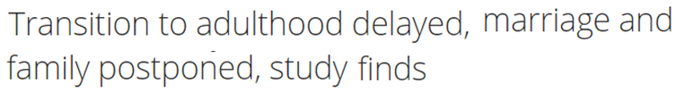


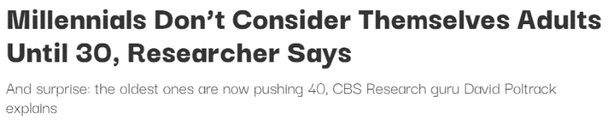
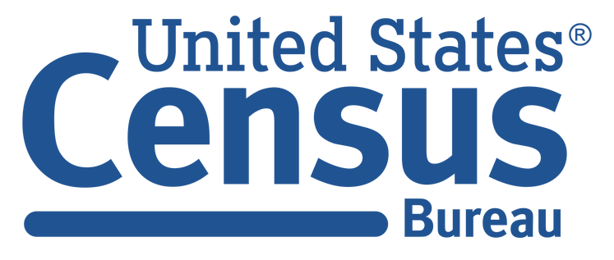



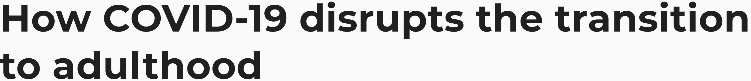
Postponing traditional adult milestones - such as employment, marriage, home ownership and having children - has been a growing trend over the years, exacerbated further by COVID
January 2004
September 2014
March 2017
August 2017
September 2020
April 2021
This information is exclusively provided to VAB members and qualified marketers. Further distribution is prohibited.
PAGE 6

Slide 7




Only half as many adults 25-34 achieved all four common ‘life milestones’ in 2016 as they did in 1975
Four Common Milestones of Adulthood Achieved
% of A25-34
Four Common Milestones
= 1975
= 2016
Employed
Live Independently
-47%
vs 1975
Married
Has Children
Live Independently + Employed + Married + Has Children
Source: U.S. Census Bureau, The Changing Economics and Demographics of Young Adulthood: 1975 – 2016, April 2017. Data based on 1975 and 2016 Current Population Survey Annual Social and Economic Supplement. Figure 5. Four Common Milestones of Adulthood – Getting Married, Having Children, Working, and Living Independently. Q: What are the most common combinations that young adults have completed?
This information is exclusively provided to VAB members and qualified marketers. Further distribution is prohibited.
PAGE 7

Slide 8


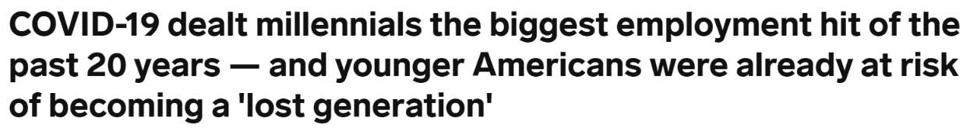
Employment: The share of adults 25-34 who are employed full time has decreased over the last twenty years
% of U.S. A25-34 who are employed full time
-10%
2000 vs. 2020
March 22, 2021
Source: VAB analysis of U.S. Bureau of Labor Statistics’ Current Population Survey data. Table 2. Employment status of the civilian noninstitutional population by detailed age, sex, and race, Annual Average, 2000, 2010, 2020.
This information is exclusively provided to VAB members and qualified marketers. Further distribution is prohibited.
PAGE 8

Slide 9
Living Independently: More than half of all young adults are now living at home with a parent, a higher percentage than during the Great Depression
39%
of younger millennials say the COVID-19 recession has led them to move back home
“Some people may be moving back home for financial reasons, but there are also those heading home for other reasons, such as to help their parents or to be in a safer or more controllable environment than they would be in with a roommate.”
- Bobbi Rebell, host of the Financial Grownup podcast
Source: Pew Research Center analysis of decennial census (1900-’90); annual average of Current Population Survey (2000, 2021); monthly CPS (2020). *’Living with a parent’ refers to those who are residing with at least one parent in the household. 1900-1990 shares based on household population. CNBC, 39% of younger millennials say the Covid-19 recession has them moving back home, 8/5/20.
This information is exclusively provided to VAB members and qualified marketers. Further distribution is prohibited.
PAGE 9

Slide 10


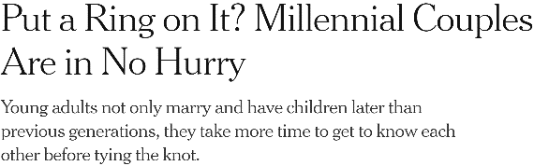

Marital Status: Fewer millennials are married than any other generation in the last century
The estimated median age to marry for the first time is 30.5 for men and 28.1 for women, up from ages 23.7 and 20.5 in 1947
% Married Between Age 25-37
By Generation
May 29, 2018
(b. 1981-1996)
(b. 1965-1980)
“Millennials are waiting longer to get married compared with previous generations because they are taking more time to find the right partner and prioritize financial success.”
(b. 1956-1964)*
(b. 1946-1955)*
(b. 1928-1945)
Source: Pew Research Center, analysis of 1968, 1982, 1989, 2001, and 2018 Current Population Survey Annual Social and Economic Supplements (IPUMS). Millennial data from 2018 survey, Gen X data from 2001 survey, Late Boomer data from 1989, Early Boomer data from 1982, Silent data from 1968. *Late Boomer' and 'Early Boomer' birth years reflect estimated split done by VAB of overall Baby Boomer birth years (1946-1964); not broken out by Pew Research Center. New York Times, The Risks of Babies to Older Fathers, 3/25/2019. U.S. Census Bureau, Census Bureau Releases New Estimates on America’s Families and Living Arrangements, 12/2/20.
This information is exclusively provided to VAB members and qualified marketers. Further distribution is prohibited.
PAGE 10

Slide 11
Children: Less millennials had children between the ages of 22-37 while births among 40+ has risen
The percentage of births to fathers aged 40+ has doubled since the 1970s and, by 2015, they accounted for 9% of all births
% of Women Who Had A Child Between Age 22-37
By Generation
“It's a sign of better access to education and employment opportunities, a rise in individualism and women's autonomy, better sex education, and a shift from religious-based to more secular values. But on a more individual level, having kids at a later age is also a result of women choosing to stay in school longer, waiting until later to marry, and paying off student debt first.”
- Christine Percheski, Associate Professor of Sociology at Northwestern University
(b. 1981-1996)
(b. 1965-1980)
(b. 1946-1964)
Source: Pew Research Center, analysis of 1986, 2002 and 2018, Current Population Survey Fertility Supplement (IPUMS). Reflects percent of 22- to 37-year-old women who have had a live birth. Millennial data from 2018 survey, Gen X data from 2002 survey, Boomer data from 1986. New York Times, The Risks of Babies to Older Fathers, 3/25/2019.
This information is exclusively provided to VAB members and qualified marketers. Further distribution is prohibited.
PAGE 11

Slide 12
Why are Young Adults ‘Delaying Adulthood’?

Slide 13

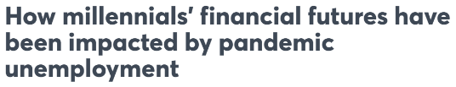
Economic uncertainty from the COVID-19 pandemic, in addition to debt from student loans and high living expenses, has impacted millennials’ ability to afford life milestones
September 17, 2020
“We’re going to see an impact on their wealth accumulation, which has an impact on some of these typical life transitions and purchases and cushions that we expect over the life-cycle,”
Cecilia Rouse
Economist & Dean of the School of Public and International Affairs, Princeton University
CNBC, 9/17/20
This information is exclusively provided to VAB members and qualified marketers. Further distribution is prohibited.
PAGE 13

Slide 14

Millennials have nearly doubled their debt over the last five years
In comparison, baby boomers and those in the silent generation have reduced their debt by 7% and 11% respectively since 2015
+76%
-7%
-11%
Source: VAB analysis of Experian Consumer Debt Study, 2021.
This information is exclusively provided to VAB members and qualified marketers. Further distribution is prohibited.
PAGE 14

Slide 15



Most of this debt is coming from educational expenses which, when coupled with higher costs of living, is impeding their path to adulthood
“Older millennials, while largely content in life, are stuck…they’re still held back by the past thanks to student loans and expensive living situations that make them unable to save for the future.”
- John Gerzema, Harris Poll CEO
68%
of older millennials are still working to pay off their student loans
40%
of older millennials have over half of their total balance still left
Source: CNBC, For many older millennials, student loan debt delayed buying homes, starting families and pursuing creative careers, 4/6/21. Survey base =1,000 U.S. adults ages 33-40, conducted from February 12-15, 2021.
This information is exclusively provided to VAB members and qualified marketers. Further distribution is prohibited.
PAGE 15

Slide 16






Consequently, they are more concerned about their financial health, which is one of the main reasons they’re putting off milestones like buying a home, getting married or having children
Because I have debt, I feel like I currently can’t or can’t yet…
% of millennials (ages 24-41) that answered the following
76%
42%
‘Buy a first or nicer home’
40%
‘Save for my future’
21%
‘Get married’
of millennials carrying debt claim they can’t achieve their personal or financial goals because of it
21%
‘Welcome children or grow my family’
18%
‘Live without financial support from family and friends’
Source: Bank of America, Better Money Habits: Winter Millennial Report, 2020, Survey base=1,903 respondents, ages 18-73 years old, conducted from September 12 – September 22, 2019.
This information is exclusively provided to VAB members and qualified marketers. Further distribution is prohibited.
PAGE 16

Slide 17
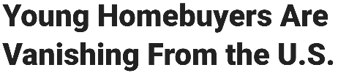
Young adults are avoiding making big purchases like buying a home, with many choosing to move back in with parents in order to save money
November 8, 2019
“Housing affordability is so difficult today, especially when coupled with rising rents and student loan debt”
Jessica Lautz
VP of Demographics & Behavioral Insights,
National Association of Realtors
Bloomberg, 11/8/19
This information is exclusively provided to VAB members and qualified marketers. Further distribution is prohibited.
PAGE 17

Slide 18
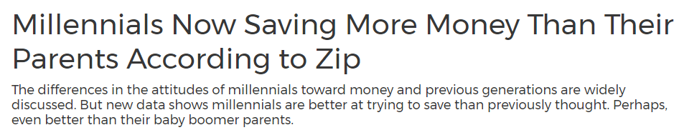
Shaped by their experiences with the Great Recession and the pandemic, millennials save at a greater rate than their parents
Nearly 3 out of 4 are actively saving money; 75% of younger millennials with savings are saving for retirement
February 27, 2021
+16%
“Millennials have come of age during a time of economic disruption, technological change and accelerated globalization. This has given them a set of behaviors and experiences vastly different from their parents. Their unique experiences will change the ways we buy and sell, forcing companies to examine how they do business now and into the future.”
Source: Bank of America, Better Money Habits: Winter Millennial Report, 2020, Survey base=1,903 respondents, ages 18-73 years old, conducted from September 12 – September 22, 2019.
This information is exclusively provided to VAB members and qualified marketers. Further distribution is prohibited.
PAGE 18

Slide 19
As a result of being more fiscally conservative and willing to live at home, the median age of first-time home buyers has increased to 33 years old
The median age for all U.S. home buyers has increased 52% over the last 40 years, outpacing growth in the U.S. population’s median age which has grown 30% over the same time period
1981 vs. 2019
31
47
+16 years
29
33
+4 years
36
55
+19 years
Source: National Association of Realtors via Bloomberg, Young Homebuyers Are Vanishing From the U.S., 11/8/2019. Note: Survey conducted almost every other year prior to 2002. No data for 1983 and 1999. VAB analysis of U.S. Census Bureau data, Population Estimates for 1980, 1990, 2000, 2010; U.S Census Bureau, Projected 5-Year Age Groups And Sex Composition of the Population, 2017 – 2060.
This information is exclusively provided to VAB members and qualified marketers. Further distribution is prohibited.
PAGE 19

Slide 20

Women are holding off on having children until their career is more established, a trend more pronounced in areas with stronger job markets
June 16, 2021
The birthrate is falling fastest in places with the greatest job growth — where women have more incentive to wait…The large urban counties that have gained the most jobs and population since the recession have seen birthrates fall twice as fast as smaller, rural counties that have not recovered as strongly.
This information is exclusively provided to VAB members and qualified marketers. Further distribution is prohibited.
PAGE 20

Slide 21





Following a pre-pandemic trend in delaying children, additional factors like COVID and debt have transformed this ‘delay’ into a strategic financial decision
Even though the top reasons are money-related, it affects all income levels as roughly the same percentage of adults across a range of brackets (>$25,000 - $200,000+ individual annual income) plan to delay having kids
‘I’m delaying kids because…’
% of respondents that answered the following
49%
60%
‘I don’t have enough money saved’
41%
‘of financial reasons because
of the COVID-19 outbreak’
of adults that plan on having kids are delaying parenthood
29%
‘I have too much debt to start
a family’
27%
‘I’m worried about contracting COVID-19’
Source: VAB analysis of Modern Fertility + SoFi’s Modern State of Fertility 2020: Career & Money. Survey base=participants between the ages of 20-45 (n=1,894), February 2020 with a follow up survey of 406 people in April 2020 asking about the impact of COVID-19 on their reproductive goals.
This information is exclusively provided to VAB members and qualified marketers. Further distribution is prohibited.
PAGE 21

Slide 22
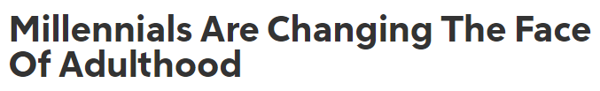
Despite putting off milestones once seen as ‘rites of passage,’ younger generations don’t feel the stigma around delaying adulthood since it is becoming the norm among their peers
September 21, 2020
“Shifts in judgments from peers about living at home will play an essential role in how millennials adjust to these new circumstances, such as living at home with parents or not owning a home…they’re trying to shift the norms of young adulthood to do what they must to survive and create their future.”
Jessica Kopitz
Social and Personality Psychology Researcher
Rocket HQ, 9/21/20
This information is exclusively provided to VAB members and qualified marketers. Further distribution is prohibited.
PAGE 22

Slide 23

Summary: Why are Young Adults ‘Delaying Adulthood’?
Debt from educational expenses and higher costs of living are the main obstacles impeding the path to adulthood for many young people
They have a greater concern for their financial health due to their experiences with economic downturns, which motivates them to hold off on milestones like getting married, having children or buying a home until they are more stable
For many young adults, especially women, establishing their career is their top priority for the foreseeable future
With less social stigma around delaying big ‘adult’ milestones, they are taking their time, choosing instead to save up for when they feel ready to take on more financial responsibility
This information is exclusively provided to VAB members and qualified marketers. Further distribution is prohibited.
PAGE 23

Slide 24
Delayed Adulthood –
The Impact on Adults Over 50

Slide 25


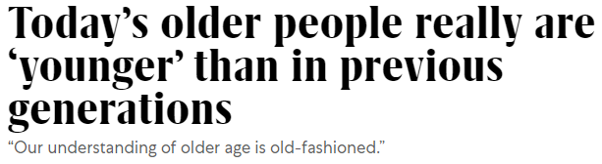





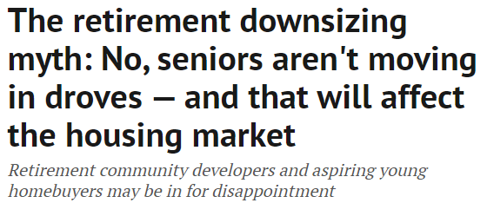
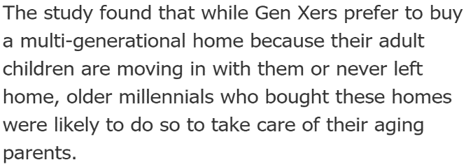
‘Delayed adulthood’ has been a trend among older adults too as they postpone ‘later’ life milestones and embrace
a more active lifestyle
October 29, 2012
September 23, 2020
May 26, 2015
April 1, 2019
October 20, 2020
This information is exclusively provided to VAB members and qualified marketers. Further distribution is prohibited.
PAGE 25

Slide 26











Older adults are spending more time staying active, participating in physical activities like hiking, weightlifting and yoga for enjoyment and to maintain their health
Top 10 Sports Adults 50-64 Personally Participated in the Last 12 months
Walking for Exercise
Swimming
Hiking
Weightlifting
Bicycling
A55+ spend 57% more time than younger millennials doing leisure activities & sports
58% of adults 50-64 claim to ‘follow a regular exercise routine’
Fishing
Golf
Yoga
Aerobics
Running
57% of adults 50-64 have participated in these sports
in the last 12 months
Source: VAB analysis of U.S. Bureau of Labor Statistics data, American Time Use Survey, 2019; % Share based on Average Hours Per Day Spent in Primary Activities; Younger millennials = A25-34. 2020 GfK MRI Spring.
This information is exclusively provided to VAB members and qualified marketers. Further distribution is prohibited.
PAGE 26

Slide 27

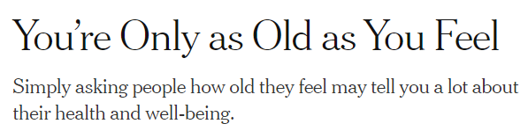

With a more active lifestyle, many older generations are feeling and acting younger than they are, proving there is much more life after age 50
Over the last 70 years, life expectancy has increased from age 68 to 79, and when coupled with working longer and more accrued wealth, people over 50 are embracing the many years left to enjoy life
At age 50, people say they feel about five years younger
October 17, 2019
“Older age is a time that we can actually look forward to. People really just enjoy themselves more and are at peace with who they are.”
Source: New York Times, You’re Only as Old as You Feel, 10/17/2019, Macrotrends, U.S. Life Expectancy 1950 – 2100.
This information is exclusively provided to VAB members and qualified marketers. Further distribution is prohibited.
PAGE 27

Slide 28

People over 50 are also typically working longer
than previous generations with more adults 55-64 employed full time now than there were 20 years ago
In comparison, full-time employment among adults 25-34 has decreased 10% over the same time period
% of U.S. A55-64 who are employed full time
+8%
2000 vs. 2020
Source: VAB analysis of U.S. Bureau of Labor Statistics’ Current Population Survey data. Table 2. Employment status of the civilian noninstitutional population by detailed age, sex, and race, Annual Average, 2000, 2010, 2020.
This information is exclusively provided to VAB members and qualified marketers. Further distribution is prohibited.
PAGE 28

Slide 29
As people work longer, older adults are accruing more wealth later in life - household income among both adults 55-64 and over 65 is outpacing growth across adults 25-54
While 23% are working later in life simply because they enjoy it, 14% of adults over the age of 65 are continuing to work primarily because they are still supporting their family as more adult children struggle to become financially independent
1999 vs. 2019
% Change
+72%
A25-34
+80%
A35-44
+73%
Average A25-54
% Change
+68%
A45-54
+81%
A55-64
+95%
A65+
Source: VAB analysis of Consumer Expenditure Survey data, U.S. Bureau of Labor Statistics, 1999, 2009 & 2019; Reflects income after taxes. Precision Living, Survey Reveals Why Seniors Are Putting Off Retirement , 2020.
This information is exclusively provided to VAB members and qualified marketers. Further distribution is prohibited.
PAGE 29

Slide 30


With more disposable income, adults 55+ account for 41% of annual total U.S. expenditures, or $3.4 trillion in total yearly spend
Compared to the average Millennial who saves around 10% of their post-tax income, baby boomers are more likely to be spenders, saving just under 7% of their post-tax income
% Share of Annual Aggregate Expenditures by Demo
Source: VAB analysis of 2019 Consumer Expenditure Survey data, U.S. Bureau of Labor Statistics, reported as of September 2020. SmartAsset, How Different Generations Spend Money, 1/16/20.
This information is exclusively provided to VAB members and qualified marketers. Further distribution is prohibited.
PAGE 30

Slide 31


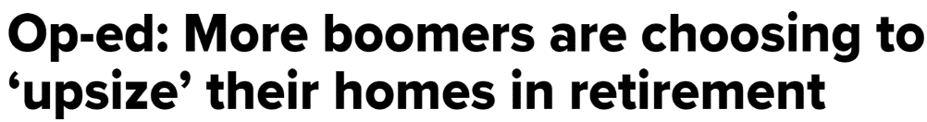
Older adults are devoting more money and time to maintaining their homes, which they are choosing to remain in longer, while some are even looking to upgrade to a bigger home
While younger generations struggle to become homeowners, adults 50-64 are 61% more likely to own a home than adults 25-34
April 13, 2021
Among 50-60-year-olds, 22% are looking to move to bigger homes and 43% want to remain in their existing home or move to a new location with comparable space
A55+ spend 51% more time than younger millennials doing household activities
to maintain their homes
Source: VAB analysis of U.S. Bureau of Labor Statistics data, American Time Use Survey, 2019; % Share based on Average Hours Per Day Spent in Primary Activities; Younger millennials = A25-34. CNBC, Op-ed: More boomers are choosing to ‘upsize’ their homes in retirement, 4/13/21. Survey base =2,003 U.S. adults ages 49-61, conducted in January 2019. 2020 GfK MRI Spring; 2000 MRI Doublebase.
This information is exclusively provided to VAB members and qualified marketers. Further distribution is prohibited.
PAGE 31

Slide 32







Consumers over 50 are spending more on non-essentials like entertainment, alcohol, pets and toys than those in the same age group twenty years ago
Older adults are living more active and social lives than previous generations, and as a result they are spending more on ‘fun’ categories, outpacing growth in spend among the average consumer
A55-64 % Increase in Average Annual Expenditures by Category: 2019 vs. 1999
Pets & Toys
Entertainment Fees & Admissions
Alcoholic Beverages
+179%
+133%
+116%
vs. 1999
vs. 1999
vs. 1999
Average Consumer % Increase: +137%
Average Consumer % Increase: +92%
Average Consumer % Increase: +82%
Audio / Visual Equipment & Services
Household Furnishings & Equipment
Vehicle Purchases
+85%
+44%
+34%
vs. 1999
vs. 1999
vs. 1999
Average Consumer % Increase: +64%
Average Consumer % Increase: +40%
Average Consumer % Increase: +33%
Source VAB analysis of Consumer Expenditure Survey data, U.S. Bureau of Labor Statistics, 1999 & 2019.
This information is exclusively provided to VAB members and qualified marketers. Further distribution is prohibited.
PAGE 32

Slide 33

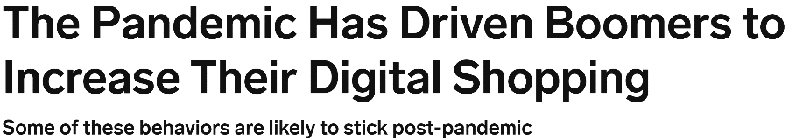





And they are buying differently - COVID has led older adults to embrace shopping online and subscribing to digital services, a trend likely to continue post-pandemic
With more disposable income and now easier ways to shop, adults 55+ spend 46% more time shopping than younger millennials
August 5, 2021
In the next 90 days, baby boomers are more likely to….
% more likely than the average consumer
190%
‘start a food delivery service subscription than the average American consumer’
9%
‘increase online grocery orders’
73%
‘start a new virtual gym subscription’
14%
‘increase their likelihood to purchase products online’
40%
‘decrease their likelihood to visit a grocery store or pharmacy in-person’
Source: VAB analysis of U.S. Bureau of Labor Statistics data, American Time Use Survey, 2019; % Share based on Average Hours Per Day Spent in Primary Activities; Younger millennials = A25-34. Insider Intelligence x eMarketer, The Pandemic Has Driven Boomers to Increase their Digital Shopping, 8/5/21. Resonate, Who Are the Baby Boomer Online Shoppers Driving Up E-Commerce?, 4/1/21.
This information is exclusively provided to VAB members and qualified marketers. Further distribution is prohibited.
PAGE 33

Slide 34
Over the last two decades, consumers over 50 have evolved into a powerful buying segment as their annual spending has increased by over $2 trillion, making them a desirable target for marketers
Adult 55+ share of annual expenditures has increased 46% since 1999 compared to A25-34 share, which has decreased by 12%
41%
34%
20%
28%
22%
15%
17%
26%
16%
Source: VAB analysis of Consumer Expenditure Survey data, U.S. Bureau of Labor Statistics, 1999, 2009 & 2019.
This information is exclusively provided to VAB members and qualified marketers. Further distribution is prohibited.
PAGE 34

Slide 35
Summary: Delayed Adulthood – The Impact on Adults Over 50
Society’s image of older adults has become progressively outdated over time, with many people over the age of 50 now living more active lives and feeling younger than they are
By staying healthy and living longer, they are willing and able to work later into life which is giving them greater disposable income
Many older adults are putting this income to work, choosing to spend, rather than save, on their homes and across categories like entertainment and alcohol
They are embracing new ways to shop, specifically online, and their share of total annual expenditures is growing along with these shifts, transforming them into a buying force to be reckoned with
This information is exclusively provided to VAB members and qualified marketers. Further distribution is prohibited.
PAGE 35

Slide 36
The Implications of ‘Delayed Adulthood’ for Marketers

Slide 37

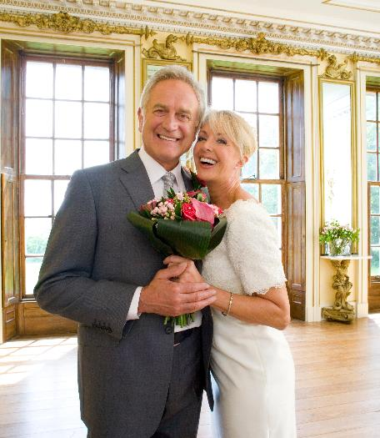


Life for many is no longer defined by age and the ‘appropriate’ corresponding milestones, a notion further fueled by the pandemic – how does that impact consumer targeting?
Marketers should….
Target based on audiences (i.e., in-market home buyers) rather than demos (i.e., A18-49)
Because….
Adults are hitting milestones at their own pace rather than conforming to ‘traditional’ societal norms
By targeting based on audiences…
Marketers will extend their message to best prospects and unlock additional revenue
This information is exclusively provided to VAB members and qualified marketers. Further distribution is prohibited.
PAGE 37

Slide 38












Instead of targeting campaigns against demo-based behaviors, marketers can utilize an audience-based buying approach to reach their best customer prospects by life stage, buying habits and characteristics
Buying Habits
Personal Characteristics
Potential New Homeowners
New Gym Members
Dining Out Regulars
Executives
Expectant Mothers
Gamers
In-Market Vehicle Buyers
Resort Travelers
Movie Goers
Newlyweds
College Graduates
Health-Conscious Adults
This information is exclusively provided to VAB members and qualified marketers. Further distribution is prohibited.
PAGE 38
This information is exclusively provided to VAB members and qualified marketers. Further distribution is prohibited.

Slide 39
Opening the TV buying demo to all adults, rather than focusing on a traditional demo target like A25-54, unlocks access to consumers that spend nearly $4 trillion annually, or 45% of total U.S. expenditures
Total Annual Aggregate U.S. Expenditures
2019
$8.3 Trillion
Source: VAB analysis of 2019 Consumer Expenditure Survey data, U.S. Bureau of Labor Statistics, reported as of September 2020.
This information is exclusively provided to VAB members and qualified marketers. Further distribution is prohibited.
PAGE 39
This information is exclusively provided to VAB members and qualified marketers. Further distribution is prohibited.

Slide 40
An adult 18+ buying demo also opens value within nearly four trillion national TV impressions, or two-thirds of the total, that can be included in TV plans for brands
Total National TV P18+ IMPs (equivalized)
2020 Calendar Year
5.7 Trillion
Source: VAB analysis of Nielsen Ad Intel data. National TV (broadcast TV, cable TV), Total Day, All Genres, C3, Demos: P18-24, P25-54, P55+; excludes Promos / PSAs / Local Avails, calendar year. Base: P18+. Note: C3 stream does not include Spanish-Language network data.
This information is exclusively provided to VAB members and qualified marketers. Further distribution is prohibited.
PAGE 40
This information is exclusively provided to VAB members and qualified marketers. Further distribution is prohibited.

Slide 41
Audience-based buying delivers impact through the purchase funnel by extending target reach and driving effectiveness, efficiencies, customer acquisition and sales conversions
Source: VAB Top 10: A top-line view of how the industry is adopting audience-based buying. VAB / Advertiser Perceptions ‘Audience-Based Buying Survey,’ fielded March 23 – 31, 2021. Survey base: Advertising decision-makers who are involved in buying or planning digital video, cable / broadcast TV, or advanced TV (n=211). Q150. To what extent do you believe audience-based buying of TV advertising can impact each of the following KPIs? (extremely impactful / very impactful). Base: Total Respondents. *such as site visits, sign ups, login ins, downloads.
This information is exclusively provided to VAB members and qualified marketers. Further distribution is prohibited.
PAGE 41
This information is exclusively provided to VAB members and qualified marketers. Further distribution is prohibited.

Slide 42



Key Takeaways For Marketing Plans
Assumptions of what people buy based on age no longer apply
See the value in older adults’ buying power
Extend reach and unlock revenue with audience-based targeting
The traditional path to adulthood and the associated life milestones that have been shifting for a while now were further intensified by the pandemic. This means that assumptions around what demographic groups are in the market for may no longer apply.
Much of the buying power has shifted as younger generations
hold off on major milestones and essentially delay their adulthood, which puts an even greater importance on the value of older adults.
By rethinking their strategies and modernizing their targeting approach to focus on audience-based buying rather than traditional demo-based buying, marketers can unlock the full value of TV to more effectively engage their best prospects.
This information is exclusively provided to VAB members and qualified marketers. Further distribution is prohibited.
PAGE 42

Slide 43











Creators
Leah Montner-Dixon
Karolina Guillen
Insights Manager
leahm@thevab.com
Senior Insights Analyst
karolinag@thevab.com
Interested in learning more? Check out this related content:
VAB Members, brand marketers and agencies get free and immediate access to VAB’s content library. Get access at theVAB.com
An Insider’s Look
Why agencies and brand marketers
are shifting to audience-based TV buying
The VAB Top 10
A Top-Line View of How the Industry is Adopting
Audience-Based Buying
Audience Migration in Context
Leveraging Population Shifts To Unlock $4 Trillion in Buying Power
Proven Strategies & Tactics In Audience-Based TV Buying
Success Stories Highlighted Through Real-World Case Studies
What Is Audience-Based Buying?
Simplifying Marketing Topics and Terms
This information is exclusively provided to VAB members and qualified marketers. Further distribution is prohibited.
PAGE 43

Slide 44

About VAB
VAB is an insights-driven organization that inspires marketers to reimagine their media strategies resulting in fully informed decisions.
Drawing on our marketing expertise, we simplify the complexities in our industry and discover new insights that transform the way marketers look at their media strategy.
Transform
We help you build your brand by focusing on core marketing principles that will help drive tangible business outcomes.
Simplify
We save you time by bringing you the latest data & actionable takeaways you can use to inform your marketing plans.
Discover
We keep you one step ahead with the latest thinking so you can create innovative, forward-looking strategies.
We are committed to your business growth and proud to offer VAB members, brand marketers and agencies complimentary access to our continuously-growing Insights library. Get immediate access at theVAB.com.
This information is exclusively provided to VAB members and qualified marketers. Further distribution is prohibited.
PAGE 44

