Slide 1




Diversity, Equity, Inclusion
& Belonging in Streaming

Slide 2


Due to its diverse programming and platforms, audiences and marketers are embracing Connected TV as it authentically connects
to today’s viewers.
Why is this important to marketers?
As cultural identity has become increasingly important, the audience demand for inclusive programming on streaming platforms has risen significantly.
In response, content producers and distributors are investing heavily in program diversity initiatives to meet this demand which is creating greater opportunities for marketers to connect with multicultural viewers.
This information is exclusively provided to VAB members and qualified marketers. Further distribution is prohibited.
PAGE 2

Slide 3
The Connected TV audience mirrors America’s diverse population, offering marketers ample opportunities to reach consumers across ethnicities and generations with a more representative base than traditional linear TV
% Composition of U.S. Population and CTV Audience by Ethnicity
% Composition of Total Viewers and CTV Audience by Generation
Source: Magnite, Connected TV is for Everyone 2021/22 Report, October 2021.Total viewers reflect respondents who watched 7+ hours of TV/week on a big screen device across linear and CTV.
This information is exclusively provided to VAB members and qualified marketers. Further distribution is prohibited.
PAGE 3

Slide 4
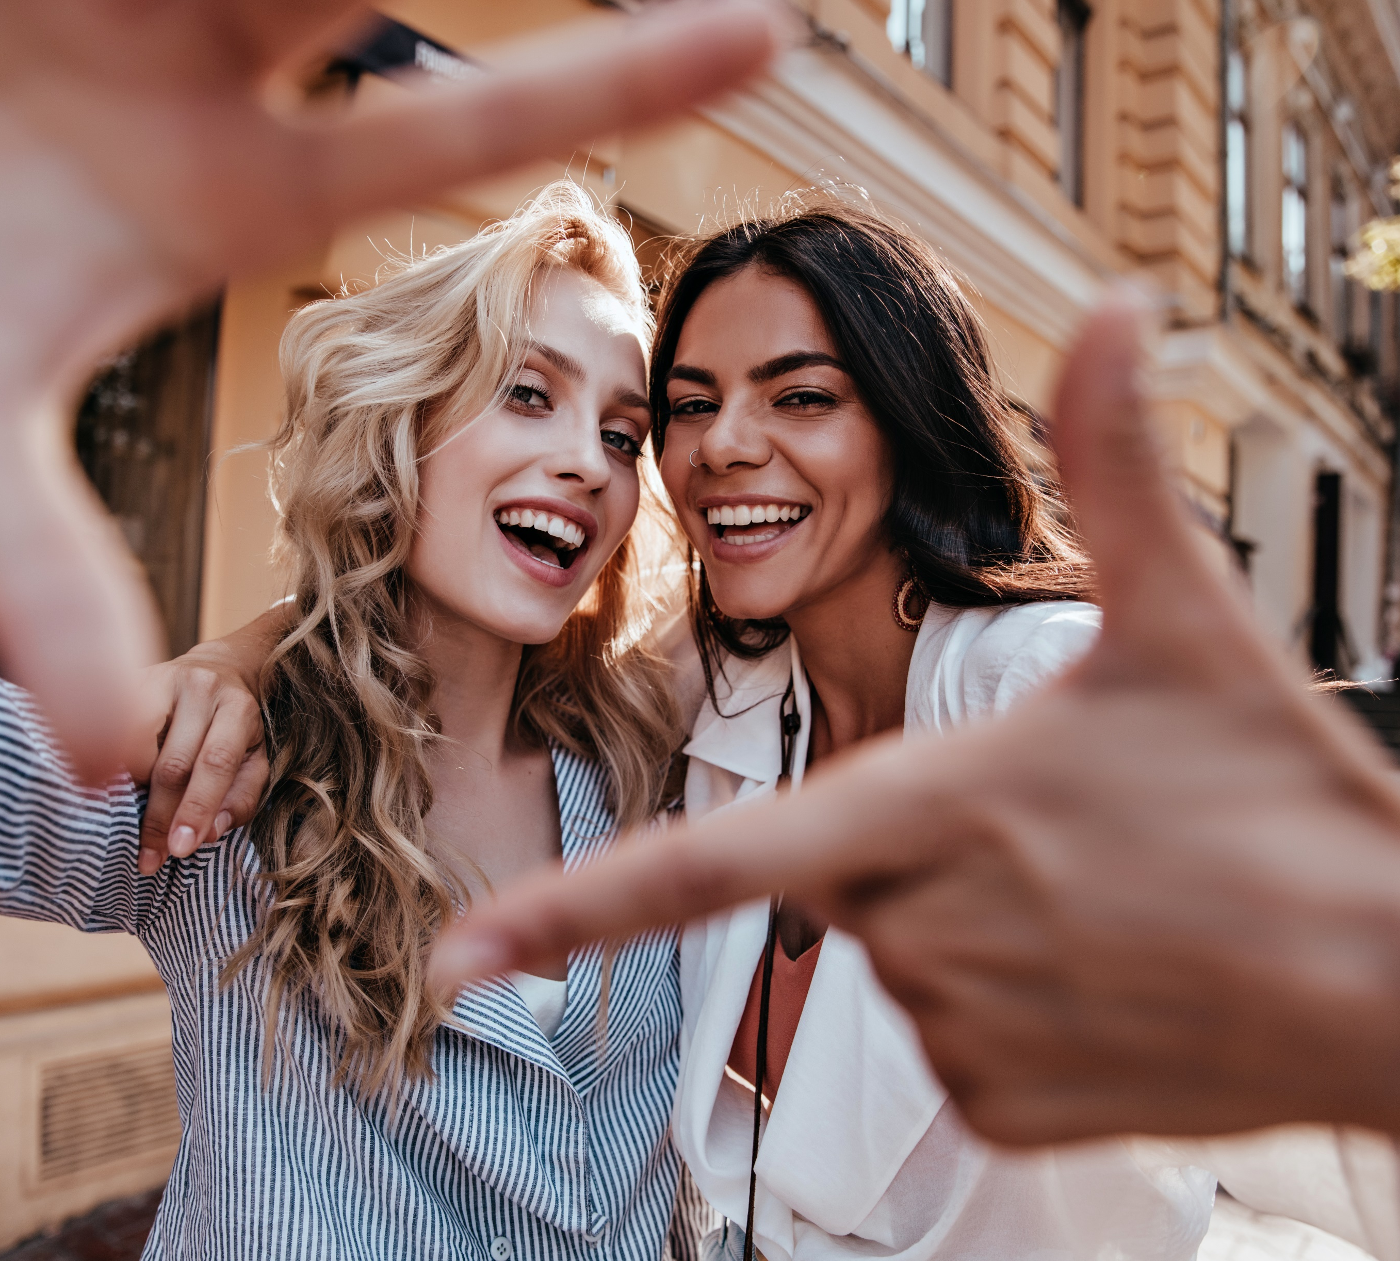
Reflecting this diversity, streaming programming is one of the most inclusive video platforms for representation of people of color, females and LGBTQ
Share of Screen by Platform
 | SVOD | Total Screen** | SVOD Index
Native American | 0.8% | 0.4% | 200
Hispanic/Latinx | 10.1% | 5.5% | 184
East Asian | 3.3% | 2.2% | 150
Female | 48.9% | 38.0% | 129
LGBTQ | 8.3% | 6.7% | 124
MENA* | 1.9% | 1.7% | 112
Black | 18.9% | 18.1% | 105
Source: Nielsen, Being Seen on the Screen: Diverse Representation & Inclusion on TV. *MENA = Middle Eastern/North African. **Total Screen = includes Broadcast, Cable and SVOD content.
This information is exclusively provided to VAB members and qualified marketers. Further distribution is prohibited.
PAGE 4

Slide 5
Cultural identity has become increasingly important across ethnicities and proper representation is highly valued within streaming content
‘My cultural / ethnic heritage is an important part of who I am’
% of respondents who agree
‘Having shows that highlight issues / stories that are important to racially diverse communities available on a streaming service makes it more valuable to me’
% of respondents who strongly/somewhat agree
White
Black
54%
70%
Hispanic
Asian
67%
57%
Source: MRI Cord Evolution Study, July 2020 & July 2021. Base=Streamed in the past 12 months.
This information is exclusively provided to VAB members and qualified marketers. Further distribution is prohibited.
PAGE 5

Slide 6

With audiences craving representation, the demand for shows featuring diverse casts is rising
Over the last three years, the demand for streamers’ diverse debuts has increased 85% and, for the first time in 2019, streamers’ scripted debut series featuring diverse casts were more in-demand than non-diverse series
Average Demand* of Annual Top 25 In-Demand U.S. Streamers’ Scripted Debut Series
Indexed to Average Annual Demand of All Scripted Debut Series (x times)
+42% margin
How To Read: In 2019, diverse debut series were 37x more ‘in-demand’ than the average scripted debut series vs. non-diverse debut series which were 26x more ‘in-demand’
*Demand represents the cross-platform popularity of content measured by audiences across various digital forms of interaction including video consumption (streaming and downloads), social media engagement (hashtags, liking, sharing) and research actions (reading about shows and writing about shows) via the global standardized metric of demand.
Source: Parrot Analytics & CAA, Measuring What Matters: The Impact of Talent Diversity on Audience Demand for Television, October 2020. Average post-premiere U.S. audience demand was used as a standardized popularity metric for the shows in this report. Non-Diverse Debut = U.S. first-run television scripted series premiere in which less than 40% of the series regular cast is non-white. Diverse Debut = U.S. first-run television scripted series premiere in which at least 40% of the series regular cast is non-white. These debuts’ casts at least mirror the percentage of nonwhites in the U.S. population according to the U.S. Census 2019 estimates.
This information is exclusively provided to VAB members and qualified marketers. Further distribution is prohibited.
PAGE 6

Slide 7
Diversity among show leads and creators, while expanding, still has much room to grow which underscores the need for greater development of relevant, authentic content to meet existing demand
Leads by Race (minority), digital scripted,
by broadcast season
Show creators by Race (minority), digital scripted,
by broadcast season
Minority % of 2020 US pop = 43%
Minority % of 2020 US pop = 43%
Source: UCLA – Hollywood Diversity Report Part II: Television, October 2021. According to this report, the minority share of the U.S. population accounted for about 42.7% in 2020.
This information is exclusively provided to VAB members and qualified marketers. Further distribution is prohibited.
PAGE 7

Slide 8





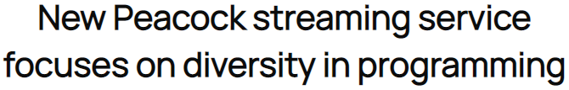












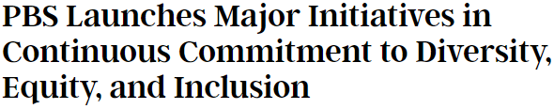

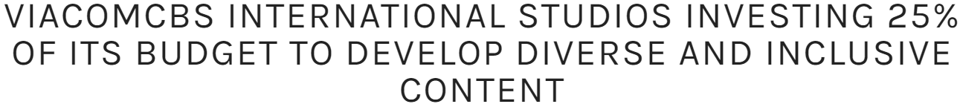
To address this disparity, multiscreen TV companies are investing heavily in diversity initiatives which is providing marketers with more opportunities to support, and authentically engage with, multicultural audiences
‘By addressing persistent racial inequities and historical underfunding of black-led projects, the TV & film industry could reap an additional $10 billion in annual revenues—about 7 percent more than the assessed baseline of $148 billion.’ - McKinsey
Source: McKinsey, Black representation in film and TV: The challenges and impact of increasing diversity, 3/11/21
This information is exclusively provided to VAB members and qualified marketers. Further distribution is prohibited.
PAGE 8

Slide 9


Marketers can strengthen engagement by advertising through a more inclusive lens since streamers are more likely to take action or share data with brands that align with their lifestyle and values
‘It is important for companies to create advertising
that is culturally diverse in order to stay relevant’
% of respondents who strongly/somewhat agree
Importance of brand values to CTV viewers
White
Black
63%
79%
62%
49%
Hispanic
Asian
say it is important to buy brands that are in line with their lifestyle and opinions
are willing to share information in order to receive ads from brands that match their interests and values
71%
73%
Source: MRI Cord Evolution – July ’21, Base=Streamed P12 months. Magnite, Connected TV is for Everyone 2021/22 Report, October 2021.
This information is exclusively provided to VAB members and qualified marketers. Further distribution is prohibited.
PAGE 9

Slide 10














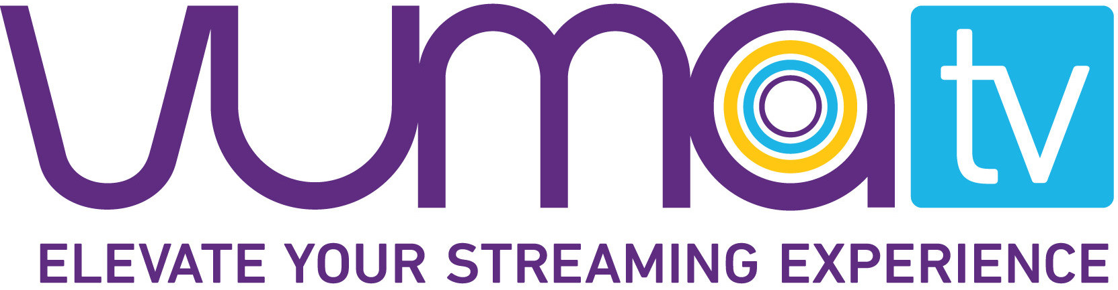

















Marketers can specifically target diverse audiences through stand-alone streaming services and curated content collections on traditional streaming services
Minority-owned Streaming Services
Minority-targeted Streaming Services
Paid Subscription
Paid Subscription
Ad-Supported
Ad-Supported
Please note, all services above are ‘minority-targeted’ platforms however, we further identified those that are currently minority-owned as well. Public companies are listed within ‘minority-targeted’ streaming services. Click on any logo to learn more about each service.
This information is exclusively provided to VAB members and qualified marketers. Further distribution is prohibited.
PAGE 10

Slide 11
The Connected TV audience mirrors the diversity of the U.S. population, making streaming one of the most inclusive video platforms for marketers to engage multicultural consumers
The audience demand for diverse streaming content
is rising considerably as cultural identity and proper representation has become increasingly important
across ethnicities
Multiscreen TV companies and their streaming platforms are investing heavily in diverse programming which is creating greater opportunities for advertisers to engage with multicultural audiences
Key Marketer Takeaways
This information is exclusively provided to VAB members and qualified marketers. Further distribution is prohibited.
PAGE 11

Slide 12



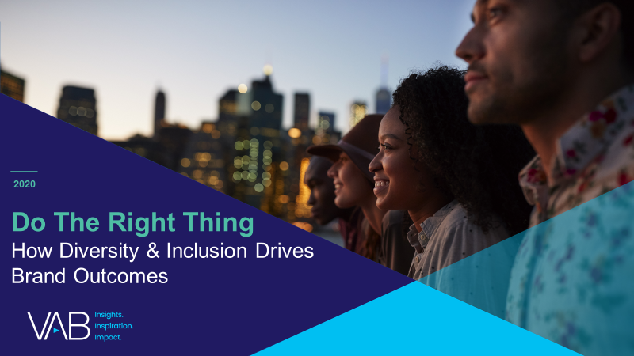



Creators
Jason Wiese
Reed Kiely
SVP, Director of Strategic Insights
jasonw@thevab.com
Associate Insights Director
reedk@thevab.com
An American Phenomenon
The Growing Influence and Value
of Asian American Consumers
A Trillion Dollar Opportunity
How to Connect with Hispanic Consumers Through Streaming
Karolina Guillen
Insights Manager
karolinag@thevab.com
Discover more
Looking for more data, insights and takeaways? Check out this related VAB content
A Fresh Take On
Engaging Black Consumers
Do The Right Thing
How Diversity & Inclusion Drives
Brand Outcomes
To find out more on the unique media consumption behaviors and cultural trends of multicultural consumers, visit our Multicultural Marketing Resource Center.
A Fresh Take
Reaching ‘Corded’ and ‘Cordless’ Audiences Through Video Streaming
A Fresh Take On
The Opportunities to Engage Adults 50+ in Streaming Video
VAB Members, brand marketers and agencies get free and immediate access to VAB’s content library. Get access at theVAB.com
This information is exclusively provided to VAB members and qualified marketers. Further distribution is prohibited.
PAGE 12

Slide 13

About VAB
VAB is an insights-driven organization that inspires marketers to reimagine their media strategies resulting in fully informed decisions.
Drawing on our marketing expertise, we simplify the complexities in our industry and discover new insights that transform the way marketers look at their media strategy.
Discover
We keep you one step ahead with the latest thinking so you can create innovative, forward-looking strategies.
Simplify
We save you time by bringing you the latest data & actionable takeaways you can use to inform your marketing plans.
Transform
We help you build your brand by focusing on core marketing principles that will help drive tangible business outcomes.
We are committed to your business growth and proud to offer VAB members, brand marketers and agencies complimentary access to our continuously-growing Insights library. Get immediate access at theVAB.com.
This information is exclusively provided to VAB members and qualified marketers. Further distribution is prohibited.
PAGE 13

