Slide 1



2020
Deciphering Direct-to-Consumer
An Insider’s Guide to America’s Fastest Growing Brands

Slide 2
Agenda
1
America’s Fastest Growing Sector
Digital-Native, Data-Driven, Outcomes-Obsessed Companies
4
From Rebellious Kids To Responsible Adults
A Deeper Look At The Evolution Of DTC Brands
2
The DNA of DTC Brands
Their Innovative Approach to Growth and the Consumer
5
Blurring The Lines Between ‘Legacy’ & ‘Direct’
How DTC Tactics Are Inspiring Traditional Companies
3
The ‘Direct-to-Consumer’ Shopper Profile
Who Are They And What Motivates Them?

Slide 3
Deciphering Direct-to-Consumer
While the world’s biggest marketers are all searching for growth, a new growth sector within the American economy has quickly emerged over the last few years: Direct-to-Consumer.
As a rising segment within e-commerce, Direct-to-Consumer (DTC) companies bypass traditional sales models by selling their product directly to end customers.
DTC brands have been a disruptive force throughout society and have rapidly taken market share from legacy companies in even the most established categories like razors, shoes and mattresses. Direct-to-Consumer isn’t a fad either as consumer acceptance and, most importantly, purchases continue to increase.
Within this guide, you’ll see the impact the DTC segment is having within specific categories, learn about the DNA of DTC brands and their customers, discover their innovative approaches to growth and how they’re evolving as they mature, and see why incumbent brands are looking to DTC companies for inspiration on how to evolve their business for today’s world.
This information is exclusively provided to VAB members and qualified marketers. Further distribution is prohibited.
PAGE 3

Slide 4

America’s Fastest Growing Sector
Digital-Native, Data-Driven,
Outcomes-Obsessed Companies

Slide 5

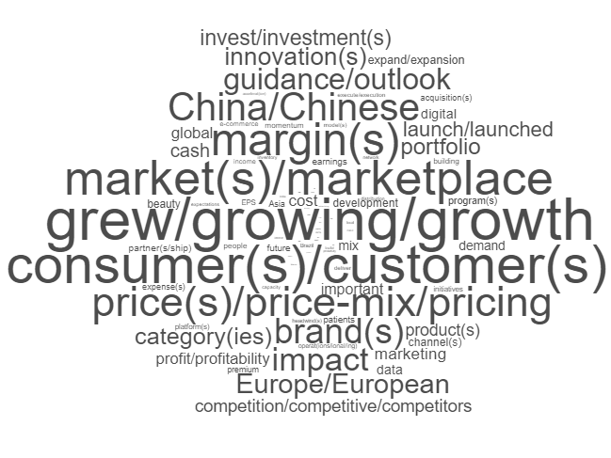
What is the top priority
of the world’s largest marketers?
According to a GroupM analysis of recent earning call transcripts, the word ‘grow’ (or ‘growing’ & ‘growth’) was cited almost three times more often by top management than anything else among a data set of more than 300,000 words.
Also worth noting, ‘consumers’ (or ‘customers’) –
the key to supporting growth – ranked #2.
While almost all marketers are talking about growth, what is the real growth sector in the American economy?
Source: Groupm, What Marketers Are Thinking About: Growth, Growth and More Growth, 9/16/2019, Brian Wieser (based on 35 companies with more than $1.5bn in annual spending and that also allocated 4% or more of annual revenue to advertising, excluding major media owners.
This information is exclusively provided to VAB members and qualified marketers. Further distribution is prohibited.
PAGE 5

Slide 6
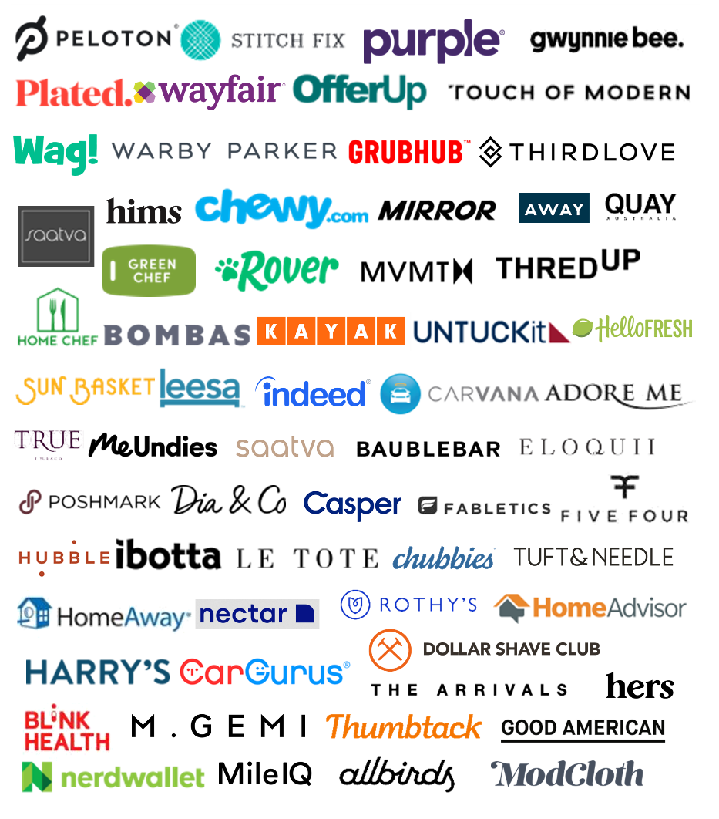
Most of the fastest growing brands in the U.S. are Direct-to-Consumer
What are Direct-to-Consumer (DTC / D2C)
or ‘Direct’ Brands?
Direct-to-Consumer (DTC / D2C) means the company is able to bypass traditional sales models by selling their product directly to end customers without being encumbered by third-party retailers, wholesalers or other parts of the legacy infrastructure / supply chain
This information is exclusively provided to VAB members and qualified marketers. Further distribution is prohibited.
PAGE 6

Slide 7
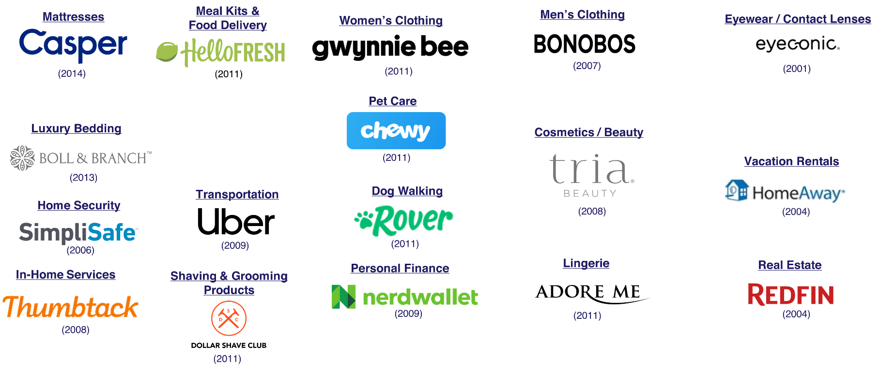
‘First mover’ DTC brands began disrupting established categories anywhere from 5 - 20 years ago with varying degrees of success
(year) = year founded
This information is exclusively provided to VAB members and qualified marketers. Further distribution is prohibited.
PAGE 7

Slide 8
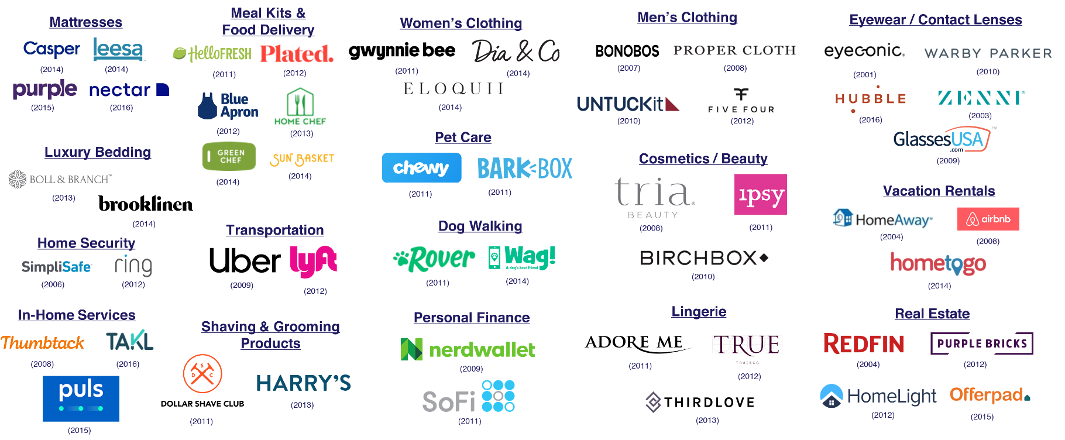
Recently, more DTC brands have entered the marketplace, by disrupting the original disruptors, within these established categories
(year) = year founded
This information is exclusively provided to VAB members and qualified marketers. Further distribution is prohibited.
PAGE 8

Slide 9








Trend-driven, high-trial categories such as personal care, apparel, food and pet care are some of the most popular DTC categories
Source: Adweek, May 19, 2019: Infographic: What People Want From Direct-to-Consumer Brands, Toluna & Unmetric, 2019.
This information is exclusively provided to VAB members and qualified marketers. Further distribution is prohibited.
PAGE 9

Slide 10

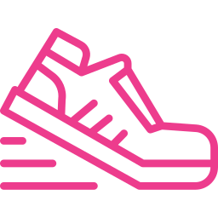







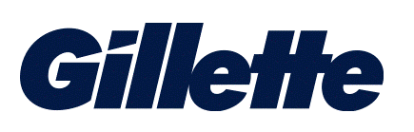
DTC startups that were only founded within the last decade have been siphoning market share from legacy brands who have existed for over 70 years
Category
Razors
Shoes
Mattresses
DTC Brand Market Share
12%
15%
20%
Sampling of
DTC Brands
(2011)
(2014)
(2012)
(2012)
(2015)
(2013)
Category Incumbents
(1901)
(1949)
(1883)
Source: Luma Partners, 2019.
(XXXX) = Year Founded
This information is exclusively provided to VAB members and qualified marketers. Further distribution is prohibited.
PAGE 10

Slide 11



DTC brands are finding success across categories with their ability to evolve with consumers and fulfill a need that may not have been met previously by other brands
Category Insights
How the Category is Evolving
Pet Care
Pet ownership is at an all-time high and while adults continually find themselves pressed for time they rely on DTC services to help care for, and spoil, their pets
Adults 18+:
58% own a pet and 67% believe pets deserve to be pampered
U.S. pet industry sales grew by 4% in 2018
Online pet product sales were up 30% in the first half of 2018
Sales for direct brand dog walking services Rover & Wag! grew 30% and 165% respectively
Personal Care & Beauty Products
An abundance of make-up / skincare online tutorials and beauty-obsessed social influencers inspire consumers to splurge on personal maintenance. In fact, watch time for beauty YouTuber videos increased 75% b/t 2017 & 2018
Adults 18+:
80% feel it is important to be well-groomed and
54% prioritize maintaining a youthful appearance
U.S. personal care & beauty products sales grew 4.5% in 2018
Online personal care & beauty sales grew 24%
Direct brand SiO Beauty tripled sales in 2018, while Kylie Cosmetics generated $420MM in revenue in its first 18 months
Furniture
DTC brands’ customization abilities allow consumers to ‘build’ a home that truly reflects their personal style
Adults 18+:
67% feel their home is an expression of their personal style and 46% are more willing to purchase a product if they are able to customize it
The total U.S. furniture market was flat from 2017 to 2018 and expected to grow annually by only 0.7% through 2023
However, digital sales accounted for a quarter of all dollars spent on home goods & furniture in 2018 and are projected to account for 38% of sales in 2022
Sources:
MRI-Simmons, 2019 Doublebase, U.S Adults 18+.
Pet Ownership: American Pet Products Association via The Washington Post, 1/31/2019; reflects most recent available data from 2016.
Pet Care: https://www.emarketer.com/content/premium-pet-food-drives-sales – American Pet Products Associate (APPA) as cited in press release, March 22, 2018, https://www.americanpetproducts.org/press_industrytrends.asp
Pet Care: https://www.vox.com/the-goods/2018/9/12/17831948/rover-wag-dog-walking-app - transactional data provided by Earnest Research
Personal Care & Beauty Products: https://www.thinkwithgoogle.com/data/beauty-youtuber-video-watch-time-data/
Personal Care & Beauty Products: https://www.digitalcommerce360.com/article/beauty-ecommerce-sales/
Personal Care & Beauty Products: https://www.forbes.com/sites/richardkestenbaum/2018/09/09/beauty-industry-biggest-trends-skin-care-loreal-shiseido-lauder/#9b79d2469823
Personal Care & Beauty Products: https://beautyandmoneysummit.com/events/beauty-and-money-ny-2018
Furniture: https://www.statista.com/outlook/17000000/109/furniture/united-states – CAGR 2019-2023
Furniture: https://www.statista.com/outlook/17000000/109/furniture/united-states#market-arpu
This information is exclusively provided to VAB members and qualified marketers. Further distribution is prohibited.
PAGE 11

Slide 12


DTC brands are attentive to consumers’ modern needs even within ‘necessity’ categories such as food preparation, eyewear and mattresses
Category Insights
How the Category is Evolving
Meal Kits
Often times, hectic work & personal lives don’t leave much room for meal planning or grocery shopping, especially for the 49% of employed U.S. women who are their household’s primary breadwinner
Adults 18+:
66% are often too busy to finish everything they need to do in a day and 73% are always on the lookout for quick and easy meal options
The U.S. meal kit market generated around $2.2 billion in 2017 and has continued to increase each year
The market is projected to reach $14.2 billion by 2025
DTC eyewear brands typically offer more cost-efficient eyewear (frames / contact lenses) than an optician and, as an added bonus, they can be delivered right to your door
Adults 18+:
62% wear eyeglasses, contact lenses and / or sunglasses and
56% are willing to use the Internet to shop for fashion products
The U.S. online eyewear market was valued at $338 million in 2017, a 16% increase compared to 2016
The market is expected to reach $505.4 million by 2025
Eyewear
Mattresses
Many consumers prefer shopping online for mattresses over the potentially awkward in-store experiences of trying out mattresses and dealing with over-bearing salespeople
Adults 18+:
55% are medium-heavy sleepers (7+ hours / night), 53% would rather shop online than go to a store
More than 100 ‘bed-in-a-box’ companies like Casper, Leesa and Purple collectively doubled their U.S. market share between 2016-2018 as leading legacy brand Tempur Sealy saw sales decline 4.6% in the first half of 2018 and Mattress Firm declared bankruptcy
Sources:
MRI-Simmons, 2019 Doublebase, U.S. Adults 18+.
Meal Kits: Forbes, Women Are Working More Than Ever, But They Still Take On Most Household Responsibilities, 5/27/19
Meal Kits: https://www.adroitmarketresearch.com/industry-reports/us-meal-kit-market
Meal Kits: https://globalnewsclip.com/2019/07/30/u-s-meal-kit-market-size-2019-industry-analysis-share-trends-growing-demand-segmentation-and-forecasts-2025/
Eyewear: https://www.prnewswire.com/news-releases/us-online-eyewear-market-size-worth-usd-5054-million-by-2025-hexa-research-678739483.html
Mattresses: https://www.usatoday.com/story/money/2018/08/07/mattress-firm-mattress-wars-casper-leesa-steinhoff-international/921721002
This information is exclusively provided to VAB members and qualified marketers. Further distribution is prohibited.
PAGE 12

Slide 13



Style and luxury is even becoming more accessible through
DTC brands who are tailoring high-end goods to the needs
of individual consumers
Category Insights
How the Category is Evolving
Department
Stores
Many consumers don’t like to spend their free time shopping & prefer brands that provide customizable products that convey the right image
Adults 18+:
57% don’t think that shopping is a great way to relax and
48% feel you can tell a lot about a person by the clothes they wear
American department stores continued a long-term decline over five years through 2018, with revenue falling at an annualized rate of 4.1%
Several clothing subscription services have seen double-digit growth, like ‘stylist-in-a-box,’ Stitch Fix, which expects to increase revenues 20-25% in 2019
Luxury Goods
Time-pressed, affluent consumers are looking for luxury & convenience.
A greater level of comfort with online shopping has led to an increase in their willingness to purchase even expensive luxury items via the Internet
Adults 18+:
64% are typically willing to pay more for high-quality items and
71% of adults with a $100K+ HHI are so busy, they often can’t finish everything they need to do
U.S. personal luxury goods brick-and-mortar sales grew 4% in 2018 while online luxury sales grew 22%
Luggage
A need for quality, cost-efficient, smart luggage is on the rise as
record-breaking levels of Americans are traveling each year
Adults 18+:
43% are planning on traveling in the next year, 67% would rather book a trip over the Internet than meet with a travel agent & 64% feel technology helps make their lives more organized
The smart luggage company, Away, grew 198% year over year in revenue
By 2018, 80% of incremental dollars in luggage sales were generated online
Sources:
MRI-Simmons, 2019 Doublebase, U.S. Adults 18+.
Department Stores: https://www.ibisworld.com/industry-trends/market-research-reports/retail-trade/general-merchandise-stores/department-stores.html
Department Stores: https://markets.businessinsider.com/news/stocks/stitch-fix-stock-price-climbs-on-analyst-buy-rating-2019-7-1028372461
Luxury Goods: https://www.bain.com/about/media-center/press-releases/2018/fall-luxury-goods-market-study/
Luggage: https://www.rakutenintelligence.com/blog/2018/running-away-smart-luggage-company-sees-sales-growth-of-nearly-200-percent
Luggage: https://www.npd.com/wps/portal/npd/us/blog/2018/luggage-takes-flight/
Travel: AAA Newsroom, AAA Says 115.6 Million Travelers will Break Holiday Records, 12/12/2019.
This information is exclusively provided to VAB members and qualified marketers. Further distribution is prohibited.
PAGE 13

Slide 14
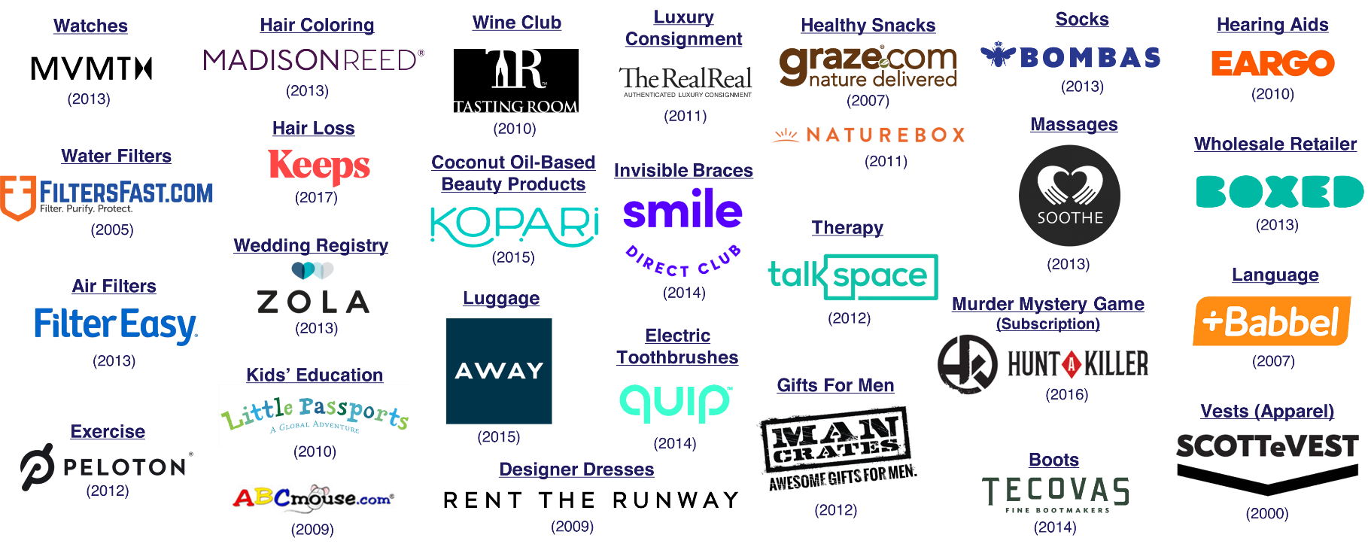
DTC brands continue to grow and are nearly everywhere (CPG,
‘on-demand services,’ ‘subscription boxes’), thriving in even the most niche categories
(year) = year founded
This information is exclusively provided to VAB members and qualified marketers. Further distribution is prohibited.
PAGE 14

Slide 15
‘Direct-to-Consumer’ is not only here to stay but is projected to account for a significant portion of purchases in the near future
How Much Do US Internet Users Expect to Purchase
from DTC Companies in the Next 5 Years?
Two-thirds of Internet Users expect that
20% or more
of their total purchases
will be through DTC brands
within the next five years
Source: Diffusion, “2018 Direct-to-Consumer Purchase Intent Index” conducted by YouGov, October 4th, 2018
This information is exclusively provided to VAB members and qualified marketers. Further distribution is prohibited.
PAGE 15

Slide 16
The DNA of DTC Brands
Their Innovative Approach to Growth and the Consumer

Slide 17






DTC brands build themselves around the needs
of the modern consumer
How Are DTC Brands Attracting Consumers?
Deliver On A Specific Consumer Need
Ensure That Their Products Are Designed & Executed Well
Offer Their Product At A Fair Price
Take Pride In Excellent Customer Service / Experience
Simplify The Buying / Returning / Exchanging Process
This information is exclusively provided to VAB members and qualified marketers. Further distribution is prohibited.
PAGE 17

Slide 18








DTC brand’s modern business models deliver many benefits to consumers over traditional retailers, especially when it comes
to cost, flexibility and customer service
Primary Reasons For Purchasing DTC Over Traditional Retailers
48%
Cheaper Cost
43%
Fast, Free Shipping & Easy Returns
26%
Positive Media Coverage Or Reviews
26%
Superior Customer Service
22%
Better Product Design
16%
Better Company & Brand Design
15%
Company Donates To People In Need With A Product Purchase
12%
Ability To Subscribe To Automatic Refills Of Product
Source: Diffusion, 2020 Direct-To-Consumer Purchase Intent Index, 2019; respondents able to select multiple options.
This information is exclusively provided to VAB members and qualified marketers. Further distribution is prohibited.
PAGE 18

Slide 19

Being digital-native, DTC brands can more easily lure in prospective customers through ‘free trials’ and other online-based acquisition methods
Source: Adweek, May 19,2019: Infographic: What People Want From Direct-to-Consumer Brands, Toluna & Unmetric, 2019.
This information is exclusively provided to VAB members and qualified marketers. Further distribution is prohibited.
PAGE 19

Slide 20
With the influx of new entrants across categories & the ability
to convert free-trial users into paying customers, almost half
of consumers have now purchased a product from a DTC brand
Have you ever bought from a DTC brand?
Yes
Source: Adweek, May 19,2019: Infographic: What People Want From Direct-to-Consumer Brands, Toluna & Unmetric, 2019.
This information is exclusively provided to VAB members and qualified marketers. Further distribution is prohibited.
PAGE 20

Slide 21
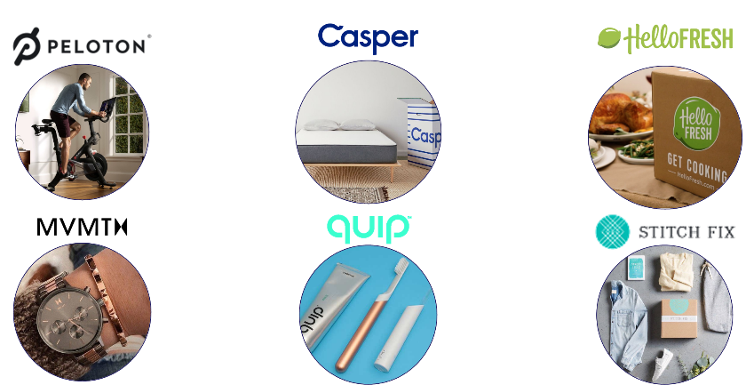
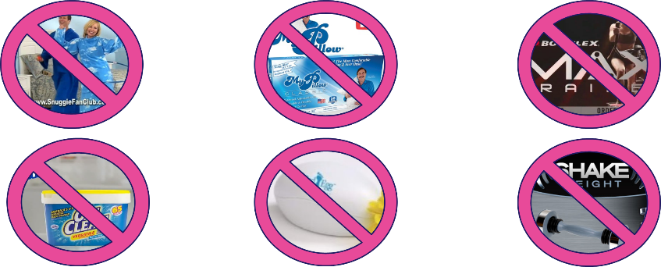
Direct-to-Consumer Brands
Even though DTC brands sell directly to the consumer,
they are not traditional
Direct Response products
Direct Response Products
This information is exclusively provided to VAB members and qualified marketers. Further distribution is prohibited.
PAGE 21

Slide 22
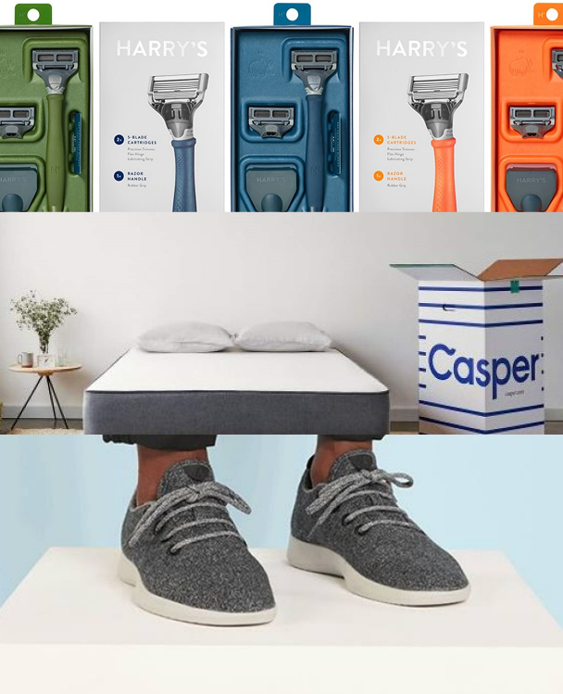
DTC brands differentiate themselves from Direct Response products and their incumbent competitors by adhering to a common set
of core principles…
This information is exclusively provided to VAB members and qualified marketers. Further distribution is prohibited.
PAGE 22

Slide 23
DTC Brands’ Core Principles
They’re E-commerce
They’re Data-Obsessed
They’re Socially-Interactive
They’re Design-Focused
They’re Consumer-Centric
They’re Customer-Led
They’re Mission-Driven
This information is exclusively provided to VAB members and qualified marketers. Further distribution is prohibited.
PAGE 23

Slide 24



They’re Data-Obsessed
DTC brands capitalize on their direct relationship with their customers online, which gives them the ability to collect and analyze first-party data internally and use it to continually build a better product and enhance the customer experience.
“When you see our data making a direct impact on a customer’s happiness, it really shows that using data isn’t cold or impersonal. It’s the best way to get to know our customers and figure out how we can give them exactly what they want — a perfectly fitting bra.”
“Internally, we are a tech company first and foremost. Outwardly, we focus on the product, the experience and the community, but everything comes together because of serious technology we have behind the scenes.”
- Heidi Zak, Co-Founder & Co-CEO, ThirdLove
-Graham Stanton, Co-Founder & SVP Global Marketing & Sales, Peloton
“We understand online very well, we also understand consumer behavior and we’re a very data driven company. Those are all advantages we have, because that is basically where we came from.”
Bonus Consumer Insight
74% of DTC shoppers feel that technology has an impact on their daily life
- Constantin Eis, Co-Founder &
Global Managing Director, Casper
Source: VAB analysis of MRI-Simmons, 2019 Doublebase (Index vs. A18+); DTC Brand Shopper Target (36% of A18+ population) = (“Ordered any item over the Internet in last 12 months”) + (Agree with 2 out of 3 statements: “The Internet is a great way to actually buy products [any agree]”, “I prefer purchasing things online for a fixed price, as opposed to bidding in online auctions [any agree]”, “In general, I’d rather shop online than go to a store [any agree]”) + (Agree with 2 out of 3 statements: “Simplicity-Keeping your life and mind as uncluttered as possible [very important]”, “I prefer to shop at stores that specialize in a specific type or style of product [any agree]”, “Technology helps make my life more organized [any agree]”).
This information is exclusively provided to VAB members and qualified marketers. Further distribution is prohibited.
PAGE 24

Slide 25

With data science a core competency, most DTC companies rely on data & analytics for their media decision-making
Performance is their currency and DTC companies know exactly what media works for growing and perhaps, more importantly, retaining their customer base
DTC’s top KPIs are focused on growth metrics like sales, customer acquisition, conversion rates and website traffic
Through their own analytics, these brands can quickly
‘test & learn’ how their media placements (and creative content) are performing and their agility allows them to react / optimize swiftly and scale up when necessary
This information is exclusively provided to VAB members and qualified marketers. Further distribution is prohibited.
PAGE 25

Slide 26
DTC brands are embracing advanced TV for its ‘digital-like’ targeting
In fact, DTC brands who value performance & branding are planning to increase their spend in advanced / addressable TV data solutions
Real-World Example:
ThirdLove buys a mix of traditional TV and addressable TV ads, and measures traditional TV ads and addressable TV spots by website visits, conversions and cost-per-actions using third party-party TV analytics software.
Source: Amobee (Videology) Ad Perceptions Survey April 2018. IAB, How To Build a 21st Century Brand, 2019-2020; February 2019.
This information is exclusively provided to VAB members and qualified marketers. Further distribution is prohibited.
PAGE 26

Slide 27
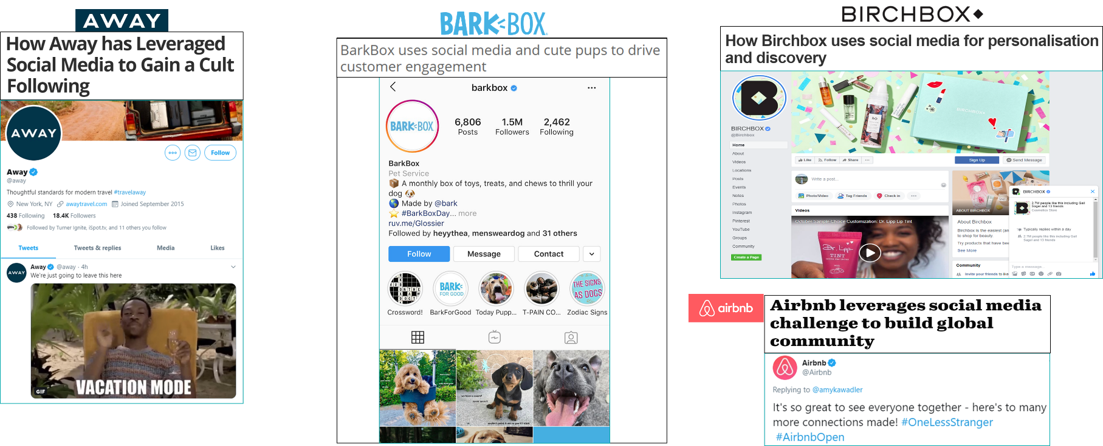
They’re Socially-Interactive
27% of DTC shoppers like to connect with brands on social media – by maintaining a strong presence online, DTC brands are able to directly engage with customers through a two-way ‘feedback and response’ conversation in real-time which aids in cultivating brand ambassadors and retaining recent purchasers
Source: VAB analysis of MRI-Simmons, 2019 Doublebase (Index vs. A18+); DTC Brand Shopper Target (36% of A18+ population) = (“Ordered any item over the Internet in last 12 months”) + (Agree with 2 out of 3 statements: “The Internet is a great way to actually buy products [any agree]”, “I prefer purchasing things online for a fixed price, as opposed to bidding in online auctions [any agree]”, “In general, I’d rather shop online than go to a store [any agree]”) + (Agree with 2 out of 3 statements: “Simplicity-Keeping your life and mind as uncluttered as possible [very important]”, “I prefer to shop at stores that specialize in a specific type or style of product [any agree]”, “Technology helps make my life more organized [any agree]”).
This information is exclusively provided to VAB members and qualified marketers. Further distribution is prohibited.
PAGE 27

Slide 28


Inherently digital, DTC brands reap benefits from advertising on social platforms through which they can engage directly with avid & loyal customers in real-time
For example, DTC brands have seen success from utilizing Snapchat’s Dynamic Ads format, which allows advertisers to automatically create ads from their own product catalogs & serve them to users on the platform based on interest they have shown in the brand online
By targeting consumers who have already expressed interest in their brand with personalized ads, these brands were able to decrease their cost per purchase while increasing their return on ad spend
(Accessories)
(Women’s Apparel)
(Sunglasses)
-21% in cost-per-purchase
-60% in cost-per-purchase
-66% in cost-per-purchase
+29% in ROAS vs. other
cross-platform e-commerce ads
+171% in ROAS vs. similar
product-focused campaigns
+286% in ROAS vs. other
cross-platform e-commerce ads
Source: Business Insider, Direct-to-consumer brands that have tested Snapchat's latest ad format say it's helping drive returns while bringing their cost-per-purchase down, 10/17/2019.
This information is exclusively provided to VAB members and qualified marketers. Further distribution is prohibited.
PAGE 28

Slide 29
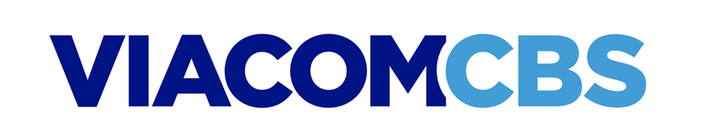

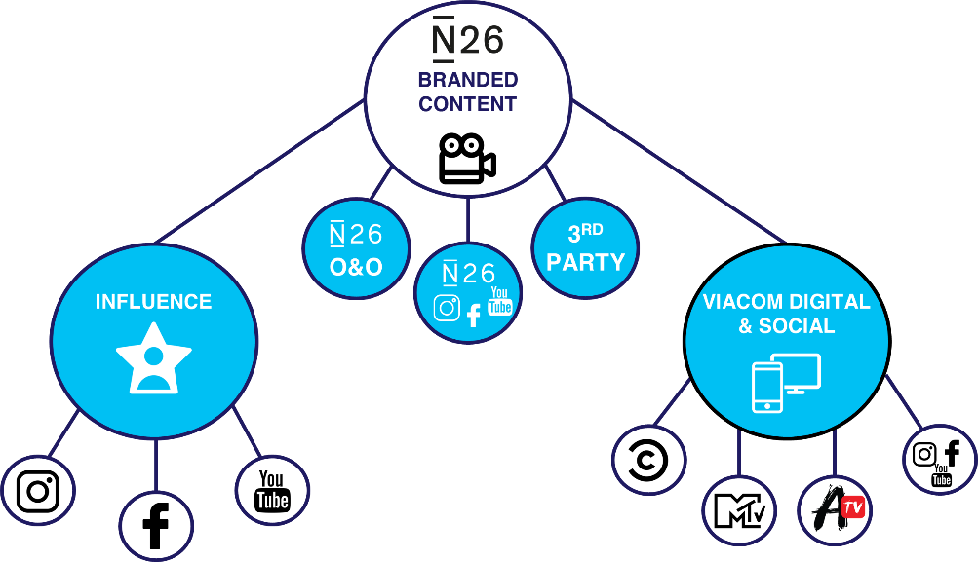
Multiscreen TV companies can also provide brands an opportunity to partner with ‘Influencers’ and create branded content which is distributed across their portfolio
of social and digital platforms
The Category: Mobile Banking
/ Partnership
The Objective:
Boost Brand Awareness & Positive Association Among U.S. Millennials & Gen Z
Build Brand Reinforcement
Drive Brand Conversion & Consumer Sign-Up
Content Ecosystem
The Strategy:
Create custom video content to tell the brand’s story & forge a meaningful connection with brands
Leveraging Viacom’s extensive reach & engaged audience base, distribute content across the content ecosystem:
  Viacom O&O platforms
  N26’s social footprint & 3rd party platforms
Tap ‘influencers’ to call consumers to action by either downloading the N26 app or signing up on their website
N26 ownership & usage rights to distribute branded content on their O&O, social platforms, and 3rd party platforms & publishers through both organic and paid
Enlist trusted influencers that the audience looks to for guidance to show, rather than tell, the many benefits of N26 and drive users to take action
Targeted cross-platform distribution of N26 brand creative across Viacom Digital properties including, Sites, Apps, and VOD/OTT
This information is exclusively provided to VAB members and qualified marketers. Further distribution is prohibited.
PAGE 29

Slide 30

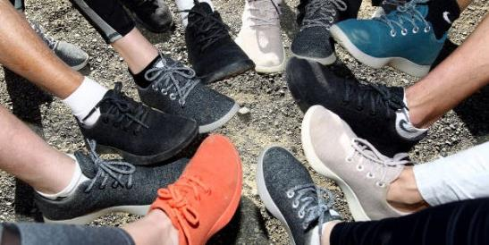
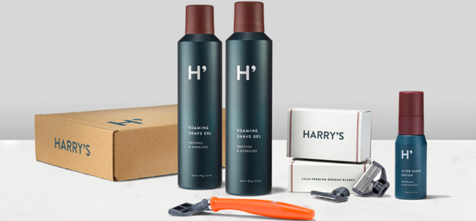
They’re Design-Focused
DTC brands often pride themselves on having a sleek, recognizable yet simple style for both product functionality and as ‘talk value’ across social media. Product design is becoming even more important as a way for DTC brands to differentiate themselves from similar new brand entrants crowding the marketplace.
“The insight that kicked this whole journey off was, ‘Could you make a very, very simple sneaker that wasn’t adorned with branding?’ It felt like it was very, very hard to find.”
-Tim Brown, Co-Founder, Allbirds
“Unlike the big brands that overdesign and overcharge, we make a high-quality shave that’s made by real guys for real guys… We’ve built Harry’s to reflect our passions and values: affinity for simple design, appreciation of well-made things, and a belief that companies should make the world a better place.“
CB Insights, 'We Analyzed 14 Of The Biggest Direct-to-Consumer Success Stories To Figure Out The Secrets To Their Growth — Here’s What We Learned,’ 9/19/2019
Bonus Consumer Insight
72% of DTC shoppers say they buy brands that reflect their style
Source: VAB analysis of MRI-Simmons, 2019 Doublebase (Index vs. A18+); DTC Brand Shopper Target (36% of A18+ population) = (“Ordered any item over the Internet in last 12 months”) + (Agree with 2 out of 3 statements: “The Internet is a great way to actually buy products [any agree]”, “I prefer purchasing things online for a fixed price, as opposed to bidding in online auctions [any agree]”, “In general, I’d rather shop online than go to a store [any agree]”) + (Agree with 2 out of 3 statements: “Simplicity-Keeping your life and mind as uncluttered as possible [very important]”, “I prefer to shop at stores that specialize in a specific type or style of product [any agree]”, “Technology helps make my life more organized [any agree]”).
This information is exclusively provided to VAB members and qualified marketers. Further distribution is prohibited.
PAGE 30

Slide 31



They’re Consumer-Centric
Many DTC companies are founded on the desire to make peoples’ lives easier by solving a common problem. They recognize that their customers lead busy lives and by tapping into that mindset, they are able to simplify the shopping experience and make the customer their primary focus.
“From inception, customer service was incredibly important to us. We were building Warby Parker as an antidote to the poor customer service we experienced, and the high prices we saw, while shopping for glasses.”
“We have folks in customer service that are dedicated to reading and responding to reviews. We are proactive about responding to our customer reviews to show them that we care.”
- Kelli Durkin, VP of Customer Service, Chewy
- Neil Blumenthal, Co-Founder & Co-CEO, Warby Parker
“We're very customer-oriented….We've always built our own technology, so we've been able to do creative things that help customers get what they want.”
Bonus Consumer Insight
78% of DTC shoppers purchase products to help organize their life
- Niraj Shah, Co-Founder & Co-CEO, Wayfair
Source: VAB analysis of MRI-Simmons, 2019 Doublebase (Index vs. A18+); DTC Brand Shopper Target (36% of A18+ population) = (“Ordered any item over the Internet in last 12 months”) + (Agree with 2 out of 3 statements: “The Internet is a great way to actually buy products [any agree]”, “I prefer purchasing things online for a fixed price, as opposed to bidding in online auctions [any agree]”, “In general, I’d rather shop online than go to a store [any agree]”) + (Agree with 2 out of 3 statements: “Simplicity-Keeping your life and mind as uncluttered as possible [very important]”, “I prefer to shop at stores that specialize in a specific type or style of product [any agree]”, “Technology helps make my life more organized [any agree]”).
This information is exclusively provided to VAB members and qualified marketers. Further distribution is prohibited.
PAGE 31

Slide 32



They’re Customer-Led
83% of DTC shoppers rely on the reviews of others before buying a product and 33% often write product reviews themselves. Due to their e-commerce business model, DTC brands can not only tackle issues directly from consumers in real time, and typically faster than their more traditional competitors, but they can also use customer feedback to quickly enhance their product offering.
“Your customers will tell you very loudly when you’re doing a good job and when you’re not doing a good job
of hitting your mission, and it’s an incredibly motivating feedback loop to have”
Hilary Coles, Co-Founder
Hims & Hers
Business of Fashion, 5/8/19
“We don’t have to wait for the wholesalers to feed [responses] back to us or wait for ‘open to buy’ windows; we can make those changes in real time and we’ve done that from the beginning,” said Brown. “[Customers] are a part of this journey and I think its been an enormous business advantage for us.”
“You learn the hard way, right, because if you ask for customer feedback, my god, you’re going to get it — good or bad or ugly….Size 15 is now my third best selling size, and it didn’t exist [before].”
Emma Grede, Founder & CEO
Good American
Business of Fashion, 5/8/19
Tim Brown, Co-Founder
Allbirds
Business of Fashion, 5/8/19
Source: VAB analysis of MRI-Simmons, 2019 Doublebase (Index vs. A18+); DTC Brand Shopper Target (36% of A18+ population) = (“Ordered any item over the Internet in last 12 months”) + (Agree with 2 out of 3 statements: “The Internet is a great way to actually buy products [any agree]”, “I prefer purchasing things online for a fixed price, as opposed to bidding in online auctions [any agree]”, “In general, I’d rather shop online than go to a store [any agree]”) + (Agree with 2 out of 3 statements: “Simplicity-Keeping your life and mind as uncluttered as possible [very important]”, “I prefer to shop at stores that specialize in a specific type or style of product [any agree]”, “Technology helps make my life more organized [any agree]”).
This information is exclusively provided to VAB members and qualified marketers. Further distribution is prohibited.
PAGE 32

Slide 33
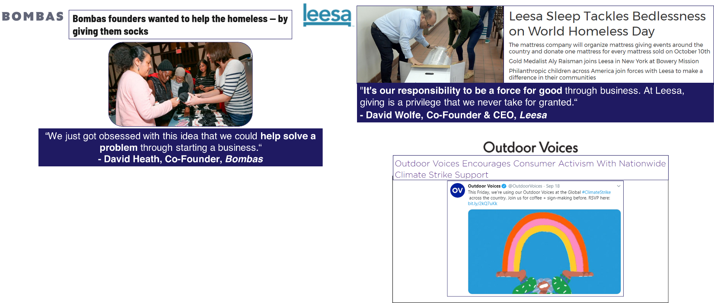
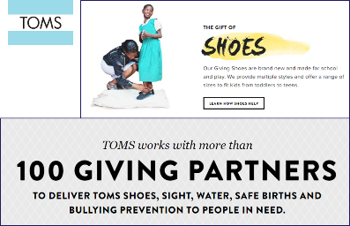
They’re Mission-Driven
Today, more and more consumers are looking to buy brands with a purpose. In fact, 37% of DTC shoppers shop with the expectation that a brand should support social causes. By actively taking steps to improve the world, DTC brands are able to increase brand loyalty and build more of an emotional connection with their customers.
Bonus Consumer Insight
63% of DTC shoppers are willing to pay more for a product that is environmentally safe
Source: VAB analysis of MRI-Simmons, 2019 Doublebase (Index vs. A18+); DTC Brand Shopper Target (36% of A18+ population) = (“Ordered any item over the Internet in last 12 months”) + (Agree with 2 out of 3 statements: “The Internet is a great way to actually buy products [any agree]”, “I prefer purchasing things online for a fixed price, as opposed to bidding in online auctions [any agree]”, “In general, I’d rather shop online than go to a store [any agree]”) + (Agree with 2 out of 3 statements: “Simplicity-Keeping your life and mind as uncluttered as possible [very important]”, “I prefer to shop at stores that specialize in a specific type or style of product [any agree]”, “Technology helps make my life more organized [any agree]”).
This information is exclusively provided to VAB members and qualified marketers. Further distribution is prohibited.
PAGE 33

Slide 34
By adhering to a core set of principles, DTC brands have tapped into a rising class of consumers who are time-pressed & tech savvy.
Unlike legacy brands who were built around last-century values, DTC brands have been shaped to fit today’s lifestyle.
DTC Brands’ Core Principles
They’re E-commerce
They’re Data-Obsessed
They’re Socially-Interactive
They’re Design-Focused
They’re Consumer-Centric
They’re Customer-Led
They’re Mission-Driven
This information is exclusively provided to VAB members and qualified marketers. Further distribution is prohibited.
PAGE 34

Slide 35
The ‘Direct-to-Consumer’ Shopper Profile
Who Are They And What Motivates Them?

Slide 36






Who is the DTC Shopper?
DTC shoppers are more likely to be educated, affluent, young professionals living in metropolitan areas who are focused on their careers and family
‘DTC Shopper’ Key Characteristics
Affluent young professionals who lead busy, time-pressed lives
  24% have a household income of $100K - $150K (137)
  56% consider their work to be a career, not just a job (124)
  70% are so busy, they often can’t finish everything they need to in a day (106)
Tech-savvy and eager to adopt new technologies / media
  70% are fascinated by new technology (121)
  20% have listened to podcasts on their phone in the last 30 days (149)
Distinguished by a mindset rather than their life-stage or age group
  23% are between the ages of 25 and 34 (126)
  29% are between the ages of 35 and 49 (118)
  43% have children living at home (112)
% = percent of DTC Brand Shoppers. (xxx) = index vs. A18+
Source: VAB analysis of MRI-Simmons, 2019 Doublebase (Index vs. A18+); DTC Brand Shopper Target (36% of A18+ population) = (“Ordered any item over the Internet in last 12 months”) + (Agree with 2 out of 3 statements: “The Internet is a great way to actually buy products [any agree]”, “I prefer purchasing things online for a fixed price, as opposed to bidding in online auctions [any agree]”, “In general, I’d rather shop online than go to a store [any agree]”) + (Agree with 2 out of 3 statements: “Simplicity-Keeping your life and mind as uncluttered as possible [very important]”, “I prefer to shop at stores that specialize in a specific type or style of product [any agree]”, “Technology helps make my life more organized [any agree]”).
This information is exclusively provided to VAB members and qualified marketers. Further distribution is prohibited.
PAGE 36

Slide 37

To understand the mindset
of the DTC Shopper,
VAB explored their
core characteristics and developed 4 custom archetypes
based on who they are and
what motivates them
This information is exclusively provided to VAB members and qualified marketers. Further distribution is prohibited.
PAGE 37

Slide 38




Mobility, early technology adoption, convenience, comfort, knowledge and advocacy highlight the main characteristics
of the DTC shopper
VAB’s Four DTC Shopper Archetypes
Internet
Idolizers
Technology Tastemakers
Convenience Conquerors
Perceptive
Purchasers
They are constantly connected and use the Internet for exploration, whether it’s to buy an otherwise ‘hard-to-find’ product, conduct price comparisons or shop for their personal needs. They make great use of their mobile device for both functional reasons and shopping.
They are busy professionals who see technology as a way to better organize and streamline their lives. They have their finger on the pulse of the latest technology and these early adopters own a lot of gadgets that feature the latest tech innovations.
Due to their busy lifestyles, convenience is key for DTC shoppers. They have a strong comfort level with conducting even their most sensitive transactions online and they use this to their advantage to gain cost efficiencies when shopping and making purchases.
They seek quality and are willing to pay for it. As they explore products to enhance their lives, these shoppers do their due diligence through research
to make sure they are making the right purchase. Once they do use a product, they will use their voice as an advocate if they have a positive experience.
Source: VAB analysis of MRI-Simmons, 2019 Doublebase; DTC Brand Shopper Target (36% of A18+ population) = (“Ordered any item over the Internet in last 12 months”) + (Agree with 2 out of 3 statements: “The Internet is a great way to actually buy products [any agree]”, “I prefer purchasing things online for a fixed price, as opposed to bidding in online auctions [any agree]”, “In general, I’d rather shop online than go to a store [any agree]”) + (Agree with 2 out of 3 statements: “Simplicity-Keeping your life and mind as uncluttered as possible [very important]”, “I prefer to shop at stores that specialize in a specific type or style of product [any agree]”, “Technology helps make my life more organized [any agree]”).
This information is exclusively provided to VAB members and qualified marketers. Further distribution is prohibited.
PAGE 38

Slide 39
Internet Idolizers
DTC shoppers are constantly connected and they use the Internet for exploration, whether it’s to buy an otherwise ‘hard-to-find’ product, conduct price comparisons or shop for their personal needs. They make great use of their mobile device in particular for both functional reasons (like getting directions) and shopping.
Constantly Connected
Online Explorers
Anytime, Anywhere Accessibility
70% would feel disconnected without the Internet (123)
69% say going online is one of their favorite things to do with their free time (119)
65% like to be connected, either by phone or Internet, at all times (118)
87% use the Internet to buy hard-to-find products (125)
81% like to compare prices across different sites before purchasing something online (119)
72% are willing to use the Internet to shop for fashion products (129)
79% say whenever they are going somewhere new, they rely on their phone / mobile device to help get them there (115)
68% often use their mobile device to compare prices before making a purchase (121)
61% often use their mobile device inside a store to help them make a purchase decision (124)
% = percent of DTC Brand Shoppers. (xxx) = index vs. A18+
Source: VAB analysis of MRI-Simmons, 2019 Doublebase (Index vs. A18+); DTC Brand Shopper Target (36% of A18+ population) = (“Ordered any item over the Internet in last 12 months”) + (Agree with 2 out of 3 statements: “The Internet is a great way to actually buy products [any agree]”, “I prefer purchasing things online for a fixed price, as opposed to bidding in online auctions [any agree]”, “In general, I’d rather shop online than go to a store [any agree]”) + (Agree with 2 out of 3 statements: “Simplicity-Keeping your life and mind as uncluttered as possible [very important]”, “I prefer to shop at stores that specialize in a specific type or style of product [any agree]”, “Technology helps make my life more organized [any agree]”).
This information is exclusively provided to VAB members and qualified marketers. Further distribution is prohibited.
PAGE 39

Slide 40

Technology Tastemakers
DTC shoppers are busy professionals who see technology as a way to better organize and streamline their lives. They have their finger on the pulse of the latest technology and these early adopters own a lot of gadgets that feature the latest tech innovations. Often they are the first of their friends to try new products which extends to emerging media like podcasts and online video steaming services as well.
Tech Junkies
On The Cutting Edge
Emerging Media Adopters
70% are fascinated by new technology (121)
63% enjoy reading about new technology products (119)
37% like to have a lot of gadgets (117)
60% say that online access to TV programs means always something to watch (119)
52% say that subscribing to online video services is totally worth the money (124)
20% have listened to podcasts on their phone in the last 30 days (149)
60% say they prefer products that offer the latest in new technology (115)
35% say they are among the first of their friends and colleagues to try new technology products (119)
% = percent of DTC Brand Shoppers. (xxx) = index vs. A18+
Source: VAB analysis of MRI-Simmons, 2019 Doublebase (Index vs. A18+); DTC Brand Shopper Target (34% of A18+ population) = (“Ordered any item over the Internet in last 12 months”) + (Agree with 2 out of 3 statements: “The Internet is a great way to actually buy products [any agree]”, “I prefer purchasing things online for a fixed price, as opposed to bidding in online auctions [any agree]”, “In general, I’d rather shop online than go to a store [any agree]”) + (Agree with 2 out of 3 statements: “Simplicity-Keeping your life and mind as uncluttered as possible [very important]”, “I prefer to shop at stores that specialize in a specific type or style of product [any agree]”, “Technology helps make my life more organized [any agree]”).
This information is exclusively provided to VAB members and qualified marketers. Further distribution is prohibited.
PAGE 40

Slide 41

Convenience Conquerors
Due to their busy lifestyles, convenience is key for DTC shoppers. Because they are tech tastemakers and Internet idolizers, these consumers have a strong comfort level with conducting even their most sensitive transactions online and they use this to their advantage to gain cost efficiencies for themselves, like their desire for ‘free shipping’ when making purchases.
Mobile Enabling ‘Ease of Use’
Comfortable Making Online Transactions
Utilizing Internet For Cost Efficiencies
72% say that mobile apps have made their life so much more convenient (119)
82% would be happy to use the internet to carry out their day-to-day banking transactions (128)
80% would rather book a trip over the Internet than meet with a travel agent (119)
73% have paid bills online in the last 12 months (142)
84% say the offer of ‘free shipping’ attracts me to a shopping website (118)
% = percent of DTC Brand Shoppers. (xxx) = index vs. A18+
Source: VAB analysis of MRI-Simmons, 2019 Doublebase (Index vs. A18+); DTC Brand Shopper Target (36% of A18+ population) = (“Ordered any item over the Internet in last 12 months”) + (Agree with 2 out of 3 statements: “The Internet is a great way to actually buy products [any agree]”, “I prefer purchasing things online for a fixed price, as opposed to bidding in online auctions [any agree]”, “In general, I’d rather shop online than go to a store [any agree]”) + (Agree with 2 out of 3 statements: “Simplicity-Keeping your life and mind as uncluttered as possible [very important]”, “I prefer to shop at stores that specialize in a specific type or style of product [any agree]”, “Technology helps make my life more organized [any agree]”).
This information is exclusively provided to VAB members and qualified marketers. Further distribution is prohibited.
PAGE 41

Slide 42

Perceptive Purchasers
DTC shoppers seek quality and are willing to pay a premium for it. As they explore products to enhance their lives, these shoppers do their due diligence through research online and amongst friends to make sure they are making the right purchase. Once they do use a product, they will use their voice as an advocate if they have a positive brand and consumer experience…or they will do the opposite if they have a bad experience.
Quality Seekers Willing To Pay A Premium
Avid Researchers
Vocal Customers
83% say before purchasing a product online, they typically read online reviews submitted by others (120)
79% like to read reviews before buying technology or electronics (121)
79% say before buying electronics, they do as much research as possible (121)
67% enjoy learning about technology or electronic products from others (122)
66% say when they find a technology or electronic product they like, they typically recommend it to people they know (123)
42% give others advice when they are looking to buy technology or electronic products (120)
41% often take the opportunity to discuss their knowledge of technology or electronic products with others (118)
33% like to share their opinions about products and services by posting reviews and ratings online (106)
74% are typically willing to pay more for high-quality items (115)
71% are willing to pay more for top quality electronics (123)
% = percent of DTC Brand Shoppers. (xxx) = index vs. A18+
Source: VAB analysis of MRI-Simmons, 2019 Doublebase (Index vs. A18+); DTC Brand Shopper Target (36% of A18+ population) = (“Ordered any item over the Internet in last 12 months”) + (Agree with 2 out of 3 statements: “The Internet is a great way to actually buy products [any agree]”, “I prefer purchasing things online for a fixed price, as opposed to bidding in online auctions [any agree]”, “In general, I’d rather shop online than go to a store [any agree]”) + (Agree with 2 out of 3 statements: “Simplicity-Keeping your life and mind as uncluttered as possible [very important]”, “I prefer to shop at stores that specialize in a specific type or style of product [any agree]”, “Technology helps make my life more organized [any agree]”).
This information is exclusively provided to VAB members and qualified marketers. Further distribution is prohibited.
PAGE 42

Slide 43




Why do marketers covet DTC shoppers?
DTC shoppers have an outsized influence on the mass market and are predicted to be the “shoppers of tomorrow”
Hard-to-Reach Audience With Above-Average Household Income
Vocal Early Adopters
Internet
Idolizers
Technology Tastemakers
Median HH Income: $97K
Under $50K: 20% (58)
$50K - $75K: 16% (94)
$75K - $99K: 15% (111)
$100K - $150K: 24% (137)
$150K+: 24% (146)
Convenience Conquerors
Perceptive
Purchasers
Source: VAB analysis of MRI-Simmons, 2019 Doublebase (Index vs. A18+); red indicates indices below 90; DTC Brand Shopper Target (36% of A18+ population) = (“Ordered any item over the Internet in last 12 months”) + (Agree with 2 out of 3 statements: “The Internet is a great way to actually buy products [any agree]”, “I prefer purchasing things online for a fixed price, as opposed to bidding in online auctions [any agree]”, “In general, I’d rather shop online than go to a store [any agree]”) + (Agree with 2 out of 3 statements: “Simplicity-Keeping your life and mind as uncluttered as possible [very important]”, “I prefer to shop at stores that specialize in a specific type or style of product [any agree]”, “Technology helps make my life more organized [any agree]”).
This information is exclusively provided to VAB members and qualified marketers. Further distribution is prohibited.
PAGE 43

Slide 44
From Rebellious Kids To Responsible Adults
A Deeper Look At The Evolution
of DTC Brands

Slide 45
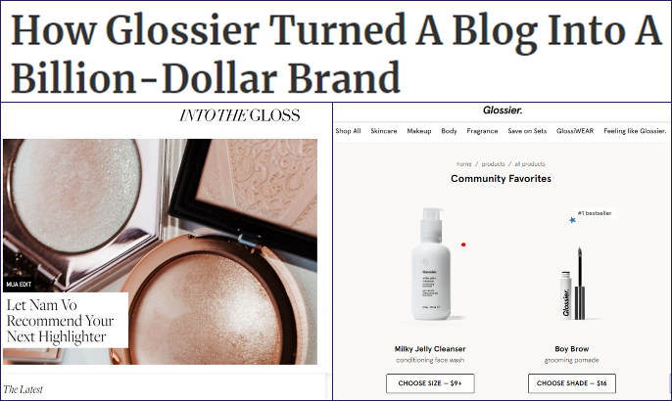
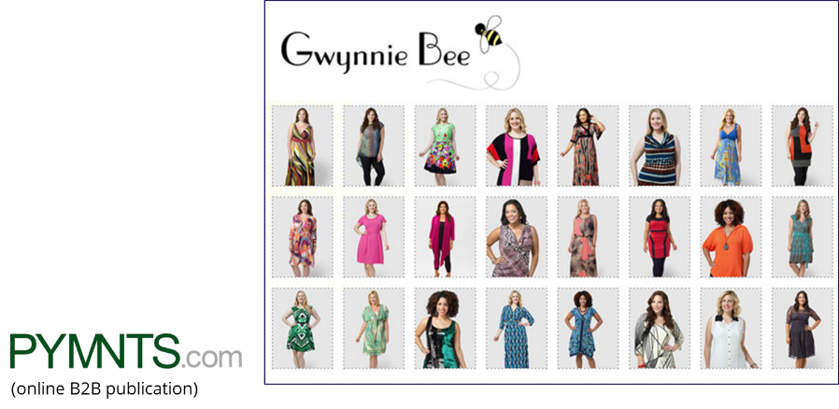
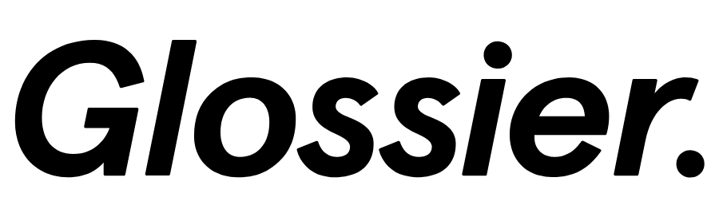

At inception, many DTC concepts start as a kernel of idea, or at least the desire to fulfill a consumer need through data & technology, and evolve into a brand
“It was never a pivot, (it) was a total evolution of the same mission, but with tactile content.”
“So seven years ago, we were thinking about using data and tech to build a business with a strong economics unit that would positively impact the lives of consumers….And we did a bunch of analysis, and found that apparel wasn’t working well online and hasn’t to date – and it seemed like a massive opportunity on the tech side to build something really disruptive.”
- Emily Weiss, Founder, Glossier
- Christine Hunsicker, Founder & CEO, Gwynnie Bee
This information is exclusively provided to VAB members and qualified marketers. Further distribution is prohibited.
PAGE 45

Slide 46







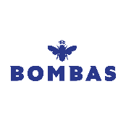
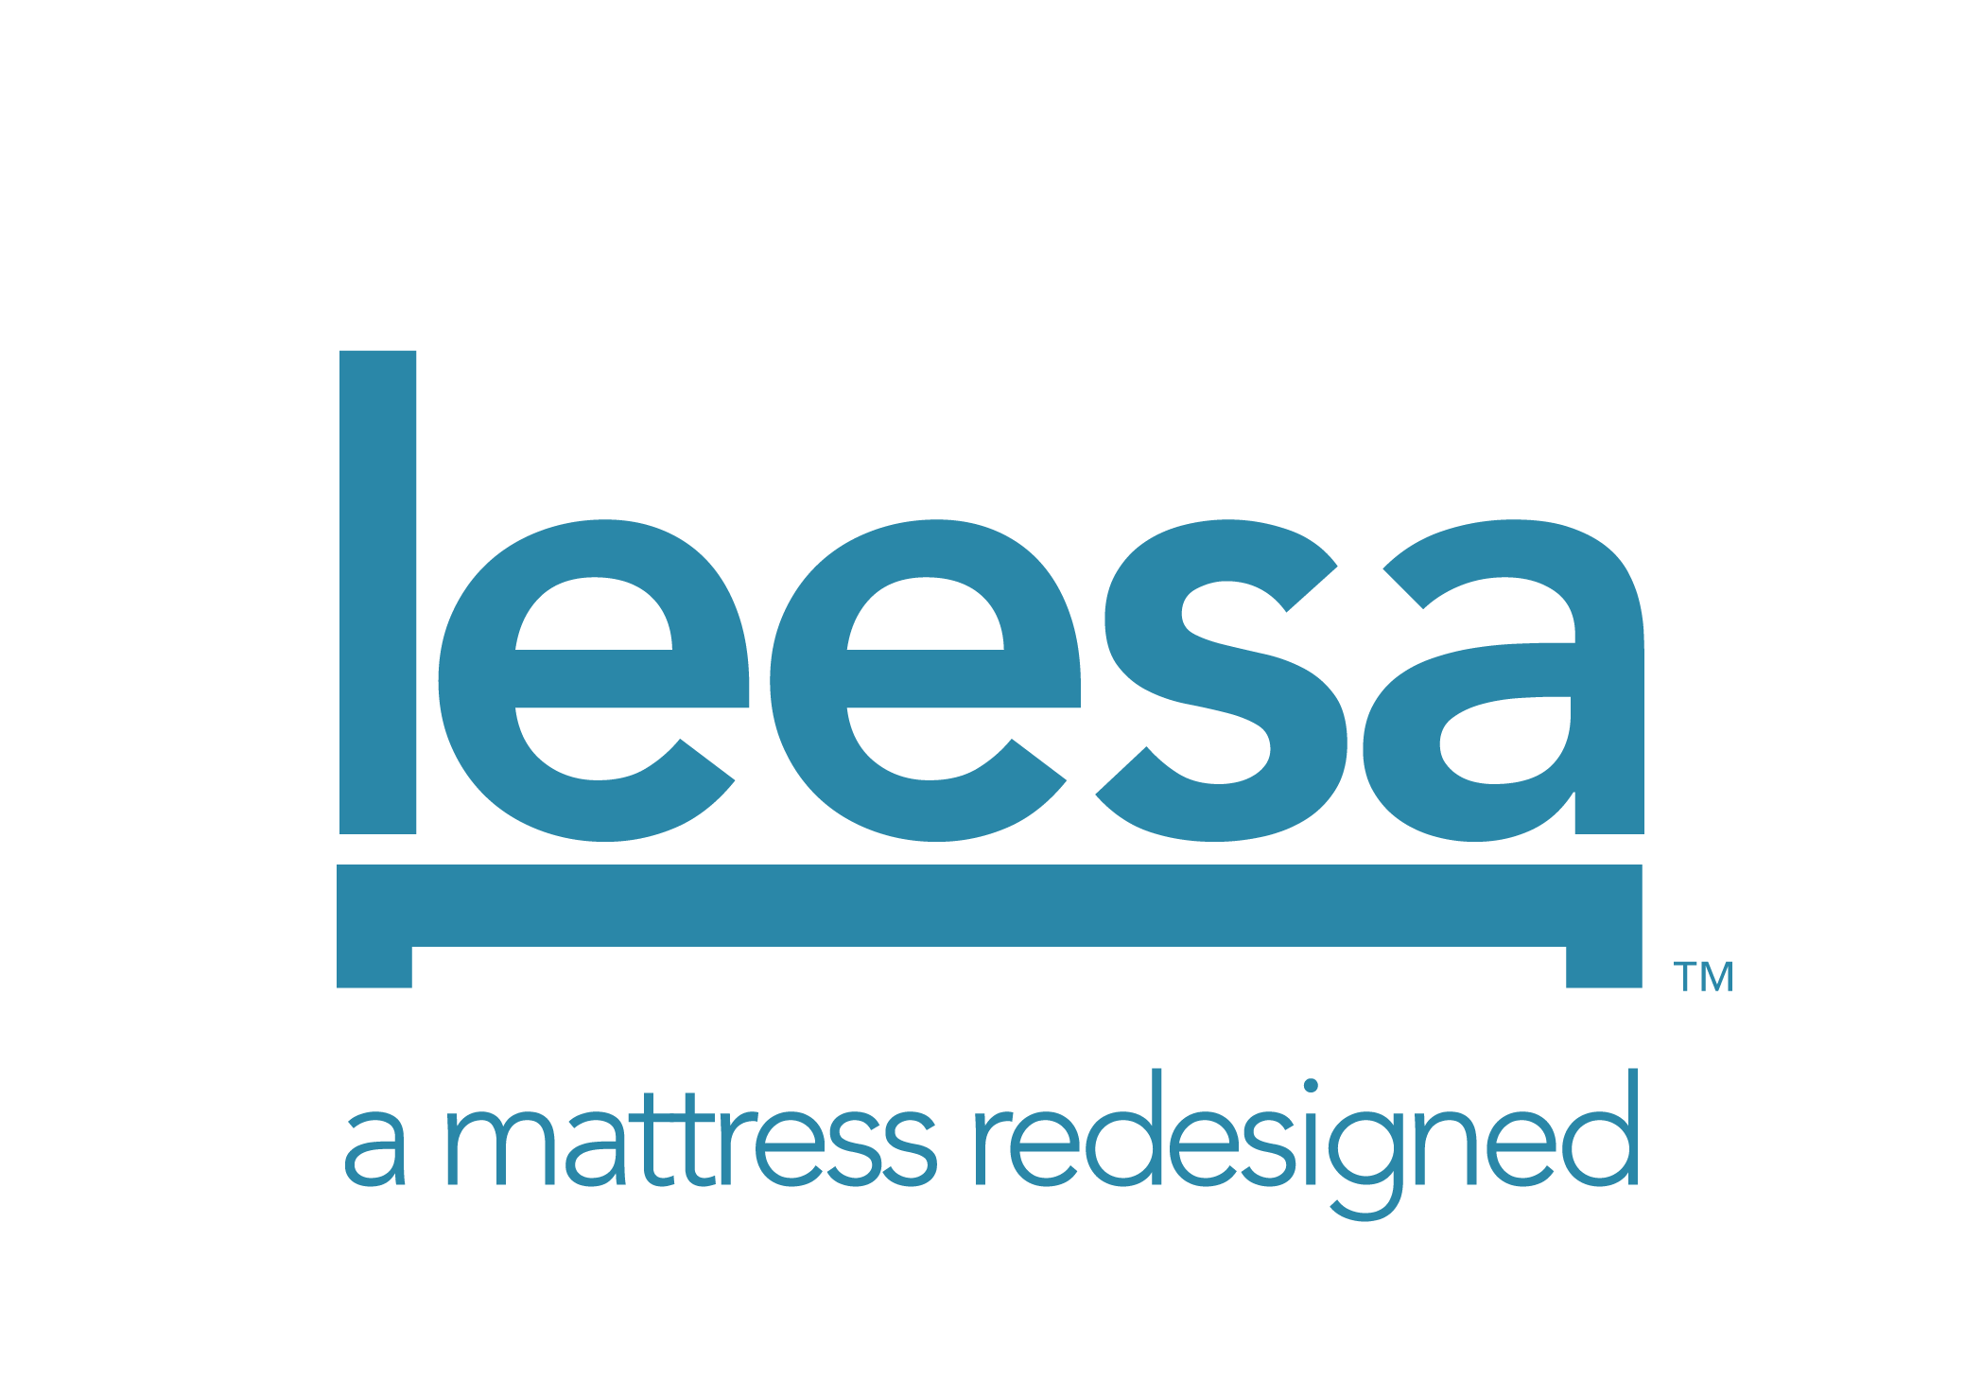






As an idea becomes a business, many DTC brands set up point-of-sale & distribution systems through e-commerce platforms like Shopify, which is built specifically for online retailers
“The 21st-century brand is the direct-to-consumer brand,” said Jeff Weiser, chief marketing officer at Shopify. “A couple of things have enabled the rise of the DTC, which is the ability to outsource the supply chain.” For Weiser, who described himself as “loving” anything to do with DTC, what Shopify does is power all of that ability — from selling to payments to marketing. “We run the gamut of a retail operating system.”
Brands above represent a sampling of DTC brands who use Shopify
This information is exclusively provided to VAB members and qualified marketers. Further distribution is prohibited.
PAGE 46

Slide 47

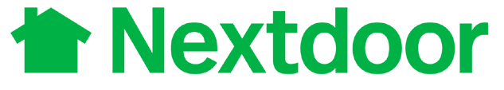














DTC brands establish their customer base through social media, but to grow beyond their initial loyal, niche consumers they must add platforms that provide a broader audience
DTC Advertising Evolution
Social Media
Sampling of brands that are primarily advertising in this channel
Podcasts, Out-of-Home, Satellite Radio
Sampling of brands that have added these channels to their media mix
Multiscreen TV
Sampling of brands that have added TV to their media mix
DTC Brand Maturity
This information is exclusively provided to VAB members and qualified marketers. Further distribution is prohibited.
PAGE 47

Slide 48

To become “main-stream” and grow into a household name,
DTC brands must attract
consumers beyond the typical
DTC shopper.
These customers may not be
as comfortable purchasing products online or making
a purchase without testing,
or touching, it first.
For these brands, it’s time to
get physical…
This information is exclusively provided to VAB members and qualified marketers. Further distribution is prohibited.
PAGE 48

Slide 49
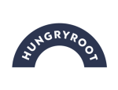

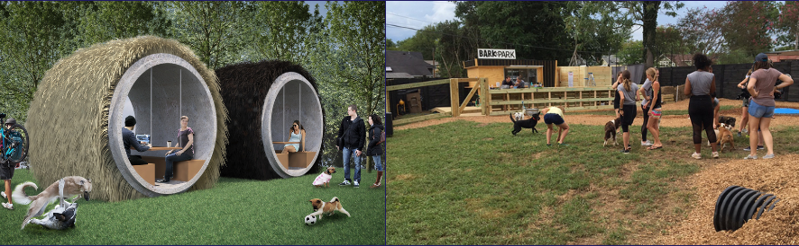
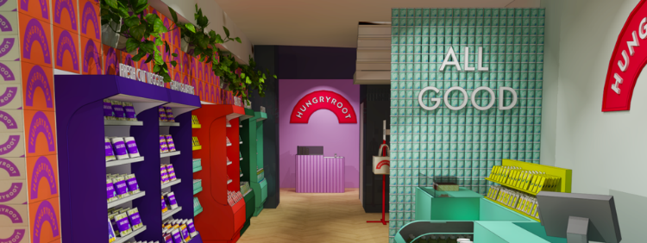
Many DTC brands create pop-up shops to directly connect with consumers and provide them with immersive, shareable, ‘on-brand’ experiences
Over 150+ DTC brands have opened temporary pop-up shops throughout the country, especially in trendy neighborhoods where they can attract attention and clientele who will happily provide free PR by spreading the word to their social following
(meal kit)
(dog products)
Hungryroot opened a pop-up in New York’s Flatiron neighborhood for New Yorkers looking for nutrient-rich, vegan friendly, ready-made meals
The brand refers to it as a ‘modern convenience store’ where customers can purchase customized Hungryroot oat cups, along with over 60 other Hungryroot products
The pop-up also hosted a rotating series of events like weekend workouts and happy hours
Barkbox opened BarkPark in September 2018 in Nashville, encompassing a landscaped green space designed for dogs to run around as well as access to Bark-branded toys and treats
BarkPark will have trained professionals or ‘hosts’ that will monitor dog play and ensure safety with events like ‘Downward Dog Yoga’ and ‘Okto-Bark-Fest’
This followed the brand’s launch in more than 1,800 Target stores nationwide in August 2018. The brand was also introduced inside Urban Outfitters.
Bonus Consumer Insight
72% of DTC shoppers feel it is very important to have stimulating experiences
Source: Forbes – DTC Healthy Food Brand Hungryroot Launches New York Pop-Up, March 26, 2019. Fortune – BarkBox Is Thinking Outside the Box With a New Experimental Retail Concept, August 16, 201; MRI-Simmons, 2019 Doublebase; Index vs. A18+, DTC Brand Shopper Target (34% of A18+ population) = (“Ordered any item over the Internet in last 12 months”) + (Agree with 2 out of 3 statements: “The Internet is a great way to actually buy products [any agree]”, “I prefer purchasing things online for a fixed price, as opposed to bidding in online auctions [any agree]”, “In general, I’d rather shop online than go to a store [any agree]”) + (Agree with 2 out of 3 statements: “Simplicity-Keeping your life and mind as uncluttered as possible [very important]”, “I prefer to shop at stores that specialize in a specific type or style of product [any agree]”, “Technology helps make my life more organized [any agree]”).
This information is exclusively provided to VAB members and qualified marketers. Further distribution is prohibited.
PAGE 49

Slide 50
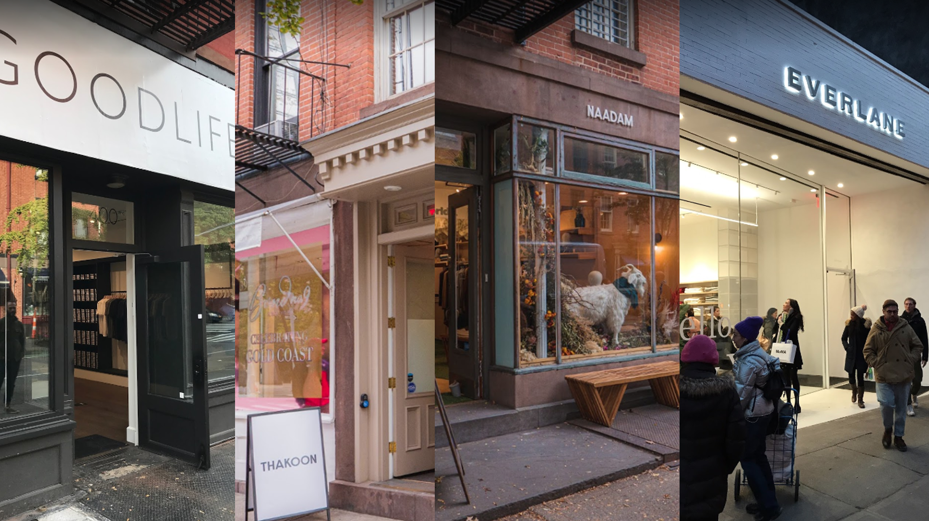
The concept of a ‘DTC neighborhood’ is starting to take shape as more digital-native brands flock to the same areas within a metro area when opening up pop-up shops or permanent brick-and-mortar locations
Similar Client Base:
“People who shop digitally native brands look similar….the category might change – clothing, home furnishing, menswear — but these digital brands attract similar shoppers….Now these digital brands are coming to the same place because their shopper is very similar,”
- Jon Levy, VP of Brand Management, Leap
Centralized Where Consumers Reside:
“When brands are starting to look at e-commerce data, they see where their customers live and shop. Brands have the billing zip codes, shipping zip codes and IP addresses where people come from,”
- Jon Levy, VP of Brand Management, Leap
Source: Glossy, The Rise of the DTC Neighborhood, 12/16/2019.
This information is exclusively provided to VAB members and qualified marketers. Further distribution is prohibited.
PAGE 50

Slide 51
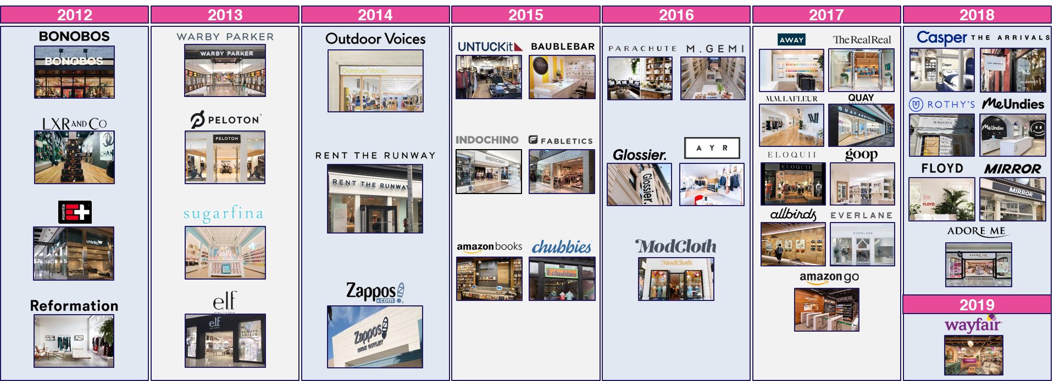
Established brands looking to expand significantly are opening permanent brick-and-mortar stores, many of which are meant to create experiences almost as much as sales
In fact, digitally-native brands will open 850 stores in the next five years, with Casper opening 200 stores within three years and Adore Me planning to open 300 stores in five years
"Many digitally-natives view (store) rent basically as search….What's the number of shoppers that come into my door divided by rent, which is basically what they'd be doing for Google Ad Words and things like that.“
- Ray Hartjen, Marketing Director, RetailNext (Retail Dive, 4/18/19)
Source: JLL Retail Research Point of View, U.S., 2018. Year represents when the first store opened for each brand.
This information is exclusively provided to VAB members and qualified marketers. Further distribution is prohibited.
PAGE 51

Slide 52
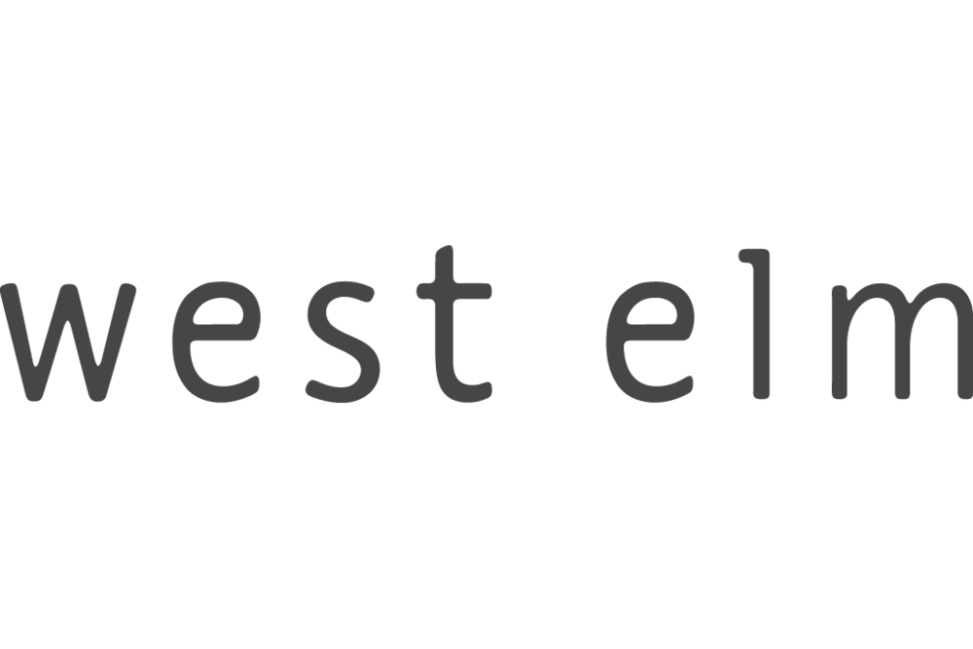














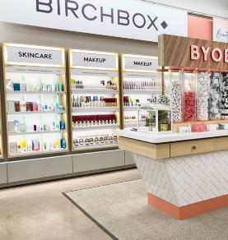
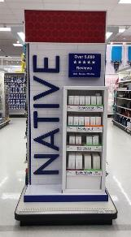
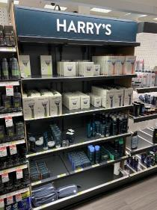
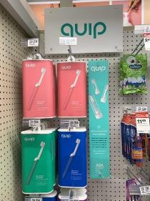
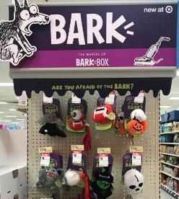
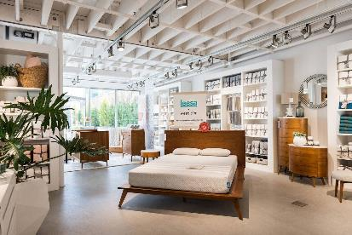
DTC brands have further increased their reach by developing partnerships with big retailers
in order to get shelf space in front of more consumers
It’s a complementary relationship as physical retailers need new, interesting product selections in stores
while digital brands need new distribution points to acquire new customers more efficiently and build profitability
    For example, 65% of Walmart Shoppers, 54% of Target shoppers and 47% of Nordstrom shoppers do not fall within the DTC shopper target
Source: MRI-Simmons, 2019 Doublebase; Index vs. A18+, DTC Brand Shopper Target (36% of A18+ population) = (“Ordered any item over the Internet in last 12 months”) + (Agree with 2 out of 3 statements: “The Internet is a great way to actually buy products [any agree]”, “I prefer purchasing things online for a fixed price, as opposed to bidding in online auctions [any agree]”, “In general, I’d rather shop online than go to a store [any agree]”) + (Agree with 2 out of 3 statements: “Simplicity-Keeping your life and mind as uncluttered as possible [very important]”, “I prefer to shop at stores that specialize in a specific type or style of product [any agree]”, “Technology helps make my life more organized [any agree]”).
This information is exclusively provided to VAB members and qualified marketers. Further distribution is prohibited.
PAGE 52

Slide 53












DTC brands often follow a similar trajectory when looking to grow from a rebellious kid to a responsible adult
At inception, many DTC brands start as a kernel of an idea
As an idea grows into a business,
DTC brands establish themselves online through an e-commerce platform
After developing their brand through social media,
DTC brands start testing other advertising channels like podcasts and experimenting with physical spaces like pop-up shops to provide more immersive experiences
These experiments with temporary, physical spaces can morph into more permanent brick-and-mortar locations
To increase their exposure among new customers, DTC brands are entering partnerships with major retailers to gain shelf space and moving into multiscreen TV advertising
The most successful DTC brands become acquisition targets of large conglomerates as traditional companies look to adopt their business practices and tech/innovation skillsets
This information is exclusively provided to VAB members and qualified marketers. Further distribution is prohibited.
PAGE 53

Slide 54
Blurring The Lines Between ‘Legacy’ & ‘Direct’
How DTC Tactics Are Inspiring Traditional Companies

Slide 55
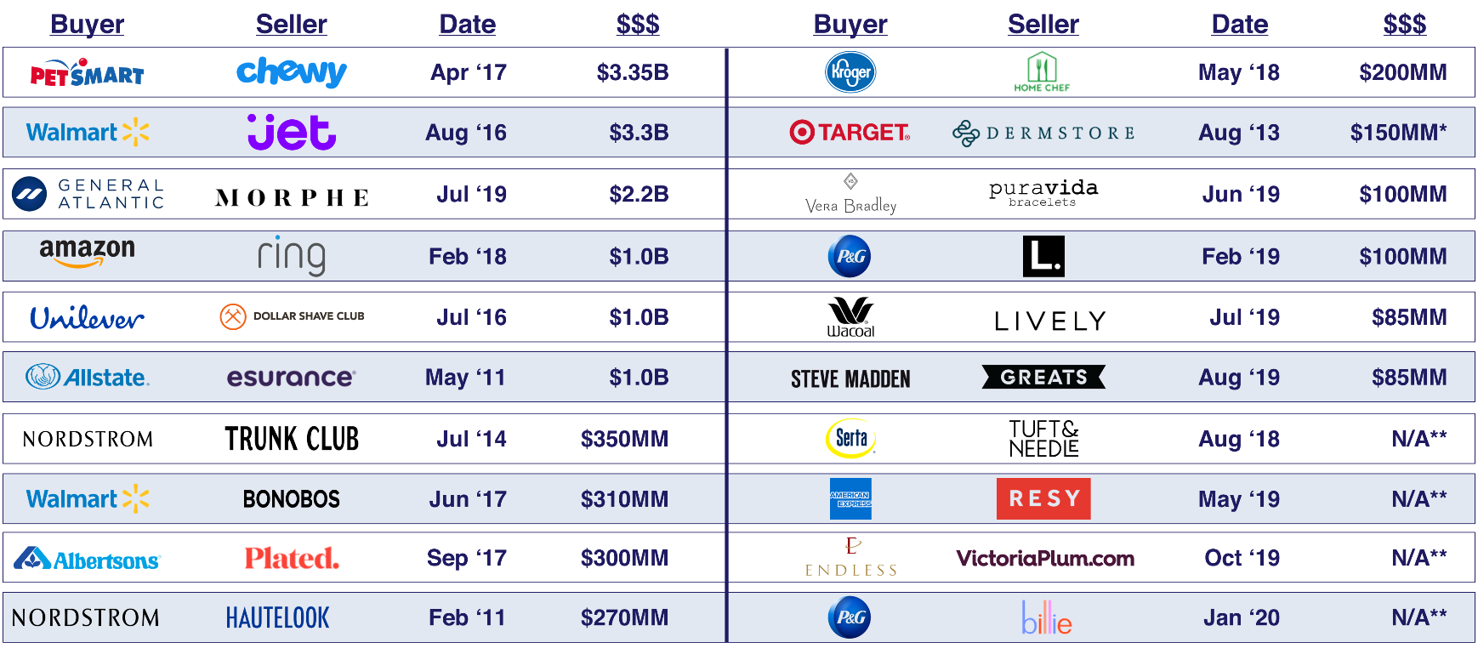
Traditional companies have been buying DTC brands to adopt
new business practices and strengthen their positioning within
the marketplace
Source: Based on company announcements and publicly reported data & filings augmented from sources including LUMA, TechCrunch, AdAge, Adweek, Business Insider & CNBC. *$$$ are estimated based on press reports as figures were not publicly released by either company. Above chart represents a sampling of recent acquisitions.
This information is exclusively provided to VAB members and qualified marketers. Further distribution is prohibited.
PAGE 55

Slide 56
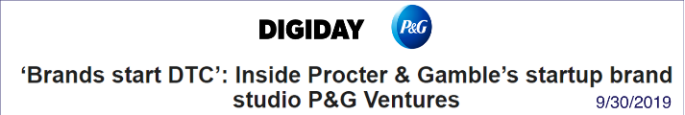
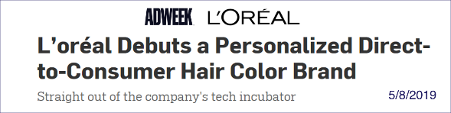




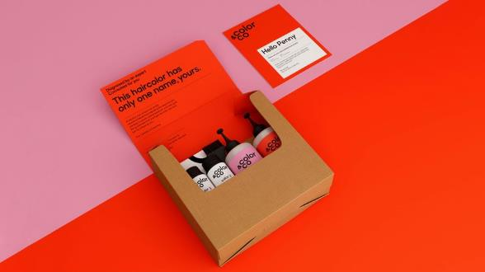
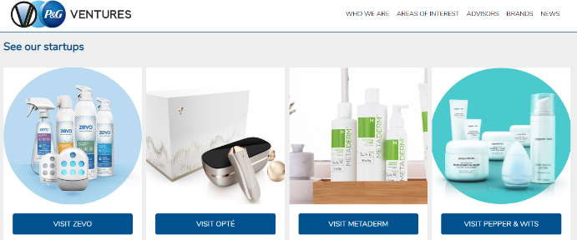
Beyond acquisitions, many major traditional companies are taking a page from the DTC handbook by creating internal tech incubators to nurture their own DTC brands
P&G now has several DTC acquisitions under its belt as a way to buy into relevance….However, acquisitions are culturally messy. And late-term free-spirited brands brought into the fold can get choked by the bureaucracy of big companies. P&G Ventures is a way to find the best of both worlds — to play a role in the inception of different business and brand models, and then throw its weight at channel management and marketing weight behind them.”
- Dipanjan Chatterjee, VP and Principal Analyst at Forrester, in an email.
“[The goal of the data is] either to improve for the customer [experience] through personalization or through shades we should we carrying”
– Guive Balooch, VP of Technology, L’Oréal
“The more information we collect, the more precise we will be even in the understanding of the goal of the person”
- Olivier Blayac, General Manager, Color&Co
This information is exclusively provided to VAB members and qualified marketers. Further distribution is prohibited.
PAGE 56

Slide 57
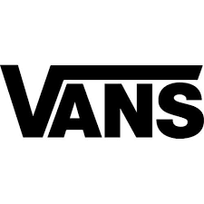


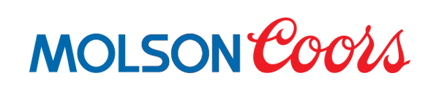


In fact, direct-to-consumer strategies and best practices are being adopted by established brands of all sizes across categories to grow their business
Under Armour Inc.’s direct-to-consumer revenue, which includes e-commerce sales, grew 16.7% last year, the retailer reported on Tuesday. In the fourth quarter, its direct-to-consumer revenue grew 13.5%.
When Nike announced in 2015 that it plans to hit $50 billion in sales by 2020, the direct-to-consumer and digital businesses were two of the key ways it intended to get there.
Much of Vans’ success is owed to its direct-to-consumer online channel, which saw 50 percent growth year over year in the quarter.
Under Armour's direct-to-consumer sales grow nearly 17% in 2017
UNDER ARMOUR
Bloomberg News, 2/13/18
Nike is trying to become the next great direct-to-consumer brand
NIKE
Quartz, 3/23/18
How a Booming DTC Business is Powering Vans
VANS
Footwear News, 1/18/19
“A direct-to-consumer website allows us far deeper insights around clickstream data, consumer behavior, how they operate and where they live,” said Trey Harshfield, Molson Coors’ global director of e-commerce. “It’s effectively solving another problem of driving awareness around buying beer.”
Lisa Mathison, senior director/media at Conagra Brands states, “We’re observing what those brands are doing and we’re trying to adapt, and adopt some of those practices into our own marketing strategies.
Amber Stepper, vice president of marketing noted, “the company has evolved many times over its 100 year history, and developing the Evenflo Gold brand as a DTC model is the next step in that journey.”
Even Molson Coors is hatching a direct-to-consumer strategy
MOLSON COORS
Digiday, 4/1/2019
Conagra draws lesson from direct-to-consumer brands
CONAGRA
WARC, 8/20/19
Why Traditional Brands Are Moving To DTC Model
EVENFLO
MediaPost, 2/27/19
This information is exclusively provided to VAB members and qualified marketers. Further distribution is prohibited.
PAGE 57

Slide 58




Key takeaways about DTC brands
Fastest Growing Sector
Modern Business Models
The DTC Shopper Profile
Evolving & Inspiring
While the world’s biggest companies are searching for ‘growth,’ digital-native DTC brands are grabbing it by quickly taking market-share from established brands across categories.
While DTC brands thrive across many established categories, they differentiate themselves from incumbent competitors by adhering to a common set of core principles focused on data, design, digital, the consumer and brand purpose.
Mobility, early technology adoption, convenience, knowledge and advocacy are the main characteristics of the DTC shopper. They are ‘Internet Idolizers,’ ‘Technology Tastemakers,’ ‘Convenience Conquerors, and ‘Perceptive Purchasers.’
As DTC brands explore new areas of growth, they begin to implement more tactics from traditional brands’ playbooks while legacy companies look
to the DTC segment for innovation and to apply
best practices to their own businesses.
This information is exclusively provided to VAB members and qualified marketers. Further distribution is prohibited.
PAGE 58

Slide 59





Creators
Danielle DeLauro
Executive Vice President
danielled@thevab.com
Jason Wiese
SVP, Director of Strategic Insights
jasonw@thevab.com
Leah Montner-Dixon
Insights Manager
leahm@thevab.com

