Slide 1




What Is… Data Privacy and Security?
Decoding Key Topics and Terms

Slide 2


Decoding data privacy & security is crucial for brands to forge consumer trust.
Data is the fuel that powers the advertising economy and is considered one of the most important assets a business can hold. The right data leveraged in the right way enables a better understanding of customers, as well
as how to serve them more effectively and efficiently.
As the creation and collection of data expands, businesses have an inherent responsibility to maintain the standards of how they collect, process and store personal data.
With 81% of U.S. adults being concerned about how companies use
the data they collect on them, the need for marketers to make sense
of what data privacy and security is and the role it plays in the advertising ecosystem has never been more critical.
In this second of a three-part series, we seek to DECODE Data Privacy & Security. By deciphering key terms and concepts, we will provide the baseline knowledge you need to further understand why data privacy legislation is growing and how to navigate the advertising ecosystem as signal loss increases.
This information is exclusively provided to VAB members and qualified marketers.
PAGE 2

Slide 3


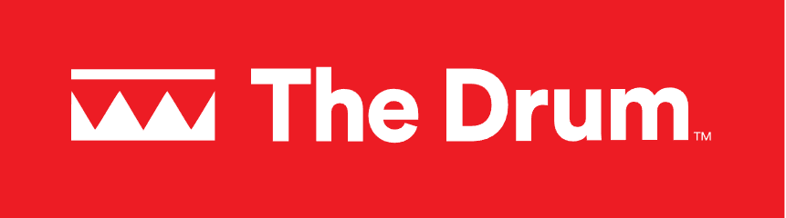

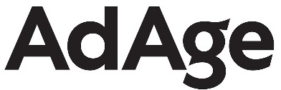



Data privacy is reshaping the conversation within the advertising landscape on how to ethically connect with consumers
April 8, 2024
July 10, 2023
April 4,2024
U.S. and E.U. Complete Long-Awaited Deal on Sharing Data
Privacy, platforms & power shifts: 3 trends reshaping marketing and measurement
US lawmakers unveil a plan to give all Americans a right to online privacy
How to Navigate the Complexities of Data Ownership
April 4,2024
December 8, 2023
HOW AD TRANSPARENCY AND PRIVACY ARE THE INDUSTRY’S NEW TABLE STAKES
You've Met Data Privacy Guidelines. But What About Data Ethics?
April 19, 2024
Navigating The Complexity Of The Latest Data Privacy Regulations
December 8, 2023
January 3, 2024
September 6, 2023
Data Privacy Tops Concerns For Americans – Who Is Responsible For Better Data Protections?
MOST PUBLISHERS SHARE CONSUMER DATA BEFORE GETTING CONSENT, COMPLIANT STUDY FINDS
Research covering 150,000 publishers and billions of impressions finds data usually flows before consent windows pop up
Most major companies admit they may be selling your personal information, a new study finds
This information is exclusively provided to VAB members and qualified marketers.
PAGE 3

Slide 4
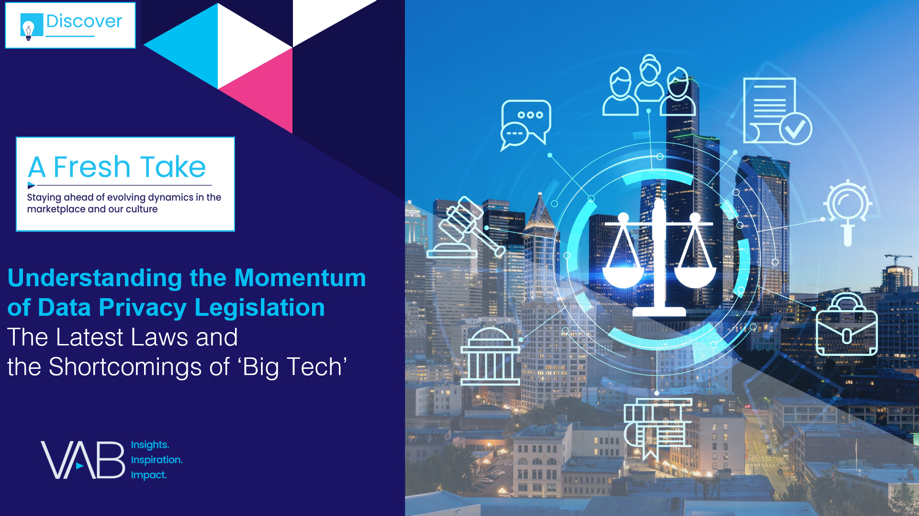
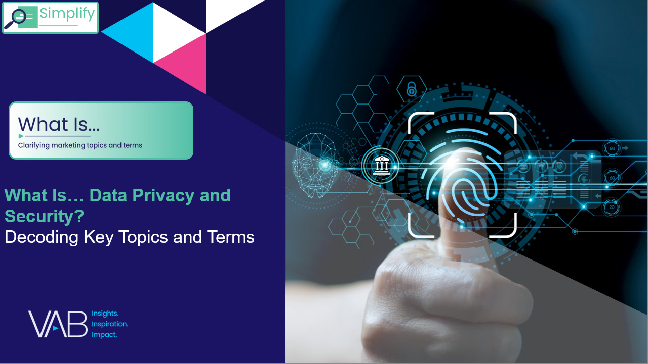


Our three-part series will help you understand, decode and navigate data privacy and security
UNDERSTAND
The momentum of data privacy & security legislation
click here to download
DECODE
data privacy and security
NAVIGATE
Marketing in privacy focused landscape
click here to download
This information is exclusively provided to VAB members and qualified marketers.
PAGE 4

Slide 5
What You’ll Learn…
Data privacy and security are a critical topic for the advertising industry today. Explore these 6 questions to get the baseline knowledge you need in your journey of implementing a privacy-first approach to your marketing strategies.
1
2
3
4
5
6
What is data privacy & security?
What are the core components of data privacy and security?
Which types
of data are businesses collecting?
What types
of data should
be safeguarded?
Are certain
types of data considered more sensitive than others?
What are some best practices for collecting
data from customers?
Click through a box above to be brought directly to the appropriate slide
This information is exclusively provided to VAB members and qualified marketers.
PAGE 5

Slide 6
Data privacy & security defined
1
2
3
4
5
6
What is data privacy & security?
What are the core components of data privacy and security?
Which types
of data are businesses collecting?
What types
of data should
be safeguarded?
Are certain
types of data considered more sensitive than others?
What are some best practices for collecting
data from customers?
Click through a box above to be brought directly to the appropriate section
This information is exclusively provided to VAB members and qualified marketers.
PAGE 6

Slide 7


The staggering amount of data generated every day is a sign of how important privacy and security should be in everyday life
Which is equal to
135 Billion
HD streaming movies
worth of data created daily*
337
Million Terabytes
of data is created daily
Source: Edge Delta, ‘Breaking Down The Numbers: How Much Data Does The World Create Daily in 2024?’,
March 2024. *Calculated from an average HD streaming movie size of 2.5GB from Tachus, ‘How Much Data Is Used When Streaming TV?’, February 2024.
This information is exclusively provided to VAB members and qualified marketers.
PAGE 7

Slide 8


Data privacy and security work together to ensure customer’s safety and anonymity while protecting from identity theft, fraud and other cybercrimes
Data Privacy
Data Security
The principle that individuals should have control over their personal data, including the ability to decide how organizations collect, store and use their data.
The principle that any entity collecting data, has an ethical and legal obligation to protect the data they collect from unauthorized access and misuse.*
Source: IBM, What is Data Privacy?, December 2023. *Harvard Business School, ”Data Privacy: 4 Things Every Business Professional Should Know”, March 2021.
This information is exclusively provided to VAB members and qualified marketers.
PAGE 8

Slide 9




Consumers are very concerned about both data privacy and data security
Over 52% of consumers feel like they’re more of a target for online fraud than they were a year ago.
% of consumers who say they are very or somewhat concerned about…
Online Security
64%
Identity Theft
64%
Online Privacy
60%
Source: Experian’s 2023 U.S. Identity + Fraud Report: Identity, Experience and the Evolving Fraud Landscape. Based on a survey of more than 2,000. U.S. consumers about their online interactions and expectations regarding security and customer experience.
This information is exclusively provided to VAB members and qualified marketers.
PAGE 9

Slide 10
Exploring key questions of data collection and storage of consumer data
1
2
3
4
5
6
What is data privacy & security?
What are the core components of data privacy and security?
Which types
of data are businesses collecting?
What types
of data should
be safeguarded?
Are certain
types of data considered more sensitive than others?
What are some best practices for collecting
data from customers?
Click through a box above to be brought directly to the appropriate section
This information is exclusively provided to VAB members and qualified marketers.
PAGE 10

Slide 11
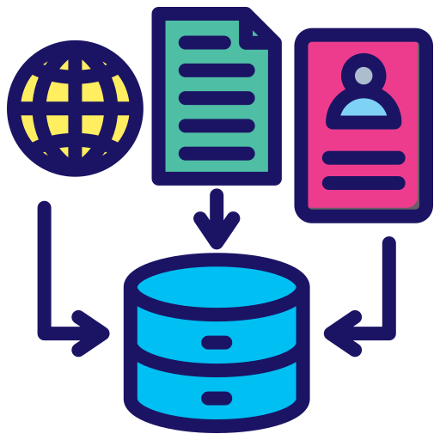


What are the core components of data privacy and security?
Data Collection
Data Storage
Data Access
Customers opt in to freely and ethically provide information
Controls are set in place to protect data from unauthorized access and misuse
Data should only be accessible by members of an organization who require it to do their jobs
Source: Harvard Business School, ”Data Privacy: 4 Things Every Business Professional Should Know”, March 2021.
This information is exclusively provided to VAB members and qualified marketers.
PAGE 11

Slide 12
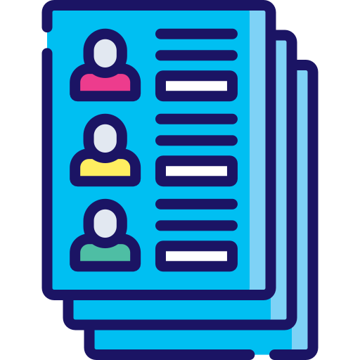



Which types of data are businesses collecting?
The four main categories of consumer data that businesses collect
Personal Data
Engagement Data
Behavioral Data
Attitudinal Data
Name
Postal Address
Email Address
Phone Number
Data of Birth
Demographics
SSN
Gender
IP Address
Web Browser Cookies
Device IDs
Website Visitation
Social Media Engagement
Email Responses
Paid Ad Interactions
Click-Through Rate (CTR)
Bounce Rate
Purchase History
Web Form Downloads
Site Duration
Abandoned Shopping Carts
Subscription Details
Average Order Value
Consumer Satisfaction Ratings
Purchase Criteria
Product Desirability
Product Preferences
Survey Responses
Customer Reviews
Source: Business News Daily How Businesses Are Collecting Data (And What They’re Doing With It), October 2023. The above represents a sampling of consumer data points within each category.
,
This information is exclusively provided to VAB members and qualified marketers.
PAGE 12

Slide 13
What types of data should be safeguarded?
The protection of PII is essential to any company that collects it; failure to do so can result in the theft of consumer data, fines and reputational damage.
Personal Identifiable Information (PII):
Information that can be used
to distinguish or trace an individual’s identity, either alone or when combined with other information that is linked or linkable to a specific individual.
75%
of countries have implemented
data privacy laws governing the
collection, retention and use of PII*
Source: U.S. Department of Labor, ‘Guidance on the Protection of Personal Identifiable Information.’
*McKinsey & Co, 'Localization of data privacy regulations creates competitive opportunities', June 2022.
This information is exclusively provided to VAB members and qualified marketers.
PAGE 13

Slide 14
Are certain types of data considered more sensitive than others?
To help guide current and future marketing strategies, determine what types of data you are using and plan to use.
Sensitive Data (Direct PII)
Data that can be directly linked to an individual's identity
Information considered as sensitive data may vary by state
Non-Sensitive Data (Indirect PII)
Data that can’t be used to directly identify an individual
Information commonly considered as sensitive
Information commonly considered as non-sensitive
  Full Name
  Social Security Number
  Telephone number
  Fingerprints
  Driver’s License
  Credit Card Information
  Medical Records
  Passport Info
  Precise Geolocation
  Internet Browsing Data
  Zip code
  Country code
  Race
  Gender
  Date of birth
  Place of birth
  Employer
  Mother’s Maiden Name
Depending on the state, Jurisdiction Sensitive PII may require
Greater security measures
Additional consent to collect it
Non-Sensitive Data Can be easily accessible
from public sources like the Internet.
Source: Department of Homeland Security, ‘Handbook for Safeguarding Sensitive PII’, December 2017. *ARF (Advertising Research Foundation), ‘6th Annual Privacy Study (2023).’
This information is exclusively provided to VAB members and qualified marketers.
PAGE 14

Slide 15



What are some best practices for collecting data from customers?
Three data collection strategies that help to build trust with customers
66
%​
Transparency
Communicate what data is being collected and how you intend to use it
Consent
of consumers would gain trust in a company if they are transparent about how they use their personal data*
Gain user permission for data collection whenever possible
Value Exchange
Provide clear benefits and details on what a user gets in return for sharing their data
Source: Harvard Business Review, ‘Customer Data: Designing for Transparency and Trust,’ May 2015. *Razorfish, ‘The Data Privacy Paradox,’ March 2023.
This information is exclusively provided to VAB members and qualified marketers.
PAGE 15

Slide 16
Marketer Takeaways: Protect your brand by taking a ‘privacy by design’ approach to your marketing efforts
Three Data Strategies to Protect Your Customers and Your Brand
1
2
3
Data Awareness
Data Standards
Data Transparency
Be conscientious of the types of data that are being leveraged throughout your marketing campaign
Set strict policies and guidelines in how data is collected, stored and secured
Ensure customers understand what data is being collected and why
This information is exclusively provided to VAB members and qualified marketers.
PAGE 16

Slide 17


Explore our full three-part series to understand, decode and navigate data privacy and security, with actionable insights
Understand the momentum behind
data privacy legislation and explore
the continued shortcomings of ‘Big Tech’ in this area.
Decode data privacy and security
to learn about the key topics, concepts and terms and why it matters to your customers.
Navigate marketing strategies in a privacy-focused landscape, with actionable tactics to reach audiences with personalized ads.
Download Here
Download Here
This information is exclusively provided to VAB members and qualified marketers.
PAGE 17

Slide 18
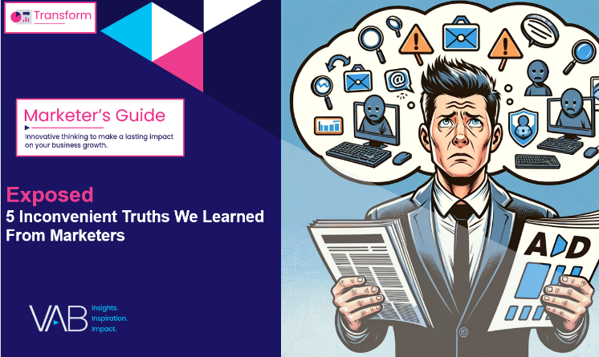

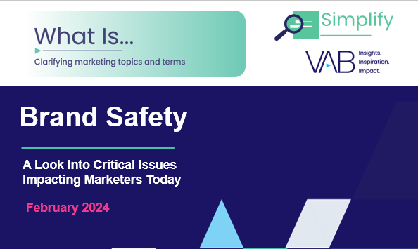
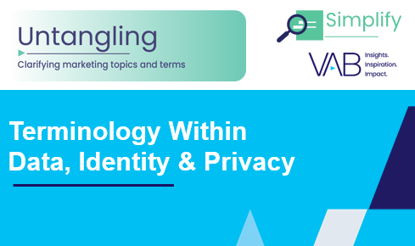
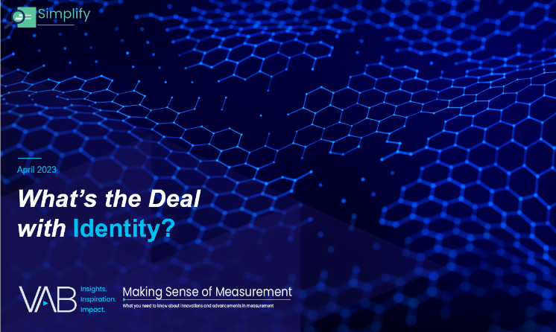
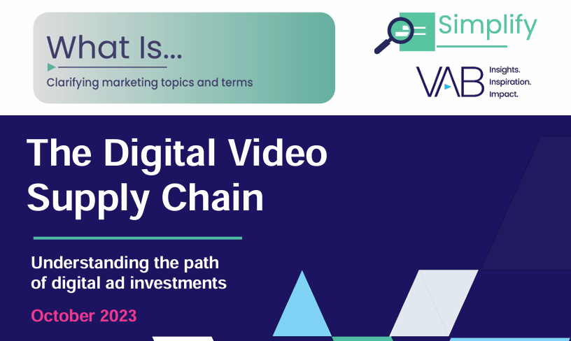
Creators
Jason Wiese
Benjamin Vandegrift
SVP, Director of Strategic Insights
jasonw@thevab.com
VP, Measurement Solutions
benjaminv@thevab.com
Reed Kiely
Kaileen Cain
Exposed
5 Inconvenient Truths We Learned From Marketers
Hidden Costs
Three critical business ramifications of digital ad fraud
Director, Data Insights & Trends
reedk@thevab.com
Senior Insights Analyst
kaileenc@thevab.com
Discover more
Looking for more data, insights and takeaways? Check out this related VAB content
What is Brand Safety?
Untangling Terminology in
Data, Identity & Privacy
What’s the Deal With… Identity?
What is The Digital Video
Supply Chain
This information is exclusively provided to VAB members and qualified marketers.
PAGE 18

Slide 19


About VAB
VAB plays a dual role in the video advertising industry. We are leading the change to bring about a more innovative and transparent marketplace. We also provide the insights and thought leadership that enables marketers to develop business-driving marketing strategies.
Drawing on our marketing expertise, we simplify the complexities in our industry and discover new insights that transform the way marketers look at their media strategy.
We are committed to your business growth and proud to offer VAB members, brand marketers and agencies complimentary access to our continuously-growing Insights library. Get immediate access at theVAB.com.
This information is exclusively provided to VAB members and qualified marketers.
PAGE 19

