Slide 1





Understanding the Momentum
of Data Privacy Legislation
The Latest Laws and
the Shortcomings of ‘Big Tech’

Slide 2


Understanding data privacy & security is crucial for brands to forge consumer trust.
Data is the fuel that powers the advertising economy and is considered one
of the most important assets a business can hold. The right data leveraged in
the right way enables a better understanding of customers, as well as how
to serve them more effectively and efficiently.
As the creation and collection of data expands, businesses have an inherent responsibility in maintaining the standards of how they collect, process and store personal data.
Consumers are particularly concerned about the practices of ‘Big Tech’ and social media platforms, with 77% of Americans having little or no trust in leaders of social media companies to publicly admit mistakes and take responsibility for data misuse.
Consumer concern has been accompanied by a surge in state level legislation with federal laws being discussed as well. At their core, these laws are focused on giving consumers more authority in how their data is collected and used
by the companies they share it with.
In the first piece of our three-part series, we seek to drive UNDERSTANDING on the Momentum of Data Privacy Legislation, and how the shortcomings
of ‘Big Tech’ have played a role in the need for further regulation.
This information is exclusively provided to VAB members and qualified marketers.
PAGE 2

Slide 3


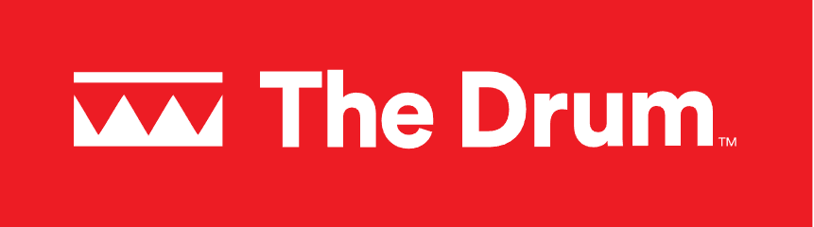





Data privacy is reshaping the conversation within the advertising landscape on how to ethically connect with consumers
April 8, 2024
July 10, 2023
April 4,2024
U.S. and E.U. Complete Long-Awaited Deal on Sharing Data
Privacy, platforms & power shifts: 3 trends reshaping marketing and measurement
US lawmakers unveil a plan to give all Americans a right to online privacy
How to Navigate the Complexities of Data Ownership
April 4,2024
December 8, 2023
HOW AD TRANSPARENCY AND PRIVACY ARE THE INDUSTRY’S NEW TABLE STAKES
You've Met Data Privacy Guidelines. But What About Data Ethics?
April 19, 2024
Navigating The Complexity Of The Latest Data Privacy Regulations
December 8, 2023
January 3, 2024
September 6, 2023
Data Privacy Tops Concerns For Americans – Who Is Responsible For Better Data Protections?
MOST PUBLISHERS SHARE CONSUMER DATA BEFORE GETTING CONSENT, COMPLIANT STUDY FINDS
Research covering 150,000 publishers and billions of impressions finds data usually flows before consent windows pop up
Most major companies admit they may be selling your personal information, a new study finds
This information is exclusively provided to VAB members and qualified marketers.
PAGE 3

Slide 4
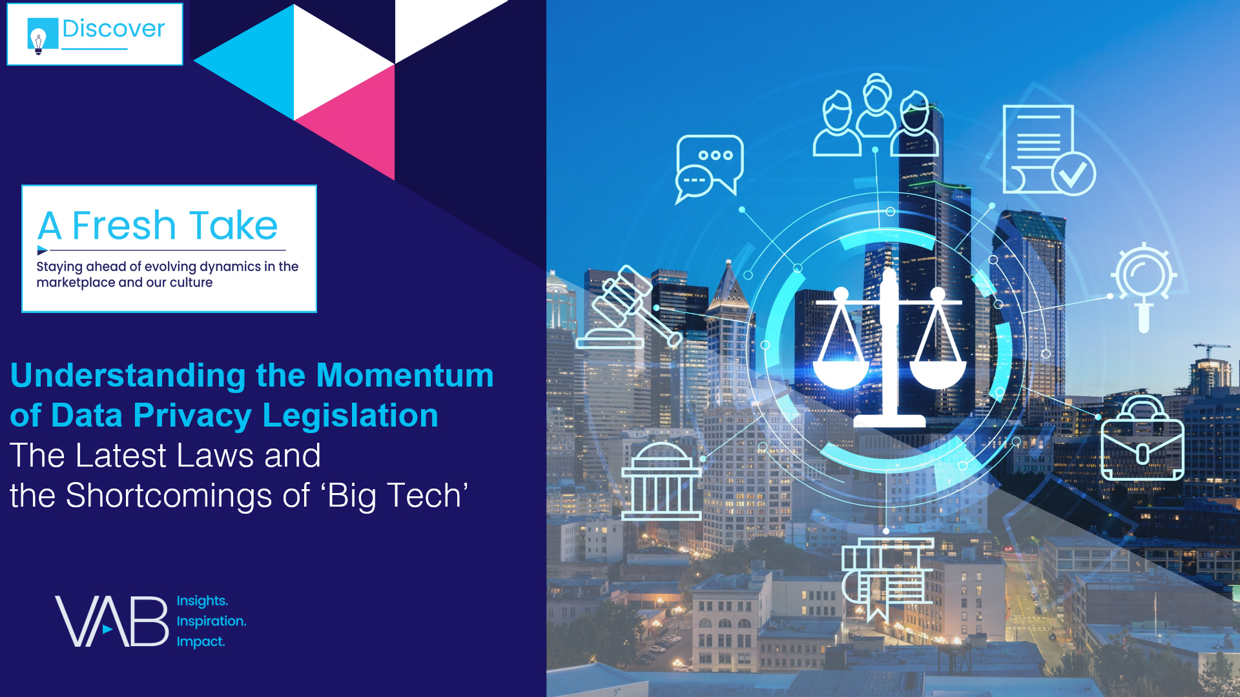



Our three-part series will help you understand, decode and navigate data privacy and security
UNDERSTAND
The momentum of data privacy & security legislation
DECODE
data privacy and security
click here to download
NAVIGATE
NAVIGATE
Marketing in privacy focused landscape
Marketing in privacy focused landscape
click here to download
This information is exclusively provided to VAB members and qualified marketers.
PAGE 4

Slide 5
What You’ll Learn…
It’s important to understand why data privacy and security is such a critical topic for the advertising industry today, as new legislation and growing consumer concern transforms the landscape
1
2
3
4
What is data privacy & security and why is it important?
What is the current momentum of data privacy regulation and legislation?
How has
‘Big Tech’ failed consumers on data privacy & security?
In which ways is multiscreen TV held to higher standards?
Click through a box above to be brought directly to the appropriate section
This information is exclusively provided to VAB members and qualified marketers.
PAGE 5

Slide 6
There are significant business and legal ramifications for failing to adhere to data privacy and security regulations
1
2
3
4
What is data privacy & security and why is it important?
What is the current momentum of data privacy regulation and legislation?
How has
‘Big Tech’ failed consumers on data privacy & security?
In which ways is multiscreen TV held to higher standards?
Click through a box above to be brought directly to the appropriate section
This information is exclusively provided to VAB members and qualified marketers.
PAGE 6

Slide 7


Data privacy and security work together to ensure customer’s safety and anonymity while protecting from identity theft, fraud and other cybercrimes
Data Privacy
Data Security
The principle that individuals should have control over their personal data, including the ability to decide how organizations collect, store and use their data.
The principle that any entity collecting data, has an ethical and legal obligation to protect the data they collect from unauthorized access and misuse.*
Source: IBM, What is Data Privacy?, December 2023. *Harvard Business School, ”Data Privacy: 4 Things Every Business Professional Should Know”, March 2021.
This information is exclusively provided to VAB members and qualified marketers.
PAGE 7

Slide 8




Marketers need to be aware of the potential business ramifications of not complying with data privacy and security regulations
Financial
Risk
Brand Reputational
& Corporate Risk
Legal
Risk
Click here to learn more about the critical business ramifications of not complying with data privacy and security regulations in 'Hidden Costs'
This information is exclusively provided to VAB members and qualified marketers.
PAGE 8

Slide 9



Failing to adhere to data privacy and security regulations can lead to serious issues for media platforms, its advertisers and their customers
Federal Investigations
Massive
Fines
Ad Waste &
Brand Risk
“United States senators sent a letter to the F.T.C., urging it to investigate whether Google and YouTube had violated COPPA.”
“Children’s privacy advocates are urging federal regulators to consider issuing a massive fine ‘upwards of tens of billions of dollars’… "
“It doesn’t just lead to wasted ad investments, but also inadvertent exposure to serious compliance and brand reputation risks…”
Ruben Schreurs, Chief Strategy Officer at Ebiquity
New York Times: ‘YouTube As May Have Led to Online Tracking of Children, Research Says,’ 8/17/23
Washington Post: ‘YouTube faces fresh complaint over its children’s privacy practices,’ 8/23/23
AdExchanger: ‘Adalytics Claps Back With Evidence of Behaviorally Targeted Ads Served in Kids Content On YouTube,’ 8/23/23
Click here to learn more about the personalized campaigns serving impressions to children in ‘VAB Investigation: Did YouTube allow for targeted campaigns to be served on “Made for Kids” channels?’
This information is exclusively provided to VAB members and qualified marketers.
PAGE 9

Slide 10



It is equally, if not more important, to follow data privacy guidelines when it comes to protected groups such as children
Privacy
Abused
Exposure to
inappropriate content
Exploitation
“There is no reasonable excuse for ads running on content intended primarily for kids other than to extort advertisers through a toddler-enabled click farm”
Sr. Advertising Executive
who chose to remain anonymous
““They (YouTube) have created a conveyor belt that is scooping up the data of children”
Jeff Chester, Executive Director at the Center for Digital Democracy
“Some of these ads reportedly involved content inappropriate for children,
such as car wrecks, medical injuries
and clips from TV-MA shows.”
New York Times: ‘YouTube Ads May Have Led to Online Tracking of Children, Research Says,’ 8/17/23
Adalytics: ‘YouTube Advertisers Inadvertently Harvesting Data From Millions of Children?’ 8/21/23
The Verge: ‘Senators want YouTube investigated over showing targeted ads to kids, again,’ 8/18/23
Click here to learn more about the personalized campaigns serving impressions to children in ‘VAB Investigation: Did YouTube allow for targeted campaigns to be served on “Made for Kids” channels?’
This information is exclusively provided to VAB members and qualified marketers.
PAGE 10

Slide 11
Data privacy legislation is on the rise at the state and federal level
1
2
3
4
What is data privacy & security and why is it important?
What is the current momentum of data privacy regulation and legislation?
How has
‘Big Tech’ failed consumers on data privacy & security?
In which ways is multiscreen TV held to higher standards?
Click through a box above to be brought directly to the appropriate section
This information is exclusively provided to VAB members and qualified marketers.
PAGE 11

Slide 12

The history of data privacy began decades ago, but has seen much more momentum in legislative action over the last several years
Past and present-day legislation continues to impact the advertising industry today
Data Privacy Legislature Timeline
1988
VPPA
Video Privacy
Protection Act
Enacted
2004
CalOppa
California Online
Privacy Protection Act
Enacted
2018 & Onwards
Various State Laws
Various U.S. states have enacted laws and proposed legislature to enforce stricter data privacy laws into place.
Continue reading to learn more about state privacy laws.
2024
Data Executive Order
Enacted
…
1988 - 2004
2018 - 2024
2000
COPPA
Children's Online
Privacy Protection Act
Enacted
2018
GDPR
General Data
Protection Regulation
Enacted
2022
KOSA
The Kids Online
Safety Act
In Progress
2024
APRA
American Privacy
Rights Act (Delete Act)
In Progress
See appendix for additional information on data privacy legislation
This information is exclusively provided to VAB members and qualified marketers.
PAGE 12

Slide 13
The data privacy landscape across the U.S. varies, with a growing number of legislative acts being implemented across individual state governments
U.S. State Privacy Legislation Tracker
Legend
WA
MT
ME
=Law Passed & Signed
(19 states)
OR
ND
MN
WI
VT
=Active Bill In Committee
(6 states)
SD
NY
ID
WY
NH
MI
MA
NV
IA
PA
RI
=Inactive Bill
(9 states)
UT
NE
OH
CT
CO
IN
NJ
IL
DE
=No Comprehensive Bill ..Introduced Yet
(16 states)
CA
KS
MO
WV
MD
VA
AZ
KY
NC
NM
TN
TX
AR
OK
SC
MS
AL
GA
LA
AK
FL
HI
Source: IAPP, ‘US State Privacy Legislation Tracker 2024,’ as of 7/8/24.
This information is exclusively provided to VAB members and qualified marketers.
PAGE 13

Slide 14
Data privacy regulations through state legislations now collectively cover over 40% of total U.S. HHs, a significant increase in just the last two years
% of Total U.S. HH Population in States That Have Signed Laws on Data Privacy
This patchwork of regulations makes measurement, and abiding by all the separate state laws, more challenging for brands.
# of states:
1
3
5
12
19
Source: IAPP, ‘US State Privacy Legislation Tracker 2024’, as of 7/8/24. *Nielsen Universe Estimates, January 1, 2024, Total U.S. HHs.
This information is exclusively provided to VAB members and qualified marketers.
PAGE 14

Slide 15
The desire for federal regulation on data privacy is one of the few issues in the U.S. that receives relatively equal bi-partisan voter support
Source: Morning Consult, ‘More Than Half of Voters Back a National Data Privacy Law’, 1/1/22, Data reflect poll conducted Jan 8-9 2022, among a representative sample of 2,000 registered voters, with an unweighted margin of error of +/-2 percentage points.
This information is exclusively provided to VAB members and qualified marketers.
PAGE 15

Slide 16

Not only do consumers agree there should be a federal privacy law, but most marketers are also in support of federal-level regulation
What level of regulatory approach do U.S. marketing
professionals want to see around data privacy?
Source: eMarketer, ‘Lawmakers address ad industry concerns in updated privacy rights legislation‘, May 2024.
This information is exclusively provided to VAB members and qualified marketers.
PAGE 16

Slide 17




Ad industry support for a federal bill on data privacy is driven by the desire to standardize and simplify the ability to conduct business in the U.S.
Four Key Marketer Implications in APRA (Delete Act)
Child Safety
Data Opt-Outs
Delete My Data
Targeted Ads
APRA is “complementary” to other bills on child safety and privacy that are expected to be taken up in the Senate.
Opt-out provisions that appear in various state bills are becoming common across the US and EU, suggesting that platforms and data brokers will soon have to make the ability to opt out prominently accessible.
“Delete my data” clauses that first appeared in California’s 2023 privacy bill are also becoming the norm, increasing transparency between the
ad industry and consumers.
The ANA and 4As support federal legislation but have expressed concern in an open letter to congress that provisions in the APRA could inhibit advertisers to activate targeted ads, which has implications for advertisers
and consumers.
Read the ANA & 4A's Letter
This information is exclusively provided to VAB members and qualified marketers.
PAGE 17

Slide 18
Increased regulations and fines are illuminating ‘Big Techs’ failures to protect and safely handle consumer data
1
2
3
4
What is data privacy & security and why is it important?
What is the current momentum of data privacy regulation and legislation?
How has
‘Big Tech’ failed consumers on data privacy & security?
In which ways is multiscreen TV held to higher standards?
Click through a box above to be brought directly to the appropriate section
This information is exclusively provided to VAB members and qualified marketers.
PAGE 18

Slide 19

Increased data privacy legislation will help protect some consumer data being tracked and used by ‘Big Tech’
“This landmark legislation (referencing the American Privacy Rights Act) gives Americans the right to control where their information goes and who can sell it. It reins in Big Tech by prohibiting them from tracking, predicting, and manipulating people’s behaviors for profit without their knowledge and consent. Americans overwhelmingly want these rights, and they are looking to us, their elected representatives, to act.”
Rep. Cathy McMorris Rodgers
House Energy and Commerce Committee Chair, (R-Wash.)
Source: EnergyCmmerce.House.gov; ‘Committee Chairs Rodgers, Cantwell Unveil Historic Draft Comprehensive Data Privacy Legislation,’ April,7 2024.
This information is exclusively provided to VAB members and qualified marketers.
PAGE 19

Slide 20
Americans are concerned with how ‘Big Tech’ walled gardens and social media companies are handling their data
Even though people don’t trust social media platforms to use their data responsibility, the total number of social network users has increased 11% since 2019 in the U.S.*
% of U.S. adults who have little or no trust that leaders
of social media companies will…
81%
Publicly admit mistakes and take responsibility when they misuse or compromise users’ personal data
Not sell users’ personal data to others without their consent
of U.S. adults are concerned about how companies use the data they collect about them
77%
76%
Source: Pew Research Center, ‘How Americans View Data Privacy’, October 2023. *eMarketer Forecast, May 2024, social networks users - Internet users of any age who use a social network via any device at least once per month (2019 – 206.2MM vs. 2023 – 228.0MM).
This information is exclusively provided to VAB members and qualified marketers.
PAGE 20

Slide 21

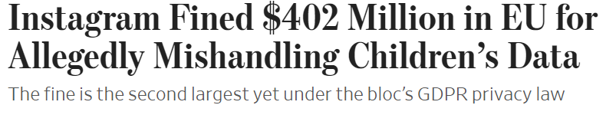
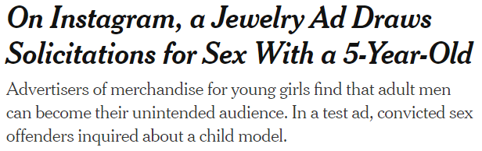



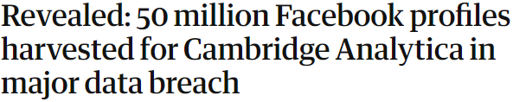
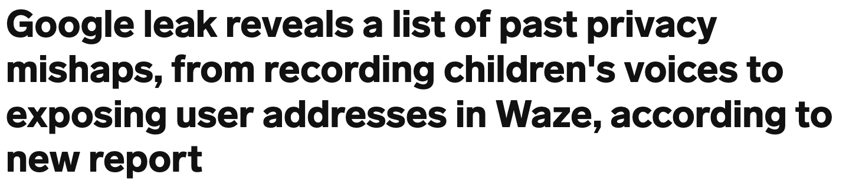


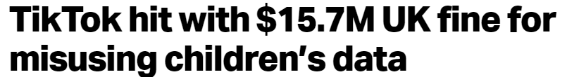



Despite increased regulations in the U.S. and abroad, ‘Big Tech’ platforms continue to commit privacy violations while putting consumer data at risk
Standardized legislation and regulation at the federal level is seen as a way to better rein in the systemic data privacy abuses caused by ‘Big Tech’ platforms
April 1,2024
May 13, 2024
September 5, 2022
The Incognito Mode Myth Has Fully Unraveled
To settle a years-long lawsuit, Google has agreed to delete “billions of data records” collected from users of “Incognito mode,” illuminating the pitfalls of relying on Chrome to protect your privacy.
December 23, 2022
March 17, 2018
Facebook parent Meta agrees to pay $725 million to settle privacy lawsuit
May 22, 2023
Meta hit with a record-breaking $1.3 billion fine over data privacy breaches
June 3, 2024
April 4, 2023
December 28, 2023
Google agrees to settle $5 billion lawsuit accusing it of tracking Incognito users
October 24, 2023
December 15, 2023
Meta Sued by California, States Over Harmful Youth Marketing
November 14, 2022
News publisher files class action antitrust suit against Google, citing AI’s harms to their bottom line
Google pays nearly $392 million to settle sweeping location-tracking case
This information is exclusively provided to VAB members and qualified marketers.

Slide 22
‘Big Tech’ platforms, and some brands that shared data with them, have incurred hundreds of millions of dollars in fines due to data misuse
Instagram
$402MM
in EU for allegedly mishandling children’s data
TikTok
$367MM
fine by Irish Data Protection Commission for allegedly mishandling children's data
Google
$155MM
in settlements over
location tracking
Twitter
$150MM
fine for allegedly breaking privacy promises
British Airways
£20MM
over breached data, some of which was shared with Google and Facebook
TikTok
$16MM
UK fine for misusing
children’s data
BetterHelp
$8MM
to online therapy users for alleged data misuse, including sharing metadata with Facebook and Google
GoodRx
$2MM
for sharing user’s health data with Google and Facebook
This information is exclusively provided to VAB members and qualified marketers.
PAGE 22

Slide 23
Conversely, decades of federal regulation have created a safe and secure environment with multiscreen TV for consumers and advertisers
1
2
3
4
What is data privacy & security and why is it important?
What is the current momentum of data privacy regulation and legislation?
How has
‘Big Tech’ failed consumers on data privacy & security?
In which ways is multiscreen TV held to higher standards?
Click through a box above to be brought directly to the appropriate section
This information is exclusively provided to VAB members and qualified marketers.
PAGE 23

Slide 24



Through the Cable Communications Policy Act, multiscreen TV has long been required by law to give consumers authority over their own data
3 Elements of the Cable Communications Policy Act of 1984
Transparent
Consented
Right to Inspect
Cable operators must give prior notice and obtain consent before collecting data from consumers
Cable operators must receive consent from consumers in order to share data with third parties
Cable subscribers have the right to inspect and correct errors in the cable operator’s databases
Source: uscode.house.gov, Cable Communications Policy Act of 1984, 47 USC 151
This information is exclusively provided to VAB members and qualified marketers.
PAGE 24

Slide 25

Held to a higher standard, Television has been required by law to manage the programming and ads served to children for over three decades
Children’s Television Act of 1990
# 1
TV broadcasters & networks must apply for a license and undergo thorough review by the FCC
# 2
Licensees must consider “the educational and informational needs of children”
# 3
FCC reviews overall programming and the share of educational programs
# 4
Licensees must limit the number of commercials during children’s programs
Source: FCC Video Division, ‘The Public and Broadcasting’.
This information is exclusively provided to VAB members and qualified marketers.
PAGE 25

Slide 26
A platform’s trustworthiness extends to its advertising environment as well which enables brands to create authentic connections with viewers
Types of Advertising U.S. Adults Find Trustworthy
% of respondents
U.S. adults are more likely to find ads on TV trustworthy vs. ads on digital platforms
2.5x
More Likely
to trust ads on TV
vs. ads on social media
1.5x
More Likely
to trust ads on TV
vs. ads on websites
Source: YouGov, Global Study: Which Types of Ads Do People Trust?, commissioned by Campaign, 2/5/2021. Note: Ages 18+ who selected very/somewhat trustworthy.
This information is exclusively provided to VAB members and qualified marketers.
PAGE 26

Slide 27
Marketer Takeaways: Protect your brand by complying with regulations, and partnering with trusted media platforms
Three Actions You Can Take Now to Protect Your Customers and Your Brand
1
2
3
Comply with Consumer Protection Laws & Regulations
Be Aware of the Risks
Associated with Non-Compliance
Partner with Trusted
Media Platforms
Adhere to the most stringent state level privacy laws to ensure you’re in compliance. Doing so enables you to put the customer first by protecting their identity and personal information.
Not complying with data privacy and security regulations, or partnering with platforms who abuse legislation, can result in financial, brand reputational and legal risk.
Brands who align with trusted media platforms that comply with regulations will be better suited to not only protect and preserve the privacy of their customers, but also protect and preserve their own reputation.
Stay up to date with privacy laws here: iapp.org
This information is exclusively provided to VAB members and qualified marketers.
PAGE 27

Slide 28


Explore our full three-part series to understand, decode and navigate data privacy and security, with actionable insights
Understand the momentum behind
data privacy legislation and explore
the continued shortcomings of ‘Big Tech’ in this area.
Decode data privacy and security
to learn about the key topics, concepts and terms and why it matters to your customers.
Navigate marketing strategies in a privacy-focused landscape, with actionable tactics to reach audiences with personalized ads.
Download Here
Download Here
This information is exclusively provided to VAB members and qualified marketers.
PAGE 28

Slide 29



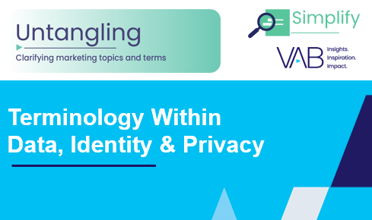


Creators
Jason Wiese
Benjamin Vandegrift
SVP, Director of Strategic Insights
jasonw@thevab.com
VP, Measurement Solutions
benjaminv@thevab.com
Reed Kiely
Kaileen Cain
Exposed
5 Inconvenient Truths We Learned From Marketers
Hidden Costs
Three critical business ramifications of digital ad fraud
Director, Data Insights & Trends
reedk@thevab.com
Senior Insights Analyst
kaileenc@thevab.com
Discover more
Looking for more data, insights and takeaways? Check out this related VAB content
What is Brand Safety?
Untangling Terminology in
Data, Identity & Privacy
What’s the Deal With… Identity?
What is The Digital Video
Supply Chain
This information is exclusively provided to VAB members and qualified marketers.
PAGE 29

Slide 30


About VAB
VAB plays a dual role in the video advertising industry. We are leading the change to bring about a more innovative and transparent marketplace. We also provide the insights and thought leadership that enables marketers to develop business-driving marketing strategies.
Drawing on our marketing expertise, we simplify the complexities in our industry and discover new insights that transform the way marketers look at their media strategy.
We are committed to your business growth and proud to offer VAB members, brand marketers and agencies complimentary access to our continuously-growing Insights library. Get immediate access at theVAB.com.
This information is exclusively provided to VAB members and qualified marketers.
PAGE 30

Slide 31
Appendix: Data Privacy Legislation Timeline
Data Privacy Legislation Timeline
1988
VPPA
Video Privacy Protection Act
Created to preserve personal privacy with respect to the rental, purchase,
or delivery of video tapes or similar
audio-visual materials.
2004
CalOppa
California Online Privacy Protection Act
A California law that requires operators of commercial websites and online services to display a privacy policy.
2018 & Onwards
Various State Laws
Various U.S. states have enacted laws and proposed legislature to enforce stricter data privacy laws into place.
Continue reading to learn more
about state privacy laws.
2024
Data Executive Order
President Biden issued an Executive Order to protect Americans’ sensitive personal data from exploitation by countries of concern.
…
1988 - 2004
2018 - 2024
2000
COPPA
Children's Online Privacy Protection Act
Created to impose requirements on website operators to protect and inform data collection and usage for children under the age of 13.
2018
GDPR
General Data Protection Regulation
Europe’s data privacy and security law, affecting global companies, that covers the transparency, accuracy, storage, integrity and accountability.
2022
KOSA
The Kids Online Safety Act
New child safety obligations for digital platforms, with safeguards against depression, sexual exploitation, bullying, harassment and other harms.
2024
APRA
American Privacy Rights Act (Delete Act)
New bi-partisan legislation introduced covering data minimization and security, consumer rights, restrictions on data brokers and an enforcement regime.
This information is exclusively provided to VAB members and qualified marketers.
PAGE 31

