Slide 1


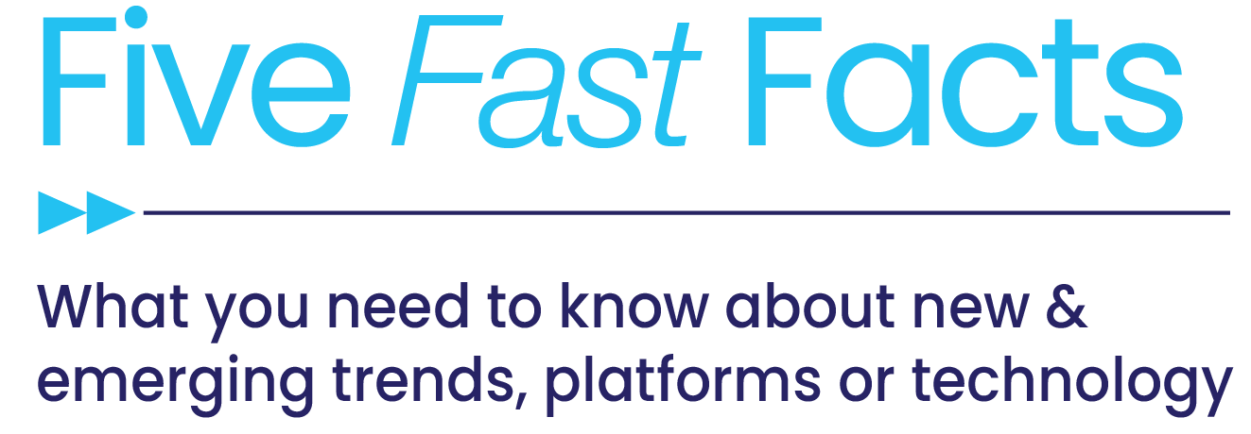

Data-Driven Opportunities
in a Cookieless World

Slide 2


As the media landscape evolves with the elimination of the third-party cookie, it leaves challenges for marketers as they adapt their media strategies to effectively identify and reach audiences.
These Five Fast Facts explore how marketers are reacting to the third-party cookie phase-out, the data value exchanges consumers are most often looking for from brands and the role a data-driven platform like CTV can play in a cookieless world.
This information is exclusively provided to VAB members and qualified marketers. Further distribution is prohibited.
PAGE 2

Slide 3
1
Third-party cookie deprecation is the top digital media challenge for marketers, and the industry as a whole today, as it’s phase-out across browsers and mobile devices is due to be complete in 2023
Top Digital Media Challenges For The Industry In 2021
Source: Integral Ad Science, The 2021 Industry Pulse Report, Q: “Please indicate the top three digital media challenges your organization will face in the next 12 months”; Google Chome Product Update Blog ‘An updated timeline for Privacy Sandbox milestones’ 6/24/21.
This information is exclusively provided to VAB members and qualified marketers. Further distribution is prohibited.
PAGE 3

Slide 4



2
This anticipated phase-out is driving marketers to reallocate budgets to channels without third-party cookies like streaming platforms and connected TV in addition to developing advanced marketing technologies such
as identity solutions and sophisticated tech stacks
Because of major browsers phasing out third-party cookies…
36%
33%
32%
My company/main client will reallocate spend to other channels without third-party cookies
My company/client will build an effective identity solution
My company/main client will develop a more sophisticated tech stack
Source: Xandr, 2020 Ad Relevance Report
This information is exclusively provided to VAB members and qualified marketers. Further distribution is prohibited.
PAGE 4

Slide 5



3
To combat the loss of the third-party cookie, six out of ten marketers are increasing their investment around the acquisition and use of first-party data from consumers as they build out their tech solutions.
How will the loss of third-party audience cookies will affect your use of data?
60%
38%
36%
Consumers are more comfortable with providing data too - 23% say they are more willing to share information with brands today than they were 1-2 years ago.
Increase spending / emphasis on use of first-party data
Increase interest in third-party identity resolution solutions
Increase efforts to build second-party data relationships
Source: Winterberry Group, Identity & Data Collaboration: Market Evolution in a Privacy-First, Post-Cookie World, 4/7/21; Innovid, 2020 Consumer Attitudes on Personalized Ads.
This information is exclusively provided to VAB members and qualified marketers. Further distribution is prohibited.
PAGE 5

Slide 6







4
Consumers - What Incentive Would You Consider Sharing Personal Data With A Brand?
(% of respondents agreeing)
Marketers tend to underestimate consumers’ motivations to share their data as people are much more willing, than marketers think they are, to exchange
data for rewards and cost incentives (personalized pricing, freebies).
57%
57%
56%
54%
51%
Rewards or discounts for frequently bought items
Personalized pricing (% off, money back)
Free samples of products or services
Free access to a service
Free or upgraded shipping options
Marketers - What Incentive Would Drive Consumers To Share Personal Data With Your Brand?
(% of respondents agreeing)
52%
47%
40%
35%
22%
Rewards or discounts for frequently bought items
Personalized pricing (% off, money back)
Personalized recommendations
More personalized customer services
Free access to a service
Source: Dentsu, The Cookieless World: A Guide for the New Era of Digital Marketing, 7/8/21, “In exchange for what incentive would your consumer / you be willing to share their / your personal data with your / a brand?”
This information is exclusively provided to VAB members and qualified marketers. Further distribution is prohibited.
PAGE 6

Slide 7
5
Marketers searching for consumer data should consider CTV as over two-thirds of viewers are willing to share personal information to improve their CTV ad experience, showing an inclination to exchange their data for relevancy and personalization.
What type of data are you comfortable sharing with brands to improve your CTV ad experience?
Source: Integral Ad Science, Press Play: CTV & Ads, October 2020; Valassis, Connected TV Isn’t Just Cool, It Really Works, March 2021
This information is exclusively provided to VAB members and qualified marketers. Further distribution is prohibited.
PAGE 7

Slide 8
The phase-out of third-party cookies means that marketers will have a need to develop more sophisticated marketing technologies such as
identity solutions and tech stacks
Marketers searching for first-party consumer data can leverage CTV to reach and engage viewers on a platform that motivates consumers to share their data in exchange for a better ad experiences
What does this mean for marketers?
This information is exclusively provided to VAB members and qualified marketers. Further distribution is prohibited.
PAGE 8

Slide 9
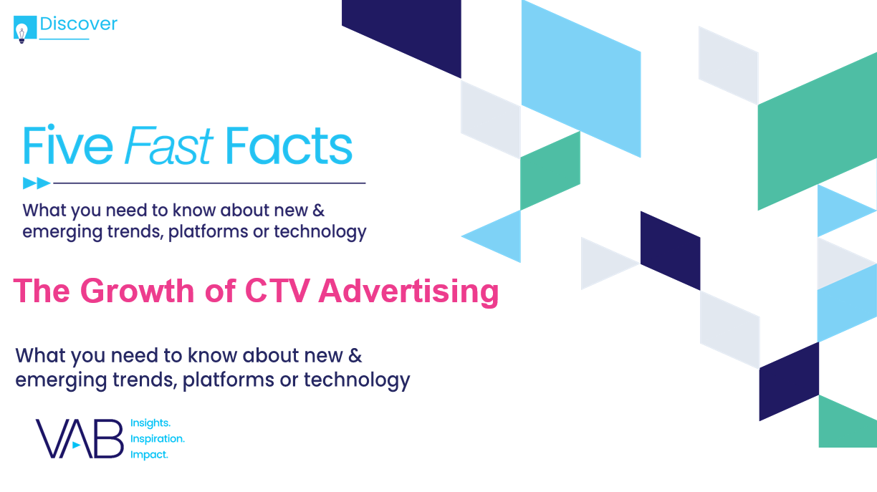
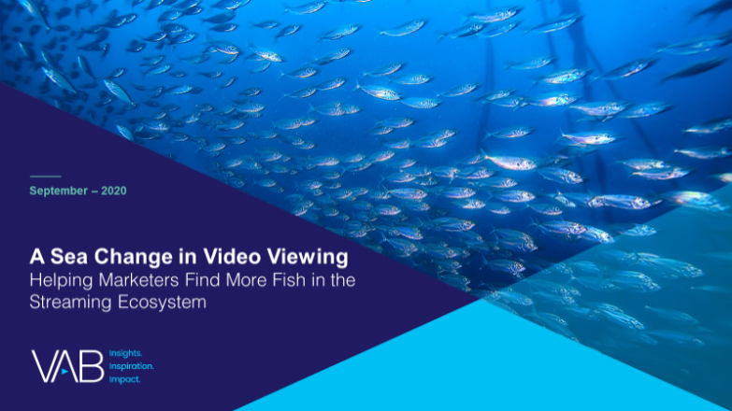

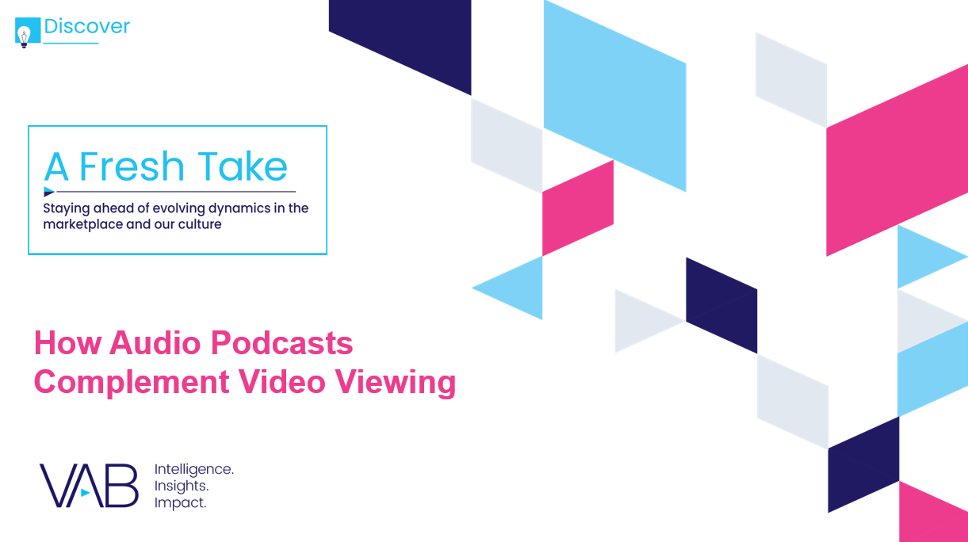

Discover more
Looking for more data, insights and takeaways? Check out this related VAB content
Five Fast Facts
The Growth of CTV Advertising
A Sea Change in Video Viewing
Helping Marketers Find More Fish in the Streaming Ecosystem
Navigating the Flood
Charting Your Way Through
Today’s Streaming Ecosystem
A Fresh Take
How Audio Podcasts Complement Video Viewing
VAB Members, brand marketers and agencies get free and immediate access to VAB’s content library. Get access at theVAB.com
This information is exclusively provided to VAB members and qualified marketers. Further distribution is prohibited.
PAGE 9

Slide 10

About VAB
VAB is an insights-driven organization that inspires marketers to reimagine their media strategies resulting in fully informed decisions.
Drawing on our marketing expertise, we simplify the complexities in our industry and discover new insights that transform the way marketers look at their media strategy.
Discover
We keep you one step ahead with the latest thinking so you can create innovative, forward-looking strategies.
Simplify
We save you time by bringing you the latest data & actionable takeaways you can use to inform your marketing plans.
Transform
We help you build your brand by focusing on core marketing principles that will help drive tangible business outcomes.
We are committed to your business growth and proud to offer VAB members, brand marketers and agencies complimentary access to our continuously-growing Insights library. Get immediate access at theVAB.com.
This information is exclusively provided to VAB members and qualified marketers. Further distribution is prohibited.
PAGE 10

