Slide 1


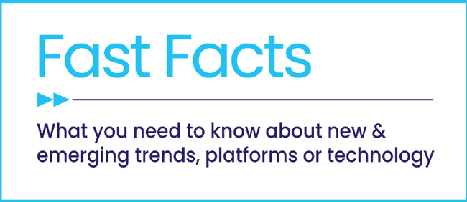


Staying Current on Streaming
The Latest on Connected TV Consumer Behaviors
June 2025

Slide 2




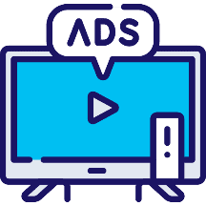
Five Current Consumer Behaviors on Streaming
1
2
3
A shift towards ad-based services
is occurring as consumers re-evaluate the cost of ad-free streaming
Consumers of all income levels and age brackets are gravitating towards ad-supported streaming
Free ad-supported streaming TV (FAST) continues to grow as viewers tune into content they crave
4
5
Consumers are turning to streaming bundles to access more content
while keeping costs down
CTV engages viewers with tailored, interactive ads, helping marketers connect in more meaningful ways
Click through a box above to be brought directly to the appropriate section
This information is exclusively provided to VAB members and qualified marketers.
PAGE 2

Slide 3

1
A shift towards ad-based services
is occurring as consumers re-evaluate the cost of ad-free streaming

Slide 4
Consumers value large libraries and exclusive content from subscription services but are mindful of their usage and cost considerations
Top Reasons For Adding an SVOD Service
% of respondents who added a service in the last 6 months
Top Reasons For Cancelling an SVOD Service
% of respondents who canceled a service in the last 6 months
Source: TiVo, Video Trends Report Q4 2024
This information is exclusively provided to VAB members and qualified marketers.
PAGE 4

Slide 5
The total monthly cost of the cheapest ad-free plan across seven major streaming services has increased more than 50% over the last five years
Aggregated Monthly Cost for the Cheapest Ad-Free Plans
Across Seven Top Streaming Services
+54%
vs. 2020
Source: VAB analysis of EMARKETER data, It’s Becoming Far More Expensive to Avoid Ads on Streaming Services, December 2024 (based on company press releases and ‘The Verge,’ 12/14/24). Data reflects the lowest-cost, ad-free, standalone monthly plan for services; excludes bundles, promotions, or cost of adding members to an account after password-sharing policies went into effect; excludes ad-supported plans.
This information is exclusively provided to VAB members and qualified marketers.
PAGE 5

Slide 6

Concern about the recurring, and rising, cost of streaming is driving increased churn rates among pure subscription services
SVOD Industry Average Churn*
based on average service
62%
of CTV viewers say that recurring streaming subscription costs
concern them
(+19% YoY)
Source: VAB analysis of LG Ad Solutions, The Big Shift - Waves III & V, April 2025 & April 2024. *Antenna, State of Subscriptions SVOD Year in Review 2024, U.S. only.
This information is exclusively provided to VAB members and qualified marketers.
PAGE 6

Slide 7
Therefore, there is an on-going shift from ad-free subscription streaming services to ad-supported services which is only projected to increase
Shift in Subscription Streaming Services vs. Free Streaming Services
Past 12 Months
Next 12 Months
Source: LG Ad Solutions, The Big Shift, April 2025
This information is exclusively provided to VAB members and qualified marketers.
PAGE 7

Slide 8
2
Consumers of all income levels and age brackets are gravitating towards ad-supported streaming

Slide 9


Two-thirds of adults prefer ad-supported streaming services and tiers over ad-free subscription services
‘I prefer streaming free video content with ads / commercials instead of paying for a subscription without ads / commercials’
% of video streamers that agree
Source: VAB analysis of MRI-Simmons March 2025 Cord Evolution Study, A18+, A18-34, A35-49 & A50+. ‘I prefer streaming free video content with ads/commercials instead of paying for a subscription without ads/commercials’ (strongly / somewhat agree). Base = ‘Streamed in the past 12 months’.
This information is exclusively provided to VAB members and qualified marketers.
PAGE 9

Slide 10


Most audiences believe there is a fair value exchange of watching ads for free or through discounted streaming services
81%
63%
say that watching ads is a fair trade-off for access to free content on streaming
Would rather watch ads while streaming and get an extra coffee each month than pay
full-price for an ad-free service
(+5% YoY)
Source: Tubi, The Stream 2025: Audience Insights Shaping Streaming
This information is exclusively provided to VAB members and qualified marketers.
PAGE 10

Slide 11
Ad-supported streaming services are used by nearly 200 million viewers, providing a platform to reach nearly two-thirds of U.S. consumers
Ad-Supported Video on Demand (AVOD) Viewers
In Millions
% of U.S. pop
45%
49%
55%
58%
60%
Source: EMARKETER, Ad-Supported Video on Demand (AVOD) Viewers, March 2025
This information is exclusively provided to VAB members and qualified marketers.
PAGE 11

Slide 12
Most new subscriptions are for ad-supported tiers, as consumers have shifted their preference towards lower-cost options with ads
75% of streaming subscribers have tried an ad-supported plan in the past 4 years*
Premium SVOD Gross Adds by Plan Tier
+21%
YoY Change
Source: Antenna, State of Subscriptions SVOD Year in Review 2024 & *State of Subscriptions Adds and Ads, May 2025, U.S. only. Excludes free tiers, MVPD + Telco Distribution, and select Bundles. Services include Discovery+, Disney+, Hulu, Max, Netflix, Paramount+, Peacock.
This information is exclusively provided to VAB members and qualified marketers.
PAGE 12

Slide 13
Higher household income levels are just as likely to subscribe to
ad-supported streaming services as they are to ad-free services
Plan Tier by Household Income
$100K+: 38%
$100K+: 37%
Source: Antenna, State of Subscriptions Adds and Ads, May 2025, U.S. only. Note: Excludes free tiers, MVPD + Telco Distribution, and select Bundles. Subscriptions as of March 2025. Premium SVOD includes 9 services.
This information is exclusively provided to VAB members and qualified marketers.
PAGE 13

Slide 14
Younger consumers are also just as likely to subscribe to ad-supported streaming services as they are to ad-free services
Plan Tier by Age Group
A18-34: 28%
A18-34: 27%
Source: Antenna, State of Subscriptions Adds and Ads, May 2025, U.S. only. Note: Excludes free tiers, MVPD + Telco Distribution, and select Bundles. Subscriptions as of March 2025. Premium SVOD includes 9 services.
This information is exclusively provided to VAB members and qualified marketers.
PAGE 14

Slide 15
3
Free ad-supported streaming TV (FAST) continues to grow as viewers tune into content they crave

Slide 16
Free ad-supported streaming TV (FAST) is used by one-third of the U.S. population, highlighting an opportunity to reach over 100 million viewers
U.S. FAST Viewers
In Millions
% of U.S. pop
30%
32%
33%
35%
36%
Source: EMARKETER, Over a Third of the Population Will Be Watching FAST This Year, March 2025
This information is exclusively provided to VAB members and qualified marketers.
PAGE 16

Slide 17


Nearly three-quarters of streamers who use ad-supported services watch FAST across a selection of channels
74%
of ad-supported streamers reported watching free streaming live TV (aka FAST) channels, growing
by +4% YoY
5.1
average number of
FAST channels watched
Source: TiVo, Video Trends Report Q4 2024
This information is exclusively provided to VAB members and qualified marketers.
PAGE 17

Slide 18



Viewers are spending considerably more time with FAST channels, growing by nearly 50% over the last few years
FAST accounts for 8% of daily time spent with digital video
Pic
+46%
increase in time spent with FAST between 2022 & 2025
(0:13 vs. 0:19 average time spent per day)
Source: EMARKETER, Time Spent With FAST is Low for Now, but It’s Growing Quickly, January 2025. Note: ages 18+, includes all time spent watching ad-supported video-on-demand (AVOD) on FAST platforms.
PAGE 18
This information is exclusively provided to VAB members and qualified marketers.

Slide 19




Viewers watch a variety of content on FAST services, including a mix of both ‘lean-back’ bingeable entertainment and ‘lean-forward’ news
FAST Consumption by Channel Type
Genre Channels
with shows fitting a theme
Binge Channels
showing same tv or movie series
32%
28%
News Channels
Other Channels
21%
19%
Source: TiVo, Video Trends Report Q4 2024
This information is exclusively provided to VAB members and qualified marketers.
PAGE 19

Slide 20
4
Consumers are turning to streaming bundles to access more content
while keeping costs down

Slide 21





Audiences are drawn to services that offer bundling of retail or other streaming services, along with ad-supported subscription options
Which of the following incentives, if any, would motivate you to continue subscribing to a streaming service?
% of total respondents
Free access to other, non-TV benefits
(e.g., Walmart+, Amazon Prime)
Access to other streaming services
at a discount
Ability to switch to a lower-priced ad-supported tier or see even more ads for a lower cost
37%
33%
26%
Exclusive benefits for premium subscribers or frequent users of a service
Ability to watch live sporting events
25%
25%
Source: VAB custom research fielded by Hub Entertainment Research as part of the 2023 Best Bundle report. Data sourced from Hub’s survey of 1,603 TV consumers, ages 16-74 who meet the following criteria: watch at least one hour of TV / week, have broadband access. Data collected early February 2023. Q: Which of the following incentives, if any, would motivate you to continue subscribing to a streaming service? Click here to download ‘Recipe for Success’ to read more.
This information is exclusively provided to VAB members and qualified marketers.
PAGE 21

Slide 22

Bundling allows consumers to streamline their streaming subscriptions while unlocking access to nearly twice as many services
Average # of Total Paid SVOD Subscriptions
70%
of consumers find services that
let you choose, manage and
pay for different subscriptions
all in one place appealing*
Source: Hub Entertainment Research, The Best Bundle, May 2025. *Includes very appealing and somewhat appealing.
This information is exclusively provided to VAB members and qualified marketers.
PAGE 22

Slide 23


Adoption of bundled streaming services is growing, with nearly half
of households subscribing, or planning to subscribe, soon
23%
of households already subscribe to a discounted SVOD bundle
25%
of households are likely to sign up for a discounted SVOD bundle in the next six months
Source: CTAM, Industry Resources: Video Streaming & Consumer Trends, May 2025.
This information is exclusively provided to VAB members and qualified marketers.
PAGE 23

Slide 24
5
CTV can engage viewers with tailored, interactive ads, helping marketers connect in more meaningful, results-driven ways

Slide 25


Viewers prefer when the ads they see streaming are relevant both to
their interests and the content they are watching
CTV Viewer Ad Preferences
75%
Prefer seeing ads that are relevant to their interests
59%
Prefer seeing ads that are relevant to the content
Source: LG Ad Solutions, The Big Shift, April 2025
This information is exclusively provided to VAB members and qualified marketers.
PAGE 25

Slide 26



Marketers can leverage interactive ads on CTV to drive increased engagement and time spent with advertising
71 seconds
Consumers spend an average of an additional 71 seconds engaging with interactive CTV ads vs. standard pre-roll
Source: Innovid, The CTV Advertising Insights Report 2025
This information is exclusively provided to VAB members and qualified marketers.
PAGE 26

Slide 27

Consumers increasingly engage interactive ads that offer them a choice, multiplying the effectiveness of the ad exposure
Engagement Rate by Interactive CTV Ad Type
Non-Choice Based
Choice Based
34x
Lift in engagement rate with choice based interactive CTV Ads
0.6%
21.6%
Source: Innovid, The CTV Advertising Insights Report 2025. Note: Choice based represent ads that are watched to gain access, including access a program on a streaming platform or wi-fi at an airport.
This information is exclusively provided to VAB members and qualified marketers.
PAGE 27

Slide 28
Ad attention and engagement on CTV leads to direct outcomes for brands, with viewers searching online, visiting digital storefronts and purchasing
Actions Taken After Seeing Streaming TV Ads
39%
Searched for a product online
38%
Visited a
website
21%
Bought a product
20%
Discussed product with friends / family
19%
Visited a
store
Source: LG Ad Solutions, The Big Shift, April 2025. Actions taken by CTV viewers.
This information is exclusively provided to VAB members and qualified marketers.
PAGE 28

Slide 29

As audiences re-evaluate the cost of ad-free subscription streaming, consumers of all income levels and age brackets are finding value in
ad-supported tiers and services
Consumers are balancing their spending in streaming by shifting towards AVOD services, watching more content through FAST channels
and unlocking greater cost efficiencies through streaming bundles
Marketers can leverage tailored, interactive ads on CTV to drive increased engagement and time spent with advertising which leads to greater outcomes for brands
Key Marketer Takeaways
This information is exclusively provided to VAB members and qualified marketers.
PAGE 29

Slide 30
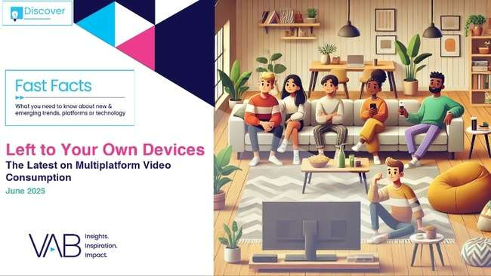
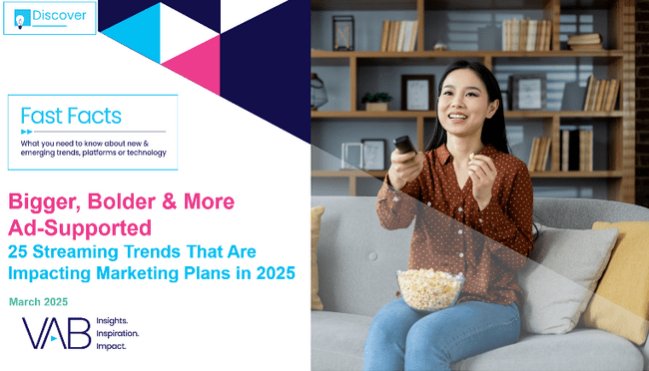
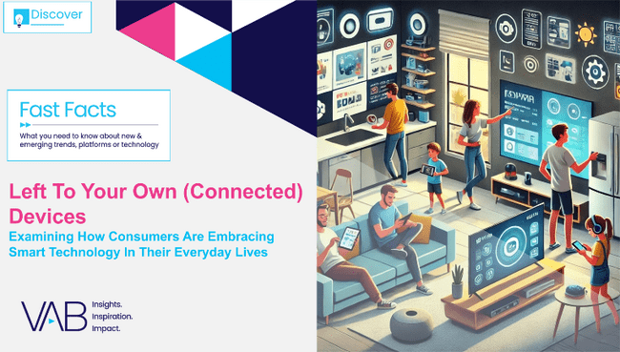


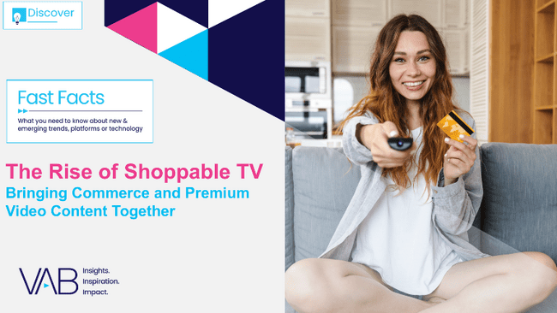
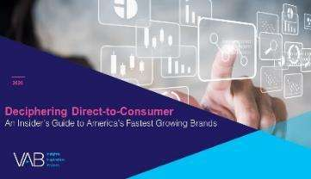
Creators
Jason Wiese
Reed Kiely
EVP, Strategic Insights & Measurement
jasonw@thevab.com
Director, Data Insights & Trends
reedk@thevab.com
Karolina Guillen
Left To Your Own Devices – June ‘25
The Latest on Multiplatform Video Consumption
Bigger, Bolder, More Ad-Supported
25 Streaming Trends That Are Impacting
Marketing Plans in 2025
Associate Director, Insights, Strategy & Analytics karolinag@thevab.com
Discover more
Looking for more data, insights and takeaways? Check out this related VAB content
Visit our Streaming Video Resources Hub
for the latest consumption stats, trends and advertising opportunities.
Left To Your Own (Connected) Devices
Examining How Consumers Are Embracing Smart Technology In Their Everyday Lives
Recipe for Success
Six Key Ingredients For Stirring Growth in Streaming
The Power of Premium Video
What It Means for Multiscreen TV
and Why It Matters to Marketers
The Rise of Shoppable TV
Bringing Commerce and Premium Video Content Together
VAB Members, brand marketers and agencies get free and immediate access to VAB’s content library. Get access at theVAB.com
This information is exclusively provided to VAB members and qualified marketers.
PAGE 30

Slide 31


About VAB
VAB plays a dual role in the video advertising industry. We are leading the change to bring about a more innovative and transparent marketplace. We also provide the insights and thought leadership that enables marketers to develop business-driving marketing strategies.
Drawing on our marketing expertise, we simplify the complexities in our industry and discover new insights that transform the way marketers look at their media strategy.
We are committed to your business growth and proud to offer VAB members, brand marketers and agencies complimentary access to our continuously-growing Insights library. Get immediate access at theVAB.com.
This information is exclusively provided to VAB members and qualified marketers.
PAGE 31

