Slide 1
Cutting to the Chase:
Disconnecting From Speculation And Plugging Into The Facts About Cord Cutting

Slide 2
The Great Disconnect
For years, the media has written about cord-cutting – households cancelling their wired cable, satellite or telco subscription in favor of streaming - as the ultimate demise of the TV industry.
There is no denying the rise in broadband and broadcast only homes in the last five years – both grew by double digits over the past year. However, even with this level of growth these homes still represent the minority of TV homes - less than 17%.
The great disconnect occurs when statistics about the rise in these homes are used to justify the premise that people in mass are cancelling their cable subscriptions and relying solely on streaming for their TV content.
When you cut through the hype and plug into the facts (from independent, well-known syndicated sources) the truth is that MVPD households (Wired Cable, Telco & satellite) have remained steady over the last 15 years, representing 83% of HHs, 98 million homes.
Broadband-only and broadcast-only homes have increased the number of total US TV households and have not come at the expense of MVPD subscriptions. The majority of households (71%) have both Cable+ and broadband, using streaming as a complement to (not replacement of) their TV viewing.
For the small group of homes that have cut the cord, the motivation is undeniable: Cost. Across several studies, the desire to cut costs is clearly the reason over other factors often cited. In fact, if cost weren’t a factor, 80% of cord cutters/nevers would opt for an MVPD subscription.
Let’s plug into the facts and connect to the truth around cord cutting…
2

Slide 3
Let’s Plug In
What Does it Mean to Cord-Cut? 4
Cutting it Down to Size - How Prevalent is Cord Cutting? 6
Who is Cord Cutting and Why? 16
Brace For Minimal Impact – Does Cord Cutting Affect TV Reach 29
“The Skinny” on the Reality of Cord Cutting 37
Connecting the Dots: Common (Mis)perceptions and Realities 45
Related VAB Reports 47
Contact Us 48
3

Slide 4
What Does It Mean To Cord Cut?
4

Slide 5


























There are Three Distinct Terms Commonly Associated With Cable, Satellite and Telco Household Status
Cord Cutters
Cord Shavers
Cord Nevers
Households that cancel their cable, satellite or telco service.
Households that continue to subscribe to cable, satellite or telco service, but downsize their programming bundle
Households that have never subscribed to a cable, satellite or telco service.
Cord cutters / shavers / nevers typically rely on internet or wireless to access television content through SVOD and/or vMVPD services, such as:
Streaming Video (SVOD)
(Subscription, Transactional, or Ad-supported)
“vMVPD” Devices/Services
5

Slide 6

Cutting It Down To Size -
How Prevalent Is Cord Cutting?
6

Slide 7
The Vast Majority of US Households, Nearly 100 Million, Subscribe To A Cable, Satellite, Or Telco Service
Cable+ Households
(000)
85%
of Total TV HHs
84%
of Total TV HHs
83%
of Total TV HHs
Cable+: A household that subscribes to Wired cable, Telco or Satellite service
Source: Nielsen Total Audience Report, Q1 ’17, Q4 ‘16, Q4 ‘15
7

Slide 8
Within the Past 5 Years, That Number Has Remained Largely Unchanged
Contrary to the hype, last year Cable+ households declined by less than 1%
Cable+ Household Trend
(000)
vs. Year Prior
- 0.4%
- 1.8%
- 1.5%
- 0.7%
- 0.9%
Source: Nielsen Total Audience Report, Q1 ‘17, Q4 ‘16, Q4 ‘15, Q4 ‘14, Q4 ’13; Cable+ = Wired Cable, Telco, Satellite
8

Slide 9
Total US TV Households Have Increased By 12%, or
13 Million Households, In the Last 15 Years
US TV Households, 15 Year Trend
(000)
US TV Household: A HH with access to video content through either wired cable, satellite, telco, broadband or over-the-air broadcast
Source: US TV Households, Nielsen. Reflects data for the month of February each year, 2002 – 2017
9

Slide 10
This Increase Has Primarily Been Driven By Broadband and Broadcast Only Homes
Broadcast only and Broadband only account for 20.6 million, or 17%, of TV households
Television Distribution Sources by Household, 2017 (000)
HHs
Broadband Only: A HH with at least one operable TV/monitor that receives video exclusively through a broadband internet connection instead of traditional means (over the air, wired cable, telco, satellite)
Broadcast Only: A mode of television content delivery that does not involve satellite transmission or cables (i.e. a paid service). Also commonly referred to as “over the air”
Source: Nielsen Total Audience Report, Q1 ’17, Cable+ = Wired cable, satellite or telco
10

Slide 11
Although The Number Has Risen, Broadband Only Represents Only 5.4 Million Households
(4% of all TV HH’s)
vs. YA
+ 24%
+ 28%
Nielsen US HHs (000)
Source: Nielsen Total Audience Report, Q4 ’14, Q4 ‘15, Q4 ’16, Q1 ‘17

Slide 12
The Majority Of Homes With Broadband Access
Subscribe to A Cable, Satellite or Telco Provider
Most homes subscribe to triple-play bundles offering deals on phone, internet, and cable
Provider Type With Internet Access, 2017
Households (000)
4%
16%
83%
Source: Nielsen Total Audience Report, Q1 ‘17, Cable + (Wired Cable, Telco, Satellite)
Broadband Only: A HH with at least one operable TV/monitor that receives video exclusively through a broadband internet connection instead of a traditional means (over the air, wired cable, telco, satellite)
Broadcast Only: A mode of television content delivery that does not involve satellite transmission or cables (i.e. a paid service). Also commonl referred to as “over the air”
12

Slide 13
Similarly, Broadcast Only Households Are Increasing, But Still Only Represent 13% of TV Households
vs. YA
+ 6%
+12%
+3%
Nielsen US HHs (000)
Source: Nielsen Total Audience Report, Q4 ’14, Q4 ‘15, Q4 ’16, Q1 ‘17
13

Slide 14
Despite A Dip In Q1 ‘17, The Fastest Growing Segment Is “Broadcast Only Homes With Broadband”
In a effort to hold on to as much linear TV programming as possible but keep costs down,
consumers are embracing antennas
4%
14%
83%
2013
vs YA
2017 (Q1)
vs YA
Source: Nielsen Total Audience Report, Q1 ’17, Q4 ‘16, ’15, ‘14, ‘13, ‘12
Broadcast Only: A mode of television content delivery that does not involve satellite transmission or cables (i.e. a paid service). Also commonly referred to as “over the air”
14

Slide 15

Who Is Cord
Cutting And Why?
15

Slide 16
Cord Cutters Exist Across Generations, Whereas Cord Nevers Are Typically Millennials
Cord Cutters, by age generation
Cord Nevers, by age generation
% and Index vs. pop size
Cord cutters are fairly evenly represented across all generations indicating that age isn’t a primary driver
In contrast, Gen Z / Millennials encompass the majority of Cord Nevers. They view streaming as an attractive option at a time when they have lower disposable income and a more on-the-go lifestyle
Source: SNL Kagan, S&P Global Market Intelligence, 2017; Age groupings: Gen Z/Millennials – 18-36, Gen X – 37-51, Boomers, 52-71, Seniors – 72+

Slide 17



Although Millennials Have The Highest Likelihood To Be “Cord Nevers,” Most Plug Back Into Cable As Their Age And Income Increase
Cable Penetration by Millennial Life Stage
84%
71%
51%
Reliant
(living with a parent)
Self-Sufficient
(living on their own)
Budding Home With child
(married with children)
“A quarter (27%) of Millennial Cord Nevers say they intend to subscribe to a traditional TV service in the next 6 months – once they are better able to afford it and for the ability to channel surf”*
Source: MRI Doublebase, cable= defined as cable tv service watched past week; reliant = respondent A18-34 lives with one or more parent; self-sufficient A18-34 lives in one person HH; Budding home= A18-34, married with kids at home; * GFK, MRI Cord Evolution New York, NY, 24.04.2017

Slide 18
Cord Cutters & Nevers Tend to Be Less Educated and
More Likely To Work Part-Time
Cutters/Nevers tend to cluster at the lowest end of the educational levels. Nearly half have only a high school education or less
They are more likely to be employed part time, largely reflective of school-age Gen Z/ Millennials and retired Boomers
Source: 2016 MRI Gfk Doublebase; Target group defined as Household that does not subscribe to Cable, Satellite or Fiber Optic TV; Index is vs. Base of Adults A18+

Slide 19
They Sit Lower On The Income Scale
Cord Cutters
Average Household Income - $52k
Cord Nevers
Average Household Income - $41k
Source: SNL Kagan, 2017 S&P Global Market Intelligence, 2017 cord cutter and cord never updates, May 2017; Gfk MRI “Cord Evolution”, 4/24/17; Index is vs. total % of US HH in that HHI bracket

Slide 20



Due To Their HHI, They Have Lower Disposable Income Than The Average Household
Index vs. Adults
In each case, they over-index at the lower expenditure amounts, except for credit card bill where they under-index across all increments
Source: 2016 MRI Gfk Doublebase; Target group defined as Household does not subscribe to Cable, Satellite or Fiber Optic TV; Index is vs. Base of Adults 18+

Slide 21
Not Surprisingly, For Both Cord Cutters and Cord Nevers, The Decision To Not Have A Pay TV Subscription Is All About Cost Savings
Source: SNL Kagan, 2017 S&P Global Market Intelligence, “2017 US video cord cutting update” 5/2/17; “2017 US video cord never update”, 5/15/17. “Pay TV service” defined as a subscription to a multichannel TV service. Base: 325 each of Cord Cutters & Cord Nevers

Slide 22
The Desire For Cost-Savings Is Also Reflected In Their Replacement Options, As 57% Are Substituting With (Free) OTA Broadcast TV
Households are using OTT Video at the same rate as OTA broadcast TV, with only 2% (Nevers) and 14% (Cutters) employing an vMVPD
Source: SNL Kagan, 2017 S&P Global Market Intelligence, “2017 US video cord cutting update” 5/2/17; “2017 US video cord never update”, 5/15/17 Base: 325 each of Cord Cutters & Cord Nevers;

Slide 23

Studies Continue to Validate That Cost, Not Content, Is The Reason People Are Cutting Their MVPD Service
Cost is the overwhelming reason
Less than half view streaming service as a reason to eliminate MVPD subscription
It’s not about content, as the desire for original streaming programs is a low factor
Source: TiVo; Q4 2016 Video Trends Report

Slide 24
Not Surprisingly, If They Had Their Choice (If Cost Weren’t A Factor), 80% Of Cord Cutters/Nevers Would Prefer An MVPD Subscription
Indicates their preference for both the content they want and how it’s delivered
Almost one-quarter (22%) of Cord Nevers intend to subscribe to a traditional TV service in the next 6 months, reflective of Millennials aging out of income constraints
Source: SNL Kagan, 2015 S&P Global Market Intelligence; GFK MRI “Cord Evolution” 4/24/17

Slide 25
In Fact, Among Those Who Recently Changed from One MVPD Provider To Another, The Majority Added Channels
Only 18% reduced the number of channels they received
Source: SNL Kagan, 6/13/17, US consumers switching multichannel service providers remarkably steady; Survey Group – those who had changed their MVPD provider in the last 12 months; Sample Size – 5,968

Slide 26





















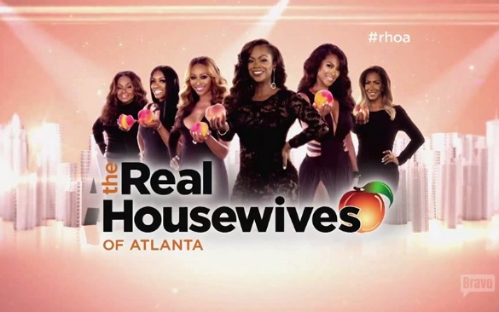










Why? Because Consumers Are Passionate About TV’s
Iconic Programming
Sports
Awards & Specials
Drama
Reality
Comedy
News
26

Slide 27
SVODs Understand The Passion Consumers Have for TV Content And So They Invest Heavily In It
Library Cable and Broadcast content is the backbone of streaming services, therefore all major services continue to invest heavily in it
Investment %: Original Programming vs Acquisitions
2016
Source: SNL Kagan, 2016, costs are amortized to reflect annual amounts; Netflix includes global content costs

Slide 28

Brace For Minimal Impact – Does Cord Cutting Affect TV Reach?
28

Slide 29
In Any Given Minute, Television’s Audience Far Surpasses That Of Any Video Device
Source: Nielsen Comparable Metrics Report Q4 2016; Data based on average week between September 26, 2016 – December 25, 2016. A18+ UE = 245,740,000. Video is a subset of each device’s (App+Web)
29

Slide 30
More Than Twice as Many Millennials are Tuning Into TV
Than a TV-Connected Device In Any Given Minute
Source: Nielsen Comparable Metrics Report Q4 2016; Data based on average week between September 26, 2016 – December 25, 2016. A18-34 UE = 73,460,000. Video is a subset of each device’s (App+Web)
30

Slide 31
More People Spend More Time With TV Than
Multimedia / Internet Connected Devices
TV delivers a larger audience in terms of reach and time spent
Multimedia Device:
A combination of usage of the Internet Connected Devices viewing source and Audio-Video viewing sources. Includes viewing on an Apple TV, Roku, Google Chromecast, Smartphone, Computer/Laptop, etc. connected to the TV.
Source: Nielsen Total Audience Report, Q1 ‘17
Television: Live + DVR/Time shifted TV

Slide 32
Looking Towards The Future, Although Connected Devices Will Grow, They Aren’t Projected To Come At The Expense Of Multichannel Subscriptions
Multichannel Subscribers and Connected Devices
2017 vs 2020 Projected (in Millions)
-4%
(-3,478 HH)
+10%
(+4,600 HH)
+21%
(+13,200 HH)
+85%
(+26,300 HH)
US HH (000)
Source: SNL Kagan, US Connected Video Devices, 12/20/16

Slide 33
This Is Because The Overwhelming Majority Of OTT HHs Also Have A Cable or Satellite Subscription
Only 15% of HHs are streaming only
Over-the-Top (OTT) Households by Service Type
Source: ComScore Total Home Custom Reporting, U.S. December 2016; comScore Single-Source (TV+OTT) Custom Reporting, U.S. December 2016
Notes:
The Drum, 5/8/17

Slide 34
Households With Both TV and an OTT service watch 5x more TV content than OTT content
Source: ComScore Total Home Custom Reporting, U.S. December 2016; comScore Single-Source (TV+OTT) Custom Reporting, U.S. December 2016
Notes:
The Drum, 5/8/17

Slide 35


And Even The Most “Unlikely” TV Viewers – Heavy Streamers and Light TV Viewers – View More TV than Streaming Video
The Heaviest Streamers are watching 8x more TV a day than streaming video on a PC
PC: Streaming:
29 minutes
TV:
236 minutes
PC: Streaming:
5 minutes
TV:
77 minutes
The Lightest TV Viewers are watching 15x more TV a day than streaming video on a PC
Source: Q1 ‘17 Nielsen Total Audience Report. Streaming based on home PC only. Chart based on “average daily minutes”. Heaviest Streamers (Quintile 1 – they represent 90% of all minutes streamed). Lightest TV (Quintiles 4/5 – they represent 8% of all TV minutes viewed)

Slide 36

“The Skinny” On The Reality Of Cord Cutting
36

Slide 37
Consumers Are Eager For “Skinny Bundles” - Customized Content Packages Tailored To Specific Interests/Genres
77% of consumers would like a customized TV package
64% of those looking for customization would re-consider leaving their cable/satellite/telco provider if allowed to choose and pay for only the channels they typically watch
Source: TiVo Q4 2016 Video Trends Report

Slide 38
In Looking To Adopt “Skinny Bundles” At Lower Costs, Consumers Often Face Challenges Replicating The TV Programming They Want

Slide 39

In Order To Get Their Desired Programming, Consumers Are Increasingly Subscribing To Three Or More Streaming Services, Driving Up Costs and Complexity
The number of HHs using 3+ services saw the most significant growth - an increase of 8x over just the last 2 years
Top OTT services (# of U.S. subscribers)
47.9M
40.9M
11.7M
Source: Hub Report; Online Subscription includes Netflix, Hulu, Amazon, Network Standalones (HBO Now, CBS All Access, etc.) and vMVPDs (Sling, YouTube TV, etc)
SNL Kagan for # of Subscribers (2016) – Economics of Internet, 4/17/17
39

Slide 40
As A Result, Depending Upon The Level Of Service,
Cord-Cutting May Not Yield Much Cost Savings
Example Package Scenarios
Scenario: Want Most Choice
 | Streaming HH | MVPD HH
Internet | $44.99 (unbundled) | $29.99 (bundled with TV)
Live TV | $75.00 (PlayStation.Vue – “Ultra” - 90 channels, including broadcast + HBO + Showtime | $59.99 (125 channels)
Device Required | $25 (Playstation) | $10 (2 DVR Boxes)
Supplemental Streaming | $12 (Netflix) $9 (Amazon Prime) | $12 (Netflix) $26 (HBO + Showtime)
Total Monthly Cost | $165.99 | $137.98
Scenario: Just the Basics
 | Streaming HH | MVPD HH
Internet | $44.99 (unbundled) | $29.99 (bundled)
Live TV | None | $59.99 (125 channels)
Device Required | None | $5 (1 DVR Box)
Supplemental Streaming | $12 (Netflix) $9 (Amazon Prime) | None
Total Monthly Cost | $65.99 | $94.98
Source: Costs based upon leading MVPD unbundled Internet and TV/Internet packages; Internet 100 Mbps, Costs based on zip code 11211, 6/9/17; Note that while PlayStation.vue can run on a variety of devices, some features are not supported on those devices, initial device cost of $299 (Best Buy, PS4 1 TB Console 6/12/17) is amortized over the first year; Costs do not include taxes or fees. YouTube TV - $35/mo for 6 broadcast nets (CBS, NBC, FOX, ABC, CW, Telemundo) & 42 Cable Networks, Cloud DVR, Showtime at $11/mo; YouTube Red - $10/mo, ads removed from all non-paid Videos

Slide 41

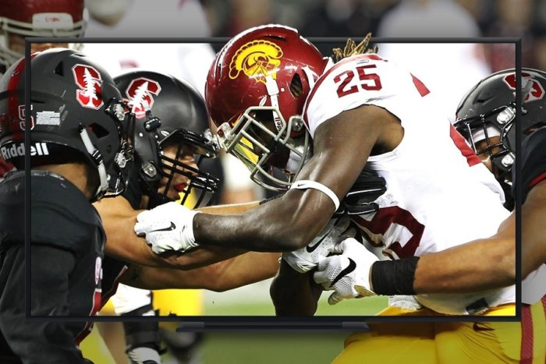


And The Quality Of The Streaming Experience Can Often Be Sub-optimal
  Only 24% of those who watch both traditional TV and streaming video believe that streaming from the internet is a better experience
High Latency
The lag time that occurs between the TV broadcast and the live stream
A frustrating experience if you're hearing viewer reaction after a big play, or reading plot updates on Twitter before anything's even happened on your TV
Low Frame Rates
TV telecasts typically run at 60 frames/second; streaming video often plays at 30
Picture can look choppy or jittery, particularly disruptive for sports
Inferior Audio
Surround sound support tends to be nonexistent
Less enjoyable viewing experience, particularly for sports and movies
Tech Glitches
Loading, buffering, or authentification issues
Disrupts the viewing experience
The Issue:
Why it Matters:
Source: IAB/Maru-Matchbox; Techhive.com/article/3179751/streaming-services/the-quest-for-smooth-60-frames-per-second-sports-in-streaming-tv-bundles.html; http://www.techhive.com/article/3199258/data-center-cloud/streaming-tv-quality-sucks-heres-how-the-industry-intends-to-make-it-better.html
41
41

Slide 42
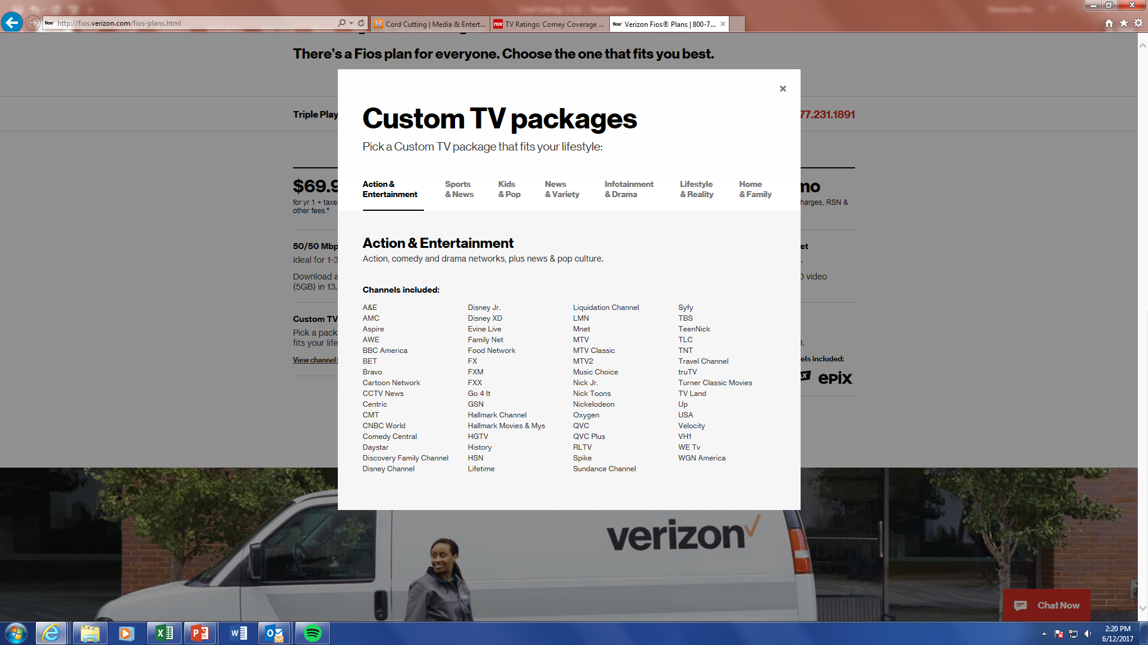
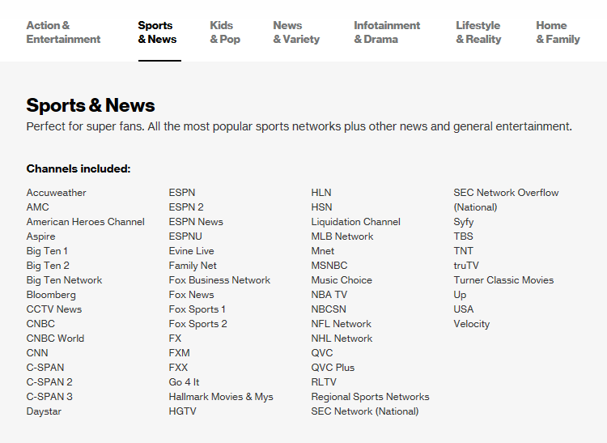
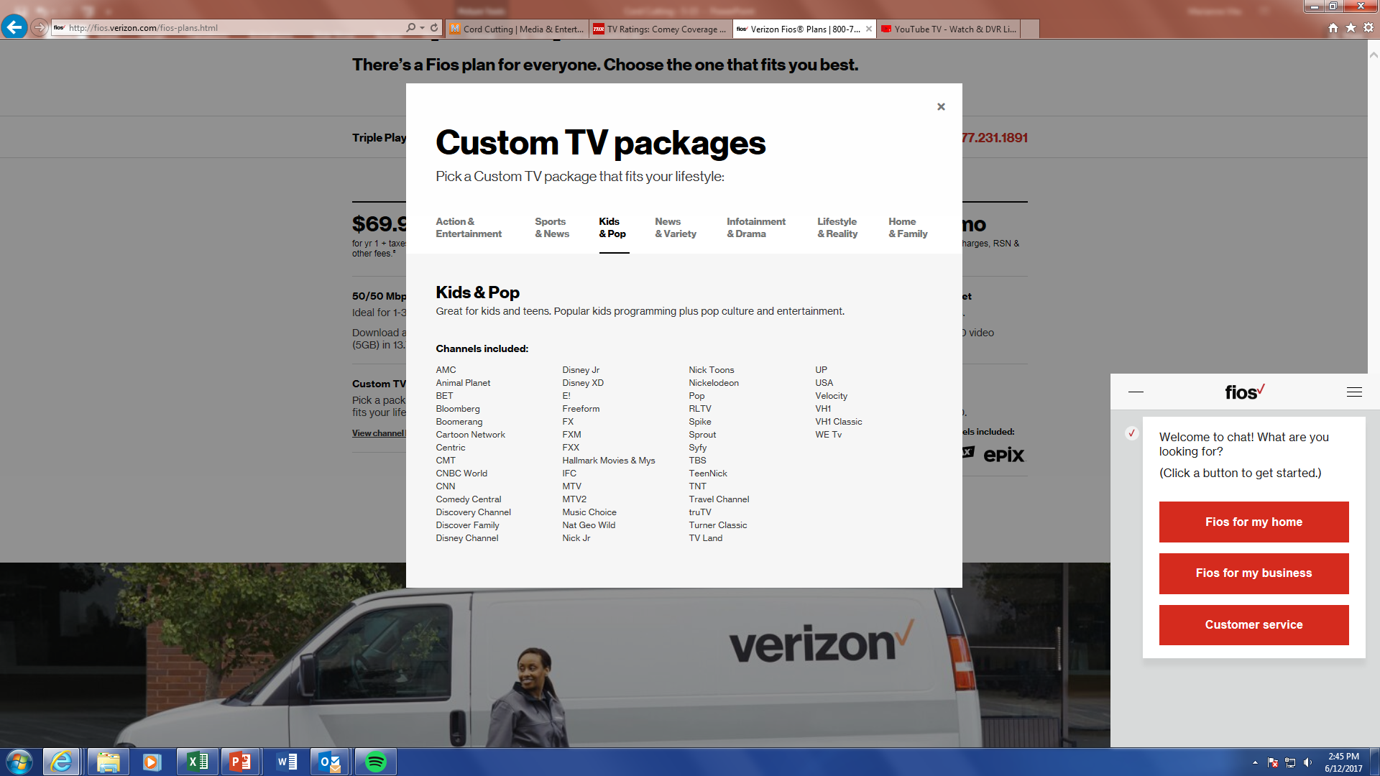
Many MVPDs are creating custom packages to retain & attract skinny bundle-seeking cord cutters/nevers
Also positions them to be ready when HHs want to trade up their subscriptions
Source: VerizonFios Custom TV Packages, 6/12/17, zip code 11211

Slide 43
With The Increased Adoption Of “TV Everywhere” Consumers Have Found Another Way To Access MVPD Content On The Go
TVE is projected to grow 20% by 2020, driven by greater acceptance and more familiarity with authentication process, plus a larger variety of program offerings including sports and new series premieres
43
Source: SNL Kagan 2016, Reflects individual TV Everywhere users as of August 2016
43

Slide 44

Connecting the Dots – Common (Mis)perceptions & Realities
44

Slide 45
Common (Mis)perceptions and Realities
Perception: Cord Cutters/Nevers are making a significant impact on the number of MVPD HHs
Perception: Cord Cutters/Nevers are Millennials, who are ushering in a new mindset of media/video consumption
Perception: The lure of original streaming content is what’s driving cord cutting
Despite the growth of cord cutter/nevers, MVPD HH represent 83% of all TV HHs. Future CC/CN growth is not forecasted to come at the expense of MVPD HHs, but rather as an additional service
Across generations, including Millennials, the majority of video viewing is with Television. The decision to cord cut is tied to income, and not the result of a Millennial generational shift in attitudes towards media consumption. Many Millennials re-engage with MVPDs as their lifestage and income mature
The shift away from MVPDs towards streaming is unequivocally rooted in cost considerations, not driven by the original content streaming services provide. The viewer’s desire for “customization” and flexibility is based upon the belief that it will yield cost savings, which may not always be the case

Slide 46
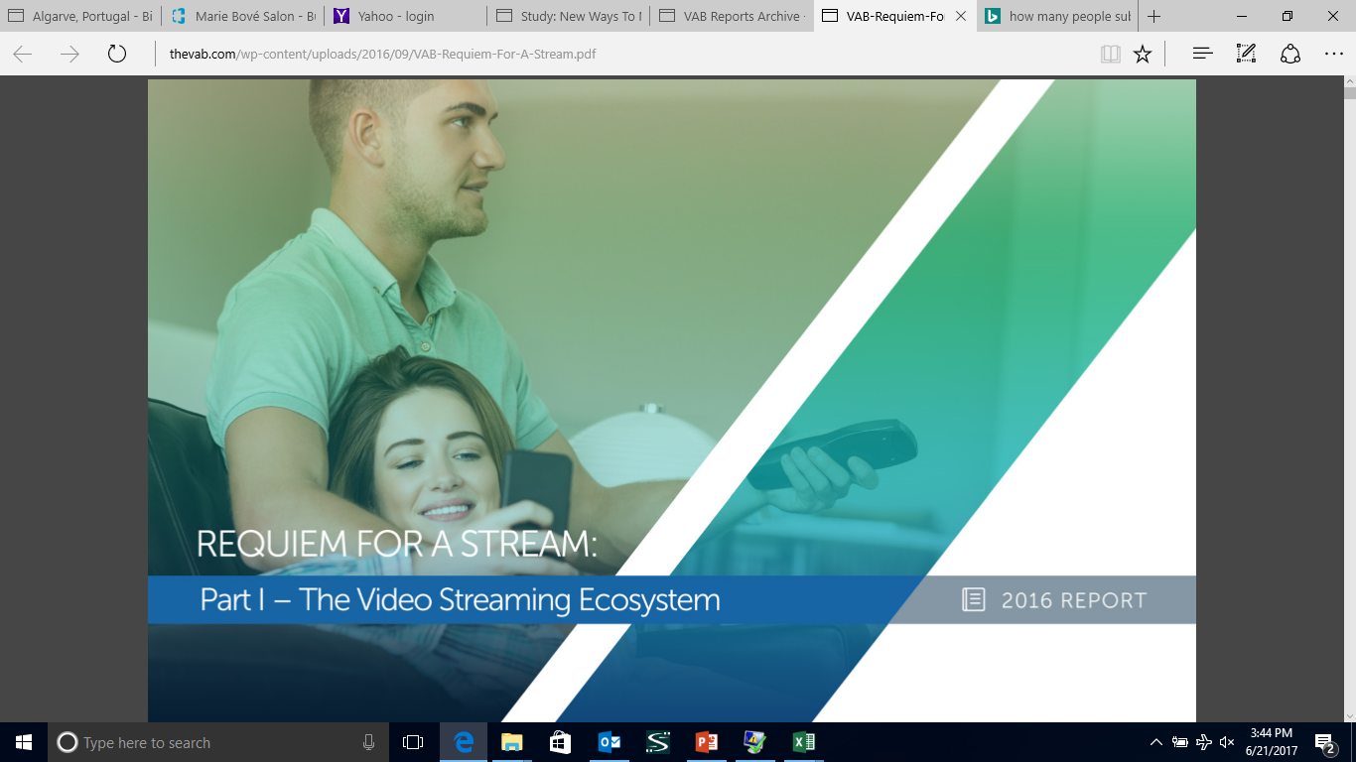
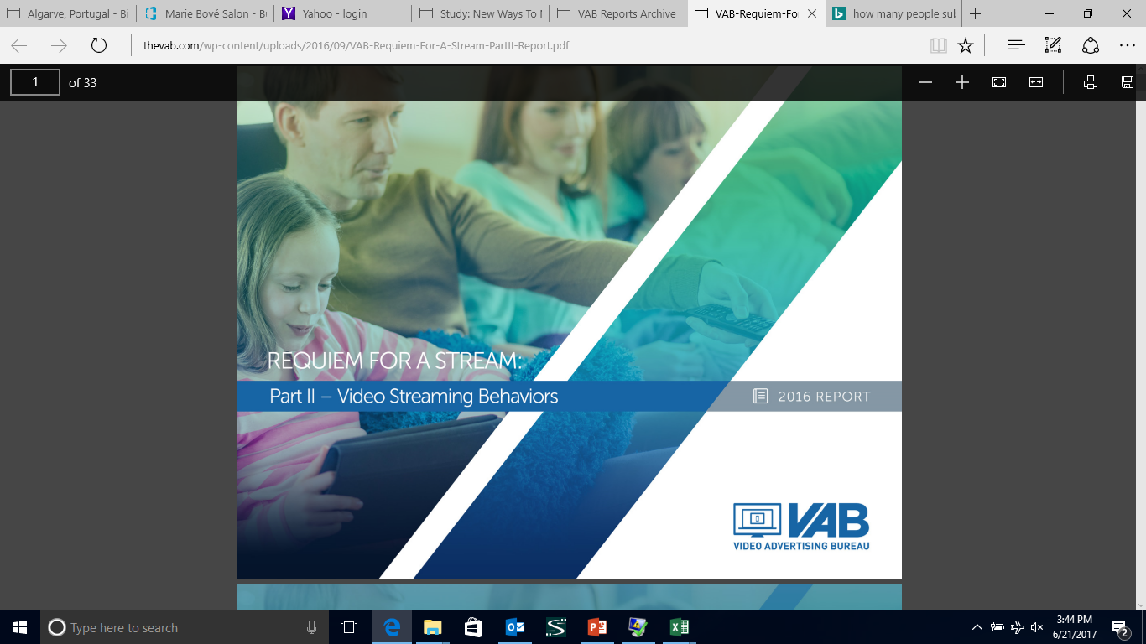
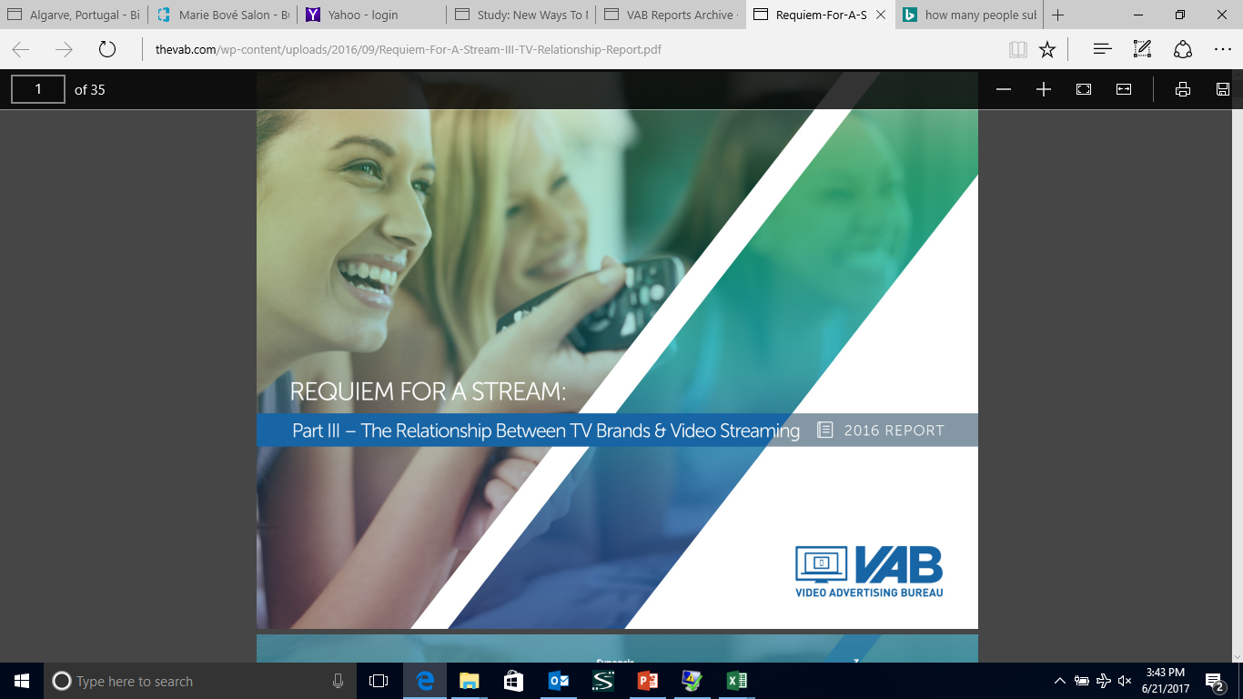
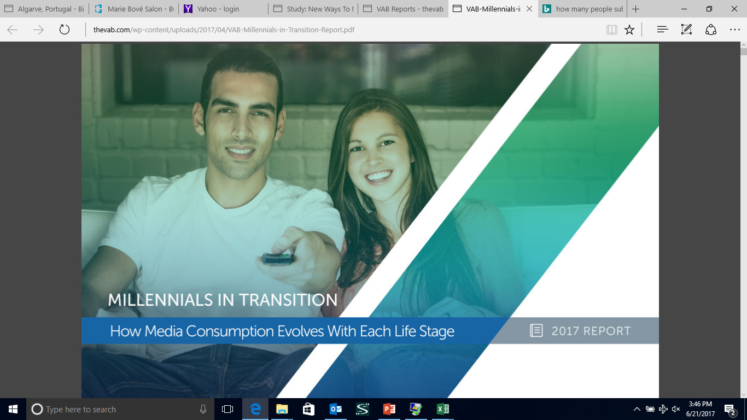
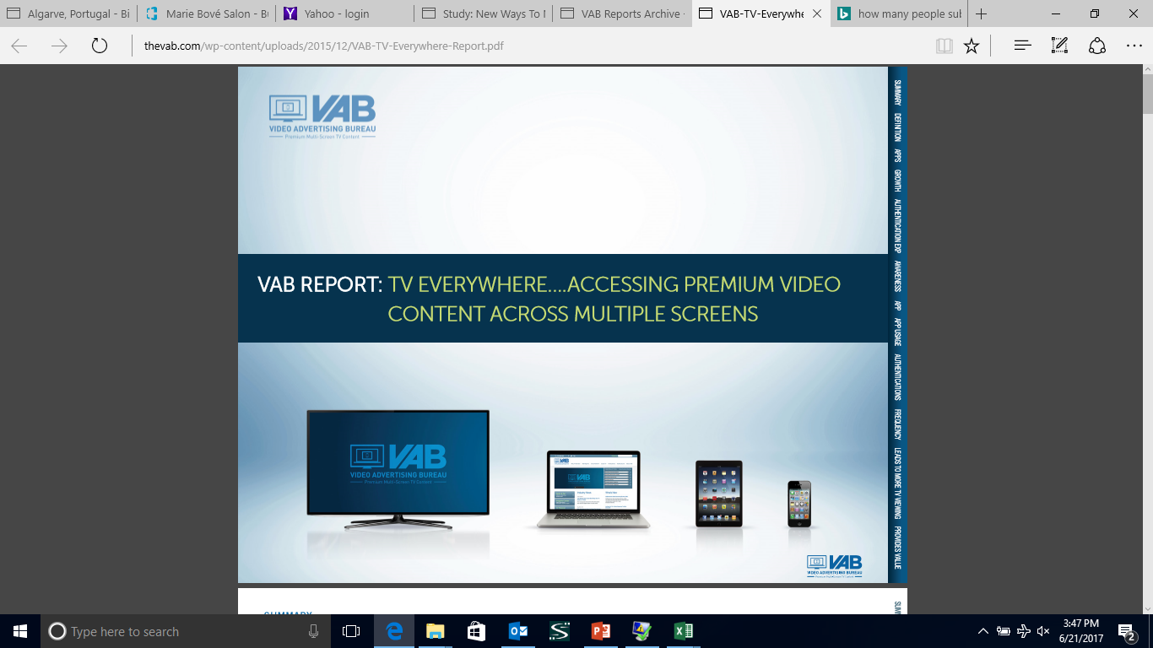
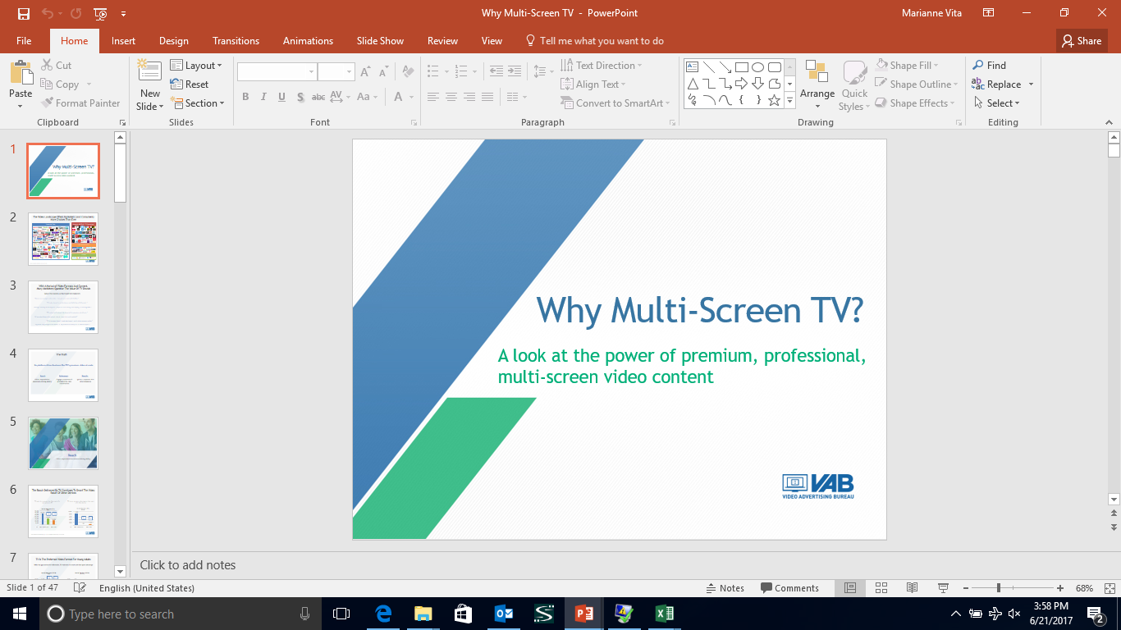
Related VAB Reports Of Interest
Requiem For a Stream – Part I: The Video Streaming Ecosystem
Requiem For a Stream – Part II: Video Streaming Behaviors
Requiem For a Stream – Part III: The Relationship Between TV Brands & Video Streaming
Millennials in Transition: How Media Consumption Evolves With Each Lifestage
TV Everywhere…Accessing Premium Video Content Across Multiple Screens
Why Multi-Screen TV? A Factual Look At the Power Of Premium, Professional Multi-Screen Content
46

Slide 47


