Slide 1





Marketer FAQs
What is convergent TV and
why is it happening?

Slide 2


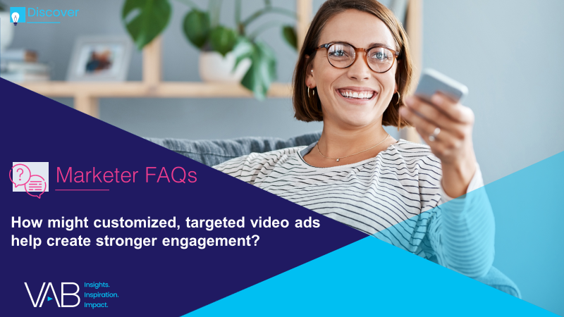
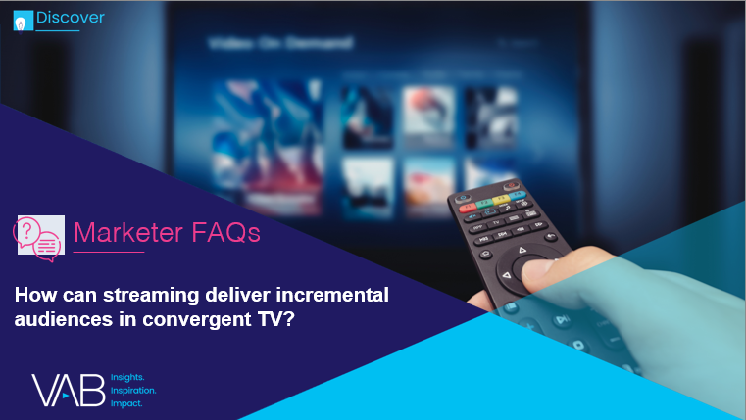



The definition of “television” has blurred, with viewers seamlessly viewing linear TV and streaming programming across a growing number of platforms.
For marketers trying to amass scale and capture viewer engagement in this fragmented landscape,
the new converged reality holds great opportunity.
To help marketers understand the trends shaping the growth of convergent TV, as well as its opportunities, we are answering 4 frequently asked questions. These data and insights will help you plan, buy, and measure successfully in a converged TV world.
What is convergent TV and why is it happening?
How might customized, targeted video ads help create stronger engagement?
How can streaming deliver incremental audiences in convergent TV?
How can a convergent TV strategy drive business results for my brand?
Looking for more? Hear directly from those who are involved in ensuring the success of Convergent TV campaigns. Get guidance, best practices, and other advice for marketers as you plan, buy and measure video campaigns. Learn more and watch here.
In this piece, we start simply by explaining
“What is Convergent TV and why is it happening?”
This information is exclusively provided to VAB members and qualified marketers. Further distribution is prohibited.
PAGE 2

Slide 3


What is ‘convergent TV’?
‘Convergent TV’ = Linear TV + Streaming
From the viewer’s perspective:
The idea that people seamlessly watch linear TV and various forms of digital / streaming TV.
From the marketplace perspective:
The idea of selling and buying video holistically through an interoperable* way of executing and measuring
linear + digital buys.
‘Convergent TV’ is not to be confused with ‘Connected TV,’ which refers specifically to a device
Connected TV (CTV): A television set that has built-in Internet capabilities (e.g., Smart TV) or is connected to the Internet via a streaming device such as a streaming box/stick, gaming console or Blu-ray player; all of which can access a variety of long-form and short-form content.
* Note: ‘Interoperable’ refers to the ways in which the technologies (and datasets) for different platforms function in conjunction with one another for planning, buying and measuring a media campaign across linear TV and streaming video.
This information is exclusively provided to VAB members and qualified marketers. Further distribution is prohibited.
PAGE 3

Slide 4
As viewing habits evolve and streaming platforms proliferate, audiences already see ‘TV’ as ‘TV,’ regardless of how and where they watch
Like viewers who have expanded their definition of TV, more than three-quarters (76%) of global marketers agree that ‘TV’ now consists of linear TV + streaming
How do you personally define TV?
Anything I can watch on my TV set whether it's via streaming or cable, satellite, fiber optic provider
Anything I can watch on any device
Any shows available via cable, satellite, fiber optic provider
Any shows created by a TV network
Source: VAB analysis of MRI-Simmons March 2022 Cord Evolution Study, A18+. Gen Z: born 1997-2010 (only includes respondents aged 18+), Millennials: born 1977-1996, Gen X: born 1965-1976, Baby Boomers: born 1946-1964. TVSquared by Innovid, The State of Converged TV: A Look at Global Trends & Adoption, 2021. Based on survey of nearly 1,000 global media buyers. Reflects % of respondents who answered “somewhat agree” or “completely agree” to the following statement: ‘“TV” is now defined as linear and streaming’.
This information is exclusively provided to VAB members and qualified marketers. Further distribution is prohibited.
PAGE 4

Slide 5
In this age of peak TV, viewers have access to more high-quality,
premium programming across convergent TV than ever before
Original Series on U.S. Broadcast, Cable and Streaming
Source: Variety VIP+, ‘Streaming Pushes Peak TV to New Heights’, Dec 17, 2021. Note: Convergent TV represents linear TV and streaming.
This information is exclusively provided to VAB members and qualified marketers. Further distribution is prohibited.
PAGE 5

Slide 6
Even in a converged TV world with so much new content accessible, people prefer to watch everyday on the biggest screen available
Average Daily Time Spent With Media
Hr:Min & % Share
4:49
total
(hr:min)
Source: Nielsen, State of Play, April 2022. Note: Convergent TV represents linear TV and streaming. *TV-Connected devices include content being viewed on the TV screen through the following internet-enabled devices: Smart TVs, streaming media players (Roku, Fire TV), game consoles, smartphone, computer/laptops, connected DVD player. Time spent with TV-Connected devices is inclusive of viewing for any purpose, not just for accessing media content, for example ‘game console’ also includes when it is being used to play internet-connected video games.
This information is exclusively provided to VAB members and qualified marketers. Further distribution is prohibited.
PAGE 6

Slide 7





Over three-quarters of homes are Wi-Fi enabled with most of them using an OTT service accessible through a variety of connected TV devices
+8% reach
vs. Jan ‘20
+14.7 MM
homes
vs. Jan ‘20
OTT Device Household Penetration
Streaming Box/Stick
52.9MM HHs
+14% YoY
Smart TV
47.3MM HHs
+18% YoY
76% reach among homes with Wi-Fi
82.4 MM homes used OTT
Gaming Console
15.1MM HHs
-22% YoY
Source: Comscore, State of OTT, 2021. Data represents U.S. only.
This information is exclusively provided to VAB members and qualified marketers. Further distribution is prohibited.
PAGE 7

Slide 8
This accessibility has enabled consumers to more than double their video services across linear & streaming, furthering the growth of converged TV
On average, Pay-TV subscribers use 9.7 services and broadband only subscribers use 6.7 services
73%
of viewers feel that their number of subscriptions are ‘just right’
Average Number of Video Services
Adults 18+
Free Services:
2.4
Paid Services*:
6.5
Source: TiVo, Q4 2021 Video Trends Report. Video services include cable / satellite / telco (MVPD) subscription in addition to TV Everyhwere apps, broadcast TV and OTT services. *Paid services include authenticated TVE apps associated with Pay TV. Note: Convergent TV represents linear TV and streaming.
This information is exclusively provided to VAB members and qualified marketers. Further distribution is prohibited.
PAGE 8

Slide 9
With people splitting their time across premium video sources, streaming has become a crucial component of converged TV (30% of total video time)
Linear TV has experienced only a nominal decrease in share over the last year amidst the growth of convergent TV
P2+ Total Time Spent With TV by Video Source
Other Streaming: 8%
Netflix: 6%
YouTube: 6%
Hulu: 3%
Prime Video: 2%
Disney+: 1%
Other Streaming: 9.2%
Netflix: 6.6%
YouTube: 6.1%
Hulu: 3.3%
Prime Video: 2.5%
Disney+: 1.7%
HBO Max: 1.0%
Cable & Broadcast:
64%
Cable & Broadcast:
61.5%
Source: Nielsen Gauge, analysis of May 2021 and April 2022, Nielsen National TV Panel Data plus Streaming Video Ratings, Total Day, P2+. ‘Other’ includes video on-demand content, cable set top box streaming, gaming and DVD usage. Note: Convergent TV represents linear TV and streaming.
This information is exclusively provided to VAB members and qualified marketers. Further distribution is prohibited.
PAGE 9

Slide 10
As marketers look to engage consumers within a fragmented landscape, embracing convergent TV by including premium OTT platforms in their campaigns can drive incremental reach
Among HHs reached only through streaming or a combination of streaming plus linear TV (18% as indicated in lefthand chart),
51% of streaming reach is incremental
Linear TV drives majority of multiscreen campaign reach
Multiscreen Campaign Average Reach % Share by Platform
18%
Reached Only
by Streaming
Reached by Streaming and Linear TV
Source: Effectv, The TV Viewership Report, 2H 2021. Comcast Aggregated Viewership Data combined with Ad Exposure Data from TV + Effectv Streaming Campaigns (2H ‘21). Effectv Streaming includes viewing from Xfinity on Demand. Data set used for this report is independently aggregated viewership data collected from more than 29 million households, whose members watched more than 15 billion hours of TV. Data from more than 20,000 multiscreen campaigns garnering over 1.5 billion impressions is included in this report as well.
This information is exclusively provided to VAB members and qualified marketers. Further distribution is prohibited.
PAGE 10

Slide 11
Adults over 50 account for 36% of the total population and nearly half of all adults
Consumers have broadened their definition of
TV and will find and follow their favorite premium content across platforms, seamlessly toggling from one platform to the next.
As TV strategies and buys are developed, marketers should consider a convergent TV approach, finding a balance between linear and streaming that is right for their brand.
Key Implications for Marketers
This information is exclusively provided to VAB members and qualified marketers. Further distribution is prohibited.
PAGE 11

Slide 12


About VAB
VAB is an insights-driven organization that inspires marketers to reimagine their media strategies resulting in fully informed decisions.
Drawing on our marketing expertise, we simplify the complexities in our industry and discover new insights that transform the way marketers look at their media strategy.
We are committed to your business growth and proud to offer VAB members, brand marketers and agencies complimentary access to our continuously-growing Insights library. Get immediate access at theVAB.com.
Curious to learn more about VAB? Check out this quick video to see what we do and how we can help you develop business-driving marketing strategies.
This information is exclusively provided to VAB members and qualified marketers. Further distribution is prohibited.
PAGE 12

