Slide 1





Marketer FAQs
How can streaming deliver incremental audiences in convergent TV?

Slide 2

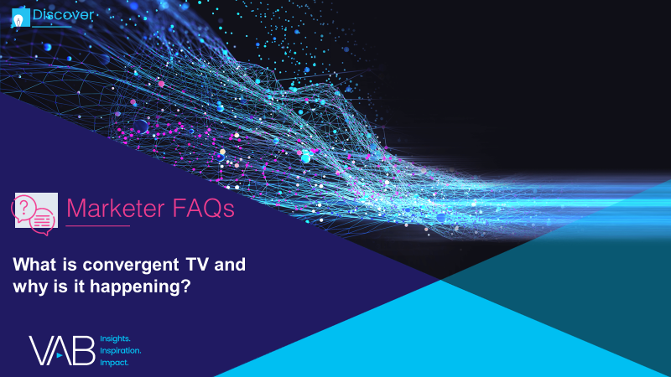
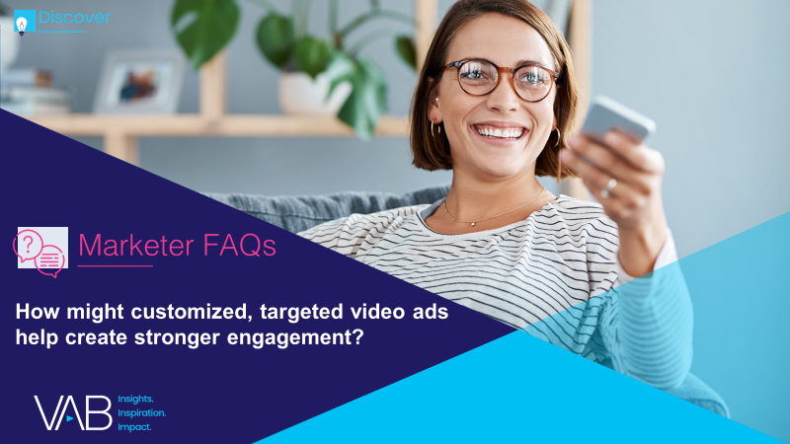
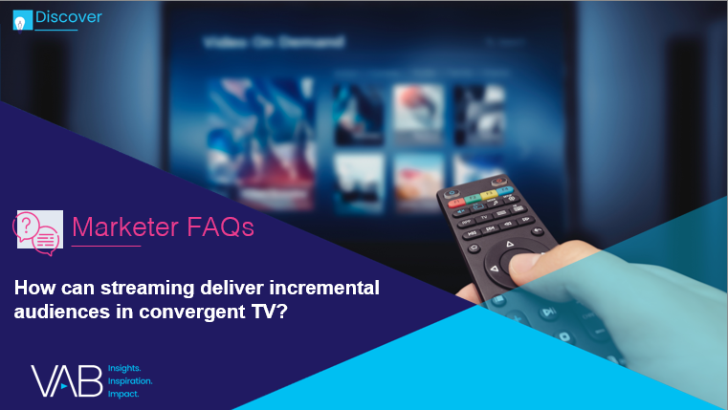



The definition of “television” has blurred, with viewers seamlessly viewing linear TV and streaming programming across a growing number of platforms.
For marketers trying to amass scale and capture viewer engagement in this fragmented landscape,
the new converged reality holds great opportunity.
To help marketers understand the trends shaping the growth of convergent TV, as well as its opportunities, we are answering 4 frequently asked questions. These data and insights will help you plan, buy, and measure successfully in a converged TV world.
What is convergent TV and why is it happening?
How might customized, targeted video ads help create stronger engagement?
How can streaming deliver incremental audiences in convergent TV?
How can a convergent TV strategy drive business results for my brand?
In this piece, we examine the growth
of ad-supported streaming and answer
“How can streaming deliver incremental
audiences in convergent TV?”
Looking for more? Hear directly from those who are involved in ensuring the success of Convergent TV campaigns. Get guidance, best practices, and other advice for marketers as you plan, buy and measure video campaigns. Learn more and watch here.
This information is exclusively provided to VAB members and qualified marketers. Further distribution is prohibited.
PAGE 2

Slide 3


What is ‘convergent TV’?
‘Convergent TV’ = Linear TV + Streaming
From the viewer’s perspective:
The idea that people seamlessly watch linear TV and various forms of digital / streaming TV.
From the marketplace perspective:
The idea of selling and buying video holistically through an interoperable* way of executing and measuring
linear + digital buys.
‘Convergent TV’ is not to be confused with ‘Connected TV,’ which refers specifically to a device
Connected TV (CTV): A television set that has built-in Internet capabilities (e.g., Smart TV) or is connected to the Internet via a streaming device such as a streaming box/stick, gaming console or Blu-ray player; all of which can access a variety of long-form and short-form content.
* Note: ‘Interoperable’ refers to the ways in which the technologies (and datasets) for different platforms function in conjunction with one another for planning, buying and measuring a media campaign across linear TV and streaming video.
This information is exclusively provided to VAB members and qualified marketers. Further distribution is prohibited.
PAGE 3

Slide 4



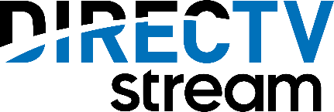
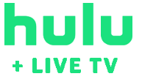
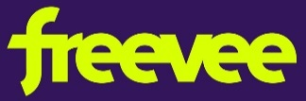













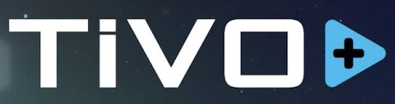




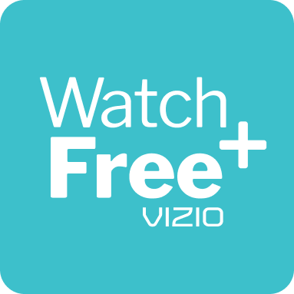


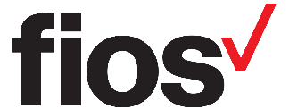







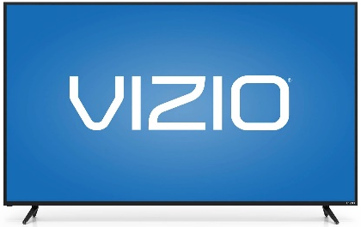
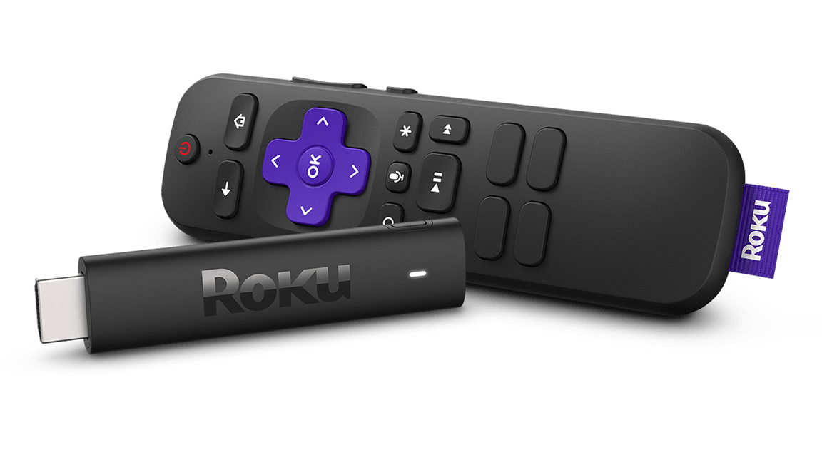


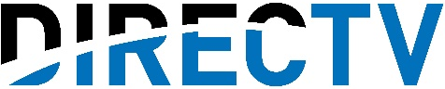


Marketers can reach consumers in ad-supported streaming through a variety of different platforms, services and devices
The landscape continues to grow with Disney+ and Netflix adding an ad-supported tier in late 2022 and 2023 /2024 respectively
Ad-Supported Streaming Models
AVOD (Ad-Supported Video on Demand): Streaming services that offer content with advertising that can either be free or at a discounted subscription tier.
FAST (Free Ad-Supported Streaming TV):
Free to watch, advertising-supported content distributed through single provider streaming apps
or linear-like channels on aggregator services.
vMVPD (Virtual Multichannel Programming Distributors): Digital platforms that provide multiple linear TV channels packaged together as an OTT service.
TV Everywhere: Network & MVPD apps with authentication access through a pay-TV provider
Connected TV Devices: Devices capable and enabled to access the internet through the television including Smart TVs, internet connected devices / streaming players, video game consoles
AVOD / FAST Services
AVOD / SVOD Hybrid
Tiered Services
vMVPD Services
TV Everywhere Apps
Connected TV Devices
Note: the above reflects just a sampling of services and devices by segment.
This information is exclusively provided to VAB members and qualified marketers. Further distribution is prohibited.
PAGE 4

Slide 5
Ad-supported services have larger TV content libraries than the top SVOD services, providing marketers a variety of environments to engage viewers
73% of people place a higher value on streaming services that offer content they can’t get anywhere else
TV Library Size By Service Comparison
# of TV Series
# of Total TV Episodes
Netflix would rank #4 in terms of TV episode library size among the largest AVOD/FAST services
(4-Service Avg*)
(4-Service Avg*)
Source: VAB analysis of S&P Global Market Intelligence, Kagan estimates. TV Show Summaries by service, 2021-2022. *Ad-Supported Streaming Average includes Tubi, Roku Channel, Hulu, PlutoTV. Fandom – State of Streaming 2022.
This information is exclusively provided to VAB members and qualified marketers. Further distribution is prohibited.
PAGE 5

Slide 6
With a wide selection of content and services to choose from, viewers spend over one-third of their streaming time with ad-supported services
Share of Streaming TV Minutes
July-December 2021
Source: Nielsen State of Play 2021. Note: AVOD includes YouTube and YouTubeTV. AVOD is inclusive of AVOD, FAST and CTV viewing, excluding vMVPD. *‘Other’ includes video on-demand content, cable set top box streaming, gaming and DVD usage.
This information is exclusively provided to VAB members and qualified marketers. Further distribution is prohibited.
PAGE 6

Slide 7



Streaming has now reached a tipping point where viewers’ preferences have shifted towards ad-supported options over paid subscriptions
56%
54%
said they would rather use AVOD streaming services than subscribe to another paid service
of respondents wish their SVOD services offered a free,
ad-supported option
Source: TiVo Video Trends Report, Q4 2021
This information is exclusively provided to VAB members and qualified marketers. Further distribution is prohibited.
PAGE 7

Slide 8
Subscription services are meeting consumer demand through the introduction of lower cost, ad-supported tiers to attract new audiences
U.S. Premium SVOD* Share of Sign-ups by Plan Tier
Source: Antenna - Netflix 1Q22 Retrospective. * Note: ‘Premium SVOD Services’ includes: AppleTV+, Discovery+, Disney+, HBO Max, Hulu (SVOD-only), Netflix, Paramount+, Showtime and Starz with most services having an available AVOD hybrid tier.
This information is exclusively provided to VAB members and qualified marketers. Further distribution is prohibited.
PAGE 8

Slide 9
With more services and lower cost tiers available to consumers,
ad-supported streaming has now reached near parity with subscription services across households
Households by Streaming Type
Households in thousands
+24%
+34%
Source: Comscore State of OTT 2021
PAGE 9
This information is exclusively provided to VAB members and qualified marketers. Further distribution is prohibited.

Slide 10
Streaming can deliver incremental reach against a younger audience, counterbalancing other aspects of an older skewing buy
% Who Use At Least One AVOD / FAST Service by Generation
66%
of American respondents indicated they use at least one AVOD/FAST service
Source: TiVo Video Trends Report, Q4 2021
This information is exclusively provided to VAB members and qualified marketers. Further distribution is prohibited.
PAGE 10

Slide 11
The growth of streaming and increase in available services is enabling marketers to add more ad-supported platforms to build further incremental reach within their convergent TV media plans
How many streaming platforms are advertisers using?
27%
43%
Source: VAB analysis of TV Squared’s CTV Accelerated, 2021. The number of streaming platforms advertisers used in 2020 vs. their 2022 outlook.
This information is exclusively provided to VAB members and qualified marketers. Further distribution is prohibited.
PAGE 11

Slide 12
As consumers continue to migrate their viewing towards free or lower cost options, the ad-supported streaming opportunity for marketers is expected to reach almost $34 billion by 2025
U.S. AVOD Ad Revenue Forecasts
$ in Billions, estimated
+73%
vs. 2020
Source: S&P Global Market Intelligence, Kagan estimates. ‘Estimated US AVOD revenues, 2020-2025’, November 2021.
This information is exclusively provided to VAB members and qualified marketers. Further distribution is prohibited.
PAGE 12

Slide 13
Adults over 50 account for 36% of the total population and nearly half of all adults
Viewers have shifted their streaming preferences to ad-based options and their evolving behavior has created an opportunity for marketers to achieve significant incremental reach and increased engagement across audiences within their convergent TV plans.
With ad-supported options continuing to proliferate, marketers can utilize audience-based targeting
and buying strategies to improve advertising performance and brand outcomes as they expand their convergent TV plans across more streaming platforms.
Key Implications for Marketers
This information is exclusively provided to VAB members and qualified marketers. Further distribution is prohibited.
PAGE 13

Slide 14


About VAB
VAB is an insights-driven organization that inspires marketers to reimagine their media strategies resulting in fully informed decisions.
Drawing on our marketing expertise, we simplify the complexities in our industry and discover new insights that transform the way marketers look at their media strategy.
We are committed to your business growth and proud to offer VAB members, brand marketers and agencies complimentary access to our continuously-growing Insights library. Get immediate access at theVAB.com.
Curious to learn more about VAB? Check out this quick video to see what we do and how we can help you develop business-driving marketing strategies.
This information is exclusively provided to VAB members and qualified marketers. Further distribution is prohibited.
PAGE 14

