Slide 1





Marketer FAQs
How might customized, targeted video ads help create stronger engagement?

Slide 2


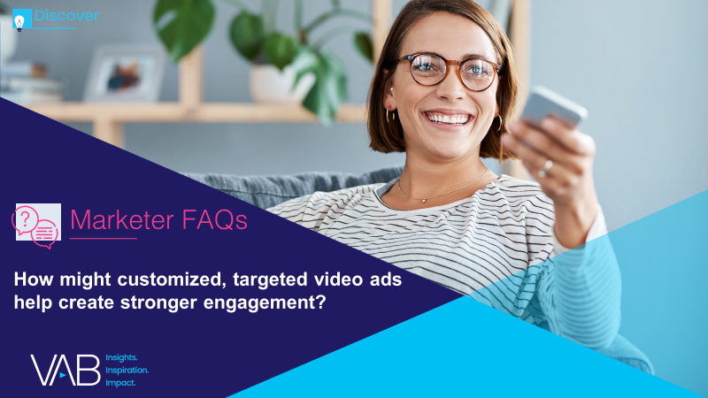
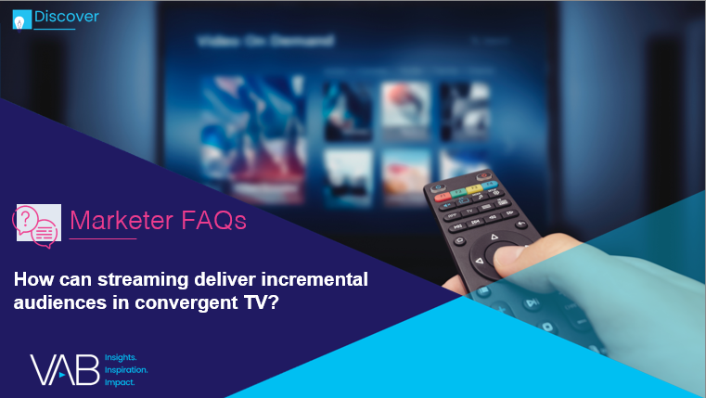



The definition of “television” has blurred, with viewers seamlessly viewing linear TV and streaming programming across a growing number of platforms.
For marketers trying to amass scale and capture viewer engagement in this fragmented landscape,
the new converged reality holds great opportunity.
To help marketers understand the trends shaping the growth of convergent TV, as well as its opportunities, we are answering 4 frequently asked questions. These data and insights will help you plan, buy, and measure successfully in a converged TV world.
What is convergent TV and why is it happening?
How might customized, targeted video ads help create stronger engagement?
How can streaming deliver incremental audiences in convergent TV?
How can a convergent TV strategy drive business results for my brand?
In this piece, we show how the growth of convergent TV means more opportunity for ad personalization and answer “How might customized, targeted video ads help create stronger engagement?”
Looking for more? Hear directly from those who are involved in ensuring the success of Convergent TV campaigns. Get guidance, best practices, and other advice for marketers as you plan, buy and measure video campaigns. Learn more and watch here.
This information is exclusively provided to VAB members and qualified marketers. Further distribution is prohibited.
PAGE 2

Slide 3


What is ‘convergent TV’?
‘Convergent TV’ = Linear TV + Streaming
From the viewer’s perspective:
The idea that people seamlessly watch linear TV and various forms of digital / streaming TV.
From the marketplace perspective:
The idea of selling and buying video holistically through an interoperable* way of executing and measuring
linear + digital buys.
‘Convergent TV’ is not to be confused with ‘Connected TV,’ which refers specifically to a device
Connected TV (CTV): A television set that has built-in Internet capabilities (e.g., Smart TV) or is connected to the Internet via a streaming device such as a streaming box/stick, gaming console or Blu-ray player; all of which can access a variety of long-form and short-form content.
* Note: ‘Interoperable’ refers to the ways in which the technologies (and datasets) for different platforms function in conjunction with one another for planning, buying and measuring a media campaign across linear TV and streaming video.
This information is exclusively provided to VAB members and qualified marketers. Further distribution is prohibited.
PAGE 3

Slide 4

Audiences prefer relevant advertising, turned off by ads that have nothing to do with their lives or interests
How bothered are you by ads not being relevant to you or your life?
% of respondents who answered “very bothered” or “somewhat bothered”
Source: Morning Consult, October 2021. Data based on poll conducted Sept. 8-11, 2021, among 2,200 U.S. adults.
This information is exclusively provided to VAB members and qualified marketers. Further distribution is prohibited.
PAGE 4

Slide 5


However, ads customized to viewers’ interests and search history are most likely to result in a positive overall viewing experience
% of viewers who were highly satisfied with their overall viewing experience after seeing ads they believe were…
60%
56%
Customized for them
Based on their search history
Source: Hub Entertainment Research, TV Advertising: Fact vs. Fiction, 2021. Q: How much did you enjoy the experience of watching that show? Based on respondents who were highly satisfied with their viewing experience (8-10 on 10-point scale). Other options included: countdown clock during ads (54%), ads shown before show begins (51%), see multiple ads from the same brands (49%), ads shown in middle of show (48%), same ad run multiple times during show (41%).
How to read: 60% of people who thought they saw ads customized for them were highly satisfied with their overall viewing experience.
This information is exclusively provided to VAB members and qualified marketers. Further distribution is prohibited.
PAGE 5

Slide 6



When consumers feel that they are being targeted by relevant, personalized advertising, they are more likely to become purchasers and brand advocates
% of consumers who are more likely to…
Purchase
Repurchase
Recommend
76%
78%
78%
Consider purchasing from brands that engage with them in a personalized and tailored way
Repurchase from brands that offer personalized communications and products / services
Recommend brands to their friends and family that offer personalized communications and products / services
Source: McKinsey & Company, Next in Personalization 2021 Report. Based on consumer survey fielded 9/7/2021-9/8/2021 (n=1,013), sampled and weighted to match the US general population 18+. Question: “Please indicate how much you agree or disagree with the statements below when it comes to personalized communications and products/services from brands/businesses.”; Purchase: “I am more likely to consider buying from brands/businesses that engage with me in a personalized and tailored way.”; Repurchase: “I am more likely to repurchase from brands/businesses that offer personalized communications and products/services.”; Recommend: “I am more likely to recommend brands/businesses to my friends and family that offer personalized communications and products/services.” Numbers shown indicate respondents that selected “somewhat agree”, “agree” and “strongly agree”.
This information is exclusively provided to VAB members and qualified marketers. Further distribution is prohibited.
PAGE 6

Slide 7

Consumer personalization is a revenue accelerator as companies with the fastest rates of growth are more likely to prioritize these actions and tactics
40%
More revenue from personalized marketing actions or tactics
Below-average
revenue growth companies
Above-average
revenue growth companies
How to read this chart: ‘Above-average growth’ companies make 40% more revenue from their personalized marketing actions or tactics than ‘below-average revenue growth’ companies.’
Source: McKinsey & Company, Next in Personalization 2021 Report. Based on survey fielded 2/7/21 – 2/14/21, (n=20) sampled among consumer companies without direct consumer relationship (e.g., CPG). Companies divided into two groups based off past-year revenue growth; top half classified as higher growth and bottom half as lower growth. Question: “What % of your revenue comes from personalized marketing actions / or tactics?” Possible responses: values from 0% to 100%.
This information is exclusively provided to VAB members and qualified marketers. Further distribution is prohibited.
PAGE 7

Slide 8

Relevant ads in premium TV and streaming content are more likely to be of higher quality than other platforms, making them both more enjoyable and memorable
Source: tvScientific, How CTV Advertising Powers the Performance TV Revolution, September 2021. Based on survey of 1,000 consumers in the U.S.; Respondents represented a wide variety of ages, ethnicities, industries, roles, education and income levels, and household sizes.
This information is exclusively provided to VAB members and qualified marketers. Further distribution is prohibited.
PAGE 8

Slide 9
Understanding the importance of relevant messaging and the impact it has on their bottom line, advertisers are increasingly leveraging targeted advertising solutions across data-enabled multiscreen TV platforms
Source: Advertiser Perceptions, 2H 2021 Video Advertising Convergence Report. Based on survey of 250 marketer and agency respondents who are involved in video advertising decision-making.
This information is exclusively provided to VAB members and qualified marketers. Further distribution is prohibited.
PAGE 9

Slide 10
Adults over 50 account for 36% of the total population and nearly half of all adults
Targeted ads that are relevant to consumers’ interests and behaviors can have a significant impact on their viewing experience and the memorability of a brand. Marketers can accelerate revenue growth and achieve greater full-funnel results by engaging with their best customer prospects through personalized messaging in a premium video environment.
As marketers seek to improve ad effectiveness and grow business outcomes, many are increasing their investment in advanced audience targeting solutions through data-enabled, premium, convergent TV platforms like data-driven linear TV, addressable TV, set-top box VOD and OTT/CTV.
Key Implications for Marketers
This information is exclusively provided to VAB members and qualified marketers. Further distribution is prohibited.
PAGE 10

Slide 11


About VAB
VAB is an insights-driven organization that inspires marketers to reimagine their media strategies resulting in fully informed decisions.
Drawing on our marketing expertise, we simplify the complexities in our industry and discover new insights that transform the way marketers look at their media strategy.
We are committed to your business growth and proud to offer VAB members, brand marketers and agencies complimentary access to our continuously-growing Insights library. Get immediate access at theVAB.com.
Curious to learn more about VAB? Check out this quick video to see what we do and how we can help you develop business-driving marketing strategies.
This information is exclusively provided to VAB members and qualified marketers. Further distribution is prohibited.
PAGE 11

