Slide 1
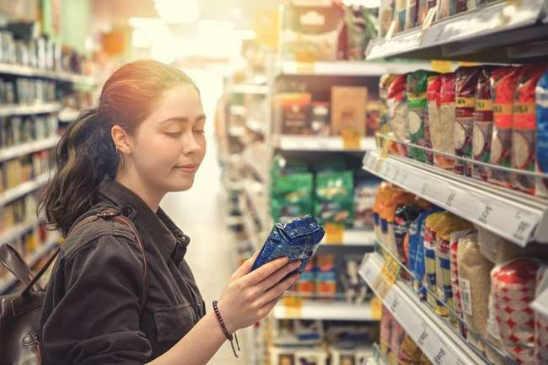


Case Study Corner
xx
Consumer Packaged Goods (CPG) Category
Brand success stories highlighted through real-world multiscreen TV case studies

Slide 2





10 CPG category ‘real world’ case studies showcasing how multiscreen TV drives business outcomes across the funnel
Upper Funnel Outcomes
Awareness
Multiscreen TV campaigns that expand reach and drive brand recall against a brand’s best customer prospects*
Sampling of ‘awareness-based’ outcomes that can be measured:
Reach / Reach Extension / Incremental Reach
Ad / Brand Recall
Cost Efficiencies (Reach / Targeted IMPs)
Mid-to-Lower Funnel Outcomes
Action
Multiscreen TV campaigns that increase the likelihood the intended audience will be motivated to act*
Sampling of ‘action-based’ outcomes that can be measured:
Conversion Rates (website traffic,
app downloads, subscription sign-ups,
tune-in, foot traffic)
Sales / Revenues
Optimizations / ROI
Cost Efficiencies (Conversions)
Full-Funnel Outcomes
Awareness + Action
Multiscreen TV campaigns that expand reach and drive brand recall while also increasing the likelihood that the intended audience will be motivated to act*
Sampling of full-funnel outcomes:
Reach → Brand Recall → Conversion Rates → Sales → Optimizations →
Cost Efficiencies
*based on campaign KPIs
This information is exclusively provided to VAB members and qualified marketers.
PAGE 2

Slide 3
Upper Funnel
Case Studies
Awareness
Multiscreen TV campaigns expand reach
and drive brand recall against a brand’s
best customer prospects
Sampling of ‘awareness-based’ outcomes that can be measured:
    Reach / Reach Extension / Incremental Reach
    Ad / Brand Recall
    Cost Efficiencies (Reach / Targeted IMPs)
How Multiscreen TV drives
Awareness
This information is exclusively provided to VAB members and qualified marketers.
PAGE 3

Slide 4

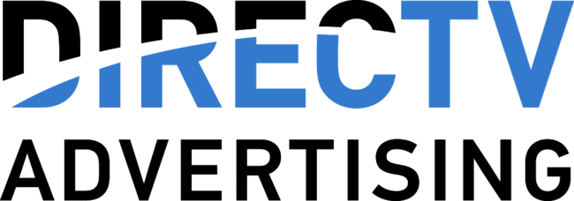
Category:
Consumer Packaged Goods (CPG)
A CPG brand optimized a more evenly distributed reach and exposure
Challenge
A CPG brand sought to attain incremental reach against viewers lightly exposed to the national campaign and to better manage impression & frequency distribution
Solution
4 week national + addressable media campaign
  By leveraging addressable technology, the brand was able to optimize TV reach and more evenly distribute impressions and exposure
Target Segment
A18+ unreached or lightly reached by national campaign
Results
The addressable campaign reached the brand’s audience not exposed or underexposed to the national campaign, increasing the brand’s total reach from 67% to 77%
Company / Platform
DIRECTV Set-top-box data
% of Total Impressions National Campaign
77% of Imps went to only 27% of HHs
After the original national campaign only reached 67% of the target audience, with 77% of the impressions going to only 27% of the HHs, the integration of addressable technology allowed the brand to evenly distribute impressions and exposure. This increased the brands total reach from 67% to 77%
% of Total Impressions National Campaign
Reached HHs not exposed to national campaign
Source: DIRECTV, Case Study: Addressable CPG. *Q1’20 campaign flight.
This information is exclusively provided to VAB members and qualified marketers.
PAGE 4

Slide 5

Category:
Consumer Packaged Goods (CPG)
A multi-brand CPG efficiently augmented their strategic target’s reach across a large portfolio of brands
Challenge
The agency of a leading CPG brand needed to efficiently allocate spend and maximize reach across all its upfront commitments, while overcoming a legacy system of manually allocating TV units across each brand
Solution
By leveraging data-driven linear TV planning and optimization, a multi-brand CPG was able to:
  Automate quarterly optimizations and allocations against their schedule of upfront inventory
  Achieve deep granularity and maximum efficiency against strategic targets (ST) across the entire brand family
  Maximize the outcome for each brand’s target within a demo-based portfolio
Target Segment
CPG Strategic Target*
Results
Campaign efficiency increased while demo and strategic reach increased
Company / Platform
Amobee / Data-driven linear
+31%
+24%
-19%
Increase in Demo Reach Across All Brands
Improvement in Strategic Target Reach
Reduction in
Strategic Target eCPM
Source: Amobee, Case Study: Major Agency Augments Multi-Brand Reach with Data Driven Linear. *Strategic targets varied according to brand, Beyond age and gender, targets leveraged data such as purchase history, family situation, location, pet ownership and household income.
This information is exclusively provided to VAB members and qualified marketers.
PAGE 5

Slide 6



Category:
Consumer Packaged Goods (CPG)
A CPG brand worked with LiveRamp to identify new audiences and increase campaign reach
Challenge
A major CPG brand was experiencing diminishing offline sales for HH’s exposed to ads 10+ times. This highlighted a need to reach new HHs and minimize waste
Measurement Innovation
LiveRamp helped the brand identify opportunities to adjust spend and increase campaign reach
This was done by suppressing heavily exposed homes across CTV and OTT. Those impressions were redirected to CTV households with little to no linear exposure to drive incremental reach
Target Segment
All households
Learnings
The CPG brand was able to drive incremental reach with unique HH reach increasing by 176% for the OTT/CTV campaign
Through this analysis, they were able to determine their ROAS and what was driving it – ROAS was 86%, mostly driven by light/med TV HHs that were previously challenging to reach
Company / Platform
LiveRamp, Data Plus Math (D+M) / Linear TV, OTT, Connected TV (CTV)
Campaign Results
More Reach
+176%
increase in unique HH reach
More Efficient
86%
ROAS
Source: LiveRamp, CPG brand case study. Campaign time period: Q1 – Q2 ‘21.
This information is exclusively provided to VAB members and qualified marketers.
PAGE 6

Slide 7
Category:
Consumer Packaged Goods (CPG)
DIRECTV’s addressable campaign successfully expanded the brand's reach beyond its national presence in College Football
Challenge
Drive incremental reach of the brand’s target beyond their existing national presence in College Football
Solution
3-week addressable campaign
Target
Custom audience minus HHs that watched over 20 minutes of College Football
Results
The Addressable campaign was largely incremental of the National campaign, highlighting the effectiveness of the target creation
Only 1% of the brand’s linear campaign impressions were delivered to the Addressable target indicating that the campaign was successful at reaching untapped HHs
Company / Platform
DIRECTV / Linear TV
Reach build over 3 weeks
+72%
HH Reach Increase
(Combined National & Addressable vs. National)
+6652%
Target HH Reach Increase
(Combined National & Addressable
vs. National)
Source: DIRECTV Advertising, Case study: Addressable Precision Targeting: Beverage CPG case study. 4Q’22. Incremental reach within DIRECTV footprint.
This information is exclusively provided to VAB members and qualified marketers.
PAGE 7

Slide 8
Category:
Consumer Packaged Goods (CPG)
DIRECTV effectively redistributed impressions to Light and Medium TV viewers, increasing overall reach for a CPG brand
Challenge
DIRECTV wanted to suppress Heavy TV Viewers from the addressable campaign to increase frequency and reach among Light and Medium TV Viewers
Solution
National + Addressable media campaign
Target
A25-54 Light & Medium TV Viewers
Flight Duration
5-weeks
Results
The Addressable campaign successfully redistributed impressions towards the Light & Medium TV viewers helping offset the National Campaign’s imbalance.
The CPG brand shifted the weight of Light & Medium impressions from 48% for National to 87% for National + Addressable.
Increased overall reach from 73% to 89% for the CPG brand.
Company / Platform
DIRECTV / Linear TV
% of total impressions delivered by target
+450%
Weekly Frequency Lift
Light & Medium TV Viewers
(Addressable & National vs. National Campaign)
+22%
Overall Reach Lift
(Addressable & National vs. National Campaign)
Source: DIRECTV Advertising, Case study: Addressable Reach & Frequency Optimization: CPG case study. 4Q’22. Incremental reach within DIRECTV footprint.
This information is exclusively provided to VAB members and qualified marketers.
PAGE 8

Slide 9




Category:
Consumer Packaged Goods (CPG)
LiveRamp partnered with a CPG brand to increase their cross-screen effectiveness by suppressing overexposed audiences
Challenge
A major CPG brand was experiencing diminishing returns in offline sales lift once consumers were exposed past a frequency of 10. The overexposure represented 15 MM HHs per quarter, highlighting a need to optimize media spend in order to mitigate sizable waste
Audience Measurement Innovation
The brand worked with LiveRamp in order to identify actionable areas to redirect linear TV overexposure (see footnote for more details*):
  Built & activated audiences to suppress digital exposure across OTT impressions for households heavily exposed to linear ads
  Inversely, those OTT impressions were redirected to households with less or no linear ad exposure
Target Segment
All households
Learnings
Suppressing overexposed linear audiences led to more effective cross-screen outcomes across OTT/CTV (see charts on the right side)
Company / Viewing Source / Media Type
LiveRamp, Data Plus Math (D+M) / ACR, Ad Log Integration / National Linear TV, OTT
+176%
Increase in Unique HH Reach for the OTT Platform
+86%
Increase in ROAS**
for the OTT platform
Mostly sourced from Light / Medium TV Households that were previously harder to reach
Source: LiveRamp, Case study: How a Major CPG Brand Increased Cross-Screen Effectiveness by Suppressing Overexposed Linear Audiences. Campaign time period: 2Q 2021. Advanced TV Measurement: Data Plus Math. *Innovation Detail: Combining ad exposures from ACR data via Inscape partnership and ad logs integration with OTT publishers resolved to RampID & HHID, custom segment creation activated on OTT based on HHs exposed to a previous quarter’s brand national linear TV campaign schedule with 10+ ad frequency from STB data via Comscore partnership, and x-screen projection scaling methodology. **Return on ad spend.
This information is exclusively provided to VAB members and qualified marketers.
PAGE 9

Slide 10
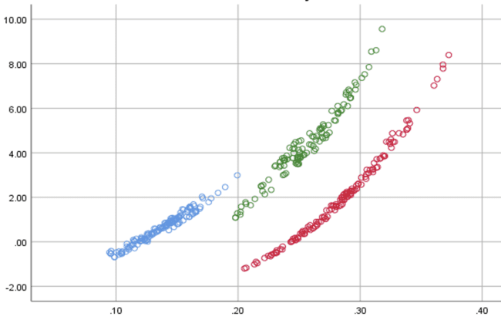
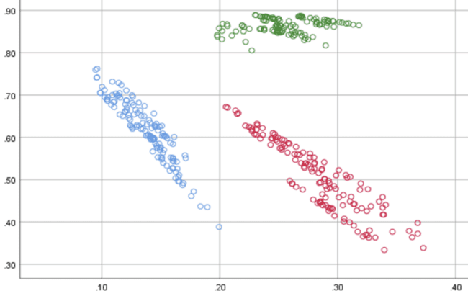

Category:
Consumer Packaged Goods (CPG)
A CPG brand utilized EDO’s BBP metric to evaluate how its own brand health had an impact on its competitors
Challenge
A CPG brand wanted to know how its brand health impacts its own and competitors’ advertising results
Measurement Innovation
EDO’s Behavioral Brand Power (BBP) is a real-time brand health metric built on proprietary Share of Search (SoS) and Share of Voice (SoV) data
BBP allows a brand to quantify its consumer interest (SoS) relative to its ad visibility in the marketplace (SoV)
Target Segment
P2+
Learnings
A five-year campaign with 237 billion imps illustrated that BBP is a strong measure and tracker of brand health
Higher BBP insulates marketers to price competition and amplifies sensitivity to changes in media weight. Marketers who invest in their advertising generate positive ripple effects for the brand
Company / Viewing Source / Media Type
EDO, Inc. / ACR, Google API / National Linear TV
SoV Elasticity vs. BBP
As BBP increases, a brand’s sensitivity to Share of Voice increases – enabling greater consumer engagement impact from its media investment
Share of Voice (SoV) Elasticity *
CPG Brand A
CPG Brand B
CPG Brand C
BBP Metric
Price Elasticity vs. BBP
As BBP increases, a brand’s sensitivity to price changes decreases – which makes the advertiser more immune to price fluctuations
Price Elasticity *
CPG Brand A
CPG Brand B
CPG Brand C
BBP Metric
Source: EDO, Inc.. Campaign time period: March 2017 to March 2022.
* Price Elasticity is a measure of Share of Revenue’s sensitivity to a change in Price Per Unit
* SoV Elasticity is a measure of Share of Revenue’s sensitivity to a change in Share of Voice
This information is exclusively provided to VAB members and qualified marketers.
PAGE 10

Slide 11
Mid-To-Lower Funnel
Case Studies
Action
Multiscreen TV campaigns increase the likelihood that the intended audience will be motivated to act
(e.g., make a purchase, download an app, sign-up
for a subscription, make a booking, etc.)
Sampling of ‘action-based’ outcomes that can be measured:
    Conversion Rates (website traffic, app downloads, subscription sign-ups, tune-in, foot traffic)
    Sales / Revenues
    Optimizations / ROI
    Cost Efficiencies (Conversions)
How Multiscreen TV drives
Action
This information is exclusively provided to VAB members and qualified marketers.
PAGE 11

Slide 12

Category:
Consumer Packaged Goods (CPG)
A carbonated beverage advertiser utilized 605’s attribution solution to connect sales with viewership of co-branded integrated programming
Challenge
A beverage brand sought to understand the impact of
two campaigns – an ad campaign for their carbonated beverage, and a product integration on a sub-brand
Specifically, they wanted to know the impact on 3 KPIs: Purchase Frequency, Conversions, Total Sales
Measurement Innovation
605’s attribution solutions leveraged 605 viewership/tune-in data, third party sales data and the client’s first-party digital data to measure the effectiveness of the brand’s cross-platform campaign compared to a “Matched Control”*
Target Segment
Customers who have previously made a purchase from the beverage brand (carbonated beverage brand target)
Customers who have previously made a purchase of one specific beverage flavor from the beverage brand (sub-brand target)
Learnings
The brand was able to see lifts vs. the ‘matched control’ for each platform individually, allowing them to more effectively allocate spend
The brand was able to see the relative impact on their core KPIs for the ad campaign vs. the product integration allowing for more informed strategy decisions in future
Company / Viewing Source / Media Type
605 / Automated Content Recognition (ACR), Set-Top Box / Linear TV (Large Entertainment Network), Digital (Large Entertainment Network’s digital platform)
CARBONATED BEVERAGE BRAND (ADS) | Index - Transactions |  | Incremental Sales
PLATFORM: | LINEAR |  | DIGITAL |  | ANY (LINEAR + DIGITAL)**
RESULTS: | LIFT vs. control | INDEX | LIFT vs. control | INDEX | LIFT
Purchase Frequency | 22% | 122 | 58% | 122 | 20.9%
Conversions | 22% | 112 | 6% | 73 | 22.0%
Total Sales | 11% | 140 | 3% | 101 | 11.1%
SUB-BRAND (PRODUCT PROGRAM INTEGRATION) | Index - Transactions
PLATFORM: | ANY (LINEAR + DIGITAL)**
LIFT PER EXPOSURE: vs. control | ANY | PREMIER EPISODE | 5+
Purchase Frequency | 34% | 41% | 51%
Conversions | 38% | 37% | 42%
Total Sales | 15% | 30% | 89%
Source: 605, Case study: Campaign for Carbonated Beverage Brand, Sales. Campaign dates: 2/7/2021 – 4/11/2021. *”Matched Control” = match each “exposed” HH to similar unexposed HH. **”Any (Linear + Digital)" is any exposure to the ad on Linear or Digital. A viewer could have seen both, but they were exposed on at least one platform during the campaign period.
This information is exclusively provided to VAB members and qualified marketers.
PAGE 12

Slide 13

Category:
Consumer Packaged Goods (CPG)
A CPG brand implemented contextually relevant binge ads, leading to incremental sales growth
Challenge
A CPG brand sought to increase sales by creating real connections with engaged viewers across connected TV, desktop and mobile
Solution
Hulu’s in-house creative team, Greenhouse, worked with the brand to create sequential Binge Ads. The contextually and situationally-relevant messages appeared during viewers’ binge-watching session
Campaign delivered & measured in collaboration with Hulu, a CPG sales partner and a data connectivity platform
Target Segment
W25-49
Results
Those only exposed to the Binge Ad were highly responsive to the campaign but those exposed to both the Binge and Standard Ad drove the highest response rate, likely due to increased frequency
Company / Platform / Media Type
Hulu / Streaming + Multiscreen / Connected TV (CTV), Desktop, Mobile
Response Index
90 | 180 | 335
●/● Response Index (Campaign Response / Households)
Source: Hulu, Binge Ad Case Study, Q1 2020. Campaign length: 3 months; Binge Ad ran 1 month.
This information is exclusively provided to VAB members and qualified marketers.
PAGE 13

Slide 14

Awareness
How Multiscreen TV drives
Full-Funnel Outcomes
Multiscreen TV campaigns expand reach
and drive brand recall against a brand’s
best customer prospects
Action
Multiscreen TV campaigns increase the likelihood
that the intended audience will be motivated to act
(e.g., visit a website, download an app, sign-up
for a subscription, make a purchase, etc.)
Case Studies
This information is exclusively provided to VAB members and qualified marketers.
PAGE 14

Slide 15





Category:
Consumer Packaged Goods (CPG)
A CTV campaign drove significant awareness, website traffic and cost efficiencies for a sweepstakes-driven promotional plan collectively across five consumer goods brands
Challenge
An agency connected with five popular consumer brands to build a campaign with a goal of increasing awareness and better position their products in front
of customers
The agency sought to build awareness and strategic positioning through promotions and sweepstakes by leveraging CTV to target specific audiences and brick and mortar locations.
Solution
Stirista enabled CTV to effectively target new audiences and drive site traffic
In addition to attribution reporting and conversion lift, Stirista also placed a VIG pixel on the campaign landing page to track site traffic and meet agency
and client goals
Target Segment
Millennial mothers around selected brick and mortar locations to highlight the campaign sweepstakes, coupons for products and recipes.
Results
The campaign delivered most impressions in only one month along with a 97% viewer completion rate
The CTV ad was seen over 1.8 million times, secured a $8.58 cost per website visitor and was responsible for 15.8% of all site traffic
Company / Platform
Stirista / CTV
15.8%
Campaign-reached site visitors
$8.58
Cost per website visitor
97%
Viewer completion rate
Source: Stirista, Stirista’s CTV Ad Drove 15.8% of Website Traffic for a Sweepstakes Campaign, Case Study. March 2023.
This information is exclusively provided to VAB members and qualified marketers.
PAGE 15

Slide 16

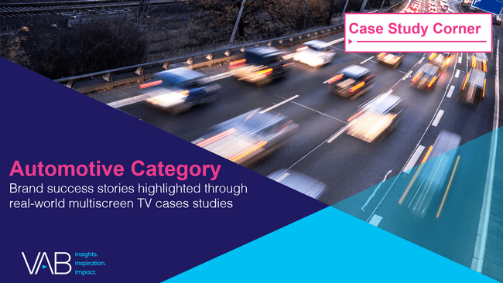
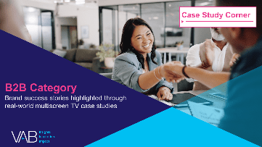
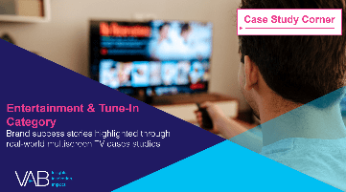

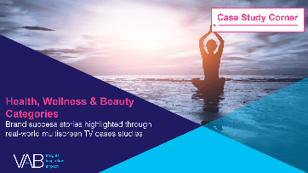
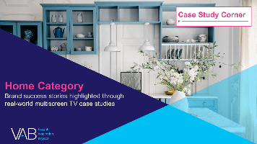


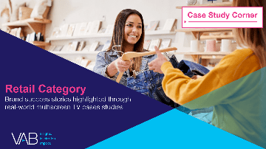

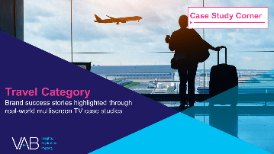
Want more? VAB has a wealth of case studies across additional categories
Automotive
Business-to-Business (B2B)
Entertainment & Tune-In
Financial Services & Insurance
Health, Wellness & Beauty
Home
Pharmaceuticals
Restaurants
Retail
Technology
Travel
Access more case studies at www.thevab.com
This information is exclusively provided to VAB members and qualified marketers.
PAGE 16

Slide 17
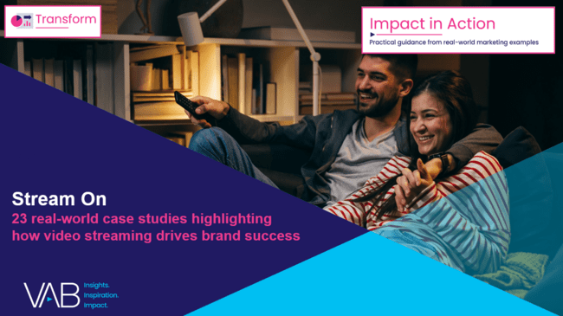
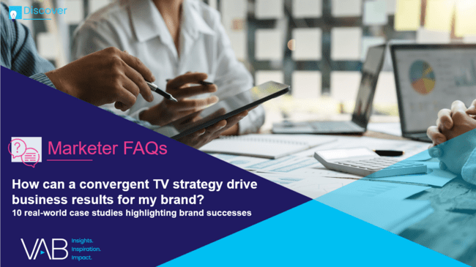
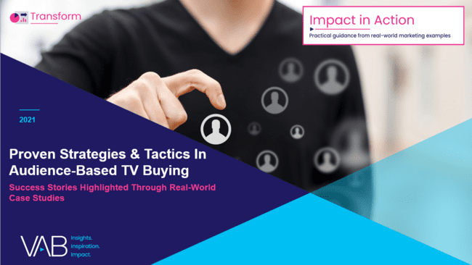


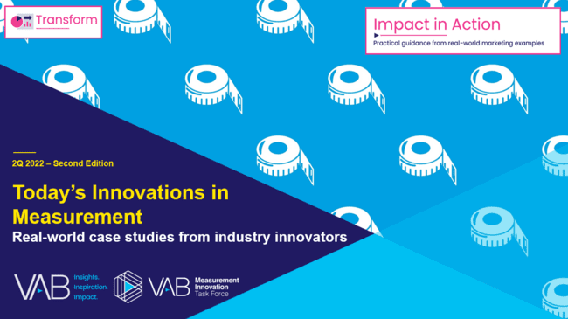
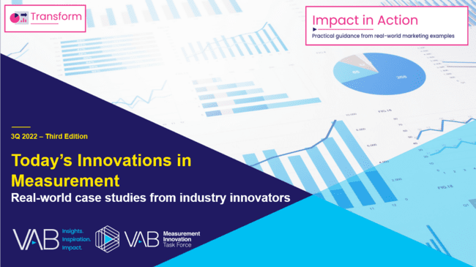
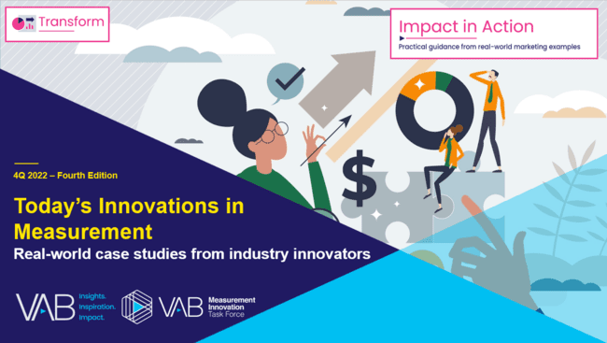
Want more? VAB also has case studies organized across multiscreen TV platforms including linear TV and streaming / CTV
Stream On
How can a convergent TV strategy drive business
results for my brand?
Proven Strategies & Tactics In Audience-Based TV Buying
Opportunities in VOD Addressable
Q1 ‘22 Today’s Innovations in Measurement
Q2 ‘22 Today’s Innovations in Measurement
Q3 ‘22 Today’s Innovations in Measurement
Q4 ‘22 Today’s Innovations in Measurement
Access more case studies at www.thevab.com
This information is exclusively provided to VAB members and qualified marketers.
PAGE 17

Slide 18


About VAB
VAB plays a dual role in the video advertising industry. We are leading the change to bring about a more innovative and transparent marketplace. We also provide the insights and thought leadership that enables marketers to develop business-driving marketing strategies.
Drawing on our marketing expertise, we simplify the complexities in our industry and discover new insights that transform the way marketers look at their media strategy.
We are committed to your business growth and proud to offer VAB members, brand marketers and agencies complimentary access to our continuously-growing Insights library. Get immediate access at theVAB.com.
This information is exclusively provided to VAB members and qualified marketers.
PAGE 18

