Slide 1

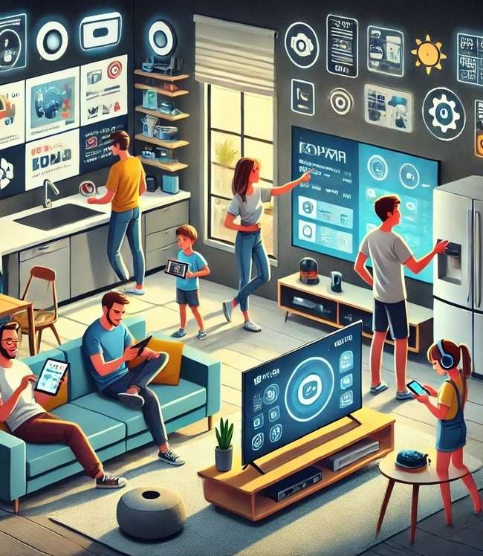



Left To Your Own (Connected) Devices
Examining How Consumers Are Embracing Smart Technology In Their Everyday Lives

Slide 2
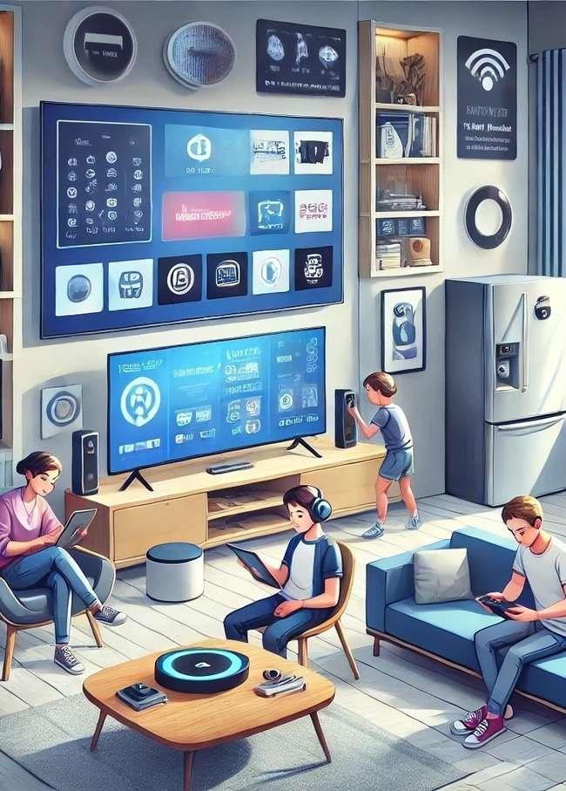

Understanding consumer penetration and usage trends across 16 connected devices
The growth of an ever-expanding list of connected devices both at home and on the go - from TVs and wearables to voice-activated assistants and smart home technology - signals a deeper integration of technology into every aspect of daily life. This shift not only reflects evolving consumer habits but also unlocks a host of new occasions for brands to engage with their audiences in more meaningful and personalized ways.
Whether it’s through in-app ads, voice-activated promotions or tailored video content on connected TVs, marketers have more opportunities to meet consumers where they are on the devices they use most and to ‘test and learn’ with the emerging technologies that are just beginning to grow.
By staying on top of the growth trends of connected devices, marketers can effectively navigate this evolving landscape and unlock new realms for meaningful engagement.
This information is exclusively provided to VAB members and qualified marketers.
PAGE 2

Slide 3







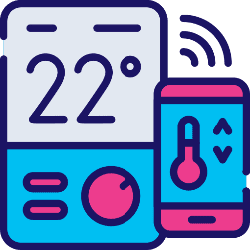
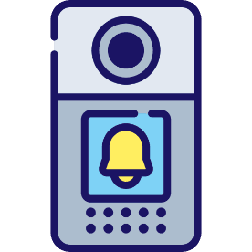


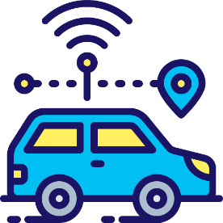


Connected devices continue to expand as they increasingly integrate into all aspects of our lives
16 Connected Devices Examined
Connected TVs
Smartphones
Computers
Tablets
Gaming Consoles
Smart Speakers
Smart Home Hubs
Place-Based
Video Screens
Thermostats
Doorbells
Wearables
AR / VR Headsets
Smart Glasses
Connected Cars
Click through a box above to be brought directly to the appropriate slide
This information is exclusively provided to VAB members and qualified marketers.
PAGE 3

Slide 4
The number of connected devices in households has doubled in less than ten years, which has unlocked fresh avenues for brand engagement
Average Number of Connected Devices
per US HHs
Source: Parks Associates, At CES 2024, Parks Associates announces new research showing average number of connected devices per US internet household reached 17 in 2023, January 11, 2024.
This information is exclusively provided to VAB members and qualified marketers.
PAGE 4

Slide 5
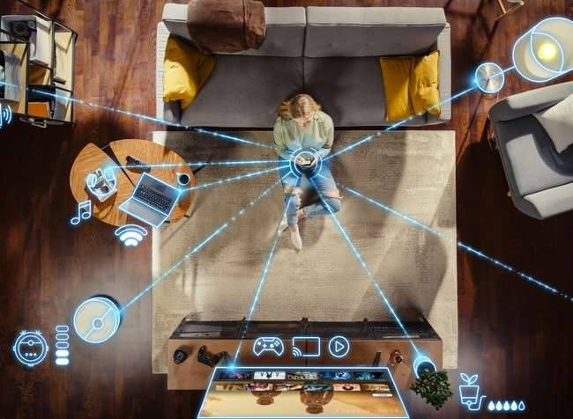
Almost half of all adults believe smart devices have significantly improved the quality of their lives and are increasingly central to their home
‘The benefits of ‘smart’ home devices / appliances could significantly improve my quality of life’
% of respondents who agree
‘Smart’ home devices / appliances have
become an important part of my life’
% of respondents who agree
Source: VAB analysis of MRI-Simmons Fall 2021 – 2024 USA Study, A18+. Based on ‘any agree’.
This information is exclusively provided to VAB members and qualified marketers.
PAGE 5

Slide 6

Our ‘connected’ world represents a mix
of well-established devices and an exciting group of emerging technologies which are all seamlessly integrating into consumers’ lives

Slide 7
Connected TVs: Two-thirds of all TVs are now Smart TVs as household penetration with multiple smart TVs continues to grow
Smart TV Set Installed Base
In millions
Average # of Smart TVs per HH
% of Total TV Households
Smart TV % of Total TV Set Installed Base
38%
51%
60%
68%
80%
86%
92%
98%
20%
31%
40%
50%
58%
65%
72%
80%
Source: S&P Global Market Intelligence Kagan estimates; industry data. Data compiled September 2024. ‘Installed Base’ refers to the total number of units of a product currently in use by customers. Compound Annual Growth Rate (CAGR): 11.0%.
This information is exclusively provided to VAB members and qualified marketers.
PAGE 7

Slide 8

Smartphones: As these devices have become ubiquitous, over a quarter are now using AI features to perform a range of audio and visual tasks
% of A18+ population who own a smartphone
Smartphone AI Features U.S. Adults Currently Use or Plan to Use*
By Age Group
Smartphone AI Feature | 18-34 | 35-54 | 55+ | Total
Voice assistant (e.g., searching the web, taking actions) | 33% | 28% | 20% | 26%
Photo and video tools (e.g., object removal, photo and video editing) | 31% | 25% | 14% | 22%
Advanced internet search engine | 30% | 20% | 14% | 20%
Visual search (e.g., image-based web search, etc.) | 30% | 21% | 11% | 20%
Writing tools (e.g., rewriting emails, summarizing) | 30% | 21% | 11% | 20%
Image or emoji generation | 19% | 15% | 9% | 14%
Organization tools (e.g., adding events mentioned in an email to your calendar) | 17% | 16% | 9% | 13%
Dictation and transcription tools | 14% | 11% | 7% | 10%
Source: VAB analysis of MRI-Simmons 2014 – 2020 Doublebase and 2021 - 2024 Spring Doublebase USA Studies, A18+. *YouGov as cited in company blog, Sep 30, 2024. 1,221 US adults ages 18+ were surveyed online during September 23-24, 2024. Figures are weighted to reflect population estimates from the Census Bureau's American Community Survey for age, gender, race/ethnicity, education level, and region.
This information is exclusively provided to VAB members and qualified marketers.
PAGE 8

Slide 9
Computers: Ownership has plateaued after a Covid-related bump with the primary activities being productivity tasks like work, email and browsing
% of households that own a desktop / laptop
For what purposes do you regularly use your desktop / laptop?*
% of respondents
Source: VAB analysis of MRI-Simmons Fall 2014 - 2024 USA study, A18+. *VAB analysis of ARF DASH study, Spring 2024. Based on survey of 10,000 A18+. Q25_5: For what purposes do you regularly use desktop computer 1? ‘Desktop 1’ refers to respondents’ primary desktop. Based on respondent weighting.
This information is exclusively provided to VAB members and qualified marketers.
PAGE 9

Slide 10

Tablets: Penetration has slowed at nearly two-thirds of adults with the primary activities being search, communications, gaming and shopping
% of adults who have a working tablet or e-reader
For what purposes do you regularly use your tablet?*
% of respondents
Source: VAB analysis of MRI-Simmons Fall 2014 – 2024 USA study, A18+. *VAB analysis of ARF DASH study, Spring 2024. Based on survey of 10,000 A18+. Q28: For what purposes do you regularly use tablet 1? ‘Tablet 1’ refers to respondents’ primary tablet. Based on respondent weighting.
This information is exclusively provided to VAB members and qualified marketers.
PAGE 10

Slide 11

Gaming Consoles: Console gamers are projected to remain relatively consistent at just over one-quarter of the population
US Digital Console Gamers
% of population
Source: EMARKETER, Digital Console Gamers in the U.S., 2019-2027. Internet users of any age who play games through the internet or games that update via the internet at least once per month via a gaming console.
This information is exclusively provided to VAB members and qualified marketers.
PAGE 11

Slide 12










Smart Speakers: Device ownership has plateaued recently at around one-third of the population as users leverage them for specific core activities
% of U.S. 12+ population who own a smart speaker
Top Activities Done Using Smart Speaker*
% of respondents
26%
24%
16%
Listened to music via streaming service
Obtained weather updates
Controlled smart home devices
11%
10%
8%
Obtained other information
Obtained news updates
Listened to live radio
8%
7%
7%
Made a phone call
Listened to a podcast
Obtained sports updates
Source: Edison Research, The Infinite Dial 2024. *VAB analysis of MRI-Simmons Summer 2024 USA study, A18+. Other activities: ‘Played a game’ (5%); ‘Purchased / ordered a product or service’ (4%); ‘Listened to an audiobook’ (4%).
This information is exclusively provided to VAB members and qualified marketers.
PAGE 12

Slide 13
Smart Home Hubs: Nearly one-third of households have a hub, with a skew towards adults 35-54, as the velocity of growth has slowed recently
% of households that have smart home hubs
connected to appliances in their home
A18+
% of households that have smart home hubs
connected to appliances in their home
A35-54
Source: VAB analysis of MRI-Simmons Fall 2019 -2024 study, A18+. Devices include: Audio system, Coffee maker, Dishwasher, Garage Door, Lighting, Oven, Refrigerator/Freezer, Security System, Thermostat, TV, Video Doorbell, Washer/Dryer, Other.
This information is exclusively provided to VAB members and qualified marketers.
PAGE 13

Slide 14
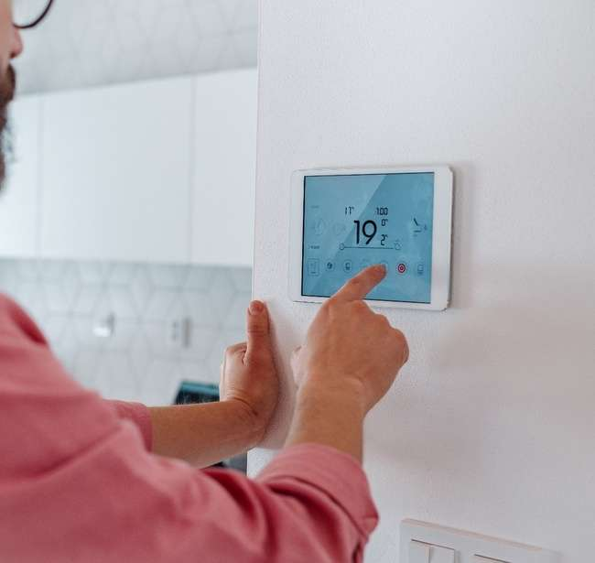
Smart Thermostats: Rising adoption of energy-saving smart technology highlights consumers' focus on cost efficiency and sustainable living
% of U.S. 18+ population who own a smart thermostat
Smart Thermostats can save individuals up to
15%
On heating and cooling bills*
Source: VAB analysis of MRI-Simmons Fall 2017-2024 USA study, A18+. *Smart Energy (Smart Energy Consumer Collaborative), Is a Smart Thermostat a Worthwhile Investment for Your Home?
This information is exclusively provided to VAB members and qualified marketers.
PAGE 14

Slide 15


Smart Doorbells: With ownership now by over one-quarter of homes, a key benefit for users is feeling safer and less anxious about outside activities
Smart Home Doorbell Households*
In millions
% of respondents who agree with the following statements after installing a smart doorbell*
79%
67%
of people felt more safe at home
of people felt less anxious about what goes on outside their home
% of total U.S. Households
17%
22%
24%
26%
27%
Source: EMARKETER Forecast, August 2024. Note: Individuals of any age who actively use smart home doorbells in their own home at least once per month. Additional Note: A smart home doorbell is an interactive device that connects via internet and/or Bluetooth (or any other connectivity protocol) that can be controlled or automated by using apps, smart home hubs or voice assistants. It notifies the homeowner when a visitor is at the door and frequently has sensors and/or cameras. Examples include Arlo, Eufy, Google Nest, and Ring doorbells.
*Porch, Smart Doorbell Suspicions: Exploring the Unintended Consequences of Smart Doorbells in Neighborhoods.
This information is exclusively provided to VAB members and qualified marketers.
PAGE 15

Slide 16

Wearables: Penetration has risen steadily, to almost 30% of the population, fueled by interest in health and fitness especially among younger demos
Smart Wearable Users by Generation
US, 2024
U.S. Smart Wearable Users
In Millions
% of population
19%
22%
24%
25%
29%
30%
32%
33%
34%
35%
Source: EMARKETER, Smart Wearable Users, November 2024. Note: Individuals of any age who at least once per month wear accessories or clothing that have the ability to connect to the internet (via built-in connectivity or tethering), which in turn collects and exchanges data with a manufacturer, operator, or other connected device; must have features that can be used without being tethered to a smartphone, PC, or other internet-connected device; excludes medical devices and VR headsets. Smart wearables include items embedded with electronics, software, or sensors, such as activity trackers, smart bands, smart clothing, smart glasses, smart headphones, and smartwatches.
This information is exclusively provided to VAB members and qualified marketers.
PAGE 16

Slide 17
AR/VR Headsets: After some fluctuation, adoption is projected to grow as consumers look to balance affordability, performance and user comfort
Augmented and Virtual Reality Headset Installed Base
In millions
Features That Are Most Important in a VR Headset**
% of respondents
Estimated % of North America population*
1.0%
3.5%
3.3%
3.5%
3.4%
4.1%
5.3%
Source: S&P Global Market Intelligence Kagan estimates; industry data. Data compiled May 2024. Based on figures for North America. ‘Installed Base’ refers to the total number of units of a product currently in use by customers. *S&P Global, North America Population (U.S. & Canada,). **YouGov as cited in company blog, January 19, 2024. Note: ages 18+; top 5 responses. Other responses: ‘Not sure’ (23%), ‘None of the above’ (13%). **(e.g., mobile phones, tablets, watches & computers). Compound Annual Growth Rate (CAGR): 15.6%.
This information is exclusively provided to VAB members and qualified marketers.
PAGE 17

Slide 18

Smart Glasses: The rise of smart glasses signals a shift toward more immersive, tech-driven experiences
Total Augmented / Virtual Reality Smart Glasses Installed Base
In millions
Estimated % of North America population*
0.003%
0.03%
0.07%
0.2%
0.2%
0.3%
0.4%
Source: S&P Global Market Intelligence Kagan estimates; industry data. Data compiled May 2024. Based on figures for North America. ‘Installed Base’ refers to the total number of units of a product currently in use by customers. Compound Annual Growth Rate (CAGR): 25.3%. *S&P Global, North America Population (U.S. & Canada).
This information is exclusively provided to VAB members and qualified marketers.
This information is exclusively provided to VAB members and qualified marketers.
PAGE 18
PAGE 18

Slide 19


Connected Cars: Two-thirds of drivers use connected cars and nearly half of all adults are willing to pay for an in-vehicle entertainment system
U.S. Connected Car Drivers
In millions
Monthly automotive subscription features
U.S. adults are willing to pay for*
% of respondents
66%
45%
In-vehicle Wi-Fi / Connectivity Packages
(Allows passengers to always connect to the internet from the car)
In-Vehicle
Entertainment
(Streaming services, movies,
games packages)
% of licensed drivers who drive connected cars
58%
62%
66%
69%
71%
Source: EMARKETER Forecast, September 2024. Note: ages 14+; licensed drivers who have driven a connected car and accessed its internet-enabled features at least once during the calendar year. *KPMG, KPMG American Perspectives Survey, May 30, 2024. Note: ages 18+. Reflects respondents who would be ‘very likely’ or ‘somewhat’ likely to pay for monthly automotive subscription features. Other features: ‘Safety features like blind spot monitoring, lane keep assist, automatic braking, etc.’ (71%); ‘Remote start from your phone’ (60%); ‘Charging station locator, with real-time information on availability and pricing’ (61%); ‘Software service and updates without going to dealership’ (59%); ‘Parking locator, with real-time information on availability and pricing’ (53%); ‘Performance features like extra horsepower’ (52%); ‘Hands-free and self-driving capabilities’ (43%).
This information is exclusively provided to VAB members and qualified marketers.
PAGE 19

Slide 20





Place-Based Video Screens: Opportunities are growing to incrementally reach and engage consumers across locations outside the home
Place-Based Digital Video Viewing*
A18+ Monthly Reach
73.1MM
16.6MM
9.7MM
7.1MM
6.8MM
Bars & Restaurants
Fast Food / QSRs
Auto Centers
Gyms
Retail Stores
% Reach Among A18+*
28%
6%
4%
3%
3%
Source: Atmosphere TV, The People Platform; Reach based on one view with Atmosphere TV content/ads; Period: April 2024. *VAB analysis of reach based on Nielsen 2024 National Universe Estimates.
This information is exclusively provided to VAB members and qualified marketers.
PAGE 20

Slide 21



Other Emerging Connected Screens: Travel is evolving as contact points for connected technology through airplane and rideshare screens
Screens on Airplanes
United Airlines is leveraging 100K seatback screens to deliver opt-out targeted ads, a decision that could catch on with other airlines
Rideshare / Taxi Screens
Screens in taxis, rideshare vehicles & rideshare apps offer opportunities for advertising
Nationwide Rideshare Campaign Case Study
An audiobook brand worked with T-Advertising Solutions to develop an interactive video ad that played snippets of select audiobooks, providing audiences with an engaging audio and visual sample of story content across 70K screens*
6/7/2024
United Airlines starts serving passengers personalized ads on seat-back screens
5.5M+
Impressions
2x
Industry average click-through rate
Over 20,000 hours of airtime for the creative
Drove 58k+ unique clicks to the brands landing page
Source: United Airlines Press Release, 6/7/2024. *T-Advertising Solutions, Case Study: Driving subscriptions with an interactive Rideshare campaign.
This information is exclusively provided to VAB members and qualified marketers.
PAGE 21

Slide 22

Adults over 50 account for 36% of the total population and nearly half of all adults
The world is only becoming more ‘connected’ which has led to an explosion of smart devices across most categories – some of these devices are well-established having been
in-market for years (such as connected TVs, smartphones and computers) while others are exciting, emerging technologies that are beginning to build traction within the minds of consumers
The growth of connected devices creates more occasions and increased opportunities for brands to engage with their best customer prospects in more meaningful and personalized ways
Since many connected devices are at various life stages and penetration levels, marketers can employ different buying strategies to engage consumers by device including considering ‘test and learn’ tactics with the emerging technologies that are just beginning to show signs of growth
Key Marketer Takeaways
This information is exclusively provided to VAB members and qualified marketers.
PAGE 22

Slide 23
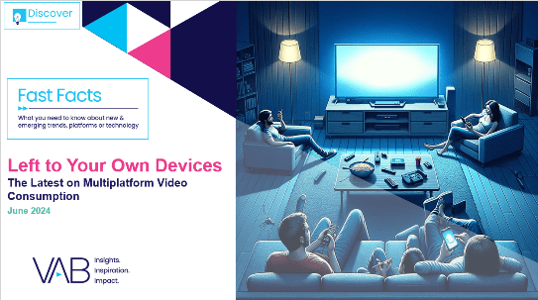

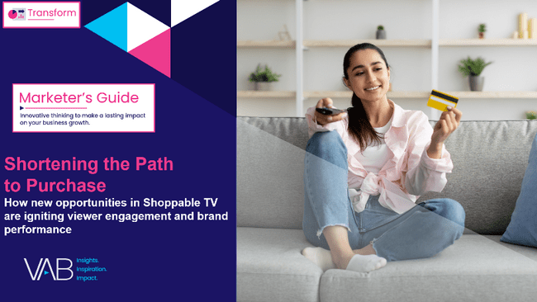

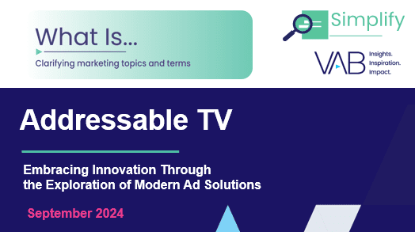


Creators
Jason Wiese
Leah Montner-Dixon
SVP, Director of Strategic Insights
jasonw@thevab.com
Director, Audience & Behavioral Insights
leahm@thevab.com
Left To Your Own Devices
The Latest on Multiplatform Video Consumption
Staying Current on Streaming
The Latest on Connected TV
Consumer Behaviors
Karolina Guillen
Kaileen Cain
Associate Director, Insights, Strategy & Analytics karolinag@thevab.com
Senior Insights Analyst
kaileenc@thevab.com
Shortening the Path to Purchase
How New Opportunities in Shoppable TV Are Igniting Viewer Engagement and Brand Performance
Recipe for Success
Six Key Ingredients for
Stirring Growth in Streaming
Discover more
Looking for more data, insights and takeaways? Check out this related VAB content
What is Addressable TV?
Embracing Innovation Through the Exploration of Modern Ad Solutions
Embrace Innovation
How Modern Ad Solutions Elevate Your Video Campaign’s Performance
VAB Members, brand marketers and agencies get free and immediate access to VAB’s content library. Get access at theVAB.com
This information is exclusively provided to VAB members and qualified marketers.
PAGE 23

Slide 24


About VAB
VAB plays a dual role in the video advertising industry. We are leading the change to bring about a more innovative and transparent marketplace. We also provide the insights and thought leadership that enables marketers to develop business-driving marketing strategies.
Drawing on our marketing expertise, we simplify the complexities in our industry and discover new insights that transform the way marketers look at their media strategy.
We are committed to your business growth and proud to offer VAB members, brand marketers and agencies complimentary access to our continuously-growing Insights library. Get immediate access at theVAB.com.
This information is exclusively provided to VAB members and qualified marketers.
PAGE 24

