Slide 1





Staying Current on Streaming
The Latest on Connected TV Consumer Behaviors
June 2023

Slide 2


What You’ll Learn
As connected TV and ad-supported streaming continue to grow, it’s important for marketers to stay current on the latest trends in consumer behaviors.
This report provides the latest updates on:
1
2
Connected TV
Trends
Convergent TV Trends
Click through a box above to be brought directly to the appropriate section
This information is exclusively provided to VAB members and qualified marketers. Further distribution is prohibited.
PAGE 2

Slide 3

1
Connected TV Trends

Slide 4
Streaming household penetration has almost reached saturation as nearly nine in ten U.S. homes now own at least one Connected TV
U.S. Share of Connected TV (CTV) Households
Source: Variety Intelligence Platform, 2023 Media & Tech Trend Tracker, First Edition, March 2023.
This information is exclusively provided to VAB members and qualified marketers. Further distribution is prohibited.
PAGE 4

Slide 5
As Connected TV HH penetration levels off, the share of smart TVs within the home continues to steadily increase as consumers upgrade their TVs
# of TV Sets by TV Households
2.9
2.9
2.8
2.8
2.8
2.8
2.7
2.7
2.7
2.7
Avg Smart TV % of TVs per TV HH
35%
40%
44%
50%
53%
58%
62%
66%
71%
75%
Source: Kagan, a media research group within the TMT offering of S&P Global Market Intelligence; industry data, Kagan estimates; smart TV set projections, 2017-2026. Data compiled June 2022. Based on total TV HHs.
This information is exclusively provided to VAB members and qualified marketers. Further distribution is prohibited.
PAGE 5

Slide 6
With fairly low price points now, consumers prefer buying a new Smart TV over other connected TV devices, like streaming sticks and boxes
26% of consumers are planning to purchase a Smart TV in the next 6 months because they want a bigger screen and higher-definition video quality; almost half of this percentage is planning to replace a non-smart TV
U.S. Installed TV Streaming Devices
Devices in Millions, (% share of devices)
383
402
345
364
303
325
+2 MM
+3 MM
+4 MM
+3 MM
+5 MM
+16 MM
+16 MM
+16 MM
+17 MM
+17 MM
How to read: In 2021, there were 111 million installed CTV devices which accounted for 37% of the installed TV streaming devices.
Source: Variety VIP+, Smart TV: Increasing Competition Tunes in a Booming Market, April 18, 2023, CTV devices include streaming sticks and set-top boxes. *TiVo, Video Trends Report, Q4 2022.
This information is exclusively provided to VAB members and qualified marketers. Further distribution is prohibited.
PAGE 6

Slide 7
Nearly 60% of Connected TV households are cordless, which illustrates the growing importance of streaming as an incremental reach opportunity
Cord Status of CTV Households
56%
52%
46%
40%
Source: Comscore, Year in Review, 2022. Comscore CTV Intelligence, December 2018 – December 2022, U.S. About 1% or less of CTV households are “cordless unknown”. Data based on December of each year.
This information is exclusively provided to VAB members and qualified marketers. Further distribution is prohibited.
PAGE 7

Slide 8
2
Convergent TV Trends

Slide 9


What is ‘convergent TV’?
‘Convergent TV’ = Linear TV + Streaming
From the viewer’s perspective:
The idea that people seamlessly watch linear TV and various forms of digital / streaming TV.
From the marketplace perspective:
The idea of selling and buying video holistically through an interoperable* way of executing and measuring
linear + digital buys.
‘Convergent TV’ is not to be confused with ‘Connected TV,’ which refers specifically to a device
Connected TV (CTV): A television set that has built-in Internet capabilities (e.g., Smart TV) or is connected to the Internet via a streaming device such as a streaming box/stick, gaming console or Blu-ray player; all of which can access a variety of long-form and short-form content.
* Note: ‘Interoperable’ refers to the ways in which the technologies (and datasets) for different platforms function in conjunction with one another for planning, buying and measuring a media campaign across linear TV and streaming video.
This information is exclusively provided to VAB members and qualified marketers. Further distribution is prohibited.
PAGE 9

Slide 10
Video viewing continues to fragment across linear TV and streaming while consumers increasingly turn to free ad-supported services for more content
Pay-TV subscribers utilize many more video services (12.7) compared to broadband only ‘cord cutters’ and ‘cord nevers’ (8.3)
Average Number of Paid & Non-Paid Video Services Used
+16%
vs Q4 ‘21
+69%
vs Q4 ‘21
+29%
vs Q4 ‘21
11.6
8.9
Source: TiVo, Video Trends Report, Q4 ’22.
This information is exclusively provided to VAB members and qualified marketers. Further distribution is prohibited.
PAGE 10

Slide 11









With people splitting their time across premium video sources, streaming has become an important platform for convergent TV campaigns
% Share of TV Usage by Platform
April 2023
6.9%
8.1%
6.9%
3.3%
2.8%
1.8%
1.2%
1.1%
1.1%
0.8%
Other Streaming
Cable + Broadcast
54%
Source: Nielsen, The Gauge, April 2023, Total Day, P2+, ‘Other’ includes all other TV including all other tuning (unmeasured sources), unmeasured video on demand (VOD), streaming through a cable set top box, gaming and other device (DVD playback) use.
This information is exclusively provided to VAB members and qualified marketers. Further distribution is prohibited.
PAGE 11

Slide 12
Nine out of ten streamers watch content with ads, with almost half of all streamers watching only ad-supported programming
What Are Streamers Watching?
86% of streamers watch
ad-supported streaming content
Source: Magnite Research, Streaming Continues To Surge- An In-Depth Look at How Ads Are Powering Streaming Growth, 2023.
This information is exclusively provided to VAB members and qualified marketers. Further distribution is prohibited.
PAGE 12

Slide 13
Integrating premium streaming platforms into video campaigns drives significant incremental reach for brands looking to optimize their exposure
Among HHs reached only through streaming or a combination of streaming plus linear TV (22% as indicated in lefthand chart),
55% of streaming reach is incremental
Linear TV drives majority of multiscreen campaign reach
Multiscreen Campaign Average Reach % Share by Platform
22%
Reached Only
by Streaming
Reached by Streaming and Linear TV
Source: Effectv, The TV Viewership Report- Multiscreen Audience Insights for Campaign Success, 2H 2022. Comcast Aggregated Viewership Data combined with Ad Exposure Data from TV + Effectv Streaming campaigns (2H ‘22).
This information is exclusively provided to VAB members and qualified marketers. Further distribution is prohibited.
PAGE 13

Slide 14

Adding streaming into a video campaign also increases frequency which aids in growing top-of-mind awareness and engagement with consumers
Average Frequency Before & After Adding Streaming
+20%
The increase in frequency between those reached by
TV & streaming than TV alone
Source: Effectv, The TV Viewership Report- Multiscreen Audience Insights for Campaign Success, 2H 2022. Comcast Aggregated Viewership Data combined with Ad Exposure Data from TV + Effectv Streaming campaigns (2H ‘22).
This information is exclusively provided to VAB members and qualified marketers. Further distribution is prohibited.
PAGE 14

Slide 15
Convergent TV collectively represents nearly a $90 billion advertising opportunity with dollars continuing to shift to Connected TV
U.S. TV and Connected TV (CTV) Ad Spending
$ in Billions
$95.4
$97.7
$87.3
$86.4
$91.0
$91.5
$83.0
Source: eMarketer, US TV and Connected TV (CTV) Ad Spending, 2021-2027, April 2023. Note: TV includes broadcast TV (network, syndication and spot) and cable TV, excludes digital. CTV includes digital advertising that appears on CTV devices, includes display ads that appear on home screens and in-stream video ads that appear on CTVs from platforms like Hulu, Roku and YouTube, excludes network-sold inventory from linear and addressable TV.
This information is exclusively provided to VAB members and qualified marketers. Further distribution is prohibited.
PAGE 15

Slide 16


Although CTV has nearly reach full household penetration there continues to be growth opportunities for the platform as consumers
replace older TV sets in their home with the latest technologically-advanced smart TVs
With streaming achieving a significant amount of viewing and ad-supported services proliferating, holistic cross-platform TV plans that include both linear and ad-supported streaming can optimize reach and frequency against target audiences to drive business KPIs
Key Marketer Takeaways
This information is exclusively provided to VAB members and qualified marketers. Further distribution is prohibited.
PAGE 16

Slide 17



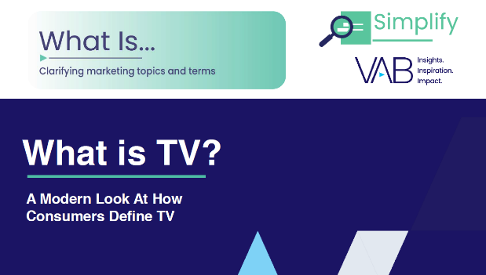
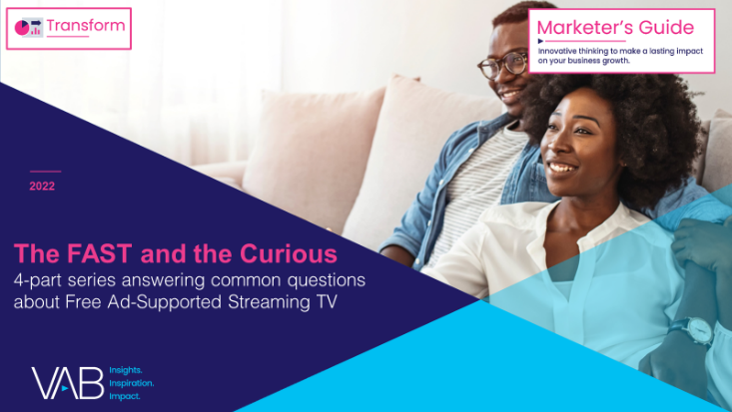



Creators
Jason Wiese
Leah Montner-Dixon
SVP, Director of Strategic Insights
jasonw@thevab.com
Associate Insights Director
leahm@thevab.com
Reed Kiely
Karolina Guillen
Associate Insights Director
reedk@thevab.com
Insights Manager
karolinag@thevab.com
Left to Your Own Devices
The Latest on Multiplatform Media Consumption
Setting the Stage
15 Streaming Trends That Will Impact Marketing Plans in 2023
Discover more
Looking for more data, insights and takeaways? Check out this related VAB content
What is TV?
A Modern Look At How Consumers Define TV
The FAST and the Curious
4-part series answering common questions about Free Ad-Supported Streaming TV
Through Upfront season, marketers are making important decisions about their video investment strategy.
We’re here to help.
Visit our Upfront Planning Resource Center
for a curated a list of resources filled with the data, analysis and insights needed to make informed investment decisions.
The Odyssey of Content Discovery
How TV Advertising Builds Streaming Audiences and Creates Engagement Opportunities
Staying Ahead of the Churn
Why migrating audiences means new ad opportunities for brands
VAB Members, brand marketers and agencies get free and immediate access to VAB’s content library. Get access at theVAB.com
This information is exclusively provided to VAB members and qualified marketers. Further distribution is prohibited.
PAGE 17

Slide 18


About VAB
VAB is an insights-driven organization that inspires marketers to reimagine their media strategies resulting in fully informed decisions.
Drawing on our marketing expertise, we simplify the complexities in our industry and discover new insights that transform the way marketers look at their media strategy.
We are committed to your business growth and proud to offer VAB members, brand marketers and agencies complimentary access to our continuously-growing Insights library. Get immediate access at theVAB.com.
Curious to learn more about VAB? Check out this quick video to see what we do and how we can help you develop business-driving marketing strategies.
This information is exclusively provided to VAB members and qualified marketers. Further distribution is prohibited.
PAGE 18

