Slide 1


.................
Committed
VIDEO ADVERTISING BUREAU - REPORT 2018
.................
Committed
Exploring Millennials’ Meaningful
Relationship With TV Programming

Slide 2
Contents
1
TV’s High Emotional Stakes
2
Survey Overview
3
The 360 Relationship Between Millennials and TV
4
Evaluating the “Emotional Stakes” Of Original YouTube Content
5
Parting Thoughts
6
Contact Information
2

Slide 3

“
Emotions lead to action, while reason leads to conclusions.”
Neurologist, Donald B. Caine
Why are Emotions Important?
…They Drive Intention & Build Brands
Someone who is highly attached is
3x more likely to engage with the brand.
They are less price sensitive, go deeper into the product line and have a higher lifetime value to an advertiser
3
Source: LEAP Media Investment

Slide 4


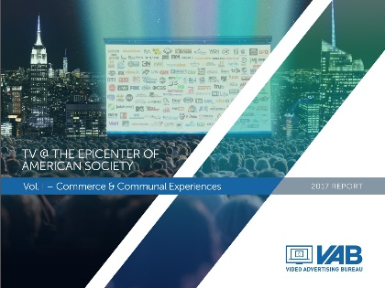
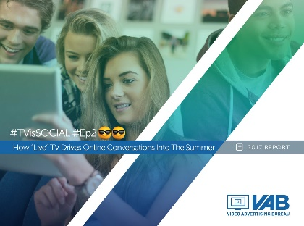
Quantifying TV’s High Emotional Stakes
We’ve proved it over and over again – the tremendous commitment and engagement viewers have with ad-supported TV programming.
In Be Still My Viewing Heart , VAB demonstrated the emotional connection viewers have to the programs and characters they love – or love to hate.
In TV @ The Epicenter of American Society, we showed the tremendous impact TV has on culture - it influences the careers we explore, what we eat, and even how we speak!
In our #TVisSocial series, we repeatedly see that viewers are excited to share their reactions to TV with the world.
This report takes our most in-depth look yet at the emotional attachment viewers have with ad-supported TV content.
4

Slide 5

To Quantify Their Engagement…
We Conducted a Custom Study
The VAB commissioned Research Now to conduct the Program Engagement Survey fielded online in April 2018 with 1,000 adult 18+ respondents surveyed.
Survey respondents skewed slightly younger but otherwise aligned with the population. Additionally, their TV consumption is line with the population. (See appendix for details)
5

Slide 6

Primary Study Objective…
To understand the emotion viewers exhibit for ad-supported TV programs* and how they express their attachment through their behaviors
*TV programs are defined as:
Programs that are currently airing or originally aired on broadcast or cable TV, inclusive of all devices and methods of viewing (e.g. watching Breaking Bad on Netflix or catching up on recent episodes of This is Us on Hulu or viewing through network apps such as CBS All Access)
6

Slide 7
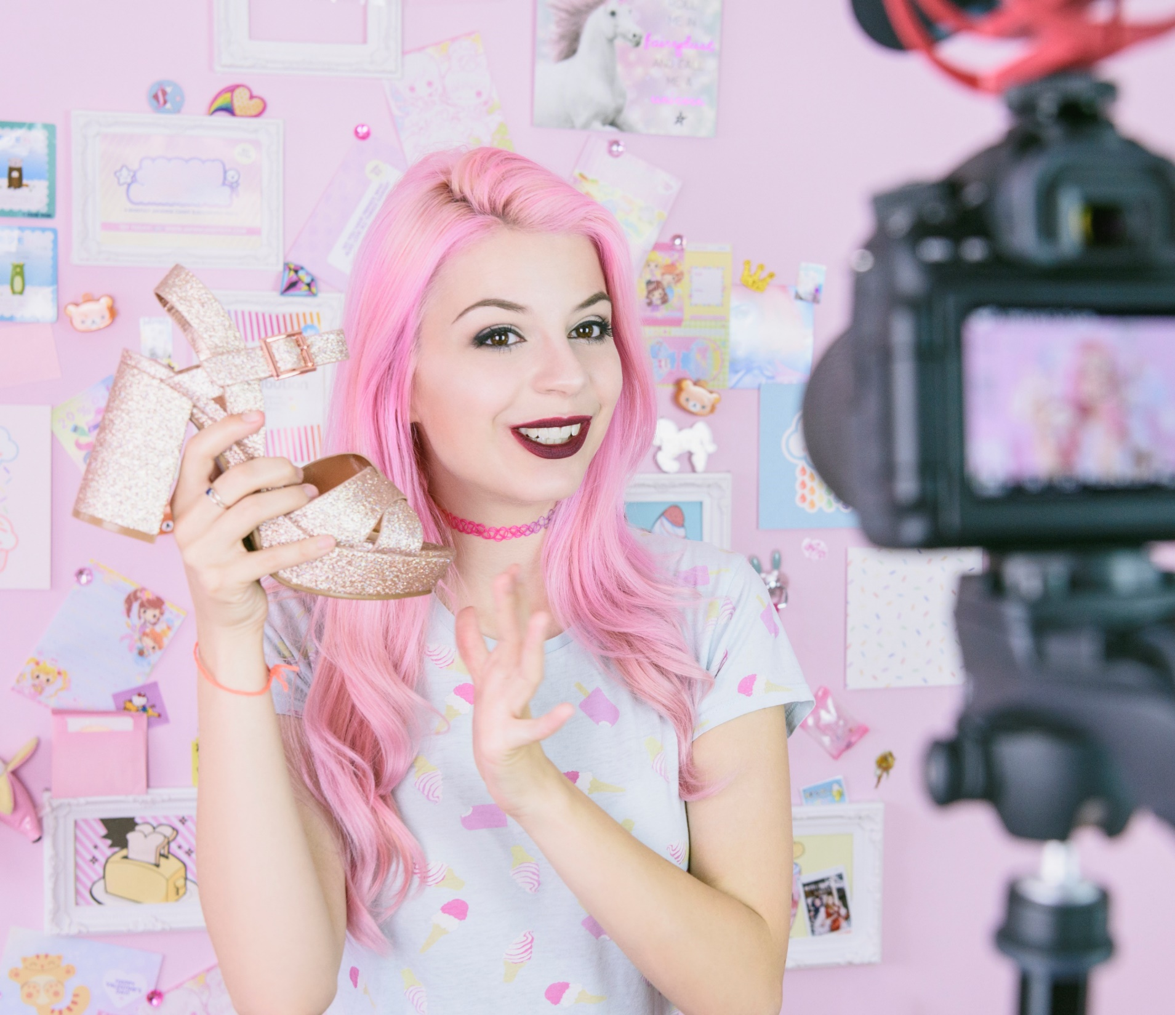
Secondary Study Objective…
Contrast a viewers commitment to TV programming against how they engage with original YouTube content
*Original YouTube Content: Videos that were produced by an established YouTube personality that are only available on YouTube and do not appear on broadcast or cable TV. Does not include user generated videos (e.g. cat videos), professionally-produced music videos, or TV program content (e.g. clips from Late Night with Stephen Colbert)
7

Slide 8




Topline Survey Findings
Millennials feel a strong bond with TV programming
Emotional connection inspires deeper program engagement
Engagement motivates purchase
They regularly set aside time to
watch their favorite
programs and
prioritize it as their
“me time.”
Viewers are actively engaged beyond the TV airing – they share and post video clips, follow actors on social media, read recaps, and scour the web for behind-the-scenes scoop
Motivated by their attachment, viewers buy products, select travel destinations, and dine at restaurants they have seen featured or advertised on TV
8

Slide 9

Millennials Up Close
Though we surveyed all adults, the focus of this report is Millennials.
Millennials are often portrayed as less attached to ad-supported TV programming however our study confirms a strong emotional (and time) investment in ad-supported TV content.
This report quantifies the ways Millennials demonstrate their commitment, engagement and passion to TV programming.
9

Slide 10

The 360 Relationship Between Millennials And Ad-Supported Television Programs

Slide 11
It Is Clear That Millennial Engagement With TV Content Goes Way Beyond Just The Time A Viewer Devotes To Watching A Program
Watch more TV shows with my favorite actor from the show
Buy that reality star’s new line of products featured on the show
Read recaps of last week’s episode
Pre-Viewing
Book a table at that TV chef’s new restaurant
Research locations featured from a show for an upcoming trip
Post-Viewing
Check Twitter for on-set tweets & teasers from cast
Dissect everything that happened with family & friends
Re-watch old episodes in anticipation
Inevitably look up spoilers for next week’s episode
Remember to set aside time to watch the new episode
During
Read reviews for opinions and reaction to that plot twist
Reach for the Kleenex while watching a character die
Feel shock from that cliffhanger ending
Look Up Actors
“Haven’t I seem him in something?”
11

Slide 12





Millennials Are Highly Invested In TV Programming And Experience A Wide Range Of Emotions When Watching TV Shows
They typically feel as strong of an emotional reaction to TV programs, if not stronger, than the average adult
“I Have Laughed Out Loud Because Of Something That Happened On A TV Program”
“I Sat Through An Episode Of A TV Program In Anticipation / Worry About What's Going To Happen Next”
“A Cliffhanger Ending Has Shocked Me”
“I Have Cried Because Of A Character's Death On A TV Program”
“I Have Gotten Angry Or Upset About A Plot Twist On A TV Program”
Millennials
73%
65%
54%
53%
51%
Adults
78%
59%
52%
45%
43%
Millennials
Adults
Source: VAB / Research Now “Program Engagement” Survey, April 2018. Q8: Which of the following statements are true for you? Check any that apply. Adults = A18+, Millennials = A18-34. Total Respondents=1,001.
12

Slide 13






This Emotional Bond Inspires Further Engagement on Digital Platforms Before, During, and After the Program Airs
Millennials
Adults
“% Always or Frequently”
Follow Or 'Like' TV Programs/Characters/Actors On Facebook Or Instagram
52% / 29%
Go On Wikipedia To Learn More About A TV Show's Topic Or Actor/Character
51% / 34%
Share, Post Or Tweet Video Clips / Content About A TV Program
45% / 25%
Tweet About Or Read A Tweet About A TV Program
43% / 24%
Visit An Official Show Website
39% / 27%
Millennials
Adults
Source: VAB / Research Now “Program Engagement” Survey, April 2018. Q9: Please indicate how often you do the following. Respondents Answer = Always/Frequently. Adults = A18+, Millennials = A18-34. Total Respondents=1,001.
13

Slide 14
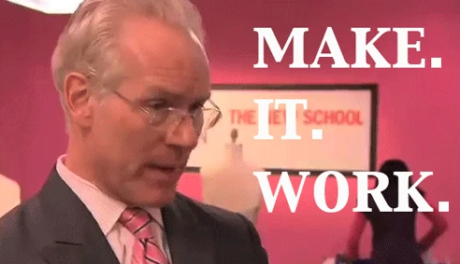

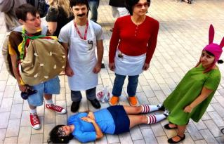
The Emotional Connection Also Carries Over Into The Physical Realm And Permeates Pop Culture
“I have used a TV-related phrase in a conversation with family/friends/co-workers”
“I was inspired to make a food recipe based on a TV show or segment”
“I have dressed up like A TV character for Halloween or a themed party”
Millennials
55%
45%
43%
Adults
50%
41%
24%
Millennials
Adults
Source: VAB / Research Now “Program Engagement” Survey, April 2018. Q10: Which of the following statements are true for you? Check any that apply. Adults = A18+, Millennials = A18-34. Total Respondents=1,001.
14

Slide 15
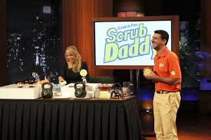
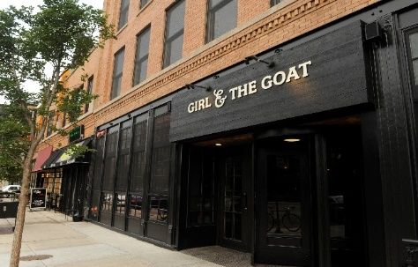
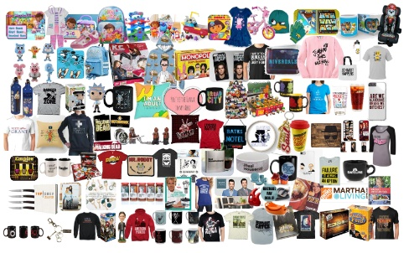

Most Importantly, This Deep Relationship Millennials Have With Programming Inspires And Influences Their Purchasing Decisions
“I purchased a product that has been shown / featured on a TV show”
“I have eaten at a restaurant because it, or its chef / owner, was featured on a TV show”
“Purchase a product I saw while watching a TV program (either a product I saw in an ad or in the actual program)”
“I have visited a location / vacationed at a place because it was featured on a TV show”
43% / 40%
43% / 37%
43% / 25%
40% / 33%
Millennials
Adults
Source: VAB / Research Now “Program Engagement” Survey, April 2018. Q9: Please indicate how often you do the following. Purchase a product I saw while watching a TV program (either a product I saw in an ad or in the actual program). Respondents Answer = Always/Frequently. Q10: Which of the following statements are true for you? Check any that apply. Adults = A18+, Millennials = A18-34. Total Respondents=1,001.
15

Slide 16
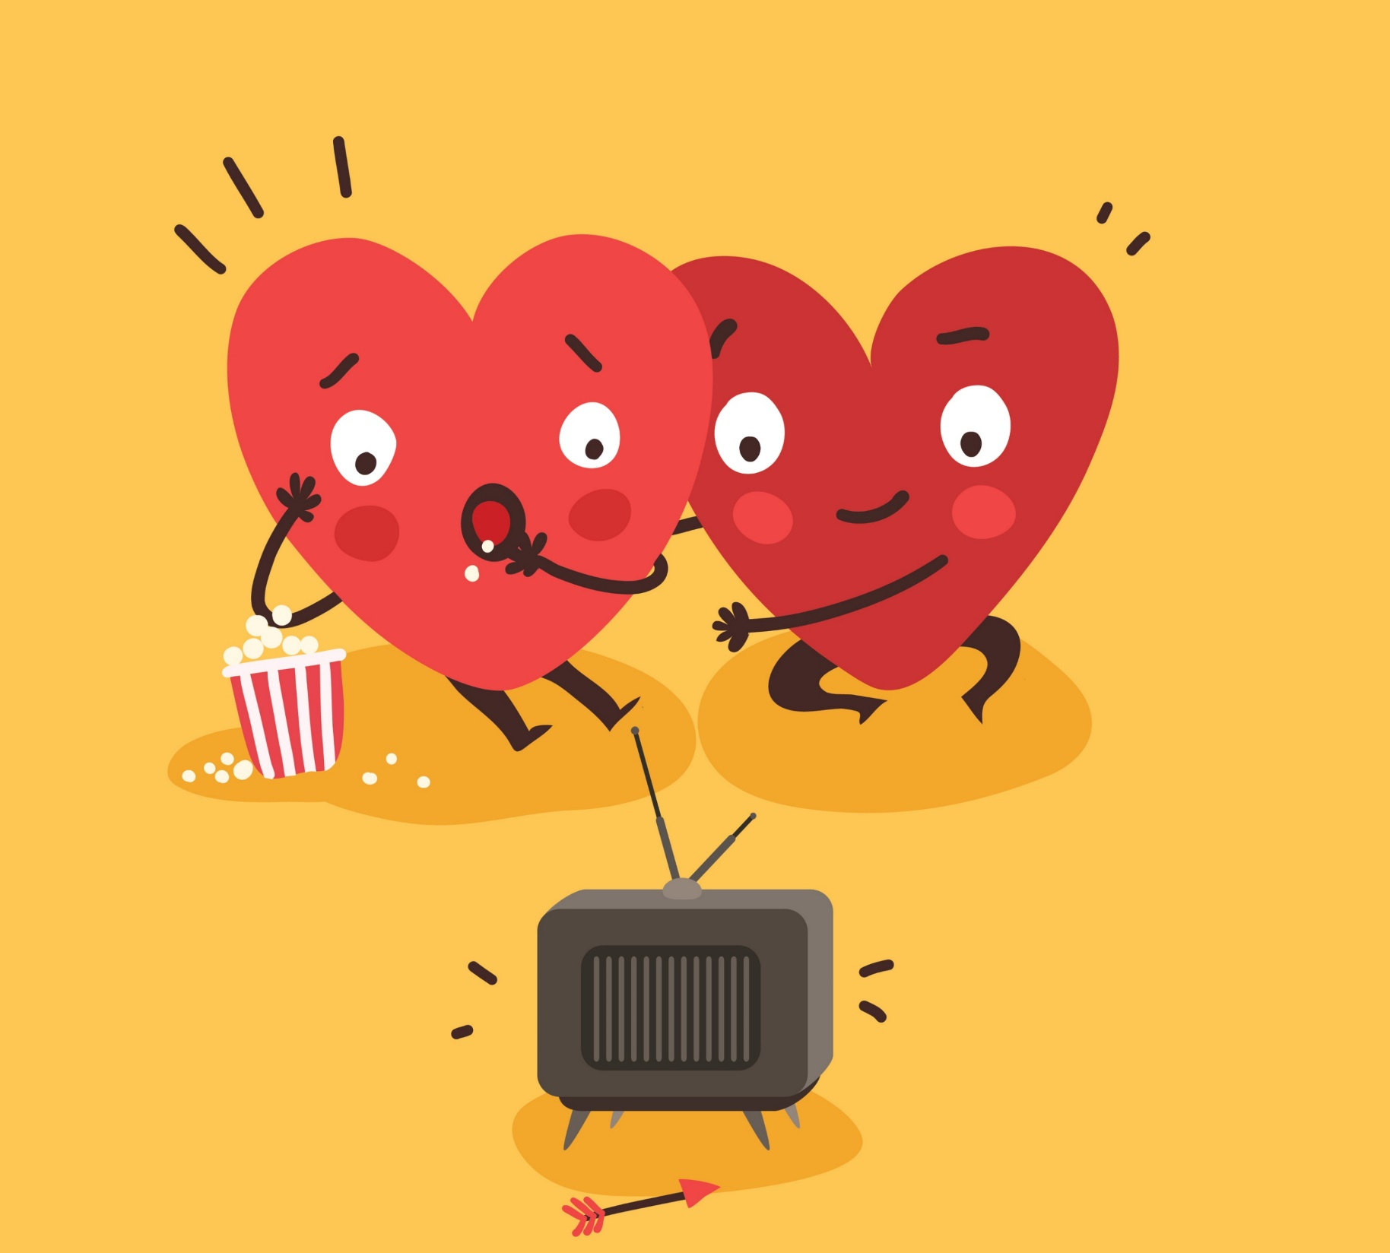
“Favorite Programs are programs you look forward to the most, watch consistently, or recommend to others.”
The Relationship Between Millennials And Ad-Supported TV Is Even More Evident When It Comes To Their Favorite Programs

Slide 17

Viewers Develop A Commitment To TV Programs In Much The Same Way They Do With Any Other Of Their Favorite Products
A viewer’s path toward commitment to their favorite TV programming develops along similar stages as the consumer purchasing funnel.
Attention
Take notice and be aware
Interest
Deepen engagement
Desire
Prioritize; Greater urgency & anticipation
Action & Advocacy
Actively support
or
promote
“Favorite Program:” Programs you look forward to the most, watch consistently, or recommend to others.
17

Slide 18


As A Result Of Its Unmatched Scale, Millennials Are More Likely To Watch Their Favorite Programs On Cable or Broadcast Than Any Other Platform
Attention
The 44% is most likely even higher for ad-supported TV as it doesn’t take into account the Cable and Broadcast programming being watched on Hulu and other ad-supported streaming apps
On Ad-Supported Cable/Broadcast
On Netflix
On Amazon Prime
On Hulu
Streaming / On-Demand App / Provider (other than Netflix, Hulu & Amazon)
Other
Source: VAB / Research Now “Program Engagement” Survey, April 2018. Q11: Where do you watch the majority of your favorite TV programs? Check any that apply. Total Respondents=1,001.
18

Slide 19


Millennials Feel A Sense of Immediacy & Community With Other Viewers Which Is Why “Live” Viewing Is Still The Most Popular Way To Watch Their Favorite Programs
Attention
Live as it airs
Time-shifted / through a DVR (another time, after it airs, delayed time)
Via a streaming service or OTT app (i.e. Netflix, Hulu, CBS All Access)
On Video-On-Demand (VOD) through a cable or set top box
Source: VAB / Research Now “Program Engagement” Survey, April 2018. Q12: How do you prefer to watch your favorite TV programs? Q13.5: Please rate how much you agree or disagree with the following statements. I like to watch my favorite TV programs with my friends / family. . % of Respondents who agree-Top 2 Box (net). Total Respondents=1,001.
19

Slide 20
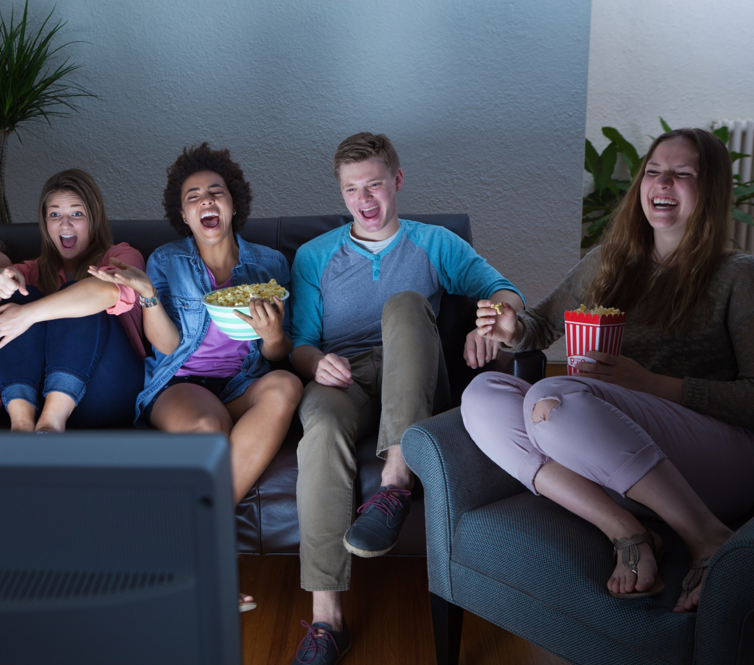
The Communal Aspect of TV
64% of Millennials enjoy watching their favorite programs with their friends and family (vs. 54% for the average adult)
20

Slide 21
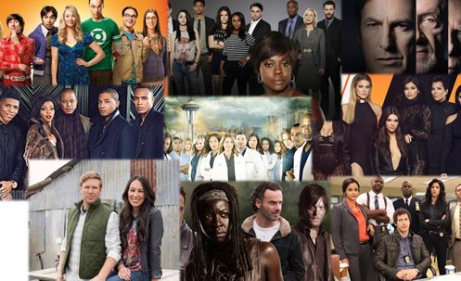
Interest
Millennials Feel Personally Invested In The Characters And Actors Of Their Favorite Shows
Both Millennials and Adults are eager to learn more about their favorite actors and characters
“I feel personally connected to the characters of my favorite TV programs”
“I have looked up the actors in the show to learn more about them 'Off The Screen’ or to see what other shows/films they have been in”
47% / 34%
58% / 52%
“I have watched other shows or movies because an actor from one of my favorite TV programs was in it”
“I have read actor or cast news to learn more about what’s going on 'Behind The Scenes‘”
57% / 55%
46% / 35%
Millennials
Adults
Source: VAB / Research Now “Program Engagement” Survey, April 2018. Q14: Again, keeping your favorite TV programs in mind, which of the following statements do you believe are true for you? Check any that apply. Adults = A18+, Millennials = A18-34. Total Respondents=1,001.
21

Slide 22

Millennials’ Favorite TV Shows Are Such Appointment Viewing They Practically Go Through Withdrawal Once A Season Is Over
Desire
Millennials
Adults
“I regularly set aside time in my busy schedule to watch my favorite TV programs”
61% / 62%
Despite their busy lifestyles, Millennials prioritize their “TV time” just as much as the average person does
“I try to watch every new episode of my favorite TV programs”
73% / 76%
“Watching my favorite TV shows is my 'me-time‘”
74% / 69%
“After the season finale, I'm sad I have to wait months for the next new episode”
56% / 56%
Millennials
Adults
Source: VAB / Research Now “Program Engagement” Survey, April 2018. Q13: Please rate how much you agree or disagree with the following statements. % of Respondents who agree-Top 2 Box (net); Q15: Which of the following statements are true for you? Check any that apply. Adults = A18+, Millennials = A18-34. Total Respondents=1,001.
22

Slide 23



Even When A Show Is Not Airing, Millennials Fuel Their Passion By Re-Watching Episodes & Engaging With Related Content Online
A&A
Online recaps, reviews, spoilers, related blogs, you name it, Millennials will consume any kind of content to satisfy their cravings and inherent curiosity
“I have re-watched episodes from previous seasons in anticipation of the upcoming season”
“I read online recaps, blogs or reviews about the episode”
“I look for spoilers”
Millennials
52%
49%
47%
Adults
49%
29%
27%
Millennials
Adults
“% After Every or Most Episodes”
Source: VAB / Research Now “Program Engagement” Survey, April 2018. Q15: Which of the following statements are true for you? Check any that apply. Q16: How often do you typically do the following after watching a new episode of one of your favorite TV programs. Respondents who answered “After every/most episodes”. Adults = A18+, Millennials = A18-34. Total Respondents=1,001.
23

Slide 24


They Are Also Much More Likely To Act As Major Advocates By Inspiring Conversation And Persuading Others To Join In The Viewing Fun
A&A
“I Discuss TV Programs With Friends, Family, Co-workers”
“I Have Tried To Convince A Friend To Start Watching My Favorite TV Program”
Millennials
59%
52%
Adults
39%
48%
Millennials
Adults
“% After Every or Most Episodes”
Source: VAB / Research Now “Program Engagement” Survey, April 2018. Q15: Which of the following statements are true for you? Check any that apply. Q16: How often do you typically do the following after watching a new episode of one of your favorite TV programs. Respondents who answered “After every/most episodes”. Adults = A18+, Millennials = A18-34. Total Respondents=1,001.
24

Slide 25
In Summary, The 360 Relationship That Millennials Have With TV Programming Is Real
57% Seek out more TV shows with favorite actor from the show
43% Bought that star’s new line of products featured on the show
49% Read recaps of last week’s episode
Pre-Viewing
43% Book a table at that TV chef’s new restaurant
40% Research locations featured from a show for an upcoming trip
Post-Viewing
43% Check Twitter for on-set tweets & teasers from cast
59% Dissect everything that happened with family & friends
52% Re-watch old episodes in anticipation
47% Inevitably look up spoilers for next week’s episode
During
61% Remember to set aside time to watch the new episode
49% Read reviews for opinions and reaction to that plot twist
53% Reach for the Kleenex while watching a character die
54% Feel shock from that cliffhanger ending
58% Look Up Actors
“Haven’t I seem him in something?”
Source: VAB / Research Now “Program Engagement” Survey, April 2018. Millennials = A18-34.
25

Slide 26

It’s clear that Millennials are highly engaged with TV programming. They feel emotionally attached to shows and characters and are moved to discuss and share with others.
But does the same behavior & “Emotional Stakes” exist for Original YouTube Content?

Slide 27









How We Define YouTube “Original Content”
  YouTube Original Content refers to videos that were produced by an established YouTube personality that are only available on YouTube and do not appear on broadcast or cable TV. This does not include user generated videos (e.g. cat videos), music videos, or TV program content (e.g. clips from Late Night with Stephen Colbert)
Examples Include:
Smosh
JennaMarbles
GoodMythicalMorning
LauraInTheKitchen
Ryan Toys Review
DudePerfect
PewDiePie
PopularMMOs
66% of Millennials regularly watch original content on YouTube, compared to 38% of Adults 18+
Source: VAB / Research Now “Program Engagement” Survey, April 2018. Q16b: Do you regularly (at least twice a month) watch original content on YouTube (i.e. Jake Paul, PewDiePie, Good Mythical Morning, Jenna Marbles, First We Feast, etc.)? Millennials = A18-34. Total Respondents=1,001.
27

Slide 28



Millennials don’t feel the same immediacy or sense of community around original YouTube videos as they do for TV
Attention
When Do Millennials Prefer To Watch Content?
TV Programs
YouTube Originals
Source: VAB / Research Now “Program Engagement” Survey, April 2018. Q12: How do you prefer to watch your favorite TV programs? Q21: I watch new videos posted by my favorite YouTube Personality…; Time-shifted YouTube viewing includes viewing, within a few hours of posting, same day as posting, within a few days, within a few weeks, whenever I have time/don’t know. Millennials = A18-34. Total Respondents=1,001.
28

Slide 29

Millennials are drawn into TV’s complex storylines, rich character development and well-known talent resulting in an unmatched emotional response
29

Slide 30





Millennials Are More Emotionally Invested In TV Programs Than They Are In
Original YouTube Content
Interest
Millennials’ Emotional Response to TV Programs and YouTube Original Content
“Laughed Out Loud Because Of Something That Happened On A TV Program”
“Sat Through An Episode Of A TV Program In Anticipation / Worry About What's Going To Happen Next"
“Cried Because Of A Character's Death on a TV Program”
“Gotten Angry Or Upset About A Plot Twist On A TV Program”
73%
65%
53%
48%
“Laughed Out Loud Because Of Something That A YouTube Personality Did”
“Sat Through A Video Of A YouTube Personality In Anticipation / Worry About What's Going To Happen Next”
“Cried Because Of Something That Happened In A Video Of An Original YouTube Personality”
“Gotten Angry Or Upset About Something A YouTube Personality Did”
59%
43%
36%
33%
Source: VAB / Research Now “Program Engagement” Survey, April 2018. TV: Q8: Which of the following statements are true for you? YouTube: Q17: Which of the following statements are true for you? Check any that apply. Base = Those who regularly watch original content on YouTube; Millennials = A18-34. Total Respondents=1,001
30

Slide 31


Millennials Also Feel a Stronger Connection With TV Characters & Actors Than to YouTube Personalities
Interest
“I feel personally connected to the characters of my favorite TV programs”
“I have looked up the actors in a TV program to learn more about them 'off the screen’”
“I have watched other shows or movies because an actor from one of my favorite TV programs was in it”
47%
58%
57%
“I feel personally connected to my favorite YouTube personality”
“I have looked up my favorite YouTube Personality to learn more about them 'off the screen’”
“I have watched other shows or movies because my favorite YouTube personality was in it”
42%
51%
47%
Source: VAB / Research Now “Program Engagement” Survey, April 2018. TV: Q14: Again, keeping your favorite TV programs in mind, which of the following statements do you believe are true for you? YouTube: Q19: Again, keeping your favorite YouTube personalities in mind, which of the following statements do you believe are true for you? Check any that apply. Base=Those who regularly watch original content on YouTube. Millennials = A18-34. Total Respondents=1,001.
31

Slide 32
There Is An Equal Level Of Interest & Escapism For Millennials Between Ad-Supported
TV Shows & Original YouTube Content
Desire
Millennials
“I try to watch every new episode of my favorite TV programs
“Watching my favorite TV shows is my 'me-time‘”
73%
74%
“I try to watch every new video posted by my favorite YouTube personality”
“Watching my favorite YouTube personality is my 'me-time‘”
72%
73%
TV Show
YouTube Original Video
Source: VAB / Research Now “Program Engagement” Survey, April 2018. TV-Q13: Please rate how much you agree or disagree with the following statements; YouTube- Q18: Please rate how much you agree or disagree with the following statements. % of Respondents who agree-Top 2 Box (net). Adults = A18+, Millennials = A18-34. Total Respondents=1,001.
32

Slide 33




However, YouTube Itself Helps Further Fuel Millennials’ Desire For TV With Supplementary Content On Its Platform
Desire
Millennials actively engage with TV content on YouTube
“% Always or Frequently”
“I Watch Video Clips From TV Shows On YouTube”
“I Read Or Post Comments About TV Content On YouTube”
“I Subscribe To Or Have Watched TV Show’s YouTube Channel”
55%
49%
31%
Source: VAB / Research Now “Program Engagement” Survey, April 2018. Q9: Please indicate how often you do the following. Respondents Answer = Always/Frequently. Q15: Which of the following statements are true for you? Check any that apply. Millennials = A18-34. Total Respondents=1,001.
33

Slide 34


Most Importantly, Given Their Greater Commitment To Television Content,
TV Programming Is More Likely Than YouTube Original Content To Inspire Purchase
A&A
Millennials are 19% more likely to purchase a product that’s been shown or featured during ad-supported TV than they are a product featured by their favorite YouTube personality
43%
36%
of Millennials have purchased a product that has been shown / featured on a TV show
of Millennials have purchased a product that their favorite YouTube personality has shown / featured during a video
Source: VAB / Research Now “Program Engagement” Survey, April 2018. TV: Q10: Which of the following statements are true for you? YouTube: Q19: Again, keeping your favorite YouTube personalities in mind, which of the following statements do you believe are true for you? Check any that apply. Millennials = A18-34. Total Respondents=1,001.
34

Slide 35

Parting Thoughts
Millennials Show A Deep Commitment To TV Programming
Their Emotional Investment In TV Programs Is Shown In Their Interest and Desire To Watch, Share & Discuss Content As Well As Their Advocacy For Their Favorite Shows
Millennials Exhibit A Greater Emotional Connection To TV Over YouTube Original Content
Ultimately, TV Has More Influence On Their Purchasing Decisions Than YouTube Original Content
35

Slide 36


Contact Us
Danielle DeLauro
Executive Vice President
danielled@thevab.com
Jason Wiese
SVP, Director of Strategic Insights
jasonw@thevab.com
Marianne Vita
VP, Strategic Insights
mariannev@thevab.com
Leah Montner-Dixon
Senior Multi-Platform Video Analyst leahm@thevab.com
@VideoAdBureau

Slide 37


Slide 38
The Survey Respondents Skew Slightly Younger But Are Otherwise Fairly Aligned With The Population
Age
Gender
At 34% of respondents, skews Millennial
Aligns with population
Annual Household Income
Ethnicity
Hispanic or Latin Descent
Fairly aligned to population
Fairly aligned to population
(Index) = Survey Respondents / U.S. Population
Source: VAB / Research Now “Program Engagement” Survey, April 2018. Total Respondents=1,001. U.S. Census data, 2017 population estimates; GfK MRI 2018 Doublebase

Slide 39

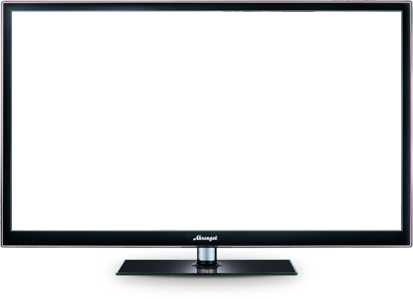
Survey Respondents’ Television Consumption
Is In Line With The Population
Adults:
Per Nielsen, Adults 18+ watch 4:46 per day
Per our Survey, 49% watch more than 3 hours per day
Millennials:
Per Nielsen, Adults 18-34 watch 2:17 per day
Per our Survey, 53% watch more than 2 hours per day
Source: VAB / Research Now “Program Engagement” Survey, April 2018. Total Respondents=1,001. U.S. Census data, 2017 population estimates; GfK MRI 2018 Doublebase; Nielsen Total Audience Report, Q1 2018.

Slide 40
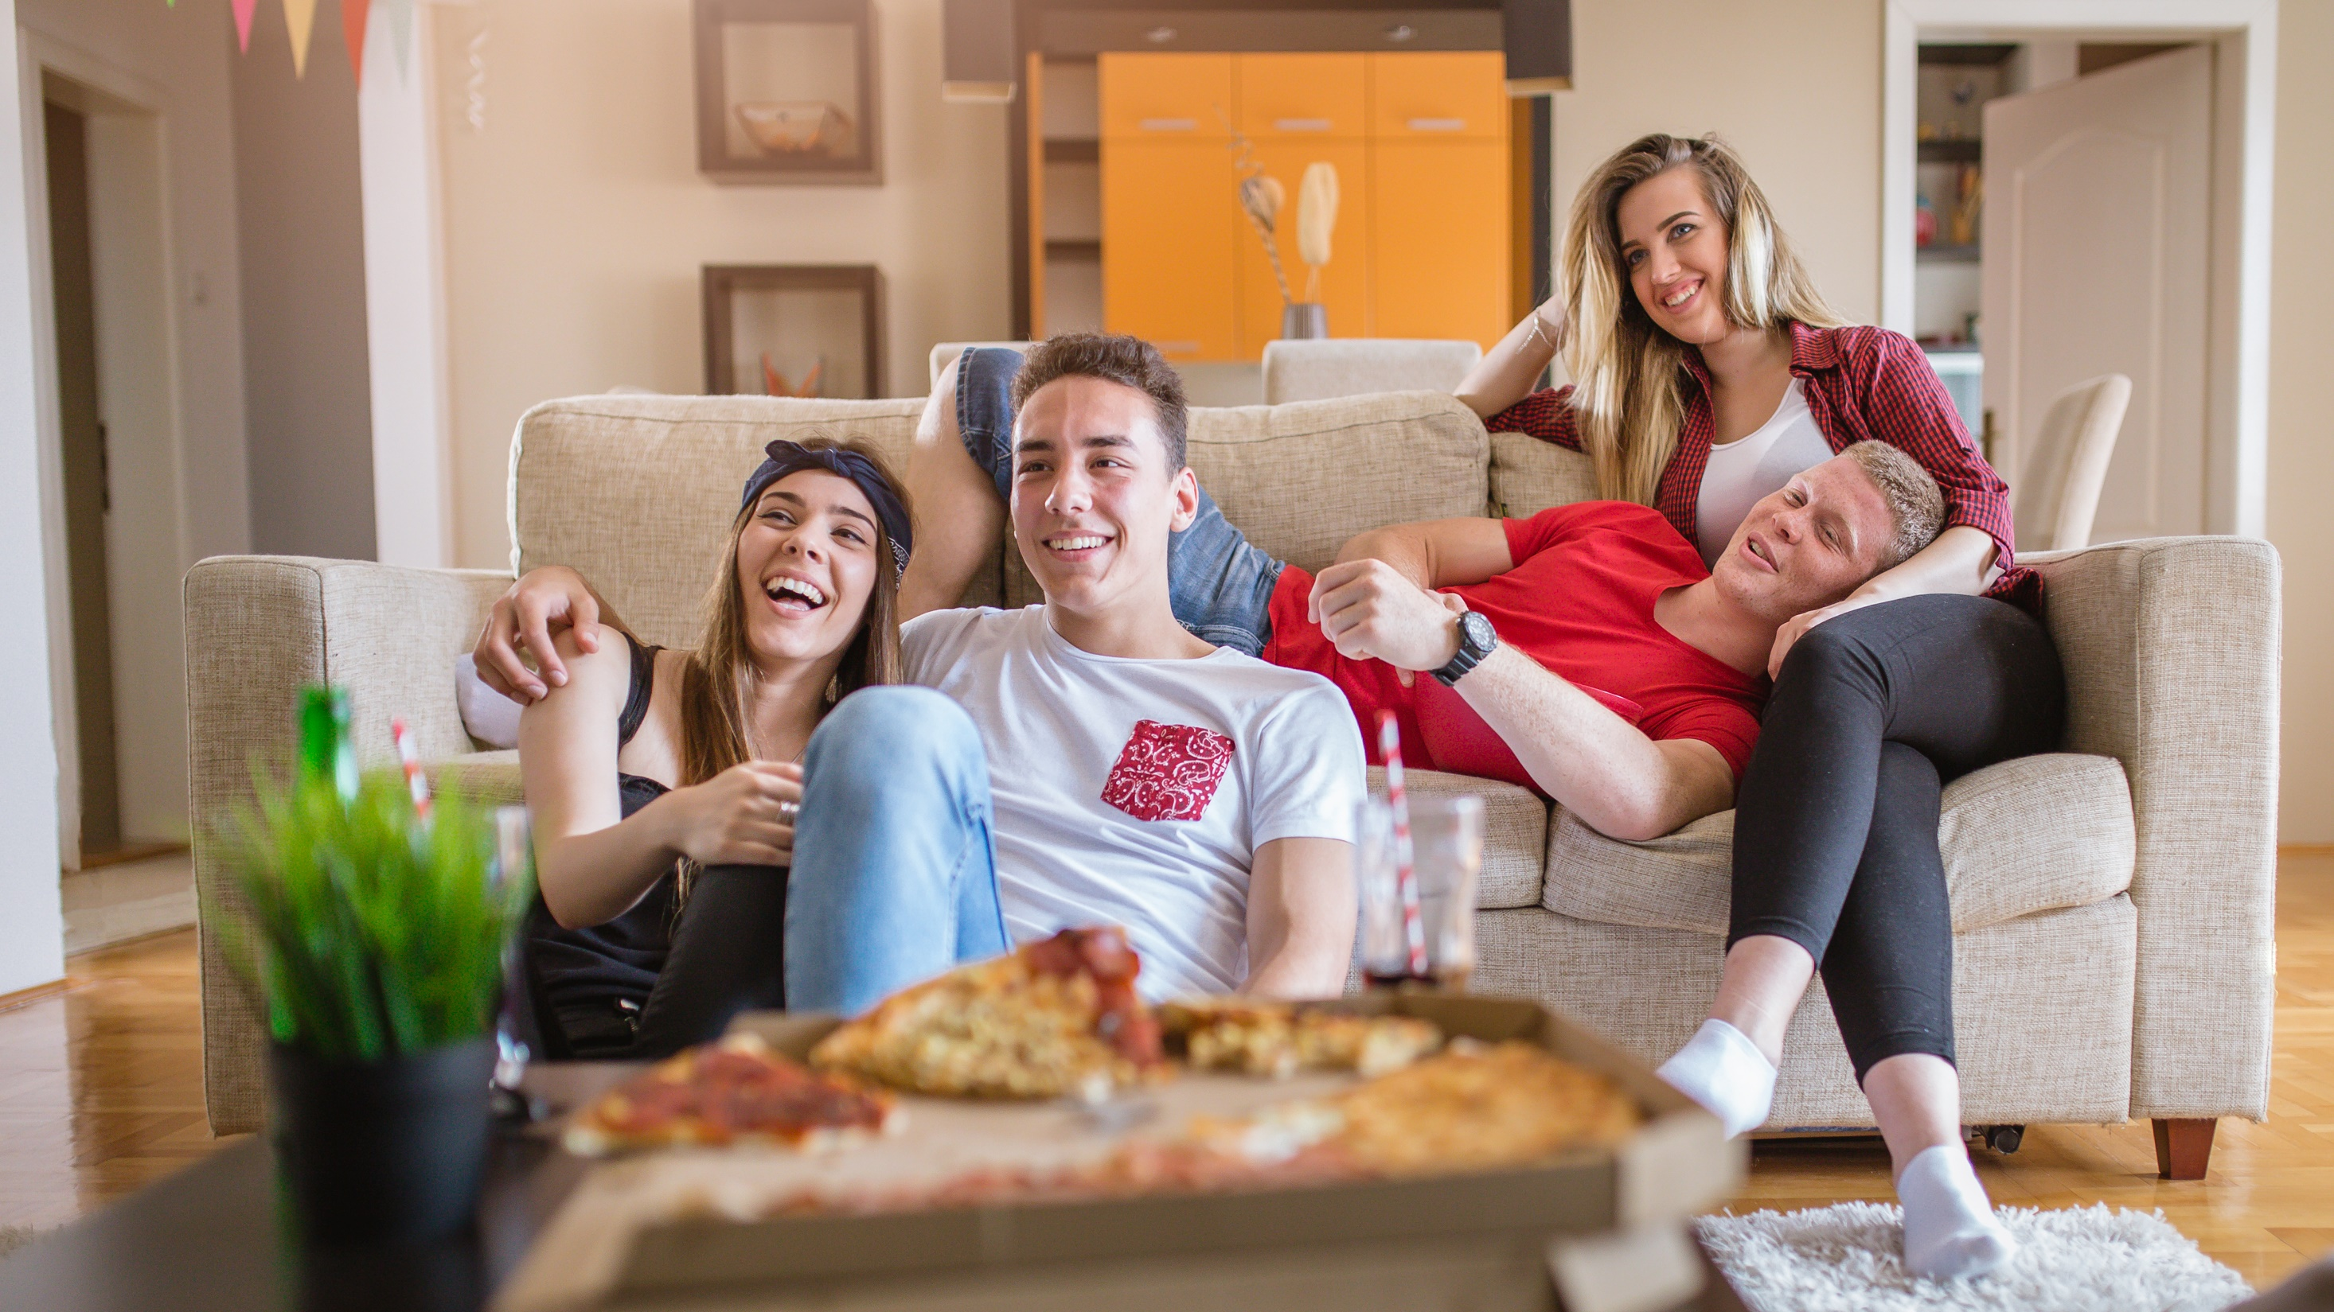
Millennial Myth Busting
Myth: They don’t watch any traditional (linear) television.
Reality: Millennials watch over 2+ hours of TV per day
Myth: They prioritize other leisure activities over TV.
Reality: 61% regularly set aside time in their busy schedules to watch their favorite TV programs
Myth: They overwhelmingly prefer original content from streaming services.
Reality: 44% of Millennials watch the majority of their favorite programs on cable & broadcast networks vs. 25% on Netflix
Source: Nielsen Total Audience Report, Q1 2018, A18-34. VAB Custom Program Engagement Study, April 2018.

