Slide 1


VIDEO ADVERTISING BUREAU - REPORT 2018
.................
Committed
Exploring Multicultural Viewers’ Passionate
Relationship With TV Programming

Slide 2
Contents
1
TV’s High Emotional Stakes
2
Survey Overview
3
The 360 Relationship Between Multicultural Viewers and TV
4
Evaluating the “Emotional Stakes” Of Original YouTube Content
5
Decidedly Different: A Summary Of How Multicultural Viewers Differ From Non-Hispanic Whites
6
Parting Thoughts
7
Contact Information
2

Slide 3

Multicultural Viewers Up Close
In the first report in our Committed series released earlier in 2018, we focused on Millennials’ relationship with ad-supported TV and how the strong emotional bonds they develop with their favorite TV shows inspire deep engagement and motivates purchase.
In this second installment of our Committed series, we examine the emotional ties that Black and Hispanic viewers have with ad-supported TV and the differences that exist between each segment and, for comparison purposes, the
Non-Hispanic White demographic.
As you’ll see, Multicultural viewers’ strong emotional engagement with TV programming often exceeds the high baselines achieved by Non-Hispanic White viewers.
3

Slide 4

Why are Emotions Important?
…They Drive Intention & Build Brands
“Emotions lead to action, while reason leads to conclusions.”
Neurologist, Donald B. Caine
Someone who is highly attached is
3x more likely to engage with the brand.
They are less price sensitive, go deeper into the product line and have a higher lifetime value to an advertiser.
4
Source: LEAP Media Investment

Slide 5
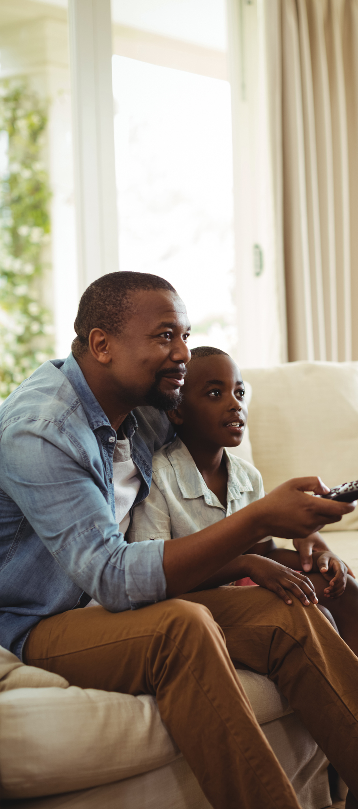
Committed, A VAB Custom Survey Series, Quantifies Viewer Emotional Attachment And Engagement To TV Programming
Study Methodology
The VAB commissioned Research Now to conduct the Program Engagement Survey fielded online in April 2018 with 1,000 A18+ respondents surveyed.
From a multicultural perspective, these respondents included:
188 Hispanic respondents
160 Black respondents (African American/Black/Caribbean American)
744 Non-Hispanic White respondents
Study Objectives
Primary: To understand the emotion viewers exhibit for ad-supported TV programs and how they express their attachment through their behaviors
Secondary: Contrast a viewer’s commitment to TV programming against how they engage with original YouTube content
Notes:
Methodology Note: there is some overlap between the Hispanic respondents and Black respondents as a small % of respondents identified themselves as both and thus are included in both demographic segments. The Asian demographic was excluded from this analysis.
Ad-supported TV programs are defined as: programs that are currently airing or originally aired on broadcast or cable TV, inclusive of all devices and methods of viewing (e.g. watching Breaking Bad on Netflix or catching up on recent episodes of This is Us on Hulu or viewing through network apps such as CBS All Access)
*Original YouTube Content: Videos that were produced by an established YouTube personality that are only available on YouTube and do not appear on broadcast or cable TV. Does not include user generated videos (e.g. cat videos), professionally-produced music videos, or TV program content (e.g. clips from Late Night with Stephen Colbert)
5
Notes:
https://www.istockphoto.com/photo/son-and-father-watching-television-gm646901042-117323681

Slide 6
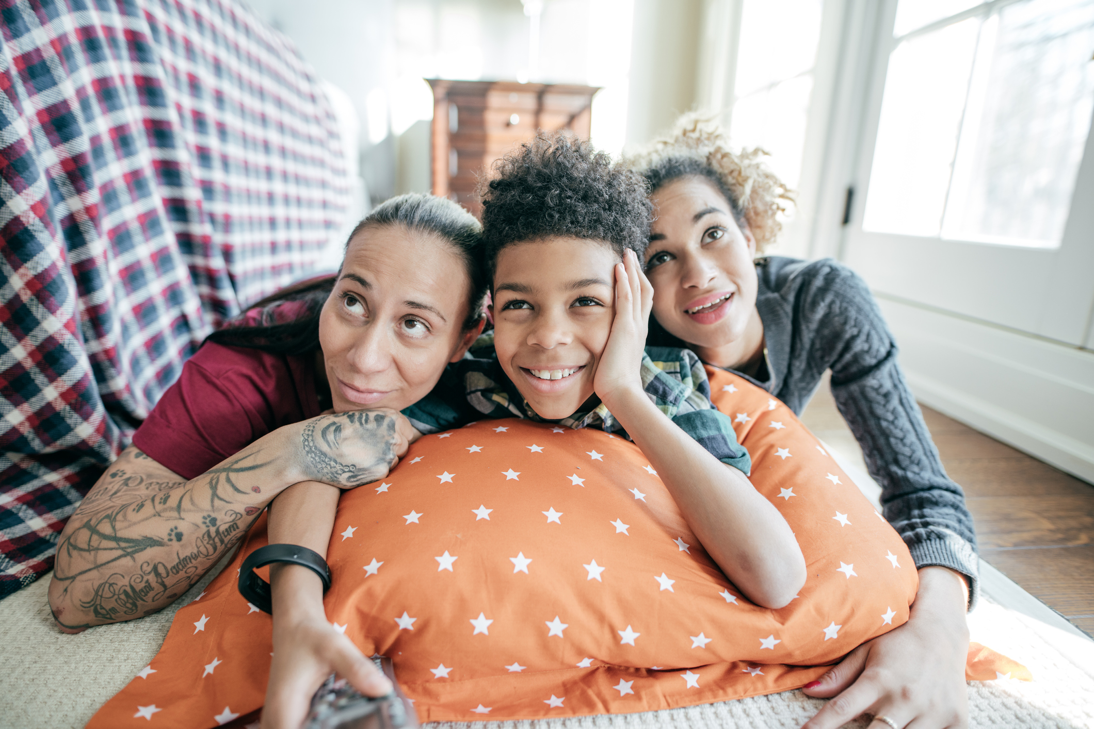
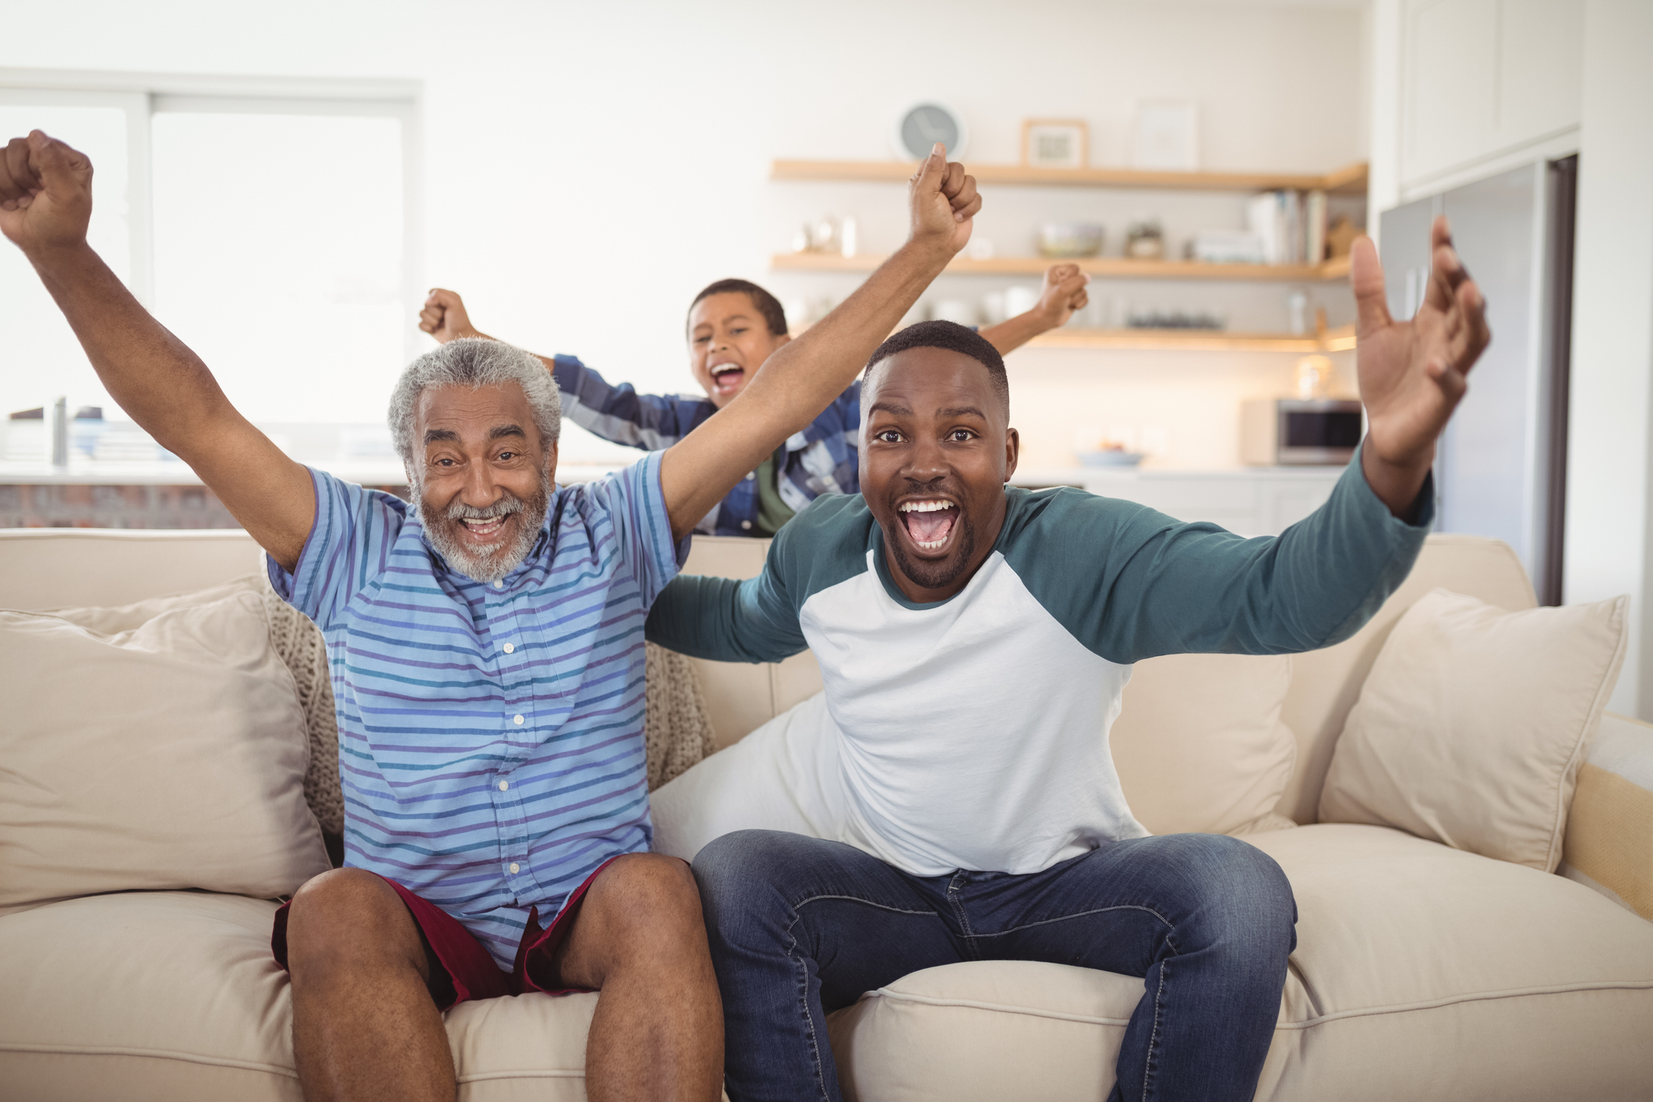

Topline Survey Findings On Multicultural Viewers
Motivated by their heavy emotional investment & intense need to be “part of the conversation,” multicultural viewers are highly vocal in sharing their thoughts & feelings online and with friends & family
They have an insatiable need for consuming MORE content from their favorite shows, TV personalities or actors
Multicultural viewers feel a stronger emotional connection with TV content vs. YouTube content
They regularly set aside time to watch their favorite
programs and prioritize it as their “me time.”
Viewers actively engage beyond the TV airing – they share and post video clips, tweet throughout and after a new episode & follow actors on social media
From reading recaps and looking for spoilers, to researching other shows their favorite actors are in, they can’t get enough of their favorite TV shows
Despite being 2x as likely as Non-Hispanic White viewers to watch original YouTube content, they show more passion, prioritization & personal connection towards TV programs vs. YouTube. This ultimately results in TV being a more powerful influencer to purchase.
This high engagement leads to a greater likelihood of purchasing products that are featured on TV
6
Notes:
https://www.istockphoto.com/photo/inexpensive-movie-bonding-gm1043568616-279333761
https://www.istockphoto.com/photo/family-cheering-while-watching-television-in-living-room-gm828867890-134810153
https://www.istockphoto.com/photo/happy-family-watching-television-gm849603870-139459695

Slide 7

The 360 Relationship Between Multicultural Viewers And
Ad-Supported Television Programs
Notes:
https://www.istockphoto.com/photo/handsome-football-fan-at-home-gm665397326-121213879

Slide 8
Multicultural Viewer Engagement With TV Content Goes Way Beyond Just The Time A Viewer Devotes To Watching A Program
Seek out more TV shows with their favorite actor from a show
Read recaps of last week’s episode
Buy a TV star’s new line of products featured on the show
Pre-Viewing
Anticipation & Preparation
Check Twitter for on-set tweets & teasers from cast
Book a table at a TV chef’s new restaurant
Post-Viewing
Insatiable Need For More
Settle in and focus their attention on the show because it is their “me-time”
Research locations featured on a show for an upcoming trip
During
Immediate Need to Connect to Community
Dissect everything that happened in the episode with family & friends
Cry over a character’s death on a show
Inevitably look up spoilers for next week’s episode
Can’t help but empathize with the character they feel personally connected to
Read reviews for opinions and reaction to a show’s ending
Look Up Actors Online
“Haven’t I seem him in something?”
Feel angry over a plot twist at the end
Tweet About A Show “OMG! Did that just happen?!”
8
Source: VAB / Research Now “Program Engagement” Survey, April 2018.

Slide 9





They Are Much More Likely To Be “Social Sharers” Who Are Actively Involved In Online Communities Centered Around TV Programs
Black
Hispanic
Non-Hispanic
White
“% Always or Frequently”
Follow Or 'Like' TV Programs/Characters/Actors On Facebook Or Instagram
40% / 39% / 27%
Go On Wikipedia To Learn More About A TV Show's Topic Or Actor/Character
44% / 45% / 32%
Share, Post Or Tweet Video Clips / Content About A TV Program
36% / 35% / 22%
Tweet About Or Read A Tweet About A TV Program
34% / 33% / 21%
Visit An Official Show Website
38% / 33% / 25%
Black
Hispanic
Non-Hispanic White
Source: VAB / Research Now “Program Engagement” Survey, April 2018. . Q9: Please indicate how often you do the following. Respondents Answer = Always/Frequently. African American/Black/Caribbean American = 160 Respondents, Hispanic = 188 Respondents, Non-Hispanic White = 744 Respondents, Total A18+ Respondents = 1,001.
9

Slide 10
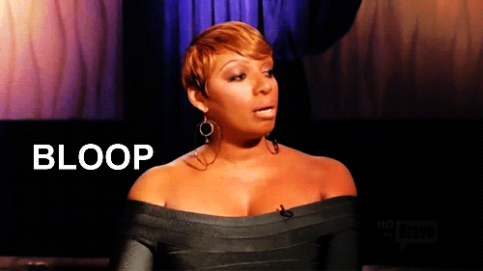


Multicultural Viewers Have An Emotional Connection That Is Grounded In How Closely They Identify With Their Favorite TV Characters or Personalities
“I have used a TV-related phrase in a conversation with family/friends/co-workers”
“I was inspired to make a food recipe based on a TV show or segment”
“I have dressed up like A TV character for Halloween or a themed party”
Black
46%
44%
31%
Hispanic
52%
44%
28%
Non-Hispanic White
51%
40%
22%
Black
Hispanic
Non-Hispanic White
Source: VAB / Research Now “Program Engagement” Survey, April 2018. Q10: Which of the following statements are true for you? Check any that apply. African American/Black/Caribbean American = 160 Respondents, Hispanic = 188 Respondents, Non-Hispanic White = 744 Respondents, Total A18+ Respondents = 1,001.
10

Slide 11
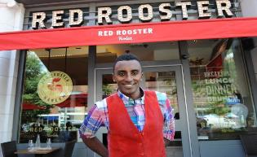

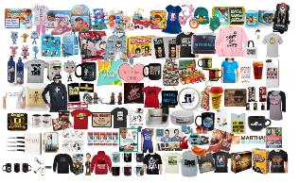
Most Importantly, Their Purchasing Decisions Are More Significantly Influenced By
Their Profound Connection To Ad-Supported TV Programming
“I have eaten at a restaurant because it, or its chef / owner, was featured on a TV show”
“I have visited a location / vacationed at a place because it was featured on a TV show”
“Purchase a product I saw while watching a TV program (either a product I saw in an ad or in the actual program)”
43% / 36% / 36%
33% / 35% / 33%
40% / 33% / 22%
+82% vs.
NHW
+50% vs. NHW
Black
Hispanic
Non-Hispanic White
Source: VAB / Research Now “Program Engagement” Survey, April 2018. Q9: Please indicate how often you do the following? Purchase a product I saw while watching a TV program (either a product I saw in an ad or in the actual program). Respondents Answer = Always/Frequently. Q10: Which of the following statements are true for you? Check any that apply. African American/Black/Caribbean American = 160 Respondents, Hispanic = 188 Respondents, Non-Hispanic White = 744 Respondents, Total A18+ Respondents = 1,001.
11

Slide 12

“Favorite Programs are programs you look forward to the most, watch consistently, or recommend to others.”
The Relationship Between Multicultural Viewers And Ad-Supported TV Is Even More Evident When It Comes To Their Favorite Programs
12

Slide 13

Multicultural Viewers Develop A Commitment To TV Programs In Much
The Same Way They Do With Any Other Of Their Favorite Products
A viewer’s path toward commitment to their favorite TV programming develops along similar stages as the consumer purchasing funnel.
Attention
Take notice and be aware
Interest
Deepen engagement
Desire
Prioritize; Greater urgency & anticipation
Action & Advocacy
Actively support
or
promote
“Favorite Program:” Programs you look forward to the most, watch consistently, or recommend to others.
13

Slide 14
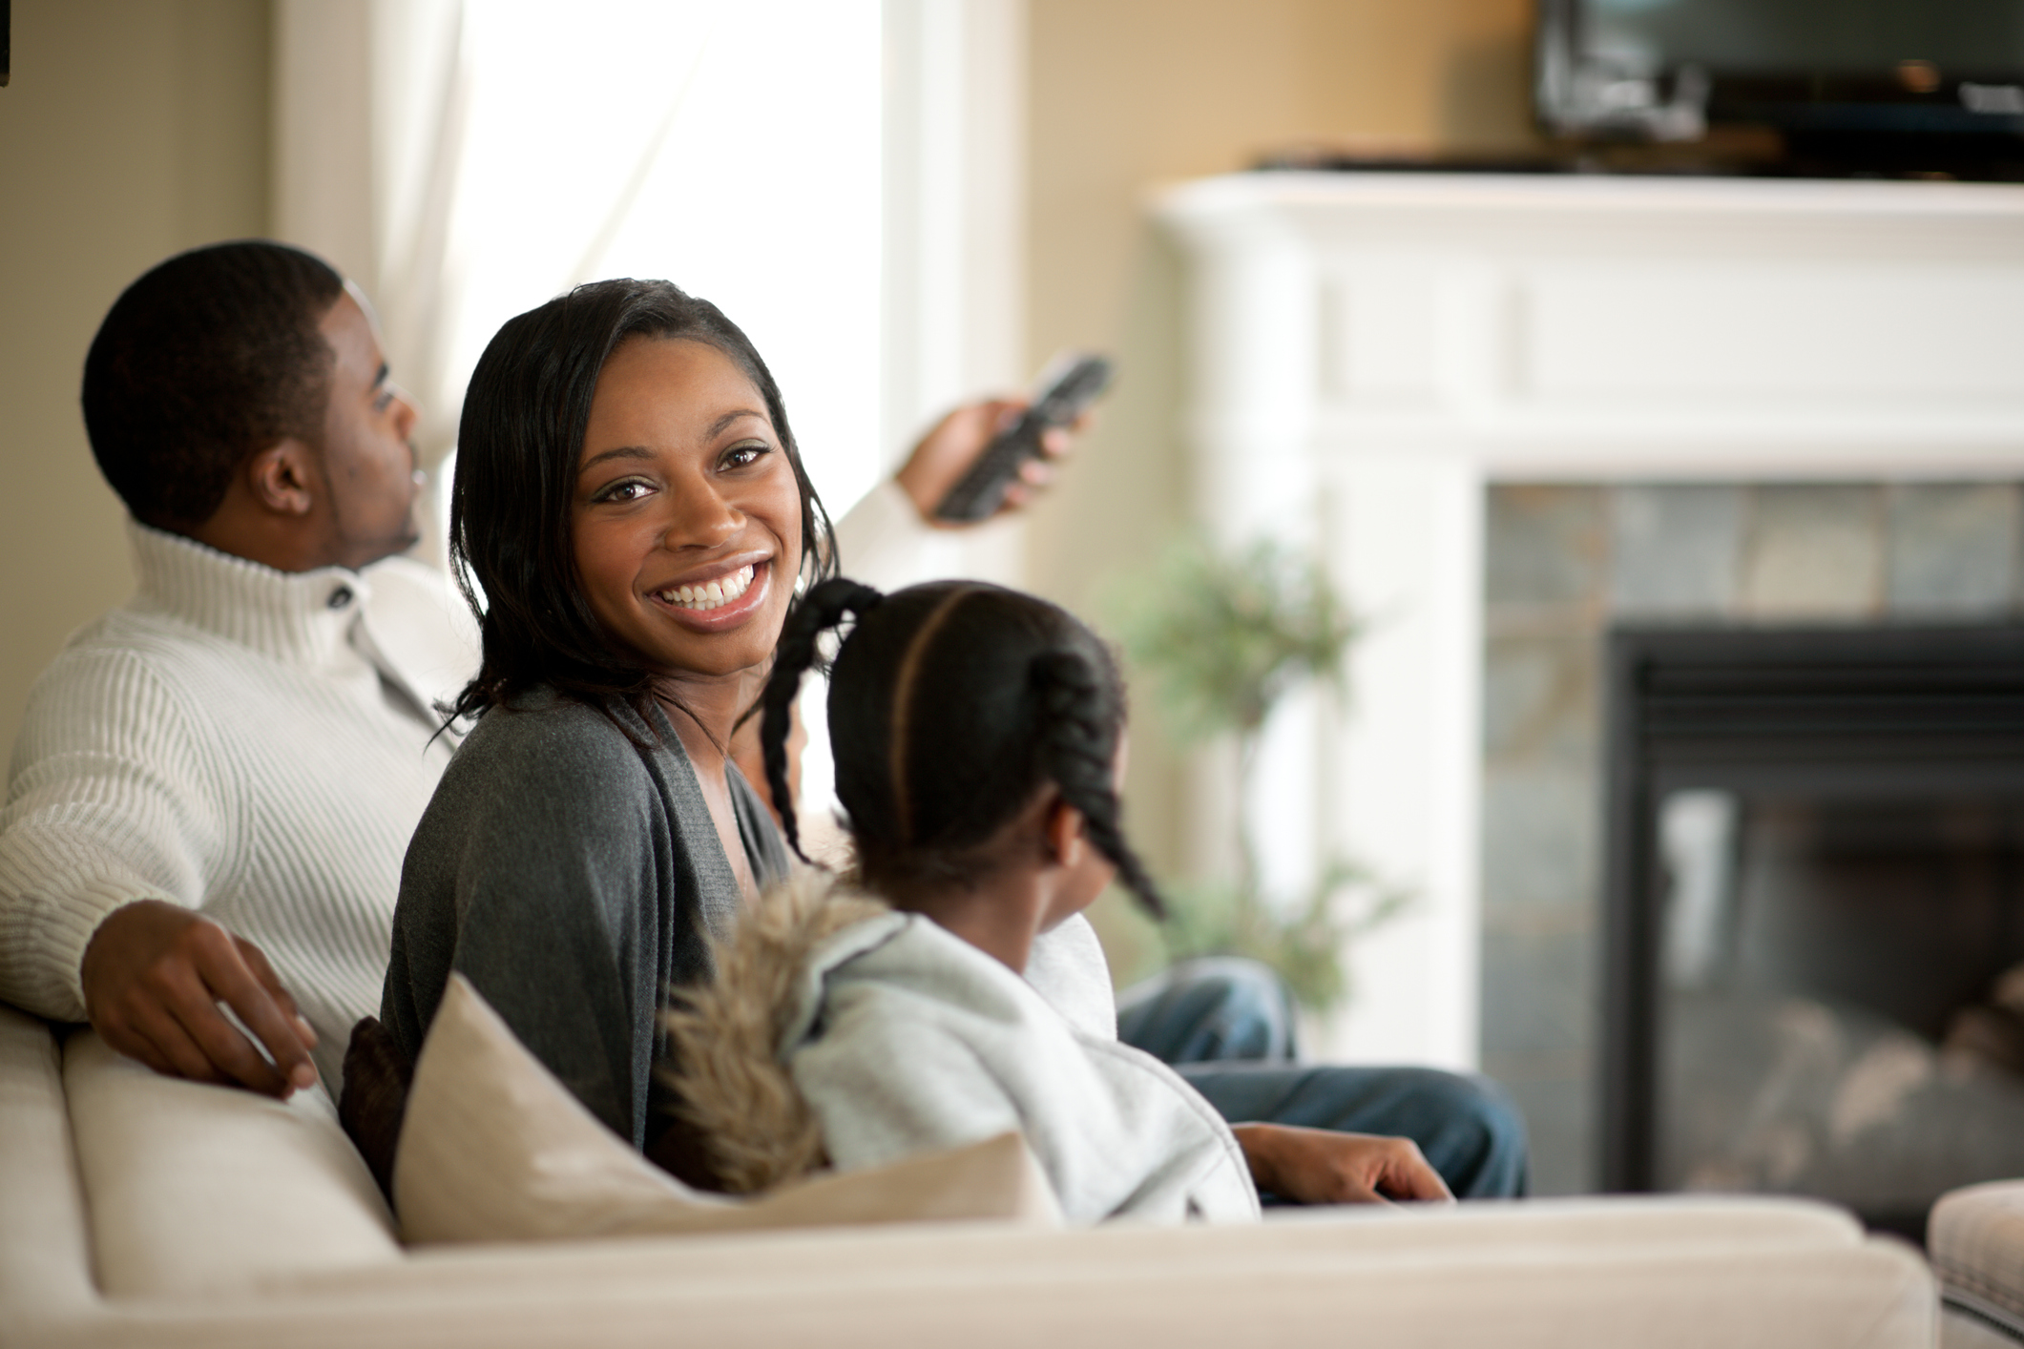
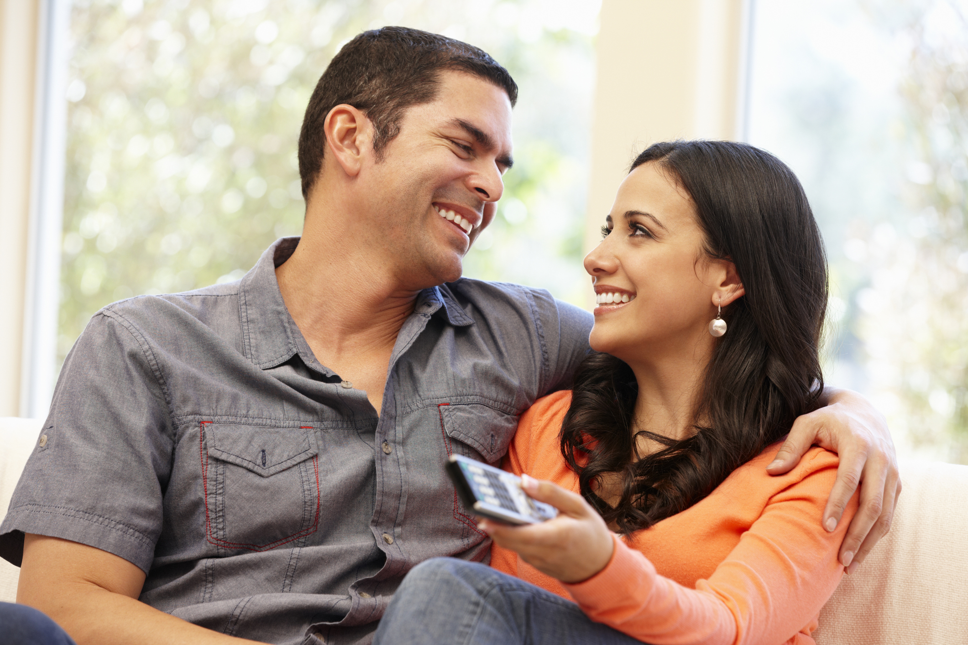
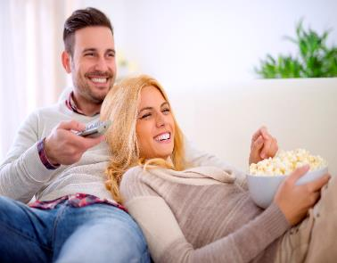
Multicultural Audiences Seek Out Conversation & Community With Other Viewers Which Is Why “Live” Viewing Is Still The Most Popular Way To Watch Their Favorite Programs
Attention
Live as it airs
Time-shifted / through a DVR (another time, after it airs, delayed time)
Via a streaming service or OTT app (i.e. Netflix, Hulu, CBS All Access)
On Video-On-Demand (VOD) through a cable or set top box
Source: VAB / Research Now “Program Engagement” Survey, April 2018. Q12: How do you prefer to watch your favorite TV programs? Q13.5: Please rate how much you agree or disagree with the following statements. I like to watch my favorite TV programs with my friends / family. . % of Respondents who agree-Top 2 Box (net). African American/Black/Caribbean American = 160 Respondents, Hispanic = 188 Respondents, Non-Hispanic White = 744 Respondents, Total A18+ Respondents = 1,001.
14

Slide 15
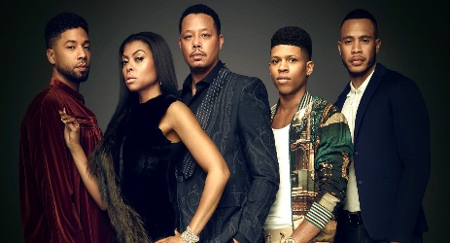
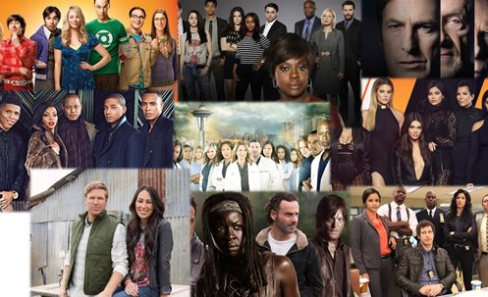
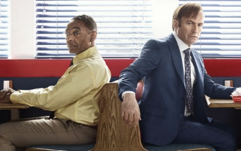
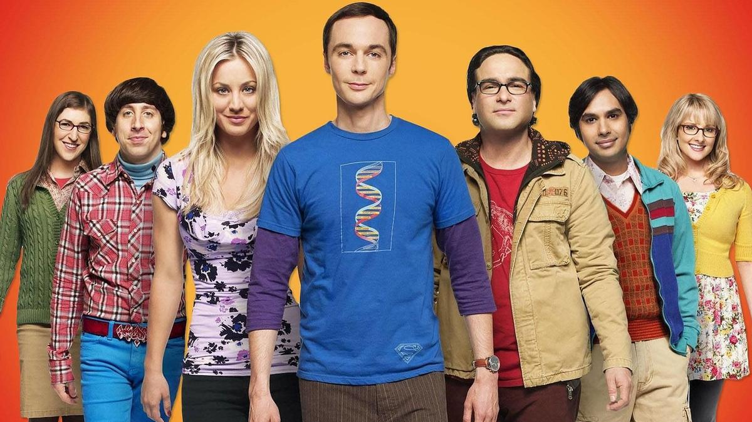
Interest
Multicultural Viewers Are More Likely To Feel Attached To The Programs They Love Because They Are Deeply Invested In The Characters And Actors
Multicultural viewers are particularly moved by programs and characters that reflect them and their experiences.
“I feel personally connected to the characters of my favorite TV programs”
“I have read actor or cast news to learn more about what’s going on 'Behind The Scenes‘”
40% / 38% / 32%
43% / 38% / 34%
Black
Hispanic
Non-Hispanic White
Source: VAB / Research Now “Program Engagement” Survey, April 2018. Q14: Again, keeping your favorite TV programs in mind, which of the following statements do you believe are true for you? Check any that apply. African American/Black/Caribbean American = 160 Respondents, Hispanic = 188 Respondents, Non-Hispanic White = 744 Respondents, Total A18+ Respondents = 1,001.
15

Slide 16

“TV Time” Is “Me Time” As These Highly Engaged Multicultural Audiences Dedicate Their Attention To Their Favorite Shows
Desire
Non-Hispanic
White
Black
Hispanic
Multicultural viewers are highly selective and therefore prioritize their favorite programs, making sure to watch, or catch up on, every episode
“Watching my favorite TV shows is my 'me-time‘”
74% / 69% / 68%
“I like to binge view my favorite programs”
63% / 64% / 54%
Black
Hispanic
Non-Hispanic White
Source: VAB / Research Now “Program Engagement” Survey, April 2018. Q13: Please rate how much you agree or disagree with the following statements. % of Respondents who agree-Top 2 Box (net); Q15: Which of the following statements are true for you? Check any that apply; African American/Black/Caribbean American = 160 Respondents, Hispanic = 188 Respondents, Non-Hispanic White = 744 Respondents, Total A18+ Respondents = 1,001.
16

Slide 17


Multicultural Viewers Can’t Get Enough Of Their Favorite Shows, Making Them Much More Likely To Seek Out Reviews, Recaps And Spoilers Online
Desire
This information often acts as “social currency” when discussing programs with family and friends.
“I read online recaps, blogs or reviews about the episode”
“I look for spoilers”
Black
41%
38%
Hispanic
39%
35%
Non-Hispanic White
26%
25%
Black
Hispanic
Non-Hispanic White
“% After Every or Most Episodes”
Source: VAB / Research Now “Program Engagement” Survey, April 2018. Q15: Which of the following statements are true for you? Check any that apply. Q16: How often do you typically do the following after watching a new episode of one of your favorite TV programs. Respondents who answered “After every/most episodes”. African American/Black/Caribbean American = 160 Respondents, Hispanic = 188 Respondents, Non-Hispanic White = 744 Respondents, Total A18+ Respondents = 1,001.
17
Notes:
https://www.istockphoto.com/photo/smiling-young-female-entrepreneur-working-on-a-laptop-at-home-gm871802194-243533392
https://www.istockphoto.com/photo/student-working-in-coffeeshop-gm627987320-111340061

Slide 18
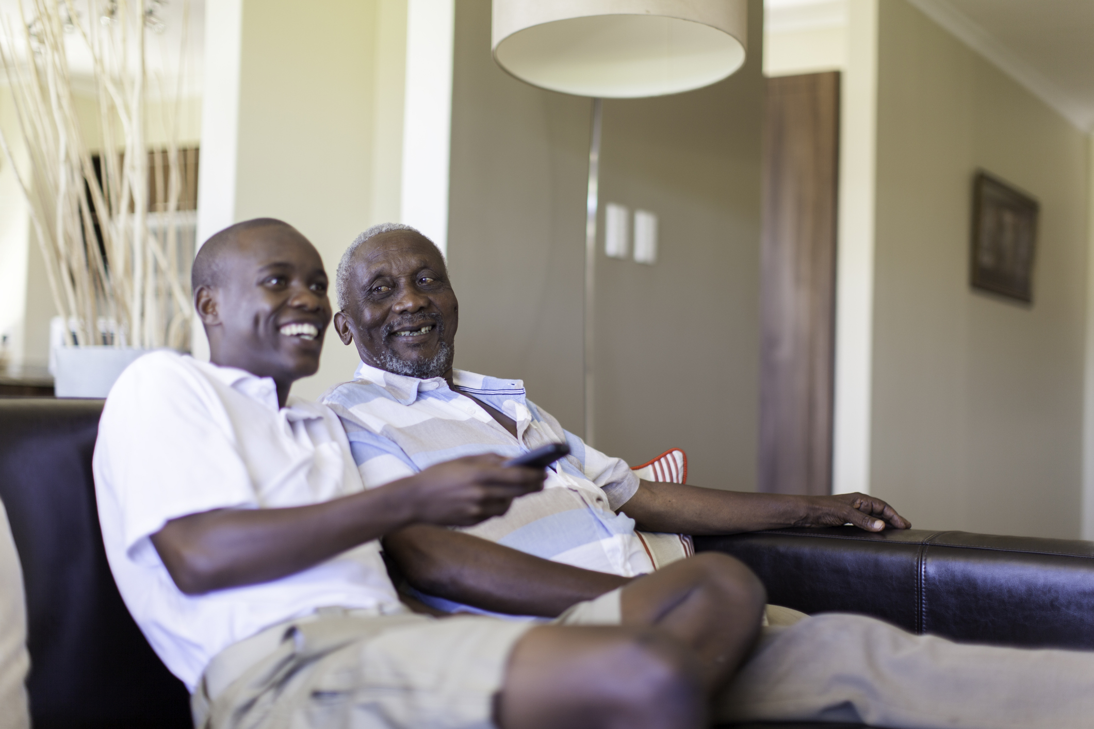
Motivated By This Deep Personal Connection To Their Favorite Programming, Multicultural Viewers Are Significantly More Likely To Share Their Opinions With Others
A&A
“I Discuss TV Programs With Friends, Family, Co-workers”
“% After Every or Most Episodes”
56%
51%
35%
+60% vs. NHW
+46% vs. NHW
Black
Hispanic
Non-Hispanic White
Source: VAB / Research Now “Program Engagement” Survey, April 2018. Q15: Which of the following statements are true for you? Check any that apply. Q16: How often do you typically do the following after watching a new episode of one of your favorite TV programs. Respondents who answered “After every/most episodes”. African American/Black/Caribbean American = 160 Respondents, Hispanic = 188 Respondents, Non-Hispanic White = 744 Respondents, Total A18+ Respondents = 1,001.
18

Slide 19
In Summary, Black Viewers Are A Highly Engaged Audience Who Have A 360 Relationship With TV Programming
41% Read recaps of last week’s episode
62% Start worrying about what will happen on the show next week
Pre-Viewing
Anticipation & Preparation
63% Binge watch episodes to catch-up
44% Bought a TV star’s new line of products featured on the show
38% Visit the show’s website for more information about a program
43% have booked a table at a TV chef’s new restaurant
Post-Viewing
Insatiable Need For More
74% settle in and focus their attention on the show because it is their “me-time”
31% have dressed up as their favorite TV character next Halloween
During
Immediate Need to Connect to Community
62% have felt worried about what’s going to happen next
56% dissect everything that happened in the episode with family & friends
40% can’t help but empathize with the character they feel personally connected to
38% inevitably look up spoilers for next week’s episode
43% Read up on actor/cast news
to see the behind-the-scenes on how a scene was filmed
47% have felt angry over a plot twist at the end
34% Tweet About A Show
“OMG! Did that just happen?!”
Source: VAB / Research Now “Program Engagement” Survey, April 2018; African American/Black/Caribbean American = 160 Respondents, Total A18+ Respondents = 1,001.
19

Slide 20
The Same Goes For Hispanic Viewers Whose Intense Emotional Connection To TV Content Goes Well Beyond The Airing Of A Program
55% Seek out more TV shows with their favorite actor from a show
45% have gone on Wikipedia to learn more about what tonight’s episode is about
52% have used a phrase they heard in a TV episode during conversation
Pre-Viewing
Anticipation & Preparation
35% check Twitter for on-set tweets & teasers from the cast
43% have booked a table at a TV chef’s new restaurant
Post-Viewing
Insatiable Need For More
69% settle in and focus their attention on the show because it is their “me-time”
35% Research locations featured in a show for an upcoming trip
During
Immediate Need to Connect to Community
51% dissect everything that happened in the episode with family & friends
50% have cried over a character’s death on a show
38% inevitably look up spoilers for next week’s episode
38% can’t help but empathize with the character they feel personally connected to
39% have read reviews for opinions and reaction to a show’s ending
52% have looked up actors online
“Haven’t I seem him in something?”
45% have felt angry over a plot twist at the end
33% Tweet About A Show “OMG! Did that just happen?!”
Source: VAB / Research Now “Program Engagement” Survey, April 2018; Hispanic = 188 Respondents, Total A18+ Respondents = 1,001.
20

Slide 21

It’s clear that Multicultural viewers are highly engaged with TV programming. They feel emotionally attached to shows and characters and are moved to discuss and share with others.
But does the same behavior & “Emotional Stakes” exist for Original YouTube Content?
21

Slide 22




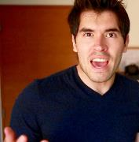




How We Define YouTube “Original Content”
  YouTube Original Content refers to videos that were produced by an established YouTube personality that are only available on YouTube and do not appear on broadcast or cable TV. This does not include user generated videos (e.g. cat videos), music videos, or TV program content (e.g. clips from Late Night with Stephen Colbert)
Examples Include:
Smosh
Jackie Aina
GoodMythicalMorning
HolaSoyGerman.
Lele Pons
DudePerfect
KSI
Felipe Neto
53% of Blacks and 56% of Hispanics regularly watch original content on YouTube, compared to 33% of Non-Hispanic Whites
Source: VAB / Research Now “Program Engagement” Survey, April 2018. Q16b: Do you regularly (at least twice a month) watch original content on YouTube (i.e. Jake Paul, PewDiePie, Good Mythical Morning, Jenna Marbles, First We Feast, etc.)? African American/Black/Caribbean American = 160 Respondents, Hispanic = 188 Respondents, Non-Hispanic White = 744 Respondents, Total A18+ Respondents = 1,001.
22

Slide 23
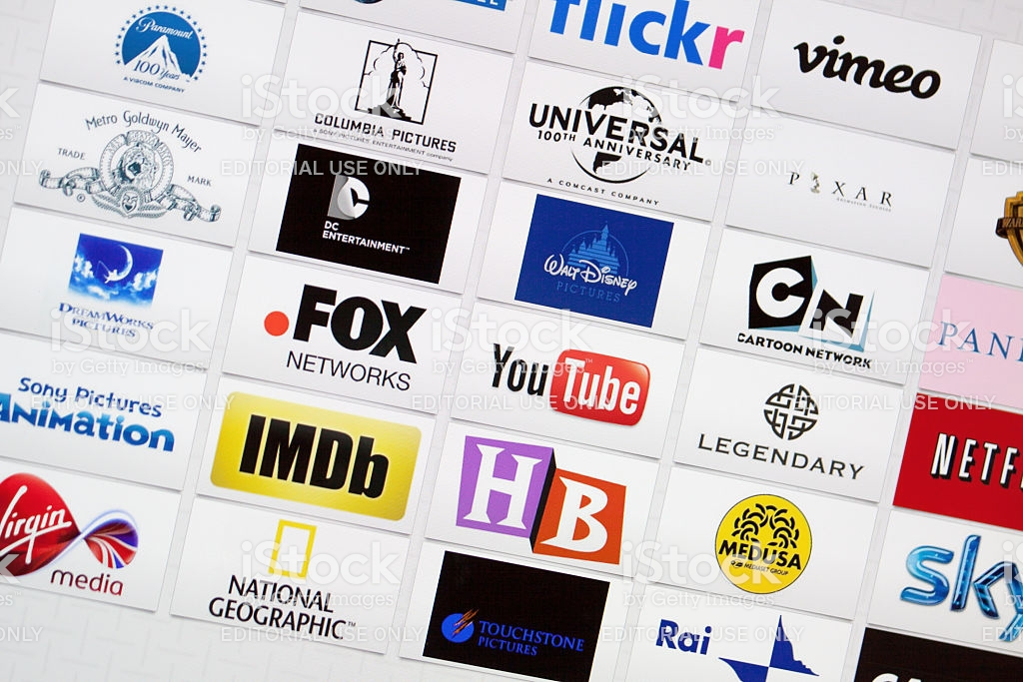
Attention
When Do Multicultural Viewers Prefer To Watch Content?
Live TV vs. YouTube Content As Soon As It’s Posted
Black
Hispanic
Non-Hispanic White
Multicultural viewers don’t feel the same immediacy or sense of community around original YouTube videos as they do for TV
TV Programs
YouTube Originals
Source: VAB / Research Now “Program Engagement” Survey, April 2018. Q12: How do you prefer to watch your favorite TV programs? (Respondents: African American/Black/Caribbean American = 160, Hispanic = 188, Non-Hispanic White = 744); Q21: I watch new videos posted by my favorite YouTube Personality… (Respondents: African American/Black/Caribbean American = 84, Hispanic = 106, Non-Hispanic White = 245); Time-shifted YouTube viewing includes viewing as soon as it’s posted, within a few hours of posting, same day as posting, within a few days, within a few weeks, whenever I have time/don’t know.
23

Slide 24

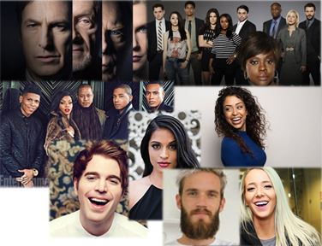


Culturally-Relevant Characters And Complex Storylines On TV
Inspire Deeper Engagement Among Multicultural Viewers Than YouTube
Interest
Although Blacks and Hispanics are more likely to watch YouTube original content, they feel a deeper connection to TV programming than non-Hispanic Whites.
“I feel personally connected to the characters of my favorite TV programs”
“I have watched other shows or movies because an actor from one of my favorite TV programs was in it”
40% / 38% / 32%
53% / 55% / 55%
VS.
VS.
“I feel personally connected to my favorite YouTube personality”
“I have watched other shows or movies because my favorite YouTube personality was in it”
37% / 34% / 44%
46% / 40% / 49%
Black
Hispanic
Non-Hispanic White
Source: VAB / Research Now “Program Engagement” Survey, April 2018. TV: Q14: Again, keeping your favorite TV programs in mind, which of the following statements do you believe are true for you? (Respondents: African American/Black/Caribbean American = 84, Hispanic = 106, Non-Hispanic White = 245). YouTube: Q19: Again, keeping your favorite YouTube personalities in mind, which of the following statements do you believe are true for you? Check any that apply. (Respondents: African American/Black/Caribbean American = 84, Hispanic = 106, Non-Hispanic White = 245); Base = Those who regularly watch original content on YouTube.
24

Slide 25





This Connection With TV Characters & Personalities Leads Them To Feel More Emotionally Invested In TV Programs Than They Are In Original YouTube Content
Interest
Multicultural Respondents’ Emotional Response to TV Programs and YouTube Original Content
“Laughed Out Loud Because Of Something That Happened On A TV Program”
“Sat Through An Episode Of A TV Program In Anticipation / Worry About What's Going To Happen Next"
“Cried Because Of A Character's Death on a TV Program”
“Gotten Angry Or Upset About A Plot Twist On A TV Program”
73% / 76% / 80%
62% / 56% / 59%
43% / 50% / 45%
47% / 45% / 41%
VS.
VS.
VS.
VS.
“Laughed Out Loud Because Of Something That A YouTube Personality Did”
“Sat Through A Video Of A YouTube Personality In Anticipation / Worry About What's Going To Happen Next”
“Cried Because Of Something That Happened In A Video Of An Original YouTube Personality”
“Gotten Angry Or Upset About Something A YouTube Personality Did”
56% / 53% / 65%
48% / 45% / 40%
31% / 35% / 33%
33% / 26% / 33%
Black
Hispanic
Non-Hispanic White
Source: VAB / Research Now “Program Engagement” Survey, April 2018. TV: Q8: Which of the following statements are true for you? (Respondents: African American/Black/Caribbean American = 160, Hispanic = 188, Non-Hispanic White = 744). YouTube: Q17: Which of the following statements are true for you? Check any that apply. (Respondents: African American/Black/Caribbean American = 84, Hispanic = 106, Non-Hispanic White = 245); Base = Those who regularly watch original content on YouTube.
25

Slide 26
Multicultural Viewers Show A Dedication To Long-Form TV Programming That’s Stronger Than Their Commitment To Short, Snackable YouTube Content
Desire
“I try to watch every new episode of my favorite TV programs
“Watching my favorite TV shows is my 'me-time‘”
76% / 70% / 76%
74% / 69% / 68%
VS.
VS.
“I try to watch every new video posted by my favorite YouTube personality”
“Watching my favorite YouTube personality is my 'me-time‘”
75% / 59% / 69%
73% / 60% / 73%
Black
Hispanic
Non-Hispanic White
Source: VAB / Research Now “Program Engagement” Survey, April 2018. TV-Q13: Please rate how much you agree or disagree with the following statements (Respondents: African American/Black/Caribbean American = 160, Hispanic = 188, Non-Hispanic White = 744). YouTube- Q18: Please rate how much you agree or disagree with the following statements. (Respondents: African American/Black/Caribbean American = 84, Hispanic = 106, Non-Hispanic White = 245); Base = Those who regularly watch original content on YouTube. % of Respondents who agree-Top 2 Box (net).
26

Slide 27


Above All, Given Their Greater Personal Investment In Television Content,
TV Programming Is More Likely Than YouTube Original Content To Inspire Purchase
A&A
Blacks are 19% more likely and Hispanics are 9% more likely to purchase a product that’s been featured on TV than they are a product featured by their favorite YouTube personality
Have purchased a product that has been shown / featured on a TV show
Have purchased a product that their favorite YouTube personality has shown / featured during a video
44%
37%
37%
34%
39%
38%
Black
Hispanic
Non-Hispanic White
Source: VAB / Research Now “Program Engagement” Survey, April 2018. TV: Q10: Which of the following statements are true for you? (Respondents: African American/Black/Caribbean American = 160, Hispanic = 188, Non-Hispanic White = 744). YouTube: Q19: Again, keeping your favorite YouTube personalities in mind, which of the following statements do you believe are true for you? Check any that apply; (Respondents: African American/Black/Caribbean American = 84, Hispanic = 106, Non-Hispanic White = 245); Base = Those who regularly watch original content on YouTube.
27

Slide 28

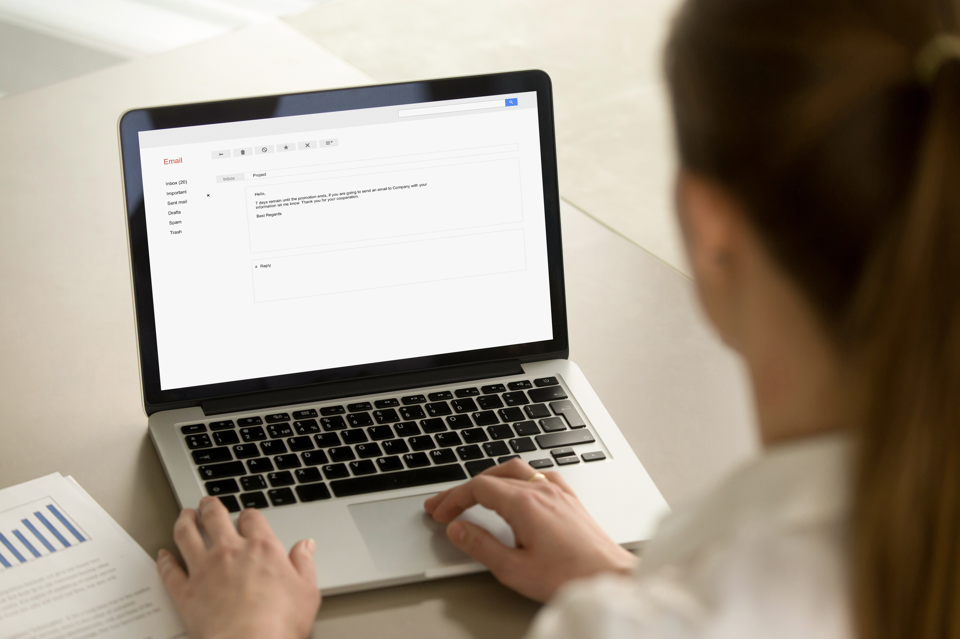

Interestingly, YouTube Itself Helps Feed Multicultural Viewers’ Voracious Appetite For TV With Supplementary Content Through Its Own Platform
A&A
Multicultural viewers actively engage with TV content on YouTube
“I Watch Video Clips From TV Shows On YouTube”
“I Read Or Post Comments About TV Content On YouTube”
“I Subscribe To Or Have Watched TV Show’s YouTube Channel”
52% / 43% / 35%
41% / 38% / 35%
26% / 25% / 16%
“% Always or Frequently”
“% Always or Frequently”
Black
Hispanic
Non-Hispanic White
Source: VAB / Research Now “Program Engagement” Survey, April 2018. Q9: Please indicate how often you do the following. Respondents Answer = Always/Frequently. Q15: Which of the following statements are true for you? Check any that apply (Respondents: African American/Black/Caribbean American = 160, Hispanic = 188, Non-Hispanic White = 744).
28

Slide 29




Decidedly Different: A Summary Of How Multicultural Viewers Differ From Non-Hispanic Whites In Their Commitment To TV And YouTube
Index vs. Non-Hispanic Whites
Passionately-Engaged Viewers
Social Sharers
Black
Hispanic
Black
Hispanic
“I Have Gotten Upset About A Plot Twist On A Program”
115
110
Share, Post Or Tweet Video Clips / Content About A TV Program
164
159
“Watching My Favorite TV Show Is My ‘Me-time’”
109
102
Tweet About Or Read A Tweet About a TV Program
162
157
“I Feel Personally Connected To The Characters Of My Favorite TV Programs”
125
119
Discuss TV Programs With Friends, Family And Co-workers
160
146
“I Feel Personally Connected To My Favorite YouTube Personality’”
84
77
Watch Video Clips From TV Shows On YouTube
149
123
“I Have Laughed Out Loud Because Of Something That A YouTube Personality Did”
86
82
Read Or Post Comments About TV Content On YouTube
117
109
Knowledge-Seekers
Inspired To Purchase
Black
Hispanic
Black
Hispanic
“I Read Online Recaps, Blogs Or Reviews About The Episode”
158
150
Have Purchased A Product I Saw While Watching A TV Program (either a TV ad or in the actual program)
182
150
“I Look For Spoilers”
152
140
Have Eaten At A Restaurant Because It, Or Its Chef / Owner, Was Featured On A TV Show
119
100
Source: VAB / Research Now “Program Engagement” Survey, April 2018. African American/Black/Caribbean American = 160 Respondents, Hispanic = 188 Respondents, Non-Hispanic White = 744 Respondents, Total A18+ Respondents = 1,001.
29

Slide 30

Parting Thoughts
Multicultural viewers exhibit a profound attachment to TV programming, characters and personalities, particularly when the actors and storylines are culturally relevant.
Motivated by their emotions, Multicultural viewers have a more intense need to share their thoughts & feelings with not only friends and family but also social media and online communities.
They are more likely to dedicate their “me time” to their favorite TV shows so it gets their full attention and they are more emotionally invested in TV than they are in YouTube original content.
Ultimately, their passion for TV inspires a +82% greater likelihood of a product purchase among Black viewers and +50% greater likelihood among Hispanic viewers vs. Non-Hispanic White viewers.
30

Slide 31



Contact Us
Jason Wiese
SVP, Director of Strategic Insights
jasonw@thevab.com
Marianne Vita
VP, Strategic Insights
mariannev@thevab.com
Leah Montner-Dixon
Senior Multi-Platform Video Analyst leahm@thevab.com
VAB
@VideoAdBureau

Slide 32


Slide 33
Black Survey Respondents: Demographic Profile
Age
Gender
Annual Household Income
Hispanic or Latin Descent
Source: VAB / Research Now “Program Engagement” Survey, April 2018. Total Respondents=1,001. U.S. Census data, 2017 population estimates; GfK MRI 2018 Doublebase; Black = African American/Black/Caribbean American = 160 Respondents, Total A18+ Respondents = 1,001.

Slide 34
Hispanic Survey Respondents: Demographic Profile
Age
Gender
Annual Household Income
Source: VAB / Research Now “Program Engagement” Survey, April 2018. Total Respondents=1,001. U.S. Census data, 2017 population estimates; GfK MRI 2018 Doublebase; Hispanic = 188 Respondents, Total A18+ Respondents = 1,001.

