Slide 1





At the Movies
15 Reasons to Include Cinema Within a Video Ad Campaign
May 2023

Slide 2


The Cinema ad experience delivers on video campaign objectives.
With its large screen projecting to a live, captive audience of lucrative consumers, Cinema can deliver on many campaign objectives as an advertising solution that other video platforms may have challenges with achieving – especially in terms of the consumer experience, the content and the advertising.
Whether it’s offering a consistent pipeline of the highest quality content at an affordable cost, the ability to deliver scale across desirable audiences, or achieving high attentiveness in a low clutter environment, this piece explores the 15 reasons why marketers should consider cinema within their next video campaign.
This information is exclusively provided to VAB members and qualified marketers. Further distribution is prohibited.
PAGE 2

Slide 3
15 Reasons to Include Cinema Within a Video Ad Campaign
1
2
3
4
5
Highest quality, premium video content
Consistent product pipeline throughout the year
Affordable entertainment, especially in times of economic uncertainty
Ease of content discovery
Shared experiences with culture-defining content
6
7
8
9
10
Popular co-viewing occasions
Scale
Lucrative consumer segments
Diverse and desirable audiences
Highly attentive platform
11
12
13
14
15
Location-based premium video opportunities
Low ad clutter
Brand safe environment
No ad fraud
More immersive experiences
click through the appropriate box if you would like to be brought directly to the corresponding fact
This information is exclusively provided to VAB members and qualified marketers. Further distribution is prohibited.
PAGE 3

Slide 4
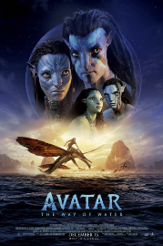
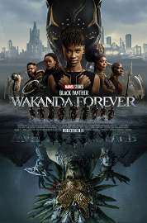
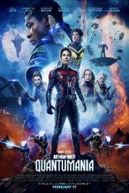
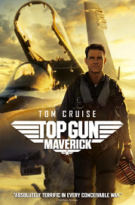
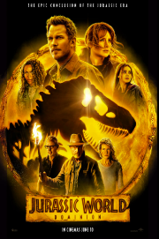
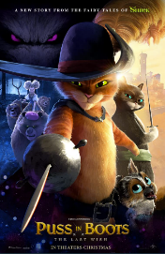


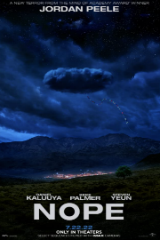



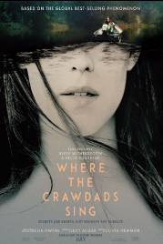
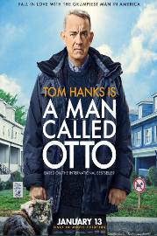
Highest quality, premium video content
1
Studios are investing millions to deliver the highest quality, most premium content to consumers at their local cineplex
Reported Production Budgets
$350+ MM
$250 MM
$200 MM
$170 MM
$165 MM
$90 MM
$85 MM
$80 MM
$68 MM
$60 MM
$45 MM
$35 MM
$25 MM
$24 MM
Source: Screendollars Newsletter (6/12/22, 11/13/22, 12/18/22, 1/29/23, 2/19/23, 2/26/23); supplemented with data from www.the-numbers.com. $$$ reflect reported product budgets and exclude prints and advertising.
This information is exclusively provided to VAB members and qualified marketers. Further distribution is prohibited.
PAGE 4

Slide 5
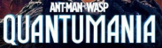

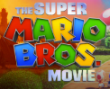
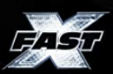


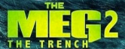

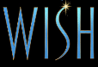
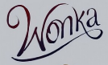



Consistent product pipeline throughout the year
Cinema is once again featuring a steady schedule of multiple, highly-anticipated ‘wide releases’ each month
2
It’s important to note that the box office didn’t decline because of streaming, it was down due to Covid-related production issues and relative lack of theatrical releases (2019 vs. 2022: -37% fewer wide releases equated to -36% less box office*)
Annual ‘Wide’ Theatrical Releases
Sampling of planned ‘wide releases’ in 2023
1/6
2/17
3/24
4/7
5/19
6/16
7/21
8/4
9/1
10/6
11/22
12/15
Source: Comscore Movies, Comscore ‘Year in Review’ webinar presentation (2/28/23) for 2017 – 2022 theatrical releases. 2023 figure is projected as of 5/4/23 from the-numbers.com and is subject to change as movies may continue to shift in and out of the year’s release schedule or change distribution strategy. ‘Wide’ theatrical release = 2,000+ locations at opening. Release dates are planned as of 5/1/23 and subject to change. *The Cinema Foundation: State of The Cinema Industry, March 2023. Movies released on 2,000+ screens: 2019 (112) vs. 2022 (71), -37%. Box Office from those movies: 2019 ($10.1 B) vs. 2022 ($6.5 B), -36%. Average Box Office per title: 2019 ($90.3 MM) vs. 2022 ($91.7 MM)
This information is exclusively provided to VAB members and qualified marketers. Further distribution is prohibited.
PAGE 5

Slide 6







Affordable entertainment, especially in times of economic uncertainty
3
When planning ‘to go out,’ the cost of a movie ticket is much more affordable than alternative activities across markets of all sizes
Entertainment Costs Across Different Market Sizes
Activity
New York City
(County ‘A’)
Cleveland, OH
(County ‘B’)
Des Moines, IA
(County ‘C’)
Bakersfield, CA
(County ‘D’)
Movie Tickets
From Fandango
1 Adult Ticket
$19.65
$10.25
$11.24
$13.75
Regal E-Walk
Capitol Theatre
Flix Brewhouse
Maya Bakersfield 16 & MPX
Bowling
1 lane for 2 hours (Group of 6)
Price Per Person
$41.43
$20.16
$13.50
$26.00
Bowlero
The Corner Alley
Air Lanes
Bowlero
Mini Golf
2 rounds of mini golf (estimated 50 – 90 mins)
Price Per Person
$43.98
$25.98
$30.00
$20.00
Shipwrecked
Swing n Things
Slideway Center
Golf N’ Stuff
Archery
Price Per Person
$40.00
$60.00
$20.00
$30.00
Gotham Archery
Crooked River Archers
Archery Field & Sports
Brainy Actz
Axe Throwing
Price Per Person for 2 hours
$42.00
$28.99
$40.00
$30.00
Bury the Hatchet
Class Axe
Ironside Axe Club
Brainy Actz
Laser Tag
Price Per Person for 2 hours
$39.99
$22.50
$32.00
$20.00
Area 53 NYC
Area 51 Laser Tag
Spare Time Entertainment
The BLVD!
Source: VAB analysis of pricing available on the specific venues’ websites for the cost of activities based on the appropriate location as of 3/24. Markets were selected from ABCD counties as categorized by Nielsen based on U.S. Census Bureau population data and metro areas.
This information is exclusively provided to VAB members and qualified marketers. Further distribution is prohibited.
PAGE 6

Slide 7



Ease of content discovery
4
Movie goers make their plans with intent and typically know what they want to watch beforehand and will secure their seats before showtime
Movie Attendance Behaviors
93%
Typically plan at least one day in advance to see a movie they are interested in at the theater
(70% = 3+ days)
48%
Buy tickets before the day of when you’re planning to see a movie
(30% = 3+ days)
Source: Screenvision, Real Fans Survey, March 2023, Base: Moviegoers. Q. How many days in advance do you typically plan to see a movie you are interested in at the theatre? Q. When do you typically purchase your ticket for a movie you plan on seeing?
This information is exclusively provided to VAB members and qualified marketers. Further distribution is prohibited.
PAGE 7

Slide 8



Shared experiences with culture-defining content
5
‘Buzzed-about’ movies bring people together in zeitgeist-like moments which can heighten the impact of advertising adjacencies
% of movie goers agree that…
97%
74%
‘Nothing beats the big screen, surround sound and shared experience with movie fans’*
‘I like being among the first to see new movies so I can talk about it with others’**
Source: *NCM, Moviegoing Audience Insights, Behind-The-Screens (BTS) Online Community, August 2022, Base: A18+ Moviegoers, August 3-8, 2022. **Screenvision, Real Fans Survey, March 2023, Base: Moviegoers.
This information is exclusively provided to VAB members and qualified marketers. Further distribution is prohibited.
PAGE 8

Slide 9
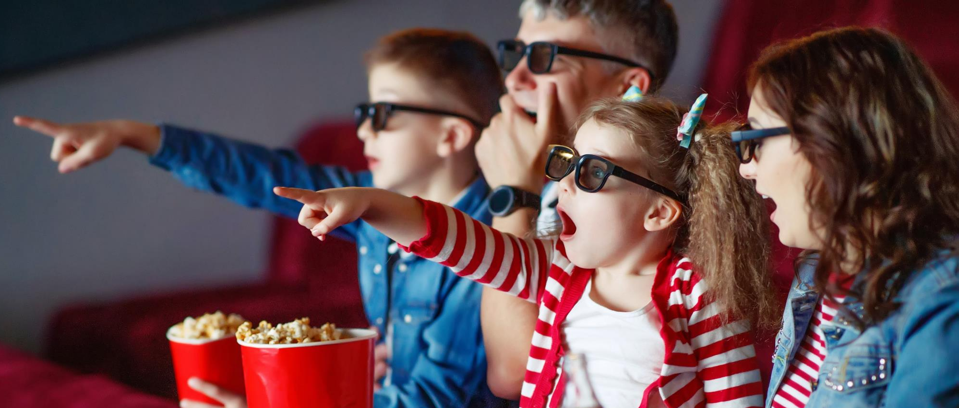


Popular co-viewing occasions
6
People see the cinema as a central part of their social lives with friends and family which creates additional targeting opportunities for brands
% of respondents who agree with the following statements
75%
Moviegoing is a social activity
for me, I enjoy going with others*
83%
Attend the movies with
their children under 12**
Source: *Screenvision, Real Fans Survey, March 2023, Base: Moviegoers. **NCM, Behind-The-Screens Community Study, January 9-23, 2023. Parents with Kids under 12. (n=248); Always/Often/Sometimes.
This information is exclusively provided to VAB members and qualified marketers. Further distribution is prohibited.
PAGE 9

Slide 10




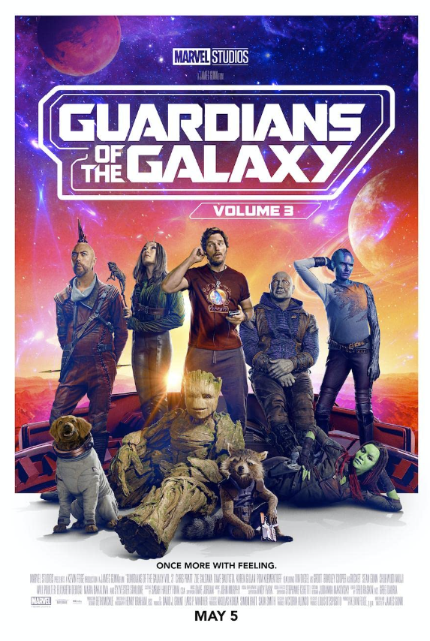
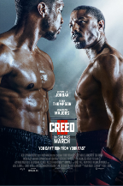

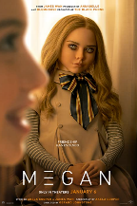





Scale
7
Established as ‘must see’ social events, more adults attend opening weekend of movie releases than participate in other popular activities
Cinema: Estimated Opening Weekend Adult 18+ Admissions*
17 MM+
12.7 MM
10 MM+
8.7 MM
8.4 MM
8 MM+
4 MM+
3.2 MM
2.5 MM
Other ‘Out-of-Home’ Activities by Comparison (Adult 18+)
Went to a bar / club
in last week: 5.8 MM
Went to a museum
in last week: 4.4 MM
Went to an NFL regular season or post-season game in last 12 months: 4.1 MM
Went to a concert / live music
in last week: 1.1 MM
Source: Screendollars Newsletter, based on data from EntTelligence (The Super Mario Bros. Movie – 4/9/23 issue; Black Panther – 11/13//22 issue; Thor: Love & Thunder – 7/10 issue; Avatar – 12/18/22 issue; Minions: The Rise of Gru – 7/3 issue; Guardians of the Galaxy Vol. 3 – 5/7/23 issue; Creed III – 3/5/23 issue; Scream VI – 3/12/23 issue; M3gan – 1/8/23 issue). ‘Other activities’ based on MRI-Simmons Fall 2022 Doublebase USA study, P18+, ‘concert / live music’ includes country, rock, classical, R&B/hip-hop/rap, music festivals or other. *The Super Mario Bros. Movie reflects a 5-day opening weekend, all other movies reflect a 3-day opening weekend.
This information is exclusively provided to VAB members and qualified marketers. Further distribution is prohibited.
PAGE 10

Slide 11
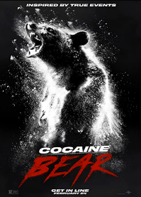
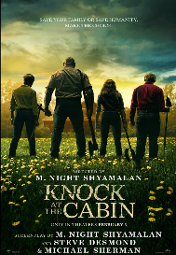
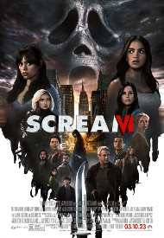

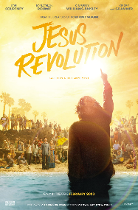



Lucrative consumer segments
8
Cinema provides content for everyone with an emphasis on releases targeted towards the lucrative ‘Elusives’ and ‘Sophisticates’ audiences
‘Elusives’
(young, diverse, ‘cordless’)
‘Sophisticates’
(influential, cultured, adults 25-44)
% of P18-34 opening weekend attendance
% of P25+ opening weekend attendance
Cocaine Bear
Knock at the Cabin
Scream VI
M3gan
Jesus Revolution
80 for Brady
Elvis
Avatar:
The Way of Water
65%
64%
63%
62%
91%
82%
80%
67%
Click here to download “Capturing the ‘Elusives’ at the Cinema”
to learn about the opportunities to reach this audience
Click here to download “Engaging the ‘Sophisticates’ at the Cinema”
to learn about the opportunities to reach this audience
Source: 2023 & 2022 Comscore Post-Trak reported box office demographics for opening weekend of above movies, with supplemental data from deadline.com.
This information is exclusively provided to VAB members and qualified marketers. Further distribution is prohibited.
PAGE 11

Slide 12

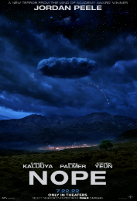

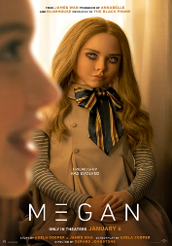

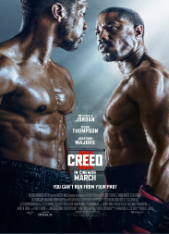

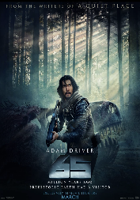
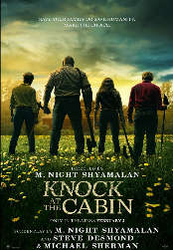
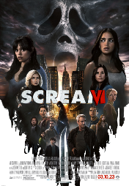
Diverse and desirable audiences
9
Cinema attracts very diverse audiences across genres which enables a wide range of engagement opportunities for marketers
Multicultural Audiences
% of opening weekend attendance
Black
Hispanic / Latino
Asian
Creed III
Black Panther: Wakanda Forever
Nope
Scream VI
M3gan
Cocaine Bear
Everything Everywhere All At Once
Knock at the Cabin
65
37%
36%
33%
38%
28%
28%
21%
17%
17%
(Black represents 13.5% of U.S. population)
(Hispanic / Latino represents 18.8% of U.S. population)
(Asian represents 7.2% of U.S. population)
Source: 2022 & 2023 Comscore Post-Trak reported box office demographics for opening weekend of above movies, with supplemental data from Screendollars newsletters and deadline.com. Comparisons to U.S. population based on 2022-2023 Nielsen Universe Estimates, P2+.
This information is exclusively provided to VAB members and qualified marketers. Further distribution is prohibited.
PAGE 12

Slide 13



Highly attentive platform
10
Cinema achieves more than six times the ad attention than social media platforms which drives highly-engaged audiences to purchase
:15 Ad Attention by Platform
(Comparing second x second viewing via eye-tracking methodology*)
Actions Taken After Seeing
a Cinema Pre-Show Ad**
88%
Recall the
pre-show ad
79%
Pay attention to pre-show ads
(those who recall seeing pre-show ads)
% Viewed
95%
44%
51%
Sought info or purchased a product from ad
Seconds Viewed
11.3
2.0
1.1
40%
Source: *NCM & Lumen, ‘Cinema in the Media Mix,’ March 2023; Cinema attention is based on an in-theater second-by-second eye tracking study with Lumen Research conducted in November 2022; Social 1 & Social 2 reflects digital norms from Attention Economy figures based on US Lumen mobile passive panel data. **Screenvision Media, Screen Engine Data, 2023, Base: Seen pre-show ads in cinema, Q13: Do you recall seeing advertising/commercials featured during the onscreen “pre-show” during your typical theater visits? – Yes, Q14: How much attention would you say you pay to ads during the onscreen “pre-show”? - My full attention or some of my attention, Q16: Have you ever sought out more information or purchased a product after seeing it advertised onscreen during the preshow? – Yes.
(those who recall seeing pre-show ads)
This information is exclusively provided to VAB members and qualified marketers. Further distribution is prohibited.
PAGE 13

Slide 14







Location-based premium video opportunities
11
Cinema is a conduit for marketers to engage socially active spenders while they are out enjoying ‘dinner & a movie’ or other activities
Super Cinema Goers are …*
(vs. total adults 18+)
% of Cinema Goers that do activities pre or post moviegoing**
60%
Dine out at a sit-down restaurant
99%
More likely to go to museums
at least once a month
87%
More likely to attend sports events
57%
Visit a fast-food or quick
service restaurant
48%
More likely to socialize with
friends around town
47%
More likely to go to bars / nightclubs
36%
Shop at a retail store
Source: *MRI-Simmons Fall 2022 Doublebase USA study. Base: A18+. ‘Super Cinema Goer’=attend a movie at least once a month. Percentages = ‘Super Cinema Goer’ vs. average adult 18+. Socialize with friends=6+ hours weekly.
**Screenvision, Real Fans Survey, March 2023, Base: Moviegoers, Q: Thinking about your typical moviegoing experience, what types of activities do you do before or after seeing a movie?
This information is exclusively provided to VAB members and qualified marketers. Further distribution is prohibited.
PAGE 14

Slide 15
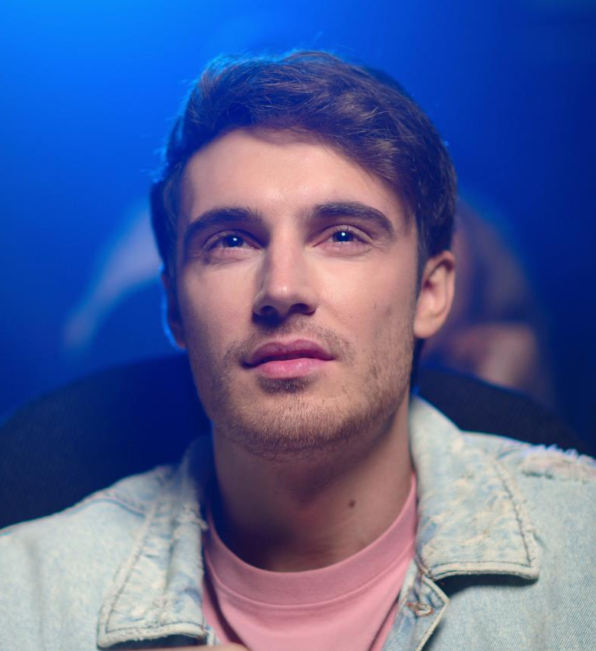

Low ad clutter
12
At an average of less than four minutes per hour of content, cinema has a low number of commercial minutes within the video ecosystem
Advertising vs. Content Ratio: Theatrical Average
Average
Ad Minutes
2-8 Minutes
Theatrical Release Average Length
2 Hours, 6 Minutes
‘Real-World’ Example
Ant-Man and the Wasp: Quantumania, Sunday March 12th, AMC Orpheum 7, New York City
Ad Minutes
7 Minutes,
10 Seconds
Movie Length
2 Hours, 5 Minutes
Source: ‘Average ad minutes’ based on industry resources and reflects the average range of commercial minutes aired before a theatrical release. ‘Theatrical release average length’ is based on the average length of the 44 movies released in 4Q ’22 that grossed $1MM+ from their theatrical release.
This information is exclusively provided to VAB members and qualified marketers. Further distribution is prohibited.
PAGE 15

Slide 16



Brand safe environment
The MPA ratings system publicizes the content material for each film so movie goers and advertisers can each make informed decisions
13
Consumers are more than twice as likely to be concerned about questionable/offensive content that they (or members of their family) might see on social media platforms vs. at the movies (56% vs. 27%)*
The Film Rating System
Parental Guidance Suggested
Action and mild Violence
PG
Established by the Motion Picture Association in 1968, the rating system was created to help parents make informed viewing choices for their children.
Some Material May Not Be Suitable for Children
G
General Audiences
Nothing that would offend parents for viewing with children
Parents Strongly Cautioned
Intense sports action, violence and some strong language
All Ages Admitted
PG-13
Parental Guidance Suggested
Check this Box for Specific Content Information
Parents urged to give ‘parental guidance.’ May contain some material parents might not like for their young children
PG
Some Material May Be Inappropriate for Children Under 13
Some Material May Not Be Suitable for Children
Parents Strongly Cautioned
Brief strong language, some drug content and some suggestive references
Parents are urged to be cautious. Some material may be inappropriate for pre-teenagers
PG-13
Parents Strongly Cautioned
Check this Box for Specific Content Information
PG-13
Some Material May Be Inappropriate for Children Under 13
Some Material May Be Inappropriate for Children Under 13
Restricted
Check this Box for Specific Content Information
Contains some adult materials. Parents are urged to learn more about the film before taking their young children with them
Restricted
Sexual material and language
R
R
Under 17 Requires Accompanying Parent or Adult Guardian
Under 17 Requires Accompanying Parent or Adult Guardian
Source: www.motionpictures.org/film-ratings; www.screendollars.com/film-data/ratings-updates/.*Screenvision, Real Fans Survey, March 2023, Base: Moviegoers. Thinking about platforms, how concerned are you about questionable or offensive content that you or members of your household might see while engaging with these media platforms? (Top 2 Box).
This information is exclusively provided to VAB members and qualified marketers. Further distribution is prohibited.
PAGE 16

Slide 17
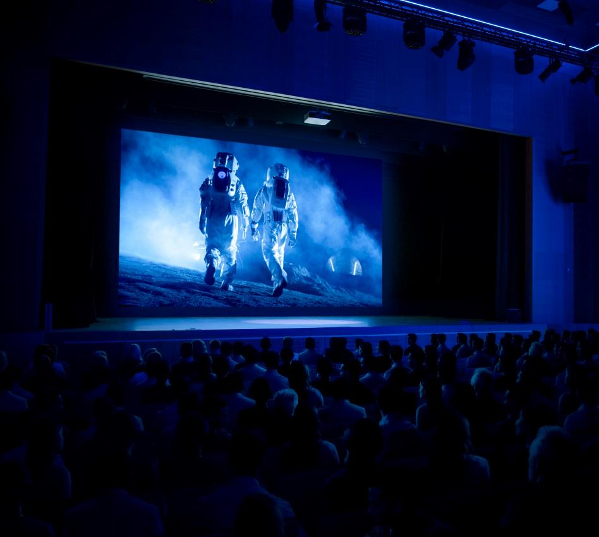
No ad fraud
14
Cinema ads run on a large screen in front of a live, captive audience and are typically transmitted electronically direct to the theater
92%
of movie-goers take their seat before the start of the trailers
Source: NCM, Moviegoing Audience Insights, August 2022. A18+, August 3-8, 2022.
This information is exclusively provided to VAB members and qualified marketers. Further distribution is prohibited.
PAGE 17

Slide 18






More immersive experiences
15
Cineplexes are upgrading their locations to enhance the consumer experience which creates more in-theater opportunities for marketers
Have you noticed any of the following upgrades at the theatre(s) you regularly visit?
85%
52%
52%
46%
Upgraded concessions
(more options, new offerings)
Upgraded or new seating in the theatre
Bars and / or alcohol offerings
of moviegoers are more
likely to go to a theatre
with upgraded amenities
38%
28%
15%
In-theatre dining options
(ordering food to your seat)
Upgraded sound system
New entertainment offerings, like arcades
Source: Screenvision, Real Fans Survey, March 2023, Base: Moviegoers.
This information is exclusively provided to VAB members and qualified marketers. Further distribution is prohibited.
PAGE 18

Slide 19
15 Reasons to Include Cinema Within a Video Ad Campaign
1
2
3
4
5
Highest quality, premium video content
Consistent product pipeline throughout the year
Affordable entertainment, especially in times of economic uncertainty
Ease of content discovery
Shared experiences with culture-defining content
6
7
8
9
10
Popular co-viewing occasions
Scale
Lucrative consumer segments
Diverse and desirable audiences
Highly attentive platform
11
12
13
14
15
Location-based premium video opportunities
Low ad clutter
Brand safe environment
No ad fraud
More immersive experiences
click through the appropriate box if you would like to be brought directly to the corresponding fact
This information is exclusively provided to VAB members and qualified marketers. Further distribution is prohibited.
PAGE 19

Slide 20
Cinema provides marketers with a highly attentive environment to reach desirable audiences through both an advertiser and viewer-friendly platform that offers immersive, brand-safe premium content at scale with low ad clutter and no ad fraud
Cinema advertising’s complete viewability, full screen coverage, sound quality and engaging content –
all delivered to a captive audience - are just a few reasons why the platform’s impressions should be highly valued within the overall video ecosystem
Key Implications
for Marketers
This information is exclusively provided to VAB members and qualified marketers. Further distribution is prohibited.
PAGE 20

Slide 21



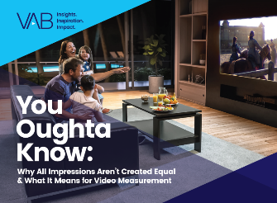

Creators
Jason Wiese
Reed Kiely
SVP, Director of Strategic Insights
jasonw@thevab.com
Associate Insights Director
reedk@thevab.com
Karolina Guillen
Insights Manager
karolinag@thevab.com
Discover more
Looking for more data, insights and takeaways? Check out this related VAB content
I Know What You Did This Summer
Harnessing Consumer Momentum
at the Movies
Capturing the ‘Elusives’
at the Cinema
How Brands Can Reach Young, Diverse and Cordless Consumers
Engaging the ‘Sophisticates’
at the Cinema
How Brands Can Reach Adults 25-44 That Value Premium Experiences
You Oughta Know
Why All Impressions Aren’t Created Equal & What It Means for Video Measurement
VAB Members, brand marketers and agencies get free and immediate access to VAB’s content library. Get access at theVAB.com
This information is exclusively provided to VAB members and qualified marketers. Further distribution is prohibited.
PAGE 21

Slide 22


About VAB
VAB is an insights-driven organization that inspires marketers to reimagine their media strategies resulting in fully informed decisions.
Drawing on our marketing expertise, we simplify the complexities in our industry and discover new insights that transform the way marketers look at their media strategy.
We are committed to your business growth and proud to offer VAB members, brand marketers and agencies complimentary access to our continuously-growing Insights library. Get immediate access at theVAB.com.
Curious to learn more about VAB? Check out this quick video to see what we do and how we can help you develop business-driving marketing strategies.
This information is exclusively provided to VAB members and qualified marketers. Further distribution is prohibited.
PAGE 22

