Slide 1





Capturing the ‘Elusives’ at the Cinema
How brands can reach young, diverse and cordless consumers

Slide 2


Bruce Wayne is Batman. Peter Parker is Spider-Man. Clark Kent is Superman. Natasha Romanoff is Black Widow. T’Challa is Black Panther. Bruce Banner is
The Incredible Hulk. Carol Danvers is Captain Marvel.
These are some of the most popular transformations seen in superhero movies today, but advertising has had its own transformation as well.
Lucrative, young, diverse and cordless audiences are more prevalent but are ‘Elusives’ when it comes to advertising.
And while these segments are harder to reach for marketers than other audiences, there is a platform that consistently captures these ‘Elusives’ – The Cinema.
We’ll explore the characteristics of this group and why they are uniquely attracted to the Cinema.
This information is exclusively provided to VAB members and qualified marketers. Further distribution is prohibited.
PAGE 2

Slide 3

1
Reaching the ‘Elusives’

Slide 4





Who are the hard-to-reach ‘Elusives’?
The ‘Elusives’
Young
Diverse
Lucrative
Cordless
This information is exclusively provided to VAB members and qualified marketers. Further distribution is prohibited.
PAGE 4

Slide 5
Young: Moviegoers are 65% more likely to be adults 18-34 than the average population as this audience sees cinema as a vital part of their social lives
Share of Movie Theater Visits by Age
(P18+)
36 Index
vs. total pop
169 Index
vs. total pop
Almost half of all moviegoers are adults 18-34…
They may be ‘Elusives’ to other media platforms but not cinema
96 Index
vs. total pop
163 Index
vs. total pop
How to read index: Cinemagoers are 69% more likely to be P18-24 than the total population.
133 Index
vs. total pop
Source: Foursquare Insights: Entertainment & Leisure, Nov ’21. Comparison to total P18+ population based on Nielsen universe estimates, 2021/2022, beginning 8/30/21, total persons (18+).
This information is exclusively provided to VAB members and qualified marketers. Further distribution is prohibited.
PAGE 5

Slide 6
Diverse: ‘Super’ cinema goers, those who go to the movies at least once a month, are much more likely to be multicultural audiences
Attend a movie at least once a month
Black P18+
Hispanic P18+
Asian P18+
+21%
+47%
+38%
more likely than
the average adult 18+
(121 index)
more likely than
the average adult 18+
(147 index)
more likely than
the average adult 18+
(138 index)
Source: MRI-Simmons 2021 Fall Doublebase, P18+, Black P18+, Hispanic P18+ & Asian P18+. Index against P18+.
This information is exclusively provided to VAB members and qualified marketers. Further distribution is prohibited.
PAGE 6

Slide 7










Diverse: Multicultural segments accounted for almost 60% of the audience for recent major theatrical releases, demonstrating their passion for seeing movies on the big screen
57% were P18-34
10-Movie Average (2021 Releases): Race/Ethnicity Composition
Based on Opening Weekend Audience
58%
U.S. P2+ pop % (38%):
18%
13%
7%
10 Movies included in analysis
Source: 2021 Comscore Post-Trak data; 10 movie average: Spider-Man: No Way Home, Shang-Chi, Fast 9: Fast Saga, Black Widow, A Quiet Place Part II, Venom, West Side Story, Candyman, Halloween Kills & Clifford. VAB analysis of Nielsen National Universe Estimates, 2021-2022, total P2+.
This information is exclusively provided to VAB members and qualified marketers. Further distribution is prohibited.
PAGE 7

Slide 8
Young & Diverse: A cross-section of genres appeal to this young, diverse audience opening up a wide range of possibilities for marketers
Race/Ethnicity Composition by Movie
Based on Opening Weekend Audience
P18-34 Comp %
61%
70%
58%
59%
Superhero
60%
64%
55%
50%
65%
69%
Horror
56%
62%
Action
61%
46%
Suspense
53%
88*%
Family
64%
44%
Musical
48%
21%
Source: 2021 Comscore Post-Trak data; *Paramount exits for an audience cut between P17-44, not P18-34. Ratings by Movie Genre: Superhero (PG-13), Horror (R), Action (PG-13), Suspense (PG-13), Family (PG), Musical (PG-13).
This information is exclusively provided to VAB members and qualified marketers. Further distribution is prohibited.
PAGE 8

Slide 9
Cordless: Craving premium long form content, the most habitual cinema goers are much more likely to be ‘cord nevers,’ a behavior particularly popular among young Hispanic and Asian adults
Cord Nevers are…
+33%
ore likely to attend a movie multiple times
a month than ‘cord loyalists’*
+94%
+21%
+75%
Cord Nevers are…
more likely to be
Adults 18-34
more likely to be
Hispanic
more likely to be
Asian
Source: MRI-Simmons 2021 Fall Doublebase, MRI Cord Evolution Study, March 2022. ‘Cord Nevers’ represent respondents that have never had Pay TV. *‘Cord Loyalists’ represent respondents that have pay TV with no changes to subscription.
This information is exclusively provided to VAB members and qualified marketers. Further distribution is prohibited.
PAGE 9

Slide 10






Lucrative: Frequent cinema goers are social and active, freely spending their money on activities and events
‘Super’ Cinema Goer vs. Adults 18+
45%
65%
58%
52%
50%
67%
more likely to go bars/nightclubs
more likely to frequently dine out
(5+ times in the last 30 days)
more likely to spend $1K+ on vacations annually
more likely to be gym members
more likely to socialize with friends around town
(6+ hours weekly)
more likely to attend sports events
Source: MRI-Simmons 2021 Fall Doublebase, ‘Super Cinema goer’ reflects people who have gone to the movies at least once in the last month.
This information is exclusively provided to VAB members and qualified marketers. Further distribution is prohibited.
PAGE 10

Slide 11
2
The ‘Elusives’ See Moviegoing
as a Full Entertainment Experience

Slide 12

The ‘Elusives’ look at going to the movie theater as an event and a central part of their social lives
‘Going to the movies is an event I make plans for in advance’
% who agree
P18-34
Hispanic
88%
89%
Asian
Black
88%
86%
Source: NCM ‘Behind the Screens’ Community Study, Wave 11, Nov 17-24, 2021, P18+.
This information is exclusively provided to VAB members and qualified marketers. Further distribution is prohibited.
PAGE 12

Slide 13

In fact, the ‘Elusives’ prefer to see movies during opening weekend, using their experience as social currency
Prefer to see a new movie during opening weekend
P18-34
Black 18+
Hispanic 18+
+47%
% more likely than the average adult 18+
+84%
% more likely than the average adult 18+
+68%
% more likely than the average adult 18+
Asian 18+
Cord Nevers
+13%
% more likely than the average adult 18+
+27%
% more likely than the average adult 18+
Source: MRI-Simmons 2021 Fall Doublebase, MRI Cord Evolution Study, March 2022, P18+, Black P18+, Hispanic P18+,
Asian P18+ & Cord Nevers. Cord Nevers represent respondents that never had pay TV.
This information is exclusively provided to VAB members and qualified marketers. Further distribution is prohibited.
PAGE 13

Slide 14
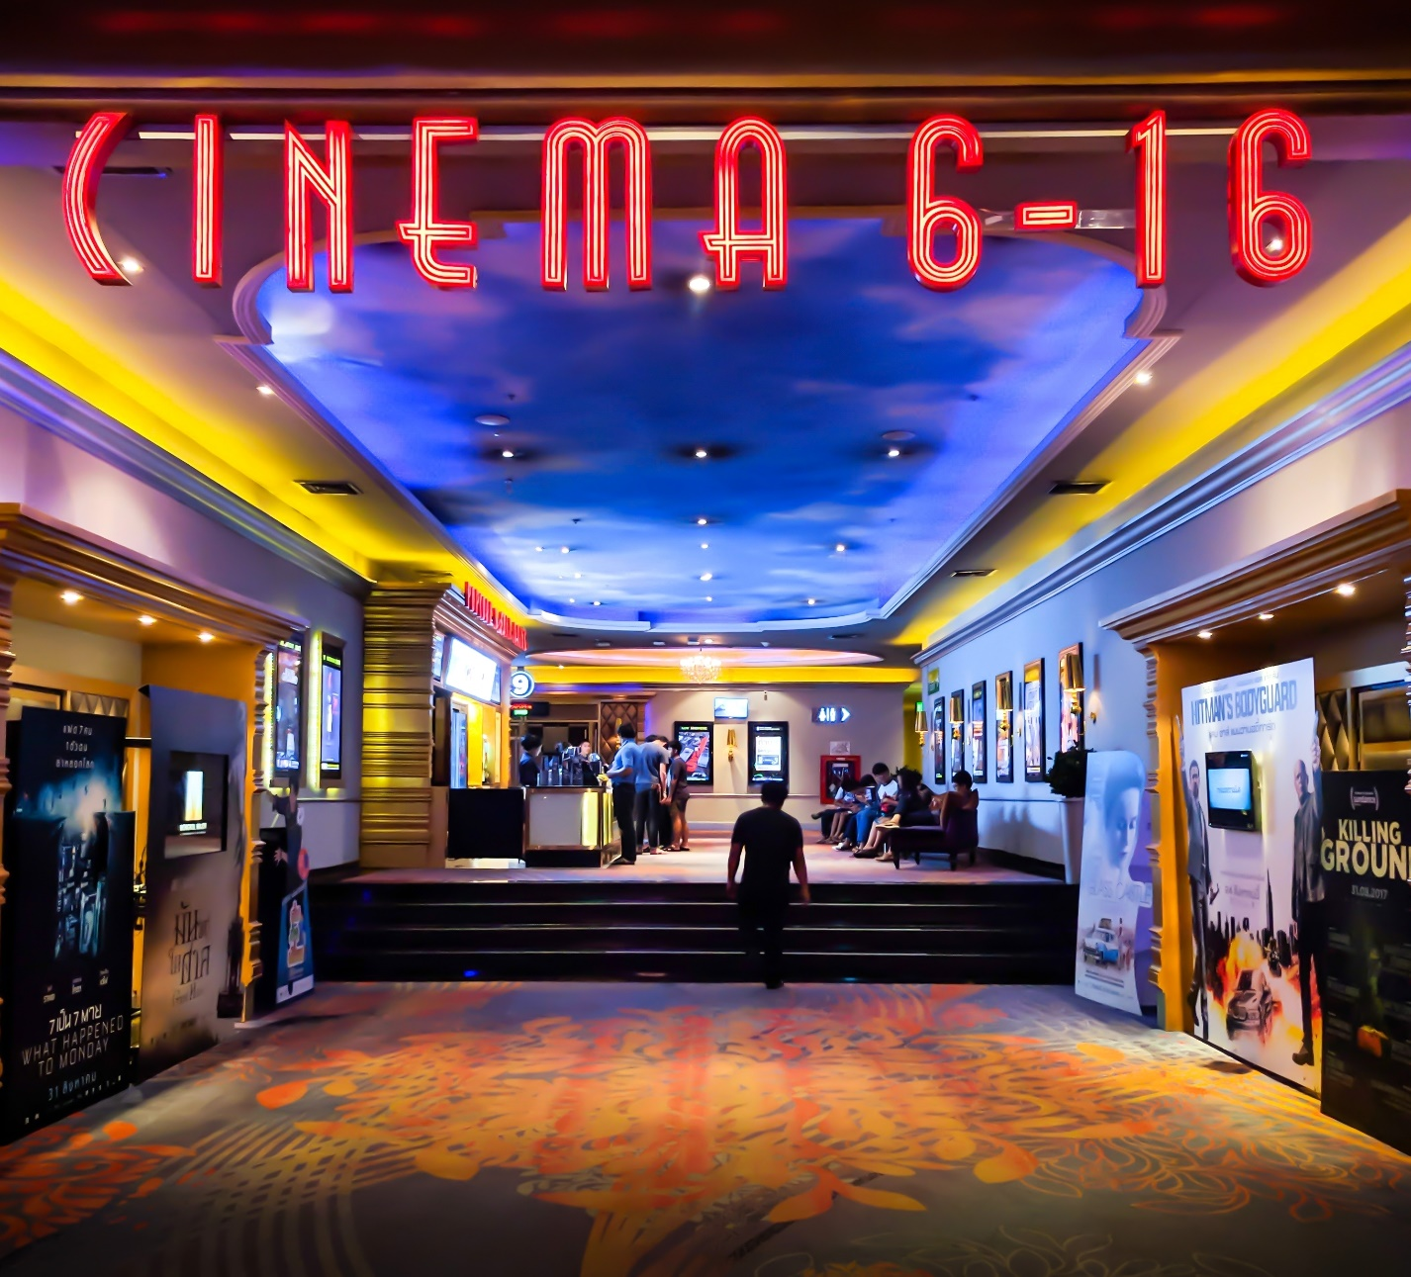
From the moment they enter the cineplex, ‘Elusives’ are receptive to in-theater advertising which provides marketers with immediate opportunities to reach these social, active and lucrative consumers
I’ve had interest in video ad(s) shown in movie theater lobbies
P18-34
Black 18+
Hispanic 18+
+50%
% more likely than the average adult 18+
+68%
% more likely than the average adult 18+
+91%
% more likely than the average adult 18+
Asian 18+
Cord Nevers
+24%
% more likely than the average adult 18+
+12%
% more likely than the average adult 18+
Source: MRI-Simmons 2021 Fall Doublebase; MRI Cord Evolution Study, March 2022. Interest includes ‘considerable interest’ and ‘some interest.’
This information is exclusively provided to VAB members and qualified marketers. Further distribution is prohibited.
PAGE 14

Slide 15
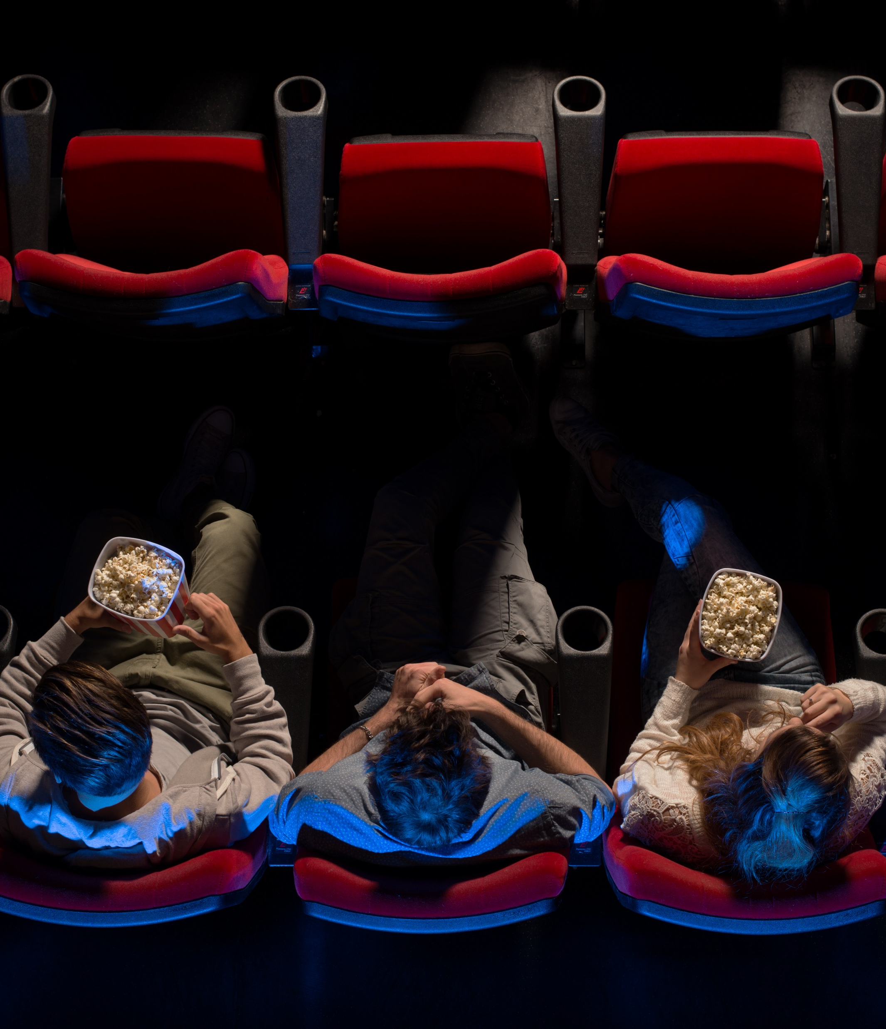
89%
of adults 18-34 take their seats before the start
of trailers
Source: NCM ‘Behind the Screens’ community study, Wave 8, June 2-9, 2021, % based on the universe that have returned to the cinema.
This information is exclusively provided to VAB members and qualified marketers. Further distribution is prohibited.
PAGE 15

Slide 16

Once seated in the theater, marketers can capture the ‘Elusives’ with marquee advertising engagement on-screen to drive brand interest
I’ve had interest in an ad(s) shown on-screen
before the start of a movie
P18-34
Black 18+
Hispanic 18+
+27%
% more likely than the average adult 18+
+41%
% more likely than the average adult 18+
+20%
% more likely than the average adult 18+
Asian 18+
Cord Nevers
+29%
% more likely than the average adult 18+
+16%
% more likely than the average adult 18+
Source: MRI-Simmons 2021 Fall Doublebase; MRI Cord Evolution Study, March 2022. Interest includes ‘considerable interest’ and ‘some interest.’
This information is exclusively provided to VAB members and qualified marketers. Further distribution is prohibited.
PAGE 16

Slide 17








In preparation for their next night out at the cineplex, ‘Elusives’ engage with movie-related digital platforms to maximize their theatrical experience
On average, across these nine websites: 41% of total visitors are P18-34 (152 index) with a 38.7 median age (vs. 45.4 total internet)
Movie Related Website / App Unique Visitor Composition
Dec ’21
Movie Tickets / In-Theater Experience
Movie Reviews
A18-34
Comp %
(vs. Total Internet)
A18-34
Comp %
(vs. Total Internet)
54% (196 Index)
48% (176 Index)
40% (148 Index)
43% (158 Index)
40% (145 Index)
38% (139 Index)
40% (146 Index)
32% (118 Index)
How to read index: 43% of Fandango visitors were P18-34, which is 58% higher than the total internet
Source: Comscore MediaMetrix multiplatform, Entertainment-Movies category, unique visitors, Dec ’21, P18+ & P18-34.
This information is exclusively provided to VAB members and qualified marketers. Further distribution is prohibited.
PAGE 17

Slide 18
3
The Resiliency of Cinema Is Being Forged by the ‘Elusives’

Slide 19








Illustrating how hungry the ‘Elusives’ are for new movies, two recent theatrical releases had larger opening box office weekends than some
of the most popular movies released prior to the pandemic
Domestic Box Office Opening Weekend Gross Revenues
Dec 17, 2021
Mar 4, 2022
Spider-Man: No Way Home
$260 MM
The Batman
$134 MM
Pre-Pandemic Movies
Pre-Pandemic Movies
Dec 20, 2019
Feb 16, 2018
Apr 27, 2018
Jun 21, 2019
May 1, 2018
Nov 7, 2019
Star Wars: Rise of the Skywalker
$177 MM
Black Panther
$202 MM
Avengers: Infinity War
$258 MM
Toy Story 4
$126 MM
Deadpool 2
$126 MM
Frozen II
$130 MM
Source: Box Office Mojo, 2018-2021, dates reflect official release dates.
This information is exclusively provided to VAB members and qualified marketers. Further distribution is prohibited.
PAGE 19

Slide 20



Cementing its status as the ‘go to’ social activity, more adults 18-34 saw Spider-man during opening weekend than collectively went to a restaurant, bar or club (in an average week)
Going to a Restaurant, Bar, Club Weekly vs. Opening Weekend Cinema Admissions
Adults 18-34
Adults 18-34
Restaurants, Bars or Clubs
12.9 MM
Spider-Man: No Way Home
14.8 MM
Estimated Adults 18-34 that go to a restaurant, bar or club at least once a week
(7 Days)
Estimated Adults 18-34
Opening Weekend Admissions
(3 Days)
Source: VAB analysis of MRI-Simmons 2021 Fall Doublebase, P18-34, “How often do you engage in these Leisure Activities?”: Dining Out & Go to Bars/Clubs, Once a week or 2 or more times a week. VAB analysis of Box Office Mojo and Comscore post-track data based on an estimate of 70% P18-34 audience admissions composition for the opening weekend. Analysis also supported with data from Screendollars, 12/26/21 and articles on Deadline, 12/20/21; Deadline, 12/26/21.
This information is exclusively provided to VAB members and qualified marketers. Further distribution is prohibited.
PAGE 20

Slide 21


Over 3 days, more adults 18-34 went to see The Batman than went to a sporting event across the six major leagues over 12 months
Sports League Attendance Over Last 12 Months vs. Opening Weekend Cinema Admissions
Adults 18-34
Adults 18-34
6 Major Sports Leagues
6.06 MM
The Batman
6.14 MM
Estimated Unique Adults 18-34 Combined
Regular Season & Playoff Attendance
(last 12 Months)
Estimated Adults 18-34
Opening Weekend Admissions
(3 Days)
Source: VAB analysis of MRI-Simmons 2021 Fall Doublebase, P18-34, 6 Major Sports League attendance reflects unique P18-34 reach for both regular season and playoff games in the last 12 months across: NFL, NBA, MLB, NHL, NCAA Football & NCAA Basketball. VAB analysis of Box Office Mojo and Comscore post-track data based on an estimate of 62% P18-34 audience admissions composition for the opening weekend. Analysis also based on Screendollars, 3/6/22 and supported by data from EntTelligence.
This information is exclusively provided to VAB members and qualified marketers. Further distribution is prohibited.
PAGE 21

Slide 22
This momentum is projected to lead to a quick recovery with box office admissions estimated to achieve near pre-pandemic levels by 2023
943 feature films having entered production in 2021, a 16% increase over 2019
Domestic Box Office Revenues
Revenue $ (MM)
Domestic Cinema Admissions
Admissions (MM)
+3%
vs. 2019
-3%
vs. 2019
Source: S&P Global, Kagan estimates, Exhibitor Market Projections, May 31, 2021. MPA THEME Report, 2021 (released in March 2022). MM = millions.
This information is exclusively provided to VAB members and qualified marketers. Further distribution is prohibited.
PAGE 22

Slide 23














The theatrical pipeline is filled with 943 feature films, creating a constant stream of upcoming releases featuring high-profile movies and potential blockbusters for the ‘Elusives’ to enjoy
April 15
May 6
May 27
June 10
June 17
July 1
July 8
July 22
October 7
October 21
October 31
November 4
November 11
December 16
Source: Box Office Mojo. Note: only represents a sampling of 2022 cinema releases. Release dates as of 3/15/22, subject to change.
This information is exclusively provided to VAB members and qualified marketers. Further distribution is prohibited.
PAGE 23

Slide 24
Connecting with ‘Elusives’ – an assembly of the young, diverse, cordless and lucrative – through cinema provides marketers an opportunity to
engage this passionate, highly desirable, ‘hard to reach elsewhere with advertising’ audience with relevant messaging on a big screen, before super premium video content in a captive environment
Marketers looking for immediate audience reach
(e.g., new product launch, a consumer promotion, seasonal campaign) would benefit from the proven ability of Cinema to quickly amass scale and reach
of a campaign.
Cinema campaigns offer marketers a way to reach and engage multicultural consumers at scale and in moments when they are highly attentive.
Key Marketer Takeaways
This information is exclusively provided to VAB members and qualified marketers. Further distribution is prohibited.
PAGE 24

Slide 25


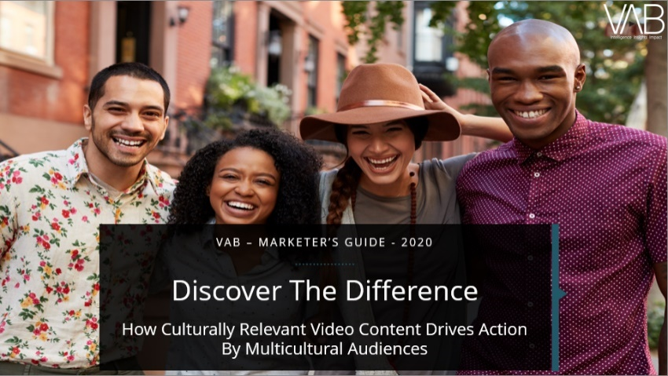
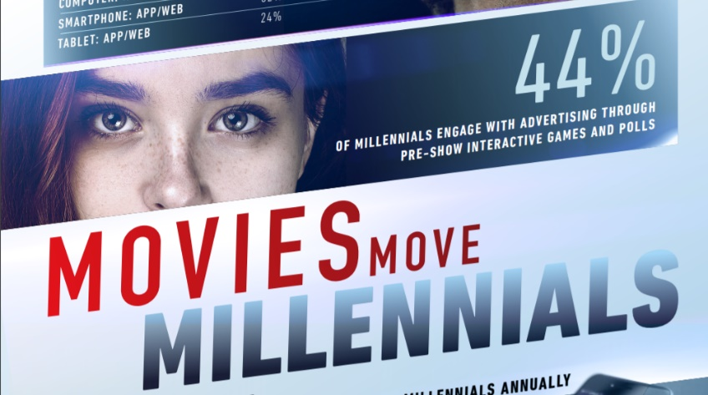

Creators
Jason Wiese
Reed Kiely
SVP, Director of Strategic Insights
jasonw@thevab.com
Associate Insights Director
reedk@thevab.com
Discover more
Looking for more data, insights and takeaways? Check out this related VAB content
A Fresh Take On Engaging Frequent Video Streamers Through Cinema
The Power of Super Cinema Goers
Super Spenders, Social and Active Consumers
We are committed to providing marketers with the data and insights they need to develop thoughtful, inclusive campaigns & strategies. To find out more on the unique media consumption behaviors and cultural trends of multicultural consumers, visit the VAB’s Multicultural Marketing Resource Center.
Discover the Difference
Culturally Relevant Video Content Drives Action By Multicultural Audiences
Movies Move Millennials
Cinema Ads Inspire Millennial Action
VAB Members, brand marketers and agencies get free and immediate access to VAB’s content library. Get access at theVAB.com
This information is exclusively provided to VAB members and qualified marketers. Further distribution is prohibited.
PAGE 25

Slide 26


About VAB
VAB is an insights-driven organization that inspires marketers to reimagine their media strategies resulting in fully informed decisions.
Drawing on our marketing expertise, we simplify the complexities in our industry and discover new insights that transform the way marketers look at their media strategy.
We are committed to your business growth and proud to offer VAB members, brand marketers and agencies complimentary access to our continuously-growing Insights library. Get immediate access at theVAB.com.
Curious to learn more about VAB? Check out this quick video to see what we do and how we can help you develop business-driving marketing strategies.
This information is exclusively provided to VAB members and qualified marketers. Further distribution is prohibited.
PAGE 26

