Slide 1





Can I prove TV has a measurable financial impact on my business?
Marketer FAQs

Slide 2
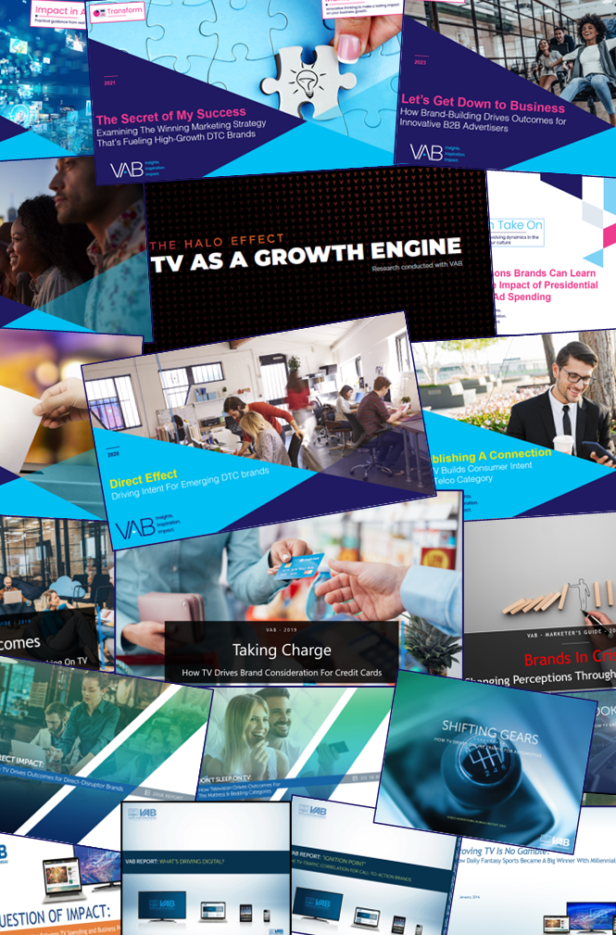



What KPIs can TV advertising deliver to drive financial success for my brand?
This is a question many business owners and marketers ask.
Through VAB’s decade-long studying of what drives business outcomes, we explore how each stage of the purchase funnel contributes to the financial impact of successful brands and how TV advertising aids in driving these results.
You’ll learn:
  How TV campaigns drive upper-to-mid funnel metrics like awareness, brand reputation and consideration
  How TV campaigns impact lower funnel metrics like website visits, sales and share of market
  How results achieved across the purchase funnel drive capital investment and company valuations
This information is exclusively provided to VAB members and qualified marketers.
PAGE 2

Slide 3







































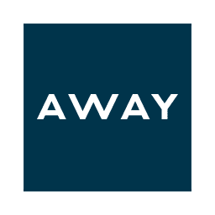
















VAB has studied hundreds of brands across categories to understand the effect TV campaigns have on each stage of the purchase funnel
Sampling of Brands Analyzed
Purchase Funnel
Awareness
Sales
Intent
Consideration
Value Creation
This information is exclusively provided to VAB members and qualified marketers.
PAGE 3

Slide 4
TV campaigns ultimately impact the financial success of brands across each stage of the purchase funnel and beyond
Awareness
Consideration
Intent
Sales
Value Creation
TV campaigns build awareness and reputation which enhances brand value
TV campaigns inspire audience curiosity which ignites online search and exposes brands to more potential customers
TV campaigns drive an influx
of new, highly-valued customers
to brands’ digital storefronts
As a performance-driven channel, TV campaigns deliver both short-term sales and long-term results
TV campaigns create both consumer and marketplace excitement that attracts capital investment
and boosts company valuations
This information is exclusively provided to VAB members and qualified marketers.
PAGE 4

Slide 5

Awareness
TV campaigns build awareness and reputation which enhances brand value

Slide 6
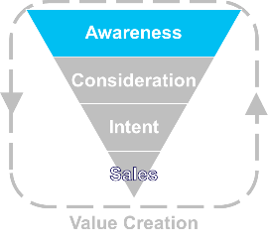
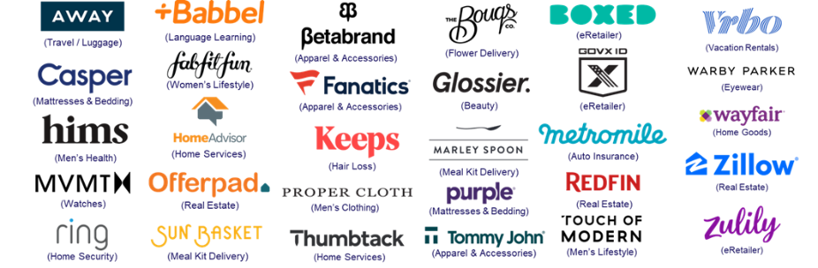
Turns brands into household names
Continued TV re-investment over multiple years has turned many disruptor brands into ‘names people know’
30 ‘Direct-to-Consumer’ Brands: Total Rolling Cume TV Spend
($ in millions, spending aggregated across years within time period)
+3X
Annual TV Spend (MM):
$28
$36
$158
$337
$395
$554
$495
$803
$1,040
$811
$141
Sources: VAB analysis of Nielsen Ad Intel data, CY 2010 – Q1 2021. TV spend includes national broadcast TV, cable TV, Spanish language broadcast TV, Spanish language cable TV, spot TV, syndication TV. Reflects the total annual TV spend across the 30 brands analyzed. Cume TV spend = the rolling totals aggregated across each year. TV spend reflects a 31% compound annual growth rate (CAGR) of cume TV spend between calendar years 2016 – 2020 (i.e., mean annual growth of TV spend across the time period).
Want to learn more? Click here to download ‘The Secret of My Success’
PAGE 6

Slide 7

(Re)Builds brand perception
Uber’s ‘Moving Forward’ TV campaign successfully re-built their reputation after a series of company crises
After a quarter of low growth with active users (+3%) and total trips taken (+4%), Uber’s “Moving Forward” campaign and the branding campaign that immediately followed, helped spur an average +10% growth in both users and trips over the next three quarters
Uber
(in millions)
Crisis
“Moving Forward” & “Post-Response” TV Branding Campaigns
*Note: Represents global figures since U.S. breakout is not available within Uber 10-Q filings, however U.S. accounts for 89% of Uber’s revenue growth per 10-Q (8/9/19) so a similar trend line would be expected between Global & U.S.
Source: Uber 10-Q filings via SEC.gov (EDGAR)
Want to learn more? Click here to download ‘Brands In Crisis’
PAGE 7

Slide 8
Consideration
TV campaigns inspire audience curiosity which ignites online search and exposes brands to more potential customers

Slide 9
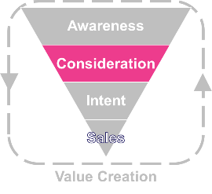
Piques curiosity for ubiquitous brands
Meta’s Oculus Quest 2 TV launch campaign drove search queries, dominating VR category SOV
Meta’s Oculus Quest 2 led category search queries with their share of voice (SOV) advantage in the VR category: $67 MM in 4Q ’20 TV spend vs. no spending by its competitors
Weekly Google Search Trend Indices & Total U.S. TV Spend
2020
Oct 13
Release Date
Source: VAB analysis of Nielsen AdIntel, 10/4/20-1/1/21, TV spend includes cable TV, broadcast TV, Spanish language cable TV, Spanish language broadcast TV, spot TV, and syndicated TV. U.S. TV spend only; VAB analysis of Google Trends, United States only, All Categories, Web Search, 10/4/20-1/1/21, SOV = Share of voice. *Google Search Index represents search interest relative to the highest point on the chart for the given region and time period, a value of 100 is the peak popularity for the term, a value of 50 means that the term is half as popular.
Want to learn more? Click here to download ‘Analyzing Outcomes From The Tech Giants’ TV Investment’
PAGE 9

Slide 10


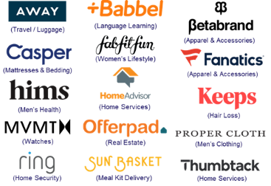
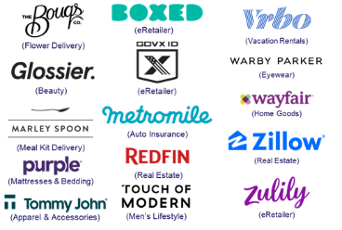
Delivers new customer prospects
TV campaigns expose brands to new audiences which delivers an influx of fresh, high-valued customers with more spending power
Unique Website Visitors Composition Shift
30 Direct-to-Consumer Brand Average
1Q ‘21 vs. 1Q ’17 (Monthly Avg)
30 DTC Brands Analyzed
Median Age
P50+ Comp %
+6.7
years
+14.1
percentage points
49.9 vs 43.2
1Q ’21 vs 1Q ’17* monthly average
52% vs 38%
1Q ’21 vs 1Q ’17* monthly average
30-Brand Cume TV spend between 2010-2016: $1.5B
30-Brand Cume TV spend between 2010-1Q 2021: $4.8B
Source: VAB analysis of Comscore mediametrix multiplatform media trend data, P18+. 1Q ’17: January – March ‘17, 1Q ‘21: January – March ‘21 (calendar months), monthly average within each quarter, P50+ comp% is based on monthly unique visitors; figures are based on monthly averages for each 3-month time period across the 30 brands analyzed. *1Q ‘17 (Jan-Mar ‘ 17) is reflective of the first 3-month measurement period available and is inclusive of a few brands that were first measured after this time period, based on their first 3-month measurement period. Note: Comscore did not begin measuring ‘median age’ as a reported metric until February ‘17, therefore the first time period reflects Feb-Apr ‘17.
Want to learn more? Click here to download ‘The Secret of My Success’
PAGE 10

Slide 11
Intent
TV campaigns drive an influx
of new, highly-valued customers
to brands’ digital storefronts

Slide 12
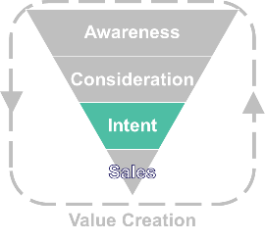
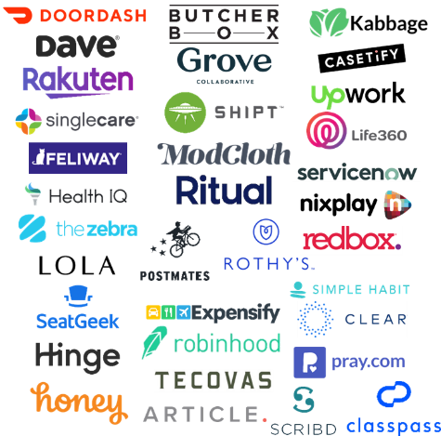
Drives people to branded digital storefronts
After TV launch, brands see a surge of new customers to their websites, with continued lifts through their campaign
36 ‘Emerging’ Direct-to-Consumer (DTC) Brands*
Average Monthly Website Unique Visitors (000)
Based Over a Four-Year Time Period: Jan ‘16 – Jan ‘20
TV Campaign Duration
36 DTC Brands Analyzed
+85%
(+1.6MM monthly uniques)
+56%
(+1.0MM monthly uniques)
vs. monthly average prior to TV launch
vs. monthly average prior to TV launch
(monthly average)
(TV launch – January 2020)
Source: VAB analysis of Nielsen Ad Intel data, TV spend (national cable TV, national broadcast TV, Spanish language broadcast TV, Spanish language cable TV, spot TV, syndication TV), Feb ‘18 – Jan ‘20 (calendar months). VAB analysis of Comscore mediametrix multiplatform media trend data, total audience (Desktop P2+, Mobile 18+), Jan ‘16 – Jan ‘20 (calendar months). ‘Prior to TV Launch’ reflects the average monthly unique visitors based on when each brand’s website began being measured by Comscore, or starting from January 2016 if measurement began before that month. *Reflects the 36 brands that are measured in Comscore and had reported monthly unique visitors in at least one month prior to their campaign launch.
Want to learn more? Click here to download ‘Direct Effect’
PAGE 12

Slide 13



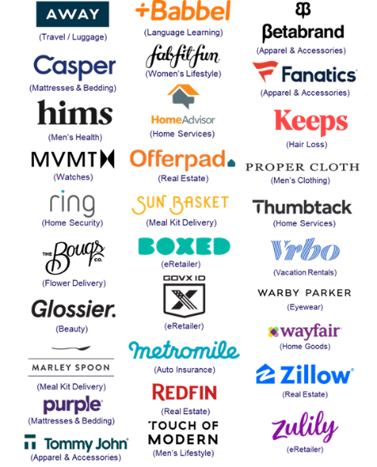
Grows customer acquisition
TV campaigns drive digital platform engagement with high-value customers who are more likely to become repeat visitors
Key Website Metrics: 30 Direct-to-Consumer Brand Average
1Q ‘21 vs. 1Q ‘17*: Monthly Avg Comparison
30 DTC Brands Analyzed
Unique Visitors (000)
Total Visits (000)
Total Minutes (MM)
# Difference
+3,156
+22,184
+95
% Difference
+63%
+135%
+89%
Total U.S. Internet Avg
% Difference
+10%
+26%
+34%
Source: VAB analysis of Comscore mediametrix multiplatform media trend data, P18+. 1Q ’17: January – March ’17, 1Q ’21: January – March ‘21 (calendar months), figures are based on monthly averages for each 3-month time period across the 30 brands analyzed. *1Q ’17 (Jan-Mar ’17) is reflective of the first 3-month measurement period available and is inclusive of a few brands that were first measured after this time period, based on their first 3-month measurement period. 30 brands total TV spend (between 1Q ‘17 – 1Q’21): $3.3B.
Want to learn more? Click here to download ‘The Secret of My Success’
PAGE 13

Slide 14
Sales
As a performance-driven channel,
TV campaigns deliver both short-term sales and long-term results

Slide 15
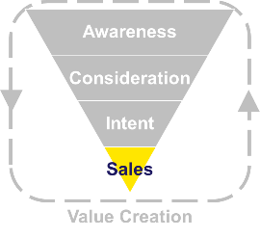



Ignites short-term business performance
TV is the catalyst for short-term business results, igniting revenue growth for brands in the year of their first TV campaign
Company
Year Prior to TV
TV Launch Year
YoY Diff
%
=revenue increase after launching TV
(TV launch: 2018)
TV Spend (000):
---
$7,662
+$7,662
Revenue (000):
$317,755
$425,841
+$108,086
+34%
Founded in 2005
(TV launch: 2018)
TV Spend (000):
---
$10,548
+$10,548
Revenue (000):
$48,000
$150,000
+$102,000
+213%
Founded in 2013
(TV launch: 2017)
TV Spend (000):
---
$3,438
+$3,438
Founded in 2012
Revenue (000):
$100,000
$150,000
+$50,000
+50%
(TV launch: 2017)
TV Spend (000):
---
$535
+$535
Founded in 2011
Revenue (000):
$50,000
$100,000
+$50,000
+100%
(TV launch: 2017)
TV Spend (000):
---
$2,670
+$2,670
Revenue (000):
$60,000
$80,000
+$20,000
+33%
Founded in 2013
Source: Revenues reflect estimated revenue data from Pivotal Research. TV spend based on VAB analysis of Nielsen Ad Intel data, TV spend (national cable TV, national broadcast TV, Spanish language broadcast TV, Spanish language cable TV, spot TV, syndication TV), CY 2016 & 2017 &TV spend based on VAB analysis of Nielsen Ad Intel data, TV spend (national cable TV, national broadcast TV, Spanish language broadcast TV, Spanish language cable TV, spot TV, syndication TV), CY 2016-2018. Revenues for public companies are based on company filings (10-K) for U.S. revenue via SEC.gov (EDGAR). Revenues for private companies are based on reports/projections/guidance provided publicly by company founders/representatives, or analyst estimates/forecasts, and reported within business/technology news outlets such as Bloomberg, CNBC, Digiday, Forbes, Inc., Recode, TechCrunch, WSJ, etc.
Want to learn more? Click here to download ‘Direct Impact’ and ‘Direct Outcomes’
PAGE 15

Slide 16



Increases long-term sales
Many brands see correlations over several years between the increases in their TV investment and growth in annual revenues
Time Period
CAGR*
Brand
2017
2020
U.S. Revenue (000)
$230,106
$485,028
+28%
Rolling Cume TV Spend (000)
$18,777
$119,923
+86%
U.S. Revenue (000)
€18,838
€127,220
+89%
Rolling Cume TV Spend (000)
$364
$2,937
+101%
U.S. Revenue (000)
$370,036
$886,093
+34%
Rolling Cume TV Spend (000)
$10,080
$72,878
+93%
U.S. Revenue (000)
$4,153,057
$11,900,658
+42%
Rolling Cume TV Spend (000)
$105,794
$450,889
+62%
U.S. Revenue (000)
$1,076,794
$3,339,817
+46%
Rolling Cume TV Spend (000)
$44,180
$155,449
+52%
Sources: Revenues are based on company filings (10-K) via sources such as SEC.gov (EDGAR) and S&P Global Market Intelligence. TV spend based on VAB analysis of Nielsen Ad Intel data (national cable TV, national broadcast TV, Spanish language broadcast TV, Spanish language cable TV, spot TV, syndication TV). For comparison purposes, rolling cume TV spend based only on the time period between CY 2017-2020, with 2020 cume TV spend based on aggregated spending across the time period beginning in CY 2017. Casper revenues are based on North America. Marley Spoon U.S. revenues were reported in euros. *CAGR = compound annual growth rate (i.e., mean annual growth across the time period).
Want to learn more? Click here to download ‘The Secret of My Success’
PAGE 16

Slide 17


Strengthens share of market
Microsoft Teams utilized TV to increase their SOV which enabled
them to take significant ‘share of market’ from a major competitor
By quickly pivoting to recognize a new consumer demand and driving share of voice (SOV) behind its relevant product, Microsoft Teams established itself as the leading business communications platform through $172 MM in TV investment
10-Month COVID Time Period vs. Previous 10-Months
May ’19 - Feb ‘20
Mar ’20 - Dec ‘20
% Change
Total U.S. TV Spend
$20.0 MM
$152.4 MM
+661%
Avg. Monthly Unique Visitors
11.8 MM
32.3 MM
+173%
Time Period Cume Total Hours Spent
68.5 MM
379.1 MM
+453%
May ’19 - Feb ‘20
Mar ’20 - Dec ‘20
% Change
Total U.S. TV Spend
N/A
$0.5 MM
---
Avg. Monthly Unique Visitors
5.1 MM
4.9 MM
-6%
Time Period Cume Total Hours Spent
101.1 MM
49.3 MM
-51%
Source: VAB analysis of Nielsen AdIntel, calendar months of May 2019 - December 2020. TV spend includes cable TV, broadcast TV, Spanish language cable TV, Spanish language broadcast TV, spot TV, and syndicated TV. U.S. TV spend only. VAB analysis of Comscore mediametrix multiplatform media trend data, total audience (Desktop P2+, Mobile 18+), May ‘19 – Dec ‘20 (calendar months)
Want to learn more? Click here to download ‘Analyzing Outcomes From The Tech Giants’ TV Investment’
PAGE 17

Slide 18
Value Creation
TV campaigns create both consumer
and marketplace excitement that attracts capital investment and boosts valuations

Slide 19
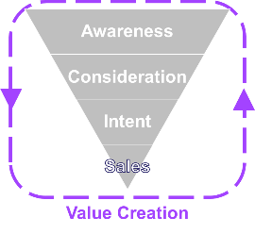








Stimulates capital investment
The excitement, exposure and increased customer base created from new TV campaigns often fuels more investor funding
72% of the overall $5 billion in investor funded raised across these 10 private companies during the time period analysis occurred when these brands were ramping up their TV investments to broaden their customer bases
Brand
Year Founded
Total Funding $$$
btwn 2010 – 1Q ‘21
% of Total Funding
btwn 2017 – Aug ’21
Cume TV Spend $$$
(btwn 2010 – 1Q ‘21)
% of Cume TV Spend
btwn 2017 – 1Q ‘21
1995
$2.7 B
74%
$826.4 MM
54%
2008
$698.2 MM
61%
$126.3 MM
58%
2010
$535.5 MM
60%
$298.0 MM
95%
2010
$266.4 MM
87%
$846.0 K
100%
2013
$245.9 MM
45%
$36.2 MM
25%
2015
$155.0 MM
100%
$37.9 MM
100%
2015
$181.0 MM
94%
$40.3 MM
100%
2012
$88.1 MM
78%
$9.1 MM
62%
2010
$83.5 MM
96%
$14.4 MM
100%
2017
$69.8 MM
100%
$72.9 MM
100%
Sources: Funding figures based on VAB analysis of crunchbase.com, as of August 2021. TV spend based on VAB analysis of Nielsen Ad Intel data (national cable TV, national broadcast TV, Spanish language broadcast TV, Spanish language cable TV, spot TV, syndication TV), CY 2010-1Q 2021. Cume TV spend reflects the aggregated spending between CY 2010 – 1Q 2021. Collectively across the 10 private companies, 67% of the cume TV spend was invested between 2017 – 1Q 2021.
Want to learn more? Click here to download ‘The Secret of My Success’
PAGE 19

Slide 20







Stokes company valuations
Brands who expanded their customer base through strong TV launches have become ‘unicorns,’ with valuations over $1 billion
‘Unicorn’ Brands
$1+ Billion Valuations
(as of 1Q ’21)
(Apparel & Accessories)
(Home Services)
(Eyewear)
$12.8 B valuation
$3.2 B valuation
$3.0 B valuation
(cume TV spend*: $895MM)
(cume TV spend:* $126MM)
(cume TV spend*: $283MM)
(Real Estate)
(Beauty)
$3.0 B valuation
(Travel / Luggage)
$1.8 B valuation
(Language Learning)
$1.54 B valuation
(Auto Insurance)
(Hair Loss)
(cume TV spend*: $38MM)
(cume TV spend*: $1MM)
$1.19 B valuation
$1.3 B valuation
(cume TV spend*: $40MM)
$1.0+ B valuation
(cume TV spend*: $26MM)
(cume TV spend*: $91MM)
(cume TV spend*: $79MM)
Sources: based on latest funding and valuation data publicly available through sources including TechCrunch, PitchBook, Bloomberg, Wall Street Journal, Fortune, CNN Money. “Unicorn” = private companies valued at $1 billion+. Keeps valuation is based on parent company, Thirty Madison. “B” = billions. TV spend based on VAB analysis of Nielsen Ad Intel data (national cable TV, national broadcast TV, Spanish language broadcast TV, Spanish language cable TV, spot TV, syndication TV), *cume TV spend based on aggregated spend from CY 2000 - 1Q 2021.
Want to learn more? Click here to download ‘The Secret of My Success’
PAGE 20

Slide 21
Adults over 50 account for 36% of the total population and nearly half of all adults
TV campaigns lift the financial impact for brands by stimulating capital investment and stoking company valuations
This financial impact is aided by TV campaign successes achieved across each stage of the purchase funnel – building awareness and reputation, igniting online search, driving an influx of new, highly-valued customers to brands’ digital platforms and the delivery of both short-term sales and long-term results
Key Implications for Marketers
This information is exclusively provided to VAB members and qualified marketers.
PAGE 21

Slide 22
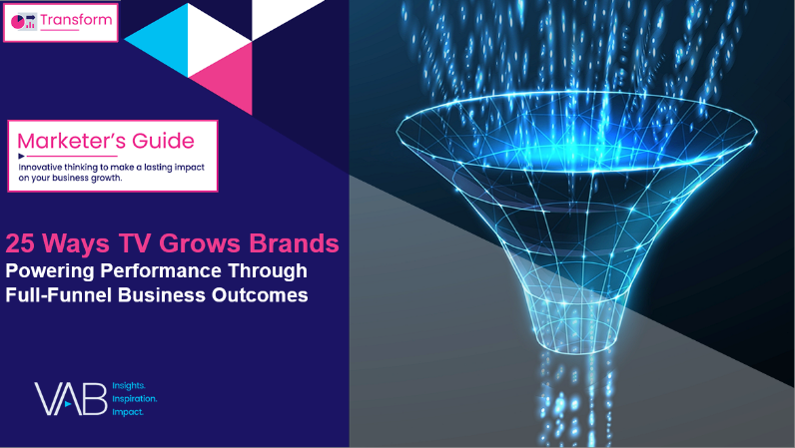
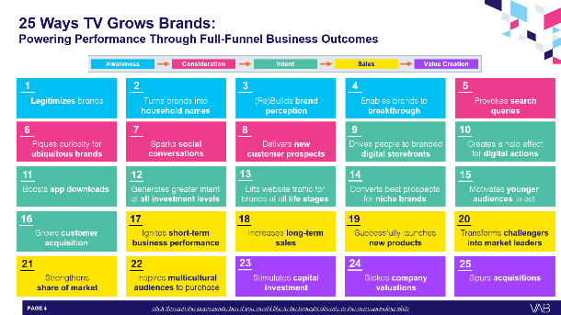
To learn more about the full-funnel impact of TV advertising, download our full report below
‘25 Ways TV Grows Brands’ explores real-world examples of how TV drives full-funnel outcomes, distilled from a decade of VAB’s TV attribution reports across 1,000+ brands, 80+ categories and
30+ metrics analyzed.
This information is exclusively provided to VAB members and qualified marketers.
PAGE 22

Slide 23


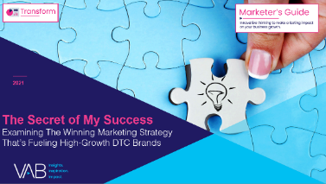


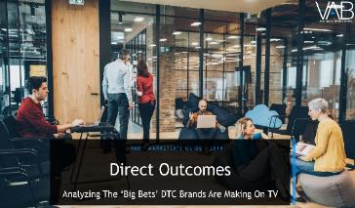
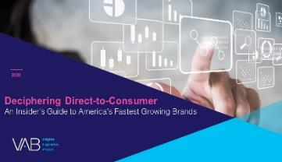
Creators
Jason Wiese
Reed Kiely
SVP, Director of Strategic Insights
jasonw@thevab.com
Director, Data Insights & Trends
reedk@thevab.com
Let’s Get Down to Business
How Brand-Building Drives Outcomes for Innovative B2B Advertisers
Let It Grow
Understanding the Importance
of Brand-Building for Niche Marketers
Discover more
Looking for more data, insights and takeaways? Check out this related VAB content
The Secret of My Success
Examining The Winning Marketing Strategy That’s Fueling High-Growth DTC Brands
The Halo Effect: TV as a Growth Engine
Why Brands are Accelerating their Path to TV
Direct Effect
Driving Intent For Emerging DTC Brands
Direct Outcomes
Analyzing The ‘Big Bets’ DTC Brands
Are Making On TV
VAB Members, brand marketers and agencies get free and immediate access to VAB’s content library. Get access at theVAB.com
This information is exclusively provided to VAB members and qualified marketers.
PAGE 23

Slide 24


About VAB
VAB plays a dual role in the video advertising industry. We are leading
the change to bring about a more innovative and transparent marketplace. We also provide the insights and thought leadership that enables marketers to develop business-driving marketing strategies.
Drawing on our marketing expertise, we simplify the complexities in our industry and discover new insights that transform the way marketers look at their media strategy.
We are committed to your business growth and proud to offer VAB members, brand marketers and agencies complimentary access to our continuously-growing Insights library. Get immediate access at theVAB.com.
This information is exclusively provided to VAB members and qualified marketers.
PAGE 24

