Slide 1


w/o May 11, 2020 Update
Make Yourself at Home
Video Viewing in the Time
of COVID-19

Slide 2

About VAB
VAB is an insights-driven organization that inspires marketers to reimagine their media strategies resulting in fully informed decisions.
Drawing on our marketing expertise, we simplify the complexities in our industry and discover new insights that transform the way marketers look at their media strategy.
Simplify
We save you time by bringing you the latest data & actionable takeaways you can use to inform your marketing plans.
Discover
We keep you one step ahead with the latest thinking so you can create innovative, forward-looking strategies.
Transform
We help you build your brand by focusing on core marketing principles that will help drive tangible business outcomes.
This information is exclusively provided to VAB members and qualified marketers. Further distribution is prohibited.
PAGE 2

Slide 3
Contents
1
5
How Has TV Viewership Changed?
HUTs / PUTs / Reach
Introduction
2
6
When Are People Watching?
Dayparts
Today’s “New Normal”
3
7
What Are People Watching?
Genres
Where Are The Sports Viewers?
4
Demanding On-Demand
Satisfying consumers’ appetite for more content through MVPD VOD and video streaming
8
Key Takeaways For Marketers
This information is exclusively provided to VAB members and qualified marketers. Further distribution is prohibited.
PAGE 3

Slide 4
What You’ll Learn…
As consumers establish new routines, the viewership spikes seen in April are flattening out, yet still significantly up vs. pre-pandemic time
Daytime, Late Night and Overnight, along with news and ‘feel good’ entertainment programming, offer reach and engagement opportunities
In looking for fresh content, viewers are expanding their programming repertoire and exploring new platforms, services, devices, and technologies
Sports fans haven’t disappeared, in fact three-quarters of them are watching more, or the same amount of, TV than they were pre-pandemic
This information is exclusively provided to VAB members and qualified marketers. Further distribution is prohibited.
PAGE 4

Slide 5
Introduction
While COVID-19 rapidly changed society and fundamentally altered people’s behaviors, by late April - six weeks into the pandemic - most people had settled into a ‘new normal’ routine of balancing their professional, family and personal lives from home.
The formal announcement of COVID-19 as a pandemic by the World Health Organization on March 11th quickly led to sweeping societal changes by state and local governments never before seen – mass ‘work from home’ mandates, school closures, community-wide lockdowns / ‘shelter in place’, non-essential business closings, mandatory social distancing and more.
With people still mostly confined to their homes and seeking both a constant source of news and a welcomed escape, we continue to quantify the affect this evolving “new normal” has had on video viewership.
This report covers a nine-week time period between February 24th – April 27th – reflecting the three weeks leading up to the ‘pandemic’ announcement through the sixth week after massive ‘stay at home’ orders were implemented – and provides an update on how many people are watching, what people are watching and when people are watching.
In addition, we look at where the sports viewer has gone in the absence of live sports and the ‘on-demand’ growth opportunities in MVPD VOD and video streaming.
This information is exclusively provided to VAB members and qualified marketers. Further distribution is prohibited.
PAGE 5

Slide 6

Today’s “New Normal”

Slide 7



TV has become the centerpiece of the household, with 8 out of 10 people saying they couldn’t imagine not having a television right now
% of respondents who agree with the statement
P18+
83%
70%
67%
“I couldn't imagine not having a television set right now”
“I binge watch more TV shows or movies”
“TV has become the central focus of our home”
Source: VAB’s 'As Time Goes By: How Media Consumption Is Helping America Cope’. VAB / Lucid ‘Media Usage In The Time of COVID-19 Survey,’ April 2020. Survey base: P18+ & household subscribes to cable, telco, internet TV or satellite TV (n=1,004). Q7: Thinking of your behavior since the start of COVID-19, please indicate below how much you agree or disagree with the following statements & Q9: Thinking of your behavior during the COVID-19 Pandemic, please indicate below how much you agree or disagree with the following statements
This information is exclusively provided to VAB members and qualified marketers. Further distribution is prohibited.
PAGE 7

Slide 8



With more time in their day, consumers are utilizing new platforms and discovering the full functionality of their existing devices
% of respondents who agree with the statement
P18+
84%
66%
54%
“I have more time to watch/listen/read media”
“I am more open to trying new types of media”
(e.g. new streaming services, podcasts, social media platforms, etc)
“I have learned how to use more features on my smart TV or a TV related device/platform”
Source: VAB’s 'As Time Goes By: How Media Consumption Is Helping America Cope’. VAB / Lucid ‘Media Usage In The Time of COVID-19 Survey,’ April 2020. Survey base: P18+ & household subscribes to cable, telco, internet TV or satellite TV (n=1,004). Q9: Thinking of your behavior during the COVID-19 Pandemic, please indicate below how much you agree or disagree with the following statements
This information is exclusively provided to VAB members and qualified marketers. Further distribution is prohibited.
PAGE 8

Slide 9
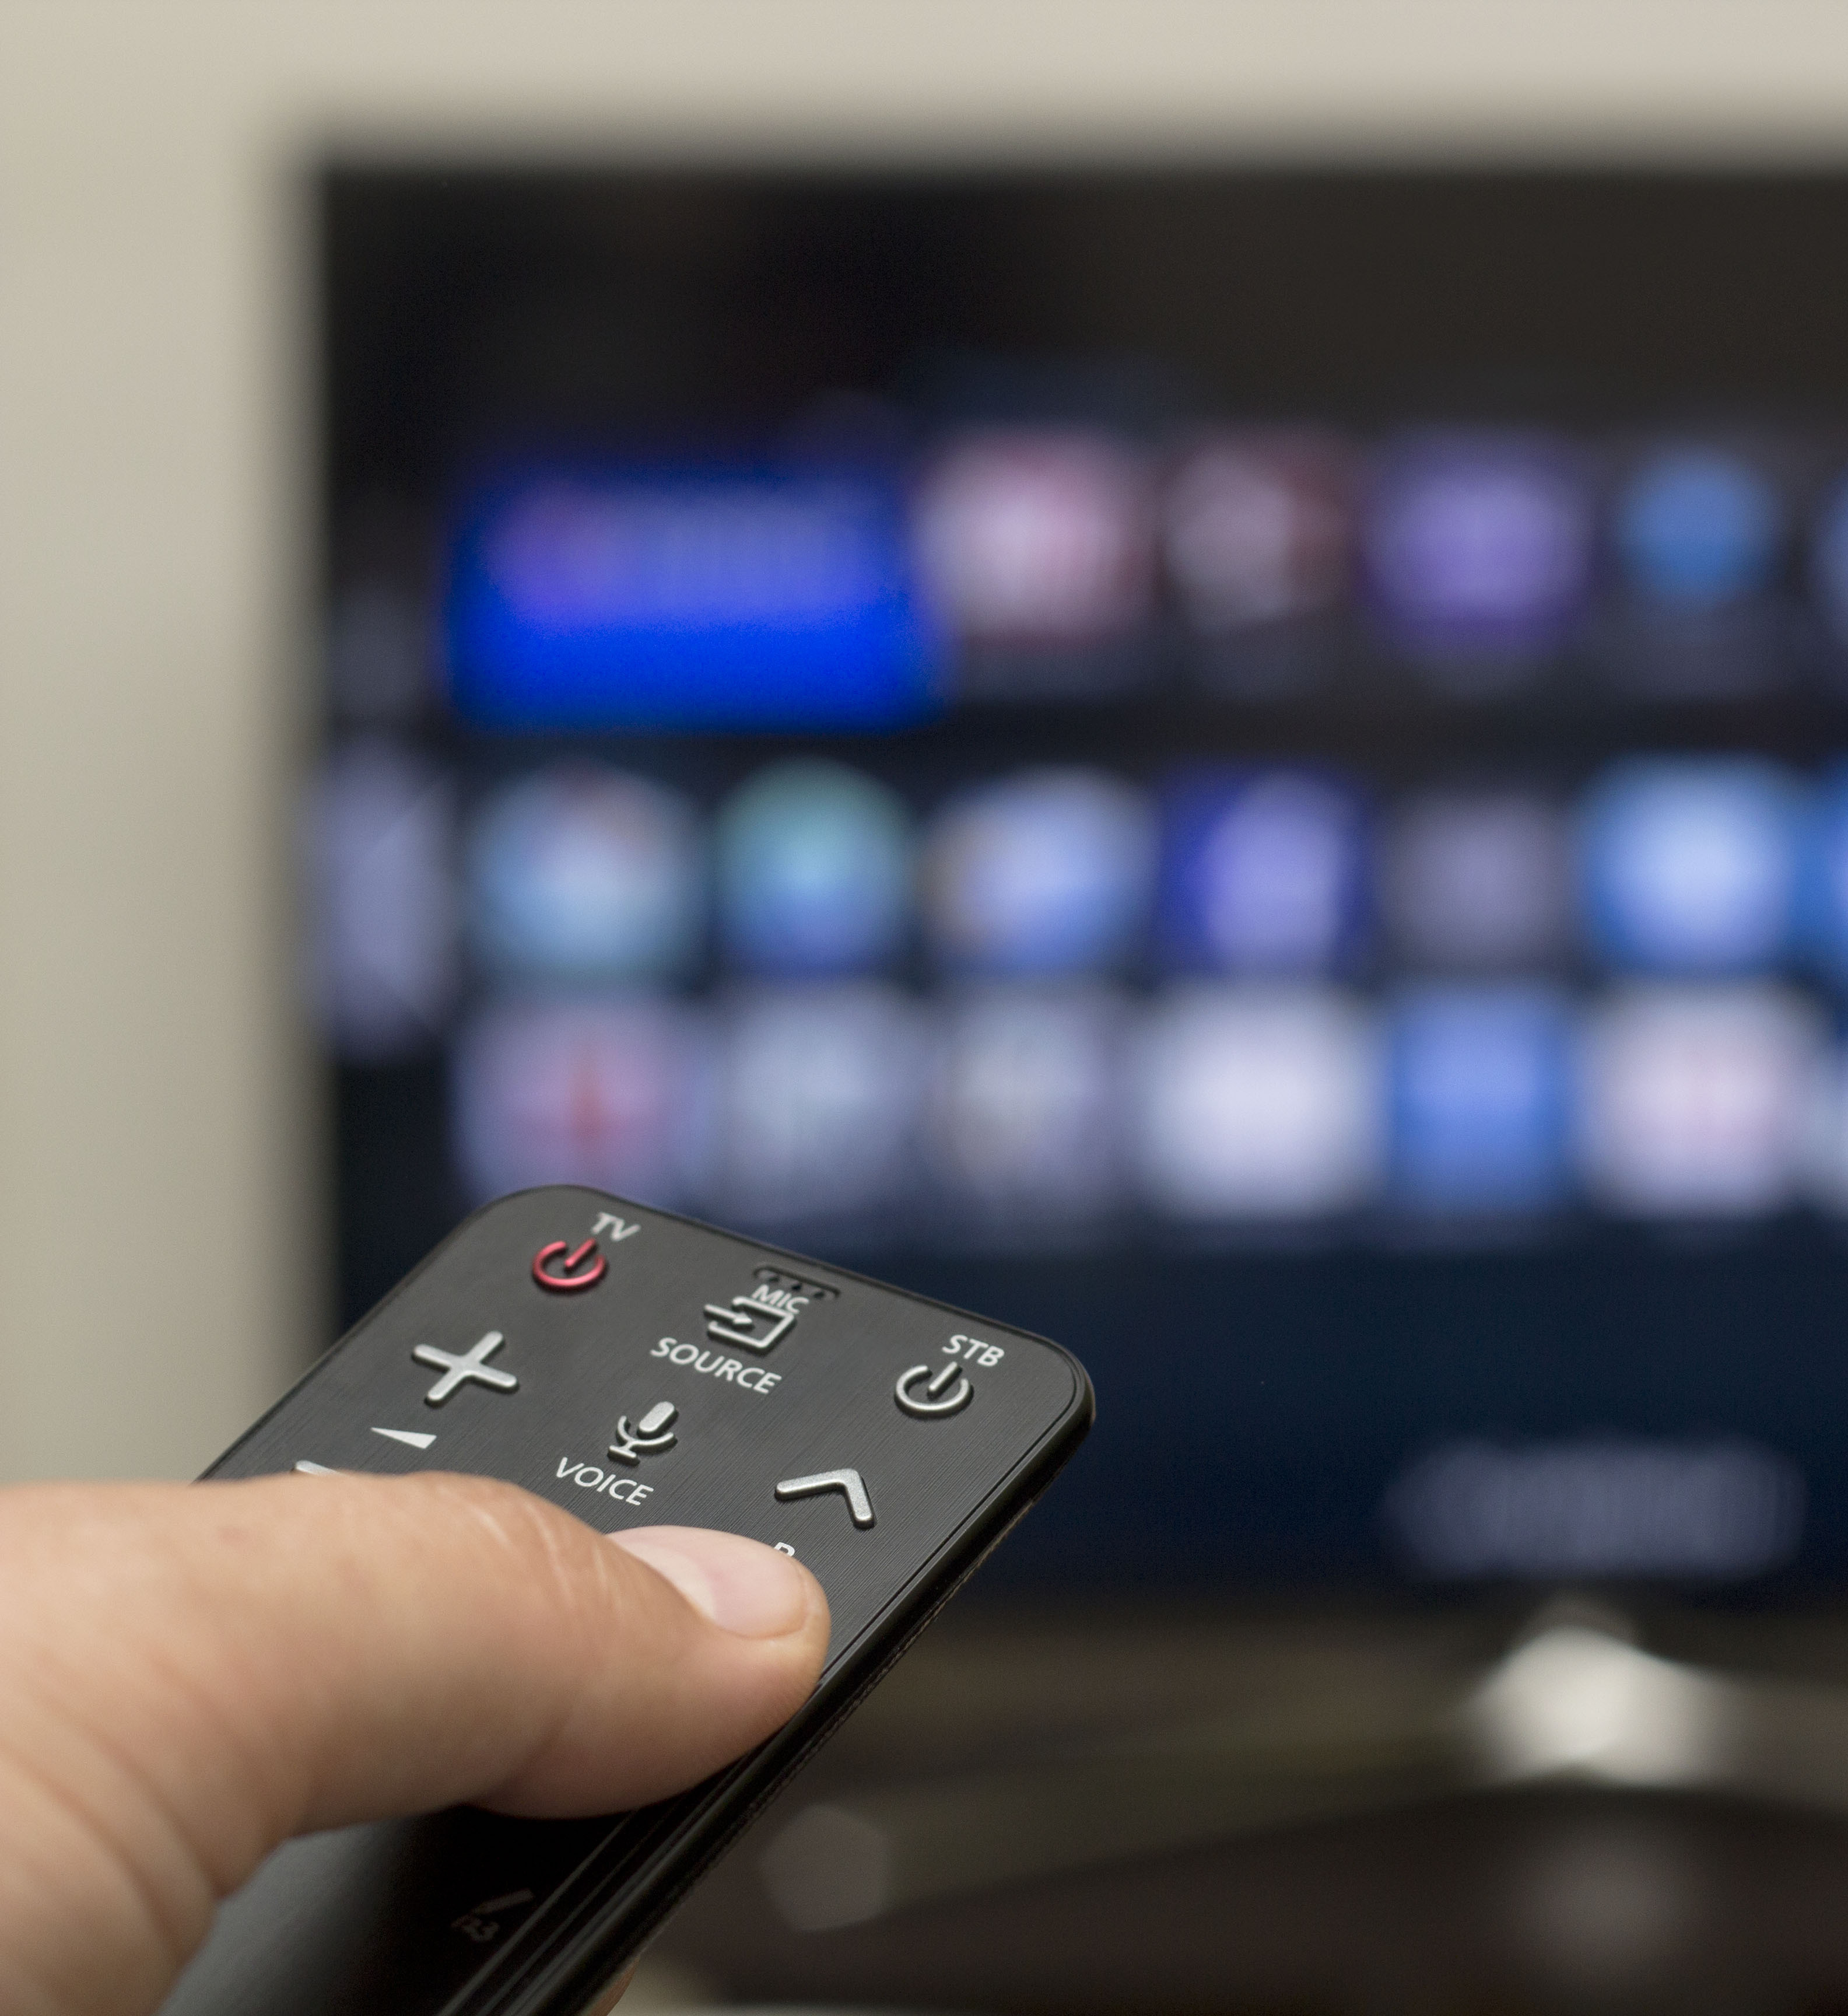
Including exploring new features on their smart TVs and connected devices
“I have learned how to use more features on my
smart TV or a TV related device/platform”
Top 2 Box (Agree Completely or Agree Somewhat)
Source: VAB’s 'As Time Goes By: How Media Consumption Is Helping America Cope’. VAB / Lucid ‘Media Usage In The Time of COVID-19 Survey,’ April 2020. Survey base: P18+ & household subscribes to cable, telco, internet TV or satellite TV (n=1,004). Q9: Thinking of your behavior during the COVID-19 Pandemic, please indicate below how much you agree or disagree with the following statement, top 2 box (agree completely or agree somewhat).
This information is exclusively provided to VAB members and qualified marketers. Further distribution is prohibited.
PAGE 9

Slide 10



While Gen Z is using video games to stay in touch with their friends, affluent targets are turning to podcasts to learn something new, and multicultural audiences are mastering TV related technology
63% Hispanic
66% Non-Hispanic Black
learned to use more features on Smart TV or TV related devices
28%
of P18-24 are playing video games to
keep in touch with friends
16%
of affluent respondents use podcasts to
learn something new
Source: VAB’s 'As Time Goes By: How Media Consumption Is Helping America Cope’. VAB / Lucid ‘Media Usage In The Time of COVID-19 Survey,’ April 2020. Survey base: P18+ & household subscribes to cable, telco, internet TV or satellite TV (n=1,004). Q4: During the COVID-19 pandemic, what are the primary reasons you utilized the media below? Does not equal 100% due to the ability to choose multiple responses.
This information is exclusively provided to VAB members and qualified marketers. Further distribution is prohibited.
PAGE 10

Slide 11




From an advertising perspective, companies that create COVID-19 related messaging can increase their brand perception among consumers
“Companies with specific COVID-19 related advertising messages positively impacts my perception of the brand”
% that agree with the statement
52%
of all respondents
Source: VAB’s 'As Time Goes By: How Media Consumption Is Helping America Cope’. VAB / Lucid ‘Media Usage In The Time of COVID-19 Survey,’ April 2020. Survey base: P18+ & household subscribes to cable, telco, internet TV or satellite TV (n=1,004). Q14: Some companies have created specific COVID-19 related advertising messages (e.g. Guinness, Ford, Burger King, Verizon). How do these types of advertisements typically impact your perception of a brand?
This information is exclusively provided to VAB members and qualified marketers. Further distribution is prohibited.
PAGE 11
PAGE 1

Slide 12





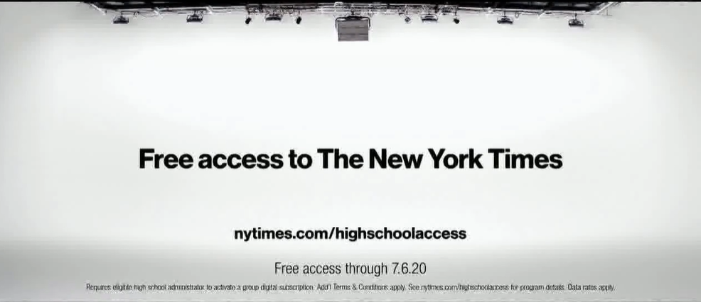








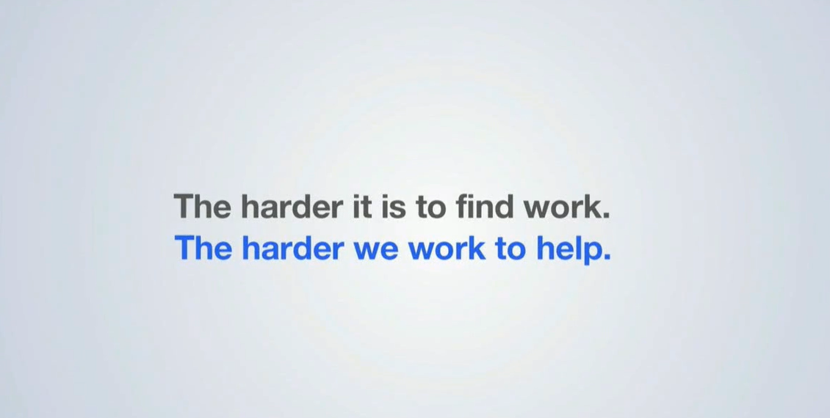

Early movers with COVID-19 messaging have continued to introduce new creative to foster greater connection with, and support of, consumers
*Reflects new creative launched between 4/4 – 4/30
This information is exclusively provided to VAB members and qualified marketers. Further distribution is prohibited.
PAGE 12

Slide 13




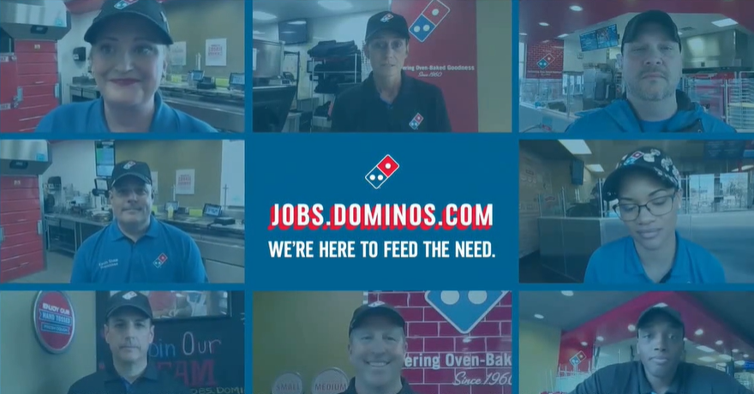


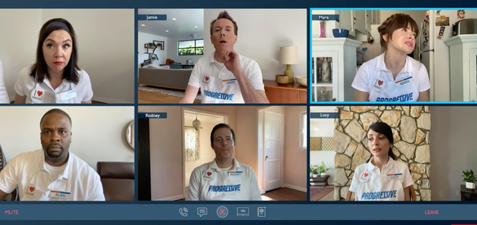
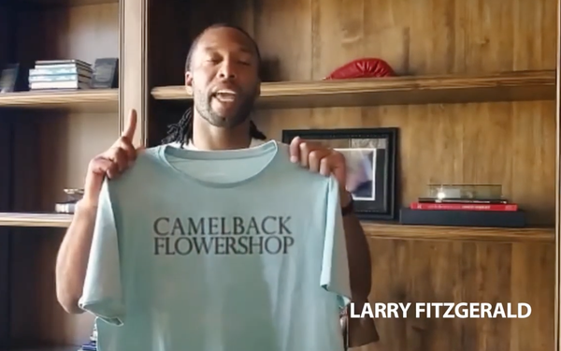








Brands representing a range of categories, from Beauty to B2B, have added their voices to an influx of advertising promoting commitment
to their community through courage, support and unity
*Reflects new creative launched between 3/24 – 4/30
This information is exclusively provided to VAB members and qualified marketers. Further distribution is prohibited.
PAGE 13

Slide 14

Through April 26th, 420 brands across 15 industries have aired COVID-19 related creative delivering over 80 billion national TV impressions
# of National TV Advertisers with COVID-19 Related Messaging
By Week
Top Brands by Industry
Industry | Brand | Nat’l TV IMPs
Restaurants | Burger King | 2.2 B
Vehicles | Lexus | 1.3 B
Retail | Lowes | 1.3 B
Electronics | Sprint | 1.4 B
Government | CDC | 2.4 B
Insurance | State Farm | 1.7 B
Home | Cottonelle | 822 MM
Business | H&R Block | 509 MM
Food & Beverage | Kellogg’s | 329 MM
Life & Entertainment | CNN | 707 MM
Health & Beauty | Dove | 681 MM
Travel | Hotels.com | 219 MM
28%
26%
27%
26%
25%
24%
15%
16%
15%
15%
18%
19%
15%
12%
8%
30%
40%
43%
47%
52%
% Share of Impressions by Industry
Restaurants
Vehicles
Government
Other
Source: VAB analysis of iSpot.tv data released 5/5/20; reported national TV impressions for COVID-19-related creative, 2/26/2020 – 4/26/2020, P18+; ‘Other’ includes retail stores, electronics & communication, insurance, home & real estate, business & legal, life & entertainment, food & beverage, health & beauty, pharmaceutical & medical, travel, education and apparel, footwear & accessories.
This information is exclusively provided to VAB members and qualified marketers. Further distribution is prohibited.
PAGE 14

Slide 15



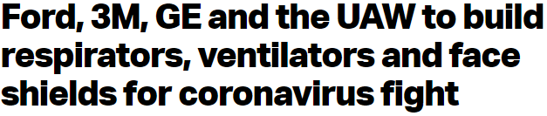
Overall, companies who do demonstrate an authentic commitment to helping communities during this crisis will likely increase purchase intent
“I am more likely to purchase a product or service from companies that are lending resources or helping local communities during the crisis”
% that agree with the statement
55%
of all respondents
Source: VAB’s 'As Time Goes By: How Media Consumption Is Helping America Cope’. VAB / Lucid ‘Media Usage In The Time of COVID-19 Survey,’ April 2020. Survey base: P18+ & household subscribes to cable, telco, internet TV or satellite TV (n=1,004). Q15: Some companies are lending resources (e.g. Comcast donating free internet, Ford, 3M and GE Healthcare making healthcare equipment), or helping local communities during the crisis (Miller Lite starts ‘virtual tip jar’ to support out-of-work bartenders). How does this affect your likelihood to purchase a product or service from this company?
This information is exclusively provided to VAB members and qualified marketers. Further distribution is prohibited.
PAGE 15
PAGE 1

Slide 16

Major Takeaways: Today’s “New Normal”
The television has become the central focus of people’s home
Looking for ways to deepen their media experience, consumers are actively exploring new media platforms and technology
People are also discovering new features on their smart TVs and connected devices to enhance the viewing experience
Companies sharing positive messages and showing a commitment to communities during this crisis are rewarded
This information is exclusively provided to VAB members and qualified marketers. Further distribution is prohibited.
PAGE 16

Slide 17
Where Are The Sports Viewers?

Slide 18

The cancellation of live sports is not keeping sports fans from watching TV, nearly three-fourths are watching more or the same amount of TV during the COVID-19 Pandemic
Due to COVID-19 virtually all live sports have been pulled off the air.
As a result, are you watching more, less or the same amount of TV?
Source: VAB’s 'As Time Goes By: How Media Consumption Is Helping America Cope’. VAB / Lucid ‘Media Usage In The Time of COVID-19 Survey,’ April 2020. Survey base: P18+, household subscribes to cable, telco, internet TV or satellite and viewers that previously watched live sports (n=797). Q12: Due to COVID-19 virtually all live sports have been pulled off the air. As a result, are you watching more, less or the same amount of TV? Excludes respondents who did not watch live sports.
This information is exclusively provided to VAB members and qualified marketers. Further distribution is prohibited.
PAGE 18
PAGE 1

Slide 19

Most sports viewers are watching significantly more TV than they were pre-pandemic, with ‘light’ viewers spending almost one-quarter more time with TV content
Source: 2020 Xandr Inc. AT&T Labs analysis of sports viewing households that had 1+ hour weekly sports viewing during week of 2/16/20. Derived from DTV STB data. Inclusive of Live/VOD/DVR. ‘Light Sports Viewers’ = Previously average
1 weekly hour w/ sports, ‘Medium Sports Viewers’ = Previously average 3 weekly hours w/ sports, ‘High Sports Viewers’ = Previously average 8 weekly hours w/ sports, ‘Sports Enthusiasts’ = Previously average 21 weekly hours w/ sports.
This information is exclusively provided to VAB members and qualified marketers. Further distribution is prohibited.
PAGE 19

Slide 20
The most diehard fans, who typically dedicate an average of three hours/day to sports programming, have re-allocated almost half
of that time to news and another one-quarter of that time to movies
Source: 2020 Xandr Inc. AT&T Labs analysis of sports viewing households that had 1+ hour weekly sports viewing during week of 2/16/20 or 3/17/19. Derived from DTV STB data. Inclusive of Live/VOD/DVR.
This information is exclusively provided to VAB members and qualified marketers. Further distribution is prohibited.
PAGE 20

Slide 21
Sports: Fans are thirsty for any kind of sports content which shows in the big viewership spike for the NFL Draft during the week of April 20th
Against P2+, sports viewership was 106% higher for the week of April 20th vs. April 13th with a 42% weekly reach
Ad-Supported TV: Sports
Total Weekly Minutes Viewed (in billions)
+156%
vs. 4/13
+127%
vs. 4/13
+105%
vs. 4/13
26%
26%
23%
24%
22%
22%
22%
20%
26%
44%
43%
42%
42%
40%
39%
39%
37%
44%
58%
58%
54%
55%
52%
51%
52%
49%
58%
Weekly Reach %
Source: VAB analysis of Nielsen R&F Program Report, Live, Total Day, Monday – Sunday, February 24 – April 26, 2020; Demos: P2+, A18-34, A35-49, A50-64, Viewing Source: Ad-Supported Cable TV & Broadcast TV (includes Spanish Language Networks). Sports represents: sports anthology, sports commentary, sports event, sports news. TV Universes (000): A18-34 (70,060), A35-49 (59,410), A50-64 (61,220).
This information is exclusively provided to VAB members and qualified marketers. Further distribution is prohibited.
PAGE 21

Slide 22
Major Takeaways: Where Are The Sports Viewer?
Sports fans haven’t disappeared, in fact three-quarters of them are watching more, or the same amount of, TV than they were pre-pandemic
The diehard sports enthusiasts have re-allocated their sports viewing time mostly to news, to stay up with what’s happening in the world, and movies, essentially trading one multi-hour, household-friendly entertainment experience for another
Fans are hungry for sports-related content and will tune in for any given opportunity such as the NFL Draft which delivered record ratings during the week of April 20th
This information is exclusively provided to VAB members and qualified marketers. Further distribution is prohibited.
PAGE 22

Slide 23
Demanding On-Demand
Satisfying consumers’ appetite for more content through MVPD VOD and video streaming

Slide 24

MVPD Video-On-Demand sessions, which skew slightly towards the weekend, were one-quarter higher in the seventh week
of ‘social distancing’ vs. the pre-pandemic average this year
Average Hourly Canoe VOD Sessions By Week
hourly averages by day within each week
+25%
vs. pre-pandemic avg
586.3
625.1
592.1
548.4
552.0
520.2
417.7
432.1
1/1 – 3/11 avg
Source: 2020 Canoe Ventures, LLC, reflects Total Day, 12a-12a.
This information is exclusively provided to VAB members and qualified marketers. Further distribution is prohibited.
PAGE 24

Slide 25
Viewers are much more likely to access MVPD Video-On-Demand after five o’clock with a skew towards post primetime hours including a fairly significant overnight audience as well
Average Hourly Canoe VOD Sessions By Week
hourly averages by time period within each week
+25%
vs. pre-pandemic avg
586.3
625.1
592.1
548.4
552.0
520.2
417.7
432.1
1/1 – 3/11 avg
Source: 2020 Canoe Ventures, LLC, reflects Total Day, 12a-12a.
This information is exclusively provided to VAB members and qualified marketers. Further distribution is prohibited.
PAGE 25

Slide 26
The most popular genres to watch on-demand during the pandemic reflect a wide range of programming including kids, reality, scripted series and movies
Most Watched Genre on VOD | Rank Week of 4/5 | Rank Week of 4/12 | % Growth Feb Avg vs. w/o 4/5 | % Growth Mar Avg vs. w/o 4/5
Children’s TV | 1 | 1 | 68% | 34%
Reality | 3 | 2 | 49% | 27%
Scripted TV Series | 2 | 3 | 40% | 19%
Feature Film | 4 | 4 | 84% | 14%
Sitcom | 5 | 5 | 65% | 34%
Travel & Cooking | 6 | 6 | 46% | 26%
Home & DIY | 7 | 7 | 54% | 41%
Documentary | 8 | 8 | 13% | 7%
Children’s Feature Film | 9 | 9 | 190% | 103%
News | 10 | 10 | 91% | 66%
Source: 2020 Xandr Inc. AT&T Labs analysis VOD derived from DTV Satellite based on 3+ minutes. Comparison are February and March weekly averages to week of 4/5.
This information is exclusively provided to VAB members and qualified marketers. Further distribution is prohibited.
PAGE 26

Slide 27


Consumers’ increased appetite for video content has led them to engage more with both ad-supported and subscription streaming services as well
Since the COVID-19 Pandemic, have you done any of the following?
P18+
37%
36%
Watched a free streaming service
Added a new streaming service
(e.g. Roku, Pluto or Tubi)
(i.e., Apple TV+, Disney+, Netflix, etc.)
Source: VAB’s 'As Time Goes By: How Media Consumption Is Helping America Cope’. VAB / Lucid ‘Media Usage In The Time of COVID-19 Survey,’ April 2020. Survey base: P18+ & household subscribes to cable, telco, internet TV or satellite TV (n=1,004). Q10: Since the COVID-19 Pandemic, have you done any of the following? Note: Percentages don’t add to 100% because it excludes “none of the above” response.
This information is exclusively provided to VAB members and qualified marketers. Further distribution is prohibited.
PAGE 27

Slide 28
Since mass lockdowns took effect in mid-March, video streaming has followed similar viewership patterns as live TV and VOD over the last
six weeks, with a spike in late March followed by a leveling off in April
Streaming Minutes Per Week
P2+ Weekly Total Streaming Minutes (billions)
+28%
vs. 2/24
168.7
161.4
169.9
156.1
154.6
147.2
116.4
127.6
115.0
Source: Nielsen, Streaming Meter Homes, sum of daily streaming minutes (weighted), P2+, Total Day, Others calculated as the difference between total streaming and the sum of the major four digital publishers.
This information is exclusively provided to VAB members and qualified marketers. Further distribution is prohibited.
PAGE 28

Slide 29
The share of streaming among streaming capable homes only has
been relatively consistent throughout the pandemic, hovering just
below one-quarter of total TV usage
Streaming Share of Total TV Usage
Among Streaming Capable Homes Only
Weekly, Persons 2+, Streaming as a % of Total TV Usage
Source: Nielsen, Custom Streaming Meter Report cut back to Streaming Capable Homes, sum of daily streaming minutes (weighted) as a percent of Total TV Usage, P2+, Total Day.
This information is exclusively provided to VAB members and qualified marketers. Further distribution is prohibited.
PAGE 29

Slide 30
Major Takeaways: Demanding Video-On-Demand
Video viewing during the pandemic is not an ‘either / or’ proposition as people are hungry for video content and consumption is up across linear, VOD and streaming
The increase in streaming has created greater trial and usage opportunities for free, ad-supported services
The ebbs and flows of weekly viewership trends are fairly aligned across Linear TV, VOD and streaming throughout the quarantine
This alignment is also shown through the relative stability of streaming’s share of total TV usage each week within streaming capable homes
In fact, during this time, more consumers are looking to try ad-supported TV streaming platforms than subscription services
This information is exclusively provided to VAB members and qualified marketers. Further distribution is prohibited.
PAGE 30

Slide 31
How Has TV Viewership Changed?
HUTs/PUTs/Reach

Slide 32







Live TV has experienced the biggest increase in usage since
the COVID-19 pandemic began
% Of Respondents Who Increased Usage By Platform Since COVID-19 Outbreak
P18+
57%
55%
54%
Live TV
Social
Media
SVOD
Service
37%
35%
31%
23%
Video
Games
Streaming Music
AVOD
Service
Podcasts
Source: VAB’s 'As Time Goes By: How Media Consumption Is Helping America Cope’. VAB / Lucid ‘Media Usage In The Time of COVID-19 Survey,’ April 2020. Survey base: P18+ & household subscribes to cable, telco, internet TV or satellite TV (n=1,004). Q2: When thinking about how you’ve spent your time during the COVID-19 Pandemic, have you increased, decreased or spent the same amount of time with the following media? SVOD: Subscription Video On Demand (e.g. Netflix, Amazon Prime Video), AVOD: Ad-Supported Video On Demand (e.g. Tubi, Roku).
This information is exclusively provided to VAB members and qualified marketers. Further distribution is prohibited.
PAGE 32

Slide 33
More households have been turning into television throughout the day since the pandemic began with an average of nearly 103 million homes tuning in daily during the week of April 20th
+4%
vs. 2/24
+13%
vs. 2/24
Source: VAB analysis of Nielsen R&F Time Period Report, Live, Total Day, 9a – 6p, Monday – Friday, w/o 2/24, 3/2, 3/9, 3/16, 3/23, 3/30, 4/6, 4/13, 4/20; Demo: Household, Viewing Source: HUTs (Households Using TV).
This information is exclusively provided to VAB members and qualified marketers. Further distribution is prohibited.
PAGE 33

Slide 34
Regardless of age, more people are tuning into television during the pandemic, especially younger audiences which have seen double-digit increases in usage vs. late February
+5%
vs. 2/24
+6%
vs. 2/24
+11%
vs. 2/24
+4%
vs. 2/24
+20%
vs. 2/24
+12%
vs. 2/24
Source: VAB analysis of Nielsen R&F Time Period Report, Live, Total Day, Monday – Friday, w/o 2/24, 3/2, 3/9, 3/16, 3/23, 3/30, 4/6, 4/13, 4/20; Demos: P2-11, P12-17, A18-24, A25-34.A35-49, A50-64, Viewing Source: PUTs (Persons Using TV).
TV Universes (000): P2-11 (39,610), P12-17 (24,480), A18-24 (28,630), A25-34 (41,430), A35-49 (59,410), A50-64 (61,220).
This information is exclusively provided to VAB members and qualified marketers. Further distribution is prohibited.
PAGE 34

Slide 35
With mass lockdowns in place for six weeks now, all age groups continue to see significant, double-digit increase during the day - especially kids, teenagers and young adults
+17%
vs. 2/24
+19%
vs. 2/24
+42%
vs. 2/24
+56%
vs. 2/24
+24%
vs. 2/24
+29%
vs. 2/24
Source: VAB analysis of Nielsen R&F Time Period Report, Live, 9a – 6p, Monday – Friday, w/o 2/24, 3/2, 3/9, 3/16, 3/23, 3/30, 4/6, 4/13, 4/20; Demos: P2-11, P12-17, A18-24, A25-34.A35-49, A50-64, Viewing Source: PUTs (Persons Using TV).
TV Universes (000): P2-11 (39,610), P12-17 (24,480), A18-24 (28,630), A25-34 (41,430), A35-49 (59,410), A50-64 (61,220).
This information is exclusively provided to VAB members and qualified marketers. Further distribution is prohibited.
PAGE 35

Slide 36
Maintaining increases seen vs. pre-pandemic, ad-supported live TV reach has leveled off over the last few weeks
Against P2+, average daily reach was 4% higher for the week of April 20th vs. Feb 24th with a 55% average daily reach
+3%
vs. 2/24
+8%
vs. 2/24
+5%
vs. 2/24
+16%
vs. 2/24
Source: VAB analysis of Nielsen R&F Time Period Report, Live, Total Day, Monday – Friday, w/o 2/24, 3/2, 3/9, 3/16, 3/23, 3/30, 4/6, 4/13, 4/20; Demos: P2+, P2-11, P12-17, A18-34, A35-49, Viewing Source: Ad-Supported Cable TV & Broadcast TV (includes Spanish Language Networks). TV Universes (000): P2-11 (39,610), P12-17 (24,480), A18-34 (70,060), A35-49 (59,410).
This information is exclusively provided to VAB members and qualified marketers. Further distribution is prohibited.
PAGE 36

Slide 37
Viewers collectively spent nearly half a billion more hours watching TV Monday-Friday during the sixth week of the lockdown vs. late February
Against P2+, total weekday viewership for the week of April 20th was 12% higher vs. Feb 24th
+14%
vs. 2/24
+11%
vs. 2/24
+26%
vs. 2/24
+32%
vs. 2/24
Source: VAB analysis of Nielsen R&F Time Period Report, Live, Total Day, Monday – Friday, w/o 2/24, 3/2, 3/9, 3/16, 3/23, 3/30, 4/6, 4/13, 4/20; Demos: P2+, P2-11, P12-17, A18-34, A35-49, Viewing Source: Ad-Supported Cable TV & Broadcast TV (includes Spanish Language Networks). TV Universes (000): P2-11 (39,610), P12-17 (24,480), A18-34 (70,060), A35-49 (59,410).
This information is exclusively provided to VAB members and qualified marketers. Further distribution is prohibited.
PAGE 37

Slide 38
Major Takeaways: Television Usage
It’s not surprising as people have settled into their new routines that spikes in viewership have started to flatten out
However, viewership is still up significantly relative to the pre-pandemic period, especially among younger audiences
This information is exclusively provided to VAB members and qualified marketers. Further distribution is prohibited.
PAGE 38

Slide 39
When are People Watching?
Dayparts

Slide 40
Early Morning: There’s been a decline in viewing across most demos
as people have settled into a morning routine with a later start to the day
Against P2+, early morning viewership decreased 2% for the week of April 20th vs. Feb 24th with a 32% weekly reach
-6%
vs. 2/24
-5%
vs. 2/24
-14%
vs. 2/24
12%
13%
12%
12%
11%
10%
11%
10%
10%
15%
15%
15%
16%
16%
16%
14%
14%
14%
34%
34%
34%
35%
35%
34%
33%
32%
32%
Weekly Reach %
Source: VAB analysis of Nielsen R&F Time Period Report, Live, Total Day, Monday – Friday, w/o 2/24, 3/2, 3/9, 3/16, 3/23, 3/30, 4/6. 4/13. 4/20; Demos: P2+, P12-17, A18-34, A35-49, Viewing Source: Ad-Supported Cable TV & Broadcast TV (includes Spanish Language Networks). Early Morning represents Monday through Friday from 6a-9a. TV Universes (000): P12-17 (24,480), A18-34 (70,060), A35-49 (59,410).
This information is exclusively provided to VAB members and qualified marketers. Further distribution is prohibited.
PAGE 40

Slide 41
Daytime: Even with a recent leveling off, this daypart is seeing significant double-digit increases while families are mostly confined to their homes
Against P2+, daytime viewership was 27% higher for the week of April 20th vs. Feb 24th with a 52% weekly reach
+35%
vs. 2/24
+26%
vs. 2/24
+129%
vs. 2/24
18%
18%
20%
36%
43%
32%
33%
31%
29%
27%
26%
28%
35%
35%
33%
33%
32%
31%
44%
43%
47%
55%
56%
54%
54%
52%
51%
Weekly Reach %
Source: VAB analysis of Nielsen R&F Time Period Report, Live, Total Day, Monday – Friday, w/o 2/24, 3/2, 3/9, 3/16, 3/23, 3/30, 4/6, 4/13, 4/20; Demos: P2+, P12-17, A18-34, A35-49, Viewing Source: Ad-Supported Cable TV & Broadcast TV (includes Spanish Language Networks). Daytime represents Monday through Friday from 9a-4p. TV Universes (000): P12-17 (24,480), A18-34 (70,060), A35-49 (59,410).
This information is exclusively provided to VAB members and qualified marketers. Further distribution is prohibited.
PAGE 41

Slide 42
Early Fringe: Similar to daytime, this daypart is also seeing double-digit viewership increases vs. pre-pandemic even with recent declines
Against P2+, early fringe viewership was 15% higher for the week of April 20th vs. Feb 24th with a 54% weekly reach
Ad-Supported TV: Early Fringe (M-F 4p-7p)
Total Weekly Minutes Viewed (in billions)
+21%
vs. 2/24
+14%
vs. 2/24
+32%
vs. 2/24
26%
26%
27%
33%
34%
30%
30%
30%
28%
30%
29%
30%
35%
34%
33%
31%
31%
31%
51%
50%
52%
57%
58%
56%
56%
55%
53%
Weekly Reach %
Source: VAB analysis of Nielsen R&F Time Period Report, Live, Total Day, Monday – Friday, w/o 2/24, 3/2, 3/9, 3/16, 3/23, 3/30, 4/6, 4/13, 4/20; Demos: P2+, P12-17, A18-34, A35-49, Viewing Source: Ad-Supported Cable TV & Broadcast TV (includes Spanish Language Networks). Early Fringe represents Monday through Friday from 4p-7p. TV Universes (000): P12-17 (24,480), A18-34 (70,060), A35-49 (59,410).
This information is exclusively provided to VAB members and qualified marketers. Further distribution is prohibited.
PAGE 42

Slide 43
Prime: Although still impacted by the cancellation of sports, prime saw
a slight increase against adult demos during the week of April 20th
Against P2+, primetime viewership was 5% higher for the week of April 20th vs. Feb 24th with a 61% weekly reach
Ad-Supported TV: Prime (M-F 8p-11p)
Total Weekly Minutes Viewed (in billions)
+5%
vs. 2/24
+4%
vs. 2/24
+18%
vs. 2/24
34%
35%
35%
38%
39%
37%
38%
37%
36%
39%
39%
40%
41%
41%
39%
39%
39%
40%
64%
64%
65%
67%
66%
65%
65%
64%
64%
Weekly Reach %
Source: VAB analysis of Nielsen R&F Time Period Report, Live, Total Day, Monday – Friday, w/o 2/24, 3/2, 3/9, 3/16, 3/23, 3/30, 4/6, 4/13, 4/20; Demos: P2+, P12-17, A18-34, A35-49, Viewing Source: Ad-Supported Cable TV & Broadcast TV (includes Spanish Language Networks). Prime Time represents Monday through Friday from 8p-11p. TV Universes (000): P12-17 (24,480), A18-34 (70,060), A35-49 (59,410).
This information is exclusively provided to VAB members and qualified marketers. Further distribution is prohibited.
PAGE 43

Slide 44
Late Night: Due to innovative content and people’s ability to stay up later, this daypart has been holding rather steady throughout the lockdown
Against P2+, late night viewership was 10% higher for the week of April 20th vs. Feb 24th with a 46% weekly reach
Ad-Supported TV: Late Night (M-F 11p-1a)
Total Weekly Minutes Viewed (in billions)
+11%
vs. 2/24
+11%
vs. 2/24
+19%
vs. 2/24
18%
19%
20%
23%
24%
23%
22%
22%
23%
25%
26%
27%
28%
28%
27%
26%
25%
28%
46%
47%
50%
50%
51%
51%
51%
49%
50%
Weekly Reach %
Source: VAB analysis of Nielsen R&F Time Period Report, Live, Total Day, Monday – Friday, w/o 2/24, 3/2, 3/9, 3/16, 3/23, 3/30, 4/6, 4/13, 4/20; Demos: P2+, P12-17, A18-34, A35-49, Viewing Source: Ad-Supported Cable TV & Broadcast TV (includes Spanish Language Networks). Late Night represents Monday through Friday from 11p-1a. TV Universes (000): P12-17 (24,480), A18-34 (70,060), A35-49 (59,410).
This information is exclusively provided to VAB members and qualified marketers. Further distribution is prohibited.
PAGE 44

Slide 45
Overnight: A similar steadiness is seen later in the night among young adults who are staying up without worrying about a morning commute
Against P2+, overnight viewership increased 3% vs. Feb 24th with a 31% weekly reach for the week of April 20th
Ad-Supported TV: Overnight (M-F 1a-6a)
Total Weekly Minutes Viewed (in billions)
+3%
vs. 2/24
+8%
vs. 2/24
+2%
vs. 2/24
10%
10%
11%
14%
14%
14%
14%
13%
13%
16%
17%
17%
19%
18%
18%
18%
17%
18%
32%
32%
34%
34%
35%
34%
34%
33%
33%
Weekly Reach %
Source: VAB analysis of Nielsen R&F Time Period Report, Live, Total Day, Monday – Friday, w/o 2/24, 3/2, 3/9, 3/16, 3/23, 3/30, 4/6, 4/13, 4/20; Demos: P2+, P12-17, A18-34, A35-49, Viewing Source: Ad-Supported Cable TV & Broadcast TV (includes Spanish Language Networks). Overnight represents Monday through Friday from 1a-6a. TV Universes (000): P12-17 (24,480), A18-34 (70,060), A35-49 (59,410).
This information is exclusively provided to VAB members and qualified marketers. Further distribution is prohibited.
PAGE 45

Slide 46
Weekend: Viewership is aligning more with pre-pandemic levels as people are diversifying their weekend activities after several weeks in lockdown
Against P2+, weekend viewership was 3% higher for the week of April 20th vs. Feb 24th with a 62% weekly reach
Ad-Supported TV: Weekend (Sa-Su Total Day)
Total Weekly Minutes Viewed (in billions)
+1%
vs. 2/24
-2%
vs. 2/24
+9%
vs. 2/24
38%
38%
40%
42%
42%
41%
41%
39%
39%
40%
40%
42%
43%
42%
42%
42%
40%
39%
65%
64%
66%
69%
68%
68%
66%
66%
64%
Weekly Reach %
Source: VAB analysis of Nielsen R&F Time Period Report, Live, Total Day, Monday – Friday, w/o 2/24, 3/2, 3/9, 3/16, 3/23, 3/30, 4/6, 4/13, 4/20; Demos: P2+, P12-17, A18-34, A35-49, Viewing Source: Ad-Supported Cable TV & Broadcast TV (includes Spanish Language Networks). Weekend represents Saturday and Sunday total day (6a–6a). TV Universes (000): P12-17 (24,480), A18-34 (70,060), A35-49 (59,410).
This information is exclusively provided to VAB members and qualified marketers. Further distribution is prohibited.
PAGE 46

Slide 47
Daypart Summary: Total viewing of ad-supported TV by key audiences was double-digits higher in the sixth week of mass lockdowns vs.
late-February
Ad-Supported TV % Differences: w/o 4/20 vs. w/o 2/24
P2+
P12-17
P18-34
P35-49
 | Reach | Time Spent
Total Day* | +4% | +12%
Early Morning (M-F 6a-9a) | -5% | -2%
Daytime (M-F 9a-4p) | +15% | +27%
Early Fringe (M-F 4p-7p) | +3% | +15%
Prime Access (M-F 7p-8p) | +2% | +8%
Prime (M-F 8p-11p) | +2% | +5%
Late Night (M-F 11p-1a) | +9% | +10%
Overnight (M-F 1a-6a) | +6% | +3%
Weekend (Sa-Su 6a-6a) | 0% | +3%
Reach | Time Spent
+16% | +32%
-15% | -14%
+58% | +129%
+7% | +32%
+10% | +17%
+5% | +18%
+29% | +19%
+34% | +2%
+2% | +9%
Reach | Time Spent
+5% | +11%
-10% | -5%
+15% | +26%
+5% | +14%
+3% | +6%
+2% | +4%
+12% | +11%
+8% | +8%
-1% | -2%
Reach | Time Spent
+3% | +14%
-6% | -6%
+16% | +35%
+4% | +21%
+2% | +11%
+1% | +5%
+9% | +11%
+4% | +3%
-2% | +1%
Source: VAB analysis of Nielsen R&F Time Period Report, Live, w/o 2/24 & w/o 4/20; Demos: P2+, P12-17, A18-34, A35-49, Viewing Source: Ad-Supported Cable TV & Broadcast TV (includes Spanish Language Networks). *Total Day - reach reflects average daily reach for the week (Monday-Friday) and 'time spent' reflects total weekly minutes viewed (Monday-Friday). Note: Reach difference reflects percentage change, not percentage point change.
This information is exclusively provided to VAB members and qualified marketers. Further distribution is prohibited.
PAGE 47

Slide 48
Major Takeaways: When Are They Watching?
As households establish new morning routines, we see viewership in early morning decline.
Across all ages, Daytime continues to offer a significant reach and engagement opportunity, a function of individuals at home
With “live at home” programming, Late Night also offers marketers a committed and attentive audience
Reflective of our changed patterns and daily routines,
the overnight hours have emerged as another reach opportunity
This information is exclusively provided to VAB members and qualified marketers. Further distribution is prohibited.
PAGE 48

Slide 49
What Are People Watching?
Genres

Slide 50
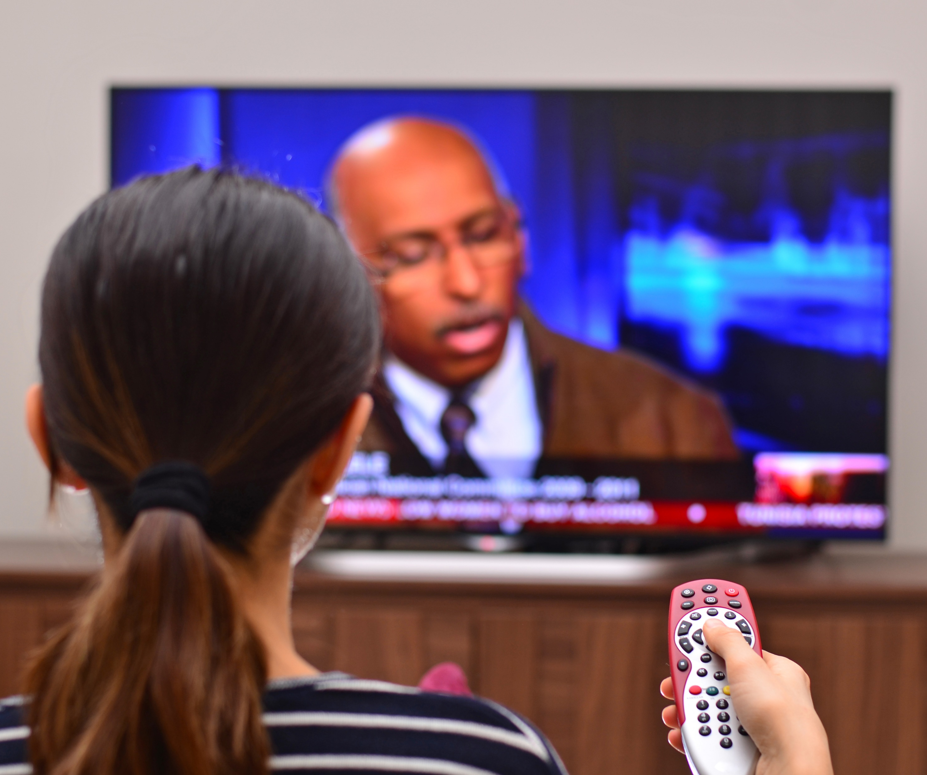
Adults are choosing television as their primary source for acquiring news - above other platforms like social media, newspapers and radio
Primary Sources for Acquiring News Since COVID-19 Outbreak
% of respondents who acquire news through the following platforms
P18+
Source: VAB’s 'As Time Goes By: How Media Consumption Is Helping America Cope’. VAB / Lucid ‘Media Usage In The Time of COVID-19 Survey,’ April 2020. Survey base: P18+ & household subscribes to cable, telco, internet TV or satellite TV (n=1,004). Q5: What are the primary sources you have been using to acquire your news?. Does not equal 100% due to the ability to choose multiple responses.
This information is exclusively provided to VAB members and qualified marketers. Further distribution is prohibited.
PAGE 50
PAGE 1

Slide 51
Cable TV News: News consumption has leveled off in recent weeks but continues to show significant double-digit growth vs. pre-pandemic
Against P2+, cable news viewership was 22% higher for the week of April 20th vs. Feb 24th with a 30% weekly reach
Ad-Supported Cable TV: News Programming
Total Weekly Minutes Viewed (in billions)
+26%
vs. 2/24
+31%
vs. 2/24
+34%
vs. 2/24
11%
12%
16%
17%
16%
15%
14%
14%
13%
25%
26%
33%
34%
33%
32%
31%
29%
27%
44%
45%
50%
51%
52%
50%
50%
49%
47%
Weekly Reach %
Source: VAB analysis of Nielsen R&F Program Report, Live, Total Day, Monday – Sunday, February 24 – April 26, 2020; Demos: P2+, A18-34, A35-49, A50-64, Viewing Source: Ad-Supported Cable TV (includes Spanish Language Networks).
News Programming represents: news, news documentary and political programming. TV Universes (000): A18-34 (70,060), A35-49 (59,410), A50-64 (61,220).
This information is exclusively provided to VAB members and qualified marketers. Further distribution is prohibited.
PAGE 51

Slide 52





The #1 way people are coping during this stressful time of the pandemic is watching TV and movies
Ways To Deal With Stress During the COVID-19 Pandemic
% of respondents who agree
P18+
77%
65%
42%
41%
TV & Movies
Music
Cooking & Baking
Social
Media
40%
34%
29%
25%
Video
Games
Self
Care
Hang With
Family
Learn Something New
Source: VAB’s 'As Time Goes By: How Media Consumption Is Helping America Cope’. VAB / Lucid ‘Media Usage In The Time of COVID-19 Survey,’ April 2020. Survey base: P18+ & household subscribes to cable, telco, internet TV or satellite TV (n=1,004). Q8: During this Pandemic, are any of the following helping you deal with stress?
This information is exclusively provided to VAB members and qualified marketers. Further distribution is prohibited.
PAGE 52

Slide 53
Movies/Films: Movies have been a popular form of escapism for viewers, especially younger ones, since the beginning of the pandemic
Against P2+, at-home movie viewership was 13% higher for the week of April 20th vs. Feb 24th with a 47% weekly reach
Ad-Supported TV: Film Programming
Total Weekly Minutes Viewed (in billions)
+10%
vs. 2/24
+20%
vs. 2/24
+34%
vs. 2/24
24%
24%
26%
30%
31%
31%
31%
29%
27%
27%
27%
29%
31%
32%
31%
31%
30%
29%
48%
48%
49%
52%
53%
53%
53%
51%
49%
Weekly Reach %
Source: VAB analysis of Nielsen R&F Program Report, Live, Total Day, Monday – Sunday, February 24 – April 26, 2020; Demos: P2+, P12-17, A18-34, A35-49, Viewing Source: Ad-Supported Cable TV & Broadcast TV (includes Spanish Language Networks). Film Programming represents: feature film programming. TV Universes (000): P12-17 (24,480), A18-34 (70,060), A35-49 (59,410).
This information is exclusively provided to VAB members and qualified marketers. Further distribution is prohibited.
PAGE 53

Slide 54
Comedy: Viewers of all ages have also been looking for laughs as a temporary escape from the seriousness of the pandemic
Against P2+, comedy viewership was 17% higher for the week of April 20th vs. Feb 24th with a 42% weekly reach
Ad-Supported TV: Comedy Programming
Total Weekly Minutes Viewed (in billions)
+21%
vs. 2/24
+19%
vs. 2/24
+41%
vs. 2/24
18%
19%
20%
23%
22%
22%
22%
22%
21%
22%
22%
24%
27%
26%
25%
25%
24%
24%
41%
40%
44%
47%
46%
46%
45%
45%
44%
Weekly Reach %
Source: VAB analysis of Nielsen R&F Program Report, Live, Total Day, Monday – Sunday, February 24 – April 26, 2020; Demos: P2+, P12-17, A18-34, A35-49, Viewing Source: Ad-Supported Cable TV & Broadcast TV (includes Spanish Language Networks). Comedy Programming represents: comedy variety & situation comedy. TV Universes (000): P12-17 (24,480), A18-34 (70,060), A35-49 (59,410).
This information is exclusively provided to VAB members and qualified marketers. Further distribution is prohibited.
PAGE 54

Slide 55
Instructional / Advice: Cooking, home improvement, self- help shows continue to be strong as people work on their hobbies, crafts & interests
Against P2+, instructional viewership was 24% higher for the week of April 20th vs. Feb 24th with a 27% weekly reach
Ad-Supported TV: Instructional / Advice / Lifestyle Programming
Total Weekly Minutes Viewed (in billions)
+26%
vs. 2/24
+32%
vs. 2/24
+37%
vs. 2/24
11%
11%
12%
14%
14%
14%
14%
14%
14%
25%
25%
26%
27%
28%
28%
28%
28%
28%
38%
38%
39%
41%
41%
41%
41%
41%
41%
Weekly Reach %
Source: VAB analysis of Nielsen R&F Program Report, Live, Total Day, Monday – Sunday, February 24 – April 26, 2020; Demos: P2+, A18-34, A35-49, A50-64, Viewing Source: Ad-Supported Cable TV & Broadcast TV (includes Spanish Language Networks). Instructional / Advice / Lifestyle Programming represents: Instruction-Advice program type. Reflects programming from networks like HGTV, Food Network, DIY Network, Cooking Channel and Travel Channel.
TV Universes (000): A18-34 (70,060), A35-49 (59,410), A50-64 (61,220).
This information is exclusively provided to VAB members and qualified marketers. Further distribution is prohibited.
PAGE 55

Slide 56
Documentaries: People have also taken the opportunity to acquire
more in-depth knowledge around topics of interest
Against P2+, documentary viewership was 14% higher for the week of April 20th vs. Feb 24th with a 42% weekly reach
Ad-Supported TV: Documentaries
Total Weekly Minutes Viewed (in billions)
+10%
vs. 2/24
+17%
vs. 2/24
+18%
vs. 2/24
20%
21%
21%
23%
23%
22%
23%
24%
24%
41%
40%
40%
43%
43%
43%
44%
44%
44%
57%
57%
56%
59%
59%
59%
60%
60%
61%
Weekly Reach %
Source: VAB analysis of Nielsen R&F Program Report, Live, Total Day, Monday – Sunday, February 24 – April 26, 2020; Demos: P2+, A18-34, A35-49, A50-64, Viewing Source: Ad-Supported Cable TV & Broadcast TV (includes Spanish Language Networks). Documentaries represents: general documentary programming. TV Universes (000): A18-34 (70,060), A35-49 (59,410), A50-64 (61,220).
This information is exclusively provided to VAB members and qualified marketers. Further distribution is prohibited.
PAGE 56

Slide 57
Kids: Viewership saw a slight bump during the week of April 20th for both children and teenagers but is mostly stable over the last month
Against P2+, kids’ programming was 13% higher for the week of April 20th vs. Feb 24th with a 28% weekly reach
Ad-Supported TV: Kids Programming
Total Weekly Minutes Viewed (in billions)
+22%
vs. 2/24
+8%
vs. 2/24
+35%
vs. 2/24
36%
36%
36%
38%
38%
37%
36%
36%
35%
21%
21%
22%
24%
24%
23%
23%
22%
22%
22%
22%
22%
24%
25%
24%
24%
23%
22%
Weekly Reach %
Source: VAB analysis of Nielsen R&F Program Report, Live, Total Day, Monday – Sunday, February 24 – April 26, 2020; Demos: P2+, A18-34, A35-49, A50-64, Viewing Source: Ad-Supported Cable TV & Broadcast TV (includes Spanish Language Networks). Kids Programming represents: Child – Live, Child Day – Animation, Child Evening, Child Multi-Weekly, Children’s News. Ad-supported cable TV makes up at least 97% of total TV viewership across each of the four weeks.
TV Universes (000): P2-11 (39,610), P12-17 (24,480), A18-49 (129,470).
This information is exclusively provided to VAB members and qualified marketers. Further distribution is prohibited.
PAGE 57

Slide 58

72% of adults 18+ are watching TV and movies with their families more often during the COVID-19 lockdown
“Watching TV or movie together as a family has become more common”
% of respondents who agree
P18-24: 70%
P25-34: 73%
P35-44: 85%
P45-54: 75%
P55+: 72%
HHI $100K+: 79%
Source: VAB’s 'As Time Goes By: How Media Consumption Is Helping America Cope’. VAB / Lucid ‘Media Usage In The Time of COVID-19 Survey,’ April 2020. Survey base: P18+ & household subscribes to cable, telco, internet TV or satellite TV (n=1,004). Q9: Thinking of your behavior during the COVID-19 Pandemic, please indicate below how much you agree or disagree with the following statements. Top 2 box (agree completely, agree somewhat).
This information is exclusively provided to VAB members and qualified marketers. Further distribution is prohibited.
PAGE 58

Slide 59
Co-Viewing: Although the co-viewing spike has leveled off in the past
few week, more opportunities exist across programs and genres than pre-pandemic
+38%
vs. 2/24
How To Read: On average, 18.9% of P18+ within HHs w/kids were watching TV with a person 2-17 during 9a-4p on 4/22.
Source: VAB analysis of Nielsen Co-Viewing Program Report, Live, Daytime (M-F 9a-4p), 2/26/20, 3/4/20, 3/11/20, 3/18/20, 3/25/20, 4/1/20, 4/8/20, 4/15/20, 4/22/20; Market Break: HHs with children (2-17), primary demo: P18+, secondary demo: P2-17.
Viewing Source: Ad-Supported Cable TV & Broadcast TV (includes Spanish Language Networks). Co-viewing share = the average percentage of adults 18+ within HH w/kids who are watching TV during that day (M-F 9a-4p) with a person 2-17.
This information is exclusively provided to VAB members and qualified marketers. Further distribution is prohibited.
PAGE 59

Slide 60
Major Takeaways: What Are They Watching?
People most often turn to TV for their news content
At the same time, when looking to destress, Americans most often turn to TV and Film, underscoring the dual role TV is playing in American life
In looking to destress, there is an increase in the popularity of ‘feel good’ programming that serves as a welcome distraction
This information is exclusively provided to VAB members and qualified marketers. Further distribution is prohibited.
PAGE 60

Slide 61



Key takeaways for marketers about COVID-19 related
viewership trends
Thirst for Video Content
As viewers hunger for new video content, consumption is up across linear, VOD and streaming. Due to shifts in daily routines and behaviors, there is particular opportunity within Daytime, Late Night and Overnight, as well as within “feel-good” programming
as viewers look to destress.
Adopting New Platforms and Technologies
With more time to fill – and more time to learn about new platforms and devices – consumers are adopting new ways of viewing video. This is seen in increased adoption of AVOD services, offering advertisers more ways
to reach and engage viewers.
The Eyeballs of Sports Fans
Sports fans, a primary audience for many brands, continue to engage with television even with the absence of live sports. They have simply shifted their viewing to news, movies, and other entertainment programming.
Rewarding Compassion, Commitment and Community
Hundreds of brands have integrated authentic, COVID-19 related themes into their advertising which fosters a greater connection within their communities and helps
increase their perception
among consumers.
This information is exclusively provided to VAB members and qualified marketers. Further distribution is prohibited.
PAGE 61

Slide 62


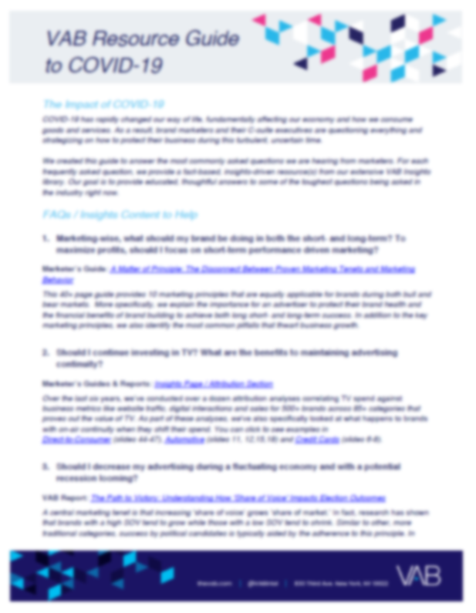

Thank You
Creators
Jason Wiese
Leah Montner-Dixon
Reed Kiely
Karolina Guillen
SVP, Director of Strategic Insights
jasonw@thevab.com
Insights Manager
leahm@thevab.com
Insights Manager
reedk@thevab.com
Senior Insights Analyst
karolinag@thevab.com
Interested in learning more? Check out this related content:
As Time Goes By
How Media Consumption Is Helping America Cope
A Second Look
10 Slides To Guide You Through The COVID 19 Pandemic
COVID-19 Insights
VAB Resource Guide To COVID-19
*VAB Members Exclusive
This information is exclusively provided to VAB members and qualified marketers. Further distribution is prohibited.
PAGE 62

Slide 63

Get immediate access to the VAB Insights library
We’ve answered hundreds of marketers’ questions.
Our guides, reports, webinars and videos provide actionable insights to help marketers navigate today’s video landscape and think differently about their strategy.
We are committed to your business growth and proud to offer brand marketers and agencies complimentary access to our continuously-growing Insights library.
Get Access at theVAB.com or visit us here
This information is exclusively provided to VAB members and qualified marketers. Further distribution is prohibited.
PAGE 63

