Slide 1


VAB Members
VAB – ADDRESS FOR SUCCESS SUPPLEMENT – 2019
.................
Bridging The Gap
Utilizing Addressable TV To Extend Hispanic-Targeted Reach

Slide 2

Summary
The Hispanic population has experienced immense growth in the United States over the last couple of decades. Now representing 18% of the total population and over 56 million people strong, their aggregated annual expenditures have grown over 50% in the last ten years and now stand at slightly under $1 trillion.
As the population grows and many become acculturated, a vast majority continue to be fluent in Spanish with 66% even speaking Spanish regularly.
But this doesn’t mean that their media consumption is siloed to just Hispanic-targeted media such as Spanish-language TV. Their media habits are much more nuanced and cross both Spanish- & English-language TV networks. In fact, while Hispanic-targeted TV networks provide great coverage of Hispanic consumers, Spanish-speaking Hispanics spend more time watching English-language TV (59% of their viewing) than Spanish-language TV (41%).
Extending Spanish-language creative to English-language TV networks enables marketers to increase reach, relevancy, engagement and credibility against Hispanic consumers. However, with Hispanics making up less than 15% of total TV viewing, marketers must also guard against potentially wasting impressions as their messaging may not be that relevant to other audiences.
In this supplement to our Address For Success marketer’s guide on Addressability released earlier this year, learn how the precision targeting of Addressable TV can be utilized to deliver incremental reach, relevancy and personalization against Spanish-speaking Hispanics with minimal wasted impressions against other segmentations.
For a deeper overview on Addressable TV, click here to download the full Address For Success marketer’s guide.
2
This information is exclusively provided to VAB members and qualified marketers. Further distribution is prohibited.

Slide 3

Over The Last Ten Years, The Hispanic Population Has Increased By 28% And
Now Represents Over 56 Million People Within The United States
Hispanic & Latino Americans Account For….
18%
Of U.S. Population
Source: U.S. Census Bureau, 2013-2017 American Community Survey 5-Year Estimates; SEX BY AGE (HISPANIC OR LATINO) - Universe: People Who Are Hispanic Or Latino; VAB Analysis of Hispanic or Latino origin of reference person: Shares of annual aggregate expenditures and sources of income, Consumer Expenditure Survey, 2017.
3
This information is exclusively provided to VAB members and qualified marketers. Further distribution is prohibited.

Slide 4
Although The Hispanic Population Has Increased By 28% Over The Last 10 Years,
Their Total Annual U.S. Expenditures Have Increased 50% During The Same Time Period
Hispanic & Latino Americans Account For….
$866B
In Total Annual U.S. Expenditures
Source: U.S. Census Bureau, 2013-2017 American Community Survey 5-Year Estimates; SEX BY AGE (HISPANIC OR LATINO) - Universe: People Who Are Hispanic Or Latino; VAB Analysis of Hispanic or Latino origin of reference person: Shares of annual aggregate expenditures and sources of income, Consumer Expenditure Survey, 2007, 2012 & 2017.
4
This information is exclusively provided to VAB members and qualified marketers. Further distribution is prohibited.

Slide 5


Within The U.S. Hispanic Population, 86% Can Speak Spanish And 66% Speak Spanish Regularly
66%
(Only Spanish, Mostly Spanish, Spanish & English Regularly)
Source: VAB Analysis of Nielsen Npower R&F Time Period Report, Hispanic A18+, Playback Time Period: Live +7 Days (+168 hours) | TV | Linear with VOD, Total Day, Measurement Interval: 12/1/18 – 12/31/18.
This information is exclusively provided to VAB members and qualified marketers. Further distribution is prohibited.

Slide 6
Both Spanish-speaking and Bilingual Hispanics appreciate when brands advertise specifically in Hispanic media.
These audiences find ads targeted towards them appealing as it signals a brand’s desire in building a direct, positive relationship with them and the greater Hispanic community.
58%
57%
65%
47%
Source: Horowitz Research, State of Consumer Engagement 2018.
6
This information is exclusively provided to VAB members and qualified marketers. Further distribution is prohibited.

Slide 7

While Reach Is High On Spanish-Language TV Networks, Advertisers Can Extend Their Messaging Further Against Spanish-Speaking Hispanics Through A Broader TV Plan
If an advertiser is trying to reach Spanish-speaking consumers, they’ll miss nearly 20% of their potential audience by only advertising on Spanish-language TV nets
+18%
pp
Source: VAB Analysis of Nielsen Npower R&F Time Period Report, Playback Time Period: Live +7 Days (+168 hours) | TV | Linear with VOD, Total Day, Measurement Interval: 12/1 – 12/31 2018; All TV includes all ad-supported Cable TV and Broadcast TV; Spanish Language TV Includes both ad-supported broadcast & cable TV: CNN en Español, Cine Latino, Discovery en Español, Discovery Familia, ESPN Deportes, Fox Deportes, Univision Deportes, beIN Sport Español, Azteca America, Estrella, Telemundo, UniMás & Univision. Spanish-Speaking Hispanic P2+ = only Spanish, mostly Spanish, Spanish & English equally, mostly English. PP = percentage point increase.
7
This information is exclusively provided to VAB members and qualified marketers. Further distribution is prohibited.

Slide 8

The Gap In Spanish-Speaking Hispanic Reach Is Even More Pronounced When Looking Specifically At Cable TV Networks Only
If an advertiser is trying to reach Spanish-speaking consumers specifically on cable TV, they’ll miss 43% of their potential audience by advertising only on Spanish-language nets
+33%
pp
Source: VAB Analysis of Nielsen Npower R&F Time Period Report, Playback Time Period: Live +7 Days (+168 hours) | TV | Linear with VOD, Total Day, Measurement Interval: 12/1 – 12/31 2018; All Cable TV includes all ad-supported Cable TV; Spanish-Language Cable TV Includes: CNN en Español, Cine Latino, Discovery en Español, Discovery Familia, ESPN Deportes, Fox Deportes, Univision Deportes, beIN Sport Español. Spanish-Speaking Hispanic P2+ = only Spanish, mostly Spanish, Spanish & English equally, mostly English. PP = percentage point increase.
8
This information is exclusively provided to VAB members and qualified marketers. Further distribution is prohibited.

Slide 9

Interestingly, Spanish-Speaking Hispanics Spend A Majority Of Their TV Time Viewing English-Language Networks
When it comes to cable TV viewing specifically, a vast majority (80%) of their time is spent engaging with English-language TV networks
Source: VAB Analysis of Nielsen Npower R&F Time Period Report, Playback Time Period: Live +7 Days (+168 hours) | TV | Linear with VOD, Total Day, Measurement Interval: 12/1 – 12/31 2018; English-Language TV includes all ad-supported English-Language Cable TV and Broadcast TV; Spanish Language TV Includes both ad-supported broadcast & cable TV: CNN en Español, Cine Latino, Discovery en Español, Discovery Familia, ESPN Deportes, Fox Deportes, Univision Deportes, beIN Sport Español, Azteca America, Estrella, Telemundo, UniMás & Univision. Spanish-Speaking Hispanic P2+ = only Spanish, mostly Spanish, Spanish & English equally, mostly English.
9
This information is exclusively provided to VAB members and qualified marketers. Further distribution is prohibited.

Slide 10
With TV viewing across two languages, it’s no surprise that a majority of each Hispanic segment, even those that speak little Spanish, also appreciate when Spanish-language ads air on English-language TV.
In fact, very few Hispanics see these ad placements as a negative.
Total Hispanic
10%
59%
Spanish Dominant
8%
62%
Bilingual
8%
64%
English Oriented
13%
52%
Source: Horowitz Research, State of Consumer Engagement 2018.
10
This information is exclusively provided to VAB members and qualified marketers. Further distribution is prohibited.

Slide 11

The Challenge
As we’ve shown, while Hispanic-targeted TV networks provide great coverage of Hispanic consumers,
a majority of TV viewing by Spanish-speaking Hispanics is on English-language networks and thus they are quite accepting of Spanish-language ads on these networks.
However, Hispanics make up less than 15% of total TV viewing, so advertisers wishing to extend the reach, relevancy and cohesiveness of their Spanish-language messaging on English-language TV networks have a need to precision-target only the Spanish-speaking Hispanic viewers of those nets.
Source: VAB Analysis of Nielsen NPower R&F Time Period Report, Hispanic 2+ Playback Time Period: Live +7 Days (+168 hours) | TV | Linear with VOD, Total Day, Measurement Interval: 12/1 – 12/31 2018
11
This information is exclusively provided to VAB members and qualified marketers. Further distribution is prohibited.

Slide 12

The Solution
Advertisers Can Further Enhance The Relevancy And Engagement Of Their Messaging By Harnessing The Power Of
Addressable TV:
Precision Targeting That Delivers Incremental Reach, Relevancy & Personalization Which Benefits Both Advertisers & Consumers
12

Slide 13
What Is Addressable TV?
Report Supplement Focus: Addressable TV Through MVPDs
For the purposes of this supplemental report, the term ‘Addressable TV’ refers specifically to the platform & technologies available through multichannel video programming distributors (MVPDs).
Addressable TV
Xandr
DISH
Charter*
Altice
Comcast
Cox*
Verizon
Definition:
Addressable TV is the use of technologies to enable advertisers to selectively deliver ads to individual households via cable, satellite, and Internet Protocol television (IPTV) delivery systems and set-top boxes (STBs).
Delivery is based on a defined audience-target developed through first-, second-, and/or third-party data. Segmentation can occur at geographic, demographic, behavioral and data-matched household levels.
Addressable TV is a means of delivering the right ad to the right people by combining the scale of TV with the targeting precision and measurement capabilities of ‘one-to-one’ marketing.
For more detail on Addressable TV and how it works, click here to download the full Address For Success marketer’s guide.
*VOD / TV Everywhere app only
Source: FreeWheel, A Buyer’s Guide to the New Living Room, October 2018; eMarketer, July 2018. Note: includes targeted TV ads delivered on a home-by-home basis via cable and satellite boxes; includes video-on-demand (VOD); excludes connected TV, smart TV and over-the-top (OTT).
This information is exclusively provided to VAB members and qualified marketers. Further distribution is prohibited.

Slide 14
In terms of reaching the right consumer, Addressable TV offers advertisers the unique ability to serve ads in other languages on English-language networks to garner incremental reach against Spanish-speaking viewers.
Precise targeting means greater relevancy and deeper consumer engagement for the audience and increased ROI for advertisers.
Precision Targeting & Increased Ad Relevance Are Among The Top Benefits Of Addressable TV
Addressable TV’s Top Benefits
% of Respondents
Targeting Precision
& Granularity
Increased Ad Relevance
Targets Unique Households
65%
59%
56%
Eliminates Waste In TV Buys
Better ROAS/ROI
Delivers Hard-To-Reach Audiences
50%
49%
47%
Source: Xandr Ahead of the Curve: Addressable TV Insights; Advertiser Perceptions Addressable TV State of the Industry, March/April 2017. Q: Please rank the top 5 benefits of Addressable TV advertising.
Base: Total Respondents.
14
This information is exclusively provided to VAB members and qualified marketers. Further distribution is prohibited.

Slide 15


















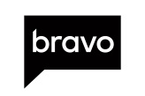

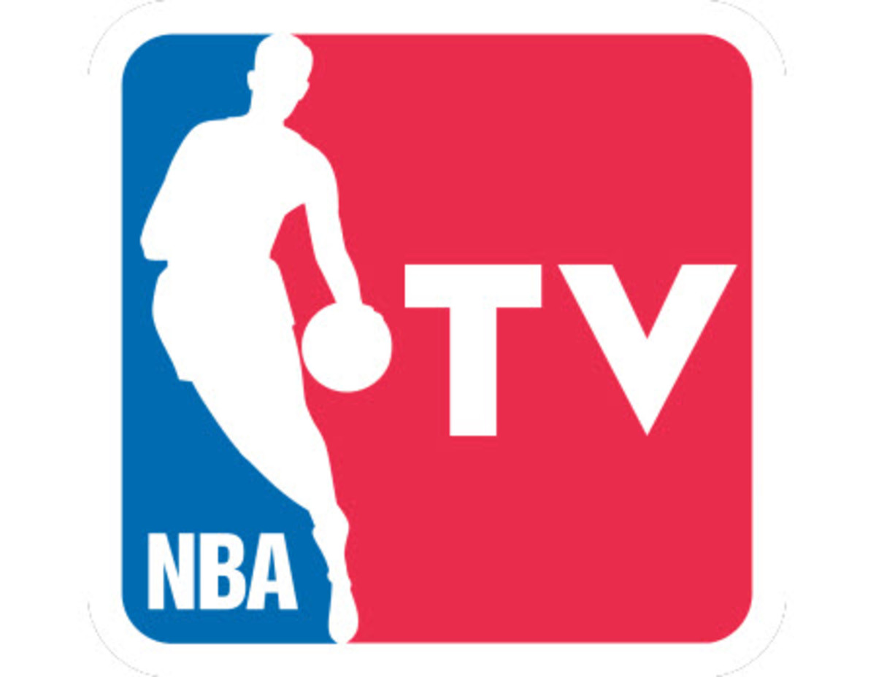




































































Addressable TV Ads Target A Specific Audience And Spanish-Speaking Hispanic Viewers Can Be Found Across Most English-Speaking Cable TV Networks…
Source: VAB Analysis of Nielsen Npower R&F Time Period Report, Spanish-Speaking Hispanic P2+ = only Spanish, mostly Spanish, Spanish & English equally, mostly English. Playback Time Period: Live +7 Days (+168 hours) | TV | Linear with VOD, Total Day, Measurement Interval: 12/1/18 – 12/31/18. Reflects networks with a monthly reach of 500K+ Spanish-Speaking Hispanics A18+.
15
This information is exclusively provided to VAB members and qualified marketers. Further distribution is prohibited.

Slide 16






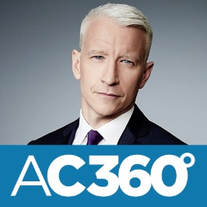







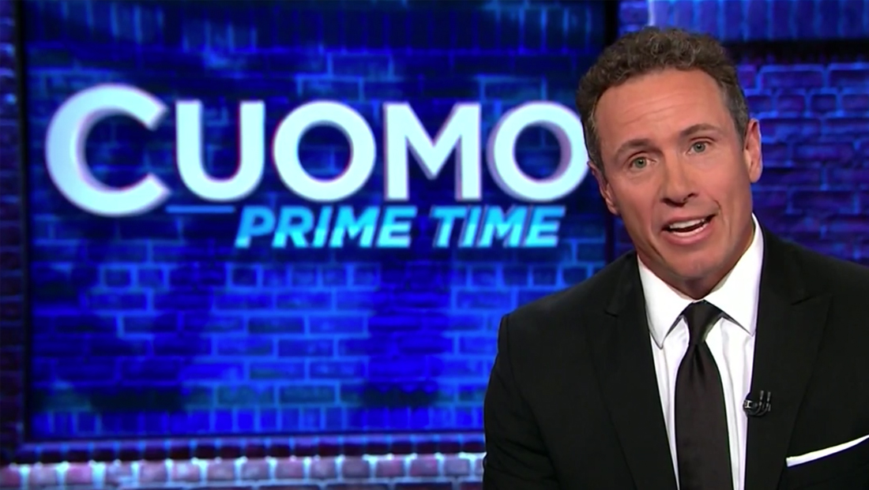















….As Well As Within A Variety Of Popular English-Language Programming Across Entertainment, News & Sports
When factoring in all cable programming, English-language programs account for 34% of the top 250 programs
Source: VAB analysis of Nielsen NPower Program Report, ranked on top 250 regular programs (regular 3 or more t/c) ad-supported cable TV by rating; total day; Spanish-Speaking Hispanic P2+ = only Spanish, mostly Spanish, Spanish & English equally, mostly English.; 12/1/18-12/31/18.
16
This information is exclusively provided to VAB members and qualified marketers. Further distribution is prohibited.

Slide 17

Addressable TV Case Studies

Slide 18

With A Hispanic-Targeted Campaign Across Both Spanish & English-Language Networks, Addressable TV Drove A Lift In Tune-In For Programming On A Hispanic TV Network
Addressable TV Case Study
Results
The Addressable campaign generated significant increases in both ratings and tune-in conversions amongst Spanish-speaking households.
Category:
Tune-In
The Challenge:
Drive tune-in to a specific Hispanic network
Flight Duration:
11-week campaign
Execution: Addressable
Addressable TV campaign utilizing AT&T viewership data to identify target audience and measure conversion. Media ran across Spanish- & English-language networks
Target Segment:
Subscribers of DIRECTV’s Spanish-language package and viewers of Hispanic networks
Target vs. Control
Target vs. All Hispanic Homes
Source: Xandr 2018; Campaign flight: Q3 – Q4 2018. Case study result are based on individual campaign factors. Xandr makes no performance warranties. All Homes: Hispanic DTV HHs. Control: Represents 10% of DTV HHs within target that did not receive ad and therefore were not exposed to Addressable spot.
18
This information is exclusively provided to VAB members and qualified marketers. Further distribution is prohibited.

Slide 19
Hispanic-Targeted Campaigns Lead To Sales Lifts In The Auto Category As Well, For Both The Overall Brand And Specific Vehicle Models
Addressable TV Case Study
Results
The Addressable campaign generated a strong lift in sales among the target audience for both specific vehicle models and the brand overall.
Category:
Auto
The Challenge:
Drive sales for major auto brand and measure campaign performance
Flight Duration:
5-week campaign
Execution: Addressable
Addressable TV campaign and sales conversion analysis utilizing Polk Audience Solutions by IHS Markit
Target Segment:
Bilingual Hispanic HHs
Adults 25+
HHI $50K+
In-market to purchase a new vehicle
Source: Xandr 2019; Campaign flight: Q1 2019. Case study results are based on individual campaign factors. AT&T makes no performance warranties. Control: Represents 10% of DTV HHs within the target that did not receive exposure to the addressable ad. Source: Polk Audience Solutions by IHS Markit. *Buy Rates are based on a subset of the target HHs for which we get return path data
19
This information is exclusively provided to VAB members and qualified marketers. Further distribution is prohibited.

Slide 20
Key Takeaways
Total annual U.S. expenditures by Hispanic have increased 50% over the last 10 years to $866 billon
86% of Hispanics can speak Spanish and 66% speak Spanish regularly
From an ad-supported cable TV perspective, 33% of Spanish-speaking Hispanics watch only English-Language TV networks and 80% of total viewing is on these networks
Advertisers can bridge the gap to deliver greater reach, relevancy and a cohesive message against Hispanics with Spanish-language creative across cable networks by utilizing precision-targeted Addressable TV on English-language networks with minimal wasted impressions
20
This information is exclusively provided to VAB members and qualified marketers. Further distribution is prohibited.

Slide 21




Contact Us
Jason Wiese
SVP, Director of Strategic Insights
jasonw@thevab.com
Join Our Email List
Leah Montner-Dixon
Senior Multiplatform Video Analyst leahm@thevab.com
VAB
@VABintel

Slide 22

While Reach Is High On Spanish-Language TV Networks, Advertisers Can Extend Their Messaging Further Against Spanish-Speaking Hispanics 18-34 Through A Broader TV Plan
If an advertiser is trying to reach Spanish-speaking 18-34 consumers, they’ll miss nearly 26% of their potential audience by only advertising on Spanish-language TV nets
+23%
pp
Source: VAB Analysis of Nielsen Npower R&F Time Period Report, Playback Time Period: Live +7 Days (+168 hours) | TV | Linear with VOD, Total Day, Measurement Interval: 12/1 – 12/31 2018; All TV includes all ad-supported Cable TV and Broadcast TV; Spanish Language TV Includes both ad-supported broadcast & cable TV: CNN en Español, Cine Latino, Discovery en Español, Discovery Familia, ESPN Deportes, Fox Deportes, Univision Deportes, beIN Sport Español, Azteca America, Estrella, Telemundo, UniMás & Univision. Spanish-Speaking Hispanic P18-34 = only Spanish, mostly Spanish, Spanish & English equally, mostly English. PP = percentage point increase.
22
This information is exclusively provided to VAB members and qualified marketers. Further distribution is prohibited.

Slide 23

The Gap In Spanish-Speaking Hispanic 18-34 Reach Is Even More Pronounced When Looking Specifically At Cable TV Networks Only
If an advertiser is trying to reach Spanish-speaking 18-34 consumers specifically on cable TV, they’ll miss 49% of their potential audience by advertising only on Spanish-language nets
+34%
pp
Source: VAB Analysis of Nielsen Npower R&F Time Period Report, Playback Time Period: Live +7 Days (+168 hours) | TV | Linear with VOD, Total Day, Measurement Interval: 12/1 – 12/31 2018; All Cable TV includes all ad-supported Cable TV; Spanish-Language Cable TV Includes: CNN en Español, Cine Latino, Discovery en Español, Discovery Familia, ESPN Deportes, Fox Deportes, Univision Deportes, beIN Sport Español. Spanish-Speaking Hispanic P18-34 = only Spanish, mostly Spanish, Spanish & English equally, mostly English. PP = percentage point increase.
23
This information is exclusively provided to VAB members and qualified marketers. Further distribution is prohibited.

Slide 24

Interestingly, Spanish-Speaking Hispanics 18-34 Spend A Majority Of Their TV Time Viewing English-Language Networks
When it comes to cable TV viewing specifically, a vast majority (80%) of their time is spent engaging with English-language TV networks
Source: VAB Analysis of Nielsen Npower R&F Time Period Report, Playback Time Period: Live +7 Days (+168 hours) | TV | Linear with VOD, Total Day, Measurement Interval: 12/1 – 12/31 2018; English-Language TV includes all ad-supported English-Language Cable TV and Broadcast TV; Spanish Language TV Includes both ad-supported broadcast & cable TV: CNN en Español, Cine Latino, Discovery en Español, Discovery Familia, ESPN Deportes, Fox Deportes, Univision Deportes, beIN Sport Español, Azteca America, Estrella, Telemundo, UniMás & Univision. Spanish-Speaking Hispanic P18-34 = only Spanish, mostly Spanish, Spanish & English equally, mostly English.
24
This information is exclusively provided to VAB members and qualified marketers. Further distribution is prohibited.

Slide 25

While Reach Is High On Spanish-Language TV Networks, Advertisers Can Extend Their Messaging Further Against Spanish-Speaking Hispanics 18-49 Through A Broader TV Plan
If an advertiser is trying to reach Spanish-speaking 18-34 consumers, they’ll miss nearly 22% of their potential audience by only advertising on Spanish-language TV nets
+20%
pp
Source: VAB Analysis of Nielsen Npower R&F Time Period Report, Playback Time Period: Live +7 Days (+168 hours) | TV | Linear with VOD, Total Day, Measurement Interval: 12/1 – 12/31 2018; All TV includes all ad-supported Cable TV and Broadcast TV; Spanish Language TV Includes both ad-supported broadcast & cable TV: CNN en Español, Cine Latino, Discovery en Español, Discovery Familia, ESPN Deportes, Fox Deportes, Univision Deportes, beIN Sport Español, Azteca America, Estrella, Telemundo, UniMás & Univision. Spanish-Speaking Hispanic P18-49 = only Spanish, mostly Spanish, Spanish & English equally, mostly English. PP = percentage point increase.
25
This information is exclusively provided to VAB members and qualified marketers. Further distribution is prohibited.

Slide 26
The Gap In Spanish-Speaking Hispanic 18-49 Reach Is Even More Pronounced When Looking Specifically At Cable TV Networks Only
If an advertiser is trying to reach Spanish-speaking 18-34 consumers specifically on cable TV, they’ll miss 43% of their potential audience by advertising only on Spanish-language nets
+32%
pp
Source: VAB Analysis of Nielsen Npower R&F Time Period Report, Playback Time Period: Live +7 Days (+168 hours) | TV | Linear with VOD, Total Day, Measurement Interval: 12/1 – 12/31 2018; All Cable TV includes all ad-supported Cable TV; Spanish-Language Cable TV Includes: CNN en Español, Cine Latino, Discovery en Español, Discovery Familia, ESPN Deportes, Fox Deportes, Univision Deportes, beIN Sport Español. Spanish-Speaking Hispanic P18-49 = only Spanish, mostly Spanish, Spanish & English equally, mostly English. PP = percentage point increase.
26
This information is exclusively provided to VAB members and qualified marketers. Further distribution is prohibited.

Slide 27
Interestingly, Spanish-Speaking Hispanics 18-49 Spend A Majority Of Their TV Time Viewing English-Language Networks
When it comes to cable TV viewing specifically, a vast majority (80%) of their time is spent engaging with English-language TV networks
Source: VAB Analysis of Nielsen Npower R&F Time Period Report, Playback Time Period: Live +7 Days (+168 hours) | TV | Linear with VOD, Total Day, Measurement Interval: 12/1 – 12/31 2018; English-Language TV includes all ad-supported English-Language Cable TV and Broadcast TV; Spanish Language TV Includes both ad-supported broadcast & cable TV: CNN en Español, Cine Latino, Discovery en Español, Discovery Familia, ESPN Deportes, Fox Deportes, Univision Deportes, beIN Sport Español, Azteca America, Estrella, Telemundo, UniMás & Univision. Spanish-Speaking Hispanic P18-49 = only Spanish, mostly Spanish, Spanish & English equally, mostly English.
27
This information is exclusively provided to VAB members and qualified marketers. Further distribution is prohibited.

Slide 28
% of Equivalized Ad Impressions
4Q 2018
From An Advertiser’s Perspective, English-Language TV Delivers More Hispanic Impressions Than Spanish-Language TV.
By targeting these demos with Spanish language ads across all TV networks, advertisers can benefit from greater reach and relevancy and deeper consumer engagement and attention.
Spanish-Language TV
English-Language TV
Source: VAB analysis of Nielsen Ad Intel, 4Q 2018; Hispanic TV includes Hispanic Cable and Broadcast networks; English-Language TV includes Cable TV networks; Spanish-Language Cable & Broadcast Nets Include: CNN en Español, Cine Latino, Discovery en Español, Discovery Familia, ESPN Deportes, Fox Deportes, Univision Deportes, beIN Sport Español, Azteca America, Estrella, Telemundo, UniMás & Univision.
28
This information is exclusively provided to VAB members and qualified marketers. Further distribution is prohibited.

Slide 29
% of Equivalized Cable TV Ad Impressions
4Q 2018
From A Cable TV perspective, nearly 9 out of every 10 Hispanic ad impressions, regardless of the demo, were delivered on English-language TV networks.
Spanish-Language TV
English-Language TV
Source: VAB analysis of Nielsen Ad Intel, 4Q 2018; Hispanic TV includes Hispanic Cable networks; English-Language TV includes Cable TV networks; Spanish-Language Cable Nets Include: CNN en Español, Cine Latino, Discovery en Español, Discovery Familia, ESPN Deportes, Fox Deportes, Univision Deportes, beIN Sport Español.
29
This information is exclusively provided to VAB members and qualified marketers. Further distribution is prohibited.

