Slide 1





Breaking Through
How New Advertisers Are Using TV
To Ignite Interest & Turn Consumers
Into Customers

Slide 2


First-time TV advertisers are achieving immediate ‘mid-funnel’ results once they launch their campaign
In our popular bi-annual 'Welcome To TV’ report series, we spotlight the group of new advertisers who recently launched their first-ever national TV campaign.
These brands, which include many small and medium-sized businesses, have all incorporated TV advertising into their marketing strategies to accelerate their growth by engaging new consumers and igniting customer action.
As a follow-up to our ‘Welcome to TV’ series, we set out to quantify
the impact that TV campaigns have on the business outcomes of new advertisers over the last three years.
What did we learn from our analysis of 230 first-time TV advertisers?
TV campaigns sparked immediate and sustained increases in brands’ website traffic and online brand searches which shows long-form, professionally produced video content’s ability to drive ‘mid-funnel’ results for advertisers of all sizes and investment levels.
This information is exclusively provided to VAB members and qualified marketers.
PAGE 2

Slide 3

Each year brings an influx of new advertisers to TV who are looking to accelerate growth by engaging new consumers and igniting customer action

Slide 4




In the past three years, new advertisers have invested over a billion dollars in national TV each year with 2023 marking the highest investment level
New National TV Advertisers
2021 – 2023
Over $4B
has been invested by
931 first-time
national TV advertisers
since 2021
Year | # of New Advertisers | # of Categories | New TV $$$
2021 | 315 | 74 | $1.32B
2022 | 303 | 71 | $1.33B
2023 | 313 | 56 | $1.36B
Source: VAB analysis of Nielsen Ad Intel data as of 2/7/24, 1/1/23-12/31/23. Prior years based on VAB analysis of Nielsen Ad Intel Data from the following periods: 1/1/2021-12/31/2021, 1/1/2022-12/31/2022. TV spend includes national cable TV, broadcast TV, Spanish language cable TV, Spanish language broadcast TV. Brands reflect those with national TV spend over $100K.
This information is exclusively provided to VAB members and qualified marketers.
PAGE 4

Slide 5







New advertisers are capitalizing on the key benefits of TV to build credibility, drive engagement and optimize their business outcomes
7 key reasons brands launch TV campaigns
Storytelling
Sight, sound and motion a TV ad can convey brand identity and further humanizes the brand and what it stands for
Availability & Accessibility
Greater product availability creates greater TV accessibility both on the national and local level
Legitimizer
Creates, builds and enhances brand reputation while legitimizing their product or
service offerings
Targetability
Scalable data-driven targeting solutions like addressable TV and data-enabled TV create efficiency and limit wastage
Inclusivity
Enhanced targeting capabilities through advanced TV solutions creates efficiencies which lowers the traditional cost of entry
Halo Effect
TV significantly improves the performance and ROI of all other digital channels as well as a brand’s online platforms
Full-Funnel Outcomes
Through greater measurement and enhanced attribution capabilities, TV has shown its ability to drive brand results
This information is exclusively provided to VAB members and qualified marketers.
PAGE 5

Slide 6





The key benefits enable new TV advertisers to achieve audience scale, engage new customers and build excitement for their brand
“We as a brand were very excited to
share with more consumers via our
TV campaigns what supplements can
do for their pets and pet ownership.”
“Launching a commercial is the natural
next step to drive more awareness
and excitement around the brand
and products.”
“Now that the brand is more established, our goal is to reach a broader audience
to showcase the benefits of Arlo’s smarter security solutions.”
Yvethe Tyszka
VP of Marketing, Zesty Paws
(Brand Innovators, 1/12/21)
Sarah Galletti
Founder & Chief Creative Officer, Tattooed Chef
(Tattooed Chef Press Release, 4/5/21)
Lily Knowles
Senior Vice President of Sales and Marketing, Arlo
(MediaPost, 8/1/22)
“We wanted the campaign to position Sunbrella as a lifestyle brand that people proactively seek out to ensure they enjoy their living spaces, worry-free.”
“It’s about scale and the halo effect television offers…. As we try to expose our brand to a larger audience and get that reach, you can really see the sound and sight of TV being able to do that.”
Eric Kallman
Chief Creative Officer / Partner, Erich and Kallman
(campaign ad agency; Little Black Book, 4/28/22)
Alvaro De La Rocha
CMO, Bespoke Post
(Digiday, 9/30/21)
This information is exclusively provided to VAB members and qualified marketers.
PAGE 6

Slide 7
As seen across the 931 advertisers, the initial success of a TV campaign prompts an increase in investment as they battle for greater market share
New TV Advertisers Average National TV Spend
TV Launch Month vs. Post-TV Launch
($$$)
2021
(315 advertisers)
2022
(303 advertisers)
2023
(313 advertisers)
+70%
+54%
+37%
(Average Advertiser)
(Monthly Average)
(Average Advertiser)
(Monthly Average)
(Average Advertiser)
(Monthly Average)
To gauge how advertisers perceived the impact of their TV campaigns, we compared the average investment across brands during the first month of their campaigns with the average investment for the months that followed.
Source: VAB analysis of Nielsen Ad Intel data as of 2/7/24, 1/1/21-12/31/23. TV spend includes nat’l cable TV, nat’l broadcast TV, Spanish language cable TV, Spanish language broadcast TV. Brands reflect those with national TV spend over $100K.
This information is exclusively provided to VAB members and qualified marketers.
PAGE 7

Slide 8
TV campaigns have a strong ability to drive ‘mid-funnel’ outcomes, to quantify these customer actions we conducted analyses
on the impact of TV across new advertisers

Slide 9



Brands are leveraging TV to pique the interest of consumers and convert them into new customers
“Our goal has always been making quality essentials accessible to more people, and TV advertising can help us bring that purpose to larger audiences while supporting business growth.”
“This is our opportunity to share
this amazing American brand
with millions…and we’re excited
for new customers to discover us.”
Tori Moreland
Head of Branding, Quince
(Business Wire, 4/10/23)
Bobby Ferrario
General Manager & CMO, Orchard Brands
(parent company)
(Business Wire, 9/13/22)
This information is exclusively provided to VAB members and qualified marketers.
PAGE 9

Slide 10


The goal of our analyses is to quantify the impact of TV campaigns on the mid-funnel outcomes that turn consumers into customers
Purchase Funnel Stage
Awareness
Intent
Consideration
Website
Visitors
Search
Queries
Sales
This information is exclusively provided to VAB members and qualified marketers.
PAGE 10

Slide 11
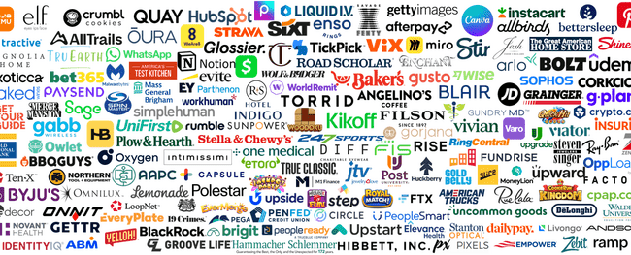



First, we developed an analysis based on first-time national TV advertisers over the last three years who have measured website traffic in Comscore
931
Total first-time
nat’l TV advertisers
2021 - 2023
201
Brands with measured website traffic available in Comscore
Source: VAB analysis of Nielsen Ad Intel, January 2021 – December 2023 (calendar months) & VAB analysis of Comscore mediametrix multiplatform media trend data, P18+. April 2020 – April 2024 (calendar months).
This information is exclusively provided to VAB members and qualified marketers.
This information is exclusively provided to VAB members and qualified marketers.
PAGE 11

Slide 12
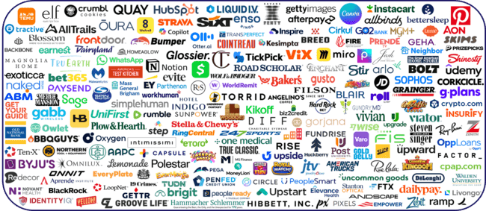
The 201 brands examined within this first analysis include brands of all sizes, especially many small and medium-sized businesses
Source: VAB analysis of Nielsen Ad Intel, January 2021 – December 2023 (calendar months) & VAB analysis of Comscore mediametrix multiplatform media trend data, P18+. April 2020 – April 2024 (calendar months).
This information is exclusively provided to VAB members and qualified marketers.
This information is exclusively provided to VAB members and qualified marketers.
PAGE 12

Slide 13
These 201 brands are spread across a variety of 68 categories, ranging from apparel & accessories to translation services
Category | # of Brands
Financial Services | 21
Apparel & Accessories | 17
Professional Services | 17
Mobile Apps | 16
Health & Wellness | 6
Home | 6
Online Banking | 6
Food Delivery | 5
Insurance | 5
Media | 5
Gaming | 4
Jewelry | 4
Travel | 4
Alcoholic Beverages | 3
Automotive | 3
Cybersecurity | 3
Eyewear | 3
Home Furnishing | 3
Marketplace | 3
Online Education | 3
Streaming Services | 3
Vitamins & Supplements | 3
Beverages | 2
Category | # of Brands
Cleaning & Sanitation | 2
Crypto | 2
Financial Services | 2
Gambling | 2
Gaming | 2
Healthcare | 2
Medical Devices | 2
Real Estate | 2
Skincare & Beauty | 2
Tech | 2
Wellness & Beauty | 2
Alcohol Delivery | 1
Car Rental | 1
Cleaning & Sanitizing | 1
Communications | 1
Drinkware | 1
Education | 1
Educational Services | 1
Educational Travel | 1
Energy Solutions | 1
Food | 1
Gifts | 1
Graphic Design | 1
Category | # of Brands
Grocery Stores | 1
Holiday Lights | 1
Home Improvement | 1
Hospitals | 1
Jewelry | 1
Mobile Tickets | 1
Online Betting | 1
Online Dating | 1
Online Delivery | 1
Online Food Delivery Service | 1
Organizations | 1
Outdoor Recreation | 1
Personal Care | 1
Pet | 1
Pet Care | 1
Social Network | 1
Sports Media | 1
Storage | 1
Telecommunications | 1
Tools & Equipment | 1
Toys | 1
Translation Services | 1
Source: VAB analysis of Nielsen Ad Intel, January 2021 – December 2023 (calendar months) & VAB analysis of Comscore mediametrix multiplatform media trend data, P18+. April 2020 – April 2024 (calendar months).
This information is exclusively provided to VAB members and qualified marketers.
PAGE 13

Slide 14
This analysis will highlight the impact of TV by quantifying the difference in website traffic before and after brands launched their first campaign
We utilized Comscore website traffic data between April 2020 through April 2024 to understand the changes in monthly visits to each brands’ digital platforms during their pre-TV launch period, TV launch month and post-TV campaign launch for TV campaigns that began between 2021 - 2023
To best understand the impact that TV campaigns have on consumer action,
we segmented the 201 measured first-time TV advertisers into two groups:
Pre-TV Launch:
Measured Website Traffic
Advertisers with measured website
traffic before TV launch
Pre-TV Launch:
Unmeasured Website Traffic
Advertisers without measured
website traffic before TV launch
173 Brands
28 Brands
Source: VAB analysis of Nielsen Ad Intel, January 2021 – December 2023 (calendar months) & VAB analysis of Comscore mediametrix multiplatform media trend data, P18+, April 2020 – April 2024 (calendar months).
This information is exclusively provided to VAB members and qualified marketers.
PAGE 14

Slide 15
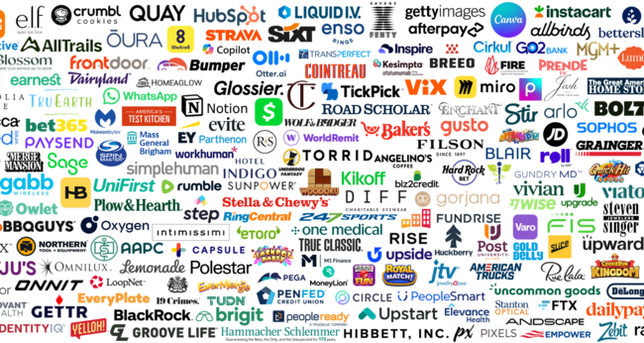
Pre-TV Launch
Measured Website Traffic
Advertisers with measured website
traffic before TV launch
Pre-TV Launch
Unmeasured Website Traffic
Advertisers without measured website
traffic before TV launch
173 Brands
28 Brands
This information is exclusively provided to VAB members and qualified marketers.
PAGE 15

Slide 16





























































































































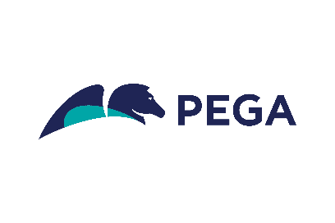











































The ‘Pre-TV Launch: Measured Website Traffic’ segment includes 173 brands across 63 categories, many of which are SMBs
83 of these advertisers are ‘direct-to-consumer’ brands
Source: VAB analysis of Nielsen Ad Intel, Jan ‘21 – Dec ‘23 (calendar months) & VAB analysis of Comscore mediametrix multiplatform media trend data, P18+. April 2020 – April 2024 (calendar months). SMBs = small * medium-sized businesses.
This information is exclusively provided to VAB members and qualified marketers.
This information is exclusively provided to VAB members and qualified marketers.
PAGE 16

Slide 17
Upon TV launch, which exposed brands to a host of new audiences, the average advertiser saw an immediate influx of over 300K website visitors
‘Pre-TV Launch: Measured Website Traffic’ Brands Analysis: Average Monthly Website Unique Visitors
Monthly Website Unique Visitors (000) Comparison
based over a four-year time period: Apr ‘20 – Apr ‘24
TV launch month vs.
six months average prior to TV launch
+12%
+326K monthly uniques
(monthly average)
Source: VAB analysis of Comscore mediametrix multiplatform media trend data, P18+. April 2020 – April 2024 (calendar months), figures are based on monthly averages for the 173 brands analyzed. VAB analysis of Nielsen Ad Intel, TV launch month is based on the first activity reported across national cable TV, national broadcast TV, Spanish language broadcast TV, Spanish language cable TV, spot TV or syndication TV. January 2021 – December 2023 (calendar months).
Source: VAB analysis of Comscore mediametrix multiplatform media trend data, P18+. April 2018 – April 2022 (calendar months), figures are based on monthly averages for the 25 brands analyzed.
This information is exclusively provided to VAB members and qualified marketers.
PAGE 17

Slide 18
After launch, monthly website traffic lifts increased as brands built a sustained presence on TV to garner greater top-of-mind awareness
‘Pre-TV Launch: Measured Website Traffic’ Brands Analysis: Average Monthly Website Unique Visitors
Monthly Website Unique Visitors (000) Comparison
based over a four-year time period: Apr ‘20 – Apr ‘24
+20%
+12%
+523K monthly uniques
+326K monthly uniques
vs. six months average prior to TV launch
vs. six months average prior to TV launch
(monthly average)
(TV launch – April 2024)
Source: VAB analysis of Comscore mediametrix multiplatform media trend data, P18+. April 2020 – April 2024 (calendar months), figures are based on monthly averages for the 173 brands analyzed. VAB analysis of Nielsen Ad Intel, TV activity based on reported spending across national cable TV, national broadcast TV, Spanish language broadcast TV, Spanish language cable TV, spot TV, syndication TV. ‘When On TV’ represents the monthly average for brands in months where they spent in TV as measured through Nielsen Ad Intel between January 2021 – April 2024 (calendar months), across the 173 brands analyzed. During this four-year analysis, the average advertiser was on TV for 13 months.
This information is exclusively provided to VAB members and qualified marketers.
PAGE 18

Slide 19










Sampling of ‘Pre-TV Launch: Measured Website Traffic’ Brands:
Monthly Website Unique Visitors (000) Comparison
based over a four-year time period: Apr ‘20 – Apr ‘24
Many first-time advertisers saw exponential growth in their unique website traffic when they were on TV as they welcomed millions of potential new customers to their digital storefronts each month
Brand | Monthly Average: 6 Months Prior to TV Launch | Monthly Average: ‘When On’ TV TV Launch – Apr ‘24 | # Diff | % Diff
 | 27,693 | 76,751 | +49,058 | +177%
 | 43,619 | 63,914 | +20,295 | +47%
 | 18,104 | 25,430 | +7,325 | +40%
 | 7,125 | 11,263 | +4,138 | +58%
 | 326 | 4,309 | +3,983 | +1,223%
 | 1,471 | 4,762 | +3,291 | +224%
 | 5,383 | 8,339 | +2,956 | +55%
 | 2,107 | 4,770 | +2,663 | +126%
 | 3,544 | 5,005 | +1,461 | +41%
 | 2,283 | 3,728 | +1,444 | +63%
Source: VAB analysis of Comscore mediametrix multiplatform media trend data, total audience (Desktop P2+, Mobile 18+), April 2020 – April 2024 (calendar months). VAB analysis of Nielsen Ad Intel, TV activity based on reported spending across national cable TV, national broadcast TV, Spanish language broadcast TV, Spanish language cable TV, spot TV, syndication TV. ‘When On TV’ represents the monthly average for brands in months where they spent in TV as measured through Nielsen Ad Intel between January 2021 – April 2024 (calendar months), across the 173 brands analyzed.
This information is exclusively provided to VAB members and qualified marketers.
This information is exclusively provided to VAB members and qualified marketers.
PAGE 19

Slide 20






Within the group of 173 brands are 83 data-driven, outcomes-obsessed Direct-to-consumer advertisers who use TV as a performance channel
Source: VAB analysis of Nielsen Ad Intel, January 2021 – December 2023 (calendar months) & VAB analysis of Comscore mediametrix multiplatform media trend data, P18+. April 2020 – April 2024 (calendar months).
This information is exclusively provided to VAB members and qualified marketers.
PAGE 20

Slide 21

Performance-driven DTC brands achieved even greater website traffic lifts across their TV campaigns than the average brand within the overall group
83 ‘Direct-to-Consumer’ Brands Analysis: Average Monthly Website Unique Visitors
Monthly Website Unique Visitors (000) Comparison
based over a four-year time period: Apr ‘20 – Apr ‘24
+50%
+28%
+1.1MM
monthly uniques
+619K
monthly uniques
vs. six months average prior to TV launch
vs. six months average prior to TV launch
(monthly average)
(TV launch – April 2024)
Source: VAB analysis of Comscore mediametrix multiplatform media trend data, P18+. April 2020 – April 2024 (calendar months), figures are based on monthly averages for the 83 brands analyzed. VAB analysis of Nielsen Ad Intel, TV activity based on reported spending across national cable TV, national broadcast TV, Spanish language broadcast TV, Spanish language cable TV, spot TV, syndication TV. ‘When On TV’ represents the monthly average for brands in months where they spent in TV as measured through Nielsen Ad Intel between January 2021 – April 2024 (calendar months), across the 83 brands analyzed. Note: Direct-to-Consumer is defined by the company’s ability to sell their product directly to end customers without third-party retailers, wholesalers or other middlemen.
This information is exclusively provided to VAB members and qualified marketers.
This information is exclusively provided to VAB members and qualified marketers.
PAGE 21

Slide 22

‘Mid-funnel’ impact from TV campaigns was achieved by first-time advertisers at all investment levels

Slide 23

Below $500K TV Ad Investment: Brands on average saw a 20% increase in their website traffic when they were on TV compared to pre-TV launch
Under $500K Spend – 35 Brand Analysis: Average Monthly Website Unique Visitors
Monthly Website Unique Visitors (000) Comparison
based over a four-year time period: Apr ‘20 – Apr ‘24
+20%
+8%
+166K
monthly uniques
+64K
monthly uniques
vs. six months average prior to TV launch
vs. six months average prior to TV launch
(monthly average)
(TV launch – April 2024)
Source: VAB analysis of Comscore mediametrix multiplatform media trend data, P18+. April 2020 – April 2024 (calendar months), figures are based on monthly averages for the 35 brands analyzed. VAB analysis of Nielsen Ad Intel, TV activity based on reported spending across national cable TV, national broadcast TV, Spanish language broadcast TV, Spanish language cable TV, spot TV, syndication TV. ‘When On TV’ represents the monthly average for brands in months where they spent in TV as measured through Nielsen Ad Intel between January 2021 – April 2024 (calendar months), across the 35 brands analyzed. The brands within this group invested under $500K in TV between January 2021 – April 2024.
This information is exclusively provided to VAB members and qualified marketers.
This information is exclusively provided to VAB members and qualified marketers.
PAGE 23

Slide 24

$2MM - $5MM TV Ad Investment: Brands with a higher investment saw a greater lift in their website traffic when they were on TV
$2MM - $5MM Spend – 35 Brand Analysis: Average Monthly Website Unique Visitors
Monthly Website Unique Visitors (000) Comparison
based over a four-year time period: Apr ‘20 – Apr ‘24
+25%
+9%
+681K
monthly uniques
+262K
monthly uniques
vs. six months average prior to TV launch
vs. six months average prior to TV launch
(monthly average)
(TV launch – April 2024)
Source: VAB analysis of Comscore mediametrix multiplatform media trend data, P18+. April 2020 – April 2024 (calendar months), figures are based on monthly averages for the 34 brands analyzed. VAB analysis of Nielsen Ad Intel, TV activity based on reported spending across national cable TV, national broadcast TV, Spanish language broadcast TV, Spanish language cable TV, spot TV, syndication TV. ‘When On TV’ represents the monthly average for brands in months where they spent in TV as measured through Nielsen Ad Intel between January 2021 – April 2024 (calendar months), across the 35 brands analyzed. The brands within this group invested $2MM-$5MM in TV between January 2021 – April 2024.
This information is exclusively provided to VAB members and qualified marketers.
This information is exclusively provided to VAB members and qualified marketers.
PAGE 24

Slide 25

$10MM+ TV Ad Investment: Brands that made the ‘biggest bet’ on TV saw the greatest return on investment in terms of their website traffic lift
$10MM+ Spend – 44 Brand Analysis: Average Monthly Website Unique Visitors
Monthly Website Unique Visitors (000) Comparison
based over a four-year time period: Apr ‘20 – Apr ‘24
+42%
+36%
+1.4MM
monthly uniques
+1.2MM
monthly uniques
vs. six months average prior to TV launch
vs. six months average prior to TV launch
(monthly average)
(TV launch – April 2024)
Source: VAB analysis of Comscore mediametrix multiplatform media trend data, P18+. April 2020 – April 2024 (calendar months), figures are based on monthly averages for the 44 brands analyzed. VAB analysis of Nielsen Ad Intel, TV activity based on reported spending across national cable TV, national broadcast TV, Spanish language broadcast TV, Spanish language cable TV, spot TV, syndication TV. ‘When On TV’ represents the monthly average for brands in months where they spent in TV as measured through Nielsen Ad Intel between January 2021 – April 2024 (calendar months), across the 44 brands analyzed. The brands within this group invested $10MM+ in TV between January 2021 – April 2024.
This information is exclusively provided to VAB members and qualified marketers.
This information is exclusively provided to VAB members and qualified marketers.
PAGE 25

Slide 26
Pre-TV Launch
Measured Website Traffic
Advertisers with measured website
traffic before TV launch
Pre-TV Launch
Unmeasured Website Traffic
Advertisers without measured website
traffic before TV launch
173 Brands
28 Brands
This information is exclusively provided to VAB members and qualified marketers.
PAGE 26

Slide 27




























The ‘Pre-TV Launch: Unmeasured Website Traffic’ segment includes 28 brands across 21 categories, many of which are SMBs
12 of these advertisers are ‘direct-to-consumer’ brands
Source: VAB analysis of Nielsen Ad Intel, Jan ‘21 – Dec ‘23 (calendar months) & VAB analysis of Comscore mediametrix multiplatform media trend data, P18+. April 2020 – April 2024 (calendar months). SMBs = small * medium-sized businesses.
This information is exclusively provided to VAB members and qualified marketers.
PAGE 27

Slide 28


Sampling of ‘Pre-TV Launch: Unmeasured Website Traffic’ Brands:
Monthly Website Unique Visitors Comparison
based over a four-year time period: Apr ’20 – Apr ‘24
Brand | Monthly Average: Prior to TV Launch | Monthly Average: ‘When On’ TV TV Launch – Apr ’24
 | N/A | 4,193K
 | N/A | 997K
 | N/A | 768K
 | N/A | 702K
 | N/A | 612K
 | N/A | 547K
 | N/A | 445K
 | N/A | 361K
 | N/A | 329K
 | N/A | 322K
TV helps build instant recognition and interest for growing brands which translated into hundreds of thousands of potential new customers to their digital platforms
Source: VAB analysis of Comscore mediametrix multiplatform media trend data, total audience (Desktop P2+, Mobile 18+), April 2020 – April 2024 (calendar months). VAB analysis of Nielsen Ad Intel, TV activity based on reported spending across national cable TV, national broadcast TV, Spanish language broadcast TV, Spanish language cable TV, spot TV, syndication TV. ‘Prior to TV Launch’ reflects the average monthly unique visitors based on when each brand’s website began being measured by Comscore, in the case of these brands there was no measurement until after they launched their TV campaign. N/A = not enough traffic for Comscore to measure. ‘When On TV’ represents the monthly average for brands in months where they spent in TV as measured through Nielsen Ad Intel between January 2021 – April 2024.
This information is exclusively provided to VAB members and qualified marketers.
This information is exclusively provided to VAB members and qualified marketers.
PAGE 28

Slide 29

Across the 28 brands analyzed, first-time TV campaign launches drove a significant influx of new customers each month
28 Brand Average: Monthly Website Unique Visitors Increase vs. Pre-TV Campaign Launch
based over a four-year time period: Apr ’20 – Apr ‘24
Monthly Average ‘When On TV’*
(TV launch – April 2024)
+387K
average unique visitors
*+246K average UVs excluding Go2Bank
Source: VAB analysis of Comscore mediametrix multiplatform media trend data, P18+. April 2020 – April 2024 (calendar months), figures are based on monthly averages for the 28 brands analyzed. VAB analysis of Nielsen Ad Intel, TV activity based on reported spending across national cable TV, national broadcast TV, Spanish language broadcast TV, Spanish language cable TV, spot TV, syndication TV. ‘When On TV’ represents the monthly average for brands in months where they spent in TV as measured through Nielsen Ad Intel between January 2021 – April 2024 (calendar months), across the 28 brands analyzed. Pre-TV campaign launch months were N/A which means there was not enough traffic for Comscore to measure.
This information is exclusively provided to VAB members and qualified marketers.
PAGE 29

Slide 30
TV drove even more new customers to the websites of performance-driven DTC brands compared to the average brand within the overall group
12 ‘Direct-to-Consumer’ Brands Analysis:
Monthly Website Unique Visitors Increase vs. Pre-TV Campaign Launch
based over a four-year time period: Apr ’20 – Apr ‘24
12 ‘Direct-to-Consumer’ Brands Analyzed
Monthly Average ‘When On TV’*
(TV launch – April 2024)
+622K
average unique visitors
*+341K average UVs excluding Go2Bank
Source: VAB analysis of Comscore mediametrix multiplatform media trend data, P18+. April 2020 – April 2024 (calendar months), figures are based on monthly averages for the 12 brands analyzed. VAB analysis of Nielsen Ad Intel, TV activity based on reported spending across national cable TV, national broadcast TV, Spanish language broadcast TV, Spanish language cable TV, spot TV, syndication TV. ‘When On TV’ represents the monthly average for brands in months where they spent in TV as measured through Nielsen Ad Intel between January 2021 – April 2024 (calendar months), across the 12 brands analyzed. Note: Direct-to-Consumer is defined by the company is selling their product directly to end customers without third-party retailers, wholesalers or other middlemen. Pre-TV campaign launch months were N/A which means there was not enough traffic for Comscore to measure.
This information is exclusively provided to VAB members and qualified marketers.
PAGE 30

Slide 31
In our second analysis, we explored 29 additional brands that are not measured
in Comscore by examining their online
search queries through Google Trends
in relation to their TV campaign launch

Slide 32
Online search is a direct reflection of consumer interest
and can be a powerful indicator of purchase behavior
“The best measurement is people who are searching, so when we see an increase
in search we see an increase in sales.”
Marc Pritchard
Chief Brand Officer, Procter & Gamble
Source: MarketingWeek, ‘P&G puts focus on reach: It’s a more important measure than spend’, 6/17/19.
This information is exclusively provided to VAB members and qualified marketers.
PAGE 32

Slide 33
We first analyzed search queries of pharma brands as a category since they are each part of larger companies and not measured individually in Comscore

Slide 34





















Almost nine out of 10 pharmaceutical brands analyzed saw their highest search volume occur once their TV campaign launched
21 Pharmaceutical Brands Analyzed
86%
of first-time pharmaceutical
TV advertisers saw their
highest brand search volume
once their TV campaign launched
Source: VAB analysis of Google Trends, United States only, All Categories, Web Search, Weeks of 07/21/19-7/21/24. Google Search Index represents search interest relative to the highest point on the chart for the given region and time period. VAB analysis of Nielsen Ad Intel, TV activity based on reported spending across national cable TV, broadcast TV, Spanish language cable TV, Spanish language broadcast TV, January 2021 – December 2023 (calendar months). Analysis reflects 18 out of 21 brands with the highest brand search volume after they launched in TV.
This information is exclusively provided to VAB members and qualified marketers.
PAGE 34

Slide 35

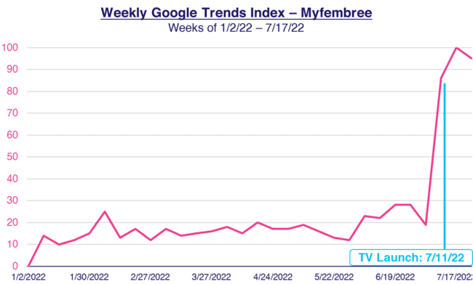
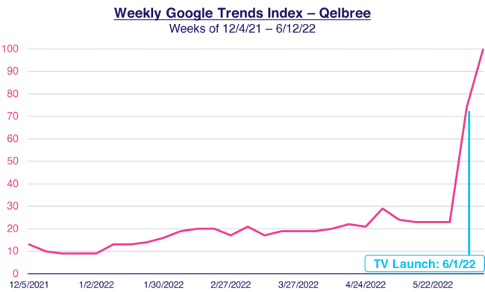
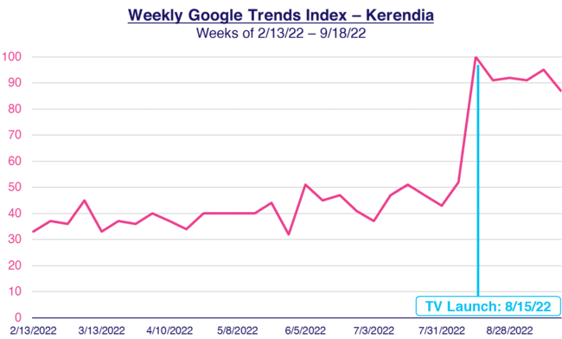
TV campaigns drove awareness and interest among potential pharma consumers that spiked online brand searches at launch or quickly after
Searches for pharmaceutical brands help to drive consumer education and spark conversations with their healthcare providers
First Time Pharma TV Advertisers - Weekly Google Trends Index
Six Months Pre-TV Campaign vs. TV Campaign Launch
Click here to see more real-world examples of how TV spend drives search for brands
Source: VAB analysis of Google Trends, United States only, All Categories, Web Search, Weeks of 12/04/21-8/14/22. Google Search Index represents search interest relative to the highest point on the chart for the given region and time period, a value of 100 is the peak popularity for the term, a value of 50 means that the term is half as popular. VAB analysis of Nielsen Ad Intel, TV spend includes national cable TV, broadcast TV, Spanish language cable TV, Spanish language broadcast TV, January 2021 – December 2023 (calendar months); Note: Light blue line marks the first day of TV spending for each brand.
This information is exclusively provided to VAB members and qualified marketers.
PAGE 35

Slide 36
Next, we analyzed several brands across categories to show the significant lift in online search after they launched their first TV campaigns

Slide 37

Cacti used their TV campaign to disrupt a very competitive category, with the newcomer capturing the attention and interest of curious consumers
Weekly Google Trends Index – Cacti
Six Months Pre-TV Campaign vs. TV Campaign Launch (Weeks of 9/6/20 – 3/14/21)
“We decided to use TV
the night before launch
to make a big statement
and build excitement
around Cacti's launch.”
TV Launch: 3/14/21
Lana Buchanan
VP of Marketing, AB InBev’s Beyond Beer Division
(Ad Age, 3/15/21)
Source: VAB analysis of Google Trends, United States only, All Categories, Web Search, Weeks of 9/6/20 – 3/14/21. Google Search Index represents search interest relative to the highest point on the chart for the given region and time period, a value of 100 is the peak popularity for the term, a value of 50 means that the term is half as popular. VAB analysis of Nielsen Ad Intel, TV launch month is based on the first activity reported across national cable TV, broadcast TV, Spanish language cable TV, Spanish language broadcast TV, January 2021 – December 2023 (calendar months); Note: Light blue line marks the first day of TV spending for each brand.
This information is exclusively provided to VAB members and qualified marketers.
PAGE 37

Slide 38

Wallbox’s ad in Super Bowl LVI highlights how leveraging high-profile TV events can significantly boost brand visibility and consumer engagement
Weekly Google Trends Index – Wallbox
Six Months Pre-TV Campaign vs. TV Campaign Launch (Weeks of 8/1/21 – 2/13/22)
“We want to introduce our innovative, design-led products to these consumers and the heavily-watched Super Bowl is the prime venue for us to market our brand to such a broad audience.”
TV Launch: 2/4/22
Barbara Calixto
CMO, Wallbox
(Wallbox Press Release, 1/18/22)
Source: VAB analysis of Google Trends, United States only, All Categories, Web Search, weeks of 8/1/21 – 2/13/22. Google Search Index represents search interest relative to the highest point on the chart for the given region and time period, a value of 100 is the peak popularity for the term, a value of 50 means that the term is half as popular. VAB analysis of Nielsen Ad Intel, TV launch month is based on the first activity reported across national cable TV, broadcast TV, Spanish language cable TV, Spanish language broadcast TV, January 2021 – December 2023 (calendar months); Note: Light blue line marks the first day of TV spending for each brand.
This information is exclusively provided to VAB members and qualified marketers.
PAGE 38

Slide 39

Truff launched TV to reach audiences beyond their digital presence which brought brand curiosity to new heights across a broader audience
Weekly Google Trends Index – Truff
Six Months Pre-TV Campaign vs. TV Campaign Launch (Weeks of 4/3/22 – 10/16/22)
“It’s important for us to find different channels to build brand awareness in a mass way…TV allows for us to get on the radar of those who may have not been familiar with our digital presence, especially as it gives us access to several different audiences and demographics.”
TV Launch: 10/3/22
Nick Guillen
Co-Founder and Co-CEO, Truff
(Ad Age, 9/30/22)
Source: VAB analysis of Google Trends, United States only, All Categories, Web Search, Weeks of 4/3/22 – 10/16/22. Google Search Index represents search interest relative to the highest point on the chart for the given region and time period, a value of 100 is the peak popularity for the term, a value of 50 means that the term is half as popular. VAB analysis of Nielsen Ad Intel, TV launch month is based on the first activity reported across national cable TV, broadcast TV, Spanish language cable TV, Spanish language broadcast TV, January 2021 – December 2023 (calendar months); Note: Light blue line marks the first day of TV spending for each brand.
This information is exclusively provided to VAB members and qualified marketers.
PAGE 39

Slide 40

72SOLD introduced themselves to America through their first TV campaign which educated more home sellers on their product offering
Weekly Google Trends Index – 72SOLD
Six Months Pre-TV Campaign vs. TV Campaign Launch (Weeks of 7/3/22 – 1/22/23)
“We get to bring 72SOLD to home sellers [through TV] across America… Now, any home seller
has the ability to get thousands
more for their home and have it sell faster than the conventional way.”
TV Launch: 1/8/23
Greg Hague
Founder, 72SOLD
(AZ Big Media, 2/9/23)
Source: VAB analysis of Google Trends, United States only, All Categories, Web Search, Weeks of 7/3/22 – 1/22/23. Google Search Index represents search interest relative to the highest point on the chart for the given region and time period, a value of 100 is the peak popularity for the term, a value of 50 means that the term is half as popular. VAB analysis of Nielsen Ad Intel, TV launch month is based on the first activity reported across national cable TV, broadcast TV, Spanish language cable TV, Spanish language broadcast TV, January 2021 – December 2023 (calendar months); Note: Light blue line marks the first day of TV spending for each brand.
This information is exclusively provided to VAB members and qualified marketers.
PAGE 40

Slide 41

PopCorners harnessed the excitement of Super Bowl LVII for their TV campaign launch, which drove a massive spike in interest
Weekly Google Trends Index – PopCorners
Six Months Pre-TV Campaign vs. TV Campaign Launch (Weeks of 10/2/22 – 2/12/23)
"Bringing PopCorners to the Super Bowl stage for the first time is a tremendous moment for a brand on the rise… We're showcasing why fans love this air-popped,
never fried snack in an exciting
and unexpected way.”
TV Launch: 2/12/23
Brett O'Brien
Chief Marketing Officer, Frito-Lay North America
(Cision, 2/6/23)
Source: VAB analysis of Google Trends, United States only, All Categories, Web Search, weeks of 10/2/22-02/12/23. Google Search Index represents search interest relative to the highest point on the chart for the given region and time period, a value of 100 is the peak popularity for the term, a value of 50 means that the term is half as popular. VAB analysis of Nielsen Ad Intel, TV launch month is based on the first activity reported across national cable TV, broadcast TV, Spanish language cable TV, Spanish language broadcast TV, January 2021 – December 2023 (calendar months); Note: Light blue line marks the first day of TV spending for each brand.
This information is exclusively provided to VAB members and qualified marketers.
PAGE 41

Slide 42
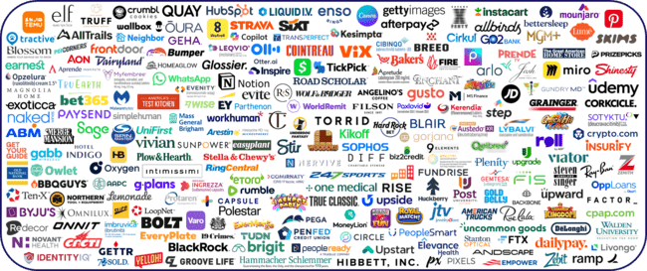
Summary: As we have shown across our analyses of 230 first-time TV advertisers, nothing drives ‘mid-funnel’ outcomes like premium video
This information is exclusively provided to VAB members and qualified marketers.
This information is exclusively provided to VAB members and qualified marketers.
PAGE 42

Slide 43
Adults over 50 account for 36% of the total population and nearly half of all adults
Premium video engages new consumers and ignites customer action like no other media
As evident across our in-depth analyses of 230 first-time advertisers who launched a TV campaign over the last three years, long-form, professionally produced video content consistently shows a strong ability to drive ‘mid-funnel’ outcomes through increased online brand searches and significant lifts in monthly website traffic
These positive business results were universal and seen across a wide variety of categories, 70 in total across all analyses, brands of all types including direct-to-consumer and companies of every size, especially small and medium-sized businesses
Brands who launched TV campaigns to accelerate their growth achieved ‘mid-funnel’ success at all investment levels, with the highest impact and greatest results coming from those advertisers that made the ‘biggest bets’ in TV
Key Marketer Takeaways
This information is exclusively provided to VAB members and qualified marketers.
PAGE 43

Slide 44

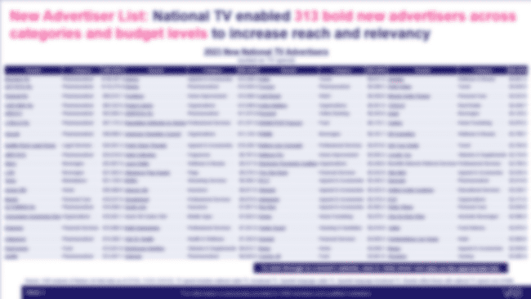

Download ‘Welcome to TV’ to learn more about the new advertisers that are turning to premium video to build their brands and achieve outcomes
Interested in getting the full 2023 new TV advertisers’ list, complete with total TV spending and hyperlinks to each of their websites?
Click this button to download the list!
Download Here
This information is exclusively provided to VAB members and qualified marketers.
PAGE 44

Slide 45





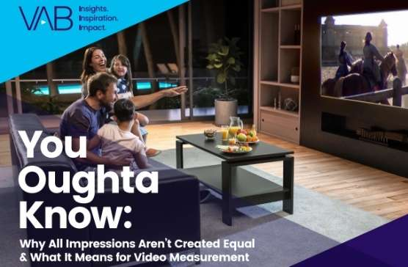

Creators
Jason Wiese
Reed Kiely
SVP, Director of Strategic Insights
jasonw@thevab.com
Director, Data Insights & Trends
reedk@thevab.com
Karolina Guillen
Kaileen Cain
25 Ways TV Grows Brands
Powering Performance Through Full-Funnel Business Outcomes
Laugh, Cry, Share, Buy
How TV & Streaming Influences Gen Z More Than Leading Social Platforms
Associate Director, Insights, Strategy & Analytics
karolinag@thevab.com
Senior Insights Analyst
kaileenc@thevab.com
Discover more
Looking for more data, insights and takeaways? Check out this related VAB content
Let’s Get Down to Business
How Brand-Building Drives Outcomes
for Innovative B2B Advertisers
How can I be more innovative
with my TV campaign?
The Secret of My Success
Examining The Winning Marketing Strategy That’s Fueling High-Growth DTC Brands
You Oughta Know
Why All Impressions Aren’t Created Equal & What it Means for Video Measurement
This information is exclusively provided to VAB members and qualified marketers.
PAGE 45

Slide 46


About VAB
VAB plays a dual role in the video advertising industry. We are leading
the change to bring about a more innovative and transparent marketplace. We also provide the insights and thought leadership that enables marketers to develop business-driving marketing strategies.
Drawing on our marketing expertise, we simplify the complexities in our industry and discover new insights that transform the way marketers look at their media strategy.
We are committed to your business growth and proud to offer VAB members, brand marketers and agencies complimentary access to our continuously-growing Insights library. Get immediate access at theVAB.com.
This information is exclusively provided to VAB members and qualified marketers.
PAGE 46

Slide 47

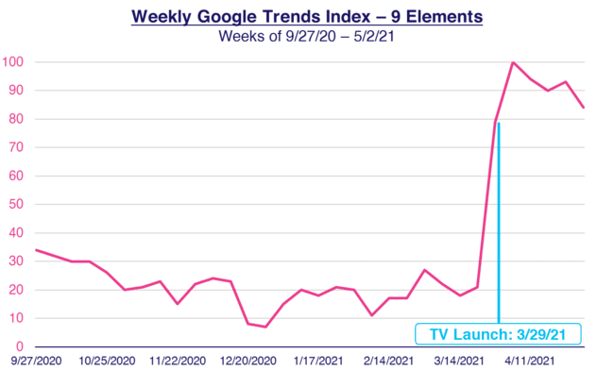
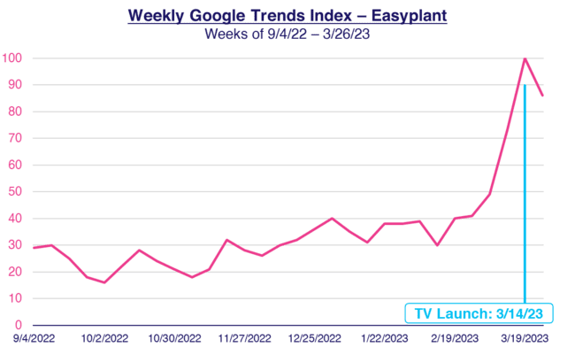


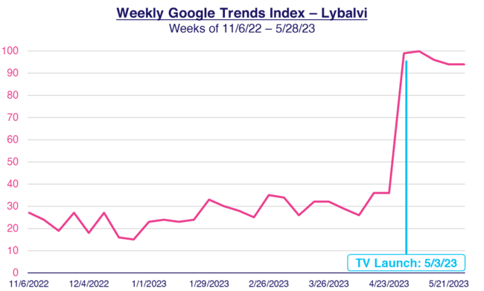
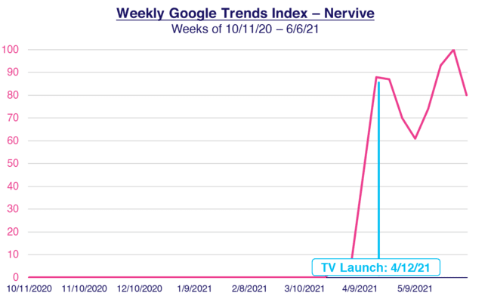

‘Google Trends’ Appendix: More examples of brands that saw a spike in online brand searches when they launched their first TV campaigns
Click to return to slide 35
First Time TV Advertisers - Weekly Google Trends Index
Six Months Pre-TV Campaign vs. TV Campaign Launch
Source: VAB analysis of Google Trends, United States only, All Categories, Web Search, Weeks of 9/27/20-3/26/23. Google Search Index represents search interest relative to the highest point on the chart for the given region and time period, a value of 100 is the peak popularity for the term, a value of 50 means that the term is half as popular. VAB analysis of Nielsen Ad Intel, TV launch month is based on the first activity reported across national cable TV, broadcast TV, Spanish language cable TV, Spanish language broadcast TV, January 2021 – December 2023 (calendar months); Note: Light blue line marks the first day of TV spending for each brand.
This information is exclusively provided to VAB members and qualified marketers.
PAGE 47

Slide 48
‘Brands by TV Investment’ Appendix: Our analysis includes companies across a range of TV investment levels
Click to return to slide 25
Under $500K TV Spend
35 Brands
$2MM - $5MM TV Spend
35 Brands
$10MM+ TV Spend
44 Brands
Source: VAB analysis of Nielsen Ad Intel, TV spend includes national cable TV, national broadcast TV, Spanish language broadcast TV, Spanish language cable TV, spot TV, syndication TV. The brands reflected in each group are based on their total TV spend between January 2021 – April 2024.
This information is exclusively provided to VAB members and qualified marketers.
PAGE 48

