Slide 1


VAB – MARKETER’S GUIDE - 2019
.................
Brands In Crisis
Changing Perceptions Through TV Advertising

Slide 2
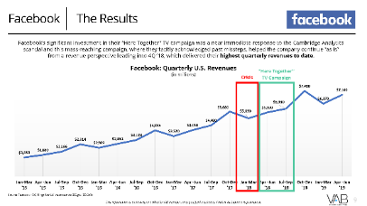
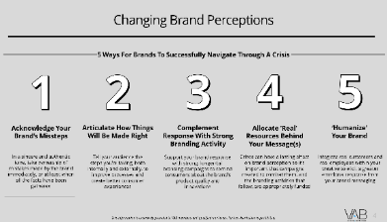
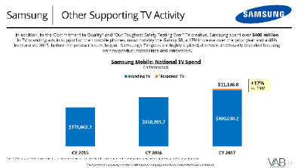
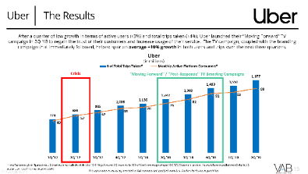
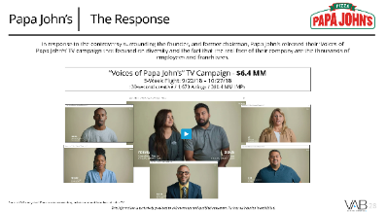
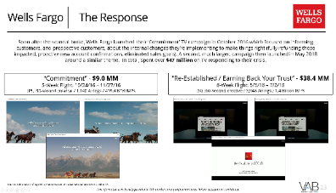
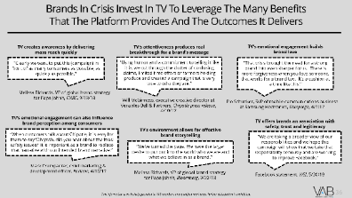
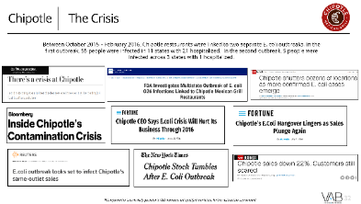

Contents
2
1
1
Brands In Crisis: Changing Perceptions
2
Facebook: Keeping Business Going “As Is”
4
3
3
Uber: Regaining Consumer Trust
4
Samsung: Preserving Brand Reputation
6
5
5
Wells Fargo: Stabilizing A Brand
6
Papa John’s: Stopping Brand Bleeding
8
7
Chipotle: Brand Building & Driving Sales
7
8
The Benefits Of Utilizing TV For Brands in Crisis
2
For PowerPoint version, put in presentation mode and click on a # above to go directly to the appropriate case study

Slide 3




















Brands In Crisis
Data privacy breaches & election meddling. Gender discrimination & sexual harassment. Explosive devices & mass recalls. Fake accounts & customer fraud. Racist remarks & NFL national anthem controversy. Not one but two E. coli outbreaks.
In the past few years, brands like Facebook, Uber, Samsung, Wells Fargo, Papa John’s and Chipotle have experienced severe crises that could have inflicted lasting, and irreversible, damage to their brand.
However, to overcome the initial damage to the brand, all six companies developed their own consumer response to either address these crises head-on with the American public or to change the narrative.
As we highlight in this report through six detailed case studies, TV advertising was a key component utilized by each brand to help change public opinion and rehabilitate their image.
TV campaigns were successful in stabilizing these brands and helping them regain consumer trust, preserve brand reputation and rebuild their positioning. TV also aided in driving sales or, at the very least, stopping the bleeding for some.
Continue reading to learn about the central role that TV played in changing consumer perceptions of these six brands that were once in crisis.
3
This information is exclusively provided to VAB members and qualified marketers. Further distribution is prohibited.

Slide 4
Changing Brand Perceptions
5 Ways For Brands To Successfully Navigate Through A Crisis
1
2
3
4
5
Acknowledge Your Brand’s Missteps
Articulate How Things Will Be Made Right
Complement Response With Strong Branding Activity
Allocate ‘Real’ Resources Behind
Your Message(s)
‘Humanize’ Your Brand
In a sincere and authentic tone, take ownership of the mistakes made by the brand immediately, or at least when all the facts have been gathered
Tell your audience the steps you’re taking, both internally and externally, to improve processes and create better consumer experiences
Support your brand response with strong, longer-tail branding campaigns to remind consumers about the brand’s product quality and innovations
Crises can have a lasting effect on brand perception so it’s important that campaigns created to combat them, and the branding activities that follow, are appropriately funded
Integrate real customers and real employees within your creative to elicit a greater emotional response from your brand messaging
4
This information is exclusively provided to VAB members and qualified marketers. Further distribution is prohibited.

Slide 5

Case Study: Facebook
How TV Keeps Business Going “As Is”

Slide 6



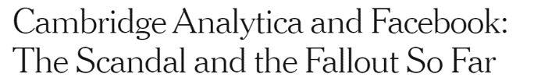



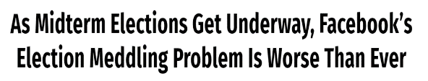
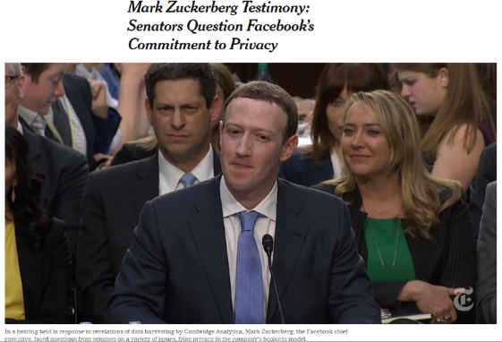
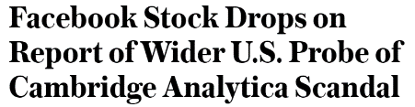



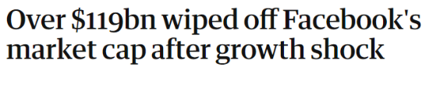


Facebook The Crisis
In March 2018, The Guardian & New York Times exposed Cambridge Analytica’s harvesting of personal data from millions of Facebook user accounts which added another scandal amidst allegations of ‘fake news’ posts and Russian meddling on social media platforms to influence the 2016 Presidential election. The scandal culminated with Facebook co-founder & CEO, Mark Zuckerberg, testifying in front of Congress on April 10th-11th 2018 about the social media platform’s mishandling of data and its’ commitment to consumer privacy.
6
This information is exclusively provided to VAB members and qualified marketers. Further distribution is prohibited.

Slide 7
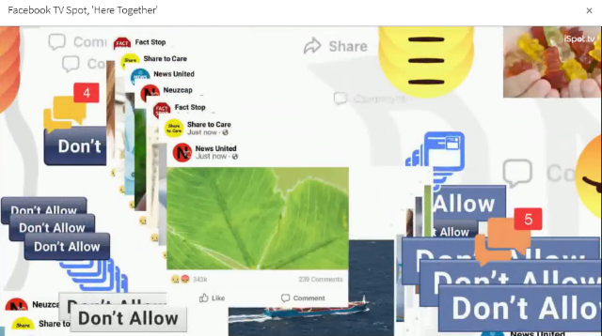
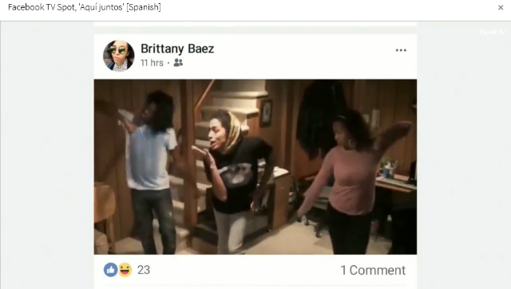
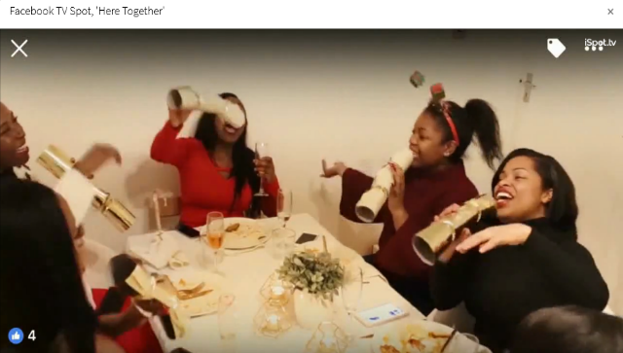
Facebook The Response
Only two weeks after Zuckerberg testified in front of Congress, and on the same day as their 1Q ‘18 earnings report release, Facebook launched their “Here Together” TV campaign in April 2018 acknowledging that people don’t want to see spam, clickbait articles and false news so moving forward they were going to show more from the people you care about on your newsfeed.
“Here Together” - $67.8 MM
12-Week Flight: 4/25/18 – 7/19/18
:30, :60-second creative / 3,713 Airings / 1.9 Billon HH IMPs
Source: VAB analysis of iSpot.tv TV occurrence data. Impressions represent US TV HHs and include activity within national broadcast and cable TV linear, national time-shifted, local, VOD and OTT. Note, figures above also includes creative labeled as ‘A Little Closer’ which accounted for 46 airings / 97.8 MM imps / $2.9 MM between 4/25/18 – 7/14/18.
7
This information is exclusively provided to VAB members and qualified marketers. Further distribution is prohibited.

Slide 8
Facebook Other Supporting TV Activity
When Facebook launched their “Here Together” TV campaign in April 2018, it ran almost exclusively throughout their flight and it represented their largest TV campaign to date. Other Facebook campaigns over the last three years focused on their products such as Facebook Live, Groups, Marketplace and Fundraisers ($155 million in TV since 4Q 2016).
Facebook: National TV Spend
(in thousands)
Source: VAB analysis of iSpot.tv occurrence data, includes national broadcast & cable TV.
8
This information is exclusively provided to VAB members and qualified marketers. Further distribution is prohibited.

Slide 9
Facebook The Results
Although the hashtag #DeleteFacebook trended across social media platforms soon after the scandal broke, daily active users remained relatively unaffected overall as the mass-reaching “Here Together” TV campaign, where they tacitly acknowledged past missteps, launched quickly after Mark Zuckerberg appeared before Congress.
Facebook: Daily Active Users
US & Canada
(in millions)
“Here Together”
TV Campaign
Crisis
Note: Daily Active User figures reflect daily average over the month ended
9
Source: Facebook 10-Q filings via SEC.gov (EDGAR)
This information is exclusively provided to VAB members and qualified marketers. Further distribution is prohibited.

Slide 10
Facebook The Results
Facebook’s significant investment in their “Here Together” TV campaign was a key component in maintaining their total number of daily active users and helped the company continue “as is” from a revenue perspective leading into 4Q ’18, which delivered their highest quarterly revenues to date.
Facebook: Quarterly U.S. Revenues
(in millions)
“Here Together”
TV Campaign
Crisis
10
Source: Facebook 10-Q filings for U.S. revenues via SEC.gov (EDGAR)
This information is exclusively provided to VAB members and qualified marketers. Further distribution is prohibited.

Slide 11

Case Study: Uber
How TV Aids In Regaining Consumer Trust

Slide 12





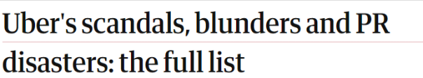








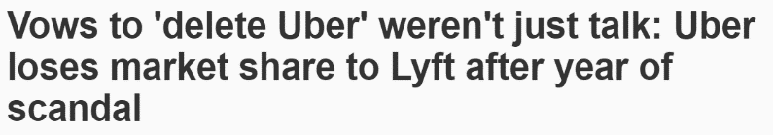

Uber The Crisis
In June 2017, Uber founder / CEO Travis Kalanick resigned after six months of scandals including gender discrimination and sexual harassment, his berating of an Uber driver caught on video and other allegations of misconduct by other executives and drivers.
12
This information is exclusively provided to VAB members and qualified marketers. Further distribution is prohibited.

Slide 13
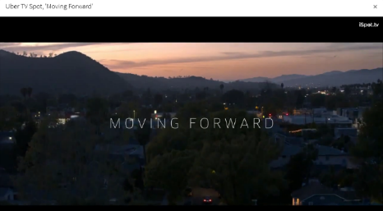
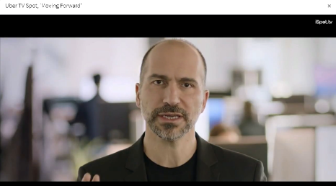
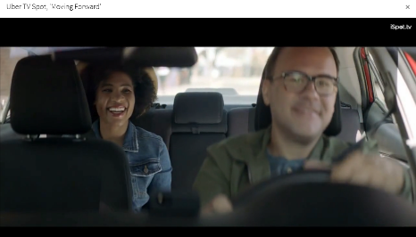
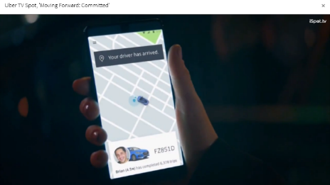
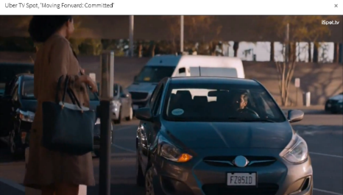
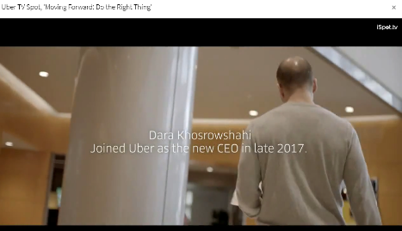
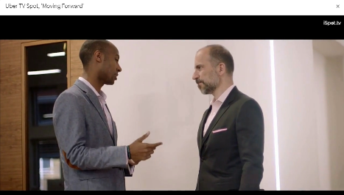
Uber The Response
In response to continual scandals, Uber released their “Moving Forward” TV campaign featuring new CEO Dara Khosrowshahi and emphasizing a new direction with new leadership and culture and their core value of ‘always do the right thing’ and how they’re listening to customers and drivers and making improvements to the service (enhanced background checks, 24/7 customer support, better ride quality, etc).
“Moving Forward / Committed” - $48.0 MM
18-Week Flight: 5/14/18 – 9/16/18
:15, :30, :60-second creative / 12,215 Airings / 2.6 Billion HH IMPs
Source: VAB analysis of iSpot.tv TV occurrence data. Impressions represent US TV HHs and include activity within national broadcast and cable TV linear, national time-shifted, local, VOD and OTT.
13
This information is exclusively provided to VAB members and qualified marketers. Further distribution is prohibited.

Slide 14
Uber Other Supporting TV Activity
94% of Uber’s TV activity between 5/14/18 – 9/16/18 was allocated towards the “Moving Forward” campaign. Immediately after that campaign ended, Uber launched a branding campaign entitled “Doors Are Always Opening” which ran through the balance of 3Q ’18 and through 4Q ‘18. In total, Uber spent $181 million in TV between 2017 & 2018.
Uber: National TV Spend
(in thousands)
Source: VAB analysis of iSpot.tv occurrence data, includes national broadcast & cable TV.
14
This information is exclusively provided to VAB members and qualified marketers. Further distribution is prohibited.

Slide 15
Uber The Results
After a quarter of low growth in terms of active users (+3%) and total trips taken (+4%), Uber launched their “Moving Forward” TV campaign in 2Q ‘18 to regain the trust of their customers and increase usage of their service. The TV campaign, coupled with the branding campaign that immediately followed, helped spur an average +10% growth in both users and trips over the next three quarters.
Uber
(in millions)
Crisis
“Moving Forward” / “Post-Response” TV Branding Campaigns
15
*Note: Represents global figures since U.S. breakout is not available within Uber 10-Q filings, however U.S. accounts for 89% of Uber’s revenue growth per 10-Q (8/9/19) so a similar trend line would be expected between Global & U.S.
Source: Uber 10-Q filings via SEC.gov (EDGAR)
This information is exclusively provided to VAB members and qualified marketers. Further distribution is prohibited.

Slide 16
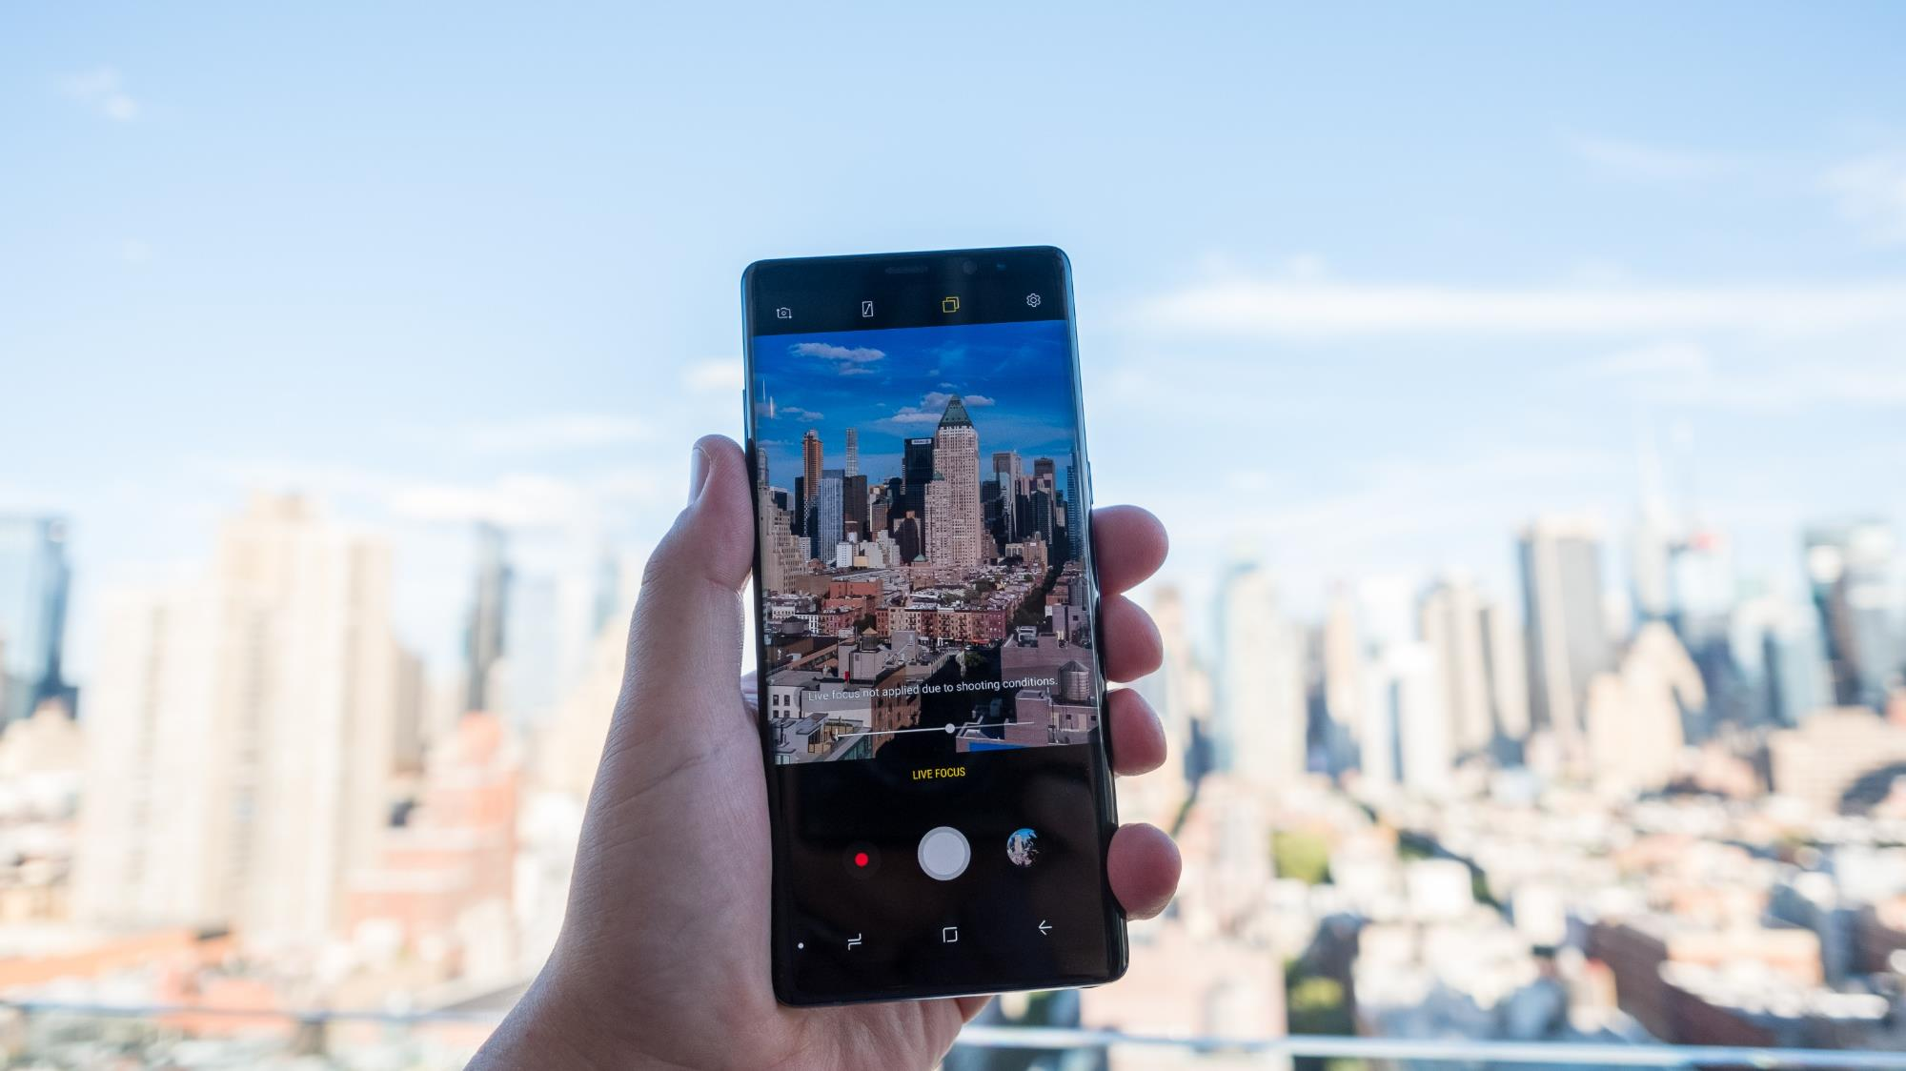
Case Study: Samsung
How TV Helps Preserve Brand Reputation

Slide 17



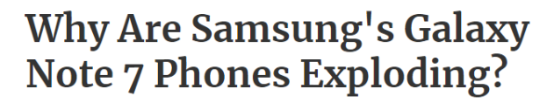
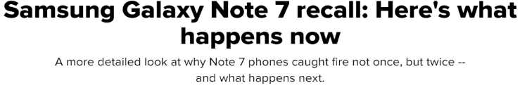





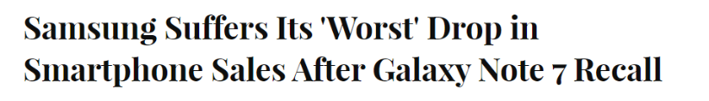
Samsung The Crisis
Between August & September 2016, users began making social media posts about their Galaxy Note 7 batteries exploding which led Samsung to officially recall them in September 2016.
17
This information is exclusively provided to VAB members and qualified marketers. Further distribution is prohibited.

Slide 18
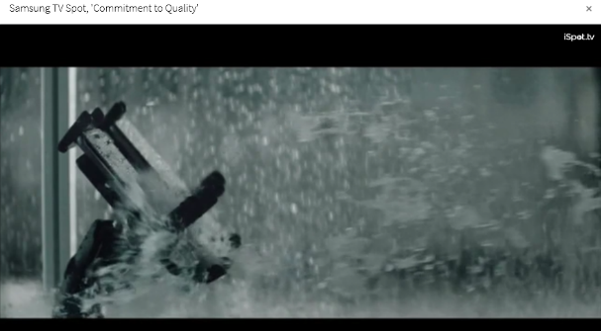
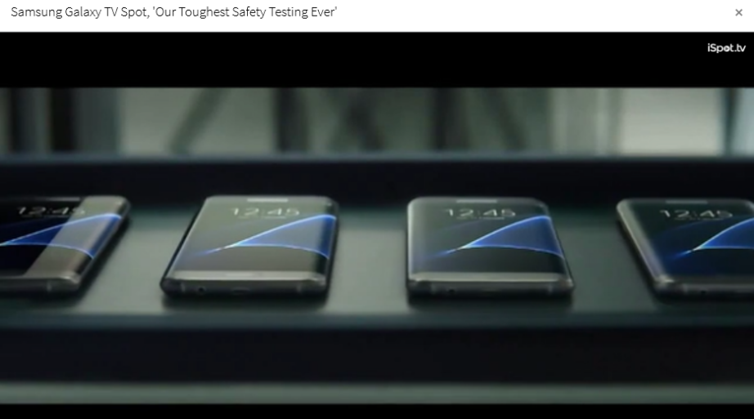
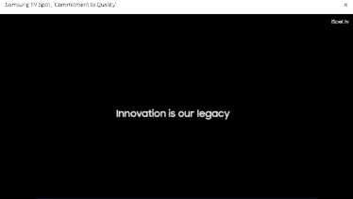
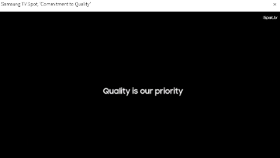
Samsung The Response
In early 2017, ahead of their Galaxy S8 phone release, Samsung spent over $11 million on TV with two creative executions specifically focused on how they extensively test, re-test and test again their phones through an 8-point battery safety check which included the tagline “Innovation is our Legacy, Quality is our Priority.”
“Commitment To Quality” - $4.4 MM
11-Week Flight: 2/26/17 – 5/14/17
:30-second creative / 132 Airings / 92.4 MM HH IMPs
“Our Toughest Safety Testing Ever” - $6.8 MM
5-Week Flight: 2/26/17 – 4/1/17
:30-second creative / 747 Airings / 213.6 MM HH IMPs
Source: VAB analysis of iSpot.tv TV occurrence data. Impressions represent US TV HHs and include activity within national broadcast and cable TV linear, national time-shifted, local, VOD and OTT.
18
This information is exclusively provided to VAB members and qualified marketers. Further distribution is prohibited.

Slide 19
Samsung Other Supporting TV Activity
In addition, to the ‘Commitment to Quality” and “Our Toughest Safety Testing Ever” TV creative, Samsung spent over $400 million in TV branding ads in support of their mobile phones, most notably the Galaxy S8, a 17% increase over the prior year and a 48% increase vs. 2015, before the product issues began. Samsung’s TV spots are highly-stylized, dramatic and heavily-branded focusing on new product capabilities and innovation.
Samsung Mobile: National TV Spend
(in thousands)
+17%
vs. 2016
Source: VAB analysis of iSpot.tv occurrence data, includes national broadcast & cable TV, reflects spending for mobile phone products only, excludes spending against VR and watch products.
19
This information is exclusively provided to VAB members and qualified marketers. Further distribution is prohibited.

Slide 20
Samsung The Results
Samsung’s “Commitment To Quality” & “Our Toughest Safety Testing Ever” TV creative in tandem with increased TV spending for their overall branding & product campaigns helped the brand minimize damage to their reputation in advance of their Galaxy S8 phone release. In fact, in 2017, TV spending for Samsung’s mobile segment was up +17% over the prior year while Samsung America’s revenues were up +18%.
Samsung America: Quarterly Revenues
(Korean Won, in billions)
Crisis
“Commitment / Safety” TV Campaign
20
Source: Samsung quarterly financial statements from their investor relations website. Samsung does not report mobile phone revenues separately for the America region, however mobile accounts for approximately 73% of their consumer segment sales.
This information is exclusively provided to VAB members and qualified marketers. Further distribution is prohibited.

Slide 21
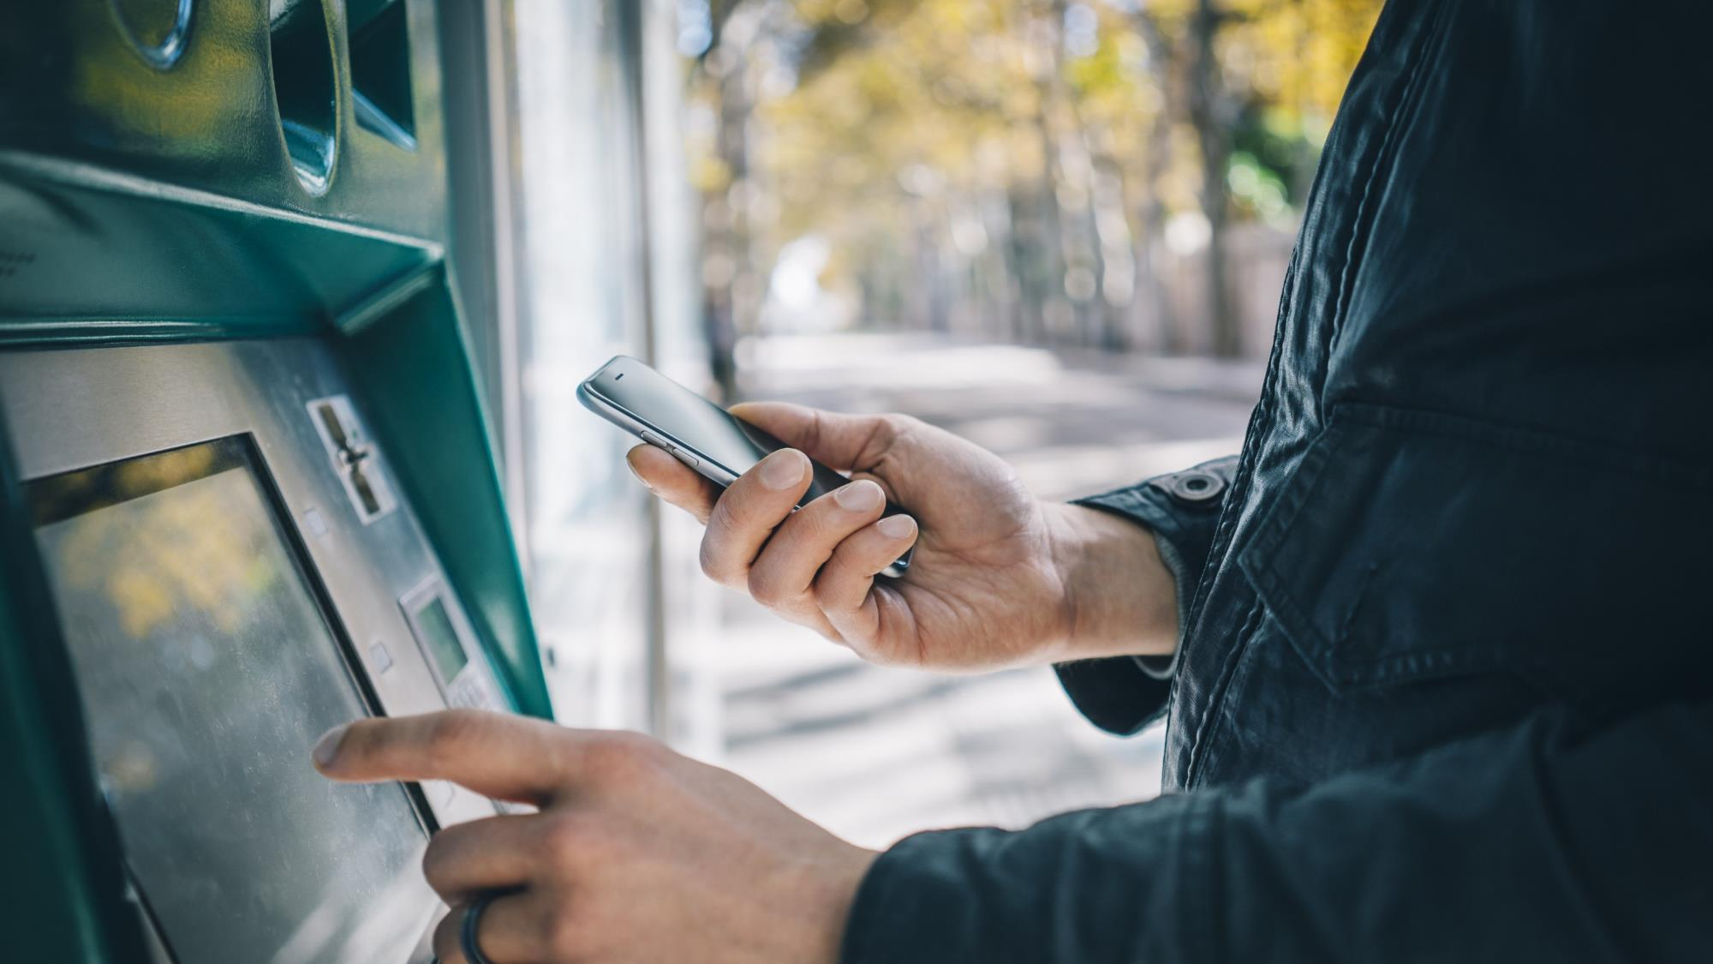
Case Study: Wells Fargo
How TV Helps Stabilize A Brand

Slide 22




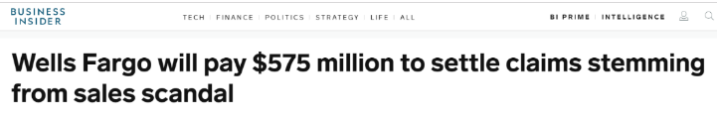
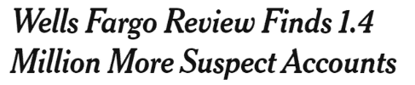




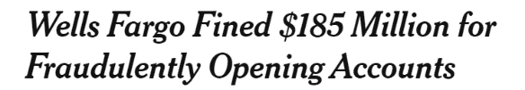
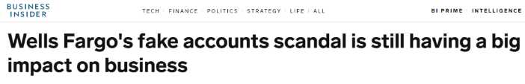

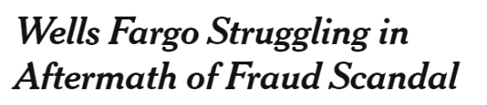


Wells Fargo The Crisis
In September 2016, federal regulators revealed that, in order to meet sales goals, Wells Fargo employees created millions of fraudulent savings, checking and credit card accounts on behalf of Wells Fargo clients without their consent.
22
This information is exclusively provided to VAB members and qualified marketers. Further distribution is prohibited.

Slide 23
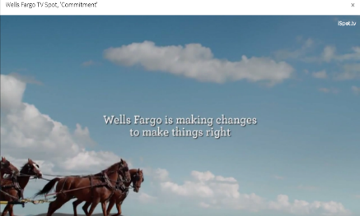
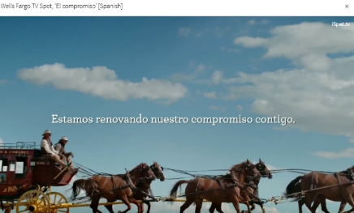
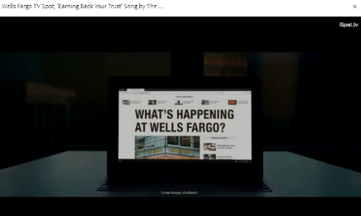
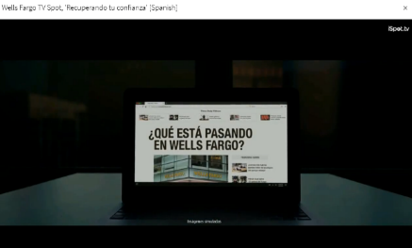
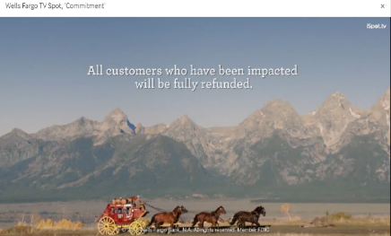
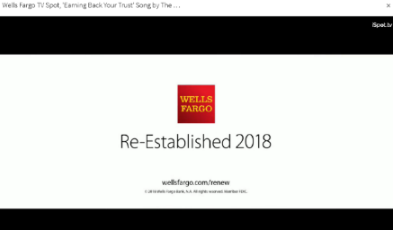
Wells Fargo The Response
Soon after the scandal broke, Wells Fargo launched their ‘Commitment’ TV campaign in October 2016 which focused on informing customers, and prospective customers, about the internal changes they’re implementing to make things right (fully refunding those impacted, proactive new account confirmations, eliminated sales goals). A second, much larger, campaign then launched in May 2018 around a similar theme. In total, spent over $47 million on TV responding to their crisis.
“Commitment” - $9.0 MM
5-Week Flight: 10/24/16 – 11/27/16
:15, :30-second creative / 1,140 Airings / 499.4 MM HH IMPs
“Re-Established / Earning Back Your Trust” - $38.4 MM
8-Week Flight: 5/5/18 – 7/2/18
:30, :60-second creative / 3,948 Airings / 1.4 Billion HH IMPs
Source: VAB analysis of iSpot.tv TV occurrence data. Impressions represent US TV HHs and include activity within national broadcast and cable TV linear, national time-shifted, local, VOD and OTT.
23
This information is exclusively provided to VAB members and qualified marketers. Further distribution is prohibited.

Slide 24
Wells Fargo Other Supporting TV Activity
Between their ‘Re-established / Earning Back Your Trust’ campaign and additional branding activity focused on their mobile banking app and security-related issues (suspicious card activity, missing cards, etc), Wells Fargo more than doubled their TV investment in 2018 vs. 2016 when the fraud scandal broke. Interestingly, recent creative (post-’EBYT’ campaign) has made much more use of people within their ads, regularly including both customers and their employees.
Wells Fargo: National TV Spend
(in thousands)
24% increase vs. 1Q-2Q ‘18
24
Source: VAB analysis of iSpot.tv occurrence data, includes national broadcast & cable TV.
This information is exclusively provided to VAB members and qualified marketers. Further distribution is prohibited.

Slide 25
Wells Fargo The Results
Wells Fargo’s two TV campaigns focusing on ‘commitment’ and ‘trust,’ along with their increased branding TV activity, helped stabilize the company and avoid a potential mass exodus of customers amidst the highly publicized scandal which affected their own clients.
Wells Fargo: Total Deposits (Quarter End)
(in billions)
“Commitment”
TV Campaign
“Earning Back Your Trust”
TV Campaign
Crisis
25
Source: Wells Fargo 10-Q filings for total period-end deposits via SEC.gov (EDGAR)
This information is exclusively provided to VAB members and qualified marketers. Further distribution is prohibited.

Slide 26
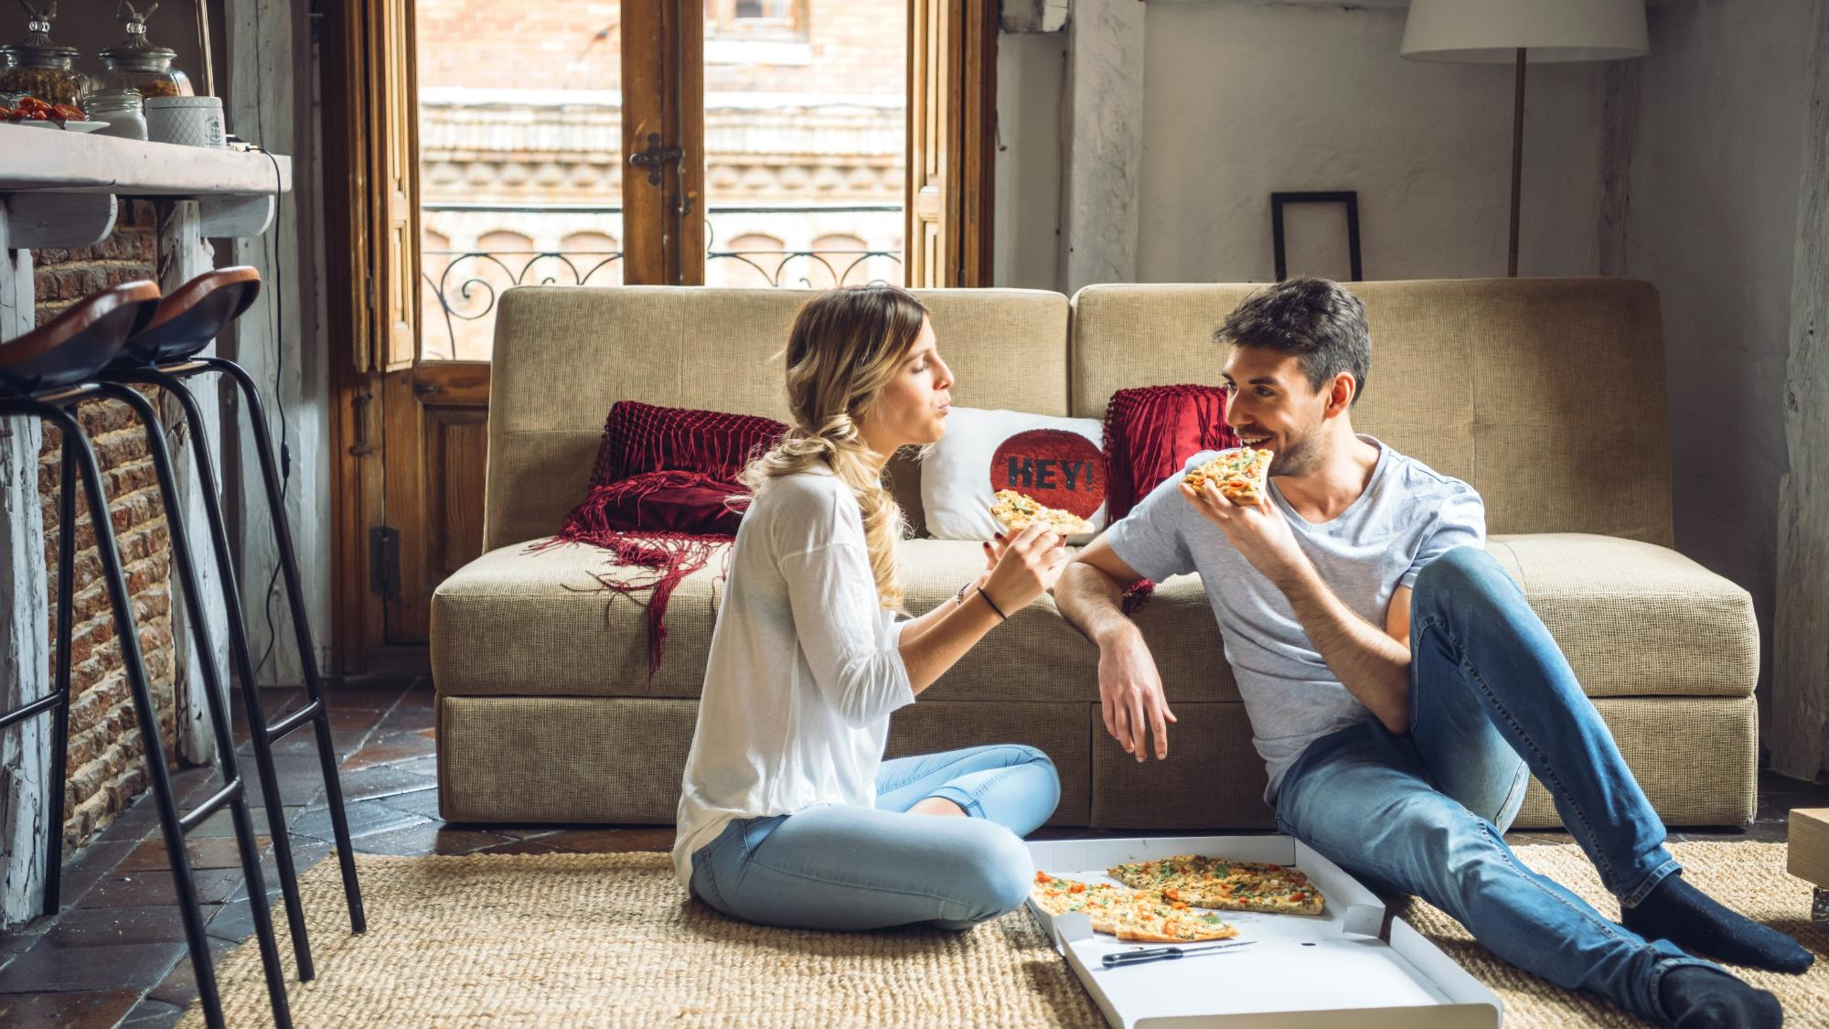
Case Study: Papa John’s
How TV Helped Stop The Brand Bleeding

Slide 27
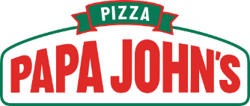

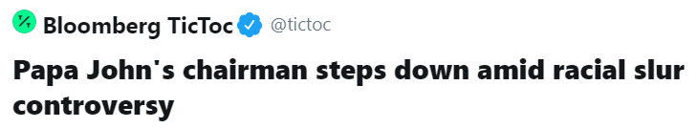




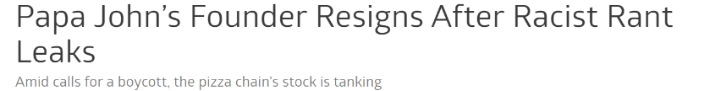

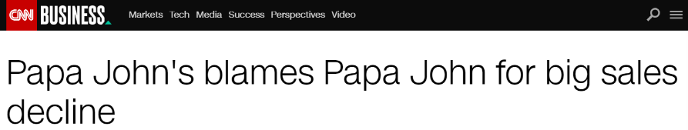

Papa John’s The Crisis
On July 11th 2018, Papa John’s founder, John Schnatter, resigned as Chairman when a scandal broke out over his use of a racial slur in a meeting when trying to minimize the controversy over earlier comments he made late in 2017 about NFL players kneeling during the national anthem.
27
This information is exclusively provided to VAB members and qualified marketers. Further distribution is prohibited.

Slide 28






Papa John’s The Response
In response to the controversy surrounding the founder, and former chairman, Papa John’s released their ‘Voices of Papa John’s’ TV campaign that focused on diversity and the fact that the real face of their company are the thousands of employees and franchisees.
“Voices of Papa John’s” TV Campaign - $6.4 MM
5-Week Flight: 9/22/18 – 10/27/18
:30-second creative / 1,673 Airings / 390.4 MM HH IMPs
Source: VAB analysis of iSpot.tv TV occurrence data. Impressions represent US TV HHs and include activity within national broadcast and cable TV linear, national time-shifted, local, VOD and OTT.
28
This information is exclusively provided to VAB members and qualified marketers. Further distribution is prohibited.

Slide 29
Papa John’s Other Supporting TV Activity
Papa John’s peeled back some of their TV spend in 2018 as controversy surrounded Papa John’s founder, however spending was flat during the first two quarters of 2019 vs. prior year. “Voices of Papa John’s” creative had the most dollars allocated towards it during it’s flight (9/22/18 -10/27/18) and, after that campaign ended, Papa John’s has been more cognizant about integrating the diversity of their employees into recent branding and promotional TV sports.
Papa John’s: National TV Spend
(in thousands)
Flat TV spend
vs. 1Q-2Q ‘18
29
Source: VAB analysis of iSpot.tv occurrence data, includes national broadcast & cable TV.
This information is exclusively provided to VAB members and qualified marketers. Further distribution is prohibited.

Slide 30
Papa John’s The Results
Interestingly, in 2017 Papa John’s TV spend increased 6% and revenues were up 4% but in 2018 TV spend decreased 25% while revenues decreased 14%. In late 2018, “Voices of Papa John’s” TV creative and the ensuing stabilization of TV spend helped stop the hemorrhaging of quarterly sales and aided in the flattening of revenues from October 2018 through the present.
Papa John’s: Quarterly U.S. Revenues
(in millions)
“Voices of Papa John’s”
TV Creative
Crisis
30
Source: Papa John’s 10-Q filings via SEC.gov (EDGAR)
This information is exclusively provided to VAB members and qualified marketers. Further distribution is prohibited.

Slide 31

Case Study: Chipotle
Utilizing TV For Brand Building & Driving Sales

Slide 32
















Chipotle The Crisis
Between October 2015 – February 2016, Chipotle restaurants were linked to two separate E. coli outbreaks. In the first outbreak, 55 people were infected in 11 states with 21 hospitalized. In the second outbreak, 5 people were infected across 3 states with 1 hospitalized.
32
This information is exclusively provided to VAB members and qualified marketers. Further distribution is prohibited.

Slide 33







Chipotle The Response
Although Chipotle didn’t respond directly to the E. coli outbreak through TV advertising, they did launch their first national TV campaign in April 2017* in order to change consumer perception of the brand by focusing initially on their fresh, ‘real’ ingredients with later campaigns spotlighting the real employees who prepare these ‘real’ ingredients.
Chipotle TV Branding Campaigns - $111.0 MM+
First-Ever National TV Campaign Launched 4/10/17 – present (stats through 9/30/19)
:06, :15, :30-second creative (50+ executions) / 18,174 Airings / 7.7 Billion HH IMPs
Source: VAB analysis of iSpot.tv TV occurrence data. Impressions represent US TV HHs and include activity within national broadcast and cable TV linear, national time-shifted, local, VOD and OTT. *Prior to their first national TV campaign, Chipotle implemented a local market TV test in 4Q 2016 within markets like Austin, Minneapolis and San Diego; separately they also ran one national TV spot in The 2012 Grammy Awards.
33
This information is exclusively provided to VAB members and qualified marketers. Further distribution is prohibited.

Slide 34
Chipotle Brand TV Spending
Chipotle has increased their TV investment each of the last two years after launching in 2Q ‘17. There’s been a particular spike in TV spend during 2019, 1Q-3Q spending reflects a 178% increase vs. same time period in 2018.
Chipotle: National TV Spend
(in thousands)
34
Source: VAB analysis of iSpot.tv occurrence data, includes national broadcast & cable TV. *CY 2019 YTD through September 30, 2019
This information is exclusively provided to VAB members and qualified marketers. Further distribution is prohibited.

Slide 35
Chipotle The Results
Aided by their heavy investments in national TV branding campaigns since April 2017, Chipotle’s 1st half 2019 revenues were up +50% vs.
1st half 2016 revenues when the brand was in the midst of the second E coli outbreak and the immediate customer fallout.
Chipotle: Quarterly U.S. Revenues
(in millions)
Crisis
National TV Branding Campaigns (April ‘17 – June ‘19: $104MM)
35
Source: Chipotle 10-Q filings via SEC.gov (EDGAR)
This information is exclusively provided to VAB members and qualified marketers. Further distribution is prohibited.

Slide 36
Brands In Crisis Invest In TV To Leverage The Many Benefits
That The Platform Provides And The Outcomes It Delivers
TV creates awareness by delivering mass reach quickly
TV’s attentiveness produces real breakthrough for a brand’s message
TV’s emotional engagement builds brand love
“Clearly we want to put this (campaign) in front of as many consumers as possible, as quickly as possible.”
“Using humor and a commitment to telling it like it is, we cut through the clutter of confusing claims, limited time offers or farmers holding produce and created a campaign that is very true to who they are.”
“That crisis brought the need for a strong brand into even sharper focus. There is more forgiveness when you love someone, that works for a brand too. It’s a cushion at a time like this.”
Melissa Richards, VP of global brand strategy for Papa John’s, CNBC, 9/18/18
Will McGinness, executive creative director at Venables Bell & Partners, Chipotle press release, 4/10/17
Pio Schunker, SVP of mobile communications business at Samsung Electronics, Campaign, 4/7/17
TV’s emotional engagement can also influence brand perception among consumers
TV offers brands an association with safety, trust and legitimacy
“When customers talk about Chipotle, it is easy for them to say ‘Oh yeah, did you hear about the food safety issues?’ It is important as a brand to replace that narrative with our intended brand narrative.”
TV’s environment allows for effective brand storytelling
“We are taking a broader view of our responsibilities and we hope this campaign will show that we take that responsibility seriously and are working
to improve Facebook.”
“We’ve turned the page. We have the larger desire to put out into the world who we are and what we believe in as a brand.”
Mark Crumpacker, chief marketing & development officer, Fortune, 4/10/17
Melissa Richards, VP of global brand strategy
for Papa John’s, Bloomberg, 9/20/18
Facebook statement, WSJ, 5/30/18
36
This information is exclusively provided to VAB members and qualified marketers. Further distribution is prohibited.

Slide 37




For more information visit us online
TheVAB.com
Join our email list
Follow us:
@VABIntel
Follow us:
VAB

