Slide 1

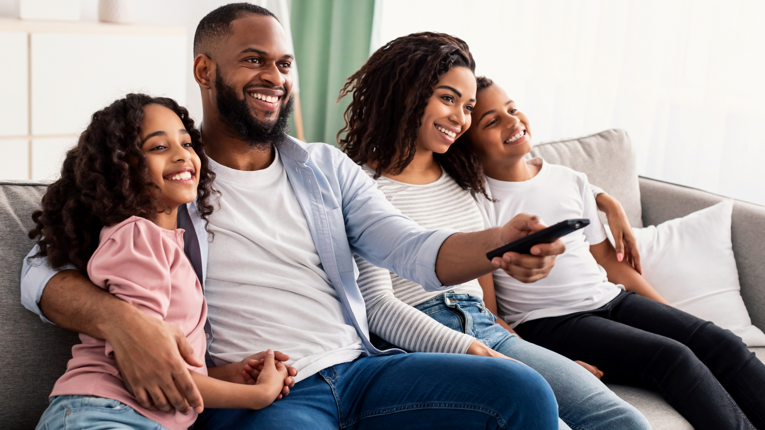



Marketer FAQs
How does on-screen representation deepen engagement with Black consumers and drive business impact for brands?

Slide 2
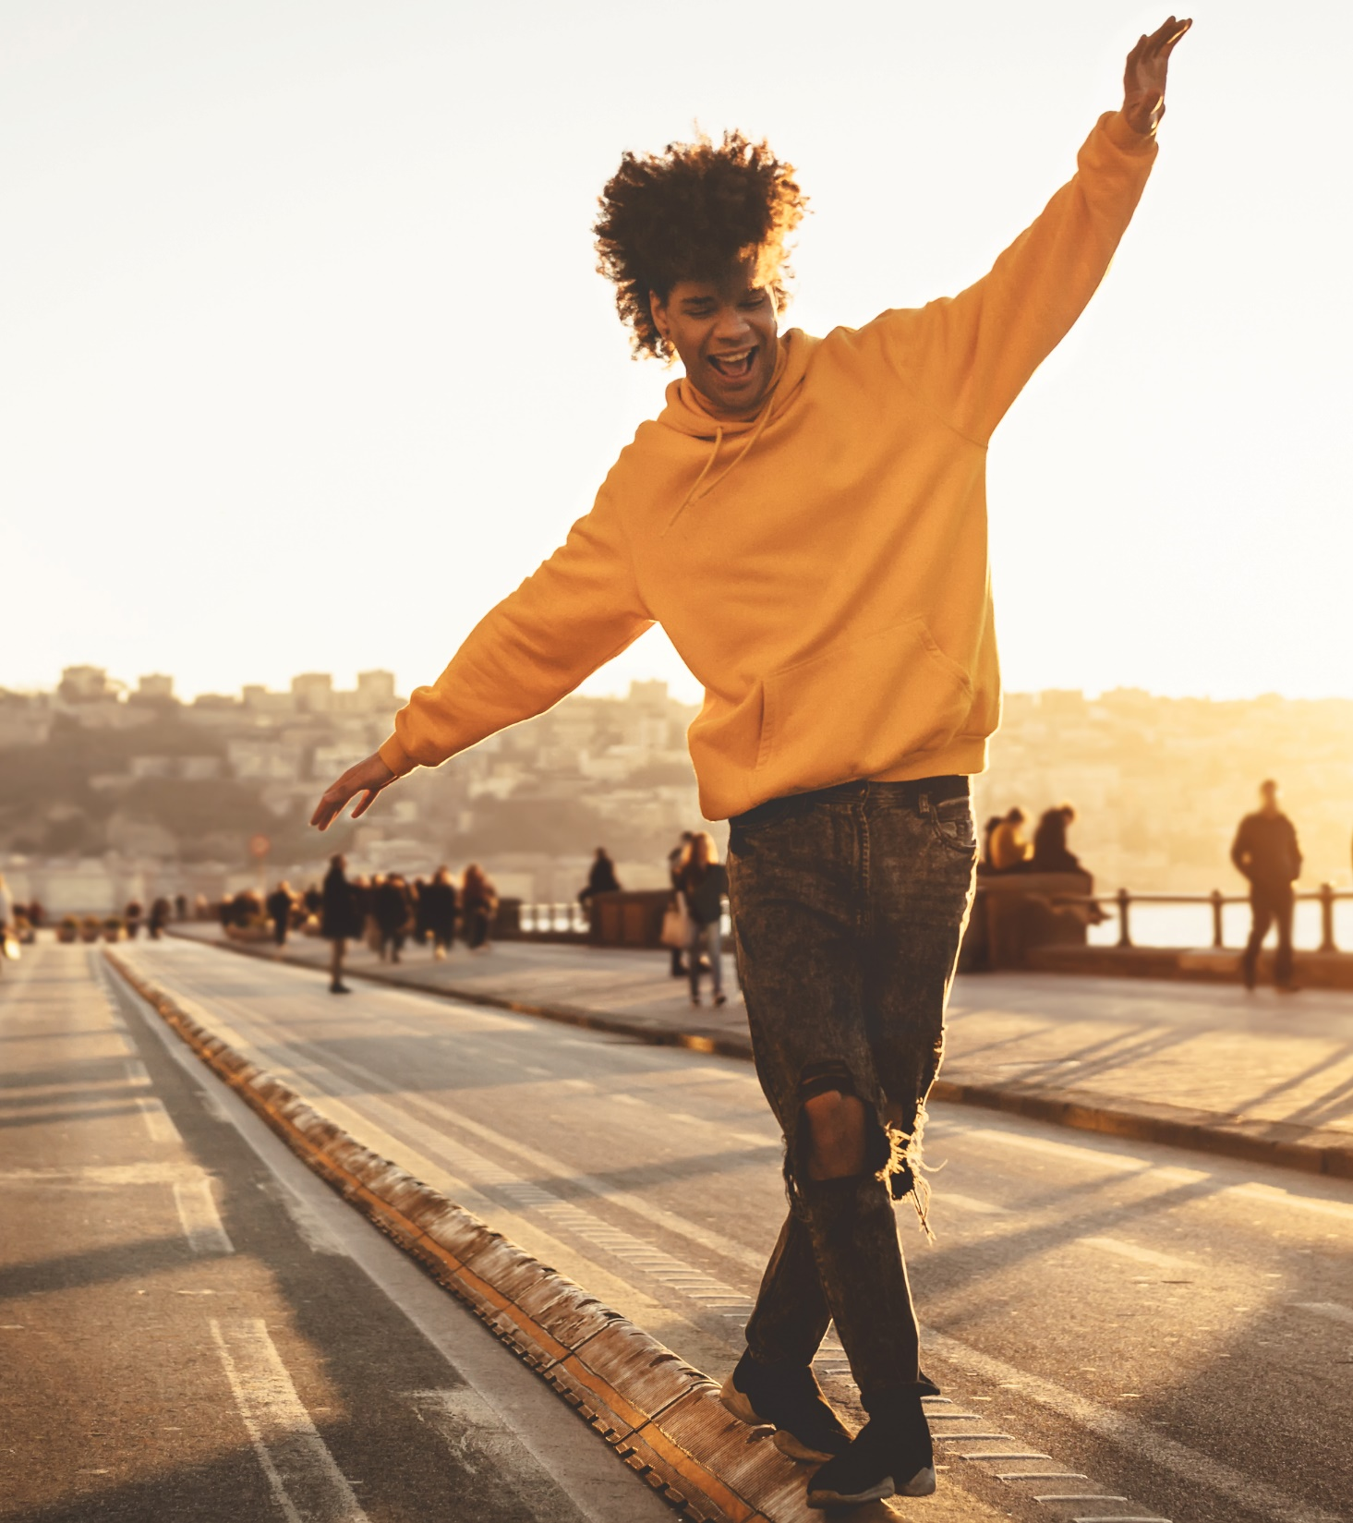
Adults over 50 account for 36% of the total population and nearly half of all adults
Marketer FAQs
As American society evolves and the population becomes more diverse, there is a greater demand for accurate, on-screen representation and inclusivity in both programming and advertising, particularly within the Black community.
How can marketers drive awareness, strengthen engagement and boost business outcomes within this passionate audience?
We explore how culturally relevant entertainment and advertising campaigns drive greater engagement and positive business outcomes among Black Americans.
This information is exclusively provided to VAB members and qualified marketers. Further distribution is prohibited.
PAGE 2

Slide 3
83%
“Across streaming, cable and broadcast platforms, viewership among adults age[s] 18 to 49 peaked in many cases when a show had a majority-minority cast.
People basically want to see the TV shows that look like America, that have characters they can relate to and have experiences that resonate with them.”
of Black adults believe that their cultural & ethnic heritage is an important part of who they are
Represents the highest percentage among ethnicity groups*
Darnell Hunt
Dean of the Social Sciences at UCLA
Source: VAB analysis of MRI-Simmons USA Study, Fall 2021; Black P18+. ‘My cultural / ethnic heritage is an important part of who I am (any agree)’. *% of P18+ respondents that agree with this statement: Asian - 82%, Hispanic – 78%, American Indian or Alaska Native - 75%, NH White – 52%.
This information is exclusively provided to VAB members and qualified marketers. Further distribution is prohibited.
PAGE 3

Slide 4
By building campaigns around TV content that not only promotes inclusivity but accurately portrays identities, marketers can further engage diverse audiences, particularly Black viewers who are more likely to prioritize this content
% that are more likely to start watching a television show or movie because characters with similar (racial, ethnic, religious, etc.) identities
as you are represented?
% of respondents who answered very/somewhat likely
Almost 80% of Black audiences believe it is important that television shows and movies accurately represent their identities
81%
71%
68%
Black
LGBTQ
Hispanic
67%
61%
Asian
non-Hispanic White
Source: VAB analysis of Morning Consult, Media Representation, September 2021.
This information is exclusively provided to VAB members and qualified marketers. Further distribution is prohibited.
PAGE 4
This information is exclusively provided to VAB members and qualified marketers. Further distribution is prohibited.

Slide 5
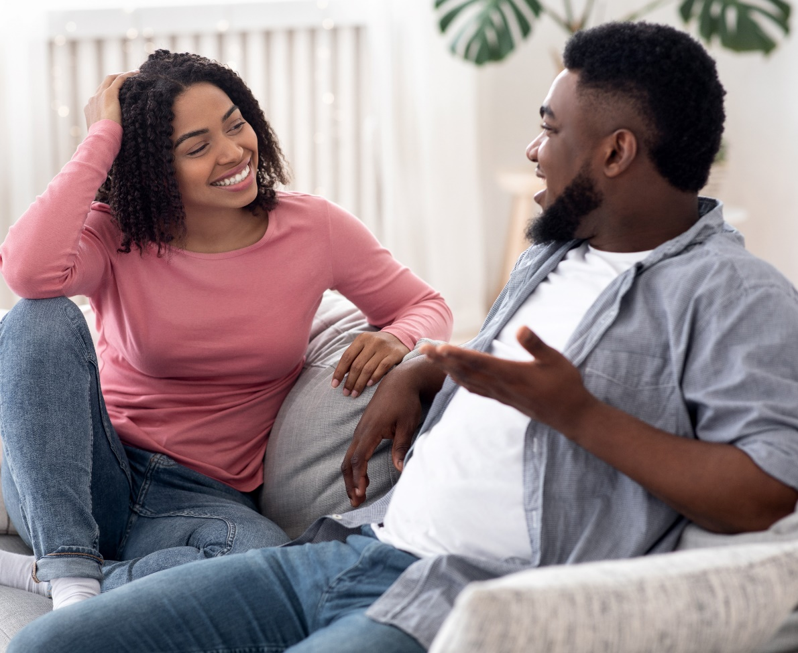
Black audiences desire more accurate representation on-screen
in order to feel a deeper connection with the stories they are watching
Reasons why ‘it is important to you that television shows and movies
accurately represent your (racial, ethnic, religious, etc.) identities’*
Responses related to ‘feeling connected’
“If I don’t see people like me on shows and movies, then I won’t watch the programs. I want to feel like people like me are included in TV shows and movies.”
“I want to feel included. I want to feel like the message is for people like me.”
“So I feel connected to it and [it] piques my interest.”
“I like watching movies and shows where I can at least relate to the characters.”
Source: VAB analysis of Morning Consult, Media Representation, September 2021. *Survey respondents that selected ‘it is important to you that television shows and movies accurately represent your (racial, ethnic, religious, etc. ) identities. Why? (‘very / somewhat important’)
This information is exclusively provided to VAB members and qualified marketers. Further distribution is prohibited.
PAGE 5

Slide 6
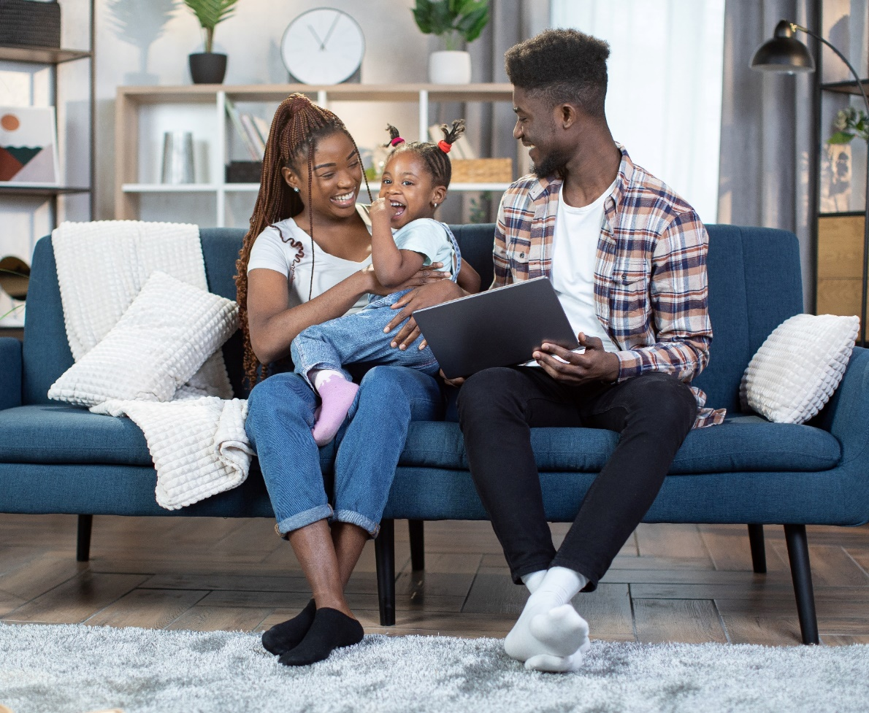
With the importance of cultural identity, it’s imperative to consider the context of on-screen representation, ensuring it does not reinforce stereotypes or promote racial discrimination within the Black community
Reasons why ‘it is important to you that television shows
and movies accurately represent your (racial, ethnic, religious, etc.) identities’*
Responses related to ‘overcoming stereotypes’
“Representation within media we consume impacts our mindset and views of the world overtime, it also impacts the minds of children.”
“Because false representations
of black people lead to racial stereotypes and discrimination.”
“More diversity needs to be displayed for the youth of today so they can know they are seen and are valued as well.”
“It is important that our Black culture is reflected in the right way. I do not think that stereotypes in the media reflect who we truly are as a race and as people.”
Source: VAB analysis of Morning Consult, Media Representation, September 2021. *Survey respondents that selected ‘it is important to you that television shows and movies accurately represent your (racial, ethnic, religious, etc. ) identities. Why? (‘very / somewhat important’)
This information is exclusively provided to VAB members and qualified marketers. Further distribution is prohibited.
PAGE 6

Slide 7




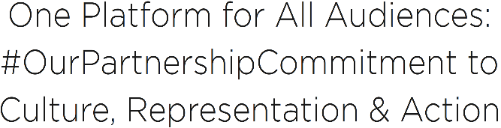


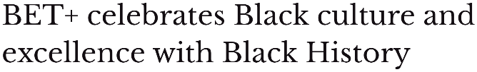


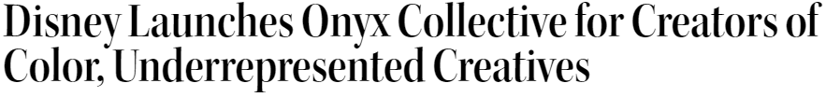

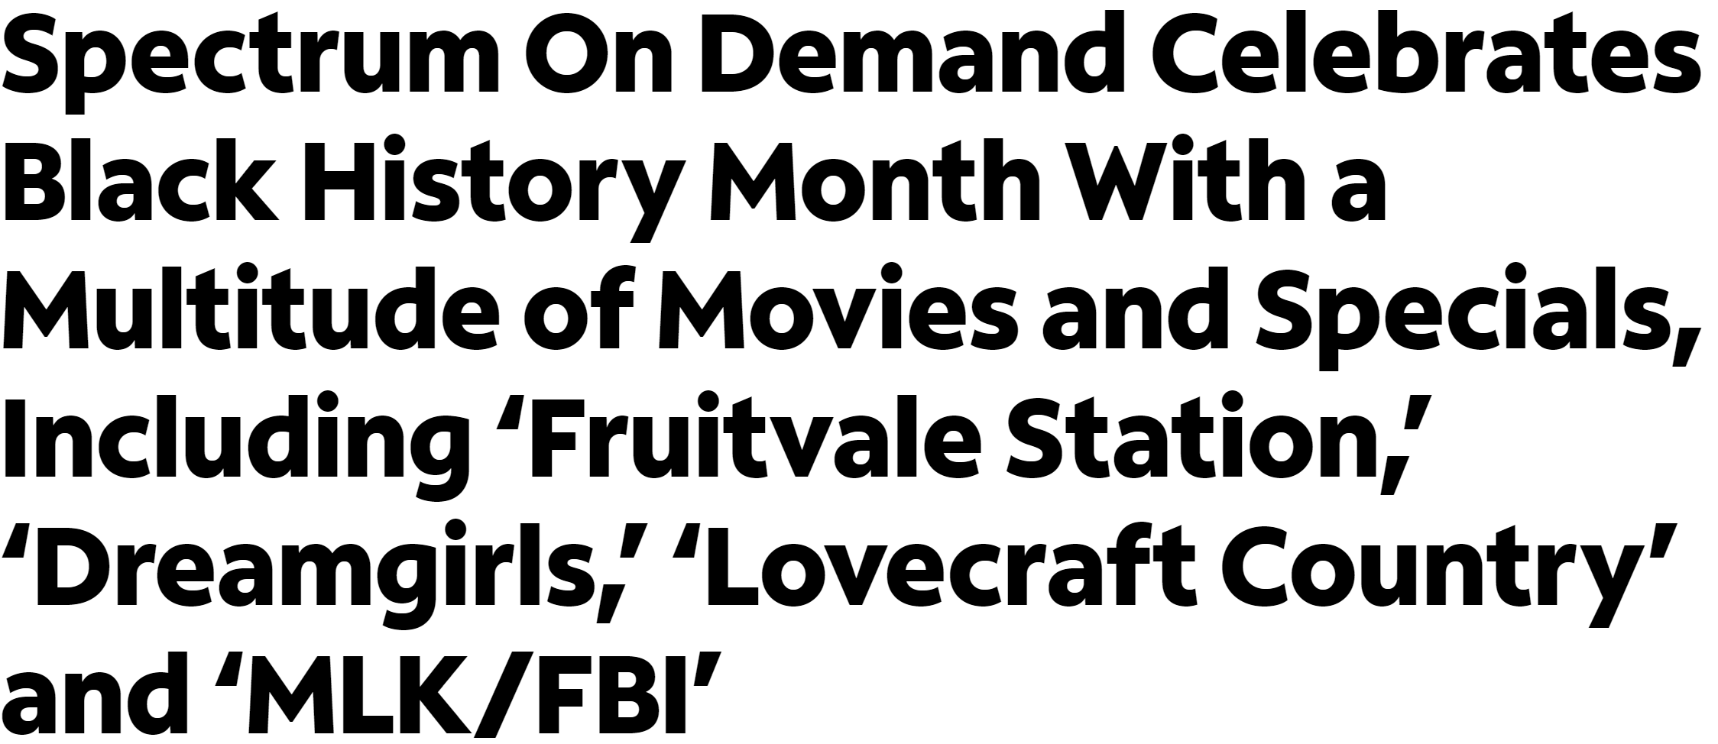
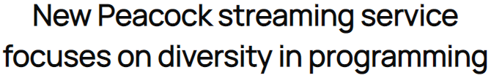


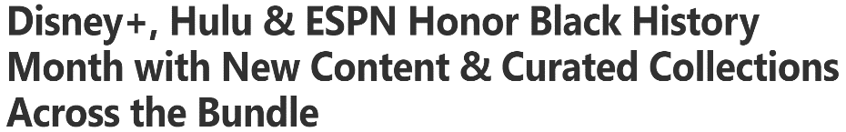


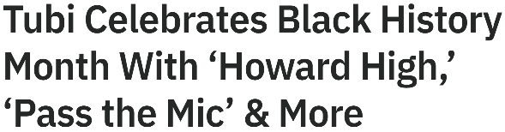



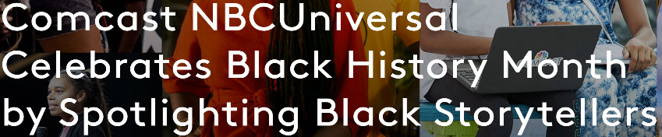

Recognizing the audience desire and impact of diverse programming, multiscreen TV companies have increased their investment
This information is exclusively provided to VAB members and qualified marketers. Further distribution is prohibited.
PAGE 7

Slide 8
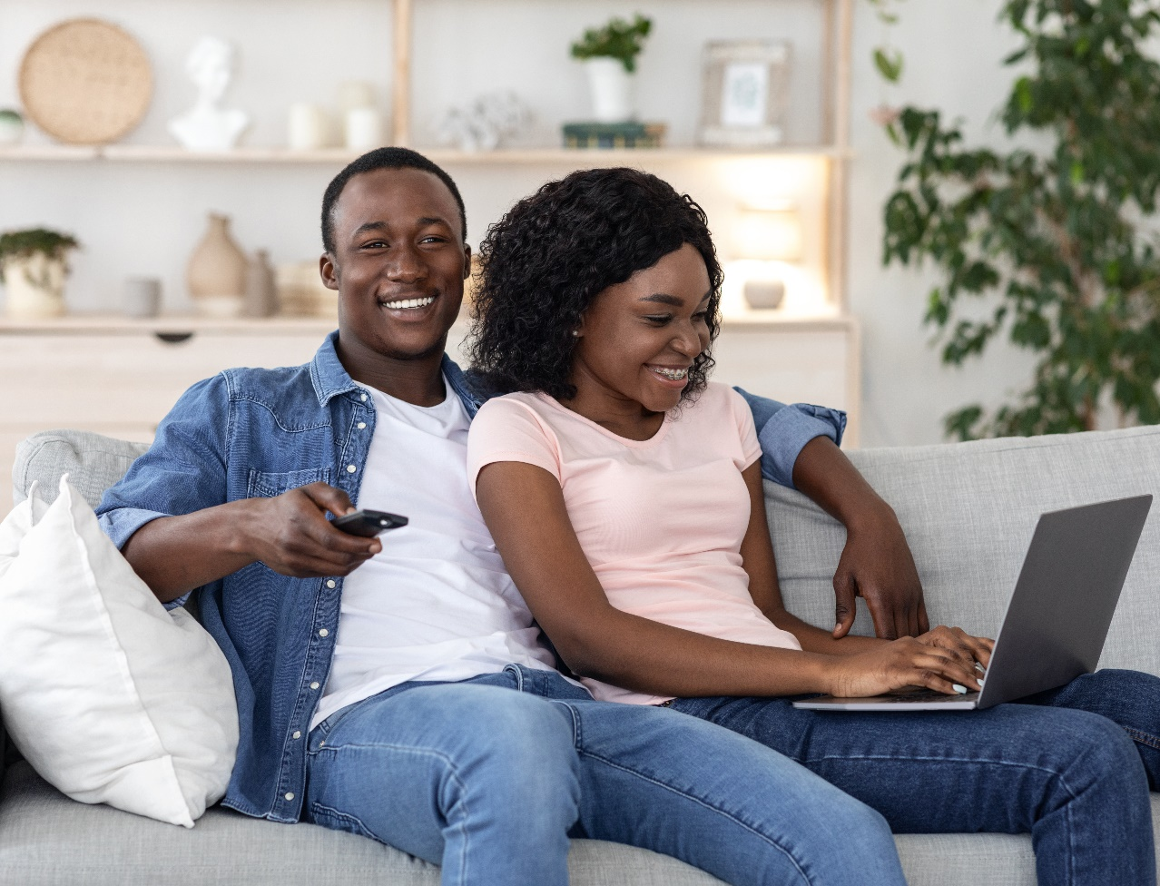
As Black viewers crave inclusive representation, more so than other minority groups, marketers can authentically connect with Black consumers by creating culturally diverse advertising campaigns
‘It is important for companies to create advertising that is culturally diverse
in order to stay relevant’
% of respondents who agree
81%
74%
74%
Black
Hispanic
LGBTQ
73%
65%
61%
Asian
Native American
non-Hispanic White
Source: VAB analysis of MRI-Simmons USA Study, Fall 2021; P18+.
This information is exclusively provided to VAB members and qualified marketers. Further distribution is prohibited.
PAGE 8
This information is exclusively provided to VAB members and qualified marketers. Further distribution is prohibited.

Slide 9

These real-world case studies clearly demonstrate the link between inclusive campaigns and business outcomes
for Black viewers
This information is exclusively provided to VAB members and qualified marketers. Further distribution is prohibited.
PAGE 9

Slide 10

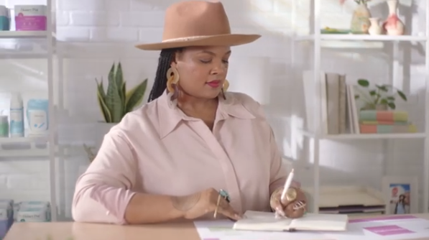
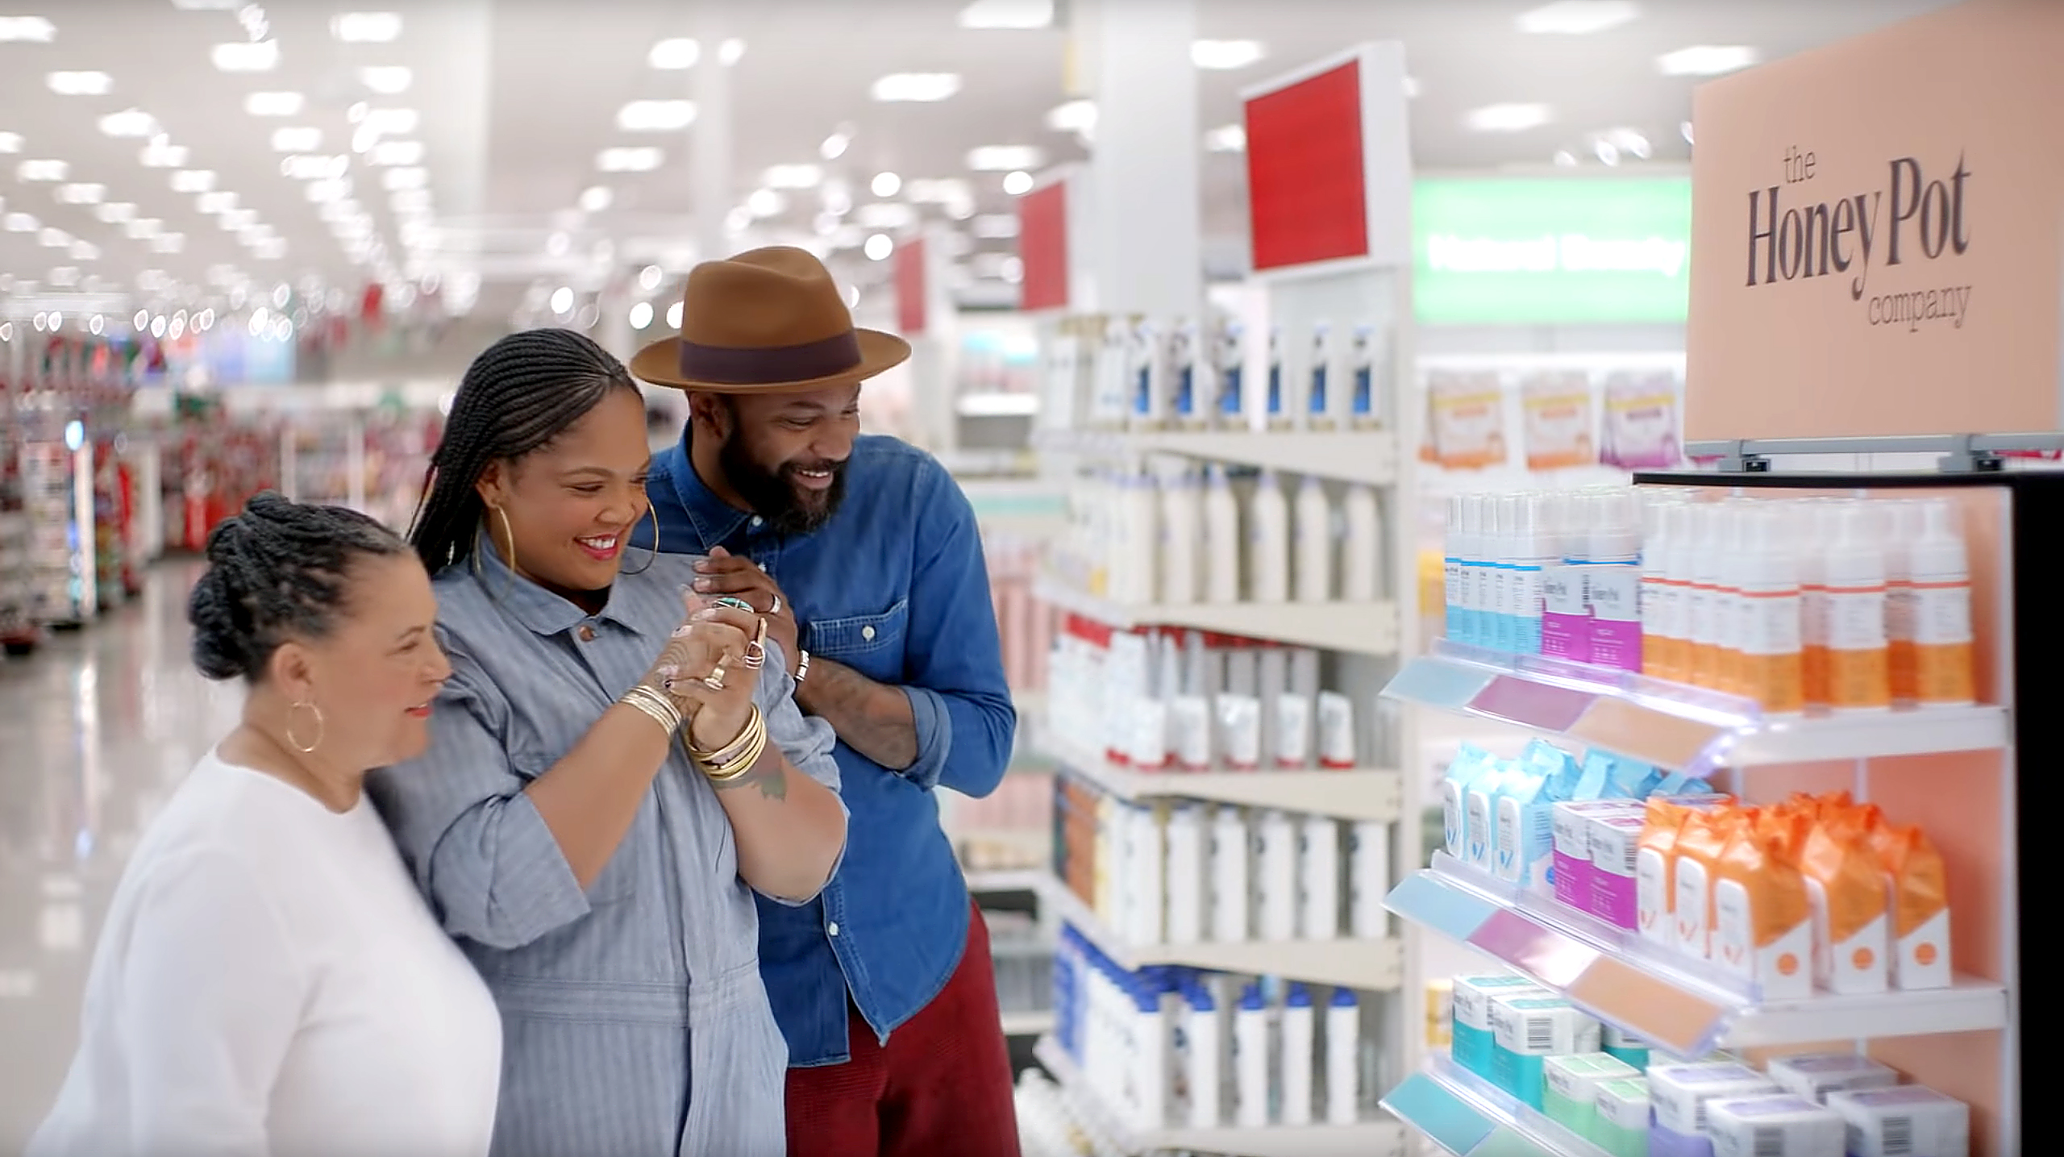
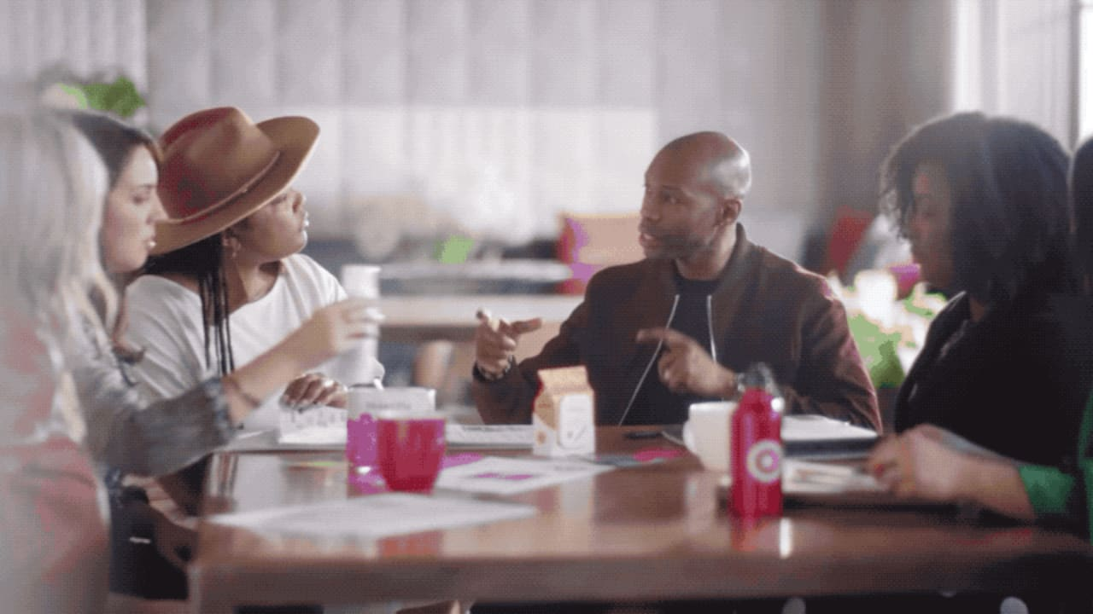

For Black History Month, Target’s ‘Entrepreneur’ campaign featuring positive messaging and support of Black, female-owned businesses ranked #8 in attentiveness out of 296 ads
For Black History Month in 2020, Target released an ad entitled ‘Entrepreneur: The Honey Pot’ as part of their ‘Founders We Believe In’ series. The spot featured Beatrice Dixon, owner of The Honey Pot, who talked about how difficult it was for her to start her own company, while expressing gratitude to Target for helping her overcome obstacles and paving the way for her to get shelf space in other retailers.
Results: One of the highest attention scores of all Target ads, Honey Pot sales increased 20-30% across its retailers a month after the campaign launched.
Business Outcomes
Ad Attention Score: 96.8
On average, the ad was viewed for 97% of its duration before interruption.
Brand Attention Index: 170
70% fewer interruptions than the average Target ad during the measured time period.
Brand Attention Ranking: #8
Ad ranked #8 in viewer attention among 296 Target ads that aired between 1/1/16 – 6/30/20.
‘Entrepreneur: The Honey Pot’ TV spot - $15.3 MM
6-Week Flight: 2/1/20 – 3/16/20
4,473 Airings / 1,244.8 MM HH IMPs
click banner above images to watch spot
Source: VAB analysis of iSpot.tv TV occurrence data and attention analytics, time period: 1/1/16 – 6/30/20, estimated media spend. Impressions represent US TV HHs and include activity within measured national broadcast and cable TV linear, national time-shifted, local, VOD and OTT. Attention scoring is based on national aired impressions viewed live/same day and played from the beginning. Interruptions = changing the channel, skipping the ad (via DVR), turning off the TV device or pulling up the programming guide. To learn more, download Do The Right Thing: How diversity & inclusion drives brand outcomes.
This information is exclusively provided to VAB members and qualified marketers. Further distribution is prohibited.
PAGE 10

Slide 11

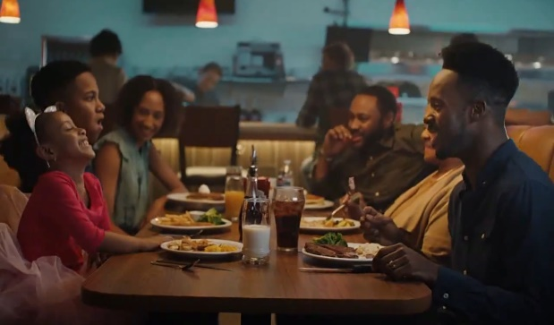
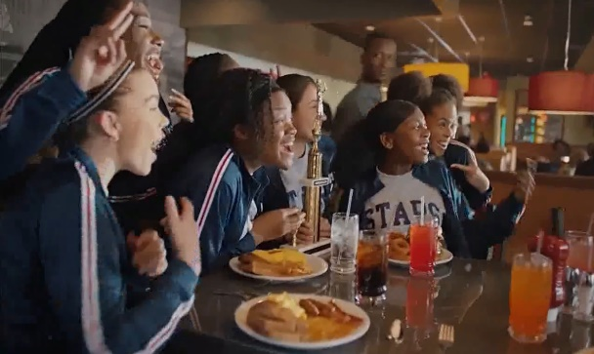
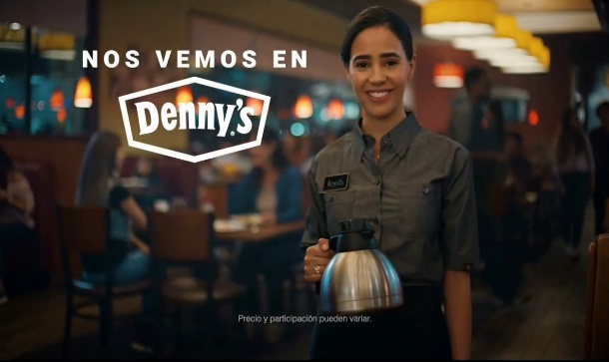
Denny’s ‘See You At Denny’s’ diversity and inclusion campaign drove a triple-digit increase in website traffic among Black / African-American audiences
In late April 2019, Denny’s launched their ‘See You At Denny’s’ campaign with a message of inclusiveness in both English and Spanish language spots. The ads, which were produced in collaboration with Fluent360, Conill and EP+Co agencies, were inspired by the diversity of Denny’s guests and captures the inclusive gatherings of modern, multicultural families and friends.
Results: There was an immediate surge in Denny’s website visitation upon launch, especially by Black / African-Americans, which continued through the duration of the campaign. Average monthly unique Black 18+ visitors post-campaign (Sep ’19 - May ’20) continues to be +50% higher than the three-month average pre-campaign (+65% higher for total P18+).
Business Outcomes
Persons 18+ Website Traffic: +86% increase
in Denny’s average monthly unique P18+ website visitors during August ‘19 (final month of campaign) vs. March ‘19 (pre-campaign), with unique visitors building through the flight.
Black 18+ Website Traffic: +135% increase
in Denny’s average monthly unique Black 18+ website visitors during the same time frame comparison as above, with unique visitors increasing steadily through the flight.
‘See You At Denny’s’ TV spot (three creatives) - $6.4 MM
4-Month Campaign: 4/29/19 – 8/25/19 (Spanish-Language ad was extended through 2/17/20)
3,381 Airings / 574.7 MM HH IMPs
click image above to watch English-language spot
click image above to watch English-language spot
click image above to watch Spanish-language spot
Source: VAB analysis of iSpot.tv TV occurrence data, time period: 1/1/19 – 6/30/20, estimated media spend. Impressions represent US TV HHs and include activity within measured national broadcast and cable TV linear, national time-shifted, local, VOD and OTT. VAB analysis of Comscore mediametrix multiplatform media trend data (desktop and mobile), P18+, Black 18+, March ‘19 – May ‘20. To learn more, download Do The Right Thing: How diversity & inclusion drives brand outcomes.
This information is exclusively provided to VAB members and qualified marketers. Further distribution is prohibited.
PAGE 11

Slide 12
Adults over 50 account for 36% of the total population and nearly half of all adults
Connecting with Black audiences in an authentic way, through both inclusive programming and culturally diverse advertising campaigns translates to stronger engagement and better business outcomes
With the growing emphasis publishers and distributors are putting on culturally relevant content, there are now more opportunities than ever to reach Black audiences across video platforms, especially streaming
Key Implications for Marketers
This information is exclusively provided to VAB members and qualified marketers. Further distribution is prohibited.
PAGE 12

Slide 13
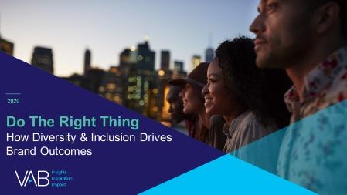
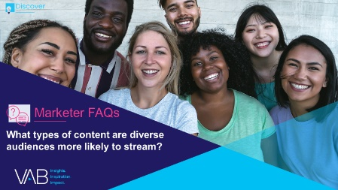

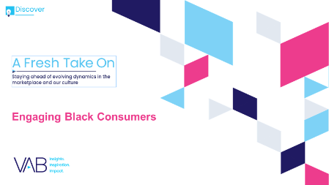
Adults over 50 account for 36% of the total population and nearly half of all adults
Creators
Reed Kiely
Karolina Guillen
Associate Insights Director
reedk@thevab.com
Insights Manager
karolinag@thevab.com
Discover more
Looking for more data, insights and takeaways? Check out this related VAB content
Do The Right Thing
How Diversity & Inclusion Drives Brand Outcomes
Marketer FAQs
What types of content are diverse audiences more likely to stream?
We are committed to providing marketers with the data and insights they need to develop thoughtful, inclusive campaigns & strategies. To find out more on the unique media consumption behaviors and cultural trends of multicultural consumers, visit our Multicultural Marketing Resource Center.
A Fresh Take
Diversity, Equity, Inclusion & Belonging in Streaming
A Fresh Take On
Engaging Black Consumers
VAB Members, brand marketers and agencies get free and immediate access to VAB’s content library. Get access at theVAB.com
This information is exclusively provided to VAB members and qualified marketers. Further distribution is prohibited.
PAGE 13

Slide 14


About VAB
VAB is an insights-driven organization that inspires marketers to reimagine their media strategies resulting in fully informed decisions.
Drawing on our marketing expertise, we simplify the complexities in our industry and discover new insights that transform the way marketers look at their media strategy.
We are committed to your business growth and proud to offer VAB members, brand marketers and agencies complimentary access to our continuously-growing Insights library. Get immediate access at theVAB.com.
Curious to learn more about VAB? Check out this quick video to see what we do and how we can help you develop business-driving marketing strategies.
This information is exclusively provided to VAB members and qualified marketers. Further distribution is prohibited.
PAGE 14

