Slide 1




Beyond the Headlines:
The State of TV Today and
the Opportunities of Tomorrow

Slide 2



Often it seems our industry headlines are dominated by
the growth in streaming, OTT and cord cutting.
As a result, the health and efficacy of TV as an advertising platform is sometimes called into question. With marketers placing billions in the TV ad market annually, it is essential that we pause and examine the facts as it relates to the impact of TV:
What is the current state of TV as a reach vehicle? An engagement driver? A catalyst for business outcomes?
At the same time, video viewing behaviors – and new viewing options – are constantly evolving. To help marketers tasked with putting together holistic video campaigns, it’s also critical that we look at the future:
How can marketers best prepare for the future of TV? Where will the future ad opportunities be?
This information is exclusively provided to VAB members and qualified marketers. Further distribution is prohibited.
PAGE 2

Slide 3
Although the pay-TV universe is declining,
the scale and engagement of TV exceeds other video platforms

Slide 4
Over the last five years,
as streaming viewership soared, almost 19 million homes shifted from pay-TV providers, according to Nielsen estimates
As more consumers transition to a hybrid live and on-demand world in the next four years,
the pay-TV household universe is expected to decline by over
10 million, according to eMarketer projections
Nielsen Media Universe Estimates: Wired Cable + DBS TV HHs
in Millions
Source: VAB analysis of Nielsen’s National Media Related Universe Estimates With Penetration of Total U.S. TV HHs data; February 2015 – February 2021. Pay-TV includes wired cable + DBS. The horizontal axis reflects month/year (i.e., 2/16 = February 2016). VAB analysis of eMarketer Pay-TV only HHs projections based on September 2020 estimates.
This information is exclusively provided to VAB members and qualified marketers. Further distribution is prohibited.
PAGE 4

Slide 5
Yet, currently, even amidst declines, regardless of age, more time is spent with linear TV than any other video platform
% Share Of Weekly “Time Spent” By Video Device – Q2 ‘20
(Hrs:Mins Among U.S. Population)
Source: VAB analysis of 2Q ‘20 data from the Nielsen Total Audience Report, as reported in their November 2020 issuance; based on hours:minutes among population; time spent based on video-focused app/web use for Smartphone, Computer and Tablet. Mobile and computer-related data is not available for P2-11 or P12-17. Only includes video capable platforms. Internet-Connected Device = devices connected to the TV that are used to stream content such as Apple TV, Roku, Google Chromecast, Amazon Fire TV, Smartphone, Computer/Laptops, etc. (inclusive of smart TV app usage). Charts exclude time spent with DVD/Blue-ray devices.
This information is exclusively provided to VAB members and qualified marketers. Further distribution is prohibited.
PAGE 5
This information is exclusively provided to VAB members and qualified marketers. Further distribution is prohibited.

Slide 6
TV as an ad platform has shown great resilience during the economic challenges and uncertainty posed by the pandemic

Slide 7
How has Coronavirus impacted your advertising efforts?
At the beginning of the pandemic, 44% of advertisers said that they canceled an upcoming campaign before launch
Furthermore, more than
half of all brands said they planned to reduce their media spend by over 20% for the rest of the year
Source: Ebiquity, ‘COVID-19 & Media: Ebiquity Client Survey Results.’ March 2020.
Source: Advertiser Perceptions, “Coronavirus Effect on Advertising’ Report. Q12: In which of the following ways has the Coronavirus (COVID-19) outbreak impact your recent or ongoing advertising efforts? Base: Total Respondents. Wave 1 = survey fielded March 17-20, 2020, 203 interviews conducted. Wave 2 = survey fielded April 1-4, 2020, 152 interviews conducted.
This information is exclusively provided to VAB members and qualified marketers. Further distribution is prohibited.
PAGE 7

Slide 8
GroupM Projections: U.S. Nat’l TV Ad Revenue
Includes digital extensions in TV, excludes political (in billions)
In reality, marketers turned to linear TV to weather the crippling pandemic and deep recession
After only a slight -8% dip
in 2020, national TV is expected to rebound to pre-COVID levels this year
Source: GroupM, ‘This Year, Next Year: U.S. End-Of-Year Forecast,’ December 2020.
This information is exclusively provided to VAB members and qualified marketers. Further distribution is prohibited.
PAGE 8

Slide 9
1H 2020 New National TV Advertisers’ Monthly Spend
in Millions
60 brands launched their first national TV campaign during the heart of the pandemic in 2Q ’20
With a collective investment of over $316 million, these advertisers represented nearly 70% of national TV spending by new advertisers in 1st half 2020
Source: VAB’s 'Welcome To TV: Introducing The 'New Kids On The Block’”, October 2020. VAB analysis of Nielsen Ad Intel data, Q1’20-Q2’20. TV spend includes national cable TV, broadcast TV, Spanish language cable TV, Spanish language broadcast TV. Brands reflect those with national TV spend over $100K.
This information is exclusively provided to VAB members and qualified marketers. Further distribution is prohibited.
PAGE 9

Slide 10
TV is proven to be a marketer’s best bet for
selling today

Slide 11
All Video Advertising Tactics Used
Summary of Top Rank
Today, more than half of advertisers identify linear TV as their single most valuable video tactic
Any Linear TV:
51%
Source: Advertiser Perceptions, Video Advertising Convergence Report, Wave 9, 2H 2020, released February 2021.
This information is exclusively provided to VAB members and qualified marketers. Further distribution is prohibited.
PAGE 11

Slide 12
Television results in an immediate lift in website traffic for all brands, regardless of life stage
Young, DTC brands saw the greatest lift following their campaign launch as their awareness skyrocketed
Direct-to-Consumer Brands:
TV Launch Month* vs. Three-Month Average Prior To TV
Average Website Unique Visitors
Three Years Old or Younger
Between Four – Seven Years Old
Eight Years or Older
+23%
+19%
+10%
Unique Visitors % increase:
Keep in mind, by the nature of their business model, DTC brands have had a digital media presence since near inception, so these increases are in the context of existing digital advertising pre-TV launch
How to Read: DTC brands that are three years old or younger saw a +23% lift in their website traffic during their TV launch month vs. their three-month average website traffic prior to TV
Source: VAB’s ‘The Halo Effect: TV as a Growth Engine’, November 2020. VAB analysis of Nielsen Ad Intel data, all measured TV spend, and Comscore mediametrix multiplatform (desktop + mobile) media trend data; P18+. Measurement Time Period: June 2016 – June 2020. *Reflects the TV launch month of each brand’s first TV campaign. Analysis includes 140 DTC brands.
This information is exclusively provided to VAB members and qualified marketers. Further distribution is prohibited.
PAGE 12

Slide 13
Brands in Traditional Categories (non-DTC)*:
‘When On TV’ Monthly Average vs. Three-Month Average Prior To TV
Average Website Unique Visitors
The earlier that ‘traditional’ brands begin advertising on TV, the greater the digital results, as TV drives awareness, recall and action which leads new customers to enter a brand’s digital storefront
Under Twenty Years Old
Over Twenty Years Old
+50%
+21%
Unique Visitors % increase:
Avg Monthly
Unique Visitors increase:
+2,302K
+315K
How to Read: ‘Traditional’ brands that are three years old or younger saw a +50% lift in their average monthly website traffic when they were airing on TV vs. their three-month average website traffic prior to TV
Source: VAB’s ‘The Halo Effect: TV as a Growth Engine’, November 2020. VAB analysis of Nielsen Ad Intel data, all measured TV spend, and Comscore mediametrix multiplatform (desktop + mobile) media trend data; P18+. Measurement Time Period: June 2016 – June 2020. *Reflects new TV advertisers in traditional categories such as health/wellness, telco, home, pet care, beverages, CPG, B2B, etc. TV launch month is based on each brand’s first TV campaign. Analysis includes 50 brands.
This information is exclusively provided to VAB members and qualified marketers. Further distribution is prohibited.
PAGE 13

Slide 14
Marketers are increasingly investing in streaming platforms

Slide 15

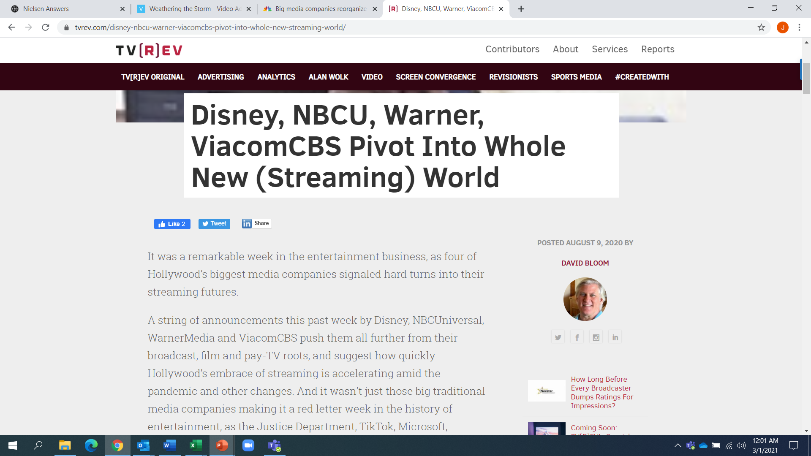
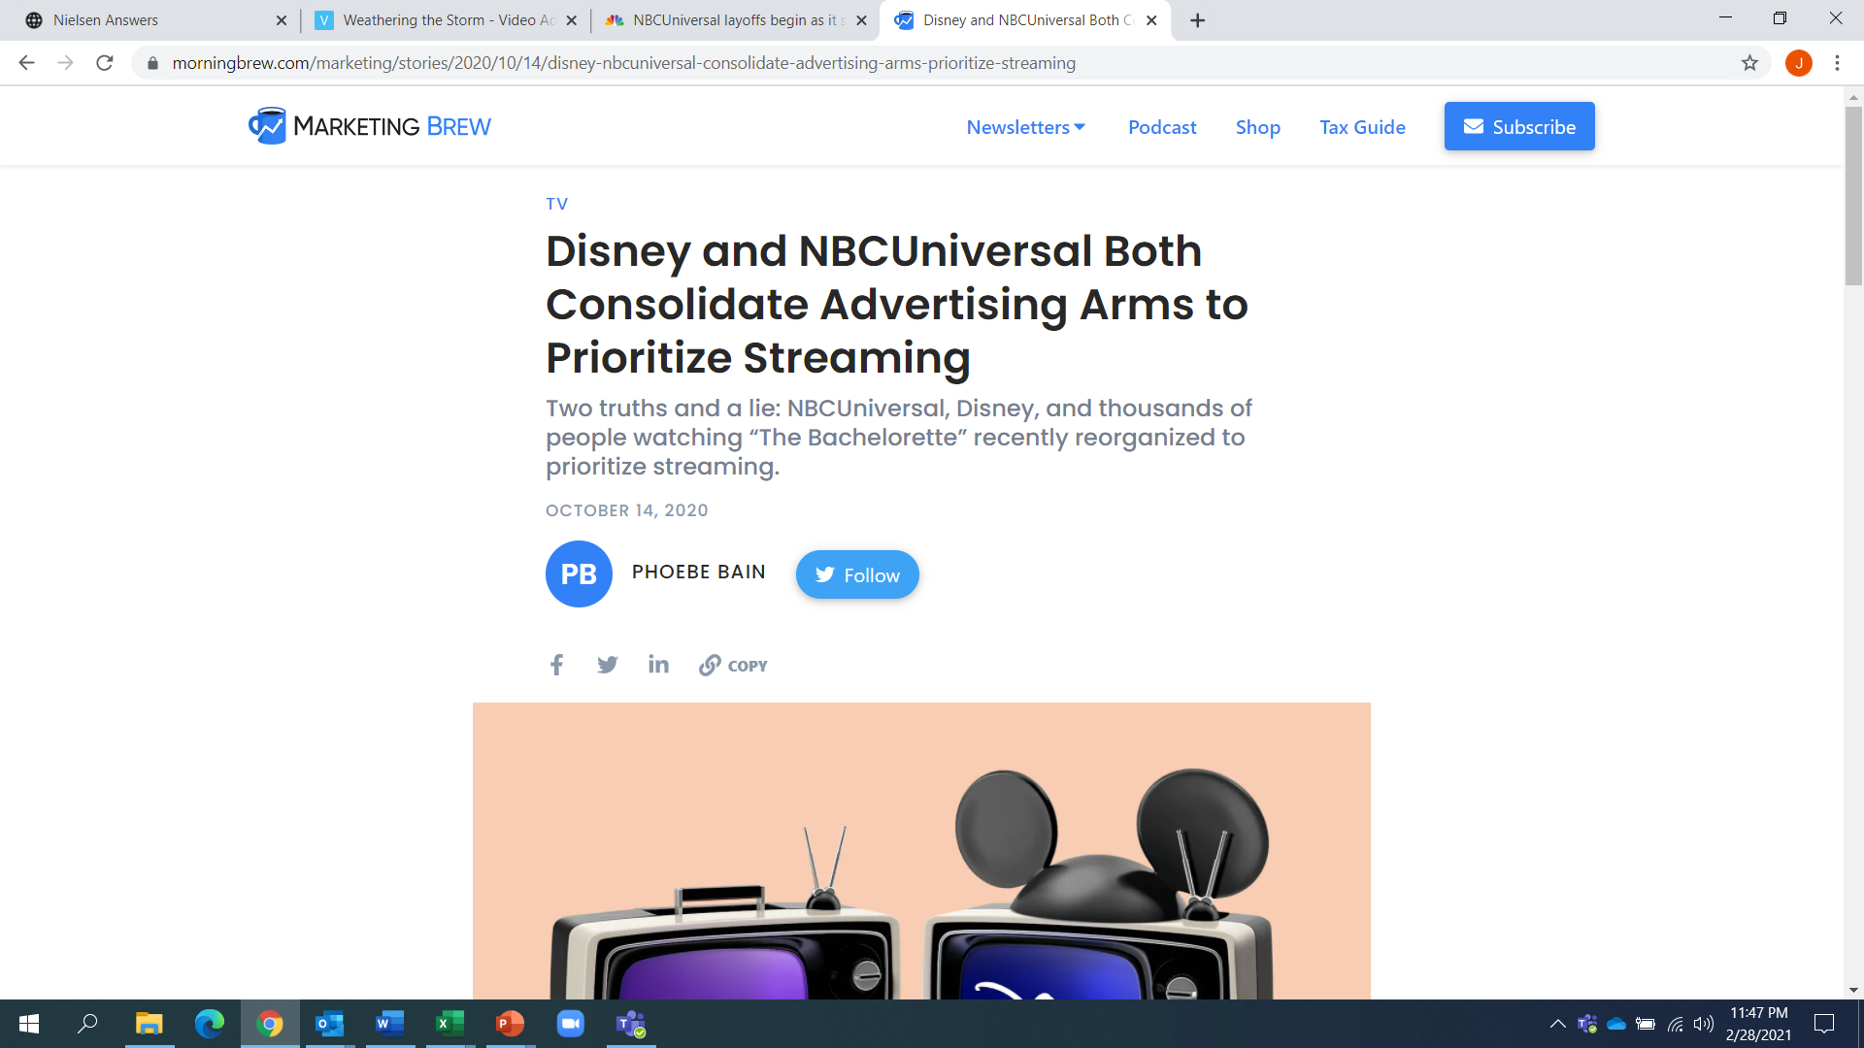
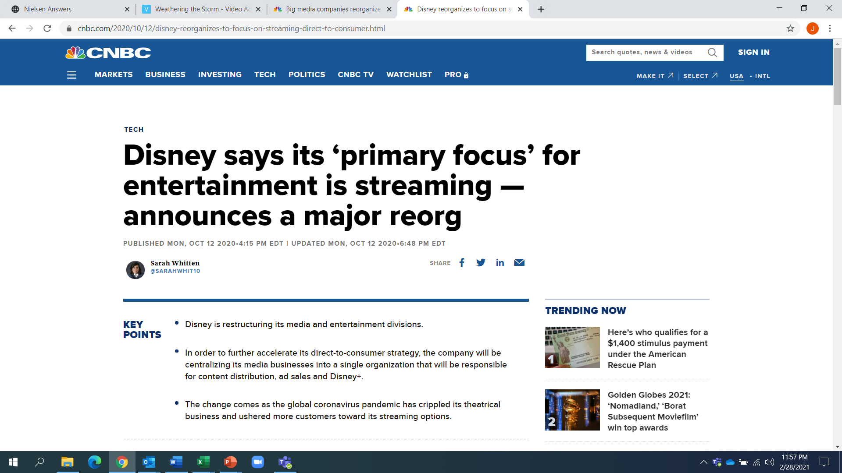
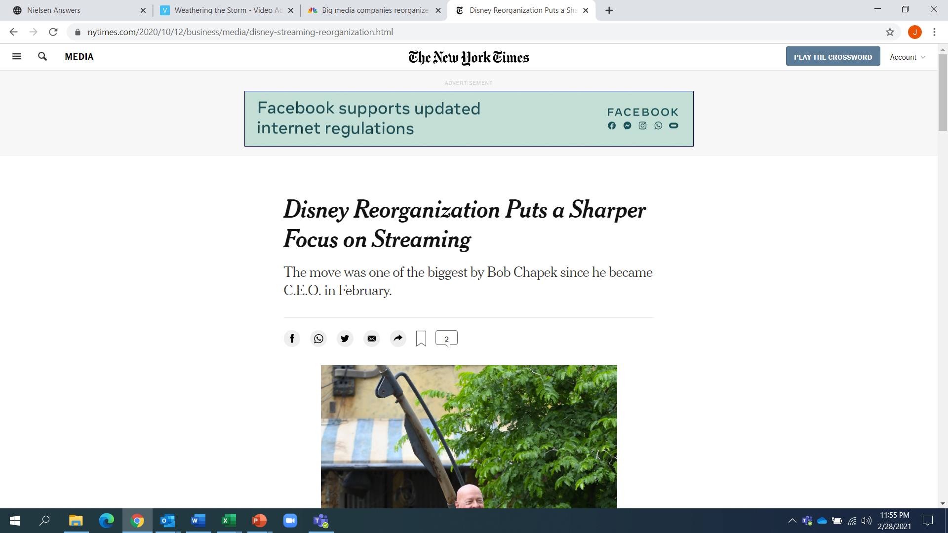
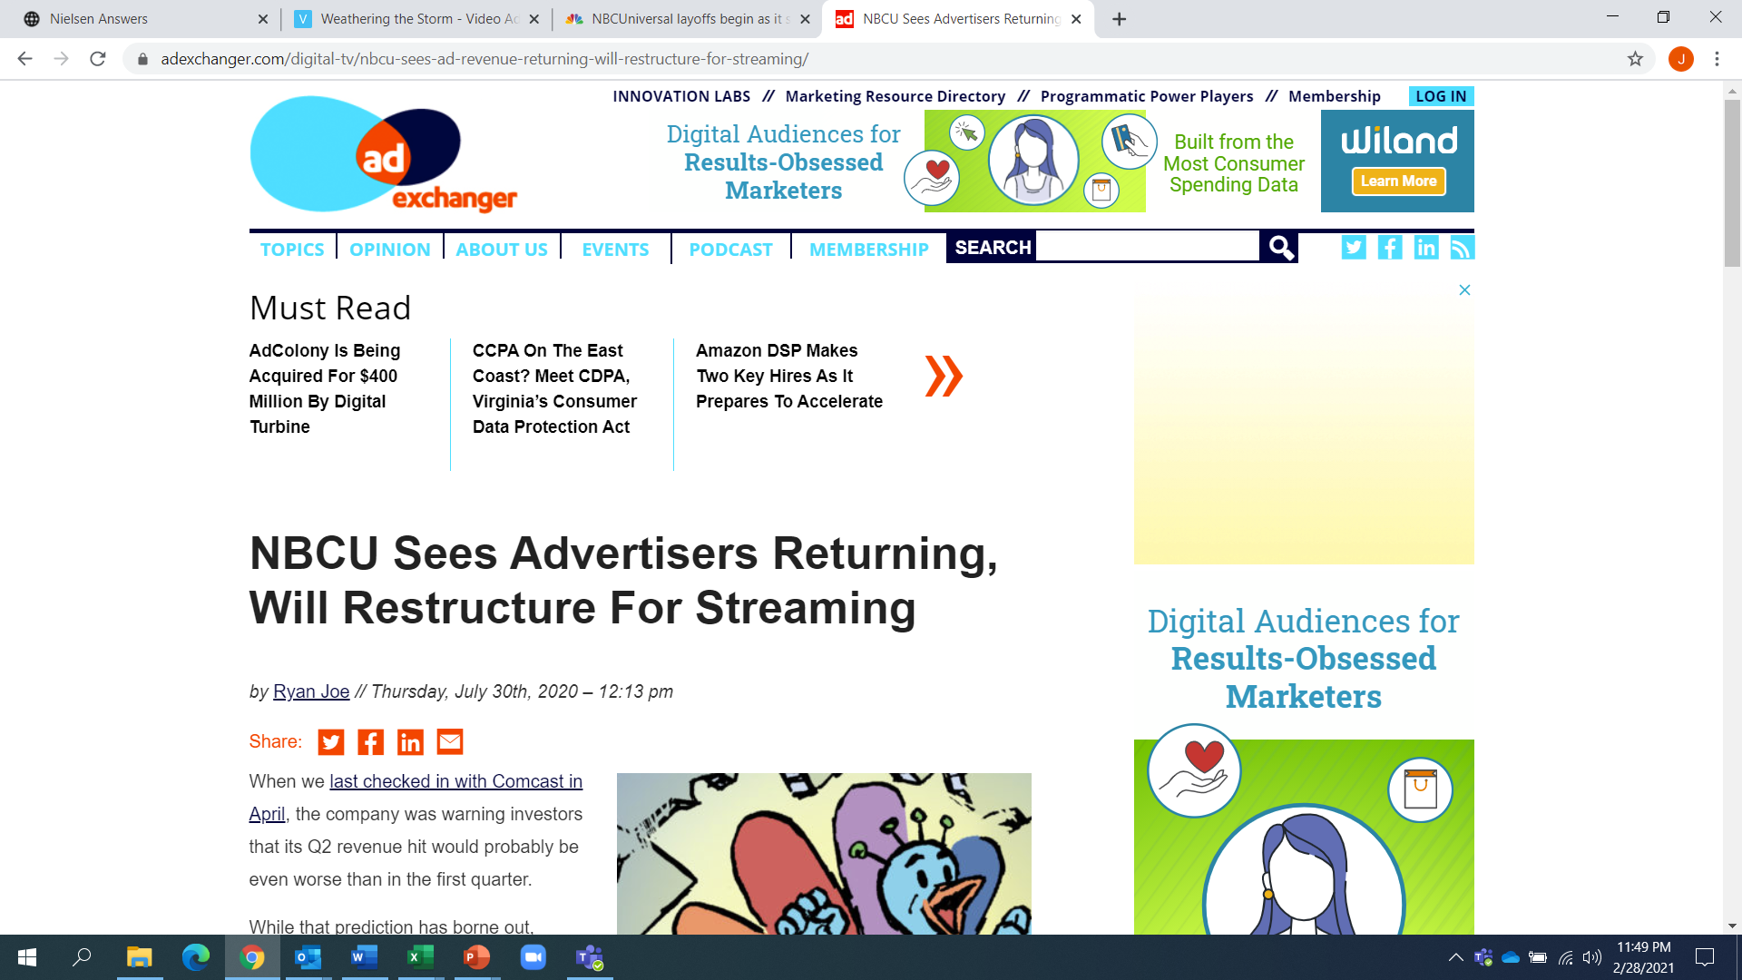
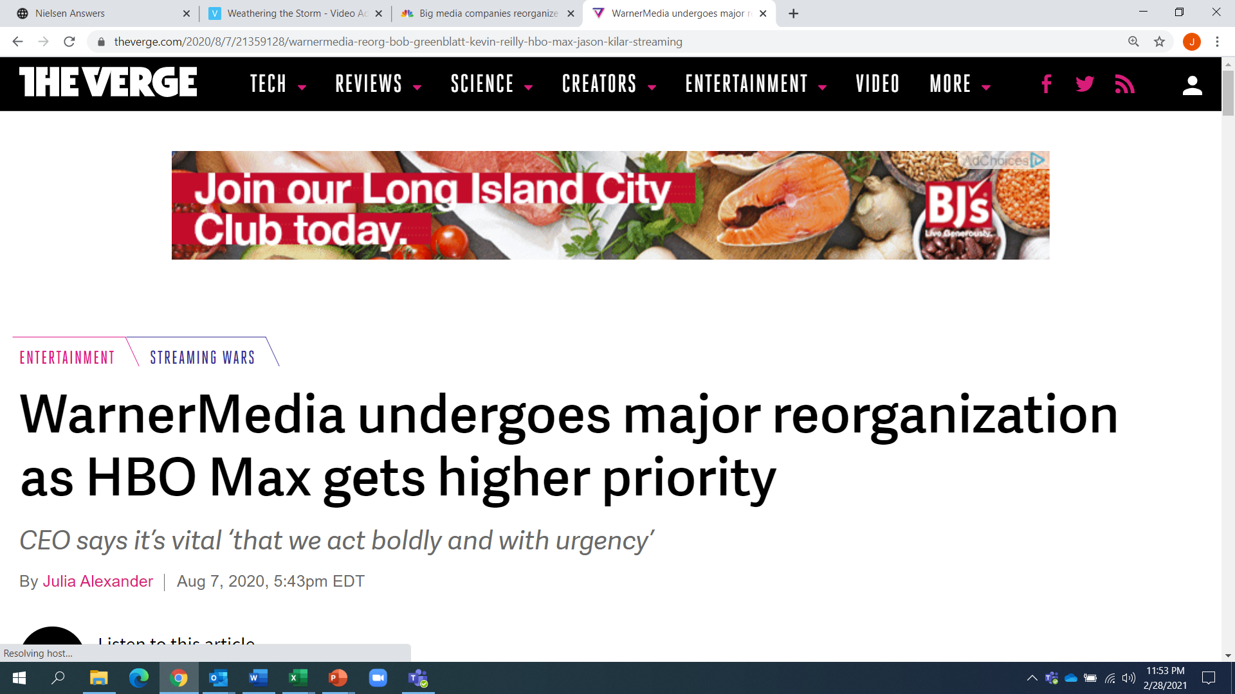
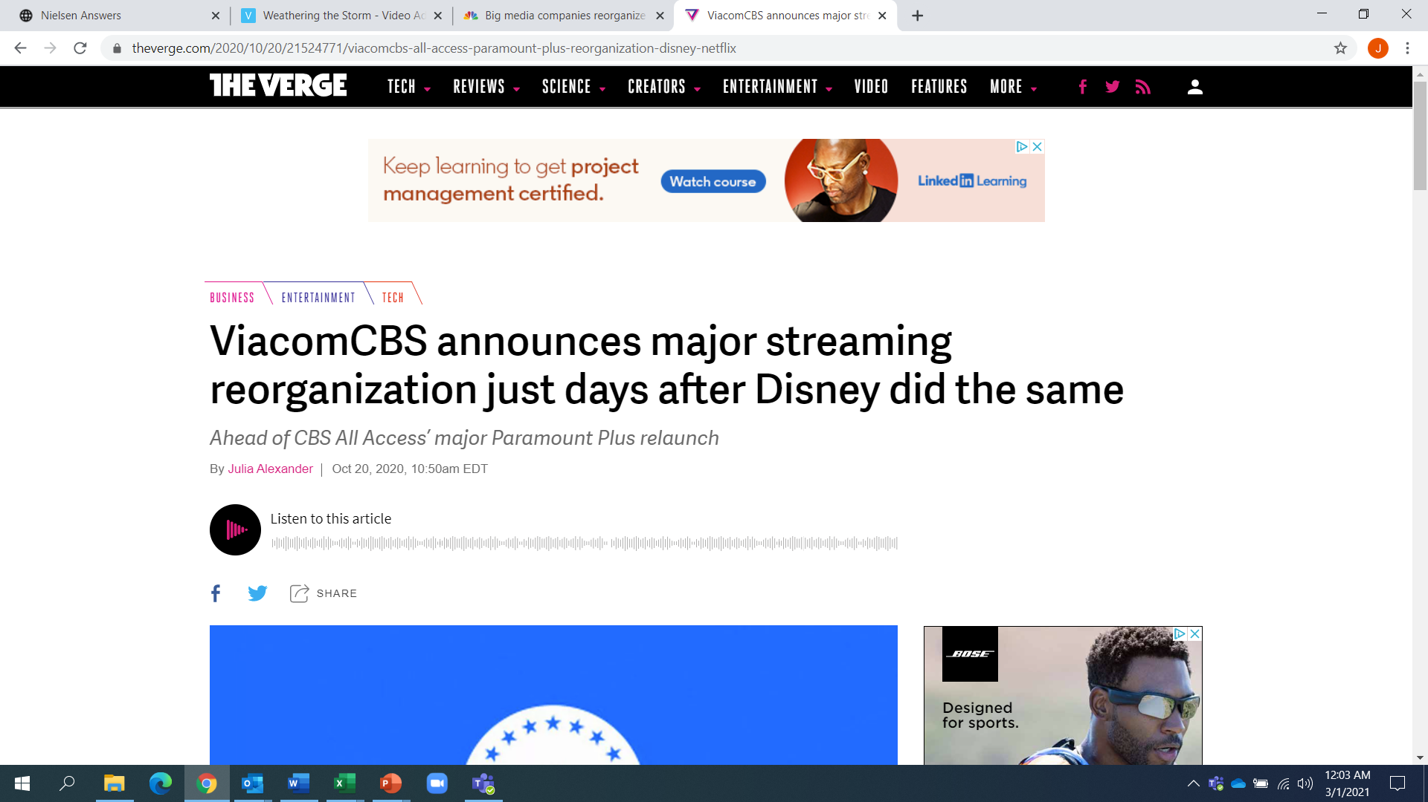
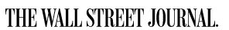
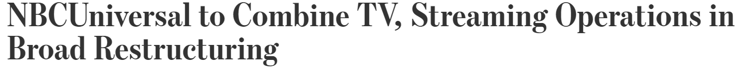
To offer viewers the best experience, and advertisers a data-driven ad product, many programmers have proactively evolved their offerings and organizations to primarily focus on streaming
This information is exclusively provided to VAB members and qualified marketers. Further distribution is prohibited.
PAGE 15

Slide 16










By 1Q 2021, many major TV network groups had launched their streaming services and several offer,
or will soon offer, multiple tiering options which include a subscription / commercial hybrid plan at a lower price point
Service | Streaming Model | Ad-Free Monthly Pricing | Ad-Supported Monthly Pricing
 | Hybrid AVOD/SVOD* | $14.99 | N/A*
 | Hybrid AVOD/SVOD | $11.99 | $5.99
 | Hybrid AVOD/SVOD | $9.99 | $4.99**
 | Hybrid AVOD/SVOD | $9.99 | Free*** or $4.99
 | Hybrid AVOD/SVOD | $6.99 | $4.99
 | SVOD | $8.99-17.99 | N/A
 | SVOD | $8.99 | N/A
 | SVOD | $7.99 | N/A
 | SVOD | $8.99-17.99 | N/A
Notes: *Ad-supported tier of HBOMax is coming Q2 2021; **‘Base Tier’ Ad-Supported Paramount+ launches in June 2021; ***Peacock offers a free tier that is ad-supported with limited content library. Chart reflects costs as of 3/1/21. AVOD = Ad-Supported Video-on-Demand; SVOD = Subscription Video-on-Demand
This information is exclusively provided to VAB members and qualified marketers. Further distribution is prohibited.
PAGE 16

Slide 17
GroupM Projections: U.S. Nat’l TV Ad Revenue
Includes digital extensions in TV, excludes political (in billions)
In the next 4 years, national TV advertising revenue is projected to remain stable as ad dollars follow the viewer and shift seamlessly from linear to alternative platforms
By 2024, Connected TV ad spend is forecasted to grow by over $10B
Source: eMarketer, October 2020
Source: GroupM, ‘This Year, Next Year: U.S. End-Of-Year Forecast,’ December 2020.
This information is exclusively provided to VAB members and qualified marketers. Further distribution is prohibited.
PAGE 17

Slide 18



What’s important for marketers to know?
TV drives business outcomes now.
The TV industry is embracing the future.
Test and learn now for future success.
Although the pay-TV universe is declining, TV’s scale, engagement and ability to impact your bottom-line exceeds that of other video platforms.
TV programmers
and distributors recognize the consumer’s desire
for on-demand video viewing options. They are embracing it by creating original premium streaming platforms and services.
Video viewing will continue to expand across platforms and devices. Marketers can set themselves up for future success by testing and learning now with opportunities like AVOD and audience-based buying.
This information is exclusively provided to VAB members and qualified marketers. Further distribution is prohibited.
PAGE 18

Slide 19






Weathering The Storm
TV’s Resilience Amid A Pandemic & Economic Uncertainty
The Halo Effect
TV as a Growth Engine
A Sea Change in Video Viewing
Helping Marketers Find More Fish in the Streaming Ecosystem
Discover more
Looking for more data, insights and takeaways? Check out this related VAB content
Audience Migration In Context
Leveraging Population Shifts To Unlock $4 Trillion In Buying Power
Left To Your Own Devices
The Latest On Multiplatform Video Consumption Habits
Five Fast Facts on Paramount+
VAB Members, brand marketers and agencies get free and immediate access to VAB’s content library. Get access at theVAB.com
This information is exclusively provided to VAB members and qualified marketers. Further distribution is prohibited.
PAGE 19

Slide 20

About VAB
VAB is an insights-driven organization that inspires marketers to reimagine their media strategies resulting in fully informed decisions.
Drawing on our marketing expertise, we simplify the complexities in our industry and discover new insights that transform the way marketers look at their media strategy.
Discover
We keep you one step ahead with the latest thinking so you can create innovative, forward-looking strategies.
Simplify
We save you time by bringing you the latest data & actionable takeaways you can use to inform your marketing plans.
Transform
We help you build your brand by focusing on core marketing principles that will help drive tangible business outcomes.
We are committed to your business growth and proud to offer VAB members, brand marketers and agencies complimentary access to our continuously-growing Insights library. Get immediate access at theVAB.com.
This information is exclusively provided to VAB members and qualified marketers. Further distribution is prohibited.
PAGE 20

