Slide 1
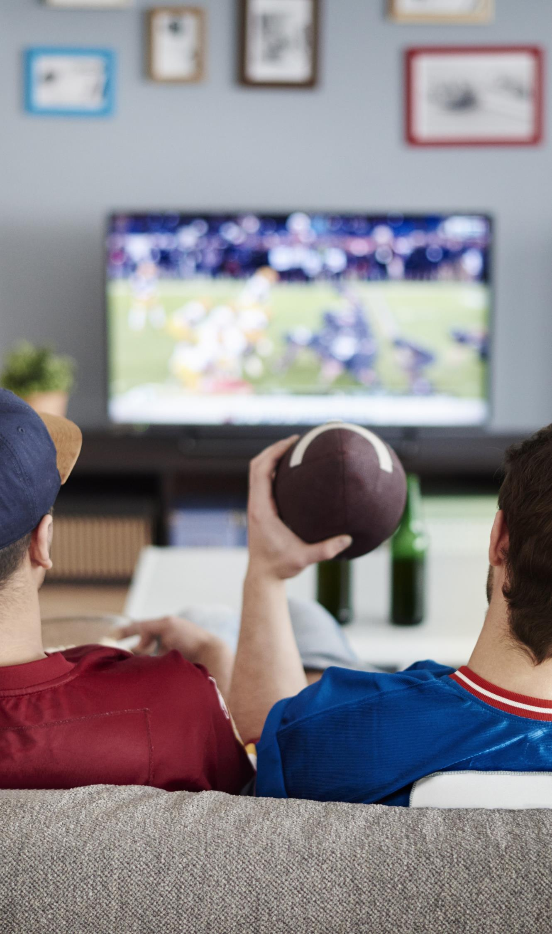

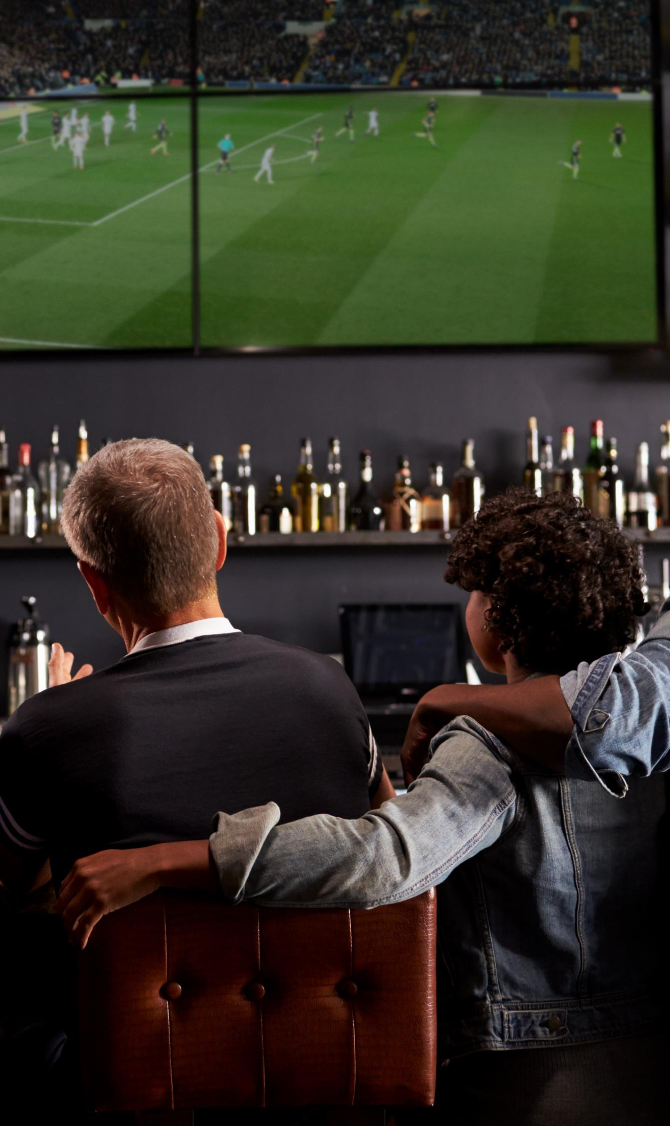
VAB – MARKETER’S GUIDE - 2020
.................
The Best Seats In The House
A Custom Study Exploring Sports Fans’ Viewing Preferences
VAB Members

Slide 2
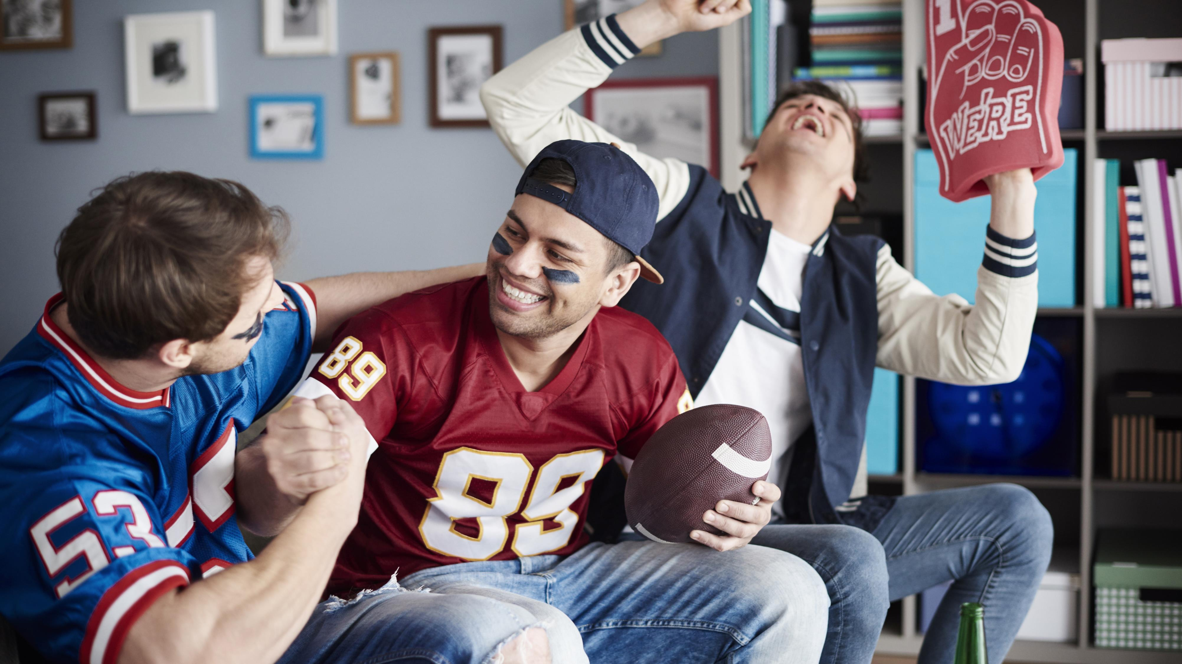
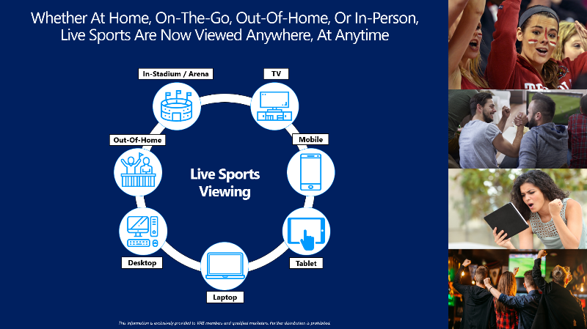
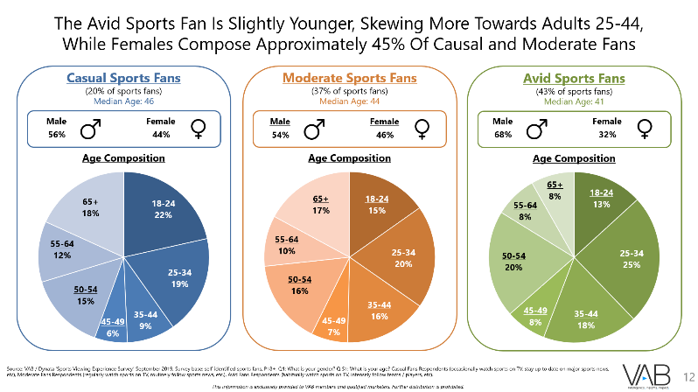
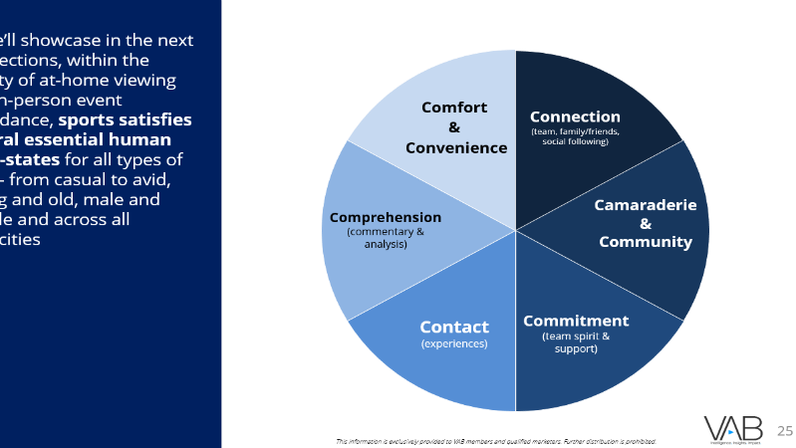
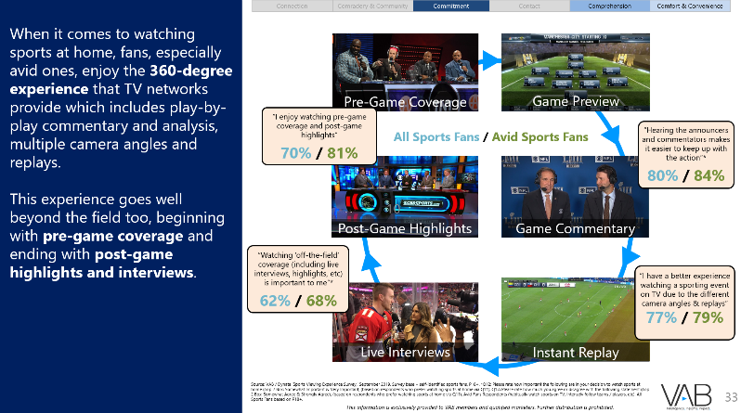
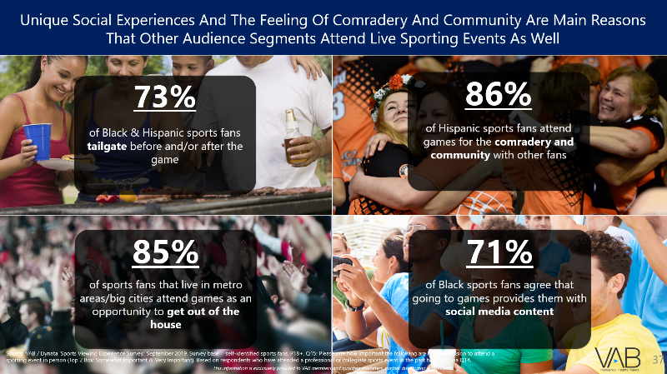
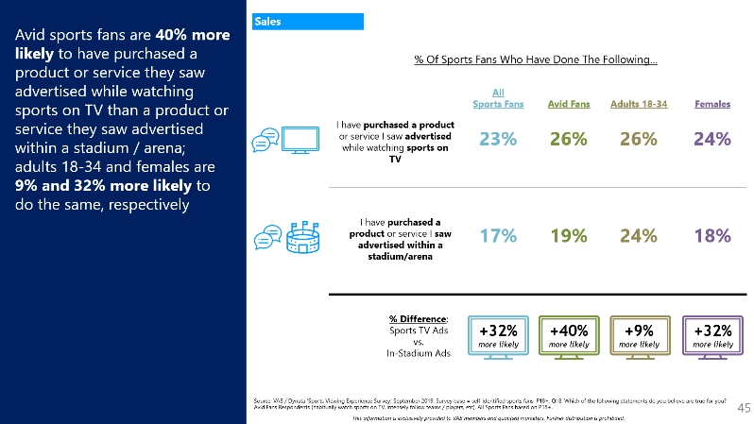
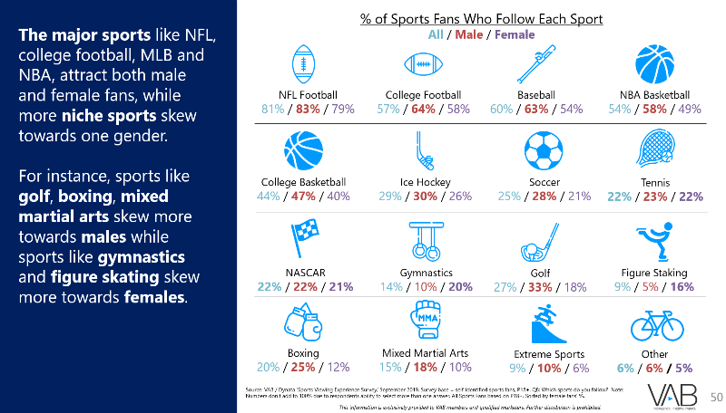
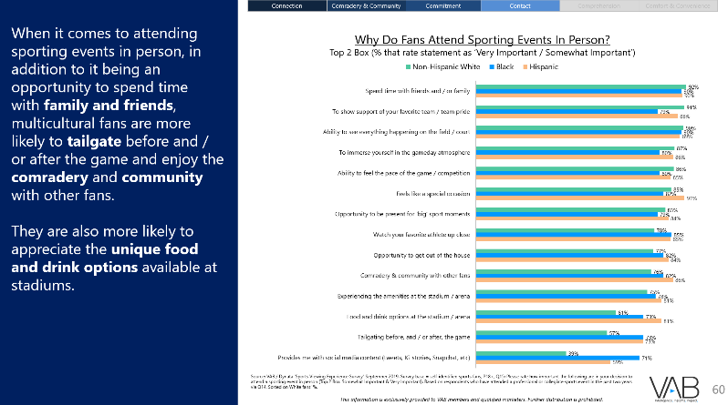
The Scouting Report
1
2
1
Live Sports: Available Anywhere, At Anytime
2
Understanding Today’s Sports Fans
A Snapshot Of Their Unbridled Passion Across Audience Segments
3
4
3
Where Do Fans Prefer To Watch Live Sports?
Quantifying Their Viewing Preferences By Location
4
The Real ‘Home Field Advantage’
A Comfortable & Convenient Front Row Seat To All Live Sports
5
Take Me Out To The Ballgame!
Experiences That Foster Connection, Commitment & Community Among Sports Fans
6
5
6
Matchup: At-Home Viewing Vs. In-Person Attendance
How Sports Advertising Drives Consumer Action Across The Purchase Funnel
Appendix
Additional Sports Fan Insights: Gender & Age
7
7
8
8
Members Exclusive Slides

Slide 3


Identifying The Best Seats In The House
In A World Of “Anywhere, Anytime” Viewing
In today’s complex video landscape, live sports are now viewed anywhere, at anytime; whether at home, on-the-go, out-of-home or in-person at a stadium or arena. Attending sporting events continues to be one of the most popular leisure activities throughout America even as the availability of live sports content explodes across a growing number of TV channels and streamed through a variety of websites and mobile apps.
To help marketers navigate this evolving landscape, VAB conducted a custom study in partnership with Dynata to understand the passion of today’s sports fans and the ‘why’s’ and motivating factors behind their viewing preferences, particularly between at-home viewing and in-person event attendance.
As we learned through the study, due to the unbridled passion involved, sports has the ability to satisfy several essential human needs for all types of fans – casual and avid, young and old, male and female, black and Hispanic – including camaraderie & community, connection, commitment, contact, comfort & convenience and comprehension.
Over 70% of all sports fans prefer watching sports at home since it’s the location that can most often deliver on all six of these need-states. From an advertiser perspective, the comfort, convenience and ease of connection and connectivity during at-home viewing means that sports fans are more likely to engage with sports TV advertising and take consumer action than if they saw in-stadium ads.
  3
This information is exclusively provided to VAB members and qualified marketers. Further distribution is prohibited.

Slide 4




Live Sports: Available Anywhere, At Anytime

Slide 5
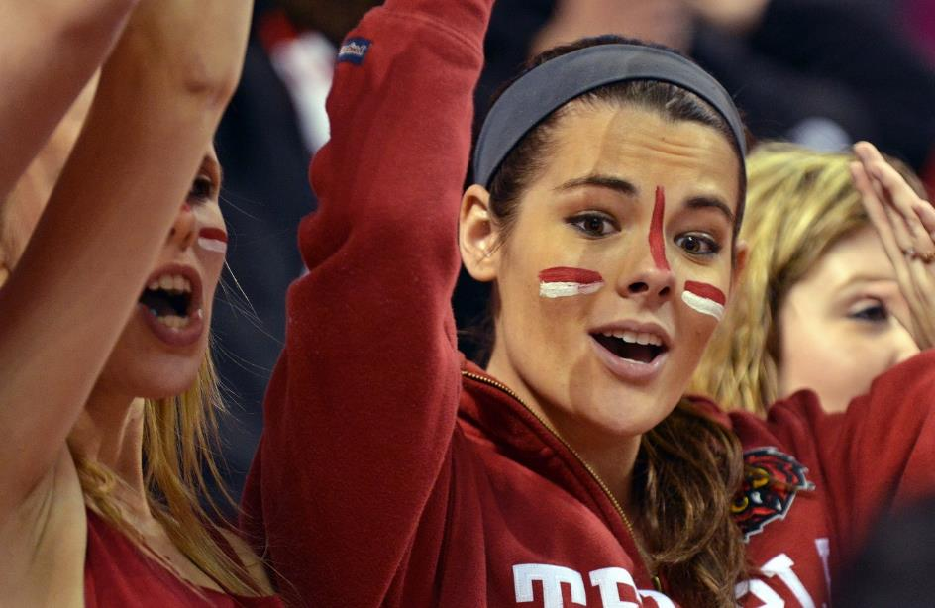









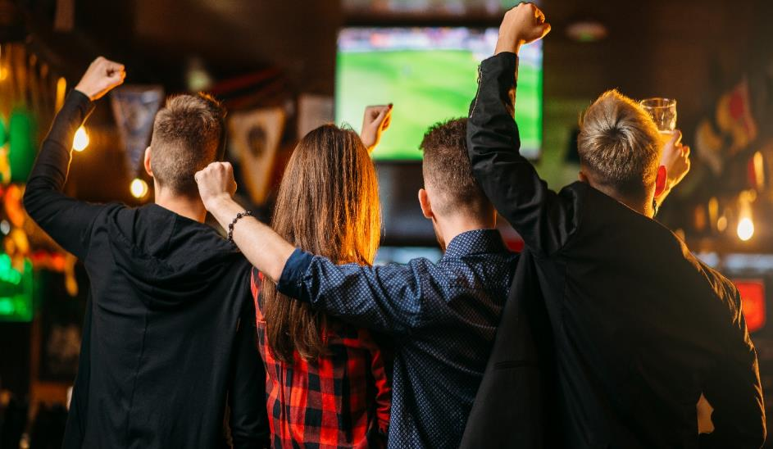

Whether At Home, On-The-Go, Out-Of-Home, Or In-Person,
Live Sports Are Now Viewed Anywhere, At Anytime
In-Stadium / Arena
TV
Out-Of-Home
Mobile
Live Sports
Viewing
Desktop
Tablet
Laptop
5
This information is exclusively provided to VAB members and qualified marketers. Further distribution is prohibited.

Slide 6

With over 130 million tickets sold across the four major sports in 2018, attending live sporting events in person continues to be one of the most popular leisure activities throughout America.
However, the high cost to attend a game for a family
of four continues to increase and the reflected costs don’t account for concessions, souvenirs, parking and
other ancillary purchases.
Average Ticket Price for a Family of Four To Attend ONE Major Sporting Event
MLB
NBA
NHL
NFL
Source: VAB Analysis of MPAA, 2016 Theatrical Market Statistics, 2017 and 2018 Theme Report
  6
This information is exclusively provided to VAB members and qualified marketers. Further distribution is prohibited.

Slide 7





























































































Meanwhile, There’s Been An Explosion Of Live Sports Content Available Across
A Growing Number Of TV Channels And Streamed Through Websites And Mobile Apps
Ad-Supported TV Networks With Sports
Premium Sports TV Packages with Ads
Non-Ad Supported Sports TV Packages
OTT Subscription Services With Sports
Ad-Supported TV Apps With Sports
Live Social Stream With Sports
*Chart represents a robust sampling of available services as of 12/1/19.
  7
This information is exclusively provided to VAB members and qualified marketers. Further distribution is prohibited.

Slide 8

And The In-Home Viewing Experience Is Only Getting Better With Increased Penetration Of ‘Next Generation’ TVs (Bigger, Clearer, Crisper And More Connected)
2014
2019
HDTV
88%
91%
Smart TV
42%
64%
42”+ Screen*
33%
55%
4K (UHD) TV
1%
49%
Source: VAB analysis of S&P Global Intelligence, Kagan, 2019, U.S. analog, digital, HD, 3D, 4K Ultra HD and smart TV set and Blu-ray player projections and Smart TV set estimated penetration of total US TVHHs % are based of TV Households; *GFK MRI, 2019 Spring & 2014 Doublebase (% based on TV owners).
  8
This information is exclusively provided to VAB members and qualified marketers. Further distribution is prohibited.

Slide 9


With An Array of Options Within The Sports Landscape, We Conducted A Custom Study To Understand Fans’ Preferences For Live Sports Viewing
As the sports viewing landscape evolves with enhancements to current platforms and growth of additional touchpoints to access content, we wanted to dig deeper to help marketers understand the passion of today’s sports fan and the ‘why’s’ and motivating factors behind their viewing preferences, particularly at-home viewing vs. in-person event attendance.
To do this, VAB commissioned Dynata to conduct the ‘Sports Viewing Experience’ Survey fielded online in September 2019. The results are based on 1,023 adult 18+ U.S. respondents who identified themselves as a sports fan (either casual, moderate or avid).
In addition to examining the different levels of fandom, we also analyzed several other demographic cuts for the sports fan including adults 18-34, adults 35+, males and females, and blacks and Hispanics.
  9
This information is exclusively provided to VAB members and qualified marketers. Further distribution is prohibited.

Slide 10

Understanding Today’s Sports Fans
A Snapshot Of Their Unbridled Passion Across Audience Segments

Slide 11
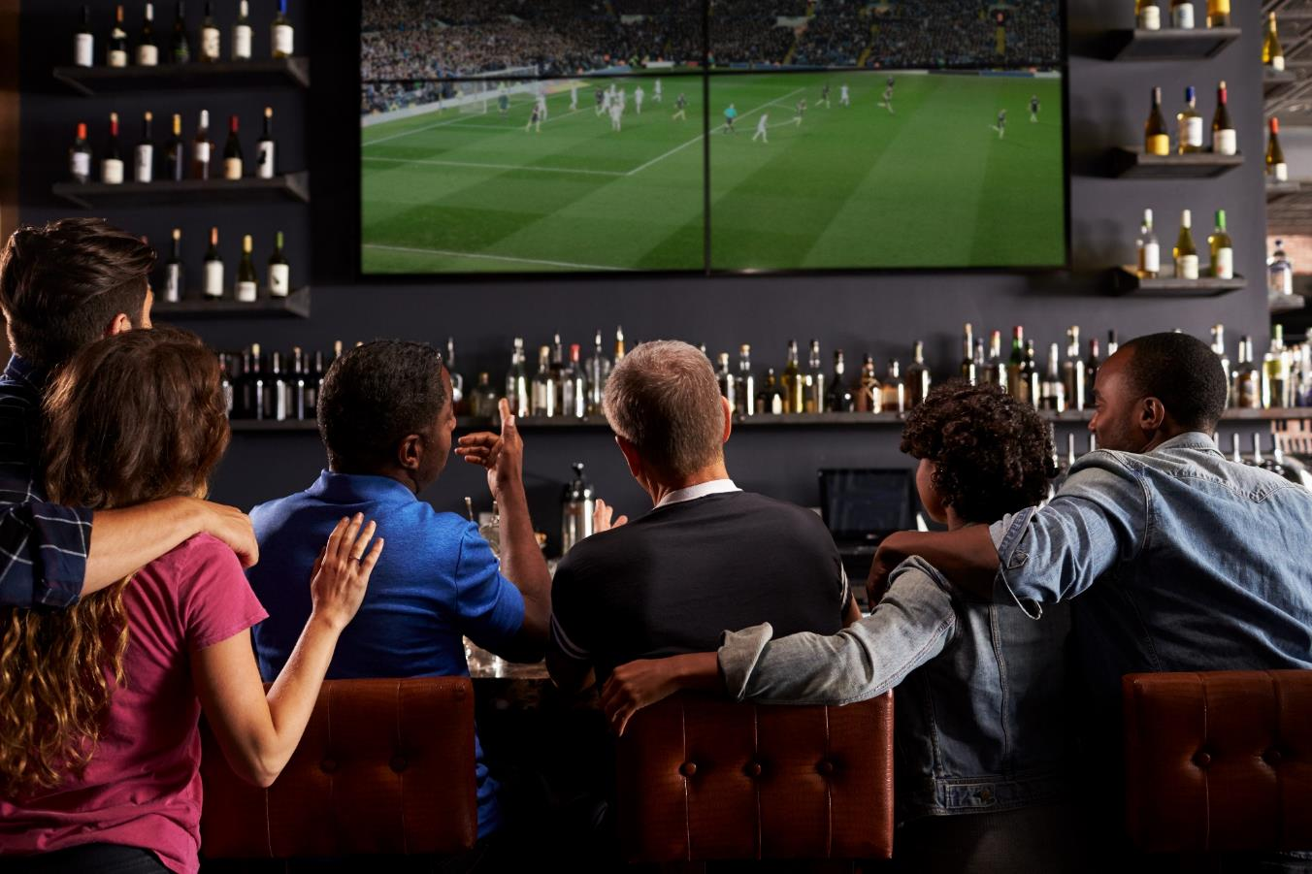
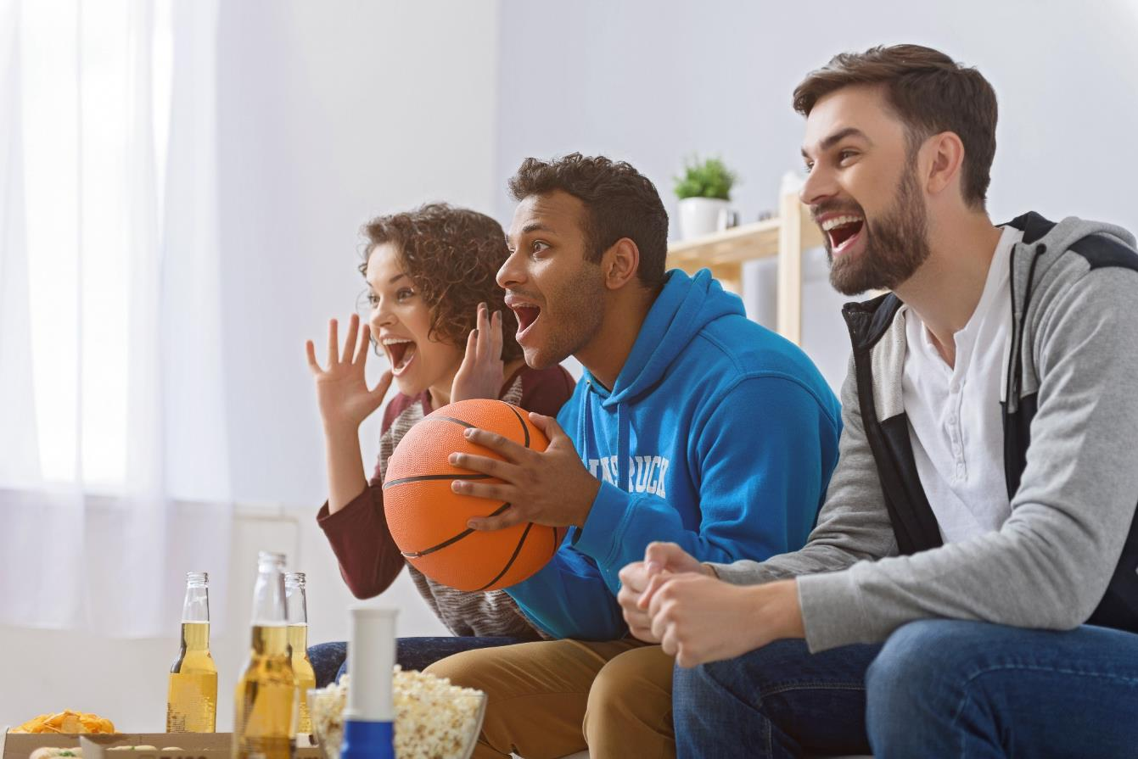
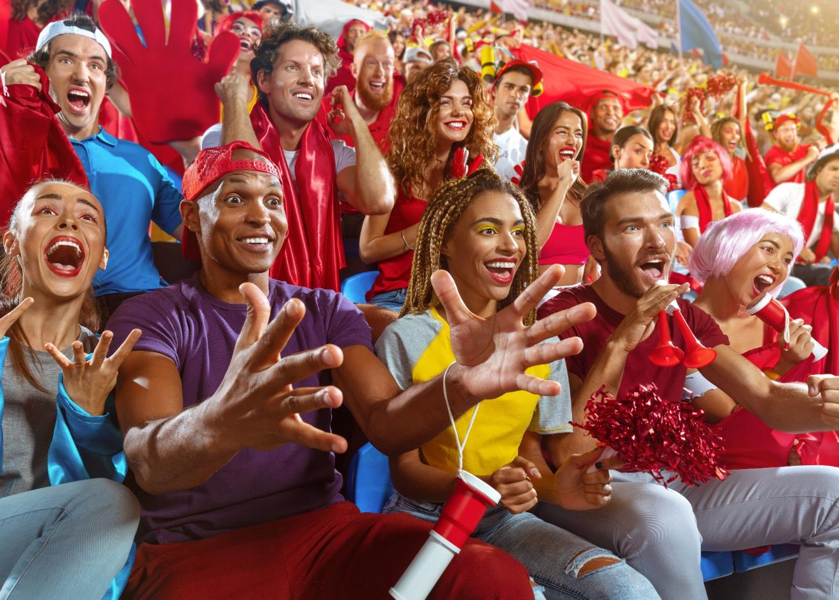
The Three Levels of Sports Fandom
Casual Sports Fan
(20% of sports fans)
Moderate Sports Fan
(37% of sports fans)
Avid Sports Fan
(43% of sports fans)
Sports is one of many interests for the casual fan. They stay up-to-date with major sports news and stories so that they can be part of the conversation with friends and family when they get together to watch sports. Casual fans occasionally watch sports on TV with two-thirds watching a live sporting event at least on a weekly basis. They are more likely to prefer watching sports at a bar/restaurant or someone’s home as part of a social gathering.
The moderate fan enjoys watching sports and routinely follows sports news and stories so they can stay up-to-date with their favorite teams. They regularly watch sports on TV with three-quarters watching live sports at least a few times a week. Moderate fans are more likely to prefer watching sports, and following their favorite teams, from the comfort of their own home but they will also attend a game in-person occasionally.
Sports are a core passion of the avid fan. They intensely follow their favorite leagues, teams and players by continually checking news and updates through their mobile sports apps. They are habitual TV viewers - 51% watch live sports on a daily basis. Avid fans also love the gameday atmosphere and enjoy rooting on their favorite team in person - 83% have attended a game/event over the last two years.
  11
Source: VAB / Dynata ‘Sports Viewing Experience Survey,’ September 2019, Survey base: self-identified sports fans, P18+. Q S3: How would you describe your level of interest in sports?
This information is exclusively provided to VAB members and qualified marketers. Further distribution is prohibited.

Slide 12


The Avid Sports Fan Is Slightly Younger, Skewing More Towards Adults 25-44,
While Females Compose Approximately 45% Of Causal and Moderate Fans
Casual Sports Fans
(20% of sports fans)
Median Age: 46
Moderate Sports Fans
(37% of sports fans)
Median Age: 44
Avid Sports Fans
(43% of sports fans)
Median Age: 41
Male
Female
Male
Female
Male
Female
56%
44%
54%
46%
68%
32%
Age Composition
Age Composition
Age Composition
Source: VAB / Dynata ‘Sports Viewing Experience Survey,’ September 2019, Survey base: self-identified sports fans, P18+. Q1: What is your gender? Q S1: What is your age? Casual Fans Respondents (occasionally watch sports on TV, stay up to date on major sports news, etc), Moderate Fans Respondents (regularly watch sports on TV, routinely follow sports news, etc.), Avid Fans Respondents (habitually watch sports on TV, intensely follow teams / players, etc).
  12
This information is exclusively provided to VAB members and qualified marketers. Further distribution is prohibited.

Slide 13
Over Half Of All Avid Fans Watch Live Sports Daily And Even Two-Thirds
Of Casual Sports Fans Watch Sports At Least On A Weekly Basis
How Often Do Sports Fans Watch Live Sports On TV*?
Casual Sports Fans
(20% of sports fans)
Moderate Sports Fans
(37% of sports fans)
Avid Sports Fans
(43% of sports fans)
*TV is inclusive of all devices (ie., TV, connected-TV device, smartphone, tablet, etc) and locations (i.e., at home, at a bar/restaurant, someone else’s home, etc)
Source: VAB / Dynata ‘Sports Viewing Experience Survey,’ September 2019, Survey base: self-identified sports fans, P18+. Q S4: On average, how often do you watch live sports on TV in a given month? Please indicate any viewing that takes place regardless of device (i.e., TV, smartphone, tablet, etc) or location (i.e. at home, at a bar / restaurant, someone else’s home, etc). Casual Fans Respondents (occasionally watch sports on TV, stay up to date on major sports news, etc), Moderate Fans Respondents (regularly watch sports on TV, routinely follow sports news, etc.), Avid Fans Respondents (habitually watch sports on TV, intensely follow teams / players, etc).
  13
This information is exclusively provided to VAB members and qualified marketers. Further distribution is prohibited.

Slide 14















% of Sports Fans Who Follow Each Sport
Casual / Moderate / Avid
The avid fan is a voracious viewer who has a wide set
of interests when it comes
to sports.
While NFL is still the unquestioned leader across
all levels of sports fandom, several others draw a significant audience with
11 sports being followed
by at least one-quarter of
avid fans.
Four sports – NFL, college football, MLB and NBA –
are followed by at least
one-quarter of casual fans.
NFL Football
71% / 80% / 87%
College Football
37% / 55% / 70%
Baseball
41% / 59% / 69%
NBA Basketball
41% / 50% / 64%
College Basketball
24% / 40% / 57%
Ice Hockey
12% / 27% / 38%
Golf
18% / 22% / 36%
Soccer
17% / 19% / 34%
Tennis
16% / 19% / 28%
Boxing
17% / 13% / 27%
NASCAR
16% / 21% / 25%
Mixed Martial Arts
11% / 10% / 20%
Gymnastics
11% / 12% / 17%
Extreme Sports
6% / 6% / 12%
Figure Staking
5% / 10% / 11%
Other
7% / 4% / 6%
Source: VAB / Dynata ‘Sports Viewing Experience Survey,’ September 2019. Survey base = self-identified sports fans, P18+. Q8: Which sports do you follow? Note: Numbers don’t add to 100% due to respondents ability to select more than one answer. Casual Fans Respondents (occasionally watch sports on TV, stay up to date on major sports news, etc), Moderate Fans Respondents (regularly watch sports on TV, routinely follow sports news, etc.), Avid Fans Respondents (habitually watch sports on TV, intensely follow teams / players, etc). Sorted by Avid fans’ %.
  14
Click here to see more demographics
This information is exclusively provided to VAB members and qualified marketers. Further distribution is prohibited.

Slide 15
Adult 18-34 Sports Fan Are Most Likely To Watch Sports Daily Regardless Of Device Or Location And Over 80% Are Habitual Viewers Who Watch At Least A Few Times A Week
How Often Do Sports Fans Watch Live Sports On TV*?
All Sports Fans
Adults 18-34
(37% of sports fans)
Adults 35+
(63% of sports fans)
*TV is inclusive of all devices (ie., TV, connected-TV device, smartphone, tablet, etc) and locations (i.e., at home, at a bar/restaurant, someone else’s home, etc)
Source: VAB / Dynata ‘Sports Viewing Experience Survey,’ September 2019, Survey base: self-identified sports fans, P18+. Q S4: On average, how often do you watch live sports on TV in a given month? Please indicate any viewing that takes place regardless of device (i.e., TV, smartphone, tablet, etc) or location (i.e. at home, at a bar / restaurant, someone else’s home, etc). All Sports Fans based on P18+.
  15
Click here to see more demographics
This information is exclusively provided to VAB members and qualified marketers. Further distribution is prohibited.

Slide 16
% of Sports Fans Who Follow Each Sport
All / Adults 18-34 / Adults 35+
Adults 18-34 are more likely to gravitate towards high-intensity sports that feature non-stop action
like the NBA, soccer and combat sports like boxing and MMA
NFL Football
81% / 75% / 85%
NBA Basketball
54% / 66% / 47%
College Football
57% / 49% / 63%
Baseball
60% / 47% / 67%
College Basketball
44% / 44% / 44%
Soccer
25% / 33% / 21%
Boxing
20% / 29% / 15%
Ice Hockey
29% / 25% / 31%
Mixed Martial Arts
15% / 23% / 9%
NASCAR
22% / 21% / 22%
Tennis
22% / 20% / 27%
Golf
27% / 17% / 33%
Gymnastics
14% / 15% / 14%
Extreme Sports
9% / 13% / 6%
Figure Staking
9% / 10% / 9%
Other
6% / 5% / 6%
Click here to see more demographics
Source: VAB / Dynata ‘Sports Viewing Experience Survey,’ September 2019. Survey base = self-identified sports fans, P18+. Q8: Which sports do you follow? Note: Numbers don’t add to 100% due to respondents ability to select more than one answer. All Sports Fans based on P18+. Sorted by A18-34 fans’ %.
  16
This information is exclusively provided to VAB members and qualified marketers. Further distribution is prohibited.

Slide 17




There is an unbridled passion that exists among sports fans.
Two-thirds of avid fans feel personally connected to the teams they root for and over half say that some of their fondest memories are tied to sports.
Furthermore, women are more likely than men to feel
a personal connection to
their favorite teams.
% of Sports Fans Who Agree
All
Sports Fans
Avid Fans
Male Fans
Female Fans
Sports are a core passion of my life
40%
64%
43%
36%
I feel personally connected to the teams I root for
54%
65%
51%
59%
Some of my fondest memories are tied to sports
47%
56%
44%
51%
I have cried because of a sports event
24%
31%
20%
32%
Source: VAB / Dynata ‘Sports Viewing Experience Survey,’ September 2019. Survey base = self-identified sports fans, P18+. Q19: Which of the following statements do you believe are true for you? Avid Fans Respondents (habitually watch sports on TV, intensely follow teams / players, etc), All Sports Fans based on P18+.
  17
This information is exclusively provided to VAB members and qualified marketers. Further distribution is prohibited.

Slide 18

Commitment runs deep among sports fans. A significant amount of sports fans, especially younger and multicultural ones, are actually passionate to the point
of superstitious when
it comes to their favorite teams
“I have a ritual I do before or during ‘big’ games to help my team win”
(% who agree)
Avid Sports Fans
Adults 18-34 Sports Fans
25%
23%
Black Sports Fans
Hispanic Sports Fans
27%
24%
Source: VAB / Dynata ‘Sports Viewing Experience Survey,’ September 2019. Survey base = self-identified sports fans, P18+. Q20: Which of the following statements do you believe are true for you? Avid Fans Respondents (habitually watch sports on TV, intensely follow teams / players, etc).
  18
This information is exclusively provided to VAB members and qualified marketers. Further distribution is prohibited.

Slide 19

Sports also makes for great, passionate conversation.
In fact, almost half of Avid fans and female fans are willing to share their passion, connection and memories around sports with complete strangers
“I have talked to a stranger about a sports event, team or athlete”
(% who agree)
All Sports Fans
Avid Sports Fans
40%
48%
Male Sports Fans
Female Sports Fans
38%
43%
Source: VAB / Dynata ‘Sports Viewing Experience Survey,’ September 2019. Survey base = self-identified sports fans, P18+. Q18: Which of the following statements do you believe are true for you? Avid Fans Respondents (habitually watch sports on TV, intensely follow teams / players, etc), All Sports Fans based on P18+.
  19
This information is exclusively provided to VAB members and qualified marketers. Further distribution is prohibited.

Slide 20
Where Do Fans Prefer To Watch Live Sports?
Quantifying Their Viewing Preferences By Location

Slide 21




Watching sports at home is ubiquitous among sports fans while a much lower percentage of fans – nearly one-third - typically also watch in-person at a stadium / arena or out-of-home
at a bar / restaurant
Where Do Sports Fans Typically Watch Sports?
All Sports Fans
Stadium
or Arena
Bar or Restaurant
Someone
Else’s Home
Elsewhere
(airport, gym, hotel, etc.)
Home
96%
31%
30%
28%
7%
Source: VAB / Dynata ‘Sports Viewing Experience Survey,’ September 2019. Survey base: self-identified sports fans, P18+. Q10: Where do you typically watch sports? All Sports Fans based on P18+, Avid Fans Respondents (habitually watch. sports on TV, intensely follow teams / players, etc), Casual Fans Respondents (occasionally watch sports on TV, stay up to date on major sports news, etc). Note: Numbers don’t add to 100% due to respondents ability to select more than one answer.
  21
This information is exclusively provided to VAB members and qualified marketers. Further distribution is prohibited.

Slide 22
Almost all sports fans regardless of their level of fandom, age, gender or ethnicity watch live sports
at home.
Adults 18-34 are more likely to attend a game in-person as well as watch a game out-of-home either at a bar / restaurant or someone else’s place.
Interestingly, female sports fans are more likely than males to attend a game.
Where Do Sports Fans Typically Watch Sports?
Stadium
or Arena
Bar or Restaurant
Someone
Else’s Home
Elsewhere
(airport, gym, hotel, etc.)
Sports Fan Type
Home
All
96%
31%
30%
28%
7%
Avid
98%
43%
41%
37%
12%
Moderate
96%
26%
25%
24%
4%
Casual
92%
17%
17%
17%
3%
Adults 18-34
93%
34%
35%
35%
8%
Adults 35+
98%
30%
28%
24%
7%
Male
96%
29%
30%
30%
8%
Female
96%
35%
31%
31%
6%
Black
89%
30%
28%
28%
8%
Hispanic
92%
34%
34%
34%
8%
Source: VAB / Dynata ‘Sports Viewing Experience Survey,’ September 2019. Survey base: self-identified sports fans, P18+. Q10: Where do you typically watch sports? All Sports Fans based on P18+, Avid Fans Respondents (habitually watch. sports on TV, intensely follow teams / players, etc), Casual Fans Respondents (occasionally watch sports on TV, stay up to date on major sports news, etc). Note: Numbers don’t add to 100% due to respondents ability to select more than one answer.
  22
Click here to see more demographics
This information is exclusively provided to VAB members and qualified marketers. Further distribution is prohibited.

Slide 23


Watching sports at home is also the most preferred viewing location by far, being favored by almost three-quarters
of all sports fans
Where Do Sports Fans Prefer To Watch Sports?
All Sports Fans
Out-Of-Home
(Bar/Restaurant, Someone Else’s Home or Elsewhere)
Home
Stadium or Arena
72%
19%
8%
Source: VAB / Dynata ‘Sports Viewing Experience Survey,’ September 2019. Survey base = self-identified sports fans, P18+, Q11: When thinking about the overall sports viewing experience, where do you prefer to watch sports? All Sports Fans based on P18+, Avid Fans Respondents (habitually watch sports on TV, intensely follow teams / players, etc), Casual Fans Respondents (occasionally watch sports on TV, stay up to date on major sports news, etc. Note: Numbers don’t add to 100% due to respondents ability to select more than one answer.
  23
This information is exclusively provided to VAB members and qualified marketers. Further distribution is prohibited.

Slide 24

Where Do Sports Fans Prefer To Watch Sports?
Regardless of the type of sports fan, at least two-thirds prefer watching sports from the comfort
of their own home.
Adults 18-34 and females are more likely than others to prefer the experience and gameday atmosphere that attending a game in-person provides.
Casual sports fans, younger demos and multicultural fans are more likely than others to prefer watching ‘out-of-home’ as part of larger social gatherings.
Stadium
or Arena
Out-Of-Home
(Bar/Restaurant, Someone Else’s Home or Elsewhere)
Sports Fan Type
Home
All
72%
19%
8%
Avid
71%
22%
8%
Moderate
75%
19%
6%
Casual
70%
16%
14%
Adults 18-34
66%
23%
11%
Adults 35+
76%
17%
7%
Male
74%
18%
9%
Female
70%
22%
7%
Black
65%
17%
19%
Hispanic
67%
18%
14%
Source: VAB / Dynata ‘Sports Viewing Experience Survey,’ September 2019. Survey base = self-identified sports fans, P18+, Q11: When thinking about the overall sports viewing experience, where do you prefer to watch sports? All Sports Fans based on P18+, Avid Fans Respondents (habitually watch sports on TV, intensely follow teams / players, etc), Casual Fans Respondents (occasionally watch sports on TV, stay up to date on major sports news, etc. Note: Numbers don’t add to 100% due to respondents ability to select more than one answer.
  24
This information is exclusively provided to VAB members and qualified marketers. Further distribution is prohibited.

Slide 25
Connection
(team, family/friends, social following)
Camaraderie
&
Community
Commitment
(team spirit & support)
Comfort
&
Convenience
Contact
(experiences)
Comprehension (commentary & analysis)
As we’ll showcase in the next few sections, within the totality of at-home viewing and in-person event attendance, sports satisfies several essential human need-states for all types of fans – from casual to avid, young and old, male and female and across all ethnicities
  25
This information is exclusively provided to VAB members and qualified marketers. Further distribution is prohibited.

Slide 26
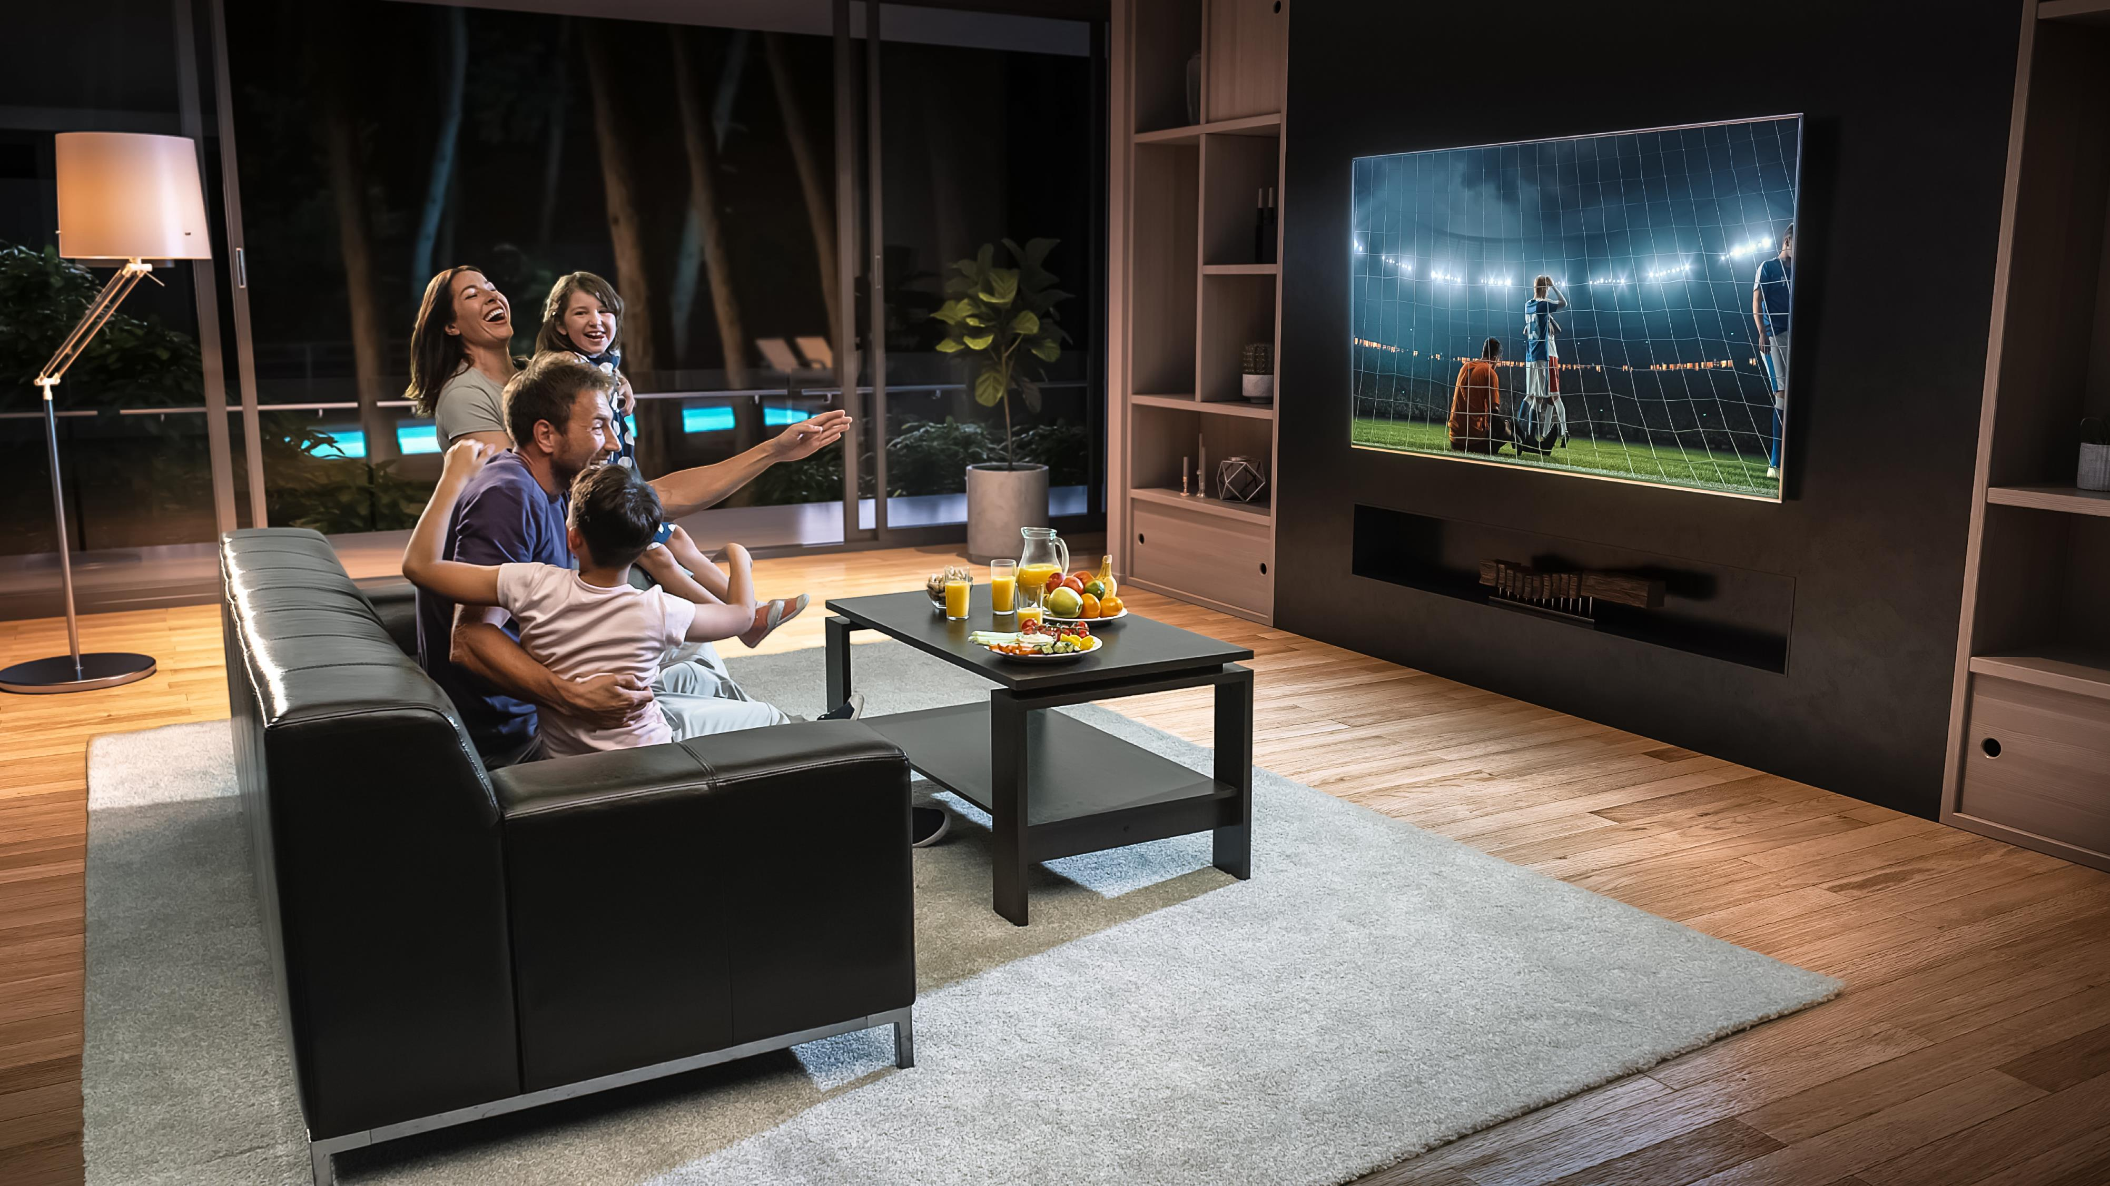
Comfort & Convenience are key needs fulfilled by watching sports at home.
92% of all sports fans enjoy home viewing because TV provides them
a front row seat to any game they want to watch
Source: VAB / Dynata ‘Sports Viewing Experience Survey,’ September 2019. Survey base = self-identified sports fans, P18+. Q12: Please rate how important the following are in your decision to watch sports at home (Top 2 Box: Somewhat Important & Very Important).
  26
This information is exclusively provided to VAB members and qualified marketers. Further distribution is prohibited.

Slide 27



Connection
Camaraderie & Community
Commitment
Contact
Comprehension
Comfort & Convenience
There’s a comfort to watching sports at home as almost two-thirds of avid fans and over half of males consider it their ‘me-time.’
Over half of avid fans regularly set aside time
in their schedule to watch sports.
And while some fans have a ritual to will their teams to a win, many also have a routine where they sit in the same seat when watching sports.
% of Sports Fans Who Agree With The Following Statements
All
Sports Fans
Avid Fans
Male Fans
Female Fans
Watching sports is my ‘me-time’
53%
64%
58%
44%
I regularly set aside time in my busy schedule to watch sports
44%
58%
44%
44%
I always sit in the same seat when watching sports
at home
38%
40%
38%
38%
Source: VAB / Dynata ‘Sports Viewing Experience Survey,’ September 2019. Survey base = self-identified sports fans, P18+. Q19 & Q20: Which of the following statements do you believe are true for you? Avid Fans Respondents (habitually watch sports on TV, intensely follow teams / players, etc). All Sports Fans based on P18+.
  27
This information is exclusively provided to VAB members and qualified marketers. Further distribution is prohibited.

Slide 28


Connection
Camaraderie & Community
Commitment
Contact
Comprehension
Comfort & Convenience
Live sports also creates valuable occasions to bring friends and family together
in the home, especially for females.
Over half of female fans think watching sports is an important family activity,
this leads many to make the occasion even more of an event by cooking / grilling
for their guests.
% of Sports Fans Who Agree With The Following Statements
All
Sports Fans
Avid Fans
Male Fans
Female Fans
Watching sports is important family time
48%
57%
43%
57%
I like to cook/grill for family or friends when watching sports on TV
42%
47%
36%
51%
Source: VAB / Dynata ‘Sports Viewing Experience Survey,’ September 2019. Survey base = self-identified sports fans, P18+. Q18 & Q19: Which of the following statements do you believe are true for you?, Avid Fans Respondents (habitually watch sports on TV, intensely follow teams / players, etc). All Sports Fans based on P18+.
  28
This information is exclusively provided to VAB members and qualified marketers. Further distribution is prohibited.

Slide 29



Connection
Camaraderie & Community
Commitment
Contact
Comprehension
Comfort & Convenience
Whether it’s because of comfort or an occasion, fans prefer to watch sports on the largest, clearest screen possible.
In fact, almost 70% of adults 18-34 have bought a bigger TV just so they could have a better sports viewing experience.
With that said, there is also
a growing acceptance
of sports viewing across all video devices as only about half of sports fans need to always watch sports on the largest screen available.
% of Sports Fans Who Agree With The Following Statements
All
Sports Fans
Adults 18-34
Avid Fans
Adults 35+
I bought a bigger TV screen just so I could have a better viewing experience for sports
63%
73%
69%
59%
I watch sports on a high definition TV so I can see the action clearer
60%
66%
54%
64%
Whenever possible I watch sports on the largest screen available in my home
48%
54%
49%
48%
Source: VAB / Dynata ‘Sports Viewing Experience Survey,’ September 2019. Survey base = self-identified sports fans, P18+. Q17: Please rate how much you agree or disagree with the following statement (Top 2 Box: Somewhat Agree & Strongly Agree), Q20: Which of the following statements do you believe are true for you? Avid Fans Respondents (habitually watch sports on TV, intensely follow teams / players, etc), All Sports Fans based on P18+.
  29
This information is exclusively provided to VAB members and qualified marketers. Further distribution is prohibited.

Slide 30
Watching sports at home satisfies the six essential need-states.
In particular, avid and casual fans both like watching sports at home because of the better viewing experience, ability to have a front row seat to every game and the convenience and comfort as opposed to the hassles involved with attending a game.
Avid fans also appreciate the flexibility that comes with home viewing including watching multiple games and the comprehensive coverage that TV networks provide.
Connection
Camaraderie & Community
Commitment
Contact
Comprehension
Comfort & Convenience
Main Reasons Why Fans Watch Live Sports At Home
Top 2 Box (% that rate statement as ‘Very Important / Somewhat Important’)
Source: VAB / Dynata ‘Sports Viewing Experience Survey,’ September 2019. Survey base = self-identified sports fans, P18+. Q12: Please rate how important the following are in your decision to watch sports at home (Top 2 Box: Somewhat Important & Very Important). Based on respondents who prefer watching sports at home via Q11. Casual Fans Respondents (occasionally watch sports on TV, stay up to date on major sports news, etc), Avid Fans Respondents (habitually watch sports on TV, intensely follow teams / players, etc). Sorted on Avid sports fans’ %.
  30
Click here to see more demographics
This information is exclusively provided to VAB members and qualified marketers. Further distribution is prohibited.

Slide 31

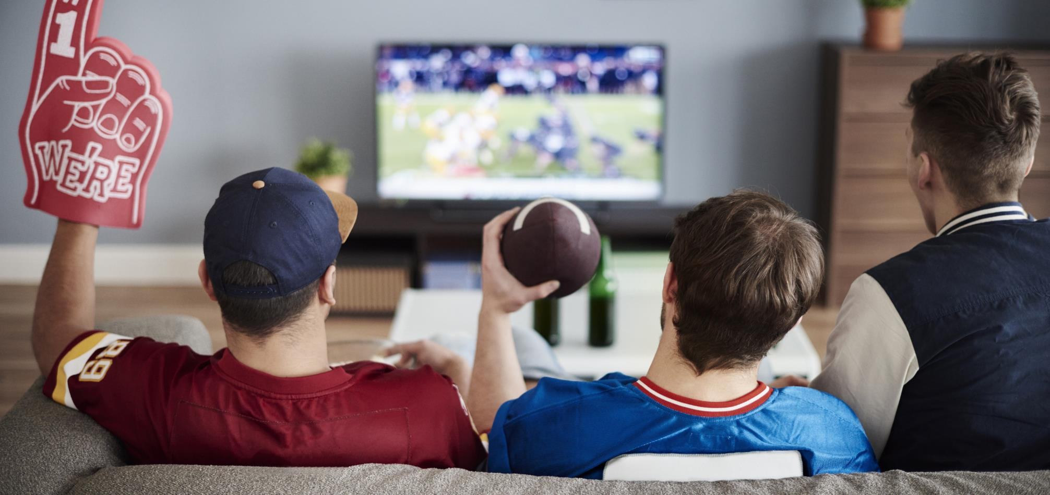

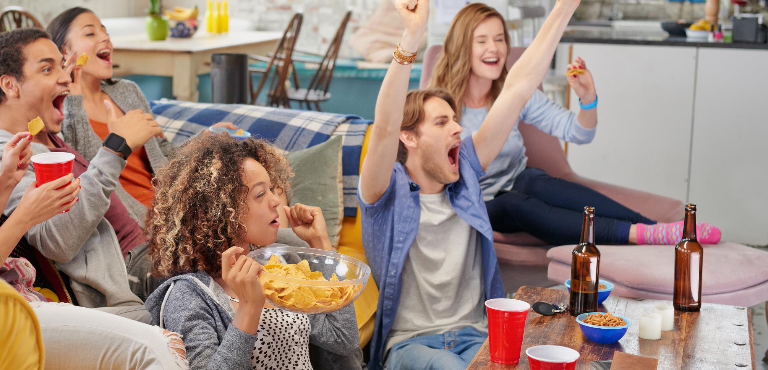
Comfort, Convenience And Viewing Experience Are Also The Main Reasons
Other Audience Segments Enjoy Watching Sports At Home
93%
92% / 91%
of married sports fans believe that TV provides them a front row seat to any game they want to watch
of single sports fans & sports fans with kids both like the conveniences of watching
at home
(food & drink easily available, a bathroom with no lines, etc)
87%
88%
of Black sports fans like
not having any of the hassles
associated with going to a game
(traffic, parking, security gates, etc)
of Hispanic sports fans prefer watching at home for the better viewing experience
(big screen TV, HDTV, etc)
Source: VAB / Dynata ‘Sports Viewing Experience Survey,’ September 2019. Survey base = self-identified sports fans, P18+. Q12: Please rate how important the following are in your decision to watch sports at home (Top 2 Box: Somewhat Important & Very Important. Based on respondents who prefer watching sports at home via Q11.
  31
This information is exclusively provided to VAB members and qualified marketers. Further distribution is prohibited.

Slide 32

Beyond the TV screen, social media enhances the sports viewing experience at home, especially among younger & multicultural fans.
In fact, three-fourths of black sports fans say they are more actively engaged in watching live sports on TV because of the related posts they read on social media platforms.
“Following social media posts keeps me more actively engaged in watching live sports on TV”
(% who agree)
Avid Sports Fans
Adult 18-34 Sports Fans
52%
69%
Black Sports Fans
Hispanic Sports Fans
74%
59%
Source: VAB / Dynata ‘Sports Viewing Experience Survey,’ September 2019. Survey base = self-identified sports fans, P18+. Q17: Please rate how much you agree or disagree with the following statement (Top 2 Box: Somewhat Agree & Strongly Agree), Avid Fans Respondents (habitually watch sports on TV, intensely follow teams / players, etc).
  32
This information is exclusively provided to VAB members and qualified marketers. Further distribution is prohibited.

Slide 33
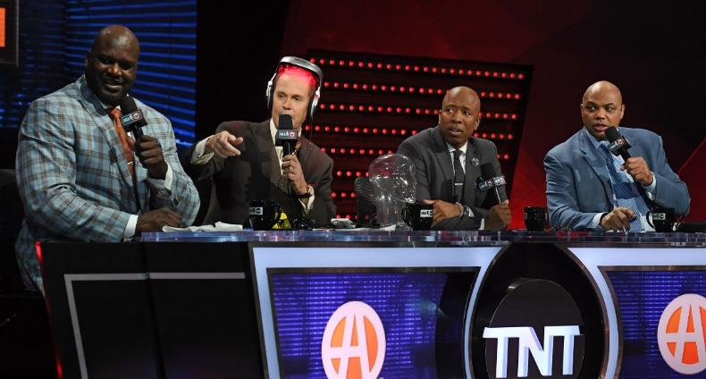
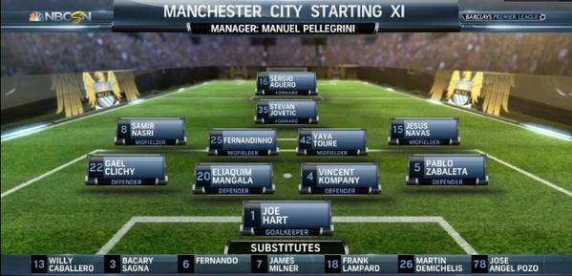
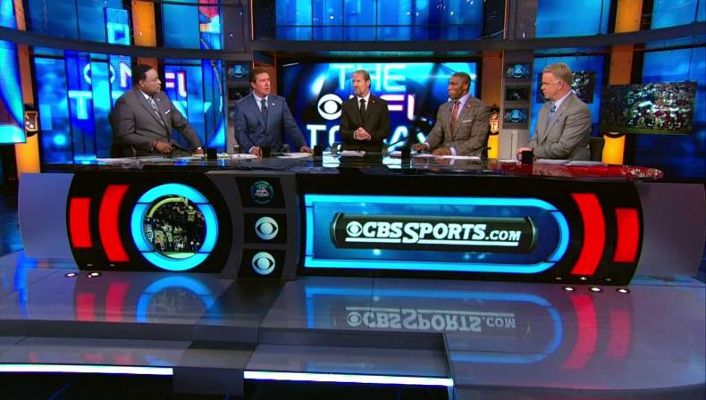
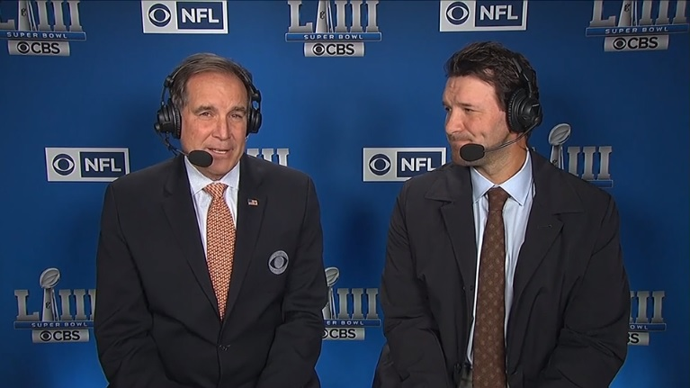

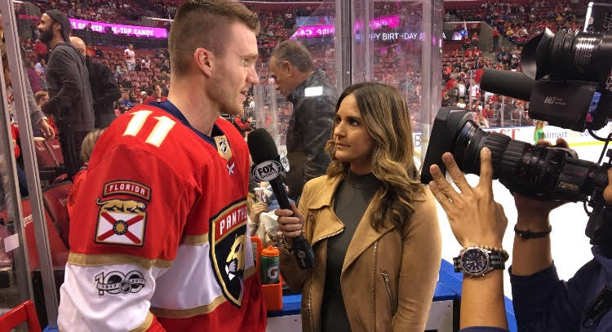
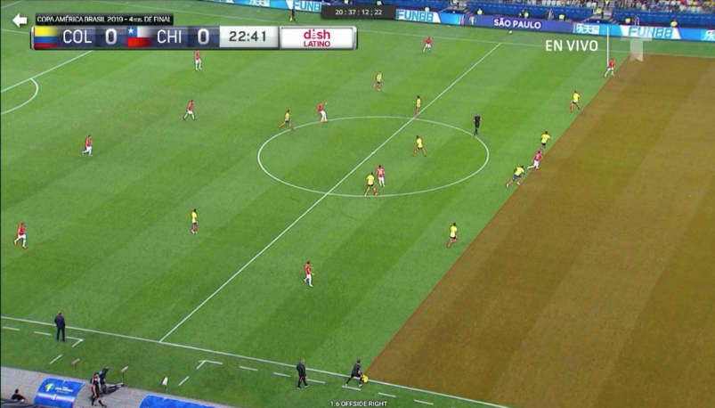
Connection
Camaraderie & Community
Commitment
Contact
Comprehension
Comfort & Convenience
When it comes to watching sports at home, fans, especially avid ones, enjoy the 360-degree experience that TV networks provide which includes play-by-play commentary and analysis, multiple camera angles and replays.
This experience goes well beyond the field too, beginning with pre-game coverage and ending with post-game highlights and interviews.
Pre-Game Coverage
Game Preview
“I enjoy watching pre-game coverage and post-game highlights”
70% / 81%
All Sports Fans / Avid Sports Fans
“Hearing the announcers and commentators makes it easier to keep up with the action”*
80% / 84%
Post-Game Highlights
Game Commentary
“Watching ‘off-the-field’ coverage (including live interviews, highlights, etc) is important to me”*
62% / 68%
“I have a better experience watching a sporting event on TV due to the different camera angles & replays”
77% / 79%
Live Interviews
Instant Replay
Source: VAB / Dynata ‘Sports Viewing Experience Survey,’ September 2019. Survey base = self-identified sports fans, P18+. *Q12: Please rate how important the following are in your decision to watch sports at home (Top 2 Box: Somewhat Important & Very Important, (based on respondents who prefer watching sports at home via Q11). Q17: Please rate how much you agree or disagree with the following statement (Top 2 Box: Somewhat Agree & Strongly Agree), (based on respondents who prefer watching sports at home via Q11), Avid Fans Respondents (habitually watch sports on TV, intensely follow teams / players, etc), All Sports Fans based on P18+.
  33
This information is exclusively provided to VAB members and qualified marketers. Further distribution is prohibited.

Slide 34

Take Me Out To The Ballgame!
Experiences That Foster Connection, Commitment & Community Among Sports Fans

Slide 35
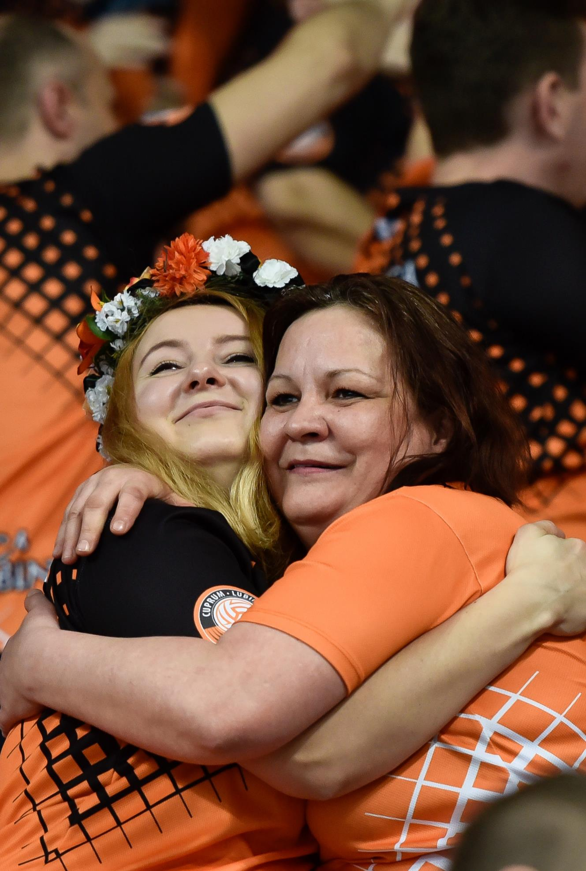

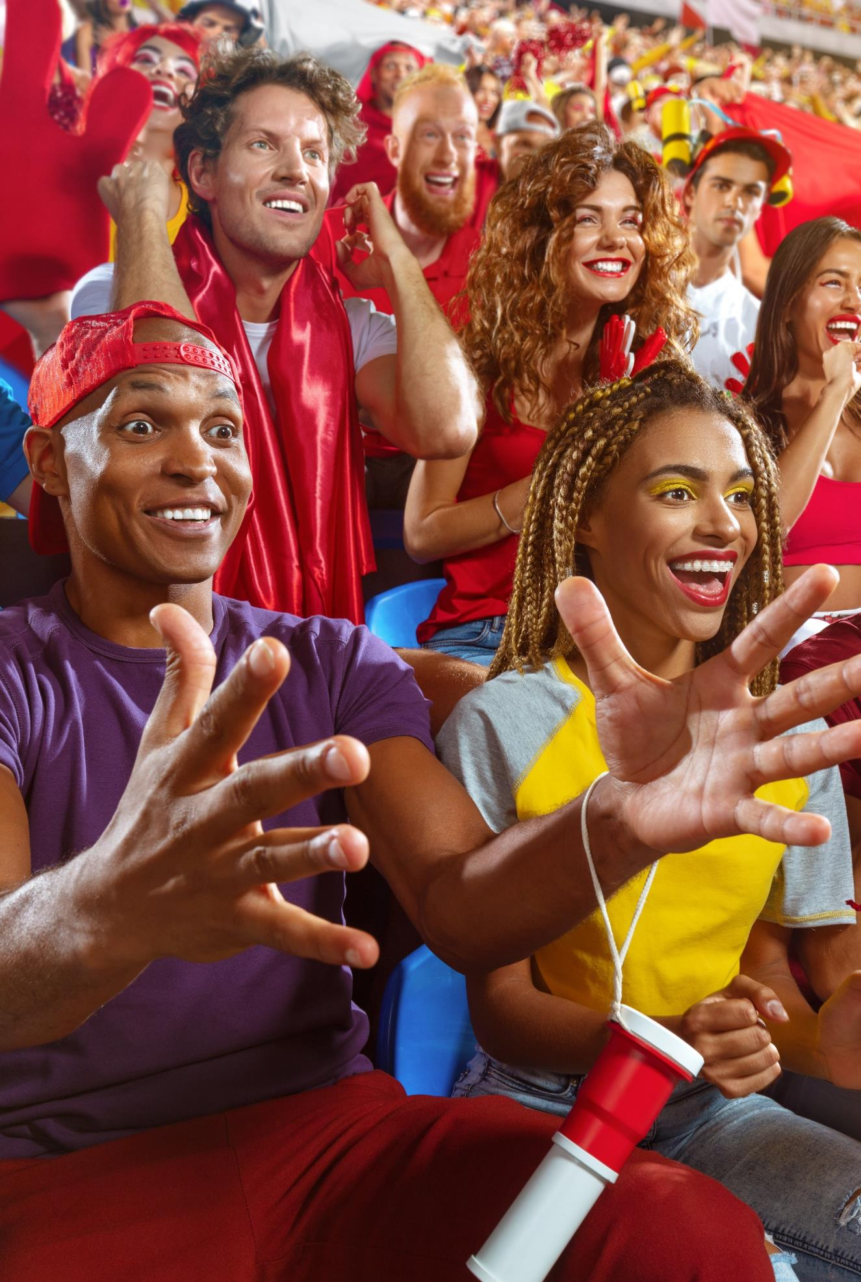
Seven Out Of 10 Sports Fans Have Attended A Game Over The Past Two Years
% Of Sports Fans That Have Attended A Professional Or Collegiate Sports Event In The Past Two Years
All Sports Fans
Casual / Avid
Black / Hispanic
72%
52% / 83%
76% / 83%
Adults 18-34 / 35+
Male / Female
Single / With Kids
79% / 67%
72% / 71%
70% / 78%
Source: VAB / Dynata ‘Sports Viewing Experience Survey,’ September 2019, Survey base = self-identified sports fans, P18+, Q14: Have you attended a professional or collegiate sports event in the past two years? (i.e. MLB, NBA, NFL, NHL, NCAA Football, etc.). Casual Fans Respondents (occasionally watch sports on TV, stay up to date on major sports news, etc)Avid Fans Respondents (habitually watch sports on TV, intensely follow teams / players, etc). All Sports Fans based on P18+.
  35
This information is exclusively provided to VAB members and qualified marketers. Further distribution is prohibited.

Slide 36
Connection
Camaraderie & Community
Commitment
Contact
Comprehension
Comfort & Convenience
Both avid and casual fans crave the communal experience that attending live sporting events provide and the ability to see everything happening
on the field.
Avid fans also like to show their team pride and support while immersing themselves in the gameday atmosphere with the potential to be present for ‘big’ sports moments.
Why Do Fans Attend Sporting Events In Person?
Top 2 Box (% that rate statement as ‘Very Important / Somewhat Important’)
Source: VAB / Dynata ‘Sports Viewing Experience Survey,’ September 2019. Survey base = self-identified sports fans, P18+. Q15: Please rate how important the following are in your decision to attend a sporting event in person (Top 2 Box: Somewhat Important & Very Important). Based on respondents who have attended a professional or collegiate sports event in the past two years via Q14. Casual Fans Respondents (occasionally watch sports on TV, stay up to date on major sports news, etc), Avid Fans Respondents (habitually watch sports on TV, intensely follow teams / players, etc). Sorted on Avid sports fans’ %.
Click here to see more demographics
  36
This information is exclusively provided to VAB members and qualified marketers. Further distribution is prohibited.

Slide 37

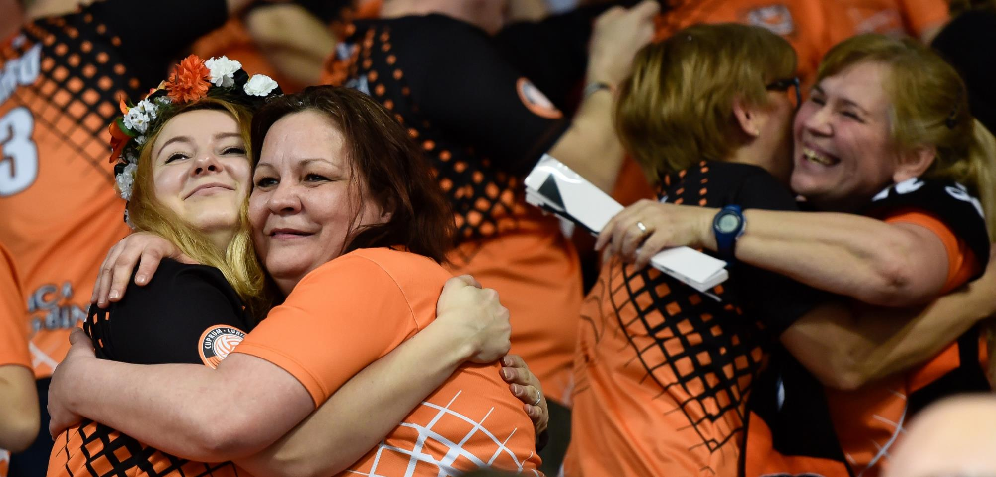


Unique Social Experiences And The Feeling Of Camaraderie And Community Are Main Reasons That Other Audience Segments Attend Live Sporting Events As Well
73%
86%
of Black & Hispanic sports fans tailgate before and/or after the game
of Hispanic sports fans attend games for the camaraderie and community with other fans
85%
71%
of sports fans that live in metro areas/big cities attend games as an opportunity to get out of the house
of Black sports fans agree that going to games provides them with social media content
Source: VAB / Dynata ‘Sports Viewing Experience Survey,’ September 2019. Survey base = self-identified sports fans, P18+. Q15: Please rate how important the following are in your decision to attend a sporting event in person (Top 2 Box: Somewhat Important & Very Important). Based on respondents who have attended a professional or collegiate sports event in the past two years via Q14.
  37
This information is exclusively provided to VAB members and qualified marketers. Further distribution is prohibited.

Slide 38


Connection
Camaraderie & Community
Commitment
Contact
Comprehension
Comfort & Convenience
In fact, when it comes to creating unique social experiences and taking part in camaraderie & community, a significant portion of fans, especially younger demos, enjoy making ‘a day of it’
and soaking up the gameday atmosphere – both in and around the stadium – before, during and after a sporting event
% of Sports Fans Who Agree With The Following Statements
All
Sports Fan
Adults 18-34
Avid Fans
Adults 35+
I enjoy making 'a day of it' when I go to sporting events by tailgating or going to area bars before and / or after a game
32%
38%
41%
27%
I prefer going to sporting events than watching on TV due to the gameday atmosphere
26%
31%
35%
20%
Source: VAB / Dynata ‘Sports Viewing Experience Survey,’ September 2019. Survey base = self-identified sports fans, P18+. Q13: Which of the following statements do you believe are true for you? Avid Fans Respondents (habitually watch sports on TV, intensely follow teams / players, etc). All Sports Fans based on P18+.
  38
This information is exclusively provided to VAB members and qualified marketers. Further distribution is prohibited.

Slide 39

However, only 29% of avid sports fans and 23% of all sports fans
say they attend more sporting events now than they have in the past
Source: VAB / Dynata ‘Sports Viewing Experience Survey,’ September 2019. Survey base = self-identified sports fans, P18+. Q13: Which of the following statements do you believe are true for you? Avid Fans Respondents (habitually watch sports on TV, intensely follow teams / players, etc),
  39
This information is exclusively provided to VAB members and qualified marketers. Further distribution is prohibited.

Slide 40
Connection
Camaraderie & Community
Commitment
Contact
Comprehension
Comfort & Convenience
Even the most passionate fans may not attend events or attend fewer than they used
to for a variety of reasons.
Among both the casual and avid fan, cost and hassles like traffic, stadium distance and seat locations are the biggest reasons.
Casual fans also find it harder to follow the action in person, they don’t like rowdy crowds and they might not want to devote all the time needed during the day to attend a game.
Reasons That May Keep Fans From Attending Live Sports In Person
Top 2 Box (% that rate statement as ‘Very Important / Somewhat Important’)
Source: VAB / Dynata ‘Sports Viewing Experience Survey,’ September 2019. Survey base = self-identified sports fans, P18+. Q16: Please rate the reasons that may keep you from attending a sporting event in person (Top 2 Box: Somewhat Important & Very Important). Casual Fans Respondents (occasionally watch sports on TV, stay up to date on major sports news, etc), Avid Fans Respondents (habitually watch sports on TV, intensely follow teams / players, etc). Sorted on Avid sports fans’ %.
  40
Click here to see more demographics
This information is exclusively provided to VAB members and qualified marketers. Further distribution is prohibited.

Slide 41

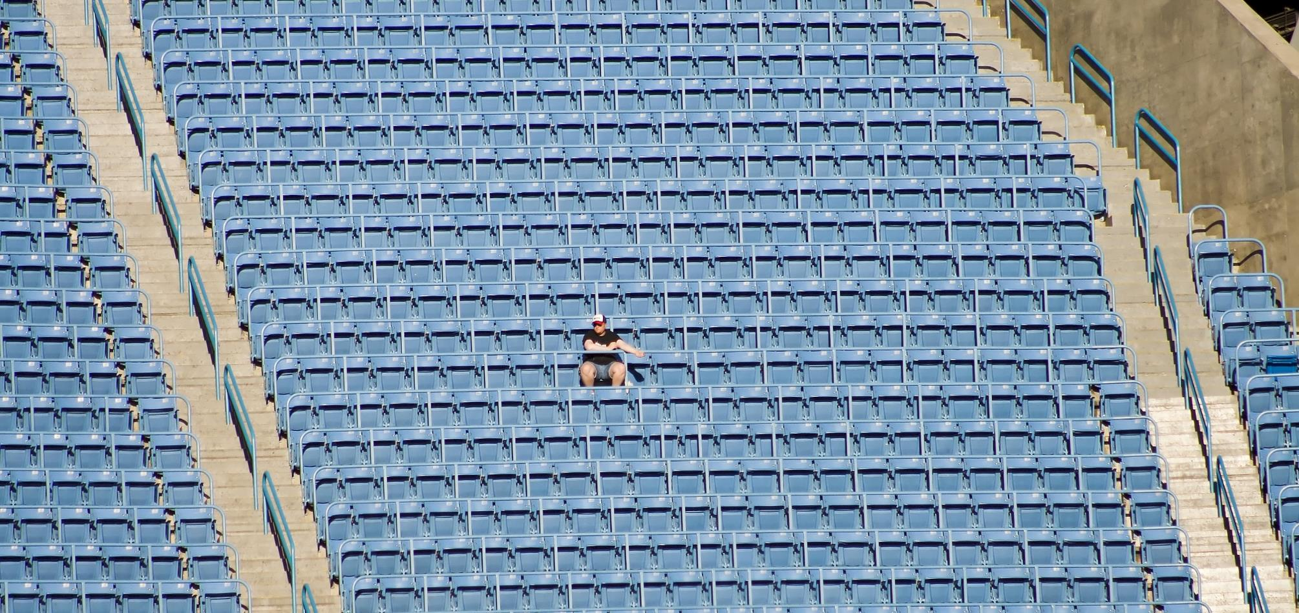


Costs And Other Inconveniences Are Also The Main Reasons Why Other
Audience Segments May Not Attend Sporting Events In Person
86% / 84%
75%
of married & adults with kids sports fans say that cost (too expensive) may keep them from attending a sporting event
of Hispanic sports fans say that their seat location (too far from the field/court) may keep them from attending a sporting event
72%
76% / 74%
of Black sports fans say that long lines for concessions and bathrooms may keep them from attending a game
of married & adults with kids sports fans cite traffic as a reason that may keep them
from attending a game
Source: VAB / Dynata ‘Sports Viewing Experience Survey,’ September 2019. Survey base = self-identified sports fans, P18+. Q16: Please rate the reasons that may keep you from attending a sporting event in person (Top 2 Box: Somewhat Important & Very Important).
  41
This information is exclusively provided to VAB members and qualified marketers. Further distribution is prohibited.

Slide 42

Matchup: At-Home Viewing Vs. In-Person Attendance
How Sports Advertising Drives Consumer Action Across The Purchase Funnel

Slide 43






The comfort, convenience and ease of connectivity during at-home viewing means that sports fans are more likely to engage
with advertising and take consumer action than if they
were at a game.
From an awareness & consideration perspective, avid sports fans are 56% more likely
to have talked with friends and/or family about an advertisement they saw while watching sports on TV than about an advertisement they
saw in a stadium/arena;
adults 18-34 and females
are 60% and 53% more likely
to do the same, respectively.
Awareness & Consideration
% Of Sports Fans Who Have Done The Following…
All
Sports Fans
Avid Fans
Adults 18-34
Females
I have talked with friends and/or family about an advertisement I saw while watching sports on TV
30%
34%
33%
35%
I have talked with friends and/or family about an advertisement
I saw within a stadium/arena
19%
21%
23%
23%
% Difference:
Sports TV Ads
vs.
In-Stadium Ads
+56%
more likely
+60%
more likely
+43%
more likely
+53%
more likely
Source: VAB / Dynata ‘Sports Viewing Experience Survey,’ September 2019. Survey base = self-identified sports fans, P18+. Q18. Which of the following statements do you believe are true for you? Avid Fans Respondents (habitually watch sports on TV, intensely follow teams / players, etc). All Sports Fans based on P18+.
  43
This information is exclusively provided to VAB members and qualified marketers. Further distribution is prohibited.

Slide 44
Avid sports fans are 24% more likely to have visited
a website for a product they saw advertised while watching sports on TV than for a product they saw advertised within a stadium / arena; females are 26% more likely to do the same.
Adults 18-34, who are almost always connected to their mobile devices, are just as likely to visit a brand’s website regardless of where they saw
an advertisement.
Consideration & Intent
% Of Sports Fans Who Have Done The Following…
All
Sports Fans
Avid Fans
Adults 18-34
Females
I have visited a website for a product that I saw advertised while watching sports on TV
22%
26%
27%
23%
I have visited a website
for a product that I saw advertised within a stadium/arena
18%
21%
27%
18%
% Difference:
Sports TV Ads
vs.
In-Stadium Ads
+22%
more likely
+24%
more likely
+1%
more likely
+26%
more likely
Source: VAB / Dynata ‘Sports Viewing Experience Survey,’ September 2019. Survey base = self-identified sports fans, P18+. Q18. Which of the following statements do you believe are true for you? Avid Fans Respondents (habitually watch sports on TV, intensely follow teams / players, etc). All Sports Fans based on P18+.
  44
This information is exclusively provided to VAB members and qualified marketers. Further distribution is prohibited.

Slide 45
Avid sports fans are 40% more likely to have purchased a product or service they saw advertised while watching sports on TV than a product or service they saw advertised within a stadium / arena; adults 18-34 and females are 9% and 32% more likely to do the same, respectively
Sales
% Of Sports Fans Who Have Done The Following…
All
Sports Fans
Avid Fans
Adults 18-34
Females
I have purchased a product or service I saw advertised while watching sports on TV
23%
26%
26%
24%
I have purchased a product or service I saw advertised within a
stadium/arena
17%
19%
24%
18%
% Difference:
Sports TV Ads
vs.
In-Stadium Ads
+32%
more likely
+40%
more likely
+9%
more likely
+32%
more likely
Source: VAB / Dynata ‘Sports Viewing Experience Survey,’ September 2019. Survey base = self-identified sports fans, P18+. Q18. Which of the following statements do you believe are true for you? Avid Fans Respondents (habitually watch sports on TV, intensely follow teams / players, etc). All Sports Fans based on P18+.
  45
This information is exclusively provided to VAB members and qualified marketers. Further distribution is prohibited.

Slide 46

Key Takeaways
With 96% of all fans typically watching sports at home, multiscreen TV is ubiquitous and offers broad reach among all ages, genders, races and levels of fandom.
Opportunities go well beyond Males 25-54 as approximately 45% of casual and moderate sports fans (and almost 40% of all sports fans) are female and one-third of Adults 18-34 watch sports through multiscreen TV daily.
In-stadium advertising and sponsorships is a good way to reach fans, especially avid fans since 43% typically go to sporting events, however these activations should be augmented by multiscreen TV in order to reach all fans, especially the more casual and moderate ones who collectively make up 57% of fans.
The passion surrounding sports satisfies several essential human needs and the fulfillment of comfort, convenience and ease of connection and connectivity during at-home viewing means that sports fans are more likely to engage with sports TV advertising than if they saw in-stadium ads.
Whether it’s at a bar or restaurant, someone else’s home, or at an airport or hotel, there is considerable out-of-home viewing for multiscreen TV content and marketers should ensure they’re capturing this audience. In fact, 14% of casual fans prefer to watch sports at out-of-home locations.
46

Slide 47




Contact Us
Register for Complimentary Access to VAB Insights
Jason Wiese
SVP, Director of Strategic Insights
jasonw@thevab.com
Reed Kiely
Insights Manager
reedk@thevab.com
VAB
@VABIntel

Slide 48

Appendix - Additional Sports Fan Insights: Gender & Age

Slide 49
From a Gender Perspective, Over 80% Of Male Fans And Two-Thirds Of Female Fans Watch Live Sports Across Devices At Least A Few Times A Week
How Often Do Sports Fans Watch Live Sports On TV*?
All Sports Fans
Male Sports Fans
(61% of sports fans)
Female Sports Fans
(39% of sports fans)
*TV is inclusive of all devices (ie., TV, connected-TV device, smartphone, tablet, etc) and locations (i.e., at home, at a bar/restaurant, someone else’s home, etc)
Source: VAB / Dynata ‘Sports Viewing Experience Survey,’ September 2019, Survey base: self-identified sports fans, P18+. Q S4: On average, how often do you watch live sports on TV in a given month? Please indicate any viewing that takes place regardless of device (i.e., TV, smartphone, tablet, etc) or location (i.e. at home, at a bar / restaurant, someone else’s home, etc). All Sports Fans based on P18+.
  49
This information is exclusively provided to VAB members and qualified marketers. Further distribution is prohibited.

Slide 50
% of Sports Fans Who Follow Each Sport
All / Male / Female
The major sports like NFL, college football, MLB and NBA, attract both male and female fans, while more niche sports skew towards one gender.
For instance, sports like golf, boxing, mixed martial arts skew more towards males while sports like gymnastics and figure skating skew more towards females.
NFL Football
81% / 83% / 79%
College Football
57% / 64% / 58%
Baseball
60% / 63% / 54%
NBA Basketball
54% / 58% / 49%
College Basketball
44% / 47% / 40%
Ice Hockey
29% / 30% / 26%
Soccer
25% / 28% / 21%
Tennis
22% / 23% / 22%
NASCAR
22% / 22% / 21%
Gymnastics
14% / 10% / 20%
Golf
27% / 33% / 18%
Figure Staking
9% / 5% / 16%
Boxing
20% / 25% / 12%
Mixed Martial Arts
15% / 18% / 10%
Extreme Sports
9% / 10% / 6%
Other
6% / 6% / 5%
Source: VAB / Dynata ‘Sports Viewing Experience Survey,’ September 2019. Survey base = self-identified sports fans, P18+. Q8: Which sports do you follow? Note: Numbers don’t add to 100% due to respondents ability to select more than one answer. All Sports Fans based on P18+. Sorted by female fans’ %.
  50
This information is exclusively provided to VAB members and qualified marketers. Further distribution is prohibited.

Slide 51
Connection
Camaraderie & Community
Commitment
Contact
Comprehension
Comfort & Convenience
There’s not much of a difference between males and females when it comes to the main reasons they like to watch live sports at home – like many of the other audience segments, it’s
about convenience, viewing experience and cost efficiency.
Female fans are more likely to appreciate the communal aspect of sports viewing, ability to more easily follow the action on TV and the
‘off-the-field’ coverage
that includes interviews
and human interest stories.
Main Reasons Why Fans Watch Live Sports At Home
Top 2 Box (% that rate statement as ‘Very Important / Somewhat Important’)
Source: VAB / Dynata ‘Sports Viewing Experience Survey,’ September 2019. Survey base = self-identified sports fans, P18+. Q12: Please rate how important the following are in your decision to watch sports at home (Top 2 Box: Somewhat Important & Very Important. Based on respondents who prefer watching sports at home via Q11. Sorted on Female fans’ %.
  51
This information is exclusively provided to VAB members and qualified marketers. Further distribution is prohibited.

Slide 52
Connection
Camaraderie & Community
Commitment
Contact
Comprehension
Comfort & Convenience
Male and female fans enjoy going to a live sporting event because they see it as an occasion to spend valuable time with their friends & family.
It also gives them the ability to see everything happening on the field
and they can show off
their team pride.
Female fans also like the camaraderie & community they feel with other fans and they’re more likely to share these moments with their followers on social media.
Why Do Fans Attend Sporting Events In Person?
Top 2 Box (% that rate statement as ‘Very Important / Somewhat Important’)
Source: VAB / Dynata ‘Sports Viewing Experience Survey,’ September 2019. Survey base = self-identified sports fans, P18+. Q15: Please rate how important the following are in your decision to attend a sporting event in person (Top 2 Box: Somewhat Important & Very Important). Based on respondents who have attended a professional or collegiate sports event in the past two years via Q14. Sorted on Female fans’ %.
  52
This information is exclusively provided to VAB members and qualified marketers. Further distribution is prohibited.

Slide 53
Connection
Camaraderie & Community
Commitment
Contact
Comprehension
Comfort & Convenience
Male and female fans typically cite the same reasons as to why they might not attend a sporting event with cost and inconveniences like traffic, stadium distance and seat locations as the biggest factors for both.
Interestingly, male sports fans are more likely to not want to devote enough time during the day to attend a game.
Reasons That May Keep Fans From Attending Live Sports In Person
Top 2 Box (% that rate statement as ‘Very Important / Somewhat Important’)
Source: VAB / Dynata ‘Sports Viewing Experience Survey,’ September 2019. Survey base = self-identified sports fans, P18+. Q16: Please rate the reasons that may keep you from attending a sporting event in person (Top 2 Box: Somewhat Important & Very Important). Sorted on Female fans’ %.
  53
This information is exclusively provided to VAB members and qualified marketers. Further distribution is prohibited.

Slide 54
Connection
Camaraderie & Community
Commitment
Contact
Comprehension
Comfort & Convenience
Both younger and older demos most appreciate the convenience and viewing experience of watching
sports at home and the ability to have a front row seat
for every live sporting event.
Adults 18-34 also like the flexibility to pause and rewind a game, the comprehensive coverage that TV networks provide and the ability to easily keep up with their fantasy teams and social media posts related to the games they’re watching.
Main Reasons Why Fans Watch Live Sports At Home
Top 2 Box (% that rate statement as ‘Very Important / Somewhat Important’)
Source: VAB / Dynata ‘Sports Viewing Experience Survey,’ September 2019. Survey base = self-identified sports fans, P18+. Q12: Please rate how important the following are in your decision to watch sports at home (Top 2 Box: Somewhat Important & Very Important). Based on respondents who prefer watching sports at home via Q11. Sorted on Adults 18-34 fans’ %.
  54
This information is exclusively provided to VAB members and qualified marketers. Further distribution is prohibited.

Slide 55
Connection
Camaraderie & Community
Commitment
Contact
Comprehension
Comfort & Convenience
When it comes to in-person attendance, younger and older demos most appreciate the ability to see everything happening on the field and spending valuable time with their friends & family along with showing their team pride & support.
Adults 18-34 also like the social aspect of attending games which can meld the physical & digital world together – they’re more likely to tailgate and post related social media content.
Separately, they’re also more likely to appreciate the unique food & drink options available in-stadium.
Why Do Fans Attend Sporting Events In Person?
Top 2 Box (% that rate statement as ‘Very Important / Somewhat Important’)
Source: VAB / Dynata ‘Sports Viewing Experience Survey,’ September 2019. Survey base = self-identified sports fans, P18+. Q15: Please rate how important the following are in your decision to attend a sporting event in person (Top 2 Box: Somewhat Important & Very Important). Based on respondents who have attended a professional or collegiate sports event in the past two years via Q14. Sorted on Adults 18-34 fans’ %.
  55
This information is exclusively provided to VAB members and qualified marketers. Further distribution is prohibited.

Slide 56
Connection
Camaraderie & Community
Commitment
Contact
Comprehension
Comfort & Convenience
Older demographics are more likely to cite cost as a reason that they may not attend a sporting event in person along with the hassles that come with too much traffic.
Both younger and older demos have issues with stadium distance and
seat locations.
Adults 18-34 generally have a lot more reasons why they don’t attend games including uncomfortable seats, rowdy crowds, hard to follow the action in person and feeling disconnected from their lives.
Reasons That May Keep Fans From Attending Live Sports In Person
Top 2 Box (% that rate statement as ‘Very Important / Somewhat Important’)
Source: VAB / Dynata ‘Sports Viewing Experience Survey,’ September 2019. Survey base = self-identified sports fans, P18+. Q16: Please rate the reasons that may keep you from attending a sporting event in person (Top 2 Box: Somewhat Important & Very Important). Sorted on Adults 18-34 fans’ %.
  56
This information is exclusively provided to VAB members and qualified marketers. Further distribution is prohibited.

Slide 57
Members Exclusive: Additional Demo Cuts To The Survey

Slide 58
Multicultural Sports Fans Are Heavier Sports TV Viewers – 60% of Black Fans
And 58% Of Hispanic Fans Watch Live Sports At Least Every Other Day
How Often Do Sports Fans Watch Live Sports On TV*?
Non-Hispanic White Sports Fans
Black Sports Fans
Hispanic Sports Fans
*TV is inclusive of all devices (ie., TV, connected-TV device, smartphone, tablet, etc) and locations (i.e., at home, at a bar/restaurant, someone else’s home, etc)
Source: VAB / Dynata ‘Sports Viewing Experience Survey,’ September 2019, Survey base: self-identified sports fans, P18+. Q S4: On average, how often do you watch live sports on TV in a given month? Please indicate any viewing that takes place regardless of device (i.e., TV, smartphone, tablet, etc) or location (i.e. at home, at a bar / restaurant, someone else’s home, etc).
  58
This information is exclusively provided to VAB members and qualified marketers. Further distribution is prohibited.

Slide 59
% of Sports Fans Who Follow Each Sport
Non-Hispanic White / Black / Hispanic
Black sports fans greatly over index against basketball and Hispanics over index against soccer while both groups over index against extreme sports and combat sports like boxing and MMA
NFL Football
84% / 74% / 71%
NBA Basketball
48% / 77% / 68%
College Football
61% / 52% / 43%
College Basketball
44% / 51% / 42%
Boxing
15% / 41% / 42%
Baseball
67% / 30% / 52%
Soccer
22% / 26% / 46%
NASCAR
23% / 20% / 26%
Tennis
21% / 25% / 19%
Mixed Martial Arts
13% / 21% / 21%
Gymnastics
13% / 19% / 21%
Ice Hockey
33% / 14% / 24%
Golf
30% / 14% / 18%
Extreme Sports
7% / 15% / 14%
Figure Staking
9% / 5% / 8%
Other
6% / 4% / 4%
Source: VAB / Dynata ‘Sports Viewing Experience Survey,’ September 2019. Survey base = self-identified sports fans, P18+. Q8: Which sports do you follow? Note: Numbers don’t add to 100% due to respondents ability to select more than one answer. All Sports Fans based on P18+. Sorted by the average of Black & Hispanic fans’ %.
  59
This information is exclusively provided to VAB members and qualified marketers. Further distribution is prohibited.

Slide 60
Connection
Camaraderie & Community
Commitment
Contact
Comprehension
Comfort & Convenience
Multicultural fans are more likely to enjoy watching sports at home because they can more closely follow all of the action both on- and off-the-field, whether it’s the ability
to pause and rewind plays
or watch interviews and highlights.
They can also more easily keep up with related social media posts and their fantasy teams at home.
Hispanics, in particular, see watching sports at home as a good way to spend time with friends and family.
Main Reasons Why Fans Watch Live Sports At Home
Top 2 Box (% that rate statement as ‘Very Important / Somewhat Important’)
Source: VAB / Dynata ‘Sports Viewing Experience Survey,’ September 2019. Survey base = self-identified sports fans, P18+. Q12: Please rate how important the following are in your decision to watch sports at home (Top 2 Box: Somewhat Important & Very Important). Based on respondents who prefer watching sports at home via Q11. Sorted on Non-Hispanic White fans’ %.
  60
This information is exclusively provided to VAB members and qualified marketers. Further distribution is prohibited.

Slide 61
Connection
Camaraderie & Community
Commitment
Contact
Comprehension
Comfort & Convenience
When it comes to attending sporting events in person,
in addition to it being an opportunity to spend time
with family and friends, multicultural fans are more likely to tailgate before and / or after the game and enjoy the camaraderie and community with other fans.
They are also more likely to appreciate the unique food and drink options available at stadiums.
Why Do Fans Attend Sporting Events In Person?
Top 2 Box (% that rate statement as ‘Very Important / Somewhat Important’)
Source: VAB / Dynata ‘Sports Viewing Experience Survey,’ September 2019. Survey base = self-identified sports fans, P18+, Q15: Please rate how important the following are in your decision to attend a sporting event in person (Top 2 Box: Somewhat Important & Very Important). Based on respondents who have attended a professional or collegiate sports event in the past two years via Q14. Sorted on Non-Hispanic White fans’ %.
  61
This information is exclusively provided to VAB members and qualified marketers. Further distribution is prohibited.

Slide 62
Connection
Camaraderie & Community
Commitment
Contact
Comprehension
Comfort & Convenience
Sports fans with children and those without children both like watching sports at home because of its convenience and comfort, the better viewing experience and the ability to have a front row seat to every game.
Not surprisingly, fans with children consider watching sports at home as a good way to spend time with family and it also allows them the flexibility to pause and rewind plays.
Main Reasons Why Fans Watch Live Sports At Home
Top 2 Box (% that rate statement as ‘Very Important / Somewhat Important’)
Source: VAB / Dynata ‘Sports Viewing Experience Survey,’ September 2019. Survey base = self-identified sports fans, P18+. Q12: Please rate how important the following are in your decision to watch sports at home (Top 2 Box: Somewhat Important & Very Important). Based on respondents who prefer watching sports at home via Q11. Sorted on sports fans with children %.
  62
This information is exclusively provided to VAB members and qualified marketers. Further distribution is prohibited.

Slide 63
Connection
Camaraderie & Community
Commitment
Contact
Comprehension
Comfort & Convenience
When it comes to the main reasons that may keep fans from attending a live sporting event, sports fans with children and those without children both cite cost as the biggest factor while inconveniences like traffic, stadium distance and seat location rank high as well.
Sports fans with children are more concerned about missing plays and following all the action by being there
in-person. They’re also more likely to feel disconnected from other things in their life while they’re at a stadium.
Reasons That May Keep Fans From Attending Live Sports In Person
Top 2 Box (% that rate statement as ‘Very Important / Somewhat Important’)
Source: VAB / Dynata ‘Sports Viewing Experience Survey,’ September 2019. Survey base = self-identified sports fans, P18+. Q16: Please rate the reasons that may keep you from attending a sporting event in person (Top 2 Box: Somewhat Important & Very Important). Sorted on sports fans with children %.
  63
This information is exclusively provided to VAB members and qualified marketers. Further distribution is prohibited.

Slide 64
Connection
Camaraderie & Community
Commitment
Contact
Comprehension
Comfort & Convenience
When it comes to the main reasons that may keep fans from attending a live sporting event, both married and single sports fan cite cost
as the biggest factor while inconveniences like traffic, stadium distance and seat location rank high as well.
Single sports fans are more concerned about missing plays and following all the action by being there in-person. They’re also more likely to feel disconnected from other things while they’re at a stadium.
Reasons That May Keep Fans From Attending Live Sports In Person
Top 2 Box (% that rate statement as ‘Very Important / Somewhat Important’)
Source: VAB / Dynata ‘Sports Viewing Experience Survey,’ September 2019. Survey base = self-identified sports fans, P18+. Q16: Please rate the reasons that may keep you from attending a sporting event in person (Top 2 Box: Somewhat Important & Very Important). Sorted on Married sports fans’ %.
  64
This information is exclusively provided to VAB members and qualified marketers. Further distribution is prohibited.

Slide 65
Regardless of where they live, almost all sports fans watch live sports at home. Fans that live in major metro areas watch sports anywhere – they’re more likely to attend sporting events in person and watch a game at a bar / restaurant, at someone else’s home or at another ‘out-of-home’ location
Where Do Sports Fans Typically Watch Sports?
Home
Stadium
or Arena
Bar or Restaurant
Someone
Else’s Home
Elsewhere
(airport, gym, hotel, etc.)
Sports Fan Type
Rural
95%
23%
22%
22%
4%
Suburban
96%
32%
30%
27%
7%
Urban
96%
36%
37%
35%
10%
Source: VAB / Dynata ‘Sports Viewing Experience Survey,’ September 2019. Survey base: self-identified sports fans, P18+. Q10: Where do you typically watch sports? All Sports Fans based on P18+. Note: Numbers don’t add to 100% due to respondents ability to select more than one answer.
  65
This information is exclusively provided to VAB members and qualified marketers. Further distribution is prohibited.

