Slide 1
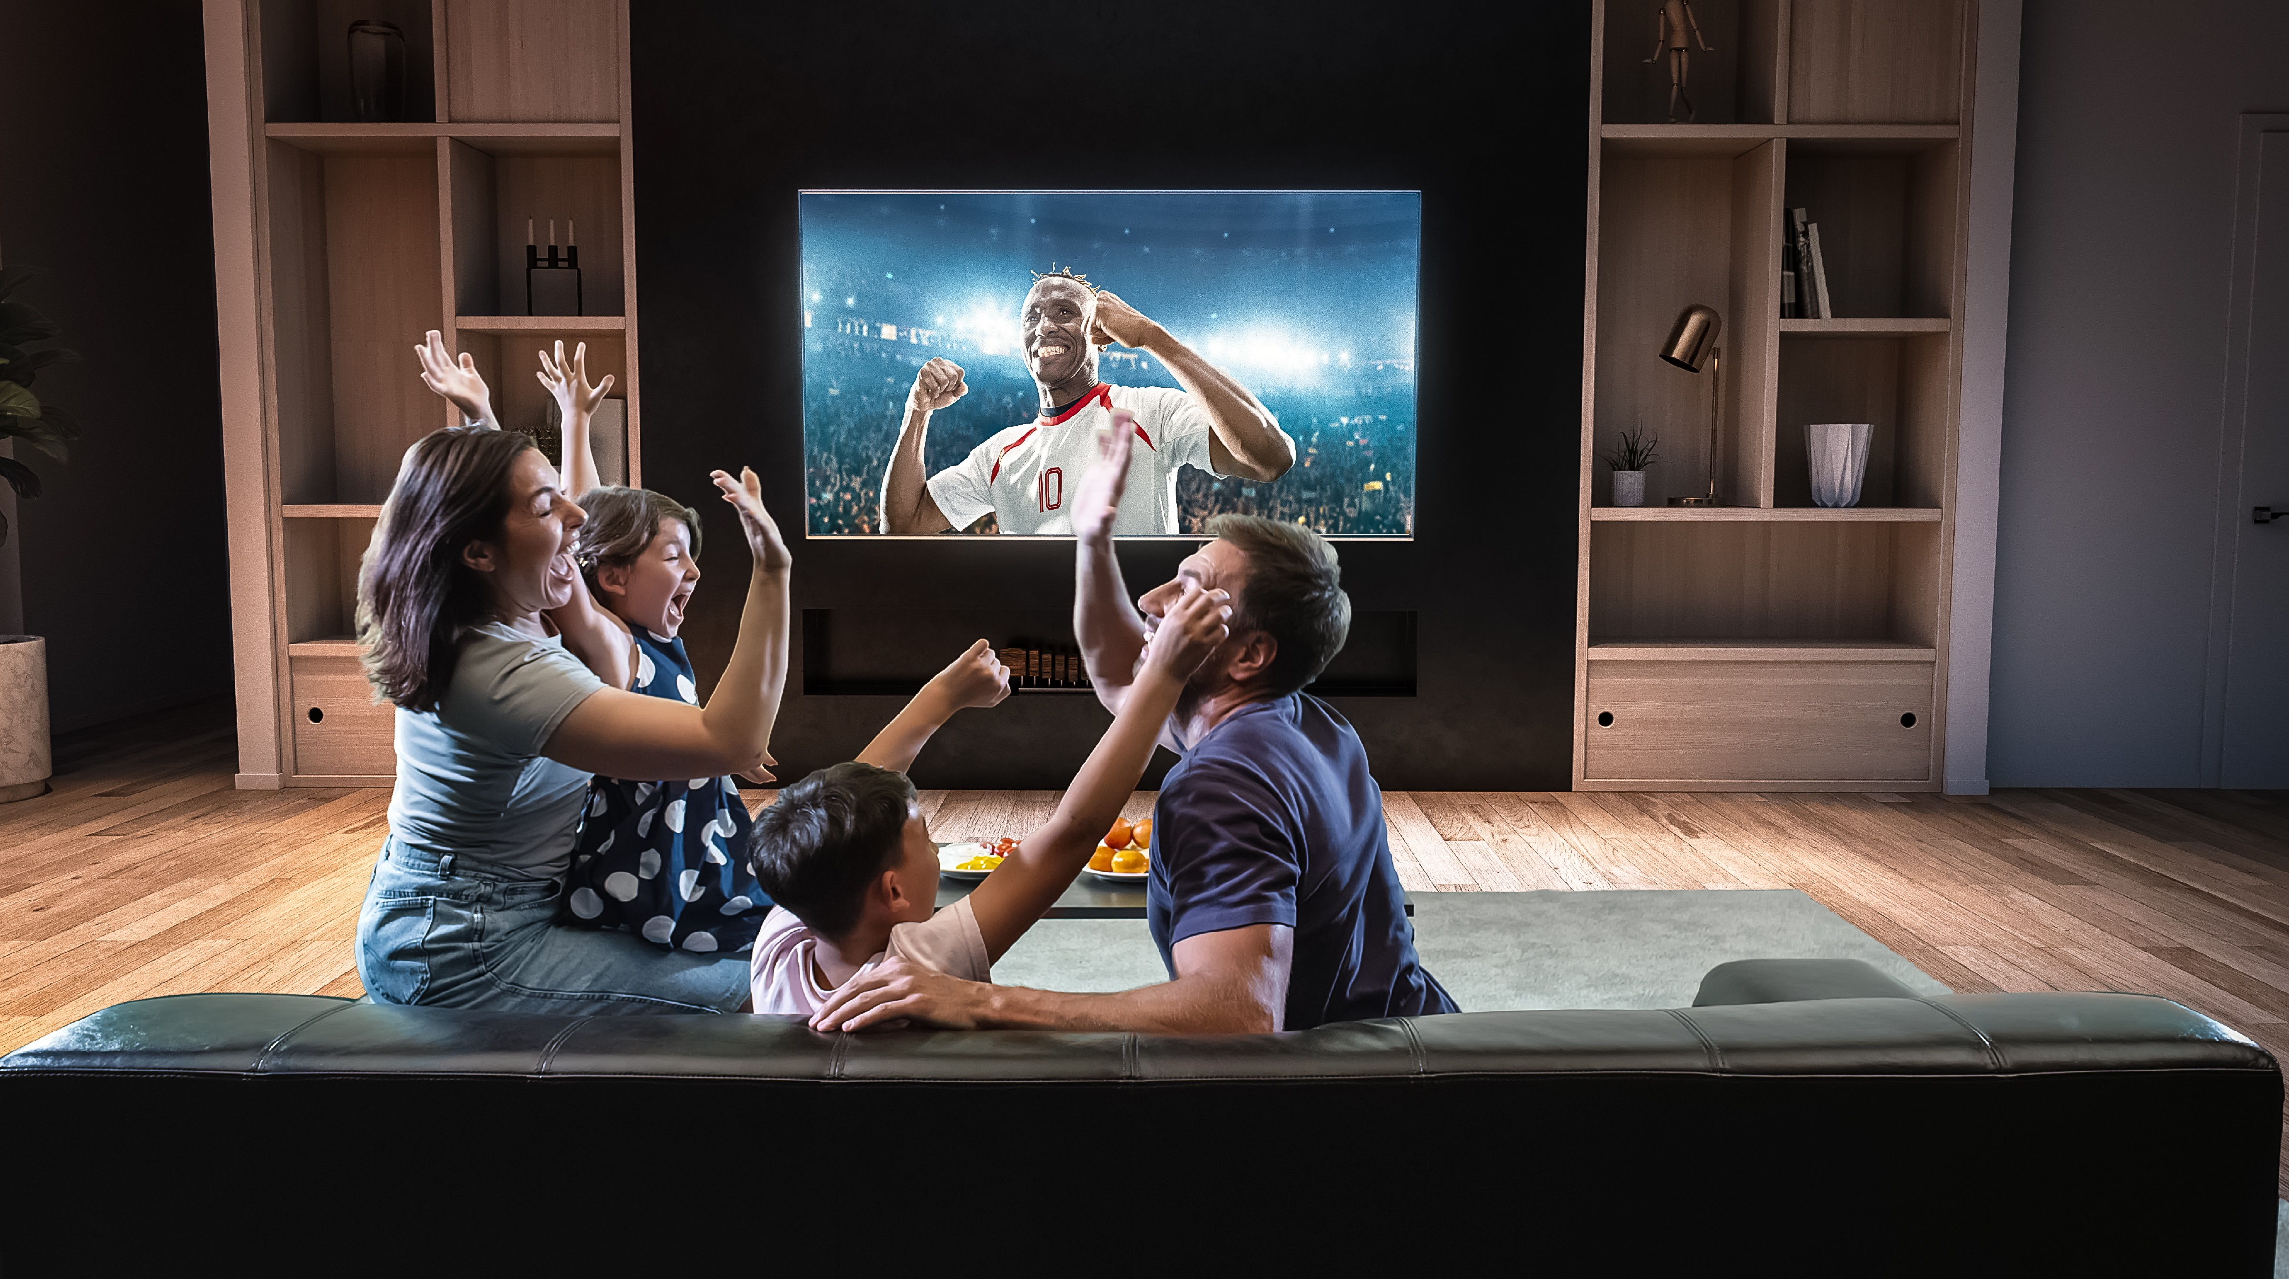
VAB – INSIGHTS REPORT - 2020
.................
The Best Seats In The House
Exploring Multiscreen TV’s Front Row Seat To Live Sports
VAB Members Exclusive Supplement

Slide 2
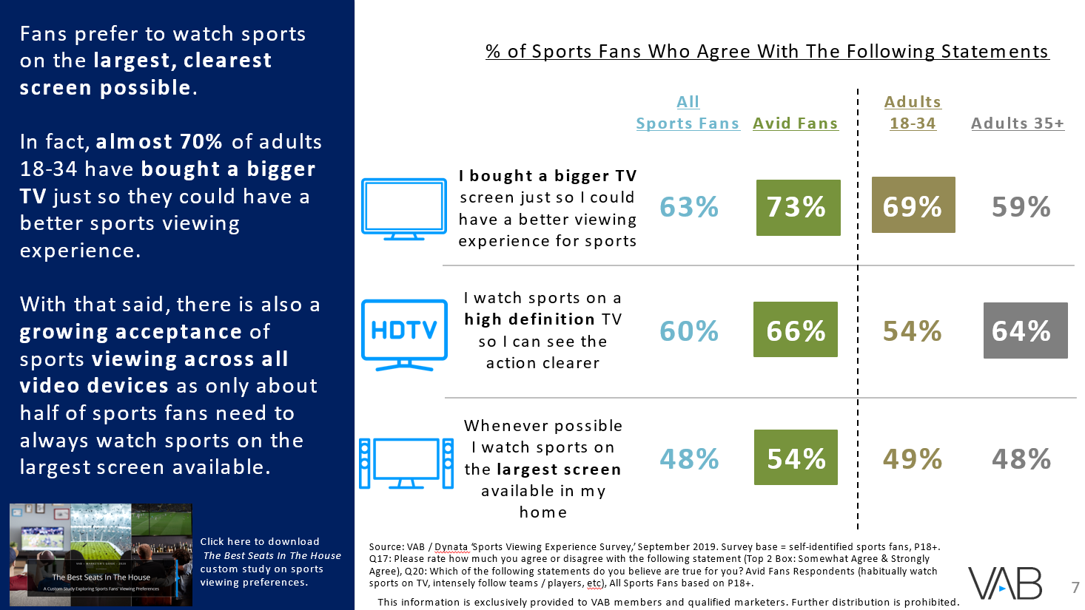

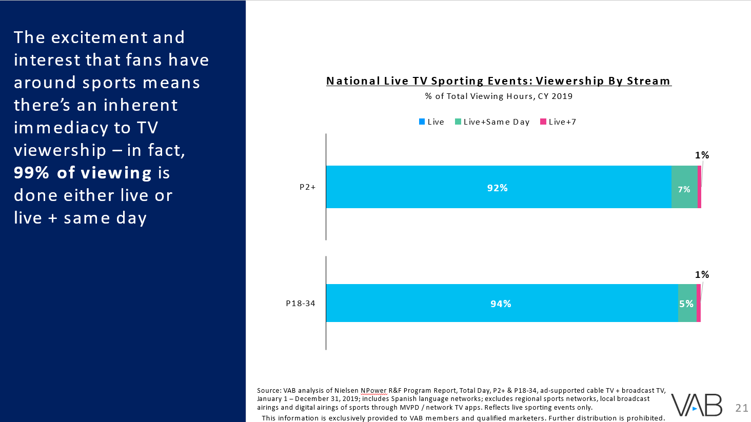
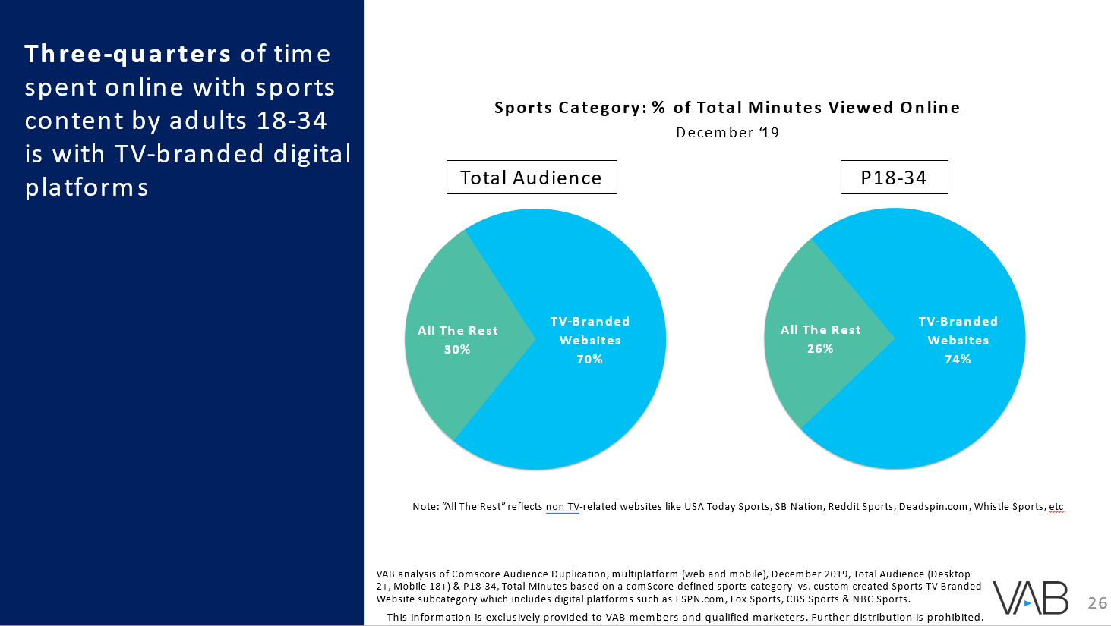
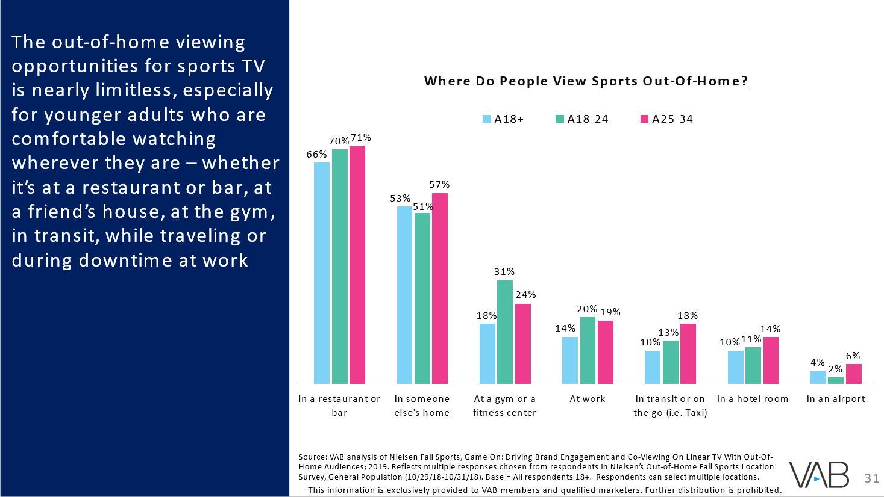
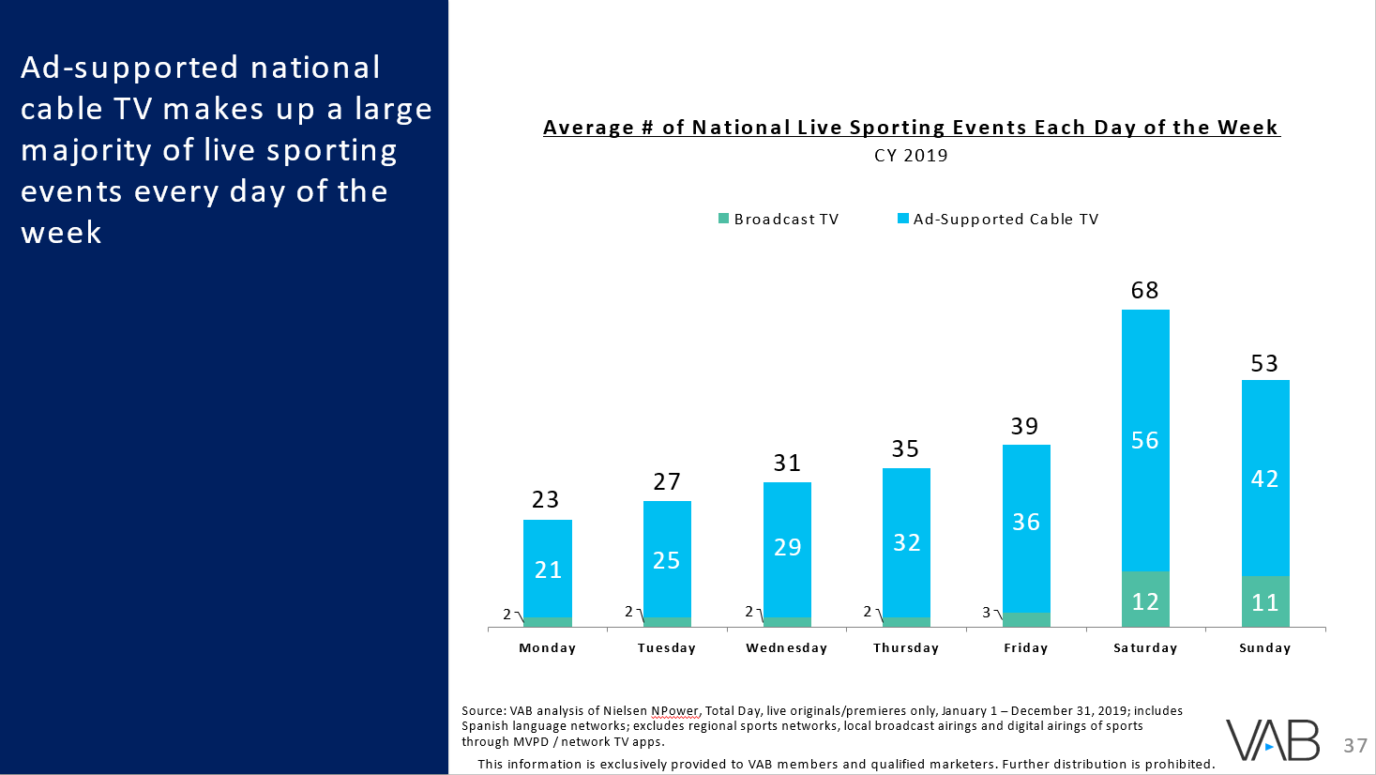
Program
1
1
Understanding Sports Fans’ Viewing Preferences
2
2
Multiscreen TV: What Does A Better Viewing Experience
And Value Get You?
3
3
Viewers Embrace Sports Content On TV
4
4
One-Two Punch: Sports Engagement Extends Across Screens
5
Away Games: Building Audiences Through Out-Of-Home Viewing
5
6
6
Appendix: A Deeper Into Sports TV Programming

Slide 3


Game Summary
VAB recently commissioned Dynata to conduct the ‘Sports Viewing Experience’ survey to understand sports fans’ preferences for live sports viewing with a particular focus on at-home viewing and in-person event attendance (full custom study report available for download here).
While it’s no surprise that almost all sports fans, regardless of their level of fandom (casual or avid), age, gender or ethnicity watch live sports at home, over 70% of all sports fans prefer home viewing over any other location.
These fans like watching sports from the comfort of their own home, across video devices, due to the better viewing experience, the ability to have a front row seat to every game and the conveniences they can enjoy as opposed to the hassles involved with attending games in-person (traffic, distance, long lines, etc).
In addition to these benefits, multiscreen TV is also comparatively less expensive at a fraction of the cost for a family of four to attend one sporting event in either of the four major sports.
So what does the multiscreen TV value proposition offer to a consumer? Access to over 14,100 nationally televised live sports annually with a front row seat to marquee events airing exclusively through multiscreen TV providers.
Also, viewership extends beyond the television as over 80% of adults 18-34 visit at least one TV-branded digital sports platform monthly and out-of-home viewing builds additional exposure by reaching people who may not ordinarily watch sports at home.
  3
This information is exclusively provided to VAB members and qualified marketers. Further distribution is prohibited.

Slide 4
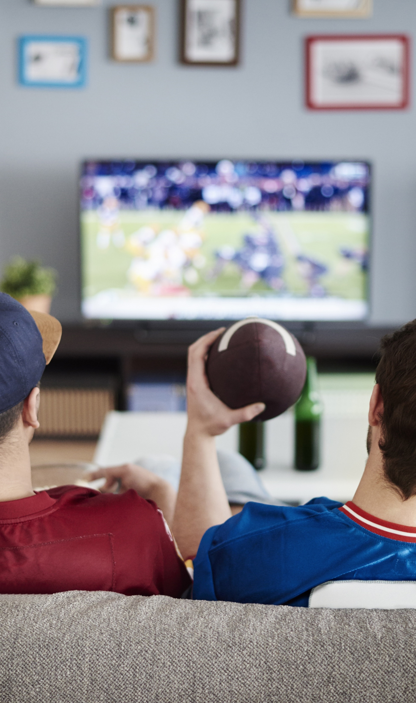
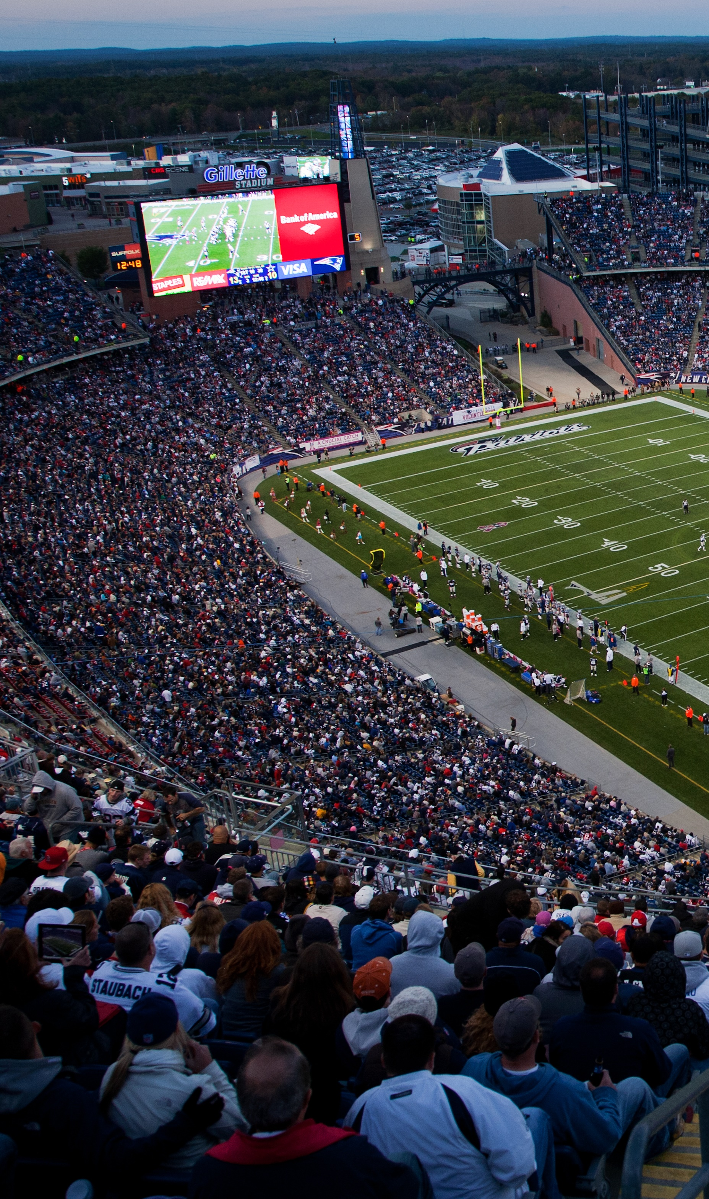

Understanding Sports Fans’ Viewing Preferences

Slide 5






Where Do Sports Fans Typically Watch Sports?
In September 2019, VAB commissioned Dynata to conduct the ‘Sports Viewing Experience’ survey to understand fans’ preferences for live sports viewing.
Almost all sports fans regardless of their level
of fandom, age, gender or ethnicity watch live sports
at home.
Stadium
or Arena
Bar or Restaurant
Someone
Else’s Home
Elsewhere
(airport, gym, hotel, etc.)
Home
Sports Fan Type
All
96%
31%
30%
28%
7%
Avid
98%
43%
41%
37%
12%
Moderate
96%
26%
25%
24%
4%
Casual
92%
17%
17%
17%
3%
Adults 18-34
93%
34%
35%
35%
8%
Adults 35+
98%
30%
28%
24%
7%
Male
96%
29%
30%
30%
8%
Female
96%
35%
31%
31%
6%
Black
89%
30%
28%
28%
8%
Hispanic
92%
34%
34%
34%
8%
Click here to download
The Best Seats In The House custom study on sports viewing preferences.
Source: VAB / Dynata ‘Sports Viewing Experience Survey,’ September 2019. Survey base: self-identified sports fans, P18+. Q10: Where do you typically watch sports? All Sports Fans based on P18+, Avid Fans Respondents (habitually watch. sports on TV, intensely follow teams / players, etc), Casual Fans Respondents (occasionally watch sports on TV, stay up to date on major sports news, etc). Note: Numbers don’t add to 100% due to respondents ability to select more than one answer.
  5
This information is exclusively provided to VAB members and qualified marketers. Further distribution is prohibited.

Slide 6

Where Do Sports Fans Prefer To Watch Sports?
Regardless of the type of sports fan, at least two-thirds prefer watching sports from the comfort of their own home, with males slightly more inclined than the average sports fan.
Stadium
or Arena
Out-Of-Home
(Bar/Restaurant, Someone Else’s Home or Elsewhere)
Sports Fan Type
Home
All
72%
19%
8%
Avid
71%
22%
8%
Moderate
75%
19%
6%
Casual
70%
16%
14%
Adults 18-34
66%
23%
11%
Adults 35+
76%
17%
7%
Male
74%
18%
9%
Female
70%
22%
7%
Black
65%
17%
19%
Hispanic
67%
18%
14%
Click here to download
The Best Seats In The House custom study on sports viewing preferences.
Source: VAB / Dynata ‘Sports Viewing Experience Survey,’ September 2019. Survey base = self-identified sports fans, P18+, Q11: When thinking about the overall sports viewing experience, where do you prefer to watch sports? All Sports Fans based on P18+, Avid Fans Respondents (habitually watch sports on TV, intensely follow teams / players, etc), Casual Fans Respondents (occasionally watch sports on TV, stay up to date on major sports news, etc. Note: Numbers don’t add to 100% due to respondents ability to select more than one answer.
  6
This information is exclusively provided to VAB members and qualified marketers. Further distribution is prohibited.

Slide 7



Fans prefer to watch sports on the largest, clearest screen possible.
In fact, almost 70% of adults 18-34 have bought a bigger TV just so they could have a better sports viewing experience.
With that said, there is also
a growing acceptance of sports viewing across all video devices as only about half of sports fans need to always watch sports on the largest screen available.
% of Sports Fans Who Agree With The Following Statements
All
Sports Fans
Adults 18-34
Avid Fans
Adults 35+
I bought a bigger TV screen just so I could have a better viewing experience for sports
63%
73%
69%
59%
I watch sports on a high definition TV so I can see the action clearer
60%
66%
54%
64%
Whenever possible I watch sports on the largest screen available in my home
48%
54%
49%
48%
Click here to download
The Best Seats In The House custom study on sports viewing preferences.
Source: VAB / Dynata ‘Sports Viewing Experience Survey,’ September 2019. Survey base = self-identified sports fans, P18+. Q17: Please rate how much you agree or disagree with the following statement (Top 2 Box: Somewhat Agree & Strongly Agree), Q20: Which of the following statements do you believe are true for you? Avid Fans Respondents (habitually watch sports on TV, intensely follow teams / players, etc), All Sports Fans based on P18+.
  7
This information is exclusively provided to VAB members and qualified marketers. Further distribution is prohibited.

Slide 8
For consumers, on top of a better viewing experience, comfort & convenience, watching sports on multiscreen TV is also comparatively inexpensive.
The average MVPD subscriber pays only $13.30 per month to receive sports TV networks as part of their cable subscription, which is a fraction of the cost
for a family of four to go to one sporting event in either of the four major American sports.
Avg Sports TV Cost Per Month
2018 Average Ticket Price for a Family of Four
(via MVPD)
Source: VAB analysis of S&P Global Intelligence, The 2019 Sports Report (2018 average cost per subscriber for sports TV network package include ESPN nets, Fox Sports nets, NBC Sports, CBS Sports, Tennis, NFL Net, Golf, MLB Net, beIN, Outdoor, etc; excludes RSN costs). Average ticket price per sport based on figures reported in the MPAA 2018 THEME Report (via Team Marketing Report).
  8
This information is exclusively provided to VAB members and qualified marketers. Further distribution is prohibited.

Slide 9

Multiscreen TV: What Does A Better Viewing Experience And Value Get You?

Slide 10










Multiscreen TV Provides A Guaranteed Front Row Seat To Thousands Of Live Sporting Events Each Year, Available Across Devices Regardless Of Where You Are
TV
Desktop
Mobile
Multiscreen TV
Laptop
Tablet
Out-Of-Home
10
This information is exclusively provided to VAB members and qualified marketers. Further distribution is prohibited.

Slide 11


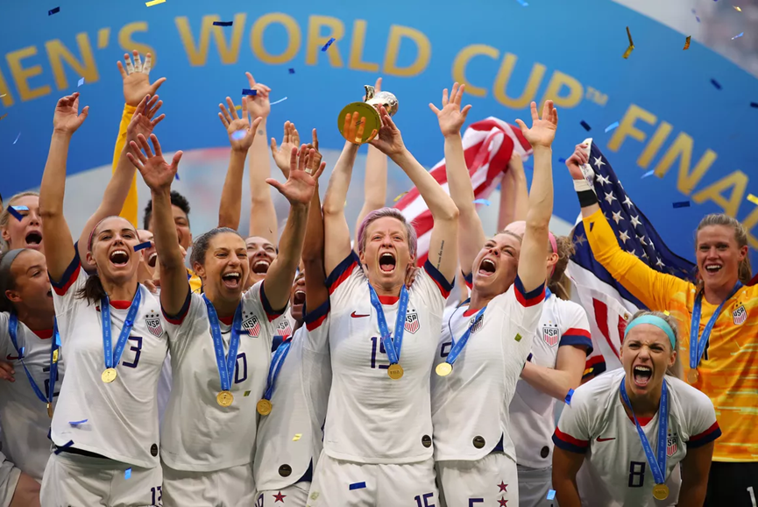
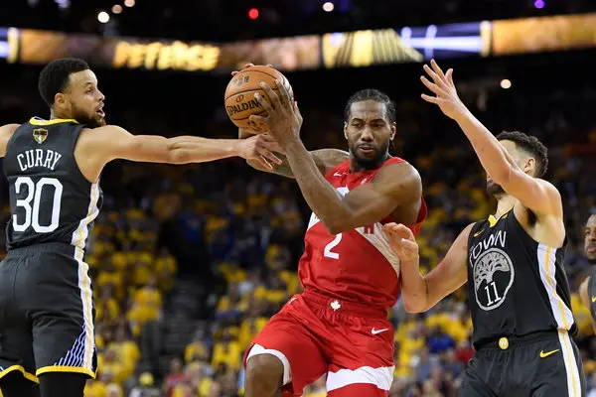


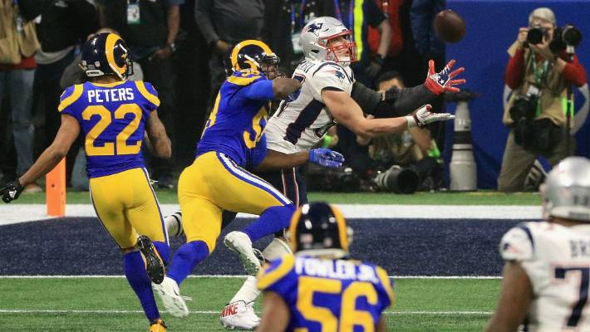

This Includes A Front Row Seat To Marquee Sporting Events Ingrained In
Popular Culture Airing Exclusively On Multiscreen TV Throughout The Year
Washington Nationals win their
first World Series title
Bianca Andreescu defeats
Serena Williams to win the
2019 U.S. Open
U.S. Women’s Soccer team wins their fourth World Cup
Toronto Raptors beat the Golden State Warriors to win the 2019 NBA Championship
October 2019
September 2019
July 2019
June 2019
Country House wins the 2019 Kentucky Derby at 65-1 odds after Maximum Security was disqualified
Tiger Woods wins the Masters, his first major win in 11 years
New England Patriots win their sixth Super Bowl
Clemson beats Alabama to win the CFP National Championship
May 2019
April 2019
February 2019
January 2019
  11
This information is exclusively provided to VAB members and qualified marketers. Further distribution is prohibited.

Slide 12
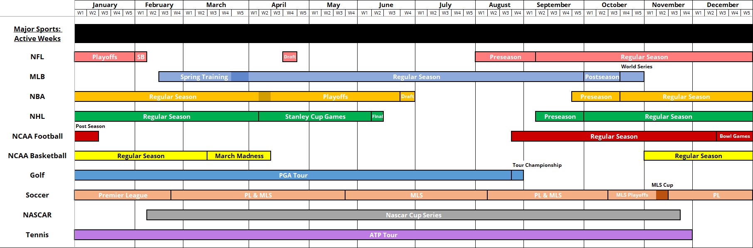
There Is Continuity Throughout The Year As Live Sports Are Always ‘In Season’
With At Least Five Major Sports Active In Each Month
2020 Calendar For 10 Major Sports
  12
This information is exclusively provided to VAB members and qualified marketers. Further distribution is prohibited.

Slide 13
Which means, at an average subscriber cost of $13.30 per month, viewers can enjoy a selection of 1,176 live sporting events on average each month airing on national TV and available across devices
# of National Live Sporting Events Per Month
2019
1,385
1,248
1,315
1,248
1,239
1,231
1,143
1,118
1,154
1,142
1,082
805
Note: Summer is dominated by the MLB, a sport that has the vast majority of its games airing on RSNs which are not reflected in the above chart.
Source: VAB analysis of Nielsen NPower, Total Day, ad-supported cable TV + broadcast TV, live originals/premieres only, January – December 31, 2019; includes Spanish language networks; excludes regional sports networks, local broadcast airings and digital airings of sports through MVPD / network TV apps.
  13
This information is exclusively provided to VAB members and qualified marketers. Further distribution is prohibited.

Slide 14
Projected out annually
at a cost of $159.60 per MVPD subscriber for sports TV networks, viewers have access to over 14,100 nationally televised live sports over 12 months.
In fact, based on 2019, there were at least two live sporting events airing every single day of the year with 90% of the days airing at least 20 live games.
How to read: In 2019, 3 days featured between 2-9 live sporting events airing on national TV.
Source: VAB analysis of Nielsen NPower, Total Day, live originals/premieres only, January 1 – December 31, 2019; includes Spanish language networks; excludes regional sports networks, local broadcast airings and digital airings of sports through MVPD / network TV apps. MVPD subscriber costs based on VAB analysis of S&P Global Intelligence, The 2019 Sports Report.
  14
This information is exclusively provided to VAB members and qualified marketers. Further distribution is prohibited.

Slide 15
On average, each day
of the week features
at least 23 live sporting events throughout the year with a skew towards weekends
Average # of National Live Sporting Events Each Day of the Week
CY 2019
68
53
39
35
31
27
23
Source: VAB analysis of Nielsen NPower, Total Day, ad-supported cable TV + broadcast TV, live originals/premieres only, January 1 – December 31, 2019; includes Spanish language networks; excludes regional sports networks, local broadcast airings and digital airings of sports through MVPD / network TV apps.
  15
This information is exclusively provided to VAB members and qualified marketers. Further distribution is prohibited.

Slide 16





































Popular ‘Branded’ Live Sports Series ‘Own’ Specific Days Throughout The Year
Sampling of Signature Live Sports Series
Monday
Tuesday
Wednesday
Thursday
Friday
Saturday
Sunday
  16
This information is exclusively provided to VAB members and qualified marketers. Further distribution is prohibited.

Slide 17






















































In addition to national TV, Regional Sports Networks, which each broadcast hundreds of live professional and collegiate sporting
events annually,
provide coverage of
local teams throughout
all major DMAs
This information is exclusively provided to VAB members and qualified marketers. Further distribution is prohibited.

Slide 18
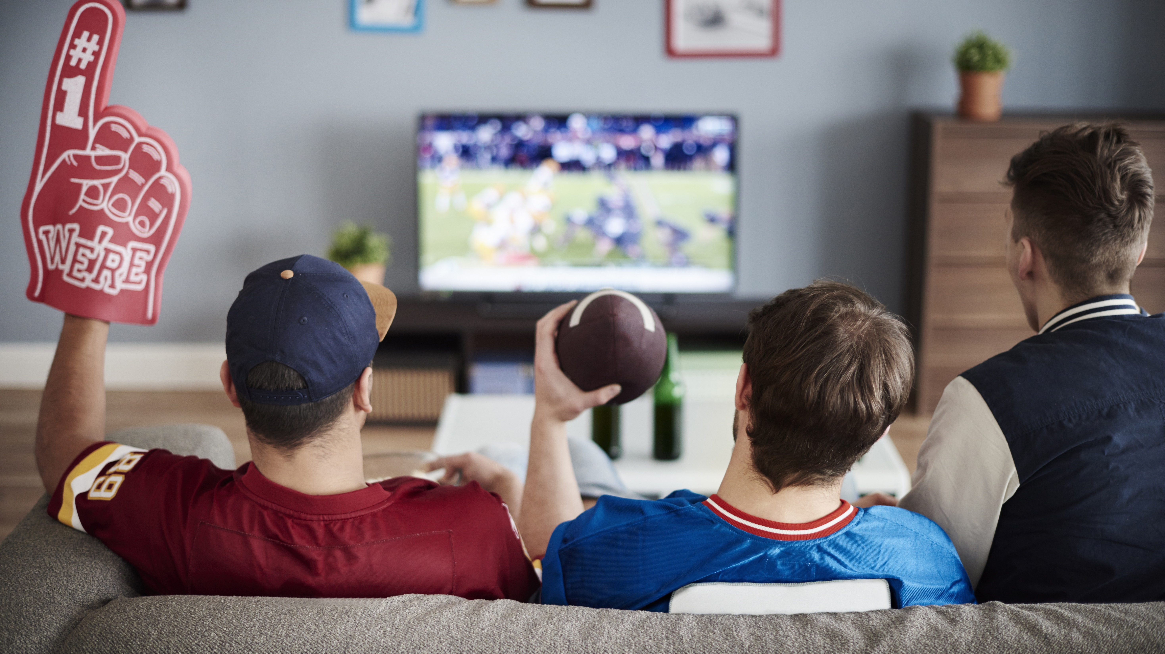
Viewers Embrace Sports Content On TV

Slide 19
Live sports are universal and one of the most popular genres across demographics with
a reach of over
281 million viewers, which equates to
92% of the population
P2+ Annual Cume Reach (000) for National Live TV Sporting Events
CY 2019
Reach %
94%
93%
92%
(excluding Winter Olympics)
Source: VAB analysis based on data from Nielsen NPower R&F Program Report, Total Day, Live+7, P2+, ad-supported cable TV + broadcast TV, based on calendar year; includes Spanish language networks; excludes regional sports networks, local broadcast airings and digital airings of sports through MVPD / network TV apps. Reflects live sporting events only.
  19
This information is exclusively provided to VAB members and qualified marketers. Further distribution is prohibited.

Slide 20
On average, these
281 million viewers devote over 6 hours each month to watching live sports,
a 3% increase vs. 2017.
Collectively, this adds
up to nearly 22 billion hours of live sports watched on TV annually.
National Live TV Sporting Events: Average Annual Minutes Viewed
P2+
(excluding Winter Olympics)
Source: VAB analysis based on data from Nielsen NPower R&F Program Report, Total Day, Live+7, P2+, ad-supported cable TV + broadcast TV, based on calendar year; includes Spanish language networks; excludes regional sports networks, local broadcast airings and digital airings of sports through MVPD / network TV apps. Reflects live sporting events only.
  20
This information is exclusively provided to VAB members and qualified marketers. Further distribution is prohibited.

Slide 21
The excitement and interest that fans have around sports means there’s an inherent immediacy to TV viewership – in fact,
99% of viewing is
done either live or
live + same day
National Live TV Sporting Events: Viewership By Stream
% of Total Viewing Hours, CY 2019
Source: VAB analysis of Nielsen NPower R&F Program Report, Total Day, P2+ & P18-34, ad-supported cable TV + broadcast TV, January 1 – December 31, 2019; includes Spanish language networks; excludes regional sports networks, local broadcast airings and digital airings of sports through MVPD / network TV apps. Reflects live sporting events only.
  21
This information is exclusively provided to VAB members and qualified marketers. Further distribution is prohibited.

Slide 22

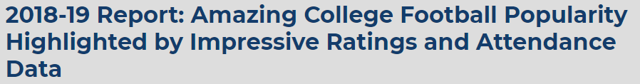
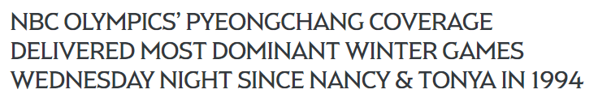
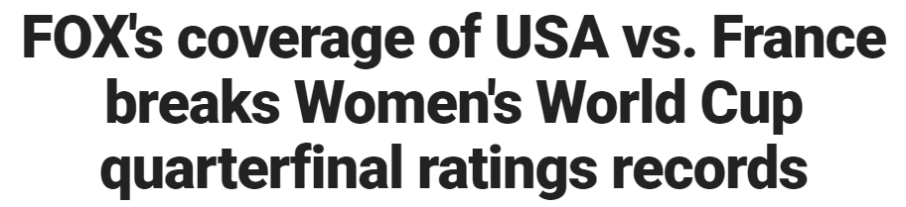
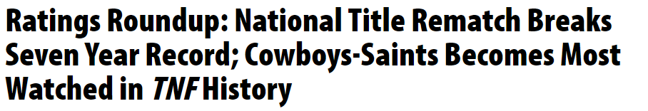
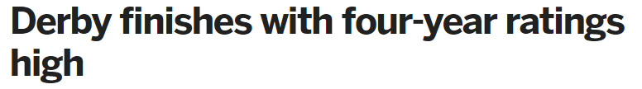
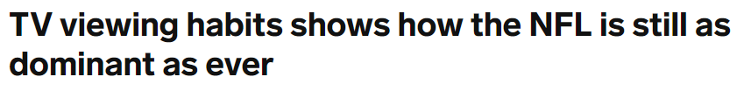
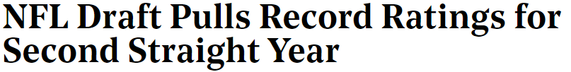
Speaking of Excitement & Interest, Many Sporting Events Across Leagues
Have Been Setting Record-Breaking Ratings Over The Past Year
  22
This information is exclusively provided to VAB members and qualified marketers. Further distribution is prohibited.

Slide 23

One-Two Punch: Sports Engagement Extends Across Screens

Slide 24






















TV Brands Extend Their Reach & Engagement Through Live Streaming
On Digital Platforms Which Allows Additional Sports Viewing Anywhere
Sampling of Live Streaming Mobile Apps
  24
This information is exclusively provided to VAB members and qualified marketers. Further distribution is prohibited.

Slide 25
Over 80% of fans who go online for sports content visit at least one TV-branded digital sports platform monthly.
Younger adult males are even more likely to visit
a TV-branded sports platform, while at least two-thirds of younger females also visit these platforms.
TV-Branded Digital Sports Platforms’ Cume Reach
as a % of Sports Category Digital Universe
December ‘19
Source: VAB analysis of Comscore Audience Duplication, multiplatform (web and mobile), December 2019, Total Audience (Desktop 2+, Mobile 18+), 18-24, 25-34, 18-34, unduplicated unique visitors based on a comScore-defined sports category vs. custom created Sports TV Branded Website subcategory which includes digital platforms such as ESPN.com, Fox Sports, CBS Sports & NBC Sports.
  25
This information is exclusively provided to VAB members and qualified marketers. Further distribution is prohibited.

Slide 26
Three-quarters of time spent online with sports content by adults 18-34 is with TV-branded digital platforms
Sports Category: % of Total Minutes Viewed Online
December ‘19
Total Audience
P18-34
Note: “All The Rest” reflects non TV-related websites like USA Today Sports, SB Nation, Reddit Sports, Deadspin.com, Whistle Sports, etc
VAB analysis of Comscore Audience Duplication, multiplatform (web and mobile), December 2019, Total Audience (Desktop 2+, Mobile 18+) & P18-34, Total Minutes based on a comScore-defined sports category vs. custom created Sports TV Branded Website subcategory which includes digital platforms such as ESPN.com, Fox Sports, CBS Sports & NBC Sports.
  26
This information is exclusively provided to VAB members and qualified marketers. Further distribution is prohibited.

Slide 27










In Fact, The Top 5 Digital Sports Platforms For Adults 18-34 Each Month
Throughout The Year Are TV-Related Brands
Top 5 Sports Digital Platform Rank By Total Minutes Viewed (P18-34)
January
February
March
April
May
June
1)
1)
1)
1)
1)
1)
2)
2)
2)
2)
2)
2)
3)
3)
3)
3)
3)
3)
4)
4)
4)
4)
4)
4)
5)
5)
5)
5)
5)
5)
July
August
September
October
November
December
1)
1)
1)
1)
1)
1)
2)
2)
2)
2)
2)
2)
3)
3)
3)
3)
3)
3)
4)
4)
4)
4)
4)
4)
5)
5)
5)
5)
5)
5)
Source: VAB analysis of comScore MediaMetrix, multiplatform media trend data, January-December 2019; sports category, P18-34, excludes non-sports media brands.
  27
This information is exclusively provided to VAB members and qualified marketers. Further distribution is prohibited.

Slide 28
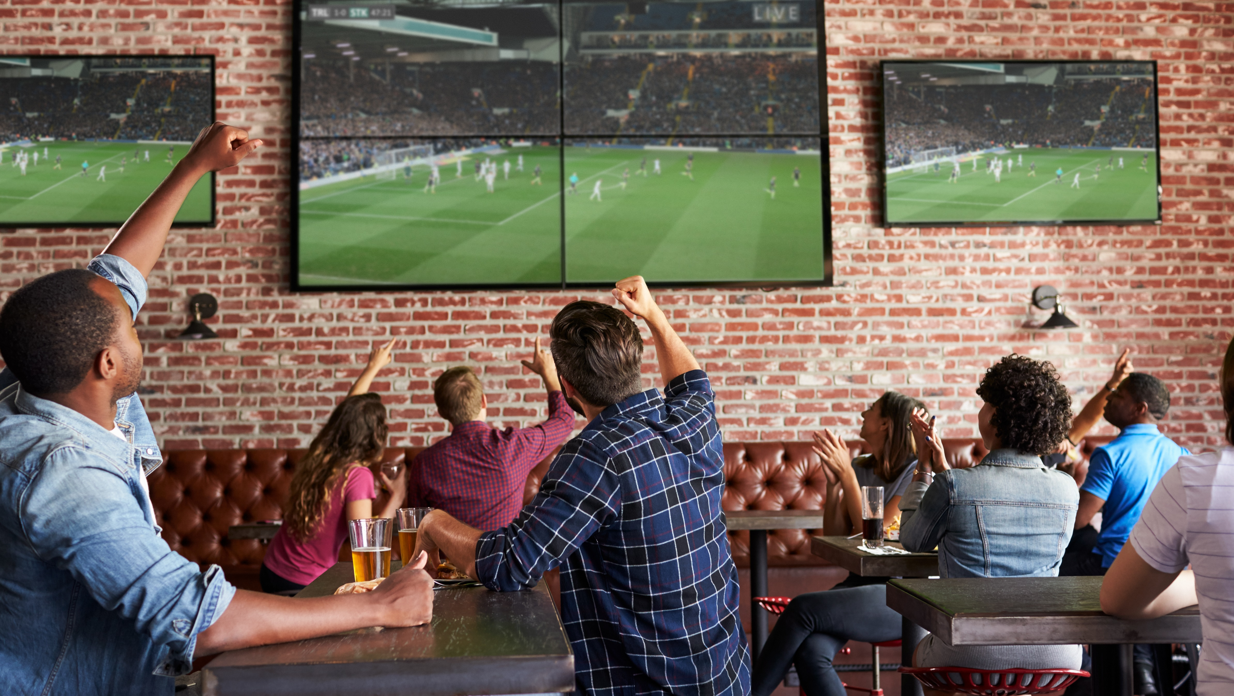
Away Games: Building Audiences Through Out-Of-Home Viewing

Slide 29
Out-Of-Home viewing
of live sports on TV is
an inherently communal, social event where friends and family gather to root on their favorite teams
or use the time as an occasion to socialize with each other during their busy lives.
With a 55% male / 45% female breakdown, OOH sports viewing is rather balanced with just a
slight male skew.
How Many People Do You Watch Sports With Out-Of-Home?
Adults 18+
15% of males and 11% of females watch sports out-of-home with more than 10 people
Source: VAB analysis of Nielsen Fall Sports, Game On: Driving Brand Engagement and Co-Viewing On Linear TV With Out-Of-Home Audiences; 2019. Reflects multiple responses chosen from respondents in Nielsen’s Out-of-Home Fall Sports Location Survey, General Population (10/29/18-10/31/18). Survey participants were able to select responses for each viewing event, leading to a distribution of over 100%.
  29
This information is exclusively provided to VAB members and qualified marketers. Further distribution is prohibited.

Slide 30
In addition to creating
a festive atmosphere among family, friends and fellow fans and providing a viewing opportunity for those
‘on the go;’ out-of-home also builds additional exposure for linear TV sports by reaching people who may not ordinarily watch sports at home
What are Reasons for Viewing Sports Out-Of-Home?
Adults 18+
Source: VAB analysis of Nielsen Fall Sports, Game On: Driving Brand Engagement and Co-Viewing On Linear TV With Out-Of-Home Audiences; 2019. Reflects multiple responses chosen from respondents in Nielsen’s Out-of-Home Fall Sports Location Survey, General Population (10/29/18-10/31/18). Base = A18+ Watch regularly OOH.
  30
This information is exclusively provided to VAB members and qualified marketers. Further distribution is prohibited.

Slide 31
The out-of-home viewing opportunities for sports TV is nearly limitless, especially for younger adults who are comfortable watching wherever they are – whether it’s at a restaurant or bar, at a friend’s house, at the gym, in transit, while traveling or during downtime at work
Where Do People View Sports Out-Of-Home?
Source: VAB analysis of Nielsen Fall Sports, Game On: Driving Brand Engagement and Co-Viewing On Linear TV With Out-Of-Home Audiences; 2019. Reflects multiple responses chosen from respondents in Nielsen’s Out-of-Home Fall Sports Location Survey, General Population (10/29/18-10/31/18). Base = All respondents 18+. Respondents can select multiple locations.
  31
This information is exclusively provided to VAB members and qualified marketers. Further distribution is prohibited.

Slide 32
The communal aspect of
out-of-home viewing is
also effective for driving engagement around ads airing during live sporting events.
With 92% of OOH sports viewers saying they pay attention to at least some of the ads airing, it’s easy for them to talk to others about brands they see and research brands on their mobile devices while watching a game.
This behavior is even more prevalent among younger demos.
Action Taken as a Result of Seeing an Ad While Watching Sports Out-Of-Home
Source: VAB analysis of Nielsen Fall Sports, Game On: Driving Brand Engagement and Co-Viewing On Linear TV With Out-Of-Home Audiences; 2019. Reflects multiple responses chosen from respondents in Nielsen’s Out-of-Home Fall Sports Location Survey, General Population (10/29/18-10/31/18). Base = Respondents who are likely to notice advertised brands while watching OOH.
  32
This information is exclusively provided to VAB members and qualified marketers. Further distribution is prohibited.

Slide 33

Key Takeaways
Watched by 96% of fans and preferred by 72%, home viewing of live sports offers an inexpensive, and always available, front row seat to over 14,100 nationally televised sporting events each year
Live sports watched on national TV delivers 281 million viewers with an aggregated time spent of nearly 22 billion hours annually
Sports are nearly DVR-proof, even among younger demos. 94% of sports viewing by adults 18-34 is done live and 99% is either live or live + same day
80% of adults 18-34 visit at least one TV-branded digital sports platform monthly which allows for additional viewing and streaming of live sports anywhere
Out-of-home viewing also builds additional exposure of multiscreen TV by reaching people who may not ordinarily watch sports at home and these people are receptive to ads as well – 33% of adults 18-24 have purchased a product they saw advertised while watching sports outside of the home
33

Slide 34




Contact Us
Register for Complimentary Access to VAB Insights
Kathy Grey
SVP, Research Innovation
kathyg@thevab.com
Reed Kiely
Insights Manager
reedk@thevab.com
Karolina Guillen
Senior Insights Analyst
karolinag@thevab.com
VAB
@VABIntel

Slide 35

Appendix: A Deeper Look Into Sports TV Programming

Slide 36
Among the over 14,100 live sporting events shown on national TV annually, 89% air on ad-supported national cable TV
Source: VAB analysis of Nielsen NPower, Total Day, live originals only, January 1 – December 31, 2019; includes Spanish language networks; excludes regional sports networks, local broadcast airings and digital airings of sports through MVPD / network TV apps.
  36
This information is exclusively provided to VAB members and qualified marketers. Further distribution is prohibited.

Slide 37
Ad-supported national cable TV makes up a large majority of live sporting events every day of the week
Average # of National Live Sporting Events Each Day of the Week
CY 2019
68
53
39
31
35
27
23
Source: VAB analysis of Nielsen NPower, Total Day, live originals/premieres only, January 1 – December 31, 2019; includes Spanish language networks; excludes regional sports networks, local broadcast airings and digital airings of sports through MVPD / network TV apps.
  37
This information is exclusively provided to VAB members and qualified marketers. Further distribution is prohibited.

Slide 38
On average, there are 1,051 live sporting events airing on ad-supported national cable TV each month and available across devices
# of National Live Sporting Events Per Month
CY 2019
1,385
1,315
1,248
1,248
1,239
1,231
1,143
1,118
1,154
1,142
1,082
805
Note: Summer is dominated by the MLB, a sport that has the vast majority of its games airing on RSNs which are not reflected in the above chart.
Source: VAB analysis of Nielsen NPower, Total Day, live originals/premieres only, January – December 31, 2019; includes Spanish language networks; excludes regional sports networks, local broadcast airings and digital airings of sports through MVPD / network TV apps.
  38
This information is exclusively provided to VAB members and qualified marketers. Further distribution is prohibited.

Slide 39
Time spent viewing
live sporting events between national broadcast TV and
ad-supported cable TV is fairly even with
a slight skew towards broadcast TV (52% share) which is driven by NFL games
National Live TV Sporting Events: Total Cume P2+ Hours Viewed
Ad-Supported Cable TV vs. Broadcast TV
CY 2017 & 2019
2017
2019
21.6 Billion
21.8 Billion
21.5 Billion
21.8 Billion
19.9 Billion
Hours
Hours
20.1 Billion
Hours
Hours
Hours
Hours
Source: VAB analysis of Nielsen NPower R&F Program Report, Total Day, P2+, based on calendar year; includes Spanish language networks; excludes regional sports networks, local broadcast airings and digital airings of sports through MVPD / network TV apps. Reflects live sporting events only.
  39
This information is exclusively provided to VAB members and qualified marketers. Further distribution is prohibited.

Slide 40
Ad-supported cable TV networks are projected to invest almost $20 Billion on sports programming by 2022
Source: VAB analysis of S&P Global Intelligence, Kagan, 2020: programming cost estimates reflect ad-supported cable TV & Regional Sports Networks; excludes programming costs by broadcast networks.
  40
This information is exclusively provided to VAB members and qualified marketers. Further distribution is prohibited.

