Slide 1
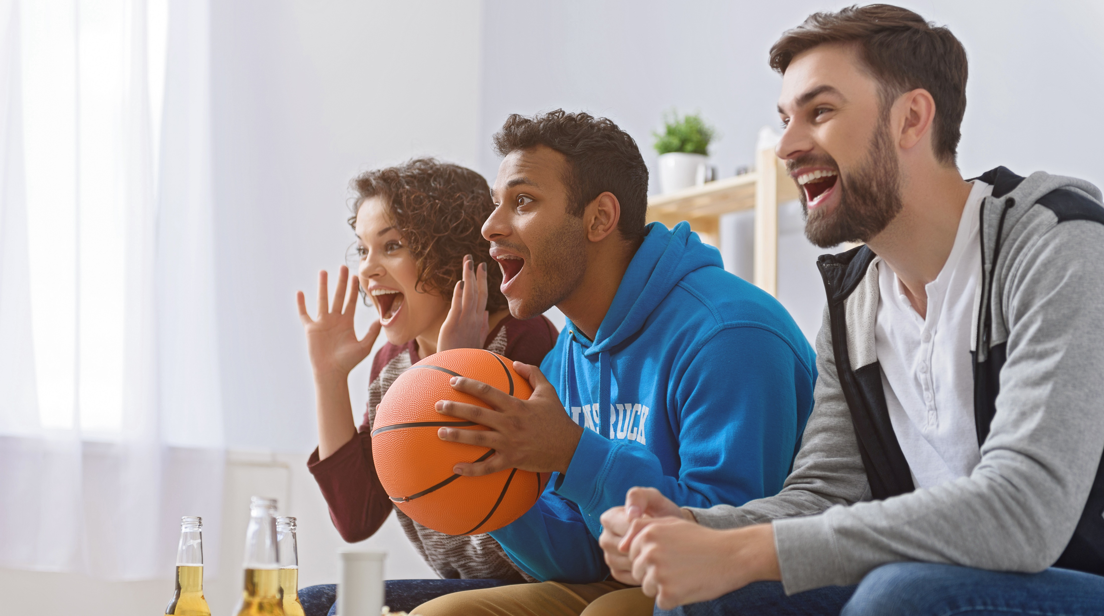


2020
The Best Seats In The House
Recreating The Gameday Sports Experience
At Home

Slide 2

About VAB
VAB is an insights-driven organization that inspires marketers to reimagine their media strategies resulting in fully informed decisions.
Drawing on our marketing expertise, we simplify the complexities in our industry and discover new insights that transform the way marketers look at their media strategy.
Simplify
We save you time by bringing you the latest data & actionable takeaways you can use to inform your marketing plans.
Discover
We keep you one step ahead with the latest thinking so you can create innovative, forward-looking strategies.
Transform
We help you build your brand by focusing on core marketing principles that will help drive tangible business outcomes.
This information is exclusively provided to VAB members and qualified marketers. Further distribution is prohibited.
PAGE 2

Slide 3
Contents
1
2
3
4
Sports Are Back!
Satisfying Fans’ Thirst For Live Sporting Events
The Real ‘Home Field Advantage’
A Front Row Seat To
All Live Sports
Away Games
Building Audiences Through Out-Of-Home Viewing
Key Takeaways For Marketing Plans
This information is exclusively provided to VAB members and qualified marketers. Further distribution is prohibited.
PAGE 3

Slide 4
What You’ll Learn…
The key benefits to sports fans that make ‘at home’ their most preferred viewing experience and how these will be further amplified during a prolonged time of social distancing and limited, or no, in-person game attendance.
The ability of sports to engage fans of all demographics that are hungry for more sports – males, females & multicultural
The opportunities for marketers to engage with viewers during live sports programming and drive consumer action.
This information is exclusively provided to VAB members and qualified marketers. Further distribution is prohibited.
PAGE 4

Slide 5

Sports Are Back!
Satisfying Fans’ Thirst For Live Sporting Events

Slide 6
Although the second half of 2020 will simultaneously feature all the major leagues and many high-impact events, the appetite for, and coverage of, sports has always been huge.
Looking back at 2019 as our last ‘normal’ year in sports:
Over 14,100 live sporting events aired across national TV platforms
330 days of the year featured at least 20 live games broadcast across these platforms
# of National Live TV Sporting Events Aired Daily
CY 2019
How to read: In 2019, 3 days featured between 2-9 live sporting events airing on national TV.
Source: VAB analysis of Nielsen NPower, Total Day, live originals/premieres only, January 1 – December 31, 2019; includes Spanish language networks; excludes regional sports networks, local broadcast airings and digital airings of sports through MVPD / network TV apps. MVPD subscriber costs based on VAB analysis of S&P Global Intelligence, The 2019 Sports Report.
PAGE 6

Slide 7

Before the return of major sports, most fans watched what they could to satisfy their passion this year, but they are hungry for much, much more
With only 30% of 2019’s average minutes watched so far in 2020, fans have the thirst and capacity for much more sports this year
P2+ Reach (000) for National Live TV Sporting Events: YoY Comparison
P2+ National Live TV Sporting Events: Average Annual Minutes Viewed
Reach %
89%
85%
4,364
Source: VAB analysis based on data from Nielsen NPower R&F Program Report, Total Day, Live+7, P2+, ad-supported cable TV + broadcast TV, Jan 1 – July 20 of 2019 & 2020 & July 21 – Dec 31 2019; includes Spanish language networks; excludes regional sports networks, local broadcast airings and digital airings of sports through MVPD / network TV apps. Reflects live sporting events only.
This information is exclusively provided to VAB members and qualified marketers. Further distribution is prohibited.
PAGE 7

Slide 8
The 2nd half of 2020 will be very active between already planned sports and those that have re-tooled their schedules to play a modified season
While the pandemic forced the MLB, NBA & NHL to restart their seasons in late July and early-August, premier sporting events like the French Open and Kentucky Derby were pushed to September and October, respectively
Magenta = reflects sports seasons / sporting events that were shifted to new dates, and being held outside of their normal season, due to pandemic-related postponements.
Note: Dates subject to change, not all schedules are finalized
This information is exclusively provided to VAB members and qualified marketers. Further distribution is prohibited.
PAGE 8

Slide 9



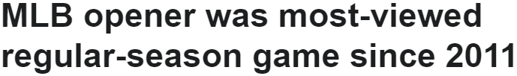
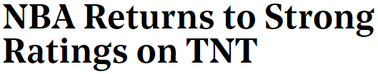









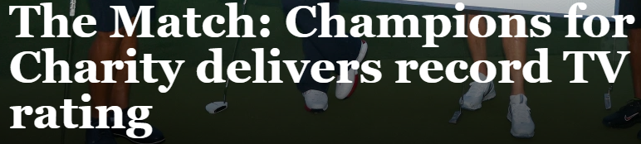

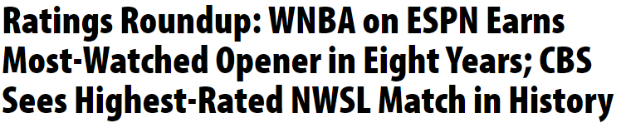


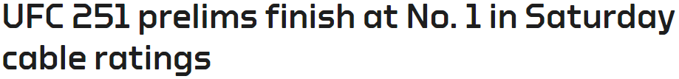
Already, the return of sports over the summer is helping to quench the thirst of fans as viewership and ratings across sports break records
This information is exclusively provided to VAB members and qualified marketers. Further distribution is prohibited.
PAGE 9

Slide 10

Summary: Sports Are Back!
The viewers’ appetite, and television coverage of, sports has always been very huge so, due to the pandemic-related postponement of most sports, fans are hungry to re-embrace their passion as their favorite leagues return to action
Between the already planned sports seasons and several other major leagues playing outside of their typical schedule dates, marketers will have even more opportunities to connect and engage with consumers through live sports programming within the second half of the 2020
Viewers have shown their excitement for the return of sports as events across leagues have been breaking viewership records over the summer
This information is exclusively provided to VAB members and qualified marketers. Further distribution is prohibited.
PAGE 10

Slide 11
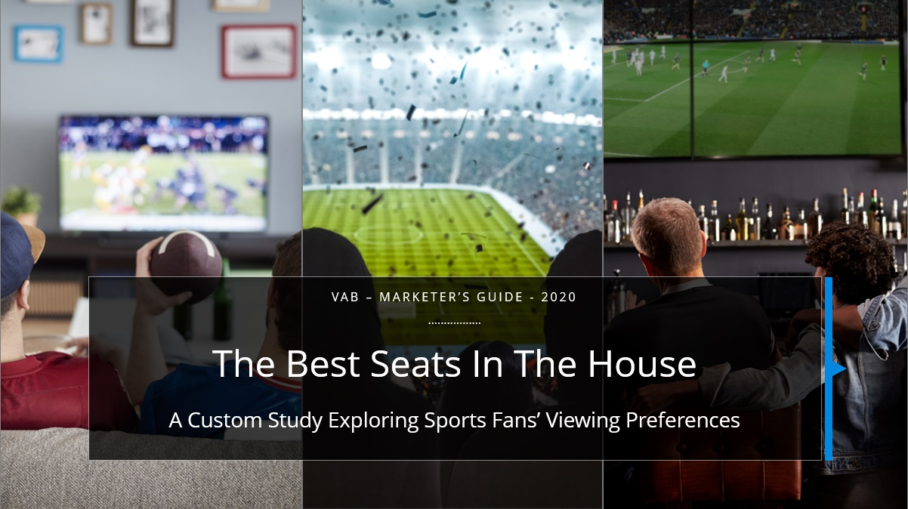
Reintroducing our custom study from earlier this year with a focus on
the key insights and behaviors that are sure to be even more important during this time of social distancing and limited, or no, game attendance
In January 2020, we released our marketer’s guide, ‘The Best Seats In The House,’ to help marketers understand the passion of today’s sports fan and the motivating factors behind their preferences for live sports viewing, particularly at-home viewing vs. in-person event attendance.
To do this, VAB commissioned Dynata to conduct the ‘Sports Viewing Experience’ Survey fielded online in September 2019. The results are based on 1,023 adult 18+ U.S. respondents who identified themselves as a sports fan (either casual, moderate or avid).
For this re-release, we’re focusing on the key roles that at-home viewing plays in the sports fans’ life so marketers can understand
their behaviors which are sure to be amplified for the near future.
This information is exclusively provided to VAB members and qualified marketers. Further distribution is prohibited.
PAGE 11

Slide 12

The Real ‘Home Field Advantage’
A Front Row Seat To All Live Sports

Slide 13
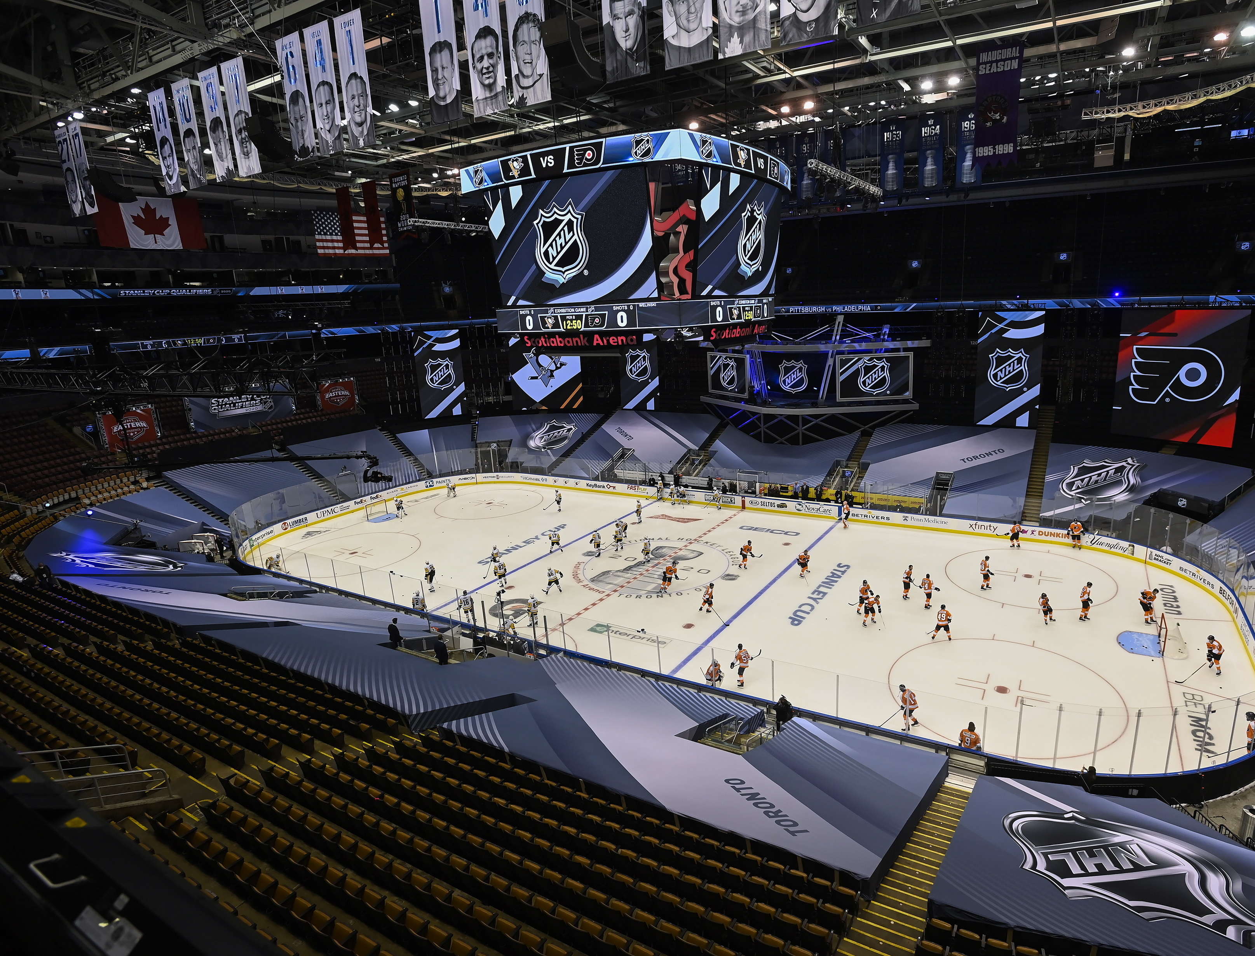
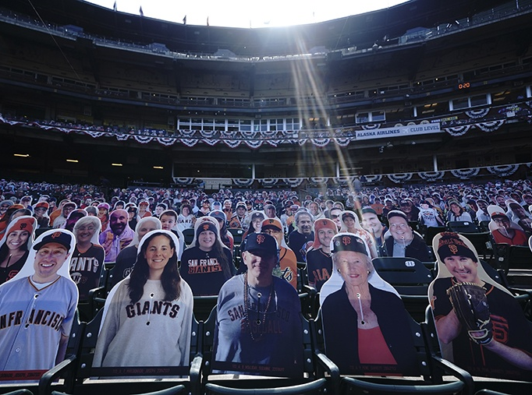


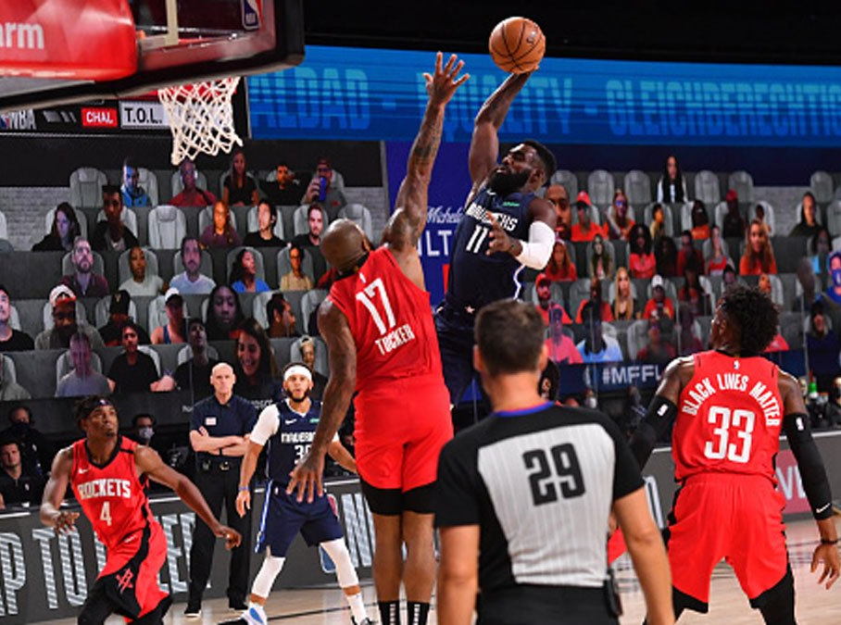
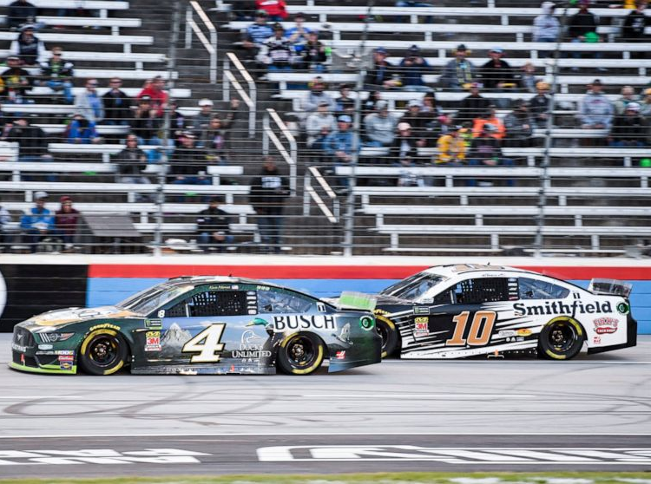


Although sports are back, the stadium experience looks very different
Social distancing has led sports leagues to use cut-out fans, ‘virtual’ fans for TV broadcasts and pumped in crowd noise to re-create the missing elements from not having fans in attendance
No in-stadium attendance for fans
No in-stadium attendance for fans
Crowd noise pumped in
Cut-outs of real fans in the stands
Two-city* ‘bubble’ to keep players and staff isolated
Crowd noise artificially created
No in-stadium attendance for fans
Limited in-person fan attendance
Virtual fans via screens & crowd noise
Social distancing and masks required
‘Bubble’ in Orlando to keep players and staff isolated
Some venues have banned tailgating
*NHL ‘Bubble’ cities are Edmonton & Toronto
This information is exclusively provided to VAB members and qualified marketers. Further distribution is prohibited.
PAGE 13

Slide 14




But even before social distancing prohibited people from attending games, most fans preferred to watch sports at home anyways
Where Do Sports Fans Prefer To Watch Sports?
All Sports Fans
Home
Stadium
or Arena
Out-Of-Home
(Bar/Restaurant, Someone Else’s Home or Elsewhere)
72%
19%
8%
Source: VAB / Dynata ‘Sports Viewing Experience Survey,’ September 2019. Survey base = self-identified sports fans, P18+, Q11: When thinking about the overall sports viewing experience, where do you prefer to watch sports? All Sports Fans based on P18+, Avid Fans Respondents (habitually watch sports on TV, intensely follow teams / players, etc), Casual Fans Respondents (occasionally watch sports on TV, stay up to date on major sports news, etc. Note: Numbers don’t add to 100% due to respondents ability to select more than one answer.
This information is exclusively provided to VAB members and qualified marketers. Further distribution is prohibited.
PAGE 14

Slide 15


Almost all sports fans regardless of their level of fandom, age, gender or ethnicity prefer to watch live sports at home
Where Do Sports Fans Prefer To Watch Sports?
Home
Stadium
or Arena
Out-Of-Home
(Bar/Restaurant, Someone Else’s Home or Elsewhere)
Sports Fan Type
In ‘normal’ times, avid fans, adults 18-34 and females are more likely than others to prefer the experience and gameday atmosphere that attending a game in-person provides.
Casual sports fans, younger demos and multicultural fans are more likely than others to prefer watching ‘out-of-home’ as part of social gatherings.
All
72%
19%
8%
Avid
71%
22%
8%
Moderate
75%
19%
6%
Casual
70%
16%
14%
Female
70%
22%
7%
Male
74%
18%
9%
Black
65%
17%
19%
Hispanic
67%
18%
14%
P18-34
66%
23%
11%
P35+
76%
18%
9%
Source: VAB / Dynata ‘Sports Viewing Experience Survey,’ September 2019. Survey base: self-identified sports fans, P18+. Q10: Where do you typically watch sports? All Sports Fans based on P18+, Avid Fans Respondents (habitually watch sports on TV, intensely follow teams / players, etc), Moderate Fans Respondents (watch sports on TV a few times a week, routinely follow team / player news, etc), Casual Fans Respondents (occasionally watch sports on TV, stay up to date on major sports news, etc). Note: Numbers don’t add to 100% due to respondents ability to select more than one answer.
PAGE 15

Slide 16
In our original custom study, we identified what fans said were the best and worst aspects of attending sporting events in person
Favorite Reasons To Go To A Sporting Event
Reasons That Would Keep You From Attending A Sporting Event
I enjoy the gameday atmosphere and making 'a day of it’ by tailgating or going to area bars
Too expensive (tickets, concessions, parking, etc)
Too much traffic
I like spending time with family and friends
Stadium / arena is too far away
I appreciate the camaraderie and community with other fans
Unpredictable weather
I like to show team pride and support my favorite team
Long lines for entry, concessions, bathrooms
Seats are usually too far away from the field / court
I like the ability to see everything happening on the field
This information is exclusively provided to VAB members and qualified marketers. Further distribution is prohibited.
PAGE 16

Slide 17
Although fans already greatly prefer ‘at-home’ viewing to anything else, those that won’t be able to attend games this season will easily replicate the gameday experience at home, without the hassles of going to the game
Favorite Reasons To Go To A Sporting Event
How Fans Recreate The Experience At Home
I enjoy the gameday atmosphere and making 'a day of it’ by tailgating or going to area bars
Cooking / grilling in the backyard / ordering in pizza, wings and beer
I like spending time with family and friends
Hosting gatherings with their close circle of friends
and family
I appreciate the camaraderie and community with other fans
Engaging with ‘shared interest’ communities through online forums and social media platforms
I like to show team pride and support my favorite team
Playing festive music, wearing the team colors and apparel and sitting in their lucky seat
I like the ability to see everything happening on the field
What’s a better view than having a front row seat from your couch for every game? Not to mention the available pre-to-post-game coverage on TV?
This information is exclusively provided to VAB members and qualified marketers. Further distribution is prohibited.
PAGE 17

Slide 18

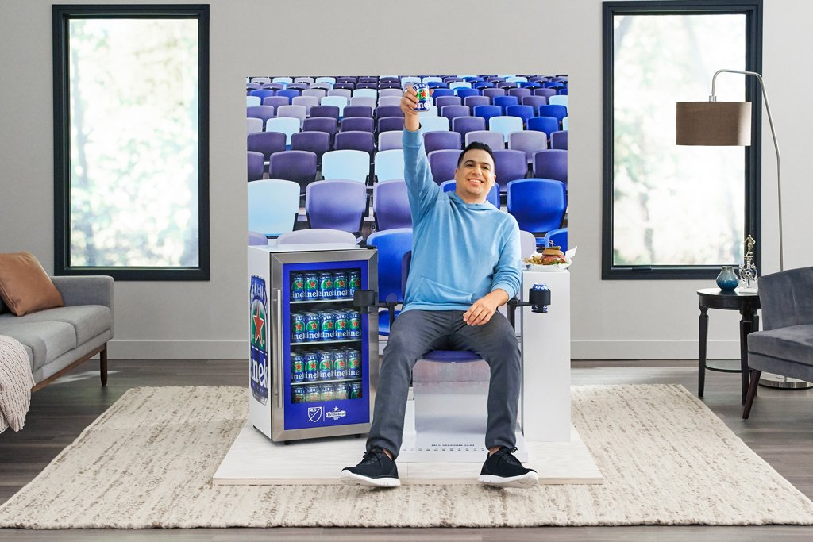

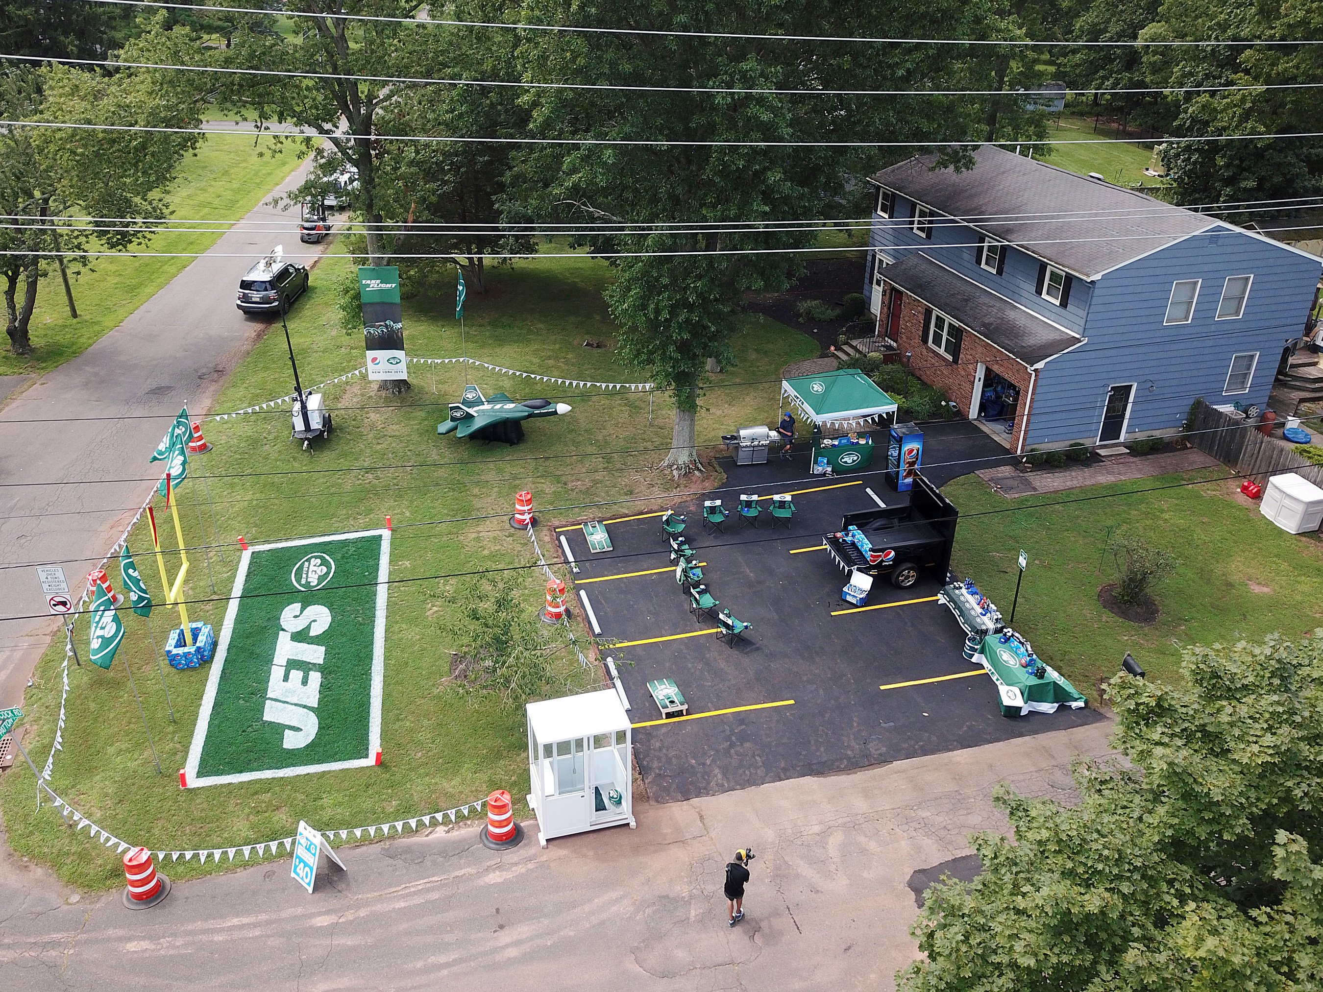

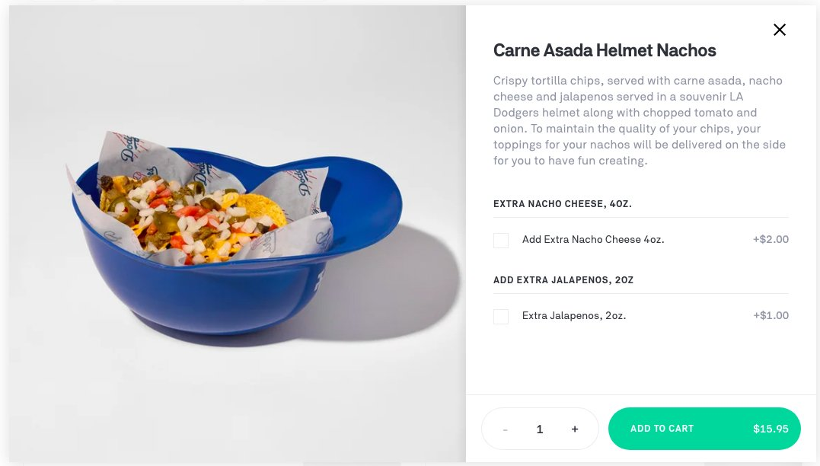


Brands are even helping fans re-create the gameday atmosphere at home with food, fun, games and authentic tailgate experiences
Stadium In A Box
‘Homegate’
Pepsi’s ‘Homegate’ sweepstakes is bringing the tailgate to fans’ houses. Winners won’t be missing the parking lots with the 16 sq-foot tailgating box that includes an outdoor projector, custom
corn hole sets and Pepsi. The brand even recreated a stadium parking lot tailgate experience for one lucky NY Jets fan complete with grill and painted end zone.
Heineken is bringing the stadium to the fans with their “Stadium in a Box” to promote their zero-alcohol Heineken 0.0. The contest winners receive an official stadium seat, branded with their team’s logo and a mini-fridge.
Dodger Home Plates
Stadium Ketchup Kits
The LA Dodgers partnered with Postmates to bring dishes from Dodger Stadium to fans’ homes. Postmates is offering delivery of “Dodgers Home Plates” in LA with fans’ in-stadium favorites including premium Dodger Dogs, Dodgers’ blue gelato and the team’s carne asada helmet nachos.
Heinz created 200 “Stadium Ketchup Kits” to help bring a bit of the ballpark home. The stadium-sized dispenser comes filled with ketchup, alongside a coupon for a free pack of Oscar Mayer hot dogs and a foam finger so fans’ can cheer on their teams from home.
This information is exclusively provided to VAB members and qualified marketers. Further distribution is prohibited.
PAGE 18

Slide 19
Connection
(team, family/friends, social following)
Camaraderie
&
Community
Commitment
(team spirit & support)
Comfort
&
Convenience
Contact
(experiences)
Comprehension
(commentary & analysis)
Through their fan passion and ability to be social around shared interests, either with a close group of family and friends or through multiscreen platforms, at-home sports viewing satisfies six essential human need states.
The fulfillment of these need states is more important than ever considering the extended lockdowns, physical isolation
and uncertainties that the country has recently endured.
This information is exclusively provided to VAB members and qualified marketers. Further distribution is prohibited.
PAGE 19

Slide 20
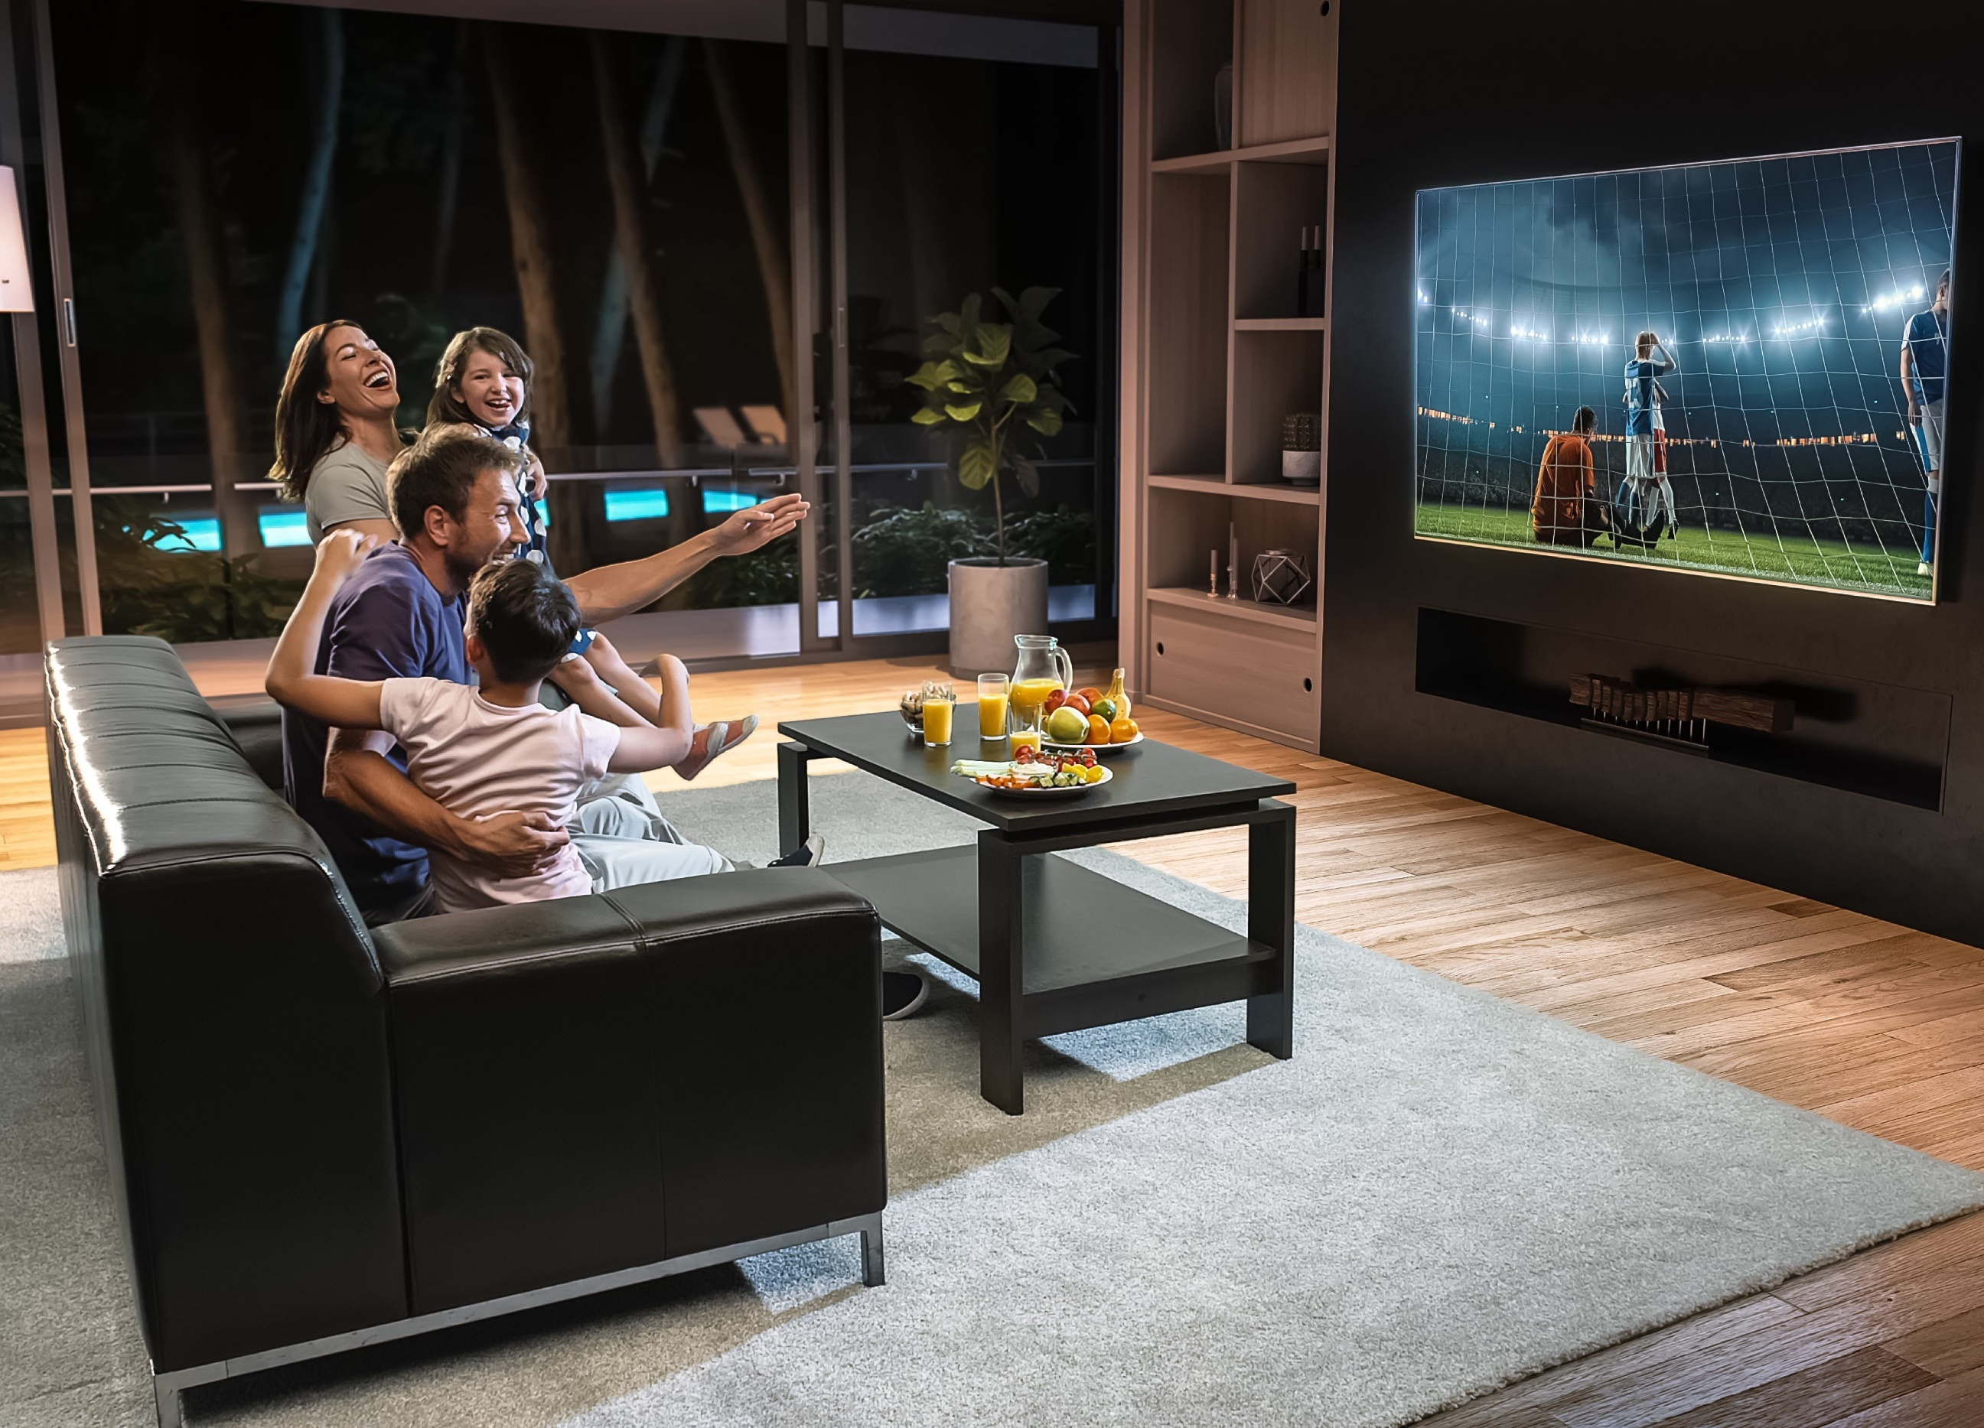
Comfort & convenience are the top needs fulfilled by watching sports at home which is driven by the superior viewing experience that exists
92% of all sports fans enjoy home viewing because TV provides them a front row seat to any game they want to watch
Source: VAB / Dynata ‘Sports Viewing Experience Survey,’ September 2019. Survey base = self-identified sports fans, P18+. Q12: Please rate how important the following are in your decision to watch sports at home (Top 2 Box: Somewhat Important & Very Important).
This information is exclusively provided to VAB members and qualified marketers. Further distribution is prohibited.
PAGE 20

Slide 21



Most fans, especially multicultural fans, have bought a bigger TV screen just so they can have a better viewing experience for sports at home
With that said, multicultural audiences are also more likely to watch sports across smaller screens as well, like mobile devices
% of Sports Fans Who Agree
All
Avid
Male
Female
Black
Hispanic
I bought a bigger TV screen just so I could have a better viewing experience for sports
63%
76%
66%
59%
68%
76%
I watch sports on a high definition TV so I can see the action clearer
60%
66%
60%
61%
52%
61%
Whenever possible I watch sports on the largest screen available in my home
48%
54%
49%
47%
41%
46%
Source: VAB / Dynata ‘Sports Viewing Experience Survey,’ September 2019. Survey base = self-identified sports fans, P18+. Q17: Please rate how much you agree or disagree with the following statement (Top 2 Box: Somewhat Agree & Strongly Agree), Q20: Which of the following statements do you believe are true for you? Avid Fans Respondents (habitually watch sports on TV, intensely follow teams / players, etc), All Sports Fans based on P18+.
This information is exclusively provided to VAB members and qualified marketers. Further distribution is prohibited.
PAGE 21

Slide 22



There’s a comfort to watching sports at home as almost two-thirds of avid fans and over half of males consider it their ‘me-time’
While multicultural audiences are more likely to set aside time to watch sports, they are less likely to consider it ‘me-time’
as they think of sports as more of a communal experience
% of Sports Fans Who Agree
All
Avid
Male
Female
Black
Hispanic
Watching sports is my
‘me-time’
53%
64%
58%
44%
50%
45%
I regularly set time aside in my busy schedule to watch sports
44%
58%
44%
44%
52%
61%
I always sit in the same seat when watching sports at home
38%
40%
38%
38%
34%
31%
Source: VAB / Dynata ‘Sports Viewing Experience Survey,’ September 2019. Survey base = self-identified sports fans, P18+. Q18 & Q19: Which of the following statements do you believe are true for you?, Avid Fans Respondents (habitually watch sports on TV, intensely follow teams / players, etc). All Sports Fans based on P18+.
This information is exclusively provided to VAB members and qualified marketers. Further distribution is prohibited.
PAGE 22

Slide 23


Live sports also creates valuable occasions to bring people together,
and a majority of female fans think of sports as an important family activity
This bonding time leads many to make the occasion even more of an event by cooking or grilling for their guests
% of Sports Fans Who Agree
All
Avid
Male
Female
Black
Hispanic
Watching sports is
important family time
44%
58%
43%
57%
48%
47%
I like to cook/grill for family or friends when watching sports on TV
38%
40%
36%
51%
50%
45%
Source: VAB / Dynata ‘Sports Viewing Experience Survey,’ September 2019. Survey base = self-identified sports fans, P18+. Q18 & Q19: Which of the following statements do you believe are true for you?, Avid Fans Respondents (habitually watch sports on TV, intensely follow teams / players, etc). All Sports Fans based on P18+.
This information is exclusively provided to VAB members and qualified marketers. Further distribution is prohibited.
PAGE 23

Slide 24
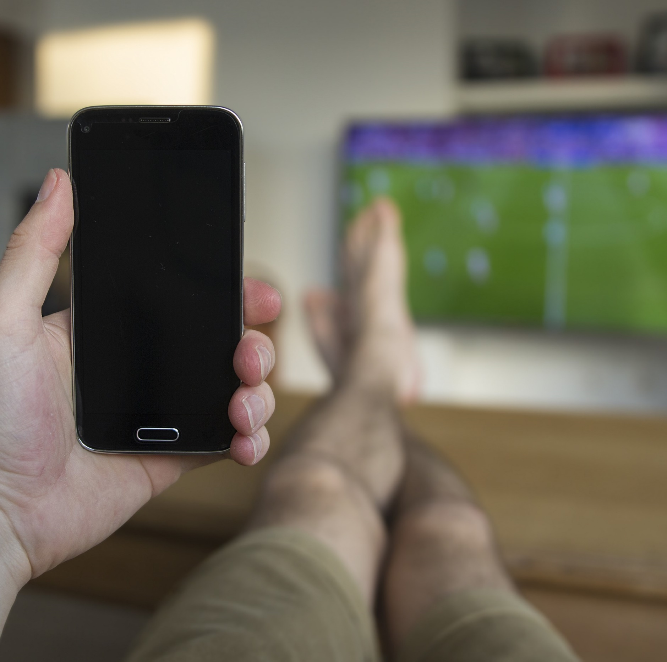
Social media enhances the sports viewing experience at home and keeps fans more engaged with games, especially among multicultural fans
Social media is an even more important platform today since it allows fans to follow, and have conversations within, shared-interest communities (virtual ‘bars’ or ‘tailgates’) during a time of continued physical distancing practices
“Following social media posts keeps me more actively engaged
in watching live sports on TV”
(% who agree)
“I have a ritual I do before or during ‘big’ games to help my team win”
(% who agree)
Avid Sports Fans
Female Sports Fans
52%
50%
Black Sports Fans
Hispanic Sports Fans
74%
59%
Source: VAB / Dynata ‘Sports Viewing Experience Survey,’ September 2019. Survey base = self-identified sports fans, P18+. Q18: Which of the following statements do you believe are true for you? Avid Fans Respondents (habitually watch sports on TV, intensely follow teams / players, etc), All Sports Fans based on P18+.
This information is exclusively provided to VAB members and qualified marketers. Further distribution is prohibited.
PAGE 24

Slide 25
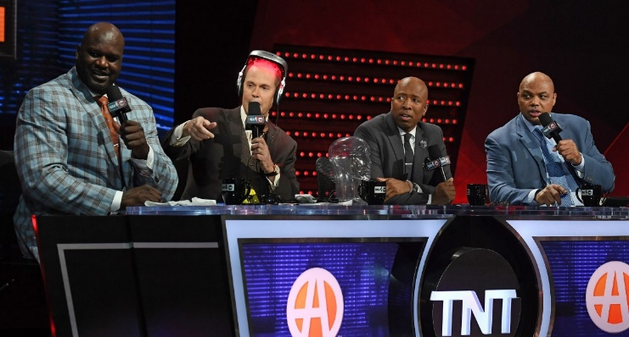
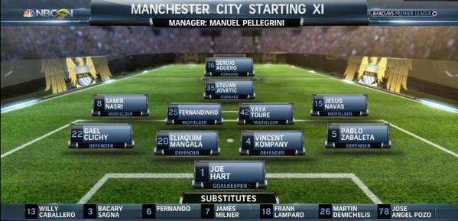
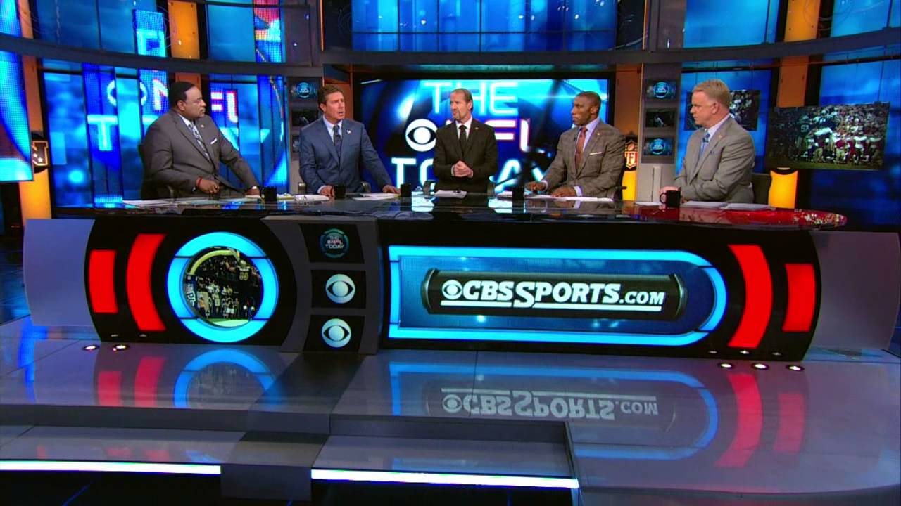
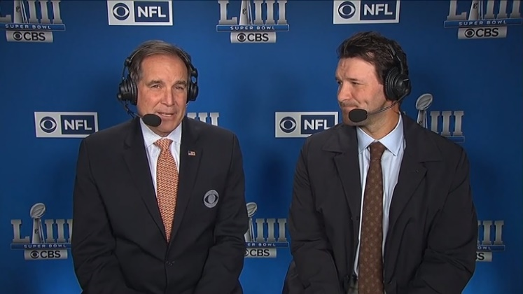
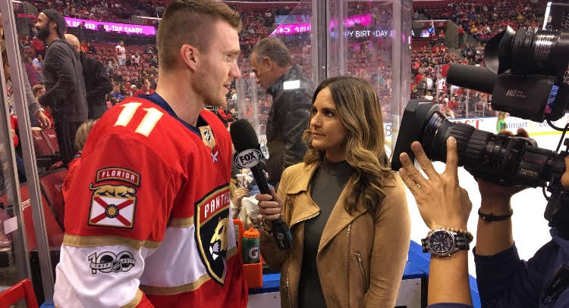
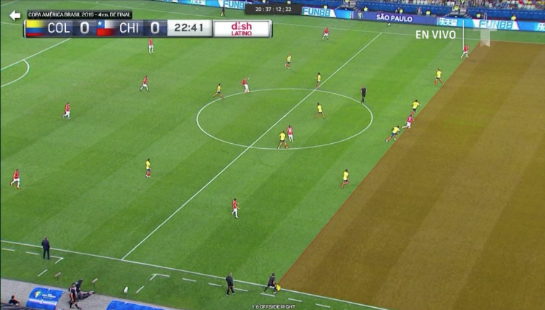
The 360-degree experience that TV networks provide - pre & post game coverage, commentary and analysis, multiple camera angles and replays - keeps viewers consistently engaged throughout the event
“I enjoy watching pre-game coverage and post-game highlights”
70% / 81%
“Hearing the announcers and commentators makes it easier to keep up with the action”*
80% / 84%
Pre-Game Coverage
Game Preview
All Sports Fans / Avid Sports Fans
Post-Game Highlights
Game Commentary
“Watching ‘off-the-field’ coverage (including live interviews, highlights, etc) is important to me”*
62% / 68%
“I have a better experience watching a sporting event on TV due to the different camera angles & replays”
77% / 79%
Live Interviews
Instant Replay
Source: VAB / Dynata ‘Sports Viewing Experience Survey,’ September 2019. Survey base = self-identified sports fans, P18+. *Q12: Please rate how important the following are in your decision to watch sports at home (Top 2 Box: Somewhat Important & Very Important, (based on respondents who prefer watching sports at home via Q11). Q17: Please rate how much you agree or disagree with the following statement (Top 2 Box: Somewhat Agree & Strongly Agree), (based on respondents who prefer watching sports at home via Q11), Avid Fans Respondents (habitually watch sports on TV, intensely follow teams / players, etc), All Sports Fans based on P18+.
This information is exclusively provided to VAB members and qualified marketers. Further distribution is prohibited.
PAGE 25

Slide 26

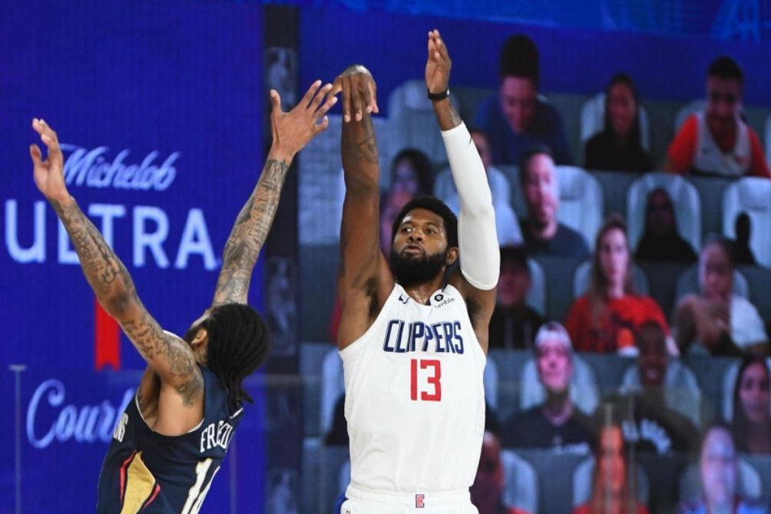

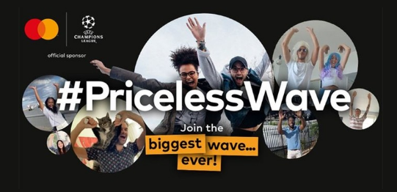

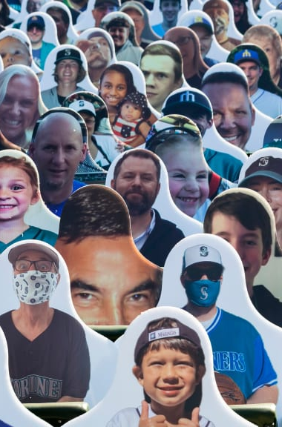
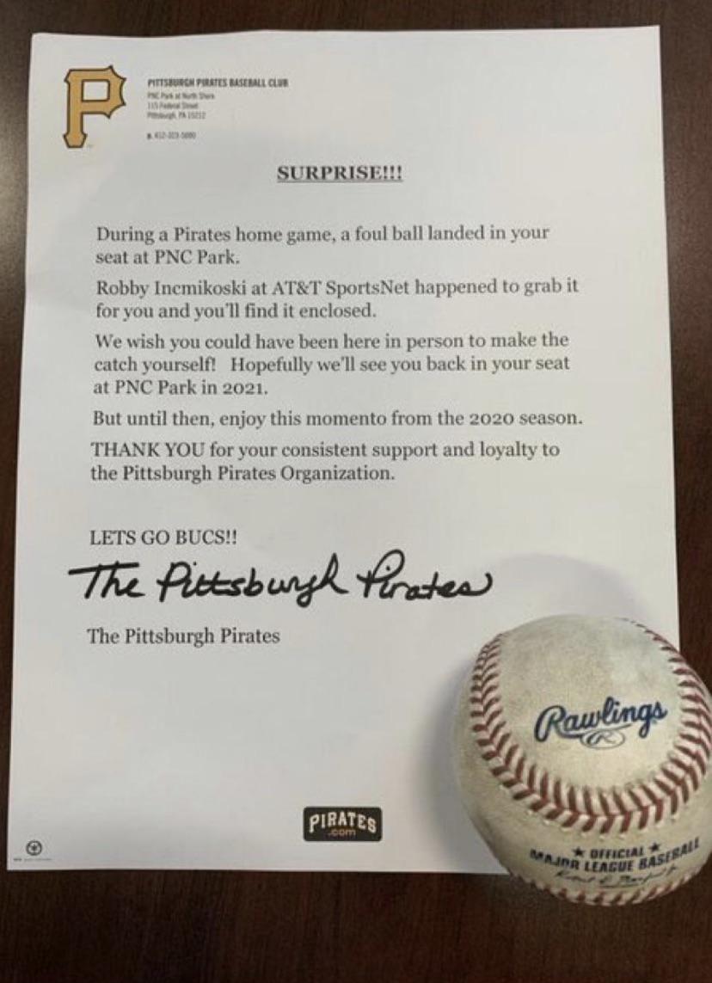
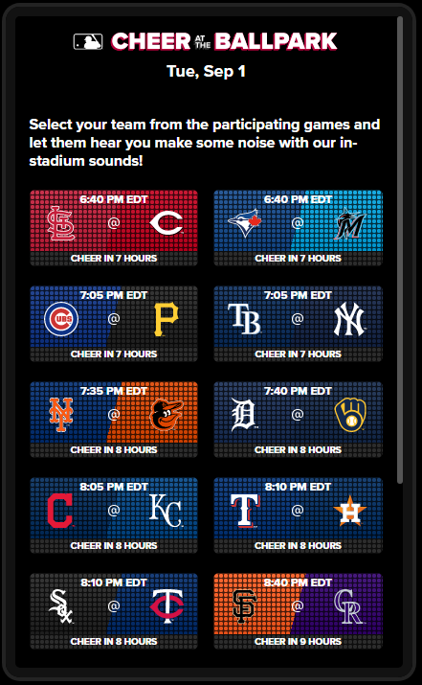
Brands and leagues are using a mix of advanced technologies, social media and CRM tactics to make the at-home fan feel like they are at the game, literally
‘Courtside’
#PricelessWave
Michelob Ultra partnered with Microsoft’s technology to bring fans virtually to the game as the NBA plays within the Orlando bubble. Fans watching from home appear on 17-foot screens that surround the players on three sides of the courts and is seen on the broadcasts.
As the finals for the UEFA Champions League approached, Mastercard brought soccer fans across the world together for the biggest stadium wave through TikTok. The #PricelessWave starts when fans record themselves and raise their arms from the bottom of the screen to the top on TikTok.
Cheer at the
Ballpark
Cardboard Cutouts & Foul Ball by Mail
Without in-stadium fans, the MLB is bringing in the noise through their “Cheer at the Ballpark” app on MLB.com. Through this app fans can cheer on their favorite team and boo their rivals during a game. Crowd noise operators at each ballpark can use this data as a guide to control stadium sounds during a game.
Some MLB teams are bringing the fans back to the stadium through carboard cutouts. Fans can have themselves featured in the stands in their favorite team gear.
A lucky Pittsburgh Pirates season ticket holder was mailed a foul ball that landed in his empty seat during a game.
This information is exclusively provided to VAB members and qualified marketers. Further distribution is prohibited.
PAGE 26

Slide 27
Because of the fan passion and engagement, the sports TV viewing experience drives consumer action through the purchase funnel
% Of Sports Fans Who Have Done The Following…
Awareness & Consideration
All
Avid
Male
Female
Black
Hispanic
I have talked with friends and/or family about an advertisement I saw while watching sports on TV
30%
34%
26%
35%
40%
34%
Consideration & Intent
Females, Black and Hispanic sports fans over-index the average sports fan in action taken through the funnel.
I have visited a website for a product that I saw advertised while watching sports on TV
22%
26%
21%
23%
28%
23%
Sales
I have purchased a product or service I saw advertised while watching sports on TV
23%
26%
23%
24%
25%
26%
Source: VAB / Dynata ‘Sports Viewing Experience Survey,’ September 2019. Survey base = self-identified sports fans, P18+. Q18. Which of the following statements do you believe are true for you? Avid Fans Respondents (habitually watch sports on TV, intensely follow teams / players, etc). All Sports Fans based on P18+.
PAGE 27

Slide 28

In ‘normal’ times, due to the comfort, convenience and connectivity during at-home viewing, sports fans are more likely to engage, and take action,
with TV advertising than advertising they see in-stadium at a game
% Of Sports Fans Who Have Done The Following…
% Difference:
Sports TV Ads
vs. In-Stadium Ads
while watching sports on TV
within a stadium or arena
Awareness & Consideration
All
All
I have talked with friends and/or family about an advertisement I saw…
30%
19%
+56%
more likely
Consideration & Intent
I have visited a website for a product that I saw advertised …
22%
18%
+22%
more likely
Sales
I have purchased a product or service I saw advertised…
23%
17%
+32%
more likely
Source: VAB / Dynata ‘Sports Viewing Experience Survey,’ September 2019. Survey base = self-identified sports fans, P18+. Q18. Which of the following statements do you believe are true for you?
PAGE 28

Slide 29
Summary: The Real ‘Home Field Advantage’
Although sports are back, the in-stadium experience looks very different due to social distancing, which is ok because most fans prefer watching sports at home
Whether hosting friends and family with food and drink or having a front row seat by yourself for any game, fans that used to typically attend games can easily replicate the gameday experience at home
At-home viewing satisfies six human need states – comfort / convenience, connection, camaraderie / community, commitment, contact, comprehension – the fulfillment of which is more important than ever during the pandemic
Multiscreen TV and social media work together to enhance the total viewing experience
Even in non-pandemic times, sports fans are more likely to engage with TV advertising than advertising they see in-stadium
This information is exclusively provided to VAB members and qualified marketers. Further distribution is prohibited.
PAGE 29

Slide 30
Away Games
Building Audiences Through Out-Of-Home Viewing

Slide 31
Out-Of-Home viewing
of live sports on TV is typically a communal experience
We supplemented our custom survey with data from a Nielsen OOH study which found that more than half of fans (54%) primarily watch sports out-of-home with three or less people.
This figure is considered ‘safe’ by pandemic guidelines for gatherings at other people’s homes and socially-distanced set-ups at restaurants and bars.
What are Reasons for Viewing Sports Out-Of-Home?
Adults 18+
Source: VAB analysis of Nielsen Fall Sports, Game On: Driving Brand Engagement and Co-Viewing On Linear TV With Out-Of-Home Audiences; 2019. Reflects multiple responses chosen from respondents in Nielsen’s Out-of-Home Fall Sports Location Survey, General Population (10/29/18-10/31/18). Survey participants were able to select responses for each viewing event, leading to a distribution of over 100%.
PAGE 31

Slide 32
While most out-of-home viewing occurs in restaurants / bars or at someone else’s home, the comfortable, controlled environment of someone’s home has taken
on even more importance given the current pandemic
Where Do People View Sports Out-Of-Home?
Watching sports with friends or family is important to many fans:
83% of fans believe that live sports brings family together in ways that other activities can’t.
66% of fans watch sporting events on TV at home with family and/or friends.
Source: NBC Sports Group “The Impact of Live Sports In 2020”; VAB / Dynata ‘Sports Viewing Experience Survey,’ September 2019. Survey base = self-identified sports fans, P18+. Q18: Which of the following statements do you believe are true for you?, Avid Fans Respondents (habitually watch sports on TV, intensely follow teams / players, etc). All Sports Fans based on P18+; VAB analysis of Nielsen Fall Sports, Game On: Driving Brand Engagement and Co-Viewing On Linear TV With Out-Of-Home Audiences; 2019. Reflects multiple responses chosen from respondents in Nielsen’s Out-of-Home Fall Sports Location Survey, General Population (10/29/18-10/31/18). Survey participants were able to select responses for each viewing event, leading to a distribution of over 100%.
PAGE 32

Slide 33
The communal aspect of
out-of-home viewing among close friends and family is also effective for driving engagement around ads airing during live sporting events
Action Taken as a Result of Seeing an Ad While Watching Sports Out-Of-Home
With 92% of OOH sports viewers saying they pay attention to at least some of the ads airing, it’s easy for them to talk to others about brands they see and research brands on their mobile devices while watching a game.
This behavior is even more prevalent among younger demos.
Source: VAB analysis of Nielsen Fall Sports, Game On: Driving Brand Engagement and Co-Viewing On Linear TV With Out-Of-Home Audiences; 2019. Reflects multiple responses chosen from respondents in Nielsen’s Out-of-Home Fall Sports Location Survey, General Population (10/29/18-10/31/18). Survey participants were able to select responses for each viewing event, leading to a distribution of over 100%.
PAGE 33

Slide 34
Summary: Away Games
While out-of-home viewing is typically a communal experience, more than half of fans primarily watch sports away from home with three or less people – conducive for in-home gatherings and restaurants/bars following social distancing guidelines
The comfortable, controlled environment of someone else’s home has taken on even more importance for out-of-home viewing given the pandemic and the desire for people to socialize with their close circle of family and friends
Much like we see for at-home, out-of-home viewing is effective for driving engagement around advertisements that air during live sporting events especially among younger audiences
This information is exclusively provided to VAB members and qualified marketers. Further distribution is prohibited.
PAGE 34

Slide 35



Key Takeaways For Marketing Plans
Better Consumer Understanding Drives Sharper Campaigns
Be Part of The Gameday Experience at Home
Harness the Power of Social Engagement
By understanding what motivates consumers to view at home (notably,
the need for camaraderie, conversation, comfort and convenience), marketers can create campaigns that resonate – ranging from messaging to the types
of activations and promotions that are developed.
With fans recreating the gameday at home, there are opportunities for brands to be a part of that experience. For example, initiatives like curating custom music play lists or developing co-op local TV partnerships with restaurants and delivery services help weave your brand into the consumer experience.
The insatiability of fans to talk, share and connect over sports means there’s a great opportunity for brands in paired TV and social opportunities. The two platforms work together to enhance and help further engage fans in the overall viewing experience.
This information is exclusively provided to VAB members and qualified marketers. Further distribution is prohibited.
PAGE 35

Slide 36



Key Takeaways For Marketing Plans
Take Advantage of the Full
Live Sports Calendar to Drive Impact Through 2H
Expand Reach and Engagement Through OOH Viewing
Re-think Marketing Investments to Follow the Consumer
Between the already planned sports seasons and several other major leagues playing outside of their typical schedule dates, marketers will have even more opportunities to connect and engage with consumers through live sports programming.
The growth in out-of-home viewing offers marketers a valuable reach and engagement extension beyond people who are watching sports within their own home.
Marketers who normally invest in in-stadium sponsorships and activations can follow those consumers by utilizing a variety of multiscreen TV solutions. This is particularly impactful considering that at-home viewers (and those watching OOH) are more likely to take action than those in-stadium.
This information is exclusively provided to VAB members and qualified marketers. Further distribution is prohibited.
PAGE 36

Slide 37
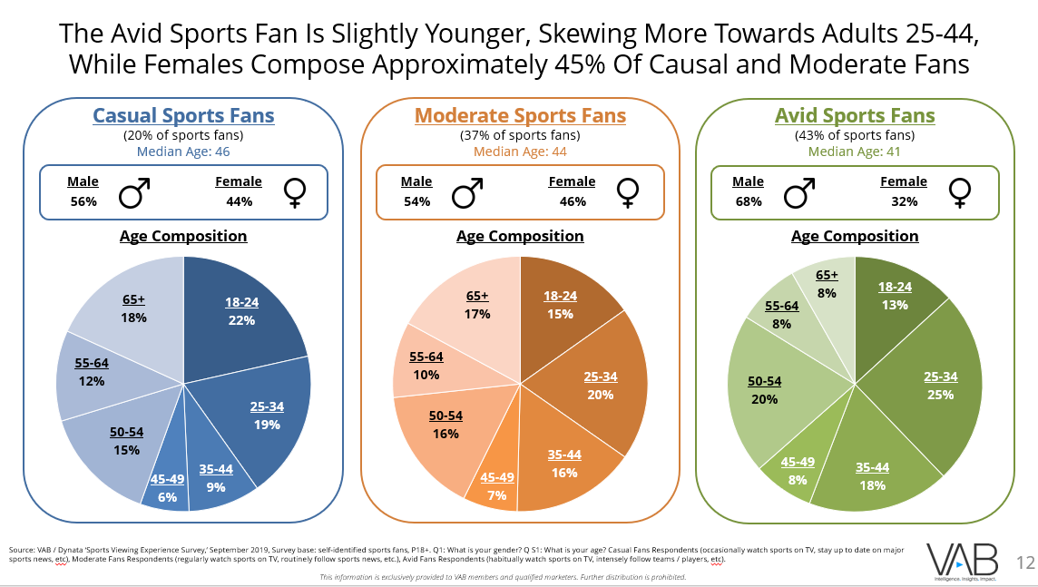
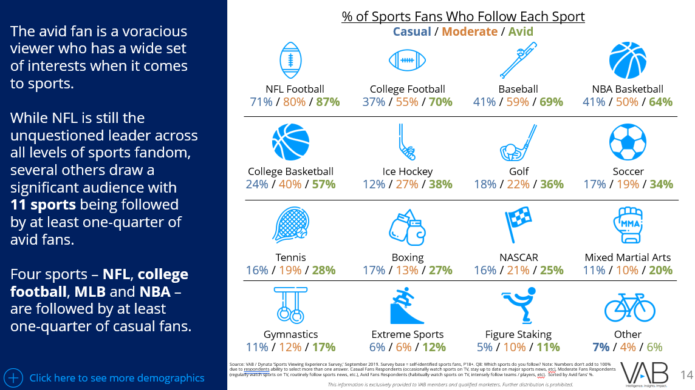
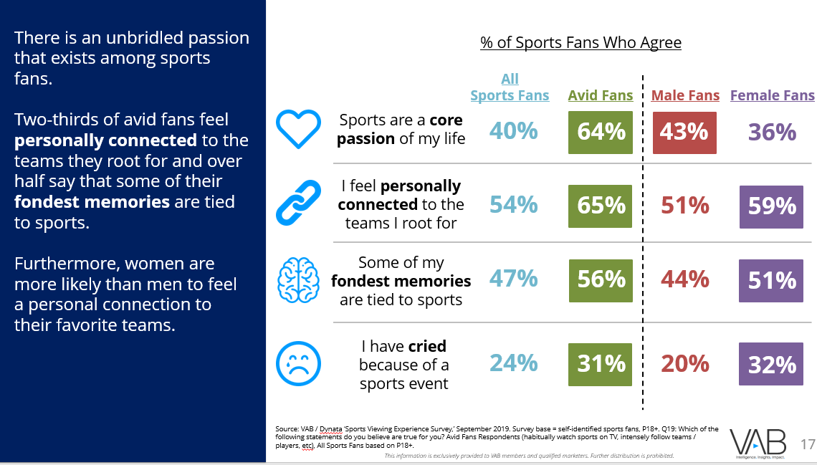
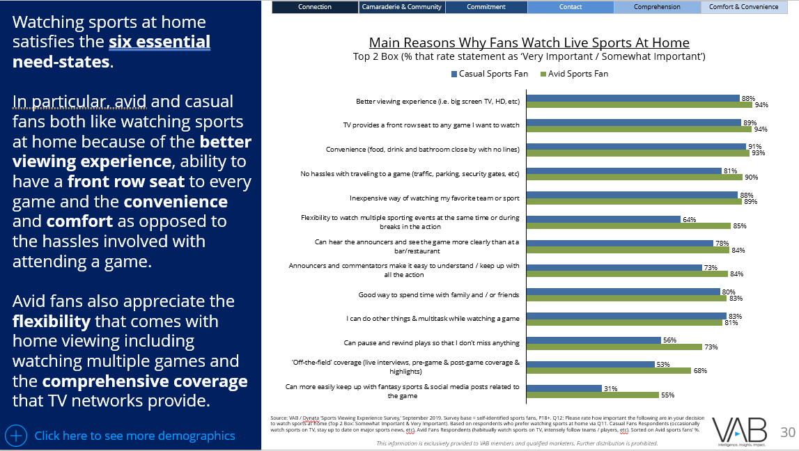
Download our original marketer’s guide to learn more about today’s
sport fan and the unbridled passion that exists across audience segments
Sampling of slides with insights into todays sports fan available in our full marketer’s guide
Click here to download report
This information is exclusively provided to VAB members and qualified marketers. Further distribution is prohibited.
PAGE 37

Slide 38

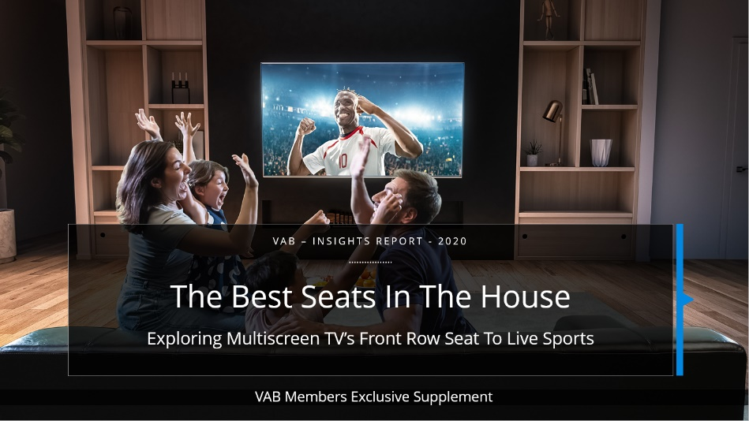




Thank You
Creators
Jason Wiese
Reed Kiely
SVP, Director of Strategic Insights
jasonw@thevab.com
Insights Manager
reedk@thevab.com
Interested in learning more? Check out this related content:
The Best Seats In The House
A Custom Study Exploring Sports
Fans’ Viewing Preferences
VAB Member Exclusive Supplement
Exploring Multiscreen TV’s Front Row
Seat To Live Sports
A Matter Of Principle
Reassessing Your Strategy in
Today’s Environment
This information is exclusively provided to VAB members and qualified marketers. Further distribution is prohibited.
PAGE 38

Slide 39

Get immediate access to the VAB Insights library
We’ve answered hundreds of marketers’ questions.
Our guides, reports, webinars and videos provide actionable insights to help marketers navigate today’s video landscape and think differently about their strategy.
We are committed to your business growth and proud to offer brand marketers and agencies complimentary access to our continuously-growing Insights library.
Get Access at theVAB.com or visit us here
This information is exclusively provided to VAB members and qualified marketers. Further distribution is prohibited.
PAGE 39

