Slide 1





Behind Billions of Lost TV Impressions
Full 16-month analysis update (Sep ’20 – Dec ’21)

Slide 2


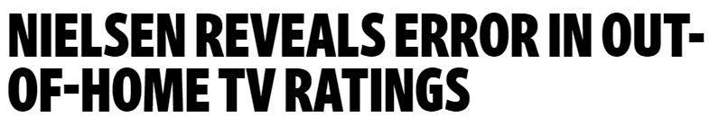


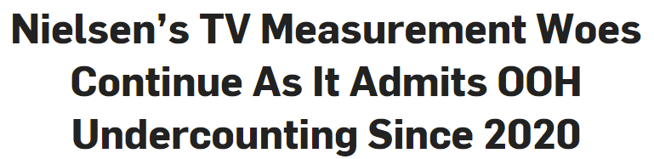
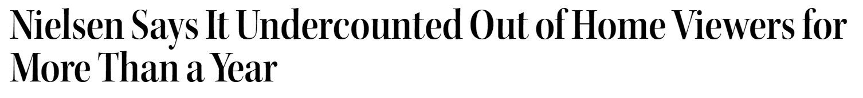


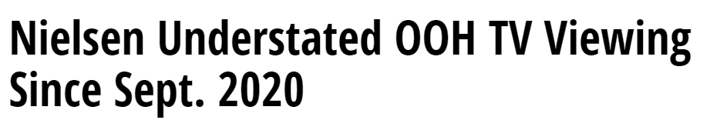


What is the issue?
What was the error and what ad assets were most impacted?
In late December of 2021 Nielsen acknowledged that an error/malfunction had caused them to undercount TV audiences for the previous SIXTEEN months (from Sept. 2020 thru Dec. 2021)
What was the error?
In September 2020, Nielsen began including out-of-home (outside primary residence) viewing in its national TV ratings
Nielsen reported on 12/22/21 that due to an internal error, OOH viewing for broadband-only (BBO) homes had never been included in national TV audience estimates (Sept. ’20 – Dec. ‘21)
December 22, 2021
December 22, 2021
December 22, 2021
What ad assets were most impacted?
December 22, 2021
Out-of-home viewing is a portion of nearly ALL TV programming
However, this error had a disproportionate effect on:
  Live sports, news and high-profile “can’t miss” programs, “tent-pole” events and specials
December 22, 2021
December 22, 2021
PAGE 1

Slide 3
Why is the industry talking about this?
Why does this matter to you?
Billions of impressions were needlessly taken out of the ‘21/‘22 Upfront, and all 4 quarters of 2021, reducing the supply of TV ad inventory and distorting the perception of TV’s overall 2021 health
The sheer “size” of this error in Nielsen TV currency data is so much more than what Nielsen admitted to in their Dec 22nd notice:
“…out-of-home viewing estimates may be understated… little to no impact to most telecasts..”
With all 16 months of re-processed Nielsen TV audience data completed now, we further reinforce
the original projections from our eight-month analysis that significantly worse undercounting is being seen across high-profile TV assets, and among many high-priority consumer groups
When in fact - the scale of this Nielsen error is unprecedented…after we conducted our first analysis in January 2022, with only half the re-processed data available to be analyzed, we already knew: billions
of impressions were not counted & hundreds of millions of ad dollars could not be activated by marketers
With two major, foundational errors in 2021, there is cause for concern about Nielsen’s core competency, and their ability to implement complicated cross-platform products using that same foundation
This mistake compounds Nielsen’s first admitted 2021 error of undercounting TV audiences during Covid (March 2020 – at least May 2021)
PAGE 2

Slide 4



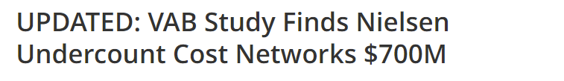
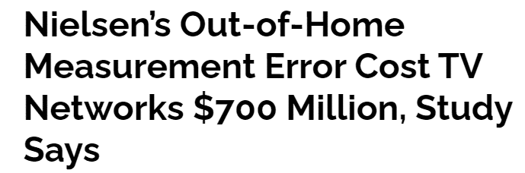
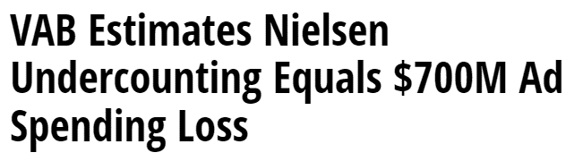
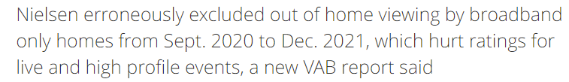




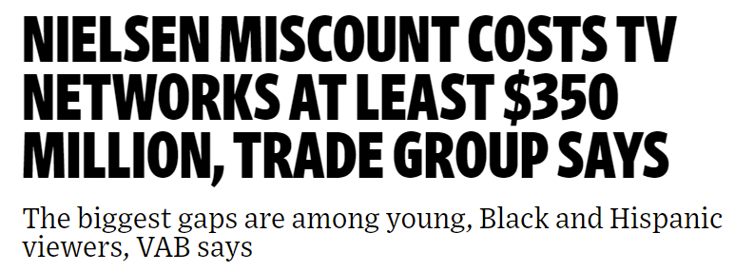
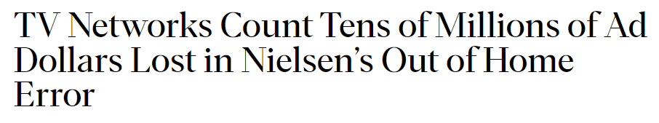

Issued on January 26th, VAB’s original analysis on the first eight months of available data, began uncovering the depth of the undercounting error
January 26, 2022
January 26, 2022
January 26,2022
January 26, 2022
January 26, 2022
January 26, 2022
PAGE 4

Slide 5
8-Month Overview Reminder (issued 1/26): 5 Fast Stats You Should Know About the Nielsen TV Out-of-Home Ratings Undercounting
Quantifying Half of the ‘Error’: 8-Month Overview of Total 16-Month ‘Undercounting’ Time Period
1
2
3
4
5
Almost 30 billion ad impressions went uncounted with only half of the months reported thus far
30 billion is 50% of
16-month total
(P2+ Total Day, May-Dec ‘21)
Over $350 million in TV ads could
not be bought or sold between May-Nov ’21
$350MM is 44% of 16-month total
(Dec ’21 $$$ not available as
of this analysis)
Nearly 400K people were not counted in the Primetime ratings every night from May – Dec ‘21
(on average across broadcast & cable, May-Dec ’21)
Over 10.5 billion
18-34 ad impressions disappeared
10.5 billion is 50% of
16-month total
(P18-34, Total Day, May-Dec ‘21)
Almost 7.0 billion Black ad impressions and over 5.5 billion Hispanic ad impressions disappeared
(Black & Hispanic P2+, Total Day, May-Dec’21)
PAGE 4
This information is exclusively provided to VAB members and qualified marketers. Further distribution is prohibited.

Slide 6

How do we grasp and quantify the full impact of this error?
With all 16 months of revised viewing data now available, we analyzed the
“lift” in audience based on this data and quantified the dollar impact of lost
ad inventory across the 16 months for ratings, impressions and ad dollars (8/31/20 – 12/21/21):
  We pulled 350+ pre-reprocessed and “reprocessed” Nielsen runs in NPower and compiled over 1,150 excel files for analyses
    “Reprocessed” data is revised numbers to account for the ‘missing’ OOH TV viewership
  Analyzed ad revenue, impressions, average audience and ratings across six demos
    Including dayparts, genres and major programming
      Ad revenue sourced from Nielsen Ad Intel and calculated based on the monthly audience lifts from NPower across each major genre (Sports, Entertainment, News, General)
PAGE 3

Slide 7
Full 16-Month Update: 5 Fast Updated Stats You Should Know About the Nielsen TV Out-of-Home Ratings Undercounting
Quantifying the ‘Error’: Total 16-Month ‘Undercounting’ Time Period
1
2
3
4
5
Almost 54 billion ad impressions went uncounted during the 16-month time period
(P2+ Total Day, Sep’20-Dec ‘21)
Over $690 million
in TV ads could not be bought or sold between Sep ’20 – Dec ’21
(NPower monthly audience lifts applied to Ad Intel $$$ across sports, entertainment, news, general genres)
Nearly 350K people were not counted in the Primetime ratings every night from Sep ‘20 – Dec ‘21
(on average across broadcast & cable, Sep’20-Dec’21)
Almost 19.5 billion
18-34 ad impressions disappeared
(P18-34, Total Day, Sep’20-Dec ‘21)
12.0 billion Black ad impressions and over 10.5 billion Hispanic ad impressions disappeared
(Black & Hispanic P2+, Total Day, Sep’20-Dec’21)
PAGE 4
This information is exclusively provided to VAB members and qualified marketers. Further distribution is prohibited.

Slide 8
Estimated ‘Undercounted’ P2+ Impressions Based on Reprocessing Lift*
aggregated across ad-supported broadcast & cable TV
Live + Same Day
Almost three and a half billion national TV impressions were
not counted on average each month, almost three-quarters
of a billion of which were in
prime time (on average)
20+ networks accounted for a majority of the 3.4 billion ‘lost’ impressions, illustrating the
wide and deep effect this
error had on TV campaigns
16-Month Time Period
Sep ’20 – Dec ’21 (8/31/20 – 12/21/21)
 | Monthly Avg % Lift | Total IMPEs (MM) Lift
Total Day | 0.66% | 53,644.3
Monthly Avg # of TV Networks w/ more than a 1% Lift | 23 | 33
Monthly Avg P2+ IMPEs Lift | 3.4 Billion
 | Monthly Avg % Lift | Total IMPEs (MM) Lift
Prime Time | 0.60% | 12,489.5
Monthly Avg # of TV Networks w/ more than a 1% Lift | 21 | 33
Monthly Avg P2+ IMPEs Lift | 781 Million
*Reprocessing lift = increase in average audience based on revised viewing estimates for each month
Source: % Lift- Nielsen NPower, Ratings Analysis Program Report, Live+SD, P2+. Time periods reflect: Sep ’20 – Dec ’21 broadcast months (8/31/20 – 12/21/21). *Reprocessing Lift reflects increase in aggregated average audience across ad-supported broadcast & cable TV based on the reported difference between the ‘National OOH – Pre-Reprocessing (9/20-12/21)’ and revised ‘National’ Sample; OOH reprocessing data goes through 12/21/21. IMPEs (MM) Lift - Nielsen Ad Intel, Live+SD, P2+, equivalized impressions, % lift was applied to the reported national TV impressions during each time period by daypart to establish an estimate of total monthly impressions undercounted.
PAGE 8

Slide 9
‘Event’ Programs: Estimated ‘Undercounted’ Impressions Based on Reprocessing Lift
16-Month Time Period: 8/31/20 - 12/21/21 (Live + Same Day)
Over 435 million impressions weren’t counted in 20 singular ‘tentpole’ events and specials, resulting in a $24 million loss in ad inventory, and the inability to properly evaluate the results of
a premium investment for both publishers and marketers
Programming | Network | P2+ IMPEs (000) Lift | P2 + % Lift | P18-34 % Lift | P18-49 % Lift | P25-54 % Lift | Black P2+ % Diff | Hisp P2+ % Lift
Super Bowl LV | CBS | 240,193 | 2.9% | 9.1% | 5.9% | 4.6% | 3.5% | 5.6%
MLB World Series 2021 (Game 4) | FOX | 50,551 | 2.6% | 10.5% | 6.6% | 5.1% | 7.8% | 3.5%
NBA Finals 2021 (Game 5) | ABC | 31,104 | 4.0% | 8.5% | 6.5% | 5.9% | 3.3% | 7.3%
Democracy 2020 - Election Night | FNC | 15,202 | 0.8% | 3.1% | 1.9% | 1.3% | 3.0% | 2.5%
Summer Olympics - Opening Ceremony | NBC | 13,303 | 1.6% | 4.6% | 3.5% | 2.6% | 3.6% | 2.0%
New Year's Rockin' Eve (Part 1) | ABC | 10,853 | 2.3% | 6.5% | 3.6% | 2.5% | 2.6% | 3.5%
NCAA Basketball Championship | CBS | 9,974 | 0.9% | 4.0% | 2.5% | 1.4% | 1.6% | 1.9%
College Football Championship | ESPN | 9,466 | 0.5% | 1.4% | 1.0% | 0.8% | 0.6% | 2.3%
The Oscars | ABC | 8,571 | 1.3% | 4.9% | 3.5% | 2.2% | 4.1% | 0.7%
Grammy Awards | CBS | 7,580 | 1.0% | 2.9% | 2.1% | 1.8% | 0.8% | 1.9%
Stanley Cup 2021 (Game 3) | NBC | 7,367 | 4.3% | 8.0% | 6.7% | 5.7% | 8.2% | 12.7%
NBA All Star Game | TNT | 7,244 | 1.9% | 4.7% | 2.7% | 2.0% | 1.4% | 2.7%
Presidential Inauguration Day | CNN | 5,639 | 0.4% | 2.0% | 1.1% | 0.8% | 0.4% | 0.7%
Oprah with Meghan & Harry | CBS | 4,860 | 0.6% | 3.3% | 1.8% | 1.6% | 1.4% | 1.0%
The Masters (Sunday) | CBS | 3,511 | 1.0% | 5.1% | 3.2% | 2.1% | 2.0% | 2.6%
Golden Globe Awards | NBC | 3,241 | 0.6% | 3.8% | 1.9% | 0.8% | 1.1% | 0.7%
UEFA Champions League Final | CBS | 3,019 | 7.1% | 14.7% | 10.5% | 8.9% | 4.3% | 25.3%
Adele One Night Only | CBS | 2,789 | 0.6% | 2.3% | 1.8% | 1.2% | 1.5% | 1.3%
The Bachelor - After the Final Rose | ABC | 1,025 | 0.8% | 3.6% | 2.4% | 1.8% | 1.4% | 0.0%
The Voice - Season Finale (12/15) | NBC | 634 | 0.4% | 1.3% | 1.7% | 1.2% | 1.2% | 0.0%
20 ‘Event’ Program Avg % Lift |  | 21,806 | 1.8% | 5.2% | 3.5% | 2.7% | 2.7% | 3.9%
Source: % Lift - Nielsen NPower, Ratings Analysis Program Report, Live+SD, P2+, P18-34, P18-49, P25-54, Black P2+, Hispanic P2+. *Reprocessing Lift reflects increase in average audience based on the reported difference between the ‘National OOH – Pre-Reprocessing (9/20-12/21)’ and revised ‘National’ Sample (AA Proj (000)); OOH reprocessing data goes through 12/21/21. The 20-program avg % lift reflects the average % lift based on the difference in AA % between ‘National OOH – Pre-Reprocessing’ & ‘National’ samples for each demo across programs. IMPEs (MM) Lift - Nielsen Ad Intel, Live+SD, equivalized impressions, % lift was applied to the reported national TV impressions for each program during the time period to establish an estimate of total monthly impressions undercounted. FNC = Fox News Channel.
PAGE 9

Slide 10
Live sports was the most effected genre with the top 10 singular sports events resulting in a loss of over $20 million in ads that could not be bought or sold between Sep ‘20 – Dec’ 21
Programs that were affected include:
Sports:
  NFL Football (multi-networks)
  Summer Olympics on NBCU nets
  Copa America & UEFA Champions League on TUDN
News:
  60 Minutes on CBS
  ABC World News Tonight
Entertainment
  The Simpsons on Fox
  Grey’s Anatomy on ABC
Major Genres:
Estimated ‘Undercounted’ Impressions Based on Reprocessing Lift
aggregated across ad-supported broadcast & cable TV
Live + Same Day
16-Month Time Period: Sep ’20 – Dec ‘21
(8/31/20 – 12/21/21)
Sports
News
Entertainment
Demo | Monthly Avg % Lift | Total IMPEs (MM) Lift | Monthly Avg % Lift | Total IMPEs (MM) Lift | Monthly Avg % Lift | Total IMPEs (MM) Lift
P2+ | 1.6% | 12,294.9 | 0.6% | 9,170.9 | 0.5% | 20,739.8
P18-34 | 5.2% | 5,165.3 | 3.5% | 1,992.3 | 2.2% | 8,407.4
P18-49 | 3.4% | 8,600.6 | 2.0% | 4,389.1 | 1.3% | 14,683.2
P25-54 | 2.6% | 7,474.3 | 1.4% | 4,577.1 | 0.9% | 12,993.1
Source: % Lift - Nielsen NPower, Ratings Analysis Program Report, Live+SD, P2+, P18-34, P18-49, P25-54. Genres: sports = sports events; news = news & news documentary; entertainment = audience participation, award ceremonies, comedy variety, concert music, conversations, colloquies, daytime drama, evening animation, feature film, general drama, general variety, instruction/advice, musical drama, participation variety, popular music, quiz give away, quiz panel, situation comedy, suspense/mystery. Time periods reflect: Sep ’20 – Dec ’21 broadcast months (8/31/20 – 12/21/21). *Reprocessing Lift reflects increase in aggregated average audience across ad-supported broadcast & cable TV based on the reported difference between the ‘National OOH – Pre-Reprocessing (9/20-12/21)’ and revised ‘National’ Sample (AA Proj (000)); OOH reprocessing data goes through 12/21/21. IMPEs (MM) Lift - Nielsen Ad Intel, Live+SD, P2+, P18-34, P18-49, P25-54, equivalized impressions, % lift was applied to the reported national TV impressions during the time period by genre to establish an estimate of total monthly impressions undercounted. The subgenres in Ad Intel were aligned with the subgenres in NPower to develop estimates for each genre.
PAGE 10

Slide 11
With the error occurring in the Broadband-only portion of the sample which skews younger, the highly coveted, elusive
18-34 audience experienced
the highest undercount of any demo
Examples of programs that were affected include:
Catfish: The TV Show on MTV
WWE Friday Night Smackdown on Fox
NBA Playoffs on ABC & TNT
Space Ghost Coast to Coast on Adult Swim
Liga MX on TUDN
Real Housewives of Atlanta on Bravo
Major Demos:
Estimated ‘Undercounted’ Impressions Based on Reprocessing Lift
aggregated across ad-supported broadcast & cable TV
Live + Same Day
16-Month Time Period
Sep ’20 – Dec ’21 (8/31/20 – 12/21/21)
Total Day | Monthly Avg % Lift | Total IMPEs (MM) Lift
P18-34 | 2.9% | 19,468.0
P18-49 | 1.8% | 35,715.6
P25-54 | 1.3% | 31,408.6
Prime Time | Monthly Avg % Lift | Total IMPEs (MM) Lift
P18-34 | 2.6% | 4,587.2
P18-49 | 1.5% | 8,010.0
P25-54 | 1.1% | 7,242.2
Source: % Lift - Nielsen NPower, Ratings Analysis Program Report, Live+SD, P18-34, P18-49, P25-54. Time periods reflect: Sep ’20 – Dec ’21 broadcast months (8/31/20 – 12/21/21). *Reprocessing Lift reflects increase in aggregated average audience across ad-supported broadcast & cable TV based on the reported difference between the ‘National OOH – Pre-Reprocessing (9/20-12/21)’ and revised ‘National’ Sample (AA Proj (000)); OOH reprocessing data goes through 12/21/21. IMPEs (MM) Lift - Nielsen Ad Intel, Live+SD, P18-34, P18-49, P25-54, equivalized impressions, % lift was applied to the reported national TV impressions during each time period by daypart and demographic to establish an estimate of total monthly impressions undercounted. Note: P18-34, P18-49, P25-54 total day impressions for the month of Dec ‘21 are higher than P2+ total day imps, from a total audience perspective these impressions are partially offset by a slight decline in P50+ total day impressions based on the reprocessed data.
PAGE 11

Slide 12
Ethnicities:
Estimated ‘Undercounted’ Impressions Based on Reprocessing Lift
aggregated across ad-supported broadcast & cable TV
Black and Hispanic audiences were also more likely to be undercounted, further exacerbating long-standing challenges with properly counting these segments
Programs that were affected include:
BET Hip Hop Awards
Real Husbands of Hollywood on BET
Tyler Perry’s Sistas on BET / BET Her
Copa America on TUDN
UEFA Champions League on TUDN
Malverde: El Santo Patron on Telemundo
La rosa de Guadalupe on Univision
Hoy on Univision
La Casa de los Famosos on Telemundo
16-Month Time Period
Sep ’20 – Dec ’21 (8/31/20 – 12/21/21)
Total Day | Monthly Avg % Lift | Total IMPEs (MM) Lift
Total P2+ | 0.7% | 53,644.3
Black P2+ | 0.8% | 11,991.7
Hispanic P2+ | 1.2% | 10,597.0
Prime Time | Monthly Avg % Lift | Total IMPEs (MM) Lift
Total P2+ | 0.6% | 12,489.5
Black P2+ | 0.8% | 2,300.3
Hispanic P2+ | 1.1% | 2,795.9
Source: % Lift - Nielsen NPower, Ratings Analysis Program Report, Live+SD, P2+, total composite, Black, Hispanic. Time periods reflect: Sep ‘20 – Dec ’21 broadcast months (8/31/20 – 12/21/21). *Reprocessing Lift reflects increase in aggregated average audience across ad-supported broadcast & cable TV based on the reported difference between the ‘National OOH – Pre-Reprocessing (9/20-12/21)’ and revised ‘National’ Sample (AA %); OOH reprocessing data goes through 12/21/21. IMPEs (MM) Lift - Nielsen Ad Intel, Live+SD (P2+) & Live+7 (L+SD is not available for the Black and Hispanic demos), P2+, equivalized impressions, % lift was applied to the reported national TV impressions during each time period by ethnicity to establish an estimate of total monthly impressions undercounted.
PAGE 12

Slide 13
Estimated impressions and ad dollar loss from Nielsen’s
two recent admitted undercounting errors is staggering:
May ‘21
Dec ‘21
5/10: COVID-related undercounting due to panel maintenance issues
12/22: Nielsen confirms exclusion
of OOH TV viewing from BBO homes
Time period of error:
March 2020 – May 2021
Time period of error:
September 2020 – December 2021
Error range (P18-49):
1 - 5%
Error range (P18-49):
1.4 - 3.2%
Impressions lost (P18-49):
17-86 Billion
Impressions lost (P18-49):
35.7 Billion
$ Value of lost ads:
$468 MM - $2.3 Billion
$ Value of lost ads:
$690 Million
PAGE 13

Slide 14

The OOH undercounting error only grew between broadcast seasons as Covid restrictions loosened
(Sep ‘20 – Dec ’20 vs. Sep ’21 – Dec ’21 comparison)

Slide 15
The effects of the measurement error were more severe in the last four months
of the 16-month period – total day & prime time undercounted impressions were 26% and 41% higher than the same time the previous year, respectively
Estimated ‘Undercounted’ P2+ Impressions Based on Reprocessing Lift*
aggregated across ad-supported broadcast & cable TV (live + same day)
2020: Sep – Dec
(8/31/20 – 12/27/20)
2021: Sep – Dec
(8/30/21 – 12/21/21)
 | Monthly Avg % Lift | Total IMPEs (MM) Lift
Total Day | 0.58% | 12,659.7
Monthly Avg # of TV Networks w/ more than a 1% Lift | 12 | 33
Monthly Avg P2+ IMPEs Lift | 3.2 Billion
Monthly Avg % Lift | Total IMPEs (MM) Lift
0.80% | 15,938.8
34 | 33
4.0 Billion
 | Monthly Avg % Lift | Total IMPEs (MM) Lift
Prime Time | 0.49% | 2,714.3
Monthly Avg # of TV Networks w/ more than a 1% Lift | 12 | 33
Monthly Avg P2+ IMPEs Lift | 679 Million
Monthly Avg % Lift | Total IMPEs (MM) Lift
0.75% | 3,816.5
30 | 33
954 Million
Source: % Lift- Nielsen NPower, Ratings Analysis Program Report, Live+SD, P2+. Time periods reflect: Sep ’20 – Dec ’20 broadcast months (8/31/20 – 12/27/20) and Sep ’21 – Dec ’21 broadcast months (8/30/21 – 12/21/21). *Reprocessing Lift reflects increase in aggregated average audience across ad-supported broadcast & cable TV based on the reported difference between the ‘National OOH – Pre-Reprocessing (9/20-12/21)’ and revised ‘National’ Sample; OOH reprocessing data goes through 12/21/21. IMPEs (MM) Lift - Nielsen Ad Intel, Live+SD, P2+, equivalized impressions, % lift was applied to the reported national TV impressions during each time period by daypart to establish an estimate of total monthly impressions undercounted.
PAGE 15

Slide 16
Many more networks experienced significant audience undercounting between Sep-Dec ’21 compared to the year prior as Covid restrictions loosened and more people gathered outside of their homes for viewing experiences
# of TV Networks with more than a 1% Reprocessing Lift
ad-supported broadcast & cable TV (live + same day)
Source: % Lift- Nielsen NPower, Ratings Analysis Program Report, Live+SD, P2+, total day and prime. Time periods reflect: Sep ’20 – Dec ’20 broadcast months (8/31/20 – 12/27/20) and Sep ’21 – Dec ’21 broadcast months (8/30/21 – 12/21/21). *Reprocessing Lift reflects increase in aggregated average audience across ad-supported broadcast & cable TV based on the reported difference between the ‘National OOH – Pre-Reprocessing (9/20-12/21)’ and revised ‘National’ Sample; OOH reprocessing data goes through 12/21/21.
PAGE 16

Slide 17
Increases in audience undercounting were uniform across genres and demos with the largest difference in lifts being seen in news followed closely by entertainment while sports maintained the largest lifts overall
Major Genres: Estimated ‘Undercounted’ Impressions Based on Reprocessing Lift
aggregated across ad-supported broadcast & cable TV (live + same day)
Sports
News
Entertainment
2020: Sep – Dec
(8/31/20 – 12/27/20)
2021: Sep – Dec
(8/30/21 – 12/21/21)
2020: Sep – Dec
(8/31/20 – 12/27/20)
2021: Sep – Dec
(8/30/21 – 12/21/21)
2020: Sep – Dec
(8/31/20 – 12/27/20)
2021: Sep – Dec
(8/30/21 – 12/21/21)
Demo | Monthly Avg % Lift | Total IMPEs (MM) Lift | Monthly Avg % Lift | Total IMPEs (MM) Lift
P2+ | 1.4% | 3,232.7 | 2.1% | 5,055.9
P18-34 | 4.5% | 1,446.0 | 6.7% | 2,008.1
P18-49 | 2.8% | 2,317.0 | 4.4% | 3,434.8
P25-54 | 2.1% | 1,939.6 | 3.3% | 3,037.9
Monthly Avg % Lift | Total IMPEs (MM) Lift | Monthly Avg % Lift | Total IMPEs (MM) Lift
0.4% | 2,002.0 | 1.0% | 3,108.5
2.3% | 436.2 | 5.1% | 577.0
1.4% | 1,004.1 | 2.8% | 1,276.3
1.0% | 1,041.2 | 2.1% | 1,374.1
Monthly Avg % Lift | Total IMPEs (MM) Lift | Monthly Avg % Lift | Total IMPEs (MM) Lift
0.4% | 4,012.3 | 0.7% | 6,663.6
1.6% | 1,722.6 | 3.1% | 2,579.3
0.9% | 2,961.7 | 1.8% | 4,401.3
0.7% | 2,529.0 | 1.2% | 3,894.4
Source: % Lift - Nielsen NPower, Ratings Analysis Program Report, Live+SD, P2+, P18-34, P18-49, P25-54. Genres: sports = sports events; news = news & news documentary; entertainment = audience participation, award ceremonies, comedy variety, concert music, conversations, colloquies, daytime drama, evening animation, feature film, general drama, general variety, instruction/advice, musical drama, participation variety, popular music, quiz give away, quiz panel, situation comedy, suspense/mystery. Time periods reflect: Sep ’20 – Dec ’20 broadcast months (8/31/20 – 12/27/20) and Sep ’21 – Dec ’21 broadcast months (8/30/21 – 12/21/21). *Reprocessing Lift reflects increase in aggregated average audience across ad-supported broadcast & cable TV based on the reported difference between the ‘National OOH – Pre-Reprocessing (9/20-12/21)’ and revised ‘National’ Sample (AA Proj (000)); OOH reprocessing data goes through 12/21/21. IMPEs (MM) Lift - Nielsen Ad Intel, Live+SD, P2+, P18-34, P18-49, P25-54, equivalized impressions, % lift was applied to the reported national TV impressions during the time period by genre to establish an estimate of total monthly impressions undercounted. The subgenres in Ad Intel were aligned with the subgenres in NPower to develop estimates for each genre.
PAGE 17

Slide 18
The highly coveted, elusive adult 18-34 audience continued to experience the highest undercount of any demo throughout the 16 months, which only grew in the last four months of the analysis
Major Demos: Estimated ‘Undercounted’ Impressions Based on Reprocessing Lift
aggregated across ad-supported broadcast & cable TV (live + same day)
2020: Sep – Dec
(8/31/20 – 12/27/20)
2021: Sep – Dec
(8/30/21 – 12/21/21)
Total Day | Monthly Avg % Lift | Total IMPEs (MM) Lift
P18-34 | 2.6% | 4,863.3
P18-49 | 1.5% | 8,472.5
P25-54 | 1.1% | 7,435.6
Monthly Avg % Lift | Total IMPEs (MM) Lift
4.0% | 6,032.7
2.4% | 10,821.5
1.7% | 9,767.3
Prime Time | Monthly Avg % Lift | Total IMPEs (MM) Lift
P18-34 | 2.1% | 1,095.5
P18-49 | 1.2% | 1,758.4
P25-54 | 0.9% | 1,569.2
Monthly Avg % Lift | Total IMPEs (MM) Lift
3.3% | 1,355.7
2.0% | 2,441.4
1.4% | 2,227.8
Source: % Lift - Nielsen NPower, Ratings Analysis Program Report, Live+SD, P18-34, P18-49, P25-54. Time periods reflect: Sep ’20 – Dec ’20 broadcast months (8/31/20 – 12/27/20) and Sep ’21 – Dec ’21 broadcast months (8/30/21 – 12/21/21). *Reprocessing Lift reflects increase in aggregated average audience across ad-supported broadcast & cable TV based on the reported difference between the ‘National OOH – Pre-Reprocessing (9/20-12/21)’ and revised ‘National’ Sample (AA Proj (000)); OOH reprocessing data goes through 12/21/21. IMPEs (MM) Lift - Nielsen Ad Intel, Live+SD, P18-34, P18-49, P25-54, equivalized impressions, % lift was applied to the reported national TV impressions during each time period by daypart and demographic to establish an estimate of total monthly impressions undercounted. Note: P18-34, P18-49, P25-54 total day impressions for the month of Dec ‘21 are higher than P2+ total day imps, from a total audience perspective these impressions are partially offset by a slight decline in P50+ total day impressions based on the reprocessed data.
PAGE 18

Slide 19
Black and Hispanic audiences were more likely to be undercounted to an even higher degree during the last four months of the analysis compared to the first four months
Ethnicities: Estimated ‘Undercounted’ Impressions Based on Reprocessing Lift
aggregated across ad-supported broadcast & cable TV
2020: Sep – Dec
(8/31/20 – 12/27/20)
2021: Sep – Dec
(8/30/21 – 12/21/21)
Total Day | Monthly Avg % Lift | Total IMPEs (MM) Lift
Total P2+ | 0.6% | 12,659.7
Black P2+ | 0.7% | 2,651.1
Hispanic P2+ | 1.1% | 2,526.4
Monthly Avg % Lift | Total IMPEs (MM) Lift
0.8% | 15,938.8
1.1% | 3,625.5
1.5% | 3,086.5
Prime Time | Monthly Avg % Lift | Total IMPEs (MM) Lift
Total P2+ | 0.7% | 2,714.3
Black P2+ | 0.6% | 482.2
Hispanic P2+ | 0.9% | 598.8
Monthly Avg % Lift | Total IMPEs (MM) Lift
0.7% | 3,816.5
0.9% | 666.8
1.4% | 857.3
Source: % Lift - Nielsen NPower, Ratings Analysis Program Report, Live+SD, P2+, total composite, Black, Hispanic. Time periods reflect: Sep ’20 – Dec ’20 broadcast months (8/31/20 – 12/27/20) and Sep ’21 – Dec ’21 broadcast months (8/30/21 – 12/21/21). *Reprocessing Lift reflects increase in aggregated average audience across ad-supported broadcast & cable TV based on the reported difference between the ‘National OOH – Pre-Reprocessing (9/20-12/21)’ and revised ‘National’ Sample (AA %); OOH reprocessing data goes through 12/21/21. IMPEs (MM) Lift - Nielsen Ad Intel, Live+SD (P2+) & Live+7 (L+SD is not available for the Black and Hispanic demos), P2+, equivalized impressions, % lift was applied to the reported national TV impressions during each time period by ethnicity to establish an estimate of total monthly impressions undercounted.
PAGE 19

Slide 20

What does this mean for marketers?
As ad video technology and consumer behaviors rapidly evolve, more measurement companies are striving to ensure that all viewing is accurately captured and measured, across all devices, locations and occasions
Ever-increasing competition in the ad video audience measurement sector is pushing the imperatives of transparency, accuracy and accountability progressively forward as “must-haves” for the full buy/sell ad marketplace;
more choices has to result in less mistakes
PAGE 20

Slide 21




Discover more
Looking for more data, insights and takeaways? Check out this related VAB content
Today’s Innovations in Measurement
Real-world case studies from industry innovators
Five Fast Facts
Behind Billions of Lost TV Impressions
Five Fast Facts on
Nielsen TV Measurement
During COVID
Just the Facts
Why VAB Requested MRC Suspend Nielsen’s National Accreditation
VAB Members, brand marketers and agencies get free and immediate access to VAB’s content library. Get access at theVAB.com
PAGE 21

Slide 22


About VAB
VAB is an insights-driven organization that inspires marketers to reimagine their media strategies resulting in fully informed decisions.
Drawing on our marketing expertise, we simplify the complexities in our industry and discover new insights that transform the way marketers look at their media strategy.
We are committed to your business growth and proud to offer VAB members, brand marketers and agencies complimentary access to our continuously-growing Insights library. Get immediate access at theVAB.com.
Curious to learn more about VAB? Check out this quick video to see what we do and how we can help you develop business-driving marketing strategies.
This information is exclusively provided to VAB members and qualified marketers. Further distribution is prohibited.
PAGE 22

Slide 23
Over 400K were not counted each night in the primetime national TV ratings between Sep-Dec ’21, an increase of 42% vs. the same time period a year ago
P2+ Average Audience (000) Reprocessing Lift* on Live + Same Day
monthly average, aggregated across ad-supported broadcast & cable TV
Source: % Lift- Nielsen NPower, Ratings Analysis Program Report, Live+SD, P2+, total day and prime. Time periods reflect: Sep ’20 – Dec’20 broadcast months (8/31/20 – 12/27/20) and Sep ’21 – Dec ’21 broadcast months (8/30/21 – 12/21/21); monthly average across each time period. *Reprocessing Lift reflects increase in aggregated average audience across ad-supported broadcast & cable TV based on the reported difference between the ‘National OOH – Pre-Reprocessing (9/20-12/21)’ and revised ‘National’ Sample; OOH reprocessing data goes through 12/21/21.
PAGE 23

