Slide 1


VAB - 2019
.................
Begun, The Streaming War Has
A Look At What’s Ahead For On-Demand Platforms

Slide 2

Streaming Is Experiencing Tremendous Growth Across The Population,
Especially On Connected TVs
2
Source: Conviva, Q2 2019 State of the Streaming TV Industry infographic, July 2019.
This information is exclusively provided to VAB members and qualified marketers. Further distribution is prohibited.

Slide 3
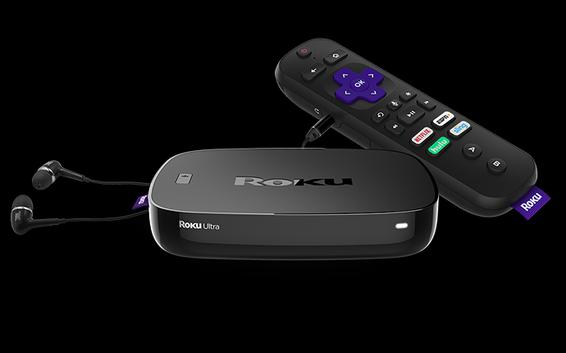


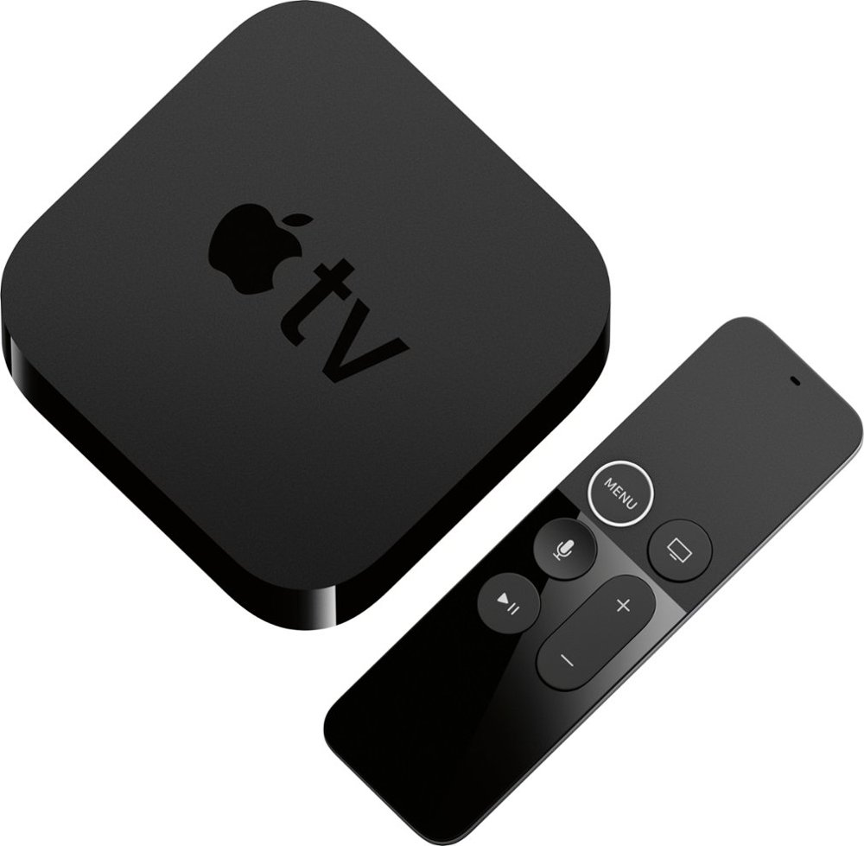
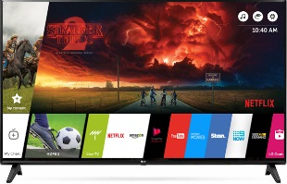
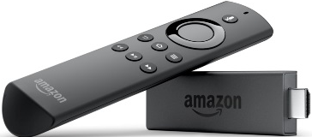
The Growth Of Connected TV Streaming Is Aided By The Popularity Of Different Access Points – Smart TVs, Players/Sticks & Game Consoles
+20.1%
YOY
+11.7%
YOY
-14.2%
YOY
-22.9%
YOY
3
Source: TiVo, Video Trends Report: Q2 2019.
This information is exclusively provided to VAB members and qualified marketers. Further distribution is prohibited.

Slide 4
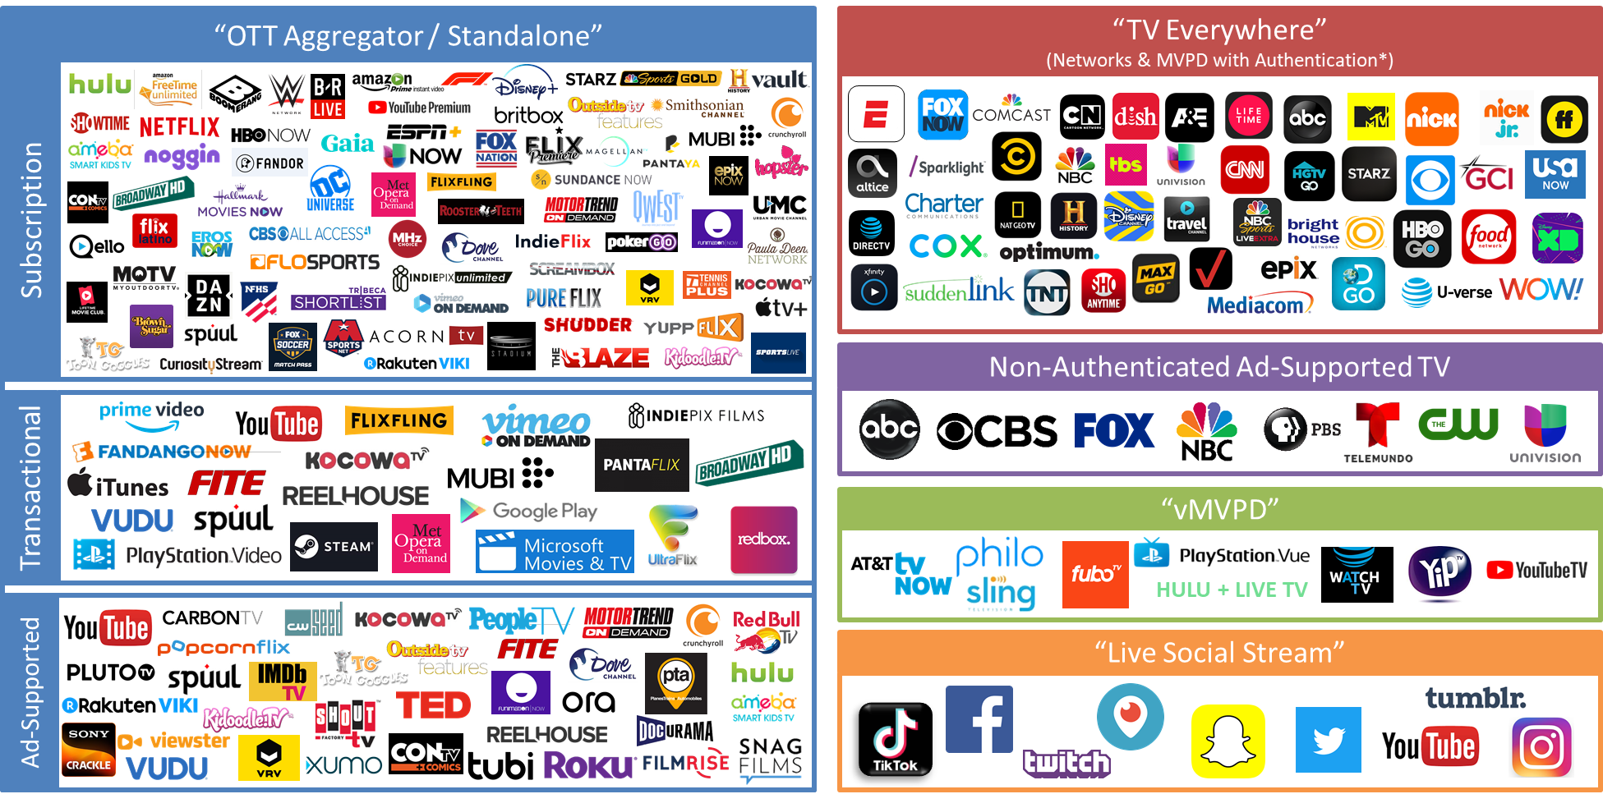
Today, Consumers Can Access TV & Video Content Through A Variety
Of Streaming Services Anywhere & At Anytime
*some streaming services have dual revenue models and are listed in multiple groupings. Chart represents a robust sampling of available services as of 11/12/19.
4
This information is exclusively provided to VAB members and qualified marketers. Further distribution is prohibited.

Slide 5






Major New Services Are Set To Cause The Largest Disruption Within On-Demand Video Since The Introduction Of Netflix Streaming & Hulu Over Ten Years Ago
6 major streaming services, featuring highly-produced, original premium video content,
are launching between November 2019 – Spring 2020
Streaming Services Launch Dates
Nov. 1, 2019
Nov. 12, 2019
Apr. 6, 2019
April 2020
Spring 2020
Spring 2020
← 2019
2020 →
5
Source: TV Time and United Talent Agency, Beyond The Big Three: The Streaming Wars Are Upon Us, October 2019.
This information is exclusively provided to VAB members and qualified marketers. Further distribution is prohibited.

Slide 6



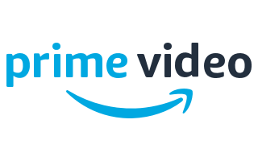
This Disruption Will Be Fueled By The Billions Of Dollars That Competing Streaming Services Will Invest In Programming Content To Acquire Viewers
$30B
Could easily be spent annually on content by SVOD streaming services
in the U.S. by 2024
(GroupM estimate)
6
Source: GroupM, Business Intelligence, November 11th, 2019. Companies shown above represent a sampling of SVOD streaming services.
This information is exclusively provided to VAB members and qualified marketers. Further distribution is prohibited.

Slide 7
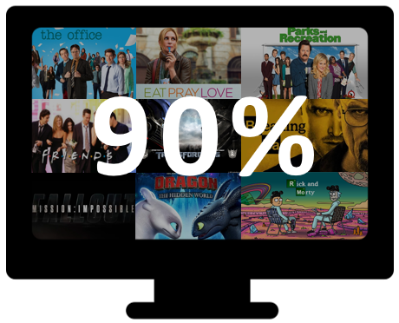
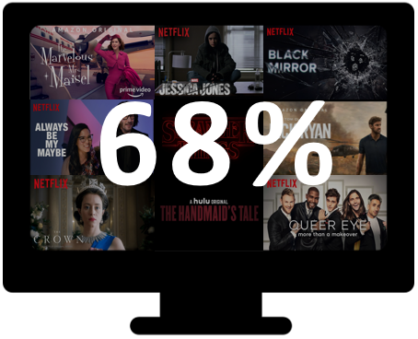
And Streaming Services That Offer A Deep Library Of Owned Or Acquired Content Have A Competitive Advantage In The Eyes Of The Consumer
Importance of Library vs. Original Content in Selecting a Service
Library Content
Original Content
of viewers find the availability of library content when considering a streaming service “important” or “very important”.
of viewers find the availability of original content when considering a streaming service “important” or “very important”.
7
Source: TV Time and United Talent Agency, Beyond The Big Three: The Streaming Wars Are Upon Us, October 2019.
This information is exclusively provided to VAB members and qualified marketers. Further distribution is prohibited.

Slide 8
Currently, A Majority Of Adults Subscribe To 1-2 Streaming Services,
While Over One-Quarter Subscribe To 3-4 Services
Gen Z are slightly more likely to subscribe to 1-2 streaming services while over one-third of Millennials are likely to subscribe to 3-4 services
How many streaming services do you currently subscribe to?
8
Source: Morning Consult and The Hollywood Reporter, National Tracking Poll #190719, July 12 – 14, 2019.
This information is exclusively provided to VAB members and qualified marketers. Further distribution is prohibited.

Slide 9
With New Subscription Offerings Coming To The Market, Two-Thirds Of Consumers Are Looking To Add At Least One More Service To Their Lineup
9
Source: TV Time and United Talent Agency, Beyond The Big Three: The Streaming Wars Are Upon Us, October 2019.
This information is exclusively provided to VAB members and qualified marketers. Further distribution is prohibited.

Slide 10
With That Said, Not All Consumers Are Looking To Add More Subscriptions Which Creates Opportunities For Ad-Based Video On Demand Platforms
10
Source: TV Time and United Talent Agency, Beyond The Big Three: The Streaming Wars Are Upon Us, October 2019.
This information is exclusively provided to VAB members and qualified marketers. Further distribution is prohibited.

Slide 11
In Fact, Within This Streaming Surge, Ad-Based VOD Is Projected To Experience 22% Compound Annual Growth And Become A $20 Billion Segment By 2024
22% CAGR
11
Source: Digital TV Research via Multichannel News (North American AVOD Revenues), June 27, 2019.
This information is exclusively provided to VAB members and qualified marketers. Further distribution is prohibited.

Slide 12




For more information visit us online
TheVAB.com
Join our email list
Follow us:
@VABIntel
Connect with us:
VAB

