Slide 1


Slide 2

Riding The Tide Of Emotions
Walter White. Sidney Bristow. Kramer. Cookie Lyon. Don Draper. Lorelai Gilmore. Bart Simpson.
Rick & Morty. Sheldon Cooper. Jane Villanueva.
VAB has often demonstrated the undeniable ability of TV to drive business growth, but in this report we explore the emotional impact of television. Television programming satisfies our human emotional need for connection; a connection not only to the characters and stories that resonate with us, but also the desire for a shared experience with our community.
The emotional bond many of us feel with Television programming is made clear by…
      The amount of time & attention we give it - 5+ hrs a day, double what we spend eating, drinking, shopping and viewing Facebook, combined
    Our insatiability for more content from the shows we love - 52 Million Facebook Followers of the top 5 shows alone
    The urgency we feel to rejoin the stories we loyally follow - 88% of primetime is viewed live
Emotionally compelling, character-driven premium programming fosters an ideal environment to showcase an advertisers message. But why is this important for advertisers?
    90% of human decision making is dictated by emotion
    85% of consumer purchases are driven by emotional attachment
    And 58% of consumers believe TV is where they are most likely to find advertising that makes them feel emotional (a figure 6x greater than that of Social media)
So, make like Olivia Pope and grab a glass of wine and popcorn, get cozy on the couch, and learn about
the emotional side of TV programming and its benefits to advertisers.
2

Slide 3
The Emotional Journey
Section I: The Indicators of Emotional Engagement
Time Spent & Attention________________________________________________6
Viewer Receptivity & Mindset___________________________________________16
Insatiable Appetite for More____________________________________________26
Attachment to Characters______________________________________________55
Section II: The Impact Of Emotional Attachment On Brands and Advertisers______________65
Summary______________________________________________________________________74
Related Reports & Contacts______________________________________________________75
3

Slide 4
The Indicators of Emotional Engagement
Measures to identify how emotionally attached
a viewer is to content
4

Slide 5

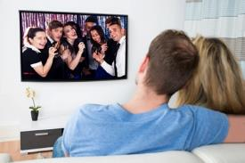


The Indicators of Emotional Engagement:
Measures to identify how emotionally attached a viewer is to content
Time Spent & Attention
In our increasingly busy lives, time is our most precious resource -focusing our attention on something signals commitment, loyalty, and interest
Viewer Receptivity & Mindset
People go to devices and platforms with an established expectation for their experience, ranging from functional to the more emotionally charged
Insatiable Appetite for More
More anticipation, more conversation, more spoilers, more episodes, more related content
Attachment to Characters
The willingness of viewers to repeatedly open their homes and hearts to the characters they love – and love to hate!
5

Slide 6
Time Spent & Attention
In our increasingly busy lives, time is our most precious resource -focusing our attention on something signals commitment, loyalty, and interest
6

Slide 7
Over The Course Of a Year, The Average American Devotes 1,908 Hours To Television
If Viewed Consecutively, He Would Spend
80 Days – 20% of the year – Watching TV
Source: Nielsen Total Audience Report, Q1 ’17, P18+; TV = Live TV + DVR + Time Shifted
7

Slide 8




Although On-The-Go Viewing Is On The Rise, Viewers Crave The Experience Of Watching On The Big Screen
Persons 2+
Millennials 18-24
Millennials 25-34
+7x
+3x
+2x
Source: Nielsen Total Audience Report, Q1 ’17; TV = Live TV + DVR + Time Shifted

Slide 9








Adults Dedicate More Time On the TV Screen Each Day Than They Do Eating/Drinking, Shopping, Talking On The Phone, Emailing, And Viewing Netflix, YouTube, And Facebook Combined
Time spent per day (Adults)
18
min
Source: Nielsen Total Audience Report, Q1 ’17, P18+; TV = Live TV + DVR + Time Shifted, reflects activity on TV set only – computer/laptop and mobile viewing not included; Bureau of Labor Statistics, 2016 Annual Average Hours Per Day in Selected Activities, Reflects P15+; comScore Media Metrix Multi-Platform Data, Desktop 2+, Mobile 18+, July 2017, Average minutes per visitor- note mobile video is not included in comScore data
9

Slide 10








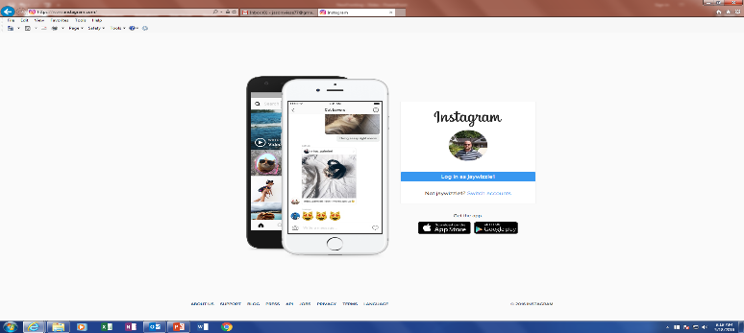

TV Viewers Are Committed & Invested In The Content, Spending More Time Watching It Than Other Video Platforms
Average Monthly Time Spent
Minutes per viewer– Adults 18+
Television
The average length of a session with TV is 43% longer than with YouTube and 240% higher than with Facebook, offering more potential for engagement
Sources: Nielsen Total Audience Report, Q1 ‘17, Live + DVR + Time Shifted, P18+, reflects activity on TV set only – computer/laptop and mobile viewing not included;
comScore Media Metrix Multi-Platform Data, Desktop 2+, Mobile 18+, July 2017, Average Min Per Visitor, July 2017; note comScore data does not include mobile video; Length of YouTube session based on Media Metrix Multi-Platform, Desktop 2+, Mobile 18+, July 2017, Average minutes per visit.
10

Slide 11




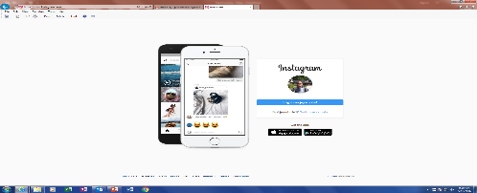

The Ultimate TV Fans?
Millennials Spend More Time Watching TV Each Day Than They Do Eating/Drinking, Shopping, And Using YouTube And Instagram Combined
Time Spent per day (Millennials)
Source: TV: Nielsen Total Audience Report, Q1 ’17; TV = Live TV + DVR + Time Shifted, A18-34, graph reflects activity on TV set only – computer/laptop and mobile viewing not included; Bureau of Labor Statistics, 2016 Annual Average Hours Per Day, P20-34; comScore Media Metrix Multi-Platform Data, P18+, July 2017, note mobile video is not included in comScore data
11

Slide 12


Millennials Spend 4x More Time Watching TV Than YouTube, the Largest Online Video Platform
Average Monthly Time Spent
Minutes per viewer – P18-34
Television
Sources: Nielsen Total Audience Report, Q1 ‘17, Live + DVR + Time Shifted, weighted average for P18-34, reflects activity on TV set only – computer/laptop and mobile viewing not included; comScore Media Metrix Multi-Platform Data, P18-34, July 2017, Average Min Per Visitor, July 2017; note comScore data does not include mobile video
12

Slide 13
How Does YouTube Compare to TV?
Does YouTube Offer the Same Experience or Environment?

Slide 14


YouTube Offers a Completely Different Viewing Experience From Television
The YouTube Viewing Experience Is Highly Fragmented
TV viewers spend more time with a more focused set of programs, fostering deeper engagement and storytelling
Weekly time spent on the 10 most viewed networks
292.5 Billion minutes viewed across 635 programs
37.2 Billion minutes viewed across 700,000+ channels
Sources: TV: Nielsen nPower Live+7, Total Day, P2+, 7/3-7/30/17, ranked on avg time spent/week with net, number of total minutes includes all telecasts;
YouTube: comScore Video Metrix Multi-Platform. Total Minutes, July 2017, Desktop, OTT: P2+, Mobile P18+
# of Channels based on SocialBlade data, Aug 2017
14

Slide 15

The Indicators of Emotional Engagement:
In Their Increasingly Busy Lives, Americans Take Time Each Day to Sit Back, Relax and Watch Hours of TV
Time Spent & Attention
If viewed consecutively, the average American would devote 80 days – 20% of their year – to watching TV
Viewer Receptivity & Mindset
Insatiable Appetite for More
Attachment to Characters
15

Slide 16
Receptivity & Mindset
People go to devices & platforms with an established expectation for their experience, ranging from functional to the more emotionally charged
16

Slide 17




Consumers Prefer Watching Content on a Television
They rely upon other devices for utility & functional benefits
Emotional Connection Potential
Primary Activities on Device:
Watching Video Content
Search/Surf
Social Media
Emailing
Shopping
Streaming Music
Streaming Video
Gaming
Messaging
Search
News/Weather Updates
Maps/Directions
Social Media
Source: CRE and Hub Research custom study “New study finds that TV outperforms Digital platforms in viewer ad attention & recall” 6/26/16; 2016 GfK MRI Doublebase – primary uses of devices, total population
17
Notes:
17
17

Slide 18




Not Surprisingly, Television Is The Platform That Provides The Strongest Opportunity For Storytelling and Emotional Engagement
Emotional Connection Potential
Entertainment & Escapism
82% enjoy it for pure entertainment
6 core reasons: for comfort, to unwind, to connect, to experience, to escape, and to indulge*
Connections Over Content
82% of users cite making connections as the best thing that’s happened to them since joining Facebook – finding old friends/acquaintances, making new friends, creating business opportunities
10% cite content, such as news updates and stories
Real-time news and second screening (of televised) events
86% of Twitter users use it primarily for keeping up with news
28% of users chat live events
Music, quick-hit humor and how-to’s
94% of the top 250 viewed videos are music
Source: American Press Institute, “How People Use Twitter” Sept 2015; comScore Media Metrics Multi-Platform, Total Audience, July 2017; note comScore data does not include mobile video; *Thinkbox “Screen Life: TV in Demand”
18

Slide 19
As A Pure Entertainment Platform, Television Programming Is Able To Elicit A Wide Array of Emotions

Slide 20

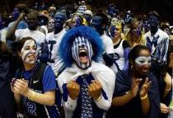




TV Programs Evoke Emotions Ranging From Suspense To Elation
Awe, Understanding, Enlightenment, Curiosity
Hope, Comradery,
Elation, Despair
Fear, Suspense, Sadness, Relief
Uncertainty, Angst,
Empowerment
Absurdity, Surprise, Escape
Joy, Delight, Relaxation
Source: Nielsen nPower, ranked on top 250 regular pgms (regular 3 or more t/c) ad-supported cable+english bdcst; total day; P2+; 1/2-8/6/17
20

Slide 21








And TV Content Taps Into Deeply Personal Topics And Brings Them Into Our Living Rooms
Delights with ideas on how to nourish family & friends
Provokes thinking and discussion about salient topics
Transports to exotic and aspirational travel destinations
Explores the relationship dynamics viewers experience in their own lives
Enables self-discovery and personal exploration
Fuels the passions of sports fandom
Inspires the creation of a warm home environment that reflects personal style
Awes and dazzles with the fashions, glitz, and glamor of Awards season
21

Slide 22
In Contrast, The Most Heavily Viewed Videos On YouTube Focus Largely On A Single Genre

Slide 23
The Overwhelming Majority Of YouTube’s Top Content Is Music
Music accounts for 30%+ of all time spent with YouTube
While music does elicit emotion, it lacks many of the basic elements required for true sustained emotional engagement: A compelling storyline, depth of character development, and the ability to develop a story over time
Sources: YouTube, August 2017, top 250 viewed videos; comScore Video Metrix Multi-Platform. “Total Minutes”, July 2017 Desktop, OTT: P2+, Mobile P18+
23

Slide 24

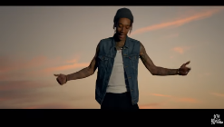

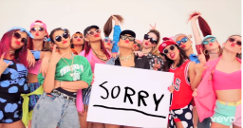




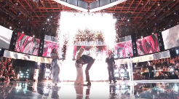
A Look At The Top Pieces of Video On Each Platform Illustrates The Disparity In Storytelling and Depth Of Emotion
Despacito
Wiz Khalifa
2017 Top YouTube content
Gangnam Style
Justin Bieber
The Big Bang Theory
This Is Us
2017 Top Television content
Bull
The Voice
Sources:
TV: Programs rank in top 10 Entertainment Programs, Nielsen, P2+, 9/16/17-5/24/17: The Big Bang Theory, This is Us, The Voice, Bull
YT: Ranking based on highest # of views, through 9/1/17 – Despacito, Gangnam Style, Justin Bieber/Sorry, Wiz Khalifa/See You Again
24

Slide 25

The Indicators of Emotional Engagement:
As A Pure Entertainment Platform, Television Programming Is Able
To Elicit A Wide Array of Emotions
Time Spent & Attention
If viewed consecutively, the average American would devote 80 days – 20% of their year – to watching TV
Viewer Receptivity & Mindset
People rely on TV for comfort, to unwind, to connect, to experience, to escape and to indulge
Insatiable Appetite for More
Attachment to Characters
25

Slide 26
Insatiable Appetite for More
More anticipation, more conversation, more spoilers, more episodes, more related content
26

Slide 27
“Insatiable Appetite for More” Means….
“Pre”
Urgency, anticipation, planning, & excitement for the content
“During”
Sustained interest & Immediate need to share
“Post”
Compelled to seek out MORE content & engage with communities
“Interest Over Time”
Sustained relevance
27

Slide 28
“Insatiable Appetite for More” Means….
“Pre”
Urgency, anticipation, planning, & excitement for the content
“During”
Sustained interest & Immediate need to share
“Post”
Compelled to seek out MORE content & engage with communities
“Interest Over Time”
Sustained relevance
28

Slide 29
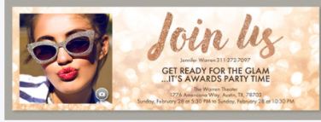


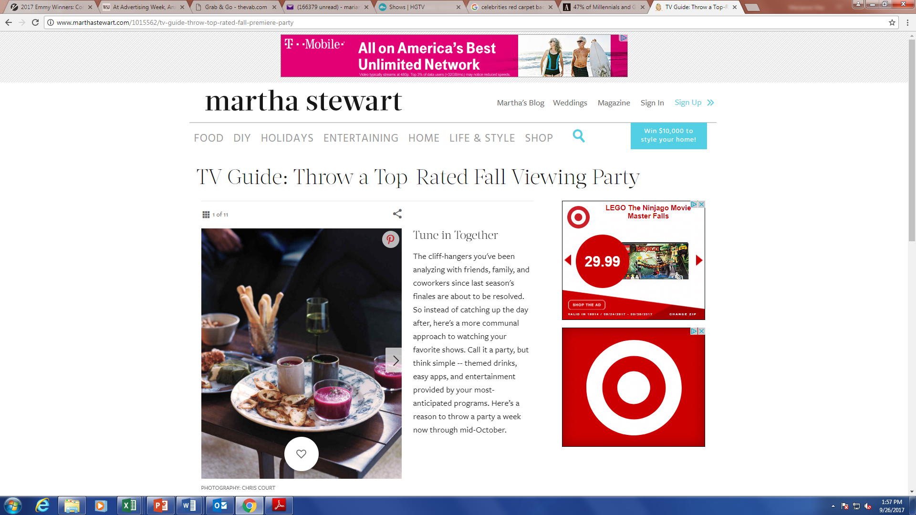

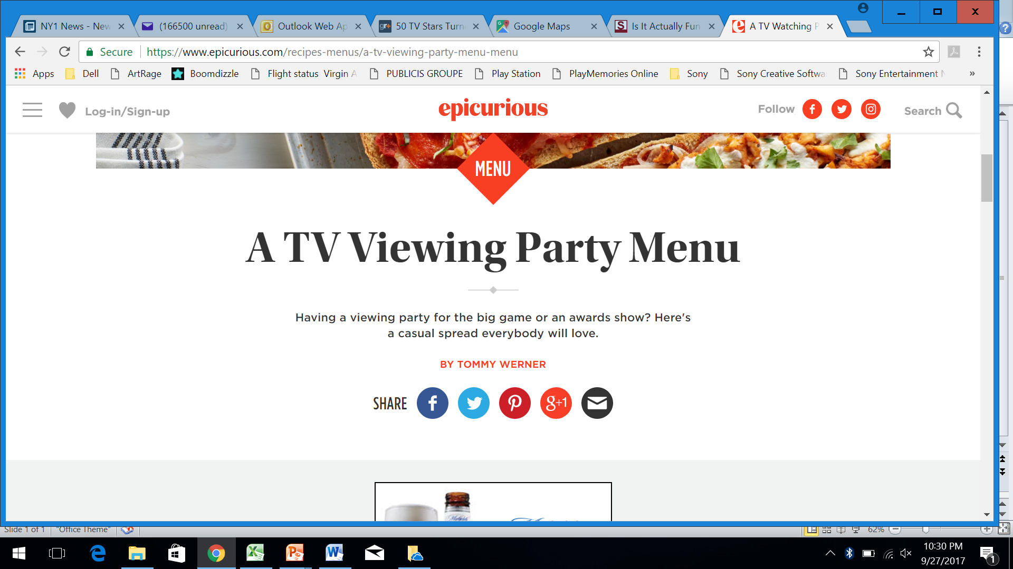
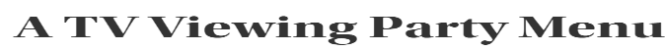
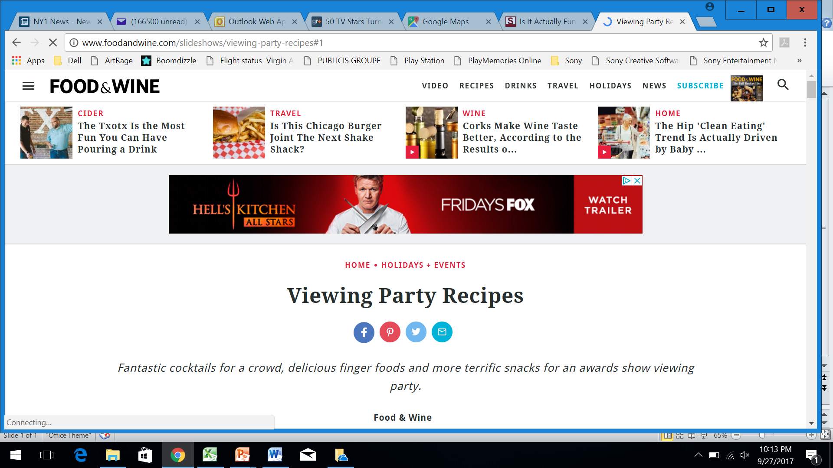
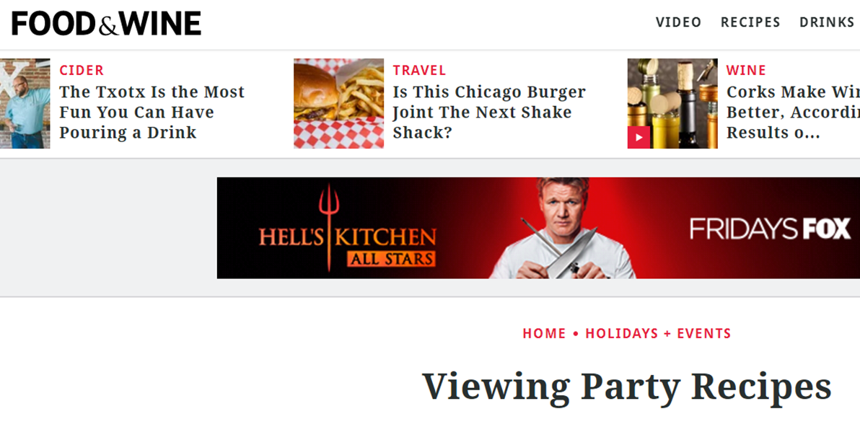

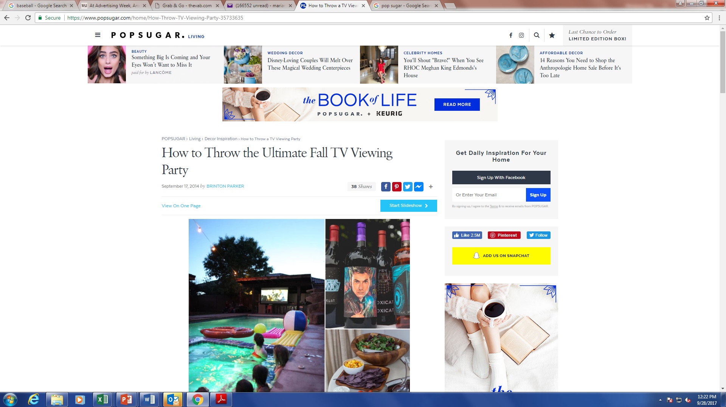

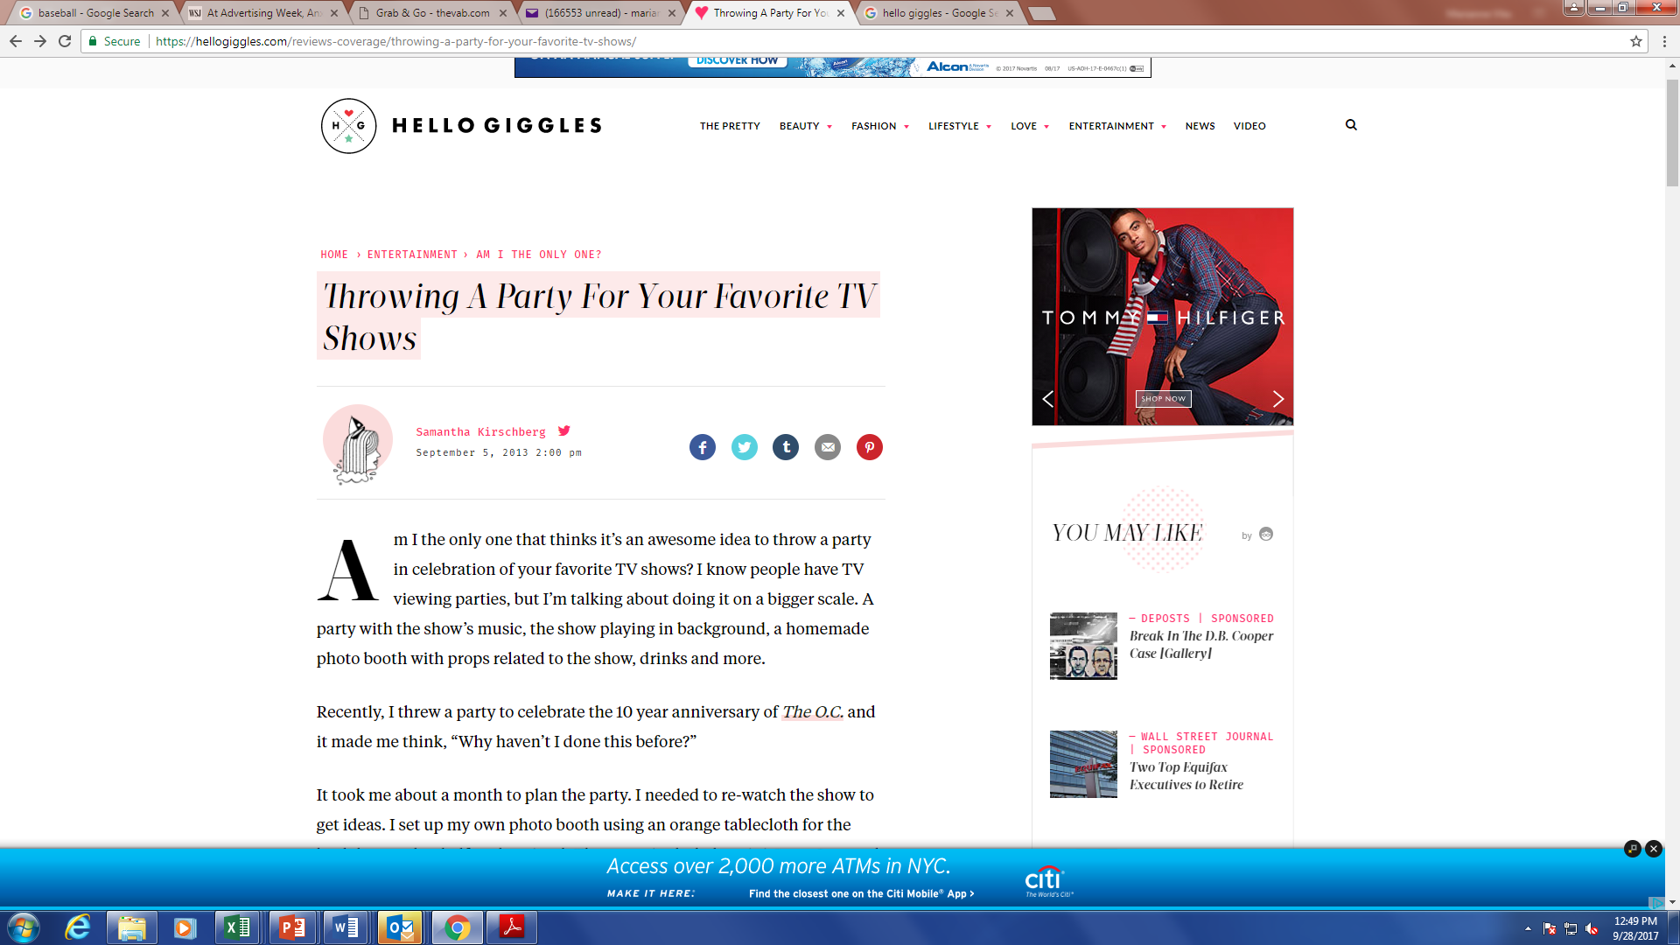





The Anticipation For Favorite Programs And Events Inspires Friends To Gather In Viewing Parties
Custom Invitations…
…A Range of Ideas & Inspiration…
…And TV Themed Food!
29

Slide 30


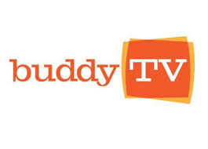








For Many, The Anticipation Is So Great That They Need To Know The Storylines And Fate Of Their Favorite Characters Immediately
“I'm just too impatient to wait, if I know there's info, I have to know it.”
”I just can't handle the shock, my heart can't take it.”
- Reddit users
The above sites receive 55 Million monthly unique visitors who spend a combined total of 240 Million minutes on these sites a month
Source: comScore, Media Metrix Multiplatform Audience Duplication Report – total population, Unique Visitors and Total Minutes , August 2017; note, SpoilerTV and SpoilersGuide were not measured in the Audience Duplication data and are not included in figures, comScore data does not include mobile video
30

Slide 31

The Majority Of Program-Related Tweets In Between Live Airings Are Expressions Of Anticipation For “What’s Going To Happen Next”
Looking at what viewers are talking about while they await the next episode, we see their excitement and urgency for upcoming episodes
“I can’t believe what happened to Character X!”
“So excited to see what happens to Character X on Tuesday!”
“@Star – what an amazing performance on Program A, loved it!”
Source: Nielsen “From Live to 24/7: Expanding Twitter Engagement Beyond The Live Airing” - total tweets collected 7/8/14-10/22/14, tweets reflected were captured for a drama program on days without a live airing
31

Slide 32
“Insatiable Appetite for More” Means….
“Pre”
Urgency, anticipation, planning, & excitement for the content
“During”
Sustained interest & Immediate need to share
“Post”
Compelled to seek out MORE content & engage with communities
“Interest Over Time”
Sustained relevance
32

Slide 33
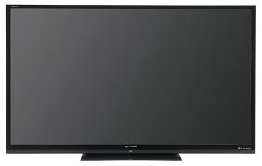
Reflecting Their Excitement For The Programming, The Overwhelming Majority of Television Is Watched Live
Viewers are excited about watching their favorite programs
% Live Viewing in Primetime
Adults 18-24
Live - 88%
Play-back -
12%
% Live – Other demos: P25-34, 86%; P35-49, 86%; P50+ 89%
Source: Nielsen, Base=DVR HHs; 9/21/15-7/24/16; Live/Same Day data
33

Slide 34
And TV Holds This Attention Throughout The Program
Across genres and broadcast/cable networks, audience fluctuation was less than 20% between the program’s beginning and end
P2+ Ratings Change Over Time
25% Through
vs. start
50% Through
vs. 25%
75% Through
vs. 50%
End
vs. 75%
Drama
Reality
News/Documentary
Sports
Comedy
Bull
Dancing with the Stars
AC 360
Sunday Night Football
Rick & Morty
Designated Survivor
The Voice
Parts Unknown
WWE
Broad City
Source: P2+ Playback Time Period: Live+7 Days (+168 Hours) | Linear with VOD( Live+7 Days (+168 Hours)|TV; Designated Survivor, 10/5/16, minutes 1, 14,30,45,60; The Voice, 11/22/16 min 1,33,58,98,120; DWTS 10/24, 1,29,60,90,120; Bull, 11/15/16 min 2,15,30,43,57; Anderson Cooper 360 10/12/16 min 1,15,30,45,56; Parts Unknown, 10/1/17, min 1,13,30,45,60; NBC Sun Night Football 10/23/16, min 1,55,110,162,220; WWE, 9/25/17, min 1, 15, 30, 45,60; Rick & Morty, 10/1/17, min 1,8,15,22,29; Broad City, 8/23/17, min 1, 7, 15,23,30
34

Slide 35
In Real-Time, Ad-Supported TV Moves Viewers To Share Their Experiences With Fan Communities And Friends

Slide 36



Ad-Supported TV Content Provokes More Real Time Conversation Than
Any Other Platform
Top 10 Twitter Trending Topics - % by platform
Over a 4 week period
Other SVOD: 4 (3%)
Ad-Supported TV
Other platform “program” highlights: Netflix – House of Cards, Sense8, The Get Down; Music – T-Wayne, Rake It Up; Online Radio – Most Requested Live (iHeart Radio); YouTube – Car Boys; HBO – HBO Boxing, Mommy Dead & Dearest, Real Time with Bill Maher, The Leftovers; Showtime – Twin Peaks; Starz – American Gods; PPV – UFC 212; Facebook Live – CFDAAwards; Snapchat – Ask Ethan & Grayson; WWE Network – WWE Backlash; Video Games – Injustice 2, Life Is Strange 2; Other streaming – E3
Source: VAB custom analysis of Top 10 trending Twitter Topics each night (8:30p, 9:30p, 10:30p, 11:30p) during 4-week time period (5/15/2017 – 6/11/2017). Based on unique program counts. For the purposes of this chart, “program / content” is an all-encompassing definition for individual pieces of content on each platform (albums & singles for music, video games, channel on YouTube, live streaming and/or personality on a social media platform, etc).

Slide 37

At Least Half Of The Top 10 Trending Topics On Any Night
Were Based on Ad-Supported TV Content
% of Top 10 Trending Topics That Are Based On TV Content (based on a 4-week average)
Monday
Tuesday
Wednesday
Thursday
Friday
Saturday
Sunday
Overall
81%
69%
66%
68%
51%
56%
78%
8:30p
65% 48% 40% 38% 35% 48% 78%
9:30p
85% 73% 68% 75% 55% 55% 80%
10:30p
85% 80% 80% 80% 58% 68% 80%
11:30p
88% 75% 78% 78% 58% 55% 73%
Source: VAB custom analysis of Top 10 trending Twitter Topics each night (8:30p, 9:30p, 10:30p, 11:30p) during 4-week time period (5/15/207 – 6/11/2017). Reflects four week average by day and time. Results include both “direct” and “related” TV topics.

Slide 38
In Contrast, There Is Less Immediacy For YouTube Content Than TV Programming

Slide 39
TV Programs Are More Than Twice As Likely To Be Watched Live/Same Day Than Newly Posted YouTube Videos – On Even The Top YT Channels
% of Views – Television & YouTube
Source: YouTube data collection of 35 videos posted on the following channels from 7/26/17-8/4/17, PewDiePie, El Rubius OMG, Smosh, Fernanfloo, VanossGaming, Vegetta777, Markiplier, Spinnin Records, Jacksepticeye ; Nielsen timeperiod share of minutes; 7/26/17-8/4/17, P2+

Slide 40









The Majority Of YouTube Trending Content – Indicating Real Time Audience Engagement -Was From Television
  Looking at 50 trending YouTube Videos over a 2 week period, over a quarter of them were popular content from television
Source: VAB Custom Analysis of YouTube trending videos, 7/17/17-8/4/17

Slide 41
“Insatiable Appetite for More” Means….
“Pre”
Urgency, anticipation, planning, & excitement for the content
“During”
Sustained interest & Immediate need to share
“Post”
Compelled to seek out MORE content & engage with communities
“Interest Over Time”
Sustained relevance

Slide 42
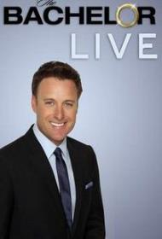











Consumers Want To See More On The Screen Of The Stories and Characters They Love
Spinoffs & Extensions
The Rise of “Fan Shows”
3 shows
3 shows
9 shows +
10 International
9 shows
10 shows/specials +
20 International
7 shows
Not so niche…Talking Dead has nearly double the audience of the #2 ranked YouTube Channel
Source: #2 YT Channel – ElRubiusOMG (by subscriber count), August 2017
42

Slide 43


They Also Want More Off The TV Screen - A Thirst For More Content And A Desire To Share Their Experience With Other Fans
The Top 5 Entertainment TV programs have a combined….
39,398 Reddit Followers
…top 5 YouTube channels have 1,492
13,012,100 pieces of Video Content on YouTube
…top 5 YouTube channels have 8,908,000
52,021,000 Facebook Followers
…top 5 YouTube channels have 42,600,000
600% increase in web traffic to the show’s sites after the new season began
Source: Data as of 9/8/17; Top TV programs based on Nielsen Television Index National Ranking Report – The Big Bang Theory, NCIS, Bull, This is Us, Blue Bloods , Excludes Paid Political Programming; Breakouts; Specials; Programs 5 minutes or Less; Sustainers; Pre-premieres, For time period **9/19/16 - 5/24/17, Reddit followers are on Official program/channel subthread; Top 5 YT channels based upon total subscribers as of 7/24/17 – PewDiePie, HolaSoyGerman, ElRubiusOMG, Smosh, Fernanfloo. Web traffic data is comScore, Media Metrix Multi-Platform, total uniques in the months of October 2016 and July 2017
43

Slide 44
Similarly, Millennials Are Inspired To Seek Out More Content On The Programming They Love
Millennials’ (18-34) top 5 entertainment programs have a combined….
185,884 Reddit Followers
…top 5 YouTube channels have 1,492
25,965,000 pieces of Video Content on YouTube
…top 5 YouTube channels have 8,908,000
91,662,028 Facebook Followers
…top 5 YouTube channels have 42,600,000
454% increase in web traffic to the show’s sites after the new season began
Source: Top TV programs based on Nielsen Season To Date (10/16/17) for A18-34 – This is Us, Young Sheldon, The Voice, Empire, The Simpsons - Excludes Paid Political Programming; Sports; Breakouts; Specials; Programs 5 minutes or Less; Sustainers; Pre-premieres; Reddit followers are on Official program/channel subthread; Top 5 YT channels based upon total subscribers as of 7/24/17 – PewDiePie, HolaSoyGerman, ElRubiusOMG, Smosh, Fernanfloo. Web traffic data is ComScore Media Metrix Multi-Platform reflects measured programs, Simpsons & This is US – P18-34; in the months of August 2017 (before new season) and September 2017 (at start of new season)
44

Slide 45
In Contrast, Even Trending YouTube Videos – The Most Buzzed About Content - Prompted Little Further Engagement With The Channel

Slide 46
  Trending Videos Had A Negligible Impact On Driving Interest For The Channel Or The YouTube Personality
  VAB tracked 50 YouTube Trending Videos to understand the impact they had on the channel that posted them…
  …did they inspire viewers to watch more of that creator’s content?
  …did they spur an increase in channel subscribers or social following?
4% lift in views across the channel’s 3 most recently posted videos
< 1% lift in social followers or channel subscribers
Source: VAB Custom Analysis of YouTube trending videos, 7/17/17-8/4/17 - % lift in YT video content measured one day after the video trended
46

Slide 47
“Insatiable Appetite for More” Means….
“Pre”
Urgency, anticipation, planning, & excitement for the content
“During”
Sustained interest & Immediate need to share
“Post”
Compelled to seek out MORE content & engage with communities
“Interest Over Time”
Sustained relevance
47

Slide 48









Compelling Storylines and Characters Have Enabled Long-Running Shows To Maintain Their Loyal Audiences For Years
12 years on air, maintained position in top 1% of all programs
13 years on air, maintained position in top 1% of all programs
13 years on air, maintained position in top 1% of all programs
10 years on air, maintained position in top 1% of all programs
12 years on air, maintained position in top 1% of all programs
8 years on air, maintained position in top 2% of all programs
7 years on air, grew from top 8% to top 1% of all programs
7 years on air, maintained position in top 6% of all programs
6 years on air, grew from top 11% to top 6% of all programs
Source: Nielsen-October 2017 for broadcast seasons: ‘04/05, ‘5/06, ’06/07, ’07/08, ‘08/09, ‘09/10, ‘10/11, ‘11/12, ‘12/13, ‘13/14, ‘14/15, ‘15/16, ‘16/17, Broadcast + Cable Prime Programs, P2+, Live+7 Days (+168 Hours) TV with Digital Linear with VOD
48

Slide 49
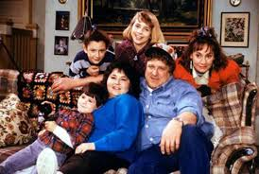


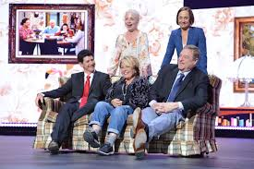
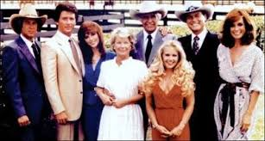



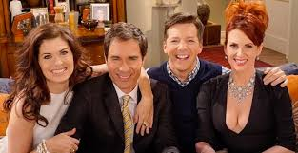
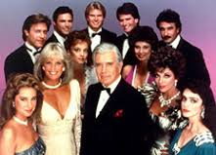

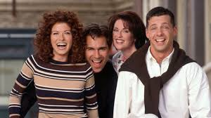


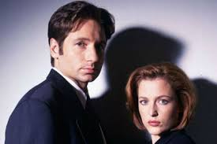
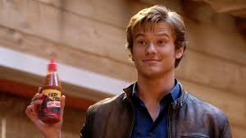

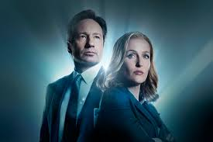
Reboots Of Beloved Programs Demonstrate That The Connection Viewers Feel To Their Favorite Shows Can Bridge Years, Even Decades
After 20 years off air
After 21 years off air
After 11 years off air
After 28 years off air
After 24 years off air
After 14 years off air
49

Slide 50








Long-Running Programming Continues to Be Celebrated By Fans And Lauded By Critics
3 of the 5 “Favorite TV Program” Nominees Have Been Running for 7+ Years
4 wins after 42 years on air
“Favorite Network TV Drama”
(after 13 years)
“Favorite TV Crime Drama”
(after 12 years)
“Best Reality Competition” win after 7 years on air
Source: Completed seasons on air; 2017 Primetime Emmys
50

Slide 51
In Contrast, YouTube Channels And Personalities Often Do Not Have The Staying Power Of Many TV Programs/Stars

Slide 52










Where Are They Now?
A look at the top TV Shows and YouTube channels from 10 years ago illustrates that TV programs cultivate a larger, more passionate fan following
Source: “Social Following” includes Facebook Fans, Twitter Followers, YouTube Subscribers, and Instagram Followers; YouTube top 5 channels defined as most subscribers on YouTube per Tube Charts - 2nd Oct 2007, Smosh, Lonelygirl15, esemmdenters, miaarose, williamsledd; TV – Nielsen, Excludes Breakouts, Sports, Programs <5 min, and Specials, 9/24/06 - 5/21/07 – American Idol, Dancing with the Stars, CSI, Grey’s Anatomy, House
52

Slide 53
The Indicators of Emotional Engagement:
Insatiable Appetite for More
“Pre”
Urgency, anticipation, planning, & excitement for
the content
Nearly 60% of program tweets between airings are anticipation for
next episode
“During”
Sustained interest & Immediate need
to share
“Post”
Compelled to seek out MORE content & engage with communities
“Interest Over Time”
Sustained relevance
88% of prime viewing is live
65% of Twitter trending topics related to ad-supported TV
The top 5 TV programs have 13 million pieces of video on YT, 46% more than top 5 YT channels
The top 5 TV programs from 10 years ago currently enjoy 2.5x the Facebook fans than YouTube channels of the same year
53

Slide 54
The Indicators of Emotional Engagement:
People Actively Engaging with TV Content Before, During & After the Show
Time Spent & Attention
If viewed consecutively, the average American would devote 80 days – 20% of their year – to watching TV
Viewer Receptivity & Mindset
People rely on TV for comfort, to unwind, to connect, to experience, to escape and to indulge
Insatiable Appetite for More
Nearly 60% of program tweets are anticipation for the next episode
Attachment to Characters
5

Slide 55
Attachment to Characters
Demonstrates the willingness of viewers to repeatedly open their lives and hearts to the characters they love – and love to hate!
55
55

Slide 56

56

Slide 57

Why Do We Become Attached To Fictional Characters on TV?
Empathy enables a true emotional connection—even if the person is a fictional one—because we learned in real life how to feel the emotions, even if we haven’t been in the exact situation
“We invest ourselves deeply in the experience of living with those characters. We tend to respond to them as though they were real individuals.”
- Howard Sklar, post doctoral researcher at University of Helsinki
“Once the viewer has a gut reaction it activates all sorts of feelings in them and it is hard to just see it as entertainment especially when it is a heart wrenching role."
- Fran Greene, The Flirting Bible
57

Slide 58
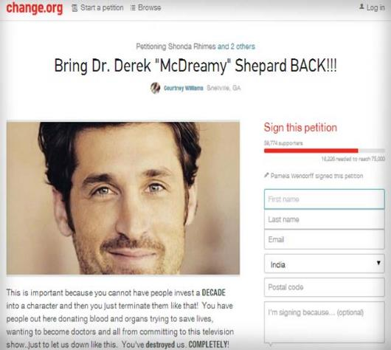
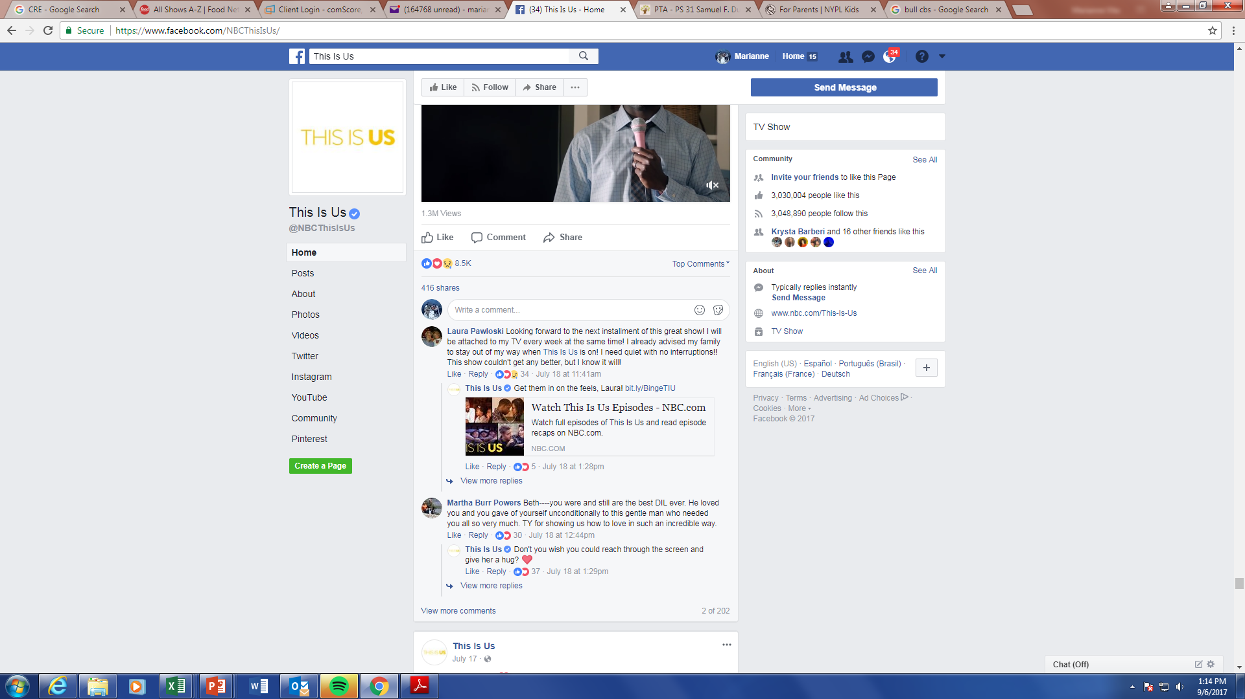

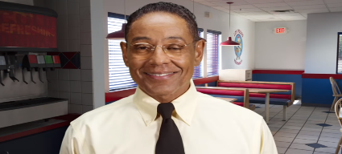

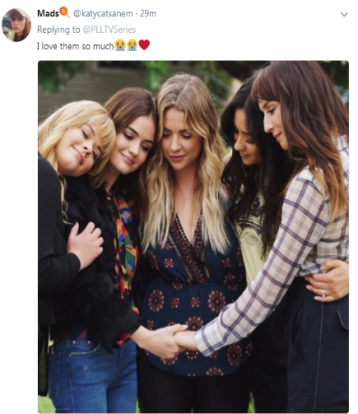

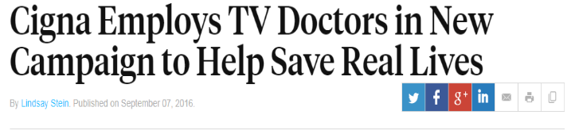
Over Time, They Become A Part Of Our Lives And We Often Begin To Feel That They Are Real
This Is Us Fan
Pretty Little Liars Fan
“You’ve destroyed us COMPLETELY!”
109,296 signatures…
Equivalent to the entire population of Cambridge, MA
Better Call Saul promos teasing return of villain Gus Fring received 993k YouTube views
Impact to Consumers: “Hundreds of thousands of people getting preventative care”
Impact to Cigna: Double-digit boost in its customer base getting checkups in markets where ads ran. 250% increase in positive brand sentiment in the first month of the campaign.
Source: Ad Age, “More TV Doctors On Call For Cigna; Better Call Saul YT views through 10/13/016
58

Slide 59










Taking On a Life Of Their Own, The Characters Themselves Often Spark Much Of The Program Discussion Online
A custom VAB study, #TVisSocial Episode 2, demonstrated that while trending topics are often about programs themselves, viewers also tweet about the character’s “I can’t believe what they just did!” moments
30% of program tweets were for “Lucious”
57% of program tweets were for “Maya Pope” or “Olivia Pope”
50% of program tweets were for “Toya” or “Tamar”
100% of program tweets were for individuals - Alicia Fox, Big Show, Bray Wyatt Enzo, Goldust, Kurt Angle, Reigns, Samoa Joe, The Drifter
Source: VAB custom analysis of Top 10 trending Twitter Topics each night (8:30p, 9:30p, 10:30p, 11:30p) during 4-week time period (5/15/2017 – 6/11/2017). Results include both “direct” and “related” TV topics.
59

Slide 60
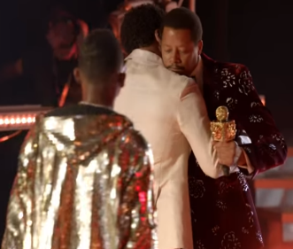



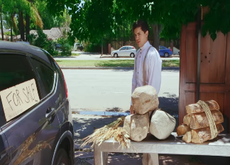
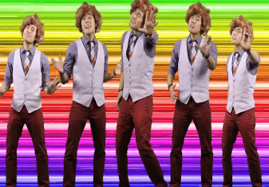


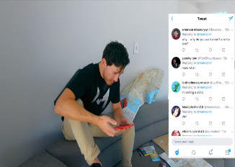
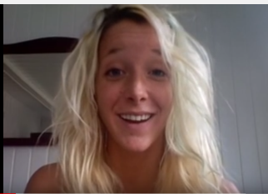
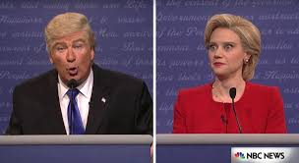
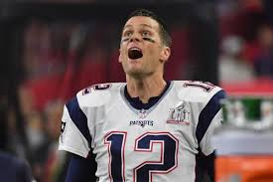
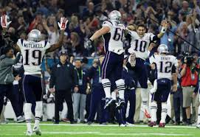
Character-Driven Storylines Create An Emotional “Stakes” That Doesn’t Readily Exist On Many Digital Video Platforms
Top 2017 Video Content
Source: Top YouTube channels 2017, Social Blade – Subscriber Count, US, Oct 2017: PewDiePie; Dude Perfect; Smosh; RyanHiga; Markiplier; JennaMarbles TV: Top shows of 2017- Empire, Young Sheldon, The Walking Dead, The Voice, Saturday Night Live, Super Bowl
60

Slide 61


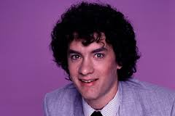

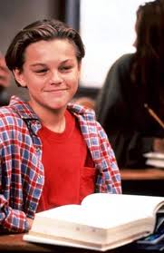

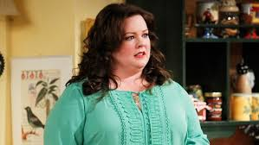


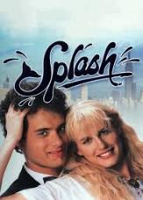




And This Base Of Passionate Fans Has Catapulted Many TV Actors To Mass Box Office Success, Even Early On
1 year after ER
During 21 Jump Street
2 years after Bosom Buddies
During Fresh Prince of Bel Air
5 years after Growing Pains
3 years after the Bill Engvall Show
During Mike & Molly
The above 7 films grossed nearly $2 Billion in the US alone
Source: Box Office Mojo, U.S. gross only
61

Slide 62
In Contrast, Few YouTube Personalities Have Successfully Amassed A Large Following

Slide 63

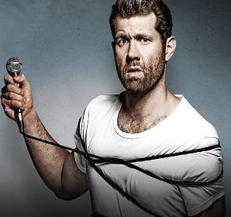
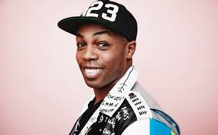

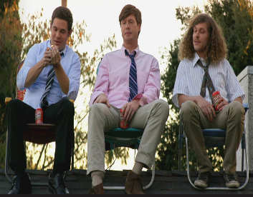
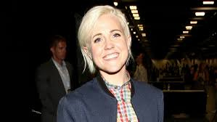

Those YouTube Personalities That Have Jumped To Starring Roles On TV Largely Continue With Niche Audiences
Adam Conover, Adam Ruins Everything, TruTV
Billy Eichner, Billy on the Street, TruTV
Todrick Hall, Todrick, MTV
Ilana Glazer, Abbi Jacobson, Broad City, Comedy Central
Adam Devine, Anders Holm, Blake Anderson, Workaholics, Comedy Central
Hannah Hart, I Hart Food, Food Network
Jon Lajoie, The League, FXX
63

Slide 64
The Indicators of Emotional Engagement:
People Have an Almost Irrational Attachment to their Favorite TV Characters
Time Spent & Attention
If viewed consecutively, the average American would devote 80 days – 20% of their year – to watching TV
Viewer Receptivity & Mindset
People rely on TV for comfort, to unwind, to connect, to experience, to escape and to indulge
Insatiable Appetite for More
Nearly 60% of program tweets are anticipation for the next episode
Attachment to Characters
Character attachment drives consumers to create petitions to change storylines, to form active fan communities, to follow their favorite TV stars to the cinema - and even impacts how they seek medical treatment!
64

Slide 65

The Impact Of Emotional Attachment On Brands/Advertisers
65

Slide 66
Why Are Emotions Important? Because They Drive Intention & Build Brands
85%
of consumer purchases are driven by Emotional Attachment
Someone who is highly attached is 3x more likely to engage with the brand. They are less price sensitive, go deeper into the product line and have a higher lifetime value to an advertiser.
“Emotion leads to action, while reason leads to conclusions.”
- Neurologist, Donald B. Calne
Source: LEAP Media Investments
66

Slide 67
TV Creates An Environment Where Brands Can Thrive And Make A Personal Connection With Viewers
(Social Media, Radio, & Newspapers)
(YouTube)
(Social Media)
(Social Media & YouTube)
Source: TV/Ad Nation, 2016, Ipsos Connect/Thinkbox, adults 15+
67
Notes:
67
67

Slide 68




Which In Turn Delivers Stronger Ad Recall
% of viewers able to identify half or more advertisers after viewing content
Source: CRE and Hub Research custom study. “New study finds that TV outperforms Digital platforms in viewer ad attention & recall” 6/26/16
68
Notes:
68
68

Slide 69
And Fosters Brand Health
(Social Media)
(Social Media)
Source: TV/Ad Nation, 2016, Ipsos Connect/Thnkbox, adults 15+
69
Notes:
69
69

Slide 70
Ultimately Driving Greater Brand Equity Lifts Than Digital Media
Source: IAB/Research Now Cross Media Effectiveness Study, January 2017; Digital Only = Desktop + Mobile Web
70
Notes:
70
70

Slide 71



Marketers Know This And Rely Upon TV As a Platform To Showcase Their Most Emotionally Compelling Ads
Examples from Budweiser and Always demonstrate the ability of the television environment to drive momentum for their emotion-based campaigns
Reported TV Ad Spend
$80.2MM
$8.8MM
TV-driven Social Actions
32.8MM
9.2MM
Source: Nielsen AdIntel; Budweiser – expenditure against all Clydesdale executions, 2013-Sept 2017; Always “Like a Girl” campaign, 2015-Oct 2016; Social Actions sourced from iSpot
71

Slide 72
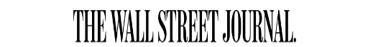



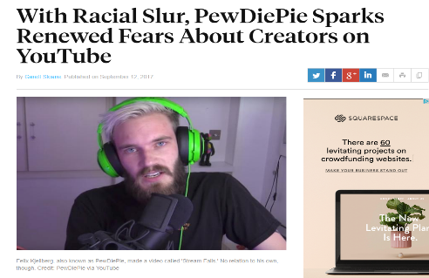

“Environment” Has Grown Increasingly Important As Ad Placement Next To Objectionable Online Content Continues To Be a Concern
Consumer reaction to online advertising adjacent to objectionable content…
    …20% will boycott, be vocal, or raise issues about it
    …37% say it will change how they think of the brand when making a decision to buy
    …48% of consumers will abandon brands they love if their ads run alongside offensive online content
Source: CMO Council, “How Brands Annoy Fans” June 2017
72

Slide 73
And So Why Are Emotions Important?
Because They Drive Intention & Build Brands
85% of purchases are drive by emotion
58% of consumers believe TV is where they will find ads that elicits emotion
64% of consumers believe TV is where they will find ads that are memorable
Source: Leap Media Investments, TV/Ad Nation Ipsos Connect/Thinkbox, 2016
73

Slide 74
Indicators Of Emotional Engagement: A Summary
Time Spent & Attention
Time is our most precious resource. Focusing our attention on something signals commitment, loyalty, and interest
Viewer Receptivity & Mindset
People go to the devices & platforms with an established expectation for their experience
If viewed consecutively, the average American would devote 80 days – 20% of their year – to watching TV
People rely on TV for comfort, to unwind, to connect, to experience, to escape and to indulge
Insatiable Appetite for More
More anticipation, more conversation, more spoilers, more episodes, more related content
Attachment to Characters
The willingness of viewers to repeatedly open their homes and hearts to the characters they love – and love to hate!
Nearly 60% of program tweets are anticipation for the next episode
Character attachment drives consumers to create petitions to change storylines, to form active fan communities, to see their favorite TV stars in movies - and even impacts how they seek medical treatment!
Why does emotional engagement matter?
85% of consumer purchases are driven by emotional attachment
58% of consumers believe TV is where they are most likely to find advertising that makes them feel emotional
(6x greater than Social media)
64% of consumers believe TV is where they will find ads that are memorable
(6x greater than Social media)
74

Slide 75





Related VAB Reports
75

Slide 76



