Slide 1





How can businesses use TV advertising to build customer relationships?
Marketer FAQs

Slide 2




How can TV advertising drive more people to my website
This is a question many businesses ask when creating their advertising campaigns.
Using a business-to-business (B2B) category analysis as
our reference, we explore how successful businesses are developing ad creative that establishes their brand and strengthens customer relationships. You’ll learn:
  Six key creative strategies that successful businesses are using in their TV advertising to create greater awareness among potential customers
  How TV ad campaigns that incorporate these strategies are converting customer awareness into increased website visits for these businesses
This information is exclusively provided to VAB members and qualified marketers. Further distribution is prohibited.
PAGE 2

Slide 3

All customers, whether business decision makers or individual buyers, are responsive to businesses that build a relationship with them on a personal level
“When B2B customers connect their personal values and motivations, such as professional credibility, success, and influence, to a brand – rather than to just strong perceptions
of business value like features, functionality and service –
they are twice as likely to make a purchase, pay a premium, and advocate for the brand.”
Dipanjan Chatterjee, Principal Analyst at Forrester
Forrester – ‘Drive B2B Brand Value With Emotion and Experience’
This information is exclusively provided to VAB members and qualified marketers. Further distribution is prohibited.
PAGE 3

Slide 4

‘Real world’ example of how successful
B2B brands are developing TV advertising creative that builds customer relationships
Download VAB’s Let’s Get Down to Business for our in-depth, full-funnel attribution analysis

Slide 5

























To understand how TV advertising connects with more customers, we examined 25 B2B advertisers that recently launched their first TV campaign
The 14 categories include banking/finance, commercial real estate, consulting, expense management, security, software, staffing and more with the analysis time period spanning between April ’18 – April ‘22
AAPC
(Healthcare)
AON Consulting
(Consulting)
Avira
(Software)
Blue Vine
(Banking/Finance)
Canva
(Graphic Design)
ABM Industries
(Commercial Real Estate)
Clear
(Security)
EY-Parthenon
(Consulting)
Fiverr
(Freelancing)
Kabbage
(Banking/Finance)
Kajabi
(Software)
Expensify
(Expense Management)
Leviton Manufacturing
(Manufacturing)
Loopnet
(Commercial Real Estate)
Palo Alto Networks
(Security)
Patriot Software
(Software)
Paychex
(Payroll)
Peopleready
(Staffing)
ServiceNow
(Software)
Ten-X Realtors
(Comm. Real Estate)
Twilio
(Communications)
Workhuman
(Human Resources)
Upwork
(Freelancing)
Webflow
(Software)
Smartsheet
(Software)
This information is exclusively provided to VAB members and qualified marketers. Further distribution is prohibited.
PAGE 5

Slide 6
These 25 brands are collectively employing six key creative strategies within their TV advertising to strengthen their relationship with customers
Touting their expertise
and trustworthiness
Highlighting the value
of their product or service through strong visual branding
Humanizing their brand through emotional messages that includes personal stories
Becoming more approachable through lighthearted, humorous moments
Partnering with celebrities
that have wide appeal
Reflecting authentic representation by incorporating greater diversity & inclusion
This information is exclusively provided to VAB members and qualified marketers. Further distribution is prohibited.
PAGE 6

Slide 7

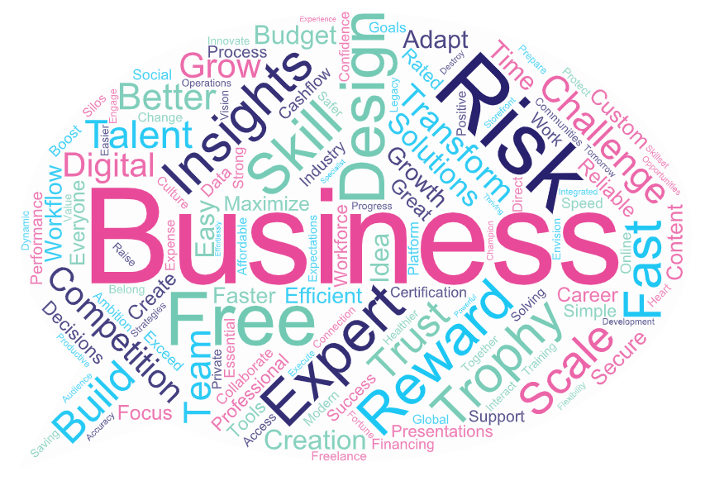

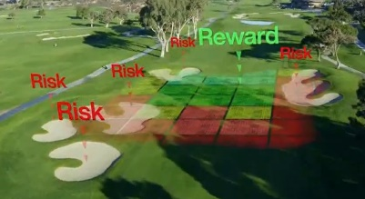

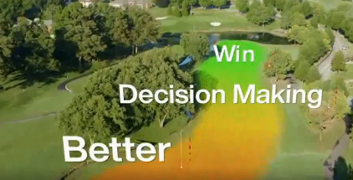



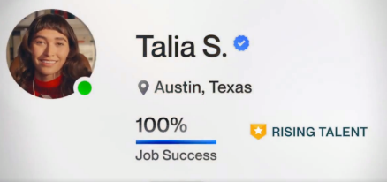

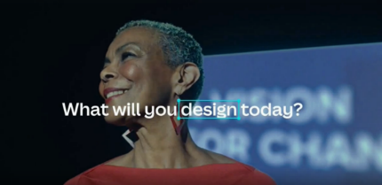

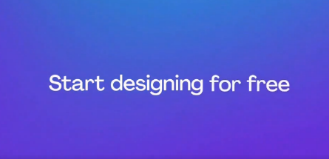
Businesses use TV advertising in high quality programs to position themselves as trustworthy experts in their category
B2B brands’ creative focuses on themes and keywords like ‘trustworthy,’ ‘risk,’ ‘talent,’ ‘scale,’ ‘transform’ and ‘expert’
Common key words used in TV campaigns
across the 25 B2B brands analyzed
Examples of B2B TV campaigns with consistent messaging
Source: Creative from iSpot.tv, time period of airing 4/1/18 – 4/30/22, note: each creative execution had to launch before 4/30/22 so some may still be actively airing on TV. Click images to watch TV spots.
This information is exclusively provided to VAB members and qualified marketers. Further distribution is prohibited.
PAGE 7

Slide 8

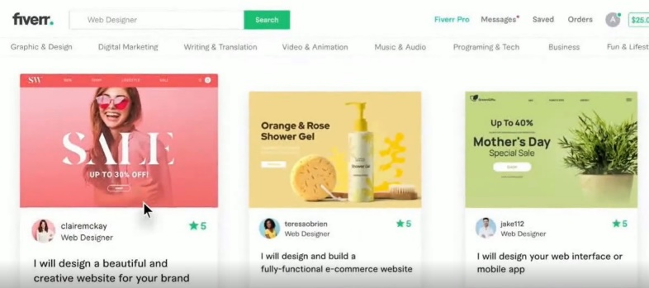
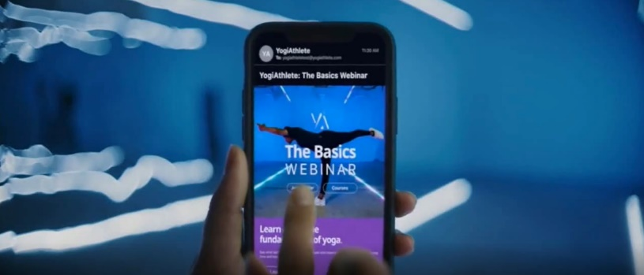




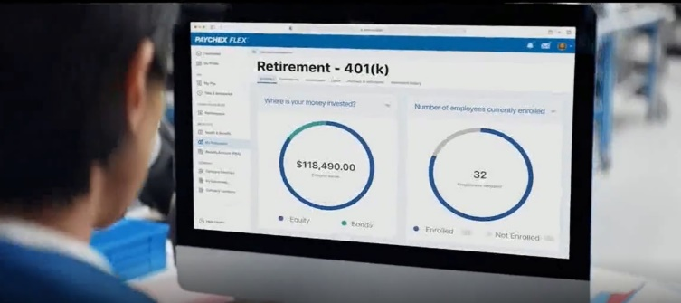
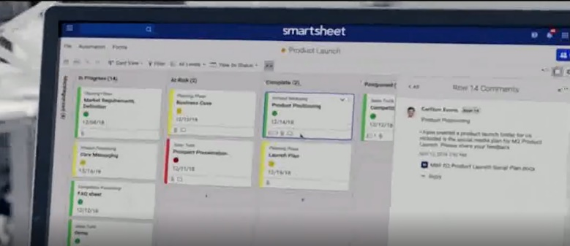
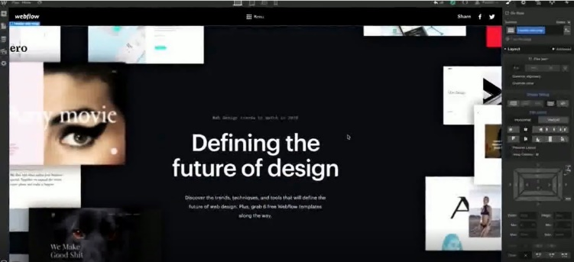
Businesses are using visual branding to demonstrate their products and services – which often includes showing pages from their website or app
‘Patina & Co.: Digital Presence’ TV Spot
(TV spot first aired: 9/14/2020)
‘What Will You Create: Yoga’ TV Spot
(TV spot first aired: 6/24/2021)
‘Use Your Voice with Decora Smart’ TV Spot
(TV spot first aired: 11/26/2018)
‘HR Can Be Hard. Paychex HR Technology Makes It Simple’ TV Spot
(TV spot first aired: 11/23/2021)
‘Achieve More With Smartsheet’ TV Spot
(TV spot first aired: 9/16/2019)
‘Design Tool From the Future’ TV Spot
(TV spot first aired: 8/4/2020)
Source: Creative from iSpot.tv, time period of airing 4/1/18 – 4/30/22, note: each creative execution had to launch before 4/30/22 so some may still be actively airing on TV. Click above images to watch TV spots.
This information is exclusively provided to VAB members and qualified marketers. Further distribution is prohibited.
PAGE 8

Slide 9


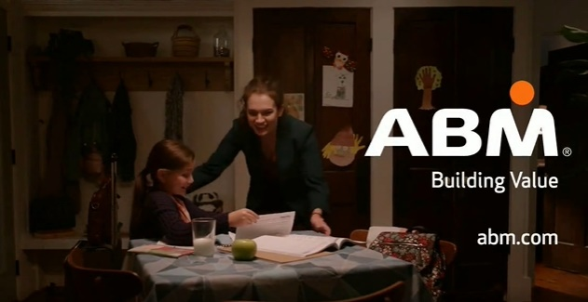
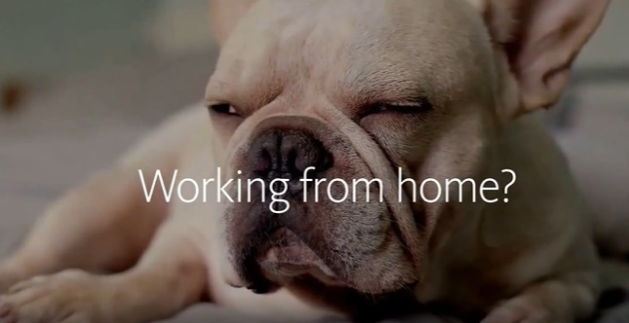
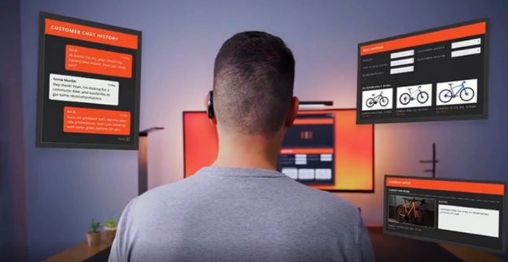
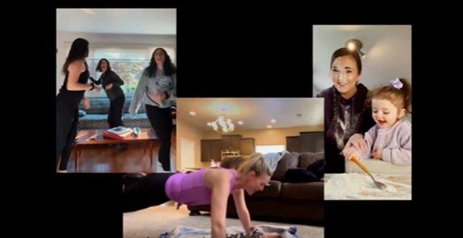
Businesses are humanizing their brands through emotional messages
by using personal stories to build a stronger relationship with customers
B2B campaigns targeting professionals who work from home and / or have families
Business purchase decision makers are people too.
Through personal stories and emotional messages, brands
are engaging their customers by showing they understand their goals as well as their daily challenges, like working from home and balancing their professional and personal lives.
(TV spot first aired: 2/22/21)
(TV spot first aired: 4/13/20)
(TV spot first aired: 9/7/20)
(TV spot first aired: 4/29/22)
Source: Creative from iSpot.tv, time period of airing 4/1/18 – 4/30/22, note: each creative execution had to launch before 4/30/22 so some may still be actively airing on TV. Click above images to watch TV spots.
This information is exclusively provided to VAB members and qualified marketers. Further distribution is prohibited.
PAGE 9

Slide 10
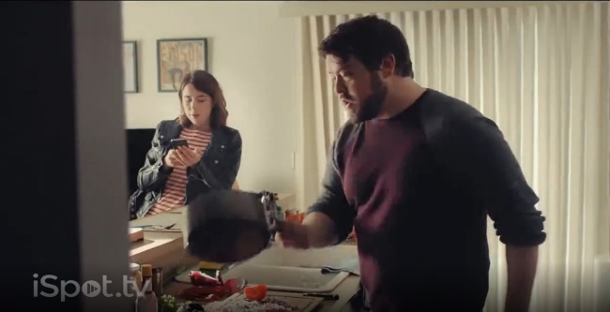

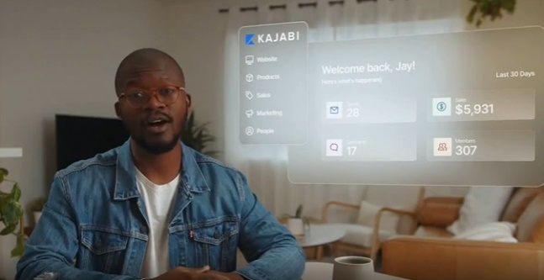
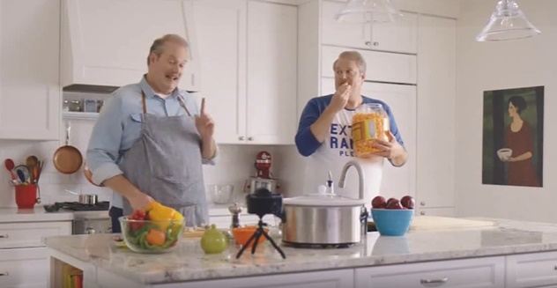
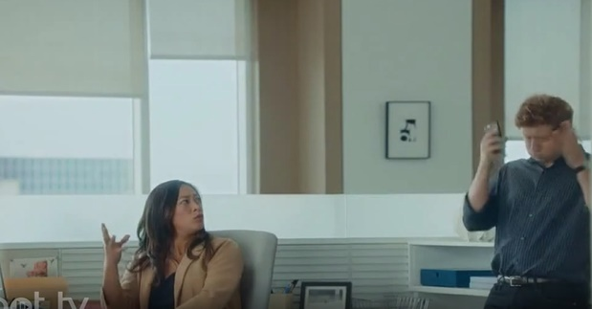
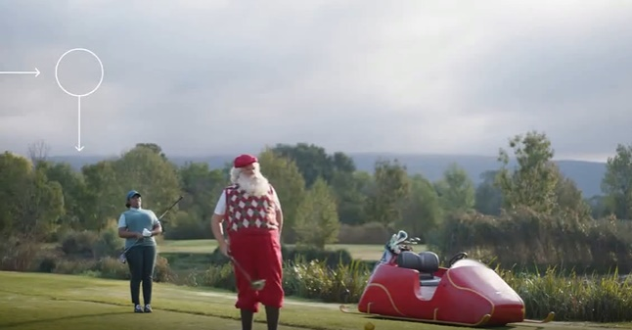
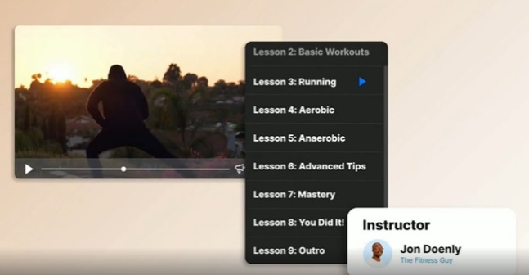
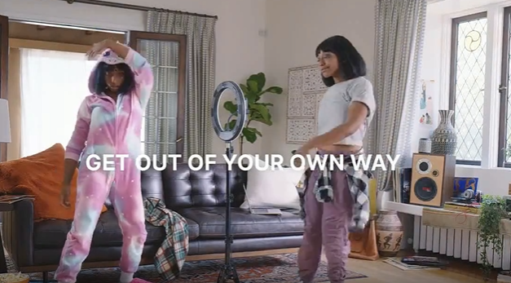
Businesses are also strengthening their bond with customers by becoming more approachable through lighthearted, humorous and fun moments
42% of B2B brand marketing leaders state that improving creative stand out and creative identity is an important brand building focus area for the year ahead*
‘Digital Workflows Are Just the Ticket to Help Wonka’s Fantastical Factory’
‘All in One Platform: Free Trial’
‘Get Out Of Your Own Way With Carl: FroYo Machine’
‘Experiences without Barriers’
(TV spot first aired: 3/30/2020)
(TV spot first aired: 4/26/2021)
(TV spot first aired: 4/19/2019)
(TV spot first aired: 10/5/2020)
‘Sound Effects’
‘Even Santa Needs a Holiday From Complexity’
‘Get Out Of Your Own Way With Kim: The Dougie’
‘Digital Product Creation’
(TV spot first aired: 3/13/2020)
(TV spot first aired: 1/18/2021)
(TV spot first aired: 9/22/2020)
(TV spot first aired: 9/29/2020)
Source: Creative from iSpot.tv, time period of airing 4/1/18 – 4/30/22, note: each creative execution had to launch before 4/30/22 so some may still be actively airing on TV. Click above images to watch TV spots. *Transmission, ‘The State of B2B Brand Building 2022”, Base: 500 B2B senior marketing leaders.
This information is exclusively provided to VAB members and qualified marketers. Further distribution is prohibited.
PAGE 10

Slide 11

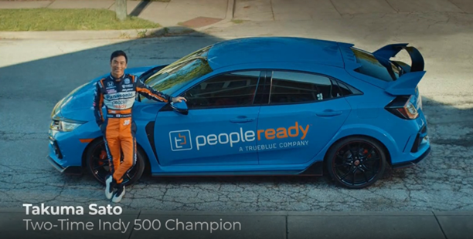
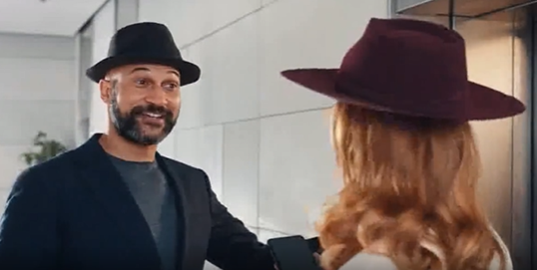
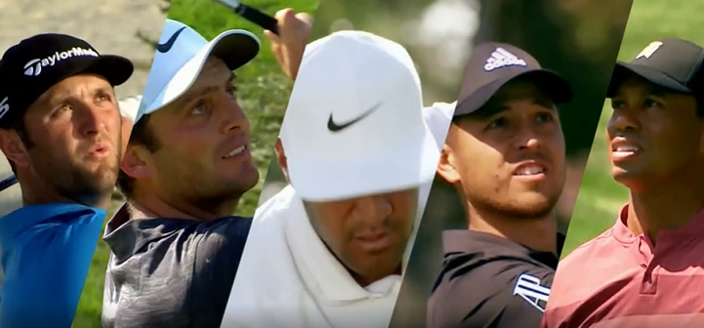


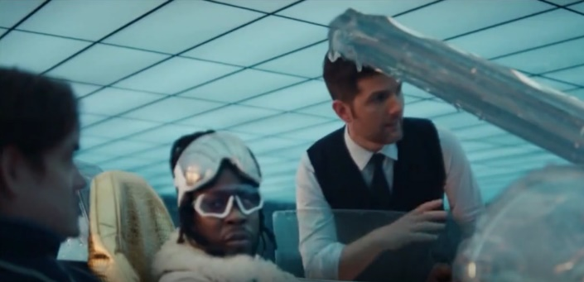



Successful businesses are standing out by partnering with celebrities that have wide appeal – such as athletes, actors, musicians, comedians
‘Ride to Work’ TV Spot
(TV spot first aired: 5/22/2021)
‘Elevator’ TV Spot
Featuring Keegan-Michael Key
(TV spot first aired: 4/19/2021)
‘PGA Tour: Risk Reward Challenge’ TV Spot
(TV spot first aired: 1/26/2019)
Super Bowl 2019 ‘Expensify This’ TV Spot
Featuring 2 Chainz and Adam Scott
(TV spot first aired: 2/3/2019)
‘We Got Next’ TV Spot
Featuring Lena Waithe, Gustavo Dudamel, Robin Frijns
(TV spot first aired: 8/30/2021)
2019 Cannes Lions
2 Gold Lion Awards
2 Silver Lion Awards
3 Bronze Lion Awards
2022 SC Awards
Winner for Security Marketing Campaign of the Year
Source: Creative from iSpot.tv, time period of airing 4/1/18 – 4/30/22, note: each creative execution had to launch before 4/30/22 so some may still be actively airing on TV. Click above images to watch TV spots. The SC Awards are the cybersecurity industry’s most prestigious and competitive honor from SC Magazine.
This information is exclusively provided to VAB members and qualified marketers. Further distribution is prohibited.
PAGE 11

Slide 12


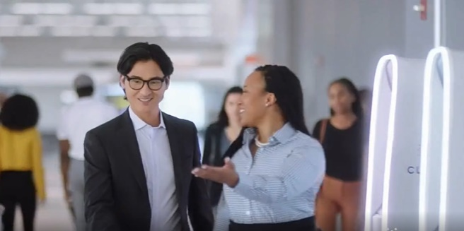
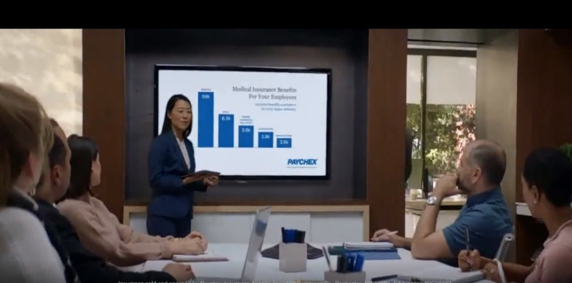
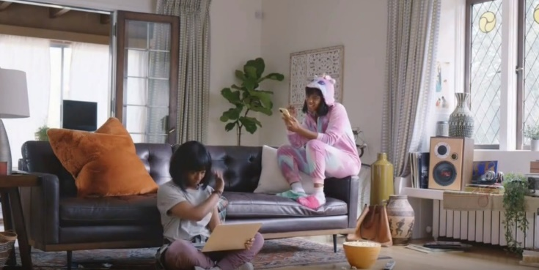



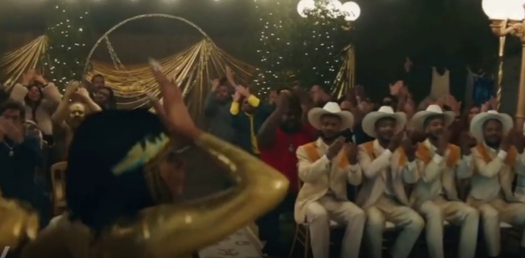
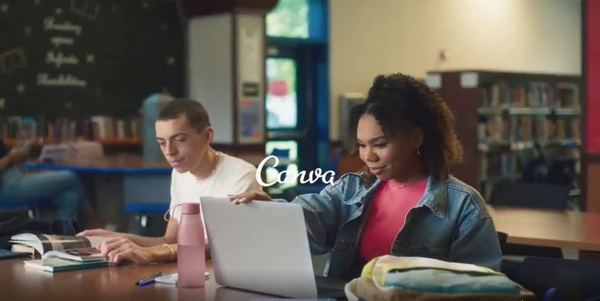
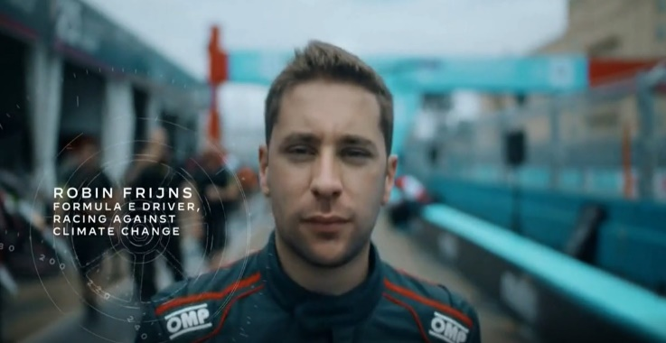
Understanding the importance of authentic representation, TV advertising creative is increasingly reflective of inclusive stories and casting
Going beyond diverse casting, B2B campaigns are seen appealing to audiences from all ages, genders and family structures
(TV spot first aired: 9/26/2019)
(TV spot first aired: 9/21/2020)
(TV spot first aired: 10/6/2020)
(TV spot first aired: 2/3/2019)
(TV spot first aired: 8/20/2021)
(TV spot first aired: 9/20/2021)
Source: Creative from iSpot.tv, time period of airing 4/1/18 – 4/30/22, note: each creative execution had to launch before 4/30/22 so some may still be actively airing on TV. Click above images to watch TV spots.
This information is exclusively provided to VAB members and qualified marketers. Further distribution is prohibited.
PAGE 12

Slide 13

How are these TV ad creative strategies driving results for businesses?

Slide 14

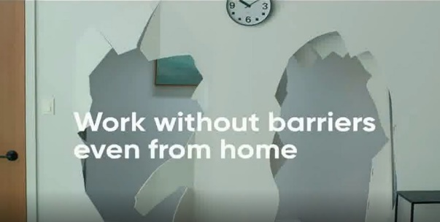
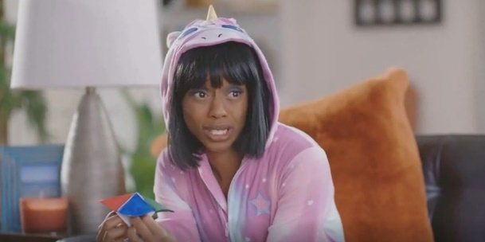
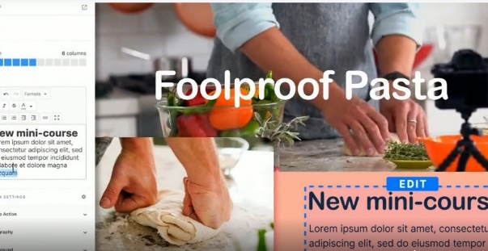
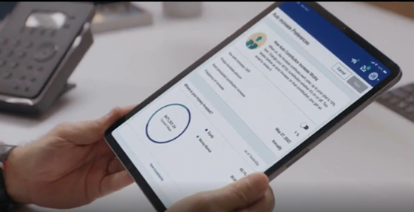


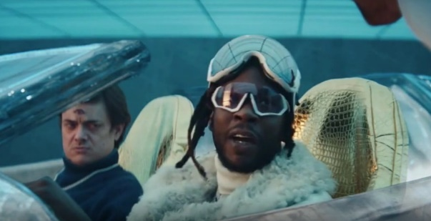
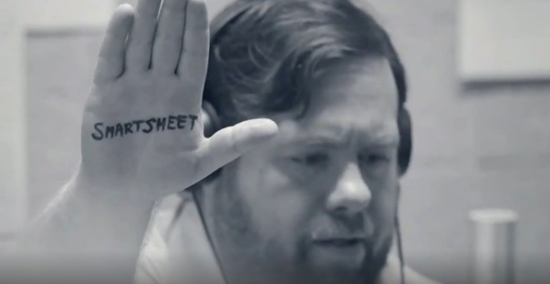
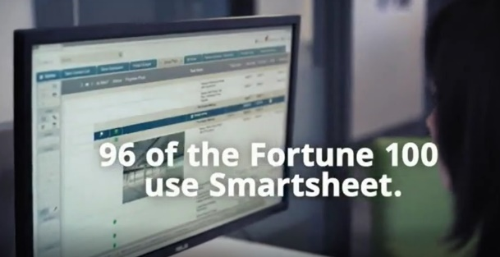

Ads that feature lighthearted moments and visual branding tend to drive the highest advertising attention and awareness among customers
Lighthearted, funny and relatable moments
Visual branding with a focus on products services
‘Experience Without Barriers’
(TV Spot first aired: 3/30/20)
‘Get Out Of Your Own Way With Kim: What People Want’
(TV Spot first aired: 9/29/20)
‘Every Business Needs a Website’
(TV Spot first aired: 9/20/20)
'Making 401(k) Simple’
(TV Spot first aired: 7/30/21)
159
Ad Attention Index
155
Ad Attention Index
160
Ad Attention Index
154
Ad Attention Index
Super Bowl 2019 TV Spot, 'Expensify This' Featuring 2 Chainz, Adam Scott
(TV Spot first aired: 2/3/19)
‘Make it Easier’
(TV Spot first aired: 10/26/19)
‘96 of 100’
(TV Spot first aired: 10/9/18)
'Protect Your Home' Featuring Danny Lipford
(TV Spot first aired: 10/11/20)
152
Ad Attention Index
132
Ad Attention Index
141
Ad Attention Index
132
Ad Attention Index
How to read: ‘Experience Without Barriers’ (159 index) had 59% less interruptions than other ads in the context of the media placement with a 100 score being average.
Source: Creative from iSpot.tv, time period of airing 4/1/18 – 4/30/22, note: each creative execution had to launch before 4/30/22 so some may still be actively airing on TV. Ad Attention Index within iSpot.tv’s Attention Analytics. Index scale is 0-200 with a 100 index seeing ad performance as expected. Click above images to watch TV spots. Note: Ad interruptions = when viewers are changing channels, fast forwarding, turning off the TV or otherwise interrupting an ad.
This information is exclusively provided to VAB members and qualified marketers. Further distribution is prohibited.
PAGE 14

Slide 15
Advertising that resonates and increases awareness consistently drives more customers to a brand’s website throughout their TV campaign
88% of B2B buyers / sellers transact via online channels* which makes the ability to drive website traffic critical to B2B marketing efforts
25 B2B Brands Analysis: Average Monthly Website Unique Visitors
Monthly Website Unique Visitors (000) Comparison
Based Over a Four-Year Time Period: Apr ‘18 – Apr ‘22
+35%
+305K monthly uniques
+15%
+127K monthly uniques
vs. three months average prior to TV launch
vs. three months average prior to TV launch
(monthly average)
(TV launch – April 2022)
Source: VAB analysis of Comscore mediametrix multiplatform media trend data, P18+. April 2018 – April 2022 (calendar months), figures are based on monthly averages for the 25 brands analyzed. ‘When On TV’ represents the monthly average for brands in months where they spend on national TV as measured through Nielsen AdIntel across the April 2018 – April 2022 (calendar months) time period across the 25 brands analyzed. During this four-year analysis, the average B2B advertiser was on TV for 12 months. *GoodFirms, ‘B2B Services: Intelligence, Competition, and Future’, September 2022, Survey of 410 B2B buyers and sellers, comprised of employees across ecommerce, SaaS, IT, logistics, fashion, healthcare, finance, and more.
This information is exclusively provided to VAB members and qualified marketers. Further distribution is prohibited.
PAGE 15

Slide 16
Adults over 50 account for 36% of the total population and nearly half of all adults
All customers, whether business decision makers or individual buyers, are responsive to businesses that build a relationship with them on a personal level which can be fostered through advertising creative that establishes their product or service and humanizes their brand
Through a sustaining TV campaign presence, advertising that resonates and builds awareness can consistently drive many
more customers to a brand’s website or app
Implications for Marketers
This information is exclusively provided to VAB members and qualified marketers. Further distribution is prohibited.
PAGE 16

Slide 17
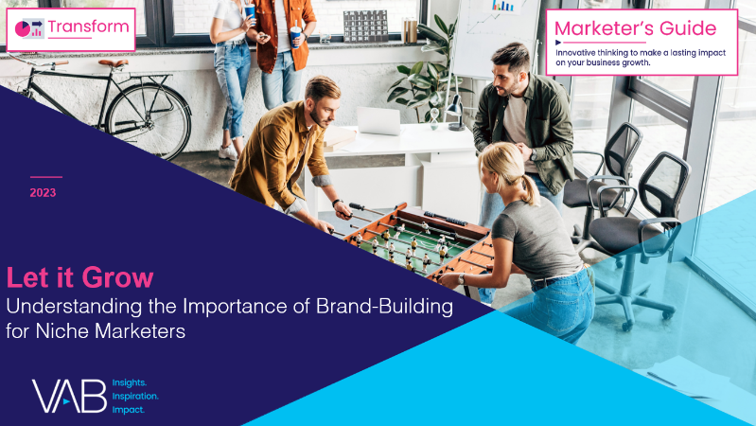
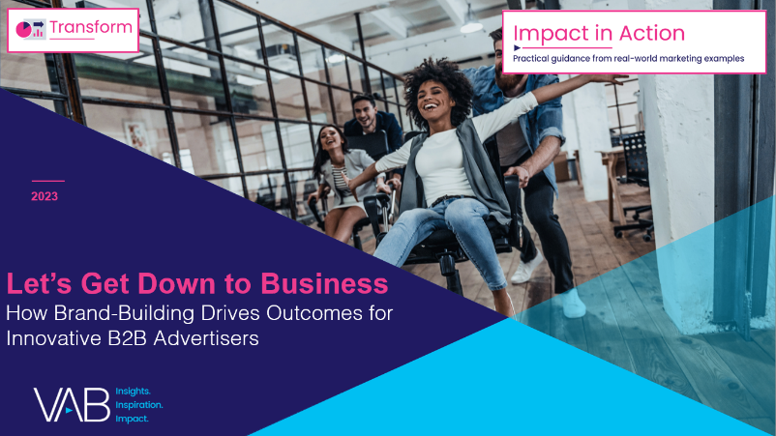
To learn more about how TV advertising creative strategies can drive results for businesses download the full-length reports below
‘Let It Grow’ uncovers the unique challenges that brands with niche targets must overcome and how they are using brand-building strategies to drive business outcomes
‘Let’s Get Down to Business’ explores real-world examples from 25 innovative B2B advertisers to quantify the impact of brand-building strategies from awareness down to sales
includes
in-depth,
full-funnel attribution analysis
Let It Grow
Understanding the Importance of
Brand-Building for Niche Marketers
Let’s Get Down to Business
How Brand-Building Drives Outcomes
for Innovative B2B Advertisers
This information is exclusively provided to VAB members and qualified marketers. Further distribution is prohibited.
PAGE 17

Slide 18
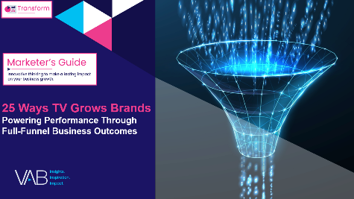

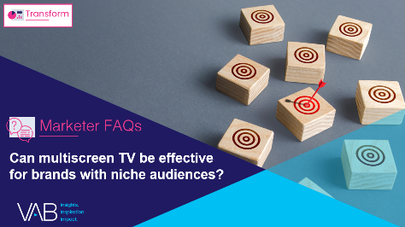

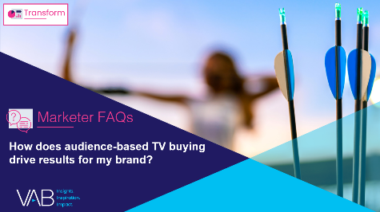
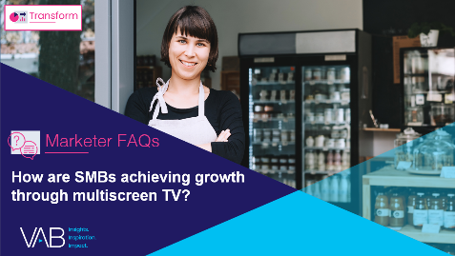

Creators
Jason Wiese
Reed Kiely
SVP, Director of Strategic Insights
jasonw@thevab.com
Associate Insights Director
reedk@thevab.com
25 Ways TV Grows Brands
Powering performance through
full-funnel business outcomes
Is equity-building important for niche brands?
Karolina Guillen
Insights Manager
karolinag@thevab.com
Discover more
Looking for more data, insights and takeaways? Check out this related VAB content
Can multiscreen TV be effective for brands with niche audiences?
What are the 7 key reasons advertisers launch TV campaigns?
How does audience-based TV buying drive results for my brand?
How are SMBs achieving growth through multiscreen TV?
VAB Members, brand marketers and agencies get free and immediate access to VAB’s content library. Get access at theVAB.com
This information is exclusively provided to VAB members and qualified marketers. Further distribution is prohibited.
PAGE 18

Slide 19


About VAB
VAB is an insights-driven organization that inspires marketers to reimagine their media strategies resulting in fully informed decisions.
Drawing on our marketing expertise, we simplify the complexities in our industry and discover new insights that transform the way marketers look at their media strategy.
We are committed to your business growth and proud to offer VAB members, brand marketers and agencies complimentary access to our continuously-growing Insights library. Get immediate access at theVAB.com.
Curious to learn more about VAB? Check out this quick video to see what we do and how we can help you develop business-driving marketing strategies.
This information is exclusively provided to VAB members and qualified marketers. Further distribution is prohibited.
PAGE 19

