Slide 1





How are SMBs achieving growth through multiscreen TV?
Marketer FAQs

Slide 2



Is my business big enough
to advertise on TV?
This is a question many owners and company founders ask.
Using B2B categories as our reference, in this analysis we
explore how small and medium-sized businesses (SMBs) are capitalizing on the benefits of TV advertising to accelerate their growth. You’ll learn:
  How SMBs are using TV to reach more new customers
  What is the impact that TV advertising has on website visitors for SMBs
This information is exclusively provided to VAB members and qualified marketers. Further distribution is prohibited.
PAGE 2

Slide 3
Businesses are increasingly buying data-driven multiscreen TV advertising, which can incorporate their own data to reach new customers
Source: VAB, ‘How might customized, targeted video ads help create stronger engagement?’. Advertiser Perceptions, 2H 2021 Video Advertising Convergence Report. Based on survey of 250 marketer and agency respondents who are involved in video advertising decision-making. Click here to download ‘How might customized, targeted video ads help create stronger engagement?’ to learn more about how personalized, targeted ads drive engagement with brands.
This information is exclusively provided to VAB members and qualified marketers. Further distribution is prohibited.
PAGE 3

Slide 4












Data-driven TV empowers SMBs to reach new customers through an audience-based approach, which enables businesses of all sizes to buy TV
Audience-Based TV Buying refers to ‘the practice of segmenting viewers beyond traditional demographics to target a
group of consumers based on buying habits, characteristics or viewing behaviors (programs, genres watched),’
which is a more accurate, and cost-effective, way to reach new customers than a prescribed age / gender bucket.
‘Small and Medium-Sized Business’ Targeting Examples
Buying Habits
Personal Characteristics
TV Viewing Behaviors
Casual Dining
Furniture
Business
Decision Makers
Financial Planner
Local News
Sports
In-market Car Buyer
Software
New Parents
Online Shopper
Award Shows
Drama
This information is exclusively provided to VAB members and qualified marketers. Further distribution is prohibited.
PAGE 4

Slide 5
Audience-based buying also allows for more personalized advertising to build customer relationships, which is proven to drive sales growth
% of Companies With Increased Market Share, by Degree of Personalization
% of respondents by market share move
Source: McKinsey, ‘The new B2B Growth Equation’, February 2022, respondents indicating market share in the past 12 months increased more than 1 percentage point vs peers.
This information is exclusively provided to VAB members and qualified marketers. Further distribution is prohibited.
PAGE 5

Slide 6

‘Real world’ example of how TV advertising drives website visitors for small and medium-sized businesses (SMBs)
Download VAB’s Let’s Get Down to Business for our in-depth, full-funnel attribution analysis

Slide 7










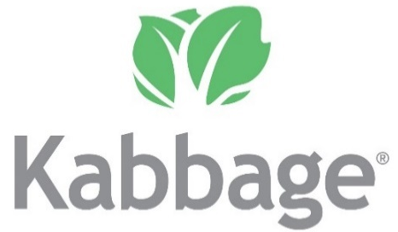














To understand how SMBs are using TV to attract new customers, we examined 25 B2B advertisers that recently launched their first TV campaign
These brands represent 14 niche categories including banking/finance, commercial real estate, consulting, expense management, security, software, staffing and more with the analysis time period spanning between April ’18 – April ‘22
AAPC
(Healthcare)
AON Consulting
(Consulting)
Avira
(Software)
Blue Vine
(Banking/Finance)
Canva
(Graphic Design)
ABM Industries
(Commercial Real Estate)
Clear
(Security)
EY-Parthenon
(Consulting)
Fiverr
(Freelancing)
Kabbage
(Banking/Finance)
Kajabi
(Software)
Expensify
(Expense Management)
Leviton Manufacturing
(Manufacturing)
Loopnet
(Commercial Real Estate)
Palo Alto Networks
(Security)
Patriot Software
(Software)
Paychex
(Payroll)
Peopleready
(Staffing)
ServiceNow
(Software)
Ten-X Realtors
(Comm. Real Estate)
Twilio
(Communications)
Workhuman
(Human Resources)
Upwork
(Freelancing)
Webflow
(Software)
Smartsheet
(Software)
This information is exclusively provided to VAB members and qualified marketers. Further distribution is prohibited.
PAGE 7

Slide 8


Small and medium-sized businesses are leaning into TV advertising to build interest among potential new customers
“For a while, there was a lot of buzzworthy conversation about TV being a dying channel. The reality is that TV is anything but that.
It continues to show up, deliver eyeballs and show interest.
We found a more engaged audience. That coupled with what’s happening on the digital front with rising CPMs … in many cases we weighed out higher efficiencies on TV.”
Orlando Baeza, Chief Marketing Officer, Kajabi
(Digiday, ‘We found a more engaged audience’: Why Kajabi is increasing its media spending on TV now, 7/29/2021)
This information is exclusively provided to VAB members and qualified marketers. Further distribution is prohibited.
PAGE 8

Slide 9

Through audience-based TV buying, B2B brands advertise across a broad mix of TV networks and programs to attract new customers
Over the last four years, the 25 brands in total have advertised across 118 national TV networks, 132 genres and 6,843 programs
25 B2B Brand Average: Nat’l TV Programs, Genres and Networks
Based Over a Four-Year Time Period: Apr ‘18 – Apr ‘22
21
28
464
Avg #
of TV Networks
Avg #
of Genres*
Avg #
of Programs
To reach targeted stakeholders, brands are advertising across a mix of sports, lifestyle and entertainment networks in addition to business and news programming
Source: VAB analysis of Nielsen AdIntel, 04/01/18-04/30/22, National TV includes cable TV, broadcast TV, Spanish language cable TV and Spanish language broadcast TV across 25 brands included in analysis. *Number of Genres includes sub-genres, e.g. ‘Sports Event: NFL Football / Regular Season.’ The total count for the 25 brands reflects an unduplicated count across national TV networks, genres and programs.
This information is exclusively provided to VAB members and qualified marketers. Further distribution is prohibited.
PAGE 9

Slide 10
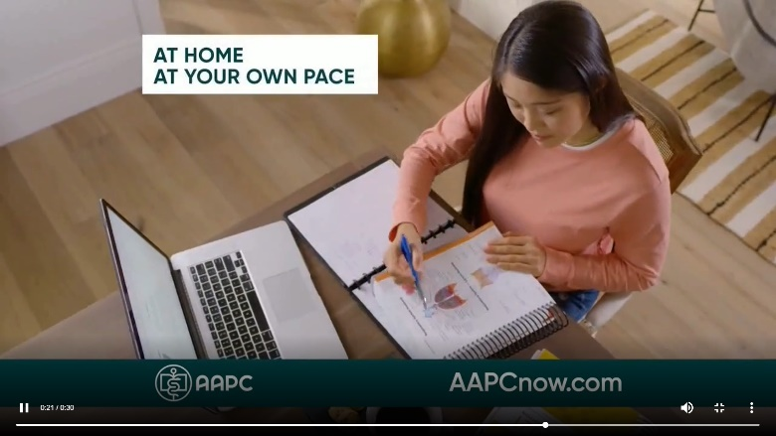
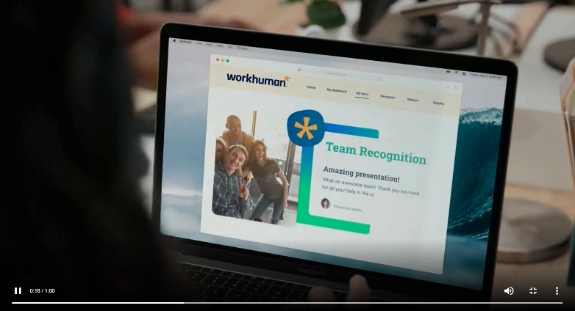
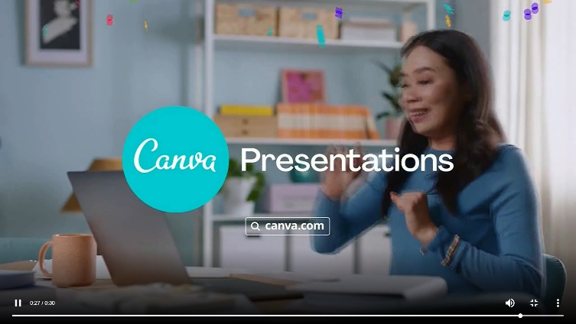
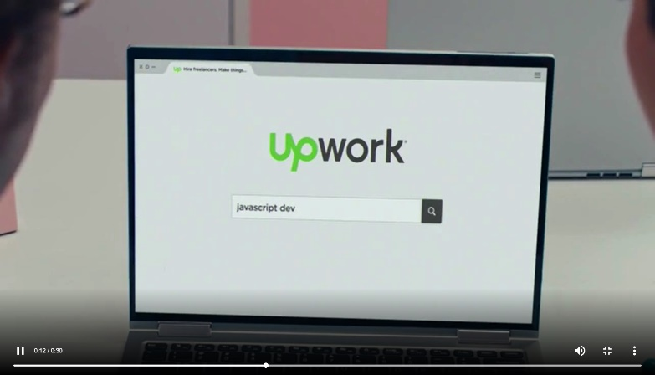
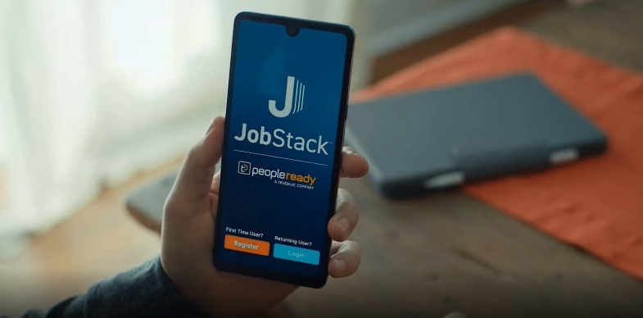
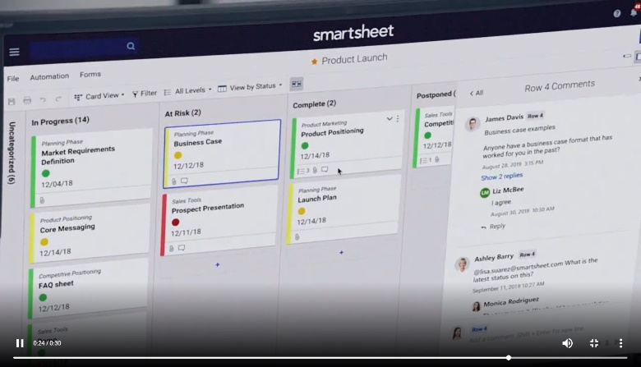
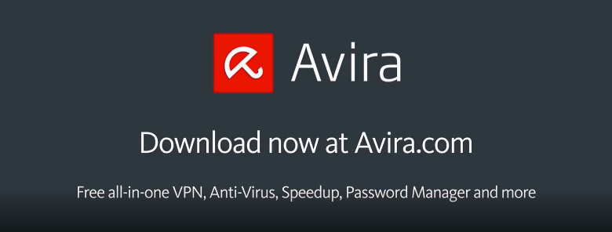
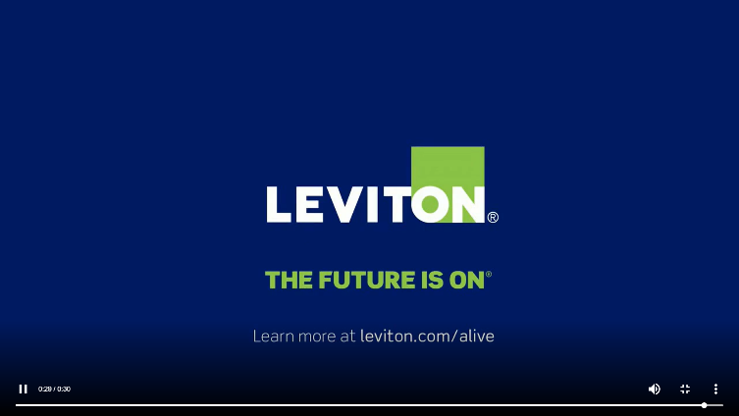

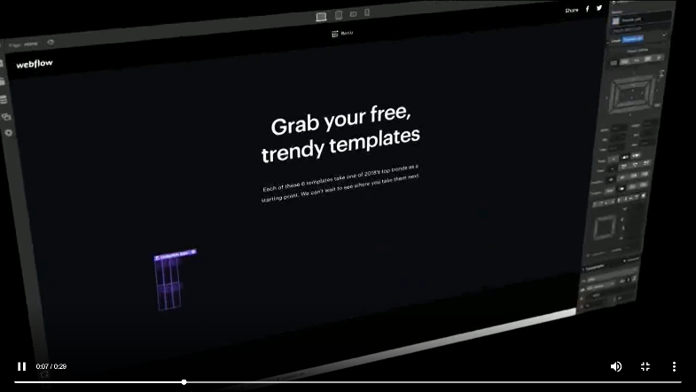
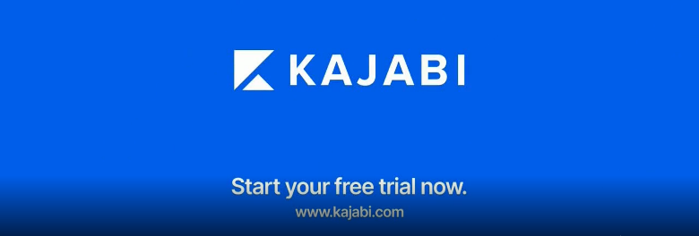
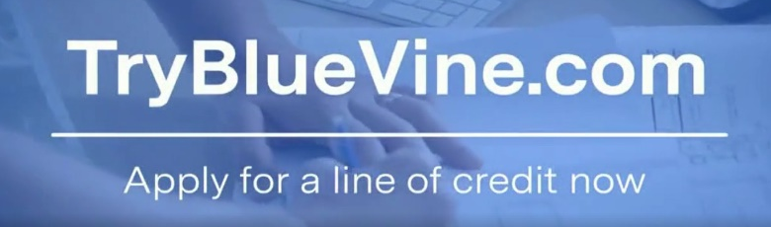
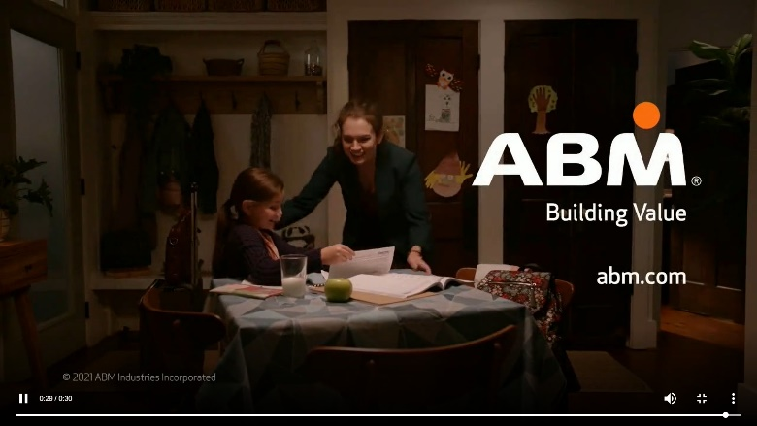

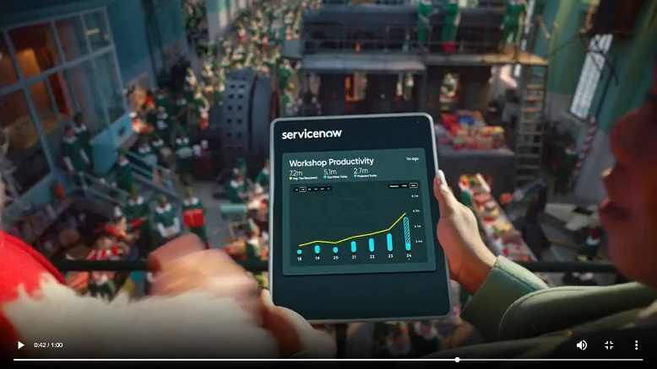

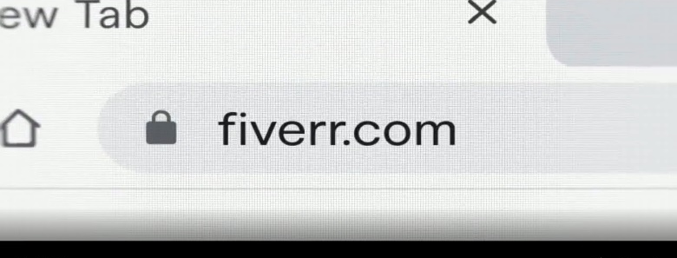
Within their TV commercials, B2B advertisers are showcasing their websites and apps to build their online presence and drive customer visits
Examples of B2B brands’ TV creative highlighting their URL or digital platforms
Source: Creative from iSpot.tv, time period of airing 4/1/18 – 4/30/22.
This information is exclusively provided to VAB members and qualified marketers. Further distribution is prohibited.
PAGE 10

Slide 11
B2B brands, many of which are SMBs, saw immediate growth in website visitors after TV launch with continued increases throughout their campaign
25 B2B Brands Analysis: Average Monthly Website Unique Visitors Comparison
Monthly Website Unique Visitors Comparison
Based Over a Four-Year Time Period: Apr ‘18 – Apr ‘22
+15%
+35%
TV Launch Month
vs.
3 Months Prior to TV Launch
(Monthly Average)
Monthly Average ‘When On TV’
(TV launch – April 2022)
vs.
3 Months Prior to TV Launch
(Monthly Average)
Source: VAB analysis of Comscore mediametrix multiplatform media trend data, P18+. April 2018 – April 2022 (calendar months), figures are based on monthly averages for the 25 brands analyzed. ‘When On TV’ represents the monthly average for brands in months where they spend on national TV as measured through Nielsen AdIntel across the April 2018 – April 2022 (calendar months) time period across the 25 brands analyzed. During this four-year analysis, the average B2B advertiser was on TV for 12 months. Average Monthly Visitors (000) – 3 Months Prior to TV Launch: 859; TV Launch Month: 986; ‘When On TV’: 1,164.
This information is exclusively provided to VAB members and qualified marketers. Further distribution is prohibited.
PAGE 11

Slide 12






B2B SMBs, specifically, saw some of the largest increases in online visitors with many more than doubling their potential new customers when on TV
Sampling of Brands: Monthly Website Unique Visitors (000) Comparison
Based Over a Four-Year Time Period: Apr ‘18 – Apr ‘22
Brand | B2B Category | Three-Month Average: Prior to TV Launch | Monthly Average: ‘When On TV’ | # Diff (000) | % Diff
 | Freelancing | 1,542 | 1,759 | 216 | 14%
 | Software | 1,288 | 1,723 | 434 | 34%
 | Software | 387 | 698 | 312 | 81%
 | Expense Mgmt. | 240 | 477 | 237 | 99%
 | Security | 217 | 644 | 427 | 197%
 | Comm. Real Estate | 144 | 419 | 275 | 191%
 | Software | 142 | 306 | 164 | 116%
 | Banking/Finance | 118 | 241 | 123 | 105%
 | Staffing | 118 | 163 | 45 | 38%
 | Software | 71 | 153 | 82 | 115%
 | Human Resources | 15 | 156 | 141 | 929%
=companies with less than 1,000 employees, as reported by ZoomInfo.com
Source: VAB analysis of Comscore mediametrix multiplatform media trend data, P18+. April 2018 – April 2022 (calendar months), figures are based on monthly averages for the 25 brands analyzed. ‘When On TV’ represents the monthly average for brands in months where they spend on national TV as measured through Nielsen AdIntel across the April 2018 – April 2022 (calendar months) time period across the 25 brands analyzed. Chart sorted by ‘three-month UV avg prior to TV launch.’
This information is exclusively provided to VAB members and qualified marketers. Further distribution is prohibited.
PAGE 12

Slide 13
Brands whose total website visits were too few to be measured benefited from TV advertising which brought in thousands of new customers monthly
Unmeasured B2B Brands: Monthly Website Unique Visitors (000) Comparison
Based Over a Four-Year Time Period: Apr ‘18 – Apr ‘22
Brand | B2B Category | Three-Month Average: Prior to TV Launch | Monthly Average: ‘When On TV’
 | Commercial Real Estate | N/A | 25
 | Banking/Finance | N/A | 35
 | Manufacturing | N/A | 75
 | Software | N/A | 166
Source: VAB analysis of Comscore mediametrix multiplatform media trend data, P18+. April 2018 – April 2022 (calendar months), figures are based on monthly averages for the 25 brands analyzed.
This information is exclusively provided to VAB members and qualified marketers. Further distribution is prohibited.
PAGE 13

Slide 14








Overall, SMBs are leveraging the key benefits of TV advertising to reach new customers and drive sales growth
7 key reasons businesses launch TV campaigns
Storytelling
Sight, sound and motion a TV ad can convey brand identity and further humanizes the brand and what it stands for
Availability & Accessibility
Greater product availability creates greater TV accessibility both on the national and local level
Legitimizer
Creates, builds and enhances brand reputation while legitimizing their product or
service offerings
Targetability
Scalable data-driven targeting solutions like addressable TV and data-enabled TV create efficiency and limit wastage
Inclusivity
Enhanced targeting capabilities through advanced TV solutions creates efficiencies which lowers the traditional cost of entry
Halo Effect
TV significantly improves the performance and ROI of all other digital channels as well as a brand’s online platforms
Full-Funnel Outcomes
Through greater measurement and enhanced attribution capabilities, TV has shown its ability to drive brand results
Click here to download ‘The Halo Effect: TV as a Growth Engine’ to learn more about why and how brands are accelerating their path to TV
This information is exclusively provided to VAB members and qualified marketers. Further distribution is prohibited.
PAGE 14

Slide 15
Adults over 50 account for 36% of the total population and nearly half of all adults
Small and medium-sized businesses are leaning into TV advertising and audience-based buying strategies to effectively, and efficiently, engage consumers and drive significantly more new customers to their online platforms (websites & apps)
Advertisers of all sizes are leveraging the key benefits of TV advertising to legitimize their product or service, reach new customers and increase sales
Implications for Marketers
This information is exclusively provided to VAB members and qualified marketers. Further distribution is prohibited.
PAGE 15

Slide 16


To learn more about TV advertising’s ability to drive results for businesses download the full-length reports below
‘Let It Grow’ uncovers the unique challenges that brands with niche targets must overcome and how they are using brand-building strategies to drive business outcomes
‘Let’s Get Down to Business’ explores real-world examples from 25 innovative B2B advertisers to quantify the impact of brand-building strategies from awareness down to sales
includes
in-depth,
full-funnel attribution analysis
Let It Grow
Understanding the Importance of
Brand-Building for Niche Marketers
Let’s Get Down to Business
How Brand-Building Drives Outcomes
for Innovative B2B Advertisers
This information is exclusively provided to VAB members and qualified marketers. Further distribution is prohibited.
PAGE 16

Slide 17





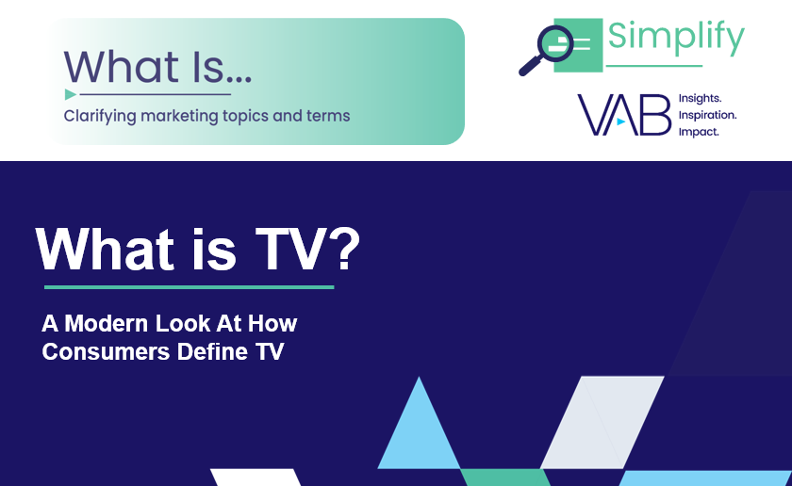

Creators
Jason Wiese
Reed Kiely
SVP, Director of Strategic Insights
jasonw@thevab.com
Associate Insights Director
reedk@thevab.com
25 Ways TV Grows Brands
Powering performance through
full-funnel business outcomes
Unlocking Brand Growth with Audience-Based Buying
A fresh look at how marketers are adopting innovative TV strategies
Discover more
Looking for more data, insights and takeaways? Check out this related VAB content
Welcome to TV – Full Year 2022
Meet the new advertisers investing in outcomes amidst economic uncertainty
The Secret of My Success
Examining the winning marketing strategy that’s fueling high-growth DTC brands
The Halo Effect
TV as a growth engine
What is TV?
A modern look at how consumers define TV
VAB Members, brand marketers and agencies get free and immediate access to VAB’s content library. Get access at theVAB.com
This information is exclusively provided to VAB members and qualified marketers. Further distribution is prohibited.
PAGE 17

Slide 18


About VAB
VAB is an insights-driven organization that inspires marketers to reimagine their media strategies resulting in fully informed decisions.
Drawing on our marketing expertise, we simplify the complexities in our industry and discover new insights that transform the way marketers look at their media strategy.
We are committed to your business growth and proud to offer VAB members, brand marketers and agencies complimentary access to our continuously-growing Insights library. Get immediate access at theVAB.com.
Curious to learn more about VAB? Check out this quick video to see what we do and how we can help you develop business-driving marketing strategies.
This information is exclusively provided to VAB members and qualified marketers. Further distribution is prohibited.
PAGE 18

