Slide 1





How does audience-based TV buying drive results for my brand?
Marketer FAQs

Slide 2



How can I use TV to reach my highly specific customer targets effectively
and efficiently?
This is a question many marketers ask.
Using B2B categories as our reference, we explore how brands with highly specific customer targets are using audience-based TV buying strategies to drive business results. You’ll learn:
  Why brands are using audience-based buying within their TV campaigns
  How brands are implementing audience-based TV buying strategies
  What is the impact of audience-based TV buying on
  their brand outcomes
This information is exclusively provided to VAB members and qualified marketers. Further distribution is prohibited.
PAGE 2

Slide 3


“Every engagement with our clients has to be that much more fruitful, we can’t have wasted impressions or activity, so every engagement has to count…Looking at our targeting strategies,
we have to be really specific and precise to make sure we are reaching the most important clients and prospects.”
Robyn McRae, Global VP of Paid Media & Marketing Automation, IBM
‘Advertising in Uncertain Times: Adapt Your Messaging to Today’s Environment’ panel session,
Advertising Week New York, October 2022
This information is exclusively provided to VAB members and qualified marketers. Further distribution is prohibited.
PAGE 3

Slide 4
Brands are increasingly leveraging more targeted solutions across
data-enabled multiscreen TV platforms to engage their best customer prospects effectively and efficiently
Source: VAB, ‘How might customized, targeted video ads help create stronger engagement?’. Advertiser Perceptions, 2H 2021 Video Advertising Convergence Report. Based on survey of 250 marketer and agency respondents who are involved in video advertising decision-making. Click here to download ‘How might customized, targeted video ads help create stronger engagement?’ to learn more about how personalized, targeted ads drive engagement with brands.
This information is exclusively provided to VAB members and qualified marketers. Further distribution is prohibited.
PAGE 4

Slide 5


Targeted, data-enabled multiscreen TV enables advertisers, even in B2B categories, to deepen their engagement with prospective customers by personalizing their messaging to them
60%
41%
of B2B buyers/sellers say that personalized experiences are very important
of B2B marketers will add more personalized content and offers to their customers*
Source: GoodFirms, ‘B2B Services: Intelligence, Competition, and Future’, September 2022, Survey of 410 B2B buyers and sellers across comprise of ecommerce, SaaS, IT, logistics, fashion, healthcare, finance, and more.
*eMarketer, ‘US B2B Digital Ad Spending Forecast 2022’, September 2022.
This information is exclusively provided to VAB members and qualified marketers. Further distribution is prohibited.
PAGE 5

Slide 6
Companies that deliver greater personalized messaging to better engage prospective buyers are more likely to increase their category market share
% of Companies With Increased Market Share, by Degree of Personalization
% of respondents by market share move
Source: McKinsey, ‘The new B2B Growth Equation’, February 2022, respondents indicating market share in the past 12 months increased more than 1 percentage point vs peers.
This information is exclusively provided to VAB members and qualified marketers. Further distribution is prohibited.
PAGE 6

Slide 7












Due to its targetability, successful brands across categories, like B2B,
are implementing audience-based buying personalization strategies
to effectively optimize their TV buys against their best customer prospects
Marketers can buy TV on buying habits, characteristics or viewing behaviors (programs, genres watched)
which is a more accurate, and cost-effective, surrogate for their customer than a prescribed age bucket
B2B Targeting Examples
Buying Habits
Personal Characteristics
TV Viewing Behaviors
Software
Business Licenses
Business
Decision Makers
C-Suite
Executives
Business News
Award Shows
Computers
Commercial
Real Estate
Small Business Owners
Managers
Sports
Drama
This information is exclusively provided to VAB members and qualified marketers. Further distribution is prohibited.
PAGE 7

Slide 8

TV campaigns that integrate audience-based buying strategies are driving business outcomes through the purchase journey for brands
Awareness
Consideration
Intent
Sales
Full-Funnel
Source: VAB / Advertiser Perceptions ‘Audience-Based Buying Survey,’ fielded March 23 – 31, 2021. Survey base: Advertising decision-makers who are involved in buying or planning digital video, cable / broadcast TV, or advanced TV (n=211). Q150. To what extent do you believe audience-based buying of TV advertising can impact each of the following KPIs? (extremely impactful / very impactful). Base: Total Respondents. *such as site visits, sign ups, login ins, downloads. To learn more about how marketers are finding success with ABB, read more in “The VAB Top 10: A top-line view of how the industry is adopting audience-based buying”.
This information is exclusively provided to VAB members and qualified marketers. Further distribution is prohibited.
PAGE 8

Slide 9

‘Real world’ example of how audience-based TV campaigns drive qualified prospects to brands’ digital storefronts and grow sales
Download VAB’s Let’s Get Down to Business for our in-depth, full-funnel attribution analysis

Slide 10
















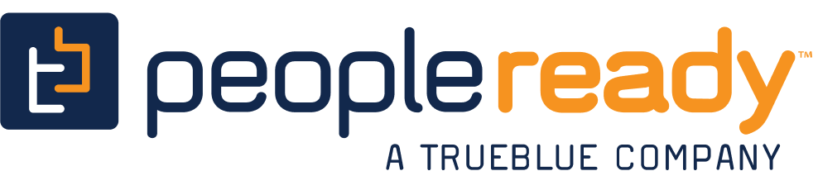








To understand how audience-based buying is driving results, we examined 25 B2B advertisers that recently launched their first TV campaign
The 14 categories include banking/finance, commercial real estate, consulting, expense management, security, software, staffing and more with the analysis time period spanning between April ’18 – April ‘22
AAPC
(Healthcare)
AON Consulting
(Consulting)
Avira
(Software)
Blue Vine
(Banking/Finance)
Canva
(Graphic Design)
ABM Industries
(Commercial Real Estate)
Clear
(Security)
EY-Parthenon
(Consulting)
Fiverr
(Freelancing)
Kabbage
(Banking/Finance)
Kajabi
(Software)
Expensify
(Expense Management)
Leviton Manufacturing
(Manufacturing)
Loopnet
(Commercial Real Estate)
Palo Alto Networks
(Security)
Patriot Software
(Software)
Paychex
(Payroll)
Peopleready
(Staffing)
ServiceNow
(Software)
Ten-X Realtors
(Comm. Real Estate)
Twilio
(Communications)
Workhuman
(Human Resources)
Upwork
(Freelancing)
Webflow
(Software)
Smartsheet
(Software)
This information is exclusively provided to VAB members and qualified marketers. Further distribution is prohibited.
PAGE 10

Slide 11


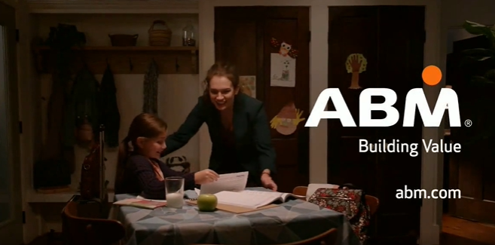

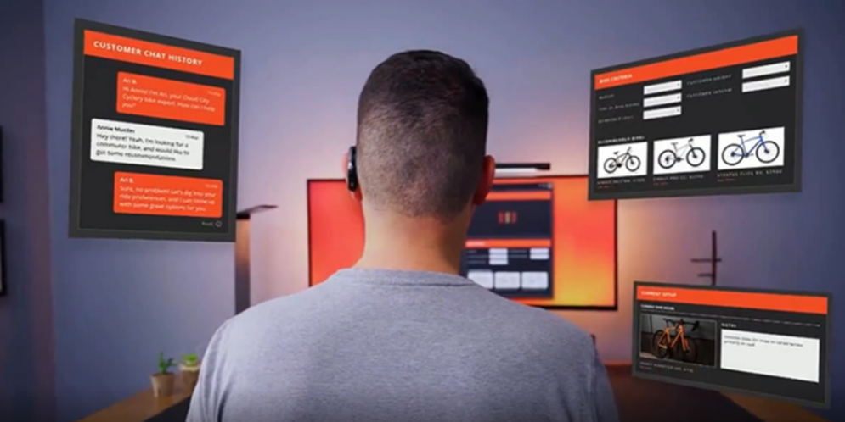
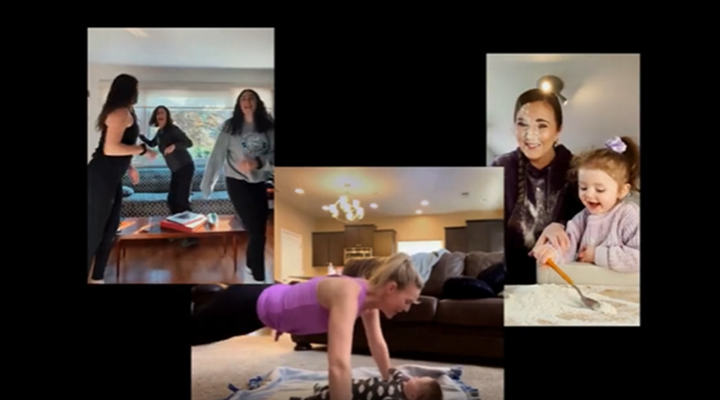
Creatively, B2B marketers are humanizing their brands through emotional messaging by integrating personal stories to better connect with their audiences of best prospects and stakeholders
B2B campaigns targeting professionals who work from home and / or have families
Business purchase decision makers are people too.
Through personal stories and emotional messages, brands
are engaging their customers by showing they understand their goals as well as their daily challenges, like working from home and balancing their professional and personal lives.
(TV spot first aired: 2/22/21)
(TV spot first aired: 4/13/20)
(TV spot first aired: 9/7/20)
(TV spot first aired: 4/29/22)
Source: Creative from iSpot.tv, time period of airing 4/1/18 – 4/30/22, note: each creative execution had to launch before 4/30/22 so some may still be actively airing on TV. Click above images to watch TV spots.
This information is exclusively provided to VAB members and qualified marketers. Further distribution is prohibited.
PAGE 11

Slide 12

From a media standpoint, B2B brands are using an audience-first approach across a broad mix of programming to reach their best customer prospects
Over the last four years, the 25 brands in total have advertised across 118 national TV networks, 132 genres and 6,843 programs
25 B2B Brand Average: Nat’l TV Networks, Genres and Programs
Based Over a Four-Year Time Period: Apr ‘18 – Apr ‘22
21
28
464
Avg #
of TV Networks
Avg #
of Genres*
Avg #
of Programs
To reach targeted stakeholders, B2B brands are advertising across a mix of sports, lifestyle and entertainment networks in addition to business and news programming
Source: VAB analysis of Nielsen AdIntel, 04/01/18-04/30/22, National TV includes cable TV, broadcast TV, Spanish language cable TV and Spanish language broadcast TV across 25 brands included in analysis. *Number of Genres includes sub-genres, e.g. ‘Sports Event: NFL Football / Regular Season.’ The total count for the 25 brands reflects an unduplicated count across national TV networks, genres and programs.
This information is exclusively provided to VAB members and qualified marketers. Further distribution is prohibited.
PAGE 12

Slide 13
A sustained TV campaign presence utilizing audience-based buying
drives new customer prospects to brands’ digital platforms each month
25 B2B Brands Analysis: Average Monthly Website Unique Visitors
Monthly Website Unique Visitors (000) Comparison
Based Over a Four-Year Time Period: Apr ‘18 – Apr ‘22
+35%
+305K monthly uniques
+15%
+127K monthly uniques
vs. three months average prior to TV launch
vs. three months average prior to TV launch
(monthly average)
(TV launch – April 2022)
Source: VAB analysis of Comscore mediametrix multiplatform media trend data, P18+. April 2018 – April 2022 (calendar months), figures are based on monthly averages for the 25 brands analyzed. ‘When On TV’ represents the monthly average for brands in months where they spend on national TV as measured through Nielsen AdIntel across the April 2018 – April 2022 (calendar months) time period across the 25 brands analyzed. During this four-year analysis, the average B2B advertiser was on TV for 12 months.
This information is exclusively provided to VAB members and qualified marketers. Further distribution is prohibited.
PAGE 13

Slide 14

Not only are the creative and TV strategies, like audience-based buying, driving greater engagement but they are also delivering substantial revenue growth for brands
Brand
Year Before TV
2019
2019
2018
2020
U.S. Revenue (000)
$808,900
$1,725,300
$105,900
$5,032,000
Annual TV Spend (000)
$0
$0
$0
$0
Year of TV Launch
2020
2020
2019
2021
U.S. Revenue (000)
$1,282,200
$2,276,000
$137,400
$5,459,000
Annual TV Spend (000)
$937
$18,913
$1,746
$1,934
TV Launch Year vs Year Prior
U.S. Revenue Lift %
+59%
+32%
+30%
+8%
Sources: Revenues are based on company filings (10-K) via sources such as SEC.gov (EDGAR) and S&P Global Market Intelligence. TV spend based on VAB analysis of Nielsen Ad Intel data (national cable TV, national broadcast TV, Spanish language broadcast TV, Spanish language cable TV, spot TV, syndication TV). For comparison purposes, annual TV spend is representative of the correlating calendar year. Note: Upwork revenues are based on ‘Talent’ & ‘Client’ U.S. revenues.
This information is exclusively provided to VAB members and qualified marketers. Further distribution is prohibited.
PAGE 14

Slide 15
Adults over 50 account for 36% of the total population and nearly half of all adults
Brands are leaning into data-enabled multiscreen platforms and leveraging the targetability and personalization of audience-based buying to effectively and efficiently engage their best customer prospects through TV campaigns
By focusing on reaching their audiences wherever they may be instead of exclusively selecting specific programs, brands are using the strengths of audience-based buying strategies to drive business outcomes
Implications for Marketers
This information is exclusively provided to VAB members and qualified marketers. Further distribution is prohibited.
PAGE 15

Slide 16


To learn more about how audience-based TV buying drives brand results download the full-length reports below
‘Let It Grow’ uncovers the unique challenges that brands with niche targets must overcome and how they are using brand-building strategies to drive business outcomes
‘Let’s Get Down to Business’ explores real-world examples from 25 innovative B2B advertisers to quantify the impact of brand-building strategies from awareness down to sales
includes
in-depth,
full-funnel attribution analysis
Let It Grow
Understanding the Importance of
Brand-Building for Niche Marketers
Let’s Get Down to Business
How Brand-Building Drives Outcomes
for Innovative B2B Advertisers
This information is exclusively provided to VAB members and qualified marketers. Further distribution is prohibited.
PAGE 16

Slide 17
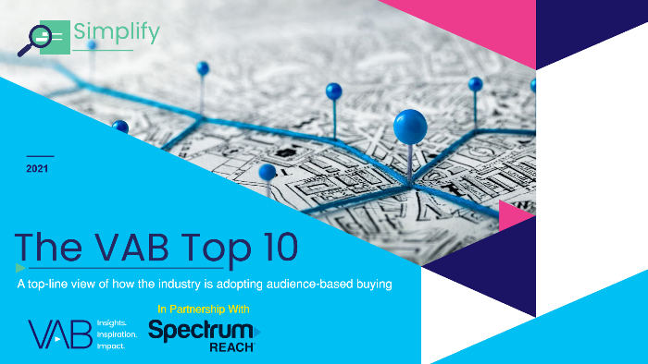


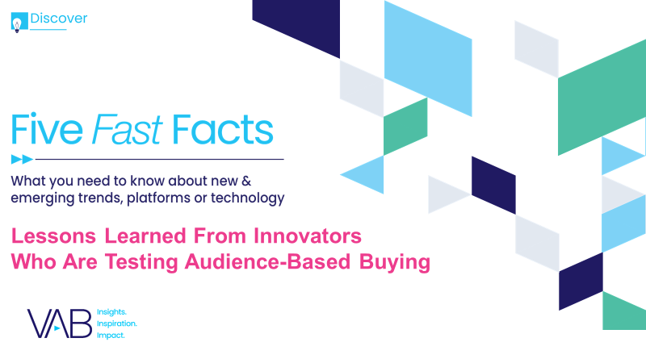



Creators
Jason Wiese
Reed Kiely
SVP, Director of Strategic Insights
jasonw@thevab.com
Associate Insights Director
reedk@thevab.com
The VAB Top 10
A top-line view of how the industry is adopting audience-based buying
An Insider’s Look
Why agencies and brands are shifting to audience-based TV buying
Karolina Guillen
Insights Manager
karolinag@thevab.com
Discover more
Looking for more data, insights and takeaways? Check out this related VAB content
Meeting Industry Challenges
Guidance and inspiration to embracing
an audience-first TV buying approach
Five Fast Facts
Lessons learned from innovators who are testing audience-based buying
A Fresh Take
The Importance of Education & Training
in Audience-Based Buying
The Secret of My Success
Examining the winning marketing strategy that’s fueling high-growth DTC brands
VAB Members, brand marketers and agencies get free and immediate access to VAB’s content library. Get access at theVAB.com
PAGE 17
This information is exclusively provided to VAB members and qualified marketers. Further distribution is prohibited.

Slide 18


About VAB
VAB is an insights-driven organization that inspires marketers to reimagine their media strategies resulting in fully informed decisions.
Drawing on our marketing expertise, we simplify the complexities in our industry and discover new insights that transform the way marketers look at their media strategy.
We are committed to your business growth and proud to offer VAB members, brand marketers and agencies complimentary access to our continuously-growing Insights library. Get immediate access at theVAB.com.
Curious to learn more about VAB? Check out this quick video to see what we do and how we can help you develop business-driving marketing strategies.
This information is exclusively provided to VAB members and qualified marketers. Further distribution is prohibited.
PAGE 18

