Slide 1





What are the 7 key reasons advertisers launch TV campaigns?
Marketer FAQs

Slide 2



How can I use TV to drive growth for my brand?
This is a question many marketers ask.
Using B2B brands as our reference, in this analysis we explore the multiscreen TV campaign strategies that brands are using to achieve positive business outcomes through the purchase funnel. You’ll learn:
  What are the seven key reasons that brands launch
  new TV campaigns
  How are brands employing strategies that capitalize
  on the benefits of TV to drive brand results
This information is exclusively provided to VAB members and qualified marketers. Further distribution is prohibited.
PAGE 2

Slide 3
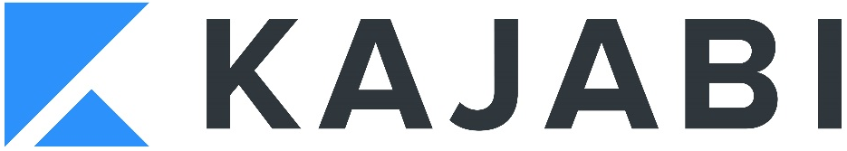



Digital-native B2B advertisers credit their TV campaigns for establishing their brands as a household name and market leader
86% of B2B brand leaders say ‘brand marketing’ is of high, or very high, importance to their CEO and board
“For a while, there was a lot of buzzworthy conversation about TV being a dying channel. The reality is that TV is anything but that.
It continues to show up, deliver eyeballs and show interest.
We found a more engaged audience. That coupled with what’s happening on the digital front with rising CPMs … in many cases we weighed out higher efficiencies on TV.”
“Fiverr has gone through some dramatic changes these past ten years and this brand evolution reflects the advancement and sophistication of the company while simultaneously embodying its purpose of providing opportunities for anyone, anywhere, to build their business, brand or dreams. Every detail, down to the font sizes and intricate color palette, was examined and reviewed to ensure that this shows the boldness of who we are as a company.”
Orlando Baeza, Chief Marketing Officer, Kajabi
(Digiday, ‘We found a more engaged audience’: Why Kajabi is
increasing its media spending on TV now, 7/29/2021)
Duncan Bird, Vice President of Brand and Digital, Fiverr
(Fiverr Unveils New Brand Campaign “It Starts Here”, Spotlights
Three Real Businesses on Their Path to Digital Transformation, 9/9/2020)
“This is an important opportunity for ABM to raise our profile and continue to position ourselves as a leader with diverse capabilities to create healthier spaces. The spotlight on essential workers and essential services is here to stay and celebrated in this commercial and across our business. It is our hope that people will feel more confident in returning to the places and spaces they love when they recognize the ABM logo.”
“The world's first music video you can expense is basically the greatest and most fun product demonstration ever, and even better with legendary "Expensivest" 2 Chainz. We want everyone to experience Expensify, so they can get back to what they truly set out to do.”
Cary Bainbridge, Chief Marketing Officer, ABM
(CleanLink, ABM Launches First Ever National TV Commercial, 2/24/21)
Hannes Ciatti, Executive Creative Director of JohnXHannes NY
(PRNewswire, Expensify Teams Up with 2 Chainz and Adam Scott for World's First Music Video You Can Expense and Super Bowl Campaign, 1/24/2019)
Source: Transmission, ‘The State of B2B Brand Building 2022”, Base: 500 B2B senior marketing leaders, Question: How much importance is placed on brand marketing by your board and/or leadership team of your company?
This information is exclusively provided to VAB members and qualified marketers. Further distribution is prohibited.
PAGE 3

Slide 4







Advertisers of all sizes and life stages are achieving success by capitalizing on the key benefits of TV to accelerate their growth
7 key reasons brands launch TV campaigns
Storytelling
Sight, sound and motion a TV ad can convey brand identity and further humanizes the brand and what it stands for
Availability & Accessibility
Greater product availability creates greater TV accessibility both on the national and local level
Legitimizer
Creates, builds and enhances brand reputation while legitimizing their product or
service offerings
Targetability
Scalable data-driven targeting solutions like addressable TV and data-enabled TV create efficiency and limit wastage
Inclusivity
Enhanced targeting capabilities through advanced TV solutions creates efficiencies which lowers the traditional cost of entry
Halo Effect
TV significantly improves the performance and ROI of all other digital channels as well as a brand’s online platforms
Full-Funnel Outcomes
Through greater measurement and enhanced attribution capabilities, TV has shown its ability to drive brand results
Click here to download ‘The Halo Effect: TV as a Growth Engine’ to learn more about why and how brands are accelerating their path to TV
This information is exclusively provided to VAB members and qualified marketers. Further distribution is prohibited.
PAGE 4

Slide 5

‘Real world’ example of how brands are leveraging the benefits of TV to achieve
full-funnel outcomes
Download VAB’s Let’s Get Down to Business for our in-depth, full-funnel attribution analysis

Slide 6









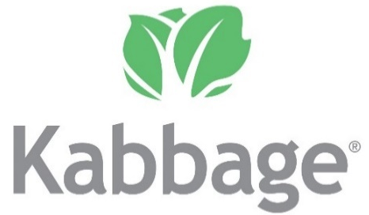














To understand how brands are using TV to achieve results, we examined 25 B2B advertisers that recently launched their first TV campaign
These brands represent 14 categories including banking/finance, commercial real estate, consulting, expense management, security, software, staffing and more with the analysis time period spanning between April ’18 – April ‘22
AAPC
(Healthcare)
AON Consulting
(Consulting)
Avira
(Software)
Blue Vine
(Banking/Finance)
Canva
(Graphic Design)
ABM Industries
(Commercial Real Estate)
Clear
(Security)
EY-Parthenon
(Consulting)
Fiverr
(Freelancing)
Kabbage
(Banking/Finance)
Kajabi
(Software)
Expensify
(Expense Management)
Leviton Manufacturing
(Manufacturing)
Loopnet
(Commercial Real Estate)
Palo Alto Networks
(Security)
Patriot Software
(Software)
Paychex
(Payroll)
Peopleready
(Staffing)
ServiceNow
(Software)
Ten-X Realtors
(Comm. Real Estate)
Twilio
(Communications)
Workhuman
(Human Resources)
Upwork
(Freelancing)
Webflow
(Software)
Smartsheet
(Software)
This information is exclusively provided to VAB members and qualified marketers. Further distribution is prohibited.
PAGE 6

Slide 7


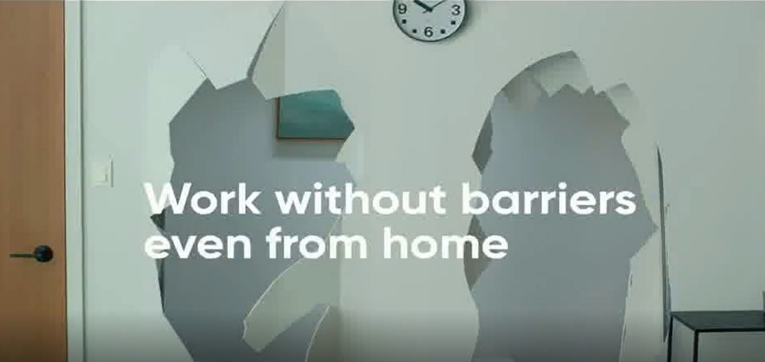
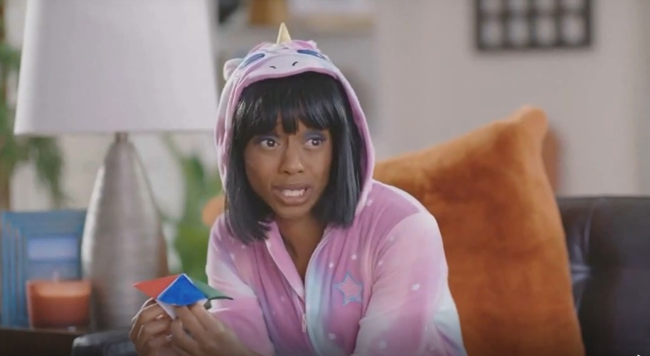
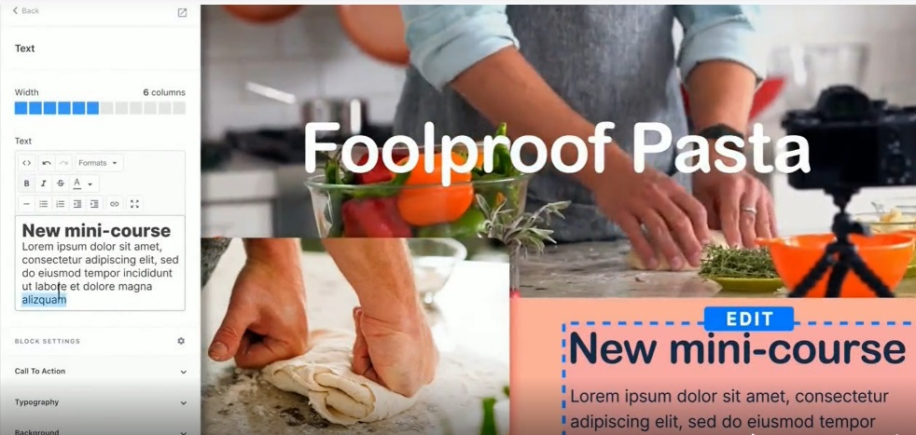
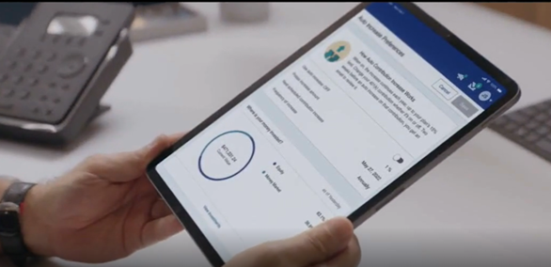





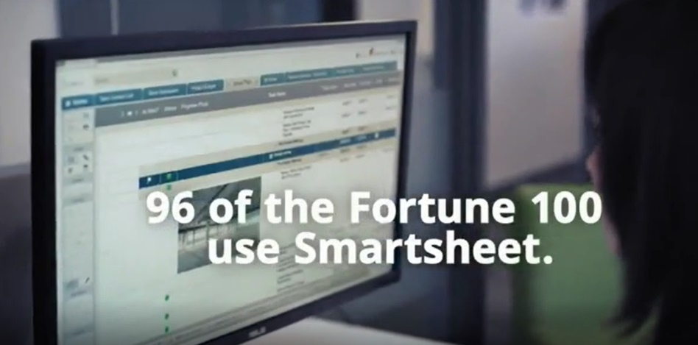

Video creative that features lighthearted messaging and strong visual branding drives attention and engagement, helping initiate the purchase journey for customers
Lighthearted, funny and relatable messaging
Visual branding with a focus on products services
‘Experience Without Barriers’
(TV Spot first aired: 3/30/20)
‘Get Out Of Your Own Way With Kim: What People Want’
(TV Spot first aired: 9/29/20)
‘Every Business Needs a Website’
(TV Spot first aired: 9/20/20)
'Making 401(k) Simple’
(TV Spot first aired: 7/30/21)
159
Ad Attention Index
155
Ad Attention Index
160
Ad Attention Index
154
Ad Attention Index
Super Bowl 2019 TV Spot, 'Expensify This' Featuring 2 Chainz, Adam Scott
(TV Spot first aired: 2/3/19)
‘Make it Easier’
(TV Spot first aired: 10/26/19)
‘96 of 100’
(TV Spot first aired: 10/9/18)
'Protect Your Home' Featuring Danny Lipford
(TV Spot first aired: 10/11/20)
152
Ad Attention Index
132
Ad Attention Index
141
Ad Attention Index
132
Ad Attention Index
How to read: ‘Experience Without Barriers’ (159 index) had 59% less interruptions than other ads in the context of the media placement with a 100 score being average.
Source: Creative from iSpot.tv, time period of airing 4/1/18 – 4/30/22, note: each creative execution had to launch before 4/30/22 so some may still be actively airing on TV. Ad Attention Index within iSpot.tv’s Attention Analytics. Index scale is 0-200 with a 100 index seeing ad performance as expected. Click above images to watch TV spots.
This information is exclusively provided to VAB members and qualified marketers. Further distribution is prohibited.
PAGE 7

Slide 8
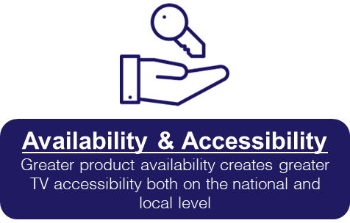
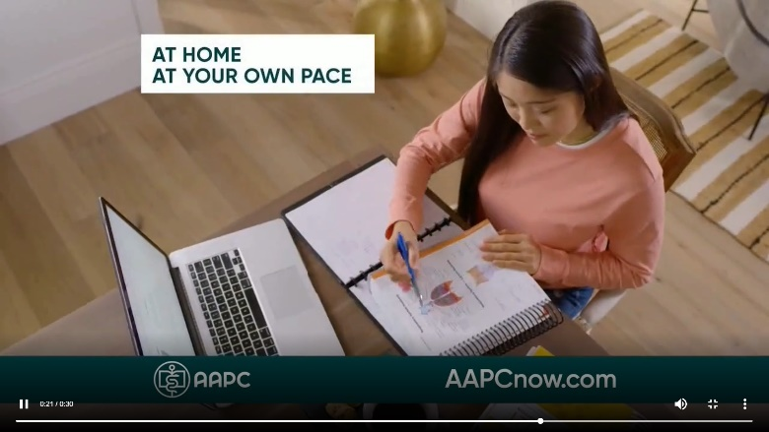
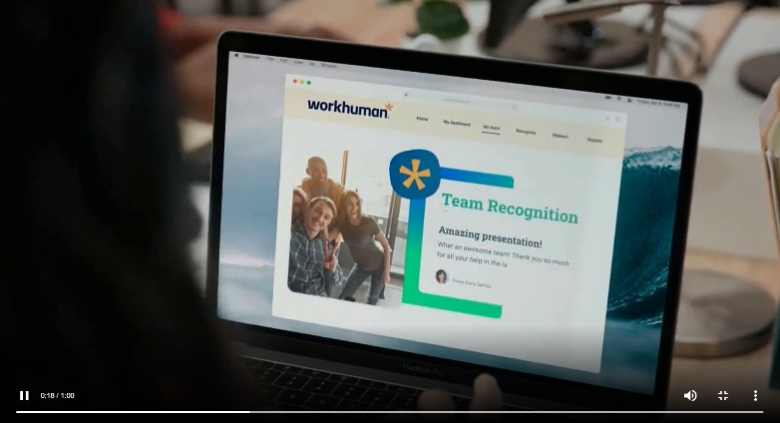
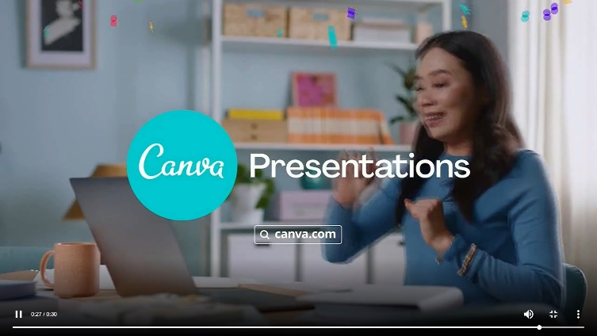
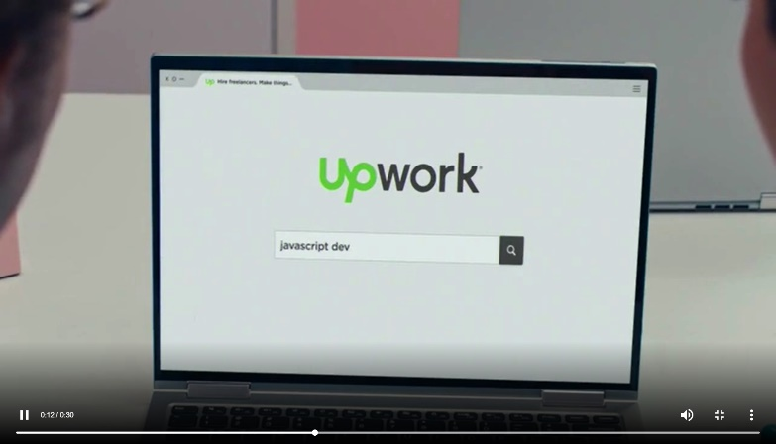
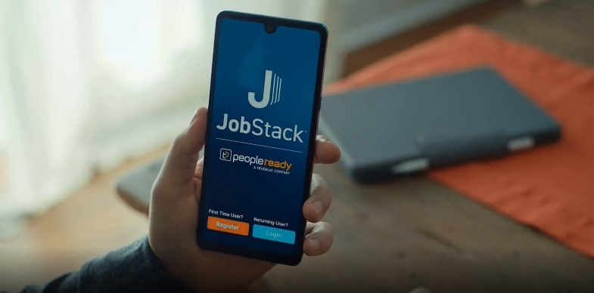
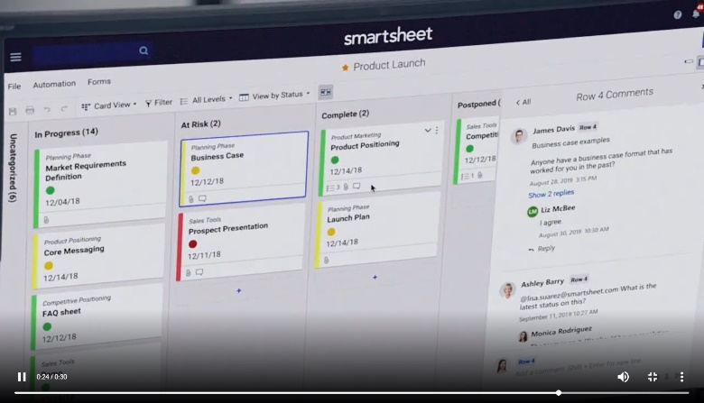
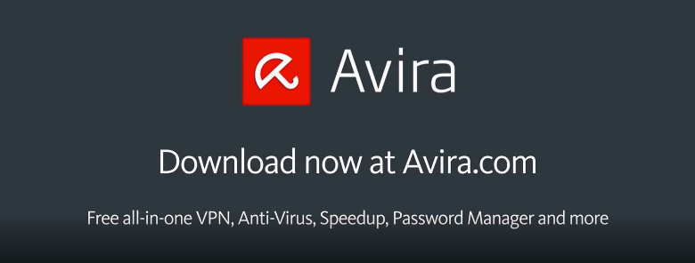
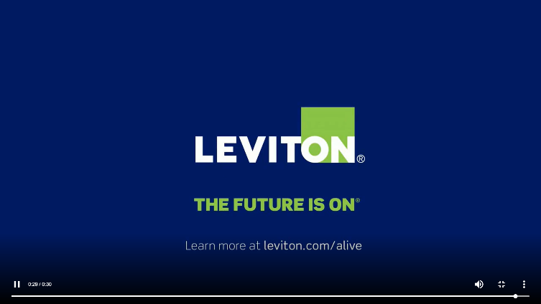
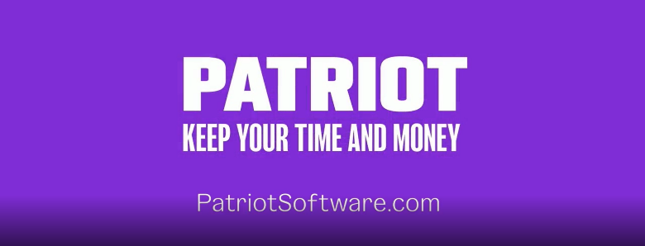
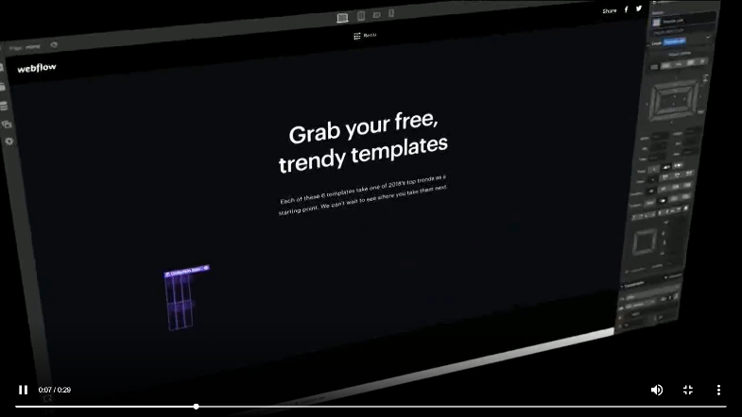
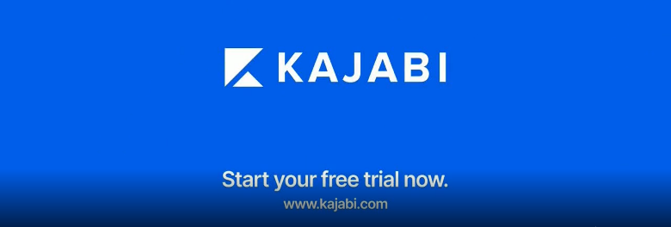
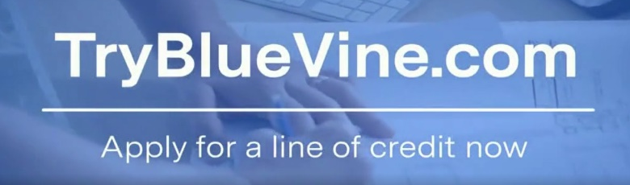
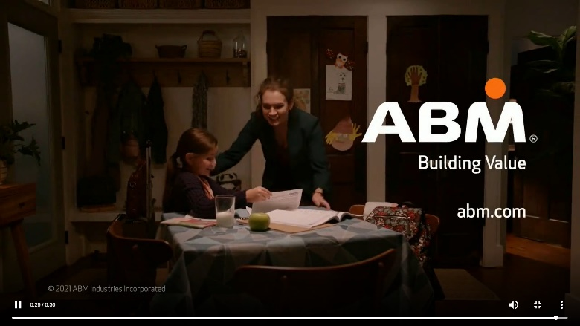

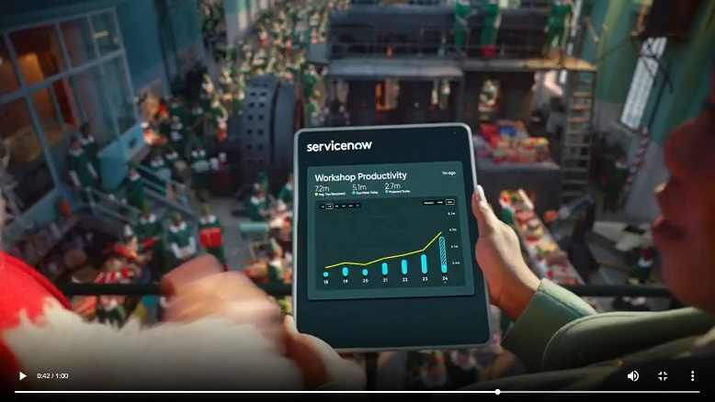

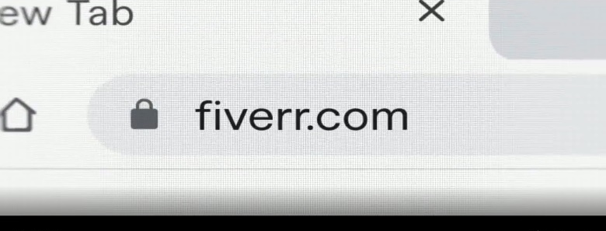
B2B brands are promoting their URL or digital platform within their TV ads, which enables greater accessibility and flexibility to meet customer’s needs anytime and anywhere
Examples of B2B creatives showcasing their URL or digital platforms
Source: Creative from iSpot.tv, time period of airing 4/1/18 – 4/30/22.
This information is exclusively provided to VAB members and qualified marketers. Further distribution is prohibited.
PAGE 8

Slide 9





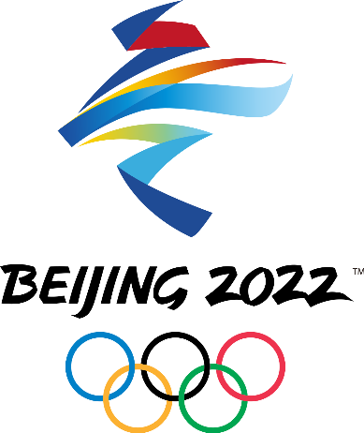
















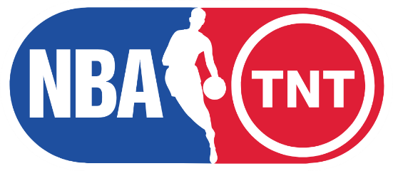






Brands are leveraging marquee TV events like the Superbowl, sports playoffs, award shows and entertainment series to legitimize their brand among an array of stakeholders
Sampling of Marquee Nat’l TV Programs Advertised On
Based Over a Four-Year Time Period: Apr ‘18 – Apr ‘22
Source: VAB analysis of Nielsen AdIntel, 04/01/18-04/30/22, National TV includes cable TV, broadcast TV, Spanish language cable TV and Spanish language broadcast TV across 25 brands included in analysis. Note: Listed genres and programs are only a sampling. *Transmission, ‘The State of B2B Brand Building 2022”, Base: 500 B2B senior marketing leaders, Question: How important are brand building programs compared to demand/lead generation programs in terms of contribution to your marketing goals?
This information is exclusively provided to VAB members and qualified marketers. Further distribution is prohibited.
PAGE 9

Slide 10
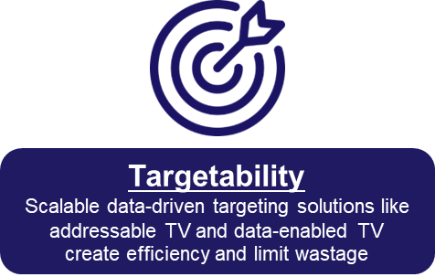












Additionally, the targetability and customization of audience-based buying allows brands to further optimize their TV buys against their best customer prospects
Marketers can buy TV on buying habits, characteristics or viewing behaviors (programs, genres watched)
which is a more accurate, and cost-effective, surrogate for their customer than a prescribed age bucket
B2B Targeting Examples
Buying Habits
Personal Characteristics
TV Viewing Behaviors
Software
Business Licenses
Business
Decision Makers
C-Suite
Executives
Business News
Award Shows
Computers
Commercial
Real Estate
Small Business Owners
Managers
Sports
Drama
This information is exclusively provided to VAB members and qualified marketers. Further distribution is prohibited.
PAGE 10

Slide 11
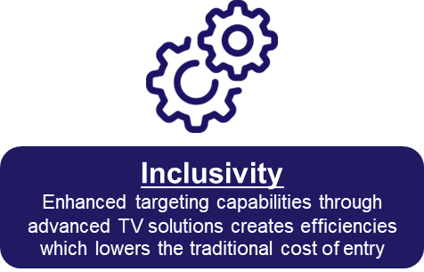

Successful brands are implementing an audience-first approach, as evidenced by their TV campaigns which air
across a broad mix of programming to reach their target
25 B2B Brand Average: Nat’l TV Programs, Genres and Networks
Based Over a Four-Year Time Period: Apr ‘18 – Apr ‘22
21
28
464
Avg #
of TV Networks
Avg #
of Genres*
Avg #
of Programs
To reach targeted stakeholders, B2B brands are advertising across a mix of sports, lifestyle and entertainment networks in addition to business and news programming
Source: VAB analysis of Nielsen AdIntel, 04/01/18-04/30/22, National TV includes cable TV, broadcast TV, Spanish language cable TV and Spanish language broadcast TV across 25 brands included in analysis. *Number of Genres includes sub-genres, e.g. ‘Sports Event: NFL Football / Regular Season.’ The total count for the 25 brands reflects an unduplicated count across national TV networks, genres and programs.
This information is exclusively provided to VAB members and qualified marketers. Further distribution is prohibited.
PAGE 11

Slide 12
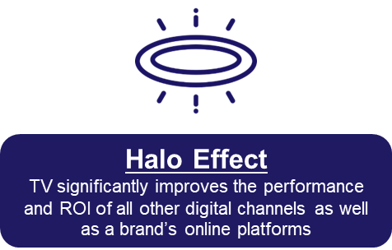
A ‘halo effect’ exists after TV launch due to ad memorability which means brands’ websites continue to see more visitors than pre-TV launch even in months when they are not on TV
25 B2B Brands Analysis
Monthly Website Unique Visitors (000) Comparison
Based Over a Four-Year Time Period: Apr ‘18 – Apr ‘22
+35%
+26%
+305K monthly uniques
+226K monthly uniques
vs. three months average prior to TV launch
vs. three months average prior to TV launch
Monthly Average ‘When On TV’
(monthly average)
(TV launch – April 2022)
(TV launch – April 2022)
Source: VAB analysis of Comscore mediametrix multiplatform media trend data, P18+. April 2018 – April 2022 (calendar months), figures are based on monthly averages for the 25 brands analyzed. ‘When On TV’ represents the monthly average for brands in months where they spend on national TV as measured through Nielsen AdIntel across the April 2018 – April 2022 (calendar months) time period across the 25 brands analyzed. ‘When Not On Air’ represents the monthly average for brands in months where they don’t spend on national TV, after their first month of TV spend, as measured through Nielsen AdIntel across the April 2018 – April 2022 (calendar months) time period across the 25 brands analyzed.
This information is exclusively provided to VAB members and qualified marketers. Further distribution is prohibited.
PAGE 12

Slide 13
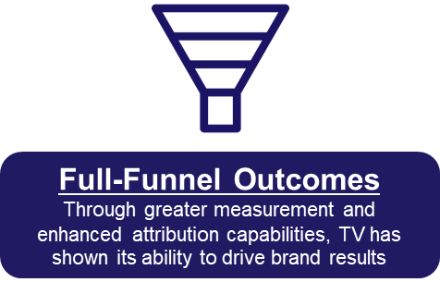
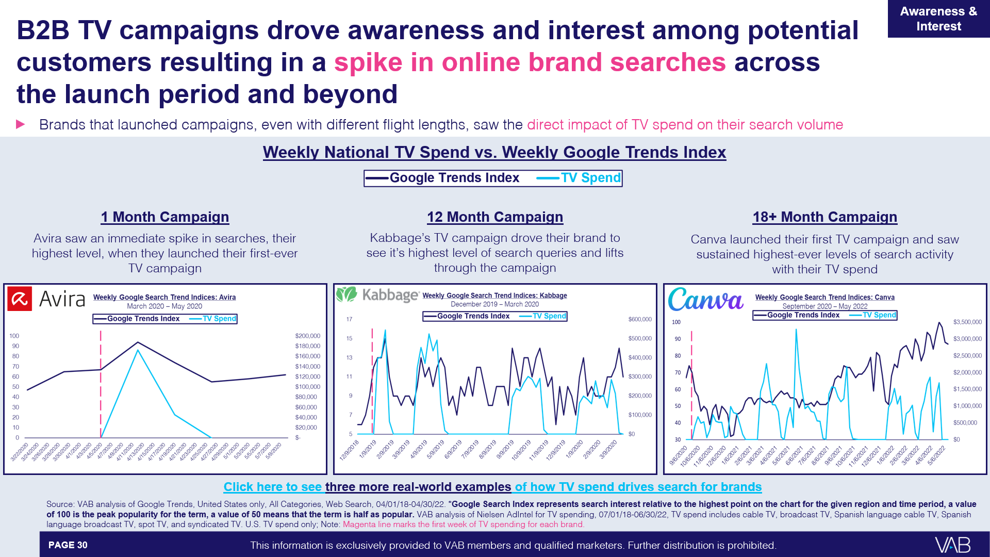
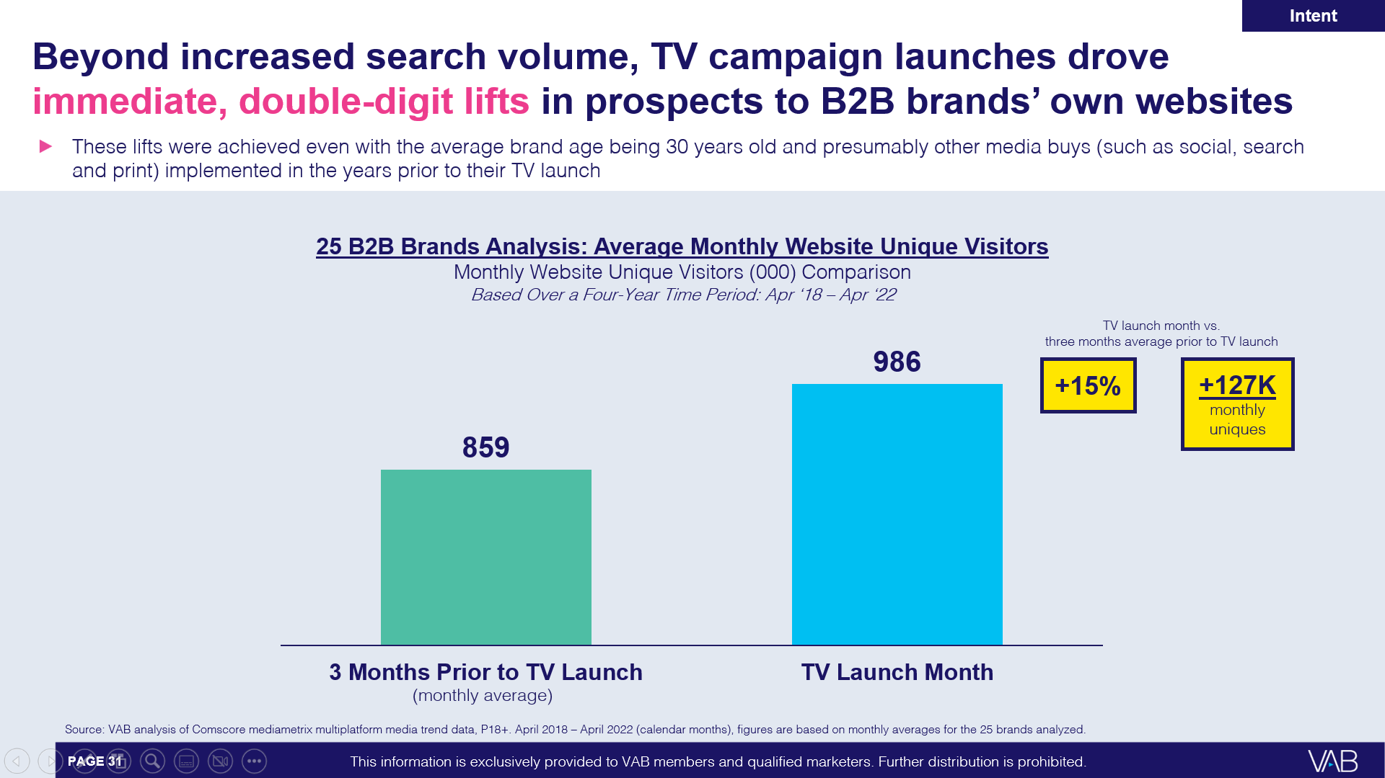
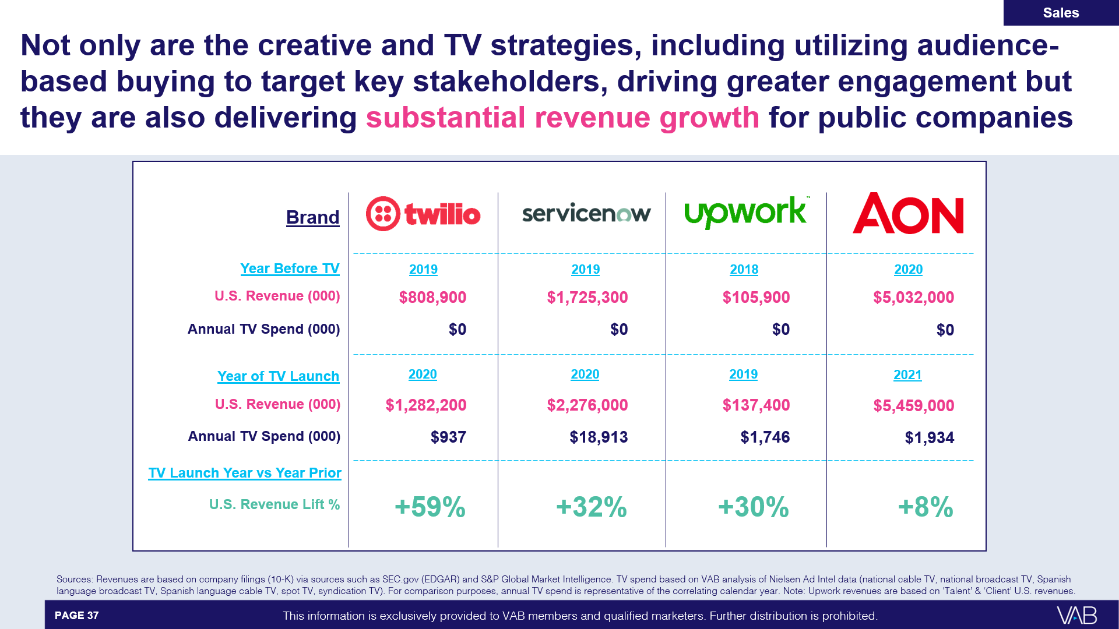
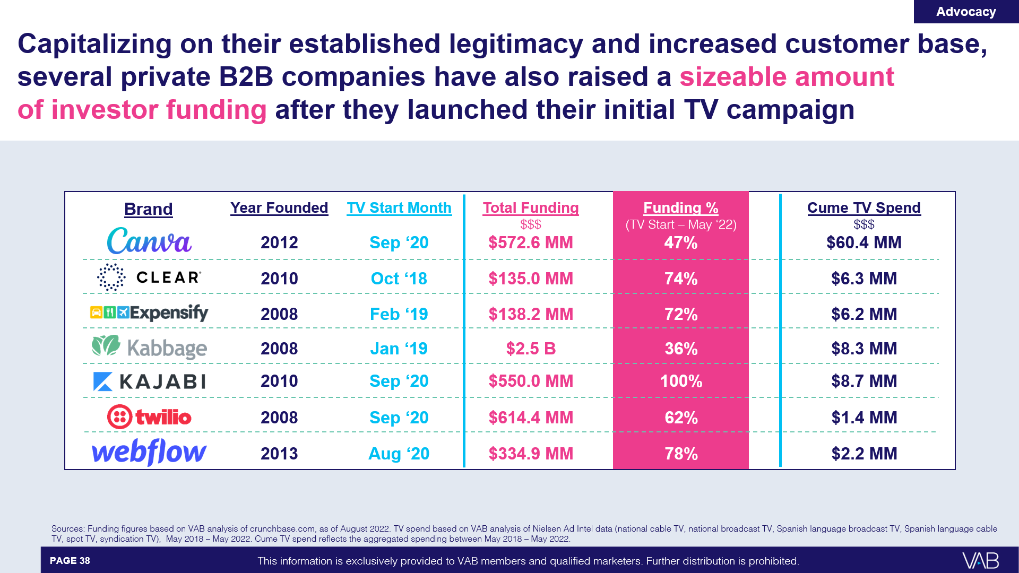
Employing strategies that capitalize on the key benefits
of TV enables brands to achieve business outcomes at
each stage of the purchase funnel and beyond
Download VAB’s
‘Let’s Get Down to Business’ for our in-depth, full-funnel attribution analysis
Awareness & Interest
Intent
Sales
Capital Investment
This information is exclusively provided to VAB members and qualified marketers. Further distribution is prohibited.
PAGE 13

Slide 14

Marketer Checklist: Leveraging the key benefits of TV campaigns to drive business results
7 key reasons brands launch TV campaigns
Storytelling
Sight, sound and motion a TV ad can convey brand identity and further humanizes the brand and what it stands for
Availability & Accessibility
Greater product availability creates greater TV accessibility both on the national and local level
Legitimizer
Creates, builds and enhances brand reputation while legitimizing their product or
service offerings
Targetability
Scalable data-driven targeting solutions like addressable TV and data-enabled TV create efficiency and limit wastage
Inclusivity
Enhanced targeting capabilities through advanced TV solutions creates efficiencies which lowers the traditional cost of entry
Halo Effect
TV significantly improves the performance and ROI of all other digital channels as well as a brand’s online platforms
Full-Funnel Outcomes
Through greater measurement and enhanced attribution capabilities, TV has shown its ability to drive brand results
Click here to download ‘The Halo Effect: TV as a Growth Engine’ to learn more about why and how brands are accelerating their path to TV
This information is exclusively provided to VAB members and qualified marketers. Further distribution is prohibited.
PAGE 14

Slide 15
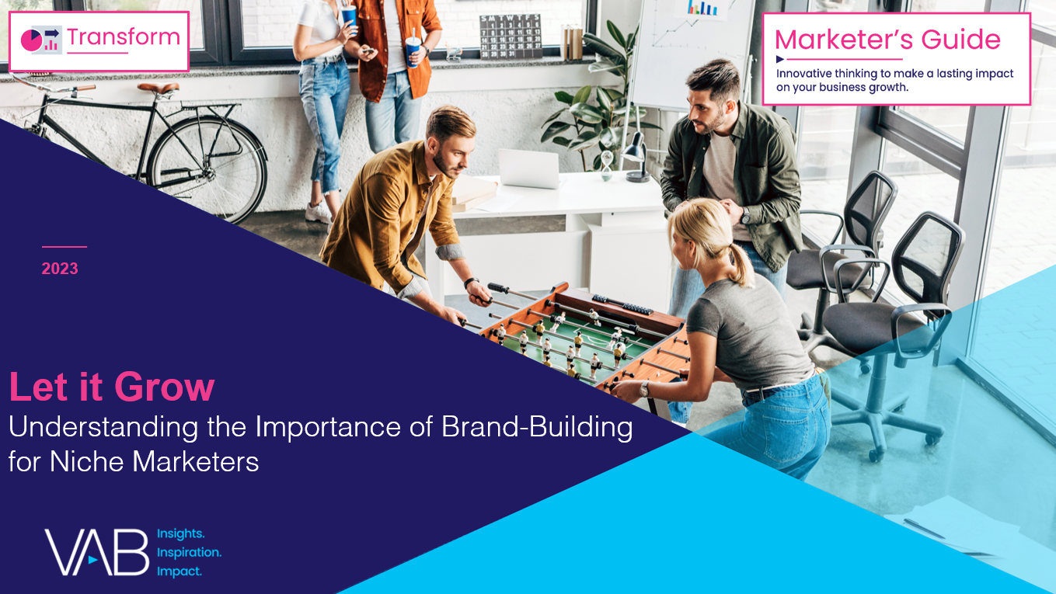
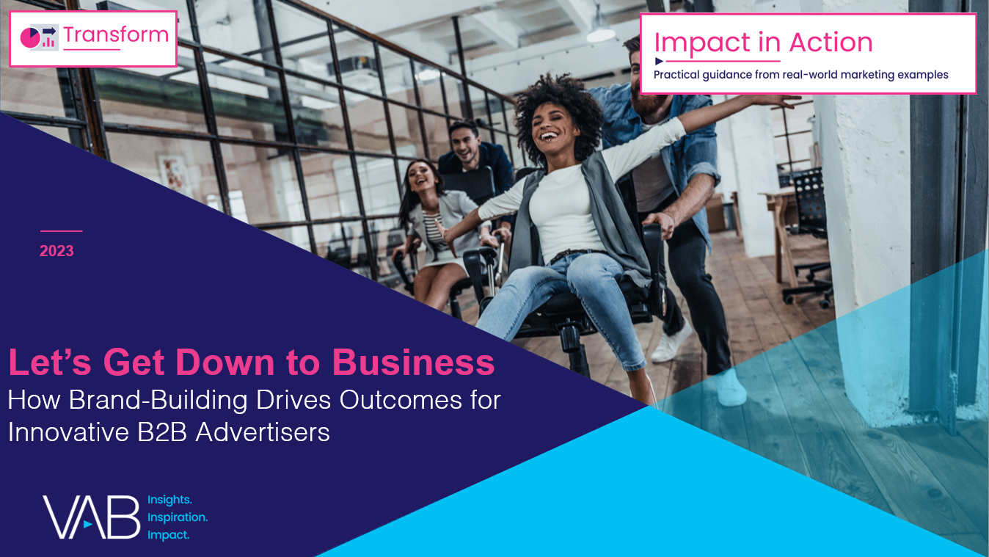
To learn more about how advertisers are capitalizing on the key benefits of TV, download the full-length reports below
‘Let It Grow’ uncovers the unique challenges that brands with niche targets must overcome and how they are using brand-building strategies to drive business outcomes
‘Let’s Get Down to Business’ explores real-world examples from 25 innovative B2B advertisers to quantify the impact of brand-building strategies from awareness down to sales
includes
in-depth,
full-funnel attribution analysis
Let It Grow
Understanding the Importance of
Brand-Building for Niche Marketers
Let’s Get Down to Business
How Brand-Building Drives Outcomes
for Innovative B2B Advertisers
This information is exclusively provided to VAB members and qualified marketers. Further distribution is prohibited.
PAGE 15

Slide 16

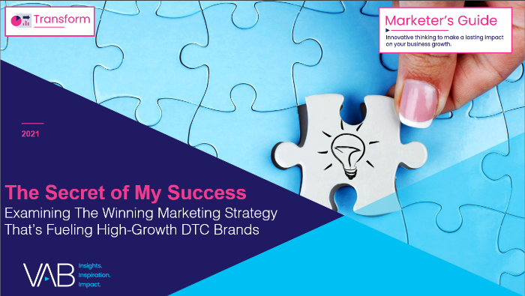


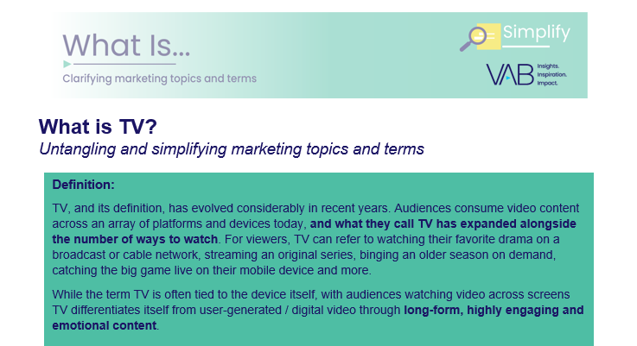
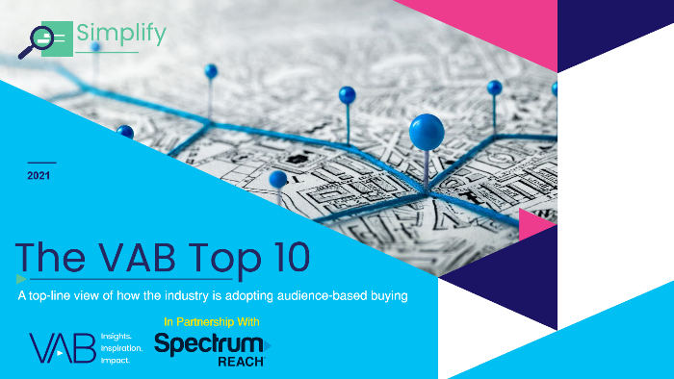
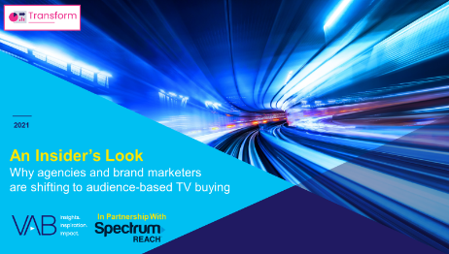

Creators
Jason Wiese
Reed Kiely
SVP, Director of Strategic Insights
jasonw@thevab.com
Associate Insights Director
reedk@thevab.com
The Secret of My Success
Examining the winning marketing strategy that’s fueling high-growth DTC brands
The Halo Effect
TV as a growth engine
Karolina Guillen
Insights Manager
karolinag@thevab.com
Discover more
Looking for more data, insights and takeaways? Check out this related VAB content
Welcome to TV – 1H 2022
Meet the Advertisers Seizing Opportunities During a New Wave of Uncertainty
What is TV?
Untangling and simplifying
marketing topics and terms
We believe in modern TV measurement.
Let us be your guide.
Visit the VAB’s Measurement Resource Center to get clear answers to questions our industry is asking about TV measurement.
The VAB Top 10
A top-line view of how the industry is adopting audience-based buying
An Insider’s Look
Why agencies and brands are shifting to audience-based TV buying
VAB Members, brand marketers and agencies get free and immediate access to VAB’s content library. Get access at theVAB.com
This information is exclusively provided to VAB members and qualified marketers. Further distribution is prohibited.
PAGE 16

Slide 17


About VAB
VAB is an insights-driven organization that inspires marketers to reimagine their media strategies resulting in fully informed decisions.
Drawing on our marketing expertise, we simplify the complexities in our industry and discover new insights that transform the way marketers look at their media strategy.
We are committed to your business growth and proud to offer VAB members, brand marketers and agencies complimentary access to our continuously-growing Insights library. Get immediate access at theVAB.com.
Curious to learn more about VAB? Check out this quick video to see what we do and how we can help you develop business-driving marketing strategies.
This information is exclusively provided to VAB members and qualified marketers. Further distribution is prohibited.
PAGE 17

