Slide 1





Can multiscreen TV be effective for brands with niche audiences?
Marketer FAQs

Slide 2



My brand has a highly specific audience,
I wonder if multiscreen TV is right for me?
This is a question many marketers ask.
Using B2B brands as our reference, in this analysis we
explore how brands with niche audiences are capitalizing
on the effectiveness of multiscreen TV to accelerate their
growth. You’ll learn:
  What are the seven key reasons that brands launch multiscreen TV campaigns
  How niche brands are leveraging data-enabled TV platforms and audience buying strategies
  What is the impact that TV campaigns have on brand outcomes
This information is exclusively provided to VAB members and qualified marketers. Further distribution is prohibited.
PAGE 2

Slide 3









A key challenge for B2B marketers is their need to effectively reach very niche audiences of business decision makers, regardless of category
U.S. Business Decision Maker Universes
% of Adults 18+
Total Business Decision Makers
14.8%
(38MM)
Business Decision Makers by Purchase Category
Business Decision Makers by Business Size
Banking Services
Telco / Communications
Computer Software
2.4%
(6.2MM)
2.4%
(6.2MM)
2.2%
(5.6MM)
Small Business
(<$10K spend)
Medium Business
($10k-$100k spend)
Large Business
(>$100k spend)
Temporary Help
Consultation Services
Comm. Real Estate
7.2%
(18MM)
4.7%
(12MM)
2.9%
(7MM)
1.8%
(4.5MM)
1.6%
(4.0MM)
0.7%
(1.9MM)
Source: MRI-Simmons Summer 2022 USA Study, Business Decision Makers represent respondents that have made business purchases in the last 12 months. Base = Adults 18+. Purchase categories reflects a sampling of business categories. Business size spend is based on last 12 months.
This information is exclusively provided to VAB members and qualified marketers. Further distribution is prohibited.
PAGE 3

Slide 4
While most niche prospects are not in market for a brand’s product category at any one time, advertising can instill ‘top-of-mind’ awareness which is activated when they do come into the market
95%
“To grow a brand, you need
to advertise to people who aren’t in the market now,
so that when they do enter
the market your brand is one they are familiar with.”
of business clients are
not in the market for many
goods and services
at any one time
John Dawes
Associate Director of the Ehrenberg-Bass Institute
& Professor at University of South Australia
Ehrenberg-Bass Institute for Marketing Science , ‘How B2B Brands Grow’
Source: ‘How B2B Brands Grow,’ The B2B Institute at LinkedIn with Ehrenberg-Bass Institute for Marketing Science (The University of South Australia), August 2021.
This information is exclusively provided to VAB members and qualified marketers. Further distribution is prohibited.
PAGE 4

Slide 5







When it comes to brand-building and establishing ‘top-of-mind’ awareness while fostering customer action, advertisers of all sizes and life stages are capitalizing on the key benefits of TV to accelerate their growth
7 key reasons brands launch TV campaigns
Availability & Accessibility
Greater product availability creates greater TV accessibility both on the national and local level
Legitimizer
Creates, builds and enhances brand reputation while legitimizing their product or
service offerings
Targetability
Scalable data-driven targeting solutions like addressable TV and data-enabled TV create efficiency and limit wastage
Full-Funnel Outcomes
Through greater measurement and enhanced attribution capabilities, TV has shown its ability to drive brand results
Inclusivity
Enhanced targeting capabilities through advanced TV solutions creates efficiencies which lowers the traditional cost of entry
Storytelling
Sight, sound and motion a TV ad can convey brand identity and further humanizes the brand and what it stands for
Halo Effect
TV significantly improves the performance and ROI of all other digital channels as well as a brand’s online platforms
This information is exclusively provided to VAB members and qualified marketers. Further distribution is prohibited.
PAGE 5

Slide 6
Marketers looking to reach niche audiences are increasingly leveraging more targeted solutions across data-enabled multiscreen TV platforms
to engage their best customer prospects effectively and efficiently
Source: VAB, ‘How might customized, targeted video ads help create stronger engagement?’. Advertiser Perceptions, 2H 2021 Video Advertising Convergence Report. Based on survey of 250 marketer and agency respondents who are involved in video advertising decision-making. Click here to download ‘How might customized, targeted video ads help create stronger engagement?’ to learn more about how personalized, targeted ads drive engagement with brands.
This information is exclusively provided to VAB members and qualified marketers. Further distribution is prohibited.
PAGE 6

Slide 7












Successful brands with niche audiences, like in B2B categories, are
utilizing the personalization and targetability of audience-based buying
to effectively optimize their TV buys against their best customer prospects
Marketers can buy TV on buying habits, characteristics or viewing behaviors (programs, genres watched)
which is a more accurate, and cost-effective, surrogate for their customer than a prescribed age bucket
B2B Targeting Examples
Buying Habits
Personal Characteristics
TV Viewing Behaviors
Software
Business Licenses
Business
Decision Makers
C-Suite
Executives
Business News
Award Shows
Computers
Commercial
Real Estate
Small Business Owners
Managers
Sports
Drama
This information is exclusively provided to VAB members and qualified marketers. Further distribution is prohibited.
PAGE 7

Slide 8

Marketers are driving business outcomes through the purchase journey by implementing audience-based buying within their TV strategy
Awareness
Consideration
Intent
Sales
Full-Funnel
Source: VAB / Advertiser Perceptions ‘Audience-Based Buying Survey,’ fielded March 23 – 31, 2021. Survey base: Advertising decision-makers who are involved in buying or planning digital video, cable / broadcast TV, or advanced TV (n=211). Q150. To what extent do you believe audience-based buying of TV advertising can impact each of the following KPIs? (extremely impactful / very impactful). Base: Total Respondents. *such as site visits, sign ups, login ins, downloads. To learn more about how marketers are finding success with ABB, read more in “The VAB Top 10: A top-line view of how the industry is adopting audience-based buying”.
This information is exclusively provided to VAB members and qualified marketers. Further distribution is prohibited.
PAGE 8

Slide 9

‘Real world’ example of how multiscreen TV campaigns drive outcomes for brands with niche audiences
Download VAB’s Let’s Get Down to Business for our in-depth, full-funnel attribution analysis

Slide 10
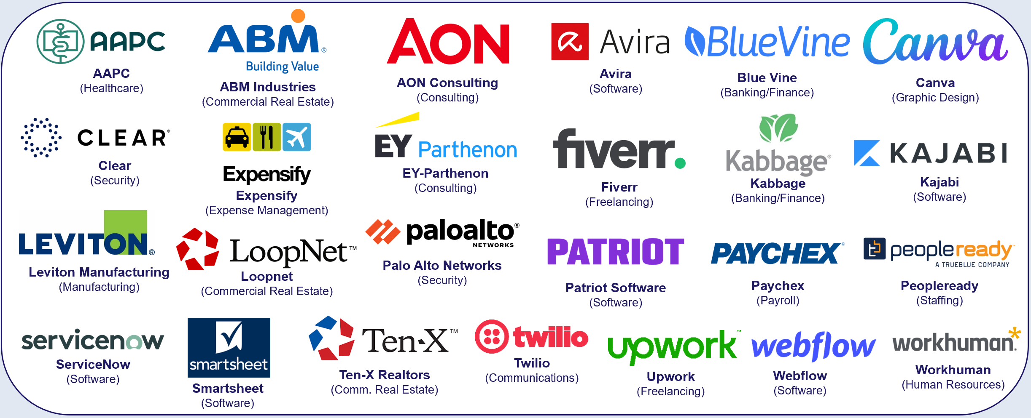
We conducted an attribution analysis of 25 B2B advertisers that recently launched their first multiscreen TV campaign in the last four years
The 14 categories include banking/finance, commercial real estate, consulting, expense management, security, software, staffing and more with the analysis time period spanning between April ’18 – April ‘22
This information is exclusively provided to VAB members and qualified marketers. Further distribution is prohibited.
PAGE 10

Slide 11

B2B brands implemented an audience-first approach, evidenced by their TV campaigns which ran across a broad mix of programming
Over the last four years, the 25 brands in total have advertised across 118 national TV networks, 132 genres and 6,843 programs
25 B2B Brand Average: Nat’l TV Programs, Genres and Networks
Based Over a Four-Year Time Period: Apr ‘18 – Apr ‘22
21
28
464
Avg #
of TV Networks
Avg #
of Genres*
Avg #
of Programs
Source: VAB analysis of Nielsen AdIntel, 04/01/18-04/30/22, National TV includes cable TV, broadcast TV, Spanish language cable TV and Spanish language broadcast TV across 25 brands included in analysis. *Number of Genres includes sub-genres, e.g. ‘Sports Event: NFL Football / Regular Season.’ The total count for the 25 brands reflects an unduplicated count across national TV networks, genres and programs.
This information is exclusively provided to VAB members and qualified marketers. Further distribution is prohibited.
PAGE 11

Slide 12
The ability to effectively, and consistently, reach best prospects throughout their TV campaigns drove double-digit increases in potential new customers to brands’ digital platforms
25 B2B Brands Analysis: Average Monthly Website Unique Visitors
Monthly Website Unique Visitors (000) Comparison
Based Over a Four-Year Time Period: Apr ‘18 – Apr ‘22
+35%
+15%
(monthly average)
(TV launch – April 2022)
Source: VAB analysis of Comscore mediametrix multiplatform media trend data, P18+. April 2018 – April 2022 (calendar months), figures are based on monthly averages for the 25 brands analyzed. ‘When On TV’ represents the monthly average for brands in months where they spend on national TV as measured through Nielsen AdIntel across the April 2018 – April 2022 (calendar months) time period across the 25 brands analyzed. During this four-year analysis, the average B2B advertiser was on TV for 12 months. Average Monthly Visitors (000) – 3 Months Prior to TV Launch: 859; TV Launch Month: 986; ‘When On TV’: 1,164.
This information is exclusively provided to VAB members and qualified marketers. Further distribution is prohibited.
PAGE 12

Slide 13
Adults over 50 account for 36% of the total population and nearly half of all adults
Brands with niche audiences are leaning into data-enabled multiscreen TV platforms and audience-based buying strategies to accelerate their growth by effectively, and efficiently, engaging their best prospects in premium environments
Niche brands that are implementing a focused, audience-based buying strategy within their TV campaigns are seeing many more new customer prospects entering their digital storefronts
Implications for Marketers
This information is exclusively provided to VAB members and qualified marketers. Further distribution is prohibited.
PAGE 13

Slide 14


To learn more about multiscreen TV’s ability to drive business outcomes for brands with niche audiences download the full-length reports below
‘Let It Grow’ uncovers the unique challenges that brands with niche targets must overcome and how they are using brand-building strategies to drive business outcomes
‘Let’s Get Down to Business’ explores real-world examples from 25 innovative B2B advertisers to quantify the impact of brand-building strategies from awareness down to sales
includes
in-depth,
full-funnel attribution analysis
Let It Grow
Understanding the Importance of
Brand-Building for Niche Marketers
Let’s Get Down to Business
How Brand-Building Drives Outcomes
for Innovative B2B Advertisers
This information is exclusively provided to VAB members and qualified marketers. Further distribution is prohibited.
PAGE 14

Slide 15


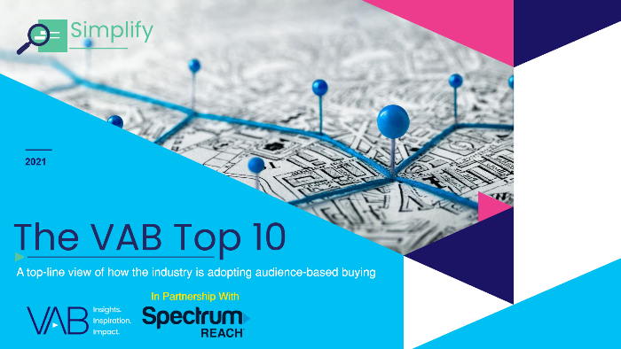


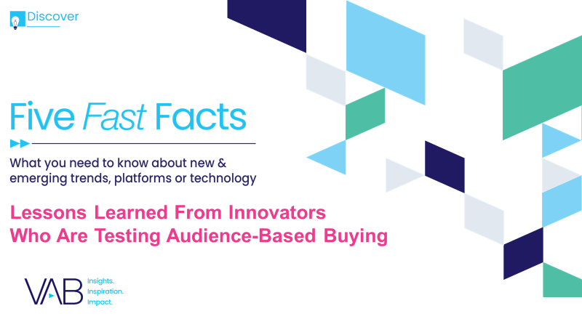

Creators
Jason Wiese
Reed Kiely
SVP, Director of Strategic Insights
jasonw@thevab.com
Associate Insights Director
reedk@thevab.com
The Secret of My Success
Examining the winning marketing strategy that’s fueling high-growth DTC brands
The Halo Effect
TV as a growth engine
Karolina Guillen
Insights Manager
karolinag@thevab.com
Discover more
Looking for more data, insights and takeaways? Check out this related VAB content
The VAB Top 10
A top-line view of how the industry is adopting audience-based buying
An Insider’s Look
Why agencies and brands are shifting to audience-based TV buying
Meeting Industry Challenges
Guidance and inspiration to embracing
an audience-first TV buying approach
Five Fast Facts
Lessons learned from innovators who are testing audience-based buying
VAB Members, brand marketers and agencies get free and immediate access to VAB’s content library. Get access at theVAB.com
PAGE 15
This information is exclusively provided to VAB members and qualified marketers. Further distribution is prohibited.

Slide 16


About VAB
VAB is an insights-driven organization that inspires marketers to reimagine their media strategies resulting in fully informed decisions.
Drawing on our marketing expertise, we simplify the complexities in our industry and discover new insights that transform the way marketers look at their media strategy.
We are committed to your business growth and proud to offer VAB members, brand marketers and agencies complimentary access to our continuously-growing Insights library. Get immediate access at theVAB.com.
Curious to learn more about VAB? Check out this quick video to see what we do and how we can help you develop business-driving marketing strategies.
This information is exclusively provided to VAB members and qualified marketers. Further distribution is prohibited.
PAGE 16

