Slide 1





Is equity-building important for niche brands?
Marketer FAQs

Slide 2



I am targeting a highly specific audience with a very specific purchase behaviors, do I need to invest in brand-building advertising?
This is a question many marketers ask.
Using B2B brands as our reference, in this analysis you’ll learn why brand-building is critical even for small brands with highly specific consumer targets. You’ll learn:
  Why top-of-mind awareness is essential for brands
  with long purchase cycles
  The relationship between brand-building and conversion / consumer action
  How brand-building can drive a variety of common business KPIs
This information is exclusively provided to VAB members and qualified marketers. Further distribution is prohibited.
PAGE 2

Slide 3









A key challenge for B2B marketers is their need to effectively reach very
niche audiences of business decision makers, regardless of category
U.S. Business Decision Maker Universes
% of Adults 18+
Total Business Decision Makers
14.8%
(38MM)
Business Decision Makers by Purchase Category
Business Decision Makers by Business Size
Banking Services
Telco / Communications
Computer Software
2.4%
(6.2MM)
2.4%
(6.2MM)
2.2%
(5.6MM)
Small Business
(<$10K spend)
Medium Business
($10k-$100k spend)
Large Business
(>$100k spend)
Temporary Help
Consultation Services
Comm. Real Estate
7.2%
(18MM)
4.7%
(12MM)
2.9%
(7MM)
1.8%
(4.5MM)
1.6%
(4.0MM)
0.7%
(1.9MM)
Source: MRI-Simmons Summer 2022 USA Study, Business Decision Makers represent respondents that have made business purchases in the last 12 months. Base = Adults 18+. Purchase categories reflects a sampling of business categories. Business size spend is based on last 12 months.
This information is exclusively provided to VAB members and qualified marketers. Further distribution is prohibited.
PAGE 3

Slide 4






Brand-building is increasingly important for B2B companies as marketers are using it to drive key business outcomes from awareness to advocacy
What Are Your Top Five Brand Marketing Objectives for the Next 12 Months?
% of B2B Marketers
71%
43%
42%
41%
40%
40%
of B2B marketing leaders say brand marketing has
increased in importance
in the last 12 months
Growing brand awareness
and familiarity
Improving creative stand out and creative identity
Strengthening brand
strategy and positioning
Improving
brand experience
(digitally and physically)
Growing
brand loyalty
and advocacy
Source: Transmission, ‘The State of B2B Brand Building 2022’, Base: 500 B2B senior marketing leaders, Question: Summary of Top 5 - “Looking ahead to the next 12 months, what are your top five brand marketing objectives or priorities?”
This information is exclusively provided to VAB members and qualified marketers. Further distribution is prohibited.
PAGE 4

Slide 5
Establishing ‘top-of-mind’ awareness is important for B2B marketers due to the greater likelihood they will be included in a customer prospects’ consideration set even before they start their research process
95%
90%
of business clients are
not in the market for many
goods and services
at any one time
of B2B decision makers ultimately choose a vendor they had in mind before beginning the search process*
Source: ‘How B2B Brands Grow,’ The B2B Institute at LinkedIn with Ehrenberg-Bass Institute for Marketing Science (The University of South Australia), August 2021. *Harvard Business Review, ‘What B2Bs Need to Know About Their Buyers’, September 2022, survey by Bain and Google of 1,208 people at U.S. companies who are involved in buying software, cloud hosting, hardware, telecommunications, logistics, marketing, and industrial equipment
This information is exclusively provided to VAB members and qualified marketers. Further distribution is prohibited.
PAGE 5

Slide 6



With most of the research process for B2B solutions taking place through online channels now, it’s imperative for marketers to develop branding strategies that drive qualified prospects to their brands’ digital storefronts
88%
52%
41%
of B2B buyers/sellers transact via online channels
of B2B buyers
prefer online transactions to buy from B2B sellers
of B2B buyers
choose vendors that provide relevant information that makes purchase decisions easier
Source: GoodFirms, ‘B2B Services: Intelligence, Competition, and Future’, September 2022, Survey of 410 B2B buyers and sellers across comprise of ecommerce, SaaS, IT, logistics, fashion, healthcare, finance, and more.
This information is exclusively provided to VAB members and qualified marketers. Further distribution is prohibited.
PAGE 6

Slide 7

‘Real world’ example of how equity-building TV campaigns drive qualified prospects to brands’ digital storefronts
Download VAB’s Let’s Get Down to Business for our in-depth, full-funnel attribution analysis

Slide 8
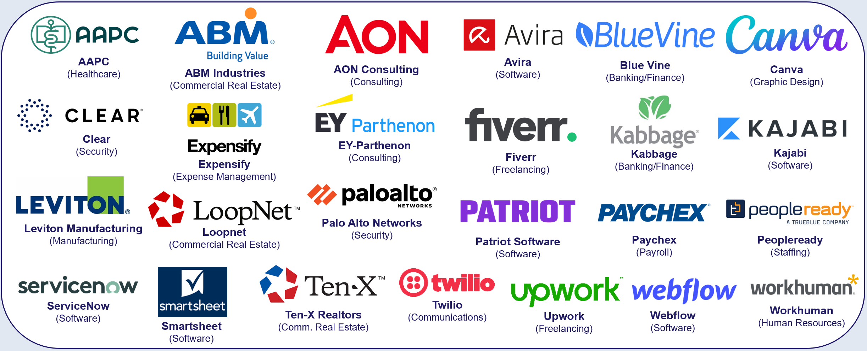
We conducted an attribution analysis of 25 B2B advertisers that recently launched their first equity-building TV campaign in the last four years
The 14 categories include banking/finance, commercial real estate, consulting, expense management, security, software, staffing and more with the analysis time period spanning between April ’18 – April ‘22
This information is exclusively provided to VAB members and qualified marketers. Further distribution is prohibited.
PAGE 8

Slide 9
After launching their TV campaign, B2B brands saw an immediate
double-digit increase in new customer prospects to their digital platform, with further growth driven through a sustained campaign presence
25 B2B Brands Analysis: Average Monthly Website Unique Visitors
Monthly Website Unique Visitors (000) Comparison
Based Over a Four-Year Time Period: Apr ‘18 – Apr ‘22
+35%
+15%
(monthly average)
(TV launch – April 2022)
Source: VAB analysis of Comscore mediametrix multiplatform media trend data, P18+. April 2018 – April 2022 (calendar months), figures are based on monthly averages for the 25 brands analyzed. ‘When On TV’ represents the monthly average for brands in months where they spend on national TV as measured through Nielsen AdIntel across the April 2018 – April 2022 (calendar months) time period across the 25 brands analyzed. During this four-year analysis, the average B2B advertiser was on TV for 12 months. Average Monthly Visitors (000) – 3 Months Prior to TV Launch: 859; TV Launch Month: 986; ‘When On TV’: 1,164.
This information is exclusively provided to VAB members and qualified marketers. Further distribution is prohibited.
PAGE 9

Slide 10
Adults over 50 account for 36% of the total population and nearly half of all adults
Niche brands are launching equity-building TV campaigns to establish ‘top-of-mind’ awareness among their customer prospects so that when they are ready to buy, they will be more likely to include their brand within their consideration set
With most of the research process for products and services now taking place online, savvy marketers are utilizing TV campaigns to drive many more new customer prospects to their digital platforms
Implications for Marketers
This information is exclusively provided to VAB members and qualified marketers. Further distribution is prohibited.
PAGE 10

Slide 11

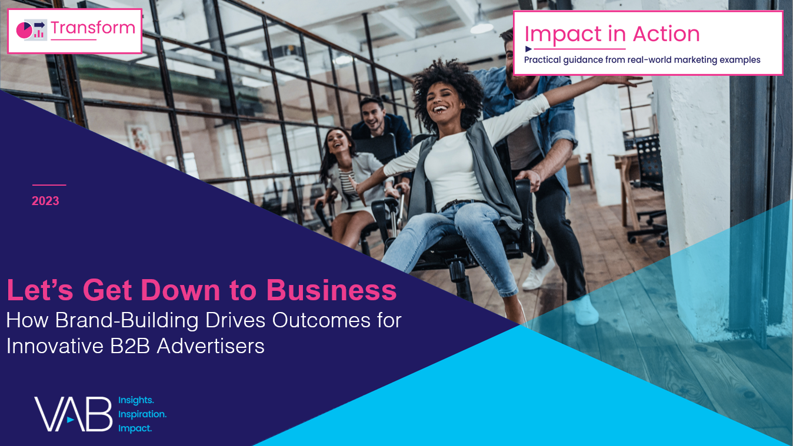
To learn more about the importance and impact of brand-building for niche brands, like Business-to-Business, download the full reports below
‘Let It Grow’ uncovers the unique challenges that brands with niche targets must overcome and how they are using brand-building strategies to drive business outcomes
‘Let’s Get Down to Business’ explores real-world examples from 25 innovative B2B advertisers to quantify the impact of brand-building strategies from awareness down to sales
includes
in-depth,
full-funnel attribution analysis
Let It Grow
Understanding the Importance of
Brand-Building for Niche Marketers
Let’s Get Down to Business
How Brand-Building Drives Outcomes
for Innovative B2B Advertisers
This information is exclusively provided to VAB members and qualified marketers. Further distribution is prohibited.
PAGE 11

Slide 12
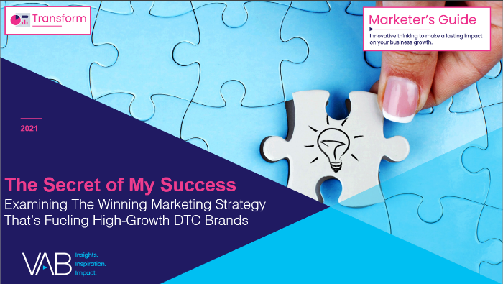
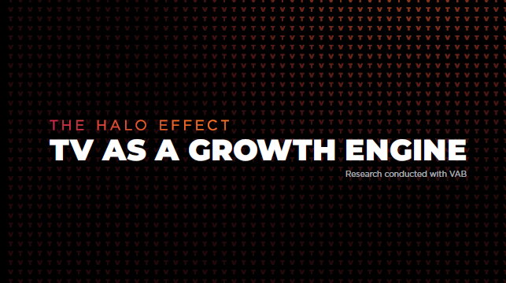
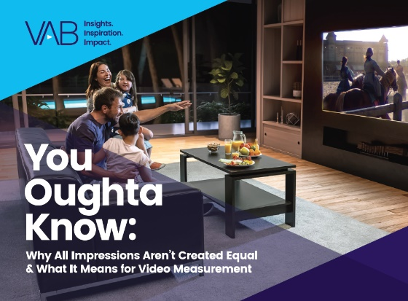
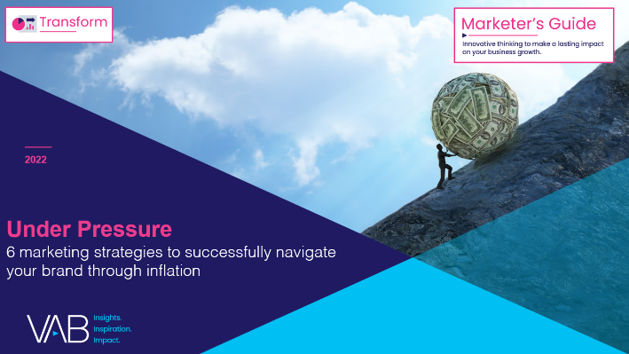



Creators
Jason Wiese
Reed Kiely
SVP, Director of Strategic Insights
jasonw@thevab.com
Associate Insights Director
reedk@thevab.com
The Secret of My Success
Examining the winning marketing strategy that’s fueling high-growth DTC brands
The Halo Effect
TV as a growth engine
Karolina Guillen
Insights Manager
karolinag@thevab.com
Discover more
Looking for more data, insights and takeaways? Check out this related VAB content
You Oughta Know
Why all impressions aren't created equal & what it means for video measurement
Under Pressure
6 marketing strategies to successfully navigate your brand through inflation
Keep Calm and Advertise On
How to successfully navigate your brand through an economic downturn
A Matter of Principle
6 Reassessing Your Strategy
in Today’s Environment
VAB Members, brand marketers and agencies get free and immediate access to VAB’s content library. Get access at theVAB.com
This information is exclusively provided to VAB members and qualified marketers. Further distribution is prohibited.
PAGE 12

Slide 13


About VAB
VAB is an insights-driven organization that inspires marketers to reimagine their media strategies resulting in fully informed decisions.
Drawing on our marketing expertise, we simplify the complexities in our industry and discover new insights that transform the way marketers look at their media strategy.
We are committed to your business growth and proud to offer VAB members, brand marketers and agencies complimentary access to our continuously-growing Insights library. Get immediate access at theVAB.com.
Curious to learn more about VAB? Check out this quick video to see what we do and how we can help you develop business-driving marketing strategies.
This information is exclusively provided to VAB members and qualified marketers. Further distribution is prohibited.
PAGE 13

