Slide 1



Case Study Corner
xx
B2B Category
Brand success stories highlighted through real-world multiscreen TV case studies

Slide 2




6 B2B category ‘real world’ case studies showcasing how multiscreen TV drives business outcomes across the funnel
Upper Funnel Outcomes
Awareness
Multiscreen TV campaigns that expand reach and drive brand recall against a brand’s best customer prospects*
Sampling of ‘awareness-based’ outcomes that can be measured:
Reach / Reach Extension / Incremental Reach
Ad / Brand Recall
Cost Efficiencies (Reach / Targeted IMPs)
Mid-to-Lower Funnel Outcomes
Action
Multiscreen TV campaigns that increase the likelihood the intended audience will be motivated to act*
Sampling of ‘action-based’ outcomes that can be measured:
Conversion Rates (website traffic,
app downloads, subscription sign-ups,
tune-in, foot traffic)
Sales / Revenues
Optimizations / ROI
Cost Efficiencies (Conversions)
*based on campaign KPIs
This information is exclusively provided to VAB members and qualified marketers.
PAGE 2

Slide 3
Upper Funnel
Case Studies
Awareness
Multiscreen TV campaigns expand reach
and drive brand recall against a brand’s
best customer prospects
Sampling of ‘awareness-based’ outcomes that can be measured:
    Reach / Reach Extension / Incremental Reach
    Ad / Brand Recall
    Cost Efficiencies (Reach / Targeted IMPs)
How Multiscreen TV drives
Awareness
This information is exclusively provided to VAB members and qualified marketers.
PAGE 3

Slide 4







Category:
B2B
DIRECTV enabled an addressable TV and pause ad campaign to increase a software brand’s overall perception and ad recall among business decision makers
Challenge
DIRECTV sought to increase brand perception and ad recall among the target audience for an information technology software company.
Solution
Paired a 12-week addressable TV campaign with out-of-stream pause ads
Target Segment
Business decision makers at 500-5,000 employee companies
Results
The campaign achieved increases across all metrics and brand perceptions among viewers who were exposed and able to recall the ad.
Including pause ads with the addressable TV campaign increased the campaign’s overall target reach by 4%
Company / Media Type
DIRECTV / Addressable TV
Viewers who were exposed and able to recall the ad agreed with all key perceptions:
Is a leader in cloud solutions
Is a company I can trust
Helps businesses overcome disruption or uncertainty
Is an innovative company
Helps companies grow
+46%
Unaided Brand Awareness
Pause Ad
(target vs. control)
10+
Pause ads frequency elicited highest gains across all attributes
Source: DIRECTV, Case Study: Addressable + Pause Ads for an Information Technology Software Brand. Analysis conducted within DIRECTV footprint. Case study results are based on individual campaign factors. DIRECTV makes no performance warranties. Control: represents 10% of DTV HHs within the target that did not receive exposure to the addressable ad.
This information is exclusively provided to VAB members and qualified marketers.
PAGE 4

Slide 5




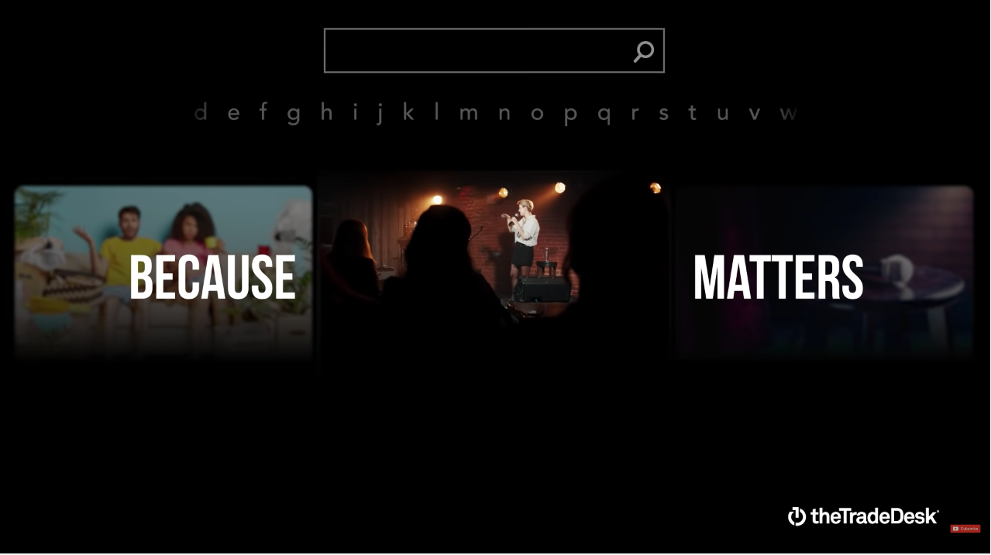

Category:
B2B
The Trade Desk, in partnership with Lucid, sought to drive awareness among target audiences
Challenge
The Trade Desk wanted to go beyond standard Connected TV performance KPIs like reach and frequency to gain a deeper understanding of how they achieved their primary KPI: driving a lift in brand awareness among the target audiences
Measurement Innovation
The Trade Desk used the Lucid integration, a survey-based solution that gives advertisers the ability to set up surveys and view brand lift reports directly within The Trade Desk media buying platform
Lucid tracks campaigns and matches the impression data against campaigns in The Trade Desk platform to identify respondents who have been exposed to the brand’s ads. Respondents are then surveyed, and their responses are measured against the client’s KPIs
Target Segment
Marketing Leaders at Agencies & Brands
Results
CTV exposure drove lift across multiple metrics — including brand awareness, which was the team’s primary campaign goal. As a result, the team now approaches media buying with a CTV-first mindset and has also increased media spend on CTV
Company / Viewing Source / Media Type
The Trade Desk / Connected TV, Desktop, & Mobile / Programmatic (on TTD)
Campaign Results
The brand lift study showed CTV exposure drove lift across multiple metrics
+4.6%
+5.7%
+7.1%
Lift in awareness
Lift in ad recall
Lift in favorability
“With our Brand Lift integration, we have greater insight into the campaign’s impact, including lift in awareness, favorability, and ad recall”
-Jeff Kerestes, Digital Marketing Director at The Trade Desk
“What Matters” Campaign
Source: The Trade Desk, case study: The Trade Desk x Lucid, a Cint Group. Campaign time period: Q4 2021
This information is exclusively provided to VAB members and qualified marketers.
PAGE 5

Slide 6
Mid-To-Lower Funnel
Case Studies
Action
Multiscreen TV campaigns increase the likelihood that the intended audience will be motivated to act
(e.g., make a purchase, download an app, sign-up
for a subscription, make a booking, etc.)
Sampling of ‘action-based’ outcomes that can be measured:
    Conversion Rates (website traffic, app downloads, subscription sign-ups, tune-in, foot traffic)
    Sales / Revenues
    Optimizations / ROI
    Cost Efficiencies (Conversions)
How Multiscreen TV drives
Action
This information is exclusively provided to VAB members and qualified marketers.
PAGE 6

Slide 7



Category:
B2B
A TV network leveraged a sell-side platform to ensure programmatic growth and increased revenue
Challenge
AMC Networks sought to simplify their ad buying process and unlock inventory for more advertisers following an increase in programming development and implementation of a more aggressive distribution strategy
Solution
Magnite’s demand facilitation specialists worked with AMC Networks to grow revenue & generate new business by leveraging platform tools and educating advertisers about AMC’s premium inventory and improving overall campaign performance
Results
The Magnite CTV platform delivered triple digit YoY programmatic growth, as well as triple digit YoY revenue growth (+415%)
Company / Platform / Media Type
Magnite / Streaming Only / Magnite Connected TV (CTV) Platform
Programmatic Growth
Revenue growth
July 2020 - 2021
Q2 2020 – Q2 2021
2020 - 2021
+120%
+311%
+415%
Source: Magnite, Case study: Magnite Helps AMC Networks Monetize Premium Video Inventory. Campaign time period: Programmatic growth - July 2020 – July 2021, Q2 2020 – Q2 2021; Revenue growth – 2020-2021.
This information is exclusively provided to VAB members and qualified marketers.
PAGE 7

Slide 8



Category:
B2B
A CTV publisher aimed to optimize their ad inventory, leading
to more advertiser interest and increased revenue
Challenge
A connected TV publisher wanted to monetize their premium CTV/OTT inventory across their
ad-supported TV network
Solution
PubMatic optimized the publisher’s CTV/OTT inventory and technical aspects of the deal set-up to drive maximum performance
  They ensured data signals such as device make, model and user agent were passing through to drive demand
  PubMatic monitored daily performance (requests, revenue, gross eCPM, fill rate, parameters and top ad request filters) and optimized as needed to maximize results
PubMatic’s Advertiser Solutions team negotiated
a unique SPO* deal with a leading agency to generate additional revenue for the client
Results
The CTV publisher increased revenue by 600% and grew the number of advertisers on the platform by 1,500
Company / Platform
PubMatic / Connected TV (CTV)
Campaign Results
+600%
1,500+
Revenue Increase
Increase in advertisers
Source: PubMatic, Case study: Unique Brand Demand. Campaign time period: Q3 2021 – Q4 2021. *SPO = ‘Supply path optimization’ which allows buyers to choose the best path towards a desired impression. Learn more about SPO here.
This information is exclusively provided to VAB members and qualified marketers.
PAGE 8

Slide 9



Category:
B2B
Future Today, a digital-first CTV publisher, wanted to drive revenue lift across their owned CTV/OTT channels
Challenge
A connected TV streaming platform, Future Today, wanted to drive substantial revenue lift across their owned CTV / OTT channels
Solution
PubMatic was selected to source incremental, unique demand and increase fill rates and yield
They monitored account performance daily (requests, revenue, gross eCPM, fill rate, parameters and top ad request filters) and implemented multiple solutions to drive incremental revenue
PubMatic drove new revenue through partnering with a leading DSP* and negotiating a PMP** deal on behalf of the publisher
Results
The publisher saw an average revenue increase of over 400% per month from 1H 2021 to 2H 2021
Company / Platform
PubMatic / Connected TV (CTV), OTT
Campaign Results
25X
2,400+
400%
Revenue Increase
Increase in advertisers
Average revenue increase per month
Source: PubMatic, Case study: Incremental Demand. Campaign time period: 1H 2021 – 2H 2021. *DSP = Demand side platform. **PMP = private marketplace.
This information is exclusively provided to VAB members and qualified marketers.
PAGE 9

Slide 10

Category:
B2B
Sling TV utilized sell-side technology to optimize their live CTV ad views and conversions
Challenge
Streaming platform Sling TV needed a way to manage the bursts of ad requests they receive from spikes in viewership during live sporting events while ensuring that ads are served in a timely manner
Solution
Magnite developed Live Stream Acceleration (LSA) to improve time out and ad response time, helping publishers optimize the amount of ad break time they have to monetize
Results
By leveraging LSA, SLING saw a 47% lift in ad conversions* compared to the previous 5 weeks
Efficiencies via LSA implementation allowed for ad delivery that would been lost or timed out
Company / Platform
Magnite / Live Connected TV (CTV)
Campaign Results
By leveraging Live Stream Acceleration (LSA) for live sports over a five-week period, SLING saw a 47% lift in ad conversions* compared to the previous five weeks
Efficiencies via LSA implementation allowed for ad delivery which otherwise would have been lost (i.e. timed out) – which is equivalent to 51 seconds of advertising airtime on a standard 1-hour live event
‘Live CTV is a key differentiator for SLING, there is no better or more valuable medium for advertisers to reach highly engaged viewers, in real time, with personalized, relevant messaging…’
- Jessica Dufresne, Head of Ad Ops and Digital Ad Tech, Dish Media
Source: Magnite, Case study: SLING TV puts Magnite’s Live Stream Acceleration Into Play and Sees 47% Lift in Ad Conversion. Campaign time period: November 23, 2021 – January 18, 2022. *’Conversions’ in this case refers to the ability to serve an actual ad (and earn revenue) vs. having space go to waste (i.e., not serving an ad).
This information is exclusively provided to VAB members and qualified marketers.
PAGE 10

Slide 11







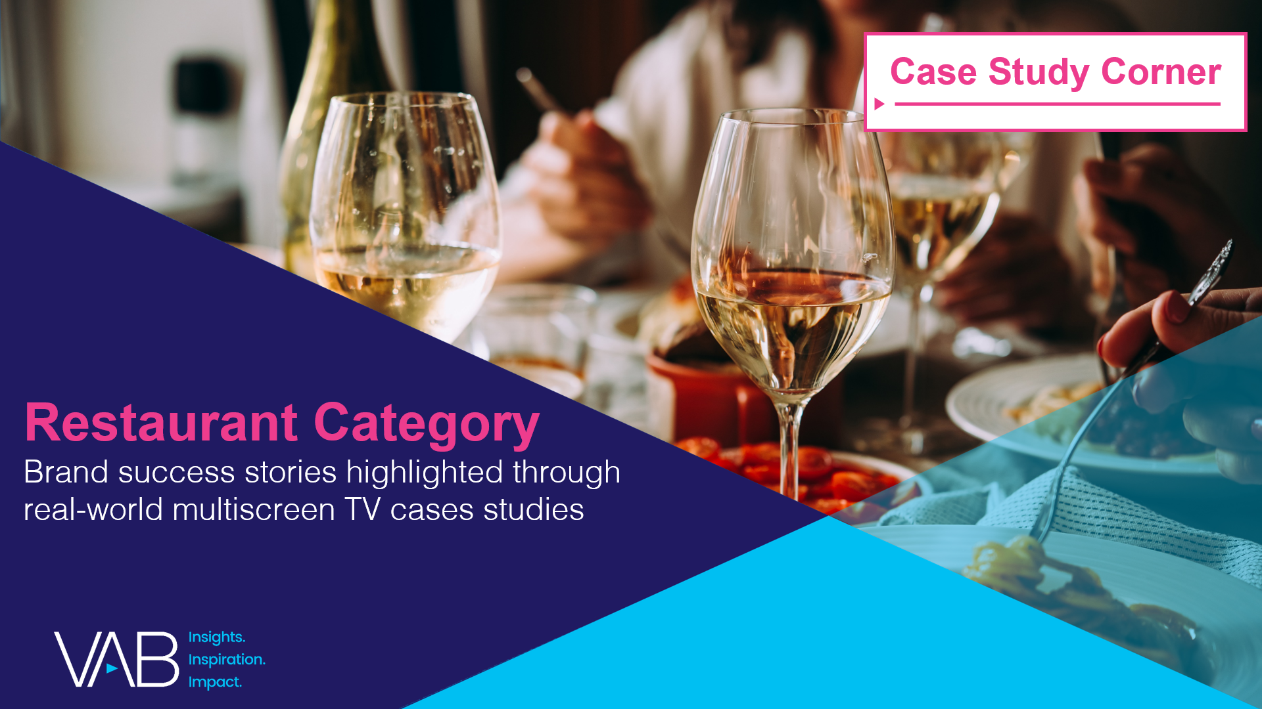
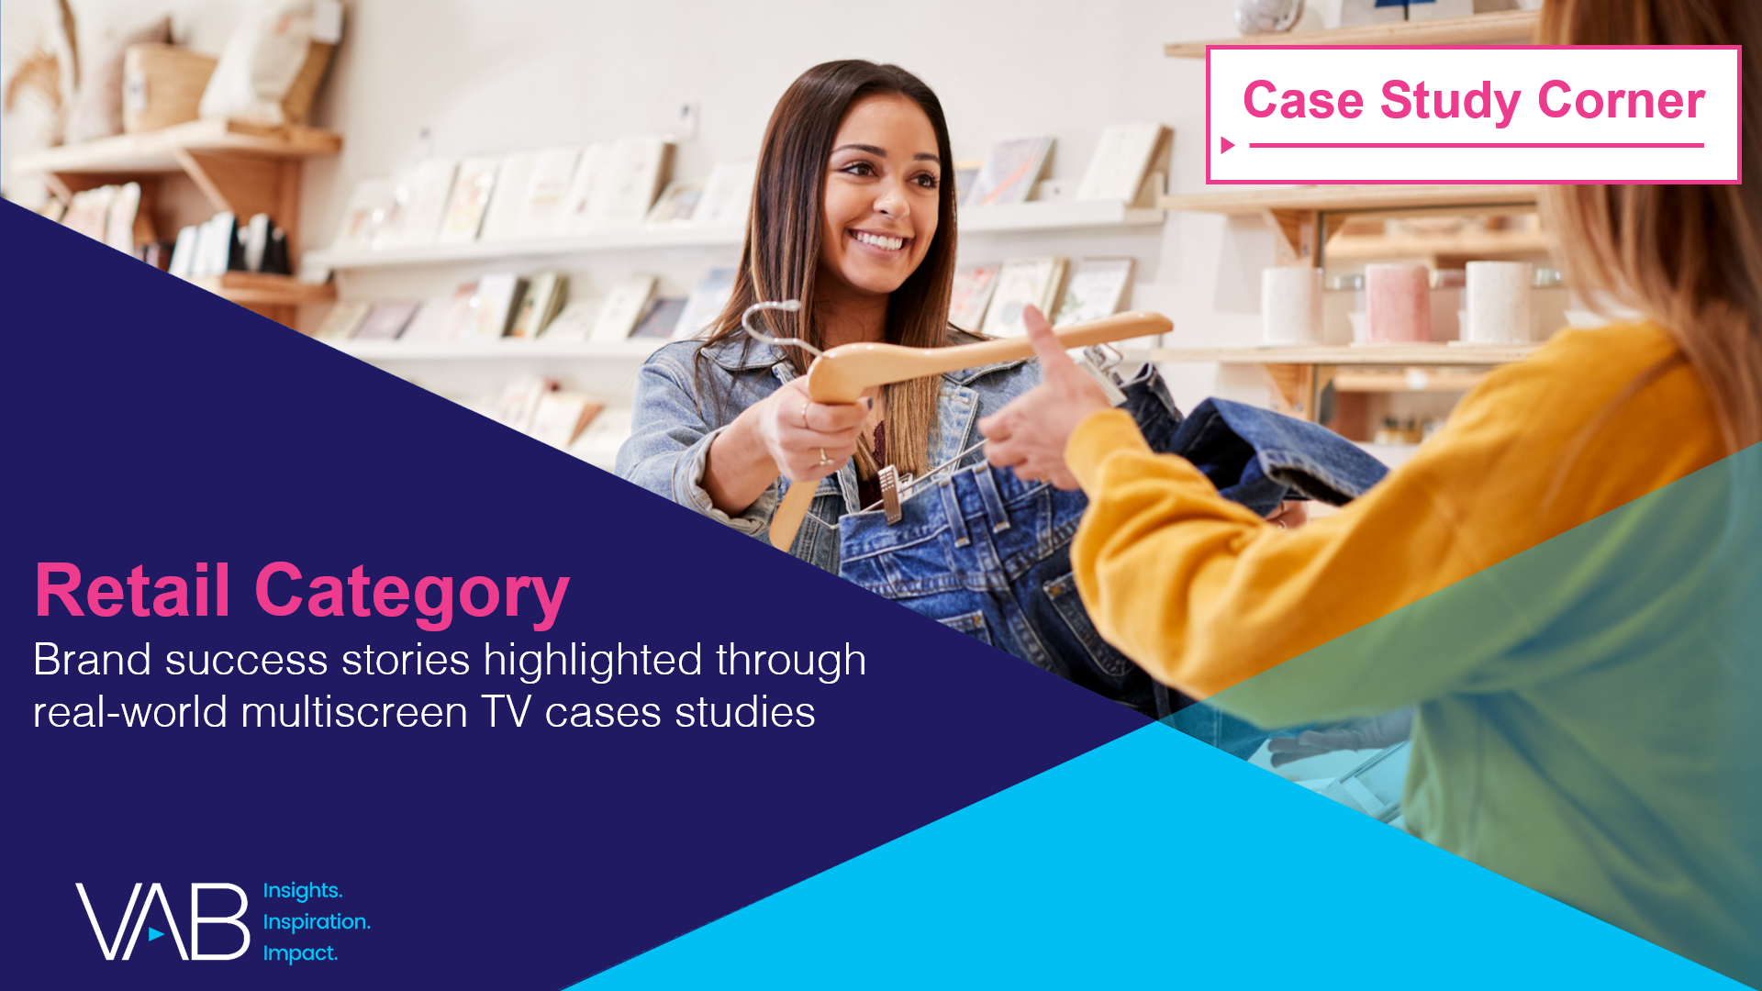

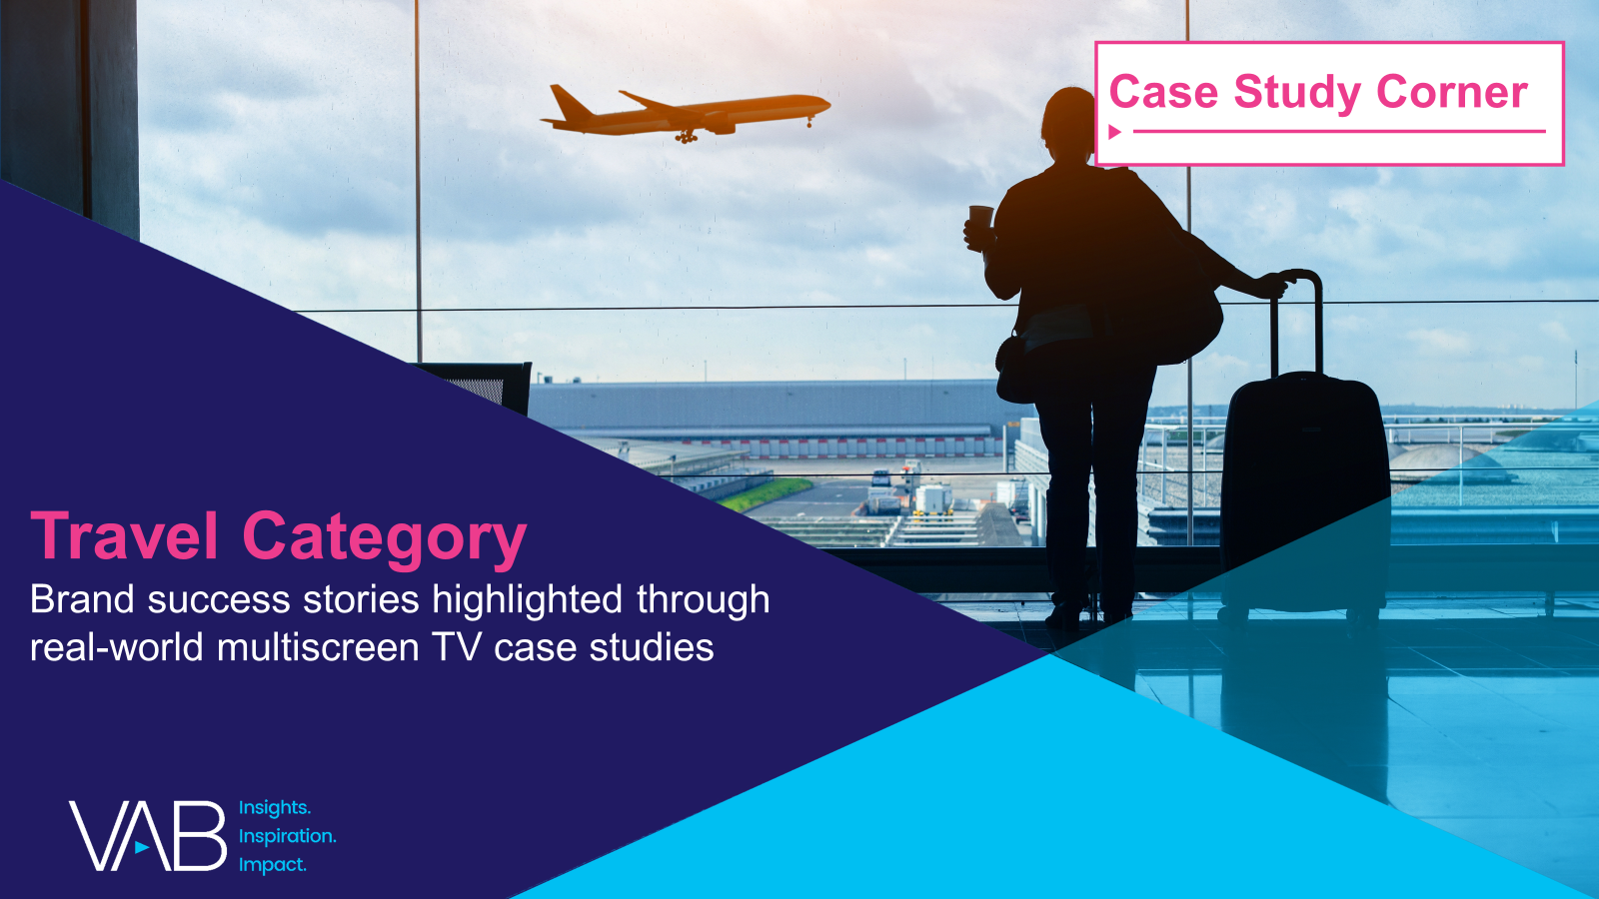
Want more? VAB has a wealth of case studies across additional categories
Business-to-Business (B2B)
Consumer Packaged Goods (CPG)
Entertainment & Tune-In
Financial Services & Insurance
Health, Wellness & Beauty
Home
Pharmaceuticals
Restaurants
Retail
Technology
Travel
Access more case studies at www.thevab.com
This information is exclusively provided to VAB members and qualified marketers.
PAGE 11

Slide 12


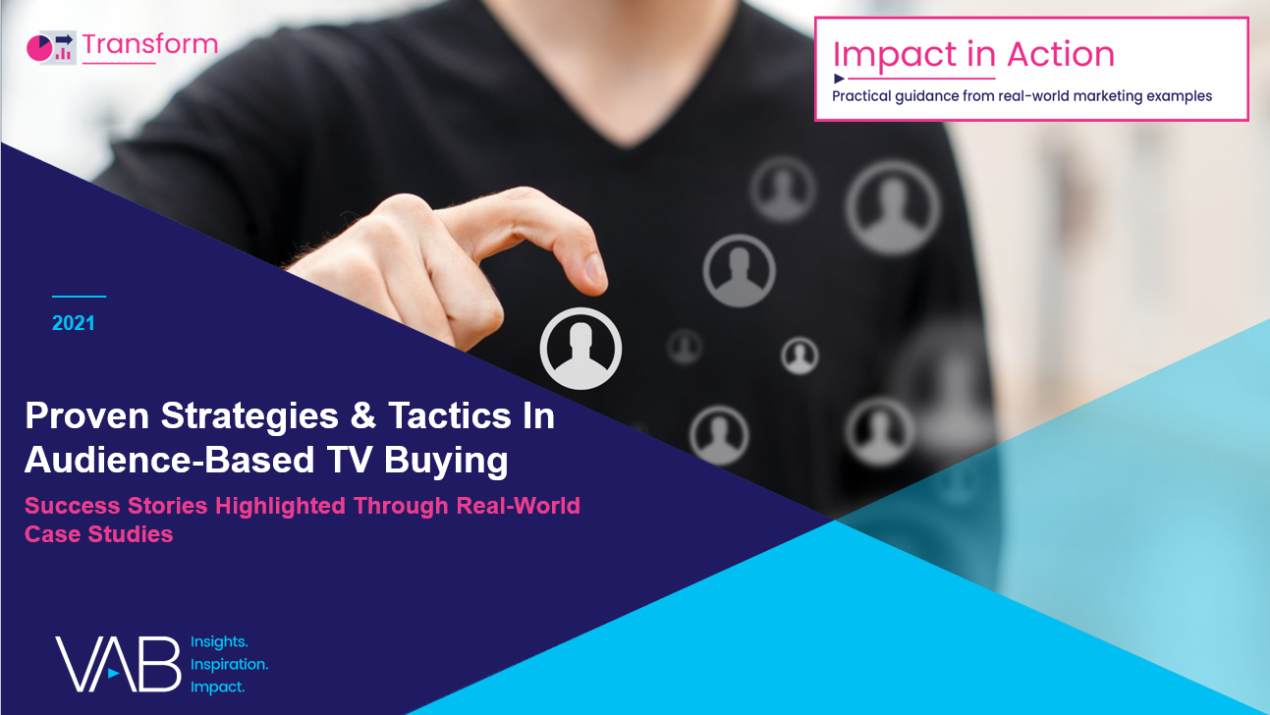
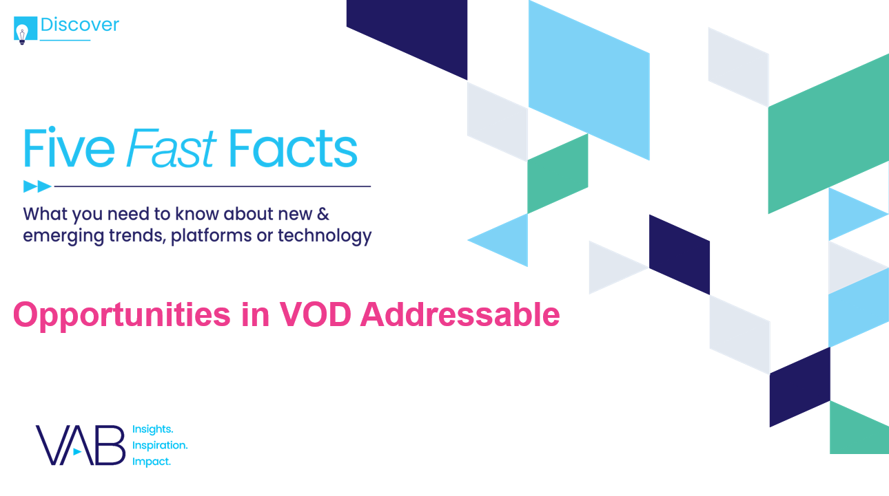

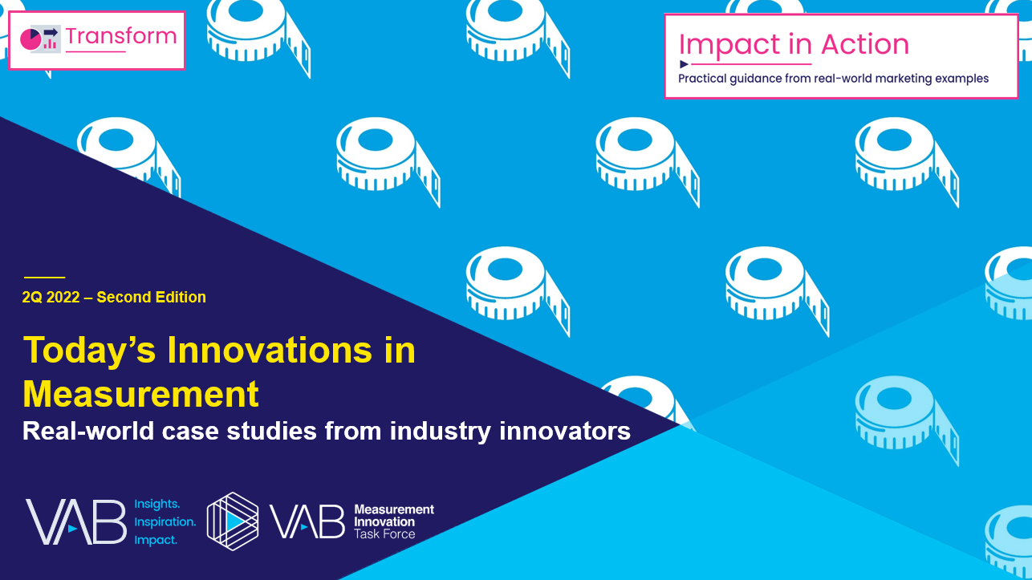
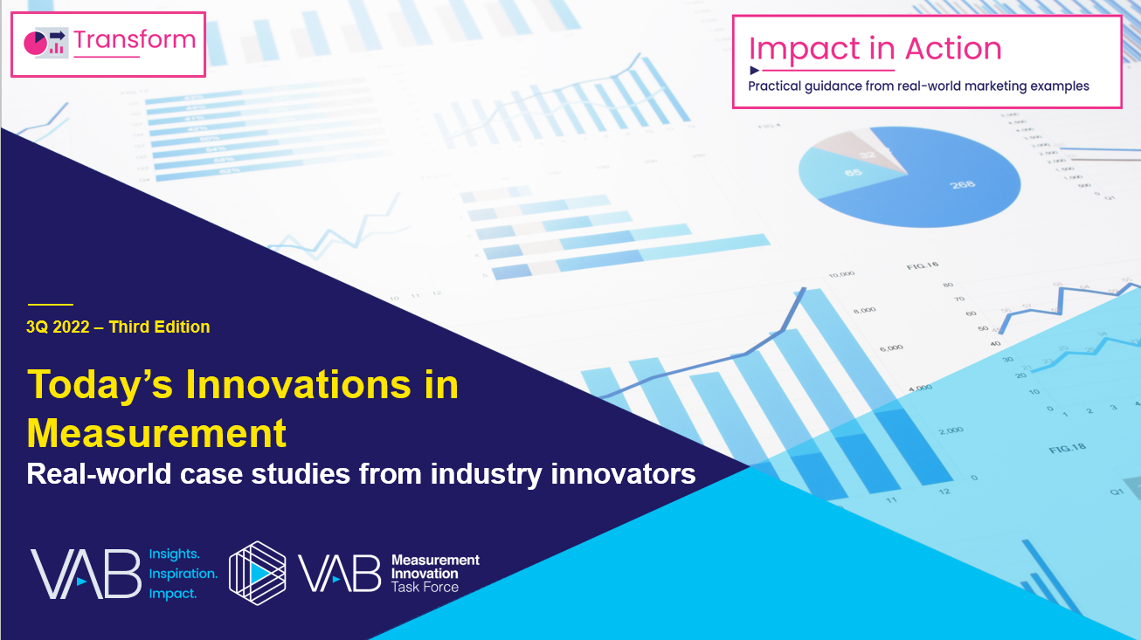
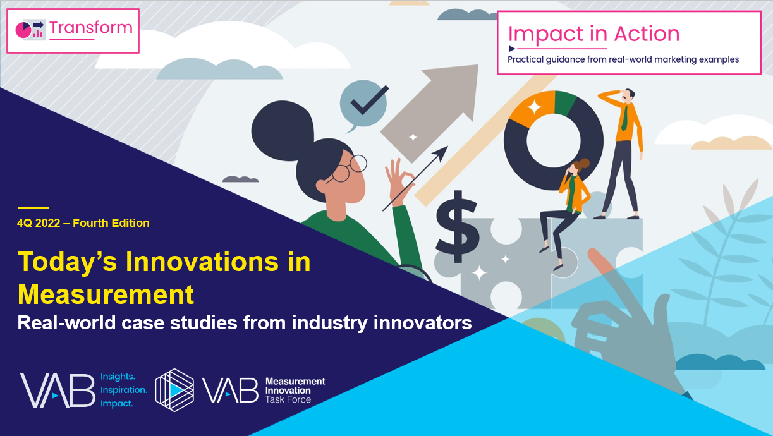
Want more? VAB also has case studies organized across multiscreen TV platforms including linear TV and streaming / CTV
Stream On
How can a convergent TV strategy drive business
results for my brand?
Proven Strategies & Tactics In Audience-Based TV Buying
Opportunities in VOD Addressable
Q1 ‘22 Today’s Innovations in Measurement
Q2 ‘22 Today’s Innovations in Measurement
Q3 ‘22 Today’s Innovations in Measurement
Q4 ‘22 Today’s Innovations in Measurement
Access more case studies at www.thevab.com
This information is exclusively provided to VAB members and qualified marketers.
PAGE 12

Slide 13


About VAB
VAB plays a dual role in the video advertising industry. We are leading the change to bring about a more innovative and transparent marketplace. We also provide the insights and thought leadership that enables marketers to develop business-driving marketing strategies.
Drawing on our marketing expertise, we simplify the complexities in our industry and discover new insights that transform the way marketers look at their media strategy.
We are committed to your business growth and proud to offer VAB members, brand marketers and agencies complimentary access to our continuously-growing Insights library. Get immediate access at theVAB.com.
This information is exclusively provided to VAB members and qualified marketers.
PAGE 13

